Slide 1
Lesson 1
OVERVIEW OF
Spacecraft THERMAL CONTROL
DAVID G. GILMORE

Slide 2
Topics
Satellite Missions
Orbits
Satellite Architectures
Role of Thermal Control Subsystem
Thermal Subsystem Architectures

Slide 3
Satellite Missions
Satellites serve wide variety of missions; communications, science, weather, GPS, surveillance, etc.
Satellites operate in a variety of orbits
  Low Earth Orbits (LEO) - less than 2000 km altitude, period of around 1.5 hours
  Geosynchronous (GEO) - 35,786 km, 24 hour period
  Mid Earth Orbits (MEO) – between LEO and GEO, 12 hour periods are common
  Molniya – highly elliptical, inclined orbit with 12 hour period

Slide 4
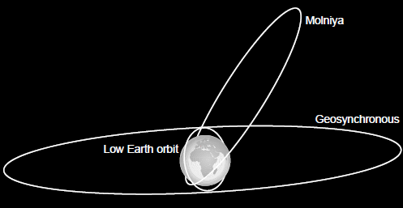
Satellite Orbits (to scale)

Slide 5
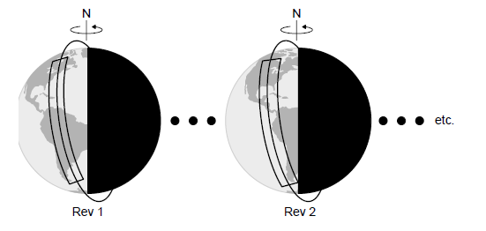
Sun synchronous orbit
Special LEO orbit that maintains fixed angle between orbit plane and sun
  Passes over places on Earth at same local time
  Good for weather and surveillance missions

Slide 6
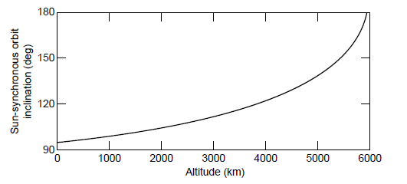
Sun synchronous inclination

Slide 7
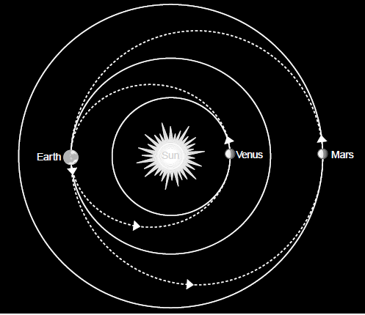
Interplanetary trajectories

Slide 8
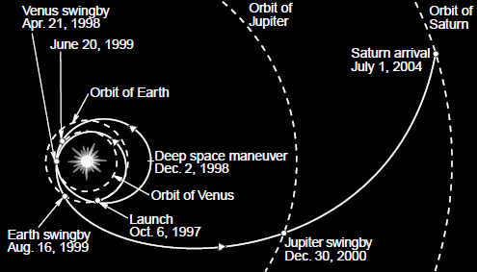
Outer planet trajectories

Slide 9
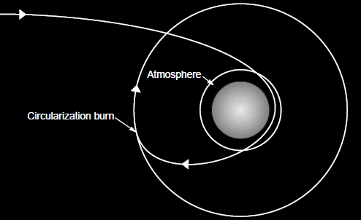
Aerocapture orbit

Slide 10
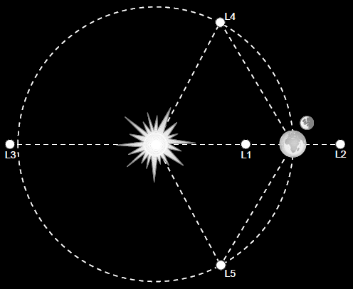
Lagrange points

Slide 11
Satellite Architectures
Most spacecraft today are 3-axis stabilized
Spin stabilized varieties were once the dominant comsat type, still occasionally produced
Pallets typically support smaller payloads and are themselves attached to a host vehicle. They are not complete satellites.

Slide 12
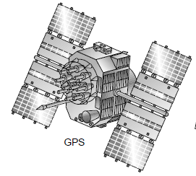
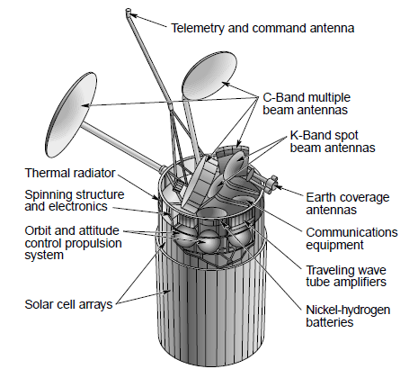
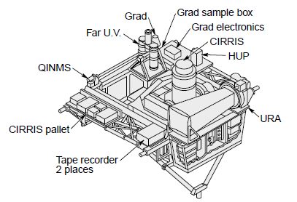
Satellite Architectures (cont)
GPS (3-Axis Stabilized)
Intelsat VI (Spin Stabilized)
Experiment Support System (Pallet)

Slide 13
Spacecraft System Terminology
System
  Satellite
Subsystems
  Thermal Control
  Structures
  Attitude Control
  Communications
  Power
  Etc.

Slide 14
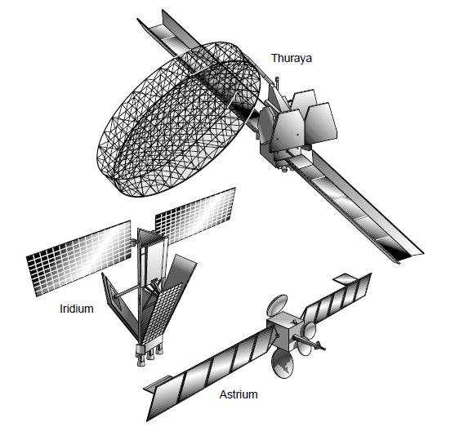
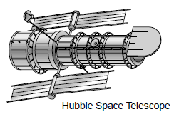
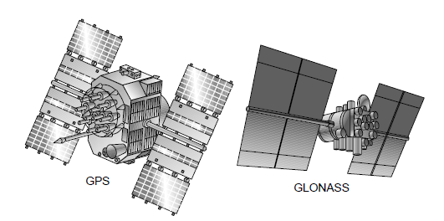
SATELLITE SUB-SYSTEM MASS FRACTIONS
35.5%

Slide 15
SATELLITE SUBSYSTEMS
Spacecraft Consists of a “Payload” and a “Bus” or “Platform”
Payload Equipment Services Primary Mission, e.g., Cloud Cover Camera for a Weather Satellite or RF Transponders for a Communications Satellite
Bus or Platform Support Payload and Consists of Numerous Subsystems
  Structures Subsystem
  Electrical Power/Distribution Subsystem (EPS or EPDS)
  Telemetry, Tracking, and Command Subsystem (TT&C)
  Attitude/Velocity Control Subsystem (ACS or AVCS)
  Propulsion Subsystem
  Thermal Control Subsystem (TCS)
Notes:
Propulsion Subsystem - Liquid and solid rockets or compressed gas jets and associated hardware used for changing satellite attitude, velocity, or spin rate. Solid rockets are usually used for placing a satellite in its final orbit after separation from the launch vehicle. The liquid engines (along with associated plumbing lines, valves, and tanks) may be used for attitude control and orbit adjustments as well as final orbit insertion after launch.
Thermal Control Subsystem - Last but not least, the hardware used to control temperatures of all vehicle components. Typical TCS elements include surface finishes, insulation blankets, heaters, and refrigerators.
All of these subsystem components are shown in the sketch of Flt Sat Com.

Slide 16
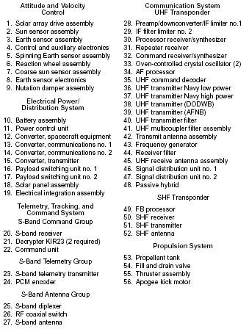
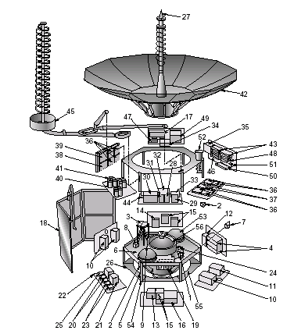
FltSatCom
Notes:
Over the past 30 years, hundreds of different satellites have been built in support of scientific, Military and Commercial missions. Most of these satellites, however, can be broadly categorized as one of three different types: spin stabilized; 3-Axis stabilized; or pallets. Each of these types has a rather distinctive set of characteristics as to the satellite configuration, internal equipment, and approach to thermal control.
The most common spacecraft configuration today is 3-Axis stabilized. This type of spacecraft is characterized by a roughly box-shaped body and deployable solar array panels as shown in the following figure. The bodies of these spacecraft are kept inertially stable with a slow rotation induced about one axis to keep the payload antennas or sensor continuously pointed toward the earth as the satellite goes around its orbit. The solar array panels are then counterrotated relative to the spacecraft body to keep them inertially fixed on the sun.
The second category of satellites in the spin-stabilized variety. These are less common than the 3-Axis type and have historically been used mostly for relatively high altitude missions in geosynchronous or Molinya orbits, although low altitude spinning satellites do exist. A typical “spinner,” DSCS II, is shown. As the name implies, attitude stability is achieved by spinning the satellite like a top at approximately 30 rpm about the axis of the cylindrical solar array. In the case of DSCS, there is a large shelf on which the communications payload is mounted and which is despun relative to the rest of the spacecraft so that it points continuously at the earth.
The final general type of spacecraft is the “pallet” which is not a complete satellite, but a collection of one or more payloads plus some limited support services such as power distribution, data recording, or telemetry sensors. These pallets may be anything from a small experiment mounted to the side of a host spacecraft to a large structure containing many instruments and mounted in the payload bay of the space shuttle. The principle difference between a pallet and a spacecraft is that the pallet is not able to function autonomously, but instead relies on the host vehicle for attitude control, electrical power, and TT&C support.

Slide 17
Role of the Thermal Control Subsystem
“Maintain System Components Within Prescribed Temperature Limits During All Mission Phases From Pre-launch Through End-of-Life in all Mission Environments.”
All spacecraft components require thermal control to some degree

Slide 18
Thermal Subsystem Architecture
Satellite Thermal Control Consists of Global Control of Satellite Thermal Balance Plus Local Thermal Control of Payloads, Appendages, and Subsystems
Global Thermal Control Approach Depends on Satellite Type
  3 Axis Most Common Type. Inertially Stable with Slow Rotation to
  Keep Payload Pointed at Earth. Typically a Box Shape Body
  With Deployable, Sun-Tracking Solar Arrays.
  Spinner Stabilized by Spinning About One Axis. Typically a Fixed
  Cylindrical Solar Array Structure With Payloads Located on a
  “Despun” Shelf.
  Pallet An Incomplete Satellite Which is Attached to the Space Station
  or Other Host Vehicle. Typically Used to Support Experiments.

Slide 19
3 AXIS THERMAL CONTROL
Insulate Main Body with Multilayer Insulation Blankets (MLI)
Provide Low Solar Absorptance (α), High Infrared Emittance (ε) Radiators to Reject Waste Heat
Use Heaters to Protect Equipment When Satellite is in Low Power Mode
Use Surface Finishes and Insulation to Control Appendage Temperatures (Antennas and Solar Arrays Typically have Very Wide Temperature Ranges)

Slide 20

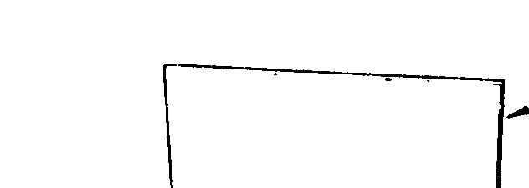
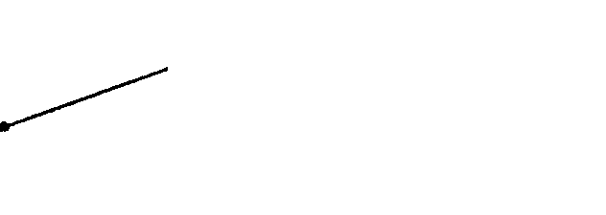


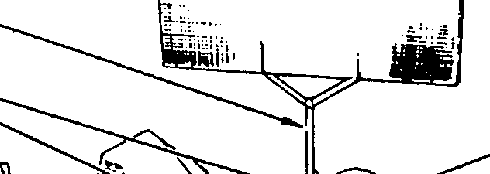


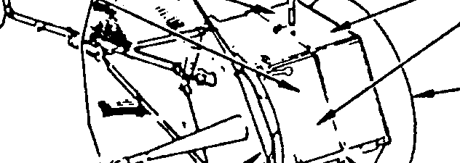
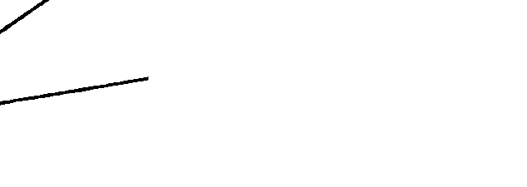
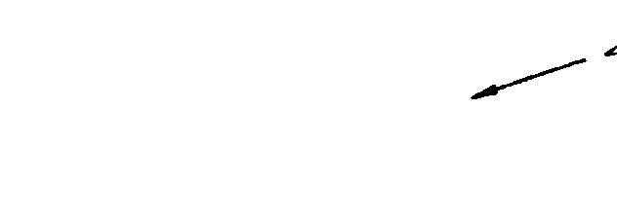
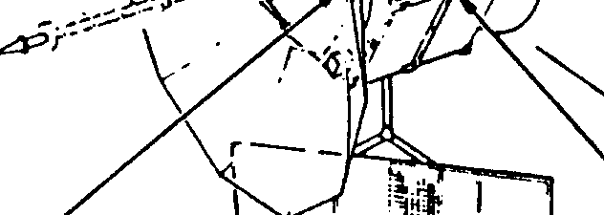









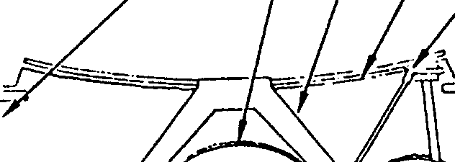





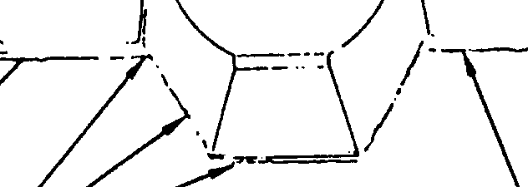





FLTSATCOM THERMAL DESIGN
Aluminized Silicone
3M Black Velvet
Paint on Booms
Paint On
12-Layer Insulation
Array Substrate
Blankets
Second Surface Silverized
Fused Silica Mirrors
Aluminized Kapton
Plume Shield
+Z
-X
Spinning Earth Sensors
Earth Sensor Head
Passively Controlled
Passively Controlled
Sun Sensors Require
Thermostatically
+Y
Actuated Heater
Thermostatically
12-Layer AKM Blanket
Controlled Heaters
Fiberglass Cone
17-Layer Antenna Blanket
Fiberglass Struts
Black Catalac
Paint Internally
10-Layer Hydrazine
Titanium AKM Support Ring
Tank Blankets
24-Layer
24-Layer Aluminized
AKM Blankets
Kapton Blanket

Slide 21
SPINNER THERMAL CONTROL
Spinning Cylindrical Solar Array Provides Room-Temperature Sink For Internal Equipment
Electronic Boxes Mounted on Shelves Radiate Waste Heat to Solar Array
Extra Radiator Area can be Provided on Forward and Aft Barriers if Required
Solar Array Temperature Drops Dramatically During Eclipse
  Electronic Boxes Do Not Cool as Much Due to High Thermal Mass
  Some Lightweight Components May Require Low ε Finish or Heaters for Eclipse Protection
Notes:
Although there are a number of spin stabilized satellite thermal designs, the most common is that typified by DSCS II, Satellite Data Systems and a host of commercial communications satellites. The approach is to use the spinning solar array as a heat sink for the internal components. A cylinder spinning with the sun normal to the spin axis will run around room temperature if the ratio of solar absorption to infrared emittance (α/ε) is approximately 1.0, as is the case with the solar cells which cover the cylinder. Because of this, the spinning solar array makes a convenient heat sink for internal components.
The figure illustrates the thermal balance in a typical spinning satellite. Electronic boxes are usually mounted on shelves and radiate their heat to the solar array and sometimes also to the forward or aft ends if extra radiator area is required. The electronic boxes are typically painted black for high infrared emittance and are mounted in such a way as to insure good heat conduction to the shelf. For most boxes the combined surface area of the box and shelf is sufficient to radiate the waste heat to the solar array without a large temperature difference developing between the box and room temperature array. If a box is small and has a high heat dissipation, a thermal "doubler" (a sheet of high conductivity material such as Aluminum, Beryllium, or Copper) may be placed under the box to help spread the heat out on the shelf and increase the effective radiating area of the box.
Because most spinners are used in high altitude geosyncronous orbits, eclipses occur only once per day and last for a maximum of 72 minutes. During eclipse the solar array temperature drops dramatically, typically from room temperature to on the order of -100ÞF. During this period, the temperature of the electronic boxes and other components will also drop, however, due to their high thermal mass, they will not cool nearly as fast as the relatively lightweight solar array. The result is that it is often possible to "coast" through the eclipse without falling below the minimum allowable operating temperature of the electronics. However, if the thermal design analysis shows that some components get too cold, then either a lower emittance finish on the cold units or a heater may be required to reduce their radiative coupling to the solar array or provide extra heating during eclipse.

Slide 22
SATELLITE DATA SYSTEMS THERMAL DESIGN

Slide 23
PALLET THERMAL CONTROL
Pallet Thermal Control can be Much Like 3-Axis Satellite with MLI, Radiator Areas, and Heaters
Pallet May Carry Many Experiments Which are Thermally Isolated from the Pallet and Each Other
Pallet May Also Rely on Host Vehicle for Thermal Control, Such as Hooking Up to the Space Station Pumped Fluid Coolant Loop

Slide 24

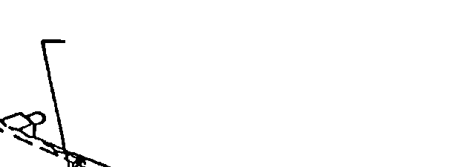
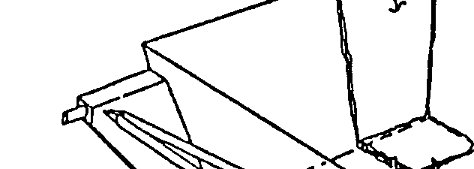
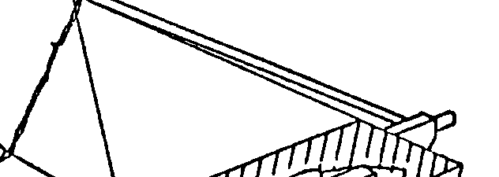
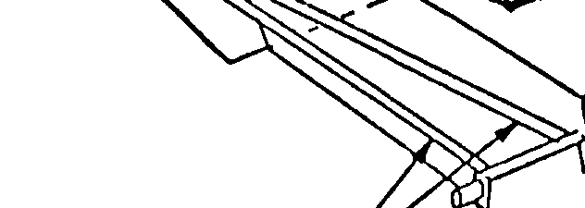
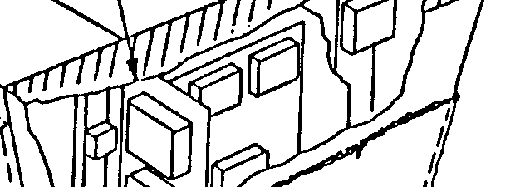

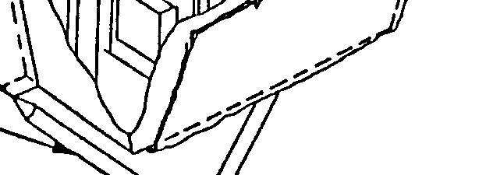


EXPERIMENT SUPPORT SYSTEM THERMAL DESIGN
5 Layer MLI Blankets
Radiator
Silverized Teflon on Radiator Surface
30 Layer MLI Blankets on All Non-Radiator Surfaces
Black Polyurethane Paint on Interior Surfaces
Four Redundant Heater Circuits
on Both Sides of
Structure
Bare (Alodine)
Aluminum

