Slide 1
Lesson 2
THERMAL CONTROL SUBSYSTEM DESIGN
DAVID G. GILMORE

Slide 2
Topics
Fundamental strategy
Design approach
Requirements flow-down
Design drivers
Thermal environments

Slide 3
The Fundamental Strategy
Heat is added to the spacecraft by;
  Internal dissipation (e.g., electronics)
  External radiation from the Sun and Earth
Heat is lost by infrared radiation to deep space
Internal heat plus heat absorbed from environment is balanced with heat radiated to space to come to equilibrium in desired temperature range
Notes:
S/C Space Craft

Slide 4
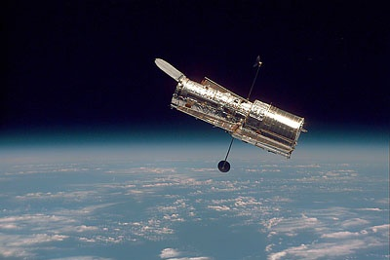
Spacecraft-emitted IR
Spacecraft-emitted IR
Direct solar
Solar
Reflected solar (albedo)
Electronics waste heat
Earth-emitted IR
INTERNAL WASTE HEAT
ABSORBED ENVIRONMENTAL HEAT
HEAT EMITTED AS IR RADIATION
+
=
Image reprinted courtesy of NASA

Slide 5
Thermal strategy
Given the internal dissipation and layout of spacecraft, the thermal control system is designed to maintain temperatures of the various components (electronics, sensors, mechanisms, etc.) within allowable limits
  Control absorption of environmental heat loads
  Provide controlled heat loss to space
  Minimize gradients (and hence distortions) where required
  Maintain temperature stability where required

Slide 6
Typical temperature control requirements
Some spacecraft components are more temperature sensitive than others.
  Wide ranges (~200°C ΔT) Antennae, Solar Arrays
  Moderate (~ 80°C ΔT) Electronic boxes
  Tight (~25°C ΔT) Batteries, Propellant Lines
  Very tight (~ 1°C ΔT ) Crystal Oscillators
  Earth Sensor focal planes
  Ultra stable (~ 0.001°C stability) Advanced Optical systems
  High-precision Clocks

Slide 7
Thermal Design Options
First assessment is whether a passive thermal design will be sufficient, or active control will be necessary
  Passive preferred for higher reliability and lower cost
Strong relationship to the requirements and configurations of other subsystems
  Narrow allowable temperature range and/or wide variations in operating environment or heat dissipation drive toward active design

Slide 8
Thermal Control Subsystem Hardware
Passive
      Surface finishes or material conductivity
      Insulation blankets
      Spacecraft geometry, positioning of components, shields
      Simple heat pipes (fixed conductance, diode)
      Louver (bimetallic actuator)
      Phase change materials
      Commandable heaters
      Thermostatic heaters
      Variable conductance heat pipes (has electronic controller)
      Louvers (electrically controlled)
      Pumped fluid loops
      Cryogenic Refrigerators
Active

Slide 9
Thermal design process
In most cases, Thermal is a “following” discipline
  Define thermal needs of satellite subsystems and components first, then design spacecraft TCS to meet those requirements
Thermal design is comprised of standard thermal components (insulation blankets, heaters, heat pipes), but most of those components must be custom sized for each spacecraft
  Not as “off the shelf” as some other subsystems
The thermal design process consists of deciding which thermal components will be used, where they will be located, and what size they will be.

Slide 10
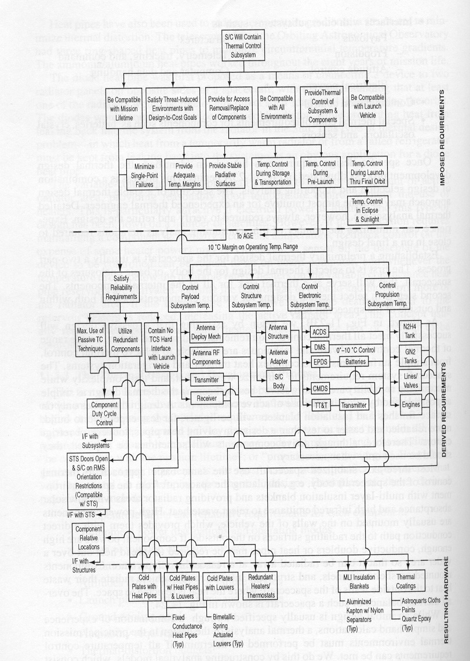
Requirements flow down

Slide 11
Design process flow
Inputs
Spacecraft Configuration
Unit temperature limits
Unit Power Consumption
Assume Passive
Thermal Design
Calculate Environmental
Heat Loads
.
.
Yes
Calculate
TCS Weight
TCS Power
Calculate Temperatures
Temperatures
Acceptable?
No
Semi-Active TCS
Establish
Radiator sizes
Insulation requirements
Thermal finishes
Heater sizes
Heat pipe characteristics
Louver characteristics
Pumped loop details
Any constraints
Active TCS
Special TCS

Slide 12
Thermal design drivers
Thermal design driven by component temperature requirements, satellite configuration, and thermal environment
Layout of satellite and orbit characteristics are usually givens
Basic temperature range of electronics boxes often established at program level
  +61°C to -24°C typical per SMC-S-016 (was MIL-STD-1540)
  +60°C to 0°C common on commercial programs
Some devices have special temperature limitations
  Hydrazine propellant freezes at 2°C
  Batteries have longer life if operated between 0 and 30°C
  IR sensors require cooling to cryogenic temperatures
  Some structures have thermal distortion limits
Notes:
The thermal design evolves dynamically in response to requirements. The basic configuration of the satellites, its orbit parameters, and attitudes are set by mission and other subsystem requirements and are usually "given" for the thermal engineer. The allowable temperature range of on-board electronic boxes are generally set by a program level standard temperature range. For military programs, this is usually the MIL-STD-1540B range of +61ÞC to -24ÞC, for commercial programs a typical range might be +60Þ to 0ÞC. It is important to note, however, that many electronic boxes on a spacecraft may have been taken from other programs and may have already been qualified to a different temperature range. Some electronic boxes and other components may have narrower temperature limits; liquid propellant must be kept from freezing, batteries have greater lifetimes if operated around 0ÞC, and thermal distortions in optical structures must be minimized. In general, it is desirable to keep the widest possible range in allowable component temperatures since this allows for a spacecraft level thermal design with less radiator area and lower heater power requirements.

Slide 13
Design Drivers (cont.)
Spacecraft Drivers
  Equipment location
    Defined by subsystem requirements
    Spacecraft designer’s choice
  Equipment interaction
    With other subsystems
    With other components
Component Drivers
  Power profile
    Constant
    On/Off duty cycle
    Varying with temperature
  Thermal capacitance
    Weight
    Material
  Heat transfer mode
    Conducted from baseplate
    Radiated from housing
  Allowable rate of temperature change
    During operation
    During warm-up/cooldown
  Allowable temperatures
    Operating limits
    Non-operating limits

Slide 14
Main Body Thermal Design
Experience and preliminary analysis with simple computer models or hand calculations used to select main body thermal design approach
Example: A 3-axis Geosynchronous satellite
  High heat dissipation boxes located on north and south panels where solar heating is minimized
  Radiator areas on north and south panels sized to dissipate total internal waste heat considering thermal backloads from environment and spacecraft appendages
  Satellite body covered in Multi Layer Insulation
  Heaters provided to protect components when spacecraft is in low power mode
Detailed thermal analyses conducted to refine design
Notes:
Given the basic satellite configuration, orbit/attitude, and a preliminary definition of allowable temperature ranges of satellite components, the thermal engineer selects a thermal design approach. This process usually starts with an overall thermal design for the main body of the spacecraft followed by more detailed designs of various components.
Using a 3-Axis stabilized geosynchronous communications satellite as an example, the satellite designers will generally know that high power dissipation components should be mounted on the north and south faces of the spacecraft. This is done because these surfaces have the lowest peak solar heating rates of the six faces of the satellite and therefore are the best places for radiating away internal waste heat. A preliminary estimate of the radiator area required to dissipate the total internal waste heat is made and the remaining area of the satellite is covered with multilayer insulation to reduce heat leaks/gains from these areas to almost nothing. The next step is to look at individual components to determine if any special thermal control techniques are required: heaters or conductive isolation for propellant tanks/lines, doublers under high power boxes, heat pipes if heat must be moved over a substantial distance, plume shield near thruster nozzles, etc. This first cut at the thermal design is usually conducted using hand calculations or simple computer math models since it will be subject to several iterations before a workable preliminary design is identified. The preliminary design is then subjected to a detailed thermal analysis of the entire satellite as well as detailed component level analyses of things such as thrusters, solar array deployment mechanism, sun and earth sensors, antennas, etc. These analyses are often revised as the satellite design changes and evolves.

Slide 15
Component Thermal Designs
Main body thermal design provides environment for internal components
Local thermal analysis conducted to refine the thermal design
  Electronic Boxes: Usually painted black and conductively mounted to spacecraft structure
  Propellant Lines/Tanks: Heaters provided to prevent freezing in cold conditions, conductively and radiatively isolated from spacecraft to minimize heater power
  Batteries: Conductively and radiatively isolated from spacecraft, heaters provided to maintain minimum allowable temperature in cold conditions
  IR Sensors: Radiatively and conductively isolated from spacecraft and shielded from external fluxes. A dewar, radiator, or refrigerator is provided for cooling.

Slide 16
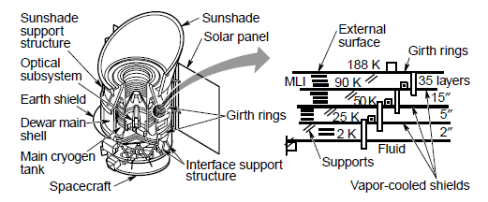
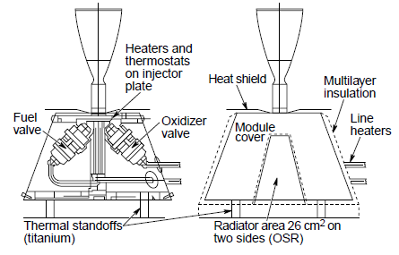
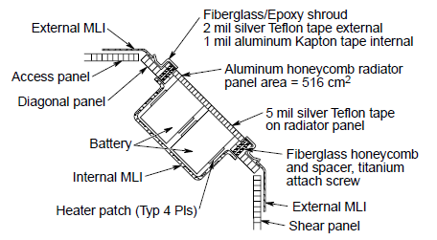
IR TELESCOPE
THRUSTER
BATTERY

Slide 17
Characteristics of a good thermal design
Reliable, flight proven approach when possible
No single point failures
Predictable by analysis and verifiable by ground test
Adequate margin and allowances for growth
Meets mission life requirements
Can be readily integrated during manufacturing
Cost conscious
Minimizes sensitivity to space, ground, and launch environments

Slide 18
Thermal Environments

Slide 19
Spacecraft Mission Phases
Prelaunch
  Spacecraft inside launch vehicle fairing
Ascent
  On launch vehicle, with and without fairing
Orbital
  Park orbit (Low Earth Orbit, LEO)
    Upper Stage/Spacecraft
  Transfer orbit
    Upper Stage/Spacecraft
    Spacecraft
  Final operational orbit
    Spacecraft

Slide 20
Ground Processing Flow

Slide 21
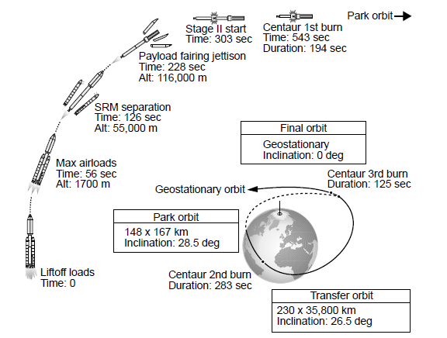
Launch Sequence

Slide 22
Prelaunch Environment
Ambient air and ground temperatures assumed to be the same
  Based on measured temperature data at launch site
Solar flux measured at ground level (Eastern Launch Site example)
  Attenuated by atmosphere
    Peak noontime value during summer is 945 W/m²
    Significantly reduced by cloud cover
      No direct solar flux assumed for cold case (cloudy day)

Slide 23
































Diurnal Air Temperature
120
Hot Day
100
80
Temperature – deg F
60
Cold Day
40
20
0
2400
400
800
1200
1600
2000
2400
Time of Day - Hours

Slide 24
Prelaunch Environment (cont.)
Sky radiation sink temperature
  Sky effective radiative sink temperature can be estimated based on ambient air temperature, humidity, and cloud cover.
    High humidity and clouds increase effective sky temperature, clear sky and low humidity lower it
Air conditioning within fairing
  Air inlet temperatures typically range from 10°C to 25°C
  Separate air conditioning spigots sometimes supplied to payload
Special liquid cooling systems available
*Nuffy and Beckman, “Solar Energy Process,” 1963 and Modified by Lockheed Martin

Slide 25
Prelaunch Environment (cont.)
Launch vehicle contractor often uses external environments (air, sun, sky, etc.) to calculate external fairing skin temperatures
Fairing skin temperatures are then used as boundary conditions to internal fairing thermal model that includes the payload (spacecraft and upper stage)
Air conditioning temperatures at main fairing inlet and for special cooling inlets are included in thermal model as boundary conditions
Thermal model predicts temperatures of spacecraft components in the prelaunch environment
  Batteries and inertial guidance systems are of particular concern

Slide 26
Ascent Environment
Worst case (synthetic) heating trajectory is developed
using 3-sigma dispersions
  Head wind
  Specific impulse of rocket engines
  Thrust misalignment
  Propellant temperature
  Free Molecular Heating (FMH)
  Density
Analysis yields fairing skin temperatures
  Used as boundary drivers for fairing/payload thermal model
  Analysis data is also used for launch vehicle thermal design
    Insulation thickness on external surfaces

Slide 27
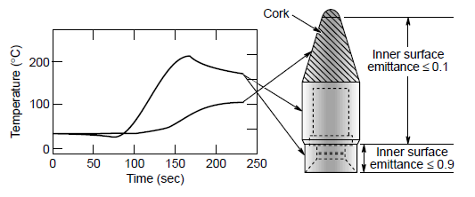
Fairing radiant heat

Slide 28
Orbital Environments
Solar
  The “Solar Constant” is the solar flux at 1 Astronomical Unit from the sun, which occurs at Equinox
  Solar flux varies by +3.5% over the year because Earth’s orbit is elliptical
    December 1414 W/m²
    June 1322 W/m²
    Equinox (March and September) ≈1367 W/m²
Albedo (Percent of a solar flux)
  Varies locally from 6 to 70%
  High over polar caps and cloud cover, low for land/water
  Highest and lowest values occur only for short time periods

Slide 29
Orbital Environments (cont.)
Earth IR radiation
  Varies locally from 108 to 332 W/m²
  High for tropical/desert regions, low for cloud cover or polar caps
  Highest and lowest values occur only for short time periods
Free Molecular Heating
  0.5∗ρ *V³ *Project Area
    ρ = Density of air
    V = Velocity of surface

Slide 30
Orbital Environments (cont.)
Environmental heating on spacecraft is also a function of the orbit
  Typical orbits: Low Earth Orbit (LEO), Mid Earth Orbit (MEO), Geosynchronous (GEO)
Albedo and Earth IR vary significantly with latitude
  Longitude variations are less pronounced
Data measured by several satellites indicates when Albedo is high, Earth IR radiation tends to be low and vice-versa

Slide 31
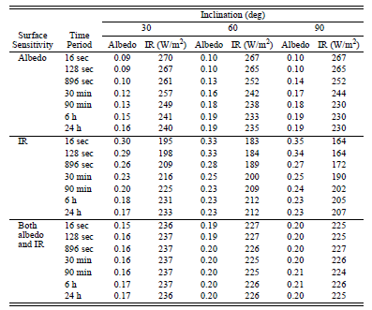
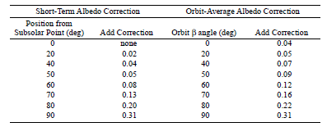
Cold Case Earth Loads

Slide 32
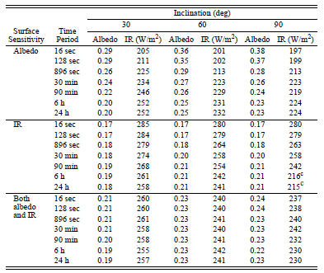
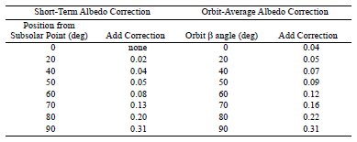
Hot Case Earth Loads

Slide 33
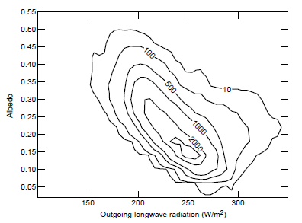
Albedo/IR Combinations

Slide 34
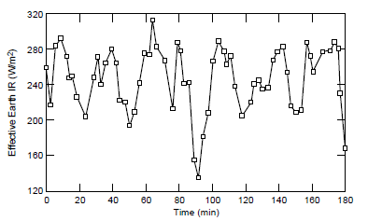
Earth IR Seen by Orbiting Spacecraft

Slide 35
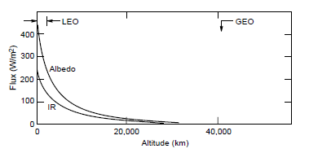
Earth Loads Drop with Altitude
Albedo and Earth radiation can generally be ignored in high-altitude orbits
  Exceptions include cryogenic radiators or sensors, which are sensitive to even very small heating rates

Slide 36
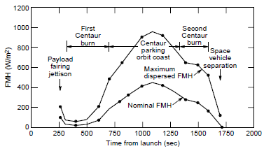
Free Molecular Heating (FMH)
Free Molecular Heating varies with altitude and velocity
  Below 150 km, FMH should be included in analysis
  Can be important for launch vehicle park orbits with perigee altitudes typically around 130 km
  For most spacecraft operational orbits, FMH is not significant

Slide 37
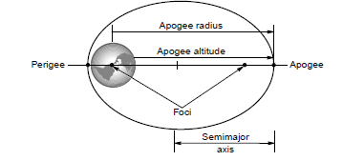
Orbit Parameters Used In Thermal Analysis

Slide 38
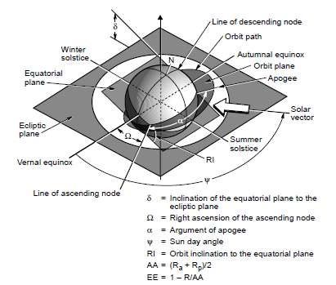
Orbit Parameters (cont.)

Slide 39
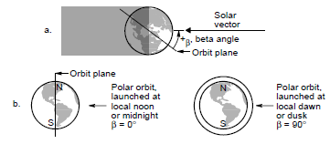
Orbit Beta Angle
Beta angle is the angle between the sun vector and the orbit plane
  Zero degree beta angle orbit appears edge-wise when viewed from the sun
  90 degree beta angle orbit appears as a circle when viewed from the sun

Slide 40
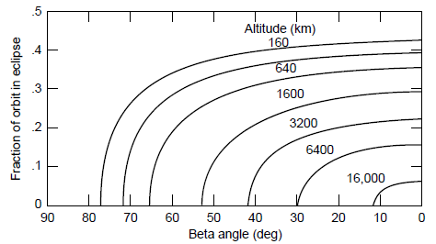
Eclipse Duration vs Beta Angle

Slide 41
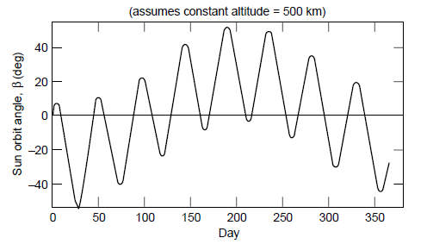
Beta Angle Drift

Slide 42
Beta Angle Utility
Conducting a spacecraft thermal analysis at a few beta angles covers all possible combinations of sun right ascension (sun day angle) and orbit RAAN
For non-sun-synchronous orbits, beta angle range = +(inclination + 23.5°)
Sun-synchronous orbits have an inclination that causes RAAN to drift at about the same rate as the Earth moves about the sun
  Results in relatively stable orbit beta angle throughout the year

Slide 43
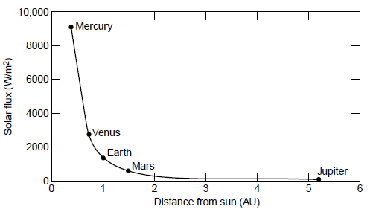
Interplanetary Cruise

Slide 44
Other Environments
Natural space environments can damage thermal surface finishes
  High energy particles (electrons and protons)
  UV radiation
Heating from weapons can affect thermal design of military spacecraft
  Lasers
  Nuclear devices

Slide 45
References For Albedo And Earth Radiance
“Guidelines for the Selection of Near-Earth Thermal Environment Parameters for Spacecraft Design”, B.J. Anderson, C.G. Justus, and G.W. Batts, NASA/TM-2001-211221, October 2001
“Earth Radiation Budgets,” Stephens, G. L., Cambel, G. G., and Vonder Harr, T. H, Journal of Geophysical Research, Vol 86, No C10, Pages 9739-9760, 20 October 1981
“The Effect of Directional Radiation Models or the Interpretation of Earth Radiation Budget Measurements,” Green, R. N., Journal of Atmospheric Sciences, Vol 37, October 1980
“Nimbus-6 Earth Radiation Budget Experiment,” Smith, W. L., Etc. Applied Optics, Vol 16, No 2, February 1977

