Slide 1
James Webb Space Telescope
Optical Telescope Element /
Integrated Science Instrument Module (OTIS) Cryogenic Vacuum Test
Part IV: Lessons Learned
Kan Yang, Stuart Glazer
NASA Goddard Space Flight Center
Brian Comber
Genesis Engineering Solutions, Inc.
Reference in this course to any specific commercial products, process, service, manufacturer, company, or trademark does not constitute its endorsement or recommendation by the U.S. Government or the NESC Academy.
Notes:
Welcome to the fourth lecture of the James Webb Space Telescope Optical Telescope Element and Integrated Science Instrument Model Cryogenic Vacuum Test lecture series. In this lecture, we will talk about the lessons learned from the planning and execution of the OTIS CV test.

Slide 2
Overview
This lecture represents the fourth part of the JWST OTIS CV Test Lecture Series
  Part I: Thermal Architecture
  Part II: Thermal Analysis
  Part III: Preparations for Off-Nominal Events
  Part IV: Lessons Learned
Objectives of this current lecture:
  Cover lessons learned for the following categories:
    Test thermal analysis
    Flight and test hardware
    Test planning and management
Notes:
Let’s quickly recap what has been already covered in this lecture series. In Part I, we went over the JWST system architecture and the OTIS CV Test setup. In Part II, we discussed the OTIS CV test thermal model development. In Part III, we looked in depth at off-nominal events.
In this fourth and final part, we will cover lessons learned. These lessons span the multiple years of planning for this test all the way through execution and post-test diagnostics. These lessons have also been gathered from the thermal teams at NASA Goddard Space Flight Center and Johnson Space Center, as well as from all of our contributing partners in industry, namely Northrop Grumman, Ball Aerospace, L3 Harris, Genesis Engineering Solutions Inc., Lentech Inc., Energy Solutions International LLC, and the Smithsonian Astrophysical Observatory, part of the Harvard-Smithsonian Center for Astrophysics.
Before we begin, I’d just like to add a quick note on terminology: if a lesson was learned on the OTIS CV test, it’s indicated as a “lesson learned” on the slide. If a lesson was previously learned on a precursor test and applied successfully to the OTIS CV test, it’s stated as a “lesson applied” instead. Also, the acronyms and locations for the components that are mentioned in this lecture were covered in the Part I of this course.
Progressing into the presentation, we will look at three major categories: test thermal analysis, flight and test hardware, and test planning and management. Separate lessons will be covered for each category.

Slide 3
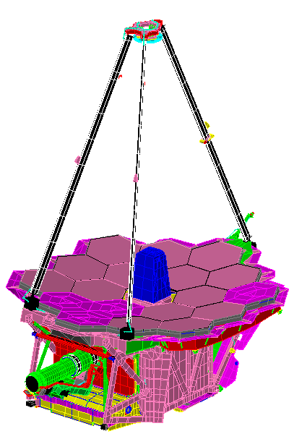
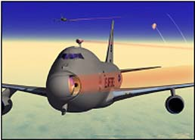
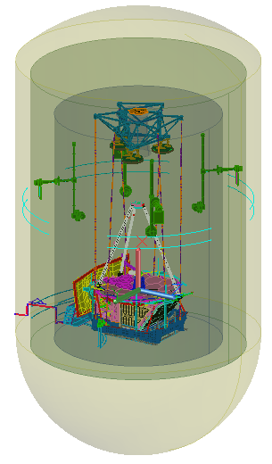
Recap: Components in the OTIS CV Test
+V1
SM / SMA
Image Source: NASA/JWST/K. Yang
+V3
Optical Path
JSC Chamber A Wall
Liquid Nitrogen (LN2) Shroud
+V2
CoCOA
Helium Shroud
USF
ACFs (3)
SMSS
Stray Light Frill
AOS
ASPA
Down / Telescop-ing Rods
GSE Bib
SVTS
FSM
PM / PMSA, 18 total
OTIS Payload
PMBSS = BSF
+ BP
Thermal Management System (TMS)
TM
GSE Cryocooler Chase
ISIM Contains: NIRSpec, NIRCam, FGS/NIRISS, and MIRI. All instruments contain POMs. NIRSpec has a separate OA and FPA.
HOSS
DTA
ISIM / ISIM Structure
IEC DSER
+V1
ISIM DSERs (5)
+V2
+V3
IEC
Harness Radiator
ADIR
FIR
Notes:
Before we proceed, let’s do a quick recap of the components in the OTIS CV test, since many of the following slides will use the acronyms for these components. We’ll start from the outside and work our way in starting with the figure on the left, which uses the V-coordinate system on the lower left-hand side. At the outer boundaries of the model is the NASA Johnson Space Center (or JSC) Chamber A pressure vessel, and cocooned within is the liquid nitrogen or LN2 shroud and then the helium shroud. Within the helium shroud, near the ceiling, we have the optical test equipment, including the Center of Curvature Optical Assembly or CoCOA, which is held by the Upper Support Fixture or USF, and the Auto-Collimating Flat mirrors, or ACFs. The OTIS payload is sitting inside the Hardpoint and Offload Support structure or HOSS, which is suspended from the ceiling via a series of six telescoping rods. The Aft Optics Subsystem Source Plate Assembly or ASPA hardware rests on top of the OTIS payload aperture and generates signals for optical testing. To set the environment around OTIS, we have on the plus and minus V3 sides the Spacecraft Vehicle Thermal Simulator or SVTS, the Ground Support Equipment or GSE cryocooler chase, a series of Deep-Space Environment Radiative Sinks or DSERs for the Integrated Science Instrument Module or ISIM, and one specialized DSER for the ISIM Electronics Compartment, or IEC.
Moving to the figure on the right, this is a closeup of the OTIS payload and uses the V-coordinate system at the top center location on the slide. In this figure, the optical path goes from the Primary Mirrors or PMs to the secondary mirror or SM, and onto the inside of the Aft Optics Subsystem or AOS where it bounces off of the tertiary mirror or TM and the fine steering mirror or FSM before going to the science instruments, or SIs. The Primary Mirror Segment Assemblies or PMSAs are a way to describe the total assembly of the primary mirror and its corresponding actuation mechanisms and mounting structure, and the Secondary Mirror Assembly or SMA is the equivalent for the SM. The ISIM, as mentioned earlier, describes the assembled configuration of all of the science instruments inside their composite ISIM structure. The ISIM contains four instruments: the Near Infrared Camera or NIRCam; the Fine Guidance Sensor and Near Infrared Imager and Slitless Spectrograph or FGS/NIRISS; the Near Infrared Spectrograph or NIRSpec, which contains separate Optical Assembly or OA and Focal Plane Arrays or FPA components; and the Mid-Infrared Instrument or MIRI, which is actively cooled through the GSE cryocooler. Each of these instruments use pick-off mirrors, or POMs, to capture the incoming light from the FSM. Supporting the ISIM is the Primary Mirror Backplane Support Structure or PMBSS, which contains two components: the backplane or BP to support the primary mirrors, and the backplane support fixture or BSF to support the instruments, radiators, and electronics boxes. The Secondary Mirror Support Structure or SMSS rises from the PMBSS in the +V1 direction to support the SMA. On the –V3 side, the deployable tower assembly or DTA connects OTIS to the spacecraft, the IEC hangs off the –V1 end of the BSF, and the harness radiator cools harnesses emanating fro the IEC into ISIM. The Thermal Management System or TMS shields the cold instruments from stray light from the spacecraft. To additionally block stray light from impacting the optical system, a GSE Bib extends from the PMBSS to the SVTS, and a frill structure encircles the PMSAs. For more details on the function of these components and their associated acronyms, please refer to Part I of this lecture series.
Finally, I will mention some other useful acronyms not listed here on this slide. K denotes Kelvin, the unit of temperature measurement; He denotes helium and GHe denotes gaseous helium; L&C denotes limits and constraints; and delta-T denotes temperature difference.

Slide 4
Lessons Learned in Test Thermal Analysis
Notes:
Let’s start off with the lessons learned in thermal analysis, primarily in planning for the OTIS CV test but also in resolving discrepancies post-test between data and predictions.

Slide 5

Test and Flight Model Integration
Lesson Learned: An integrated test and flight thermal model may be extremely beneficial for future flight missions
  This requires keeping an inactive chamber and GSE inside the flight thermal model and selectively building these for any test cases that need to be run
  While this increases overall model size, this allows the test model to consistently run with the latest payload, and prevents any discrepancies between model versions when recommendations made with the test model are integrated with flight
  In the OTIS CV test thermal model, the flight and test models were built separately (and in different thermal software): for model revisions in either the flight model or the GSE models, a time-intensive process of reintegrating the test thermal model was required
JSC Chamber Model
Harris Corp. Test Model
NGAS Flight Model
Source: NASA/JWST/K.Yang
Notes:
First, with building the OTIS CV test thermal model, an important lesson learned was that placing all flight and test components into the same thermal model can save much heartburn later. For a flight run, test elements, such as the chamber and GSE, can be made inactive in their own separate layers during model development, and can avoid being built during runtime so that only flight elements are considered for the radiation calculations and thermal math model solver. In a test run, similarly, flight elements not included in the test can be omitted. While this increases overall model size, this allows the test model to consistently run with the latest payload updates, and prevents any discrepancies between test and flight model versions, especially when test correlations contribute to the flight model. For Thermal Desktop™, this can also be accomplished with an external reference or XREF so that model size is not affected, and an XREF has the additional benefit of allowing other payloads to port in a chamber model as necessary. It is important, though, this flight and test model integration must be decided early on the model development process.
For the OTIS CV test thermal model development, since the flight model developers and GSE model developers spanned separate organizations, the incompatibility between the thermal software that each organization used resulted in two separate thermal models being maintained for chamber GSE and flight hardware. For integration between the payload and test elements into an integrated test thermal model, an extremely time-intensive process was required to take out all of the non-test elements from the flight model and add the chamber GSE and test logic. This process was repeated for all major model revisions either in GSE or in flight, and consumed valuable time that could have been spent to analytically pursue other trade studies or investigations. An integrated test and flight thermal model would have been extremely helpful in this scenario if planned early on by the JWST project. If separate models need to be maintained, ensure that the same thermal modeling software is used to develop both models.

Slide 6
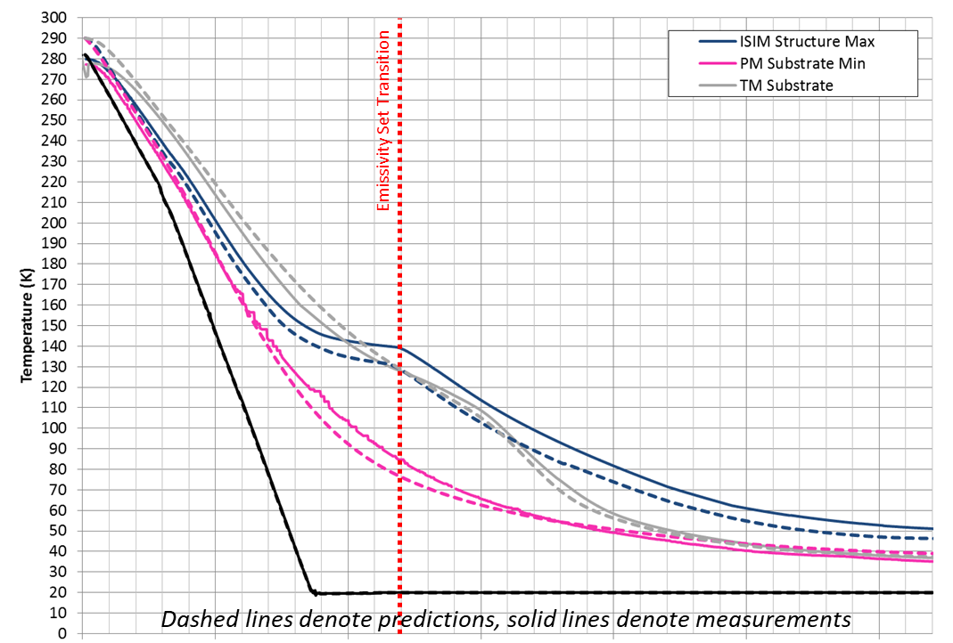
Temperature-Dependent Emissivity Sets
Lesson Learned: In transient cooldown and warmup predictions, use of a greater number of temperature-dependent emissivity sets is critical to accurately predict hardware behavior
OTIS CV thermal model used only two sets in the interest of runtime ➔ inaccuracy of predictions vs. test when PMBSS average 60-170 K
Generally, assumption of room temp emissivities when PMBSS average > 90K cause model predictions to cool more rapidly than test, while assumption of cryogenic emissivities after PMBSS average < 90K cause predictions to transition slower than test
 | 0 | 5 | 10 | 15 | 20 | 25 | 30
Days from Start of Test
Source: NASA/JWST
For future projects: trade studies need to weigh accuracy vs. runtime to determine what is the optimal number of emissivity sets to use (project-dependent)
Notes:
As we saw in Part II, one of the principal uses for the OTIS CV test thermal model was in pre-test predictions of transient cooldown and warmup. Due to the temperature-dependent nature of emissivities, the thermal model used a separate room temperature and cryogenic emissivity set, transitioning between sets when the PMBSS average temperature passed 90 K. While only two sets of emissivities were used in the interest of model runtime, this is a very coarse assumption when it comes to model accuracy, especially considering that not all test and flight components in the chamber were at a uniform temperature or transitioned temperatures at the same rate.
For example, in OTIS CV test cooldown, when the PMBSS structure switched emissivity sets from room temperature to cryogenic at 11 days into the cooldown, components near the Integrated Electronics Compartment or IEC were still around room temperature, while the Integrated Science Instrument Module or ISIM radiators at the other extreme of the payload were already close to their steady-state cryogenic temperatures. Therefore, while the assumption of room temperature emissivities is accurate at the beginning of cooldown, when most of the payload and GSE are closer to room temperature, and the assumption of cryogenic emissivities is accurate close to the end of cooldown, when most of the payload and GSE are approaching cryogenic steady-state, the predictions deviate from test when the PMBSS average is between 60 and 170 K. Generally, the trends seen with just using two emissivity sets is that when the PMBSS average is above 90 K, assumption of room temperature emissivites cause the model predictions to cool more rapidly than test, while when the PMBSS average is below 90 K, assumption of cryogenic emissivities cause the predictions to transition slower than test. The predictions for overall cooldown time are still fairly accurate though.
When considering future projects, especially those that passively cool to cryogenic temperatures, one of the most important trade studies that must be performed at the outset of the project is to weigh the need for accuracy versus the need for quick runtime to determine how many emissivity sets would be optimal to use for transient predictions. If greater predictive accuracy is desired through transition from room to cryogenic temperatures, more emissivity sets would be beneficial. Depending on the need for precision, dynamic SINDA may actually be used, which recalculates radks for every timestep based on the temperature of each surface. However, if runtime is paramount, and predictive accuracy is only needed closer to the beginning and end of temperature transitions, then perhaps two or three emissivity sets may be sufficient to understand general trends in room-to-cryogenic temperature transitions and estimate the total amount of transition time required.

Slide 7
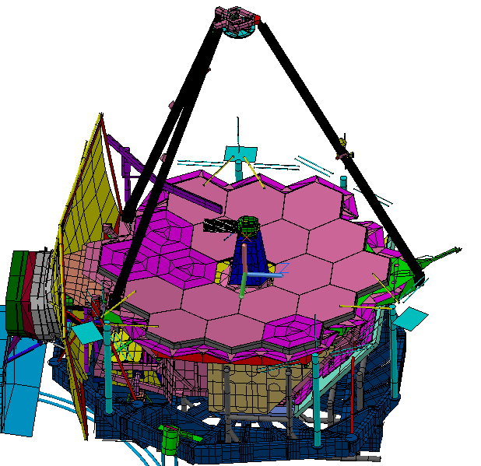
Modeling of Heat Sources
Lesson Learned: In a cryogenic test, ensure that all heat sources are modeled sufficiently to determine instrumentation needs
For stray-light Frill structure and SVTS Bib, there was not enough pre-test work performed to understand how heat from the CoCOA would impact temperatures on these soft structures
More thermal modeling of shutter effects would have resulted in more sensors in key locations on these structures to characterize their behavior during the test
Heat from CoCOA source
Spacecraft Vehicle Thermal Simulator (SVTS) Bib
Stray-light Frill
Source: NASA/JWST/K.Yang
Notes:
In a cryogenic test, it is critical that we model all heat sources sufficiently, since even small amounts of heat entering the system can have a big impact on resultant temperatures and heat flows, especially on soft structures with low thermal mass, such as thermal blankets.
In OTIS CV optical testing, to measure the curvature of the primary mirrors, a shutter opens at the top of the chamber to allow a line-of-sight between the Center of Curvature Optical Assembly (or CoCOA) to the mirrors. The CoCOA interferometer is kept at room temperature to meet its hardware temperature limits, and the opening of the shutter causes this warm heat source to be exposed to a cold chamber.
During optical testing at cryogenic steady-state conditions, it was observed that when the CoCOA shutter opened, the temperatures on the the GSE SVTS Bib soft structure between the OTIS payload and the L5 sunshield simulator, as well as the stray-light frill structure encircling the perimeter of the primary mirrors, drastically increased by as much as 13 K in some locations. This was not anticipated in pre-test analysis due to the coarse resolution of the model at these locations, and as a result of the perceived triviality of heat flux from the CoCOA source on payload temperatures, there was not enough instrumentation planned for these locations either to fully understand the maximum impact of CoCOA heat flux on their temperatures. If we had understood the magnitude of the CoCOA effect beforehand, more thermal modeling of shutter effects would have resulted in more sensors placed at key locations pre-test to characterize their behavior during the test.

Slide 8
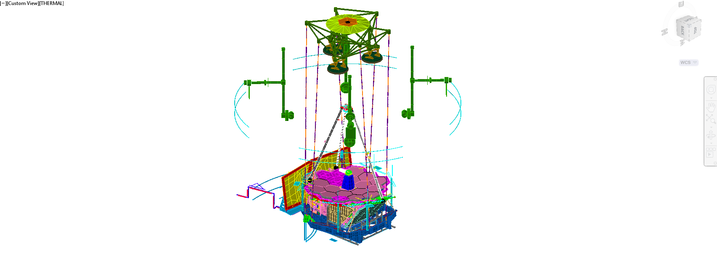
Sparsity of Temperature Sensors:
Evaluating Thermal Stresses
Lesson Learned: Ensure there are enough sensors during room-to-cryogenic temperature transitions to evaluate thermal stresses, especially across large structures
  During the OTIS cryo-load test with GSE, there were insufficient sensors to easily assess stresses in low conduction stainless steel structures with large gradients
  Must confirm that the form factor of the gradients between test and analysis agree; the largest temperature gradient is not necessarily the largest stress
  Extensive thermal model simulations were required to interpolate and extrapolate readings both for USF and for HOSS; HOSS had the added uncertainty of inadequate flow rate data
Upper Support Frame (USF)
Hardpoint and Offload Support Structure (HOSS)
Source: NASA/JWST/K.Yang
Notes:
This and the following three lessons learned pertain to the sparsity of temperature sensors in the OTIS CV test and how they had a negative impact both on diagnosing anomalies in-test and with post-test model correlation. For any cryogenic vacuum test or indeed any thermal vacuum test, the desire is to have more temperature sensors on the test article, especially in areas of large thermal gradient or stress. Unfortunately, for JWST, the scarcity of total telemetry channels for the flight observatory meant that the number of channels allocated for flight temperature sensors on the payload, as well as the locations they would be mounted, were defined early in the design process, far before any test planning for OTIS occurred. As a result, the locations selected for the flight sensors were optimized for flight operations monitoring, but very rarely took test considerations into account, especially for those limits and constraints only applicable during testing in a 1g environment, and not for flight.
In the OTIS CV test, some test-only sensors were mounted onto the OTIS payload to complement flight telemetry and fill in gaps where flight sensors were missing. However, the lack of accessibility into the already-integrated flight payload to install and remove the sensors meant that most test sensors resided on the outer surface of OTIS, unless they were already planned during I&T to be clip-and-fly. There were a total of 922 sensors on the payload, of which twenty percent were test sensors and the rest were flight. 964 additional sensors were used for the test GSE, not counting the facility sensors on the chamber and shrouds. While close to 1900 sensors in the test may seem like a large amount, recall the sheer size of the payload and test setup. Let’s do a quick thought exercise: if you took every surface on the payload and GSE, excluding the chamber and shrouds, and calculated the total surface area for the test thermal hardware, spreading the total of 1,886 sensors between them would result in roughly one sensor per 0.6 square meters, and there are locations on the test article where the expected gradient is more than 200 K per square meter. This simple example emphasizes the magnitude of the sensor sparsity problem in a test setup of this size.
One area where sensor sparsity was a major detriment was in the evaluation of thermal stresses, especially across large, low-conduction stainless steel structures with large gradients, such as the HOSS and the USF. During the room-to-cryogenic and vice versa temperature transitions in the OTIS CV test, there were an insufficient number of sensors to easily assess thermal stresses, and furthermore sensors were placed corresponding to the locations with the largest predicted temperature gradients, but not necessarily the largest predicted thermal stresses. When it was understood through precursor GSE system tests to OTIS that the sensors were not capturing the thermal stress extremes in these structures, extensive thermal model simulations were required to interpolate and extrapolate sensor readings both for the USF and HOSS.
On the USF, the issue with sensor sparsity was location as much as quantity. The original sensor allocations were placed on the most thermally-massive nodes since the thermal team was interested in understanding the time constant for the slowest and heaviest items shedding all of their latent heat. However, for gradients and rates, the lighter beams were more interesting and harder to correlate in the thermal model. On the HOSS, there was the added uncertainly of inadequate flow rate data to properly assess how the helium flow through this structure was impacting the thermal stresses. To get a detailed test temperature map, you would need to accurately correlate the fluid heat transfer of the gaseous helium line and its interaction with the structure. With the over 600 feet (or 183 m) of cooling line snaking through the system, short of placing a sensor in each location corresponding to a thermal node in the model, there would be no possible way to obtain an accurate temperature map of the structure.
While each of these structures went through a pre-test model correlation campaign, and increased number of sensors located at the most thermal stress-critical places on each structure on would have saved a tremendous amount of analysis time and uncertainty.

Slide 9
Sparsity of Temperature Sensors:
Thermal Distortion Model Crosschecks
Lesson Learned: For a mission such as JWST with very stringent wavefront error (WFE) requirements, a sufficient number of thermal sensors is essential to gather enough data for thermal distortion model crosschecks
  The OTIS CV test had requirements to measure the thermally-induced change in PM WFE and Radius-of-Curvature (Figure Drift) as well as the relative alignment between the AOS-to-SMA and global PM-to-AOS (Alignment Drift)
    Objective is to demonstrate that the change in WFE is within prediction from the thermal-structural model
  Usual method for mapping from temperature sensor data to thermal distortion model: interpolate via conduction from sensor locations to all of the structural elements
    However, OTIS CV test temperatures are driven by radiation, not conduction; conductive interpolation results in inaccurate temperature maps
    A new Linear Distance Weighted Interpolation Method (LDWI) was developed by our partners at the Smithsonian Astrophysical Observatory (SAO)^{[1]} to augment thermal model predictions based on the collected sparse sensor data from the OTIS CV test
Sufficient temperature sensors reduces the need for over-reliance on thermal model predictions and interpolation for thermal distortion model crosschecks
Notes:
Another area where sensor sparsity had a tremendously negative impact was in gathering data to crosscheck the thermal distortion model predictions. Two of the main objectives of the OTIS CV test were to measure the thermally-induced change in primary mirror wavefront error and radius-of-curvature via a figure drift test, and to measure the relative alignment between the AOS to SMA and global PM to AOS via an alignment drift test. These thermal distortion tests were touched on earlier in part 2 of this lecture series, their ultimate goal being to confirm that the thermal distortion model could produce an accurate prediction of the change in wavefront error due to temperature variation.
For the thermal distortion group at NASA Goddard, the usual method employed to map temperature sensor data to thermal-structural models would be to interpolate temperatures between sensor locations via conduction to all of the structural elements. However, the OTIS payload presented two significant challenges to applying this usual method: first, the sparsity of temperature sensors on the PMBSS structure meant that there were large distances between sensor locations where there were no direct temperature measurements, and second, the temperatures on the OTIS payload and especially the low-conductivity composite trusses were driven by radiation and not conduction. Therefore, using conductive interpolation leads to inaccurate temperature maps that were not representative of the actual temperature distribution on the hardware.
To address this problem, our partners at the Smithsonian Astrophysical Observatory developed a new scheme for temperature interpolation named the Linear Distance Weighted Interpolation method, or LDWI, to augment thermal model predictions based on the collected sparse sensor data from the OTIS CV test. Essentially, the LDWI method uses an inverse linear distance relationship among the sensors and thermal model nodes to perform its interpolation, and through this process adjusts predictions over all nodes in a bulk shift manner to correspond with measured sensor data. More information about LDWI can be found in reference 1 listed at the end of this presentation. However, the takeaway here is that the significant effort used to interpolate temperatures for the thermal-structural model nodes would have not been necessary had there been sufficient thermal sensors outright at the start of the test to gather enough data for the thermal distortion model. For future projects, especially those operating at cryogenic temperatures with large gradients, an adequate number of thermal sensors obviates the need for over-reliance on thermal model predictions and interpolation.

Slide 10
Sparsity of Temperature Sensors:
Diagnosing Anomalies
Lesson Learned: For thermally critical interfaces, ensure there are enough temperature sensors to understand the heat flows and physical phenomena that occur at these interfaces in case the trends observed are not what’s expected from pre-test predictions
  Cryogenic systems need far more diagnostic sensors than ambient spacecraft for hardware safety and anomaly assessment : this needs to be a planned expense from the early stages of spacecraft development
  In the OTIS CV Test, unexpected behavior was observed at two locations with only a sparse number of temperature sensors available:
    The interface between the BSF and the IEC, 2 thermal sensors located coincidentally: anomalous temperature excursions at this interface, over 20 K warmer than model predictions
    The stray-light Frill, 2 thermal sensors: instability observed in PM figure during
    optical testing
  The lack of temperature data to aid in these investigations resulted in a heavy emphasis on analysis to understand their temperature distribution and thermal behavior, as well as a protracted investigation to "sanity check" models with few sensors available
    Would have been made unnecessary with enough measured thermal data to directly observe the phenomenon of interest, or at least provide a suitable model crosscheck
Notes:
The last lesson learned in sensor sparsity is to have enough temperature measurements at thermally critical interfaces to understand the heat flows and physical phenomena that occur at these locations. In cryogenic systems, a general rule of thumb is that far more diagnostic sensors are needed than ambient spacecraft for hardware safety and anomaly assessment. Therefore, thermal sensors need to be budgeted in both for the expense of the physical sensor as well as telemetry channel allocations in the early stages of spacecraft development.
For the OTIS CV test, there was unexpected behavior seen at two locations. The first was the interface between the cold BSF composite structure at roughly 90 K, and the adjacent IEC, which was almost 200 K warmer. At this interface, there was insufficient sensor information to determine what was causing temperature measurements to be over 20 K warmer than model predictions. However, while we didn’t have more sensors to enhance our understanding of thermal gradients in this area, the two coincidentally-located sensors read through different data acquisition systems were extremely important in alerting us to the issue and confirming that it was not just sensor error that was causing the anomalous reading. The second was on the stray-light frill, where there were three different types of instability observed on the PM figure during optical testing. However, with only two temperature sensors on the frill, it was difficult to understand how frill temperatures were impacting the PM figure, or if they were at all.
The lack of temperature data distributed at more locations across these components resulted in a heavy emphasis on analysis to understand their temperature distribution and thermal behavior, and protracted investigations for each to verify that the model predictions were correct. This, again, would have been made unnecessary with enough measured thermal data to directly observe the phenomena of interest. The next two slides will go into each of these scenarios in greater detail.

Slide 11
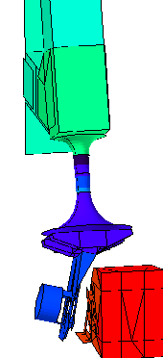
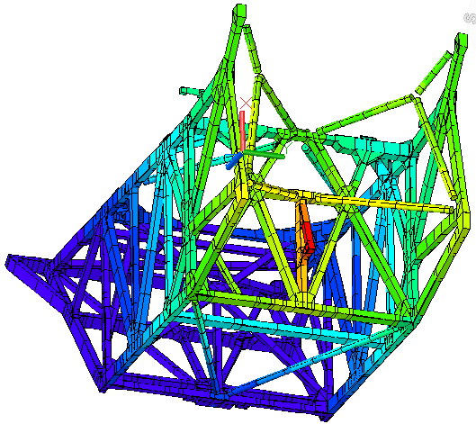
Sparse Temperature Sensor Scenario 1:
BSF-to-IEC interface ^{[Ref. 2]}
Observed Phenomenon: In OTIS CV test, two thermal sensors on PMBSS structure at BSF/IEC interface achieved steady-state temperatures approximately 22 K warmer than predicted (surrounding sensors show warmer temps as well)
Location of BSF temp sensors
Suspected Cause: This part of the PMBSS structure is connected to an open Launch Release Mechanism (LRM), the other half of which is attached to the warm IEC shell. If there was a mechanical short across the LRM, this may explain the unexpectedly warm interface
Analysis Approach:
  Initial thermal analysis focused on mechanical shorts across this interface. However, only an unreasonable number of high-conductivity shorts could replicate the 22 K temperature rise
  Later thermal analysis focused on modeling errors with composite conductivity
Resolution: There was no mechanical short. Rather, the flight PMBSS model assumed too much conductivity through the composite tubes (for conservatism in heat flow to instruments)
BSF (PMBSS)
Possible mechanical short?
LRM
LRM
IEC
Source: NASA/JWST/K.Yang
Location on PMBSS structure of thermal sensor temperature deviation from predictions
Notes:
For the first scenario on the BSF-to-IEC interface, the figure on the lower left-hand side shows the temperature distribution on the BSF structure during cryo-balance, with the area of interest enlarged to display the design of the launch restraint mechanism or LRM between the composite BSF structure and the IEC. During the OTIS CV test, the two halves of this LRM were disconnected, ensuring that there was no direct conductive path between the IEC side at 278 K and the BSF. The BSF side was predicted to be about 70 K at the composite structure location closest to the LRM, as indicated on the inset.
Our first indication that there was an anomaly at this LRM location was that the sensors on the BSF side read 92 K at cryogenic steady-state, approximately 22 K warmer than what was predicted by the thermal model. An errant sensor reading was considered, but since there were two co-located thermal sensors at this location, one flight and one test, and both measured the same temperature despite being read via independent systems, the possibility of sensor error for both systems was remote. The surrounding thermal sensors to this location also corroborated the story of warmer temperatures in this region, albeit with less stark of a divergence from predictions than these. Additionally, the thermal model generally did a good job at cryogenic steady-state, predicting within 3 K of test measurements on the rest of the BSF structure, and making this particular discrepancy between analysis and hardware seem more egregious. The possibility of a mechanical short across the LRM was considered, but compounding the issue, there were no temperature sensors immediately across the LRM interface on the IEC side that could directly confirm the presence of a short.
We approached the diagnosis of this problem by initially assuming that a thermal short across the LRM interface caused the unexpectedly high temperatures on the BSF side. While much analysis effort was spent to understand what type of short across which components would result in the observed phenomenon, we concluded after trying dozens of cases that the 22 K temperature rise could only be replicated if an unreasonably large number of high-conductivity shorts bridged the gap between the BSF and IEC, and post-test inspections revealed no such shorts existing. Later, after the idea of a mechanical short was abandoned, thermal analysis focused on post-test correlation of the BSF composite conductivity itself. After months of post-test analysis, it was finally determined that the observed temperature anomaly was due to extremely conservative assumptions of BSF structure conductivity in the delivered flight model. In flight steady-state predictions where the aim is to predict the largest amount of parasitic heat leak that could possibly flow through the BSF structure to the instruments, it behooves the thermal engineer to use as large of a composite thermal conductivity as feasible in the interest of design conservatism. However, this did not realistically reflect the actual thermal conductivity of the BSF structure, and by assuming a much higher conductivity, the local hot spot at the BSF/IEC interface was not predicted correctly. This belies the fundamental difference in goals between flight and test predictions, where flight aims to use predictions to assess worst-case scenarios, while test modeling is meant to be as realistic as possible to assess performance against limits and constraints for hardware safety. The realization of overly conservative BSF composite conductivities led to the JWST flight model being changed to reflect more realistic thermophysical material properties. Now, tying back to the original issue of sensor sparsity, a greater number of thermal sensors at this location not only would have confirmed there was no mechanical short across the LRM, precluding the need for the enormous thermal analysis effort associated with this assumption, it would have also allowed the thermal team to more quickly realize that BSF composite conductivity assumptions were incorrect.

Slide 12
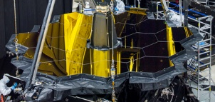
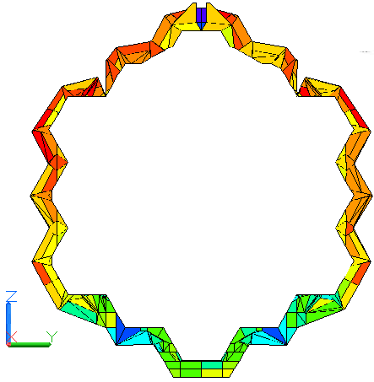
Sparse Temperature Sensor Scenario 2:
Stray-Light Frill ^{[Ref. 2]}
Observed Phenomenon: During cryo-stable optical testing in OTIS CV, it was observed that there were three types of unexpected PM instability: cyclic drift from cycling of the IEC heater, long term instability from CoCOA shutter motion impacting frill temperature, and tilt events
Cause:
  Cyclic drift: Purely due to the ground test configuration, and would not occur in flight
  Long term instability and tilt events: Due to frill material relaxing and contracting with opening of CoCOA shutter for optical testing
Analysis Approach: Large thermal, thermal distortion, and optical analysis campaign focused on impact of frill motion on the change in wavefront error (WFE), and how observed behavior from exposure to CoCOA aperture in OTIS may scale to flight motion from observatory slews (extremely difficult to correlate model with two thermal sensors)
Resolution: Rework of frill required
Source: NASA/Chris Gunn
Frill
Location of frill temp sensors
Source: NASA/JWST/K. Yang
Frill Temperature Predictions
Notes:
For the second scenario on the frill, it was observed during cryo-stable optical testing at OTIS CV that there was unexpected instability on the primary mirrors, and that this instability occurred in three different flavors: cyclic drift from cycling of the IEC heater, long term instability from the CoCOA shutter motion impacting frill temperature, and tilt events. Post-warmup ambient testing showed that the cyclic drift of the PM figure was due purely to the mounting of the IEC in its ground test configuration, and this phenomenon would not occur in flight. Modifications made during the OTIS CV test to reduce the deadband of the IEC heaters were recommended and accepted for flight operations.
The diagnosis of the long-term instability and tilt events was a more intensive process, and these phenomena were eventually attributed to the opening and closing of the CoCOA shutter for optical testing. At cryo-stable temperatures with the CoCOA shutter closed and the payload sitting in a uniformly 20 K shroud environment, the frill material contracted due to cryo-shrinkage, exerting small forces and torques on its supporting composite backplane, which in turn affected the mirror figure. When the CoCOA shutter opened, the frill was bathed in heat from the room-temperature interferometer, causing the material to relax slightly and release some of its tension, thus again changing the backplane shape and PM figure.
Unfortunately, the frill in total only had two temperature sensors in the OTIS CV test, the locations of which are shown in the temperature contour plot on the lower left-hand corner of the slide. Depending on the proximity to the warm core region of OTIS, the frill did not uniformly change in temperature at each location when the CoCOA shutter opened. The warmer –V3 end might only have seen a 4 K temperature change, while the colder +V3 end might have seen as much as a 13 K temperature change. With the dearth of temperature sensor data around the frill though, it was extremely difficult to confirm whether thermal model predictions were correct for the areas of the frill that responded more drastically in temperature rise to the CoCOA shutter opening. Furthermore, since the thermal distortion and optical analysis models relied on the thermal model for temperature maps to assess how frill motion impacted the change in wavefront error, there was very little sensor data corroboration that could confirm if the outputs from the thermal model were accurate inputs to the thermal distortion and optical analysis efforts. While there will not be a CoCOA interferometer to worry about after JWST launches, since JWST slews in flight to acquire different observational targets, views from the frill to other spacecraft components such as the sunshield will change with observatory slew. If we lack a good understanding of how a point heat flux from the CoCOA affects frill temperature and therefore PM figure, how do we verify our understanding of the impact on wavefront error from flight motion during observatory slews?
Through a large thermal, thermal distortion, and optical analysis campaign, which lasted over a year past the end of the OTIS CV test, it was determined that scaling to the small temperature changes expected in flight scientific operations, the expected PM figure effects are reduced by an order of magnitude. Also, it was found that the slack intended for cryo-shrinkage in the frill design was compromised by some pre-OTIS CV test installation processes. Post-test rework reintroduced the design slack in the frill and blanket assemblies, ensuring that the tension seen due to frill material cryo-shrinkage would be minimized in flight. It should be noted that this was one of the most significant findings of the OTIS CV test, and underscores the extreme importance of testing in the relevant environment before flight.
Let’s now come back and tie it to the lesson of sensor sparsity. If sensors were placed all around the frill in-test, much of the grueling analysis effort to understand and predict frill thermal behavior could have been avoided, and better model crosschecks would have increased confidence that the thermal distortion and optical analysis for flight was accurate. Though we were relieved that our analysis campaign eventually resulted in a rework on the frill and mitigation of flight risk, we could have avoided a lot of painful hours of analysis, extrapolation, and deliberation simply with more thermal sensors.

Slide 13
Lessons Learned for Flight and Test Hardware
Notes:
Let’s now move to the lessons learned in implementation of hardware, both for test and flight.

Slide 14
Flight Heater Setpoint Modification
Lesson Learned: Flight heater setpoints should be made as easily modifiable as possible in the flight software
  The Integrated Electronics Compartment (IEC) had its heater setpoints hard-coded to the flight software
  For the Sparse Sensor Scenario #2 described earlier, to diagnose if the IEC heater behavior was affecting cyclic behavior on WFE (i.e. does changing the heater behavior affect WFE in the same way?) much time was spent in waiting for flight software patches to change the IEC heater setpoint and deadband control values
  The software included a brief turn-off of heaters at the start of the patches, causing the IEC components to drift towards their lower temperature limits
Source: NASA/JWST/K.Yang
IEC
Location on OTIS CV Test
Notes:
As discussed previously in the second sparse temperature sensor scenario concerning the frill, a cyclic instability was seen on the primary mirrors during optical testing at cryo-balance. Since the cyclic instabilities mirrored the frequency of the IEC software-controlled bang-bang heaters, it was immediately suspected that the IEC heaters had a direct impact on the PM wavefront error. To confirm this, a change in IEC heater deadband was needed to change the frequency of heater oscillations and see if the PM wavefront error underwent a corresponding change. However, in the original IEC heater design for JWST, these heaters had their setpoints hard-coded in the flight software, since it was assumed that there was no need to change their setpoint values in-flight. Unfortunately, in this test scenario, the need to now change these setpoints meant that the flight software governing these heaters had to be rewritten and reloaded into the IRSU. This was an intensive process, requiring patches to the flight software, quality checks, and re-approval by management, and the test team was left waiting for long periods of time until these patches could be loaded. Furthermore, integration of new flight software meant that the IRSU, which powered the heaters, needed to be power-cycled. With the heaters off, the IEC components drifted towards their lower temperature limits as the team nervously waited for the heaters to turn back on, indicating success of the flight software change. If the flight software was made to accommodate changes in heater setpoint from the outset, this time delay and unnecessary risk to the hardware could have been avoided.

Slide 15
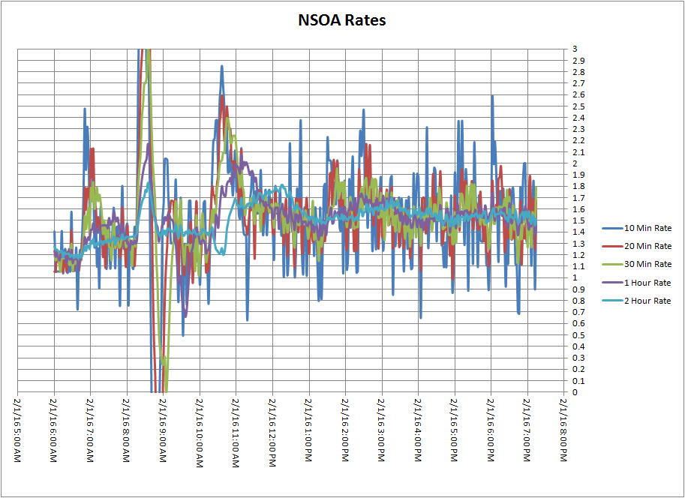
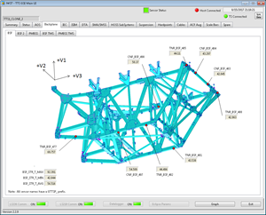
Test-Monitoring Software
Lesson Applied: User-friendly test monitoring software is critical for tests as complex as OTIS CV
  Fusion was instrumental to monitor temperature-dependent limits and constraints with complex equations not easily programmable into Eclipse (flight): To diagnose difficult thermal problems that arose during the test, Fusion’s capability to output easily readable historical data was a huge benefit
  Thermal Test Set (TTS) and associated Eclipse Graphical Generator (EGG) program provided the added benefit of sensor data mapped spatially onto plots of hardware, allowing for easy identification of problem locations or out-of-family temperatures
Screenshot of Fusion Software
Source: Genesis ESI/Brian Comber
Screenshot of Harris TTS Data Acquisition System
Source: NASA/Harris Corp.
Notes:
User-friendly test monitoring software was critical for tests such as OTIS CV, especially when the data acquisition was coming through three separate sources: the flight ECLIPSE system, the GSE TTS system, and the facility DARAC system. The Fusion software was instrumental in monitoring temperature-dependent limits and constraints, allowing sensor data acquired through different data acquisition systems to be plotted on the same graph, compared with temperature-dependent L&Cs that used complex equations to define their limits, and tracked against thermal model predictions. Fusion also had three features specifically developed to accommodate the needs of the OTIS CV test: the RTM to calculate real-time virtual sensor temperatures for AOS components; an extrapolation tool to estimate the time for a sensor to reach steady-state, which was useful for schedule estimation; and a tool to compute the heat flows on the ISIM heat straps and verify their thermal conductance.
The Thermal Test set or TTS system, developed by Harris Corporation, provided the added benefit of allowing sensor data to be mapped spatially onto plots of hardware. Though TTS performed GSE data acquisition, a specific Eclipse Graphical Generator, or EGG, program could acquire flight data from ECLIPSE and map those temperatures onto the same plots as test sensors. These spatial temperature maps, partitioned by structure or subsystem, allowed easy identification of problem locations or out-of-family temperatures, and offered a complete look at the global gradients across the OTIS structure. For L&C monitoring, by monitoring the temperatures of surrounding sensors, it also confirmed which limit exceedances were real and which were the result of faulty sensor readings.
Additionally, the Cryovac development test program, including the prior Thermal Pathfinder test and ISIM CV tests, provided crucial opportunities to find and fix bugs as well as add useful capabilities on these test monitoring software systems. It gave thermal test personnel a chance to train, become familiar with, and refine these systems in a real test scenario, so that the process became much more streamlined by the time of the OTIS CV test.

Slide 16
Use of Virtual Sensors
Lesson Learned: Critical optical components, such as the Fine Steering Mirror (FSM) and Tertiary Mirror (TM), should always have temperature sensors
  Even with use of the Real-Time Model (RTM), lack of temperature sensors made for difficult monitoring and control to satisfy structural and contamination L&Cs
  If virtual sensor use is unavoidable, uncertainty of calculations needs to be understood and monitored by every member of the operations team
    Virtual sensor uncertainty needs to be quantified
    in time to include in pre-test predictions
    RTM uncertainly needs to be included in model
    predictions, operations planning, and on-orbit
    monitoring when evaluating L&Cs for flight
    Operations team (flight or test) also needs to be
    educated on RTM/virtual sensor usage and
    limitations to avoid false alarms
    RTM calculation veracity should always be
    monitored
FSM
Source: NASA/JWST/K.Yang
TM
Location on OTIS CV Test
Notes:
While the previous slide showed the benefit of having the Fusion program as a platform for the Real-Time Model or RTM, the true lesson learned here was that critical optical components, such as the FSM and TM, should always have physical temperature sensors, and virtual sensors should be avoided whenever possible. It was initially thought that temperature sensors on the mirrors would distort the mirror figures, and therefore no sensor was allocated for these optical components. The RTM that was developed by Ball Aerospace to monitor these virtually was a powerful tool, but as its calculation was based on surrounding temperature sensors and the test environment, rather than sensors directly mounted on the hardware, model uncertainly became a significant issue especially at lower temperatures. RTM uncertainty became the driver for its usage. It needed to be understood by each member of the team and included in model predictions, operations planning, and even plans for future on-orbit monitoring when evaluating L&Cs for flight. This uncertainty was also quantified far before the test start in order to be included in the pre-test predictions, such that the control method that was developed for temperature transitions did not cause any exceedances of limits PLUS uncertainty margins. The operations team was furthermore required to be trained extensively on RTM and virtual sensor usage, including the limitations of the software and how to monitor RTM calculation veracity to avoid false alarms. Caveats based on the uncertainty of the RTM calculation governed the operator response to L&C exceedances where these virtual sensors were used, and the Fusion hardware was preprogrammed to check the energy balance sum on the RTM calculations during the OTIS CV test, flagging the calculations if the energy balance calculated was not near zero.
All of this effort was undertaken purely due to model uncertainty. This brings us back to the original takeaway message: if there are L&Cs levied between various components on optical assemblies, ensure that there are actual physical temperature sensors to track these components. Don’t generate hardware safety requirements, even if they are only test-specific, and have no way to monitor them directly.

Slide 17
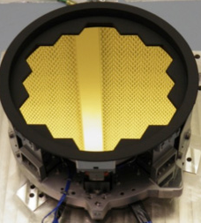
Heaters on Optical Surfaces
Lesson Learned: When possible, heaters on mirrors should be placed directly on the mirror structure itself
  It was thought originally that heater mounted on mirror substrate would affect the surface figure of the mirror
  Heaters on separate components removed from the FSM and TM made for extremely difficult control of the mirror substrate temperatures
FSM Mirror Surface
FSM
Source: NASA/JWST/K.Yang
Source: NASA/Ball Aerospace/Tinsley Ref. 3
Baseplate
(heater on underside)
Location on OTIS CV Test
Flight Fine Steering Mirror
Notes:
In a similar vein as the lesson on the previous slide, heaters should be placed directly on the mirror structure when possible. Originally, it was thought that a heater mounted on the mirror substrate would affect its surface figure. However, heaters placed on components removed from the mirror, such as a baseplate, resulted in many more problems with control of the intended mirror. Their reliance on radiative heating and weak conductive heating meant that heaters needed to drive the component they were mounted on much hotter to affect response on the mirror, causing thermally-induced stress within the mirror assemblies. There was also a significant time lag between heater action and mirror response, up to four hours for the FSM, making any quick actions to avert hardware damage all but impossible. FSM hardware safety entirely depended on the skill of the thermal operator to foresee trouble ahead and take early evasive action.
Ultimately, it is up to the engineering team to decide whether mounting a heater directly to the underside of a mirror substrate will unacceptably impact the surface figure. Depending on the project-specific distortion requirements, an analysis should be performed trading off ease of mirror temperature control with smoothing out the point-loaded gradient that heater installations can create.

Slide 18
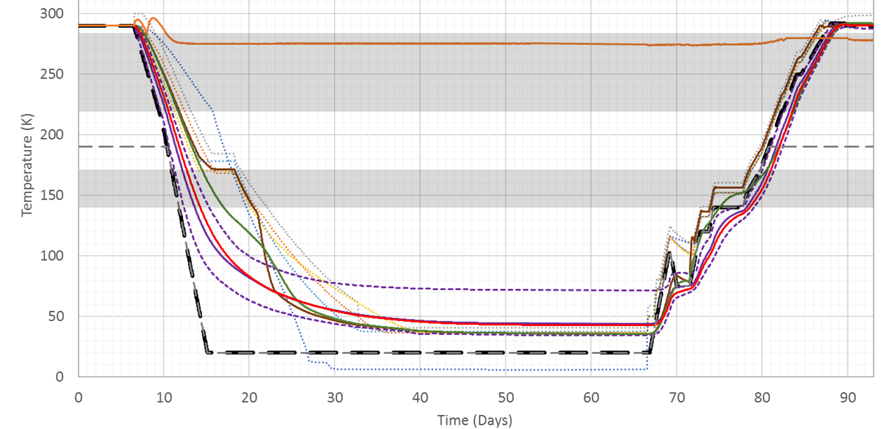
Contamination Constraints
Lesson Applied: Plan in detail the implementation of contamination constraints on test operations
  Contamination constraints are complex in a system that needs to cool through molecular and water emission bands
  Develop procedures with all subject matter experts running the test, and be sure all are trained
  Clearly define where there is flexibility in the constraints
  Once the RTM uncertainty was applied to the CC L&C’s, it became a pacing item for certain portions of warmup
    This wasn’t anticipated by pre-test thermal model predictions
Molecular Contamination Band 220-285K
Water Contamination Band 140-170K
Source: NASA/JWST/K.Yang
Notes:
Also related to the RTM is the implementation of contamination constraints during test operations with model uncertainty. This was addressed in detail for the FSM in Part II of this lecture series, but is reiterated more generally here. Contamination constraints are extremely complex for a system that goes though water emission on the composites at 140-170 K, and molecular contamination emission from 220-285 K. The contamination L&Cs were developed with contamination team subject matter experts assuming there would be direct knowledge of the FSM temperature, and its temperature deltas to the ISIM pick-off mirrors, the AOS components, and the surrounding environment would be clearly understood. However, the addition of model uncertainty from the RTM extremely limited the margins from which FSM temperature could deviate from the other ISIM POM temperatures, and made for an extremely rigid, slow, and precarious warmup methodology to avoid any L&C exceedances, becoming the pacing item for the last ten days of warmup.
Modeling uncertainty must be factored early on in the test design process so that the procedures can be designed with these in mind. It was precisely that the OTIS CV team accounted for this modeling uncertainty in pre-test temperature predictions that we minimized the amount of surprises during warmup, and it proceeded on-schedule with our predictions.

Slide 19
Thermal Instrumentation
Lesson Applied: Develop a robust thermal instrumentation plan; multiple systems may be needed to rigorously interpret test results in a cryogenic test
  Extensive effort was spent to ensure the calibrated test sensors and data acquisition hardware would provide the desired accuracy and resolution
    This was complemented with radiometers that could measure localized heat sources to high sensitivity
    This was further complemented with calorimeters that were simple and independent of mounting technique for understanding radiative boundaries and icing
  JWST would have benefited from a more robust gaseous helium flow calibration: model results would have been much easier to compare to test data if accurately measured flow rates were available
Notes:
Let’s now talk about thermal instrumentation, specifically GSE hardware used to interpret test results. In a cryogenic test, it is essential to have accurate instrumentation and multiple independent verifications of the same measurement to be sure that you’ve quantified your temperatures and heat flow accurately. As such, extensive effort was spent to ensure that the calibrated test sensors and the data acquisition units reading them would provide the desired accuracy and resolution. These thermal sensors were complemented with radiometers that could measure localized heat sources to high sensitivity, then further complemented with calorimeters to understand radiative boundaries and surfaces that may have collected ice in the test. Earlier in this lecture, you saw how much the opening of the CoCOA shutter impacted soft structure temperatures in the test through the introduction of a small radiative heat source. If we did not have the radiometers and calorimeters in the test and solely depended on the sparse temperature sensors to quantify heat flux from the CoCOA, our analytical troubleshooting would have been made even more difficult, and we would not have had any independent verification that the behavior we saw on the sensors was accurate.
If you recall earlier discussions of test design from previous lectures, there were also large GSE systems which were controlled actively through helium flow, the HOSS and DSERS being the most prominent. These large structures formed significant temperature gradients during transitions due to their sheer thermal mass. However, flow rates through the gaseous helium tubing welded onto these structures were not measured very accurately. As many of these components provided radiative boundaries for the payload, this introduced another layer of uncertainty to the post-test model correlation.

Slide 20
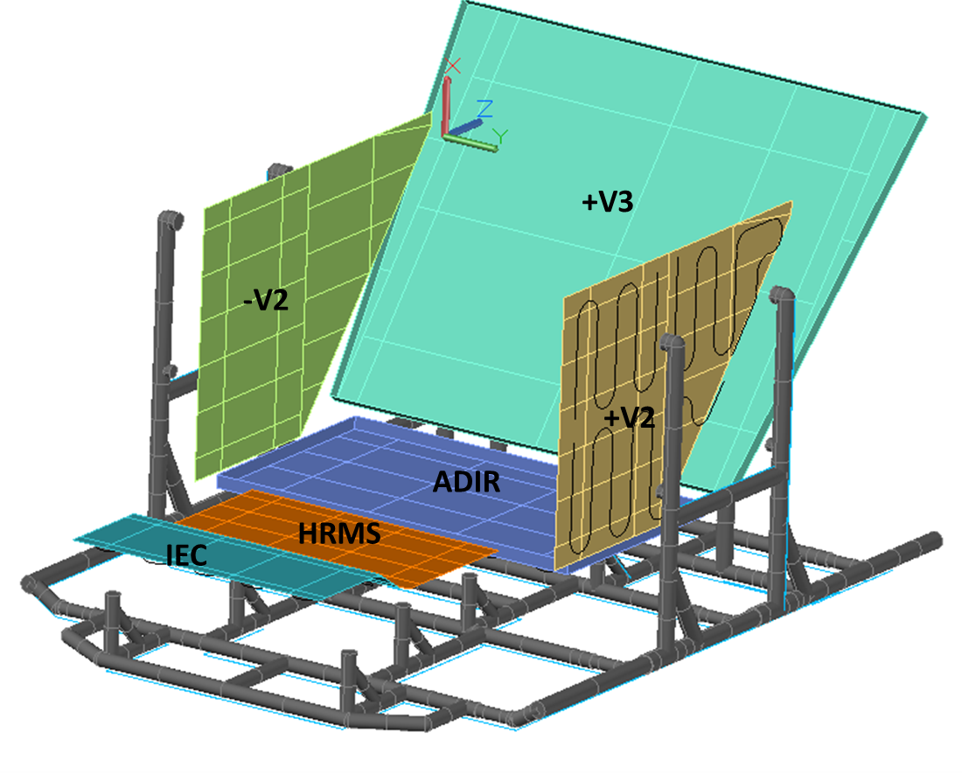
Securing of Critical Thermal Sensors
Lesson Learned: Critical sensors, including GSE sensors, need to be mechanically secured in a cryogenic test
  95% of sensors held well with thermal tape, but adhesion was workmanship and substrate dependent
    This was particularly problematic on the ISIM DSERs, which undergo large temperature swings very rapidly
  If a sensor is critical then be sure that at least the representative locations (that capture the temperature extremes for a specific piece of hardware) are secured more robustly
Source: NASA/JWST/K. Yang
ISIM DSERs
Source: NASA/JWST/K. Yang
Location on OTIS CV Test
Notes:
On the topic of thermal instrumentation, all critical sensors, whether test or GSE, must be mechanically secured in a cryogenic test. In the OTIS CV test, the ISIM DSERS saw the full gamut of temperatures and underwent rapid temperature swings due to their active gaseous helium loop. While 95% percent of the total test sensors held with thermal tape, adhesion was workmanship and substrate dependent, and the DSERS saw a disproportionate number of temperature sensors detach at cryogenic temperatures, causing us to lose valuable test information. If a test sensor is critical, ensure that at least the locations which capture the temperature extremes for a specific piece of hardware are secured more robustly.

Slide 21
“On-Off” Heater Control in Cryogenic
Flight Systems
Lesson Learned: A cryogenic flight system with on-off heater control (“bang-bang”) should be avoided
  Proportional-Integral-Derivative (PID) Heater control for cryogenic telescopes is recommended
    If PID control is utilized, plan sufficient time to develop control parameters pre-test, or plan test time to tune the controllers
      There were not many opportunities during test where PID control parameters could be tuned without impacting another test event
    PID control requires significant analysis time or dedicated test events
      For example, the CoCOA thermal enclosure was hard to tune because the panels were so radiatively coupled
      Pre-cool strap heaters required significant tuning time in relevant environment during Thermal Pathfinder test
  From Harris GSE thermal engineer’s experience, some of the hardest heaters to control were ACF heaters and BSF/hardpoint strut heaters, due to their extremely long thermal time constants
Notes:
Another lesson learned for cryogenic systems is that on-off heater control, otherwise known as “bang-bang” heater control, should be avoided, especially in cases where optothermal stability is necessary. While Proportional-Integral-Derivative or PID heater control is recommended to achieve greater stability, budget sufficient time to develop or tune control parameters pre-test. In the OTIS CV test, there was not enough analysis performed pre-test to tune parameters, nor were there many opportunities where PID control parameters could be tuned during test without impacting another test event. As a result, some heaters were difficult to control during the test with the parameters that they had, and on-the-fly tuning for certain hardware such as the CoCOA enclosure was equally difficult due to the strong radiative coupling of the enclosure panels, given that the interferometer needed to be maintained at a uniform room-temperature thermal environment. Others, such as the pre-cool strap heaters, required significant tuning in the Thermal Pathfinder test, utilizing a similar thermal environment and similar heat load, before we were confident that it could control heat flow to the flight payload.
As an interesting aside, the L3 Harris GSE thermal engineers indicated that some of the most difficult heaters to control were not necessarily because they lacked a PID algorithm, but rather because of the extremely long time constants from their immense thermal mass. For the heaters mounted around the ACFs and the zero-Q heaters at the hardpoint struts supporting OTIS, extensive simulation time was needed to extrapolate the appropriate setpoint for these heaters, and all of the pre-OTIS cryo-vacuum tests at JSC provided experience operating these heaters before the main event at OTIS CV.

Slide 22
High Gas Loads
Lesson Applied: Plan for high gas load contingencies in modeling, analysis, and test design
  Gas heat transfer due to GHe backfill and also due to chamber air leaks had major ramifications for thermal management of Photogrammetry cameras (PG) and Absolute Distance Measure Assembly (ADMA)
  PG and ADMA purge gas heating systems were upgraded to accommodate the thermal shorts at higher pressures
  Gas backfill can be successfully used to accelerate payload temperature transition times, but precisely modeling the response of complex geometries is a developing art
Photogrammetry Cameras (PG)
Source: NASA/JWST/K. Yang
Absolute Distance Measure Assembly (ADMA)
Notes:
Concluding this hardware lessons learned section is a caution to plan for high gas load contingencies in modeling, analysis, and test design. Gas heat transfer, whether through planned gaseous helium backfill events or unplanned off-nominal scenarios had major ramifications for the thermal management of both flight and GSE components. On GSE, the photogrammetry cameras and absolute distance measure assembly, both used for optical metrology, had purge gas heating systems. However, the original design would have been damaged during high gas load events when parts of the design that were intended to remain at cold temperatures coupled with warmer components. These systems were upgraded pre-test to accommodate thermal shorts at higher pressures.
Conversely, as learned from the Thermal Pathfinder test, high gas loads can be beneficial to test design as the greater heat transfer helps accelerate payload temperature transition times over using radiation alone. However, this approach was abandoned for the OTIS CV test because we could not verify with our simplified assumptions for gas coupling that the hardware would be absolutely safe under higher pressures. Precisely modeling the response of a complex payload to gas heat transfer is a developing art, and the recommendation from the OTIS thermal team to future projects is to use this option for accelerating transition times extremely cautiously, unless the payload does not have any stringent L&Cs.

Slide 23
Lessons Learned in Test Planning and Management
Notes:
Let’s now explore the final section of lessons learned in test planning and management.

Slide 24
Pre-Test Training
Lesson Applied: Train your team on what to monitor, and ensure that this is all properly captured and documented while on shift
  The OTIS CV test was a big success due to the expanded training regimen for the GSE, facility, and flight hardware teams
  Multi-day training sessions were held to educate all members of the team on the OTIS system as a whole: Team members were briefed on subsystems and components that they weren’t necessarily responsible for to add to their understanding of the overall test design and what to look for from the other subsystems during each test phase
  Having a large team traveling in-and-out through the duration of the test, as well as working offsite when not in Houston, presented many additional challenges
  Communication both between teams and between individual test operators within each team is extremely important: The overlap between payload thermal team shift transitions, as well as to new operators coming in for a shift cycle, was crucial for continuity of knowledge and operational experience during the 100-day test
Notes:
In many aspects, pre-test training was the most crucial element that made the OTIS CV test successful. Personnel on the GSE, facility and flight hardware teams all went through multi-day training sessions to expand their understanding of the OTIS CV test system as a whole. They were trained on what to monitor during each phase of the test, what to capture and document while on shift, and what information to pass on to the next shift. Team members were briefed on other subsystems and components that they weren’t responsible for in the interest of adding to their overall understand of the test design, as well as what to look for from the other subsystems. The emphasis on personnel having attended the OTIS CV pre-test training, as well as having had experience on the preceding JWST cryogenic vacuum tests leading up to OTIS, made sure everyone was on the same page.
Since most of the test team was not based in Houston, staffing the 100-day test required large team traveling in-and-out through the duration of the test. Adding to the staffing complexity, the team originated from all parts of the United States and abroad. Communication was paramount in this case, both between teams and between individual members of each team. The overlap between team shift transitions and new test operators traveling in for a shift cycle meant that continuity of knowledge needed to be seamless from shift-to-shift. We accomplished this by prioritizing the information that needed to be transferred through shift reports, and providing easily digestible summaries subsystem-by-subsystem of what happened on each shift.

Slide 25
Runaway Heaters
Lesson Learned: In cryogenic test conditions, a runaway heater can have devastating consequences
  Ensure that adequate controls are in place between temperature monitoring system, max heat settings, or software to address the risk
  Train your team on what to monitor, especially if automated methods are not possible
  Plan an instrumentation design capability which will reduce maximum available power as a function of temperature
  For OTIS, all critical heaters had current and ramping rate limits imposed
Notes:
In cryogenic test conditions, a runaway heater can have devastating consequences, as just a small amount of heat can cause a rapid temperature increase and disturb thermal stability or worse, break hardware. Ensure that you have adequate controls in place, whether in the temperature monitoring system, the maximum amount of heat that can be applied to the heater, or the contingencies coded into the flight software. If there are a large number of sensors to monitor, train your team to focus on the most critical sensors, and place alarms on rate limits when possible to detect if a heater is rapidly warming. Also, plan a capability on your instrumentation to reduce the maximum available power to a heater as a function of temperature.

Slide 26
Temperature Sensors
Lesson Learned: Test limitations & constraints should always be defined based on measurable data, and it is absolutely necessary that every temperature sensor needs to have a red and yellow limit preprogrammed in
  Sensor locations should correlate with limits
  Uncertainty factors are required if sensors do not capture peak stresses
Lesson Learned: Define test management rules when hardware is near red and yellow limits
  Early in test planning, the JWST test team had multiple interpretations of how to react to a limit violation (across and within organizations)
    Definition and consistent interpretation is needed early in the test planning phase
  Define methods to control gradients effectively for each piece of hardware with a gradient limit (especially if they are not heater-controlled)
    For passive flight components, shroud rate was the primary tool for gradient control
    For many GSE components, flow rate and shroud rate were the primary tools
Notes:
This slide captures two lessons, one for temperature sensor monitoring methodology, and one for personnel response when a sensor is near its limit.
First, temperature sensors should always have a red and yellow limit preprogrammed in reflecting a limitation or constraint, and test limitations and constraints should always be defined based on measurable data. Associated with this is sensor placement: sensors should be placed where a structure or component would see its most extreme temperatures. If this is not the case, then either test or model-based uncertainty margins should be added to account for sensor offset from the location of the temperature extreme.
Second, test management and response rules should be explicitly defined when hardware is at or near red and yellow limits. Early on in test planning, even within the JWST thermal team, there were multiple interpretations of how to react to a limit violation. Many times, this reflected the policy of the organization from which that thermal engineer originated. For example, is exceeding a yellow limit when you begin taking action to avert progressing to a red limit, or should you take action before the yellow limit is exceeded? Is staying at a temperature between yellow and red limits acceptable as long as the trend is not proceeding to red, or should you invest as much effort as reasonable to bring the hardware below yellow limits? These and other questions were representative of the inconsistencies between organizations that we as the OTIS thermal team were required to iron out before test. A similar coordinated response was needed for temperature gradient control across large structures. Since most OTIS payload structural components were not actively controlled, the shroud rate was the main driver for gradient control. As such, decisions on what shroud rate to go to in case of hardware safety concerns needed to be agreed upon among thermal team personnel. For GSE, this was an even more complex decision as the gaseous helium flow rate and shroud rate were both the primary tools for controlling the hardware.

Slide 27
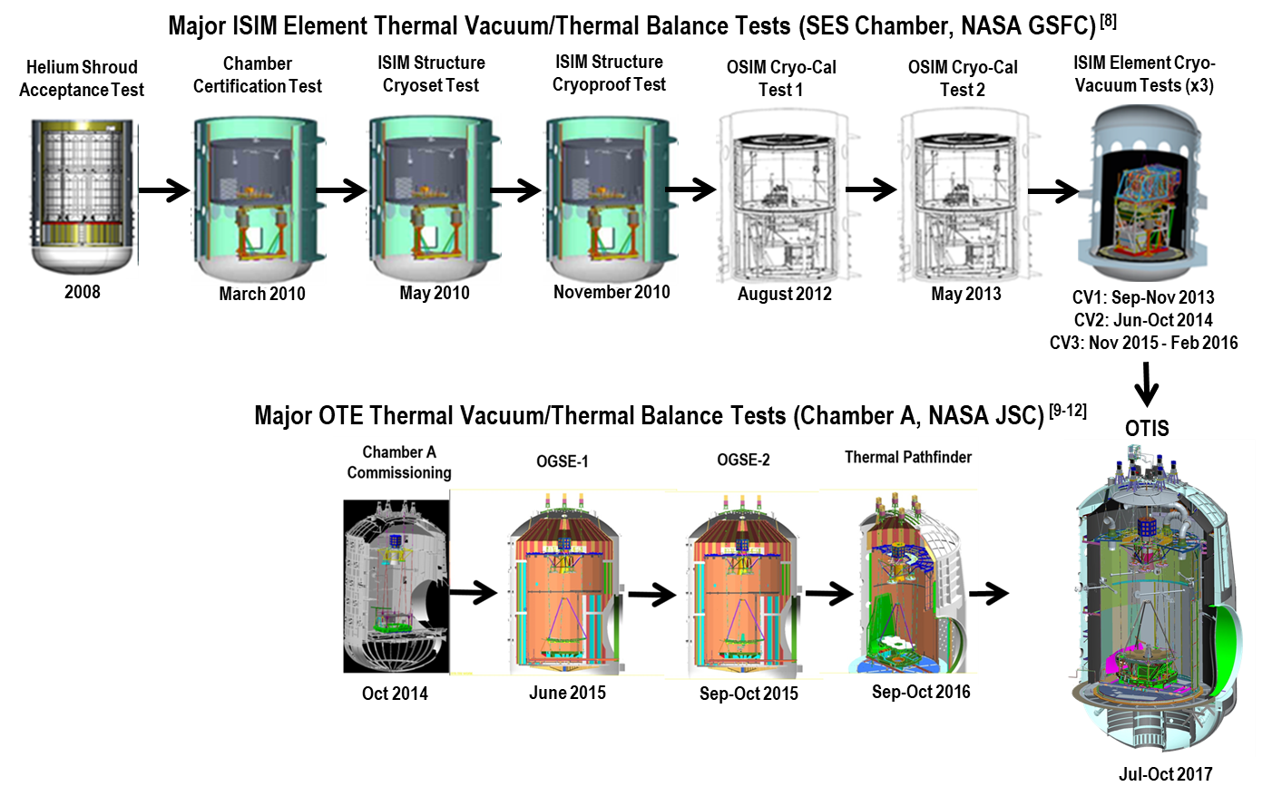
Risk Mitigation
Lesson Applied: Develop a test plan that burns down risk rigorously
  The JWST CV development testing program and the demonstration of successful operation of all GSE metrology systems prior to the final flight test was a huge risk reduction for OTIS
  Early identification of test challenges provided time to implement solutions
  Test preparation in documents, procedures, emergency planning, and training paid off well with OTIS
Image Sources: NASA/JWST/K.Yamg
Notes:
The final lesson applied from precursor tests to the OTIS CV test was to develop a test plan that burns down risk before subjecting your payload to environmental testing. The success of the JWST cryogenic vacuum development testing program was contingent upon two major test campaigns: one, the ISIM CV test campaign which demonstrated that all flight instruments functioned as-intended within their intended flight environment before being integrated to OTIS; and two, the demonstration that all GSE metrology systems could operate as intended in their test environment before the payload was brought in. This provided a huge risk reduction, and gave the project confidence that a test of the magnitude and complexity of OTIS CV could be executed. These tests also identified early-on the challenges that we would encounter with OTIS CV, and gave us time to implement solutions. Our extensive preparation in documents, procedures, emergency planning, and training paid off well with the successful cryogenic vacuum testing of the most complex space telescope ever built.

Slide 28
Part IV Summary
In this lecture, we covered the “lessons learned” from the OTIS CV test
  Test thermal analysis
  Flight and test hardware
  Test planning and management
Thank you for your interest and attention!
Notes:
In this lecture, we covered the lessons learned from the OTIS CV test in three major categories: test thermal analysis, flight and test hardware, and test planning and management. This concludes the JWST OTIS CV test lecture series. We as part of the OTIS Thermal team hope you have learned a bit about how we designed and executed the OTIS CV test, and the many challenges we overcame to make it a success. We hope that for future large cryogenic missions, this lecture will serve as a guideline for planning system-level thermal vacuum tests. Thank you so much for your interest and attention!

Slide 29
Acknowledgements
Thank you to the entire OTIS CV test team for your countless hours of hard work and sacrifice to ensure a successful test at NASA JSC, especially in the face of extraordinary events such as Hurricane Harvey
Special thanks go to the following people for their invaluable contributions to the thermal team
ATA Aerospace Tamara O’Connell Carl Reis Ball Aerospace Randy Franck Pamela Brinckerhoff Rusty Schweickart Denny Teusch Lentech, Inc. Wes Ousley William Chang Angelique Davis Theodore Michalek Chuen Or | Energy Solutions International, LLC Paul Cleveland Christopher May Genesis Engineering Solutions, Inc. William Burt Brian Comber Danilo Tagle L3 Harris Keith Havey Dwight Cooke Jesse Huguet Clint Travis Mark Waldman | NASA Johnson Space Center Facilities Team Northrop Grumman Perry Knollenberg Joshua Adamson George Harpole Peter Munther John Pohner Harvard-Smithsonian Center for Astrophysics Sang Park Stinger Ghaffarian Technologies, Inc. Dharmendra Patel | NASA Goddard Space Flight Center Stuart Glazer Christine Cottingham Lee Feinberg Russell Harrison John Johnston Randy Kimble Mark Kobel Juli Lander Doug McGuffey Alan Sherman Shaun Thomson Regis Venti Mark Voyton
Notes:
I’d like to acknowledge the entire OTIS CV test team for their countless hours of hard work and sacrifice to make our test a success. My appreciation extends to those people listed here who made invaluable contributions to the thermal design, analysis, and execution of the test. I would also like to thank Stuart Glazer, Brian Comber, Bill Burt, Wes Ousley, Perry Knollenberg, Shaun Thomson, Keith Havey, Randy Franck, Lee Feinberg, Carl Reis, Mark Voyton, and Juli Lander for their leadership during the OTIS CV test, and specifically Stuart Glazer, Brian Comber, Randy Franck, Keith Havey, and Jesse Huguet for their diligent review of the content in this lecture series.
Finally, I’d like to thank Daniel Nguyen at NASA Goddard Space Flight Center, Ruth Amundsen at NASA Langley Research Center, and Steve Rickman at NASA Johnson Space Center for giving me the opportunity to create this lecture series for the NESC Academy. It has certainly been a privilege to be able to share this content on the JWST OTIS CV test with all of you.

Slide 30
Reference: Acronyms
Acronym | Definition | Acronym | Definition
AOS | Aft Optical System | ESA | European Space Agency
ACF | Auto-Collimating Flat | FGS | Fine Guidance Sensor
ADIR | Aft Deployable ISIM Radiator | FIR | Fixed ISIM Radiator
ASPA | Aft Optical System Source Plate Assembly | FPA | Focal Plane Arrays
BP | Back Plane | FSM | Fine Steering Mirror
BSF | Backplane Support Fixture | GSE | Ground Support Equipment
CoCOA | Center of Curvature Optical Assembly | GSFC | NASA Goddard Space Flight Center
CPP | Cryo-Pumping Panels, cold panels between the Helium and LN2 shrouds at NASA JSC | HOSS | Hardpoint and Offload Support Structure
CSA | Canadian Space Agency | IEC | ISIM Electronics Compartment
CTE | Coefficient of thermal expansion | IR | Infrared
CV | Cryogenic Vacuum | ISIM | Integrated Science Instrument Module, which contains the Science Instruments (SIs)
ΔT, Δt | Change in temperature; change in time | JSC | NASA Johnson Space Center
DTA | Deployable Tower Assembly | JWST | James Webb Space Telescope
DSERS | Deep Space Environment Radiative Sink | K | Kelvin
EC | European Consortium | L&Cs | Limits and Constraints
Notes:
Here is a list of the acronyms that were used in this and all previous JWST OTIS CV lectures.

Slide 31
Reference: Acronyms
Acronym | Definition | Acronym | Definition
L5 | Layer 5 Sunshield simulator | POM | Instrument Pick-Off Mirror
LN2, N2 | Liquid Nitrogen; Gaseous Nitrogen | PM | Primary Mirror(s)
LRM | Launch Release Mechanism | PMSA | Primary Mirror Segment Assembly
MIRI | Mid-Infrared Instrument | PMBSS | Primary Mirror Backplane Support Structure (BSF + BP)
MLI | Multi-Layer Insulation | Q | Heat
NASA | National Aeronautics and Space Administration | SI | Science Instrument
NGAS | Northrop Grumman Aerospace Systems | SINDA | Systems Improved Numerical Differential Analyzer modeling tool
NIRCam | Near-Infrared Camera Instrument | SM | Secondary Mirror
NIRSpec | Near-Infrared Spectrograph Instrument | SMA | Secondary Mirror Assembly
OA | Optical Assembly | SMSS | Secondary Mirror Support Structure
OGSE | Optical Ground Support Equipment, a series of pre-OTIS Optical pathfinder tests | SVTS | Space Vehicle thermal Simulator
OTE | Optical Telescope Element | TM | Tertiary Mirror
OTIS | Optical Telescope Element plus Integrated Science Instrument Module (OTE + ISIM) | TPF | Thermal Pathfinder test
PG | PhotoGrammetry cameras | W | Watt(s)
Notes:
This is the second page of acronyms.

Slide 32
References
Park, S. et al. “Augmented Method to Improve Thermal Data for the Figure Drift Thermal Distortion Predictions of the JWST OTIS Cryogenic Vacuum Test.” Proceedings of SPIE. 10374, Optical Modeling and Performance Predictions IX, 1037406. 2017.
Kimble, R. et al. “James Webb Space Telescope (JWST) optical telescope element and integrated science instrument module (OTIS) cryogenic test program and results.” Proceedings of SPIE. 10698, Space Telescopes and Instrumentation 2018: Infrared and Millimeter Wave, 1069805. 24 July 2018.
“Webb’s Mirrors.” NASA’s James Webb Space Telescope Flickr Account. https://www.flickr.com/photos/nasawebbtelescope/5891526008
Park, S., Brinckerhoff, P., Franck, R., Schweickart, R., Thomson, S., Burt, W., and Ousley, W. “Successful Completion of the JWST OGSE2 Cryogenic Test at JSC Chamber-A while Managing Numerous Challenges.” 46th International Conference on Environmental Systems. Vienna, Austria, July 13-17, 2016.
Notes:
Here is a list of references used in this lecture. On behalf of the OTIS CV test team, thanks again for your attention. We hope it has been a valuable experience.

