Slide 1
Facilitating and not Interfering with
Work System Resilience with New Technology
Emily S. Patterson, PhD May 10, 2022

Slide 2
acknowledgments
This work was supported by The MITRE Corporation, NASA Johnson and the Veteran’s Health Administration. The views, opinions and/or findings are those of the author and not necessarily MITRE, NASA, or the VA.
Slides from MITRE are approved for public release and unlimited distribution(22-0560).

Slide 3

My research themes
Health Information Technology
  Alarms, alerts, reminders
  Workarounds
  Evaluate resilience, usefulness, usability
  Embedded automation
Communication
  Handovers
  Auditory environment
  Visual displays
  Whiteboards

Slide 4
Guiding Question
In high-consequence work settings and in situations with challenging conditions,
    what factors affect system resilience
    when implementing new technology?

Slide 5
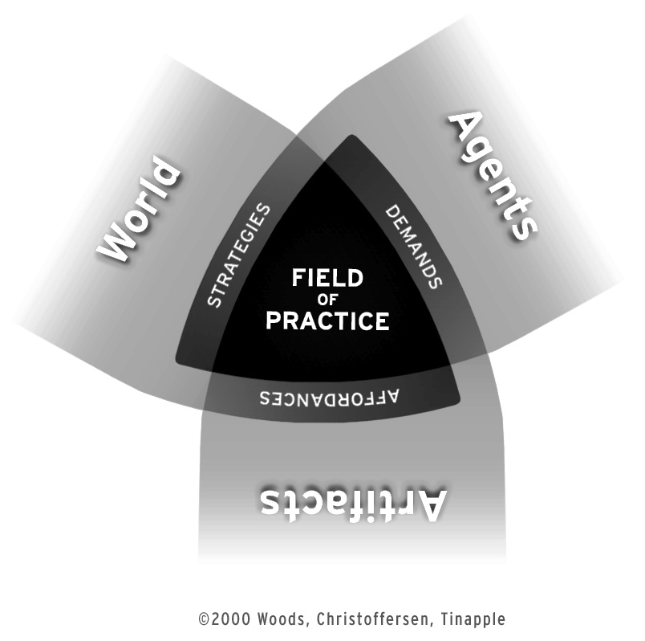
Human factors: coping with complexity
With Experts
In Challenging Scenarios
Supported by Artifacts
Cognitive Triad

Slide 6
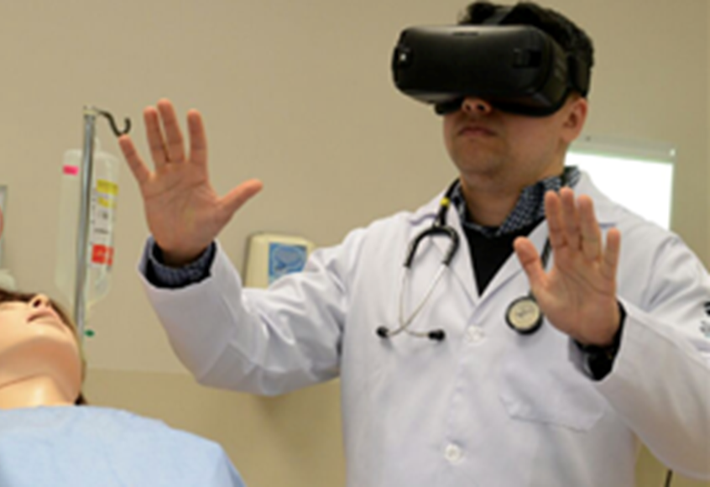
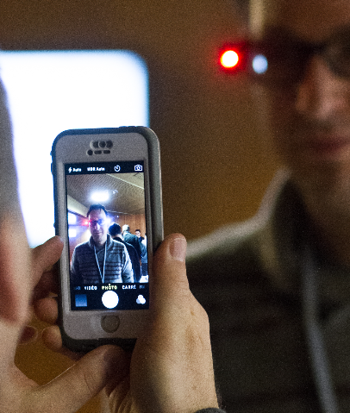
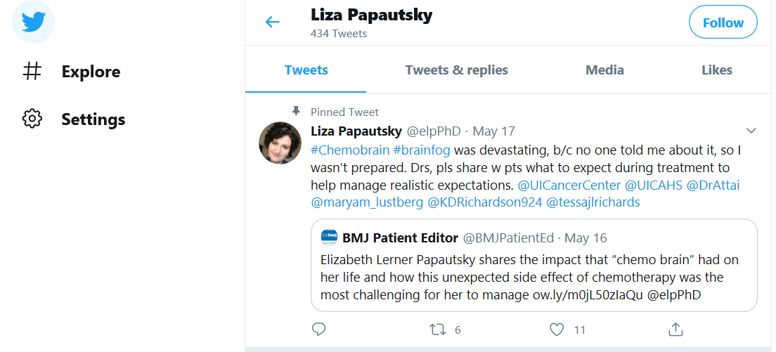
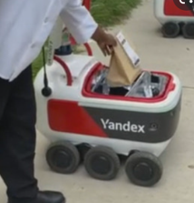
Advances in New technology
Portable Devices
Networked Communications
Augmented Reality
Embedded AI/Automation

Slide 7
System resilience
A system is resilient if it can:
adjust its functioning
prior to, during, or following events
    (changes, disturbances, and opportunities), and thereby
sustain required operations
  under both expected and unexpected conditions
Erik Hollnagel, 2016
https://erikhollnagel.com/ideas/resilience-engineering.html#:~:text=In%20the%20fourth%20book%20(Resilience,under%20both%20expected%20and%20unexpected

Slide 8
System resilience & tech design/implementation
How new technology is designed and implemented influences the effort needed to maintain resilience by a work system under expected and unexpected conditions
In other words, assessing whether resilience-centered design and implementation requirements are met can facilitate resilience, and therefore reduce the likelihood of unfortunate outcomes
Emily Patterson, May 10, 2022

Slide 9
Cognitive work & problem representation
How a problem is represented influences the cognitive work needed to solve the problem, either improving or degrading performance...
In other words, the same problem, from a formal description, when represented differently, can lead to different cognitive work, and therefore different levels of performance
David Woods, 1997
Human Factors and Ergonomics Society president

Slide 10
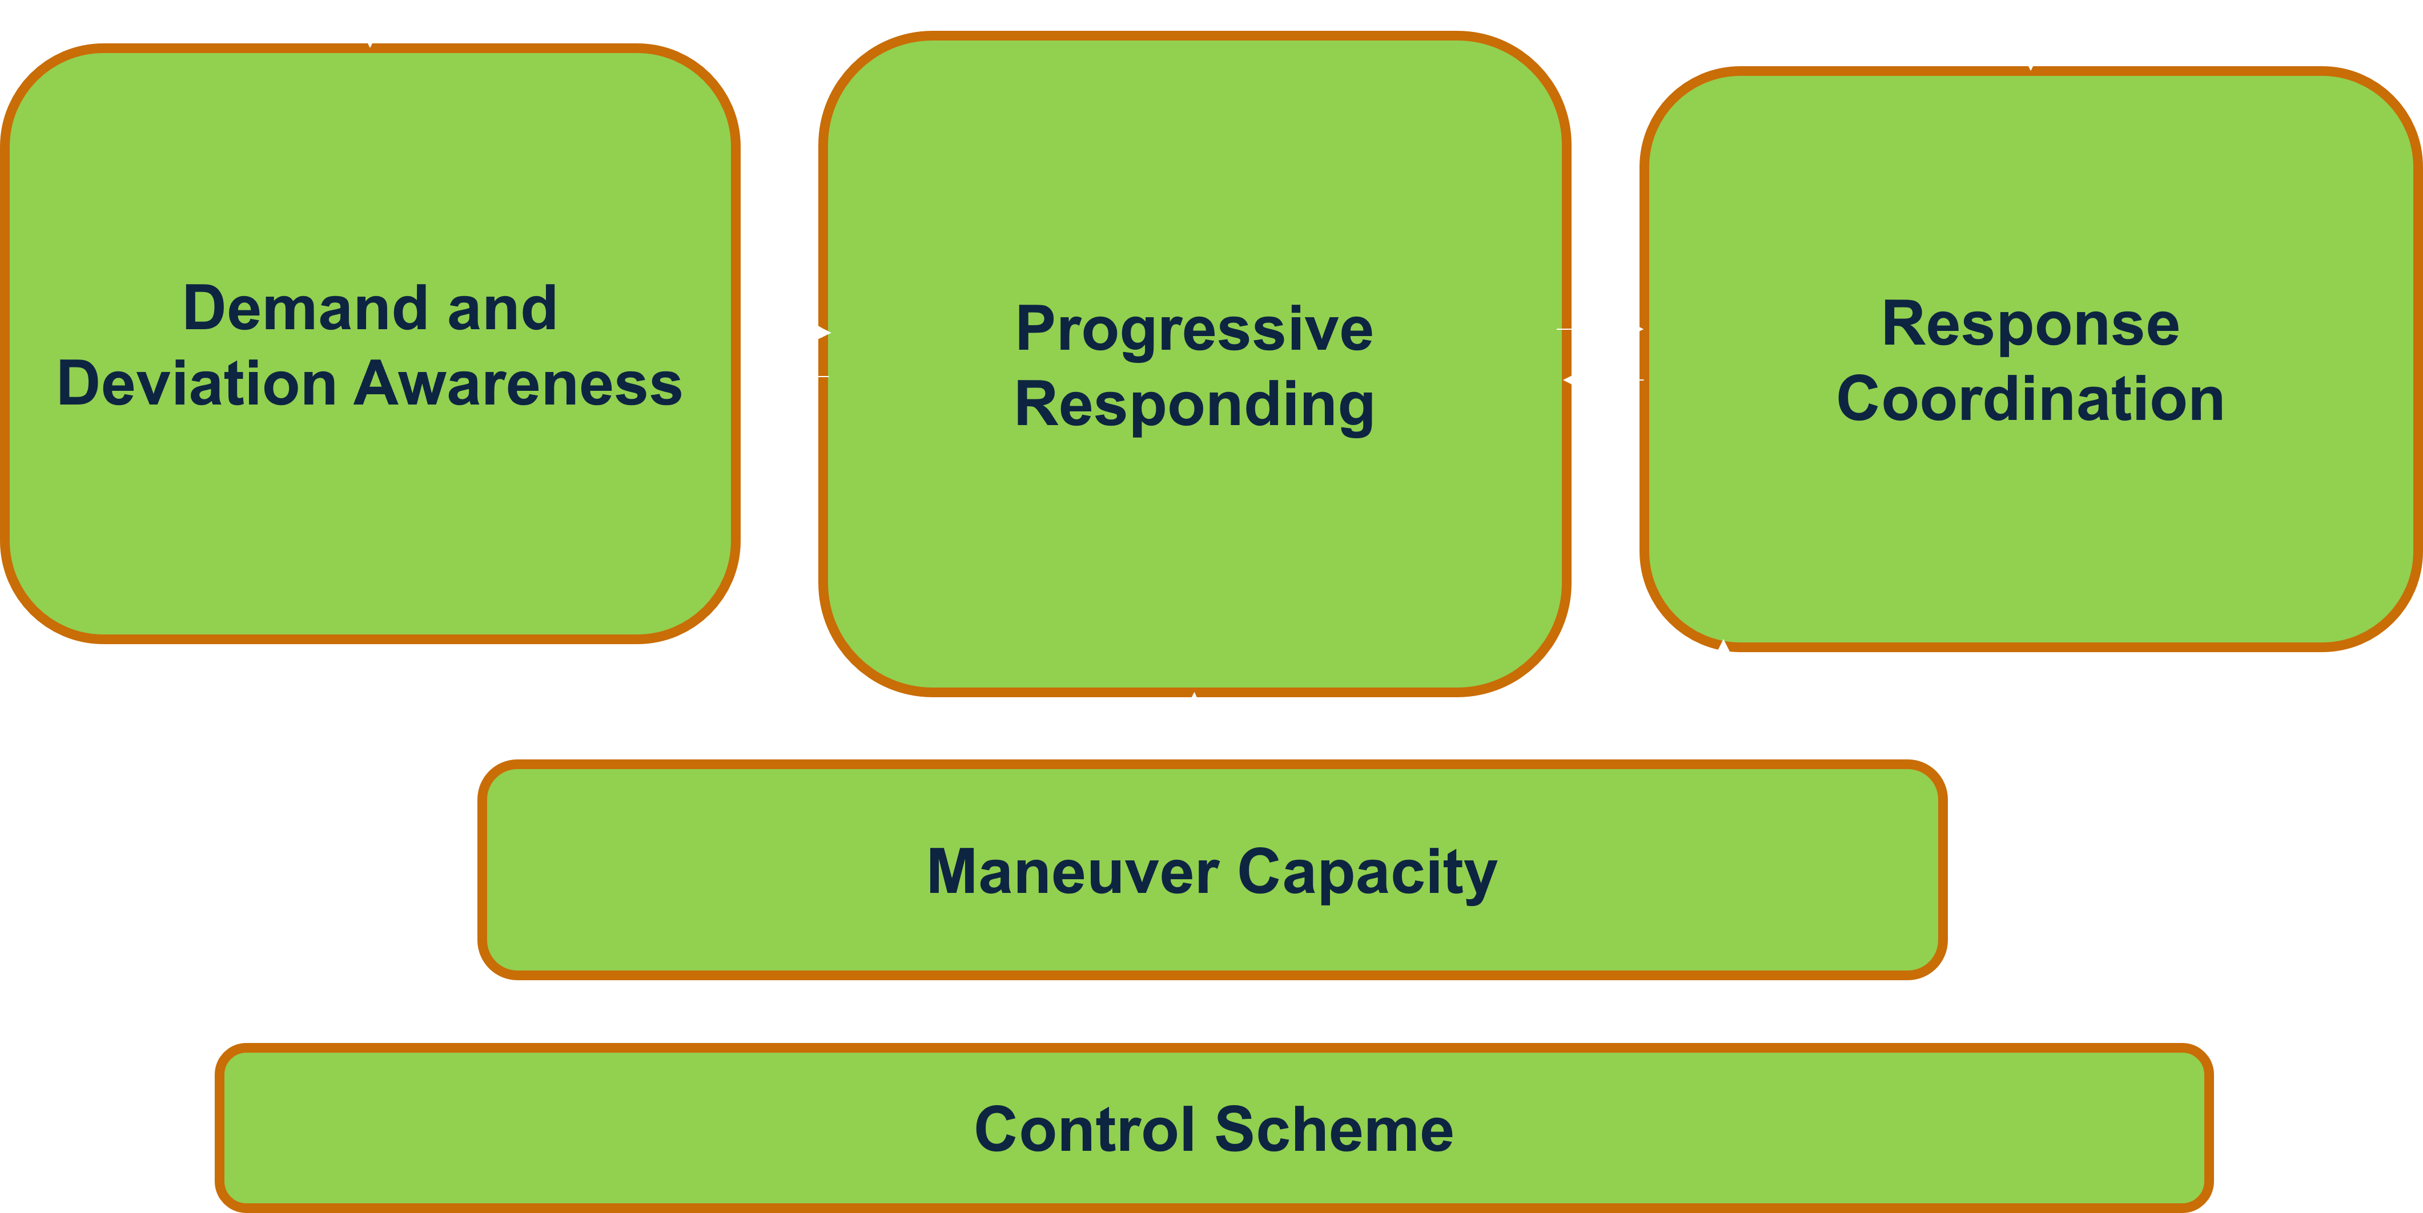
The TRUSTS Framework and Complementary Technology Requirements
Stable, Routine Conditions
Complex Conditions: Unpredictability, Emergence, Nonroutine
Rules, Procedures, Repetitive Processes
TRUSTS Framework of Work System Resilience Sources
Capabilities of Individual System Entities
Human-Machine Teaming Requirements (Observability,
Directability, etc.)
Macro-cognition
Initiative
© 2022 THE MITRE CORPORATION. ALL RIGHTS RESERVED
10

Slide 11
Transform with Resilience during Upgrades to Socio-Technical Systems (TRUSTS) Framework of Work-System Resilience Sources
Demand and Deviation Awareness
Progressive Responding
Response Coordination
Maneuver Capacity
Control Scheme
© 2022 THE MITRE CORPORATION. ALL RIGHTS RESERVED
11

Slide 12
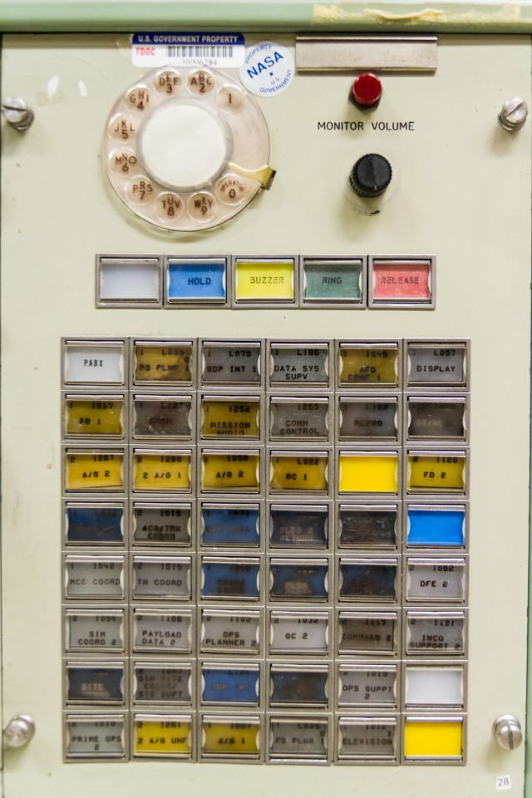
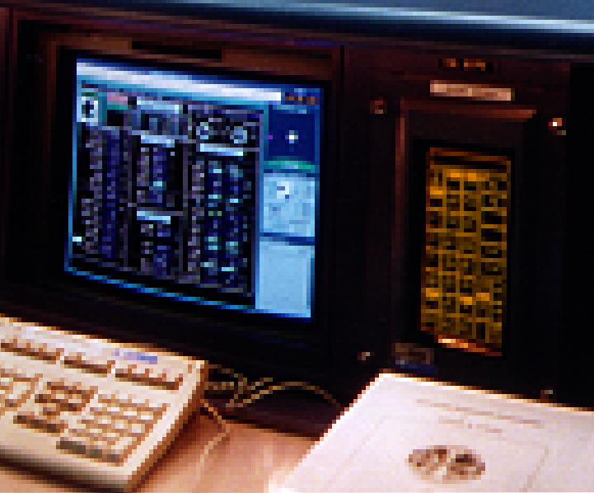
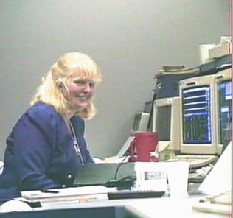
Resilience sources example: voice loops during sts-76

Slide 13
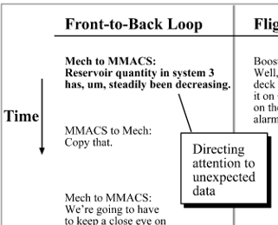


Deviation awareness: back room mech directs attention
Back room support staff (Mechanical Engineer 1) tells front room supervisor (MMACS) about leak in hydraulic system powered by APU 3

Slide 14
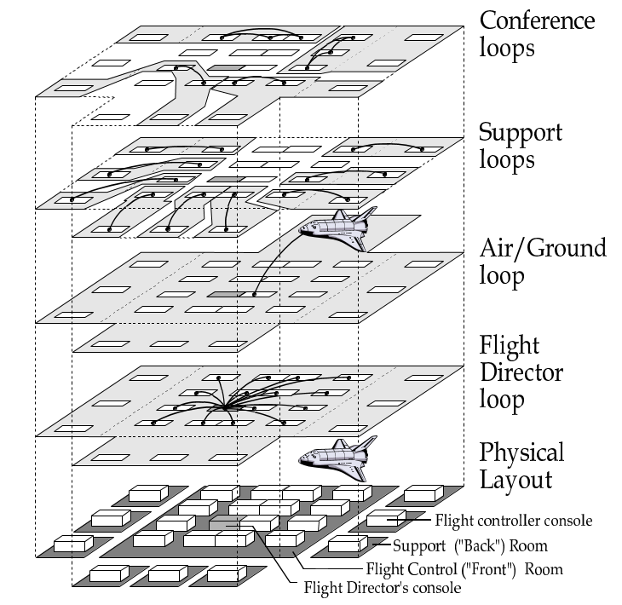
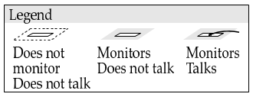
…and everyone hears about it
Work on 1 Support Loop
Update Flight Director
Monitor Air/Ground
Monitor ~5 others

Slide 15
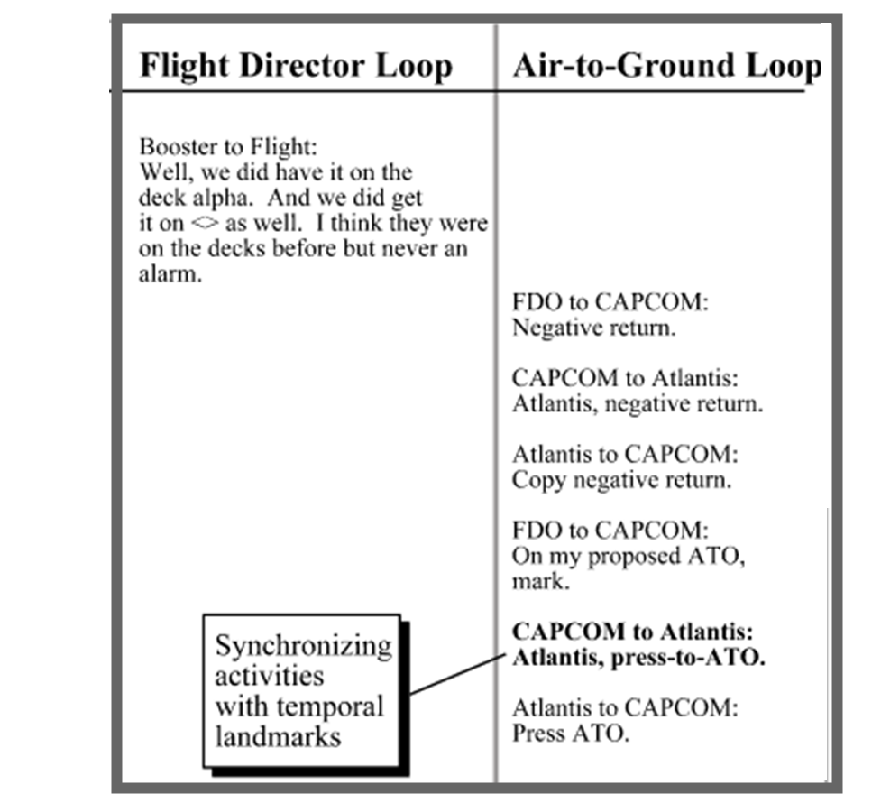
Demand & deviation awareness: voice loops support knowing…
Landmark events (MECO)
Agreement to proceed (Go)
Unexpected events (Leak)
  Emerging changes to plans (Mir docking)
  Level of certainty (Leak rate)

Slide 16
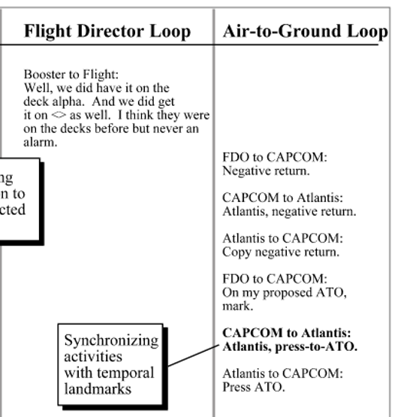
Response coordination: voice loops support…
Synchronizing activities with temporal landmarks
Role-based communication
Identifying when someone can be interrupted
Continuity across shift changes

Slide 17
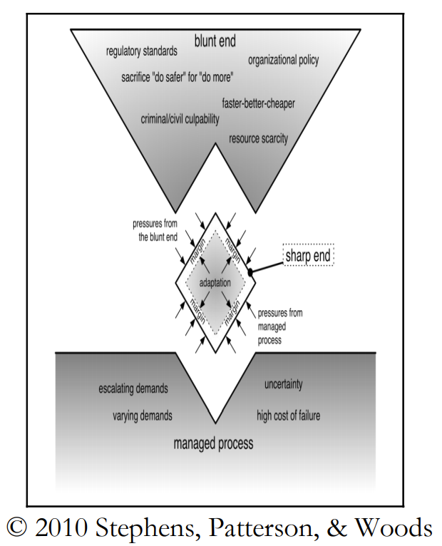
Maneuver capacity: voice loops support…
Relaxing top-down constraints to
  Deviate from the plan
  Request permission
  Have volunteers help
  Set up ad hoc teams
Experts coordinating to employ alternative approaches

Slide 18
TRUSTS Framework of Work System Resilience Sources
Demand and Deviation Awareness
Progressive Responding
Response Coordination
Early Action, Actions that increase Maneuver Capacity
Prespecified Contingency
and Crisis Plans, Templates
Dynamic System-Wide View of:
Support for response evalua-tion (via what-iffing, simulation)
Resource Brokers | Reciprocity | Open Comms where Competition
Threats
Deviations from Routine
Progressive Feedback
Shared Awareness of Competing Demands and Priorities
Approaching/Crossed Thresholds
Tactical
Strategic
Multi-modal bidirectional info flow
Status Changes
Situation Recognition
Fixation Avoidance
Baseline plans and agreements
Maneuver Capacity
Coordinated Local Adaptations
Flexibility of Action and Resource Employment
Ability to Process Range of Relevant Variables
Variety and Flexibility of Connections
Control Scheme:
Telescoping Focus
Local Control
Nested, Overlapping Layers
© 2022 THE MITRE CORPORATION. ALL RIGHTS RESERVED
18

Slide 19
Approach
1. Develop a framework of sources of resilience in high-consequence work systems |  | 2. Integrate the framework into the processes of technology development
Tabletop Exercise (TTX) Technology-Assessment Tool
TRUSTS* Framework
Work-System Resilience Sources Operationalized
Resilience-Aware Iterative Development
Resilient-Mission Engineering
*TRUSTS – Transform with Resilience during Upgrades to Socio-Technical Systems
Work System Resilience Evaluation
© 2022 THE MITRE CORPORATION. ALL RIGHTS RESERVED

Slide 20
summary
A resilient system adjusts around events and sustains operations under unexpected conditions
New technology facilitates resilience by:
  Shared awareness of deviations & demands
  Not overcommitting to an ongoing course of action
  Lightweight coordination across shifts, roles, epochs
  Relaxing constraints to increase maneuver capacity
  Embedded loose guidance as resources for action

Slide 21
references
Patterson, E. S., Watts-Perotti, J., & Woods, D. D. (1999). Voice loops as coordination aids in space shuttle mission control. Computer Supported Cooperative Work (CSCW), 8(4), 353-371.
Patterson, E. S., Watts-Perotti, J., & Woods, D. D. (2017). Voice loops: Engineering overhearing to aid coordination. In Improving Healthcare Team Communication (pp. 79-95). CRC Press.
Patterson, E. S., Watts-Perotti, J., & Woods, D. D. (2008). Voice Loops: Engineering Overhearing. Improving healthcare team communication: Building on lessons from aviation and aerospace, 79.
Patterson, E. S. (2007). Communication strategies from high-reliability organizations: translation is hard work. Annals of surgery, 245(2), 170.
Militello, L. G., Patterson, E. S., Bowman, L., & Wears, R. (2007). Information flow during crisis management: challenges to coordination in the emergency operations center. Cognition, Technology & Work, 9(1), 25-31.
Woods, D. D., & Patterson, E. S. (2001). How unexpected events produce an escalation of cognitive and coordinative demands. PA Hancock, & PA Desmond, Stress, workload, and fatigue. Mahwah, NJ: L. Erlbaum.

Slide 22
references
Patterson, E. S. (2018). Workarounds to intended use of health information technology: a narrative review of the human factors engineering literature. Human factors, 60(3), 281-292.
Patterson, E. S., Woods, D. D., Cook, R. I., & Render, M. L. (2007). Collaborative cross-checking to enhance resilience. Cognition, Technology & Work, 9(3), 155-162.
Watts-Perotti, J., & Woods, D. D. (2007). How anomaly response is distributed across functionally distinct teams in space shuttle mission control. Journal of cognitive engineering and decision making, 1(4), 405-433.
Watts, J. C., Woods, D. D., Corban, J. M., Patterson, E. S., Kerr, R. L., & Hicks, L. C. (1996, November). Voice loops as cooperative aids in space shuttle mission control. In Proceedings of the 1996 ACM conference on Computer supported cooperative work (pp. 48-56).
Watts-Perotti, J., & Woods, D. D. (2009). Cooperative advocacy: an approach for integrating diverse perspectives in anomaly response. Computer Supported Cooperative Work (CSCW), 18(2), 175-198.

