Slide 1
‘ORAL HISTORY’ of THERMAL (1960 – mid 1970s)
“HISTORY MATTERS”
Ed Powers – micro bio
Incredible time to be at Goddard
Agenda items with details and War stories
How we ‘invented’ the spacecraft thermal design concept, based on the SPACE PHYSICS Environment ☺
Truth Squad
Joe Skladany, Archie Fitzkee, Norm Ackerman, Jim Heaney, and Ted Michalek

Slide 2
AGENDA
‘HISTORIC’ OVERVIEW- the very early days (early 60s); Importance of the early design philosophy; Relevance to today? The in-house missions were mostly (space science) explorers.
CAPABILITIES OF THE ‘THERMOPHYSICS’ BRANCH –
Thermal design
Coatings –thin films, vapor deposition, paints, Ag Teflon
Facilities – solar simulation; large TV chamber, small chambers
Software – punch cards, 100 nodes, IBM computer at Goddard occupied the basement in Building 1
SMALL COMPUTER MODEL LEGACY
Some specifics regarding ‘spin stabilized spacecraft’
Evolution in mid/late 1960s; insular to national and ‘international’
Technology - louvers, heat pipes, Ag Teflon
Observatories – in-house and Applications Technology Satellite (ATS-6)
Observatory thermal designs developed; ‘off the shelf’ spacecraft
War stories – Highjacking Engineers (Exposing the villains)
LESSONS LEARNED – small models, enhance the tool- box, branch reviews, better documented results, ‘test as you fly’,
EUROPEAN SPACE PROGRAM was emerging. Teams were co-located at Goddard for extensive training. French, British, Italian, Spanish, …even in the mid 1960s. Then came ITAR; UGH

Slide 3
OVERALL HISTORICAL PERSPECTIVE/SCIENCE MISSIONS- THE ‘SIXTIES’+
IMP (Interplanetary Monitoring Platform) was a series of NASA probes, managed by the Goddard Space Flight Center, aimed at investigating plasma (ionized gas) and magnetic fields in interplanetary space. The placement of IMPs in a variety of solar and Earth orbits enabled the study of spatial and temporal relationships of geophysical and interplanetary phenomena simultaneously by several spacecraft. The IMP network also provided a crucial early warning of solar flare activity for Apollo manned missions that ventured beyond the Van Allen belts. IMPs were a subprogram of the Explorer series and also designated Explorers 18, 21, 28, 33, 34, 35, 41, 43, 47, and 50
IN-HOUSE EXPLORER TYPE MISSIONS – 10 in 10 YEARS, plus others
SERB – WHAT GODDARD WAS CAPABLE OF DOING!!! 7 weeks from go ahead to launch

Slide 4
A LITTLE DEEPER INTO AN OVERVIEW OF THE PERIOD
Very little precedent existed in the early 60s. ‘Thermal Designs’ were based on ‘Space Physics’. Goddard Thermal had little contact with the outside world.
Thermophysics Branch had the responsibility for the end-to-end
thermal design, coatings development and implementation/application, optical measurements, and thermal balance development and verification testing. Bob Kidwell, an electrical engineer, was the ‘creator’ and mentor for the thermal design group.
Thermal design capability and accomplishments became one of the best during this era of the early 1970s; coatings development, branch testing capabilities, including solar simulation, were the best in the business.
Specific ‘technology’ examples - Silver Teflon story, louvers story, MLI, heat pipe initiation story.
However, very little was documented.

Slide 5
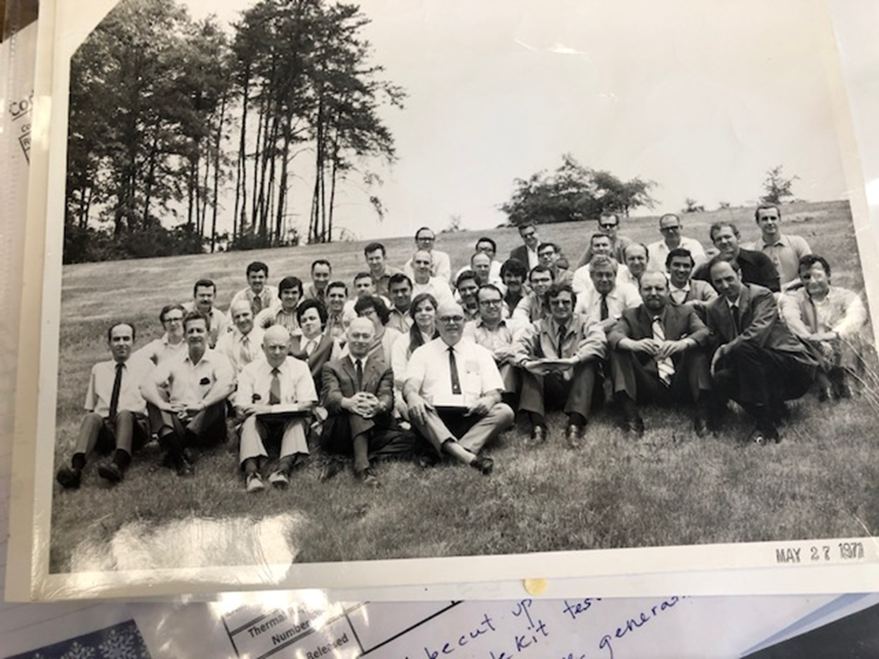
THE ‘GANG’
Our leader and mentor was Bob Kidwell, conceived the early designs, transferred from NRL in 1960. Bob liked electrical networks to simulate ‘thermal’.
I was the 4th member of the thermal group arriving in March 1962, along with Jim Heaney. Mike Coyle and Joe Skladany were there since 1960. (The following year, Dick Hoffman, Norm Ackerman (future Branch Head, longest duration), Archie Fitzkee, Stan Ollendorf, Nelson Hyman, … joined.)
The thermal design work force expanded greatly over the next decade. (Dennis Hewitt, future Branch Head and Ted Michalek, future Chief Engineer, - 1970) Both were hijacked from the Mechanical Branch (mini ‘war story’), Al Sherman, future Director of Engineering joined in 1971.

Slide 6
THERE WERE ‘NO’ CONTRACTORS IN THE EARLY DAYS; All design work was performed by civil servants, usually one engineer per mission. There were no GEVS or GOLD RULES. All aspects of the design were the responsibility of the ‘PDL’. (Proliferation of acronyms were a generation away. ☺)
The Thermophysics Branch also had the responsibility for coatings, measurements, and TVAC test facilities. All aspects of thermal systems were in one branch, located in Goddard Building 4, in the beginning, and up until (circa) 1973
Later on, facilities, coatings R&D, were very negatively impacted by management ’economizing’ and restructuring; the post Apollo effect.

Slide 7
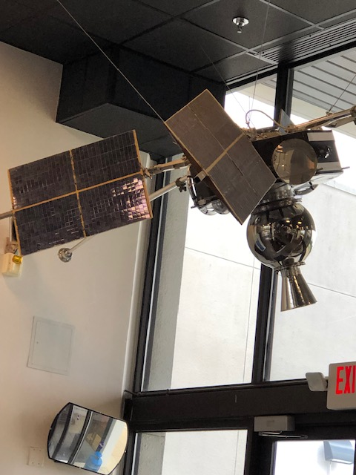
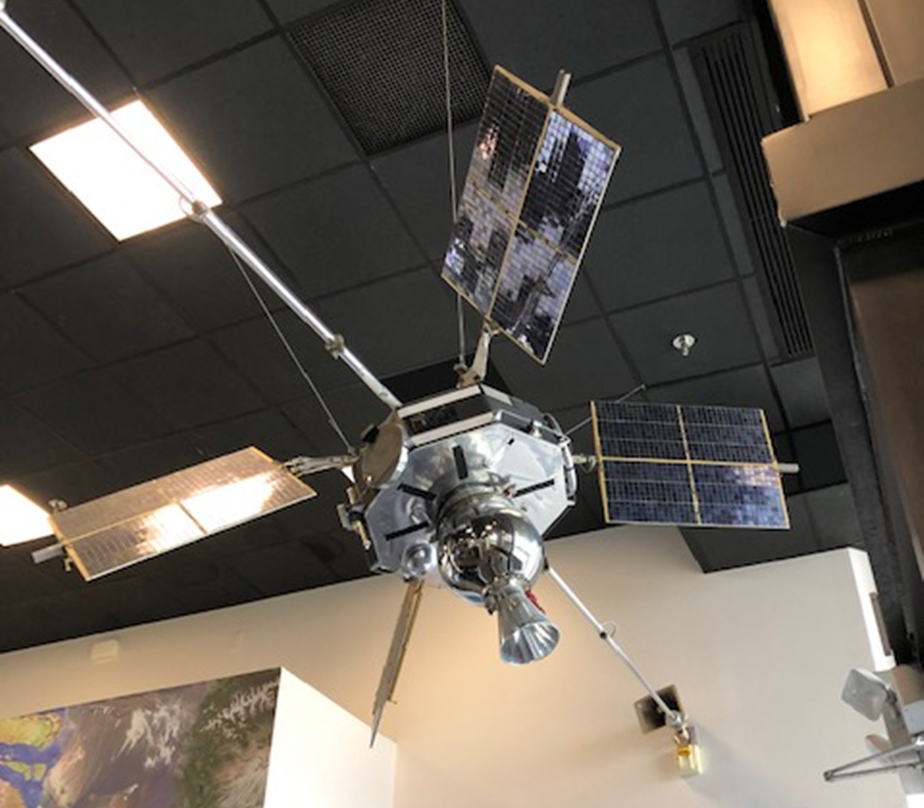
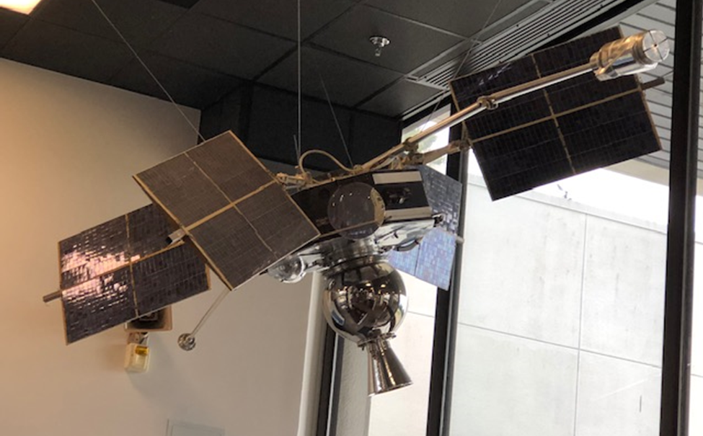
NOW, SOME IMPORTANT SPECIFICS
IN THE BEGINNING, THE SPACECRAFT THERMAL DESIGNS WERE SUN DOMINATED. WHAT DOES ‘SUN DOMINATED’ MEAN? Energy balance based largely on solar absorbed rather than ‘internal’ power. Therefore, surface coatings were critical. Today, in most cases, we try to avoid the sun, like the plague, via MLI and radiator orientation.
Most of the missions were Explorer Class, roughly equivalent to small and medium class missions. They were Goddard in-house built spacecraft with instruments from the Goddard science community and many universities.
Spin stabilized spacecraft with solar paddles were common configurations. Power was at a premium; solar cell conversion was very inefficient by today’s standards. Therefore, since the solar absorbed is dominant in the design, accurate projected areas to sunlight, was critical.

Slide 8
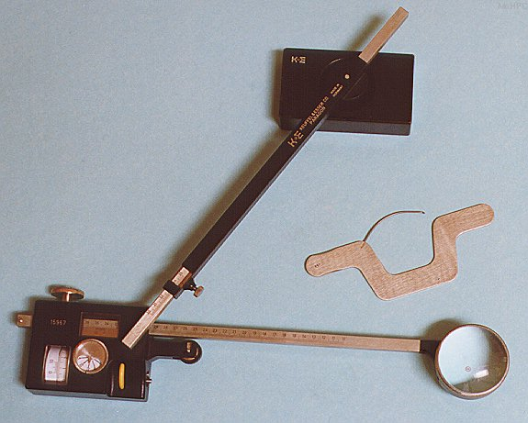
So how did we accurately measure the projected areas?
Enter the ‘planimeter’, and scale models of the spacecraft, which were photographed for all sun angles.(Again - photos of spinners with paddles.) Thermal usually had to ‘live’ with the configuration developed by mechanical, which was NOT kind to the thermal engineer. ‘Huge lesson to be learned’ Henry Hartley
Philosophy was to use available coatings; paints, VDA, VDG and thin (SiO) films. Why was that?
Stability of coating solar absorptance was sometimes an issue, especially the impact of contamination; not well understood at the time.
Anchored IMPS are significant examples. How to counteract the potential impact of contamination.

Slide 9
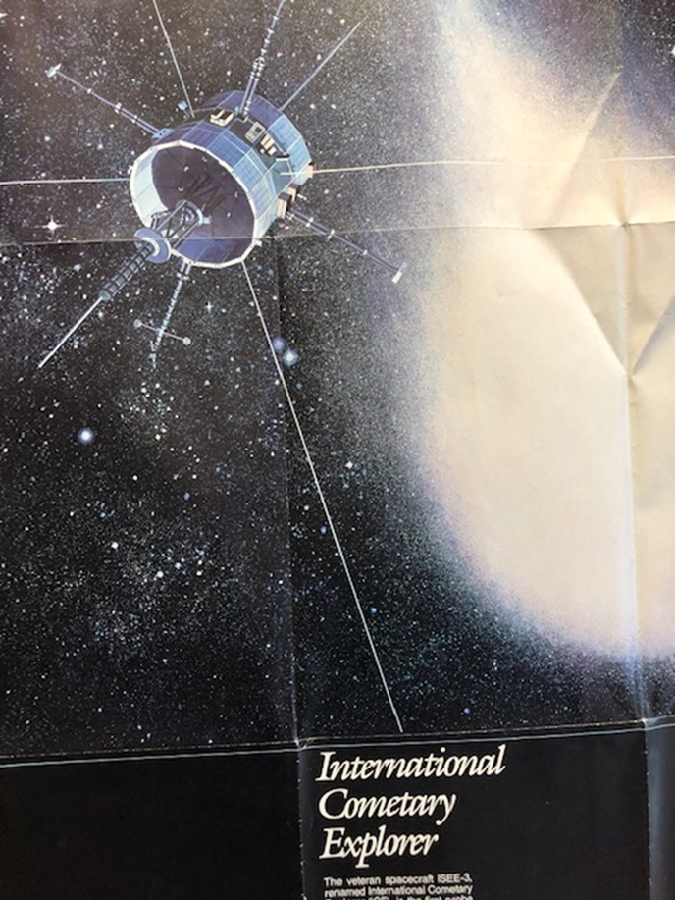
THERMAL BRANCH SPECIFICS
DESIGN CONFIGURATIONS ‘GRAVITATED’ TO ‘SPINNING CYLINDERS’ WITH BODY MOUNTED SOLAR ARRAYS. (ISEE AND MMS). VASTLY SIMPLER. WHY? (PHOTO OF INTERNATIONAL SUN EARTH EXPLORER, ISEE/ICE)
A black cylinder insulated on the ends will be 25C. Think of a s/c with body mounted solar cells; great heat sink, high energy balance, result is an average temperature of 25C. No paddle shadowing to worry about. Very reliable!
Some other items become 2nd nature to the thermal engineer as the math model was developed. Opposite sides of a cube, and adjacent sides all have a ‘geometric’ view factor = 0.2, or the following; black plate in space with MLI on the backside will be 120C; w/o MLI it will be 60C. A black sphere in sunlight will be 6C; etc.
Back to the flat plate in sunlight; white paint will allow it to run at room temperature, before it degrades.
SMALLER MATHEMATICAL MODELS, MANY, MANY FEWER NODES; BETTER UNDESTANDING OF VIEW FACTORS, RELATIVE IMPORTANCE OF COATINGS, HOW AND WHEN TO USE THEM…..

Slide 10
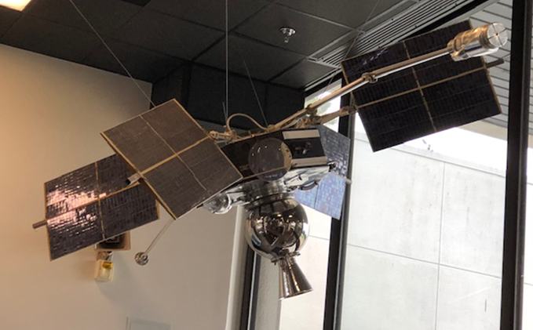

What would we do with an ‘IMP’ today’? Two possibilities.

Slide 11
COATINGS FACILITIES
The Thermal Branch facilities were state of the art for that era
The coatings facility was the best of its kind in the industry.
Jack Triolo/Jim Heaney were the ‘measurements’ experts as well as the developers of state-of-the-art thin film (SiOx) coatings,.
Bob Sheehy was the ‘innovator’, manager and architect of coatings application. He was the developer of Ag Teflon, was chosen to provide the coated sun visors for the astronauts etc.
Grace Miller arrived in the late 60s, as an expert on coatings applications, and is, to this day, as vital as ever. Contamination was not yet ‘discovered’. Jack Triolo became the czar.
Who developed the paint for the Statue of Liberty?
Coatings were ‘the’ critical thermal element during that era.

