Slide 1
7 Elements of Good Flight Rationale
Commercial Crew Program Training
NESC Academy
December 7, 2022
Stan Graves
AXIENT Subject Matter Expert

Slide 2
Introduction
I was Chief Engineer for the Space Shuttle RSRM from 1995 to 2005
Supported more than 50 Space Shuttle launches in Florida
Perhaps spent more time in front of the Mission Manage Team at Level I FRRs than anyone (we had a lot of technical issues, and the MMT Chair was leery about having solid rocket motors on manned space launch vehicles)
Purpose
Change culture from “sell management” on safe to fly versus “share the risk”
Change culture from being silent to one that fosters robust debate and discussion
Introduce the notion of “Normalization of Deviance”: the process by which hardware that does not meet design intent is accepted as “normal”.

Slide 3

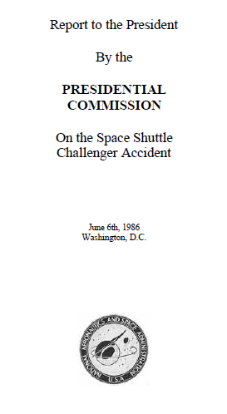
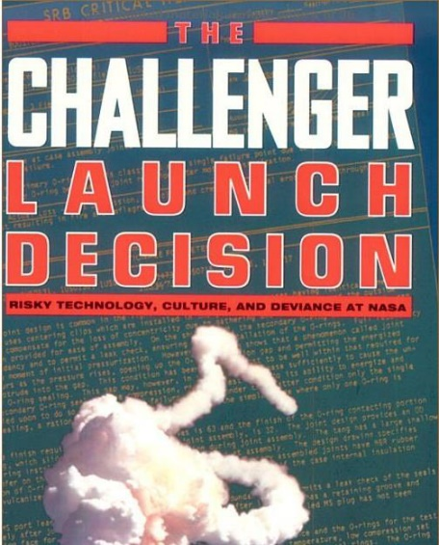
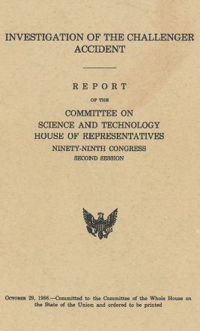
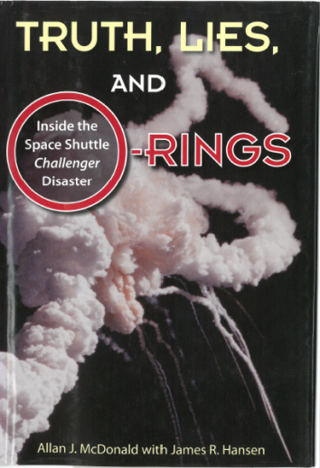
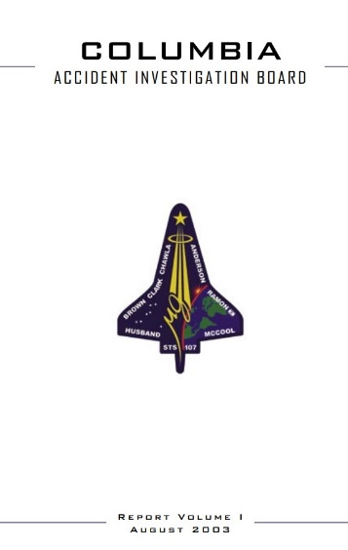
Challenger and Columbia Disasters
A Personal Retrospection*
* “Creating a World Class Safety Culture:
Lessons Learned from Launch Vehicle Failures and Industrial Accidents”
Stan Graves, Senior Director, Orbital ATK
64th JANNAF Propulsion Meeting, May 22, 2017

Slide 4
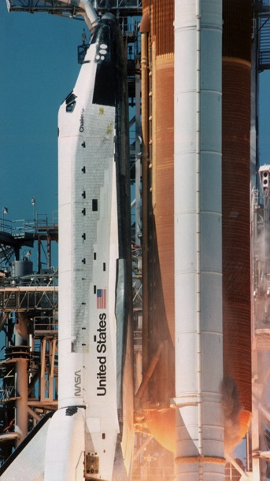
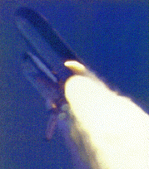
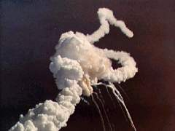
January 28, 1986 - Challenger Liftoff 11:38 a.m.
MAXIMUM DYNAMIC PRESSURE AND WIND SHEAR
Joint Leak Restarts
T + 59 Seconds
Explosion
T + 76 Seconds
Liftoff
Leak at T + 0.678 Seconds

Slide 5
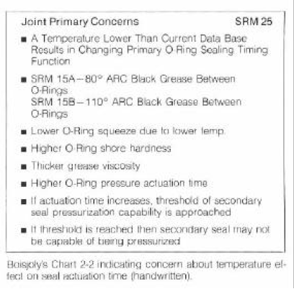
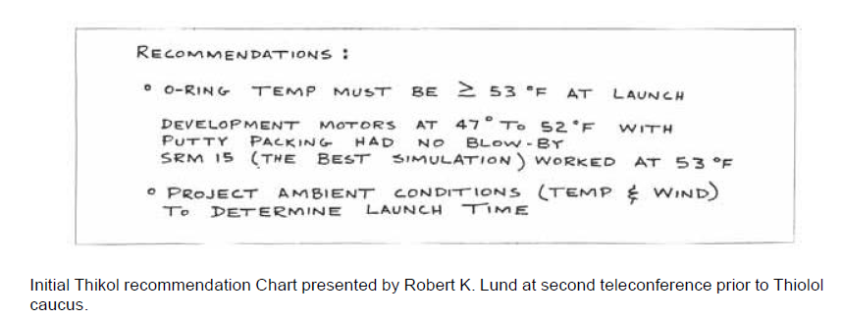
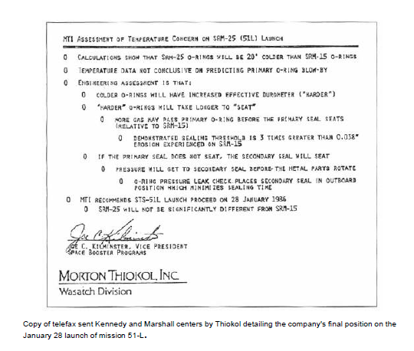
Evening of January 27, 1986
8:45 p.m.:O-ring temp must be ≥ 53 °F at launch
“My God, Thiokol, when do you want me to launch, next April?” Larry Mulloy
“Bob, take off your engineering hat and put on your management hat.” Jerry Mason.
“I’m appalled.”
George Hardy
11:00 p.m.: “MTI recommends STS-51L launch proceed on 28 January 1986”
How and why did this happen?
What would I have done if I had been the Engineering vice president in 1986?

Slide 6
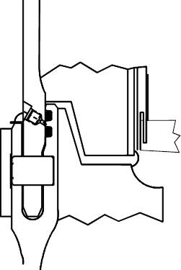
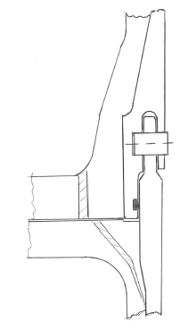
Field Joint Design Overview
Tang
Clevis
Dual O-rings
Gap Opening*
Single O-ring
Titan IIIC Clevis
Single O-ring
Tight insulation fit
Clevis facing down
Heater strip
Over 1,000 successful joints flown
Tight Insulation Fit
Primary
Secondary


Putty
Clevis
Putty
Shuttle SRM
Dual O-rings
Leak check port
Putty thermal barrier
Clevis facing up
No heater strip
Tang
Space Shuttle SRM clevis field joint design based on successful Titan IIIC design, circa 1972
Pressurized Joint:
Rotation Effect (exaggerated)
*Early finite element models used nodal constraints to attach the tang to the clevis. Improper radial constraints made the joint appear static.

Slide 7
Development Program 1973 - 1980
Contract Award 11/20/1973
DM-1 7/18/1977
Hydroburst Test 9/1977
DM-2 1/18/1978
DM-3 10/19/1978
DM-4 2/17/1979
QM-1 7/13/1979
QM-2 9/27/1979
QM-3 2/13/1980
Because the static test motors were assembled horizontally, Thiokol was worried that the assembled condition would result in a different configuration than the vertical assembly at Cape Kennedy
Visible gas path or blow holes in the putty were tamped tight in all static test motors via personnel entry into the motor bore
No hot gas impingement on the O-rings occurred
The September 1977 hydrotest data showed the field joints were rotating open to the point where the O-rings could lose contact with
the mating surfaces
Thiokol did not believe the test results were valid
This was the beginning of an 8-year debate over the magnitude of the joint gap opening
In October 1977, NASA expressed serious concerns that the field joint did not meet the design intent (dynamic sealing versus static sealing), and recommended a redesign
The design certification review completed in September 1980 concluded:
Design has adequate margins with updated design: Larger O-rings, thicker shims
The joint has been sufficiently verified with Titan IIIC history, lab scale tests, a full-scale structural test article, and 7 static tests

Slide 8
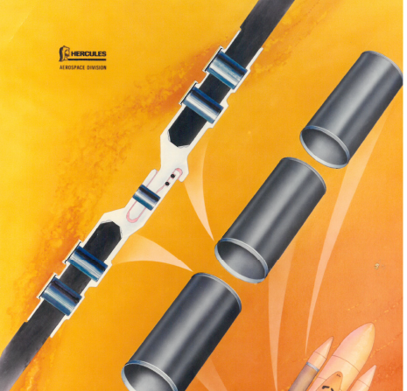
1981 - 1983
STS-1 4/12/1981
STS-2 11/12/1981 0.053 in. erosion at 70°F
STS-3 3/22/1982
STS-4 6/27/1982
DM-5 10/21/1982
STS-5 11/11/1982
QM-4 3/21/1983
STS-6 4/4/1982
STS-7 6/18/1983
STS-8 8/30/1983
STS-9 11/28/1983
STS-2: 0.053 in. primary O-ring erosion on right SRB aft field joint due to “blow holes” in the putty
Flight rationale
  Bounding case shows max possible erosion 0.090 in.
  Thermal environment is self-limiting – heating stops when free volume is filled
  O-ring with 0.095 in. simulated erosion sealed at 3,000 psi (3x design operating pressure)
  Design has adequate margin
May 1982: NASA starts development program for a graphite/epoxy Filament Wound Case (FWC)
Higher performance motors needed for DoD missions requiring polar orbits out of Vandenberg
Design includes a “capture feature” to limit joint rotation

Slide 9
1984 – May 1985
Note that each time the hardware performance got worse, it was accepted and became the new basis for “in-family”. Diane Vaughn called this “Normalization of Deviance”.
STS-41B 2/3/1984 Erosion at 57°F
STS-41C 4/6/1984 Heat affect at 63°F
STS-41D 8/30/1984 0.026 in. erosion at 70°F
STS-41G 10/5/1984
DM-6 (FWC) 10/25/1984
STS-51A 11/8/1984
STS-51C 1/24/1985 Blow-by in 2 joints with heat-affected secondary seal at 53°F
STS-51D 4/12/1985
STS-51B 4/29/1985
O-ring erosion recurs on STS-41B, 41C, and 41D
Flight rationale
  Observed erosion less than previous worse case (STS-2)
  Motors are in-family; erosion on future motors possible
  Bounding case shows max possible erosion 0.090 in.
  Thermal environment is self-limiting
  O-ring with 0.095 in. erosion sealed at 3,000 psi
  Design has adequate margin
“100-year Cold Spell” for three days prior to STS-51C
  Nighttime temperatures ranged 17 to 22 °F
  Launch delayed one day because temps were below freezing
  No one raised concerns about cold temperature effects
  It doesn’t get cold in Florida, right?
A new worse case event occurs on STS-51C - blow-by of 2 primary O-rings with heat- affected secondary O-ring
Flight rationale
  Cold temperature effects: putty becomes stiffer, O-ring becomes harder, O-ring squeeze reduced
  Low temperature enhances probability (STS-51C coldest in history)
  Erosion within experience base and within established margins
  Secondary seal in proper position via leak check
  Secondary O-ring is redundant
  STS-51D could exhibit the same behavior.
  Condition is not desirable, but is acceptable

Slide 10
June 1985 - January 1986
DM-7 (FWC) 5/9/1985
STS-51G 6/17/1985
STS-51F 7/29/1985
STS-51I 8/27/1985
STS-51J 10/3/1985
STS-61A 10/30/1985 Primary O-ring blow-by in 2 joints at 75°F
STS-61B 11/26/1985
STS-61C 1/12/1986 Erosion at 58°F
STS-51L 1/28/1986 Total joint failure at ≤28°F
In mid-1984, the design team began a 27-month development program to fix the seal erosion problems. One solution: eliminate the putty.
July 1985 - Forgings put on order to incorporate a capture feature on steel case segments
August 19, 1985 – 54-page presentation on O-ring issue at NASA HQ
  “….secondary seal may not seal the motor”
  “…ways to eliminate joint rotation should be incorporated as soon as possible”
  “Efforts need to continue at an accelerated pace”
  No mention of cold temperature concerns
  Recurrence of a “100-year” cold day viewed an improbable event
Events in family of previous experience; no change in flight rationale
STS-61C was scrubbed 4 times; Temps below 53°F for each day
Temperatures were in the low 40s on the first scheduled launch attempt
No concerns about temperature were raised
January 26 - Launch delayed due to weather - rain and high winds
January 27 - Launch delayed due to faulty latch handle
January 27 midday - NASA’s Larry Wear called Thiokol, “What did we say about STS-51C and potential cold temperature effects?”
“Any concerns?”

Slide 11
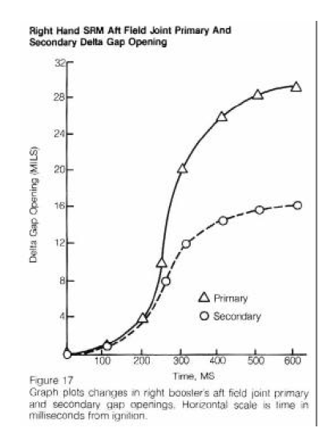
It’s All About the Putty
Discussions prior to Challenger were all about the O-rings
Post-Challenger testing revealed unknown variation in the putty performance
Pre-Challenger assertion
  Putty is plastic and will flow into the joint acting like a hydraulic ram to seat the primary O-ring
Post-Challenger discovery
  The putty can maintain motor pressure; consequently the O-rings are not pressurized
  Pressure flow through putty blow holes can be delayed during the ignition transient. Tests showed:
    Pressure was delayed for 530 milliseconds at 75°F
    Pressure was delayed for 1.9 seconds in a test at 20°F
Consequences of pressure delays
  The primary O-ring will be unseated at room temperature
  The secondary O-ring will seal consistently down to 55°F
  The secondary O-ring can seal (intermittently) down
  to 30°F
  The secondary O-ring will consistently fail at temperatures below 30°F
Primary seal requires pressure-assist to seal.
Gap Opening vs Time
Primary and Secondary Seals

Slide 12
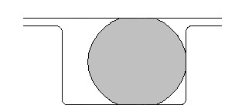
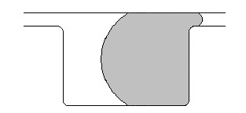
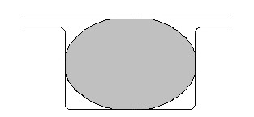
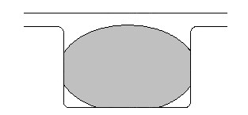
4-Wall Contact
Prior to Challenger, it was believed that the secondary O-ring would be in position to be forced into the extrusion gap via “pressure assist”
Hot Motor Gases
Hot Motor Gases
Resultant:
Better Seal
Joint Gap
(widens)
O-ring as Pressurization Begins: Desired Configuration
O-ring After Pressurization: No Blow-by
After Challenger, it was learned that design changes to create ever greater O-ring squeeze could result in “4-wall” contact resulting in potential blow-by of both the primary and secondary O-rings at any temperature
Hot Motor Gases
Hot Motor Gases
Blow-by
Joint Gap
(widens)
Resultant:
Push O-ring down
O-ring as Pressurization Begins: 4-wall Contact
O-ring After Pressurization: Blow-by Occurs

Slide 13
Outcomes for Various Putty Configurations
Event | Frequency | Primary Seal Outcome | Secondary Seal Outcome
No gas paths in putty (Unknown that putty could hold pressure) | 140 | No hot gas to O-ring, system seals at any temperature | No hot gas to O-ring, system seals at any temperature
Gas paths with instant pressure to primary O-ring | 5 STS-2 at 70°F STS-41B at 57°F STS-41C at 63°F STS-41D at 70°F STS-61C at 58°F | Impingement erosion on primary O-ring. Seals will function well below 30°F. Bounded and self- limiting condition. | No gas to the secondary seal
Gas paths with instant pressure to the primary O-ring, but O-ring has 4-wall contact (Unknown domain prior to Challenger) | 2? STS-61A at 75°F? | Blow-by and erosion of primary O-ring can occur at room temperature | Secondary seal can function below 30°F with no 4-wall contact Secondary can fail at room temperature with 4-wall contact
Gas paths with pressure to primary O-ring delayed by 250 – 500+ ms (Unknown domain prior to Challenger) | 3? STS-51C at 53F°? STS-51L at ≤28°F | Blow-by and erosion of primary can occur at room temperature | Secondary will seal down to 55°F Intermittent secondary seal failure 30 to 55°F Secondary seal failure below 30°F

Slide 14
O-ring Damage vs Temperature: Complete Data Set
Why didn’t management believe there was a temperature effect on O-ring damage?
Condition | Flight Temp | Comments
Impingement Erosion | STS-2 70F STS-41D 70F STS-41C 63F STS-61C 58F STS-41B 57F | In models used to predict bounding, worse case erosion, temperature has no effect on the physics of impingement erosion. O-ring damage is controlled by fill volume and gas path dimensions.
Blow-by and Erosion of Primary O-ring | STS-61A 75F STS-61A 75F STS-51C 53F STS-51C 53F | We know today that low temperature affects O-ring resiliency, but this is all the data available to management on the evening of January 27, 1986
They had 9 data points to look at. Frequency and damage at room temperature were indistinguishable from that at lower temperatures, albeit the damage on -51C was worse….
(Side note. 5 of the 6 joints on STS-51L worked fine at <28F. If the aft field joint didn't have a gas path, the total data set would have included 6 successes at very low temperatures.)

Slide 15
What Did We Learn After the Accident?
Prior to the accident, neither NASA nor Thiokol fully understood the mechanism by which the joint sealing function took place
The design was unacceptably sensitive to several factors
  Temperature
  Physical dimensions
  Character of materials
  Effects of reusability
  Processing and handling
  Complex interactions due to joint dynamic loading
Ironically, design fixes (like the capture feature and putty modifications) were on the way and would have been incorporated by mid-1986
Management thought that they had a little more time….

Slide 16
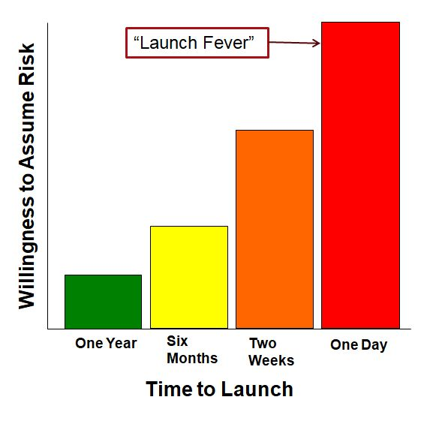
Personal Retrospection:
The launch rate in 1985 and 1986 is incomprehensible
  13 launches and 2 static tests in a 15-month period. Holy Cow!
  STS typically launched 4 to 6 times a year (8 maximum one year)
  The pace to keep up with post-flight results and resolve technical issues prior to each subsequent launch was incredible
Schedule pressure to keep flying in 1986 must have been palpable
  Months before a launch, the design team is very risk adverse
    Adverse events are anticipated, and Launch Commit Criteria (LCC) are vetted
    Tendency is to anticipate and define when not to fly
  Risk taking (launch fever) gets intense as the next launch date approaches
    Tendency is to find a reason to fly
What would I have done..?
  Engineering team had been saying it was safe to fly for over 4 years
  Engineering team had not put much work into understanding cold temperature effects
    100-year storms only occur every 100 years…. It doesn’t get cold in Florida
  Their attempt to establish a new LCC at 53°F the evening before a launch was ill timed and their concerns about cold temperatures were not technically well-founded
I certainly would have challenged the team and their logic…

Slide 17
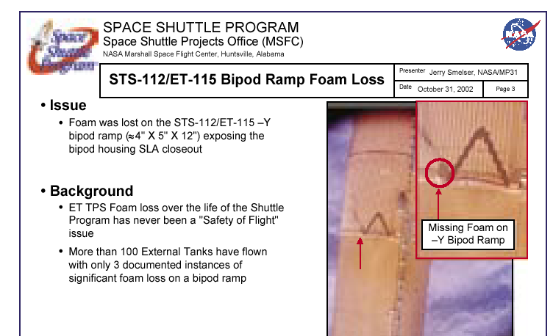
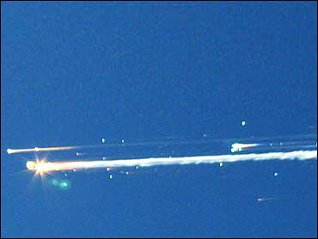
Columbia Disaster: Bipod Ramp Foam Loss
Foam loss has never been a “Safety of Flight” issue
Columbia – 1 February 2003
The Mission Management Team wasn’t concerned about the impact*.
“Like hitting a Styrofoam cooler with your car…”
Except, the car is going 550 miles per hour, and the chunk of foam weighs 1.7 pounds
*Why the Mission Management Team wasn’t completely puckered by the foam impact on ignition is baffling to me. They knew the mass and velocity of the foam at impact. A simple kinetic energy calculation would show that the impact energy was 2 orders of magnitude higher than that required to damage the Orbiter carbon-carbon leading edge.

Slide 18
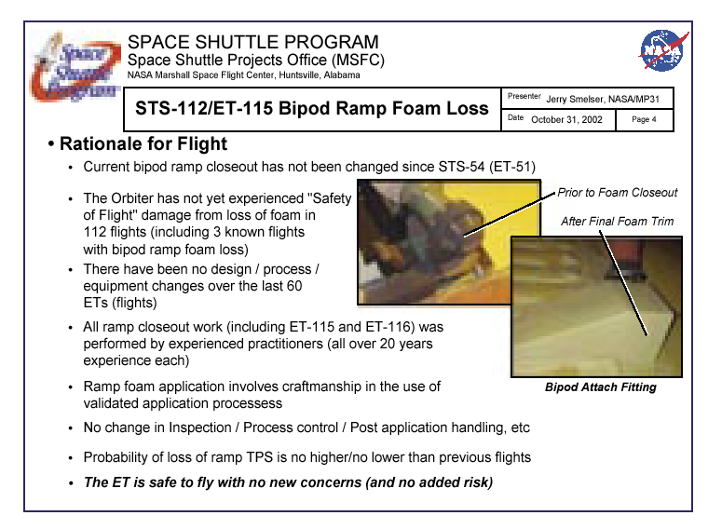
STS-113 Level I FRR (two missions before Columbia)
“Not Yet” implies it could experience “Safety of Flight Damage”
Hazards Analysis identified foam loss as a potentially catastrophic event
ET PM cites 3 known foam loss events. Actual number of known events was 5 prior to STS-112.
He stated that the last event was over 10 years ago, making it sound like the next event wouldn’t happen for another 10 years
Foam loss was deemed “normal”.
“Craftsmanship” suggests a finicky process that requires an expert to make it work
There had been design, material, and process changes over the years
Should have said, “The probability of loss of ramp TPS on the next flight is just as high as it was on STS-112.”

Slide 19
Columbia Disaster: Personal Retrospection
I was present at the STS-113 FRR when foam loss was presented by NASA ET Project Manager
The presentation was technically awful
Members of the FRR board were generally quiet
NASA HQ S&MA Director began asking flight safety related questions, but quit probing when told that foam loss was an accepted risk in the formal hazards assessment system
When polled, I answered, “Go” like everyone else
  The audience in the room would never challenge other Shuttle elements, and only speak if called on to answer a question
In the hall outside the conference room, I told NASA’s RSRM project manager, “The foam loss presentation was terrible! If I were on the Board, I’d be ‘No Fly’. He said, “We have to trust the other Shuttle elements to do their job. We’ve done ours.”
A culture of silence existed in the formal FRR setting in 2003
Once an anomaly investigation team determines it is safe to fly, they get into “sell mode”, rather than “share the risk mode”
January 21, 2003 email from Mission Management Team Chair to Shuttle Program Manager: “The ET rational for flight for the STS-112 foam loss was lousy. Rationale was lousy then, and still is..”

Slide 20
7 Elements of Good Flight Rationale
https://sma.nasa.gov/vids/video-item/return-to-flight

Slide 21
Elements of Good Flight Rationale
STS-51D Flight Rationale (April 1985)
Cause of erosion and blow-by on STS–51C understood
O-ring erosion on STS-51C within experience base
Tests showed O-ring seals at 3,000 psi with 0.095-in erosion
    Greater than worst case prediction
    Almost twice as great as worst observed in SRM history
Heat effects on secondary O-ring well below worst case prediction
Secondary O-ring sealed by leak check
Erosion and blow-by confirmed to be self-limiting
STS-51D could exhibit same behavior as 51C
Note: Central to risk assumption at Level III was notion that record low temps seen for -51C would not occur again
Physics-based understanding
Within experience base
Adequate margins
Assessment based on extensive testing and analysis
Bounding case
Self-limiting
Diane Vaughn* noticed a consistent pattern in developing rationale for safe flight following each mission
*Diane Vaughn, “The Challenger Launch Decision”, The University of Chicago Press, 1996.

Slide 22
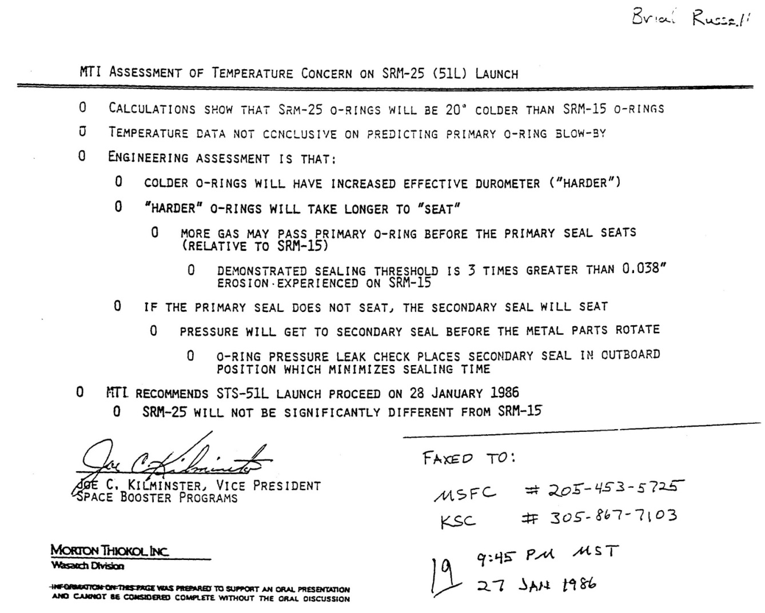
Elements of Good Flight Rationale
STS-51L Flight Rational 27 January 1986
Out of family
Poor data, physics not understood
Large margins, self limiting
Bounding assessment
A critical assessment of the flight rationale for STS-51L would have revealed several weaknesses that reflected increased risk for the mission

Slide 23
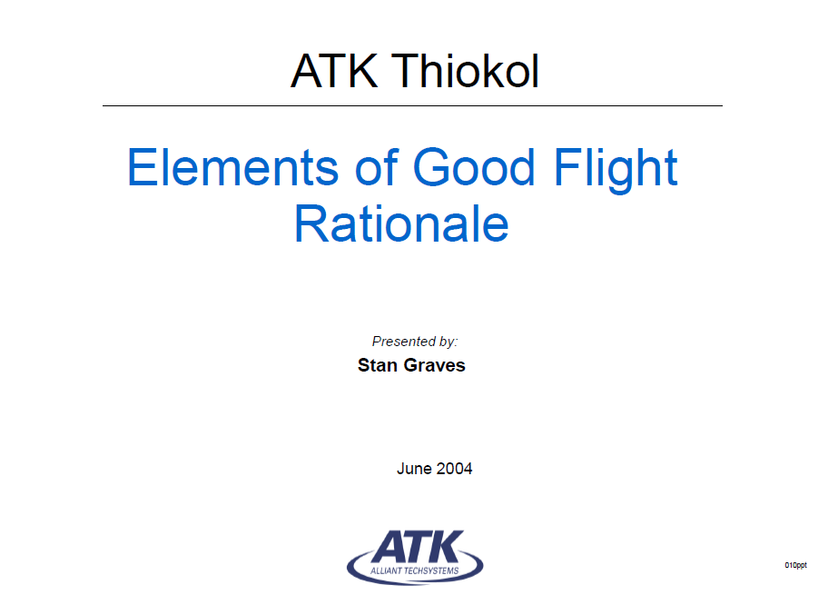
7 Elements of Flight Rationale
Premise
Use of a common template for discussing the basis for safe flight will help communicate risk and identify “holes” or weaknesses in the flight rationale
  The FRR board should understand quickly the level of risk associated with the issue
  The board should probe and enthusiastically debate those technical issues with varying degrees of unknowns or uncertainties
Conops
The ideal case is to have all six (see next page) elements in place for every technical issue
The FRR board can choose to accept the risk and fly without every element being in place, but every element has to be addressed in the presentation
After studying the communication breakdown between the engineering teams and the management team on both Challenger and Columbia disasters, I developed a standard format for presenting technical issues at the FRR board meeting

Slide 24
Flight Rationale: Necessary Elements
  Physics-based understanding
  Within experience base (flight or test)
  Adequate margins
  Bounding case
  Self limiting
  Assessment based on data, testing and analysis
  Interactions with other elements or conditions addressed

Slide 25
Applying the 7 Elements to STS-112 Foam Loss
Are physics of foam loss understood?
  Charts do not address physics of the problem
Is the observation within the experience base?
  Yes – prior instances of bipod foam loss with damage to the carbon-carbon leading edge
Is there an adequate safety margin?
  Charts do not address potential outcomes and margins
Has a bounding case been established?
  Yes. Loss of vehicle and crew. Accepted risk.
Is the observed behavior thought to be self limiting?
  Charts do not address potential outcomes and damage limiting rationale
Is safe-flight assessment based on data, testing, and analysis?
  Charts do not provide engineering data or analysis
Columbia – February 2003

Slide 26
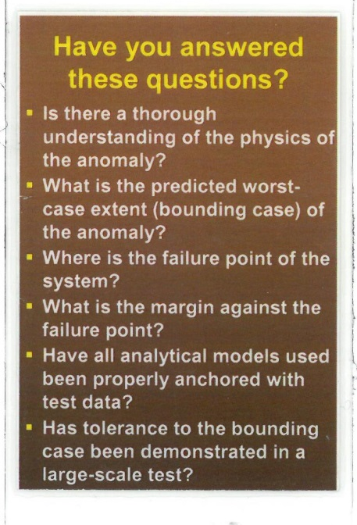
Risk Assessment or Flight Rationale Elements
Elements of Flight Rationale
Solid technical understanding
Condition relative to experience base
Bounding case established
Self-limiting aspects
Margins understood
Assessment based on data, testing, and analysis
Interactions with other elements or conditions addressed
Necessary elements, expanded:
Physics-based or root cause understanding of issue, based on engineering data (perhaps using a fault tree)
Experience base includes full-scale flight, ground test, or qualification-level tests
Using physics-based understanding, determine the bounding case (e.g., lower A-basis allowables, upper three sigma loads and environments, anchored with test data)
Physical reasons why it can’t get any worse than the bounding case or show the part is fail-safe
Adequate margins, ideally not substantially reduced from baseline
Final risk assessment based on test data and analysis, not gut feel or expert opinion
Address interactions with other conditions (MRB, changes, technical issues), and vehicle elements
NASA Badge Overlay

Slide 27
Risk Management in a Nutshell
Key Questions about adverse events.
What is our current risk posture?
  What is the likelihood of a recurrence?
  What is the worst credible consequence of a recurrence?
  Is such an outcome acceptable?
If results of credible adverse events are unacceptable, brainstorm:
  What can we do to reduce the likelihood of a future event?
  What can we do to reduce the consequences of a future event?
4. Using Yankee ingenuity, how can we achieve an acceptable risk posture while being good stewards of our resources?
Provide leadership with program options, costs, impacts, etc.
Make a recommendation!

Slide 28
STS O-ring Erosion and Blowby
Adverse Events:
Impingement erosion on primary seal
  Physics understood. No consequences
Blowby and erosion of primary and secondary seals
  Physics not understood. Consequences of worst credible event catastrophic!
Highly Likely
5
(1)
(2)
Worst Credible
(2)
Likely
4
Observed
Possible
3
Likelihood of Occurrence
Unlikely
2
(3)
Remote
(4)
Brainstorm:
What can we do to reduce the likelihood of O-ring blowby?
  Eliminate the putty. Vent the joint. Add porous thermal barriers. Add joint heaters. Physics understood. (Joint design margins are small. Joint design is not redundant.)
What can be done to reduce the consequences of O-ring blowby?
  Standdown the program until a permanent fix (capture feature, J-leg, heaters, etc.) can be implemented
1
1
2
3
4
5
Minimal or no impact
Severe- Mission Failure
Extensive / Objectives lost
Significant Degraded Performance
Moderate / Some Reduction in Performance
Consequence of Occurrence
x
Size represents uncertainty
In this case uncertainty is significant

Slide 29
External Tank Bipod Ramp Foam Loss
Adverse Events:
Observed: foam doesn’t hit Orbiter
  No consequences
Worst Credible: Foam impact damages Orbiter wing carbon-carbon leading edge
  Consequences: loss of life and mission
Highly Likely
5
(1)
Worst Credible
(2)
Likely
4
Observed
Possible
3
Likelihood of Occurrence
(3)
Unlikely
2
Remote
(4)
Brainstorm:
What can we do to reduce the likelihood of foam loss?
  Improved M&P controls, proof testing, mechanical reinforcement, secondary retention features?
What can be done to reduce the consequences of foam loss?
  Standdown the program until permanent fix is implemented (eliminate foam entirely)
1
1
2
3
4
5
Minimal or no impact
Severe- Mission Failure
Extensive / Objectives lost
Significant Degraded Performance
Moderate / Some Reduction in Performance
Consequence of Occurrence
x
Size represents uncertainty
In this case uncertainty is significant

Slide 30
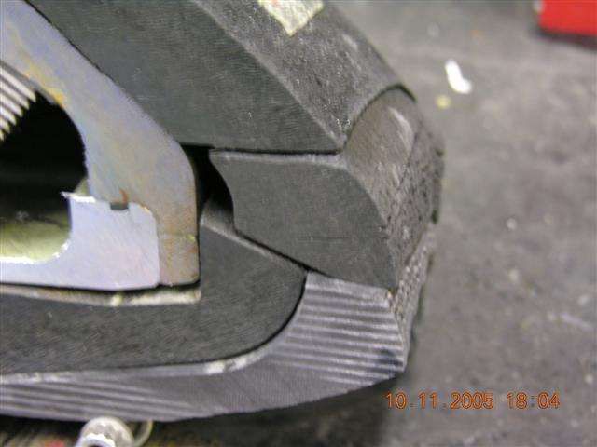
Nozzle Wedge Shift Issue
Observation
  Leading edge insulator wedge-shift has occurred on static test motors -1 and -2
  No performance anomalies occurred
Concern
  Nozzle is not performing as designed, and technical understanding of phenomenon is not 100% solid
Wedge that Moved
Two static test nozzles worked, but performance did not meet design intent
Design Team concluded that the risk of nozzle failure was low, and recommended that the program proceed without modification
After seeing the 7 Elements Risk Assessment, Management found the risk to be unacceptable
  The nozzle was successfully redesigned

Slide 31
Nozzle Wedge Shift Risk Assessment:
Solid technical understanding?
  Poor physics-based understanding. Current models do not predict wedge shifting phenomena.
Condition relative to experience base (flight or test)?
  FT-2 delaminations are bounded by conditions tested in SFT-1 and SFT-2
Margins understood?
  Design intent is to have the ablative rings remain bonded. Wedgeout conditions are much less robust, and consequences are difficult to predict
Bounding case established or condition self-limiting?
  Credible (possible) cases evaluated that result in nozzle failure
    Ejection of a 360-degree wedge
    Hot gas flow between the ablative ring and the metal housing
Assessment based on data, testing and analysis?
  Two static test nozzles with more severe initial conditions worked
  Risk assessment is largely based on empirical observations and expert judgment
Interactions with other elements or conditions?
  None identified

Slide 32
Nozzle Risk Assessment
Possible Events:
Nozzle experiences minor wedge-out
  Performance similar to SFT-1 and SFT-2
  No impact on motor ballistic performance
Delaminations propagate full circumference within a single ply
  Entire wedge is ejected
  Nozzle is destroyed
Small (7 mil) gap between rings allows hot gas flow to the metal housing
  Nozzle is destroyed
High Likely
5
1
Likely
4
Possible
3
2, 3
Likelihood of Occurrence
Unlikely
2
Remote
1
1
2
3
4
5
Minimal
Moderate
Significant
Extensive
Mission Failure
Consequence of Occurrence

Slide 33
Nozzle Wedge Recommendation to Management
Probability of nozzle failure is judged to be low
  The FT-2 nozzle is enveloped by the SFT-1 and SFT-2 results and any wedge creation is expected to be less severe than previously experienced
  Expect no effect on ballistic performance
Nozzle failure is possible
Failure risk can be mitigated by removing the current nozzle and replacing it with rayon based ablative rings
Based on this risk assessment, the flight nozzle was changed out and flew successfully

Slide 34
Questions or Comments?

