Slide 1
James Webb Space Telescope
Optical Telescope Element /
Integrated Science Instrument Module (OTIS) Cryogenic Vacuum Test
Part II: Thermal Analysis
Kan Yang
NASA Goddard Space Flight Center
Notes:
Welcome to the second lecture of the James Webb Space Telescope Optical Telescope Element and Integrated Science Instrument Module Cryogenic Vacuum Test lecture series. In this lecture, we will talk about thermal analysis.

Slide 2
Overview
This lecture represents the second part of the JWST OTIS CV Test Lecture Series
  Part I: Thermal Architecture
  Part II: Thermal Analysis
  Part III: Preparations for Off-Nominal Events
  Part IV: Lessons Learned
Objectives of this current lecture:
  Provide an overview of the OTIS CV test thermal model development
  Describe the limits and constraints that drove pre-test planning and the development of the OTIS test methodology
  Introduce the logic for optimizing the helium shroud profile by trading off between test time and hardware safety
  Understand how our pre-test predictions compared with the actual hardware performance in the OTIS CV Test
Notes:
In Part I, we went over the JWST system architecture and the OTIS CV Test setup. In Part II, we will provide an overview of the OTIS CV test thermal model development. A description of some of the driving limits and constraints will be provided, as well as how these influenced our test planning and eventual execution. One significant aspect of our pre-test planning is the method by which we optimized the OTIS CV test cooldown and warmup profiles using the thermal model by incorporating a feedback loop for driving helium shroud temperature. We will spend some time introducing the logic for this feedback loop, which traded test time versus model safety to determine the most efficient way to cool and warm the payload. Finally, we will take a look at how our pre-test predictions compared with our actual performance in the OTIS CV test.

Slide 3
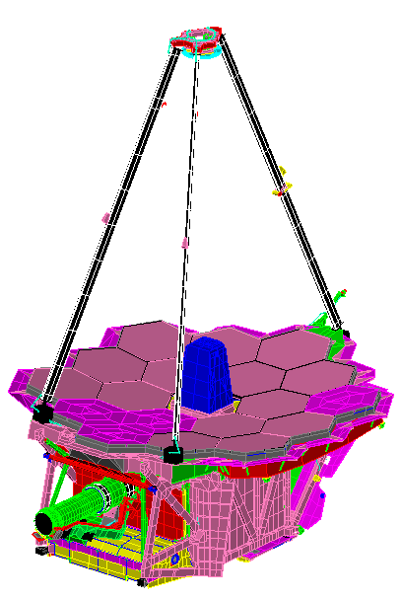
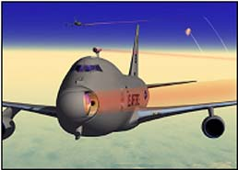
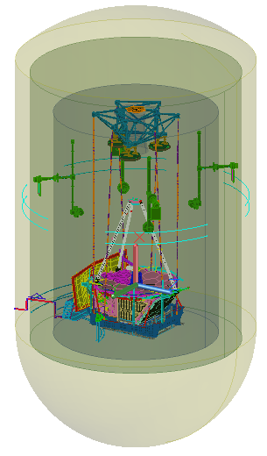
Recap: Components in the OTIS CV Test
+V1
SM / SMA
Image Source: NASA GSFC
+V3
Optical Path
JSC Chamber A Wall
Liquid Nitrogen (LN2) Shroud
+V2
CoCOA
Helium Shroud
ACFs (3)
SMSS
AOS
ASPA
Down / Telescop-ing Rods
SVTS
FSM
PM / PMSA, 18 total
OTIS Payload
PMBSS = BSF
+ BP
Thermal Management System (TMS)
TM
GSE Cryocooler Chase
ISIM Contains: NIRSpec, NIRCam, FGS/NIRISS, and MIRI. All instruments contain POMs. NIRSpec has a separate OA and FPA.
HOSS
DTA
ISIM / ISIM Structure
IEC DSER
+V1
ISIM DSERs (5)
+V2
+V3
IEC
Harness Radiator
ADIR
FIR
Notes:
Before we begin talking about the modeling effort, let’s do a quick recap of the components in the OTIS CV test, since many of the following slides will use the acronyms for these components. We’ll start from the outside and work our way in starting with the figure on the left, which uses the V-coordinate system on the lower left-hand side. At the outer boundaries of the model is the NASA Johnson Space Center (or JSC) Chamber A pressure vessel, and cocooned within is the liquid nitrogen shroud and then the helium shroud. Within the helium shroud, near the ceiling, we have the optical test equipment, including the Center of Curvature Optical Assembly or CoCOA and the Auto-Collimating Flat mirrors or ACFs. The OTIS payload is sitting inside the Hardpoint and Offload Support structure or HOSS, which is suspended from the ceiling via a series of six telescoping rods. The Aft Optics Subsystem Source Plate Assembly or ASPA hardware rests on top of the OTIS payload aperture and generates signals for optical testing. To set the environment around OTIS, we have on the plus and minus V3 sides the Spacecraft Vehicle Thermal Simulator or SVTS, the Ground Support Equipment or GSE cryocooler chase, a series of Deep-Space Environmental Radiators or DSERs for the Integrated Science Instrument Module or ISIM, and one specialized DSER for the ISIM Electronics Compartment, or IEC. Moving to the figure on the right, this is a closeup of the OTIS payload and uses the V-coordinate system at the top center location on the slide. In this figure, the optical path goes from the Primary Mirrors or PMs to the secondary mirror or SM, and onto the inside of the Aft Optics Subsystem or AOS where it bounces off of the tertiary mirror or TM and the fine steering mirror or FSM before going to the science instruments. The Primary Mirror Segment Assemblies or PMSAs are a way to describe the total assembly of the primary mirror and its corresponding actuation mechanisms and mounting structure, and the Secondary Mirror Assembly or SMA is the equivalent for the SM. The ISIM, as mentioned earlier, describes the assembled configuration of all of the science instruments inside their composite ISIM structure. The ISIM contains four instruments: the Near Infrared Camera or NIRCam; the Fine Guidance Sensor and Near Infrared Imager and Slitless Spectrograph or FGS/NIRISS; the Near Infrared Spectrograph or NIRSpec, which contains separate Optical Assembly or OA and Focal Plane Arrays or FPA components; and the Mid-Infrared Instrument or MIRI, which is actively cooled through the GSE cryocooler. Each of these instruments use pick-off mirrors, or POMs, to capture the incoming light from the FSM. Supporting the ISIM is the Primary Mirror Backplane Support Structure or PMBSS, which contains two components: the backplane or BP to support the primary mirrors, and the backplane support fixture or BSF to support the instruments, radiators, and electronics boxes. The Secondary Mirror Support Structure or SMSS rises from the PMBSS in the +V1 direction to support the SMA. On the –V3 side, the deployable tower assembly or DTA connects OTIS to the spacecraft, the IEC hangs off the –V1 end of the BSF, and the harness radiator cools harnesses emanating fro the IEC into ISIM. The Thermal Management System or TMS shields the cold instruments from stray light from the spacecraft.

Slide 4
Recap: Other Commonly-Used Acronyms
Acronyms:
GSE: Ground Support Equipment (in contrast to “flight” equipment)
K: Kelvin
L&Cs: Limits and Constraints
LN2 / N2: Liquid Nitrogen / Gaseous Nitrogen
ΔT or delta T: Temperature Difference
Δt or delta t: Change in time
Shorthand references:
“Gradients”: not used in context of temperature change per length, but rather in magnitude of the temperature difference, especially on large structures
“Harness”: electrical wire bundles
“Model”: specifically refers to the OTIS CV Test Thermal Model unless otherwise indicated
“Payload” or “OTIS”: refers to the entirety of the JWST OTIS system-level hardware assembly under test, as distinguished from the OTIS CV test
“Shroud”: specifically refers to the Helium Shroud unless otherwise indicated
Notes:
Here are some other acronyms that will be commonly referred to in this lecture. GSE is ground support equipment, which describes non-flight articles developed in support of this test. K describes the unit Kelvin, while L&Cs are limits and constraints. LN2 refers to liquid nitrogen, and N2 refers primarily to gaseous nitrogen. Delta capital T either spelled out or using the Greek symbol describes temperature difference between two components, especially as it pertains to limits and constraints. Conversely, delta lowercase t refers to the change in time over a model timestep.
In this talk, there will also be a few shorthand ways to refer to certain items important to our test campaign. The term gradient is used interchangeably on James Webb with the magnitude of temperature difference, especially over a large structure such as the PMBSS or on either side of an interface, rather than in the physical context of temperature change per length. You’ll hear the term “harness”, which refers to any bundle of electrical wires used in the test. The model discussed here specifically refers to the system-level OTIS CV test thermal model unless otherwise indicated. Payload or OTIS refers to the flight OTIS unit under test, as it exists in its system-level assembly inside the test chamber. This is different from the term “OTIS CV test”, which refers to the combination of payload and test setup. “Shroud” specifically refers to the helium shroud unless otherwise indicated. A more complete list of acronyms can be found on the few slides of this lecture.

Slide 5
OTIS CV Test Planning: Pre-Test Thermal Analysis
The development of the OTIS CV Test Thermal Model was a multi-year process that required coordination between five separate organizations
Pre-OTIS CV Test planning using this model encompassed the following scope of thermal analyses and produced the following deliverables:
  Cooldown and Warmup studies to establish timelines
    Full transient cooldown and warmup within all specified limits and constraints
    Temperature stability estimation and time required to reach stability criterion
    Handoff of model results for stray light, thermal distortion, and stress analyses
  Timeline optimization against OTIS payload sensitivity
  Prediction of temperatures and heatflows during cryo-balance for ISIM and OTE, and validation that steady-state test requirements can be met
  Mapping of flight and test thermal sensors to OTIS thermal model
  Analysis of off-nominal thermal conditions in OTIS CV test
  Incorporation of correlated model parameters on a case-by-case basis from previous subsystem-level CV testing: ISIM Cryo-Vacuum Test, Core 2 Test, and Thermal Pathfinder test
Notes:
Now that we’re once again familiar with some of the major OTIS components and the commonly-used acronyms, let’s talk about the development of the OTIS CV Test Thermal Model. Model development was a multi-year process that began in 2013 and continued through the completion of the OTIS CV test in 2017. Note that this thermal model development period does not speak to the total time for OTIS CV test development, which had been ongoing since 2008. The systems-level thermal model development required coordination between five separate organizations: NASA, who was responsible for the overall coordination and execution of the OTIS CV test; the Northrop Grumman Corporation, the prime contractor for JWST who developed and integrated the flight hardware; Ball Aerospace, who designed and built the advanced optical technology and lightweight mirror system for JWST; Genesis Engineering, responsible for developing the IEC and executing thermal tests to understand the interactions between the warm spacecraft and OTIS; and the Harris Corporation, who designed, integrated, and tested the GSE including the optical metrology equipment and thermal control surfaces necessary for the OTIS CV test. The major objectives of the system-level model were to conduct analyses to correctly capture payload behavior both in temperature transitions and in the cryo-stable phase, and to accurately predict test time. Transient model runs for cooldown and warmup were performed to establish timelines, as well as estimate the amount of time necessary to reach certain test criteria. With this model, we also wanted to understand the temperatures and heat flows for each component during the cryo-stable phase of the test, and observe payload response for safety during any off-nominal conditions. The next slide will describe some of the major subsystem-level components of the model.

Slide 6
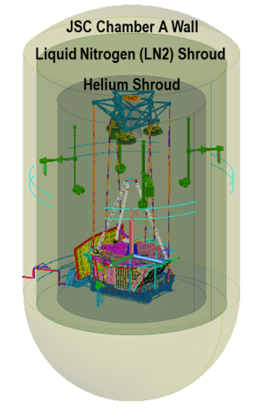
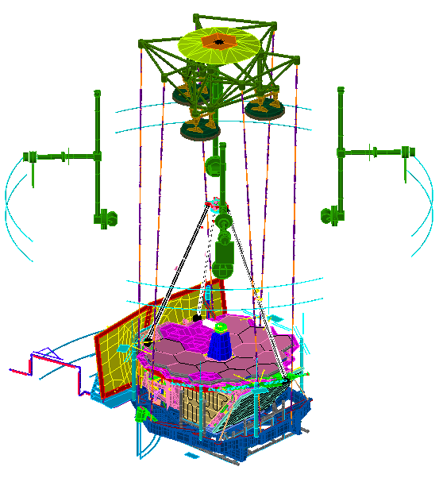
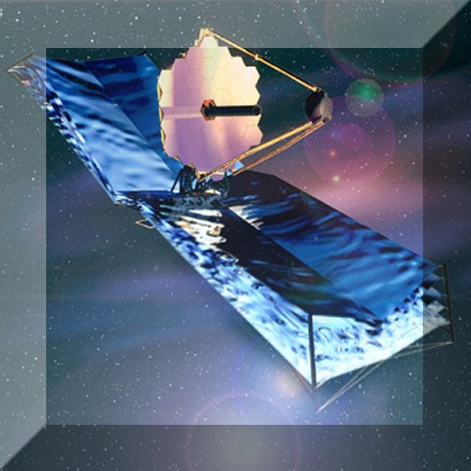





OTIS CV Test Thermal Model: A System-Level Integration of Subsystem-Level Deliveries
Chamber / LN2 Shroud / Helium Shroud Dimensions from NASA JSC Chamber A Facilities Team
Secondary Mirror Model used Ball Aerospace Detailed Thermal Model for tracking gradients / transient behavior
Reduced GSE Model from Harris Corp.
Select PMSA Models used a “Detailed” Geometric Representation from Ball Aerospace to better track gradients / mirror transient behavior
Ball Aerospace AOS Source Plate Assembly Model
Northrop Grumman Corporation Detailed Flight OTIS Model
Image Source: NASA GSFC
Notes:
The OTIS CV Test thermal model was developed in SINDA/FLUINT as the integration of four separate subsystem-level deliveries. The Chamber A Facilities Team at NASA JSC provided the chamber, helium shroud, and LN2 shroud dimensions, which were each represented in the model by simple boundary surfaces with these dimensions. Harris Corporation generated a reduced GSE model which provided ample resolution for all of the radiative and conductive boundaries which interfaced the detailed OTIS payload. In the interest of understanding the performance of their GSE components and how best to control them with the OTIS cooldown and warmup plans, Harris also developed a separate systems model which emphasized detail on the GSE systems but carried a reduced OTIS payload, in effect the opposite of this OTIS CV Test thermal model. Discussion of the detailed GSE and reduced payload systems model is beyond the scope of the current talk. Switching focus to the flight payload side, the OTIS model was delivered by the Northrop Grumman Corporation as a partitioned subsection of their full flight JWST model. The flight model was primarily used for steady-state predictions on-orbit, so it had simplified representations for certain components which had little impact on accuracy in steady-state. For the OTIS CV test, however, we wanted to capture the transient behavior of sensitive components in more detail for limit and constraint tracking during temperature transitions. Since Ball Aerospace developed the optical systems of James Webb, for the OTIS CV test thermal model, we replaced the Northrop SMA with a more detailed representation from Ball Aerospace, and four of the 18 primary mirror assemblies were replaced by detailed PMSA models in locations where we predicted to have the largest temperature gradients. The integration of all of these sub-assemblies, plus some additional modifications which are discussed on the next slide, produced the OTIS CV test system-level thermal model. Thermal Desktop was used to perform ray tracing and obtain the radiation couplings between payload and GSE. After optimization to balance model accuracy and runtime, the final iteration of the OTIS CV Test Thermal Model had over 84,000 nodes and over 9 million radiation conductors, and typically required more than a week of wall-clock time with optimized SINDA run parameters to simulate a cooldown profile of 35 days or warmup profile of 20 days.

Slide 7
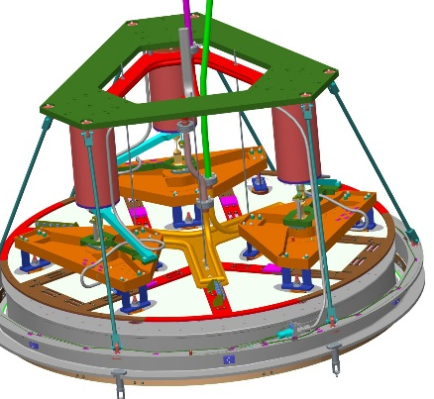
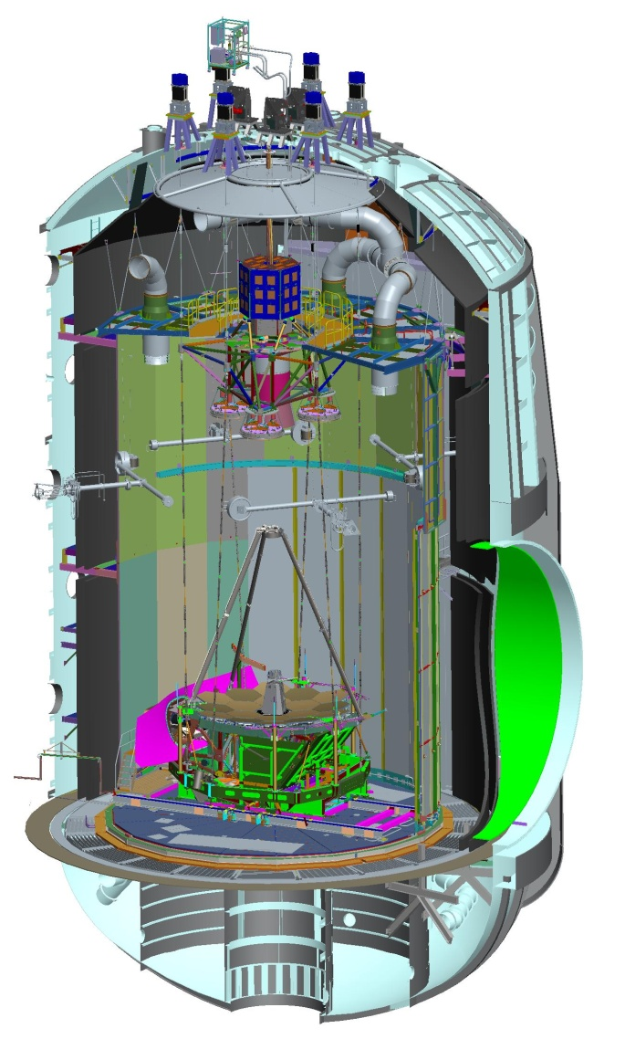
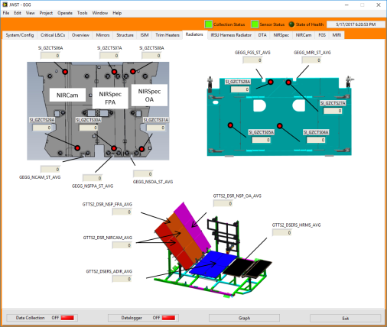
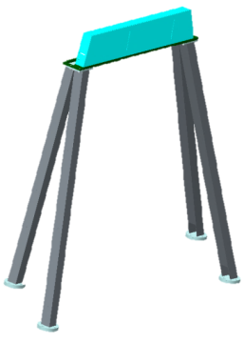
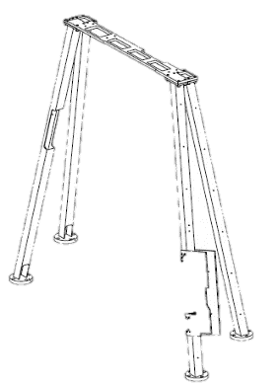
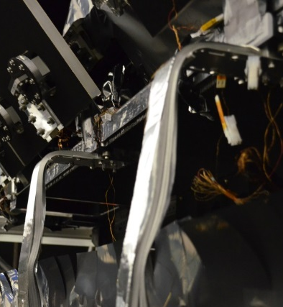
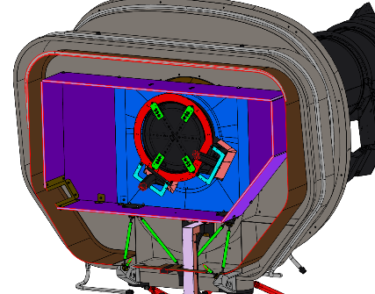
GSE Thermal Updates and Modeling for the OTIS CV Test
ACF Augmentation
Harris Thermal Test Set (TTS) and Eclipse Graphical Generator (EGG) Systems
Modifications to DTA Offloader
ISIM Pre-Cool Straps
SVTS MLI Modifications
Notes:
Let’s talk about some of the GSE updates for OTIS both in terms of hardware and the thermal model before focusing on the payload. Many of these GSE components were introduced in part I of the lecture. Focusing on this slide, the ACFs were determined to be the schedule driver for cooldown and warmup not just for GSE components, but for the entire test. For the original ACF design, the sheer thermal mass of the mirrors meant that cooldown to its operational temperatures and stability requirements would exceed 90 days, almost 60 more than the slowest payload component, vastly exceeding the budgeted time and cost for the test. Therefore, “augmentation” hardware in the form of helium lines and cold plates were added to the ACFs, and extensive thermal analysis was performed by the Harris team to ensure that their augmented design would achieve cooldown and warmup faster than the slowest payload component. This design further underwent thermal vacuum testing in both a component-level at Harris and system-level at the Thermal Pathfinder Test to ensure that it met its temperature transition goals. The DTA offloader, a GSE structure meant to support the payload deployment tower assembly in 1g, was both mechanically and thermally modified for the OTIS test. Mechanically, its legs were notched to provide clearance for the electrical harnesses running up the flight DTA; thermally, copper straps were added to improve thermal conduction and ensure that this structure would not exceed its gradient requirements in cooldown. On the SVTS, there were multiple thermal modifications to accommodate OTIS. Specific blankets closed out the OTIS DTA to the GSE spacecraft simulator, and within the SVTS a “warm box” at 264 K simulated the correct thermal environment for the harnesses, while a surrounding “cold box” at 20K prevented harness heat from becoming a stray light source. Additional blankets blocked the warm harnesses’ view to the cold payload and were designed to move dynamically with the SVTS to account for cryo-shrinkage. On the +V3 end, the ISIM pre-cool straps were attached at one end to the interfaces with the flight heat straps, and attached at the other end to assemblies which both had helium lines for cooling and zero-Q heaters for establishing thermal balance. These zero-Q heaters could also be used to add supplemental heat to the payload in the event of an emergency. These hardware updates were all captured in the GSE system-level model delivery, which integrated with the OTIS payload model. Included in this delivery were models of the helium lines using one-way conductors to capture realistic line gradients, and detail on the IEC DSERs to capture the effect of its warmup heaters. Also key was the model fidelity of structural components such as the HOSS and USF, which had enough detail to accurately predict the thermal stresses experienced by these components. This ensured that they were acceptable throughout cooldown and warmup simulations, and never drove the test schedule beyond than the payload components. Furthermore, since all of this GSE hardware was tested in Thermal Pathfinder as a dress rehearsal for OTIS, these models were correlated with Pathfinder test data to ensure accuracy. Finally, unrelated to modeling but still critical to the OTIS test effort, Harris had also developed both the Thermal Test Set or TTS system and Eclipse Graphical Generator or EGG software. TTS was the main data acquisition and control system for the GSE components, which read from the test instrumentation and processed data useful for monitoring by the thermal test operator, as well as allowed the operator to control test heaters. EGG was an additional graphical interface developed to visualize temperatures coming from the flight Eclipse system, and allowed thermal test operators to plot and visualize the thermal performance of the payload. Fusion, a program developed in-house at NASA Goddard, combined both data from TTS and Eclipse to provide a higher-level view of the hardware performance for the entire system.

Slide 8
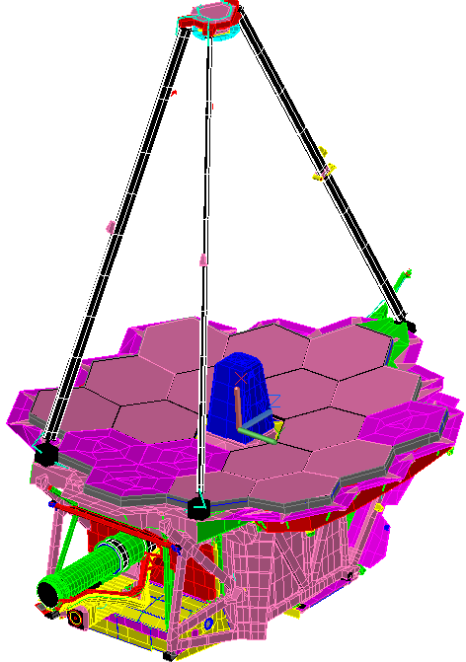









Modifications to Flight OTIS Model to Match CV Test Configuration
+V1
Image Source: NASA GSFC
+V3
Secondary Mirror Assembly: Flight Lightshield removed to reflect test configuration with optical test targets, mirror mount and harness connections changed to accommodate detailed SM model
+V2
GSE “Saver Plate” interfaces modeled to correctly capture heat transfer from OTIS to offloading structure (HOSS)
Detailed payload Secondary Mirror Support Structure model added to simulate mechanism deployment heater operations
NG stray-light bib structure replaced with GSE bib to match test configuration
Hingeline GSE Clamps between backplane center structure and wings added to simulate test supports for gravity loading
OTE and IEC harnesses on DTA attached to GSE SVTS
DTA base held at room temperature to simulate spacecraft boundary
Stray-light frill cutouts for primary mirror optical test targets added to match OTIS test configuration
IEC Changes:
Various Thermal-structural component GSE replacements
Heater setpoints modified for ground testing
-V2 GSE vent cover
+V2 vent tied to contamination sequestration duct
ISIM precool straps attached to flight radiator interfaces
Aft Deployable ISIM Radiator (ADIR) only deployed 1 degree due to GSE interference
GSE cryoline interface between GHe Chase and flight cryoline for MIRI instrument
Flight stray-light Batwings partially deployed due to GSE interference
Notes:
Now let’s move onto the payload itself. To reflect the hardware configuration changes for OTIS CV testing, The Northrop Grumman-delivered flight OTIS model required some modifications from its system-level delivery. The secondary mirror model had a stray light shield removed since this hardware was not present in the test to give space to mount optical test targets. The coarser secondary mirror support structure flight model was replaced with a model which contained detailed representations of mechanisms so that the effect of room-temperature deployment heater tests in cryogenic temperatures could be understood before they were executed in OTIS. On the PMBSS structure, conductors were added representing the hingeline GSE clamps to keep the mirrors deployed in 1g on the V2 sides, or “wings”. On the –V1 end, the Fixed ISIM Radiator or FIR had its instrument heat strap interfaces hooked up to the ISIM pre-cool straps for conductive cooling. As OTIS also sits inside the GSE HOSS structure, the aft deployable ISIM radiator or ADIR could only be deployed 1 degree in this model. The IEC additionally saw various modifications to accommodate its test support structure and contamination sequestration hardware. On the –V3 end, the interfaces were resolved between payload and GSE such that the harnesses emanating from the payload were attached to the GSE SVTS, the base of the DTA was held as a boundary at the spacecraft temperature, and the MIRI cryocooler line was linked to the GSE cryocooler. Finally, all of the soft-structure stray light shields around OTIS were modified to match their test configurations.

Slide 9
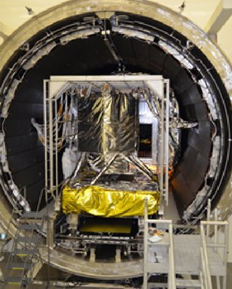
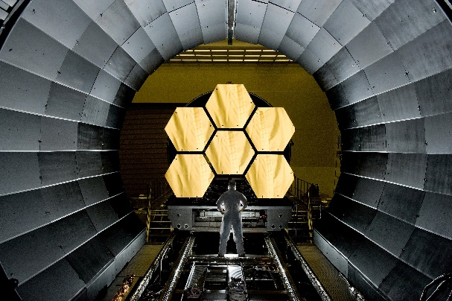
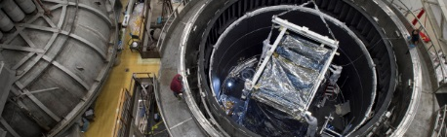
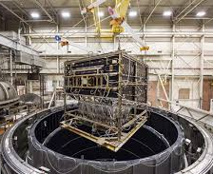
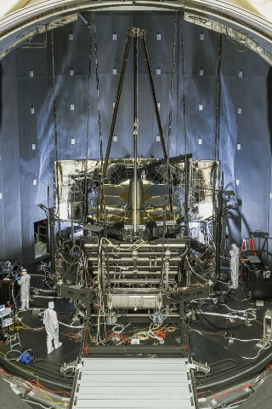
Subsystem Model Heritage
Payload
  AOS: correlated to subsystem-level testing at Ball Aerospace^{[1]}
  IEC: correlated to subsystem-level testing at NASA GSFC^{[2]}
  ISIM: correlated to ISIM CV testing^{[3,4]}
  PM and SM: correlated to segment assembly testing at Ball Aerospace^{[5]}
  PMBSS Structure: correlated to tests at NASA MSFC’s X-Ray Cryogenic Facility (XRCF)^{[6]}
GSE
  Harris thermal simulators, mechanical support hardware, metrology systems: correlated to individual subsystem-level tests and system-level testing at Thermal Pathfinder^{[7,8,9]}
CoCOA Test at NASA MSFC
PM EDU Test at NASA MSFC
ISIM CV Testing at NASA GSFC
Core 2 Test at NASA GSFC
Thermal Pathfinder at NASA JSC
Image sources: NASA/JWST
Notes:
So, how did we verify that the subsystem-level models being integrated into the OTIS system-level model were correct? All of the delivered models were rigorously correlated to each of their subsystem-level thermal vacuum tests to make sure that their predicted behavior matched the as-built hardware. The AOS was correlated to its component test at Ball Aerospace, and the IEC models were matched to the test results of both the IEC engineering model test and the Core 2 Test on the interface region between the OTE, sunshield, and spacecraft elements. The ISIM models were correlated to the series of three ISIM CV tests at NASA Goddard; the thermal models for the PM and SM used test data from their individual component assembly tests at Ball Aerospace to verify their accuracy; and the BSF with backplane center section and backplane wings were tested separately at NASA Marshall’s X-Ray Cryogenic Facility, from which data was also used to derive their temperature gradient limits and constraints. On the GSE end, most GSE underwent their own individual component-level thermal vacuum testing before being tested as an integrated system in the Thermal Pathfinder test at Johnson Space Center.

Slide 10
Model Verification
Northrop Grumman “Math Model Guidelines” document
  All subsystem models designed to this guideline
    Recurring reviews to assess model status / ensure compliance
  For Thermal Model, defines coordinate systems, mass and thermal dissipation conventions, boundary conditions, model size/numbering/naming
Crosschecks for OTIS system-level model accuracy
  Flight separate model crosschecks are performed with incoming flight and flight test correlated models that constitute the main OTIS payload model
    NASA GSFC maintains separate flight model in different thermal analysis software than Northrop Grumman model for crosscheck
  OTIS system crosschecks performed by analysts working independently on the same model to verify model accuracy:
OTIS CV thermal model version releases and thermal results provided to other subsystems for their model analyses: thermal distortion model, structural model for stress analysis, optical stray light model
Post-test “calibration” of thermal model to OTIS CV test data; enhancement of flight model with test results
Notes:
Even with the verification of the subsystem-level models, it still does not imply that the assembled system-level OTIS CV thermal model is accurate. To this end, the model was developed with stringent math model guidelines provided by Northrop Grumman to ensure that modeling best practices were being implemented at every step of the development process. All of the subsystem models were already designed to this guideline, and recurring reviews and model interchange meetings with all of the organizations contributing to the OTIS CV test were held regularly to scrutinize the model details. The document also defined conventions for the thermal model, such as coordinate systems, standards for mass and thermal dissipation, boundary conditions, model size, and node numbering. For the payload components, modeling crosschecks were performed on the SINDA/G Northrop Grumman flight thermal model with an independent IDEAS TMG thermal model maintained by NASA Goddard to ensure that both models produced consistent results. Also, a team of analysts from different organizations working independently on the OTIS CV thermal model verified model accuracy through their tasks, whether it was coordinating the transfer of model results to parties downstream, running the OTIS model separately for off-nominal cases, or understanding how the changes in emissivity as a function of temperature impacted the thermal results. Model results were also provided to the thermal distortion, structural, and optics teams as input to their models, and inconsistencies in OTIS CV thermal model output would be questioned by the other subsystem engineers if incongruities appeared in their models. Finally, a post-test calibration effort for the OTIS CV thermal model was performed by Northrop Grumman to match model results to test data by varying parameters such as composite thermal conductance and emissivity. Many changes made to the test model were implemented in the flight model to improve its accuracy.

Slide 11
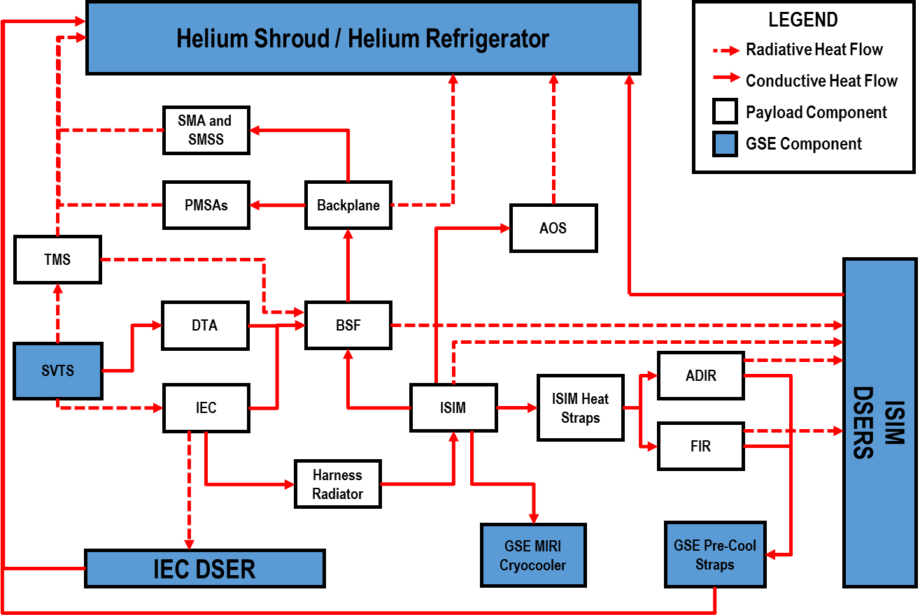
Heat Flows on the OTIS Payload
Notes:
No thermal understanding of a system is complete without examining the heat flows. In the OTIS CV test, the primary source of heat on the OTIS payload was from the IEC, kept at 278 K to ensure the instrument electronics boxes remained within their operating temperatures. The –V3 side of the payload also saw heat from the SVTS radiating to the payload thermal management system or TMS, which isolates the cold optics and instruments. The IEC rejected most of its heat in the –V1 direction through its radiator to the IEC DSER. Any harness parasitic heat loads conducting from the IEC were further rejected via the Harness Radiator to its own DSER before they entered the cryogenic instruments. Within ISIM, the MIRI optical bench was actively cooled to 6 K via its cryo-line leading to the GSE cryocooler. The Near IR instruments and the MIRI instrument kinematic mounts were passively cooled via high-purity Aluminum heat straps to their respective radiators on the FIR and ADIR. The ISIM DSERs facing these instrument radiators provided the final sink for payload heat. On the optical telescope element or OTE side, there is some conduction of heat between the deployable telescope assembly or DTA to the two elements of the PMBSS structure: the backplane and BSF, and further out to the attached PMSA, SMSS, and SMA assemblies. However, the OTE is mainly dominated by radiative heat exchange with its environment. The helium shroud is the main driver for OTE behavior.

Slide 12
Driving Parameters for OTIS Test
Methodology (1 of 2)
One of the primary objectives for the OTIS CV Thermal Test Model was to develop the methodology for cooldown and warmup of the OTIS payload while ensuring payload safety and optimizing test time
For ensuring payload safety, the OTIS CV Test needed to consider all 92 separate thermal limits and constraints (L&Cs) during all test phases:
  These can be divided into four general categories
    Absolute temperature limits
    Structural gradient or temperature difference (ΔT) requirements
    Rate requirements
    Contamination control requirements
Notes:
Now that we understand a bit about the model, we need to comprehend the logic behind operating it to produce useful test results. One of the primary objectives for the OTIS CV test model was to develop the methodology for cooling and warming the OTIS payload while ensuring payload safety and optimizing test time. However, to ensure payload safety we need to understand what its drivers are. The OTIS payload has 92 thermal limits and constraints, all resultant from rigorous review of previously developed L&Cs for flight and for precursor tests. These had been developed over a period of years, and were extensively reviewed and edited by all instrument, ISIM, and optical component teams, as well as contamination control engineers. Hence, these must all be respected during every test phase to be certain that the payload is not at risk of damage. There are four major categories of these L&Cs: absolute temperature limits, which define the hottest and coldest temperatures a component can get to; structural gradient or delta-T requirements, which describe how large a temperature difference can be achieved on a particular component or between components; rate requirements, defining the Kelvin per hour a component can change; and contamination control requirements, in place to prevent sensitive optics which cannot be cleaned from being a collector for contaminants.

Slide 13
Driving Parameters for OTIS Test
Methodology (2 of 2)
Additionally, the following items needed to be addressed:
  Margins for all test hardware to ensure that action was being taken to avoid limits and constraints well before the constraint was violated
  Heater control logic for each ISIM instrument, the FSM and the TM: these needed to reflect the actual hardware installed, as well as control to avoid any limit and constraint violations
  MIRI GSE cryocooler logic: needed to reflect the actual function and stage transitions of the hardware to capture the correct temperatures on the MIRI cryocooler line and MIRI optical bench
The overall goal of OTIS thermal analysis is to achieve a thorough understanding of the driving parameters for payload temperature transition, which “knobs to turn” we have, and when to use them to avert hardware damage
Notes:
Additionally, to develop the OTIS CV test methodology, the following items need to be addressed: one, we need to talk about margins: what temperatures, delta-temperatures, or rates are we comfortable with the payload getting to before we need to take action. Two, the heater control logic needs to be programmed into the thermal model, both to reflect the actual hardware installed, as well as to provide control for specific components to prevent limit and constraint violations. For many components , active control through a heater is the first step to ensuring hardware safety, as changing shroud temperature or rate to mitigate L&C violations costs time and has a global effect on the test article. The last item to manage is the cryocooler logic: the correct lift curves and behavior must be programmed into the MIRI cryocooler model to extract the correct amount of heat from the MIRI instrument, thereby allowing for accurate prediction of both the optical bench and cryocooler line temperatures. The ultimate goal of the OTIS CV test thermal analysis is to understand what our driving L&Cs are when the payload is transitioning cold or warm, what “knobs to turn” we have to avert any L&C violations, and when to use them during the test.
The next few slides will focus specifically on two categories of limits and constraints: structural L&Cs and contamination control L&Cs.

Slide 14
Contamination Control Limits and
Constraints
Since OTIS has a composite truss frame, at 140-170K water is emitted from the composite structure, and at 220-285K molecular contaminants are released
  The sensitive optical components (18 Primary Mirrors, Secondary Mirror, Tertiary Mirror, Fine Steering Mirror, ISIM Pick-Off Mirrors) are at risk of being contaminated unless they are kept warmer than the surrounding structure
  A plan was developed with the contamination control team to actively heat ISIM and FSM mirrors above environment during cooldown and warmup
  Helium shroud and DSER warmup rates were also controlled to prevent
  a large ΔT from forming between environment and primary / secondary / tertiary mirrors
In cooldown, an ISIM contamination avoidance phase was used, keepingall instruments above 170K until ISIM structure stopped emitting water below 140K
In warmup, both active heater control and shroud rate were used to keep all components within contamination constraints at temperature ranges for water emission and molecular contaminant emission
Notes:
First, let’s explore the category of contamination control L&Cs. Since both the PMBSS structure and the ISIM Structure are composite truss frames, they are generally hygroscopic to some degree, meaning they retain some moisture at ambient temperatures, and at low pressures they will release water contamination between 140 and 170K, and molecular contamination between 220 and 285 K. As contaminants migrate and collect on the coldest surface, multiple contamination constraints were developed for the OTIS CV test to prevent any damage to the sensitive optics, which include the 18 primary mirrors, the secondary mirror, tertiary mirror, fine steering mirror, and ISIM pick-off mirrors. The ISIM POMs and FSM baseplate are actively heated above their environment in cooldown and warmup for contamination control. In cooldown, specifically, an ISIM contamination avoidance phase was used, keeping all instrument components above the maximum water emission temperature of 170K until the ISIM structure was below 140K. In warmup, a series of constraints limited the rate of helium shroud and DSER temperature increase such that the ISIM and FSM baseplate heaters could maintain an acceptable temperature difference above their surrounding environment. While it would be preferable for optical surfaces to be maintained warmer than the environment during warmup to prevent contamination, the PMs, the SM and TM do not have direct active thermal control because of the inability to mount heaters on the mirror substrates due to distortion concerns, and are therefore designed to be passively driven by the helium shroud. As a result, the contamination control team imposed delta temperature requirements between these optical surfaces and the helium shroud, allowing the mirrors to be slightly colder, but ensuring that the amount of possible contaminants collecting on these surfaces is minimal and acceptable.

Slide 15
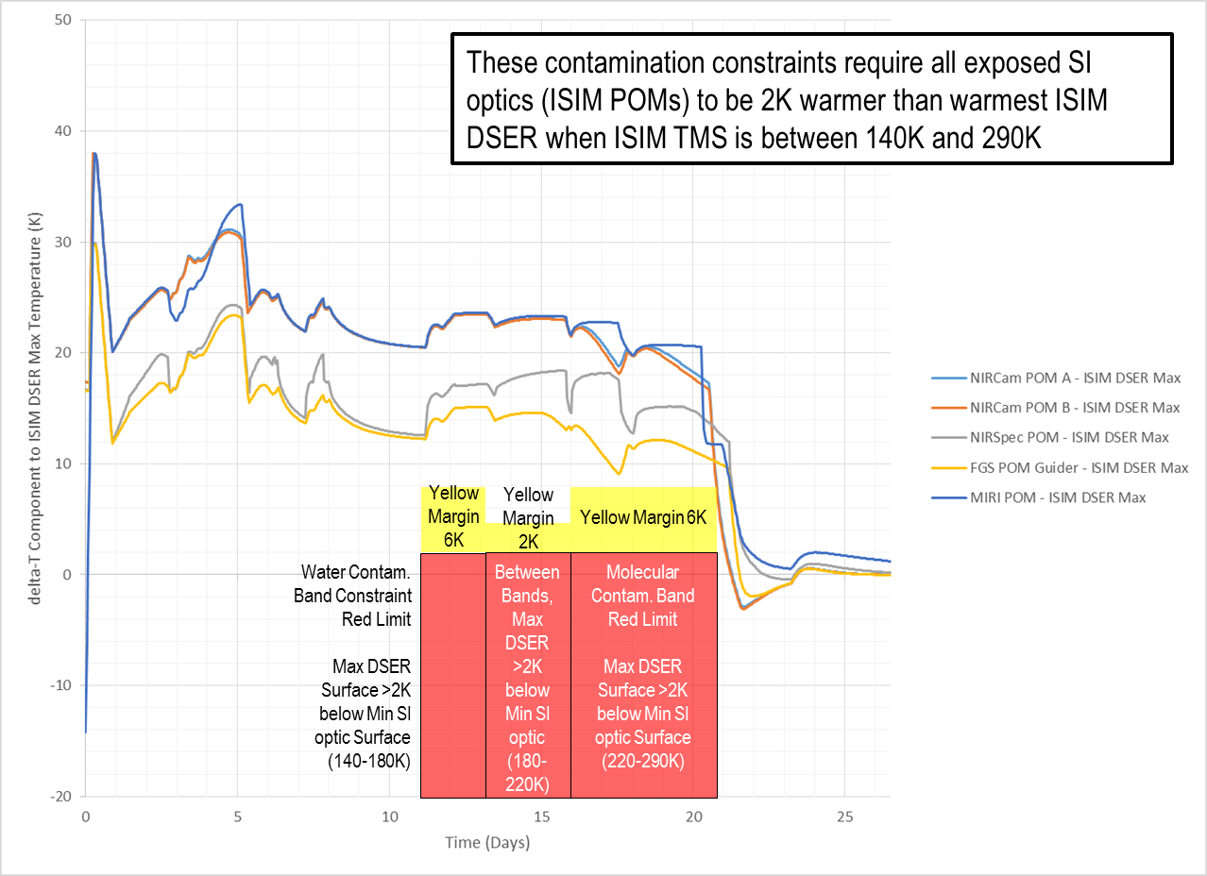
Sample Thermal Model Predictions
Against One Contamination Constraint
Notes:
This slide shows a sample plot predicting payload performance against the contamination constraint requiring all ISIM POMs be warmer than the ISIM DSERs in warmup. The red blocks represent the absolute limits, yellow blocks represent the margins that shall be avoided within and between the water and molecular contamination bands, and the lines are calculated delta-Ts between each ISIM POM and the ISIM DSER max temperature. As seen from the plot, all lines reside above the constraints, indicating compliance with the limits in this phase. Each contamination constraint was similarly assessed with the thermal model cooldown and warmup results to ensure that we were fulfilling the contamination requirements through all phases of the test.

Slide 16
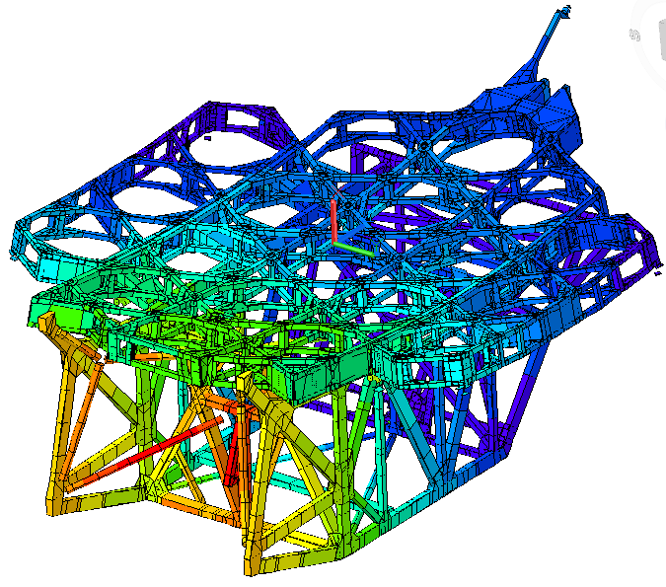
Structural Limits and Constraints (1 of 2)
To maintain structural integrity and prevent any unacceptable stresses from forming in structural joints and members, PMBSS and ISIM structures both have L&Cs defining allowable ΔTs across any two points
  For both structures, this was the result of structural model analysis with predicted thermal gradients and cryo-cycle testing of bare composite structure assemblies
  ISIM structure ΔT requirement
  remained constant
  PMBSS ΔT requirements varied based
  on temperature and if the structure was
  warming or cooling
    Especially challenging to manage
    given the large ΔTs between heat
    sources and sinks inside the
    helium shroud, as well as reliance
    on passive control to maintain
    structural gradients
Source: NASA GSFC
Cryogenic steady-state temperature distribution on PMBSS composite truss structure
Notes:
Next, let’s explore structural L&Cs. In addition to contamination concerns, the composite trusses were also vulnerable to large temperature gradients causing unacceptable stresses in structural joints and members. For both the PMBSS and ISIM structures, there were L&Cs defining allowable delta-Ts across any two points within each structure. These constraints were derived from extensive structural analysis with predicted thermal gradients, as well as cryo-cycling each bare composite structural assembly. The ISIM delta-T requirements were constant at any temperature, while PMBSS delta-T requirements varied based on the bulk average temperature of the structure and if the structure is warming or cooling. In the OTIS CV test, controlling PMBSS gradients was an especially challenging task given the large temperature differences between heat sources and sinks inside the test setup. The helium shroud environment could be as cold as 20 K while the IEC and SVTS ran as high as 290 K, and at certain temperatures the allowable temperature difference across the entire PMBSS structure was as restrictive as 55 K. As an added layer of difficulty, there were no active thermal controls for the PMBSS or ISIM structures. Only passive control based on shroud rate could be used to ensure that nothing was damaged or broken. The picture on the upper right corner of the slide gives an example of the extensive temperature gradients that form on the composite structure at cryo-stable temperatures.

Slide 17
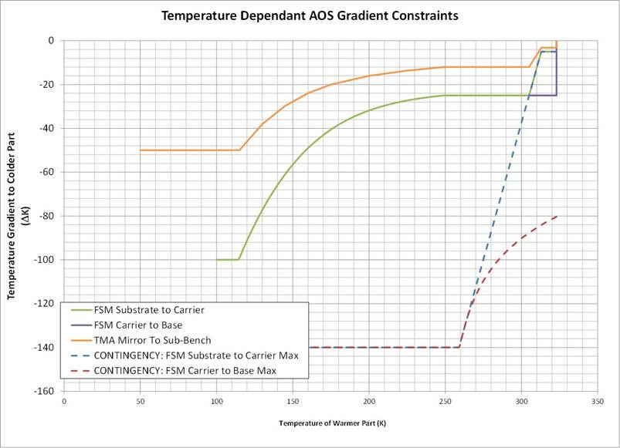
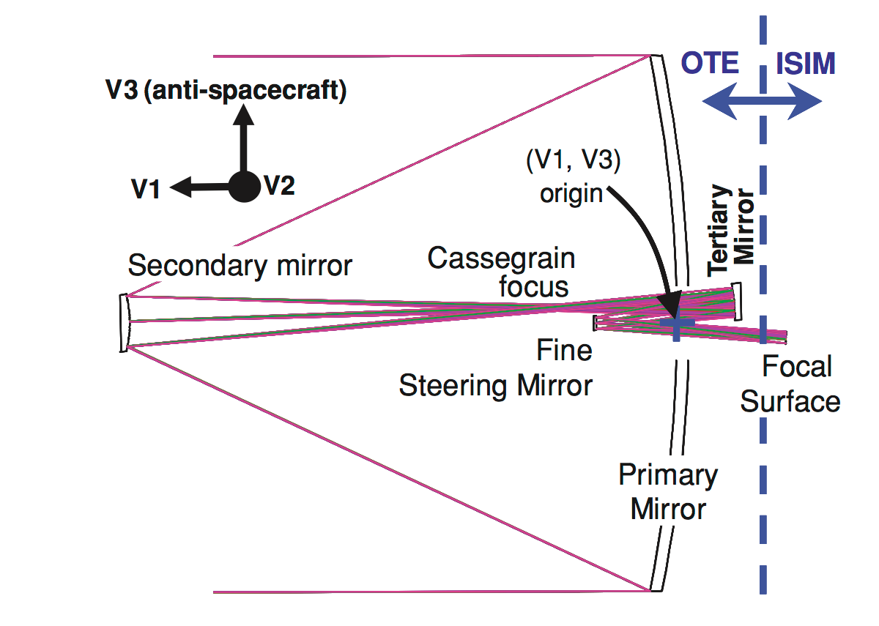
Structural Limits and Constraints (2 of 2)
For mirror assemblies, there are temperature-dependent ΔT requirements between components for structural integrity and to prevent optical distortion
  Violation of limitations on optical components can result in increased surface figure error, resulting in degraded observatory optical performance
  Violation of constraints can cause stress in mirror substrates
    Results in permanent deformation of mirror surface performance
Temperature Difference to Colder Part
Source: Ball Aerospace
Source: Ref. 10
Temperature of Warmer Part
Position of the TM and FSM in the JWST Optical Design
Sample temperature-dependent ΔT requirements for AOS mirror assemblies
Notes:
Another class of structural constraints on the OTIS payload describe the temperature-dependent inter-component delta-T requirements on assemblies. For mirrors, these requirements maintained the structural integrity between the mirror substrates and their structural supports or actuating mechanisms. Any violation of these could result in greater optical distortion, or in an extreme case result in permanent deformation of the mirror surface. The relative position of the tertiary mirror and the fine steering mirror in the optical design is shown on the lower left side of the chart. A sample graph is provided on the lower right side, which shows the allowable temperature difference between TM and FSM components on the AOS with the change in temperature of the warmer component. Aside from mirror assemblies, there were also structural constraints for interfaces to make sure that the temperature differences between them did not compromise their structural integrity. Examples of these are delta-T limits between the AOS and ASPA, and the delta-T limits on either end of the kinematic mounts that secure the ISIM to the BSF.

Slide 18
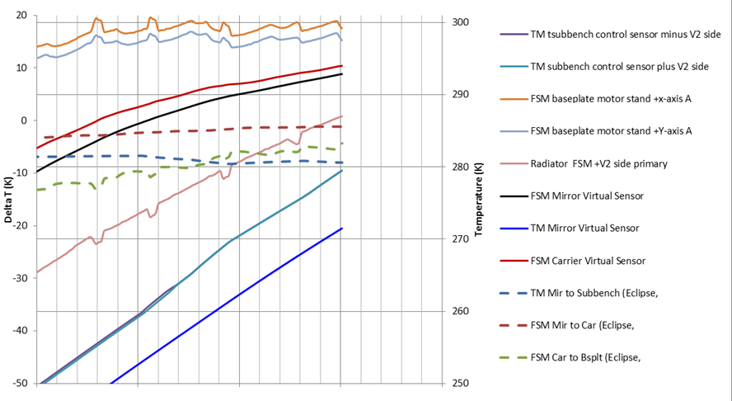
Real-Time Model (RTM) for
AOS Components^{[11]}
There were no sensors on the Tertiary Mirror (TM) and Fine Steering Mirror (FSM) had no sensors to track performance against their structural and contamination constraints
A Real-time Thermal Model (RTM) was developed by Ball Aerospace to produce “virtual sensor” telemetry by calculating energy balances based on nearby sensor data, temperature-dependent conductors and thermal mass
  Provides tracking of TM and FSM temperatures when no physical sensors are available, but “virtual sensors” have uncertainty to them
AOS Warmup Tracking at OTIS Using Virtual Sensor Data
Notes:
Components on the AOS represented a particularly difficult thermal challenge. Both the FSM and TM had inter-component structural constraints. The tertiary mirror had temperature-dependent delta-T requirements between its mirror substrate and its sub-bench. The FSM had temperature-dependent delta-T constraints from the mirror to the carrier, and carrier to the baseplate. There were also contamination constraints levied on both components: the FSM had delta-T constraints to remain in-family with all of the ISIM POMs to prevent cross-contamination, and the TM had delta-T constraints to the helium shroud with the objective of preventing the TM from becoming the driving schedule item in warmup. However, the FSM and TM assemblies only contained one sensor each, and neither were mounted on the mirror substrates for fear that the sensors would distort the mirror figures. Though this hardware decision was made early in the JWST project due to the scarcity of telemetry channels, this lack of sensors made it all but impossible to monitor these extremely stringent structural and contamination L&Cs which arrived late in manufacture, and which required knowledge of temperatures on the substrates as well as the various subcomponents of each mirror assembly.
To allow for real-time tracking during the test, Ball Aerospace developed a reduced thermal real-time model or RTM as a necessity for both the FSM and TM. The RTM was developed as a reduction of the correlated thermal models from AOS subsystem-level tests, and could be calculated in seconds during the test through the Fusion monitoring software rather than hours with the full OTIS CV test thermal model. When operated in conjunction with the OTIS CV test data acquisition system and temperature telemetry from sensors surrounding each assembly, and based on the past couple of timesteps of data acquisition, the RTM provided an estimate every two minutes of mirror temperatures with a temperature-varying uncertainty band. Therefore, these inferred “virtual sensor” temperatures effectively calculated temperature deltas between mirror assembly components and from mirror substrates to the helium shroud or ISIM POMs. However, as mentioned earlier, the modeling uncertainly must be accounted for in all L&C tracking with these components. The plot on this slide shows a screenshot of the real-time model on the Fusion system during warmup. Other than the sensors on the TM subbench and FSM baseplate and radiator, all of the other values were calculated through the RTM.

Slide 19
Example: Constraints for the Fine Steering Mirror (FSM)
FSM had both structural and contamination constraints
  The FSM structural components have temp-dependent ΔTs between mirror substrate, carrier, and baseplate
  FSM Substrate has no sensor: temp must be calculated by RTM
    Uncertainty for calculated FSM temperatures
    The FSM mirror also has a view to the ISIM POMs, possible cross-contamination
    The FSM must be held within a certain temp constraint of each ISIM during temperatures when composite structure emits water (140 K - 170 K) and molecular (220 K - 285 K) contamination.
    ISIM Optics themselves already have L&Cs between each instrument ➔ FSM substrate temperature needs to be maintained almost at median of ISIM temps
    The FSM and ISIM POMs must be warmer than Helium shroud and DSERs
Heater power tables were generated to provide guideline for required FSM heater power during each test phase
Warmest Instrument Optic Temperature (NIRSpec Focal Plane Assembly = NIRSpec Bench Temp + Offset)
FSM Avg + Uncertainty
FSM-to-POM reqt
FSM Average
ISIM Optic-to-Optic Requirement
FSM Avg - Uncertainty
FSM-to-POM reqt
Coldest Instrument OpticTemperature
Offset to DSER
Helium shroud and ISIM DSERS temperature
Notes:
Now, let’s move onto a specific example of constraints levied on a component to illustrate some of the struggles that we faced during the OTIS CV test. We’ll look at the FSM in detail, which had both structural and contamination constraints. (click 1) As mentioned in the previous slide, the FSM structural components could not exceed its temperature-dependent delta-Ts between its mirror, carrier, and baseplate. (click 2) However, the substrate and carrier temperatures must also be calculated by the real-time model since the only location which had a thermal sensor was the baseplate. Due to model limitations and lack of sensor data, there was significant uncertainty to this model, which was greater at colder temperatures. (click 3) Now, further constraining the system, since the FSM had a view to the ISIM POMs, the FSM was required to be held within a certain temperature requirement of each POM and instrument optical assembly during the temperature ranges when the ISIM structure emitted water and molecular contamination, so that neither the FSM nor the ISIM optics became a contamination source nor sink to the other. (click 4) The ISIM optics already had an optic-to-optic L&C between themselves, and the warmest optical component, the NIRSpec FPA, was required to be offset warmer than the NIRSpec bench or OA. Therefore, all of the instrument components traveled in a narrow temperature band during warmup, bound by the NIRSpec bench at the lower end and the NIRSpec FPA at the higher end. For conservatism, the FSM substrate temperature needed to be maintained at almost the exact median of all of the ISIM POM temperatures to ensure that the FSM average minus uncertainly was within the FSM-to-POM temperature requirement to the hottest ISIM POM temperature, and the FSM average plus uncertainty was also within this requirement to the coldest ISIM temperature. (click 5) Additionally, all of the ISIM POMs and the FSM were required to run at a temperature offset above the ISIM DSER which varied by test phase so that the environment around this assembly didn’t contaminate the assembly itself. As you can see, all of the constraints in this system had severely restricted how we could operate the FSM. There was only one way we could correctly operate the FSM to make sure there are no constraints broken.
(click 6) One final complication to this FSM configuration is the FSM heater. To prevent any distortion of the mirror surface during operation, a design decision was made early in AOS development to mount the FSM heater to the baseplate. However, this implied that during the OTIS CV test and in flight, the heater could only provide indirect control due to radiative coupling and weak conductive coupling, introducing a time lag response to heater power changes and adding another level of difficulty to controlling an already highly-constrained component, one which did not have a sensor directly on the substrate for feedback in heater control, but relied on the RTM for calculations of FSM temperature. To aid in test operation, a series of tables were generated by the OTIS CV test thermal model to provide a guideline for the amount of heater power required for each test phase. While the tables did act as a primer, giving test operators a general idea of how much heat flux to apply on the FSM heater every hour during the test, in practice the actual amount of FSM heater power used required extensive judgment of thermal engineer on-shift, both by looking at the performance history of the FSM with respect to all of its L&Cs at that time, and projecting to determine where they would like the FSM to go.
In the OTIS CV test as a whole, the FSM may have been represented a particularly difficult example of the thermal control challenges we faced, but each subsystem and component had its own unique set of obstacles to overcome to ensure safe and effective operation.

Slide 20
Thermal Margin Philosophy for Sparse Sensors
Distributed structural thermal ‘GRADIENTS’
Final red limit
Red – no ops
< Thermal prediction + margin, approved by structural analysis
< then Sparse sensors derating applied
Thermal model defined
Yellow – caution
< Raw thermal prediction using all the math model nodes
Engineering control zone buffer
Operate - green
Notes:
The last topic we need to address before we head on to how we developed the OTIS CV test methodology is that of margins placed on our defined structural constraints. In the OTIS CV test, red limits were placed at the constraint at which permanent equipment damage may occur, while yellow limits were defined as an engineering control zone buffer where, if exceeded, action could be taken quickly to reverse an undesirable trend. In designing the process for the OTIS CV test, we always wanted to control L&Cs to below yellow limits. This slide discusses the margin philosophy for large composite structures such as the PMBSS and SMSS, and the philosophy for interfaces is discussed in the next slide. For large structures, thermal math model temperature predictions at various thermally critical phases of cooldown and warmup were inflated by a multiplication factor to produce a more extreme gradient than the baseline prediction, thus buying margin against model uncertainty. These temperatures were then mapped onto a structural model to determine whether the more extreme distribution produced acceptable stresses. If the stresses were acceptable, the constraint would be placed at the largest point-to-point structural delta-T from the inflated predictions. Generally if we did not meet the first pass inflated gradient limit even after refining the stress analysis, we dialed back on the limit until an acceptable stress level was reached.
Now, we cannot immediately take the constraint determined above and set it as the red limit. Even with the more-than-thousand thermal sensors that populated the OTIS CV test, for many components and interfaces these sensors were not positioned at ideal locations to directly measure their performance against L&Cs. For large composite structures such as the PMBSS and the SMSS, since we also could not place a sensor on every corresponding location to the nodes in the thermal math model to capture all of the temperature extremes seen on the structure, a derating to the red limit must be used to account for the sparsity of sensors in the hardware. Taking the PMBSS as an example, thermal results for cooldown and warmup with all thermal math model nodes for the PMBSS were compared against the group of nodes corresponding solely to thermal sensor locations on the hardware. The maximum temperature difference between these two groups was considered the sparse sensor derating, and the temperature constraint value from the structural model analysis saw this temperature difference subtracted to arrive at the test red limit. The yellow limit was either a fixed temperature offset from or a percentage of the red limit, determined through thermal analysis or other means to be of sufficient temperature margin to take action if exceeded. While we could operate in the yellow zone, dwelling for a long term here could desensitize thermal engineers to this undesirable condition, and would result in continual yellow visual and audible alarms. It was preferable bring the payload out of yellow whenever possible, but a modification to a yellow limit could also be discussed on a case-by-case basis during the test with appropriate approvals from the concerned subsystems, in cases where the yellow violation was stable and not progressing to the red limit. Below the yellow limit, all operations were permissible without a reversal of course or other mitigations.

Slide 21
Thermal Margin Philosophy for Interfaces
INTERFACES-type 1: Sensor(s) on both sides – ideal case.
INTERFACES - type 2: Sensor(s) on one side.
INTERFACES - type 3: No sensor(s)
on either side.
No added sparse sensor derating needed if single point sensors are on isothermal HW)
Red – no ops
L&C document
user red limit
Yellow – caution
15% derating on no sensor side.
Engineering control zone buffer
15% derating on both for no sensor either side.
Operate - green
Notes:
The sparse sensor derating is applied differently when considering interfaces, such as those between mirror assembly components. If there exists a pair of sensors on either side of the interface, there is no need for a sparse sensor derating and the constraint could remain at the value designated by the L&C document, either sourced from that assembly’s hardware specification or user’s manual. However, if there is only one sensor available to measure delta-T across an interface, compliance with the thermal constraint can only be verified through modeling, with the sole sensor temperature as a cross-check of the prediction. Therefore, a 15% derating is applied across-the-board to account for model uncertainty, based on the typical model correlation error experienced in JWST testing. The most undesirable scenario is to have a constraint imposed on an interface when there no sensors to measure the temperature at either side. Verification of these constraints is purely though the thermal model, and therefore a total of 30% derating is applied for model uncertainty. For any operational methodology developed for the OTIS CV test, the thermal model must show that the predicted component temperatures across an interface comply with all of these constraints plus margins to be a viable and safe test method.

Slide 22
Control Methods and Optimization of
Helium Shroud Profile
The OTIS CV test employed both passive and active control methods
  Helium shroud rate is the biggest driver of payload transition rate and hardware safety
    This also directly drives DSER transition rate, all helium uses common refrigerator
    The majority of components on the OTIS payload are passively controlled through interaction with the test environment (composite structure, PMSAs, TMS)
  ISIM instruments, the SM, TM, and FSM, are actively controlled: heaters used when possible to drive transition rate/control L&Cs
Many thermal analysis iterations were performed with different control methodologies to determine the most time-optimized means to cool and warm the payload while ensuring hardware safety
  Since the helium shroud rate is the biggest driver of payload transition, an optimization code was developed allowing the model to analyze a full cooldown or warmup with the shroud temperature as a variable
  All thermally-critical L&Cs were programmed into the thermal model to ensure that the payload was not violating any L&Cs with each time step
NOTE: With all model predictions, coating emissivities cannot be assumed constant within the 20 K – 300 K temperature range of the OTIS CV Test
Two radk files: one with room temperature emissivities and one with cryogenic emissivities
The model transitioned from one set to the other when the PMBSS average reached 90 K
Notes:
With a firm understanding of the L&Cs in the OTIS CV test and a description of margin philosophy, we can now enter to the second part of our lecture: a discussion about what drives our development of the OTIS CV test methodology, and how we determine which “knobs to turn” we use and when to use them to avert any L&C violations. Most OTIS payload components are not actively controlled, and therefore rely on passive thermal control for temperature transitions and hardware safety. For these components, the helium shroud rate is the biggest driver for L&C compliance, and since all helium gas temperature used in the shroud and DSERS are controlled by the same refrigerator, the DSER rate follows the shroud rate. The one exception to this is the IEC DSER, which could be controlled independently of the helium shroud when needed to assure hardware safety in cooldown and warmup. For actively controlled components such as the ISIM instrument benches, the SM, TM, and FSM, heaters are used to mitigate any L&C violations first, and the helium shroud is used as a last resort if the heaters cannot maintain required temperatures. Control logic in the thermal model predictions must follow this priority so that we are not unnecessarily slowing down the shroud for a problem that could be remedied through heater use.
Using these control methods, we then embarked on a thermal analysis campaign to understand the sensitivities of the payload to each control method, as well as to develop the fastest and safest process to cool and warm the payload. Early discussions in developing the control logic for the OTIS CV test thermal model showed the necessity of employing an iterative code to essentially have the transient simulations cool and warm themselves, with the thermally-critical L&Cs as drivers for the helium shroud behavior. The crux of this code logic centers around employing the helium shroud rate as a variable. In any particular timestep, if there are no L&C violations, the shroud is allowed to cool or warm at a pre-determined maximum rate. If there are violations, the model holds the shroud temperature constant. Once the iterative code is run through for one full cooldown or warmup run, we can step back and look at the general trends that emerge out of the iterated shroud profile, and a series of discrete rates becomes apparent for each major part of cooldown or warmup. In fact, there tends to be only one or two constraints that are drivers for the rest of the system in long stretches of both the cooldown and warmup. Therefore, the model effectively uses feedback from payload response to create the fastest shroud profile while ensuring hardware safety.
One large caveat must be mentioned here to our model prediction results. Emissivity for all coatings cannot be assumed constant in the immense range of temperatures that the OTIS CV test experiences. Unfortunately, it is also impractical to have emissivity vary on each component with each timestep, as this would require a new radiation coupling or radk calculation at every timestep, a task that takes up to 24 hours in the OTIS CV test thermal model for just one radk run. To reduce runtime while accounting for some of the effects of temperature-dependent emissivity, it was determined through trade studies that two discrete radk files would be sufficient for making rough schedule predictions with the OTIS CV test thermal model. The first radk file assumes all surfaces have their room-temperature emissivities, while the second set of radks assume that all surfaces have cryogenic emissivities. The PMBSS average temperature passing 90 K was determined to be the most optimal point for transitioning between the two radk sets. Though use of more discrete emissivity sets or continuous emissivity variation as a function of temperate would have improved the solution, this case represented the best trade between accuracy and runtime for the OTIS CV test configuration.

Slide 23
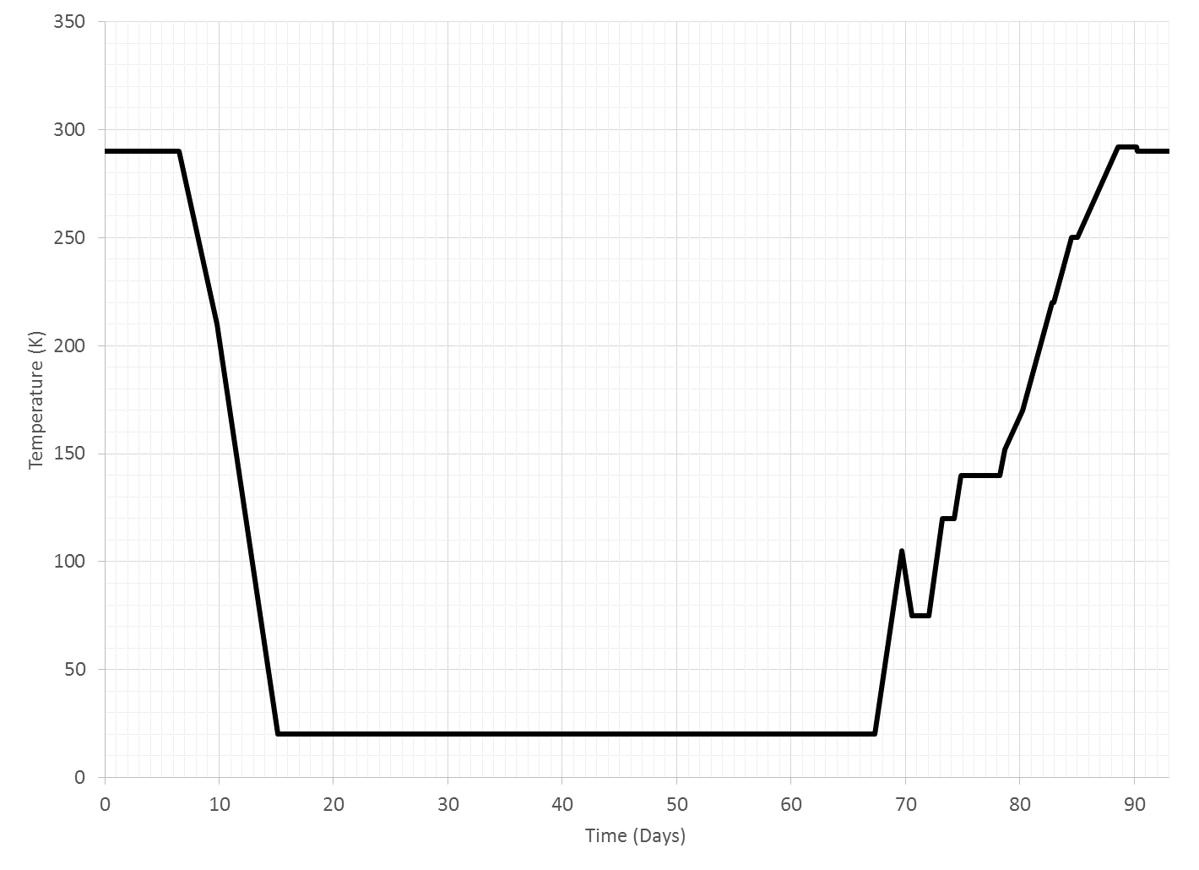


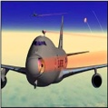


Derived Helium Shroud Profile from Optimization Code^{[12,13]}
Pre-Cryo Warm Vac (6.5 days)
Cooldown (33 Days)
Cryo-Stable (20.9 days)
Thermal
Balance
(6 Days)
Warmup (22.5 Days)
Post-Cryo Warm Vac (3.8 days)
Shroud rate 1 K/hr: avoid exceedance of PMSA Structure Component-to-Component ΔT Constraints
Shroud plateaus at 292 K to drive all optics to their ambient temp requirements, then isothermalizes with payload
Transition to 0.5 K/hr to avoid exceedance of DSER-to-ISIM POM constraint
Molecular Contamination Band 220-285K
Transition to Max shroud rate of 1.5 K/hr, no more limiting constraints for remainder of cooldown
Shroud Hold at 140 K until end of Mechanism Heater Tests and large N2 “burp”
Shroud Rate 1.5 K/hr after completion of NIRSpec hold
Water Contamination Band 140-170K
Shroud Hold 24 hours at 120 K to allow NIRSpec to isothermalize
Shroud rate increases between contamination bands
Shroud Rate 1.5 K/hr after completion of Alignment Drift
Shroud Rate faster then slower to avoid exceedance of PM-to-shroud contamination constraints in water band
Shroud Plateau at 20 K
For Thermal Distortion Alignment Drift Test: Shroud driven at 1.5 K/hr to 105 K, then back down at -1.5 K/hr to 75 K, to be held constant at 75 K
Alignment Drift Test
Mech-anism Heater Tests
Notes:
For our OTIS CV test, this was the final shroud profile generated based on the iterative optimization code. First, I want to draw your attention to the horizontal bands in grey: these indicate the temperatures when multiple species of molecular contaminants and water emit from the composite structure and condense on other surfaces based on their vapor pressures. When the helium shroud is within these temperature bands, additional sets of contamination constraints apply so that the sensitive optics on OTIS aren’t contaminated. Note that molecular contaminants do not stop condensing above 285 K; this was just chosen as a practical upper bound for testing.
Now, each of the colored vertical blocks, as well as the two white ones on the ends, represent a test phase. There are six main test phases pertaining to the principal contamination constraints and to testing. From the model results, it states that when we begin OTIS CV, after we pump down the shroud to less than 1x10^-6 torr, we keep helium shroud temperatures ambient while we conduct tests to verify the functionality of the system in a pre-cryo warm vacuum environment. (click 1) Then, we move to a 33 day cooldown phase to drive the payload to its cryogenic operational conditions for optical testing. The helium shroud starts at a rate of 1 K/hr to avoid exceedance of the component-to-component delta-T requirements on PMSAs, as it was shown from pre-test predictions that 1.5 K/hr would be too aggressive and violate these constraints. Below 210 K on the helium shroud, it was predicted that the PMSA structural L&Cs were past their peak, and there were no other limiting constraints on the shroud rate for the remainder of cooldown, so the shroud is transitioned to its max rate of 1.5 K/hr. By day 16, the helium shroud reaches 20 K, establishing the planned environment for cryo-stable testing, and remains plateaued at that temperature until the start of warmup. We don’t begin the next phase until all of the operational temperatures and stability requirements are met on the payload, at day 39.5. The cryo-stable test phase lasts 20.9 days, followed by an OTE thermal balance for about 6 days. When thermal balance conditions are met, we are ready to warm up.
The prediction for time to warm up the payload is 22.5 days. (click 2) At the beginning of warmup, there is a special thermal distortion test that we need to execute to determine the change in alignment between the primary and secondary mirrors at two separate cryogenic operating conditions. To take measurements for this alignment drift test, we need the PMBSS and SMSS at a different temperature plateau than during the cryo-stable phase, with a thermal stability of under 100 mK/hr. It was determined from thermal analysis that the best way to achieve this would be to quickly drive the shroud to 105 K at 1.5 K/hr, then back down at the same rate to conclude at a plateau of 75K. (click 3) Once the payload reaches its stability requirement at the new temperature and measurements are taken, we resume a shroud rate of 1.5 K/hr to 140 K, with a brief 24 hour hold at 120K to allow the NIRSpec bench gradients to isothermalize. During this transition period, a series of heaters on the DTA, ADIR, SMSS, and PMBSS raise deployment mechanisms to room temperature to both verify that there is enough heater power to do so, as well as simulate the thermal gradients that will develop on these mechanisms during deployment after launch. At 140K, we conduct a prolonged hold for three reasons: one, we’d like our payload gradients to come together, especially those between the optical components and the helium shroud, so that the shroud does not contaminate the optics in the water emission band. Two, we want the mechanism heater tests to complete, since warming further would void the effectiveness of heating these components to room temperature in a cryogenic environment to examine gradients. Three, contaminants such as solid nitrogen have been gathering through the length of the test on cold scavenger plates placed strategically through the chamber, but especially on the large cryo-pumping panels or CPPs which reside between the helium and nitrogen shrouds. At this point, we’d like to be able to pump them out of the chamber without stressing these CPPs further due to the water emission, but to do this we need to raise their temperatures, which causes a pressure increase or “burp” in the chamber as the nitrogen sublimates. This also represents a thermally critical phase as gas conduction from the increased pressure causes greater heat transfer between components. Warm components with a view to cold components could couple better, increasing the risk that a limit or constraint could be violated. Therefore, this phase needs to be watched carefully by test operators to ensure that there is no damage to the hardware.
(click 4) When we are ready to finally resume warmup into the water contamination band between 140 and 170K, the shroud increases at a faster rate until the gap between the temperature for the helium shroud and the coldest primary mirror grows from thermal lag to 35 K, the yellow limit for contamination. Then, the shroud slows to maintain this 35 K gap and avoid any exceedance of the contamination limit. Once 170K is reached on the shroud, the rate increases again as the primary mirror contamination constraint is not applicable anymore. However, inter-component structural constraints on the TM and FSM, as well as the contamination constraint requiring that the FSM and ISIM POMs always lead the DSERs, limit the speed at which we can warm up in this range to about 0.8 K/hr. At 220 K on the shroud, we again perform a quick hold for isothermalizing the optics before progressing into the molecular contamination band. At 250 K, the shroud transitions to a 0.5 K/hr rate to ensure that the ISIM POMs still lead the DSERs, since heater power for most of the instruments is saturated by this point in the warmup, and it becomes increasingly difficult for to actively heat the POMs to lead their environment and avoid contamination. When the shroud achieves ambient temperatures, it holds constant at 292 K and waits for all of the other optical surfaces to catch up. After the 18 primary mirrors, the SM, TM, FSM, and ISIM instruments are all above their ambient requirements, the shroud decreases a few Kelvin to isothermalize with the instruments. At ambient temperatures, a post-cryo warm vacuum period of 3.8 days is planned to conduct functional tests and make sure the payload survived all 93 days of the OTIS CV test intact. Once everything is checked out, the chamber is allowed to repressurize.

Slide 24
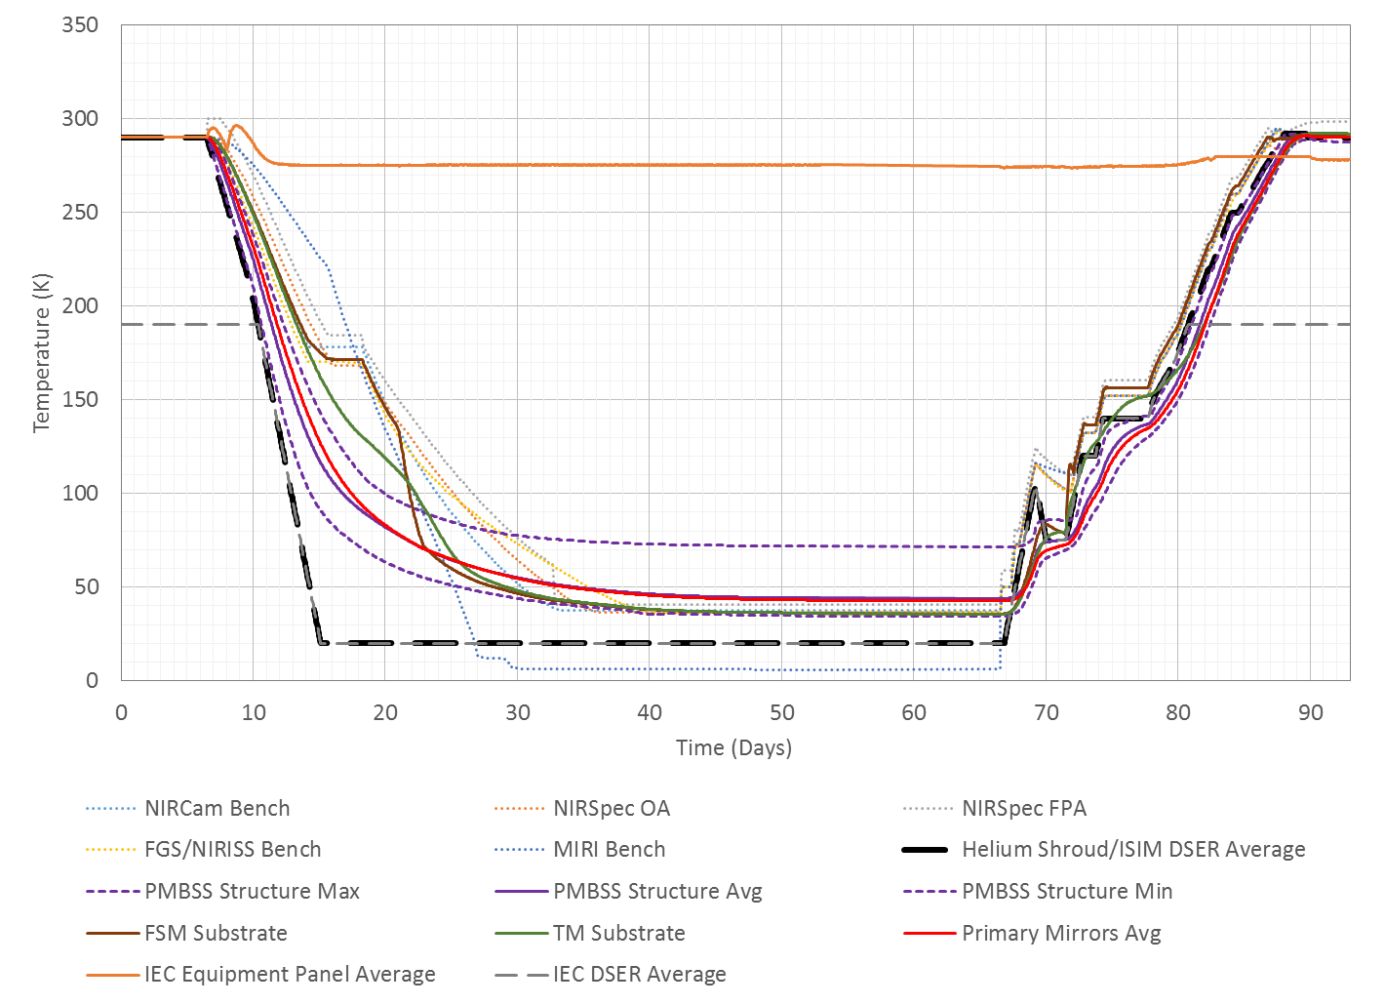
Resultant Payload Performance Predictions from Optimized Shroud Profile
Pre-Cryo Warm Vac (6.5 days)
Cooldown (33 Days)
Cryo-Stable (20.9 days)
Thermal
Balance
(6 Days)
Warmup (22.5 Days)
Post-Cryo Warm Vac (3.8 days)
MIRI cryocooler turn-on
End of molecular contamination band
Start of molecular contamination band
Molecular Contamination Band 220-285K
Contamination avoidance hold for ISIM
End of water contamination band
Start of water contamination band
ISIM heater step-down through water contamination band
Mechanism Deployment Heater Tests
Water Contamination Band 140-170K
ISIM pre-cool strap “zero-Q”
MIRI cryocooler “pinch point”
Notes:
Now, let’s overlay the payload predictions with the shroud profile we introduced in the last slide. Here, we’ve plotted each of the instrument benches, the maximum, minimum, and average temperatures of the PMBSS structure, the PM, TM, and FSM, and the IEC equipment panel, which represents the panel where the instrument electronics boxes are mounted on. Note that the ISIM DSER panels follow the same temperature as the helium shroud, but there’s an additional line for the IEC DSER temperature when the helium shroud is above 190 K. The IEC DSER is plumbed on a separate liquid nitrogen line so that it can provide a 190 K cold sink for the warm electronics during the pre- and post-cryo vacuum ambient tests, but when the helium shroud is below 190 K, it follows the shroud and ISIM DSER profile. The flight IEC itself stays heater-controlled around room temperature throughout the duration of the test to keep the instrument electronics boxes warm.
For the majority of components on the OTIS payload, the thermal mass of each component and its radiative view to the helium shroud are the main drivers for that component’s total cooldown time. At the beginning of cooldown, the helium shroud rate has a large impact on the cooldown rate. However, past five days after the start of cooldown, the temperature difference between the helium shroud and bulk payload average is sufficiently large that further increases in the ΔT causes little additional change to the rate of radiative heat transfer from the payload. This is seen on the PMBSS, TM, and PM behavior, which asymptotically reach their final cryo-balance temperatures by day 40, but mostly do not mirror the helium shroud profile shape.
The science instrument, or SI, cooldown, conversely, is governed by its contamination constraints. When cooldown begins, the near-IR instruments, including the NIRCam, NIRSpec optical assembly or OA, NIRSpec focal plane assembly or FPA, and the FGS passively cool with the shroud profile until each bench reaches around 170K. Then, the contamination constraint requires the critical optical and detector elements in the science instruments to be held via heaters above 170K until the composite tubes of the ISIM structure are below 140K, so that the instruments do not become collectors for the moisture outgassed by the structure. After the ISIM structure falls below 140K around day 15, the MIRI cryocooler is turned on, as seen in the inflection of MIRI cooldown rate at this time. By day 18, once the MIRI bench reaches the temperature range of the other SI benches, the science instruments all “step down” within 5K of each other through the water contamination band through a series of successively lower heater setpoints. Below 140 K and towards cryogenic operating temperatures, the near-IR SIs do not show the same asymptotic behavior as the OTE mirror components because the thermal conductivity of the flight thermal links to the radiators increases by nearly an order of magnitude from ambient to 40K; and the pre-cool straps artificially cool and “overdrive” the radiators to maximize the ΔT between instruments and radiators. When the near-IR instruments reach their operational temperatures, each pre-cool strap uses its zero-Q heater it make its respective interface adiabatic, allowing for a true thermal balance on the payload instruments and radiators. The cooldown of MIRI below 140K is governed specifically by the operation of the cryocooler. MIRI operates in its Pulse-Tube cryocooling mode with cold helium circulation through the cryocooler line and MIRI bench, bypassing the Joule-Thomson cryocooler, until the MIRI optical module reaches 18K. Below 18K, a “pinch-point” occurs where circulation was disabled to the bench and the Joule-Thomson cryocooler was turned on, driving the bench to 6K.
On warmup, the OTIS composite structure, the PMs, the SM, and all of the passive components are driven warm by heat from the helium shroud. The TM is actively heated, but the heater power remains low to prevent the TM from exceeding its inter-component structural delta-T requirements. The ISIM instruments are required by contamination constraints to lead the ISIM DSERs by at least 8K with a goal of 10K, while the NIRSpec FPA leads the NIRSpec bench by 12 K. The FSM, as seen from the earlier slide describing its constraints, is actively controlled to follow the median of ISIM temperatures as close as possible. Therefore, the aim of the instruments and the FSM is to consistently occupy the band of temperatures 10K-22K above the helium shroud and DSERs in the entirety of warmup. During the alignment drift test, after the shroud peaks at 105 K, the instruments are actively held at 115-127 K through the entirety of the shroud’s 75K hold until the shroud temperature catches back up after the completion of the test. These measures are to ensure that the instruments never become a collector for contaminants, and are kept safe until they reach ambient temperatures.

Slide 25
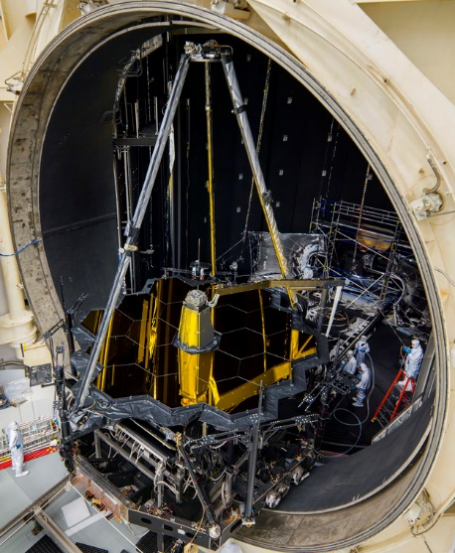
How did we do in test vs. predictions?
Overall, the OTIS CV payload thermal model predicted the hardware performance well in cooldown
  Transient simulation predicted 33 days of cooldown. OTIS payload reached cryo-stable criterion (27 mK/hr on PMBSS average rate, all instruments stable at operating temperatures) at 32 days.
Simplifications made for temperature-dependent emissivity regimes caused predictions to be less accurate when hardware was between 60-170K
Thermal balance predictions matched test results very closely
Warmup of the payload occurred faster than model predictions
  Transient simulation predicted 22.5 days of warmup. OTIS payload reached end of warmup by 20 days.
  Some primary schedule drivers from pre-test warmup simulation were observed to be secondary schedule drivers in test
Image Source: NASA/Chris Gunn
Notes:
So, how did we do in pre-test model predictions versus actual test results? The overall model predictions for major component temperatures during cooldown agreed extremely well with what was observed during test. The model captured both transient and steady-state cryo-stable behavior of the payload well, and was able to anticipate all major areas of concern with respect to L&Cs, allowing the OTIS team to plan well in advance the correct environmental controls to ensure hardware safety. The thermal model predicted 33 days of cooldown, and two major cryo-stable criterion, namely the PMBSS average rate falling below 27 mK/hr and the instruments being stable at their operational temperatures, were achieved by 32 days. However, the simplifications made to reduce temperature-dependent emissivity to only two regimes with a transition when the PMBSS average was 90K caused less-accurate predictions in the range between 60-170K. Predictions tended to cool faster than measurements because of the high room-temperature emissivities before the transition, while predictions were slower than measurements after the transition due to the cryogenic emissivities. For warmup, transition from cryo-stable to ambient temperatures occurred faster than model predictions by more than two days. The payload was overall more responsive to environmental changes in test than in simulations due both to the emissivity assumptions and the use of stacked worst-case scenarios for schedule conservatism. Also, some of the primary schedule drivers from pre-test warmup simulation were observed to be secondary schedule drivers in test. In the water and molecular contamination bands, the assumed schedule driver from predictions was the contamination constraint governing OTE optic surface-to-shroud delta-T. In reality, the driver was the ISIM POM delta-T requirement to maintain above the ISIM DSER temperatures. Let’s now take a detailed look at how the predictions matched test results in each phase.

Slide 26
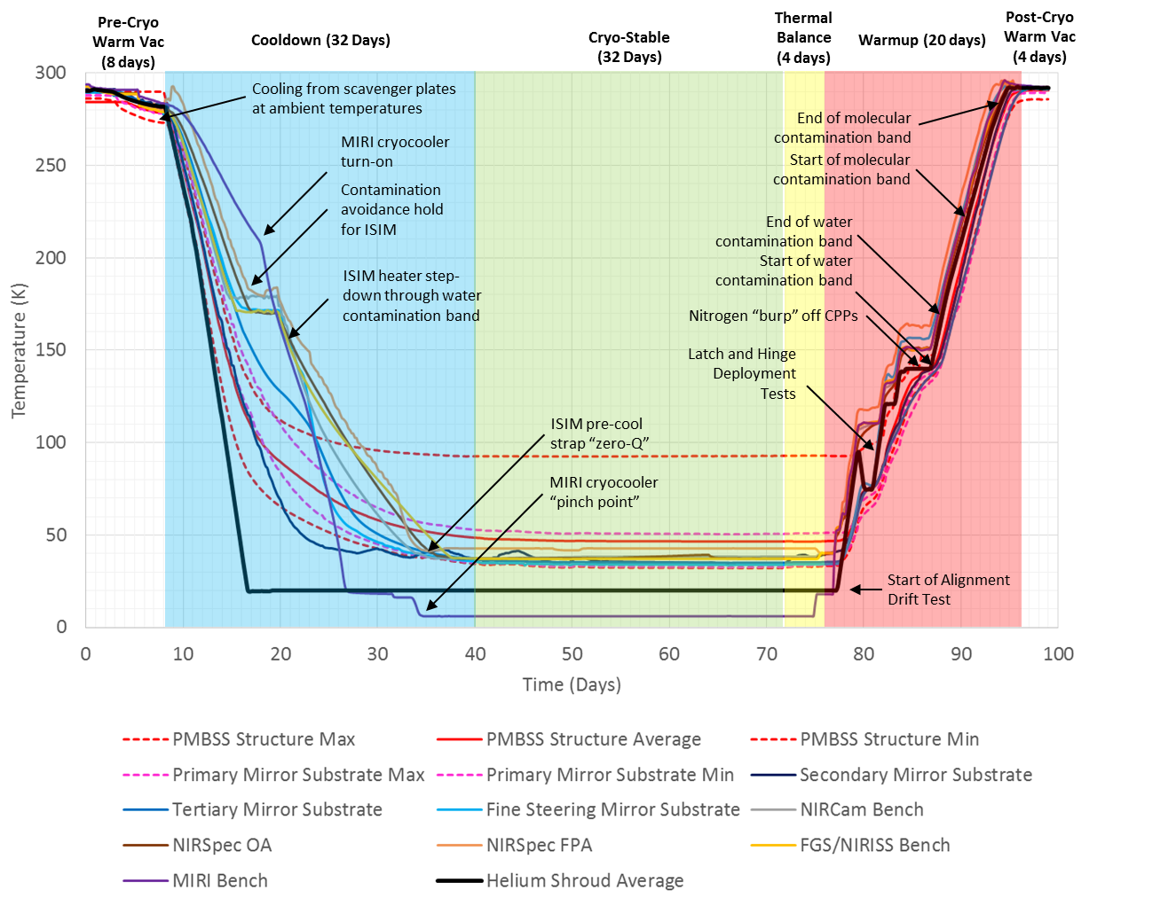
As-Tested Shroud Profile from the OTIS
CV Test
Notes:
Seen here is the as-tested profile for the entirety of the OTIS CV test on the major payload components. When we began the test, ambient pre-cryo vacuum testing with cold scavenger plates resulted in some surprise limit violations. Since we assumed that this phase was conducted in a benign environment, these constraint violations were not anticipated as we did not perform warm transient vacuum simulations with the thermal model. However, the long duration of the pre-cryo warm vacuum phase allowed the cold sink of the scavenger plates to have a large enough impact on the payload to break limits. While this did not cause any damage on the hardware, it certainly alarmed the test operators. Thankfully, the subsequent phases of the test were analyzed in detail before the test by the thermal model. This pre-test planning and analysis averted most other unexpected situations in cooldown, cryo-stable, thermal balance, and warmup. These will be discussed at length in the following slides.

Slide 27
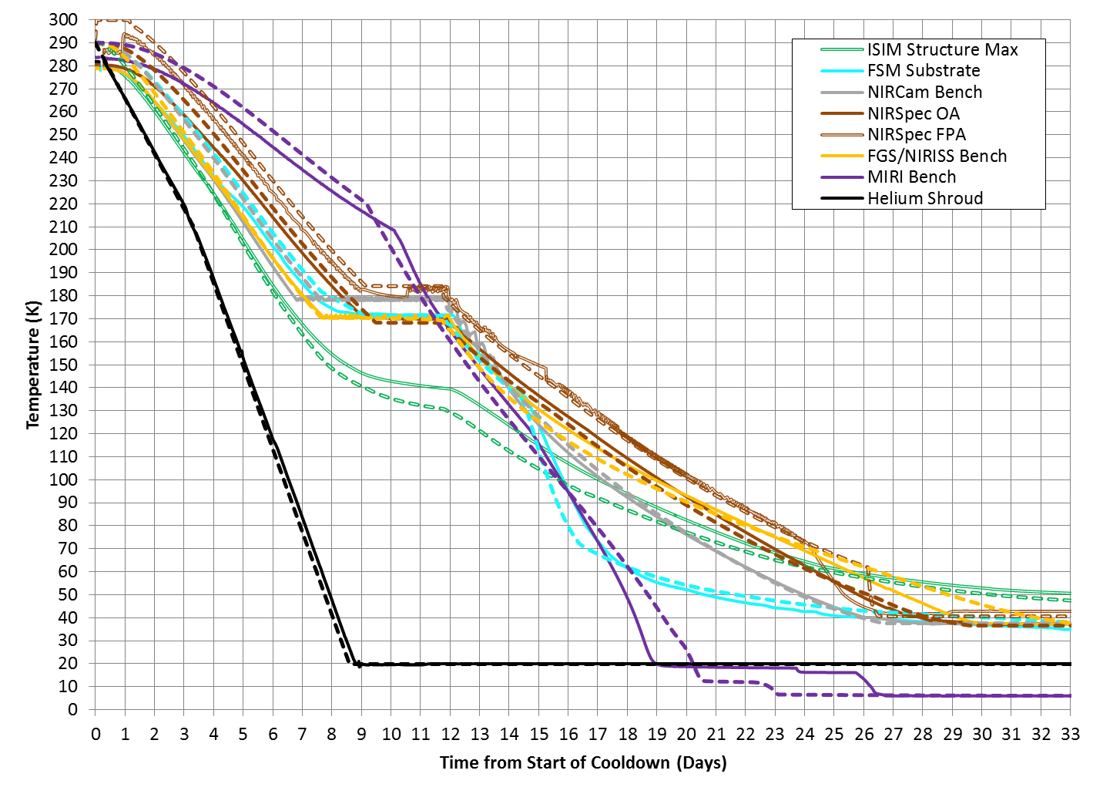
Comparison Between Model Predictions and Measured Test Data in Cooldown: ISIM
Start of ISIM Decontamination Hold
ISIM Structure Max ΔT predicted up to 10 K lower in this range: anticipated earlier end to Decontamination phase
Molecular Contamination Band 220-285K
Instrument step-down through water contamination band at end of ISIM Decontamination Hold
Predicted MIRI cryocooler Pinch-Point
Water Contamination Band 140-170K
Measured MIRI cryocooler Pinch-Point in test
ISIM Decontamination Hold
ISIM
Step-down
Notes:
On the ISIM side in cooldown, the actively-heated instruments all followed their prescribed cooldown profiles closely, indicating that the thermal mass and heat paths out of each of these instruments was captured correctly by the thermal model. Please note that in this and subsequent slides, the dashed lines represent model predictions, and the solid lines represent test measurements. Analogous components in model and test results are matched by color. The near-IR instruments were all held at above 170 K starting on day 7 for the ISIM decontamination hold, then stepped down on day 12 through 14 after MIRI was actively cooled to be in-family with the near-IR instrument temperatures. The model predicted a faster ISIM structure cooldown and therefore an earlier end to the ISIM decontamination hold when the max composite structure temperature was less than 140K. In reality, the ISIM structure took longer to cool down since, due to the use of discrete sets of room temperature and cryogenic emissivities in the interest of model runtime, the emissivity assumptions used in this transition regime were higher than reality. The model also predicted MIRI cryocooler pinch-point occurring at day 22, whereas in test it actually occurred on day 26. However, this is not an inaccuracy in the model predictions. Since the MIRI cryocooler is an actively-controlled thermal system, the transition of modes at pinch-point is purely determined by the parasitics on the cryocooler line and the judgment of the cryocooler team, rather than a predetermined time.

Slide 28
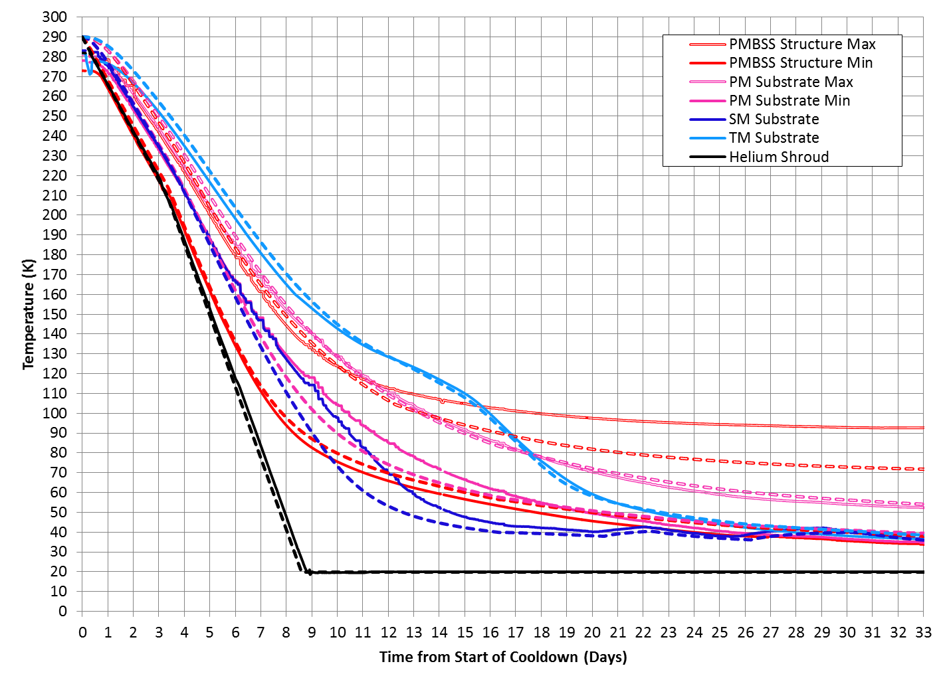
Comparison Between Model Predictions and Measured Test Data in Cooldown: OTE
Divergence of SM (up to 20K) and PM (up to 15K) between pre-test predictions and measured data due to emissivity simplifications in transition regime. Specifically for SM, divergence was also due to activation of SM heater for L&C control
Molecular Contamination Band 220-285K
TM predictions track within 5K of test data through entire cooldown
Divergence of predicted PMBSS structure max up to 22K due to model discrepancy at LRM interface between BSF and IEC
Water Contamination Band 140-170K
PMBSS Stability Requirement (27 mK/hr) met for Cryo-Balance Optical Tests
Notes:
For the OTE optics, the primary mirror predictions followed very closely from ambient temperatures through 170 K. However, below 170 K, especially on the colder PMs, the predictions began diverging significantly from test measurements, up to 15 K difference at 90 K average temperature. Towards the cryo-stable phase, the predictions and measurements converged again. This difference between model predictions and test between 60 and 170 K is again due to the use of the two emissivity sets for the interest of model runtime. When the model predicted transient temperatures on the payload before the emissivity set transition, it overestimated the emissivity on all components, but especially those components which had less thermal mass and reach colder temperatures quicker. Conversely, after the emissivity set transition, the model underestimated the emissivity on all components, but especially those components which were more massive and still warm even after the switch. Hence, for the PMs before the emissivity transition, the model overestimated the PM emissivity and predicted colder than test measurements; after the emissivity transition, the model underestimated PM emissivity, resulting in a slower cooling rate than measured and allowing for model and test results to converge towards cryogenic steady-state. A similar trend is seen on the SM. The TM predictions better correspond to the actual temperature-dependent emissivity variation on tertiary mirror itself. Therefore, the predictions match much better to test measurements through the entirety of cooldown.
On the PMBSS structure, the pre-test predictions for the cold end generally matched well with test measurements. However, for the PMBSS structure maximum temperatures, the model predictions started diverging versus test at about 120 K, and reached a measured quasi-steady value at cryo more than 20K higher than model predictions. This egregious difference between model and test results was extremely surprising to the OTIS team at first, given that the model generally predicted within ±3K for all other major components. Subsequent investigation found that this temperature difference was due to model error on the BSF composite conductance, which incorrectely predicted the distribution of temperature gradient between the room-temperature IEC and roughly 70 K BSF across a launch-release mechanism interface. The bulk of the other sensors spread through the PMBSS structure showed close matches between model and test, and assessments by the structural team proved that this localized hot spot at the LRM interface had a negligible impact on the structural integrity of OTIS. This error will be covered more in detail in the fourth lecture, which describes the lessons learned from the OTIS CV test.

Slide 29
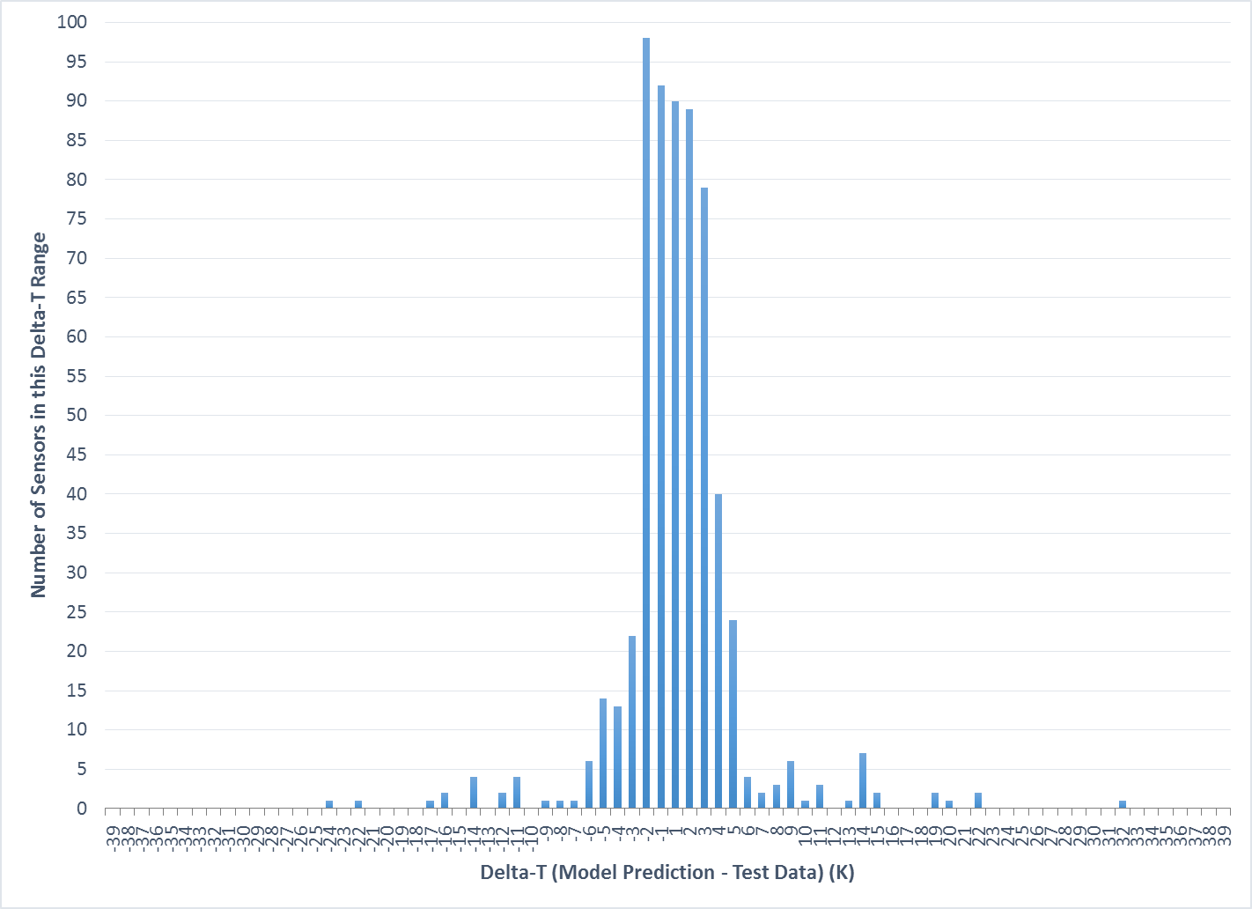
Thermal Balance: Temperature Difference Between Model and Test Sensors
Vast majority of temperatures were within 3K of predictions
PMSA mechanisms predicting colder in OTIS model than test
DTA and IEC predict warmer than test due to configuration differences in model / some incorrect model assumptions
Discrepancy at BSF/IEC LRM Interface
Notes:
After the completion of the cooldown and cryo-stable phases, a thermal balance was achieved on the payload to obtain measurements for OTIS CV and flight model correlation. This histogram shows the ΔT of model predictions minus test data for all hard structure sensor locations at thermal balance, out of the more than 1000 sensors on this very large test article, as a way to quantify model accuracy and obtain a general understanding of how well the model performed versus test measurements. The steady-state comparison of model to test showed extremely good correlation: over 90% of all test sensor measurements were matched within ±4 K by model-predicted values at corresponding sensor locations. This gave strong confidence that the OTIS CV thermal model captured accurately the payload behavior in the cryo-stable test environment, and further provided assurance that the flight model would be an accurate predictor of temperatures on-orbit, since the OTIS payload model was directly sourced from Northrop Grumman Corporation’s flight model. The bulk average of all of the predicted temperatures to their corresponding measured sensors was to within 0.1 K. Even so, there are some outliers. The discrepancy at the BSF/IEC interface on the PMBSS structure, as explained in the previous slide, accounts for the extreme model deviations colder than test measurements. On the other end, the sensors around the SVTS, IEC, and DTA region predicted warmer in the model than in test. This effect was eventually attributed to the blanket performance on the IEC. The OTIS payload model assumed a conservative ε* value of 0.03 for IEC MLI through-thickness effective emissivity, carried over from the flight observatory model. This allowed more heat to escape from the warmest payload components inside the chamber (the room-temperature instrument electronics boxes) and raised the background sink temperature of the entire modeled test environment. However, in test, the IEC released less heat than expected to the environment due to two factors: the conductance from the IEC to the supporting GSE struts was correlated from test data to be greater than predicted, reducing the amount of radiated heat; and the assumed ε* value of 0.03 was too large given the beginning-of-life properties of the blankets. This contributed to a lower background sink temperature, causing the sensor measurements in these regions to be consistently lower than model predictions.

Slide 30
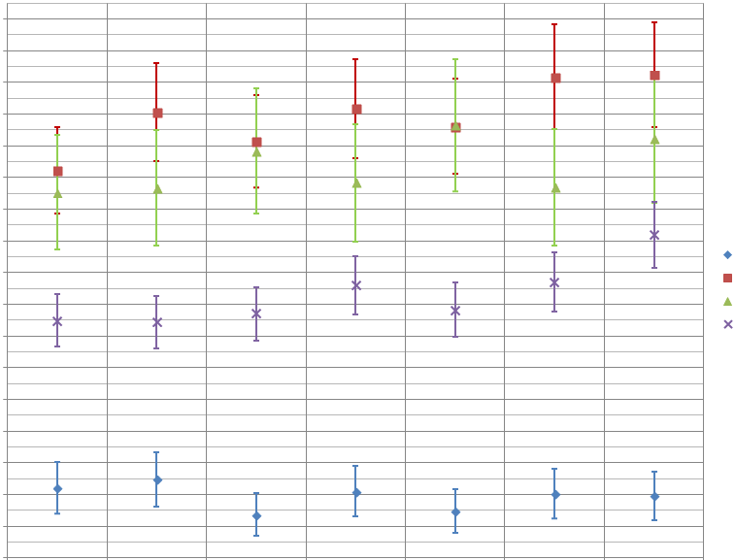
ISIM Heat Strap Conductance
Measurements^{[14]}
390
370
350
330
310
290
270
250
230
210
190
170
150
130
110
90
70
50
FGS
NIRCam
NIRSpec OA
NIRSpec FPA
Strap Conductance (mW/K)
ISIM CV2 Cold Balance (GS) | ISIM CV2 Warm Balance (GS) | ISIM CV3 Cold Balance (GS) | ISIM CV3 Warm Balance (GS) | ISIM CV3 Cold Balance (GS) | ISIM CV3 Warm Balance (PM) | OTIS Test Cold Balance (PM)
Notes:
To satisfy another balance objective during the OTIS test, the poor-man Q-meters or PMQMs were developed as a tool to measure end-to-end thermal conductance for each ISIM instrument heat strap and ensure that their performance and integrity have not degraded with each successive test and installation. As we are measuring milliwatt-level variations at cryogenic operational temperatures, this testing was performed with the smaller operational trim heaters on each instrument rather than the large contamination control heaters used for cooldown and warmup. Previously, for the ISIM CV testing, the measurement for thermal conductance was taken by changing the trim heater power per instrument and observing the change in Q-meter reading versus the change in strap delta-Temperature. However, in OTIS, the available “head-room” for signal using the trim heaters was very small due to their already high settings to maintain operational temperatures. This small signal was further washed by normal system oscillations due to instrument optical testing. Eventually, an in-situ workaround was implemented, using the Harris pre-cool strap zero-Q heaters to warm the radiators of each instrument, then turning down each trim heater to maintain the same approximate instrument temperatures during testing. This resulted in much larger strap Delta Delta T which was large enough for meaningful measurement against system instability. The plot shown on this slide compares the measured thermal strap conductance for each of the near-IR instruments from the ISIM CV2 through OTIS CV. The acronyms on this plot indicate how the measurement was taken: GS implies an independent GSE Q-meter developed specifically for measuring heat flow, whereas PM implies the in-situ Poor-Man Q-meters. The OTIS measurements were consistent with all previous levels of testing, indicating that the instrument heat straps maintained their integrity through the whole integration and testing process.
Similarly, a measurement of end-to-end MIRI cryocooler heat load was also possible in the OTIS test. A procedure was developed to measure the amount of heat lifted from the MIRI instrument through the cryocooler. By comparing these measurements to previous values in the ISIM CV tests, the cryocooler team could determine if there were any extraneous heat loads present that could indicate damage following integration or OTIS environmental testing. From the OTIS CV test, it was determined that the measured cryocooler heat loads were consistent with those modeled and expected from the hardware.

Slide 31
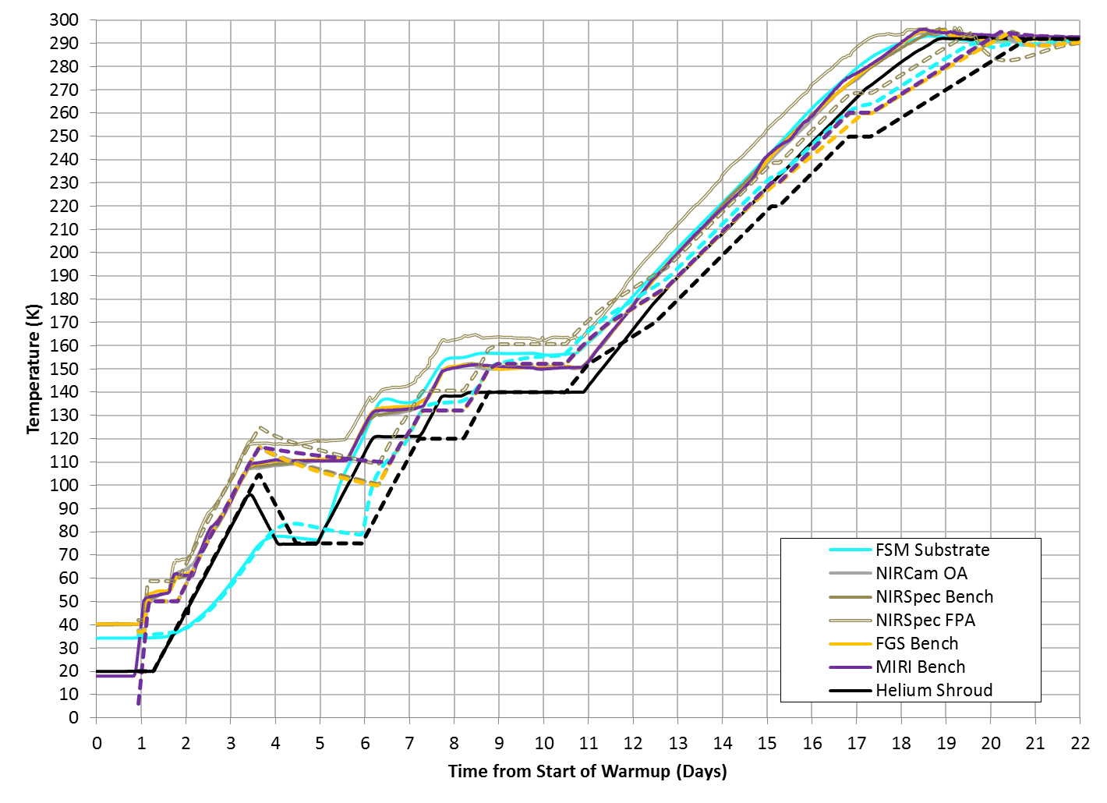
Comparison Between Model Predictions and Measured Test Data in Warmup: ISIM
Discrepancy between model predictions and test measurements in warmup rate due to model bias towards schedule conservatism, as well as changing of contamination requirements in-test
Molecular Contamination Band 220-285K
End of molecular contamination band
Hold of ISIM instruments at Alignment Drift test “peak” values
Start of molecular contamination band
Water Contamination Band 140-170K
End of water contamination band
Mechanism Deployment Heater Tests
Start of water contamination band
Alignment Drift Test
Notes:
Progressing to warmup, the response of the payload was less well-matched temporally between the model and test results. On the ISIM side, all of the instruments were pre-heated to greater than 50K before the start of shroud warmup to prevent any migration of contaminants from the shroud to the instruments as they transferred to the cryo-pumping panels, which now act as large scavenger plates and take the shroud’s place as the coldest surfaces in the chamber. As the shroud began to increase in temperature, the instruments occupied a band 10-22 K warmer than the shroud temperature through most phases. However, at the peak of the alignment drift test, rather than following the shroud down in temperature, the instruments held at their peak values until the shroud caught back up again after the end of alignment drift. During this entire phase, the FSM and TM were not actively heated since it would influence the PMBSS gradients. With the completion of alignment drift, the FSM heater was powered rapidly so that it could be in-family with the ISIM temperatures before the start of contamination constraints above 140 K. At the end of the 140 K shroud hold, after the end of the mechanism deployment heater tests, the previously-mentioned nitrogen “burp” occurred from sublimation of solid nitrogen as the cryo-pumping panels began to warm, raising the pressure in the chamber. While the instruments being in a cold environment were relatively unaffected, the external surfaces of the room-temperature IEC coupled to colder sinks, dragging down the soft structure temperatures. Thankfully, despite some cold limit violations, quick actions taken by the thermal test operators to slow the rate of sublimation prevented any risk of hardware damage. Through both alignment drift and deployment heater testing on the ISIM, the model matched test results fairly well when comparing the instrument temperature offsets to a given shroud temperature.
Into the water and molecular contamination emission bands, the model consistently predicted a slower warmup rate than was executed during the test. The helium shroud warmup rate was driven by both the contamination constraint to maintain all of the OTE optics within 35 K of the average helium shroud temperature, as well as the constraint to maintain the ISIM and FSM above the shroud and DSERs. The original pre-test thermal analysis stacked worst-case conditions to predict warmup through these contamination bands with ample schedule conservatism, excluding the benefits of gas heat transfer during the nitrogen burp to bring the mirrors closer to the helium shroud temperature, as well as allowing for interim holds to keep all of the instruments in compliance with contamination limits. The thermal model predicted that the helium shroud rate would need to decrease to as low as 0.5 K/hr average to limit the lag of the OTE optics and keep the instruments actively controlled ahead of the DSERs. However, when it was observed in test that all of the OTE optics and instruments could maintain a faster rate with respect to the shroud without violating any constraints, and it was deemed acceptable by the contamination control team that the instruments only lead the ISIM DSERS by 6.5 K in the interest of schedule, the helium shroud was sustained at 0.6-0.8 K/hr through the end of warmup. The TM heater was also turned on through most of the warmup post-alignment drift to prevent the TM from becoming a schedule driver. Therefore, the completion of warmup actually occurred more than two days earlier than pre-test predictions. This trend can be seen in the next slide as well, which describes the OTE warmup.

Slide 32
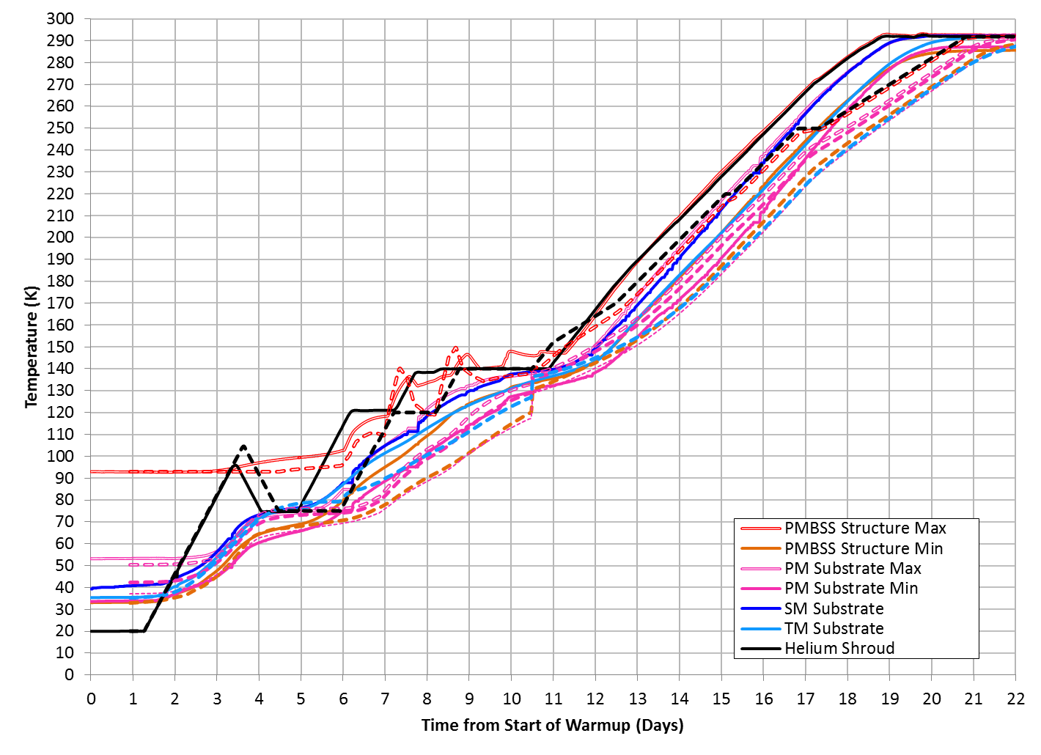
Comparison Between Model Predictions and Measured Test Data in Warmup: OTE
Molecular Contamination Band 220-285K
Thermal Distortion Alignment Drift Test: test-predicted peak for driving PMBSS and SMSS was 105K on the Helium shroud. Actual payload response only required shroud to be driven to 95K
Large N2 “burp” event
Water Contamination Band 140-170K
Mechanism Deployment Heater Tests
Alignment Drift Test
Notes:
On the OTE side, the thermal distortion alignment drift test was executed at the beginning of warmup as the PMBSS and SMSS were driven as quickly as possible to sub-100 mK/hr stability at a 75 K average, achieving a stable condition for photogrammetry measurements of the OTIS payload structural geometry. The model predicted that this overdrive maneuver on the structure would require the helium shroud to increase at 1.5 K/hr to a 105 K average, then decrease to 75 K, after which it would hold constant at 75 K until both the PMBSS and SMSS were below their temperature rate requirements for data acquisition. In reality, the payload structure responded much more quickly than expected. From pre-test analysis, it was understood that a “trigger point” for reversing the helium shroud rate occurred when the PMBSS structure average reached 71 K. While in predictions, this point occurred when the shroud was at 105K, the PMBSS reached this 71K average in test when the helium shroud was only at 95 K. This required immediate response from the thermal team to turn the helium shroud rate to -1.5 K/hr and stem the rise of the PMBSS and SMSS temperature, both preventing a longer recovery time to 75K average and allowing for these structures to settle sooner at their stability requirements. The entire alignment drift phase completed one full day earlier than predicted, but why was the model off in its schedule predictions? Well, it was found later that the faster overall payload response was again due to the pesky simplification of emissivity tests to only one cryogenic set and one room temperature set. As the payload rose above cryo-stable temperatures, the assumption of cryogenic emissivities was no longer completely valid, and therefore the model underestimated the amount of heat transfer actually occurring on the payload. As such, the model response was slower and more temporally conservative than what was observed during the test.
Beyond the end of the thermal distortion phase on day 5, the model predictions matched test results on the OTE fairly closely. The duration of the helium shroud rise to 140 K and subsequent payload response was similar to expectations from pre-test analysis. The length of the 140 K helium shroud hold differed however, as the model did not attempt to simulate the gas conduction during the N2 burp event, and therefore did not capture the correct temperature distribution across the payload before the start of the next phase, which were more favorable towards a faster shroud rate. As mentioned in the last slide, the predicted OTE behavior reflected schedule conservatism in the model, and the OTE optics took longer to warm in the model than in test.

Slide 33
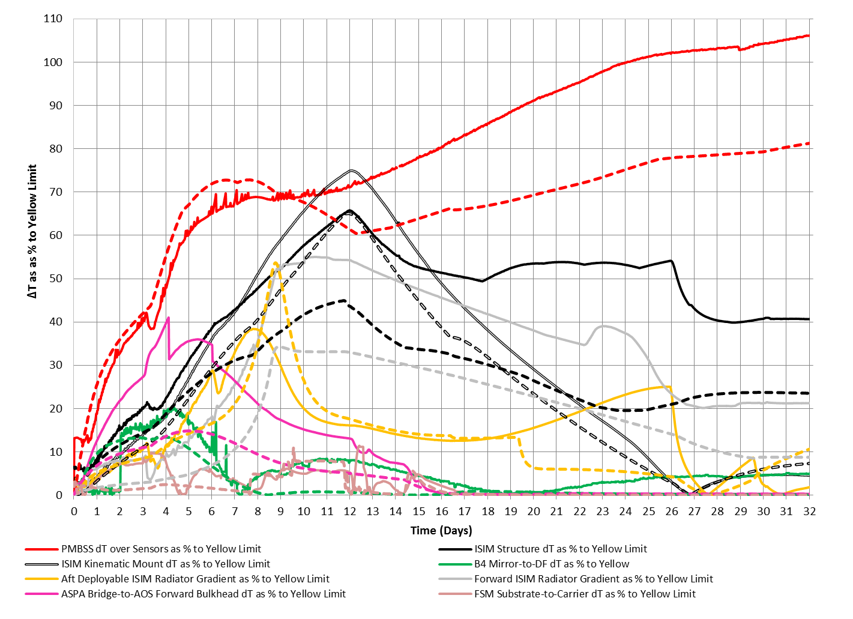
Sample ΔT as % to Yellow Limit Plot for L&C Tracking
Notes:
As a final note before we conclude this lecture, plots like these were used extensively in pre-test analysis and the OTIS CV test to track our performance against critical L&Cs. Each line shown here is a plot of delta-T as a percentage to the yellow limit of a critical constraint over the entire cooldown period. If any line reaches 100% on the vertical axis, then the yellow limit has been exceeded and action must be taken immediately to reverse the trend before it exceeds the red limit. The percentage to the requirement or red limit was also trended in these cases as a cautionary measure, but if any changes were made in-test to limits per subsystem approval, they were reflected in these plots. As before, the dashed lines represent predictions, and the solid lines represent test measurements. From the plot, the predicted delta-T as % to constraint for most structural components were of the correct magnitude and shape as what was measured in the test. However, there were notable model underpredictions with the ISIM structure point-to-point delta-T, the ASPA-to-AOS allowable delta-T, and PMBSS structure point-to-point delta-T versus what we observed in test. In the case of the ISIM structure and the ASPA-to-AOS delta-T, since these were never driving constraints that approached their limits, model inaccuracy in predicting gradients did not put any hardware at risk. However, for the PMBSS structure past day 24 and towards the end of cooldown, there was a yellow limit exceedance which could not be mitigated because the PMBSS was settling into its steady-state gradient based on its cryo-stable environment. This underscores the profound importance of model accuracy in a test of this magnitude, where thermal predictions play a large role in determining the method of test execution and verifying model safety during temperature transitions. Though we were lucky that, with some emergency structural analysis, we determined the area of the PMBSS structure causing the delta-T exceedance would not impact its structural integrity as a whole, one can imagine a scenario where an unexpected constraint exceedance may compromise certain phases of the test or at the very least, lead to schedule delays as we try to reverse undesirable trends.

Slide 34
Part II Summary
In this lecture, we completed a detailed discussion of the OTIS CV test thermal model, covering the following topics:
  Driving constraints for model development
  Process for developing the OTIS CV test methodology
  Comparison of pre-test predictions with test measurements
In the next lecture, we will discuss the pre-test planning for off-nominal events
  Off-nominal “matrix” for emergency actions to take at each phase of the test
  How pre-test planning prepared us for actual off-nominal events in our test
Notes:
In summary, for Part II, we completed a detailed discussion of the OTIS CV test thermal model. We began with the driving payload constraints for our OTIS CV test, including contamination and structural L&Cs, and how they impacted or model development. This topic led into the process for developing the OTIS CV test methodology, with focus on how we optimized the shroud profile. Finally, using our pre-test results, we compared these against the test measurements to see where our model performed well and where it fell short.
In the next lecture, we will talk about the extensive pre-test planning we performed to prepare for off-nominal events, both in failures of the test system such as loss of vacuum or loss of helium control, as well as unplanned scenarios such as fires or storms which require emergency safing of the test article. Since each scenario requires a different response in different phases of the test, an off-nominal matrix was developed matching scenario and test phase to determine response. This will be discussed in detail, leading to an assessment of how well all of this pre-test planning actually helped us when we encountered our own off-nominal scenario during the OTIS CV test.

Slide 35
Reference: Acronyms
Acronym | Definition | Acronym | Definition
AOS | Aft Optical System | ESA | European Space Agency
ACF | Auto-Collimating Flat | FGS | Fine Guidance Sensor
ADIR | Aft Deployable ISIM Radiator | FIR | Fixed ISIM Radiator
ASPA | Aft Optical System Source Plate Assembly | FPA | Focal Plane Arrays
BP | Back Plane | FSM | Fine Steering Mirror
BSF | Backplane Support Fixture | GSE | Ground Support Equipment
CoCOA | Center of Curvature Optical Assembly | GSFC | NASA Goddard Space Flight Center
CPP | Cryo-Pumping Panels, cold panels between the Helium and LN2 shrouds at NASA JSC | HOSS | Hardpoint and Offload Support Structure
CSA | Canadian Space Agency | IEC | ISIM Electronics Compartment
CTE | Coefficient of thermal expansion | IR | Infrared
CV | Cryogenic Vacuum | ISIM | Integrated Science Instrument Module, which contains the Science Instruments (SIs)
ΔT, Δt | Change in temperature; change in time | JSC | NASA Johnson Space Center
DTA | Deployable Tower Assembly | JWST | James Webb Space Telescope
DSERS | Deep Space Environment Radiative Sink | K | Kelvin
EC | European Consortium | L&Cs | Limits and Constraints

Slide 36
Reference: Acronyms
Acronym | Definition | Acronym | Definition
L5 | Layer 5 Sunshield simulator | PM | Primary Mirror(s)
LN2, N2 | Liquid Nitrogen; Gaseous Nitrogen | PMSA | Primary Mirror Segment Assembly
LRM | Launch Release Mechanism | PMBSS | Primary Mirror Backplane Support Structure (BSF + BP)
MIRI | Mid-Infrared Instrument | Q | Heat
MLI | Multi-Layer Insulation | SI | Science Instrument
NASA | National Aeronautics and Space Administration | SINDA | Systems Improved Numerical Differential Analyzer modeling tool
NGAS | Northrop Grumman Aerospace Systems | SM | Secondary Mirror
NIRCam | Near-Infrared Camera Instrument | SMA | Secondary Mirror Assembly
NIRSpec | Near-Infrared Spectrograph Instrument | SMSS | Secondary Mirror Support Structure
OA | Optical Assembly | SVTS | Space Vehicle thermal Simulator
OGSE | Optical Ground Support Equipment, a series of pre-OTIS Optical pathfinder tests | TM | Tertiary Mirror
OTE | Optical Telescope Element | TMS | Thermal Management System
OTIS | Optical Telescope Element plus Integrated Science Instrument Module (OTE + ISIM) | TPF | Thermal Pathfinder test
PG | PhotoGrammetry cameras | W | Watt(s)
POM | Instrument Pick-Off Mirror

Slide 37
References (1 of 2)
Franck, R. A. “Thermal design, build and test of the JWST Aft Optics Subsystem.” Cryogenics vol. 64, pp. 235-239. 2014.
Franck, R. A. et al. “JWST Core2 Thermal Test Design.” 47th International Conference on Environmental Systems. Charleston, SC, July 17-20, 2017.
Kimble, R. A. et al. “Cryo-Vacuum Testing of the JWST Integrated Science Instrument Module.” Proceedings of SPIE. Vol. 9904, id. 990408. 2016.
Glazer, S. and Comber, B. “James Webb Space Telescope Integrated Science Instrument Module Thermal Vacuum/Thermal Balance Test Campaign at NASA’s Goddard Space Flight Center.” 29th Space Simulation Conference, Annapolis, MD, Nov 14-17, 2016.
Franck, R. A. et al. “Optical Element Thermal Modeling for JWST to Support System Level Ground Tests” 44th International Conference on Environmental Systems. Tucson, AZ, July 13-17, 2014.
Park, S., Freeman, M., Cohen, L. “JWST PMBSS Deployable Wings Thermal Management during Cryo-Cycle at XRCF” 44th International Conference on Environmental Systems. Tucson, AZ, July 13-17, 2014.
Havey, K., Cooke, D., Huguet, J., and Day, R. “Thermal Management of JWST Cryo-Vacuum Test Support Equipment.” 48th International Conference on Environmental Systems. Albuquerque, NM, July 8-12, 2018
Cooke, D., Day, R., Havey, K., and Huguet, J. “Developing Controlled Conductive Boundaries for JWST Cryogenic Testing.” 48th International Conference on Environmental Systems. Albuquerque, NM, July 8-12, 2018

Slide 38
References (2 of 2)
Huguet, J., Day, R., Havey, K., and Cooke, D. “Thermal Control of Boundaries for JWST Infrared Tests in Cryogenic Vacuum Configuration.” 48th International Conference on Environmental Systems. Albuquerque, NM, July 8-12, 2018
Gardner, J.P. et al. “The James Webb Space Telescope”, Space Science Reviews vol. 123, 485. 2006.
Franck, R., Schweickart, R., and Comber, B. “The Use of Real Time Models to Produce Virtual Sensor Telemetry During the JWST OTIS Test.” 48th International Conference on Environmental Systems. Albuquerque, NM, July 8-12, 2018
Yang, K., Glazer, S., Ousley, W., and Burt, W. “Thermal Considerations for Reducing the Cooldown and Warmup Duration of the James Webb Space Telescope OTIS Cryo-Vacuum Test.” 47th International Conference on Environmental Systems. Charleston, SC, July 17-20, 2017.
Yang, K., et al. “Thermal Model Performance for the James Webb Space Telescope OTIS Cryo-Vacuum Test .” 48th International Conference on Environmental Systems. Albuquerque, NM, July 8-12, 2018
Comber, B., Glazer, S., and Cleveland, P. “James Webb Space Telescope Integrated Science Instrument Module Design, Optimization, and Calibration of High-Accuracy Instrumentation to Measure Heat Flow in Cryogenic Testing” 41st International Conference on Environmental Systems, Portland, OR, July 17-21, 2011. AIAA 2011-5009.

