Slide 1
Neil Dennehy cornelius.j.dennehy@nasa.gov
Welcome…
Fundamentals of Vision Based Navigation
Dr. John Christian, WVU

Slide 2
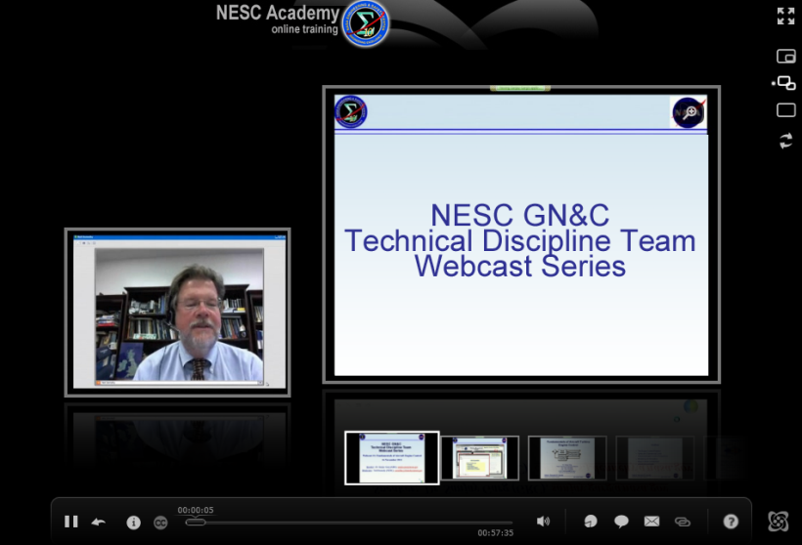



Slide 3
Fundamentals of Vision-Based Navigation
26 February 2014
Dr. John A. Christian
Assistant Professor, Department of Mechanical & Aerospace Engineering
Benjamin M. Statler College of Engineering & Mineral Resources
West Virginia University (WVU)
john.christian@mail.wvu.edu
Applied Space Exploration Laboratory (ASEL)
http://asel.mae.wvu.edu

Slide 4
You are Already an Vision-Based Nav Expert

Slide 5
You are Already an Vision-Based Nav Expert
Think about how you found your way from your home to the office this morning.
If you’re like most people, you combined visual input from your eyes with inertial measurements from your inner ear to navigate and avoid obstacles.
Visual cues allowed you to turn at the correct intersection.
Visual cues also helped you estimate your position and velocity relative to other vehicles and (hopefully!) avoid any collisions.
Congratulations! Years of training have made you a vision-based navigation expert!

Slide 6
What is Spacecraft Vision-Based Navigation
The use of optically acquired data (typically an image) for the purposes of spacecraft navigation
Images contain information about the state of both the spacecraft and the observed object
Passive images have long been used for both planetary navigation and relative navigation
Modern optical navigation include both passive and active sensors that operate at a number of different wavelengths (not necessarily in the visible spectrum).

Slide 7
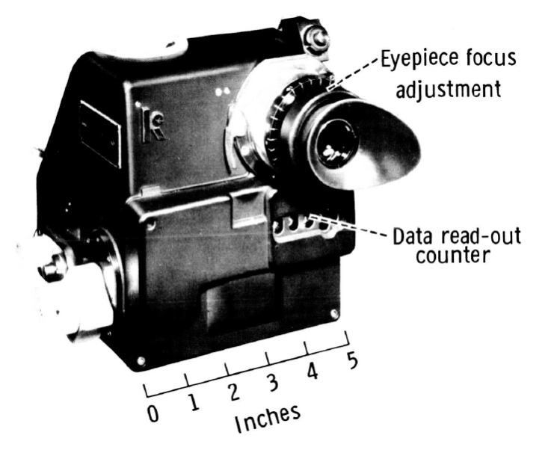
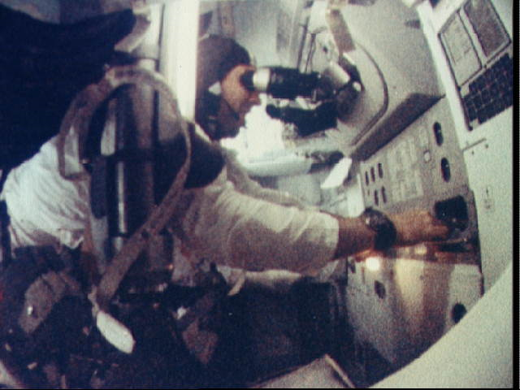
A Historical Perspective
Images courtesy of NASA
Gemini hand-held space sextant
James Lovell using the space sextant during the Apollo 8 mission.
Gemini and Apollo programs lay the theoretical and practical foundations for future optical navigation.
1960
1970
1980
1990
2000
2010

Slide 8
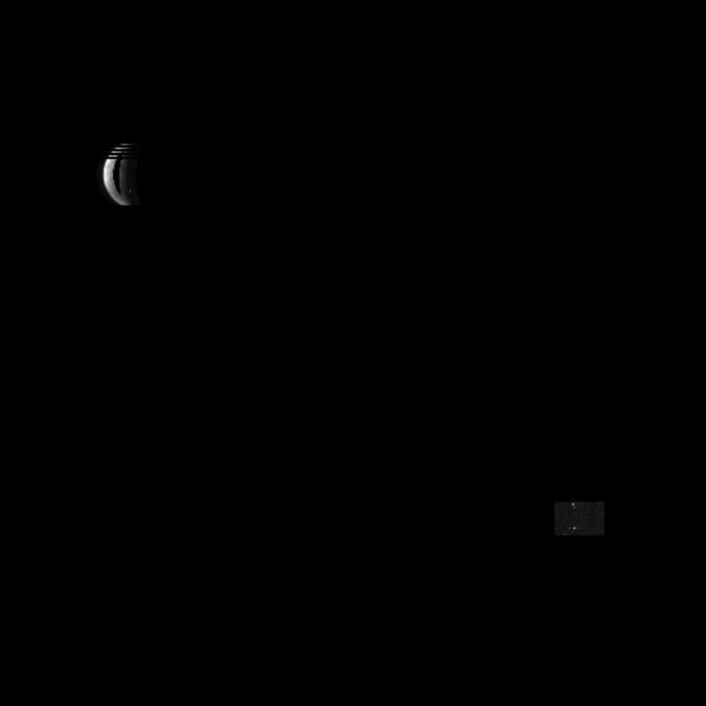
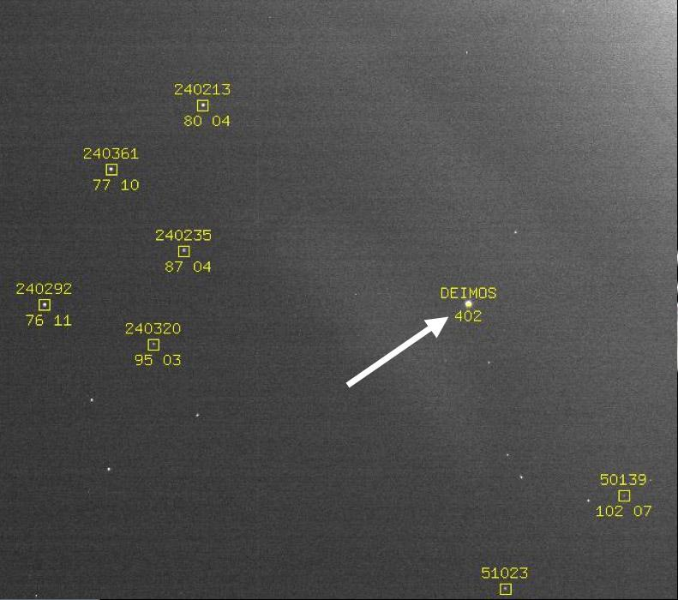
A Historical Perspective
Image courtesy of NASA/JPL-Caltech
Image of Ganymede and reference star taken by Galileo in 1996.
Image of Deimos and background stars taken by Mars Reconnaissance Orbiter in 2006.
Numerous robotic missions use optical navigation measurements during encounters with planets and moons. The images were sent to Earth and processed on the ground along with radiometric tracking data.
1960
1970
1980
1990
2000
2010

Slide 9
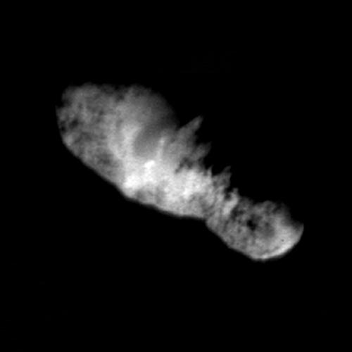
A Historical Perspective
Image courtesy of NASA/JPL-Caltech
Image of asteroid Borrelly taken by Deep Space 1 in 2001.
Autonomous optical navigation algorithms were developed for encounters with small bodies (e.g. asteroids, comets, etc.) and used on numerous missions.
1960
1970
1980
1990
2000
2010

Slide 10
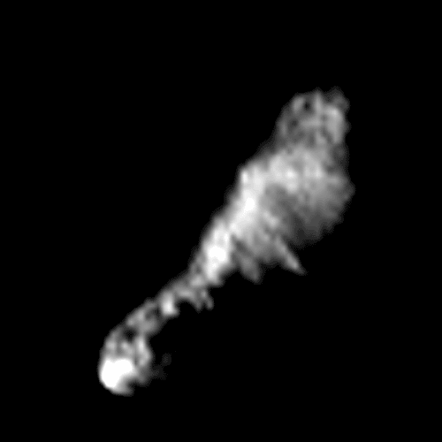
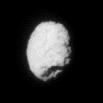
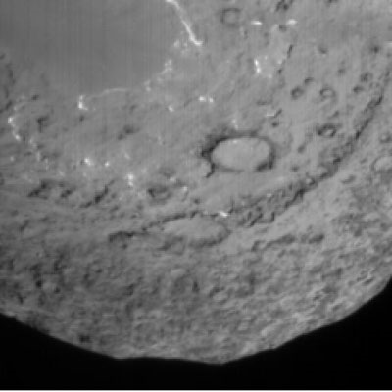
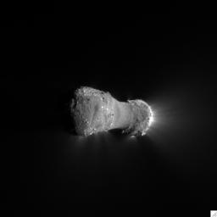
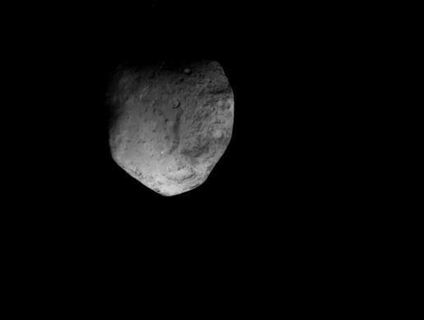
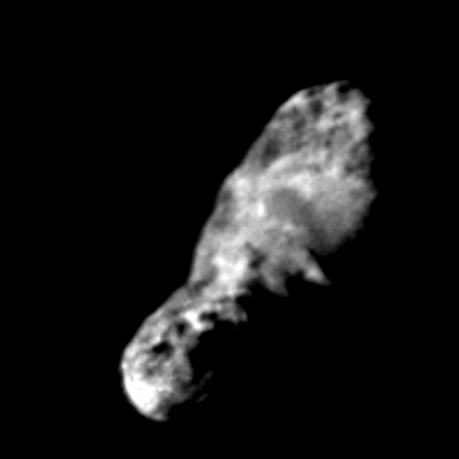
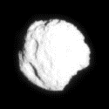
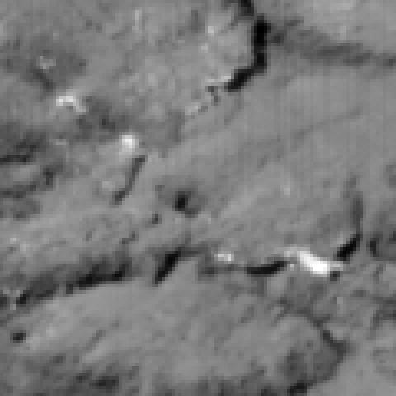
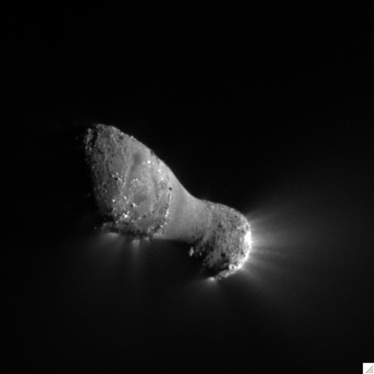
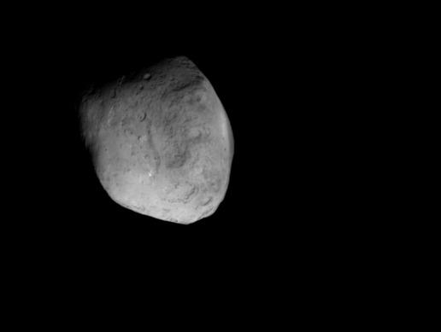
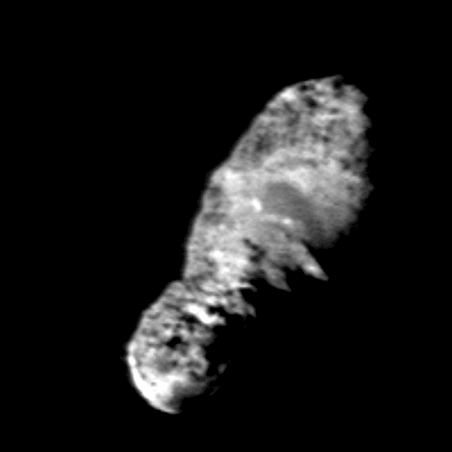
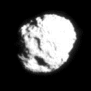
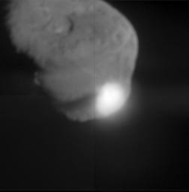
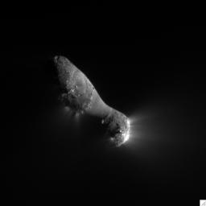
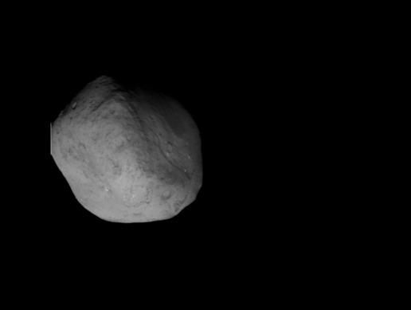
A Historical Perspective
Images courtesy of NASA/JPL-Caltech
Many thanks to Shyam Bhaskaran for passing these along!
19/P Borrelly
Deep Space 1
2001
81/P Wild 2
Stardust
2004
9/P Tempel 1
Deep Impact
2005
103/P Hartley 2
EPOXI
2010
9/P Tempel 2
Stardust NExT
2011

Slide 11
A Historical Perspective
Voyager
NEAR
MESSENGER
Classic OpNav
Mariner 6&7
Mariner 9
Galileo
Cassini
Autonomous OpNav
DS1
Deep Impact
Stardust
1960
1970
1980
1990
2000
2010
Harris Corner Detector
Speeded Up Robust Features (SURF)
Hough Transform to detect lines & curves
Shift Invariant Feature Transform (SIFT)
Pose Estimation
Simultaneous Localization
& Mapping (SLAM)
While all of these mission matured vision-based navigation for space applications, great strides were also made by the computer vision community.

Slide 12
The Vision-Based Navigation Process
The vision-based navigation process may generally be broken down into three primary steps
Capture
Image
1. Capture an image that contains an image of the body to which you intend to generate a relative measurement.
Extract Meas. From Image
2. Given an image containing one or more bodies of interest (and possibly some background stars), use image processing techniques to extract useful measurements.
Filter
Meas.
3. Given measurements providing partial insight into the relative state between the camera and the observed body, filter the measurements to compute an optimal estimate of the relative state.

Slide 13
Capturing an Image
Focal Plane
Array (FPA)
Lens
Capture
Image
Camera Boresight
Extract Meas. From Image
Focal Length
Image on the FPA is flipped version of the observed scene!
Filter
Meas.

Slide 14
Capturing an Image
Focal Plane
Array (FPA)
Lens
Capture
Image
Camera Boresight
Extract Meas. From Image
Therefore, we introduce the imaginary image plane at a distance of the focal length in front of the lens.
Focal Length
Focal Length
Image on the FPA is flipped version of the observed scene!
The picture in the image plane may be constructed by simply altering how the data from the detector on the FPA is read out.
Filter
Meas.

Slide 15
Capturing an Image
u-direction
Capture
Image
v-direction
Camera Optical Center (location of “pinhole”)
Observed object in 3D space
[X_{i}, Y_{i}, Z_{i}]
Extract Meas. From Image
Camera
Sensor Frame
[x_{i}, y_{i}]
Y-axis
X-axis
Z-axis
x-direction
Camera Boresight
(out of camera)
Filter
Meas.
f
y-direction
Camera
Image Plane

Slide 16

Capturing an Image
u-direction
Capture
Image
v-direction
Camera Optical Center (location of “pinhole”)
Observed object in 3D space
[X_{i}, Y_{i}, Z_{i}]
Extract Meas. From Image
Camera
Sensor Frame
[x_{i}, y_{i}]
Y-axis
X-axis
Z-axis
x-direction
Camera Boresight
(out of camera)
Filter
Meas.
f
y-direction
Camera
Image Plane

Slide 17

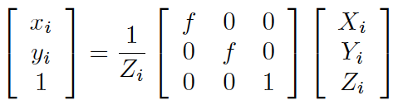
Capturing an Image
u-direction
Capture
Image
v-direction
Camera Optical Center (location of “pinhole”)
Observed object in 3D space
[X_{i}, Y_{i}, Z_{i}]
Extract Meas. From Image
Camera
Sensor Frame
[x_{i}, y_{i}]
Y-axis
X-axis
Z-axis
x-direction
Camera Boresight
(out of camera)
Filter
Meas.
f
y-direction
Camera
Image Plane

Slide 18
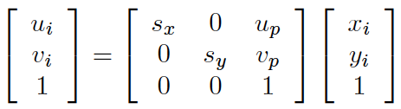
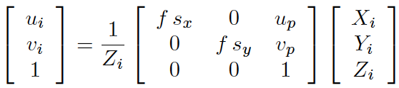
Capturing an Image
We are now in a position to understand the relationship between a particular pixel on the FPA (or the image plane!) and a direction in 3D space.
u-direction
Capture
Image
By convention images typically have their origin in the upper left-hand corner
v-direction
v_{p}
x-direction
y-direction
Extract Meas. From Image
u_{p}
Filter
Meas.

Slide 19
Extracting Measurements from an Image
One of the most challenging aspects of vision-based navigation is the reliable extraction of measurements from noisy images.
Capture
Image
To obtain these measurements requires the application of techniques from image processing.
We will consider vision-based navigation with respect to two major classes of objects:
Extract Meas. From Image
1. Cooperative Objects: observed objects that are equipped with markers, reflectors, or some other form of optical navigation aid
2. Non-Cooperative Objects: observed objects that have no purpose-built navigation aid
Filter
Meas.

Slide 20
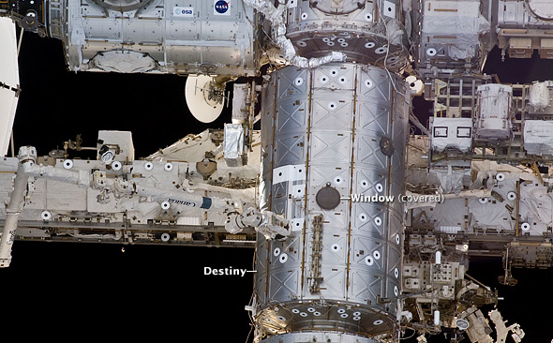
Passive Cooperative Targets
Passive cooperative targets typically use fiducials or markers that are passively observed by a camera on the active vehicle.
Capture
Image
There are an assortment of fiducial shapes that one can use to simplify the detection process.
Concentric Contrasting Circles (CCC) are a notable example of such features. They are robustly detectable and are (mostly) insensitive to translations and rotations.
Extract Meas. From Image
A notable application of this cooperative feature are the Space Vision Sensor (SVS) targets on the ISS.
Filter
Meas.
Image courtesy of NASA

Slide 21
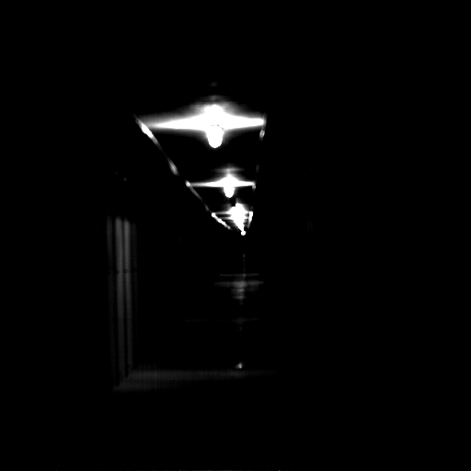

Active Cooperative Systems
Images courtesy of NASA MSFC
Many thanks to Andy Heaton.
Active cooperative systems either actively illuminate the scene, have flashing targets, or have some other active mechanism.
Capture
Image
Reflectors are perhaps the most common marker used on active systems. These are used by both LIDARs and traditional camera systems.
A good example is NASA MSFC’s Advanced Video Guidance Sensor (AVGS).
Extract Meas. From Image
Filter
Meas.

Slide 22
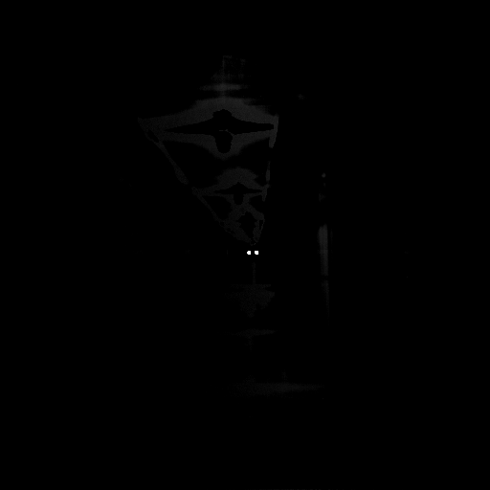
Active Cooperative Systems
Images courtesy of NASA MSFC
Many thanks to Andy Heaton.
Active cooperative systems either actively illuminate the scene, have flashing targets, or have some other active mechanism.
Capture
Image
Reflectors are perhaps the most common marker used on active systems. These are used by both LIDARs and traditional camera systems.
A good example is NASA MSFC’s Advanced Video Guidance Sensor (AVGS).
Extract Meas. From Image
Filter
Meas.

Slide 23
Non-Cooperative Targets
Any object that is not equipped with a purpose-built navigation aid is considered non-cooperative. Such objects include:
Planets
Moons
Asteroids
Comets
Legacy spacecraft
All the planetary exploration missions that we discussed earlier are examples of navigation with respect to a non-cooperative target.
Capture
Image
Extract Meas. From Image
Filter
Meas.

Slide 24
Object Centroiding
When the camera is sufficiently far away from an observed object, that object will only subtend a few pixels. In such situations, we typically look for the centroid of this small blob.
Capture
Image
Extract Meas. From Image
A variety of methods exist for finding centroids, including template matching and thresholding.
Filter
Meas.

Slide 25
Ellipse Detection
Circles, spheres, and triaxial ellipsoids all project to a 2D ellipse on the FPA (or image plane). This is a key observation that will allow us to use ellipse detection for numerous applications.
Capture
Image
Image plane
Extract Meas. From Image
Camera Z-axis
Camera
X-axis
Circular feature with
surface normal
Filter
Meas.
Camera
Y-axis
An excellent discussion of the projective geometry of such objects is provided by Shiu and Ahmad in [29].

Slide 26
Nav Relative to Planets, Moons, & Asteroids
As discussed in the historical review, there is a long history of using optical measurements for navigation near planets and moons.
A variety of measurements types are available for navigation with respect to these types of objects:
Star-horizon
Centroid & Apparent Diameter
Surface Feature Tracking
Capture
Image
Extract Meas. From Image
Filter
Meas.

Slide 27
Star-Horizon Measurements
angle from star
to horizon
Capture
Image
Extract Meas. From Image
Scalar angle between planet horizon and reference star creates a cone of position on which the spacecraft must lie.
Filter
Meas.

Slide 28
Star-Horizon Measurements
By combining multiple star-horizon measurements the spacecraft location may be reduced to a line of position.
angle from star
to horizon
Capture
Image
Extract Meas. From Image
Scalar angle between planet horizon and reference star creates a cone of position on which the spacecraft must lie.
Filter
Meas.

Slide 29
Centroid & Apparent Diameter
Consider these two real images of Venus taken by the MESSENGER spacecraft.
Capture
Image
Extract Meas. From Image
Filter
Meas.

Slide 30
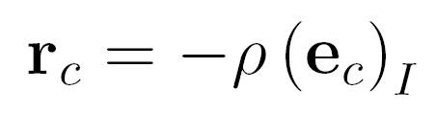
Centroid & Apparent Diameter
Consider these two real images of Venus taken by the MESSENGER spacecraft.
Capture
Image
Extract Meas. From Image
If the actual size of a planet is known, its observed size in the image may be used to obtain an estimate of the range between the camera and the planet.
e_{c}
d_{a}
Filter
Meas.
ρ

Slide 31
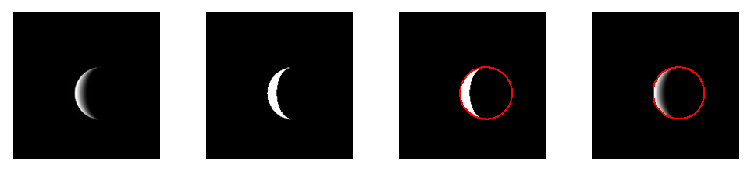
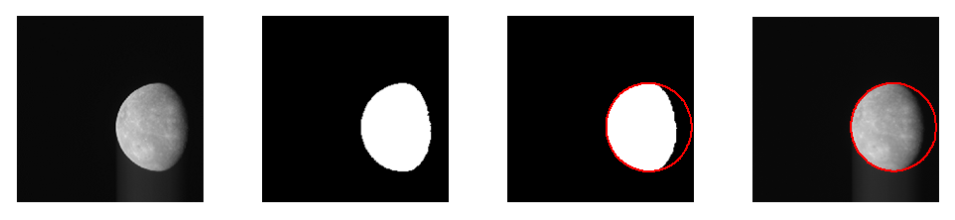
Centroid & Apparent Diameter
Images from Christian, et al., [6].
Venus: Raw image taken by MESSENGER Narrow Angle Camera on 6 June 2007
Raw image
Thresholded image,
τ = 50
Closed image with
best MSAC ellipse
Raw image with
best MSAC ellipse
Mercury: Raw image taken by MESSENGER Narrow Angle Camera on 15 Jan 2008
Raw image
Thresholded image,
τ = 50
Closed image with
best MSAC ellipse
Raw image with
best MSAC ellipse

Slide 32
Landmark Tracking
Rather than tracking the entire planet, moon, or asteroid, we may also track known landmarks on the surface of these bodies.
Capture
Image
We can search for craters using ellipse extraction techniques and then match unique clusters of craters to a catalog (see [16, 28]).
More general features can be used by simply finding “unique” features (not necessarily circular objects), [13,14].
Extract Meas. From Image
Filter
Meas.

Slide 33
Landmark Tracking
Images from Liounis, et al., [23].
As an example, it is possible to achieve reasonable steady-state errors on LLO using only optical measurements of well-distributed landmarks.
Capture
Image
Extract Meas. From Image
Filter
Meas.

Slide 34
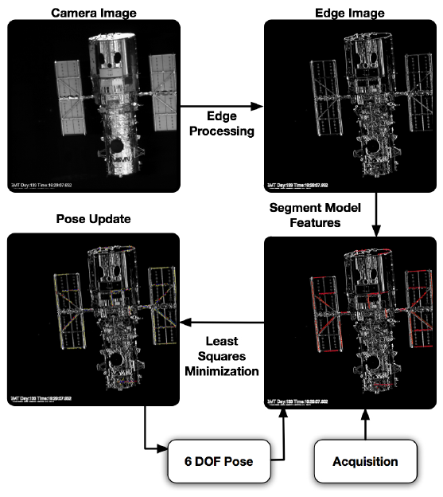
Natural Feature Image Recognition (NFIR)
NFIR is another technique that may be used to track features on a non-cooperative object.
Compares observed edges in an image with expected edge locations.
Capture
Image
Extract Meas. From Image
Filter
Meas.
Images courtesy of NASA GSFC
Many thanks to John Van Eepoel.

Slide 35
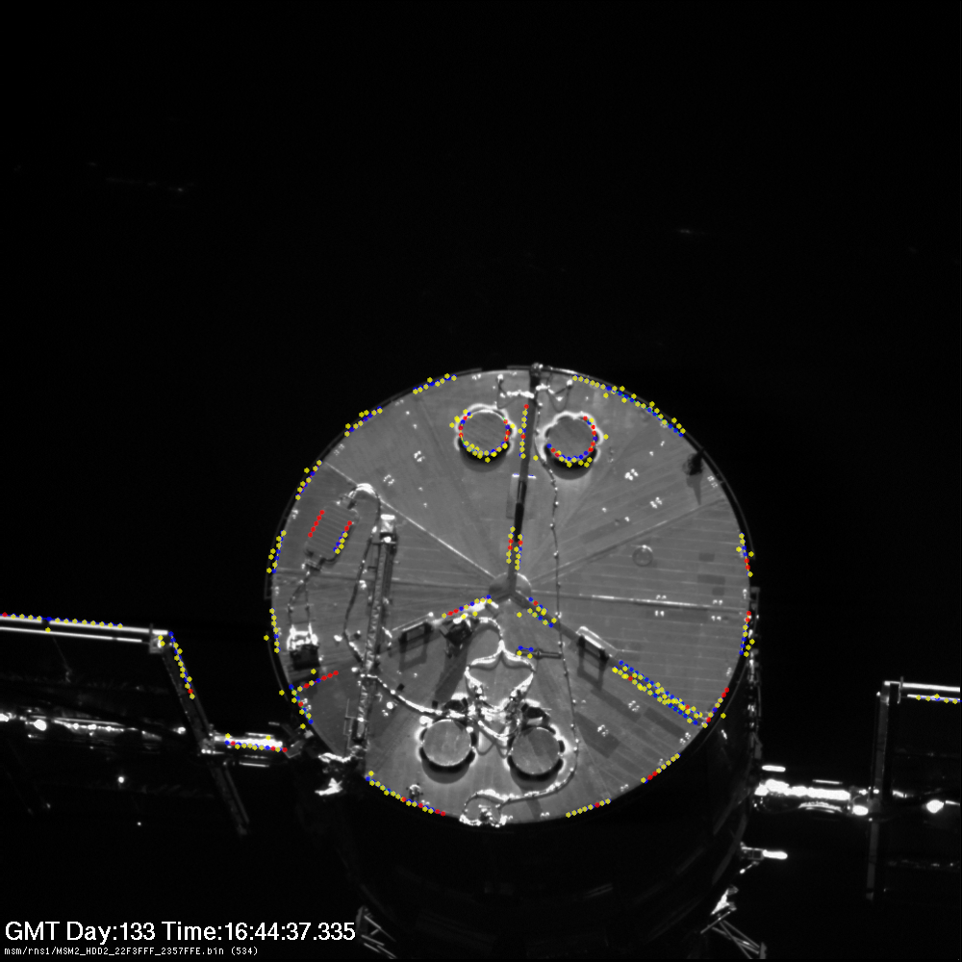
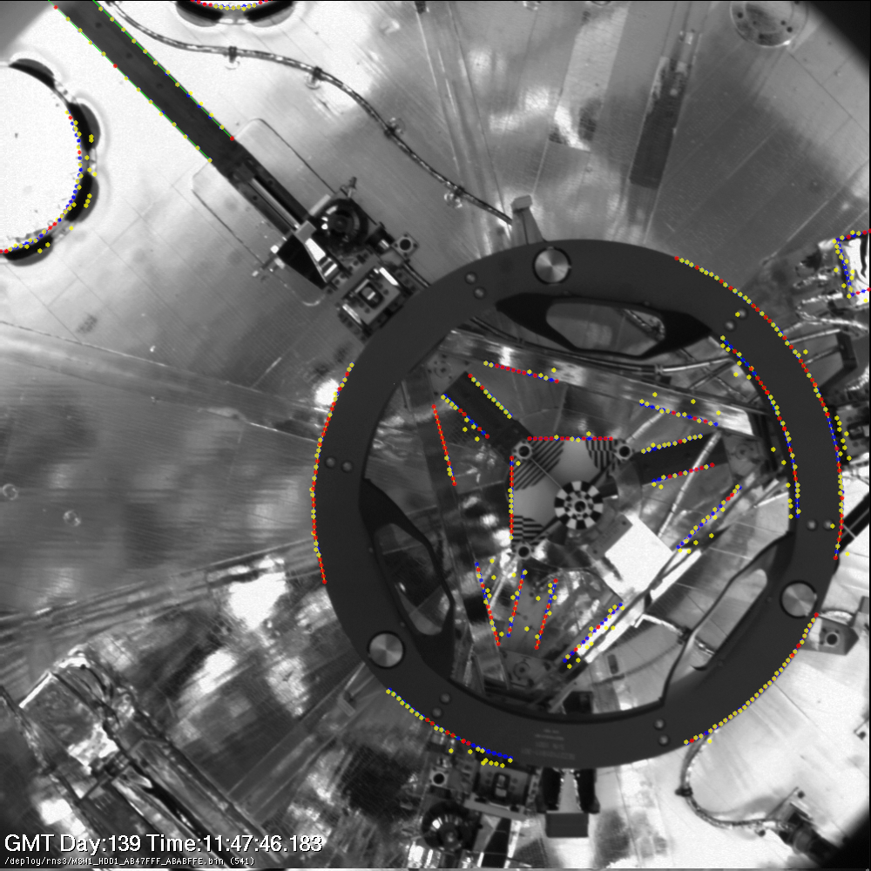
Natural Feature Image Recognition (NFIR)
Example results of GNFIR tracking the Hubble Space Telescope using data collected by the RNS on STS-125.
Capture
Image
Extract Meas. From Image
Filter
Meas.
Images courtesy of NASA GSFC
Many thanks to John Van Eepoel.

Slide 36
Filtering Measurements
There are a number of different paradigms that may be used when filtering measurements in vision-based navigation applications.
Some paradigms of particular note include:
Ground-based batch estimation where images are combined with radiometric tracking data and any other measurements that might be available
On-board filtering of object centroids/bearings directly into EKF
On-board filtering of many points on observed body directly in EKF
On-board tracking of many points with vision-based computation of pose; pose output is then filtered in an EKF
Capture
Image
Extract Meas. From Image
Filter
Meas.

Slide 37
Observability Challenges
When performing an on-orbit rendezvous between two spacecraft, there is a well-known difficulty with the observability of the relative orbit when only tracking the observed object’s centroid.
Capture
Image
A fantastic discussion of this is provided by Woffinden and Geller in [32].
Extract Meas. From Image
???
Filter
Meas.

Slide 38

Pose Estimation
Pose estimation is “easy” if we have two sets of corresponding 3D points: one from our vision-based navigation system and the other from a model of the observed object.
Capture
Image
Camera Frame
Extract Meas. From Image
r
x_{i}
y_{i}
Object’s
Body Frame
Filter
Meas.

Slide 39
Pose Estimation
Pose estimation is “easy” if we have two sets of corresponding 3D points: one from our vision-based navigation system and the other from a model of the observed object.
Capture
Image
Camera Frame
Extract Meas. From Image
y_{i}
Object’s
Body Frame
Filter
Meas.

Slide 40
Pose Estimation
Pose estimation is “easy” if we have two sets of corresponding 3D points: one from our vision-based navigation system and the other from a model of the observed object.
Capture
Image
Numerous elegant and robust solutions exist, each with their own advantages and drawbacks:
Singular Value Decomposition (SVD), [17]
Horn’s Method (q-Method), [20]
Cayley Transform, [22]
These solutions to the pose problem bear a very strong resemblance to the solutions to the attitude estimation problem (Wahba’s Problem).
Extract Meas. From Image
Filter
Meas.

Slide 41
Pose Estimation
Unfortunately camera’s don’t measure range and, therefore, we do not directly obtain two sets of corresponding 3D points.
At best, we obtain a set of 2D image-plane points and corresponding set of 3D model points.
Numerous methods exist to infer the range to points in the image using geometry.
Important solutions to this problem include:
POSIT, [9, 10]
Triangulation for a set of three points, [2, 18]
Haralick Method, [17]
Capture
Image
Extract Meas. From Image
Filter
Meas.

Slide 42
Flash LIDARs
LIDAR FOV
Broad laser pulse illuminates entire FOV at once.
Observed Object
LIDAR
Laser is reflected off of objects in the scene and simultaneously generate measurements to many points in the scene on the focal plane array.
A summary of the use of LIDARs in space applications by be found in [4] by Christian and Cryan.

Slide 43
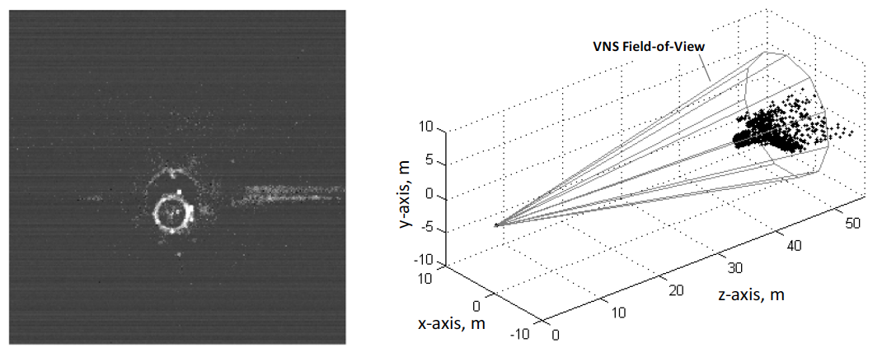
Flash LIDARs
At each measurement time, Flash LIDARs create both an intensity image and a range image. The range image may be reinterpreted as a 3D point cloud.
Example: STORRM VNS Image from STS-134
Image Credit: Christian, J., et al., “Comparison of Orion Vision Navigation Sensor Performance from STS-134 and the Space Operations Simulation Center,” AIAA Guidance, Navigation, and Control Conference, Minneapolis, MN, 13-16 August 2012.

Slide 44
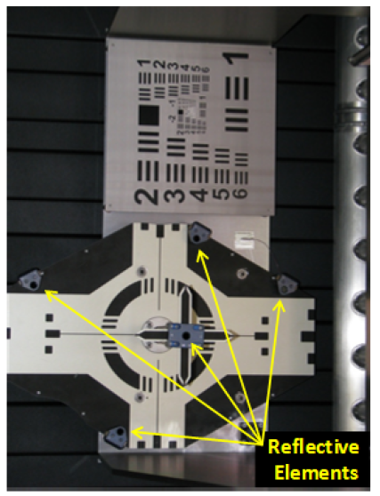
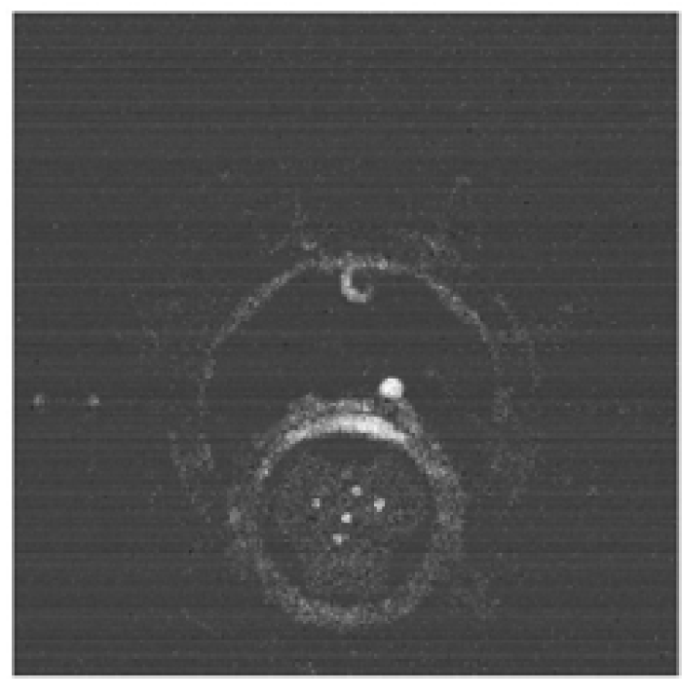
Cooperative RelNav with Flash LIDARs
Image Credit: Christian, J., et al., “Comparison of Orion Vision Navigation Sensor Performance from STS-134 and the Space Operations Simulation Center,” AIAA Guidance, Navigation, and Control Conference, Minneapolis, MN, 13-16 August 2012.

Slide 45
Summary
Vision-based navigation uses optically acquired data (typically an image) for the purposes of spacecraft navigation
Images contain information about the state of both the spacecraft and the observed object
Both active and passive sensors may be used; passive images have long been used for both planetary navigation and relative navigation
Cooperative targets may be used in some applications to make the image processing task easier

Slide 46
References and Recommended Reading
Battin, R., “Some Funny Things Happened on the Way to the Moon,” Journal of Guidance, Control, and Dynamics, Vol. 25, No. 1, 2002, pp. 1-7.
Calhoun, P. and Dabney, R., “A Solution to the Problem of Determining the Relative 6 DOF State for Spacecraft Automated Rendezvous and Docking,” Proc. SPIE 2466, Space Guidance, Control, and Tracking II, 1995, pp. 175-184.
Campbell, J., Synnott, S., and Bierman, G., “Voyager Orbit Determination at Jupiter,” IEEE Transactions on Automatic Control, Vol. 28, No. 3, 1981, pp. 256-268.
Christian, J.A., and Cryan, S., “A Survey of LIDAR Technology and its Use in Spacecraft Relative Navigation,” AIAA Guidance, Navigation, and Control Conference, Boston, MA, 19-22 August 2013.
Christian, J.A., Hinkel, H., D’Souza, C.N., Maguire, S., and Patangan, M., “The Sensor Test for Orion RelNav Risk Mitigation (STORRM) Development Test Objective,” AIAA Guidance, Navigation and Control Conference, Portland, OR, 8-11 August 2011.

Slide 47
References and Recommended Reading
Christian, J.A., and Lightsey, E.G., “An On-Board Image Processing Algorithm for a Spacecraft Optical Navigation Sensor System,” Journal of Spacecraft and Rockets, Vol. 49, No. 2, 2012, pp 337-352.
Christian, J.A., Patangan, M., Hinkel, H., Chevray, K., and Brazzel, J., “Comparison of Orion Vision Navigation Sensor Performance on STS-134 and in the Space Operations Simulation Center,” AIAA Guidance, Navigation, and Control Conference, Minneapolis, MN, 13-16 August 2012.
Christian, J.A., Robinson, S.B., D’Souza, C.N., and Ruiz, J.P., “Cooperative Relative Navigation of Spacecraft Using Flash Light Detection and Ranging Sensors,” Journal of Guidance, Control, and Dynamics, Vol 37, No 2, 2014, pp 452-465.
David, P., Dementhon, D., Duraiswami, R., and Samet, H., “SoftPOSIT: Simultaneous Pose and Correspondence Determination,” International Journal of Computer Vision, Vol. 59, No 3, 2004, pp 259-284.
Dementhon, D., and Davis, L., “Model-Based Object Pose in 25 Lines of Code,” International Journal of Computer Vision, Vol. 15, No. 1-2, 1995, pp 123-141.

Slide 48
References and Recommended Reading
Forsyth, D., and Ponce, J., Computer Vision: A Modern Approach, Prentice Hall, 2003.
Gatrell, L., Hoff, W., and Sklair, “Robust Image Features: Concentric Contrasting Circles and Their Image Extraction,” Proc. SPIE 1612, Cooperative Intelligent Robotics in Space II, March 1992.
Gaskell, R.W., “Automated Landmark Identification for Spacecraft Navigation,” Paper AAS 01-422, AAS/AIAA Astrodynamics Specialist Conference, Quebec City, Aug 2001.
Gaskell, R.W., et al., “Characterizing and Navigating Small Bodies with Imaging Data,” Meteoritics & Planetary Science, Vol. 43, No. 6, 2008, pp 1049-1061.
Gaskell, R.W., et al., “Landmark Navigation Studies and Target Characterization in the Hayabusa Encounter with Itokawa,” AIAA/AAS Astrodynamics Specalist Conference, Keystone, CO, Aug 2006.
Hanak, F., Lost in Low Lunar Orbit Crater Pattern Detection and Identification, Ph.D. thesis, The University of Texas at Austin, May 2009.

Slide 49
References and Recommended Reading
Haralick, R., Joo, H., Lee, C., Zhuang, X., Vaidya, V., and Kim, M., “Pose Estimation from Corresponding Point Data,” IEEE Transactions on Systems, Man, and Cybernetics, Vol. 19, No. 6, 1989, pp. 1426-1446.
Haralick, R., Lee, C., Ottenberg, K., and Nolle, M., “Analysis and Solutions of the Three Point Perspective Pose Estimation Problem,” Proc. of the IEEE Computer Society Conference on Computer Vision and Pattern Recognition (CVPR), Maui, HI, June 1991.
Hoag, D., “The History of Apollo On-board Guidance, Navigation, and Control,” The Eagle has Returned, edited by E. Steinho, Vol. 43, Univelt, 1976, pp. 270-300.
Horn, B., “Closed-form Solution of Absolute Orientation Using Unit Quaternions,” Journal of the Optical Society of America, Vol. 4, No. 4, 1987, pp. 629-642.
Howard, R.T., Heaton, A.F., Pinson, R.M., and Carrington, C.K., “Orbital Express Advanced Video Guidance Sensor,” IEEE Aerospace Conference, Big Sky, MT, March 2008.

Slide 50
References and Recommended Reading
Junkins, J., Majji, M., Macomber, B., Davis, J., Doebbler, J., and Noster, R., “Small Body Proximity Sensing with a Novel HD3D LADAR System,” AAS Guidance and Control Conference, Breckenridge, CO, Feb 2011.
Liounis, A., Daniel, S., and Christian, J.A., “Autonomous Navigation System Performance in the Earth-Moon System,” AIAA SPACE 2013 Conference and Exposition, San Diego, CA, 10-12 September 2013.
Ma, Y., Soatto, S., Kosecka, J., and Sastry, S., An Invitation to 3-D Vision: From Images to Geometric Models, Springer, New York, NY, 2010.
Naasz, B., Van Eepoel, J., Queen, S., Southward, C.M., and Hannah, J., “Flight Results of the HST SM4 Relative Navigation Sensor System,” Paper AAS 10-086, AAS Guidance & Control Conference, Breckenridge, CO, 2010.
Owen, W.M., “Methods of Optical Navigation,” Paper AAS 11-215, AAS Space Flight Mechanics Conference, New Orleans, LA, 2011.
Owen, W.M., Duxbury, T.C., Action, C.H., Synnott, S.P., Riedel, J.E., and Bhaskaran, S., “A Brief History of Optical Navigation at JPL,” Paper AAS 08-053, AAS Guidance and Control Conference, Breckenridge, CO, Feb 2008.

Slide 51
References and Recommended Reading
Owen, W.M., Wang, T.C., Harch, A., Bell, M., and Peterson, C., “NEAR Optical Navigation at Eros,” Paper AAS 01-276, AAS/AIAA Astrodynamics Specialist Conference, Quebec City, Aug 2001.
Shiu, Y. and Ahmad, S., “3D Location of Circular and Spherical Features by Monocular Model-Based Vision,” IEEE Conference on Systems, Man and Cybernetics, 1989.
Silva, R., Jorris, T., and Vallerie, E., “Experiment D009 - Simple Navigation,” The Gemini Program: Physical Sciences Experiments Summary, NASA TM X-58075, National Aeronautics and Space Administration, Sept 1971, pp. 37-49.
Thrun, S., Burgard, W., and Fox, D., Probabilistic Robotics, MIT Press, 2006.
Woffinden, D. and Geller, D., “Observability Criteria for Angles-Only Navigation," IEEE Transactions on Aerospace and Electronic Systems, Vol. 45, No. 3, 2009, pp. 1194-1208.

Slide 52
Questions?
Dr. John A. Christian
Assistant Professor, Department of Mechanical & Aerospace Engineering
Director, Applied Space Exploration Laboratory (ASEL)
Benjamin M. Statler College of Engineering & Mineral Resources
West Virginia University (WVU)
john.christian@mail.wvu.edu
Applied Space Exploration Laboratory (ASEL)
http://asel.mae.wvu.edu

Slide 53

Thank you for
attending…
Fundamentals of Image Processing for Terrain Relative Navigation (TRN)
April 16th, 2PM EDT
Andrew Johnson

