Slide 1
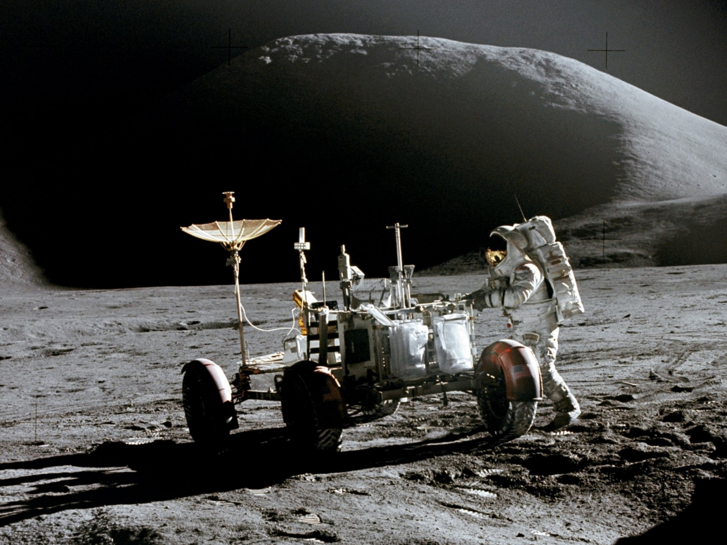
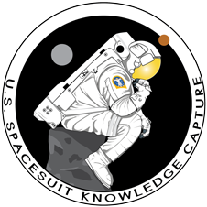
Intra-Extra Vehicular Activity Apollo Spacesuits
Presented by
Kenneth S. Thomas
August 30, 2016
Moderated by Cinda Chullen
U.S. Spacesuit Knowledge Capture Program

Slide 2
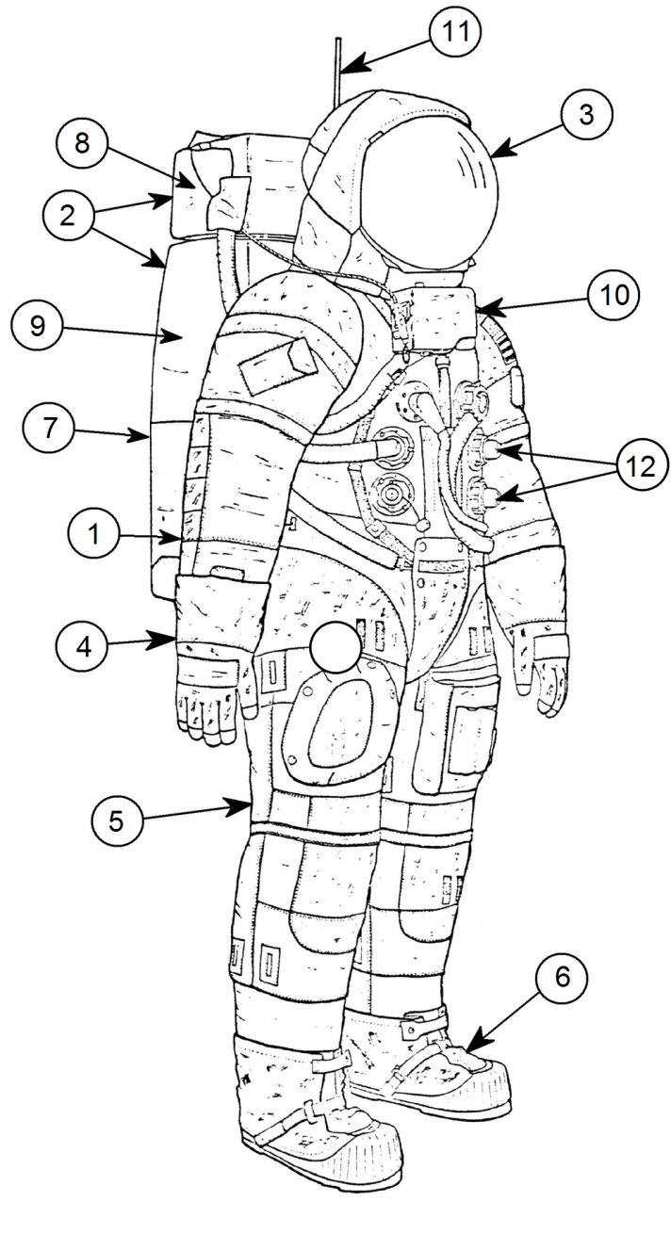
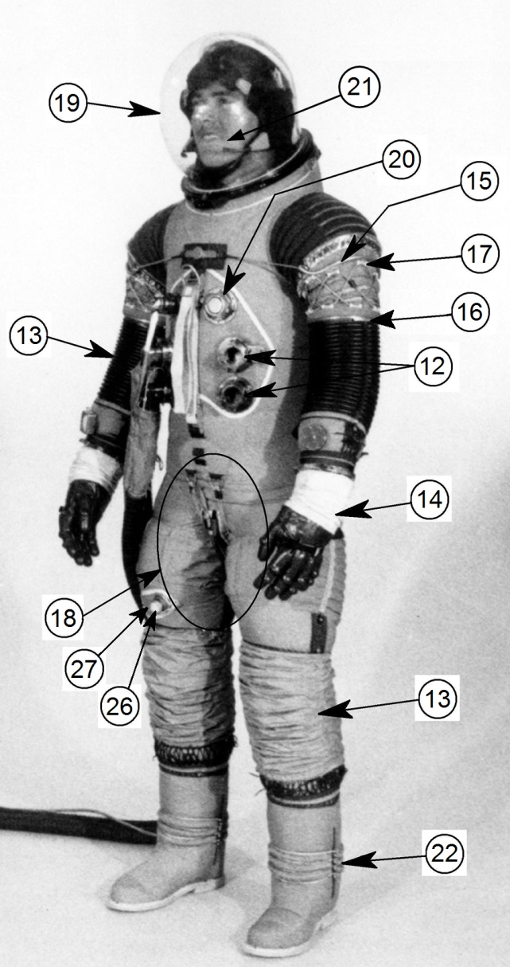
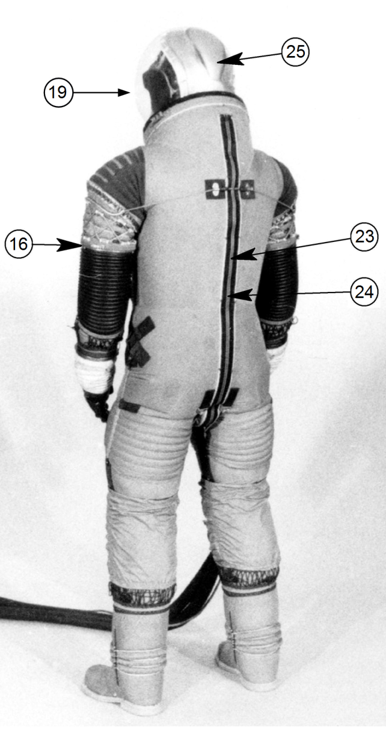
Apollo 11 IEVA Spacesuit Origins
  X
2

Slide 3
Apollo IEVA Spacesuit Origins, Cont.
1. Pressure Suit Assembly – “The suit” was developed and manufactured by International Latex Corporation (ILC) in Dover Delaware, USA. In a 1968 patent application (US3751727) authored by ILC personnel and approved by NASA, ILC/NASA recognized Leonard F. Shepard, George P. Durney, Melvin C. Case, A. J. Kenneway, Ill, Robert C. Wise, Dixie Rinehart, Ronald J. Bessette, and Richard C. Pulling as the inventors of the Apollo “Space Suit.” In 1969, International Latex partially sold its pressure suit organization to form what is now ILC-Dover LP. ILC-Dover relocated to Fredrica, Delaware, in two increments starting in 1969. International Latex sold its remaining interest in ILC-Dover in 1984. Reference numbers 3-6 and 12-25 explain features embodied in the Apollo pressure suit.
2. Portable Life Support Assembly - The “backpack,” a separately donnable life support assembly, was developed and manufactured by the Space and Life Systems unit of the Hamilton Standard (HS) Division of United Aircraft located in Windsor Locks, Connecticut. Because of the acquisitions and mergers of Sundstrand and Goodrich Corporations in 1999 and 2012, respectively, the Division became Hamilton Sundstrand, and then United Technologies Aerospace Systems. The remnants of the unit that supported Apollo still exist in Windsor Locks. Reference numbers 7-11 explain the subassemblies and features embodied in the Apollo backpack.
3. Lunar Extravehicular Visor Assembly – The gold coating process for the eye-protecting Apollo sun visor was developed by Perkin Elmer Corporation in Norwalk, Connecticut starting in 1963 under contract to HS. ILC initially was responsible for the remainder of the visor assembly design and development. Hamilton assumed visor design and prototyping in November 1963. Hamilton analysis indicated that thermal insulation would be required over the entire helmet area. This was initially planned to be provided by the hood of a parka-looking outer garment. A fiberglass outer shell was incorporated to support the weight of the garment. This was revised in 1965 to having a thermal cover directly attached to the outer shell of the visor assembly. The resulting visor cover extended down to cover and wrap around the neckring. In parallel, NASA engineers O’Kane and Jones designed their own helmet with LEVA. Their analysis indicated that the polycarbonate layers of the LEVA and helmet would provide sufficient thermal insulation that a thermal outer covering was unnecessary. They selected Air-Lock Corporation in Milford, Connecticut as the manufacturer of their prototype visors, and Apollo Program visors after 1965. Thermal transfer issues caused this design to gain an ILC-provided neckring thermal cover by 1967. As a result of condensation in the helmet during Apollo 9 shaded periods, the visor assembly was revised to have a fiberglass outer shell, a 1965 style thermal cover and side opaque sun shields that could retract or be flipped down as needed. This configuration was used for Apollo 11 to 13. Apollo 14 to 17 used a derivation that added an opaque center visor.
3

Slide 4
Apollo IEVA Spacesuit Origins, Cont.
4. Integrated Thermal Outer Gloves - David Clark Company (DCC) was the advocate for integrated glove coverings rather than separately, donnable outer gloves. At NASA’s request, DCC educated Hamilton and ILC on its outer glove construction methods for Apollo. The techniques for layering and securing the insulation material in the outer glove were developed by NASA and DCC for the Gemini Program. DCC transferred these developments to ILC at NASA’s request. The tactile, reinforced, molded RTV (room temperature vulcanite aka “rubber”) finger tips were an ILC innovation and development.
5. Torso Thermal Meteoroid Garment – DCC was the advocate for torso coverings being an integrated part of the pressure suit rather than separately, donnable outer garments. ILC adopted this system for Apollo in 1967.
6. Extra-Vehicular Over Boots – ILC introduced the Apollo 11 to 17 style of thermal over-boot. The over-boot used Chromel-R, a stainless steel wire fabric, on the outer surfaces and thermal insulation techniques introduced by DCC during Gemini that were substantially refined by ILC. The reinforced, molded RTV soles were an ILC innovation and development.
7. Primary Life Support System – Development included the invention of Porous Plate Sublimator (U.S. Patent No. 3,170,303 inventors John S. Lovell and George C. Rannenberg), which allows rejection of body and life support system heat to space with no moving parts. This system also supplied oxygen, removed carbon dioxide, controlled humidity and cooled both ventilation gas and water for Liquid Cooling Garments (LCG). Developed and manufactured by HS.
8. Oxygen Purge System – A nominally 30-minute backup life support system of the Apollo spacesuit. Developed and manufactured by HS.
9. Backpack Thermal Outer Cover – DCC provided the base construction techniques. NASA made the final material selections. HS manufactured these covers.
10. Remote Control Unit – The chest mounted display and control system for the backpack life support system, which Hamilton Standard developed and manufactured.
11 Antennae – Radio antenna breakage was an early program challenge and great concern as it would result in loss or greatly reduced communications. The durability and flexibility of a Stanley Tool Company tape measure led to purchase and space certification of a roll of tape measure raw stock to support the communications of men on the Moon.
4

Slide 5
Apollo IEVA Spacesuit Origins, Cont.
12. Gemini Style Life Support Connectors - The Apollo Program started considering these connectors in 1964. Air-Lock Corporation (A-L) developed the Gemini connector for the DCC. NASA and ILC elected to make them the Apollo Program connector in late 1965.
13. Molded Convolute Joint - The base design and construction of this molded convolute originated with B.F. Goodrich as Russell Colley’s “Tomato Worm” mobility element in the early 1940s. ILC recruited Goodrich personnel in the early 1950s, by which time Goodrich was evolving past molded convolutes in favor of fabric mobility joints. ILC’s George Durney, who was not a former Goodrich employee, refined and continued development of this type of molded convolute to make it a lower effort mobility system (US Patent 3,432,860).
14. Molded Pressure Gloves – B. F. Goodrich’s (BFG) initial approach to making pressure gloves in WWII was molded rubber into a fabric mesh sub-straight. Goodrich finally abandoned the approach during the 1950s in favor of separate fabric bladder and restraint layers for improved reliability. In 1962, ILC competed for Apollo with a separate neoprene rubber bladder and (leather) restraint layer glove system. In 1962-63 development for Apollo, ILC chose a single layer, molded rubber into a fabric mesh sub-straight that was similar to earlier Goodrich designs. Palm bars, which allow the palm area to bend for grasping tools, were initially developed in the WWII MX-115 Program and were made available to numerous U.S. manufacturers. Palm bars were an element of Goodrich Mercury gloves. The first Apollo (1962-63) multi-directional wrist joint (by ILC) was a single cable arrangement that was unstable in one axis and required sufficient effort in the other direction to cause bruising. Additionally, it was non-redundant, so a cable failure could result in loss of pressure and life. The second Apollo multi-directional wrist joint was created by HS in 1964. This used a Teflon cord and ferrule wrist joint that was stable with low effort. It used three cords, so three cord failures were needed for possible loss of pressure. The remainder of the Apollo glove was a copy of the preceding ILC Apollo design. For the 1965 competition, ILC developed a third Apollo design that had a redundant, two-steel cable, multi-directional wrist joint, which became the Apollo Program glove with ILC’s win of the 1965 competition. In these and later ILC gloves, Teflon sleeving in the metallic wrist restraint conduits reduced effort to move. Teflon sleeving of metallic restraint conduits appears to have been a Hamilton innovation that was adopted by ILC.
15. Shoulder Cable Restraint System – This was first seen in the U.S. MX-115 pressure suit development program of WWII. It enjoyed popularity with Goodyear and Republic Aviation. The early attempts with this approach experienced excessive force to achieve mobility. ILC experienced similar problems in their first four Apollo suit designs. Teflon sleeving in the metallic restraint conduits reduced friction, allowing acceptable mobility. This appears to have been a Hamilton innovation that was adopted by ILC.
5

Slide 6
Apollo IEVA Spacesuit Origins, Cont.
16. Pressure (lip) Sealed Upper Arm Bearings – These were features on the BFG’s 1953 “Omni-Environment Inflatable Suit” (ref. Patent 2,966,155, Carroll Krupp inventor) and in the Goodrich Mk. II suits that followed. Unfortunately, the cramped cockpits of fighter aircraft made hard contact from these bearings unacceptable. Goodrich brought upper arm bearings to the Apollo Program in late September or early October 1964 in a joint Goodrich/HS prototype effort. Initial negative NASA reaction delayed consideration of the approach until ILC adopted it for its rear entry State-of-the-Art (SOA) Suit of late January or early February 1965. ILC won the Apollo Block II Pressure Suit competition with a prototype also using such bearings made by Air-Lock. In 1968, NASA wanted upper arm bearings more compact than A-L could produce, so ILC took over the redesign and made the subsequent Apollo Program upper arm bearings in-house.
17. Shoulder Teflon Ferrule Multi-Directional Joint - Invented by HS (patent 3,492,672 inventors Michael A. Marroni Jr., Douglas E. Getchell, and John J. Korabowski), used this Teflon cord. ILC adopted it for its 1965 Block II competition suit. Later, ILC switched from Teflon cord to plastic coated aircraft cable in the joint.
18. The Apollo Walking Brief – ILC’s Apollo brief system was invented by George Durney (ref. Patent No. 3,699,589). This was initially developed under the Apollo contract and first appeared in November 1964. This was refined to become a highly successful system in ILC’s Block II competition prototype in July 1965. With some subsequent refinements, this would be used for all the Apollo and Skylab pressure suits.
19. Bubble Helmet - In the 1940s, full-bubble helmets were popular with many manufactures. Such helmets had acrylic bubbles and fell out of favor because switching from un-pressurized breathing of ambient air to pressurized use necessitated don and doff of helmet. This led to development of flip-type pressure visors for high altitude pressure suits. Acrylic also had poor impact properties. A broken Gemini (acrylic) pressure visor in 1964 caused NASA to switch to polycarbonate pressure visors. Soon after this, NASA’s Jim O’Kane and Bob Jones championed the development of the polycarbonate full-bubble helmet. The problem with polycarbonate was the difficulty of drawing a full bubble while retaining optical quality. In 1967, Air-Lock Corporation was the first organization to get optical quality helmet bubbles into production. Consequently, Air-Lock produced the O’Kane/Jones design for Apollo, Skylab, and Shuttle extravehicular (EV) spacesuits.
6

Slide 7
Apollo IEVA Spacesuit Origins, Cont.
20. LCG & Multiple Water Connector - Apollo 1963 manned testing proved that gas cooling was impractical for extra-vehicular activity (EVA). This caused two inventions. First was the spacesuit LCG (U.S. Patent No. 3,289,748 inventor David C. Jennings). This garment provided both liquid cooling via water flowing through tubes that were in contact with the body and supplemental gas cooling via an open mesh, tubing-constraint garment. The introduction of the LCG required cooling water to travel through the wall of the pressure suit. To support this, Hamilton’s Bradford Booker invented Apollo’s Multiple Water Connector (MWC). The MWC allowed the LCG and the backpack life support system to independently connect and disconnect from the suit without breaking the pressure seal. The cooled water flowed from the backpack through the MWC to the LCG where the water flowed around the astronaut removing heat. The warmed water then flowed back through the MWC to the backpack life support system. The LCG and MWC were the result of Hamilton internally funded development. NASA purchased patent rights to both in March 1966. NASA and ILC elected to allow Air-Lock to redesign the MWC in 1966.
21. Helmet Drink Port – While not shown on this helmet, a patent for “Helmet With Pressure Seal Port” (No. 3,067,425 inventor Russell S. Colley) was filed on November 9, 1959. This helmet food and drink port was subsequently used by NASA on Gemini and Apollo helmets.
22. Walking Ankle Joint - Litton introduced the first pressure suit ankle joints in its Mk. I pressure suit of the late 1950s. This joint used hard gimbals to control pressurized movement. HS invented an all soft boot with ankle joint for Apollo (Patent No. 3,605,293 inventors Douglas E. Getchell, John J. Korabowski, and Michael A. Marroni Jr.) that first appeared on the 1965 Apollo AX5H suit model. NASA’s testing of the Hamilton-Goodrich Apollo Block II competition suit resulted in NASA desiring incorporation of the Hamilton style ankle joint into the ILC Apollo suits that followed. Because of schedule constraints, this was not accomplished until 1967.
23. Rear Entry – This concept for entry was introduced on a David Clark pressure suit in the 1950s by designers Joe Ruseckas and John Flagg. This approach was refined by Dick Sears and Don Robbins for the prototype that gained the David Clark the Gemini suit contract. The rear entry of the Gemini suits was so well liked by the astronaut corps that ILC started developing an ILC derivation under internal funding that made its public debut in a 1965 prototype and ILC’s Block II competition suit. This was a feature on all the Apollo 7 through 14 and 18 suits, plus the Apollo 15 through 17 Command Module Pilot (CMP) Suits.
7

Slide 8
Apollo IEVA Spacesuit Origins, Cont.
24. Pressure Sealing Zipper - The BFG development and manufacture of pressure sealing zippers in 1965 made lengthy rear entry zippers practical for Apollo. This significantly reduced gas leakage to permit rear entry suits to meet the program requirements.
25. Helmet Vent Duct - The rear vent duct flowing vent gas over the head and facial area appears to have started with a NASA (O’Kane/Jones) prototype full-bubble helmet in 1964. This duct became part of the Apollo, Skylab, and Shuttle Programs’ full-bubble helmets. NASA continues to use of this same helmet duct system for International Space Station EV spacesuit helmets to the present.
26. Urine Collection and Transfer Assembly – First U.S. development of such a system was on the BFG Mercury Program.
27. Injection Patch - First U.S. development of such a system was on the David Clark Apollo Block I Program.
8

Slide 9
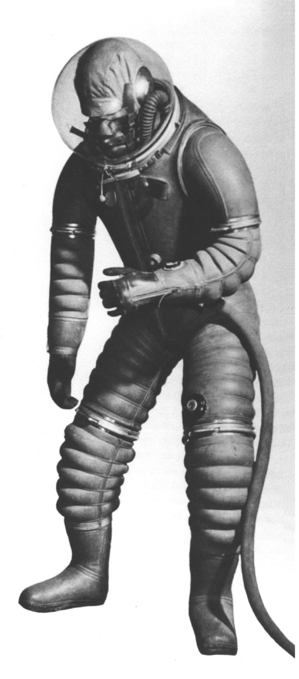
Before the Apollo Program
  The WWII American MX-115 Program introduced:
  Palm-bars
  Cable restraints
  Metal conduits sliding on cables
  Molded rubber convolute joints debuted on the BFG’s Tomato Worm Suit
  Russel Colley / BFG XH-5 “Tomato Worm Suit”
9

Slide 10
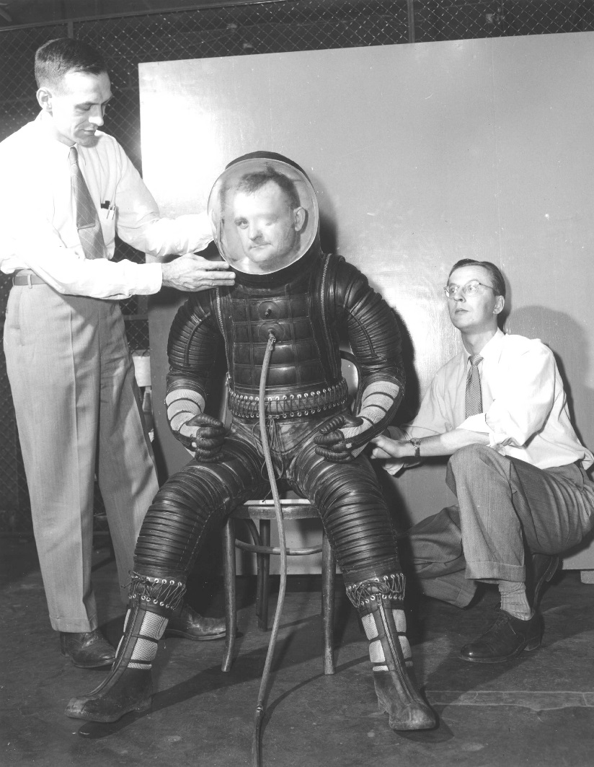
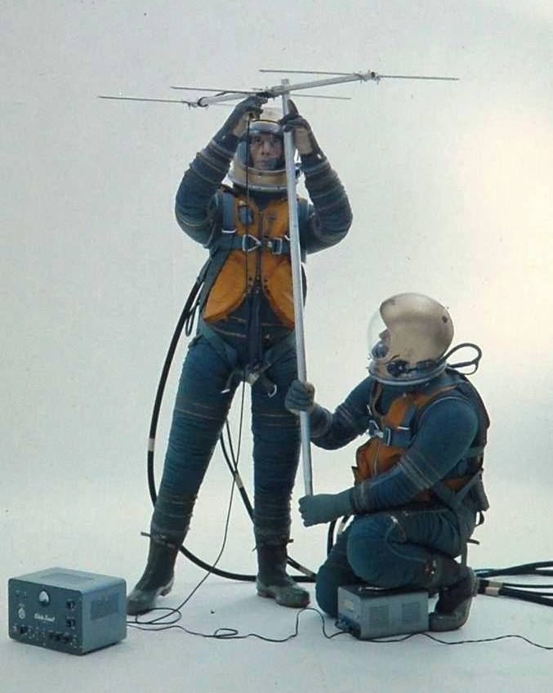
Before the Apollo Program, Cont.
  In the 1950s, BFG introduced pressure-sealed upper arm bearings attaching bi-axial restraint elbow convolute joints
  1952 Goodrich Model 1
  1956 Goodrich Mark II
10

Slide 11
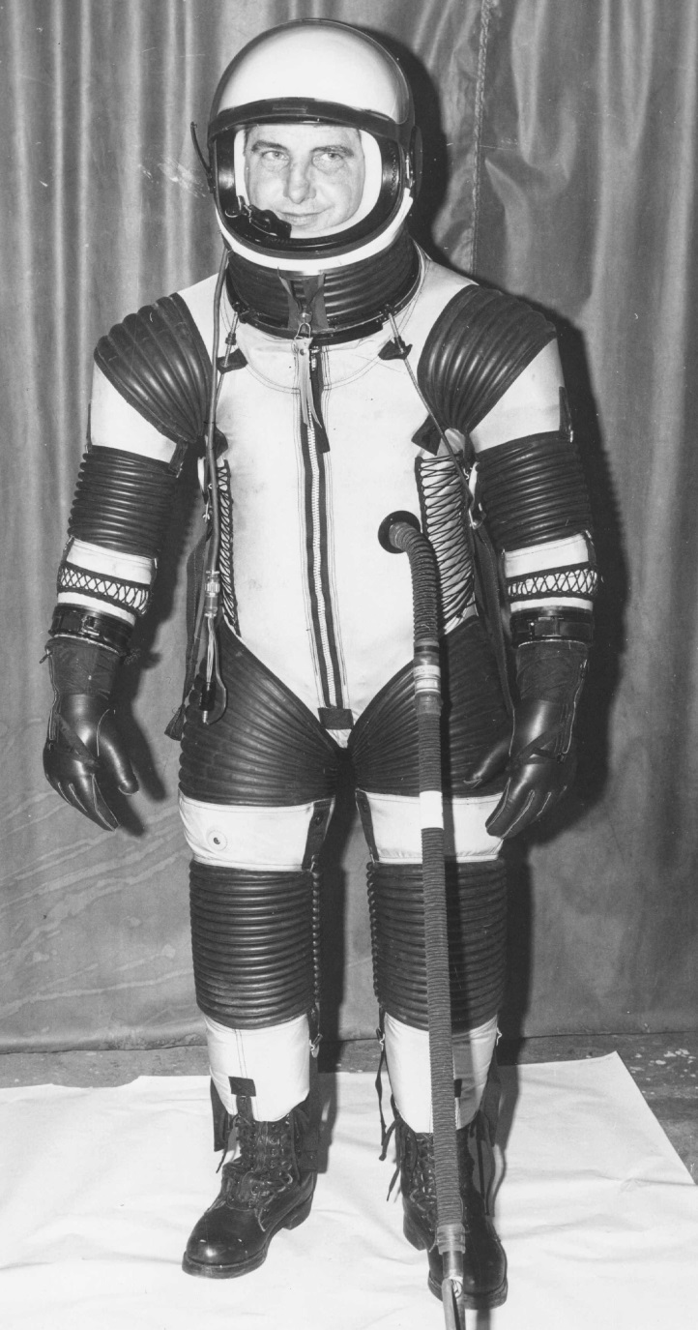
Before the Apollo Program, Cont.
  1959 – NASA’s High-Speed Flight Station (now Dryden Research Center) tasked with lunar EVA spacesuit development. While intra-vehicular activity (IVA) use was considered, efforts focused on EVA (developments did not influence Apollo Program development).
  October 1961 – NASA’s Langley Research Center funded Arrowhead Rubber, DCC, ILC, and Protection Incorporated for pressure suit study prototypes.
    The ILC prototype offered much lower-effort mobility (in a single axis). The NASA manager in charge later depicted in a 1966 interview that this was where NASA selected ILC as the Apollo pressure suit provider.
  1961 ILC Prototype
11

Slide 12
Original Apollo SSA Program (1962-65)
  The Apollo Space Suit Assembly (SSA) contract competition was formally started on March 30, 1962. NASA set proposal metabolic requirements at 11,300 btu/day (2,848 kcal/day). No hourly or peak rates. Competitors or competitor teams included:
    Bendix Corporation’s Eclipse-Pioneer Division of Litton Systems
    General Electric/BFG
    Grumman Aircraft/AiResearch Division of Garrett Corporation
    Hamilton Standard Division (HSD)/DCC
    ILC/Republic Aviation/Westinghouse Corporation
    Ling-Temco-Vought
    North American Aviation
    Northrop Corporation’s Space Laboratory
12

Slide 13
Original Apollo SSA Program, Cont.
  The Apollo SSA contactor selection:
    In April, NASA decided to split contractor teams as it desired HSD to be the Portable Life Support System (PLSS) and overall suit-system provider with ILC being the Pressure Garment Assembly (PGA) subsystem supplier. HSD proposal based on average EVA metabolic rate 500 btu/hr (126 kcal/hr) with no peak metabolic requirement.
      HSD/ILC clash of cultures.
    In parallel, NASA funded ILC directly for suits.
    In August, HSD and ILC were able to reach a working agreement.
    In September, HSD was allowed to direct ILC for existing configuration training suits.
    In October, contact was formally awarded with requirement metabolic of 930 btu/hr (234 kcal/hr) average, with a 1600 btu/hr (403 kcal/hr) peak load.
13

Slide 14
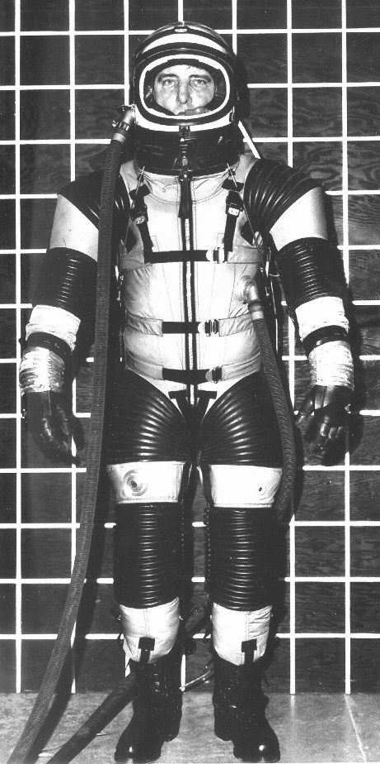
Original Apollo SSA Program, Cont.
  Overview of SSA development contract:
    Awarded Contract (aka “The Plan”) = Complete SSA development (incl. thermal/meteoroid) in 10 months
      PGA: five Prototype development series
      PLSS: one 4-hour chamber unit
      Emergency Oxygen Supply (EOS) = one 10-minute chamber unit
  Separate Training Suit contract:
    Fleet of 20 existing design suits.
    Per NASA, HSD involvement limited to source inspection.
    New design Apollo glove introduced in Training Suit production.
1962-63 Apollo SPD-143 Training Suit
14

Slide 15
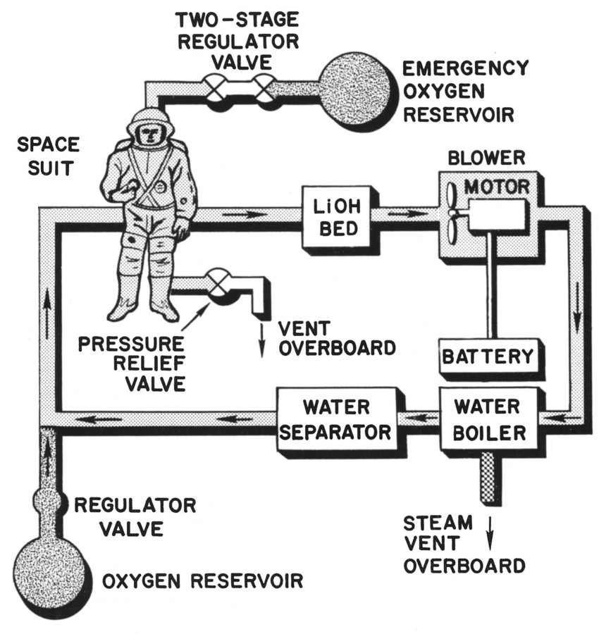
Original Apollo SSA Program, Cont.
The Apollo SSA System Schematic in program’s first 10 months:
15

Slide 16
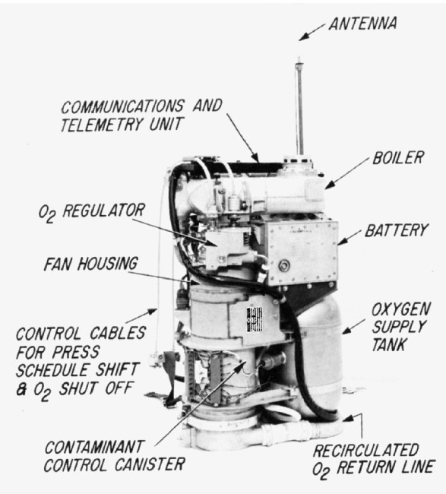
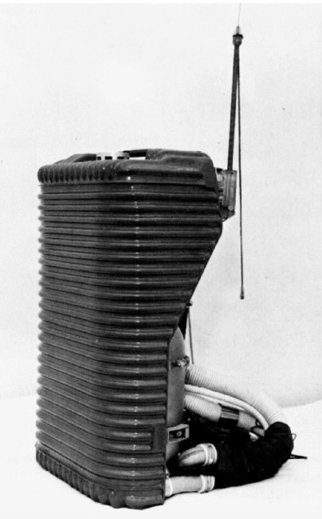
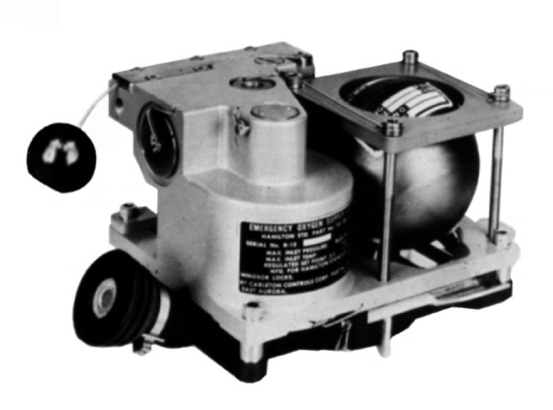
Original Apollo SSA Program, Cont.
Apollo PLSS at 10 Months, cont.:
  PLSS & EOS test units delivered on time and met all requirements
Above – 1963 First Apollo EOS
Left - 1963 First, “Gas Cooled” Apollo PLSS
16

Slide 17
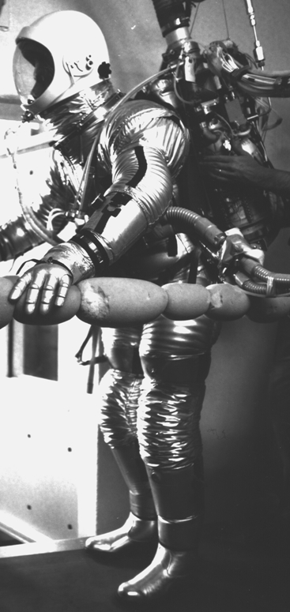
Original Apollo SSA Program, Cont.
Apollo PGA at 10 Months, cont.:
  Training fleet of SPD-143 suits:
    Excellent schedule and budget performance.
  PGA development - Significantly over budget. No prototypes delivered in 10 months (first PGA delivered a couple weeks later).
    HSD judged that the shoulders were too wide, mobility was unacceptable.
    NASA judged that the stance was unacceptable. Agreement on shoulders too wide and mobility being unacceptable took another two months.
  Thermal and meteoroid protection prototypes proved inadequate
  Corrective actions directed by HSD, but second PGA design effort (AX2H) probably in delivery flow, so changes were minimal.
1963 AX1H-021, First Apollo New-Design Suit, In Test
17

Slide 18
Original Apollo SSA Program, Cont.
  Manned testing in and out of chamber in following months indicated:
    Apollo suit-system metabolic requirements had been underestimated. Requirements increased again to 1204 btu/hr average and a 2000 btu/hr (504 kcal/hr) peak metabolic load was added. The current cooling by ventilation gas was not acceptable.
  Helmet unacceptable because of visibility and visor fogging.
  Mobility of PGA found not acceptable:
    November 1963, NASA cited HSD for failure to meet contract PGA requirements expecting a corrective action plan within 48 hours. HSD proposed:
      HSD assumed helmet design to allow ILC resources to concentrate on mobility.
        HSD/ILC friction increased over helmet development
      HSD created a PGA engineering design group to aid ILC.
  January 1964, HSD discovered ILC had attempted to remove Apollo production PGA from HSD contract via a cost-saving direct-to-NASA contract.
18

Slide 19
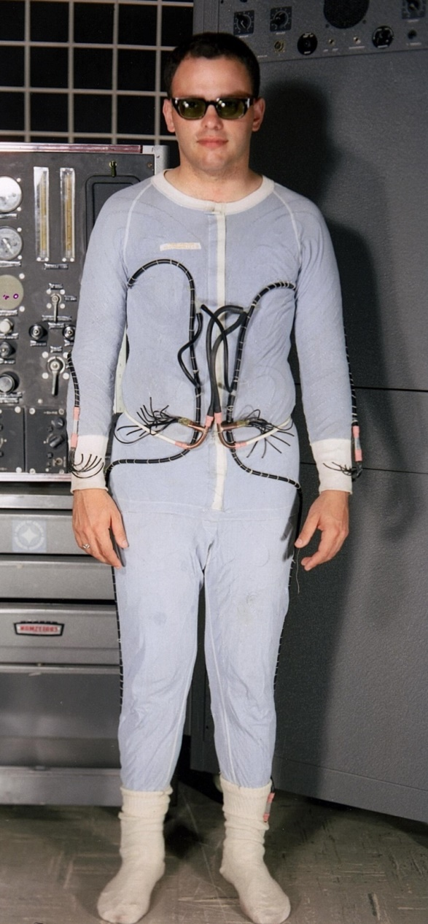
Original Apollo SSA Program, Cont.
      From the start of the program, HSD aware of heat rejection risks to the SSA Program.
        During 1962-63, HSD internally funded heat rejection development resulting in 1963 invention of PLSS porous plate sublimator.
        In February 1963, HSD started cooling garment IR&D efforts.
          First cooling suits were high-flow-rate gas cooling garments.
        In parallel, NASA concerns result in Houston investigating classified RAF LCG development that started in November 1962. RAF LCGs featured:
          Solid heavy fabric torso garment
          Tubes routed through cuts in torso fabric.
        Unable to gain immediate access to RAF prototype, NASA creates their own LCG.
The NASA Houston LCG
in June 1964
19

Slide 20
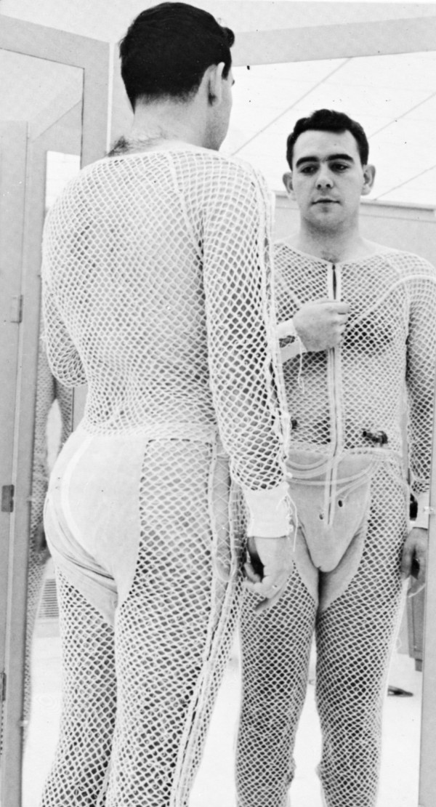
Original Apollo SSA Program, Cont.
      Based on a 1950’s RAF cooling vest report, HSD starts investigating the potential of liquid cooling in October.
      In November, RAF demonstrates their LCG to NASA in Houston.
        HSD not included in evaluation.
      HSD David Jennings first prototype LCG completed in December 1963. Two more iterations follow with months. HSD LCGs featured:
        Open mesh garment for air cooling in addition to liquid cooling.
        Sown tubes garment (LCG) development started October
        Mrs. Jennings adds chiffon liner in 1965
      HSD shown RAF LCG in June 1964 for NASA advocacy of RAF approach to attaching tubes.
        RAF approach not incorporated
The 2nd HSD Apollo LCG Prototype Completed April 1964
20

Slide 21
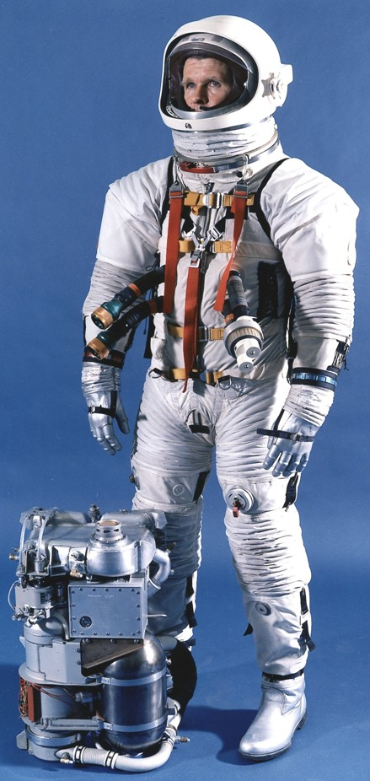
Apollo SSA Program Recovery Efforts
      In March 1964, Command Module testing indicated on the DCC Gemini suits acceptable for Apollo intravehicular use.
      Also in March, the third design suit (AX3H) was delivered for high-visibility evaluation at Grumman. PGA experienced failures. User ratings were very unfavorable. Gordon Cooper announced “I would not go to the Moon in that suit” in front of Washington and Houston top NASA management.
Initial program PGA response delayed by ILC president on vacation in Europe.
Right - Original AX3H-024 Suit With Apollo PLSS
21

Slide 22
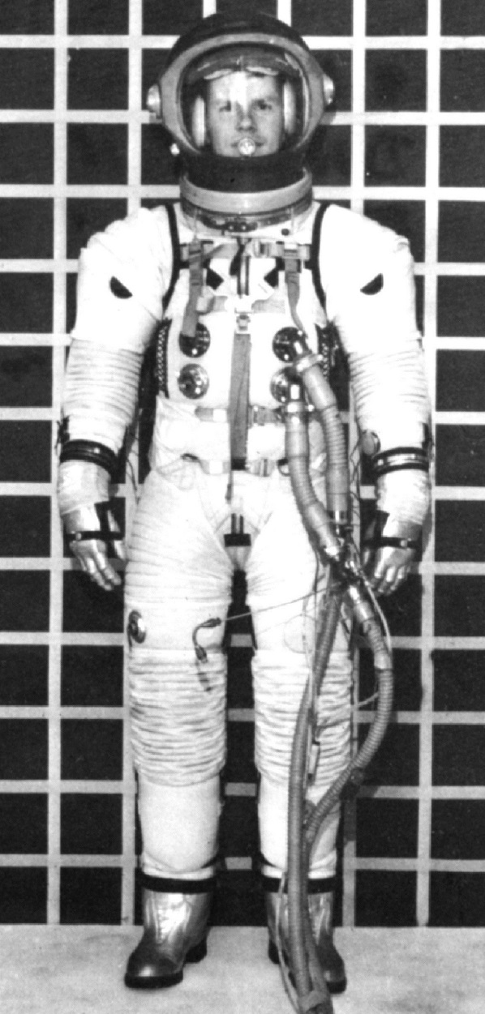
Apollo SSA Program Recovery Efforts, Cont.
Program PGA response:
  HSD/ILC posturing.
  HSD sent a task force to ILC and became directly involved with PGA re-design and production quality control.
    The “Revised AX3H” became AX4H-024, the basis of the Apollo A4H suit configuration.
  HSD hired suit expert Dr. Edwin Vale
  HSD internally funded BFG to provide additional PGA design and fabrication assistance.
  NASA got DCC to aid HSD in thermal/meteoroid garment
Right – Revised AX3H-024 Suit With HSD Helmet
22

Slide 23
Apollo SSA/EMU Program Recovery Efforts, Cont.
NASA Risk Mitigation:
  Because of HSD indicating development of the “Liquid Cooled” PLSS (one that worked with a LCG) would take at least a year, NASA funded AiResearch in early 1964 for a parallel Apollo PLSS effort.
  With Apollo manned flights expected to start in 1966, favorable Litton development, and successful use Gemini suits for IVA evaluations, NASA split Apollo into three Blocks:
    Block I – IVA only flights would use Gemini based DCC suits (disc)
    Block II – Early EVA flights. Successful HSD PLSS chamber testing averted a PLSS competition. The Block II PGA competition to be held in 1965.
    Block III – Extended EVA missions would have exclusively EVA suits.
  With Apollo splitting into blocks, the Block II system-level transitioned from SSA to Extravehicular Mobility Unit (EMU) and the PGA became the Pressure Suit Assembly (PSA).
23

Slide 24
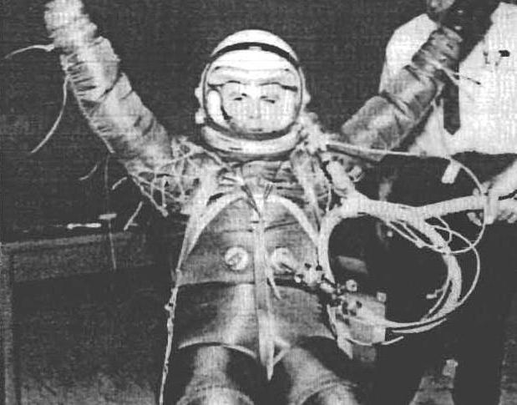
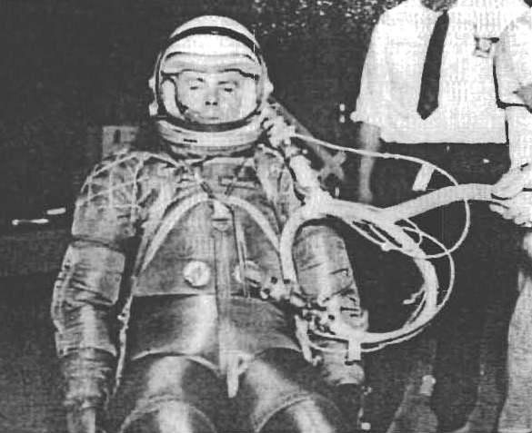
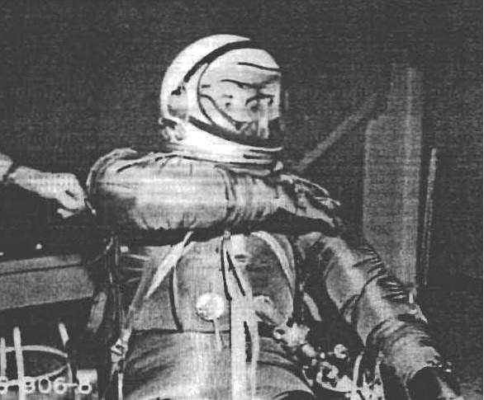
Apollo EMU Program Recovery Efforts, Cont.
  BFG started supporting Apollo Program in June 1964 under NASA stipulation all developments and subsequent manufacturing go to ILC:
    First (BFG) “Mobility Suit” prototype delivered in September 1964.
    Second BFG Apollo prototype (also named Mobility Suit) featured a multi-directional shoulder (HSD design), an upper arm bearing (BFG design) and an axial restraint elbow joint (BFG design).
      Met width and demonstrated excellent upper torso mobility, but was rejected on October 16, 1964 by NASA (Radnofsky) based on adding a potential crit 1/1 failure mode and a possible hard contact issues.
    All subsequent BFG and HSD developments explored multi-directional joints.
1964 (Second) Mobility Suit, The First HSD/BFG Apollo Prototype
24

Slide 25
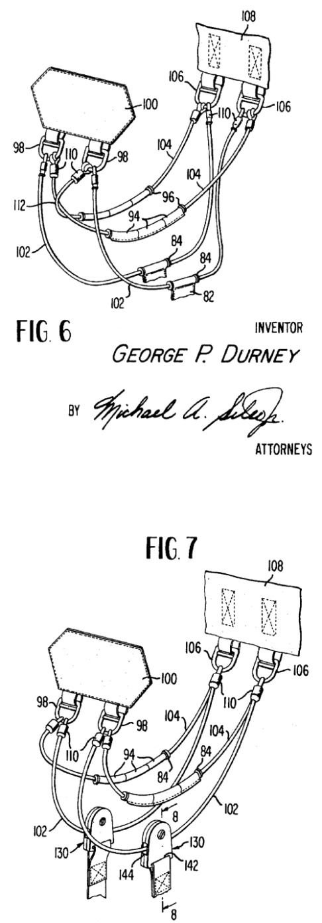
Apollo EMU Program Recovery Efforts, Cont.
  HSD overseeing all developments with HSD to recommend 5th program design (A5H) to NASA in December 1964 for production in early 1965.
  All ILC upper torso mobility efforts before November 1964 were based on finding attachment points so the axis for the shoulder or elbow joints would provide adequate mobility to AX1H base design (never successful).
  ILC provided three new designs in November 1964 (more than HSD or BFG). One PGA featured an ILC walking brief that, with later refinement, would be used on the Apollo A7L and A7LB.
  HSD produced one unsuccessful “Tiger Suit” prototype.
  BFG delivered two suits.
  DCC Gemini training suit also tested.
  In November evaluations, BFG XN-20 tests best.
    ILC asked for one-month delay on A5H decision to produce revolutionary new suit.
Right - ILC “George Durney” Walking Brief. Top illustration is the 1965-67 configuration. The bottom shows the 1968-75 configuration.
25

Slide 26
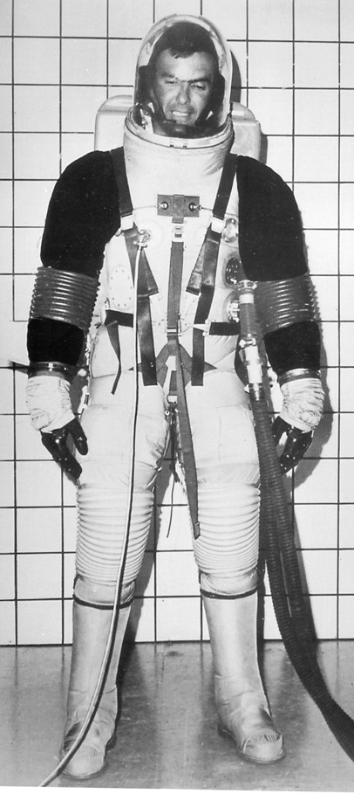
Apollo EMU Program Recovery Efforts, Cont.
      In parallel to ILC, two HSD groups internally funded to continue development.
      ILC prototype not received in time for HSD evaluation data delivery and NASA design decision (January 13, 1965).
      January 16, 1965, ILC made its last HSD Apollo Program “prototype” delivery, an incomplete PGA (probably a A4H production reject). HSD and NASA reaction negative.
        HSD issues stop work on ILC developments.
      By the first week in February, ILC had started working with NASA’s O’Kane and Jones to make a new ILC (rear entry) SOA suit into a demonstration platform for their NASA Bubble Helmet.
      ILC elected not to share this prototype development HSD or NASA management.
ILC Rear Entry SOA Suit
26

Slide 27
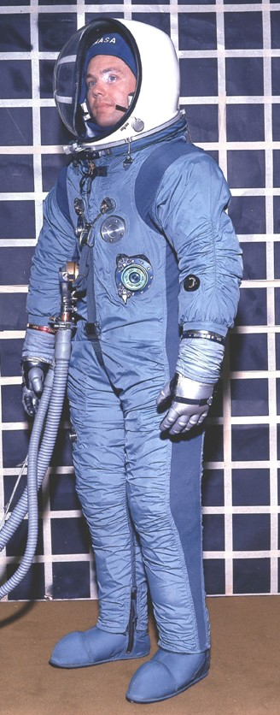
Apollo EMU Program Recovery Efforts, Cont.
      A5H PGA Developments :
      While Tiger Suit continued to be unsuccessful, a second HSD group used existing ILC or BFG suits retrofitted to HSD Teflon ferrule multi-directional mobility systems. Christmas to New Year’s testing indicated as good or better performance than BFG XN-20. HSD recommended the Teflon ferrule HSD design. NASA accepted recommendation for A5H.
      Teflon ferrule multi-directional mobility systems used on Apollo A5H, A6H, “AX4L”, A5L, A6L, A7L & A7LB
      The HSD designed and fabricated first A5H suit. This was the first Apollo Program design to:
        Meet all Apollo PGA requirements
        Include a LCG (used on A7L & A7LB)
        Feature a fabric pressure boot with walking ankle joints (used on A7L & A7LB)
Left - 1965 AX5H Suit
27

Slide 28
Apollo EMU Program Recovery Efforts, Cont.
HSD and ILC were never able to reach an effective working agreement.
  Between October 1962 and September 1965, ILC produced more Apollo design configurations in competition to HSD than for HSD.
  HSD and top NASA management unaware of any ILC developments after November 1964.
  In January 1965, ILC refused to manufacture a HSD design Block II competition suit and A5H training suits. This was recanted by ILC in February.
  On March 3, 1965 with NASA (R. Johnston) concurrence, HSD replaced ILC with BFG as the Apollo PSA supplier.
28

Slide 29
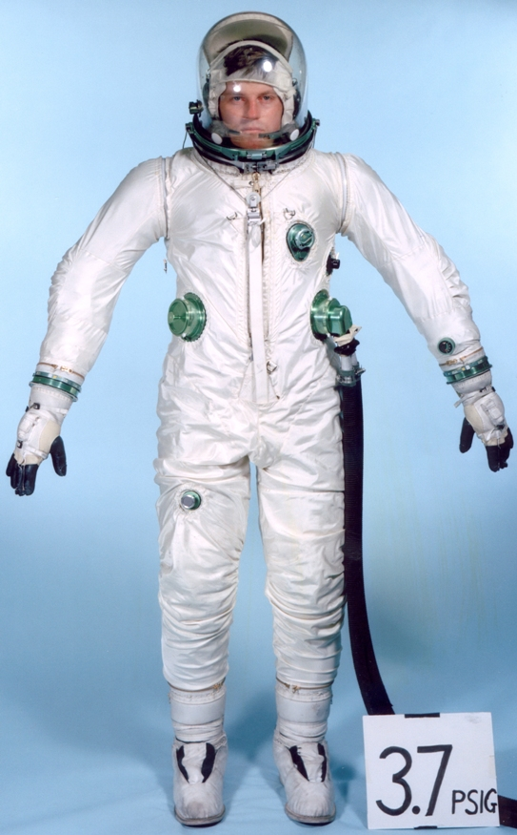
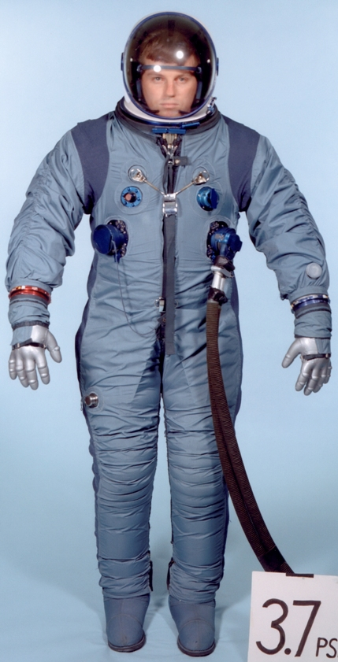
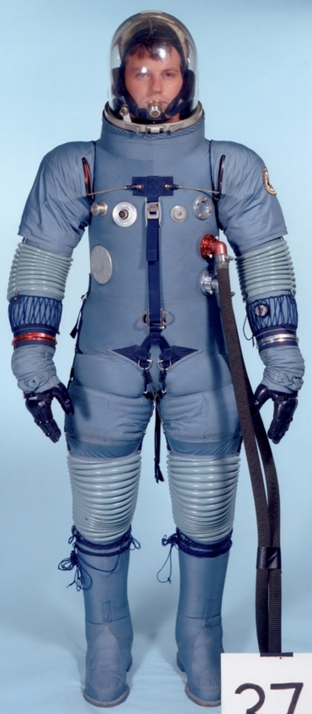
Apollo EMU Program Recovery Efforts, Cont.
The 1965 Apollo Block II PSA competition started on June 15, 1965. The two PSAs at the start of the competition were from HSD and DCC. NASA allowed ILC to enter the competition two weeks later.
NASA selected ILC and the AX5L. NASA additionally desired the LCG, Multiple Water Connector and “walking” (ankle joint) pressure boots.
DCC AX1C
Hamilton Standard AX6H
International Latex AX5L
29

Slide 30
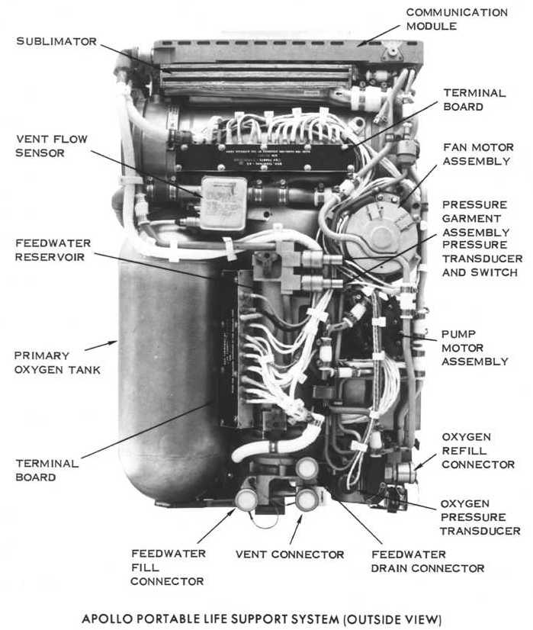
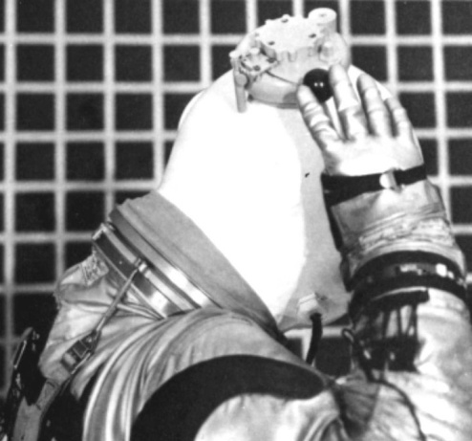
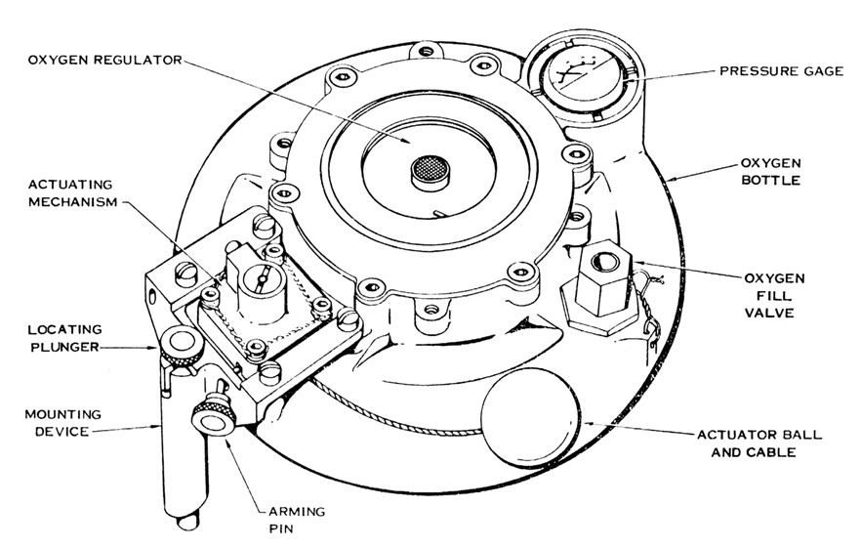
Apollo EMU Program Recovery Efforts, Cont.
PLSS Developments - HSD “Liquid Cooled” PLSS (used LCG) completed development and reached manned chamber testing in September 1965 and a second, lighter, and more compact EOS was certified to maintain volume and weight requirements.
Left - 1965 “Liquid Cooled” PLSS supporting LCG use.
Right & Below – 1964-65 EOS
30

Slide 31
Apollo EMU Program Recovery Efforts, Cont.
Original Plan = Complete baseline SSA development (incl. thermal/meteoroid) in 10 months
  PGA Development = 3 design iterations
  PLSS & EOS = 1 design iteration
Actual Apollo EMU design solution = Complete baseline development (incl. thermal/meteoroid) in 36 months
  PSA Development = 35 development design configurations from ILC, HSD, BFG, Litton, or DCC
  PLSS = 3 Designs from 2 suppliers
  EOS = 2 Designs from 1 supplier
31

Slide 32
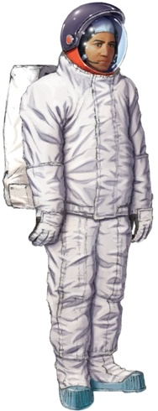
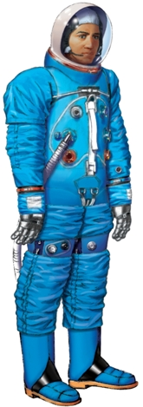
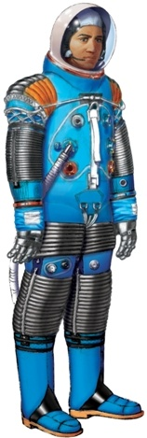
NASA EMU Program Before Flight
NASA effectively became the EMU in August 1965 with contractual follow-up in March 1966. In 1966, the Apollo EMU had a separately
  donning thermal-meteoroid garment and came in two configurations of PSA:
  Training with A5L Suit
  Flight A6L Configuration:
    The A6L soon morphed into a series of training and flight evolutions.
  During this period, EOS was replaced by a longer duration Oxygen Purge System (OPS)
EVA Accessories Donned
In IVA Configuration
Without Abrasion Covers
32

Slide 33
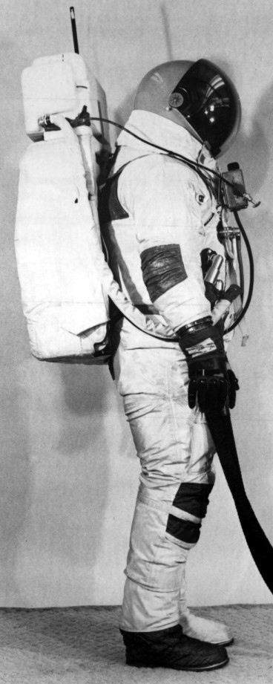
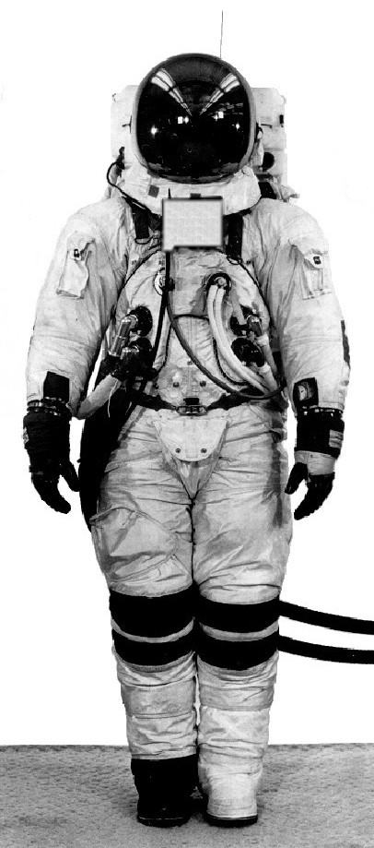
NASA EMU Program Before Flight, Cont.
In 1967, the Apollo capsule fire caused material changes in both the PSA and PLSS. The PSA gained an Integrated (always attached) Thermal Meteoroid Garment (ITMG) and a full-bubble polycarbonate helmet. The PLSS gained a (chest mounted) Remote Control Unit (RCU).
OPS
Note: The PSA in the pictured Apollo 9 EMU prototype with an A6L.
RCU
33

Slide 34
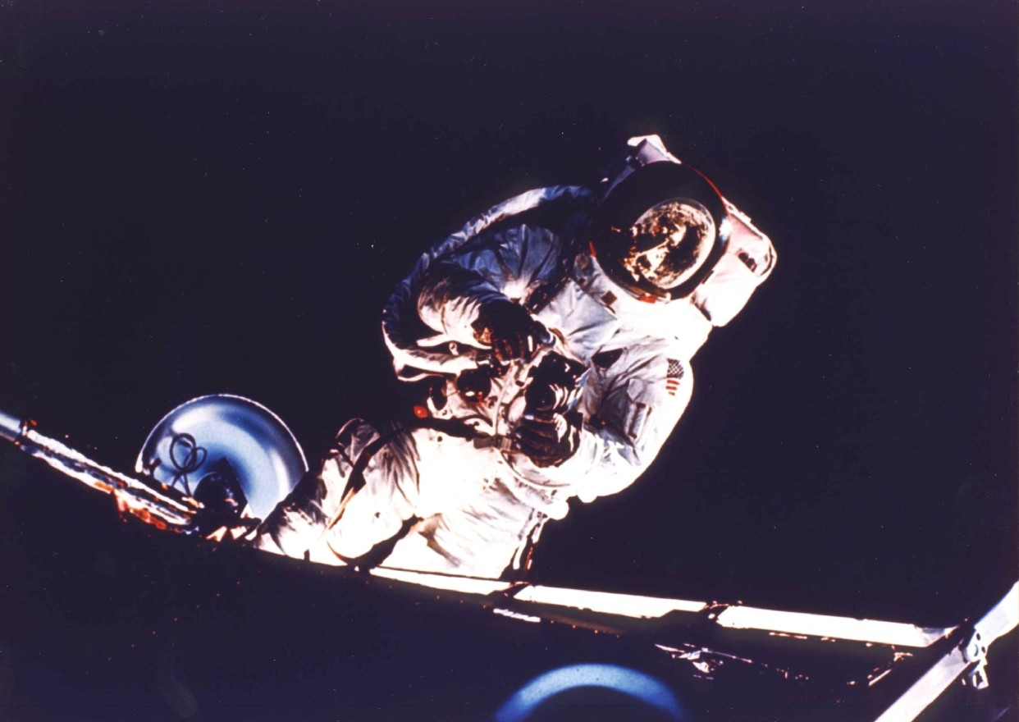
Apollo 9 & 10 EMU (1969)
7-10
Apollo 9 - First U.S. Autonomous EVA
34

Slide 35
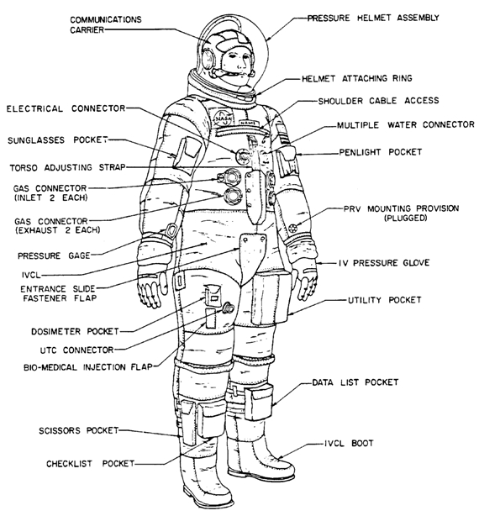
Apollo 9 & 10 EMU (1969), Cont.
The EMU was used only in IVA configuration in Apollo missions 7 and 8.
7-10
35

Slide 36
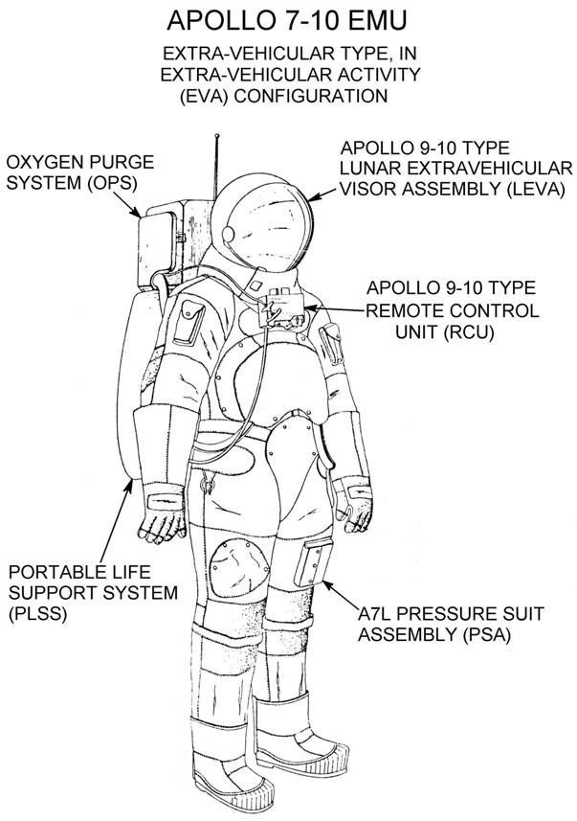
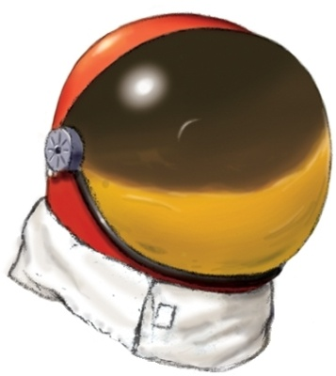
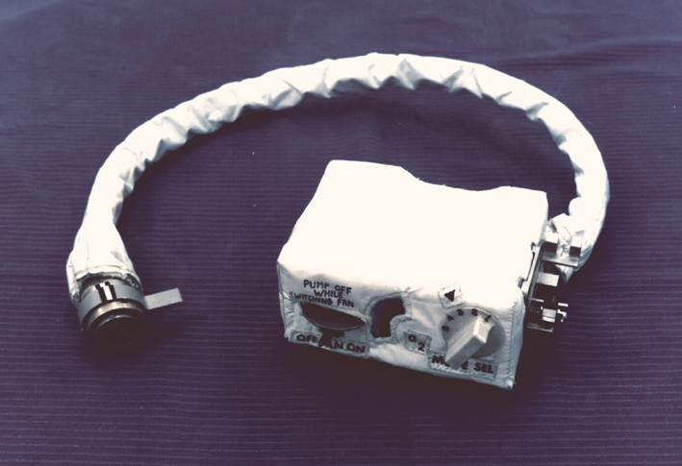
Apollo 9 & 10 EMU (1969), Cont.
The EVA configuration of the Apollo 7 -10 EMU was used on Apollo 9 and carried on Apollo 10.
Apollo 9-10 unique EVA accessories:
The LEVA formed minor frost inside in Apollo 9’s EVA.
The challenge of taking pictures made the Apollo 9 RCU obsolete.
Apollo 7-10 EVA Configuration
36

Slide 37
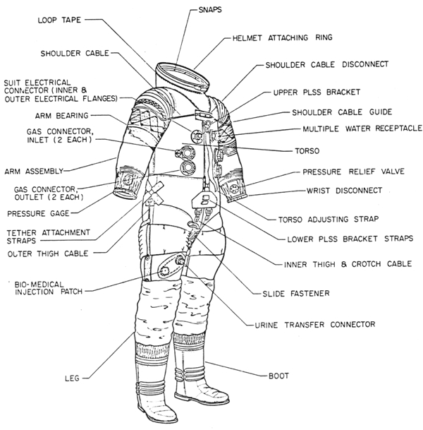
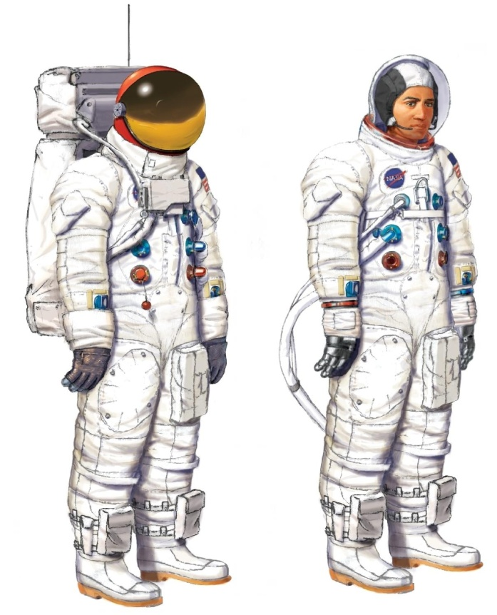
Apollo 9 & 10 EMU (1969), Cont.
All Apollo missions used two configurations of PSA. The Lunar Module crew were provided with EV versions of the A7L PSA.
37

Slide 38
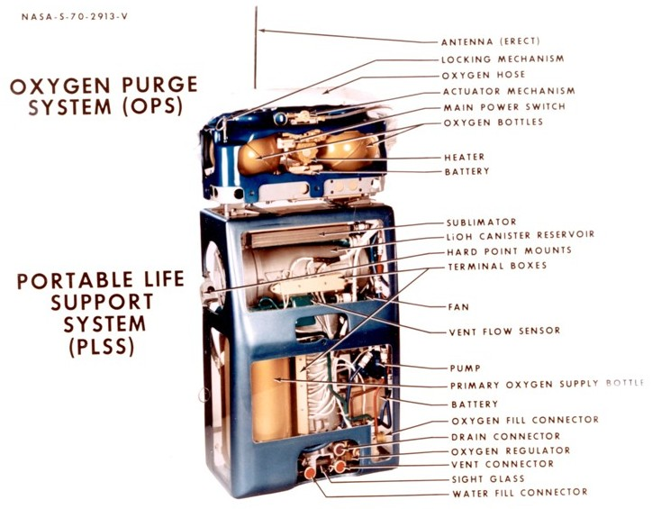
Apollo 9 & 10 EMU (1969), Cont.
The Apollo 9 and 10 missions were supported by the -5 configuration of PLSS.
38

Slide 39
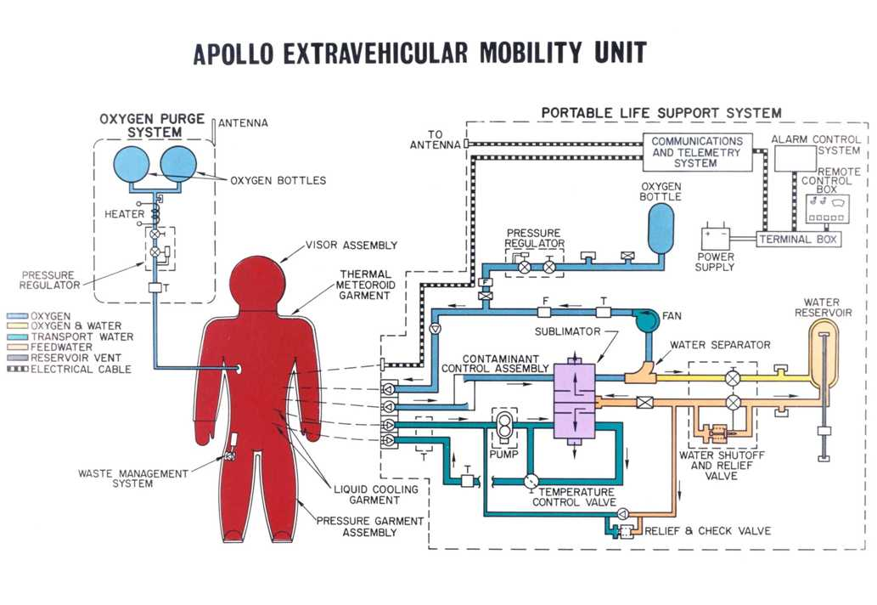
Apollo 9 & 10 EMU (1969), Cont.
The Apollo 9 to14 PLSS Schematic
39

Slide 40
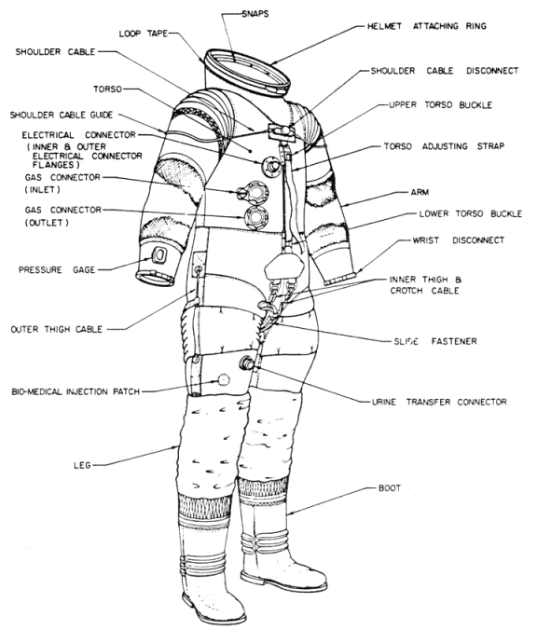
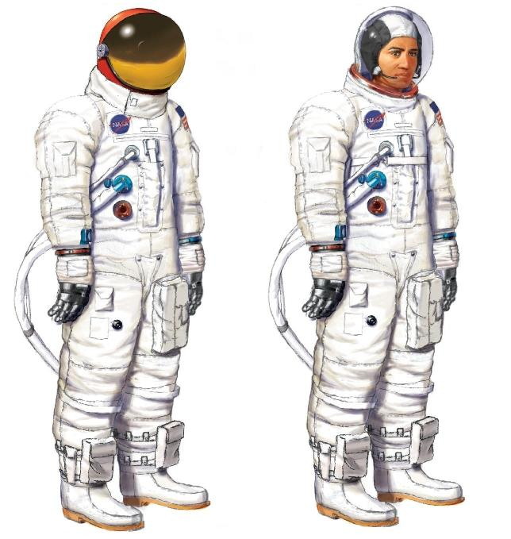
Apollo 9 & 10 EMU (1969), Cont.
For Apollo 7-14, the CMP version of the A7L had only one set of life support connectors and no upper arm bearings on the PSA.
40

Slide 41
Apollo 9 & 10 EMU (1969), Cont.
Development & Operational Dates: Both the PSA and PLSS were incremental improvements to the last iteration of the A6L and the -3 and -4 PLSS. The -3 PLSS incorporated the material improvements from the Apollo fire corrective actions. Because it was unclear if there would be sufficient time to develop the RCU, it was a separate, parallel development that was merged with the -3 to form the -5. This configuration supported one, two-astronaut EVA for a total of 1.5 man-hours outside the spacecraft.
Technical Characteristics:
  Operating Pressure (Nominal): 3.7 psi (25.5 kPa)
  IVA PSA Weight @ 1-G: 53 lbs (24 kg)
  EVA PSA Weight @ 1-G: 64 lbs (29 kg)
  LSS Weight @ 1-G: 125 lbs (56.7 kg)
  EVA System Weight @ 1-G: 189 lbs (85.7 kg)
  Minimum Hatch Size: 30 in. X 30 in. (762 mm X 762 mm)
  LSS, EVA, Primary: 6 hours certified, longest use 4.8 hours
  LSS, EVA, Backup: 30 minutes certified, never used in flight
Quantities Manufactured: See Apollo 11 through 14 (next topic) for A7L summary. As the Apollo PLSSs were retrofitted from one configuration to the next, the PLSS total is provided in the Apollo 15-17 EMU summary.
41

Slide 42
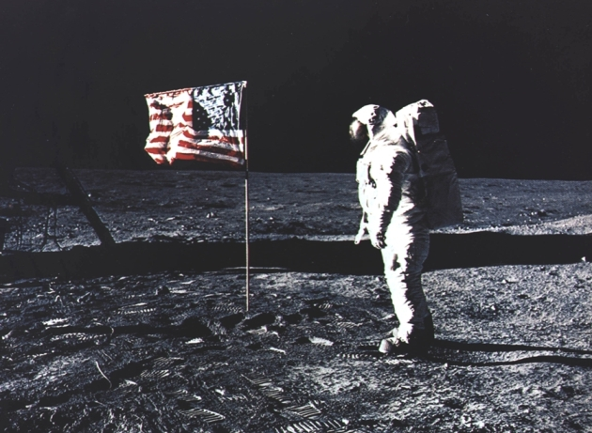
Apollo 11 - 14 EMU (1969-70)
Apollo 11 – Man’s First Visit to the Moon
42

Slide 43
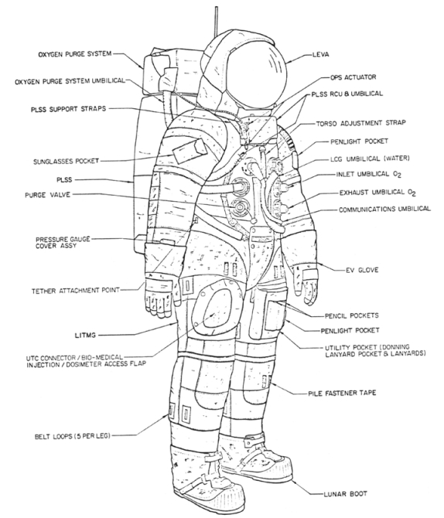
Apollo 11 - 14 EMU (1969-70)
The EMU was used in Apollo missions 11 through 14 with essentially one noticeable variation.
7-10
43

Slide 44
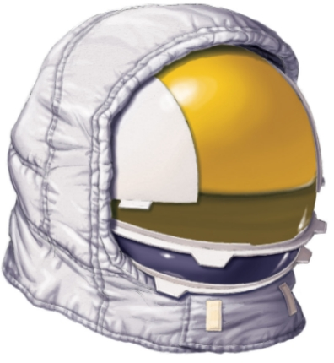


Apollo 11 - 14 EMU (1969-70)
Apollo 11 and Subsequent Features:
The Apollo 11-13 LEVA
Glare and thermal conductivity on Apollo 9 caused a redesign of the LEVA.
The Apollo 11-17 RCU
Difficulty working controls and taking pictures with EV gloves caused a redesign of the RCU for Apollo 11. The knobs grew larger and were more conveniently placed. The front of the RCU gained a bayonet fitting to hold the camera for the astronaut. This provided steady photographs that chronicle man’s exploration of the Moon.
The Apollo 14-17 LEVA
Glare continuing to be a problem the LEVA to redesigned one last.
44

Slide 45
Apollo 11 - 14 EMU (1969-70)
Development & Operational Dates: Both the PSA and PLSS were incremental improvements to the Apollo 7-10 system. For Apollo 11-13, the PSA’s visor assembly gained an outer shell and the thermal cover. For Apollo 14, the visor assembly was again revised to add an external opaque center sunshade. This would also be used on the Apollo 15-17 EMUs. The Apollo 11-14 PLSS had its RCU chest-mounted display and control unit revised to make it easier to operate with pressure-gloved hands and to add a camera mount on the front. This configuration supported 5, two-astronaut EVAs for a total of 39.1 man-hours outside the spacecraft.
Technical Characteristics:
  Operating Pressure (Nominal): 3.7 psi (25.5 kPa)
  IVA PSA Weight @ 1-G: 53 lbs (24 kg)
  EVA PSA Weight @ 1-G: 64 lbs (29 kg)
  LSS Weight @ 1-G: 125 lbs (56.7 kg)
  EVA System Weight @ 1-G: 189 lbs (85.7 kg)
  Minimum Hatch Size: 30 in. X 30 in. (762 mm X 762 mm)
  LSS, EVA, Primary: 6 hours certified, longest use 4.8 hours
  LSS, EVA, Backup: 30 minutes certified, never used in flight
Quantities Manufactured: At least 105 A7L suits were made. These suits supported Apollo 7 through 14 and Apollo 15-17 CMP usage (see next topic). As the Apollo PLSSs were retrofitted from one configuration to the next, the PLSS total is provided in the Apollo 15-17 EMU summary.
45

Slide 46

Apollo 15-17 EMU (1971-72)
1971 Apollo 15 – The First Apollo Rover Mission
46

Slide 47


Apollo 15-17 EMU (1971-72), Cont.
While it can be debated if there was a competition for the Apollo 15-17, there were competing activities. Within weeks of loosing the suit-side of the Apollo contact, HSD made an Apollo prototype that began an attempt to gain what became the Apollo 15-17 PSA. Later (1968) suits introduced bias control for improved anthropomorphic shape plus mobility and structural improvements.
The 1966 HSD Apollo XM-2A prototype
47

Slide 48








Apollo 15-17 EMU (1971-72), Cont.
In early 1968, HSD funded two more Apollo prototypes based on Manned Orbiting Laboratory (MOL) Program developments and started an advanced suit.
The Advanced Apollo Suit build was terminated in April 1968 because of the HSD management perception that there was no HSD suit business opportunity in Apollo.
1968 “Apollo Suit” Prototypes (above)
The Advanced Apollo Suit Design (right)
48

Slide 49


Apollo 15-17 EMU (1971-72), Cont.
By 1967, it was apparent that the A6L would not be suitable for Rover use. NASA funded DCC for an advanced mobility prototype. While this did not find a place in Apollo, the restraint technology did see a resurrection in Lunar-Mars developments in the 1990s.
The 1967 David Clark Apollo Suit
49

Slide 50

Apollo 15-17 EMU (1971-72), Cont.
  After program termination in June 1969, USAF offers NASA its certified-for-space MOL suit fleet (HSD made) for Apollo 15 and subsequent use. NASA rejects potential use because:
  MOL suits not designed to interface with Apollo PLSS and LCG.
  MOL ITMG not designed for Lunar thermal contact requirements.
  Suit Subject MOL Pilot Dick Lawyer Shown
50

Slide 51

Apollo 15-17 EMU (1971-72), Cont.
No one remembers exactly who was responsible for the idea that many called the “Omega Project.” It seems to have germinated in the ranks of NASA or ILC engineering sometime in very late 1967 or early 1968. The first known activity appears to have been a very informal study conducted in the summer of 1968 by NASA and ILC field personnel. This “study” permitted a closer look at entry concepts. This was accomplished by taking several obsolete A5L and/or A6L suits and sewing on zippers to represent proposed entry configurations. Then ILC technicians cut the pressure garment along the opening plain of the zipper to evaluate these various concepts. This effort ultimately produced two configurations that were called the “A8L” and “A9L.” The “Omega Project” was proposed to fund the building of A8L and A9L prototypes to permit competitive evaluation.
An Omega Effort Slide
51

Slide 52

Apollo 15-17 EMU (1971-72), Cont.
While the technical definition of the A8L concept has been lost, there is perhaps a clue in a patent application initiated by ILC personnel in 1968. A concept by NASA’s James V. Correale Jr. (ref. US Patent 3221339) was acknowledged in a listing of developments that contributed to the Apollo PSA. However, this acknowledgement was without explanation and the concept (shown right) has no known fabrication or evaluation in the Apollo Program.
It is unclear if A8L and A9L prototypes were actually built. Differing versions of history have not been proved or disproved.
The funding for Omega Project was never approved. The NASA/ILC technical teams were obliged to propose one concept for a funded prototype. The concept selected was A9L, which was subsequently re-identified A7LB to indicate this was not a new design that should have been competed, but rather a slight modification of the existing A7L design.
Possible “A8L” Entry System
52

Slide 53


Apollo 15-17 EMU (1971-72), Cont.
A9L/A7LB (EV) Restraint System (above)
NASA’s Joe McMann Testing a Prototype A7LB EV (right)
53

Slide 54


Apollo 15-17 EMU (1971-72), Cont.
The Apollo 15-17 Extra-Vehicular Configuration
As NASA elected to re-use existing, rear-entry A7L suits for Apollo 15 and subsequent CMP use (discussed later).
The new side entry, former A9L configuration became the A7LB EV.
EVA Configuration IVA Configuration Without Covers
54

Slide 55

Apollo 15-17 EMU (1971-72), Cont.
This last version of the Apollo PLSS was the -7 (dash seven). The challenge was to retain the external envelope, but produce a system that was certified for 8 hours of operation at an average metabolic rate of 930 btu/hr. or 6 hours of life at an average metabolic rate of 1204 btu/hr. The Apollo -6 PLSS was certified for 4 and 6 hours, respectively.
The -7 Apollo PLSS, like its -6 predecessor, operated flawlessly (within operating parameters) on all the Lunar missions. The -7 PLSS routinely performed 7-hour plus EVAs, returning to the Lunar Module with capacity to spare. On December 12, 1972, the world's record for the longest EVA, 7 hours and 37 minutes, was set by Apollo 17 astronauts Cernan and Schmitt with the HSD Apollo PLSS. This record remained until May 13, 1992, when the STS-49 astronauts Thuot, Hieb, and Akers performed an 8-hour and 39- minute EVA using the HS-designed and made Shuttle PLSSs.
The "Lunar Rover" 8-Hour PLSS
55

Slide 56

Apollo 15-17 EMU (1971-72), Cont.
The Buddy Secondary Life Support System (BSLSS) as part of an effort to reduce costs for the Apollo 15 and later missions. With minor modification, the Apollo 15 and later -7 PLSS had the capacity to support the cooling needs of two astronauts simultaneously. If a PLSS failed, the BSLSS allowed two astronauts to share the cooling from the other, working PLSS. The crewmember with the failed PLSS would activate and set his OPS on the "low flow" to extend his back-up life support from 30 to 75 minutes.
The Buddy Secondary Life Support System
56

Slide 57


Apollo 15-17 EMU (1971-72), Cont.
The Apollo 15-17 CMP Configuration
Most of the 15-17 Apollo CMP A7LB PSAs were retrofitted rear entry A7L EV PSAs. Conversion was accomplished by the removal of the LCGs and MWCs. A limited quantity of new-build A7LB CMP PSAs were manufactured to support Apollo 17.
EVA Configuration IVA Configuration Retrofit Without Covers
57

Slide 58

Apollo 15-17 EMU (1971-72), Cont.
Man’s Last Deep Space Occurred With Apollo 17
58

Slide 59
Apollo 15-17 EMU (1971-72), Cont.
Description: The A7LB EV and CMP PSAs were designed and manufactured by ILC Industries of Dover, Delaware (a separate business entity partially owned by ILC). The Apollo PLSS/OPS was developed and manufactured by HS of Windsor Locks, Connecticut.
Development & Operational Dates: Development for this configuration started in 1968 and were evolutionary improvements on the preceding systems. First flight was in 1971. This last Apollo EMU supported 3 flights, 13 EVAs (12, two-astronaut; 1, one-man “Stand-up EVA”) for a total of 127.8 man-hours outside the spacecraft.
Technical Characteristics:
  Operating Press. (Nom.): 3.7 psi (25.5 kPa)
  IVA PSA Weight: 55 nom., 62 max. lbs (25 / 28 kg)
  EVA PSA Weight: 67 nom., 83 max. lbs (30 / 37.6 kg)
  LSS Weight @ 1-G: 134 lbs (60.8 kg) fully charged max.
  EVA System Weight: 212 lbs (96 kg)
  Minimum Hatch Size: 30 in. X 30 in. (762 mm X 762 mm)
  LSS, EVA, Primary: 7 hrs certified, used 7.62 hrs
  LSS, EVA, Backup: 30 minutes (never used)
59

Slide 60
Apollo 15-17 EMU (1971-72), Cont.
Quantities Manufactured: At least 30 side/mid-entry A7LB EV suits were made for Apollo. While most of the A7LB CMP suits were retrofitted A7L EV suits, at least four new-build A7LB CMP suits were manufactured. There were 34 Apollo PLSSs manufactured from 1965 to 1972 to support development, certification, training, and missions.
60

Slide 61

Skylab EMU
(1969-74)
61

Slide 62

Skylab EMU (1969-74), Cont.
62

Slide 63
Skylab EMU (1969-74), Cont.
  Suit candidates were many:
    ILC A7L Apollo suit
    ILC “Omega” suit
    HSD MOL suit
    Litton Constant Volume Suit (CVS)
    AiResearch CVS
  A7LB EV suit planned for Apollo 15 and subsequent selected:
    Connectors relocated for Skylab
    Boots were revised to aid in use of foot restraints
    Visor assembly and insulation layers changed because of change in thermal environment from Moon to orbit
  Station damaged in Skylab I launch, heat would soon destroy station
    Skylab 2, 3, and 4 EVAs turned rescue into success
63

Slide 64

Skylab EMU (1969-74), Cont.
Pressure Control Unit (PCU)
Umbilical gang connector
Leg-mounted 30 minute Secondary Oxygen Package (SOP)
60 foot Life Support Umbilical (LSU)
64

Slide 65
Skylab EMU (1969-74), Cont.
Description: The Apollo Skylab EMU consisted of an adaptation of the side/mid-entry Apollo A7LB EV PSA and an Astronaut Life Support System (ALSA). The A7LB PSA was designed and manufactured by ILC Industries of Dover, Delaware. The winner of the ALSA competition and contract was the AiResearch Division Of Garrett Aerospace Corporation located in Torrance, California. During ALSA development, AiResearch became part of AlliedSignal Corporation (now Honeywell) by merger. The Torrance division continued on to be the manufacturer of the ALSA. Development of Allied Signal’s competition concept was unsuccessful. The revised design that was certified was amazingly similar to the HSD competition architecture. The complications in development caused schedule delays and cost over-runs that would work against Allied Signal in the future Shuttle EMU competition.
Development & Operational Dates: Program competition and contact award was in 1969. The Skylab EMU first flight was in 1973.
Technical Characteristics:
  Operating Pressure (Nominal): 3.7 psi (25.5 kPa)
  IVA PSA Weight @ 1-G: 62 lbs (28 kg)
  EVA PSA Weight @ 1-G: 76 lbs (34.7 kg)
  LSS Weight @ 1-G: 71 lbs (32.3 kg) (PCU plus SOP)
  EVA System Weight @ 1-G: 147 lbs (66.8 kg)
  Minimum Hatch Size: Trapezoidal shape 15 x 22 x 30 in
  LSS, EVA, Primary: Indefinite (longest EVA 7 hrs 1 Min)
  LSS, EVA, Backup: 30 minutes
Quantities Manufactured: At least 35 Skylab A7LB suits and 16 ALSAs were made for Skylab.
65

Slide 66

Apollo-Soyuz
(1970-75)
Deke Slayton Ready For Launch
66

Slide 67
Apollo-Soyuz (1970-75), Cont.
  Consideration for possible EVA dropped early in program
    No EVA life support required
  Rear entry A7LB CMP suit from Apollo 15 and subsequent selected:
    Suits modified to reduce weight and cost. The normal outer cover layer of Teflon Beta cloth with under layers of aluminized Kapton with nylon spacers was replaced with Teflon Beta polybenzimidazole (PBI) fabric, which increased its durability. Suit positive pressure relief valve and EV visor were removed.
    Helmets and boots were of the Skylab variety.
      Total PSA 48 lbs (22 kg)
    At least 9 rear-entry A7LB PSAs were manufactured in support of ASTP.
  The single ASTP mission launched on July 15, 1975, and marked the successful debut of the first international cooperation in manned spaceflight through the linkup of the Russian and American vehicles.
67

Slide 68



NESC Academy Webcast
Questions?

