Slide 1

Electronic Component Fatigue

Slide 2


NASA Engineering & Safety Center (NESC) Academy
Dynamic Concepts, Inc.
Huntsville, Alabama

Slide 3
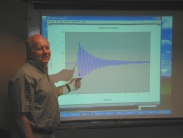
Tom Irvine
Email: tirvine@dynamic-concepts.com
Phone: (256) 922-9888

Slide 4
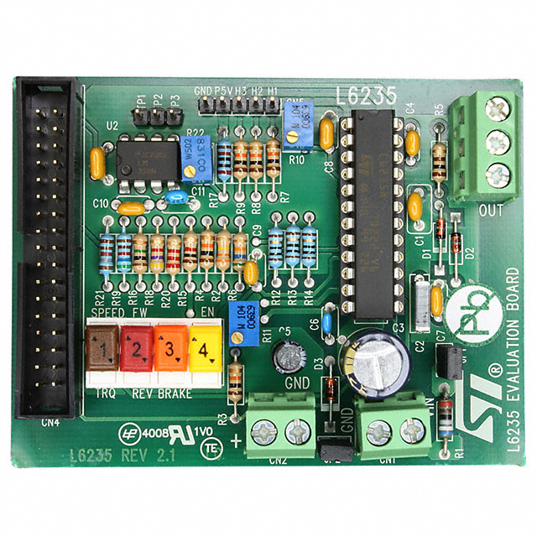
Circuit Board Response
Launch vehicles have numerous avionics components.
Random vibration causes the avionics circuit boards to bend.
Solder joints and lead wires experience stress reversal cycles.
Fatigue failure may result.

Slide 5

Reference

Slide 6
Circuit Board and Component
Lead Diagram
L
Relative Motion
h
Component
Z
B
Relative Motion
Component

Slide 7
Fatigue Introduction
The following method is taken from Steinberg.
Consider a circuit board that is simply supported about its perimeter. A concern is that repetitive bending of the circuit board will result in cracked solder joints or broken lead wires.
Let Z be the single-amplitude displacement at the center of the board that will give a fatigue life of about 20 million stress reversals in a random-vibration environment, based upon the 3σ circuit board relative displacement.

Slide 8

Empirical Fatigue Formula
The allowable upper limit for the 3-sigma relative displacement Z is
inch (20 million cycles)
B | = | length of the circuit board edge parallel to the component, inches
L | = | length of the electronic component, inches
h | = | circuit board thickness, inches
r | = | relative position factor for the component mounted on the board
C | = | Constant for different types of electronic components 0.75 < C < 2.25

Slide 9
r Parameter
r | Component Location (Board supported on all sides)
1 | When component is at center of PCB (half point X and Y)
0.707 | When component is at half point X and quarter point Y
0.5 | When component is at quarter point X and quarter point Y

Slide 10
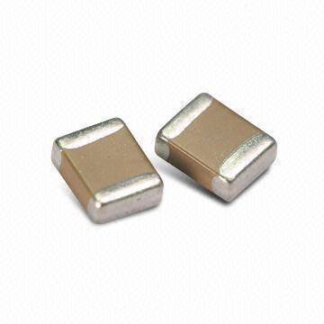
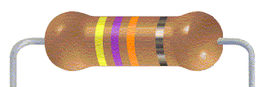
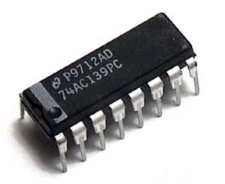
Component Constants
C=0.75
Axial leaded through hole or surface mounted components, resistors, capacitors, diodes
C=1.0
Standard dual inline package (DIP)

Slide 11
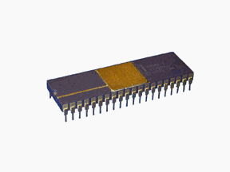
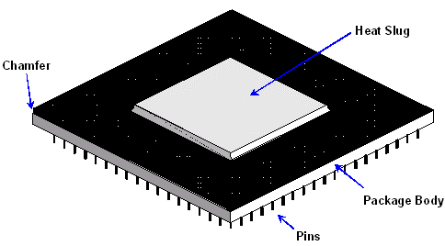
Component Constants (cont.)
C=1.26
DIP with side-brazed lead wires
C=1.0
Through-hole Pin grid array (PGA) with many wires extending from the bottom surface of the PGA

Slide 12
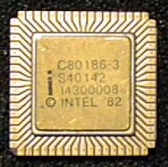
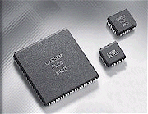
Component Constants (cont.)
C=2.25
Surface-mounted leadless ceramic chip carrier (LCCC).
A hermetically sealed ceramic package. Instead of metal prongs, LCCCs have metallic semicircles (called castellations) on their edges that solder to the pads.
C=1.26
Surface-mounted leaded ceramic chip carriers with thermal compression bonded J wires or gull wing wires.

Slide 13

Component Constants (cont.)
C=1.75
Surface-mounted ball grid array (BGA).
BGA is a surface mount chip carrier that connects to a printed circuit board through a bottom side array of solder balls.

Slide 14
Component Constants (cont.)
C = 0.75 | Fine-pitch surface mounted axial leads around perimeter of component with four corners bonded to the circuit board to prevent bouncing
C = 1.26 | Any component with two parallel rows of wires extending from the bottom surface, hybrid, PGA, very large scale integrated (VLSI), application specific integrated circuit (ASIC), very high scale integrated circuit (VHSIC), and multichip module (MCM).

Slide 15
Circuit Board Maximum Predicted Relative Displacement
Calculating the allowable limit is the first step.
The second step is to calculate the circuit board’s actual displacement.
Circuit boards typically behave as multi-degree-of-freedom systems. Thus, a finite element analysis is required to calculate a board’s relative displacement.
The formula on the following page is a simplified approach for an idealized board which behaves as a single-degree-of-freedom system. It is derived from the Miles equation, which is covered in a later unit.

Slide 16
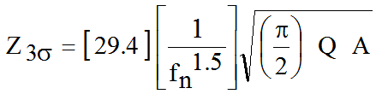
SDOF Relative Displacement
The 3σ relative displacement per Miles’ equation is
(inch)
fn | is the natural frequency (Hz)
Q | is the amplification factor
A | Is the input power spectral density amplitude (G^2/Hz), assuming a constant input level

Slide 17
Exercise 1
A DIP is mounted to the center of a circuit board.
Thus, C = 1.0 and r = 1.0
The board thickness is h = 0.100 inch
The length of the DIP is L =0.75 inch
The length of the circuit board edge parallel to the component is B = 4.0 inch
Calculate the relative displacement upper limit
inch (20 million cycles)

Slide 18
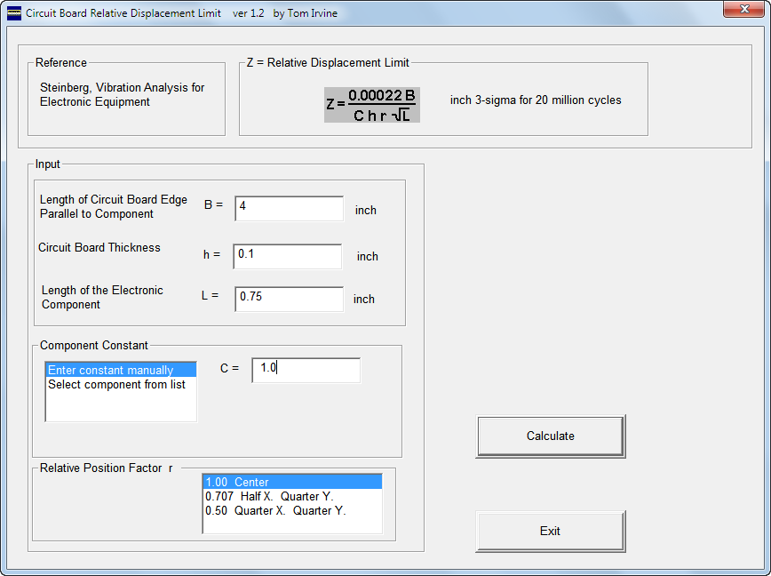

Slide 19
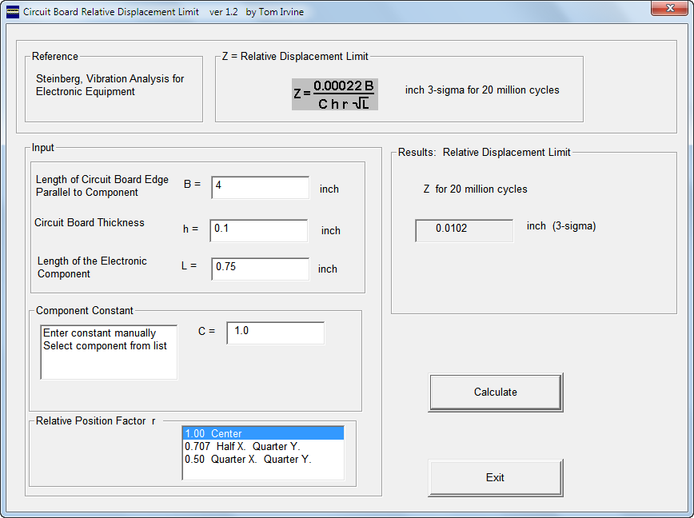

Slide 20
Exercise 2
A circuit board has a natural frequency of fn = 200 Hz and an amplification factor of Q=10.
It will be exposed to a base input of A = 0.04 G^2/Hz.
What is the board’s 3-sigma displacement?
Use program: Miles.m

Slide 21
Miles.m ver 1.1 February 15, 2005
by Tom Irvine
This program calculates the response of a single-degree-of-freedom system to a base input power spectral density input via Miles equation.
Enter the natural frequency (Hz) 200
Enter the PSD (G^2/Hz) value at the natural frequency 0.04
Enter the Q value (typically Q=10) 10
Acceleration Response = 11.21 GRMS (1 sigma)
= 33.63 G (3 sigma)
Relative Displacement = 0.00274 inch (1 sigma)
= 0.00822 inch (3 sigma)
Relative Displacement = 0.0696 mm (1 sigma)
= 0.209 mm (3 sigma)

Slide 22
Relative Displacement
Assume that the circuit board in exercise 1 is the same as the board in exercise 2.
Will the DIP at the center of the board survive 20 million cycles?
Yes . . .
Maximum Expected < Failure Threshold
0.00822 inch (3 sigma) < 0.0102 inch (3 sigma)

Slide 23
Cycles & Duration
Assume that the stress reversal cycles take place at the natural frequency which is 200 Hz.
What is the duration equivalent to 20 million cycles ?
( 20e+06 cycles ) / ( 200 cycles/sec ) = 100,000 sec
= 27 hr 46 min 40 sec

Slide 24
Program Summary
circuit_board.exe
Miles.m

