Slide 1
U.S. SPACESUIT KNOWLEDGE
CAPTURE SERIES
Apollo Block I Spacesuit Development and
Apollo Block II Spacesuit Competition
JAMES W. McBarron II Retired NASA JSC January 29, 2013

Slide 2
AGENDA
Apollo Block I Spacesuit Development
  Chronology
  Requirements
  Configuration
  Procurement Plan
Apollo Block II Spacesuit Competition
  Chronology
  Competition spacesuits
  Test plan details
  Test results
  Program change implementation
Lessons Learned

Slide 3
APOLLO BLOCK I SPACESUIT CHRONOLOGY
January, 1964–North American Aviation (NAA) presented block change concept to the Manned Spacecraft Center (MSC):
  Block I spacecraft would carry no rendezvous and docking equipment
and would be for Earth-orbital missions only.
  Block II Command Service Module (CSM) changes were necessary: Lunar Excursion Module (LEM) compatibility; structural changes to reduce weight and improve CSM center of gravity; plus other critical systems changes. Block II CSM would be final design configuration for lunar missions.
February - March, 1964–During this time, Crew Systems Division (CSD) began reviewing the possibility of using Gemini suits during Apollo Earth orbital flights, and during the next several weeks, began testing Gemini suits in Apollo environments.

Slide 4
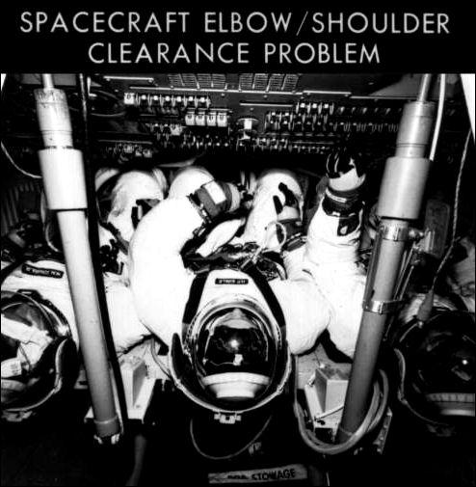
APOLLO BLOCK I SPACESUIT CHRONOLOGY
April, 1964 - MSC and NAA conducted review of Block I CSM mockup.
  First time three prototype spacesuits were used in CM couches.
  Testing of three suited astronauts lying side by side in couches at
3.7 psig showed suit elbows and shoulders overlapped preventing effective operation of CM displays and controls.
- Previous tests with only one suited subject indicated prototype suit
mobility was adequate.
“One of the most worrisome items astronauts found in the CM arrangement was an "elbow- shoulder clearance problem," Four years later, in 1968, this problem still vexed astronauts Walter Schirra, Donn Eisele, and Walter Cunningham, the first crew to fly an Apollo spacecraft…..”

Slide 5
APOLLO BLOCK I SPACESUIT CHRONOLOGY
May, 1964–Decision made to use Gemini suits for Block I missions.
  Use of Gemini suits for Apollo Block I Earth orbital missions promised a substantial financial saving.
  Existing Hamilton Standard (HS)/International Latex Corporation (ILC) Apollo space suit contract was redirected to concentrate on later Apollo Block II flights.
  Redesign of prototype Apollo suit shoulders and elbows was initiated.
June, 1964–MSC directed NAA to make whatever design changes necessary to make Block I CSM compatible with the Gemini spacesuit.
July, 1964–NASA gave David Clark Company (DCC) program for
modifying and testing Gemini suits for use in Apollo program after
the decision was made to use Gemini space suits for Apollo Earth-orbital
flights. Formal contract award to DCC scheduled for later this year.

Slide 6
APOLLO BLOCK I SPACESUIT CHRONOLOGY
October, 1964–MSC CSD investigated environmental control system (ECS) implications of using Gemini suits in Apollo Block I missions.
  Results indicated ECS capable of maintaining nominal cabin temperature and
carbon dioxide partial pressure levels.
  This mode of operation had an adverse effect on cabin dew-point temperature and water condensation rate.
November,1964–MSC determined lights on spacesuit glove fingertips were adequate to supplement CM interior lighting. Exact requirements for fingertip lights to be defined. Astronauts preferred red bulbs, a redesign to the existing Gemini glove system.
Sept-Dec, 1964–CSD approved use of modified Gemini spacesuits in
Block I Apollo spacecraft.
  MSC amended DCC Gemini suit contract for design and fabrication of a prototype Apollo Block I suit.
November, 1964–Apollo Spacesuit Assembly designated Apollo Extravehicular Mobility Unit (EMU) by direction of Max Faget, MSC engineering director.

Slide 7
APOLLO BLOCK I SPACESUIT CHRONOLOGY
January, 1965–Block II CM Preliminary Design Review held at NAA. Significant problems identified:
  Wear cycles and requirements for donning and stowage of spacesuits needed to be resolved and incorporated into CSM specifications.
  NAA interpretation of specifications conflicted with MSC CSD’s then current plan that all three crewmen should be able to wear suits without helmets during the first several missions.
January, 1965–Apollo System Program Office (ASPO) Systems Engineering Division (SED) concluded Block I CMs should be outfitted
for partial suit wear to build confidence in the pressurization system and recommended ASPO manager direct NAA to incorporate provisions for partial suit wear in Block I.

Slide 8
APOLLO BLOCK I SPACESUIT CHRONOLOGY
February, 1965–MSC CSD tested the time an astronaut could don and doff a Block I suit assembly while at various stations inside the spacecraft in the Apollo CM mockup.
- Two subjects average donning times were 9 min 33 sec and 10 min; mean doffing times were 4 min 5 sec, and 5 min 23 sec.
February, 1965–Navy Air Crew Equipment Laboratory (NACL) began subject testing Gemini Block I Apollo spacesuit in a wide range of environmental temperatures to determine comfort and physiological responses.
February, 1965–MSC and DCC reached agreement on a sole source contract for Apollo Block I spacesuits. First delivered suits would go to NAA for CM testing.

Slide 9
APOLLO BLOCK I SPACESUIT CHRONOLOGY
March, 1965–First Project Gemini Flight; GT-3
March, 1965–CSD recommended a "shirtsleeve" environment be kept in the CM:
  This design was simpler and more reliable, and promised greater personal comfort than wearing a spacesuit during an entire mission.
November, 1965–CSD reviewed and approved majority of Block I spacesuit drawings:
  Design of Block I spacesuit helmet ear cup and attachment was finalized.
Existing Gemini-type "soft" ear cups were deemed adequate for Block I flights based on evaluation of acoustic test data.
  NAA and DCC specifications were changed to reflect revised requirements.
.

Slide 10
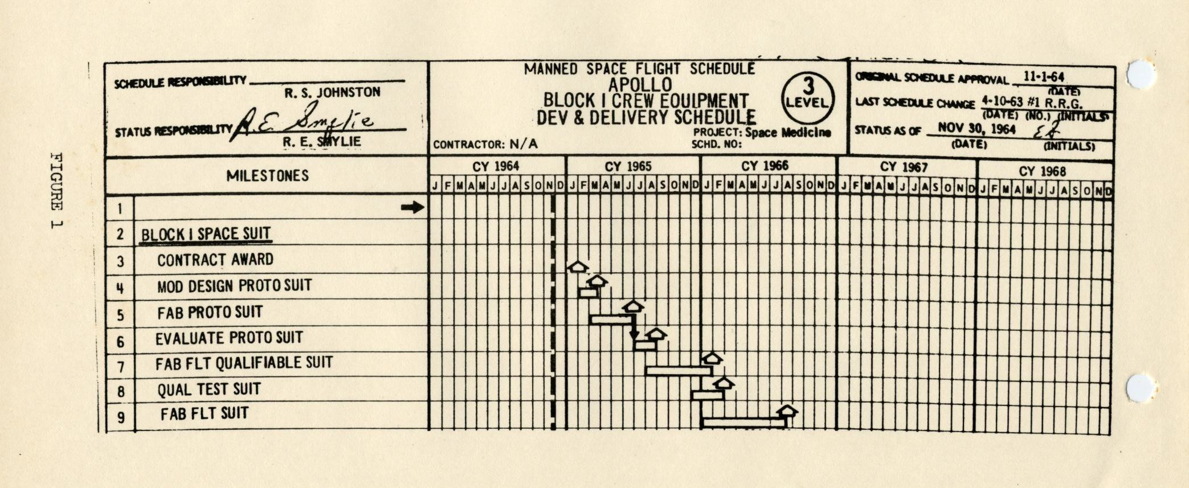
APOLLO BLOCK I SPACESUIT PROGRAM PLAN

Slide 11
APOLLO BLOCK I SPACESUIT PROCUREMENT
Contract NAS 9-1396, Amend. 6, Modification 12–December 15, 1964
Program scope:
  Review Apollo CM interfaces and incorporate modifications required for spacesuit compatibility.
  Identify necessary design changes and modify the Gemini G-3C spacesuit
configuration for Apollo Block I Earth orbital missions.
  Employ DCC developed Project Gemini processes and documentation to maximum extent possible.
  Fabricate and deliver prototype, qualification, program support, and training and flight spacesuits.
  Provide operations support for Apollo Block I Earth orbital missions.
January, 1967–Contract effort was terminated after SA-204 (Apollo 1) mission pre-launch pad fire in CM resulting in loss of all crewmen.

Slide 12
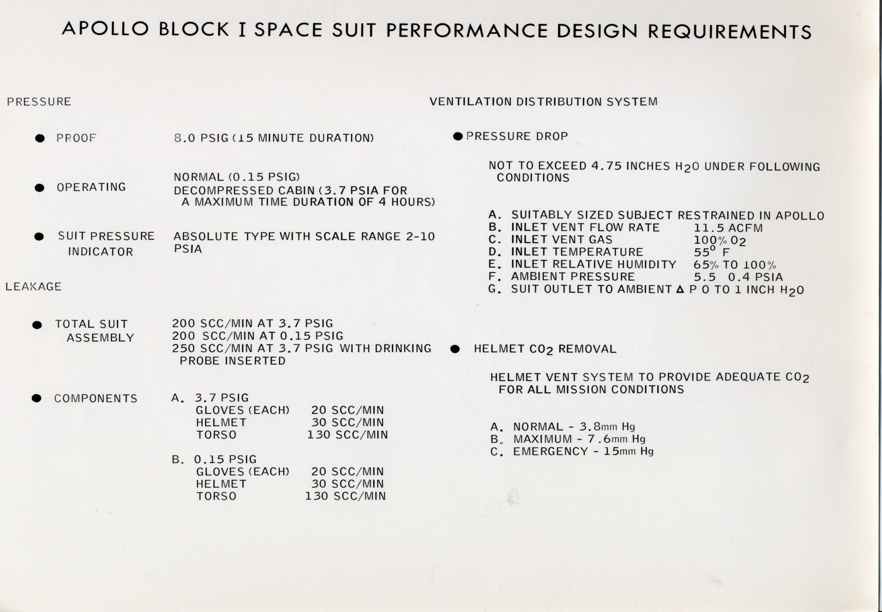

Slide 13
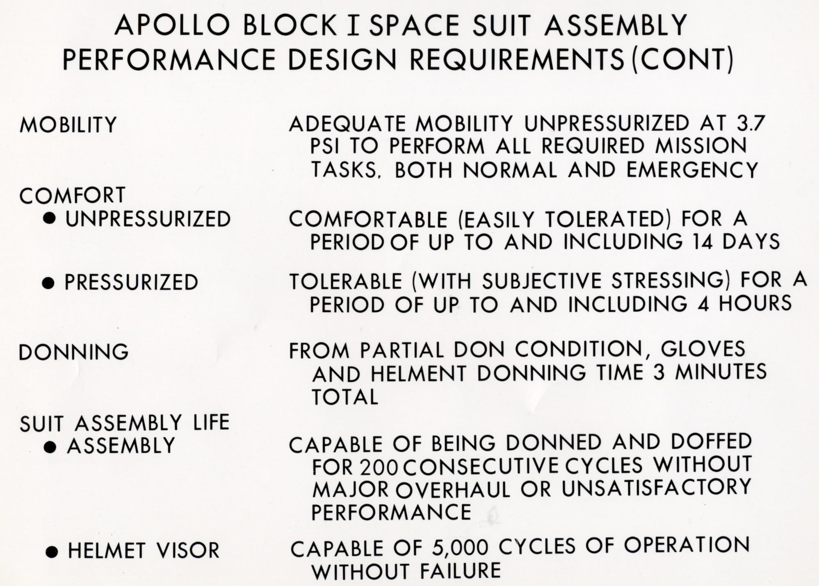

Slide 14
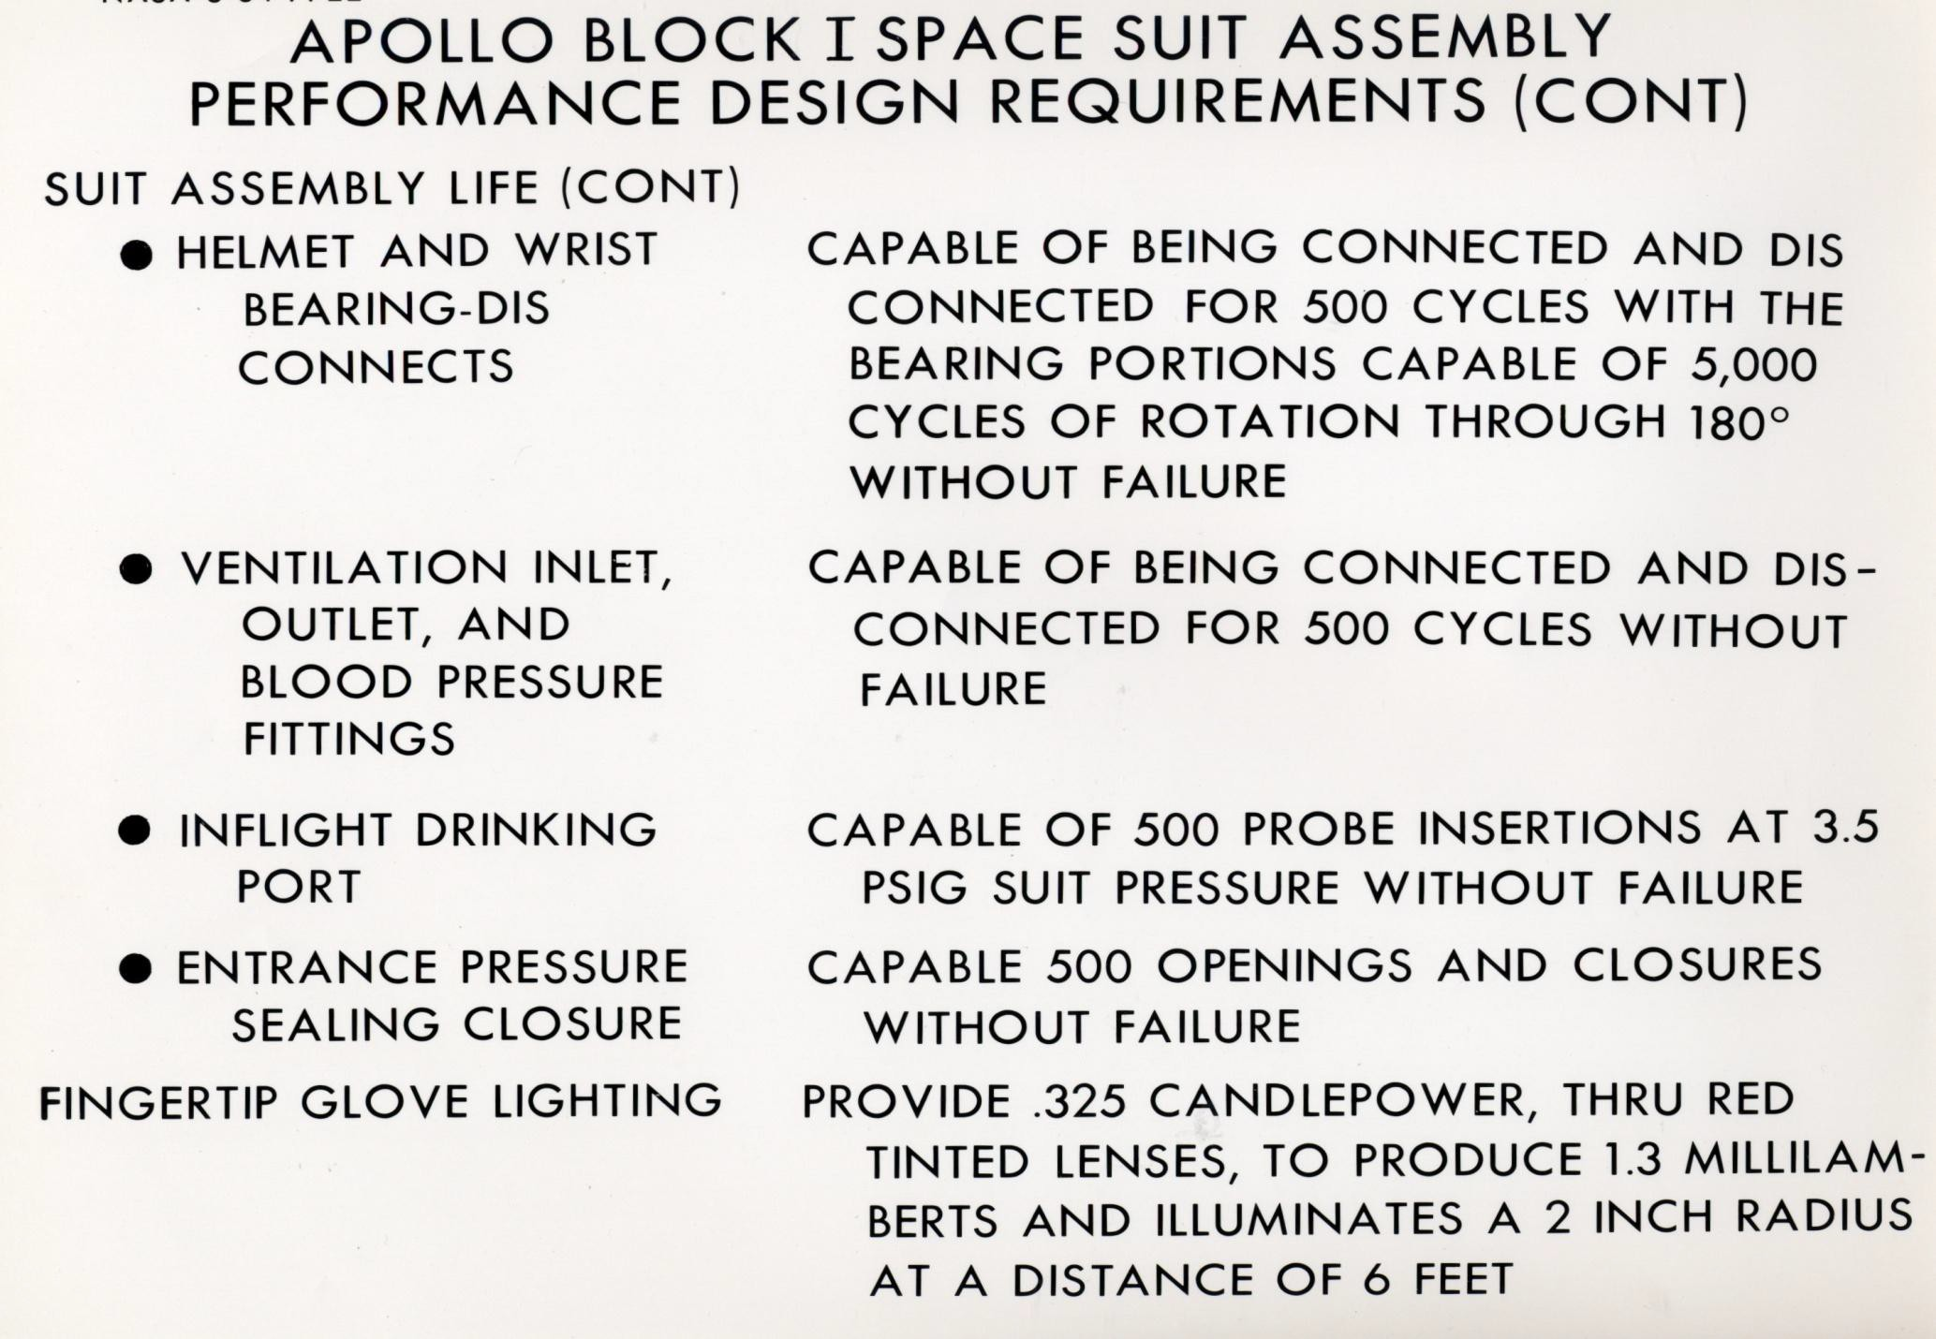

Slide 15
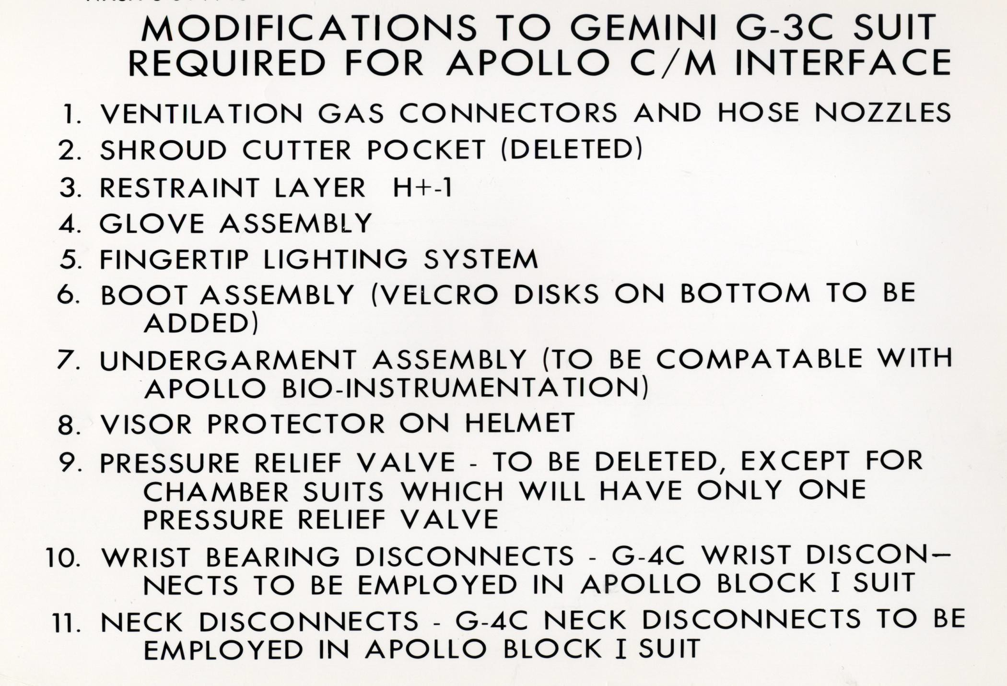

Slide 16
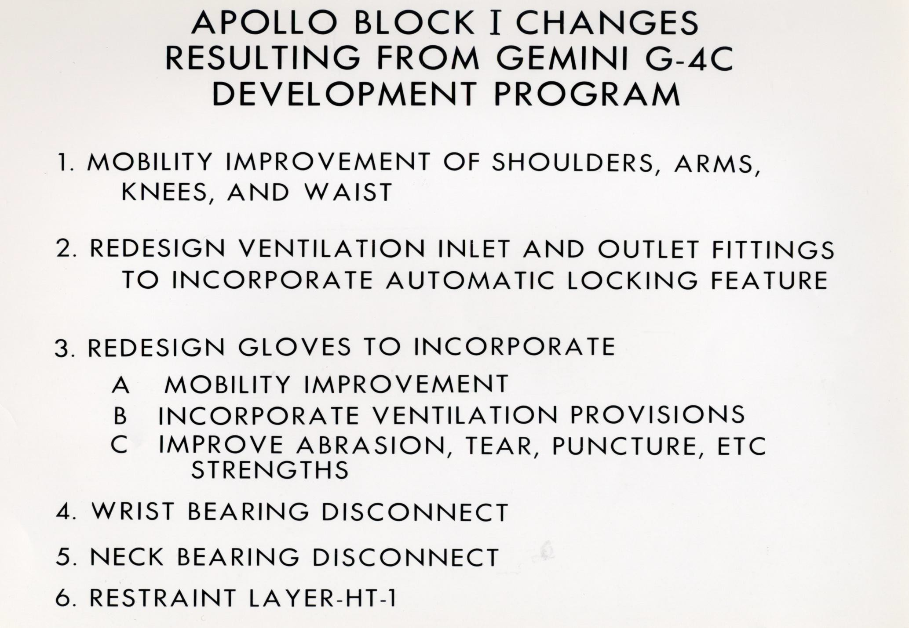

Slide 17
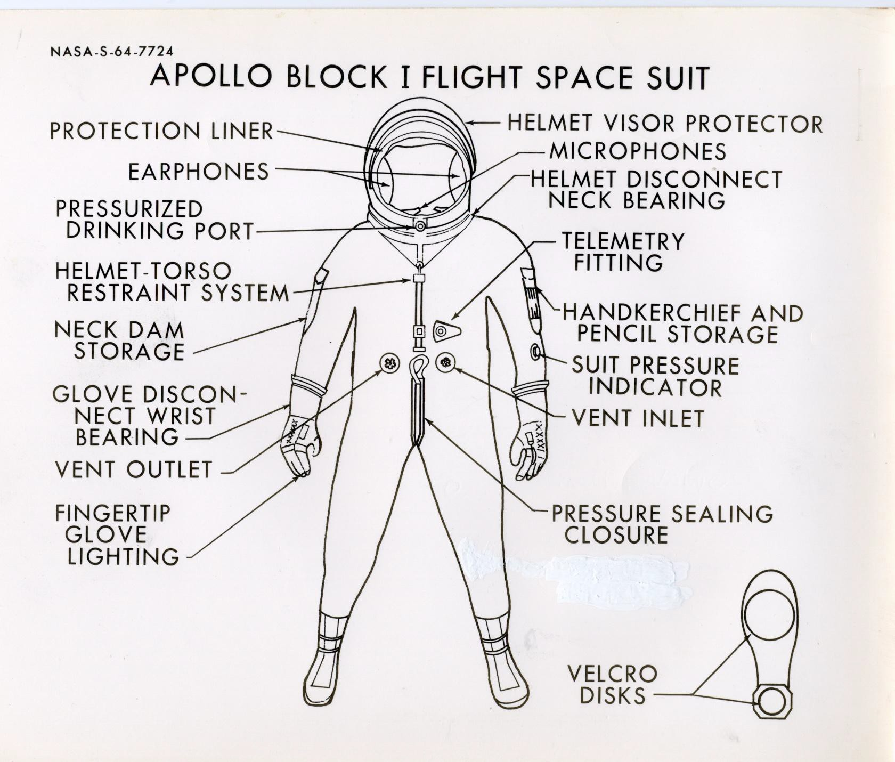

Slide 18
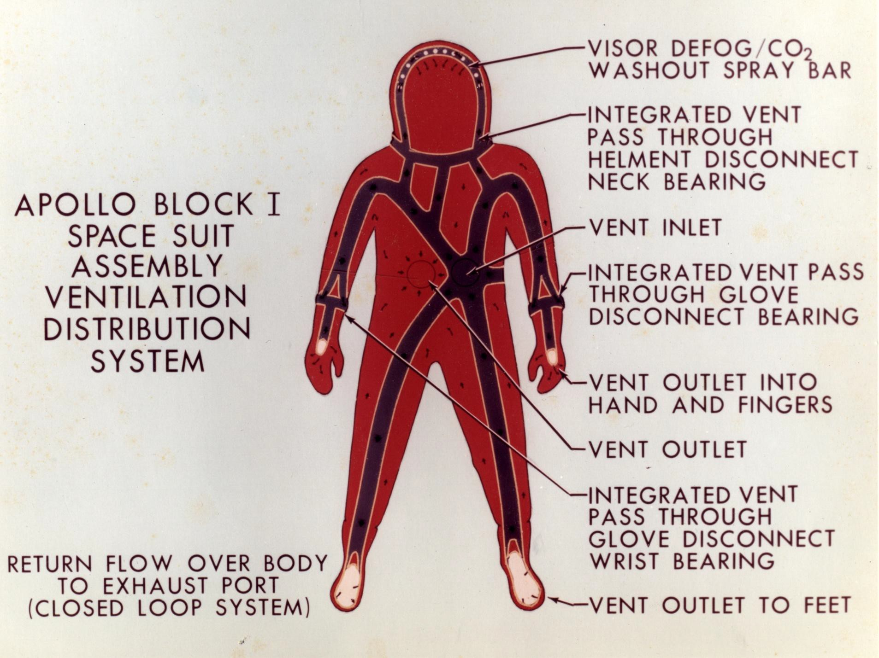

Slide 19
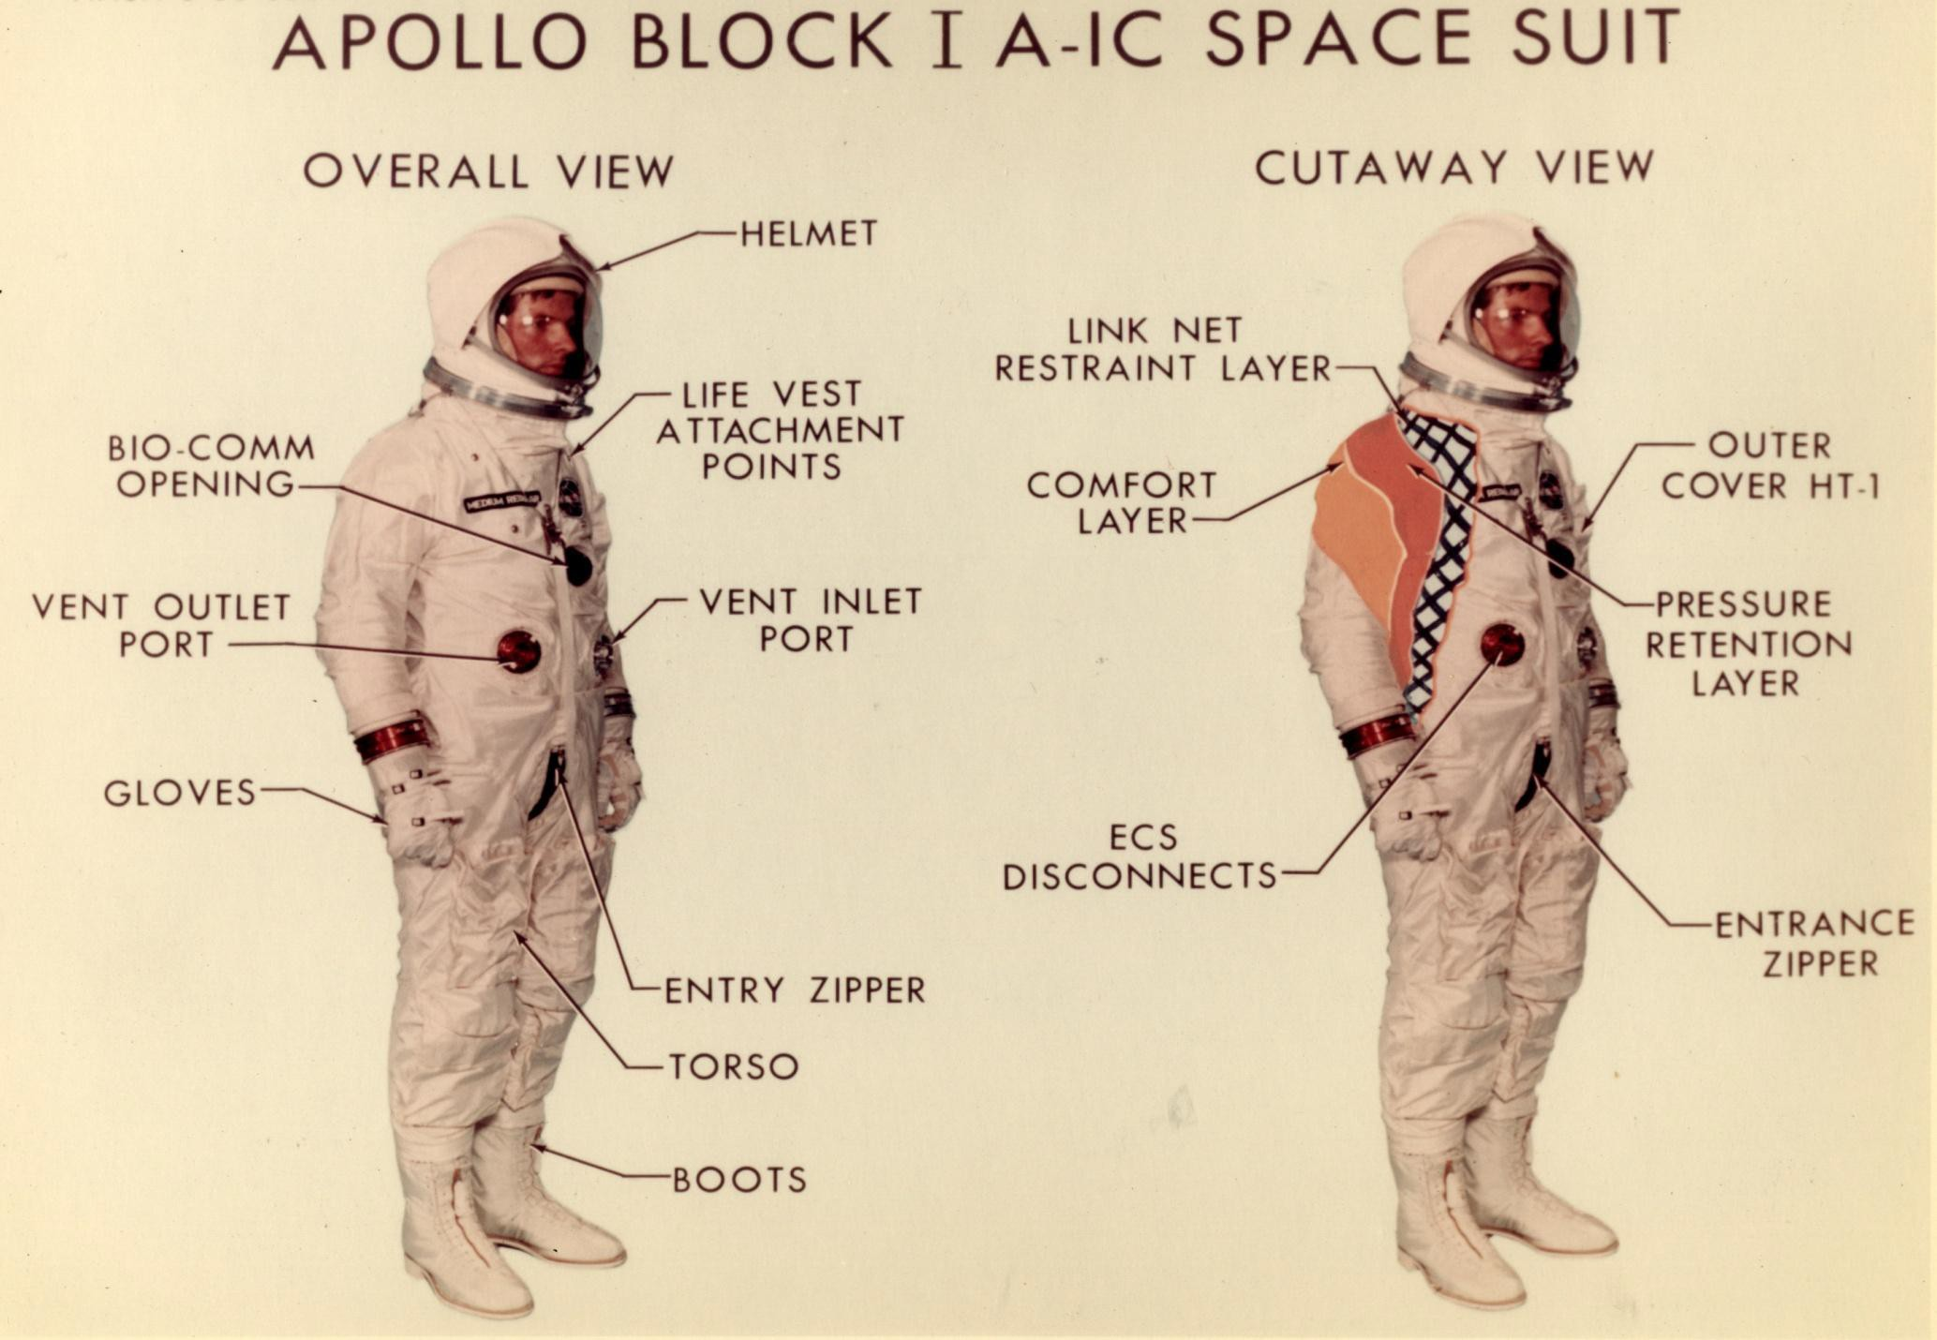

Slide 20
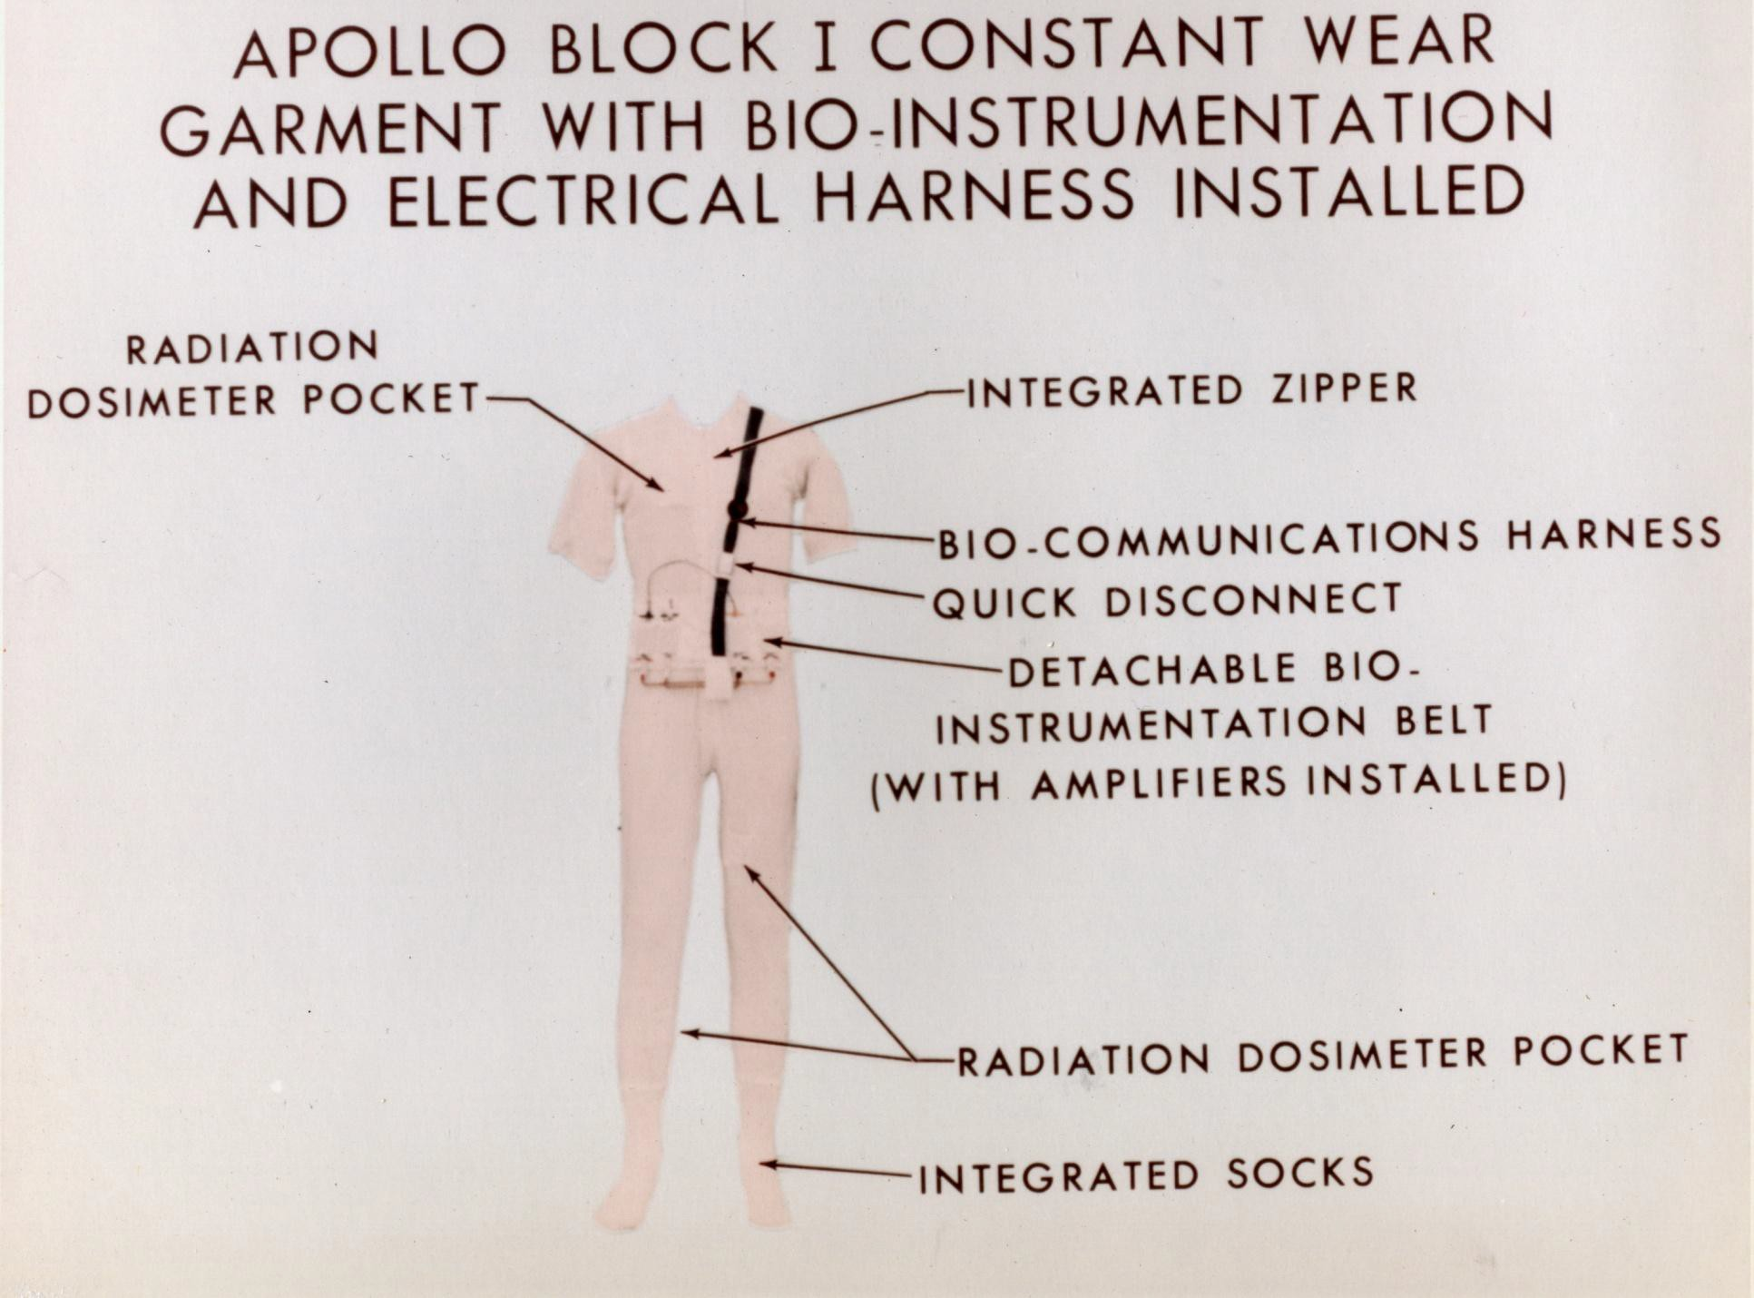

Slide 21
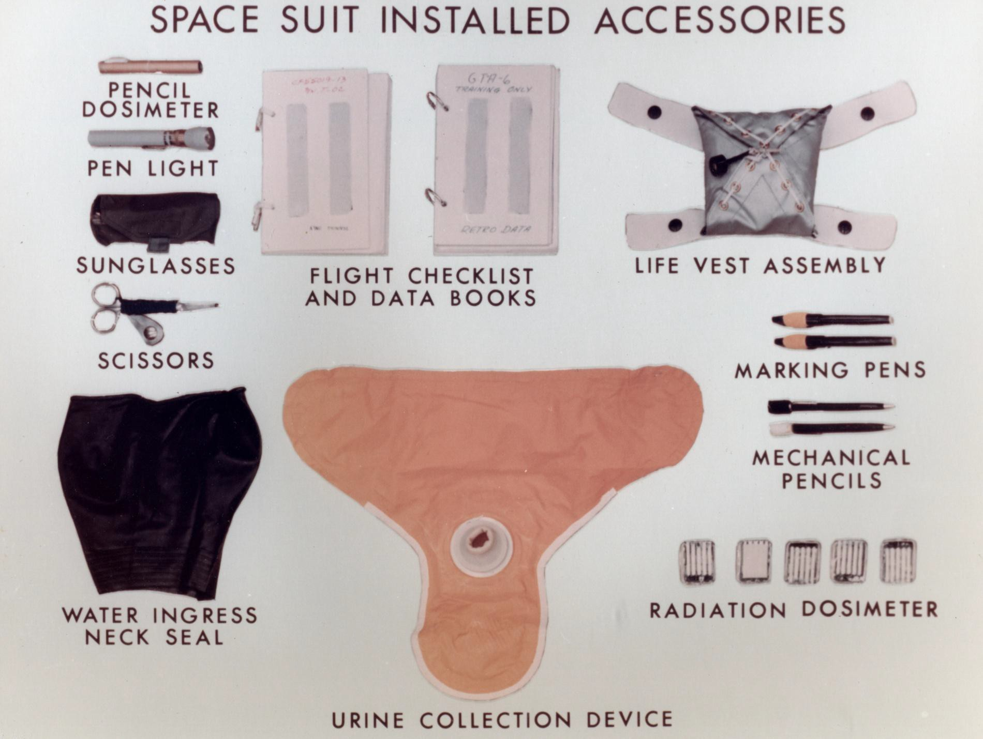

Slide 22
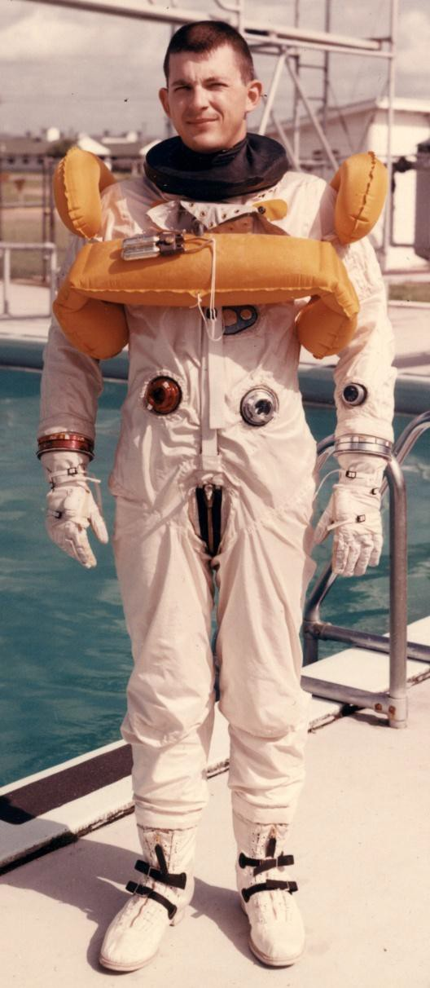
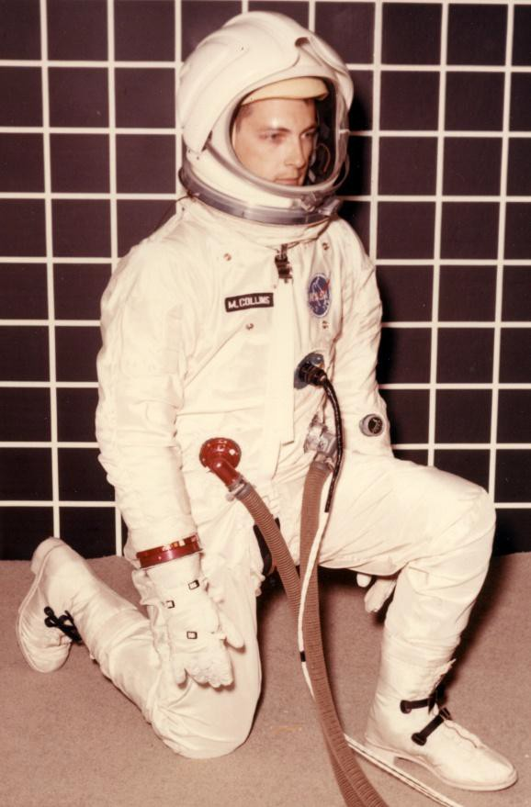

APOLLO BLOCK I SPACESUIT
Water Ingress Ready
Vent Pressure
3.75 psig

Slide 23
BLOCK II SPACESUIT COMPETITION CHRONOLOGY
January, 1965–MSC negotiated backup Block II spacesuit development program with DCC, paralleling the HSD spacesuit program:
  Criteria for selecting spacesuit for ultimate Block II development would be from
the EMU and performance specification.
  MSC to conduct selection test program using CM mockup, lunar
simulation facility, and LEM mockup.
June, 1965–MSC conducted comprehensive test program:
  Evaluation of suit design, function, operation, and man/suit interfaces
  Test conditions controlled to present identical test situations to each suit
  Basic evaluation rational emphasized mission requirements
  Test procedures structured to maximize objectivity
  Sixty-five separate evaluation situations conducted and scored
  Astronaut Mike Collins was primary test subject, and an experienced CSD suit subject served as second test subject
  Each test conductor and test subject scored each test and sublevel test results using pre-established weighting factors
  Weighting factors were established by a committee representing responsible MSC branch managers and suit engineers, astronaut Mike Collins, and overall test program manager.

Slide 24
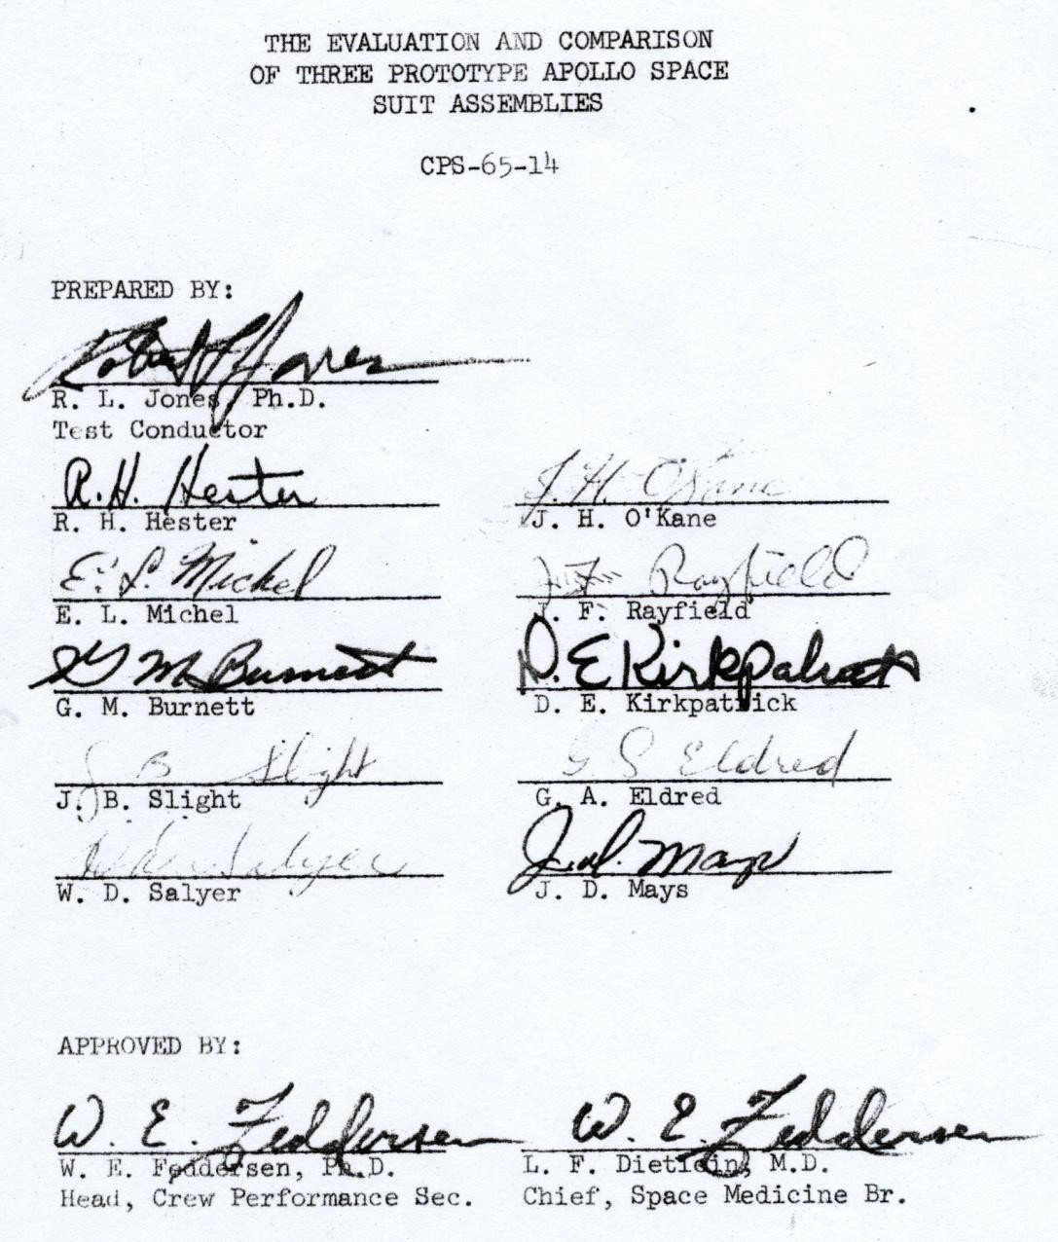
APOLLO BLOCK II SPACESUITS COMPETITION TEST PLAN

Slide 25
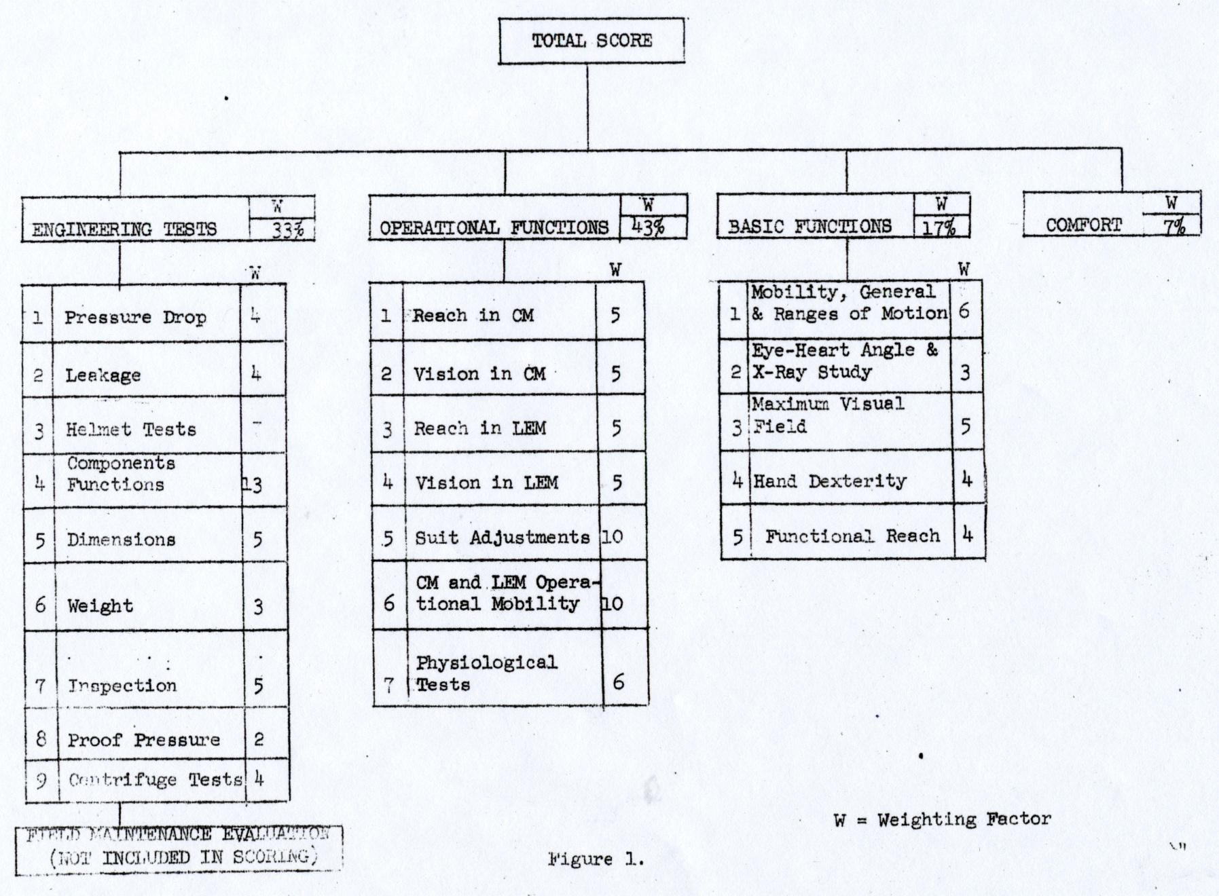
APOLLO BLOCK II SPACESUITS COMPETITION TEST PLAN

Slide 26
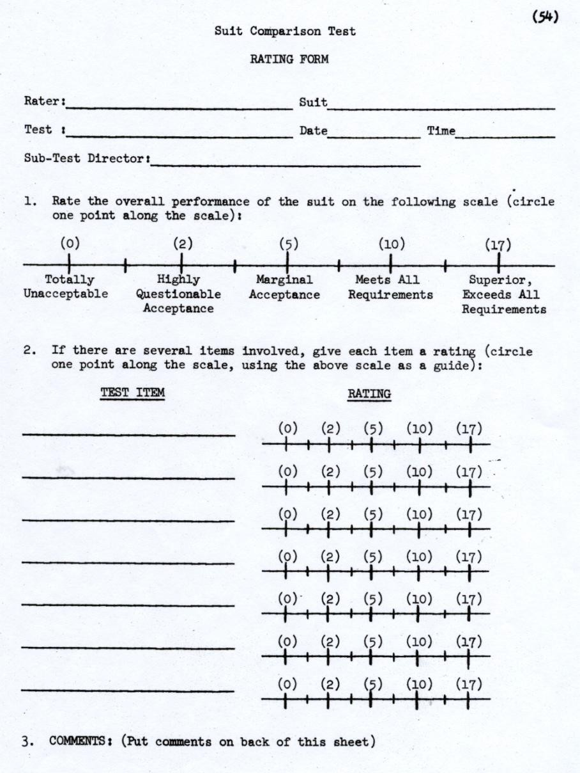
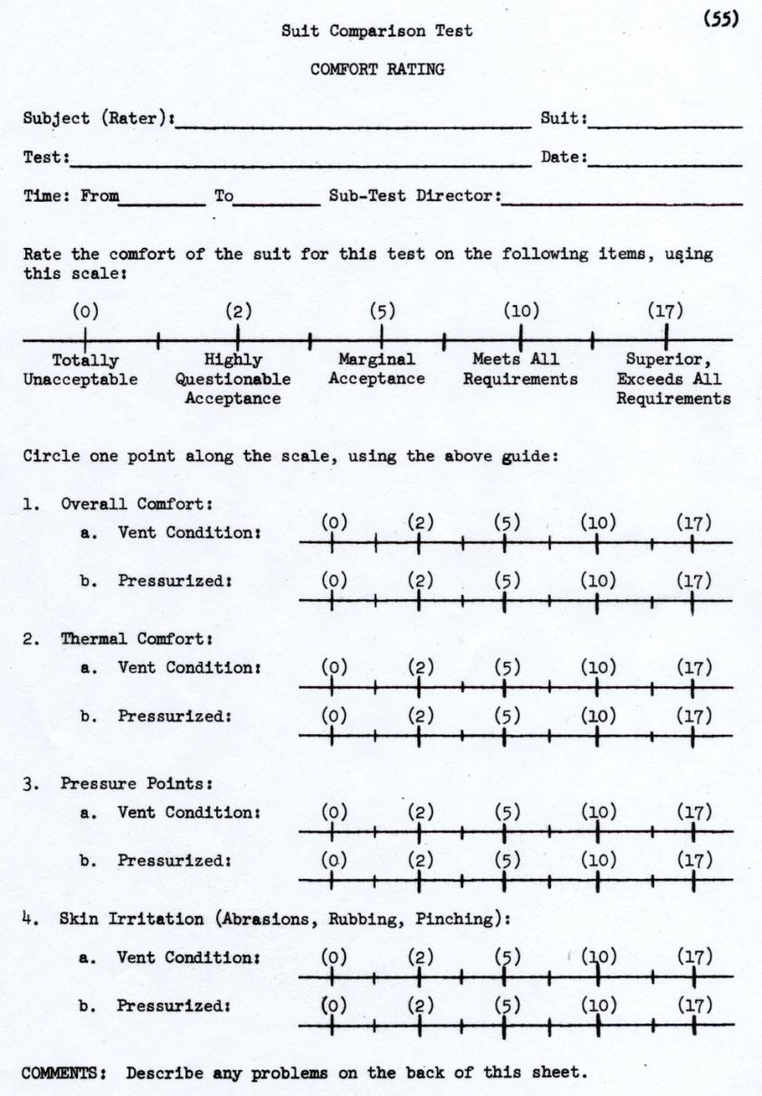
NASA BLOCK II SPACESUIT COMPETITION TEST PLAN

Slide 27
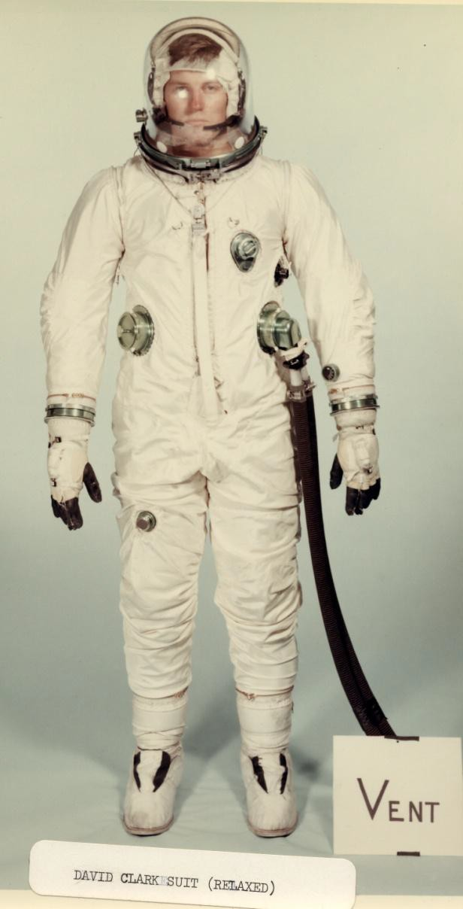
APOLLO BLOCK II COMPETITION TEST ARTICLES
AX-1C-1 DCC Prototype Spacesuit:
- Apollo Block II model developed under NASA contract with DCC
Developed from Project Gemini and Apollo Block I spacesuit configurations
Design used front single-fold gusset top entry/closure
Incorporated multiple composite gas connectors and a water connector developed
and provided by Hamilton Standard Division (HSD)
ILC-type gloves were provided by HSD
Helmet was developed by NASA MSC personnel

Slide 28
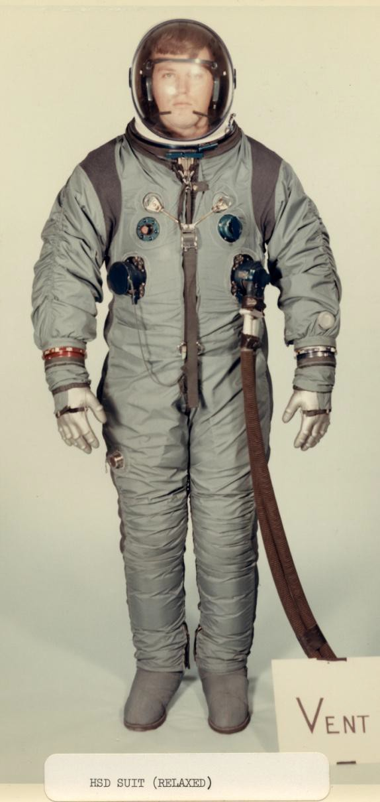
APOLLO BLOCK II COMPETITION SPACESUITS
AX-6H-037 HSD Prototype Spacesuit:
- Sixth prototype model developed under NASA
Apollo spacesuit contracts with HSD
- Suit subcontractor was changed after fifth prototype model from ILC to B. F. Goodrich (BFG) because of contracts performance issues
Design incorporated front single-fold gusset
top entry/closure
Incorporated multiple composite gas connectors and a water connector
Helmet was developed and fabricated by HSD
ILC-type gloves incorporated
Remainder of suit jointly fabricated by HSD and BFG at HSD

Slide 29
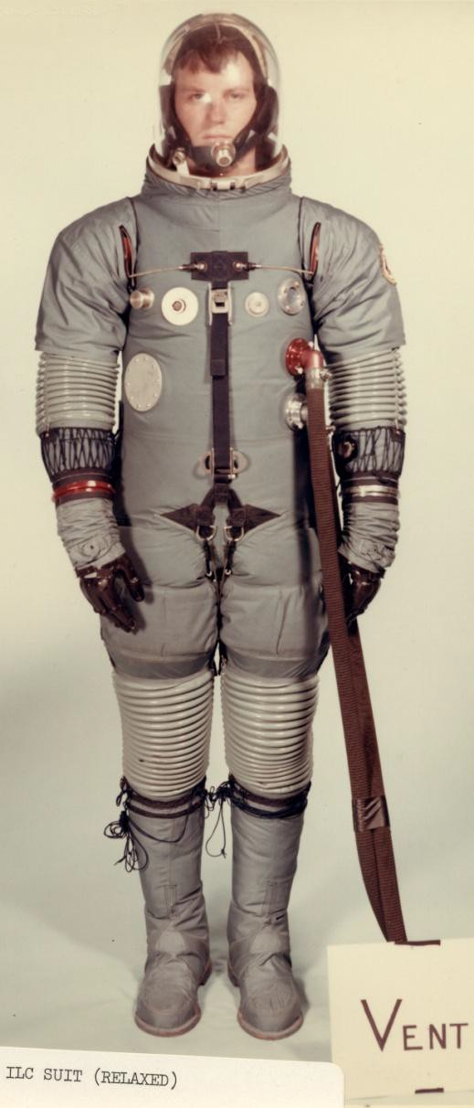
APOLLO BLOCK II COMPETITION SPACESUITS
AX-5L ILC Prototype Spacesuit
- Prototype model developed in-house by ILC and included in the suit competition by ILC request
Developed from design concepts used in prior spacesuit development programs
  Incorporated rear entry Project Gemini-type
pressure sealing closure
  Incorporated Project Gemini-type gas connectors
  Used sliding cable shoulder/arm and hip/leg
mobility systems
  Incorporated ILC-developed gloves
  NASA MSC developed, fabricated, and provided helmet

Slide 30
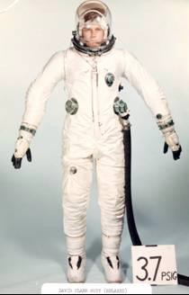


APOLLO BLOCK II SPACESUITS COMPETITION
DCC AX-1C-1
HSD/BFG AX-6H-037
ILC AX-5L

Slide 31
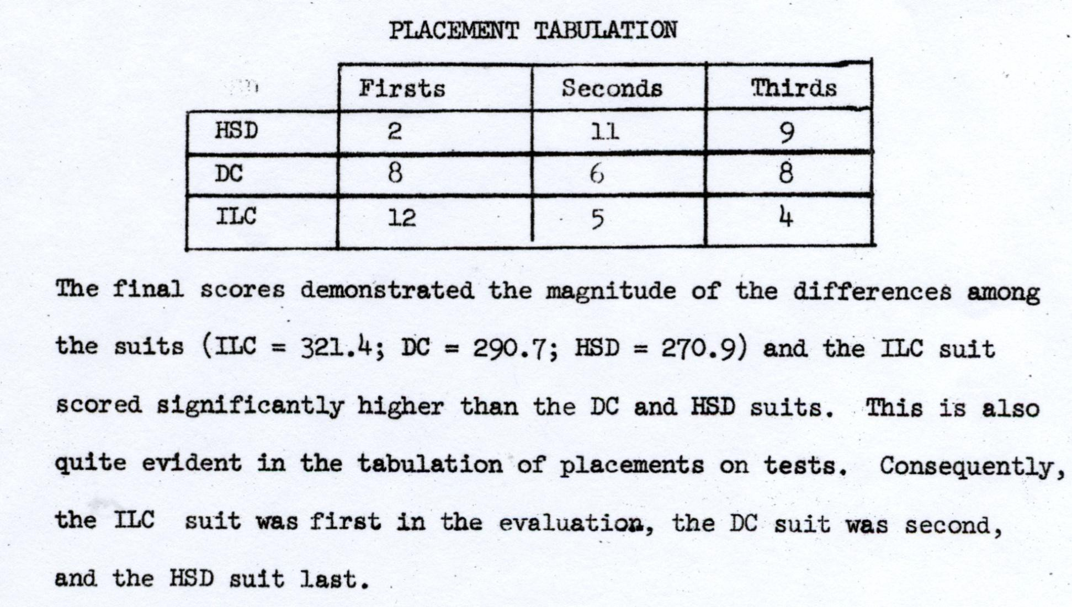
APOLO BLOCK II SPACESUIT COMPETITION RESULTS

Slide 32
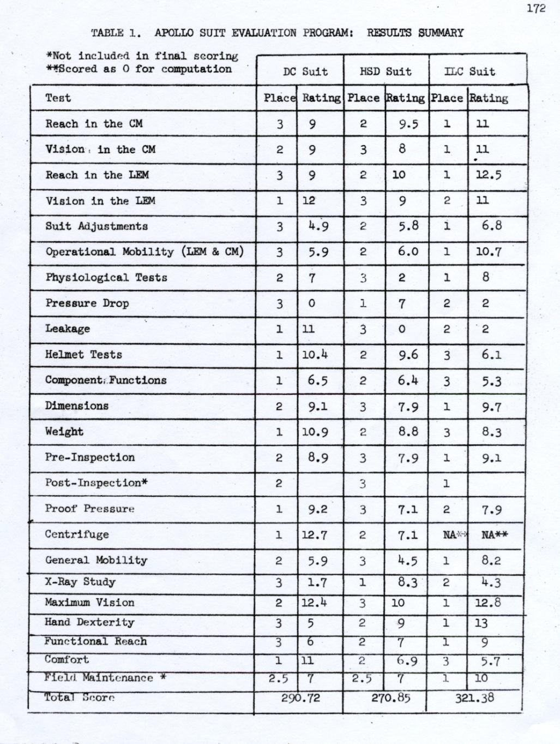
APOLLO BLOCK II SPACESUIT COMPETITION RESULTS

Slide 33
APOLLO BLOCK II SPACESUIT PROGRAM MODIFICATION
September, 1965–Robert R. Gilruth, MSC director, sent details of actions taken regarding development of the Apollo EMU to NASA Hdqrs. He recommended three changes inconsistent with the overall procurement plan previously approved by NASA Hdqrs:
  Amend the existing HSD contract to provide for development, qualification, and fabrication of the Portable Life Support System (PLSS) and associated equipment only. Contract would cover delivery of all flight equipment for the Apollo Block II flight program.
  Award a separate contract to ILC for development and fabrication of test and flight spacesuits and associated equipment.
  MSC would assume responsibility for total program management,
systems integration, and spacesuit qualification.

Slide 34
APOLLO BLOCK II SPACESUIT PROGRAM MODIFICATION
September, 1965 (cont)–Basis for MSC director’s recommendations to NASA Hdqrs:
  Comparative suit evaluation of spacesuits submitted by ILC, HSD, and DCC in June, 1965.
  Reassessment of ILC’s capabilities and the previous difficulties of HSD inadequate total system development, but recognizing their competence in the PLSS work.
  MSC plan to establish resident engineer at ILC to provide onsite contractor management.
November, 1965–NASA announced that it would negotiate with ILC for a contract to fabricate the Apollo (Block II) spacesuit consisting of the liquid- cooled undergarment, constant wear garment, pressure garment assembly, and thermo-micrometeoroid protective over garment. At the same time, a contract was negotiated with HSD for continued development and manufacture of the PLSS.

Slide 35
LESSONS LEARNED
Establish and document joint spacecraft module and spacesuit contractor physical and functional interface control documents early in the development process.
Before module and government furnished equipment (GFE) hardware designs are finalized, provide a module ship set of development model GFE hardware to verify adequacy of the interface design.
Consider use of the CPS-65-14 test plan procedures and process as an analysis tool for future competitive evaluations and management decision making.

Slide 36
Next Proposed Knowledge Capture Series Briefing
Apollo A-7L Block II Spacesuit Development for
Apollo 7 Through 14 Missions”

Slide 37
REFERENCES
"Apollo Monthly Progress Report," SID 62-300-22, pp. l-2.
Project Apollo Board Report for NASA Inspection and Review of Block I Mock-Up, April 23-30, 1964," pp. 1-2;
MSC, "ASPO Weekly Management Report, June 25-July 2, 1964.”
Rector to Grumman, Attn.: Mullaney, "Stowage volume requirements for Lunar Excursion Module," 27 Nov. 1964; MSC, Consolidated Activity Report, 19 July-22 Aug. 1964, p. 21
Memorandum, H. F. Battaglia, MSC, to Chief, MSC Crew Systems Div., "Trip report for visit to David Clark Company, Worcester, Massachusetts concerning Space Suit Program," July 16, 1964.
Memorandum, Robert E. Smylie, MSC, to Chief, Program Control Division, "Apollo Spacecraft Program Quarterly Status Report No. 10," January 19, 1965, and enclosures.
Memorandum, Maxime A. Faget, MSC, to Distr., "Change in Designation of the Apollo Space Suit Assembly (SSA)," November 5, 1964.
Memorandum, William A. Lee, MSC, to Assistant Director for Flight Crew Operations, "Spacesuit Utilization on Block I CSM Earth Orbital Missions," January 6, 1965.
"Apollo CSM-Block II Preliminary Design Review (PDR), NASA- MSC-ASPO, NAA- S&ID, 6-8 January 1965," pp. 4-40. "Apollo CSM-Block II Preliminary Design Review (PDR), NASA- MSC-ASPO, NAA-S&ID, 6-8 January 1965," pp. 4-40.
Memorandum, Owen E. Maynard, MSC, to Manager, Apollo Spacecraft Program
Office, "Evaluation of space suit wear criteria," January 6, 1965.

Slide 38
REFERENCES (cont)
"ASPO Weekly Management Report,” February 11-18, 1965.
Memorandum, Matthew I. Radnofsky, MSC, to Gemini and Flight Support Procurement, Attn: Arc F. Lee, "Contract NAS 9-3642, Apollo Block I Suit, David Clark Company," February 25, 1965. MSC, "ASPO Weekly Management Report,” November 4-12, 1965.
Memorandum, Richard S. Johnston, MSC, to Joseph Shea, "Block II Apollo suit program," January 25, 1965.
Memorandum, Maxime A. Faget, MSC, to Manager, ASPO, "Crew Systems Division recommendation on establishment of suit wear criterion," March 17, 1965.
“Apollo Block I spacesuit” photographs and documents images, from author’s
personal records.
“Evaluation and comparison of three Apollo Spacesuits,” Report CPS-65-14,1965, from author’s personal records.
Letter, Gilruth to NASA Headquarters, Attn: George E. Mueller, "Procurement plan for the Apollo Extravehicular Mobility Unit and EMU ground support equipment development and fabrication," sgd. George M. Low, September 20, 1965.
NASA News Release 65-346, "NASA to Negotiate for Apollo Suit, Support System," November 5, 1965; "ASPO Weekly Management Report, November 4-12, 1965."
“Early Spacesuit Dates” personal communication from Jerry Goodman to author, January, 2013.

