Slide 1
CubeSat Proximity Operations Demonstration (CPOD) Overview
In-Space Inspection Workshop 2014
Houston, TX
07/16/2014
Austin Williams
CPOD Vehicle Bus Lead

Slide 2
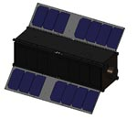

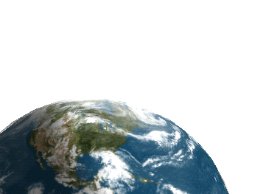
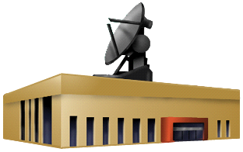
Operational View
- CubeSat Proximity Operations Demonstration (CPOD)
RSO
Chaser
UHF Ground Stations
S-Band Ground Network
Mission Operations Center (MOC)
Notes:
CubeSat Prox Ops Flight Experiment Study

Slide 3

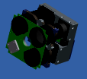
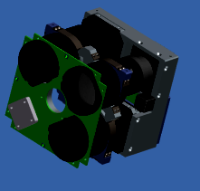

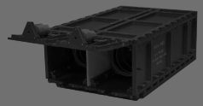


System View
- CubeSat Proximity Operations Demonstration (CPOD)
SPACE SEGMENT
CPOD Spacecraft B
Inter-Satellite Link w/ Ranging
CPOD Spacecraft A
GPS
GPS
Signal
CMD / TLM
RPO Sensors and Image Software
RPO Sensors
Rendezvous, Proximity Operations (RPO) Payload
CubeSat Bus
GROUND SEGMENT
USER SEGMENT
LAUNCH / ORBIT INSERTION SEGMENT
S-Band
UHF
NASA-Tyvak 6U Dispenser
S-Band Tracking Stations
Hosted UHF Remote Station
Launch
Platform / Orbit Insertion
User /
Customer
VPN
Mission Operations Center

Slide 4

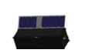
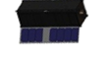

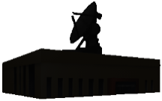
CONOPS
- Designed to Maximize Mission Success Probability
CubeSat A performs RPO relative to CubeSat B
Decreased Range RPO & Docking Scenarios
Orbit Maneuvering to Initial Proximity Distance (Walking Safety Ellipse)
Increased Range RPO Scenarios
6
9
A
7
Non-passively Safe Maneuvers
Separate and Continue Checkout
4b-c
5
8
Initial SOH Checkout
B
A
4a
Release together from 6U dispenser
CMD /
TLM
CMD / TLM
CMD / TLM
B
Residual Ops
3
CMD /TLM
10
CMD / TLM
Disposal
TLM
11
2
Launch
CMD
Ground Network
Main RPO Experiment Phases
Mission Operations Center
Mission-Planning / Pre-Launch
1

Slide 5
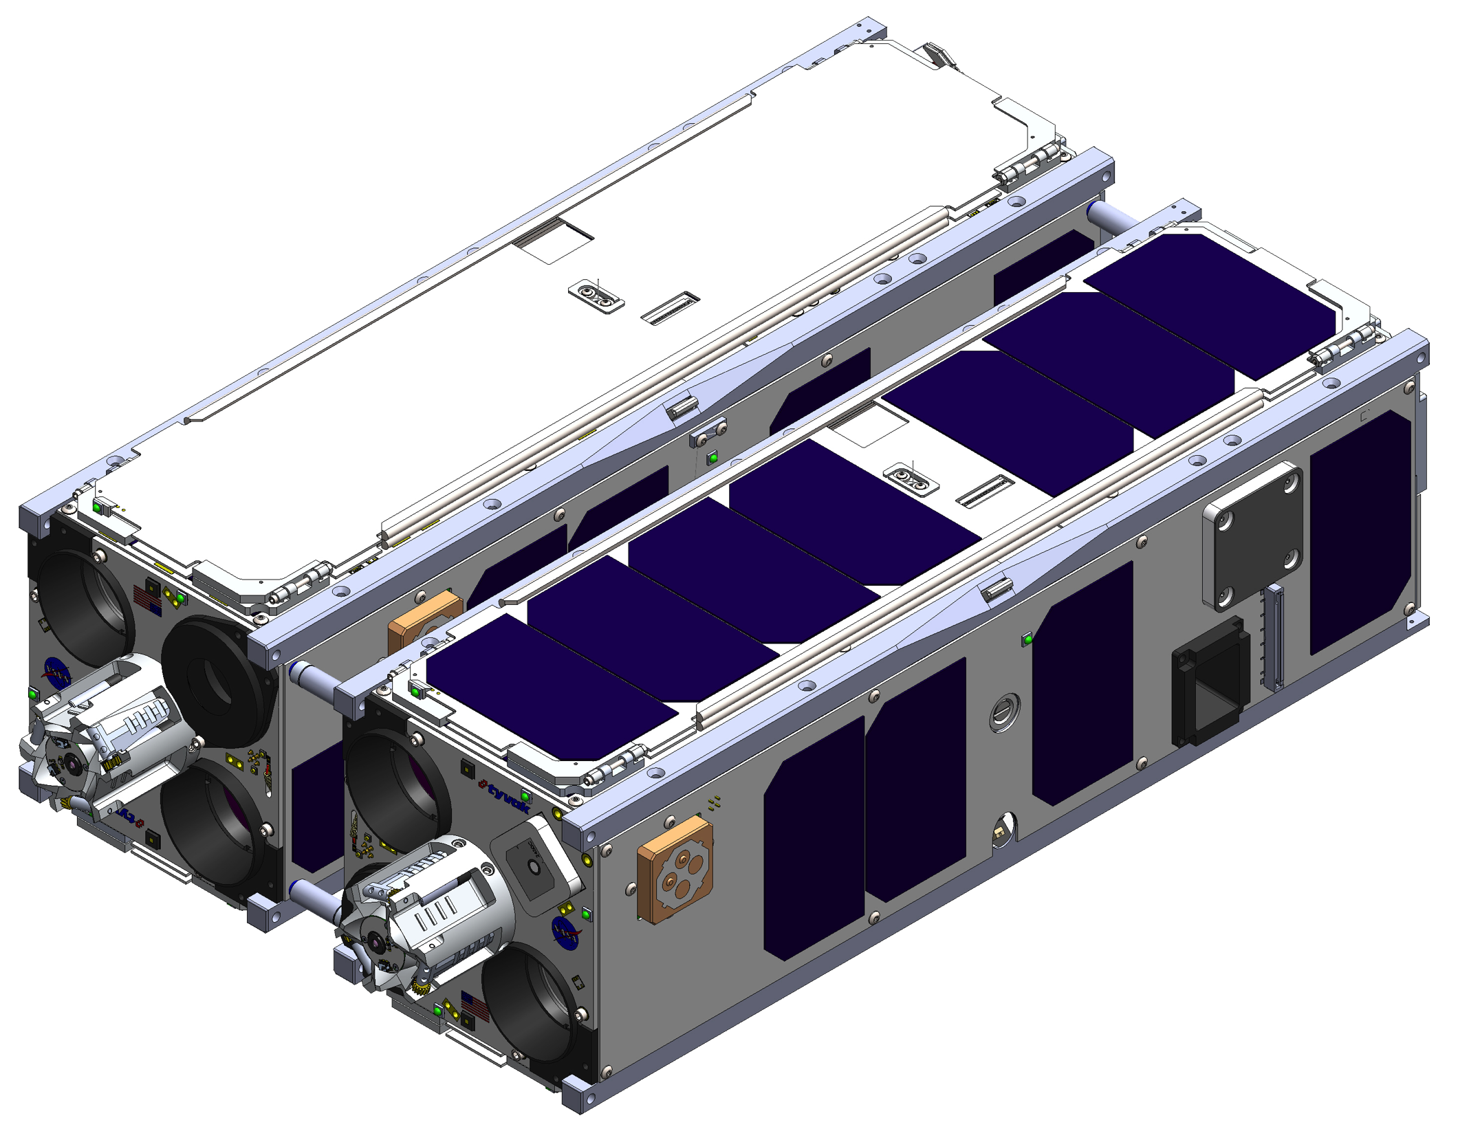
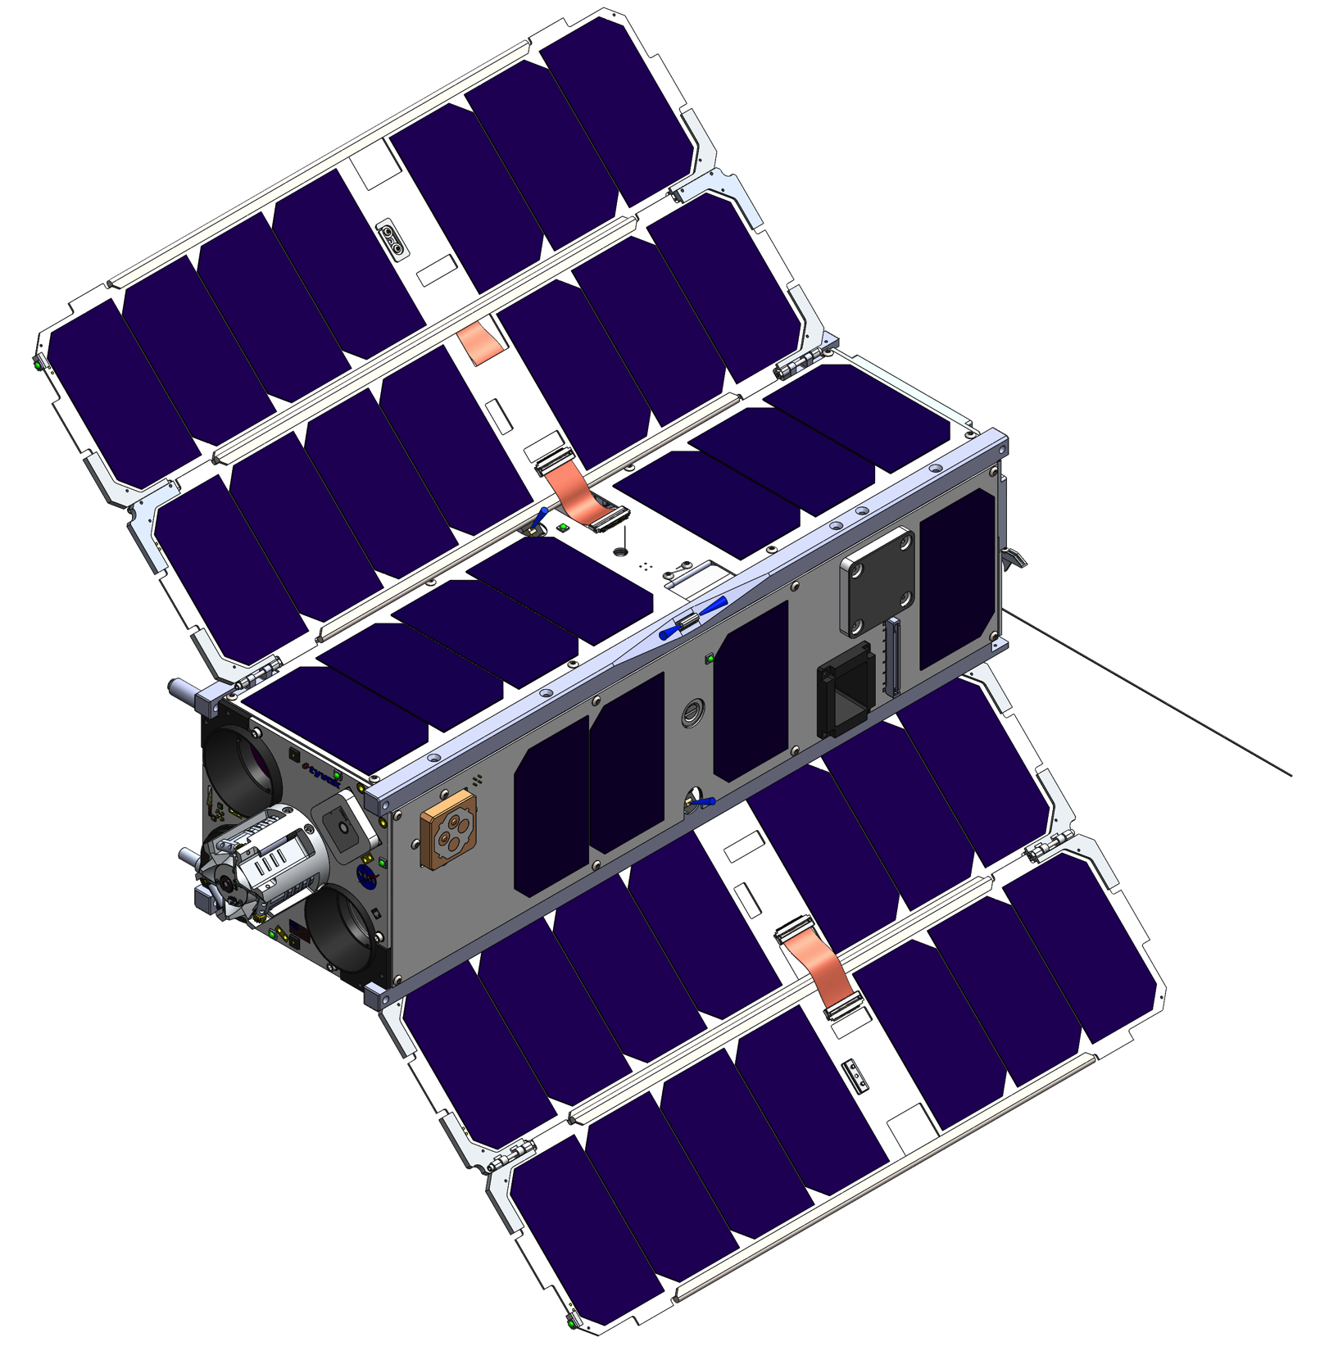
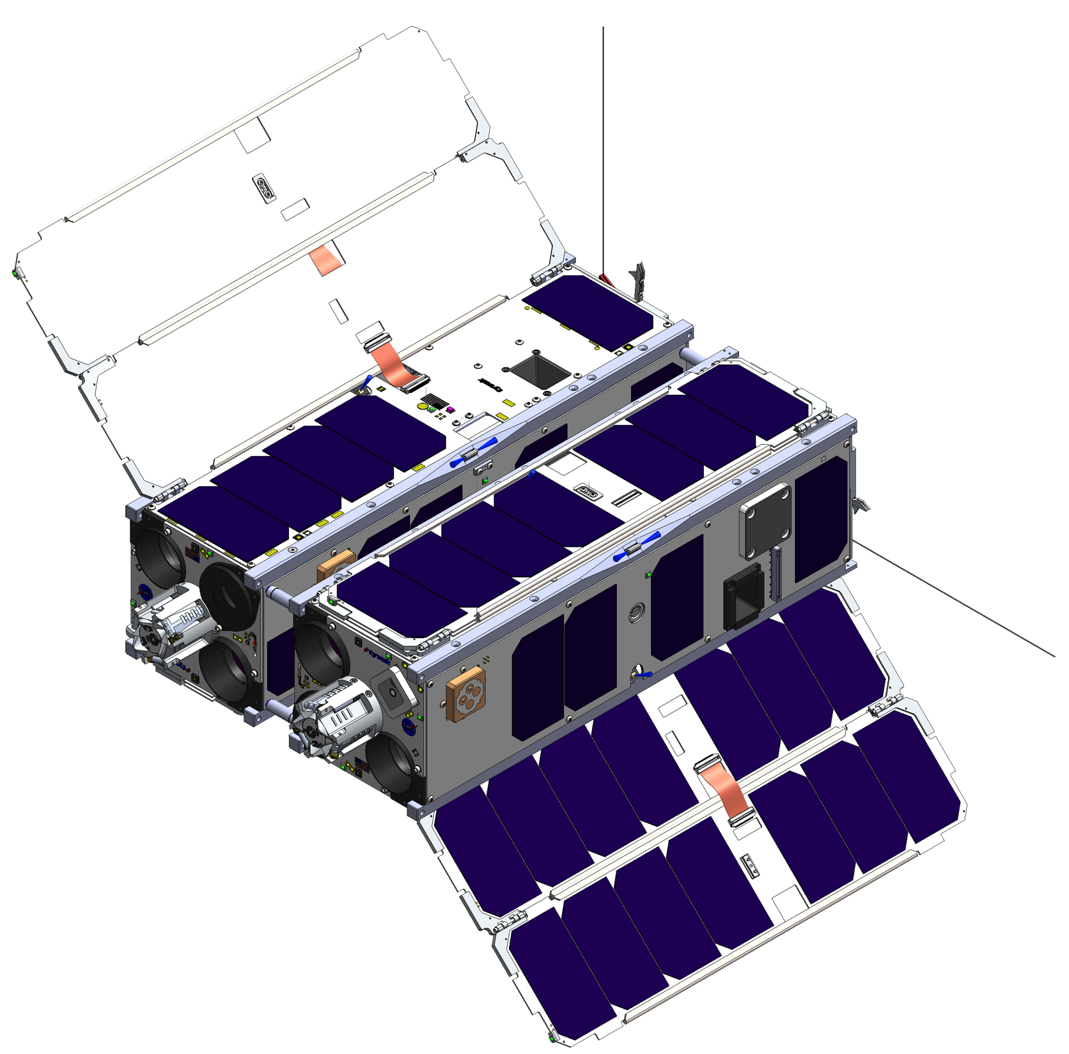
Deployment Configurations and Vehicle Checkout
3
Connected “6U” Configuration
4a
First Panel Deploy
Deploy UHF Antenna
Initial SOH Checkout
4b-c
Vehicle Separation
Second Panel Deploy
Complete Checkout
Notes:
CubeSat Prox Ops Flight Experiment Study

Slide 6
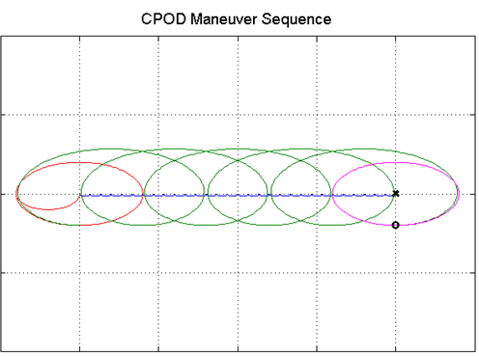
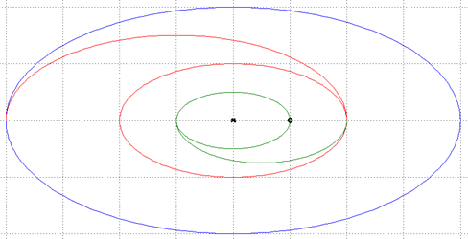
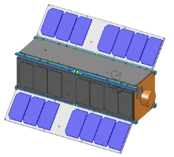
CONOPS Overview
∆GPS via ISL
ISL Ranging
NFOV Bearings
Rbar
Inject into Walking Safety Ellipse
NFOV Ranging
Reduce Size Safety Ellipses & NFOV checkout
100s m
5.1
Initiate Safety Ellipse
5.2
6
Rendezvous
Vbar
B
A
Stabilize into Safety Ellipse about CubeSatB
4
5.3
Drift km’s during checkout
Rbar
NFOV Bearings & Ranging
ISL Ranging
Docking Bearings
Docking Ranging
Reduce Size Safety Ellipse & Docking Sensor checkout
Docking
IR1 B & R
IR2 B & R
Transfer to InPlane NMC
Approach to WP1
Approach to WP2
Transfer to V-bar
7.1
Approach & Dock
Reduced Size NMC
7.6
7.5
7.4
7.3
7.2
6.3
Vbar
B
A

Slide 7
Space Vehicle Architecture
EPS
SYSTEM PROCESSOR
ADCS
Health & State Sensors
State Estimation & Control Processor
3-axis IMU
Heater
Star Trackers w/ dedicated processing
Power Sequencing
COMM
3-axis Reaction Wheel Set
S-BAND (downlink)
UHF
3-axis Sun Sensor Set
GPS
3-axis Magnetometer Set
Inter-Satellite link (Comm / Ranging)
3-axis
Mag. Torquer Set
RPO
8-thruster Cold Gas
Wide Field
Visible Imager
Relative Position Estimation Processor
(Imaging Processor)
Maneuver Planning Processor (GN&C)
Infrared Imager
CONTRIBUTIONS
Docking Mechanism
Tyvak Nano-Satellite Systems
Infrared Imager
Optical Target Aid
Applied Defense Solutions
Docking
Sensor
406 Aerospace
VACCO

Slide 8
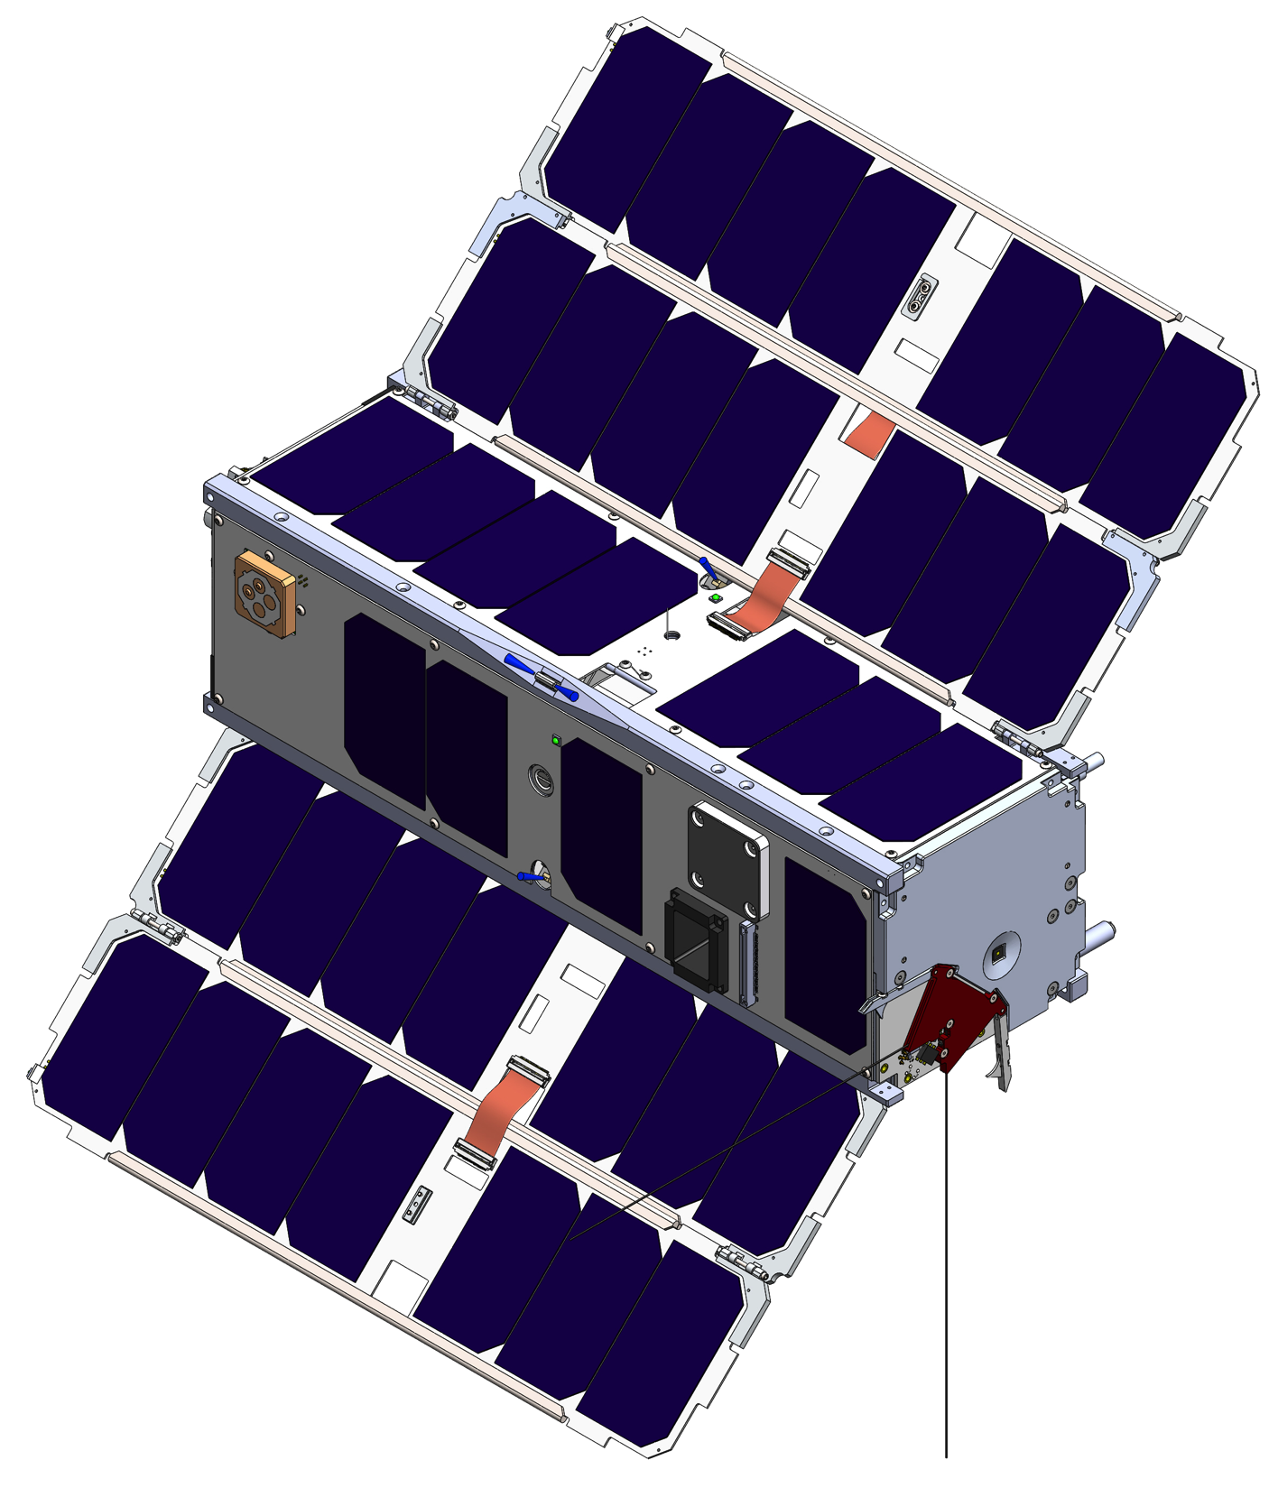
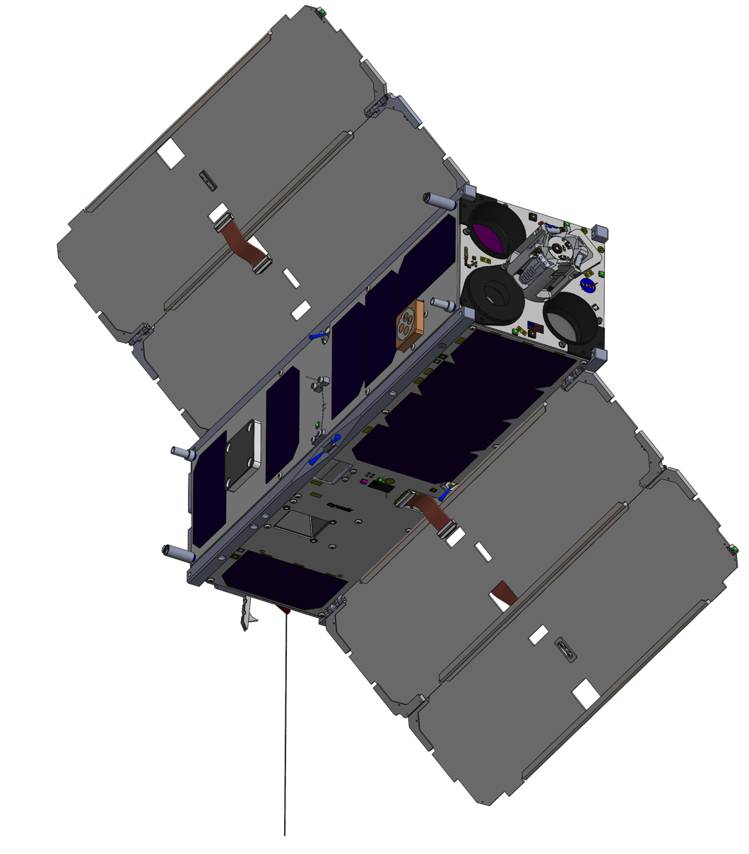
Vehicle Configuration
- External Arrangement, Isometric Views
Thermal
Radiators
Solar Panel Arrays
with MPPTs
GPS
Patch
Docking Mechanism
S-Band
Patch
Thermal
Radiator
Separation Devices
Star Trackers
UHF Antennas
Notes:
CubeSat Prox Ops Flight Experiment Study

Slide 9
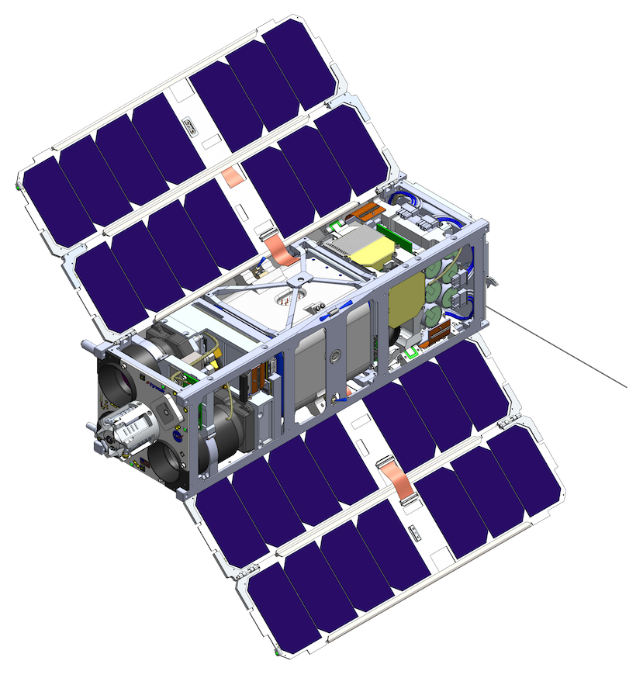

Remote Proximity Operations and Docking Module (RPOD)
RPOD
Module
LED
35mm IR Camera
ISL Patch Antenna
LED
50mm IR Camera
70mm Visible Camera
LED
Notes:
CubeSat Prox Ops Flight Experiment Study

Slide 10
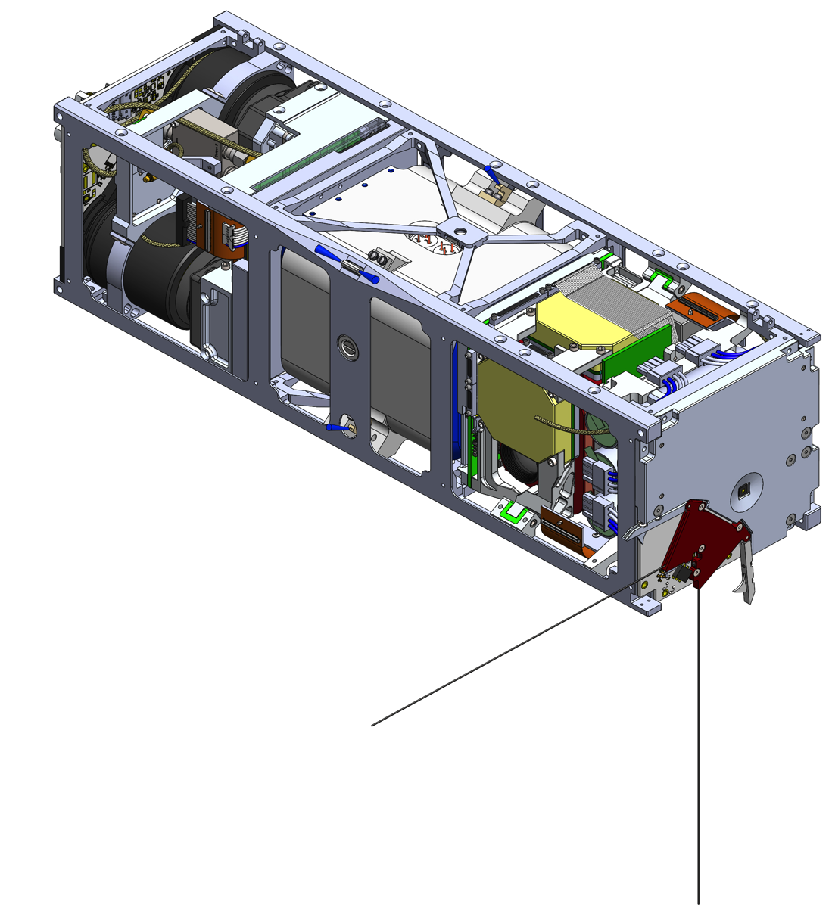
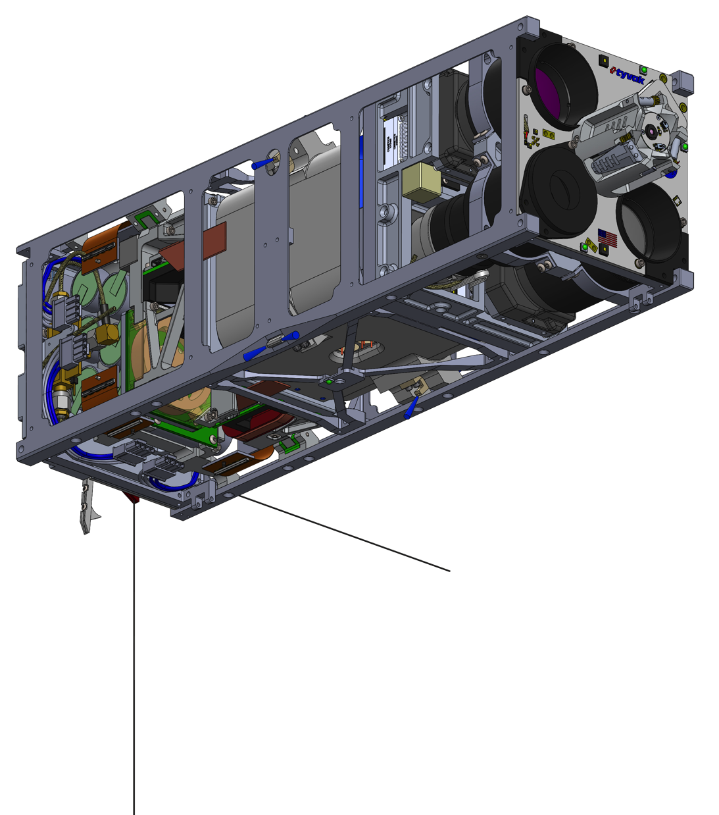
Vehicle Configuration
- Internal Arrangement and Packaging
GPS Receiver
Battery Module
Cold Gas
Thrusters (8)
S-Band Transmitter
UHF Radio
RPOD Module
Inertial Reference Module (IRM)
Propulsion
Module
Battery Module
Endeavour Bus
Notes:
CubeSat Prox Ops Flight Experiment Study

Slide 11
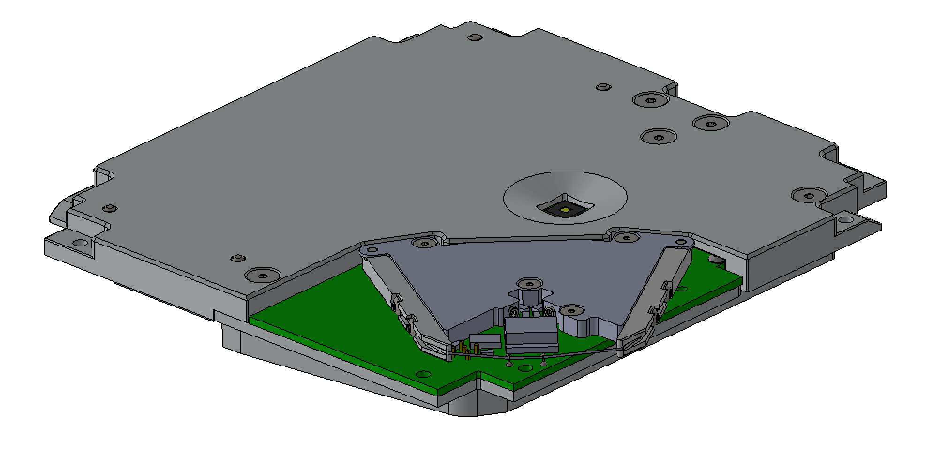
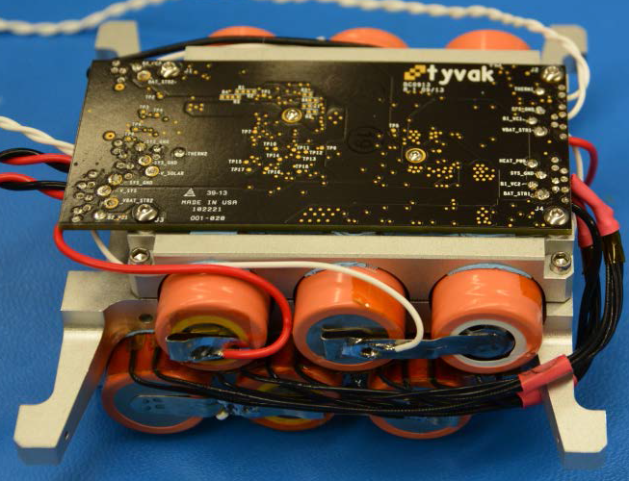
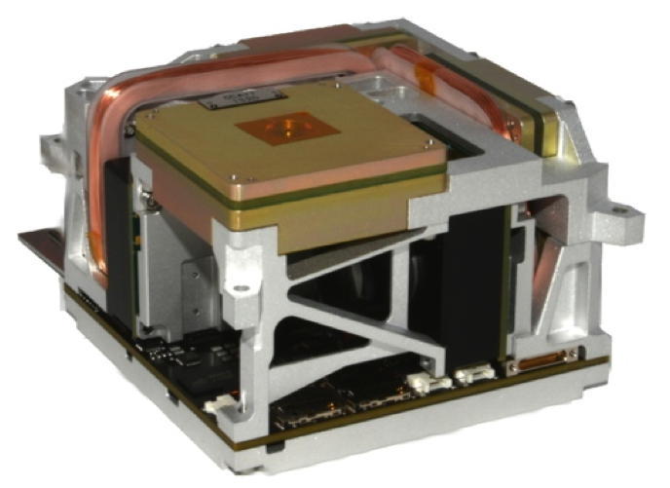
1U Endeavr Avionics
UHF Radio and Antenna
S-Band Radio
Battery Module
Torque Coils (3x)
Reaction Wheels (3x)
IMU
C&DH and ADCS
Star Trackers (2x)
Endeavour C&DH
Control Processor

Slide 12
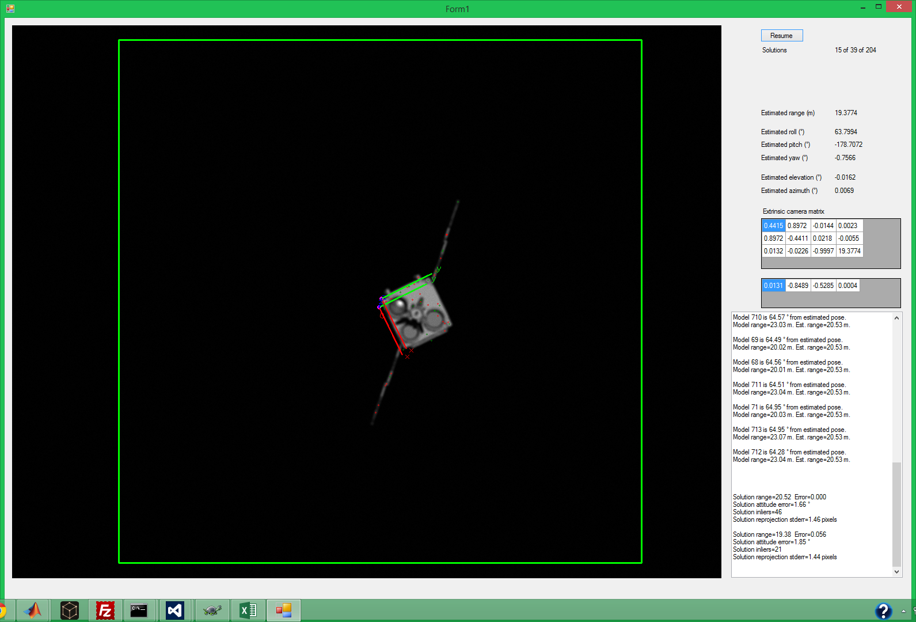
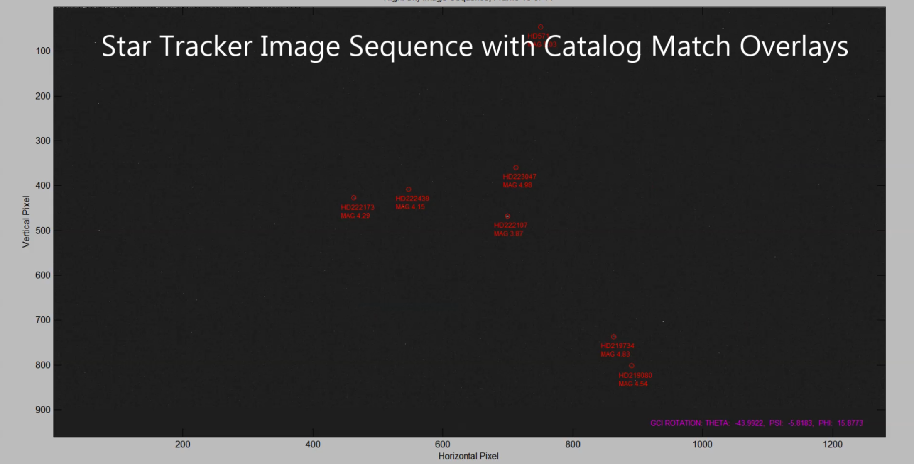
Algorithm Simulations
Actual Range
20.53 m
Calculated Range1
20.52 m
Range 1 Error
0.05%
Calculated Range 2
19.38 m
Range 2 Error
5.93%
Two Solutions

Slide 13
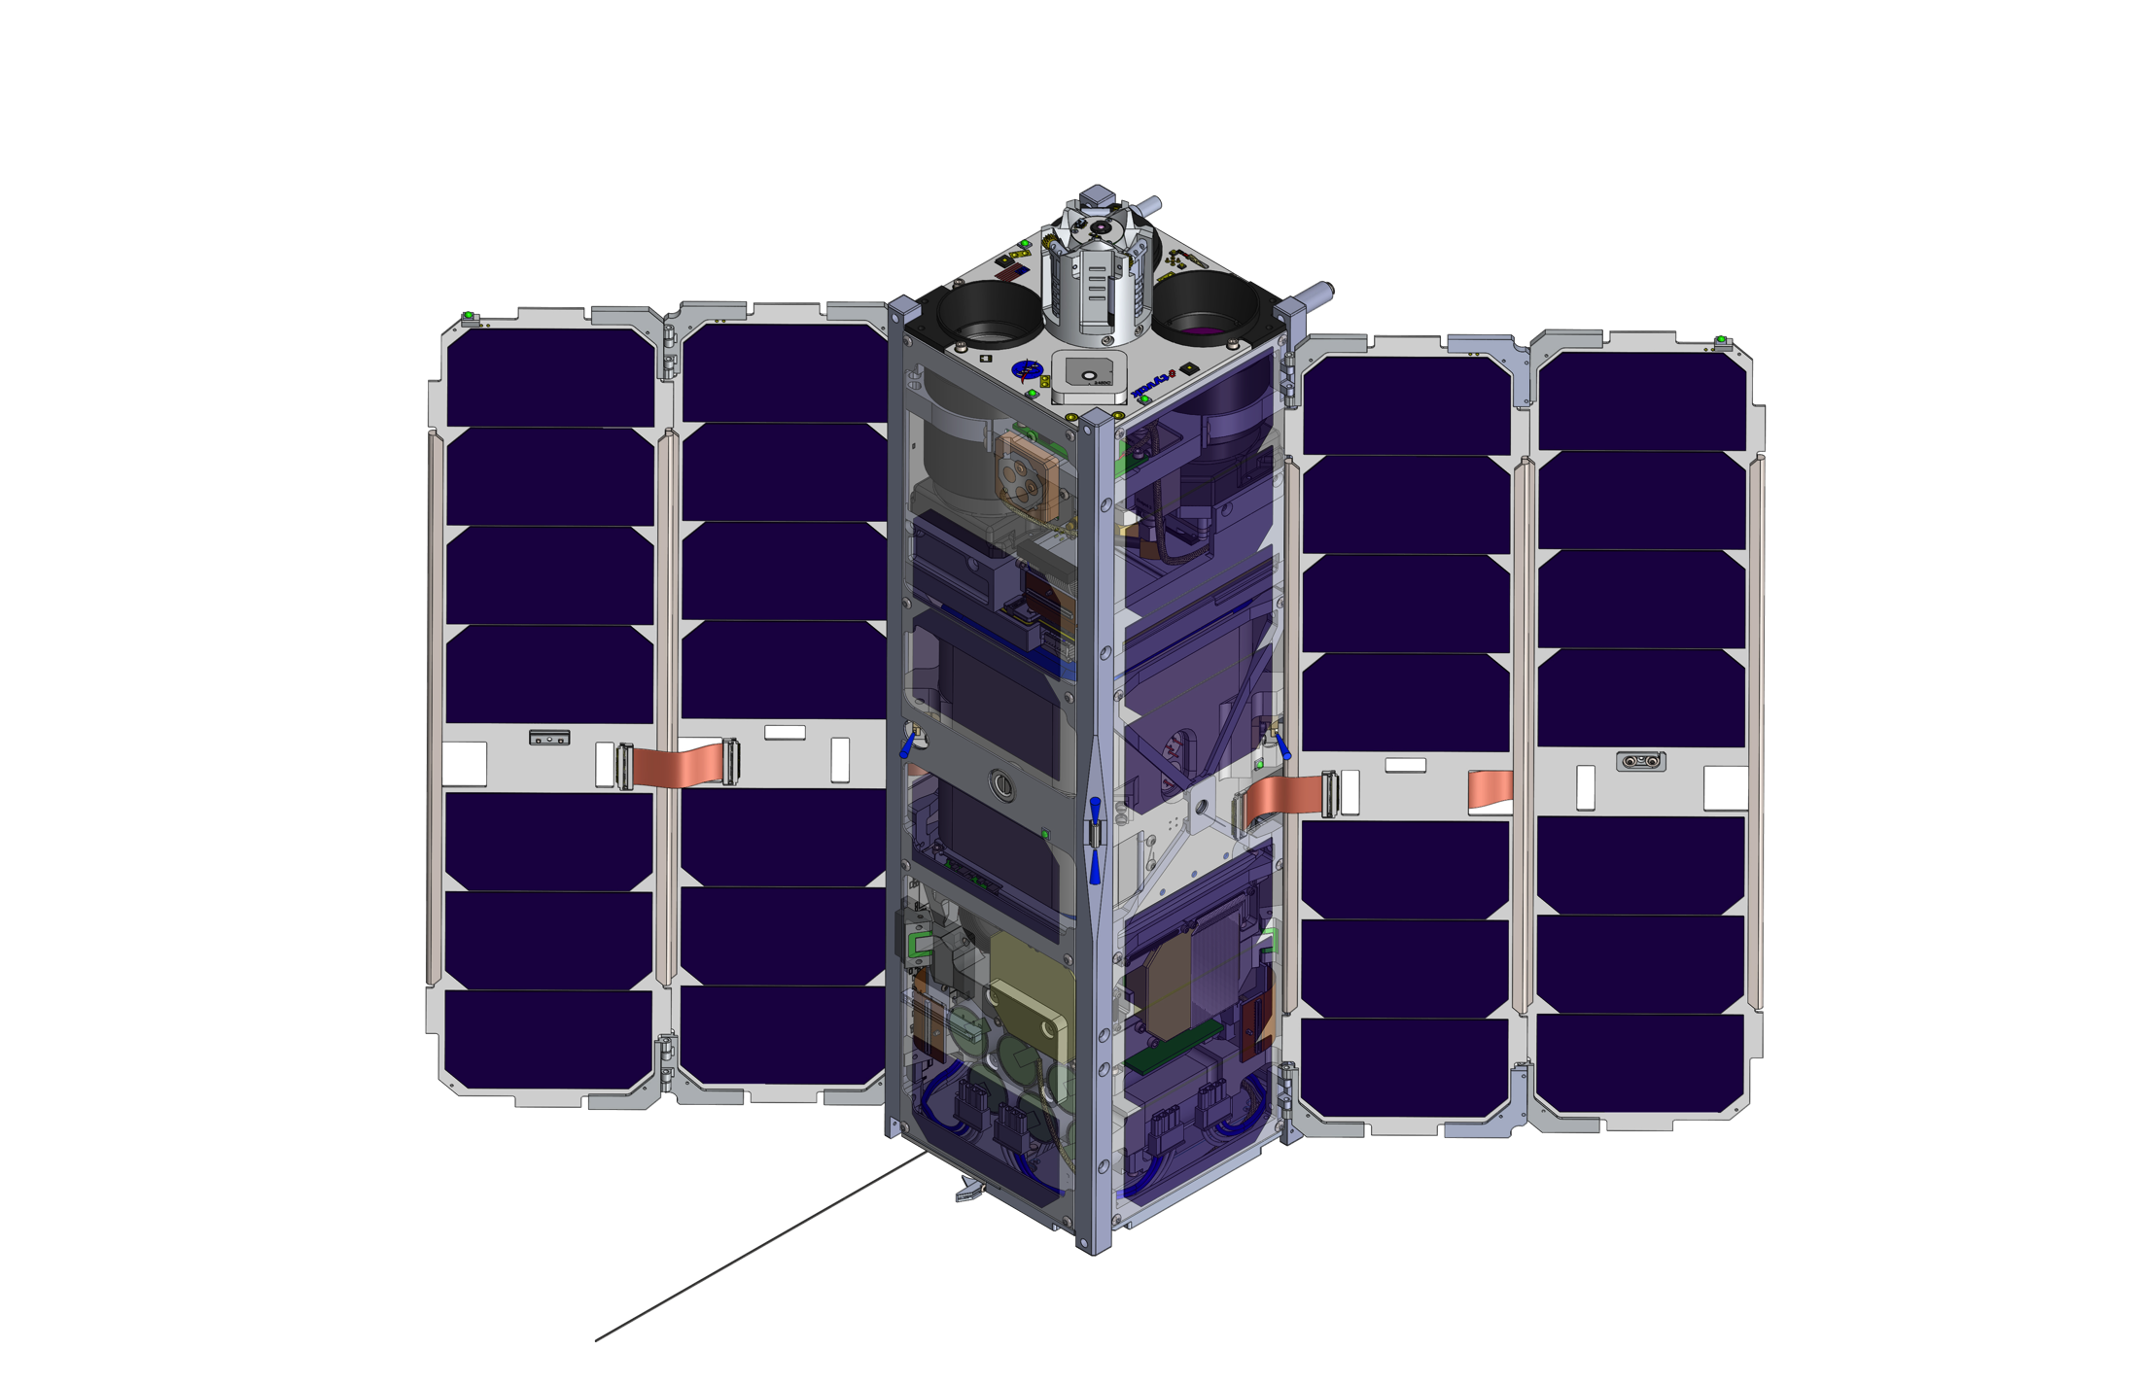
CPOD Performance Summary
Capability | Specification | Comments
Average Power Generated | ~17W to 30W OAP | Polar Sun-Sync
Average Load | ~15W | Fully Active
Pointing Accuracy | <0.15 degrees | Star Trackers available under all mission scenarios
Mission Data Downlink | ~60MB / day | UHF and S-Band
Delta-V | ~20 m/s | Cold Gas
Total Mass | 5.990kg | Wet Mass (13% Margin)

Slide 14
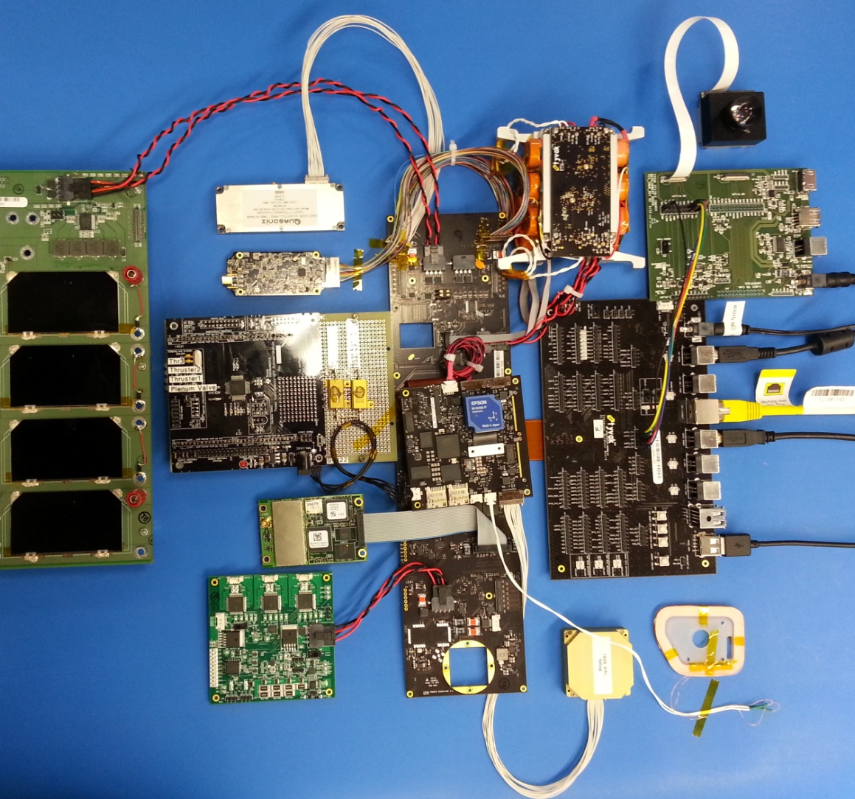
CPOD Integrated Flat-Satellite
Accomplishments to date
  EDU avionics bring-up complete with 100% of subsystems functionally verified using software driver implementations
  Complex low-level bus protocols functionally verified with flight data rates and electrical connectivity
  Initial EMI compatibility testing complete
  Vibration and Thermal Vacuum survivability tests
  Reaction Wheel life testing complete
  Star Tracker outdoor testing complete

Slide 15
Summary and Status
State of the art Proximity, Rendezvous and Docking system
  Scalable architecture
Leverage on Tyvak’s Endeavour bus architecture
Sensor suite and algorithms created to interact with Tyvak’s vehicle
Great flexibility of operations
Design phase complete
  Leveraging on multiple quick iterations with hardware evaluation
Main interface risks retired through early adoption of FlatSat and dedicated risk reduction environmental tests
Final iteration of Engineering Development hardware is on order
  Qualification unit completed by November
Extensive mission assurance campaign through testing and ground demonstration

Slide 16
Questions?
For additional inquiries, please contact:
Dr. Marco Villa
CPOD Program Manager
Marco.Villa@tyvak.com
310-956-5973

