Slide 1
Ball Bearings 101
Alan Leveille
Welcome…
Dr. Mike Dube
michael.j.dube@nasa.gov

Slide 2
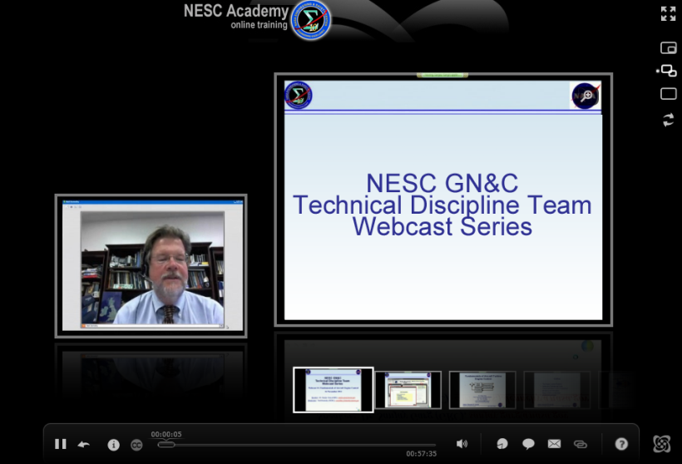

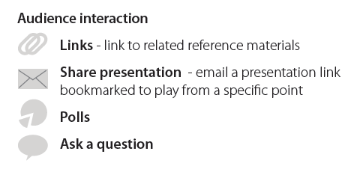
SLaMS Webcast
Series

Slide 3

Ball Bearings 101
Alan Leveille April 23, 2014

Slide 4
Ball Bearings 101
GOAL – To provide a very basic explanation of ball bearings
By itself, this lecture does not contain sufficient information to select or analyze what bearing to use.
Bearing manufacturer’s catalogs contain the information needed to select a preliminary bearing design that then may need modification based on more detailed evaluation.
It is the failure to follow fundamental bearing industry specifications that often causes premature failures.
2

Slide 5
Acknowledgement
The Barden Corporation kindly gave this writer permission to extract from their catalog pictures and other information for illustration purposes only. We equally could have used any other bearing company catalog and the use of the Barden information is not intended to convey an endorsement of their product versus any other manufacturer.
3

Slide 6
Outline – Ball Bearings 101
1. What is a ball bearing?
2. Geometry
3. Preload
4. Static & and Dynamic Capacities
5. Essence of math models
6. Why do Bearings Fail?
7. Materials used
8. Lubricants used
9. How to select the right bearing for your
application
4

Slide 7
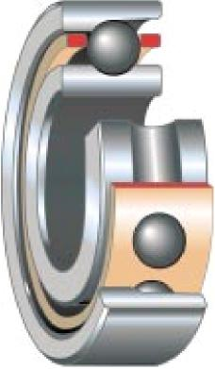
Components of a Ball Bearing
OUTER RING
CAGE RETAINER CAGE SEPERATOR SEPERATOR
BALLS
INNER RING
INNER RING
5

Slide 8
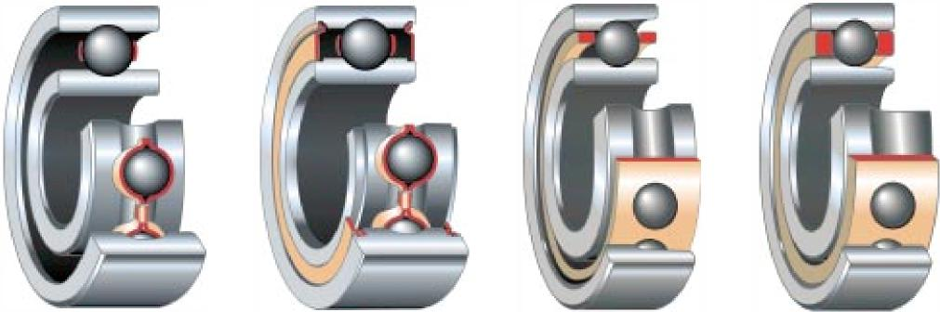
Illustration of Deep Groove & Angular Ball Bearings
DEEP GROVE
OPEN
DEEP GROVE
SHIELDED
ANGULAR CONTACT
NON-SEPERABLE
ANGULAR CONTACT
SEPERABLE
Deep Grove - Full Raceways
Angular Contact - Partial Raceways
6

Slide 9
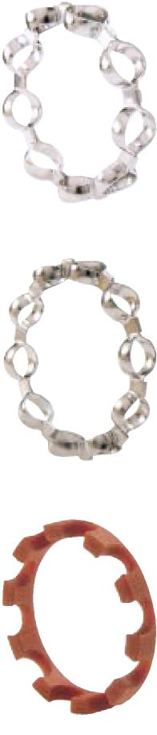
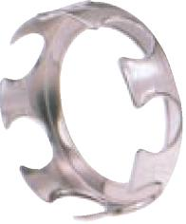
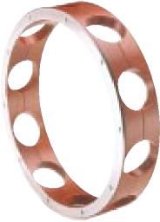
Some Deep Groove Bearing Cages
DEEP GROVE BEARINGS MUST USE OPEN BALL POCKETS OR TWO PIECES THAT CAN BE JOINED BY SOME MECHANICAL MEANS
2 PIECE RIBBON CAGE HELD TOGETHER WITH CRIMPED TABS
2 PIECE CAGE WITH ALUMINUM RAIL
7

Slide 10
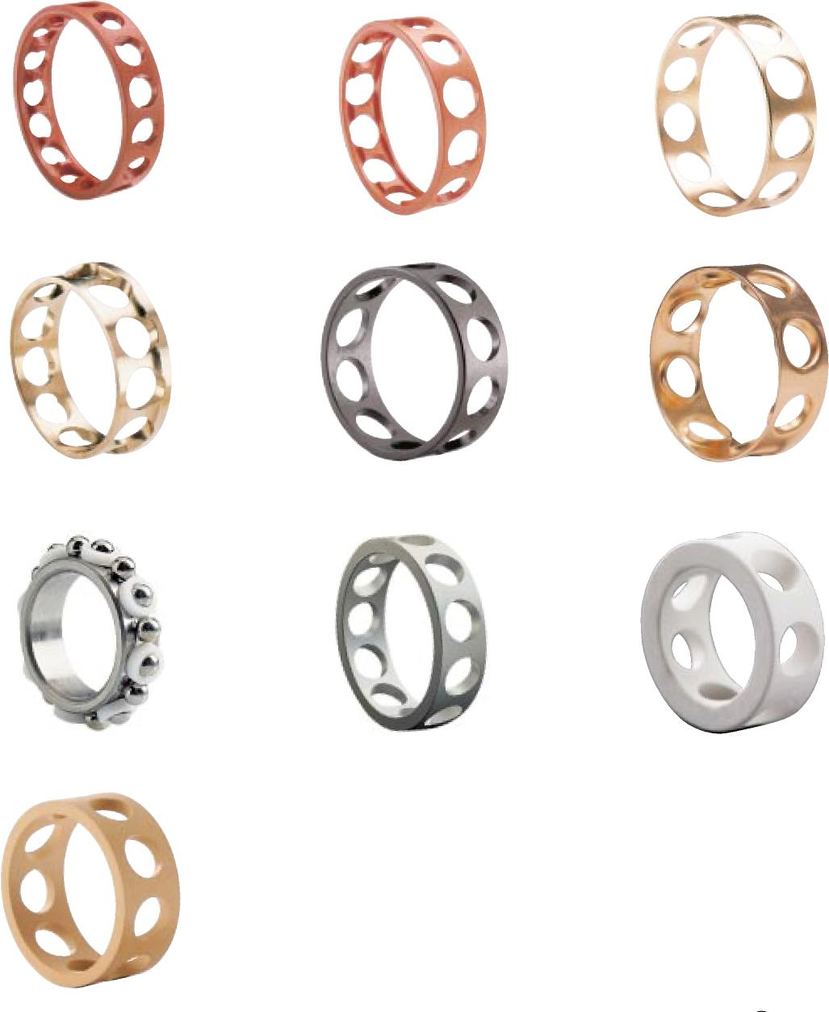
Some Angular Contact Bearing Cages
ANGULAR CONTACT BEARINGS CAN BE MADE OF ONE PIECE BECAUSE THE OUTER RING CAN BE SEPERATED FROM THE INNER RING.
THIS ALLOWS THE BEARING TO HAVE MORE BALLS THEREBY INCREASING IT’S LOAD CARRYING CAPACITY
8

Slide 11
Outline – Ball Bearings 101
1. What is a ball bearing?
2. Geometry
3. Preload
4. Static & and Dynamic Capacities
5. Essence of math models
6. Why do Bearings Fail?
7. Materials used
8. Lubricants used
9. How to select the right bearing for your
application
9

Slide 12
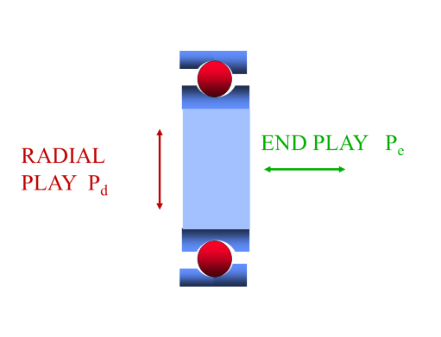
Radial Play, P_{d} & End Play, P_{e}
10

Slide 13

Contact Angle, β
(Pe/Pd) = Cot(β/2)
β | Cot(β/2)
5^{ο} | 22.9
10^{ο} | 11.4
15^{ο} | 7.56
20^{ο} | 5.67
25^{ο} | 4.51
$$β$$
CONTACT ANGLE
11

Slide 14
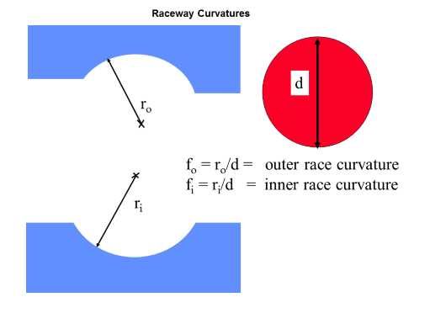
Curvatures or Conformity
12

Slide 15
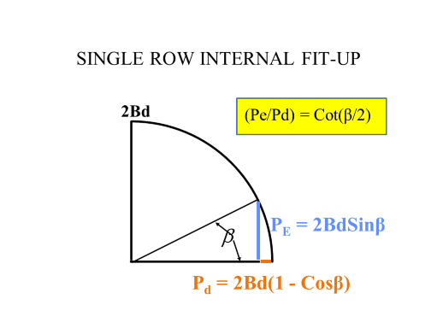
How the Internal Geometry fits together
13

Slide 16
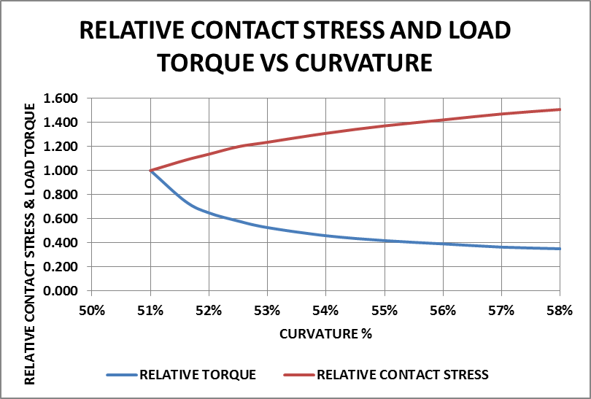
Effect of Curvatures on Contact
Stress and Torque
Curvatures are in the range of 51.6% to 58%
Close curvatures reduce contact stress but at the expense of higher ball to race micro-sliding friction which degrades lubricant.
Close curvatures makes the bearing more sensitive to geometry and alignment errors further increasing friction and lubricant degradation.
Where possible, avoid curvatures below 52%
14

Slide 17
Outline – Ball Bearings 101
1. What is a ball bearing?
2. Geometry
3. Preload
4. Static & and Dynamic Capacities
5. Essence of math models
6. Why do Bearings Fail?
7. Materials used
8. Lubricants used
9. How to select the right bearing for your
application
15

Slide 18
What is Preload?
DF PAIR
ROW 1
ROW 2
PRELOAD
β | Cot(β/2)
5^{ο} | 22.9
10^{ο} | 11.4
15^{ο} | 7.56
20^{ο} | 5.67
25^{ο} | 4.51
PRELOAD = AXIAL LOAD REQUIRED TO CLOSE THE GAP
16

Slide 19
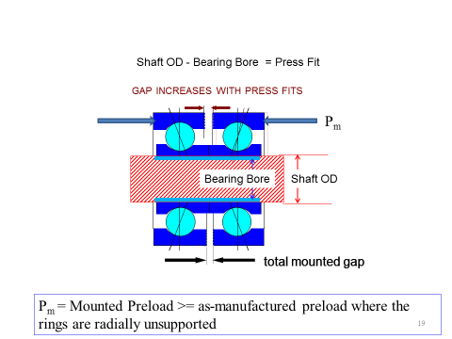
Mounted preload increases with press fits
(Pe/Pd) = Cot(β/2)
β | Cot(β/2)
5^{ο} | 22.9
10^{ο} | 11.4
15^{ο} | 7.56
20^{ο} | 5.67
25^{ο} | 4.51
17

Slide 20
Why Preload?
Preloading loads all the balls uniformly and does not allow free movement through internal looseness. Preload results in resistance to damage due to vibrations and provides rotational accuracy and controlled stiffness.
18

Slide 21
Preload Configurations
DF -FACE TO FACE,
CONTACT ANGLES EXTERNALLY DIVERGING
DB -BACK TO BACK,
CONTACT ANGLES EXTERNALLY CONVERGING
DF BEARING PAIR
DB BEARING PAIR
19

Slide 22
Outline – Ball Bearings 101
1. What is a ball bearing?
2. Geometry
3. Preload
4. Static & and Dynamic Capacities
5. Essence of math models
6. Why do Bearings Fail?
7. Materials used
8. Lubricants used
9. How to select the right bearing for your
application
20

Slide 23
Static & Dynamic Load Capacity
Static Capacity is the maximum load which when applied and then removed will not result in any raceway or ball damage which can cause noise and/or torque disturbances.
Dynamic Capacity is the load which when applied and the bearing rotated 1,000,000 revolutions will result in 10% of the population failing by metal fatigue.
21

Slide 24
Quiet Running Static Capacities for
Commonly Used Ball Bearing Steels
MATERIAL | MEAN CONTACT STRESS LEVELS WHICH IF EXCEEDED WILL CAUSE INDENTATIONS IN THE STEEL (BRINELLS) AND RESULT IN VIBRATIONS AND TORQUE NOISE WHEN OPERATED
440C | 2310 MPa (335 KSI)
52100 | 2480 MPa (360 KSI)
M50 | 2480 MPa (360 KSI)
M62 | 3790 MPa (550 KSI)
22

Slide 25
Non-Quiet Running Static Capacities for
Commonly Used Ball Bearing Steels
MATERIAL | MEAN CONTACT STRESS LEVELS WHICH WILL CAUSE INDENTATIONS (BRINELLS) ~.0001TIMES THE BALL DIAMETER. THESE VALUES CAN BE USED FOR SHORT LIFE MECHANISM’S FOR WHICH INDUCED VIBRATIONS AND TORQUE NOISE DO NOT IMPAIR PERFORMANCE. LONG TERM OPERATION AT THESE STESS LEVELS WILL REDUCE FATIGUE LIFE BELOW VALUES PREDICED BY FATIGUE LIFE EQUATIONS.
440C | 2760 MPa (400 KSI)
52100 | 2960 MPa (430 KSI)
M50 | 2960 MPa (430 KSI)
M62 | 4070 MPa (590 KSI)
23

Slide 26
Outline – Ball Bearings 101
1. What is a ball bearing?
2. Geometry
3. Preload
4. Static & and Dynamic Capacities
5. Essence of math models
6. Why do Bearings Fail?
7. Materials used
8. Lubricants used
9. How to select the right bearing for your
application
24

Slide 27
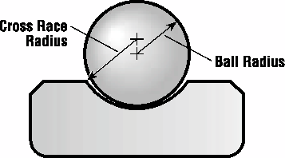
Essence of Math Models
Heinrich Hertz 1883
P = normal load
S_{mean} = mean compressive stress over elliptical contact area πab
S_{max} = maximum compressive stress at center = (3/2)S_{mean}
S_{mean} = P/πab
Elliptical Contact Area
2b
2a
S_{mean} = K_{s}P^{1/3}
It takes an 8 times increase in load
to double the stress
δ_{n} = K_{n}P^{3/2}
δ = Normal approach between the ball and the raceway
25

Slide 28
Outline – Ball Bearings 101
1. What is a ball bearing?
2. Geometry
3. Preload
4. Static & and Dynamic Capacities
5. Essence of math models
6. Why do Bearings Fail?
7. Materials used
8. Lubricants used
9. How to select the right bearing for your
application
26

Slide 29
Why do Bearings Fail?
Almost always - Lubricant used up due to:
  Wrong lube for environment/ temperature/speed
  Insufficient lubricant to last mission life – i.e. lube ok but simply not enough to last
  Good bearing practices and specs not followed.
  Excessive ball to race sliding caused by misalignments and/or raceway distortions due to mounting distortions
  Excessive induced thermal loadings or unloading due to incorrect combination of bearing and structure materials for thermal environment
Metal Fatigue
  While possible- virtually never happens because lubricant failure comes first
27

Slide 30
Outline – Ball Bearings 101
1. What is a ball bearing?
2. Geometry
3. Preload
4. Static & and Dynamic Capacities
5. Essence of math models
6. Why do Bearings Fail?
7. Materials used
8. Lubricants used
9. How to select the right bearing for your
application
28

Slide 31
Commonly Used Ball Bearing Steels
MATERIAL | Modulus | Poisson Ratio | CTE | Density | Rc
440C | 200 GPa 29,000 ksi | .29 | 10.2 μm/m-^{ο}C 5.67μin/in-^{ο}F | 7.80 gr/cc .282lb/in³ | 58
52100 | 30,500 ksi | .30 | 11.9 μm/m-^{ο}C 6.61μin/in-^{ο}F | 7.80 gr/cc .282lb/in³ | 62
M50 | 203 GPa 29,500 ksi | .27 | 11.3 μm/m-^{ο}C 6.28 μin/in-^{ο}F | 7.83 gr/cc .283 lb/in³ | 65
M62 | 234 GPa 34,000 ksi | .29 | 11.2 μm/m-^{ο}C 6.24 μin/in-^{ο}F | 7.83 gr/cc .283 lb/in³ | 67
29

Slide 32
Outline – Ball Bearings 101
1. What is a ball bearing?
2. Geometry
3. Preload
4. Static & and Dynamic Capacities
5. Essence of math models
6. Why do Bearings Fail?
7. Materials used
8. Lubricants used
9. How to select the right bearing for your
application
30

Slide 33
Example of the information for oils in the Barden catalog
Barden Code | Designation | Base Oil | Operating Temperature Range °F | Maximum dN | Comments
0–9 | Exxon instrument oil | Petroleum | –65 to 150 | 1,500,000* | Anti-oxidation, anti-corrosion E.P. additives.
0–11 | Winsorlube L-245X | Diester | –65 to 175 | 1,500,000* | Attacks paint, neoprene, anti-corrosion additives. MIL-L-6085.
0–14 | Exxon Turbo Oil #2389 | Diester | –65 to 350 | 1,500,000* | Anti-oxidation, additives, MIL-L-7808.
0–28 | Mobil SHF-61 | Synthetic hydrocarbon | –65 to 350 | 1,500,000* | Good heat stability, low volatility.
0–49 | Exxon Turbo Oil #2380 | Diester | –65 to 350 | 1,500,000* | Anti-oxidation additives, MIL-L-23699.
0–50 | NYE Synthetic 181B | Synthetic hydrocarbon | –40 to 300 | 1,500,000* | Good heat stability, low volatility.
0–59 | Bray Micronic 815Z | Perfluorinated polyether | –100 to 500 | 400,000 | Low surface tension, but does not migrate.
0–62 | Du Pont Krytox 1506 | Fluorocarbons | –60 to 550 | 400,000 | Low surface tension, but does not migrate.
0–64 | NYE Synthetic Oil 2001 | Synthetic hydrocarbon | –50 to 260 | 400,000 | Instrument, general purpose lubricant excellent for use in hard vacuum applications where very low out gas properties are desired
OJ-201 | Aeroshell Fluid 12 | Synthetic Ester | –65 to 300 | 1,500,000* | MIL-L-6085, Attacks paint, natural rubber, and neoprene. Contains anti-corrosion additives.
OJ-228 | Nycolube 11B | Synthetic Ester | –65 to 300 | 1,500,000* | MIL-L-6085, Attacks paint, natural rubber, and neoprene. Contains anti-corrosion additives.
OJ-262 | Anderol L465 | Synthetic | –20 to 450 | 1,500,000* | Low out gas properties for wide temperature range. Contains anti-corrosion, and anti-oxidation additives. Contains anti-corrosion, anti-wear additives.
OJ-273 | Nyosil M25 | Silicone | –58 to 390 | 200,000 | Low surface tension, tends to migrate.
31

Slide 34
Outline – Ball Bearings 101
1. What is a ball bearing?
2. Geometry
3. Preload
4. Static & and Dynamic Capacities
5. Essence of math models
6. Why do Bearings Fail?
7. Materials used
8. Lubricants used
9. How to select the right bearing for your
application
32

Slide 35
How to select the right bearing for your application
By itself, this lecture does not contain sufficient information to select or analyze what bearing to use.
Bearing manufacturer’s catalogs contain the information needed to select a preliminary bearing design that then may need modification based on more detailed evaluation. Depending on the complexity and criticality of the application you should consider seeking expert help .
It is the failure to follow fundamental bearing industry specifications that often causes premature failures. The specifications for the most fundamental aspects are too often ignored and that leads to unreliable performance and premature failures.
33

Slide 36
Back-up Slides
34

Slide 37
Theoretical basis of Static Capacity
Applying Hertzian contact stress theory, Timoshenko in 1934 showed that the maximum sub-surface shear stress goes plastic when the mean contact stress at the surface equals 1.1 times the yield stress in simple tension or frictionless compression
Sm = l.l Y
Bearing companies referred to this limit as a “quiet running” static capacity – but no one verified this with empirical data until Murphy and Leveille (my father) in 1974 when it was shown that torque noise doubled when Δ/d ~ .00003
Where d = ball diameter and Δ = permanent indentation depth.
35

Slide 38
Example of the information for greases in the Barden catalog
36

Slide 39
Questions???

Slide 40
Thank you for
attending…
Upcoming SLaMS Webcast:
Force Limited Testing
Dr. Ali Kolaini
May, 2014

