Slide 1
Gas Bottle Blow-Down
Analysis

Slide 2
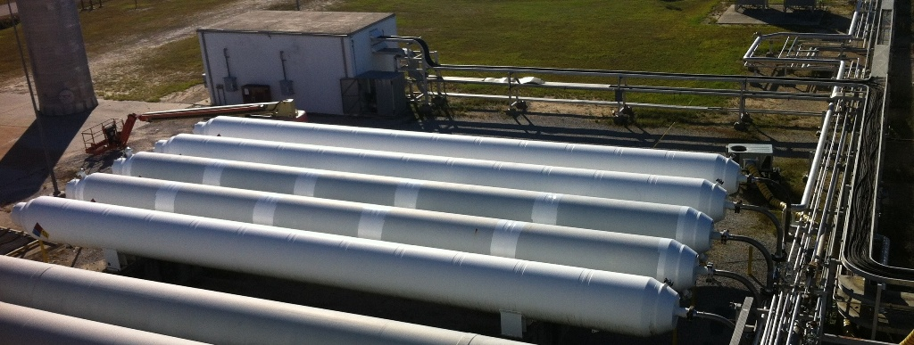
Introduction
This lesson provides the means to estimate the gas state in a pressure vessel during or after depressurization (blow-down) from a known state, a uniform-flow thermodynamic process.

Slide 3
Overview
For the given thermodynamic problem of depressurization of a pressure vessel, the governing thermodynamic equations are derived.
Solutions are described for 3 methods: two using the simplifying process assumptions, isentropic and isothermal, and a third using more a generalized approach.

Slide 4
Scope
In a propulsion testing system, pressure vessels (or bottles) supply propellants or pressurize liquid propellant tanks for a rocket engine test.
During the preliminary design, it may be important to estimate the capability of the bottles.
Gas Bottle
Control Valve
Gas Bottles
Control Valve
Run Tank
To Test Article
To Test Article

Slide 5
Lesson Breakdown
Bottle Blow Down Problem Description
Governing Thermodynamic Equations
Example Problems
Concluding Remarks
Acknowledgements
References/Credits

Slide 6


Lesson Roadmap
Problem Description
Conservation of Mass
1st Law of Thermodynamics
Isothermal Assumption
2nd Law of Thermodynamics
Isentropic Assumption
Example Problems
Isothermal Example
Isentropic Example
Generalized 1st Law Algorithm Example
Spreadsheet Excerpt
Acknowledgements
Concluding Remarks
References/ Credits

Slide 7
Bottle Blow-Down Problem Description
Problem: Find the final state of a real gas in a control volume (CV) following a Uniform-Flow process.
Solution: Use the 1st and 2nd Laws of Thermodynamics for a control volume.

Slide 8
Fundamentals

Slide 9
Nomenclature
E = energy
Q = heat transfer
W = work
ke = specific kinetic energy
pe = specific potential energy
h = specific enthalpy
u = specific internal energy
m = mass
S = entropy
S_{gen} = entropy generation
T = boundary temperature
s = specific entropy

Slide 10
Conservation of Mass
The Conservation of Mass Principle is needed in the derivation of the 1st and 2nd Law equations and is defined by the statement below:
The net mass transfer to or from a system during a process is equal to the net change in the total mass of the system during that process (Ref. 1).
Also known as the Continuity Equation.

Slide 11
Conservation of Mass (Cont.)
Rate form of the Continuity Equation:
(Adapted from Ref. 1)
Or for a single inlet and a single outlet:

Slide 12
1st Law of Thermodynamics
The 1st Law of Thermodynamics is defined by the following statements:
Energy cannot be created or destroyed; it can only change forms. Energy is defined as the ability to cause change. The total energy is a property of a system (Ref. 1).
The Conservation of Energy Principle is the result.

Slide 13
1st Law Energy Balance
The Conservation of Energy Principle:
  The change in energy content of a body or any other system is equal to the difference between the energy input and the energy output, and the energy balance (Ref. 1).
Rate Form of the Energy Balance Equation:
(Adapted from Ref. 1)

Slide 14
1st Law Energy Balance (Cont.)
Rate Form of the Energy Balance for a Control Volume:
(Adapted from Ref. 1)
where
and

Slide 15
1st Law Energy Balance for Bottle Blow-Down
T₁ = Known
P₁ = Known
mass flow out
heat in
No Work
0
No Mass In
0
No
Heat
0
No
Work
0

Slide 16
1st Law Energy Balance for Bottle Blow-Down (Cont.)
No ke
0
No pe
0
No ke
0
No pe
0
No ke
0
No pe
0

Slide 17
1st Law Energy Balance for Bottle Blow-Down (Cont.)
Often, heat transfer can be neglected for short duration processes or well-insulated vessels.
When the process duration and heat transfer are sufficiently large, the process can be isothermal.

Slide 18
Isothermal Blow-Down
The isothermal assumption is valid when process duration is such that gas temperatures remain approximately constant or return to the initial temperature (recovery state).
Final state fixed by density and temperature.
  →Use thermodynamic tables or software such as Refprop (Ref. 2) to find final state properties.

Slide 19
2nd Law of Thermodynamics
The 2nd Law of Thermodynamics is defined by the following statements:
Energy has a quality as well as a quantity. Processes have a direction and occur in the direction of decreasing quality of energy or increasing entropy (adapted from Ref. 1).

Slide 20
2nd Law of Thermodynamics (Cont.)
Entropy is a property of a system and is defined as the quantitative measure of microscopic disorder for a system generated by heat transfer, mass flow, and irreversibilities (Ref. 1).
The Entropy Balance Equation can be derived from the Clausius Inequality and the Definition of Entropy.

Slide 21
2nd Law Entropy Balance
Rate form of the Entropy Balance:
(Adapted from Ref. 1)
Rate form of the Entropy Balance for a control volume:
(Adapted from Ref. 1)
where

Slide 22
2nd Law Entropy Balance for Adiabatic Bottle Blow-Down
T₁ = Known
P₁ = Known
mass flow out
Adiabatic
No Entropy Generated Due to Frictional Losses
0
No Heat
0
No Mass In
0
Adiabatic means no heat transfer

Slide 23
2nd Law Entropy Balance for Adiabatic Bottle Blow-Down (Cont.)
where
therefore
Often, heat transfer can be neglected for short duration processes or well-insulated vessels
When the process heat transfer and entropy generation can be neglected, the process is isentropic.

Slide 24
Isentropic Blow-Down
The isentropic assumption is valid when the process duration is short or the bottle is well-insulated.
Final state fixed by density and entropy
  →Use thermodynamic tables or software such as Refprop (Ref. 2) to find final state properties.

Slide 25
Examples

Slide 26
Example Problems
Problem Statement:
  A 28 m³ nitrogen bottle at 20 MPa and 300 K undergoes a process where mass exits at 15 kg/sec for 150 sec.
  Find final temperature and pressure, assuming the process is:
  Isothermal
  Isentropic
  Heat transfer rate = 1800 kW

Slide 27
Isothermal Example (A)
State 1 is defined by temperature and pressure:
  ρ₁ = 212.5 kg/m³ → m₁ = 5951 kg
  2250 kg is removed from the bottle, leaving 3701 kg. Final density is calculated from final mass and volume. Temperature of the nitrogen in the vessel is constant due to the isothermal assumption.
  State 2A defined by temperature and density:
      ρ_{2A} = 132.2 kg/m³
      T_{2A} = T₁ = 300 K

Slide 28
Isothermal Example (A) (Cont.)
    Final pressure can be found by using the thermodynamic tables in Reference 3 or software such as Refprop (Ref. 2):
      P_{2A} = 11.9 MPa
      This is also the recovery pressure of the vessel if the vessel is depressurized and then allowed to heat back up to the initial temperature.

Slide 29
Isentropic Example (B)
State 1 is defined by temperature and pressure:
  ρ₁ = 212.5 kg/m³ → m₁ = 5951 kg
  s₁ = 5.163 kJ/kg*K
  2250 kg is removed from the bottle, leaving 3701 kg. Final density is calculated from final mass and volume. Entropy of the nitrogen in the vessel is constant due to the isentropic assumption.
      State 2B defined by density and entropy:
      ρ_{2B} = 132.2 kg/m³
      s_{2B} = s₁ = 5.163 kJ/kg*K

Slide 30
Isentropic Example (B) (Cont.)
    Final temperature and pressure can be found by using the thermodynamic tables in Reference 3 or software such as Refprop (Ref. 2):
      T_{2B} = 234.2 K
      P_{2B} = 8.6 MPa

Slide 31
Generalized Problem (C)
T₁ = Known
P₁ = Known
mass flow out
heat in
This problem must be solved numerically using the above equation derived from the Energy Balance Equation for a control volume.

Slide 32
Generalized Problem (C) (Cont.)
State 1 is defined by temperature and pressure:
  ρ₁ = 212.5 kg/m³ → m₁ = 5951 kg
The final temperature and pressure of the nitrogen were found to be:
T_{2C} = 300 K
  P_{2C} = 11.9 MPa

Slide 33
Generalized Problem (C) (Cont.)
The heat rate into the vessel, 1800 kW, was chosen to produce the isothermal result, giving us the average heating rate needed to keep the nitrogen at a constant temperature.
This solution was obtained using a spreadsheet with a thermodynamic properties subroutine (Refprop.xls) and a time step of 0.1 sec.
Refprop.xls is included with the installation of Refprop (Ref. 2).

Slide 34
Energy Balance Algorithm
With initial temperature (T₁) and initial pressure (P₁), find initial mass (m₁), initial internal energy (u₁), and initial enthalpy (h₁ = h_{out}).
With chosen time step, mass flow rate, and heat rate in (Qdot_{in}), solve for the resulting total internal energy (U₂) and mass (m₂), using the 1st Law energy balance and the continuity equation, respectively.
With U₂, m₂, and volume calculate resulting internal energy (u₂) and density (d₂).

Slide 35
Energy Balance Algorithm
With u₂ and d₂, find resulting temperature (T₂) and pressure (P₂) and other thermodynamic properties if required.
Update T₁ and P₁ with T₂ and P₂, then find next u₁ and h₁ = h_{out} for the next time step.
Repeat for next time step.

Slide 36
Energy Balance Algorithm (Cont.)
3
2
1
4
6
5

Slide 37
Energy Balance Algorithm (Cont.)
1

Slide 38
Energy Balance Algorithm (Cont.)
2

Slide 39
Energy Balance Algorithm (Cont.)
3

Slide 40
Energy Balance Algorithm (Cont.)
4

Slide 41
Energy Balance Algorithm (Cont.)
6
5

Slide 42
Energy Balance Algorithm (Cont.)
Notes:
Algorithm assumes user has numerical means of solving for thermodynamic properties
Can be programmed in an Excel spreadsheet using the Refprop.xls worksheet (Ref. 2)
Recommend an initial run without heat transfer and check against isentropic process

Slide 43
Concluding Remarks
When the Blow-Down process can be approximated as isothermal or isentropic, final state properties can be found using thermodynamic tables (or thermodynamic software).
When heat transfer is a significant factor, the energy balance equation must be solved numerically, but a simple algorithm can be used to solve for the final state.

Slide 44
Acknowledgements
Special acknowledgement is given to Steven Rickman, Ruth Amundsen, and David Gilmore for their assistance and review of this lesson.
This author is grateful to the NESC Passive Thermal Technical Discipline Team (TDT) for their contributions and technical review of this lesson.

Slide 45
References/Credits
  “Thermodynamics: An Engineering Approach”, 4th ed., Cengel and Boles, McGraw-Hill, 2002.
  Lemmon, E.W., Huber, M.L., McLinden, M.O. NIST Standard Reference Database 23: Reference Fluid Thermodynamic and Transport Properties-REFPROP, Version 9.0, National Institute of Standards and Technology, Standard Reference Data Program, Gaithersburg, 2010.
  “Fundamentals of Thermodynamics”, 5th ed., Sonntag, Borgnakke and van Wylen, Wiley, 1998.
  Microsoft® Clip Art was used in the presentation.

