Slide 1
Numerical Modeling of Cryogenic Fluid Management
Notes:
I am Alok Majumdar work at NASA/Marshall Space Flight Center. In this lesson I will talk on Numerical Modeling of Cryogenic Fluid Management.

Slide 2
Introduction
Cryogenic Fluid Management (CFM) involves storage and transfer of cryogenic liquids [1].
Cryogenic liquids are extremely cold (36 R or 20 K for liquid hydrogen; 162 R or 90 K for liquid oxygen). As a result cryogenic tanks and transfer lines experience very large temperature gradient with the ambient.
An extremely good insulation is necessary to prevent boiling of cryogenic fluid stored in tanks.
Cryogenic transfer lines need to be cooled down to cryogenic temperature before steady flow of liquid is established.
Notes:
Cryogenic Fluid Management, also known as CFM, involves storage and transfer of cryogenic liquids. Due to extremely cold temperature cryogenic liquids need special attention for storage and transport. At normal atmospheric pressure, the saturation temperature of liquid hydrogen is 36 R or 20 K and the saturation temperature of liquid oxygen is 162 R or 90 K. Evidently the cryogenic tanks and transfer lines experience very large temperature gradient. Therefore, extremely good insulation is necessary to prevent loss of liquid due to boiling. Cryogenic Transfer Lines need to be cooled down to saturation temperature of the liquid or below before steady flow of liquid is established.

Slide 3
Introduction
Numerical modeling of cryogenic fluid management applications is very complex because it must account for the strong coupling of fluid flow and heat transfer with change of phase.
Numerical modeling is, however, necessary to answer questions, such as:
How long does it take to chilldown the transfer line and fill the tank?
How much propellant is needed to chill down the system?
How much propellant will be lost due to boil-off and how to minimize the loss?
Notes:
Numerical modeling of Cryogenic Fluid Management applications such as storage and transfer, are very complex because it must account for strong coupling of fluid flow and heat transfer with change of phase. There will always be some boiling of liquid even with good insulation. Therefore, numerical modeling is necessary to answer the questions, such as:
How long it takes to chilldown the transfer line and fill the tank?
How much propellant is needed to chill down the system?
How much propellant will be lost due to boil-off and how to minimize the loss?

Slide 4
Introduction
This lesson describes the basics and applications of a finite volume procedure [2] in a fluid network in modeling a few cryogenic fluid management applications which include transfer, loading and storage of cryogenic fluids in tanks.
The finite volume procedure has been extensively used in commercial CFD codes such as FLUENT, CFX & FLOW3D
The finite volume procedure has been incorporated in Generalized Fluid System Simulation Program (GFSSP) [3] for modeling network flow
GFSSP has been used to analyze four CFM application problems described in this lesson
Notes:
In this lesson we are going to learn the basics of a finite volume procedure for modeling flow in a network and application of this procedure in several fluid management applications. Finite volume procedure of solving governing equations of fluid flow has been extensively used in commercial Computational Fluid Dynamics also known as CFD code. FLUENT, CFX and FLOW3D are few examples of commercial CFD codes that use finite volume procedure. The finite volume procedure has been implemented in NASA/MSFC developed thermo-fluid dynamic software, Generalized Fluid System Simulation Program also known as GFSSP for modeling flow network. GFSSP has been used to analyze four CFM application problems described in this lesson.

Slide 5


Lesson Roadmap
Finite Volume Procedure Basics
Governing
Equations
Thermodynamic
Properties
Solution
Procedure
Cryogenic Transfer Line Chilldown
(Example – 1)
No vent chill & Fill of Cryogenic Tank
(Example – 2)
Boil-off in a Ground
Storage Tank
(Example – 3)
Two-phase flow
Multi-Layer Insulation
Boil-off in Propellant
Tank in space
(Example -4)
Putting It All Together
Research needed
for further Improvement
5
Notes:
This slide shows the lesson roadmap. In the first part of the lesson, the basics of the finite volume procedure is covered. It includes the description of governing equations of fluid flow and heat transfer in a flow network. Thermodynamic and thermo-physical properties that are required to construct the equations are discussed. Finally, the numerical solution procedure for solving the governing equations are explained.
In the second part of the lesson, finite volume procedure in modeling four CFM applications are described. The chilldown of cryogenic transfer line is the topic of the first example. The second example is about chilling and filling a cryogenic tank with minimum loss of cryogenic propellant. Modeling of boil-off in a ground storage tank is described in example 3. The final example discusses how to minimize boil-off in a propellant tank in space. The lesson concludes by identifying further research needed to improve the fidelity of the numerical procedure.

Slide 6
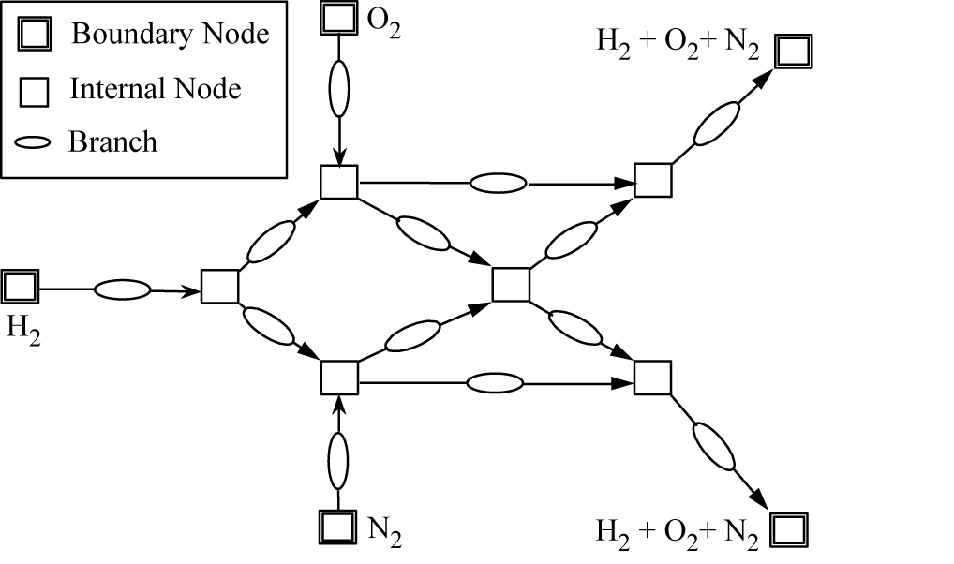
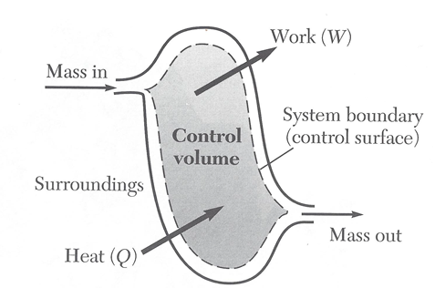
Finite Volume Procedure
Basics
The Finite Volume Procedure for a fluid network is an extension of single control volume analysis of mass and energy conservation in classical thermodynamics.
Control Volume Analysis
in Classical Thermodynamics
Finite Volume Analysis in Fluid Network
Notes:
In this slide we introduce the fundamental of finite volume procedure. Finite volume procedure is an extension of the control volume analysis technique of classical thermodynamics. On the left a typical control volume is shown for mass and energy conservation based on the first law of thermodynamics. Finite volume analysis of fluid network is shown on the right. A fluid network consists of boundary nodes, internal nodes and branches. Boundary and internal nodes are connected through branches in series or parallel arrangements. Mass and energy conservation equations are solved in internal nodes similar to control volumes of classical thermodynamics. Flowrates are calculated in branches. In control volume analysis, mass flow rates are known. In finite volume analysis, the mass flow rates are not known and therefore momentum equations are solved in branches to calculate flowrates which are necessary to solve mass and energy conservation equations in the node. In addition to flow energy, heat and work can be added to internal nodes similar to control volumes. Thus the finite volume procedure can model thermodynamics, fluid flow and heat transfer within an unified mathematical framework.

Slide 7
Finite Volume Procedure
Basic Components
Development of governing equations describing the conservation of mass, momentum and energy of cryogenic fluid and conservation of thermal energy of solid in contact with cryogenic fluid [3]
Use of accurate thermodynamic and thermo-physical property of cryogenic fluid and material properties in development of the governing equations
Numerical solution of the governing equations by an iterative method
Notes:
There are three basic components of the finite volume procedure. The first component is the development of governing equations describing the conservation of mass, momentum and energy of cryogenic fluid and conservation of thermal energy of solid in contact with cryogenic fluid.
The second component of the finite volume procedure is to provide thermodynamic and thermo-physical properties of cryogenic fluid and material properties of the solid in constructing the governing equations.
The third and final component is to solve the governing equation using a numerical solution technique to calculate the variables such as pressure, temperature and flowrate.

Slide 8
Finite Volume Procedure
Mathematical Closure
Unknown Variables Governing Equations to Solve
1. Pressure 1. Mass Conservation Equation
2. Flowrate 2. Momentum Conservation Equation
3. Fluid Temperature 3. Energy Conservation Equation of Fluid
4. Solid Temperature 4. Energy Conservation Equation of Solid
5. Mass 5. Thermodynamic Equation of State
Notes:
This slide explains the mathematical closure of the finite volume procedure. Listed here are the unknown variables and the corresponding governing equations designated to solve for the unknown variable. Pressure is calculated from mass conservation equation, flowrate is calculated from momentum conservation equation, fluid temperature is obtained by solving energy conservation equation of fluid; solid temperature is solved from energy conservation equation of solid. Finally, the resident mass in the internal node is calculated from thermodynamic equation of state.
We will now describe those five equations in next few slides. We first describe the meaning of each symbol before describing the equations.

Slide 9
Nomenclature
Symbol | Description
A | Area (ft²)
c_{p} | Specific Heat (Btu/lb ºF)
D | Diameter (ft)
g | Gravitational Acceleration (ft/ sec²)
g_{c} | Conversion Constant (= 32.174 lb-ft/lb_{f}-sec²)
h | Enthalpy (Btu/lb)
h_{ij} | Heat Transfer Coefficient (Btu/ft²-sec-°R)
J | Mechanical Equivalent of Heat (778 ft-lb_{f}/Btu)
K_{f} | Flow Resistance Coefficient (lb_{f}-sec²/(lb-ft)² )
k | Thermal Conductivity (Btu/ft-sec-° R)
L | Length (ft)
m | Resident Mass (lb)
 | Mass Flow Rate (lb/sec)

Slide 10

Nomenclature
Symbol | Description
p | Pressure (lb_{f}/ ft²)
Pr | Prandtl Number
Re | Reynolds Number
R | Gas Constant (lb_{f}-ft/lb-R)
T | Fluid Temperature (º F)
T_{s} | Solid Temperature (º F)
u | Velocity (ft/sec)
V | Volume (ft³)
x | Quality and Mass Fraction
z | Compressibility Factor
ρ | Density (lb/ft³)
$Q,\dot{q,}$ $\dot{S}$
Heat Source (Btu/sec)

Slide 11
Nomenclature
Symbol | Description
θ | Angle Between Branch Flow Velocity Vector and Gravity Vector (deg)
ε_{ij} | Emissivity
β | Coefficient of thermal expansion (1/R)
μ | Viscosity ( lb/ft-sec)
 | Distance between two solid nodes(ft)
Δτ | Time Step (sec)
 | Stefan Boltzmann Constant
Subscript
a | Ambient
S | Solid
i | Node
ij | Branch
v | Vapor
l | Liquid
11

Slide 12
Finite Volume Procedure
Governing Equations (1)
Node
Fluid
j = 2
Mixture
Mass Conservation Equation
.
m
ij
Fluid
Mixture
Node
.
Node
.
Node
j = 1
m
ji
i
m
ij
j = 3
Note : Pressure does not appear explicitly in Mass Conservation Equation although it is earmarked for calculating pressures
Single
Fluid
k = 1
.
.
.
m
ji
m
ij
=
-
m
ji
Single
Node
Fluid
j = 4
k = 2
Notes:
Mass conservation equation is described in this slide. The schematic shows that node I is connected with four neighboring nodes (j=1,4) through four branches. The flowrate,
is positive when flow is from ith to jth node. The negative value of implies that flow is jth node to ith node. It is possible that two different fluids (k = 1 & 2) can enter into node i from two neighboring nodes, designated by j =1 & 4 and mixes and fluid mixture enter into nodes designated by j = 2 & 3. k is the fluid index and a different value of k indicates a different fluid. The equation in this slide represents mass conservation equation. The left side of the equation represents rate of change of mass with time. The right hand side of the equation represents net influx into the node, i. With positive influx, the resident mass in the node, m increases and vice-versa. For steady state, the left hand side of the equation is zero which implies that rate of inflow is equal to the rate of outflow. It may be noted that pressure does not appear explicitly in mass conservation equation although it is earmarked for calculating pressures. It is possible only when mass and momentum conservation equations are solved simultaneously; this will be explained later in the lesson.

Slide 13
Finite Volume Procedure
Governing Equations (2)
Momentum Conservation Equation
Represents Newton’s Second Law of Motion
Mass X Acceleration = Forces
Node
j
Branch
Pressure
Gravity
Friction
Unsteady
Longitudinal Inertia
.
m
ij
q
Node
i
g
Notes:
Momentum Conservation equation is the representation of Newton’s Second Law of motion for fluid flow. Momentum conservation equation is solved in branches shown in the schematic. Pressures are located at the inlet and outlet of a branch and flowrates are assumed to be located in the middle of the branch. Gravity always acts vertically downward, and angle theta represents the angle between the flowrate vector and gravity vector. According to Newton’s second law of motion, product of mass and acceleration of fluid equals to the applied force on the fluid. The product of mass and acceleration consists of unsteady and longitudinal inertia. The applied force term consists of pressure, gravity and friction.

Slide 14
Finite Volume Procedure
Governing Equations (2)
Momentum Conservation Equation
Mass X Acceleration Terms
Force Terms
Pressure
Unsteady
Gravity
Longitudinal Inertia
Friction
Notes:
In this slide each term of momentum conservation equation is presented. The unsteady term is expressed as the rate of change of momentum in the branch. The longitudinal inertia is expressed as the product of mass flowrate and velocity change between the current and upstream branch. The MAX operator helps to account for computing inertia of flow in either direction. If the flow is positive, the first term exists and the second term is zero. For negative flowrates, the first term is zero and the second term exists. The pressure term is expressed as the product of branch cross-sectional area and pressure difference between upstream and downstream node. The gravity term is the product of density, gravitational acceleration, g, volume, and cosine of the angle between gravity vector and flowrate vector divided by conversion factor, g_{c}. The friction term is represented by the product of Resistance Factor, K_{f} and square of mass flow rate and branch cross-sectional area. The square of the mass flowrate is represented by the product of the flowrate and its absolute value. Such representation allows the friction term to always act opposite to the direction of flow.

Slide 15
Finite Volume Procedure
Governing Equations (3)
Energy Conservation Equation for Fluid
Node
Fluid
j = 2
Mixture
  Energy Conservation Equation is expressed in enthalpy based on upwind scheme
.
m
ij
Fluid
Mixture
Node
.
Node
.
Node
j = 1
m
ji
i
m
ij
j = 3
Single
Fluid
k = 1
.
.
.
m
ji
m
ij
=
-
m
ji
Rate of Increase of Internal Energy =
Enthalpy Inflow - Enthalpy Outflow + Heat Source
Single
Node
Fluid
j = 4
k = 2
Notes:
Energy conservation equation is expressed in terms of enthalpy which states that the rate of increase of internal energy equals the net inflow of energy into the node plus any heat source applied to the node. Upwind scheme has been used to model the advection of energy from neighboring nodes. If the flow is from I to j, then energy inflow in the node I is expressed as the product of mass flowrate and enthalpy of node j. On the contrary, if the flow is from j to I, the energy inflow is expressed as the product of mass flowrate and enthalpy of node j. The “MAX” operator in the equation allows that.

Slide 16
Finite Volume Procedure
Governing Equations (4)
Solid – Fluid Network for Conjugate Heat Transfer
Solid Node
Boundary Node
Ambient Node
Internal Node
Conductor
Branches
Solid to Solid
Solid to Fluid
Solid to Ambient
Notes:
Continuing with the discussion of governing equations this slide introduces the network for a solid to fluid conjugate heat transfer. In addition to boundary nodes for fluid (double rectangle), internal nodes for fluid (single rectangle) and branches for fluid flow, solid network consists of solid node, ambient node and conductors. The conductors are of three different kinds: solid to solid, solid to fluid and solid to ambient. With the help of these additional five elements, any solid-fluid network can be constructed.

Slide 17
Finite Volume Procedure
Governing Equations (4)
Energy Conservation for Solid Node
Ambient Node
Solid Node
Fluid Node
Notes:
The energy conservation equation for a solid node has been considered in this slide. The solid node, i has four neighboring solid nodes (j_{s} = 1,4), has four neighboring fluid nodes (j_{f} = 1,4), and has two ambient nodes (j_{a} = 1,2). In the next slide we will discuss the energy conservation equation for solid node, i.

Slide 18
Finite Volume Procedure
Governing Equations (4)
Energy Conservation for Solid Node
Conservation Equation
Successive Substitution Form
Notes:
The differential form of the conservation equation is expressed on the left. The rate of change of energy in the node i appears in the left side of the equation. The right hand side of the equation expresses the net inflow of energy from neighboring nodes and heat source. The inflow of energy from neighboring nodes consist of three terms.
q_{ss}’ represents heat conduction between solid nodes, q_{sf}’ represents convection heat transfer between solid and fluid nodes, q_{sa}’ represents heat transfer between solid and ambient nodes. h represents the heat transfer coefficient, A is the surface area of heat transfer, T_{s}, , T_{f}, , T_{a} are the temperatures of solid, fluid and ambient nodes respectively. The equation expressed on the right is the successive substitution form of the conservation equation. Following a few steps of algebraic manipulation, T_{s} is expressed as a function of temperatures of neighboring nodes, temperature at the previous time step and heat source. This equation is solved in conjunction with fluid flow equation.

Slide 19
Finite Volume Procedure
Governing Equations (5)
Equation of state
For unsteady flow, resident mass in a control volume is calculated from the equation of state for a real fluid
z is the compressibility factor determined from the equation of state of real fluid
Notes:
Finally, the thermodynamic equation of state is used to calculate the resident mass of the node. According to the equation of state, the resident mass can be expressed in terms of node pressure, p, node volume, V, Gas Constant, R, node temperature, T and compressibility factor, Z. Z is determined from the equation of state of the real fluid.

Slide 20
Thermodynamic & Thermo-physical Properties
Governing equations require thermodynamic and thermo-physical properties which are dependent on fluid properties such as pressure and temperature (or enthalpy)
The properties are evaluated using a thermodynamic property program for a given value of pressure and enthalpy at the node at each iteration
The thermodynamic property program provides density, viscosity, conductivity and specific heat for all fluid regimes (liquid, vapor and saturated mixture of liquid and vapor)
Notes:
You have already observed that thermo-dynamic and thermo-physical properties are required to develop the governing equations discussed in the previous slides. These properties are evaluated using a thermodynamic property program for a given value of pressure and enthalpy at the node at each iteration. The thermodynamic property program provides temperature, density, viscosity, conductivity and specific heat for all fluid regimes (liquid, vapor and saturated mixture of liquid and vapor)

Slide 21
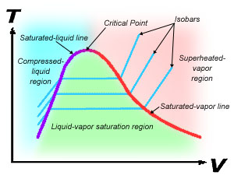
Thermodynamic & Thermo-physical Properties
GASP[4] Fluid Library
Thermodynamic state of a real fluid
Notes:
GASP is the thermodynamic and thermo-physical property program used in all example problems discussed in this lesson. Based on pressure and enthalpy, GASP locates the thermodynamic state of the fluid in the appropriate region: compressed liquid region, liquid-vapor saturation region or superheated vapor region as shown in the right side of this slide. GASP provides thermodynamic properties of the fluids listed in the table shown in left side of the slide. All cryogenic fluids used in liquid propulsion applications are included in GASP.

Slide 22
Solution Procedure
Non linear Algebraic Equations are solved by
  Successive Substitution
  Newton-Raphson
The present procedure uses a Hybrid Method
  SASS ( Simultaneous Adjustment with Successive Substitution)
  This method is a combination of Successive Substitution and Newton-Raphson
Notes:
Now we turn our attention to solving the governing equations discussed in previous slides. The system of governing equations are non-linear algebraic equations. There are two methods of solving non-linear algebraic equations: Successive Substitution and Newton-Raphson. The procedure discussed in this lesson uses a hybrid method. This method uses a combination of successive substitution and Newton-Raphson and is called Simultaneous Adjustment with Successive Substitution (SASS).

Slide 23
Solution Procedure
Successive Substitution Method
STEPS:
Guess a solution for each variable in the system of equations
2. Express each equation such that each variable is expressed in terms of other variables: e. g. X = f (Y,Z) and Y = f (X,Z) etc
3. Solve for each variable
4. Under-relax the variable, if necessary
5. Repeat steps 1 through 4 until convergence
Notes:
Successive Substitution method consists of five steps. First, a solution is guessed for each variable in the system of equations. In the second step, the equations are so arranged that each variable is expressed in terms of other variables. Then each variable is solved and a new value of each variable is obtained. Instead of using the new variables in the next iteration, an weighted average of old and new value is often used in the next iteration to ensure numerical stability. This process is called under-relaxation of the variables during iterative process. Finally convergence is checked by making sure that the variables are no longer changing with iterations. If changes between two successive iterations are large, steps 2 to 4 are repeated until convergence is achieved.

Slide 24
Solution Procedure
Successive Substitution Method
ADVANTAGES:
Simple to program; takes less computer memory
DISADVANTAGES:
It is difficult to make a decision in which order the equations must be solved to ensure convergence
Notes:
The advantage of the successive substitution method is that it is simple to program and takes less computer memory. The disadvantage is the difficulty to make a decision in which order the equation must be solved to ensure convergence. For a highly non-linear and coupled problems, many trials are necessary to find the optimum solution sequence to achieve the convergence. It may also require high under-relaxation which slows down the convergence.

Slide 25
Solution Procedure
Newton-Raphson Method
STEPS:
Guess a solution for each variable in the system of equations
2. Calculate the residuals of each equation
3. Develop a set of correction equations for all variables
4. Solve for the correction equations by Gaussian Elimination method
5. Apply correction to each variable
6. Iterate until the corrections become very small
Notes:
We now describe the Newton-Raphson Method of solving non-linear and coupled algebraic equations. Like the successive substitution method, in the first step, the solution for each variable in the system of equation is guessed. With the guessed values equations are not satisfied. In other words F(x,y,z) is not equal to zero. Instead there are residuals. In the second step, the residuals of each equation are calculated. The third step involves the development of correction equations. The intent of these correction equations is to correct each variable to force the residuals to zero. The correction equations are solved in the fourth step by the Gaussian Elimination Method. In the fifth step corrections are applied to each variable. Finally, iterations of steps 2 through 5 are continued until the corrections become very small.

Slide 26
Solution Procedure
Newton-Raphson Method
ADVANTAGES:
No decision making process is involved to determine the order in which equations must be solved
DISADVANTAGES:
Requires more computer memory; difficult to program.
Notes:
The advantage of the Newton-Raphson method is the simultaneous solution of each variable. No decision making process is involved to determine the order in which equation must be solved. The disadvantage of the N-R method that it requires more computer memory and is also more difficult to program than the successive substitution method.

Slide 27
Solution Procedure
Mass Conservation
Momentum
Conservation
Energy Conservation
Equation of State
Heat Conduction
Thermodynamic Property
Mass & Momentum conservation equations are solved simultaneously by Newton-Raphson method
Energy & Species conservation equations are solved by successive substitution method
This hybrid practice reduces code overhead while maintaining superior convergence characteristics
Mass
Momentum
Simultaneous
State
Energy
Successive Substitution
Specie
Notes:
In the SASS algorithm, mass and momentum conservation equations are solved simultaneously by Newton-Raphson method. The energy and species conservation equations are solved by successive substitution method. This hybrid practice reduces code overhead while maintaining superior convergence characteristics. The schematic at the top of the slide shows the flow of the solution procedure to describe how each equation is used to compute different variables and how the equations are coupled. For example, the mass conservation equation is used to calculate pressure and the mass conservation equation needs the input of mass flowrate and resident mass. The mass flowrate is calculated by solving the momentum conservation equation and resident mass is calculated from the equation of state.

Slide 28
Solution Procedure
Numerical Modeling consists of 10 steps for a time-dependent (transient) conjugate heat transfer problem:
Subdivide the flow domain into fluid nodes and branches
Subdivide the solid domain into solid nodes and conductors
Connect the solid and fluid nodes with solid to fluid conductors
At each fluid node solve mass and energy conservation equation to calculate pressure (p) and enthalpy (h) of fluid and equation of state to compute resident mass (m_{R}) of fluid
Notes:
In next two slides, we describe ten necessary steps to numerically model CFM applications which are time-dependent conjugate heat transfer problems. Initially, the flow domain is discretized into fluid nodes and branches and solid domain into solid nodes and conductors. Solid and fluid nodes are then connected with solid to fluid conductors to account for coupling between fluid flow and heat transfer from solid walls. At each fluid node, mass and energy conservation equations are solved to calculate pressure (p) and enthalpy (h) of fluid, and thermo-dynamic equation of state is solved to compute resident mass of fluid.

Slide 29
Solution Procedure
5. At each fluid branch, solve momentum conservation equations to calculate flow rate ( )
6. From pressure and enthalpy, calculate fluid temperature (T_{F}) and all other thermo-dynamic and thermo-physical properties required in governing equations
7. At each solid node, solve energy conservation equation to calculate temperature of the solid node (T_{S})
8. Steps 4 through 7 are repeated until convergence
9. Steps 4 through 8 are repeated for each time step
10. Terminate the calculation when final time step is reached
Notes:
At each fluid branch, the momentum conservation equation is solved to calculate the flowrate. It may be recalled that fluid nodes are connected by branches and therefore flowrates are calculated at branches. From pressure and enthalpy, fluid temperatures and all other thermo-dynamic and thermo-physical properties are calculated. These properties are required to develop the governing equations. At each solid node, the energy conservation equation is solved to calculate the temperature of the solid node. Steps 4 through 7 are repeated until convergence. After obtaining the convergence, the solution proceeds to the next time step. The solution progresses through the time steps until the final time step is reached. After reaching the final time step, the solution is complete.

Slide 30
Example Problems
CFM application problems described in this lesson
Problem Description | Purpose
1. Chilldown of Cryogenic Transfer Line | Estimation of chilldown time, temperature and flowrate history
2. No Vent Chill and Fill of a Cryogenic Tank | Time to fill the tank and propellant consumption
3. Boil-off in a Cryogenic Propellant Tank | Performance of insulating material to reduce boil-off
4. Self-Pressurization of a Cryogenic Propellant Tank Due to Boil-off | Modeling heat leak through Multi Layer Insulation and Thermodynamic Vent System to reduce boil-off
30
Notes:
Now we will discuss the application of the numerical procedure described in this lesson. We will describe four CFM application problems.
In the first problem we will consider the chilldown of a cryogenic transfer line. The purpose of this application problem is to estimate how long it takes to chill down a given transfer line to establish a steady flow of propellant through the line. The model also calculates the temperature of solid wall and flow properties including flowrate, velocity and other thermodynamic and thermo-physical properties of the fluid.
Modeling of no vent chill and fill of a cryogenic tank is the subject of the second problem. The model calculates the time to fill the tank and consumption of propellant to chill the tank prior to fill.
The third application problem is the estimation of boil-off in a cryogenic propellant tank. The purpose of the numerical model is to compare the performance of different insulating materials to reduce the boil-off in a propellant storage tank.
The last problem we will discuss is self-pressurization of a cryogenic propellant tank due to heat leak and boil-off. We will discuss modeling of heat leak through multi-layer insulation, and evaporative mass transfer at the liquid-vapor interface.

Slide 31
Chilldown of Cryogenic Transfer Line
(Example 1)
Cryogenic liquid flashes into vapor on contact with the pipe wall at ambient temperature
Heat of vaporization is extracted from solid wall to chill the wall
As walls are chilled to saturation temperature, vapor starts condensing, liquid flow is established
Liquid front gradually advances from upstream to downstream
Flow rate gradually increases as more and more vapor condensed to liquid
Chilldown follows a “reversed boiling curve”
Notes:
Thermodynamics, Fluid Mechanics and Heat Transfer: all three disciplines play crucial role in the process of chilldown of a cryogenic transfer line. Cryogenic liquid flashes into vapor on contact with the pipe wall at ambient temperature. Heat of vaporization is extracted from the solid wall to cool the wall. As the walls are cooled to saturation temperature, vapor starts condensing and liquid starts flowing through lines with some vapor content. The liquid front gradually advances from upstream to downstream. Flow rate gradually increases as more and more liquid occupies the line. Chilldown follows a reversed boiling curve. In boiling, temperature difference between solid wall and liquid gradually increases as liquid reaches saturation and then becomes superheated. A reverse trend happens during chilldown. Initially temperature difference between solid and fluid is very large and gradually decreases during chilldown.

Slide 32
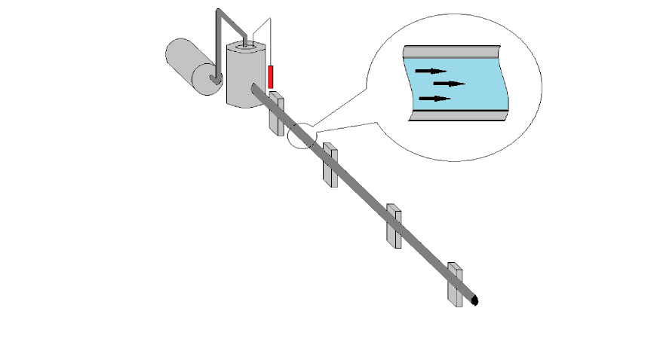
Chilldown of Cryogenic Transfer Line (Example 1)
Experiment conducted in National Bureau of Standard in Boulder, Colorado [ 5 ]
Storage Dewar
Pressurizing Gas
Vacuum Jacket
Transfer Line (Copper)
Length: 200 ft
Inner Diameter: 5/8 in
Station 1
Station 2
Station 3
Station 4
Notes:
This slide shows the schematic of an experiment conducted in National Bureau of Standards in Boulder, Colorado to study the chilldown of long transfer line using liquid hydrogen. A 200 ft long, 5/8 inch diameter, vacuum jacketed copper tube was chilled using liquid hydrogen from a dewar. Temperature of the tube wall was measured at 4 stations.

Slide 33
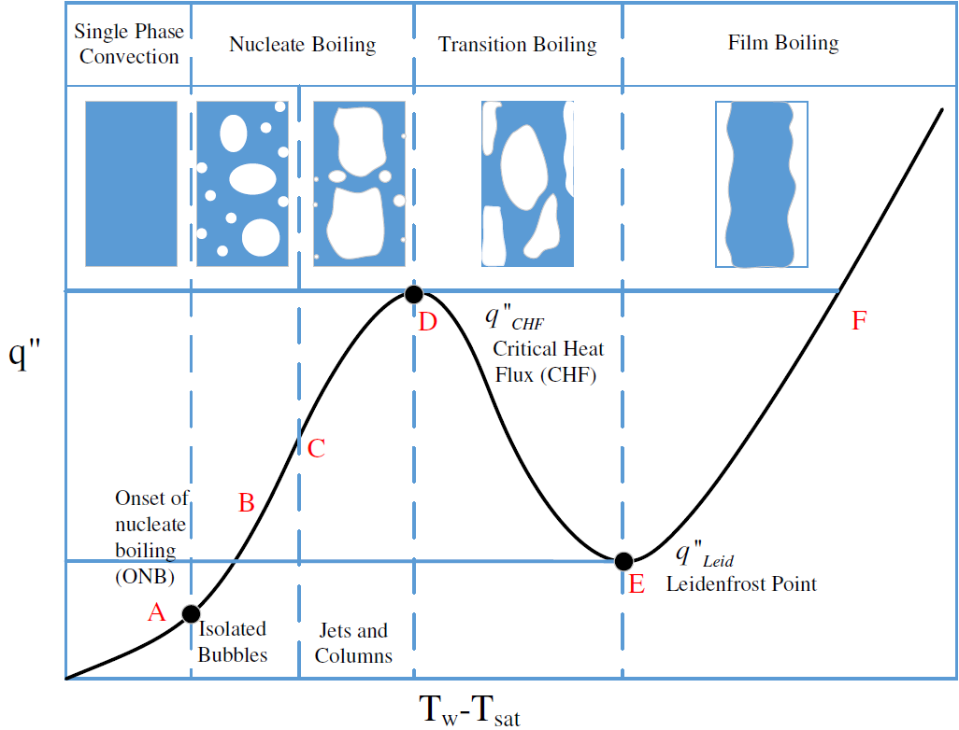
Chilldown of Cryogenic Transfer Line (Example 1)
Boiling Curve
Notes:
The different regimes of a boiling curve are shown in this slide. The variation of heat fluxes with the temperature difference between solid wall and saturation temperature at different regimes of boiling are shown. Chilldown may be considered as a reverse boiling curve as it starts from right hand side of the curve. The chilldown begins with the film boiling because initial temperature difference is very high. A considerable amount of time is spent in this region until it reaches Leidenfrost point labelled as E when it enters into Transition Boiling. Heat Flux decreases until Leidenfrost point and starts increasing in the Transition region. The heat flux increases until it reaches critical heat flux at point D. After reaching critical flux, heat flux diminishes as temperature difference diminishes in the Nucleate Boiling and Single Phase Convection heat transfer regime with the reduction of temperature difference.

Slide 34
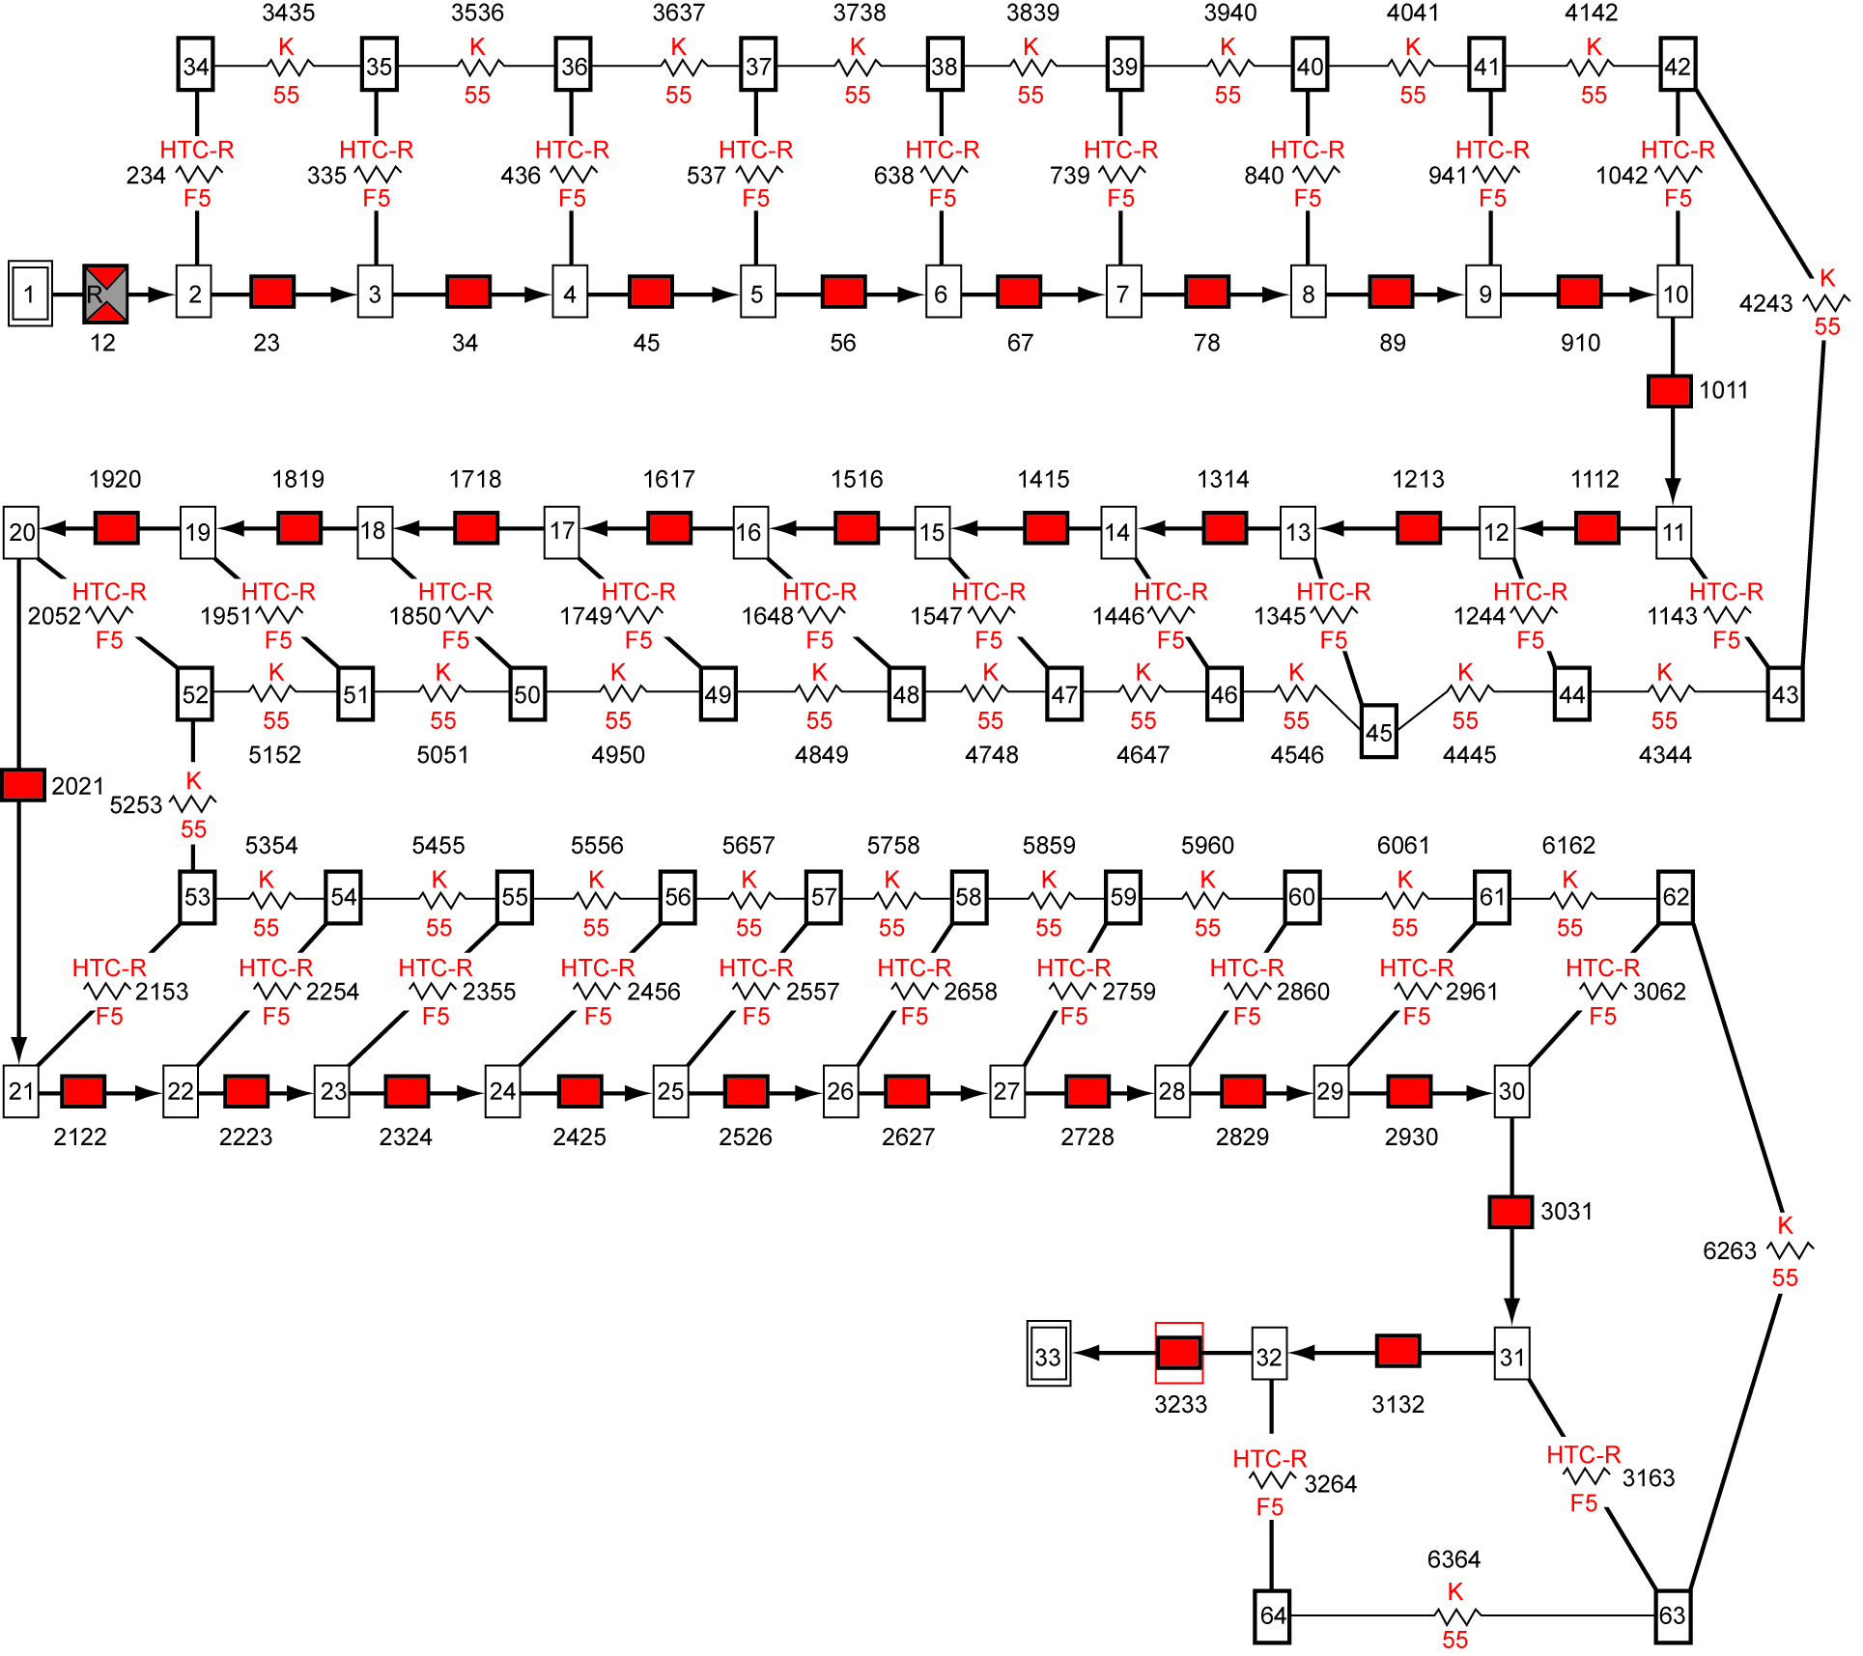
Chilldown of Cryogenic Transfer Line (Example 1)
Solid to Solid Conductor
Solid to Fluid Conductor
Solid Node
Fluid Node
Fluid Branch
Network flow model of the Experimental Setup
Notes:
The numerical model of the test setup is shown in this slide. The 200 ft pipe line has been discretized into 30 pipe segments, each with 80 inches of pipe length. There are 31 fluid nodes, each fluid node is connected with solid nodes. The total mass is distributed to 31 solid nodes. The fluid and solid nodes are connected by solid to fluid conductors. The solid nodes are connected by solid to solid conductors. The boundary nodes 1 and 33 represent the inlet dewar and ambient outlet respectively.

Slide 35
Chilldown of Cryogenic Transfer Line (Example 1)
Heat Transfer Coefficient
Dittus-Boelter Equation for Single Phase
Notes:
For single phase flow the Dittus-Boelter equation has been used to calculate heat transfer co-efficient between solid and fluid. Nusselt number is expressed as a function of Reynolds number and Prandtl number. Reynolds number is calculated at the node from density, upstream velocity, diameter and viscosity and Prandtl number is calculated from specific heat, viscosity and conductivity.

Slide 36
Chilldown of Cryogenic Transfer Line (Example 1)
Modified Miropolski’s Correlation [6] for Two Phase Flow
Notes:
For two phase flows, modified Miropolski’s correlation is used for computing heat transfer coefficient for film boiling to model the chilldown problem considered in this lesson. Since film boiling regime prevails during chilldown process, the heat transfer coefficient for two phase flows used modified Miropolski’s correlation. In this correlation, Nusselt number is expressed as function of Reynolds number, Prandtl number and two phase multiplier, Y. Y is computed from quality and ratio of liquid and vapor density. Reynolds number also accounts for vapor quality and density ratio. For single phase flow, modified Miropolski’s correlation reduces to Dittus Boelter equation.

Slide 37
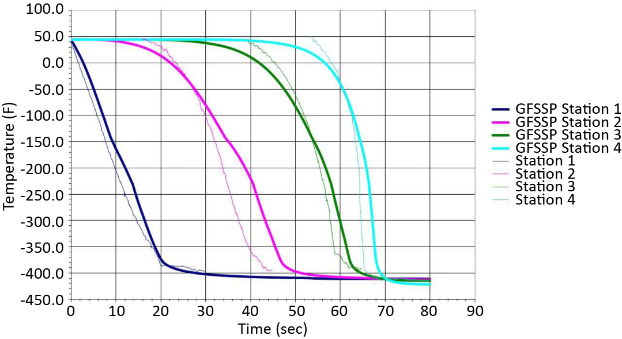
Chilldown of Cryogenic Transfer Line (Example 1)
Comparison between Test & Prediction
TBD
Station 1 – 20 feet from Entrance ; Station 2 – 80 feet from Entrance
Station 3 – 141 feet from Entrance ; Station 2 – 198 feet from Entrance
Notes:
The comparison between predicted and measured temperature at 4 measuring stations are shown in this slide. The predictions and measurements compare reasonably well. In general measurements show more rapid chilldown than predictions. This discrepancy can be attributed to the deficiency of heat transfer correlation that does not account for other boiling regimes such as nucleate and transition.

Slide 38
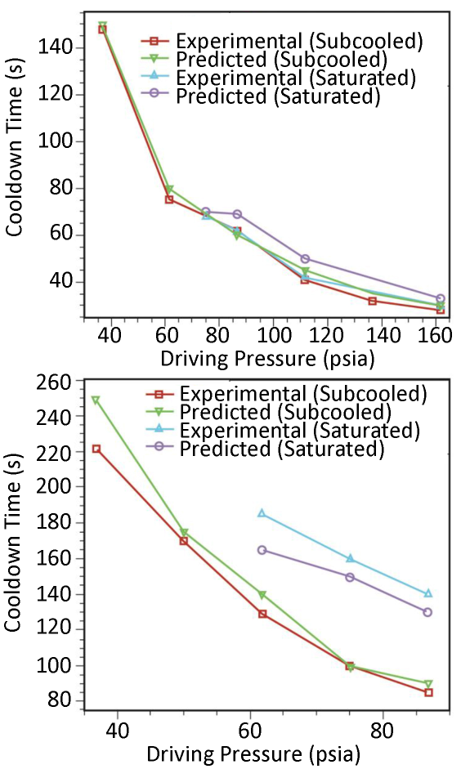
Modeling Transfer Line Chilldown Experiments[7] (Example 1)
Chilldown time decreases with increasing pressure primarily due to higher flowrate at higher pressure
Sub-cooling helps reducing chilldown time
Generally predicted chilldown time is slightly higher than measured data
Discrepancy between prediction and measurements can be attributed to the inaccuracy in Heat Transfer Coefficient Correlation
LH₂
LN₂
Notes:
The comparison of measured and predicted chilldown time of the transfer line at different driving pressures for both liquid hydrogen and nitrogen is shown in this slide. Chilldown time decreases with increasing pressure primarily due to higher flowrate at higher pressure. Sub-cooling helps reduce chilldown time. Generally, predicted chilldown time is slightly higher than measured data.
Discrepancy between the prediction and measurements can be attributed to the inaccuracy in Heat Transfer Coefficient Correlation as discussed in the previous slide.

Slide 39
No Vent Chill and Fill of a Cryogenic Tank (Example 2)
Tank Chilldown in micro-gravity environment is different than ground based tank chilldown
During normal gravity chilldown, a vent on top of the tank is kept open to vent the vapor generated during chill process and maintain a low tank pressure
In micro-gravity environment, due to absence of stratification, such practice may result in dumping large amount of liquid overboard
The intent of no-vent chill & fill method is to minimize the loss of propellant during chilldown of propellant tank in micro-gravity environment
No-vent chill & fill method consists of repeated cyclic process of charge, hold and vent
Notes:
In the second problem of this lesson, we consider no vent chill and fill of a cryogenic tank. Tank filling in space is more challenging than on the ground.
Tank Chilldown in micro-gravity environment is different than ground based tank chilldown. During normal gravity chilldown, a vent on top of the tank is kept open to vent the vapor generated during chill process and maintain a low tank pressure
In micro-gravity environment, due to absence of stratification, such practice may result in dumping large amount of liquid overboard.
The intent of no-vent chill & fill method is to minimize the loss of propellant during chilldown of propellant tank in micro-gravity environment
No-vent chill & fill method consists of repeated cyclic process of charge, hold and vent. Vent valve is closed during charging with liquid propellant.

Slide 40
No Vent Chill and Fill of a Cryogenic Tank (Example 2)
K-site Test Tank(GRC)
The LH2 chilldown test [8]
Tank Material – 2219 Aluminum
Tank Volume = 175 ft³ (87 x 72.5 inch)
Tank Weight = 329.25 lbs
Tank Insulation – 34 layers of MLI
Chilldown Method:
6 Cycles of Charge-Hold-Vent Process
Injection rates were measured
714.35 lbs of LH2 was injected in 2.35 hrs
Tank was filled to 94%
Fluid and wall temperatures measured
Estimated consumption of LH2 = 32 lbs
40
Notes:
An experiment was performed in the K-site Test Tank at GRC to gather test data on no vent chill and fill of a cryogenic tank. An 175 ft³ Aluminum tank weighing 329 lbs was insulated with 34 layers of MLI. The tank was subjected to 6 cycles of charge-hold-vent process. A small amount of LH₂ was injected into the closed tank and turned into vapor, extracting heat from the tank wall. In this process, the tank chills down and becomes pressurized. After a hold process, the tank is allowed to vent to lower the pressure. After the venting, the vent valve is closed and the next cycle of charge-hold-vent process begins. It took 6 cycles to reduce the tank wall to saturation temperature. 714 lbs of LH₂ was loaded in the tank in 2.35 hours and tank was filled to 94%. The fluid and wall temperatures were measured and measured consumption of LH₂ was 32 lbs.

Slide 41
No Vent Chill and Fill of a Cryogenic Tank (Example 2)
Single Node Tank Model
Outlet Boundary
Fixed
Flow
Vent Valve
Tank
Interior
Tank
Wall
Notes:
Using GFSSP, two numerical models were developed. First, a single node tank model was developed. A fixed flowrate branch was used to charge a given amount of propellant to the tank. Tank wall was represented by a solid node. A vent valve was connected to the outlet boundary.

Slide 42

No Vent Chill and Fill of a Cryogenic Tank (Example 2)
Nine Node Tank Model [9]
Notes:
A nine node tank model was also developed to model this experiment. The tank was discretized into nine nodes and eight branches. Each fluid node was connected to a corresponding solid node. The total flowrate was equally distributed into 9 branches with fixed flowrate option.

Slide 43
No Vent Chill and Fill of a Cryogenic Tank (Example 2)
Heat Transfer Coefficient
Notes:
Solid to fluid heat transfer coefficient was calculated from a heat transfer correlation for a natural convection flow over a vertical plate. Nusselt number was expressed as a function of Grashoff and Prandtl number.

Slide 44
No Vent Chill and Fill of a Cryogenic Tank (Example 2)
Pressure and Inlet Flowrates into the Tank
Notes:
Inlet flowrate into the tank and predicted pressure are shown in this slide. There are five short pulses of liquid hydrogen flow into the tank. After each pulse, there is a period of no flow into the tank. During this period, the tank holds the propellant with vent valve closed for the tank to reach thermal equilibrium with cold vapor. Pressure rises almost instantaneously because of liquid turning into vapor with large increase in specific volume. The pressure continues to increase at a lower rate due to heat transfer from wall during this hold period. The hold period is followed by venting causing pressure to drop rapidly. After shutting the vent valve, the next pulse of inlet flow occurs. After five pulses, a constant inlet flow was maintained to fill the tank. Once the continuous filling starts, pressure initially drops due to some condensation of vapor in the tank. Once the tank is getting nearly filled, pressure rises due to the compression of vapor in the ullage space.

Slide 45
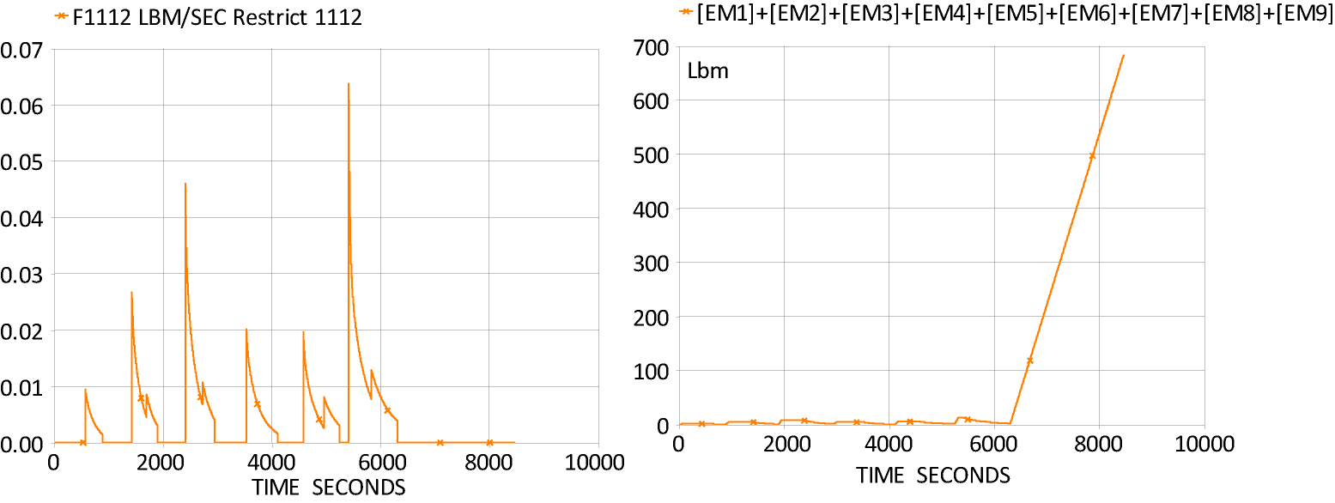
No Vent Chill and Fill of a Cryogenic Tank (Example 2)
Calculated Propellant Loss = 32.5 lbs
Estimated Propellant Loss = 32 lbs
(From Test)
Vent Flowrate
Tank Loading
Notes:
This slide shows the predicted vent flowrate during five cycles of charge-hold-vent. The total amount of propellant vapor vented during this period is 32.5 lbs. This number compares well (within 1.5%) with measured propellant loss during the test. This slide also shows the predicted history of tank loading. Very little mass is accumulated during first six charge-hold-vent cycles. Once the tank wall reaches the saturation temperature, the tank is easily filled with a closed vent valve.

Slide 46
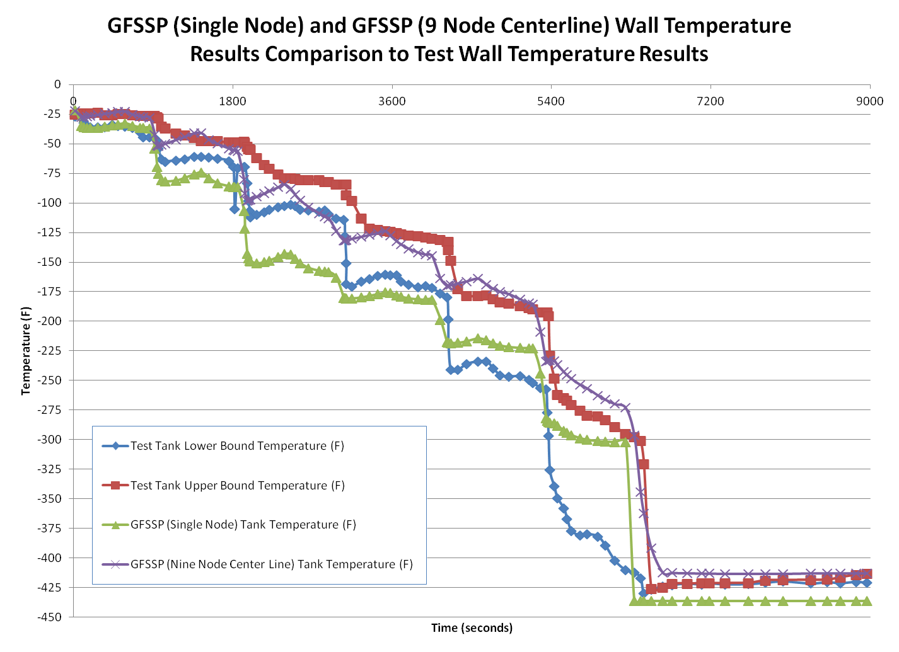
No Vent Chill and Fill of a Cryogenic Tank (Example 2)
46
Notes:
Temperatures were measured during the test. The upper and lower bound of measured temperature history is shown in this slide. GFSSP model results for single and nine node are also shown to compare the predicted and test data. For nine node model, the centerline temperature is plotted.

Slide 47
  Boil-off in a Cryogenic Propellant Tank (Example 3)
Cost of boil-off of propellants in cryogenic storage tanks at launch complex 39 at Kennedy Space Center is in order of $1 M per year
The vacuumed annulus space between inner and outer spheres of the storage tank is filled with insulation
Numerical modeling of boil-off was performed to study the effect of thermal properties for different insulations on boil-off
Notes:
The third example in this lesson is the modeling of boil-off in a Cryogenic Propellant Tank. A study was undertaken in Kennedy Space Center to reduce the boil-off from Liquid Hydrogen Storage Tank at KSC.
Cost of boil-off of propellants in cryogenic storage tanks at launch complex 39 at Kennedy Space Center is in order of $1 M per year. The vacuumed annulus space between inner and outer spheres of the storage tank is filled with insulation. Numerical modeling of boil-off was performed to study the effect of thermal properties for different insulations on boil-off.

Slide 48
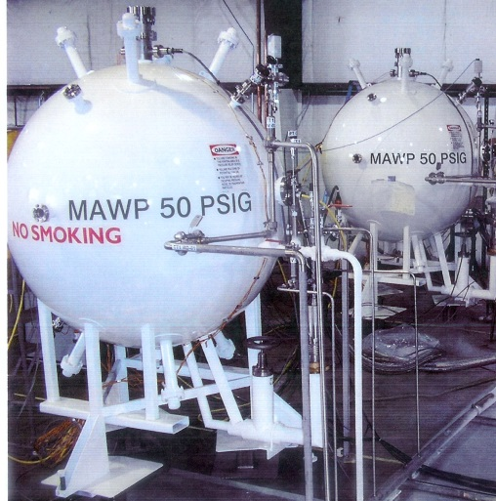
  Boil-off in a Cryogenic Propellant Tank (Example 3)
Two 1000L (35.3 ft³) 1/15 ^{th} scale Demonstration Tanks (inner diameter = 49 inches, outer diameter = 60 inches, wall thickness of 0.1875 inch were built at KSC to study the performance of Perlite and Glass Bubble insulation
Notes:
The intent of this study was to validate the numerical procedure by comparing with test data from a small scale experiment. The validated numerical procedure was then used to model the full scale storage tank to predict the field data and perform parametric study on the performance of different insulation.
Two 1000L (35.3 ft³) 1/15 ^{th} scale Demonstration Tanks (inner diameter = 49 inches, outer diameter = 60 inches, wall thickness of 0.1875 inch were built at KSC to study the performance of Perlite and Glass Bubble insulation

Slide 49
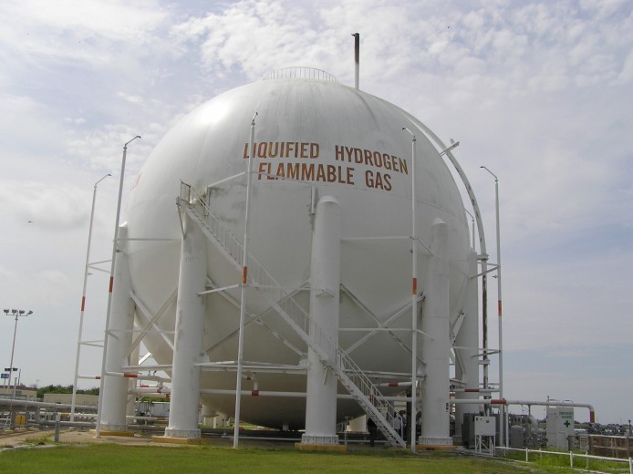
  Boil-off in a Cryogenic Propellant Tank (Example 3)
Liquid Hydrogen Storage Tank at Launch Complex 39, KSC (inner diameter = 61.4 ft, outer diameter = 70 ft, wall thickness = 0.6875 in) has Perlite insulation
Notes:
This slide shows the Liquid Hydrogen Storage Tank at Launch Complex 39 used for space shuttle launch. The inner and outer diameter of the spherical tank is 70 and 61.4 feet respectively. The wall thickness is 0.6875 inch and the annulus space is filled with perlite insulation.

Slide 50
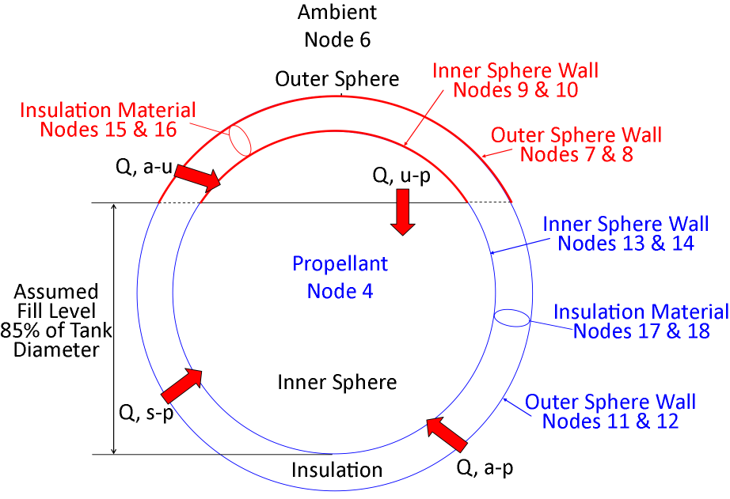
  Boil-off in a Cryogenic Propellant Tank (Example 3)
Cryogenic Propellant receives heat from three different sources
  Heat Leak to propellant through insulating layer
  Heat transfer from ullage (empty space between tank and propellant) to propellant
  Heat leak through support structure
Boil-off rate is calculated assuming all heat transfer contributes to phase change
Notes:
This slide describes the different heat leaks to the propellant. Cryogenic Propellant receives heat from three different sources: 1. Heat Leak to propellant through insulating layer, 2. Heat transfer from ullage to propellant, and 3. Heat leak through support structure. In propellant tank ullage is defined as the empty space between liquid propellant and top wall of the tank. This space is usually filled with propellant vapor.
Boil-off rate is calculated assuming all heat transfer contributes to phase change

Slide 51
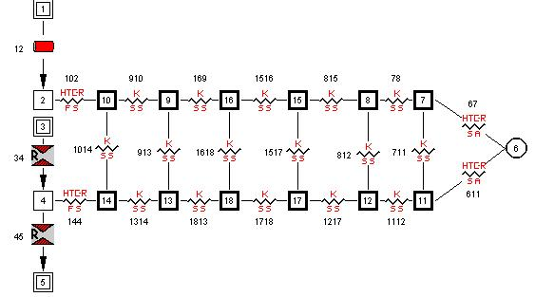
  Boil-off in a Cryogenic Propellant Tank (Example 3)
Metal
Insulation
Metal
Tank Ullage
Liquid Propellant
Demonstration Tank
Pseudo boundary node separates liquid surface and ullage
Unsteady simulation is performed until steady-state solution is reached
The model predicts boil-off rate, temperature distribution in metal, temperature and pressure of propellant and ullage
Notes:
This slide shows the GFSSP model of boil-off in the demonstration tank. Nodes 2 and 4 represent the Tank Ullage and Liquid Propellant in the tank. A pseudo boundary node 3 separates liquid and vapor surface. Both ullage and propellant nodes are connected with solid nodes. There are 6 solid nodes in series connected with both ullage and propellant nodes. The inner tank wall, insulation and outer tank wall are represented by six solid nodes. The boil-off vapor was allowed to vent through branch 12. During the entire simulation branch 46 was closed.
Unsteady simulation was performed until steady-state solution was reached
The model predicts boil-off rate, temperature distribution in metal, temperature and pressure of propellant and ullage.

Slide 52
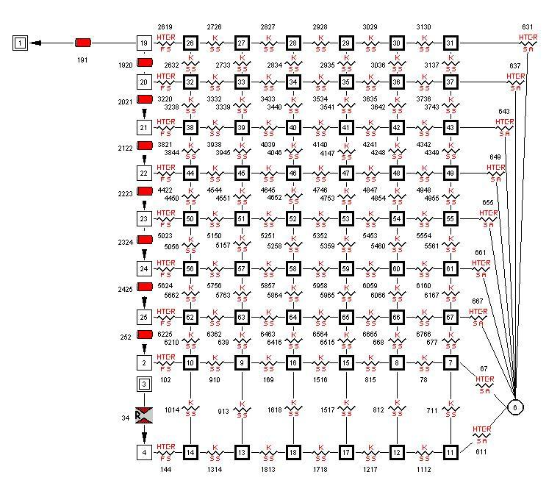
  Boil-off in a Cryogenic Propellant Tank (Example 3)
Metal
Insulation
Metal
Tank Ullage
Ambient
Liquid Propellant
LH2 Storage Tank at KSC
Notes:
GFSSP model of LH2 storage tank at KSC is shown in this slide. The difference between this model and the model of demonstration tank described in the previous slide is the discretization of the ullage space. In this model, the ullage was discretized into eight nodes and seven branches to model the stratification in the ullage. For each ullage node, there are six solid nodes to represent inner wall of metal, insulation and outer layer of metal.

Slide 53
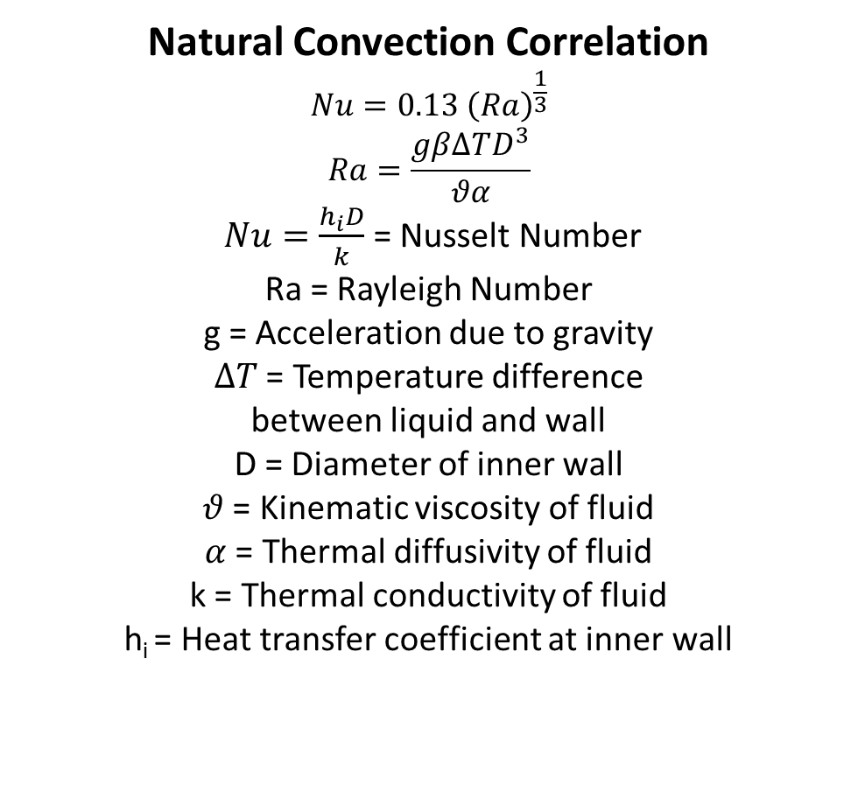
  Boil-off in a Cryogenic Propellant Tank (Example 3)
Natural Convection Correlation
$$Nu=0.13 {\left(Ra\right)}^{\frac{1}{3}}$$
$$Ra=\frac{gβ∆TD^{3}}{θα}$$
$Nu=\frac{h_{i}D}{k}$ = Nusselt Number
Ra = Rayleigh Number
g = Acceleration due to gravity
$∆T$ = Temperature difference
between liquid and wall
D = Diameter of inner wall
$θ$ = Kinematic viscosity of fluid
$α$ = Thermal diffusivity of fluid
k = Thermal conductivity of fluid
h_{i} = Heat transfer coefficient at inner wall
Notes:
The heat transfer from wall to ullage and ullage to liquid was estimated from a natural convection correlation where Nusselt number was expressed as a function of Raleigh number. Raleigh number has been expressed as a function of Acceleration due to gravity, Temperature difference between liquid and wall, Diameter of inner wall, Kinematic viscosity of fluid, Thermal diffusivity of fluid, and Thermal conductivity of fluid

Slide 54
  Boil-off in a Cryogenic Propellant Tank (Example 3)
Insulating Material Physical Properties
 | Perlite | Glass Bubble
Thermal Conductivity (Btu/ft-s-F) | 1.61x10⁻⁷ | 1.12x10⁻⁷
Specific Heat (Btu/lb-F) | 0.2 | 0.19
Density (lbm/in³) | 0.00361 | 0.0045
Notes:
Two types of insulation were considered to investigate the performance to reduce boil-off of cryogenic propellant. In this slide, the physical properties of Perlite and Glass Bubble insulation are compared. Glass Bubbles thermal conductivity is 30% less than perlite but 25% heavier. Glass Bubbles, manufactured by 3M, are hollow glass microspheres with a high strength to density ratio.

Slide 55

  Boil-off in a Cryogenic Propellant Tank (Example 3)
  (Comparison with Test Data)
 |  | Boil-off Rate (ft³)** |  | T_{skin,ullage} (R) |  | T_{skin,propellant} (R)
 |  | Test Data | GFSSP Prediction | Test Data | GFSSP Prediction | Test Data | GFSSP Prediction
Nitrogen | Perlite | 0.1377 | 0.1225 | 163.8 | 145.8 | 138.6 | 136.8
 | Glass Bubble | 0.1141 | 0.0880 | 165.6 | 144 | 138.6 | 138.6
Hydrogen | Perlite | 0.7209 | 0.7409 | 61.2 | 37.8 | 36 | 36
 | Glass Bubble | 0.4731 | 0.4563 | 55.8 | 37.8 | 36 | 36
**at standard atmospheric condition
Notes:
This slide shows the comparison of test data and predictions for both nitrogen and hydrogen using perlite and glass bubble insulation. Both test and predictions show improved performance to reduce boil-off when using glass bubble insulation. The test results show that there is about 17% improvement for Nitrogen whereas GFSSP predicts about 28 % improvement. For hydrogen, test result predicts 33% improvement where as GFSSP predicts 38% improvement. The discrepancy may be due to inaccuracy in thermal conductivity of the materials at cryogenic temperature.

Slide 56
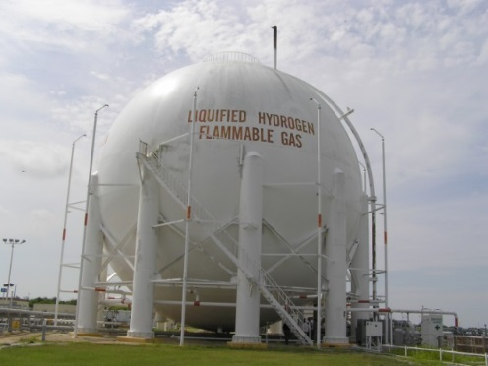
  Boil-off in a Cryogenic Propellant Tank (Example 3)
Comparison with Field Data & Stratification in Ullage
Temperature (R)
Comparison with Field Data
Height from Propellant Surface (in)
Boil-off (Gallons/day)
Field Data
GFSSP Perlite
GFSSP Glass Bubble
300
258
182
Notes:
This slide shows the field data and predicted results of full scale LH2 storage tank at Kennedy Space Center. According to field data about 300 Gallons/day is the amount of boil-off from the tank. However the numerical model predicts 258 Gallons/day. The observed discrepancy may be attributed to the degradation of the insulating material due to compacting or any other reasons. The model also predicts about 30% improvement in performance by using glass bubble insulation. This slide also shows predicted stratification in the ullage. The predicted temperature difference between top and bottom layer is in the order of 180 R.

Slide 57
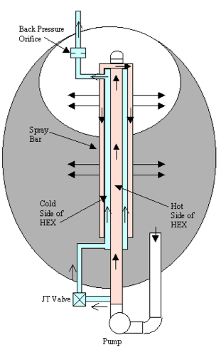
Self-Pressurization of a Cryogenic Propellant Tank Due to Boil-off (Example 4)
Propellant boil-off can be reduced by TVS
Small amount of propellant drawn from Tank is cooled by cold two-phase mixture
Cold two-phase mixture is produced by passing a tiny fraction of liquid through a J-T valve
Cooled liquid is sprayed in the ullage to reduce pressure build-up due to boil-off
The vapor in the cold side of heat exchanger is allowed to escape in the space
Thermodynamic Vent System (TVS) in MHTB (Multi-purpose Hydrogen Test Bed) Tank [11]
57
Notes:
The fourth and last example of this lesson is the modeling of self-pressurization of a cryogenic propellant tank due to heat leak and boil-off. An experiment was performed in the Multi-purpose Hydrogen Test Bed at Marshall Space Flight Center to investigate the performance of the Thermodynamic Vent System to reduce boil-off.
Propellant boil-off can be reduced by TVS. A small amount of propellant drawn from the Tank is cooled by a cold two-phase mixture in a heat exchanger where liquid propellant is passed through an inner tube. Cold two-phase mixture is produced by passing a tiny fraction of liquid through a J-T valve. This cold mixture is allowed to go through annulus surrounding the inner tube where liquid propellant is flowing. Cooled liquid is sprayed in the ullage to reduce pressure build-up due to boil-off. The vapor in the cold side of heat exchanger is allowed to escape in the space. Thermodynamic vent system only operates within a certain pressure band. TVS starts only when pressure reaches a set pressure after self-pressurization due to heat leak and boil-off. In this example, only self-pressurization of the MHTB Tank was modelled.

Slide 58
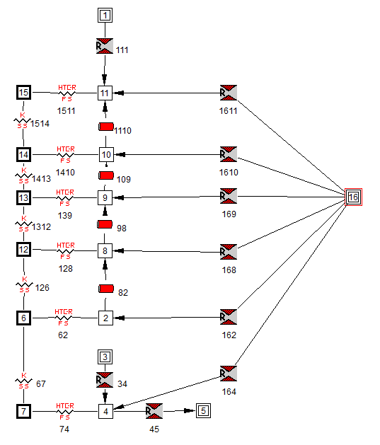
Self-Pressurization of a Cryogenic Propellant (Example 4)
Numerical Model
Notes:
The numerical model of the self-pressurization of MHTB tank is shown in this slide. The tank was self-pressurized at 50% fill level. The ullage space was discretized into 5 nodes and 4 branches. The branches were represented as pipe segments. The length and diameter of the pipe was set up to represent the correct ullage height and volume. Each fluid node was connected with a solid node that represents the tank wall. Each ullage node is also connected with branches to allow the liquid spray when TVS system is in operation. For this model, however, the TVS is not in operation. Node 4 represents the liquid propellant. Node 3 is a pseudo-boundary node that separates liquid-vapor interface.

Slide 59




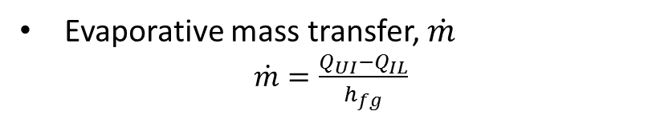

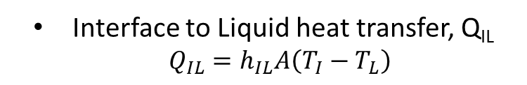

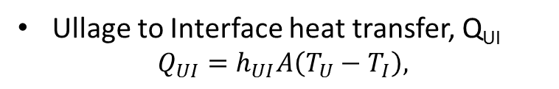
Self-Pressurization of a Cryogenic Propellant (Example 4)
Evaporative Mass Transfer at Liquid-Vapor Interface
$$Q_{UI}$$
Ullage
$\dot{m}$_{v}
$$T_{U}$$
$$T_{I}$$
Liquid
$$T_{L}$$
$$Q_{IL}$$
Ullage to Interface heat transfer, Q_{UI}
$$Q_{UI}=h_{UI}A\left(T_{U}−T_{I}\right),$$
Interface to Liquid heat transfer, Q_{IL} $Q_{IL}=h_{IL}A\left(T_{I}−T_{L}\right)$
Evaporative mass transfer, $\dot{m}$
$\dot{m}=\frac{Q_{UI}−Q_{IL}}{h_{fg}}$
59
59
Notes:
This slide describes the evaporative mass transfer at Liquid-Vapor interface. The evaporative mass transfer is calculated from the heat balance at Liquid-Vapor interface. First Ullage to Interface heat transfer, Q_{UI} is calculated. Then the Interface to Liquid heat transfer, Q_{IL} is calculated. Finally evaporative mass transfer is calculated from the difference between the two heat transfer rates.

Slide 60
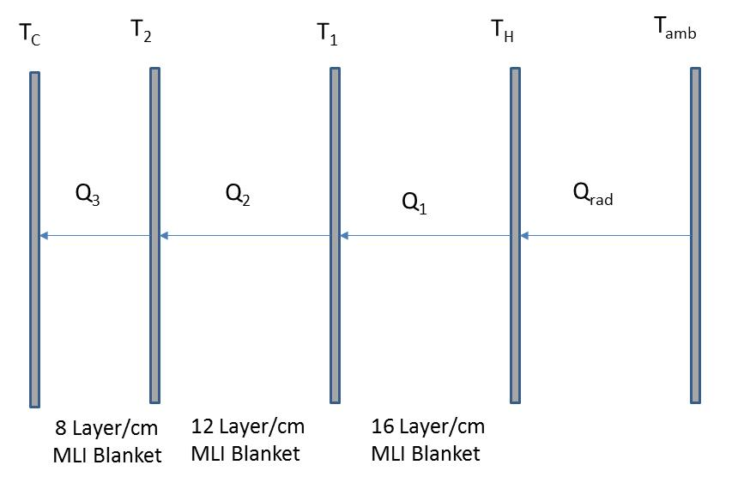
Self-Pressurization of a Cryogenic Propellant (Example 4)
Heat Transfer through MLI
Q_{rad}= Q₁ = Q₂= Q₃,
60
Notes:
The MHTB tank was wrapped with three Multi Layer Insulation (MLI) blankets to reduce the heat leak. The outer blanket is more dense than inner blankets as shown in this slide. T_{C} represents cold wall temperature; the ambient temperature is represented by T_{amb}. The intent of the heat transfer model through MLI is to calculate the temperatures in the intermediate sections (T_{2,} T₁ and T_{H}) and the heat flux between the sections. According to law of energy conservation, the heat flux between the sections must be identical.

Slide 61
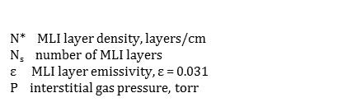
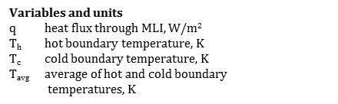
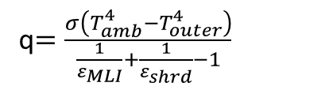
Self-Pressurization of a Cryogenic Propellant (Example 4)
Heat Transfer through MLI
Modified Lockheed Equation [12]
q$=\frac{σ\left(T_{amb}^{4}−T_{outer}^{4}\right)}{\frac{1}{ε_{MLI}}+\frac{1}{ε_{shrd}}−1}$
Radiative Heat Transfer
Notes:
The two governing equations to calculate heat leak to the cryogenic tank are the modified Lockheed equation and the radiative heat transfer equation. The modified Lockheed equation calculates heat flux through a MLI blanket with given hot and cold boundary temperatures. The heat flux is a function of MLI layer density, number of MLI layers, MLI emissivity, interstitial gas pressure and average of hot and cold boundary temperatures. The radiative heat transfer is calculated between the ambient and outer surface of the MLI blanket.

Slide 62
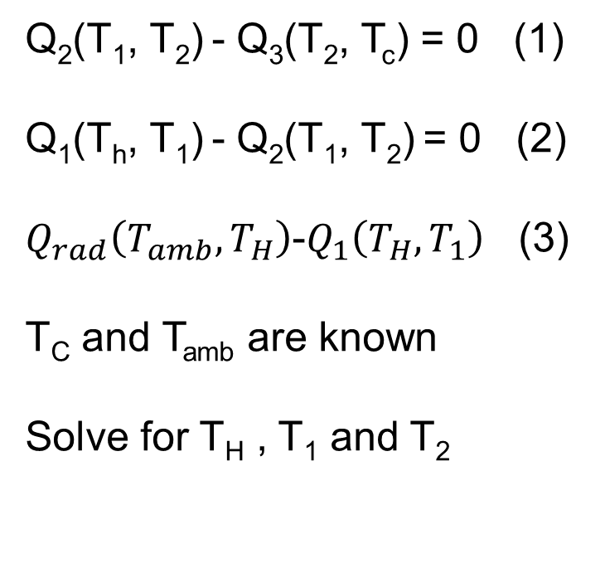
Self-Pressurization of a Cryogenic Propellant (Example 4)
Modeling of MLI Heat Transfer
The law of energy conservation
Q_{rad}= Q₁ = Q₂= Q₃,
Q₂(T₁, T₂) - Q₃(T₂, T_{c}) = 0 (1)
Q₁(T_{h}, T₁) - Q₂(T₁, T₂) = 0 (2)
$Q_{rad}\left(T_{amb},T_{H}\right)$-$Q_{1}\left(T_{H},T_{1}\right)$ (3)
T_{C} and T_{amb} are known
Solve for T_{H} , T₁ and T₂
Notes:
The governing equations to model MLI heat transfer are solved by the Newton-Raphson method. In order to solve a set of equations by Newton-Raphson method, the equations must be expressed as F(x, y, z) = 0. Therefore, the energy conservation equations are expressed in this form. The unknown variables are T_{H} , T₁ and T₂. The governing equations (1, 2 & 3) are solved to find the three unknown variables.

Slide 63
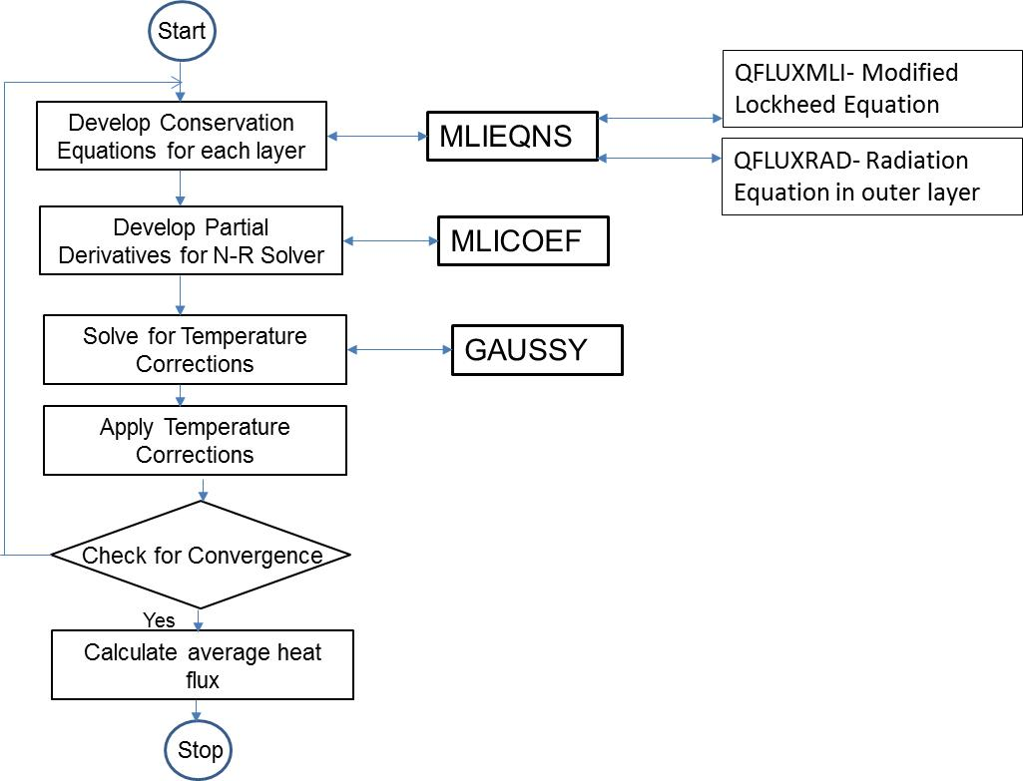
Self-Pressurization of a Cryogenic Propellant (Example 4)
Modeling of MLI Heat Transfer
Notes:
This slide shows the flow diagram of the computer program developed to solve the governing equations described in the previous slide. The three major subroutines are MLIEQNS, MLICOEF and GAUSSY. The conservation equations are developed in MLIEQNS. MLIEQNS calls QFLUXMLI and QFLUXRAD to compute modified Lockheed equation and radiation equation. The partial derivatives for N-R solver are computed in MLICOEF. The correction equations are solved by GAUSSY. The driver routine calls these subroutines and control the iterative process. This set of subroutines is included in GFSSP to model heat transfer through MLI.

Slide 64
Self-Pressurization of a Cryogenic Propellant (Example 4)
Computational Details
The model consists of 6 fluid nodes, 6 solid nodes and 13 fluid branches
The model was developed for 50% fill level of MHTB tank
The separation of liquid and vapor in the tank is modeled through a pseudo boundary node
The model simulates 16.7 hours of self-pressurization in a tank without any venting
A time step of 0.1 second was used that required 598,900 time steps to complete the simulation
Notes:
A few important details of the numerical model are described in this slide.
The model consists of 6 fluid nodes, 6 solid nodes and 13 fluid branches. The model was developed for 50% fill level of MHTB tank. The separation of liquid and vapor in the tank is modeled through a pseudo boundary node. The model simulates 16.7 hours of self-pressurization in a tank without any venting. A time step of 0.1 second was used that required 598,900 time steps to complete the simulation.

Slide 65
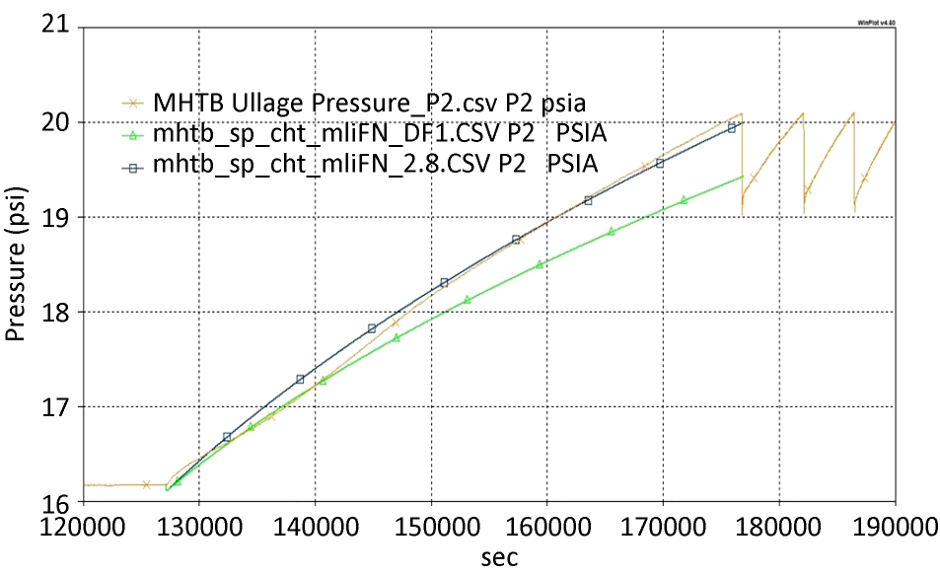
Self-Pressurization of a Cryogenic Propellant (Example 4)
Application Results for MHTB Self Pressurization Model (50 % Fill Level)
MHTB
Test Data
MLI DF=1
MLI DF=2.8
Notes:
The comparison between the test data and numerical prediction is shown in this slide. The orange line represents the test data which includes both self pressurization and pressure cycling due to TVS spray. Numerical predictions are performed only during self pressurization. The numerical predictions are shown for Degradation Factor (DF) of 1 and 2.8. The Degradation Factor is an empirical factor in the modified Lockheed equation. It may be noted that DF = 2.8 provides better comparison with test data.

Slide 66
Summary
This lesson described the basics of the finite volume procedure for a fluid network
Governing equations and solution procedure were described
This numerical procedure has been incorporated into a general purpose flow network code (GFSSP- Generalized Fluid System Simulation Program)
Four example problems were described where finite volume procedure was used to model
Chilldown of a cryogenic transfer line
No vent chill and fill of a cryogenic propellant tank
Boil-off in a cryogenic propellant tank
Self-pressurization of cryogenic propellant tank
Notes:
This lesson has two major parts. In the first part, the basics of the finite volume procedure for a fluid network has been described. We also discussed the governing equations and methods of solving those equations. This numerical procedure has been incorporated into a general purpose flow network code (GFSSP- Generalized Fluid System Simulation Program).
The second part of the lesson describes the application of the finite volume procedure in solving four major problems of Cryogenic Fluid Management:
Chilldown of a cryogenic transfer line
No vent chill and fill of a cryogenic propellant tank
Boil-off in a cryogenic propellant tank
Self-pressurization of cryogenic propellant tank

Slide 67
Need for Future Research
Implementation of full boiling curve that includes film boiling, transition between film boiling and nucleate boiling and nucleate boiling
Development of numerical algorithm to model two phase separated flow that will address the physics of unsettled condition
Development of technique to integrate two or more models for integrated system analysis
Notes:
This slide describes three areas of research to improve the state of the art of numerical modeling of Cryogenic Fluid Management applications.
Implementation of full boiling curve that includes film boiling, transition between film boiling and nucleate boiling and nucleate boiling. This will improve the fidelity of prediction of cryogenic transfer line chilldown
Development of a numerical algorithm to model two phase separated flow that will address the physics of unsettled condition. This will improve the fidelity of tank loading model in micro-gravity condition.
Development of a technique to integrate two or more models for integrated system analysis. This will allow modeling of an integrated system of a cryogenic tank with a thermo-dynamic vent system.

Slide 68
Acknowledgements
This author is grateful to JSC/Steve Rickman, GSFC/Daniel Nguyen, MSFC/John Sharp, GSFC/Xiaoyi Li, LARC/Ruth Amundsen and NESC Passive Thermal Technical Discipline Team (TDT) for their contributions and technical review of this lesson. The author also wishes to thank LaRC/Leanna (Dee) Bullock for her support with Graphics.
Notes:
I would like to acknowledge the listed individuals and NESC Passive Thermal Technical Discipline Team for their contributions and technical review of this lesson. I would also like to thank Dee Bullock for her support with Graphics.

Slide 69
References/Credits
Norman R. Augustine, “Seeking A Human Space Flight Program Worthy of a Great Nation” - Review of US Human Spaceflight Plans Committee, October, 2009: http://www.nasa.gov/pdf/617036main_396093main_HSF_Cmte_FinalReport.pdf
Patankar, S. V., “Numerical Heat Transfer and Fluid Flow”, Hemisphere Publishing Corp., Washington, D. C., 1980
A.K. Majumdar, A.C. LeClair, R. Moore, P.A. Schallhorn, “Generalized Fluid System Simulation Program, Version 6.0”, NASA/TM—2013–217492, October 2013. https://gfssp.msfc.nasa.gov/pdf/NASA_TM_2013_217492.pdf
Hendricks, R. C., Baron, A. K., and Peller, I. C., “GASP - A Computer Code for Calculating the Thermodynamic and Transport Properties for Ten Fluids: Parahydrogen, Helium, Neon, Methane, Nitrogen, Carbon Monoxide, Oxygen, Fluorine, Argon, and Carbon Dioxide”, NASA TN D-7808, February, 1975.
Brennan, J. A., Brentari, E. G., Smith, R. V., and Steward, W. G., “Cooldown of Cryogenic Transfer Lines, An Experimental Report,” National Bureau of Standards Report 9264, November 1966.
Cross, Matthew, Majumdar, Alok, Bennett, John & Malla, Ramesh, “Modeling of Chill Down in Cryogenic Transfer Lines”, Journal of Spacecraft and Rockets, Vol. 39, No. 2, pp 284-289, 2002
Notes:
The publications referred in this lesson are listed in last two slides. This concludes the presentation of Numerical Modeling of Cryogenic Fluid Management.

Slide 70
References/Credits
7) Majumdar, Alok and Ravindran, S.S., “Numerical Modeling of Conjugate Heat Transfer in Fluid Network”, Journal of Propulsion and Power, Volume 27(3), pp.620-630, 2011.
8) David Chato & Rafael Sanabria, “Review and Test of Chilldown Methods for Space-Based Cryogenic Tanks”, NASA Technical Memorandum 104458, AIAA-91-1843.
9) Majumdar, Alok, “No vent tank fill and transfer line chilldown analysis by Generalized Fluid System Simulation Program”, TFAWS 2013, July 29-August 2, 2013, KSC, Florida
10) Majumdar, A.K., Steadman, T.E., Maroney, J.P., Sass, J.P., and Fesmire, J.E., “Numerical Modeling of Propellant Boil-off in a Cryogenic Storage Tank”, Advances in Cryogenic Engineering: Transactions of the Cryogenic Engineering Conference – CEC, Vol. 53, pp. 1507-1514
11) L.J. Hastings R.H. Flachbart, J.J. Martin, A. Hedayat, and M. Fazah, Spray Bar Zero-Gravity Vent System for On-Orbit Liquid Hydrogen Storage, NASA/TM—2003–212926, October 2003.
12) Hastings, L. J., Hedayat, A., and Brown, T. M., Analytical Modeling and Test Correlation of Variable Density Multilayer Insulation for Cryogenic Storage, NASA/MSFC, NASA/TM-2004-213175, May 2004.

