Slide 1

NASA Engineering and Safety Center (NESC) Academy
GN&C Tutorial Lecture
An Introduction to the Fundamentals of
Control-Structure Interaction
Dr. Davin Swanson
Director, Control Analysis Department, The Aerospace Corporation
davin.k.swanson@aero.org
Neil Dennehy
NASA GN&C Technical Fellow
cornelius.j.dennehy@nasa.gov
NESC Academy Webcast
15 March 2017

Slide 2
What is CSI?
“Control-structure interaction” is defined as detrimental closed-loop coupling between structural modes and a feedback control system
  Detrimental can imply poor performance or instability
Separated from open loop response that causes unwanted behavior not coupled to the control system
  E.g., high frequency disturbances well above control bandwidths

Slide 3
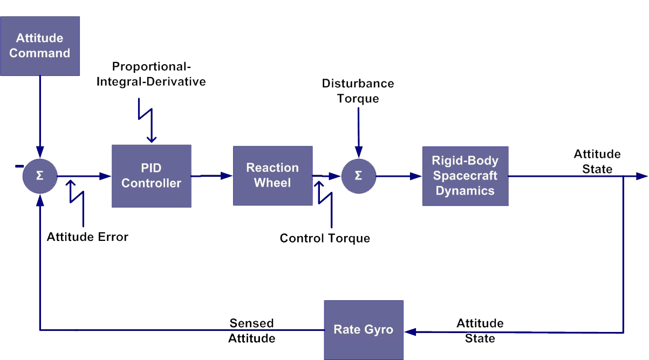
Conceptual example of CSI
Rigid body only analysis
6 dB, 30°

Slide 4
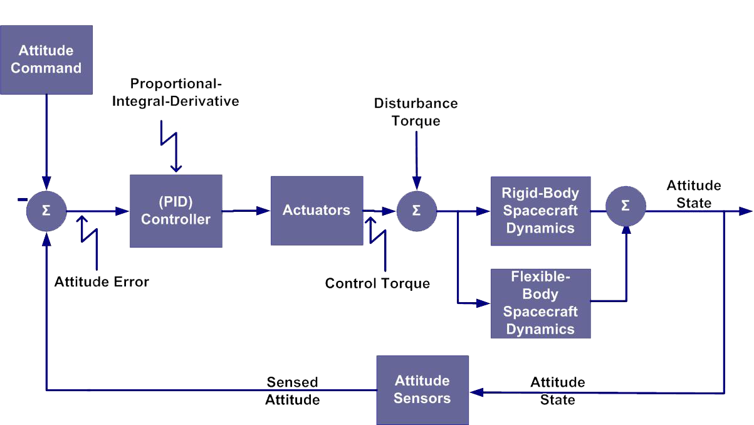
Conceptual example of CSI
Add flex modes – oops!

Slide 5
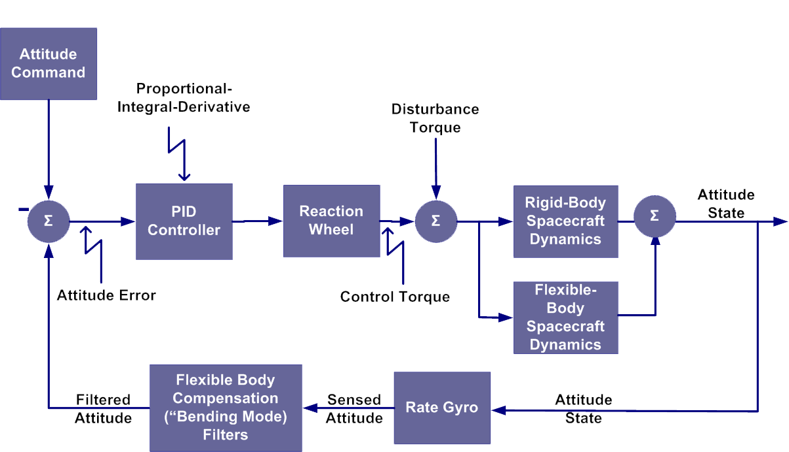
Conceptual example of CSI
Add compensation for flex modes – whew!

Slide 6

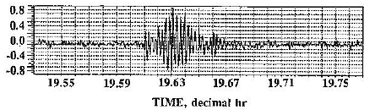

A real example
The Hubble Space Telescope (HST) experienced solar array “flutter”- high amplitude oscillations due to interaction between ACS and solar array modes
This wasn’t a stability issue, but rather a performance issue
  Oscillations were unacceptable for science users

Slide 7
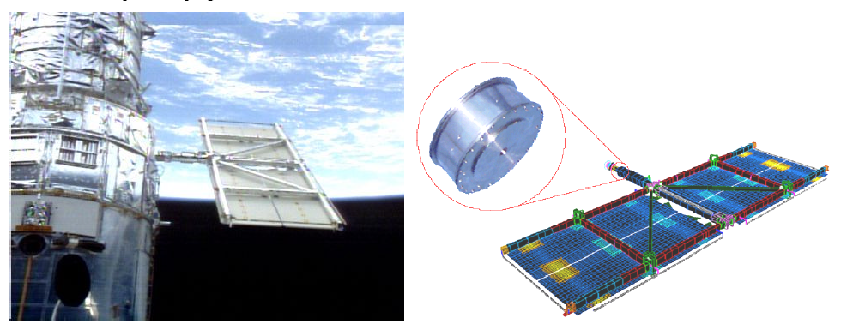
Fixing HST’s flutter problem
A software fix for the flutter problem wasn’t viable, so a hardware fix was sought
Arrays were replaced with a stiffer design, and viscoelastic dampers were added to supporting masts
  Over 3% damping achieved in body/array coupled modes
Luckily, on-orbit servicing was an option!

Slide 8
Importance of assessing CSI in spacecraft design
Modern spacecraft design trends make consideration of CSI in system design critical
  This is not solely an ACS task: involves structures, software, integration and test, payload, propulsion, etc.
Trends that have lead to more structural flexibility lead to need for increasingly robust design assessment of CSI:
  Movement towards lower cost launch options puts focus on reducing vehicle mass
  Increasingly complex deployable payloads
  More capable payloads requiring tighter pointing accuracy/knowledge
  Multiple payloads per vehicle
A system level design process that identifies and resolves potential CSI problems early is critical

Slide 9
What sorts of spacecraft features can drive CSI issues?
Propulsion
  Thruster command profiles
  Fuel slosh
  Valve timing
  Minimum impulse
Solar arrays
  Gimbal motors
  Thermal snap
  Rewind to home position
  Inter-panel hinges
Gimbaled payloads
  Stiction
  Cable wrap torques
Reaction wheels and control moment gyros
  Rotor imbalance
  Bearing noise
  Sub-harmonics
  Zero crossings
Instruments
  Filter wheel motions
  Scan mirror motions
  Cryocoolers
  Spinning mechanism imbalances
  Lidar scanners

Slide 10
CSI as part of the system design process
Assessing CSI should be part of the normal spacecraft control design process
Spacecraft conceptual design can drive a risk-based approach
  Spacecraft configuration and ACS performance requirements can drive level of early assessment
Structural modeling
  Structural design iteration with control design not uncommon, so plan for it
  Level of model detail and maturity have significant impact
Control analysis
  Iterative process that starts with linear design/analysis, nonlinear effect assessment, and time domain performance validation
  Conceptual design and first order analysis should flow modal requirements to structures
Leads to iterative system level design and analysis process
  Early insight avoids late changes
Notes:
Assessing CSI should be part of the normal spacecraft control design process
Spacecraft conceptual design can drive a risk-based approach
Cases where early CSI assessment may be skipped by inspection – highly rigid structure with low performance requirements
Cases where CSI must be checked and given high weight to drive requirements – many flexible appendages, high performance requirements
Is there a metric or figure of merit?
Structural modeling
Structural design and modeling may require iterations with control design
Consider model maturity in control analyses – structural test driven model updates can support tighter margins
Details (cables, bolted interface, deployment/actuation joints, discrete damping) can strongly impact control performance
Control analysis
Iterative process that starts with linear design/analysis, nonlinear effect assessment, and time domain performance validation
Leads to iterative system level design and analysis process
Early insight avoids late changes
A preliminary assessment prior to SRR can get hooks in place to make later changes less painful

Slide 11
Structural modeling
Model complexity driven by vehicle complexity and design phase
  Lumped mass may be appropriate for early assessments, or for full assessment for low bandwidth applications
  Finite element models (FEM) typically required for more complex vehicles or higher performance systems
Model accuracy requirements
  Lumped mass models are relatively straightforward to build and validate if stiffnesses are well understood
  FEMs are more complex (next few slides)
  In all cases, look out for nonlinearities
Combining multiple models
  Models from different vendors may be combined by the integrator for system analysis
  When combining these models, interface modeling is critical
Notes:
Model complexity driven by vehicle complexity and design phase
Lumped mass may be appropriate for early assessments, or for full assessment for low bandwidth applications
Finite element models (FEM) typically required for more complex vehicles or higher performance systems
Additional model complexity requires additional testing/validation and drives need for more performance margin
Stowed models are routinely built for coupled loads (launch) analysis, but deployed models require additional validation steps
These models are often used for jitter analysis (open loop system response to disturbances) as well as for CSI analysis (closed loop)
Model accuracy requirements
Lumped mass models are relatively straightforward to build and validate if stiffnesses are well understood
FEMs are more complex (next few slides)
In all cases, look our for nonlinearities (dead zones and backlash, friction induced limit cycles, etc.)
Combining multiple models
Not uncommon for vehicle and payloads to be built by different vendors, each with their own structural model
When combining these models, interface modeling is critical
Define good sanity checks!

Slide 12
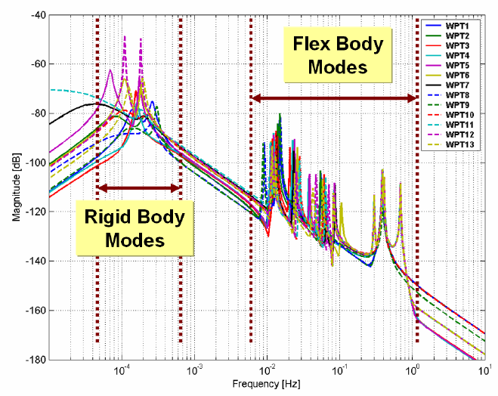
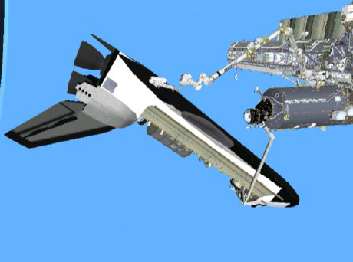
Sample structural modeling plot
ISS and STS Orbiter in Orbiter Repair Maneuver configuration shown below
  Note close proximity of rigid body and flexible modes
Reference: Bedrossian, Jang, Alaniz, Johnson, Sebelius, and Mesfin. “International Space Station US GN&C Attitude Hold Controller Design for Orbiter Repair Maneuver.” 2005 AIAA Guidance, Navigation, and Control Conference, San Francisco, CA.
Notes:
A challenging control design: ideally, a high control gain in the rigid body section and a low control gain in the flex section is desirable!

Slide 13
Structural and mechanism damping
Damping has significant impact on modal peaks and low damping can complicate control design
What types of damping levels are common for structural damping?

Slide 14
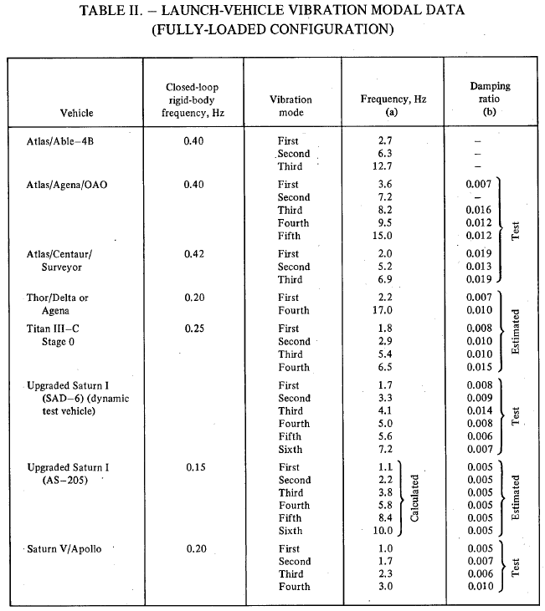
Structural damping levels
Structural damping captures energy dissipation through flexible motion of structural elements
Typically implemented as modal damping applied to entire structural model
  Expressed as a ratio to critical damping level
What ratio to use is the subject of great philosophical discussion
Table at right shows estimate and measured damping ratios for several launch vehicles
Most rules of thumb put damping ratio between ¼ and ½ percent (0.0025-0.005)
Cryogenic systems can have damping ratios below 0.1 percent
NASA SP-8079, Structural Interaction with Control Systems. Nov 1971

Slide 15
Mechanism and discrete damping
Mechanisms and purpose-built damping elements are modeled separately from modal damping
  Typically have damping ratios higher than structural damping
  Not including these elements can lead to overconservative models
Often FEM models are synthesized into a model appropriate for control analysis (e.g., state space or transfer functions)
  Analysis models must have inputs and outputs at physical locations in order to add discrete damping elements
Examples of elements that may introduce additional damping:
Additional damping may be added to the system in order to reduce targeted peaks
  E.g., earlier HST example
  Bearings
  Elastomeric mounts
  Dampers
  Cables
  Hinges and latches

Slide 16
FEM model reduction
Full structural FEM models can have tens or hundreds of thousands of modes
Reduced versions are required to make the control design and analysis process tractable
  Modes that do not contribute to motion of GN&C points of interest can be removed
  Points of interest are locations of sensors, actuators, payload elements, etc.
  Frequency coverage must be balanced with simulation time constraints
Modal significance analysis can be used to determine influence of each mode to each point of interest or set of points of interest (e.g., sensor/actuator pair)
It is common to generate multiple reduced models
  Reduced order model: smaller number of modes, used in design process where many iterations are needed
  Evaluation model: larger number of modes, more accurate compared to full model, used for final performance evaluation

Slide 17
FEM model validation
Each FEM model (full and reduced versions) must be validated as part of the design and verification process
  Dynamic testing should be performed and system response compared to model predictions
  Transfer functions of interests from reduced models and full model should match well
A test model will be generated, which represents the system in the test configuration
  E.g., grounded on air bags vs. free-free or bolted to launch adapter
The test model should be modified to make modal response match test data
  Changes should be based on enhancing fidelity of model in specific areas of the physical system. “Fudge factors” just to match data are not ideal
  Same changes should be made to analysis models and analysis process iterates
Type of testing typically selected based on program risk posture and cost/schedule constraints
  Full vehicle modal testing provides highest fidelity data, but is expensive, time consuming, and comes very late in the program
  Earlier assembly and subassembly testing can be very useful in finding and fixing problems early

Slide 18
Dynamic model uncertainty
Even the most carefully validated structural models will have uncertainty
Model uncertainty must be captured in control analysis process, typically by varying model parameters over a range
  Modal and discrete damping
  Mode amplitudes
  Mode frequencies
Parameter ranges should be carefully selected to ensure robustness, but not overly constrain the design
  10-20% variation on modal frequencies is typical
  2x variation on modal amplitudes is typical (this is sometimes bounded by conservative damping assumptions)
  In some systems with high bandwidths, amplitude variations at higher frequencies are increased
If periodic testing (subassembly, assembly) is performed, uncertainty can be reduced at each step

Slide 19
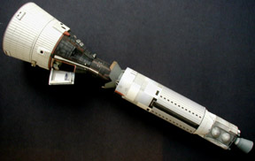
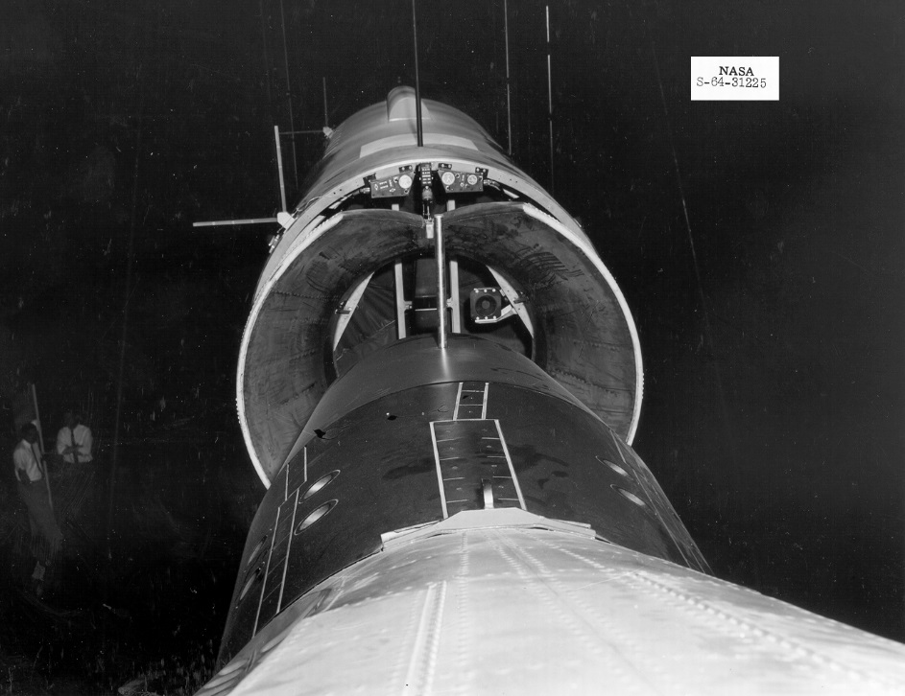
Dynamic model uncertainty - example
Gemini–Agena was used to practice rendezvous and docking and large orbital change maneuvers in preparation for Apollo
  Gemini capsule mated with unmanned Agena booster at docking interface
Initial structural model predicted first bending mode at 5 Hz, control design used notch filter to maintain 6 dB of gain margin
Further analysis predicted mode closer to 3 Hz, lead-lag compensation used to close control design
Ground test: 3.6 Hz measured, 3% damping
On orbit data: 4.0 Hz measured, 4% damping
Lessons:
Dynamic testing and model validation can end up changing frequencies significantly
Control design should be robust and have high margins when using early non-validated models
Carefully assess robustness of designs using notch filters
Notes:
Note that this example used analog components…
Notch filter comments:
Don’t put a notch early in the life cycle, it will likely move
Safe mode controllers

Slide 20
Control analysis techniques
Typical control design and analysis techniques should be used with the flexible models incorporated into the plant model
  Linear analysis – design compensator, verify rigid/flex stability margins
  Nonlinear analysis – describing functions, nonlinear time domain simulations
  Discrete time impacts – model zero-order holds, look for aliased modes
  Include factors for dynamic model uncertainty
The linear analysis / nonlinear time domain analysis are not uncoupled and will likely require iteration
  Stability margins impact time domain response
  Specific behaviors in nonlinear sim may be addressed by loop shaping in linear frequency domain
  Nonlinearities can introduce additional damping not reflected in linear models, which may improve performance and allow for larger linear margins
  Spot check phase and gain margins in time domain sim through gain and time delay adjustments
Notes:
Control design notes
Nonlinear analysis – describing functions to check for limit cycles, nonlinear time domain for performance verification and check for nonlinear instability issues

Slide 21
Linear analysis example
Remember this?
It can be difficult to retain stability margins when stabilizing flex modes
  Margins impact performance
First cut control designs using rigid models should have extra margin

Slide 22






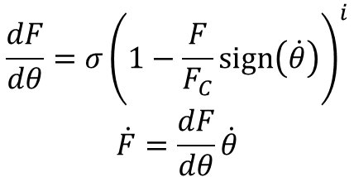


Nonlinear analysis example
We’ve been talking about flex modes, but even rigid body systems can exhibit CSI
Consider a single-axis gimbal with nonlinear Dahl friction:
The nonlinear friction can cause the system to limit cycle
  Can be evaluated in detailed nonlinear time-domain simulation
  Describing functions can be used to predict and design around potential limit cycles
$$+$$
$$+$$
$$τ$$
$$\dot{θ }$$
$$θ$$
$${θ }_{ref}$$
C
1/Js
1/s
$$−$$
$$+$$
$$\frac{dF}{dθ}=σ{\left(1−\frac{F}{F_{C}}\text{sign}\left(\dot{θ}\right)\right)}^{i}$$
$$\dot{F}=\frac{dF}{dθ}\dot{θ}$$
Dahl
Friction (F)

Slide 23
Nonlinear analysis example – describing function
Below example shows describing function analysis that predicts a possible limit cycle in a system with Dahl friction
  Tuning control law to decrease integral gain eliminates the limit cycle
Closed loop disturbance rejection plot and describing function intersect at:
ω = 0.07 Hz, A = 0.005 deg
ω = 0.11 Hz, A = 0.034 deg
Adjusting integral gain eliminates intersections

Slide 24
CSI design and analysis – An iterative process
Process
CSI design and analysis – An iterative process
Iteration Step
Define Finite Element
Modal Requirements
Develop and Validate Finite Element Model
Incorporate Structural Test Data
Perform Modal Significance Analysis using Full Order Model
Generate Reduced-Order Model (ROM)
Generate Evaluation Model (EM)
Flexible Body Linear Control Design and Stability Analysis
Time-Domain Performance Simulations
Modify Control Design
Modify Modal Requirements
Notes:
Define Finite Element Modal Requirements:
Define spacecraft configurations and appendage orientations
Define ACS sensor/actuator locations and degrees of freedom
Define other ACS/System points of interested (payloads? Antennas? Discrete dampers? Physical points?)
Develop and Validate Finite Element Model:
“Free-free” configuration with zero damping
Produce mode shape vectors & model frequencies
Perform Modal Significance Analysis using Full Order Model:
Perform sanity checks
Define actuator/sensor pairs for each ACE mode
Rank significance of each mode for each actuator/sensor pair and for other points of interest
Define reduced order model (ROM) & evaluation model (EM)
Flexible Body Linear Control Design and Stability Analysis
Assess control system stability (SISO and/or MIMO) using ROM
Determine control loop phase and gain stability margins
Design loop compensation to achieve desired stability margins and disturbance rejection
Consider analysis of significant nonlinearities at this point, if known and possible
Time-Domain Performance Simulations:
Incorporate evaluation model into time-domain simulation
Determine performance requirements compliance
Perform stability cross checks against linear frequency domain analysis
Address nonlinear affects and modify control design if needed
Incorporate Structural test data:
Can happen multiple times, if testing is at multiple levels of integration

Slide 25
Design process areas to consider
Identify potential risks for CSI early on and flow requirements to structures and mechanisms groups – strong and complete ICDs should be put in place early
  Requires good “back of the envelope” control assessment early in program
  If difficult to nail down specifics early, TBRs should be used as placeholders for areas of concern
  Identify required bandwidths and discrete sample rates
  The goal is to prevent late hardware changes- expensive and time consuming
Try to maintain plenty of stability margin in early control designs to allow for model updates as test data is incorporated
Put in hooks in the control implementation in flight software for additional filters
  E.g., biquads with coefficients set to unity response
  Changing database is easier than changing FSW if control tweaks are needed
Make smart choices about placement of sensors and actuators
  Colocate them if possible or ensure structure between them is stiff
Pay close attention to modeling of joints and interfaces in structural models
An inherently cross-discipline process: cooperation and coordination are key for mission success

Slide 26
Design process areas to consider
How should a control designer deal with flexible modes?
Gain stabilization is preferable to phase stabilization
  Gain stabilization is more robust but generally requires more separation between control bandwidth and flexible modes
  Where phase stabilization is necessary (e.g., very low structural modes or high performance systems), analysis of modal frequency variations and understanding of system time delays is critical
  Be careful when considering notch filters for gain stabilization – slight changes in modal frequency can wreak havoc
There is no universally accepted standard for stability margin requirements
  Many organizations have their own internal standards (e.g., Goddard Gold Rule, next chart)
  Programs should clearly state margin requirements for rigid body and flex modes in specification documents
  Good practice to hold additional margin early in program when models are immature
  As a rule of thumb, gain stabilization of flex modes should be mandated
    Phase stabilization should require a waiver or, at a minimum, extensive supporting analysis
Notes:
gain stabilization is more robust – inertias are usually well known, plus margin in structural model means gain stab. is typically good.
Time delay uncertainty or slight frequency shifts in modes can make phase stab go wonky

Slide 27
GSFC Gold Rule for controller stability margins

Slide 28
Summary
This introduction to Control-Structure Interaction is intended to provide insight and context into this important part of the design process
Design and assessment of CSI is inherently a cross-discipline task
  Controls, structures, flight software, avionics, and many more…
  Strong communication and coordination are key
Early upfront work in the mission formulation and concept design phases pays off
Industry trends (weight savings, vehicle complexity, etc.) strengthen the case for a robust CSI assessment process
This is a complex sub-discipline- check out references for more info

Slide 29
References
“GN&C Engineering Best Practices For Human-Rated Spacecraft Systems.” NASA/TM-2008-215106, January 2008.
“NASA Space Vehicle Design Criteria (GNC), Effects of Structural Flexibility on Spacecraft Control Systems.” NASA SP-8016, April 1969.
“NASA Space Vehicle Design Criteria (GNC), Effects of Structural Flexibility on Launch Vehicle Control Systems.” NASA SP-8036, February 1970.
“NASA Space Vehicle Design Criteria (Structures), Structural Interaction with Control Systems.” NASA SP-8036, February 1970.
Bedrossian, Jang, Alaniz, Johnson, Sebelius, and Mesfin. “International Space Station US GN&C Attitude Hold Controller Design for Orbiter Repair Maneuver.” 2005 AIAA Guidance, Navigation, and Control Conference, San Francisco, CA.
Wie, “Space Vehicle Dynamics and Control.” Chapter 9, Attitude and Structural Control.
Wie and Byun, “New Generalized Structural Filtering Concept for Active Vibration Control Synthesis,” Journal of Guidance, Control, and Dynamics, March-April 1989, pp 147 – 154
“NASA Goddard Space Flight Center Rules for the Design, Development, Verification, and Operation of Flight Systems.” (Gold Rules) GSFC-STD-1000F.
Stockwell, “A Verification Procedure for MSC/NASTRAN Finite Element Models.” NASA Contractor Report 4675, NASA Langley Research Center.
Spanos, “Control Structure Interation in Precision Pointing Servo Loops.” Journal of Guidance, Control, and Dynamics, Vol 12, No. 2, 989.

