Slide 1
Systems engineering processes in NASA and commercial projects
Paul Componation
Kathryne Schomberg
Susan Ferreira
Jordan Hansen

Slide 2
Systems Engineering and Project Success Studies in this Research Stream
Study | Focus
2007 | 12 NASA MSFC Flight Hardware Projects SE Processes map to technical, budget, schedule and overall success SE processes appear to impact budget and schedule more than technical success
2013 | 130 commercially run projects studies Commercial government-focused and commercial commercial-focused were studied. Notable differences between the two populations with SE processes more important in commercial-government focused projects.
2014 | 50 NASA projects studied Evaluate government-focused, commercial-focused, and NASA-focused projects.
2016 | 180 projects from the 2013 and 2014 studies. Quantify the perceived impact of individual SE processes on individual project success metrics.

Slide 3
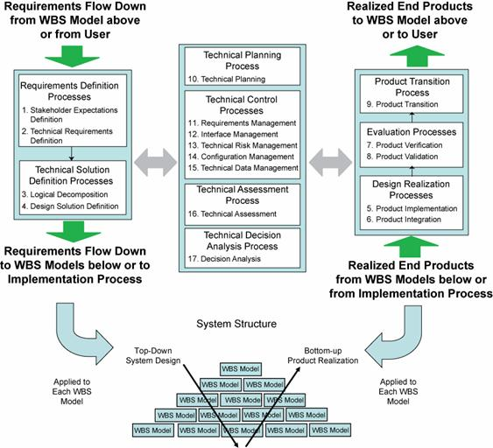
The NASA Systems Engineering Engine

Slide 4
Data Analysis
Participants
Commercially Run
Commercial-Focused Projects
Commercially Run
Government-Focused Projects
NASA Run
NASA-Focused Projects
Project
Description
Project
Success
Metrics
Systems
Engineering
Processes

Slide 5
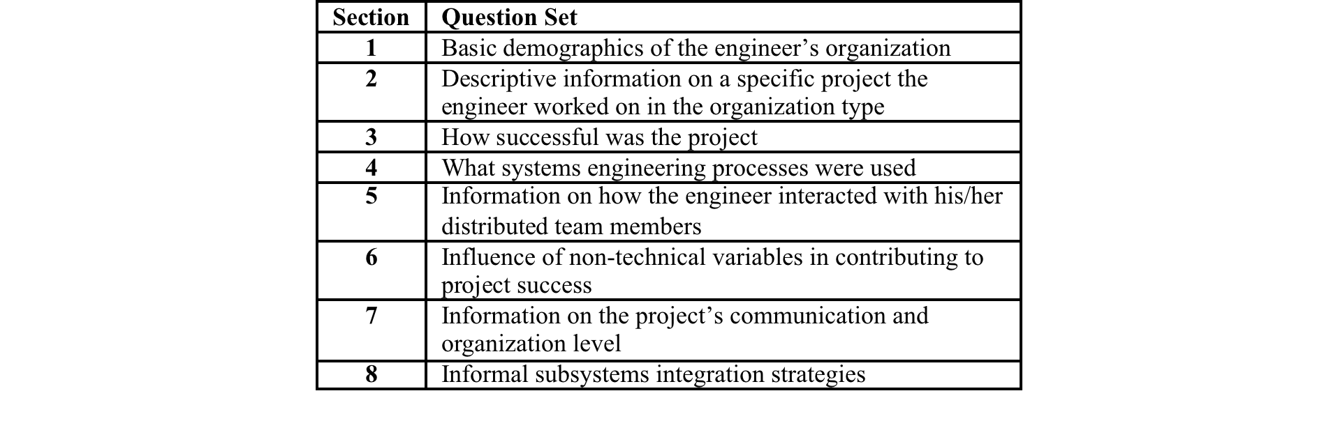
Modified Data Collection Instrument
Survey comprised of 82 questions. / 50 relevant to this study.
Commercial and NASA SME teams – 8 team members each
Beta Test – 25 engineers with a paper copy
  No significant errors so this group was included in the full data set
Data collection – 129 engineers from commercial organizations with paper and on-line surveys
  46 government-focused
  83 commercial-focused
Data collection - 51 engineers from NASA with an on-line survey

Slide 6
Sample Questions from the Survey
8. This project had significant technical risk.
- Strongly Agree
- Agree
- Neither Agree nor Disagree
- Disagree
- Strongly Disagree
- Not Applicable
15. This project was a success when compared to the original technical requirements.
- Strongly Agree
- Agree
- Neither Agree nor Disagree
- Disagree
- Strongly Disagree
- Not Applicable
28. This project translated the requirements into a design solution.
- Strongly Agree
- Agree
- Neither Agree nor Disagree
- Disagree
- Strongly Disagree
- Not Applicable
38. This project identified, controlled, and preserved (recorded) the system configuration.
- Strongly Agree
- Agree
- Neither Agree nor Disagree
- Disagree
- Strongly Disagree
- Not Applicable

Slide 7
Analysis Plan
1. Analysis of Organizational Differences
  1.1 Differences between the organization types (commercial-focused, government-focused, NASA-focused)?
  1.2 Difference between the project description variables (relevant scope of work, schedule risk, budgetary risk, technical risk)?
  1.3 Interaction between organizational types and the project description variables?
2. Analysis of Project Success Metrics
  2.1 Difference between the organization types (commercial-focused, government-focuses, NASA-focused)?
  2.2 Difference between project success metrics (technical success x2, schedule success x2, budget success x2, management, overall success x2)?
  2.3 Interaction between organizational type and project success metrics?
3. Analysis of Systems Engineering Processes
  3.1 Difference between the organization types (commercial-focused, government-focuses, NASA-focused)?
  3.2 Difference between systems engineering processes (17 processes)?
  3.3 Interactions between organization type and systems engineering processes?

Slide 8
1. Analysis of Organizational Differences
1.1 There are significant differences between organizational types
1.2 There are significant differences between project description variables
1.3 There is no interaction between organizational types and the project description variables

Slide 9
2. Analysis of Project Success Metrics
2.1 There are significant differences between organizational types
1.2 There are significant differences between project success metrics

Slide 10
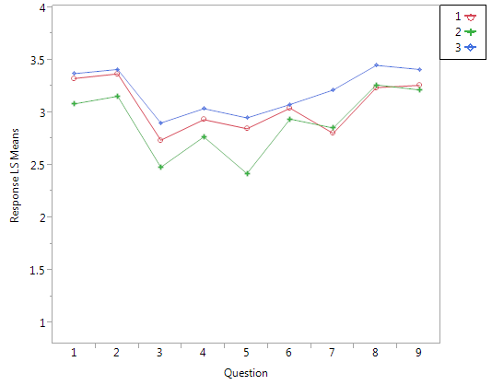
2. Analysis of Project Success Metrics – cont.
2.3 There is an interaction between organizational types and project success metrics
1 = Commercial-government
2 = Commercial-commercial
3 = NASA
Success Metrics:
Technical relative to initial requirements
Technical relative to similar projects
Schedule relative to original plan
Schedule relative to similar projects
Budget relative to original plan
Budget relative to similar projects
Satisfaction with project management
Overall project success (organization)
Overall project success (stakeholder)

Slide 11
3. Analysis of Systems Engineering Processes
3.1 There are significant differences between organizational types

Slide 12
3. Analysis of Systems Engineering Processes – cont.
3.2 There are significant differences between systems engineering processes

Slide 13
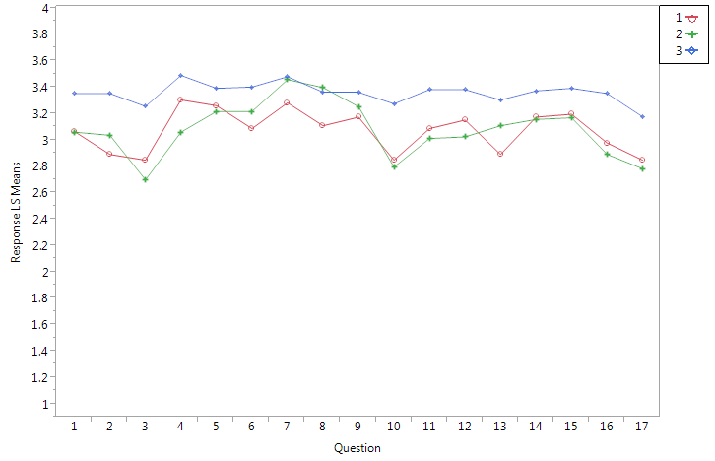
3. Analysis of Systems Engineering Processes – cont.
3.3 There is an interaction between organizational types and the system engineering processes
1 = Commercial-government
2 = Commercial-commercial
3 = NASA
Systems Engineering Processes:
Stakeholder expectations definition
Technical requirements definition
Logical decomposition
Design solution
Product implementation
Product integration
Product verification
Product validation
Product transition
Technical planning
Requirements management
Interface management
Technical risk management
Configuration management
Technical data management
Technical assessment
Decision analysis

Slide 14
Conclusions
1. Analysis of Organizational Differences
  1.1 Differences between the organization types (commercial-focused project, government-focuses, NASA-focused)?
  1.2 Difference between the project description variables (relevant scope of work, schedule risk, budgetary risk, technical risk)?
  1.3 Interaction between organizational types and the project description variables?
2. Analysis of Project Success Metrics
  2.1 Difference between the organization types (commercial-focused, government-focuses project, NASA-focused)?
  2.2 Difference between project success metrics (technical success x2, schedule success x2, budget success x2, management, overall success x2)?
  2.3 Interaction between organizational type and project success metrics?
3. Analysis of Systems Engineering Processes
  3.1 Difference between the organization types (commercial-focused, government-focuses, NASA-focused)?
  3.2 Difference between systems engineering processes (17 processes)?
  3.3 Interactions between organization type and systems engineering processes?

Slide 15
Threats to Validity
Focus on NASA Systems Engineering model was a perceived threat, but reviews by SME teams and the alpha test group did not find this an issue.
The use of parametric statistics is a concern by some researchers although these approaches have been shown to be relatively robust.
To compare these results with other studies we need to assess the relative impact of each systems engineering process against each project performance metric.

Slide 16
Next Steps
The first is to explore the use of other statistical analysis tools that may better fit the survey data. The use of parametric statistics to analysis categorical survey data is open to debate even though it is a common practice.
identifying the magnitude of the specific relationships between the project performance metrics and the systems engineering processes.
More data

