Slide 1
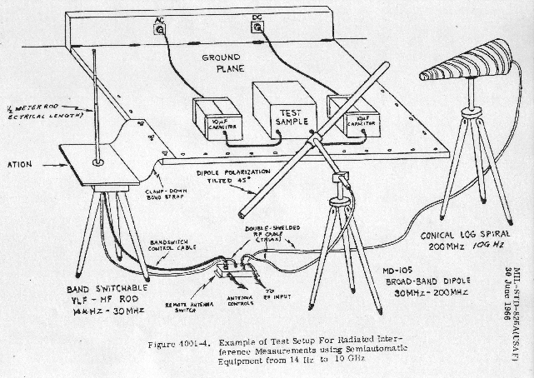
Antenna Fundamentals,
With a Strong Emphasis on EMI Testing Issues
EMC Compliance,
Huntsville, AL

Slide 2

Ken Javor
30+ YEARS IN EMI/EMC
Consultant to Government and Industry
Industry representative to MIL-STD-461 and MIL-STD-464 Tri-Service Working Groups…
ken.javor@emccompliance.com
(256) 650-5261

Slide 3
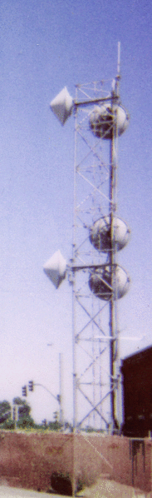
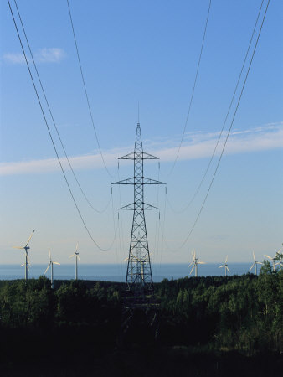
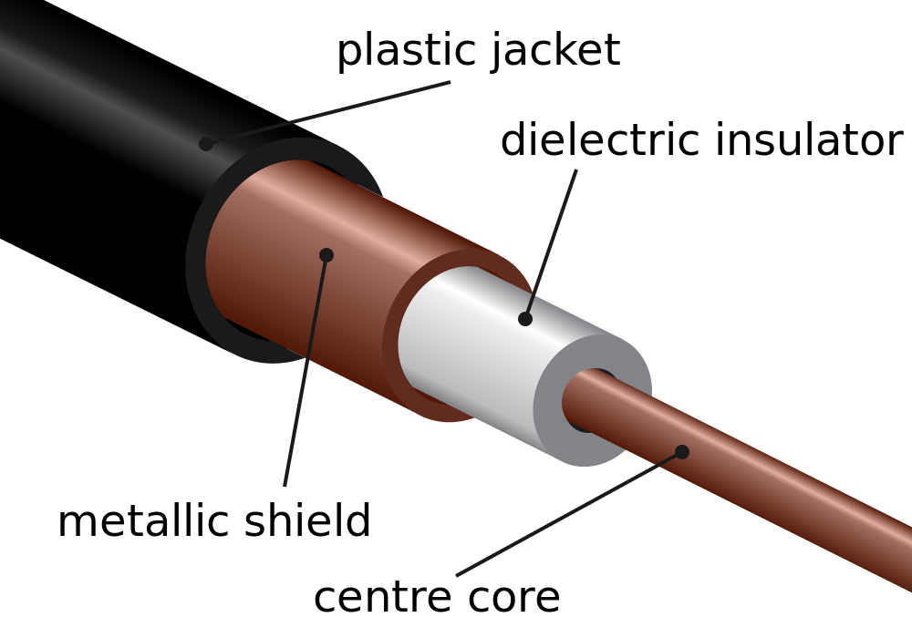
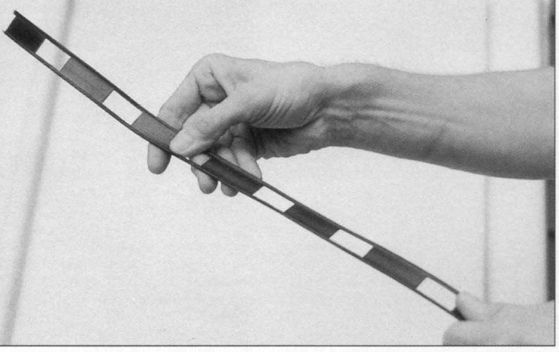

How electrical energy moves depends on purpose and distance
Electrical power at 50/60 Hz is routed on wires
Electrical communication at radio frequencies is routed on controlled impedance transmission lines…
or through space
Electrical communication at voice frequency is routed on wires

Slide 4

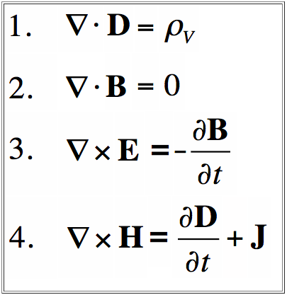
The Basics
Gauss’ / Coulomb’s Law
no magnetic monopoles
Faraday’s Law
Ampere’s Law

Slide 5
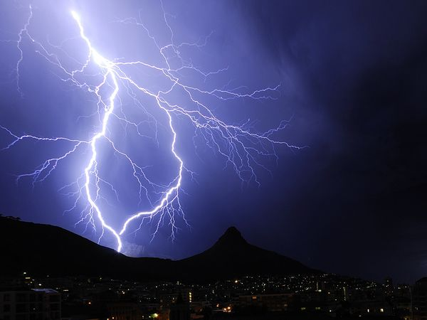

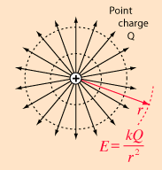

The Basics
Gauss’ / Coulomb’s Law
The electric field of a point charge, a group of charges; the similarity (inverse square law action-at-distance) of electric and Newtonian gravitational fields

Slide 6

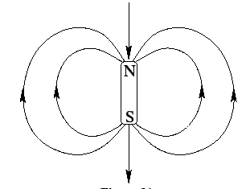
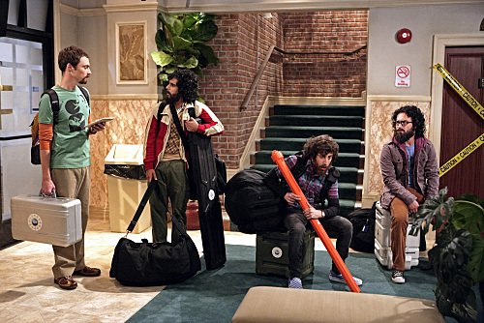
The Basics
Gauss’ Law for Magnetism
No magnetic dipoles
The Electric Can Opener Fluctuation
EMC Compliance,
Huntsville, AL

Slide 7
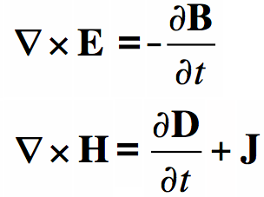


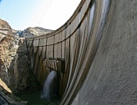
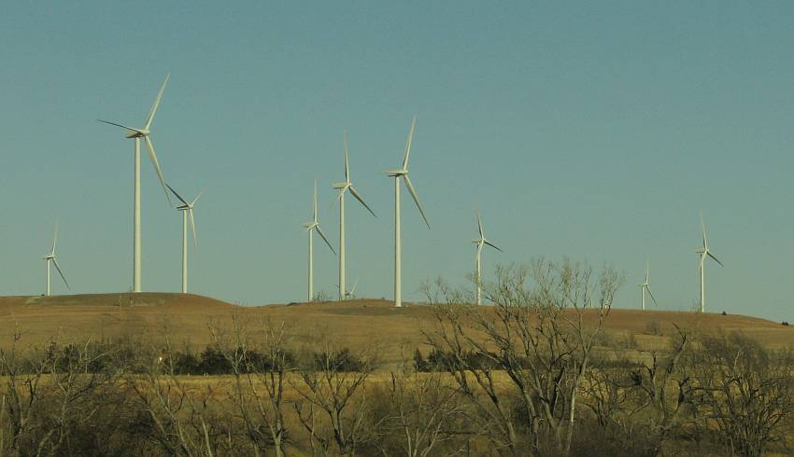
The Basics
Faraday’s Law: a time changing magnetic field causes an electric field
EMC Compliance,
Huntsville, AL

Slide 8
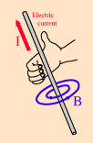
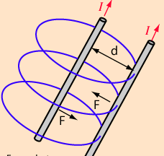
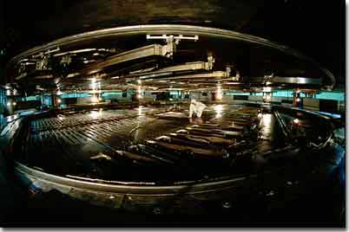
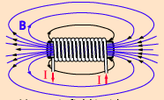
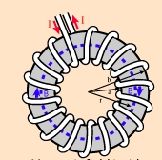
The Basics
Ampere’s Law: a time changing electric field causes a magnetic field
cyclotron
EMC Compliance,
Huntsville, AL

Slide 9
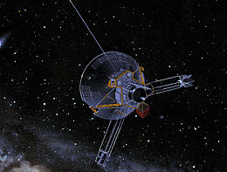
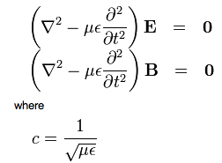
The Basics
Faraday’s Law: a time changing magnetic field causes an electric field
Ampere’s Law: a time changing electric field causes a magnetic field
Equations for wave: traveling electromagnetic energy
c = 1/√με

Slide 10
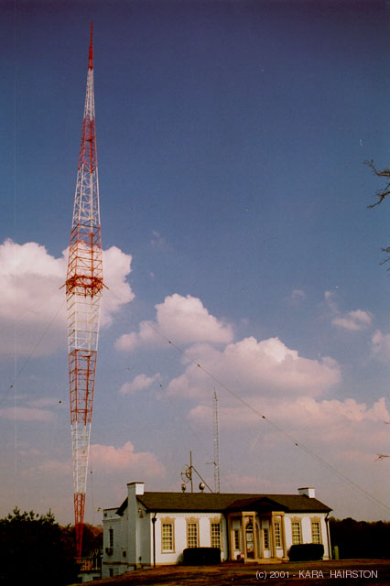
Equations for wave: traveling electromagnetic energy
WSM - AM 650
50,000 Watts
Nashville, TN
Important points:
Only changing fields (hence currents and potentials) can cause radiation
Both electric and magnetic fields (and thus both circuit potentials and currents) must be present to cause radiation
EMC Compliance,
Huntsville, AL

Slide 11
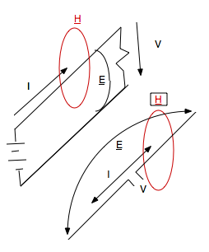
The Basics
Important point:
Only changing fields (hence currents and potentials) can cause radiation
S = E x H
Huntsville, AL

Slide 12
DEMO
41” Rod “Antenna” Picking up E-field
S = E x Hl, AL
The induction field
In the frequency range 0.15 to 20 mc, radiating elements, pick-up antennas and distances, generally used for radiated radio interference measurements, are small compared to wavelength. The amount of energy transferred from field to antenna depends on the nature of the signal source and the type of receiving antenna used. For instance, if the radiating interference source is a single, small closed loop of wire, a great deal of current can flow without developing much voltage across the loop. Consequently, a large magnetic component is developed in the induction field in conjunction with a comparatively small electric component. To extract a large amount of energy from such a field, a similar loop antenna, correctly matched to a receiver, should be used as the pick-up device to provide what may be compared to a good impedance match in ordinary circuit theory. If a short rod antenna, sensitive to the electric component of the field, were used as the pick-up device very little energy transfer would result and a situation comparable to a condition of impedance mismatch would exist. When a short rod antenna is the signal source, a large voltage can be developed on the rod, but with very little current flow. Consequently, the field developed is composed of a large electric component and a small magnetic component. In this case, another rod used as a pick-up device would indicate the presence of an intense field, whereas, a loop antenna would give very little indication. Typical radio interference sources in aircraft include the extreme cases described and all other variations. In general, the ratio of the electric to the magnetic components surrounding an unshielded lead will vary directly as the impedance of the load terminating the lead, and the apparent impedance presented to the various pick-up antennas will vary in the same manner. This statement applies to radial and tangential field components as contrasted with the more usual concept of wave impedance encountered in shielding theory, which applies only to the components tangential to the line of propagation.
REPORT NO. NADC-EL-5515
10 AUG 1955
FINAL REPORT, EVALUATION OF RADIO INTERFERENCE PICK-UP DEVICES AND EXPLANATION OF THE METHODS AND LIMITS OF SPECIFICATION NO. MIL-I-6181B

Slide 13
The Basics
Important point:
Both time-changing electric and magnetic fields (and thus both circuit potentials and currents) must be present to cause radiation.
EMC Compliance,
Huntsville, AL
Totally ignoring electrodynamics, it has to be this way, because transmitted energy represents lost power, therefore it requires power dissipation in a circuit (both potential and current) to generate the lost power. A potential or a current alone cannot cause radiation.

Slide 14
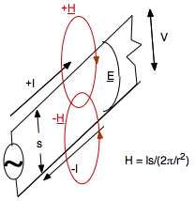
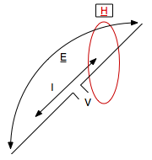
The Basics
S = E x H
EMC Compliance,
Huntsville, AL
E ~ 1/r
If dipole length long – retarded potentials

Slide 15




Wave impedance: Free Space vs. Guided Waves
The following equations describe the fields interior to an (air dielectric) coaxial transmission line:
Equation 1
which are both quasi-static equations easily derived from Gauss’ Law and Ampere’s Law, respectively, for the cross-section of a coaxial transmission line.
Electric field is divided by the magnetic field, in order to determine the field impedance:
Equation 2
Since V/I is determined by the load on the line, it can be designated ZL. If ZL is picked to match the transmission line characteristic impedance, ZC, then equation 2 becomes

Slide 16
Wave impedance: Free Space vs. Guided Waves
Therefore, it appears that a coaxial transmission line, terminated in its characteristic impedance, develops an internal 377 Ω field.
It is interesting to notice the explicit field impedance dependence on the ratio of voltage to current in equation 2. This simply states that for any load impedance, the field impedance is directly proportional to the load impedance.
For the special case of a matched coaxial transmission line the constant of proportionality (a function of geometry) is such as to yield a 377 Ω field impedance.
This works for any matched transmission line, regardless of geometry.
Thus, an antenna is a matching network between a guided and unguided wave with free space impedance, whether in free space, or not.

Slide 17
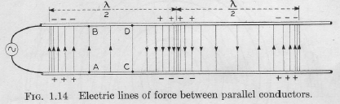
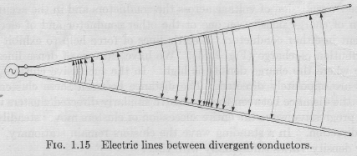
Wave impedance: Free Space vs. Guided Waves
Reproduced from Schelkunoff & Friis, 1952.

Slide 18
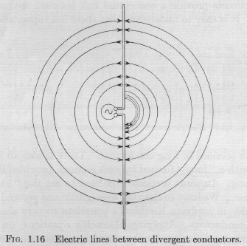
Wave impedance: Free Space vs. Guided Waves
Reproduced from Schelkunoff & Friis, 1952.

Slide 19
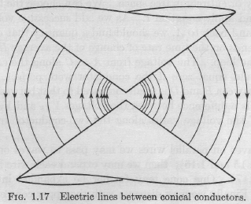
Wave impedance: Free Space vs. Guided Waves
Reproduced from Schelkunoff & Friis, 1952.

Slide 20
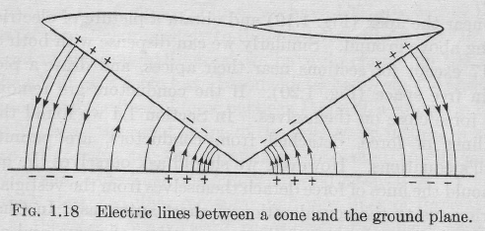
Wave impedance: Free Space vs. Guided Waves
Reproduced from Schelkunoff & Friis, 1952.

Slide 21
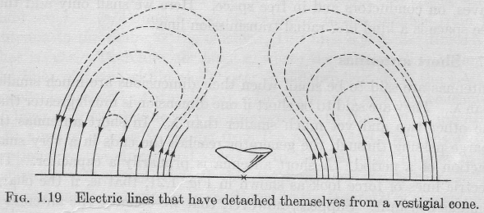
Wave impedance: Free Space vs. Guided Waves
Reproduced from Schelkunoff & Friis, 1952.

Slide 22
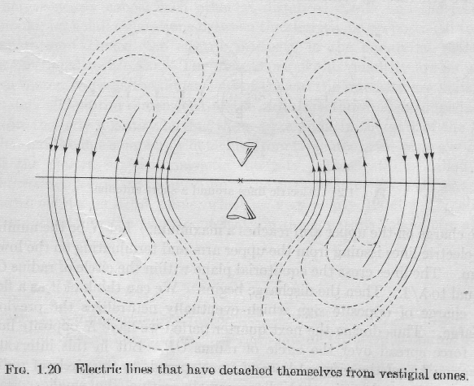
Wave impedance: Free Space vs. Guided Waves
Reproduced from Schelkunoff & Friis, 1952.

Slide 23

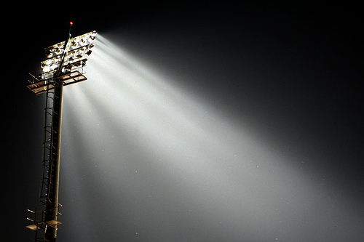
The Concept of Directivity - Intuitive
Omni-directional
and
directive transmission

Slide 24
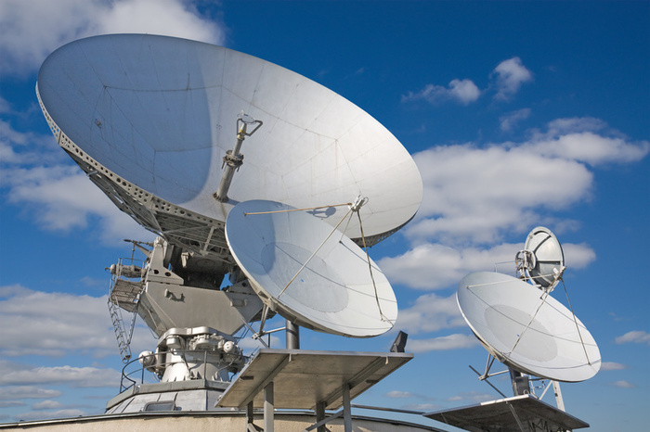
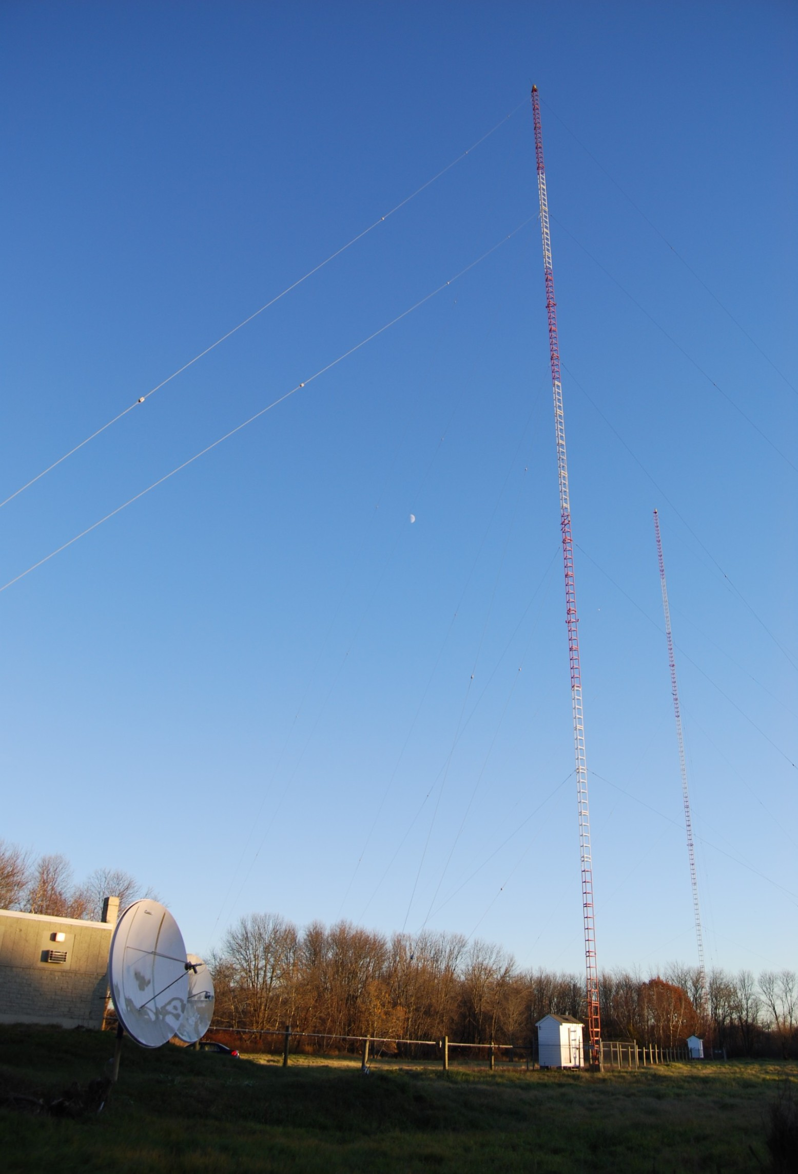
The Concept of Directivity - Intuitive
omni-directional
directive transmission

Slide 25


The Concept of Directivity - Intuitive
Omni-directional
vs.
directive reception
Telephoto - one hopes, but direct evidence
Wide angle

Slide 26

A Basic Concept - Conservation of energy
Total Power transmitted into a volume = power density * surface area
or, using Gaussian terminology
Total power into a volume equals the flux of power through any surface enclosing the volume
P_{t} = P_{d} A, or
P_{d} = P_{t} / A

Slide 27
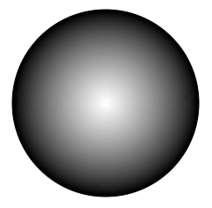
The Concept of Directivity - Two basic concepts
Conservation of energy and surface area of a sphere
Total Power transmitted into a volume = power density * surface area
Surface area of sphere = 4πr²
P_{t} = P_{d} 4πr², or
P_{d} = P_{t} / 4πr²
4π steradian omni-directional illumination from center of sphere

Slide 28
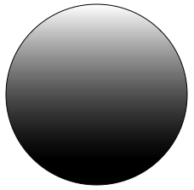
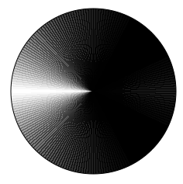
The Concept of Directivity - Geometrical
4π steradian omni-directional illumination from center of sphere
2π steradian hemispherical illumination = 4π/2
P_{d} ∝ P_{t}D/4πr²
π steradian quarter-spherical illumination = 4π/4
Sector = 4π/directivity

Slide 29
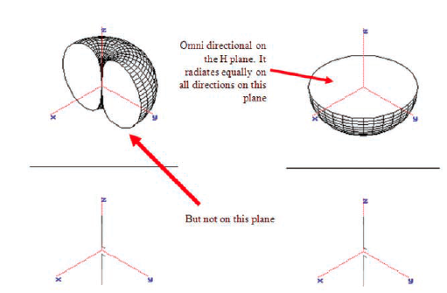
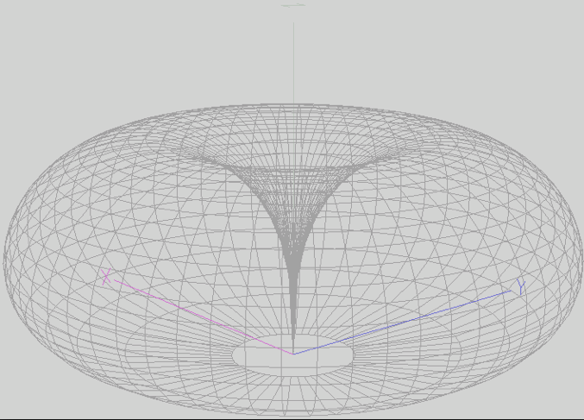
Real Antenna Patterns
Vertical dipole
Directivity = 1.64, or 2.15 dBi
But not omni in the E plane
Courtesy of Vince Rodriguez of ETS-Lindgren
Vertical monopole over ground plane
Directivity = 3.28, or 5.15 dBi

Slide 30
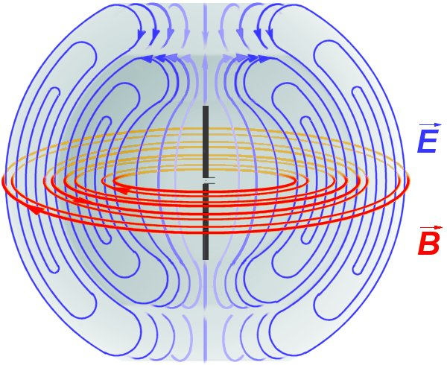
Real Antenna Patterns
Vertical dipole - pattern explanation
Courtesy of Vince Rodriguez of ETS-Lindgren

Slide 31
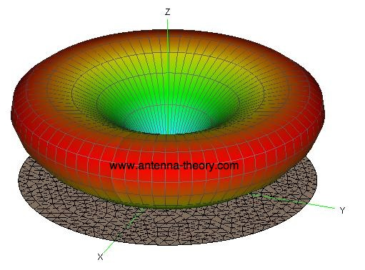
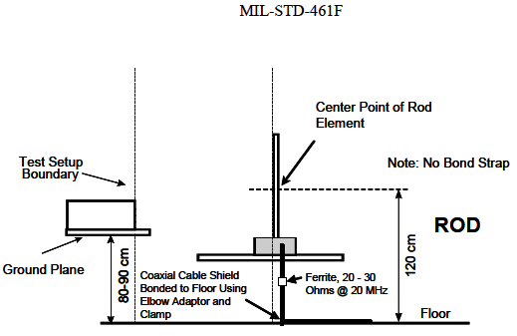
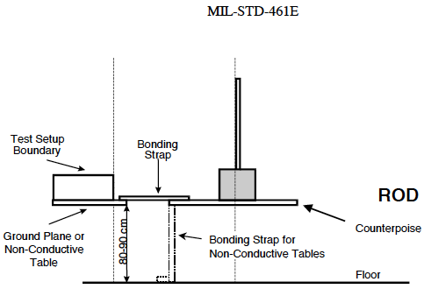
Real Antenna Patterns - practical application
Monopole over infinite ground plane pattern
Monopole over small ground plane pattern

Slide 32
Another Basic Concept - Gain
Gain is directivity multiplied by antenna efficiency (P_{out}/P_{in})
Here, directivity is unity, so gain relates to the fraction of power emitted as visible light compared to total power dissipated in the filament
In general, antenna efficiency is related to how much power is dissipated as heat (dc to daylight), instead of in the band of interest.
P_{d} ∝ P_{t}D/4πr²
P_{d} = P_{t}εD/4πr²
G = εD
P_{d} = P_{t}G/4πr²

