Slide 1
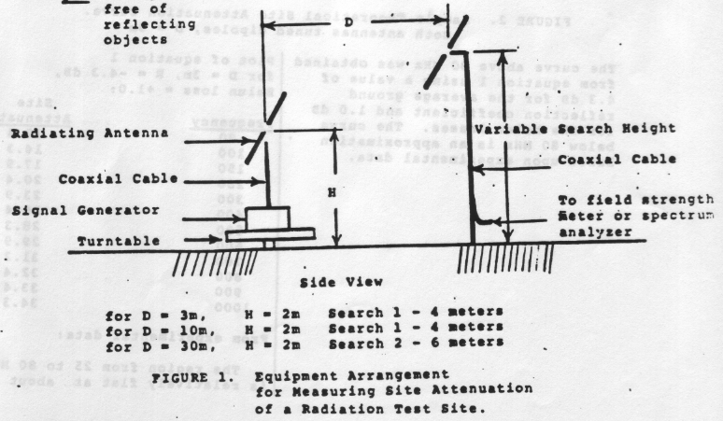
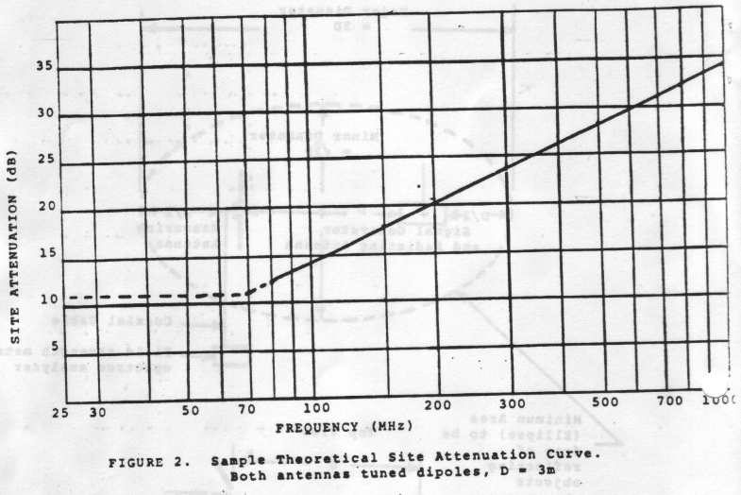
Limits of space loss calculations

Slide 2
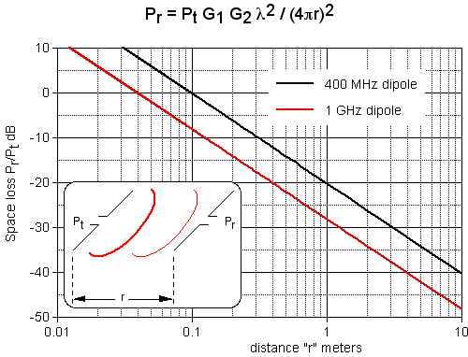
Limits of space loss calculations

Slide 3
Near Field / Far Field
Far field implies a plane wave.
A plane wave is an asymptotic extrapolation of a spherical wave front.

Slide 4
Near Field / Far Field
How can we determine “how far is far enough?”
A plane wave is an asymptotic extrapolation of a spherical wave front. When we are in the far field of a source, we say it is a point source. This is shorthand for saying that the distance from any part of the source to our point-of-observation are all equal.
R
R’
R = R’ @ ∞

Slide 5
Near Field / Far Field
R
How can we determine “how far is far enough?”
R = R’ @ ∞
R
D
R’ = √[R² – (D/2)²]
R – R’ ≤ fraction (λ)
Pick: R – R’ ≤ αλ, α<<1
R - √[R² – (D/2)²] = αλ
R ≥ D²/8αλ + αλ/2
For α = 1/16, R ≥ 2D²/λ + λ/32

Slide 6
Near Field / Far Field
R ≥ D²/8αλ + αλ/2
R ≥ 2D²/λ + λ/32
Interesting cases:
Short dipole: “D” << λ/2
Tuned dipole: “D” = λ/2
137 cm tip-to-tip biconical (MIL-STD-461, RTCA/DO-160, CISPR 25)
uhf DRG (MIL-STD-461E/F): “D” is the greater of 69 cm x 94.5 cm
microwave DRG (MIL-STD-461E/F): “D” is the greater of 24.2 cm x 13.6 cm

Slide 7
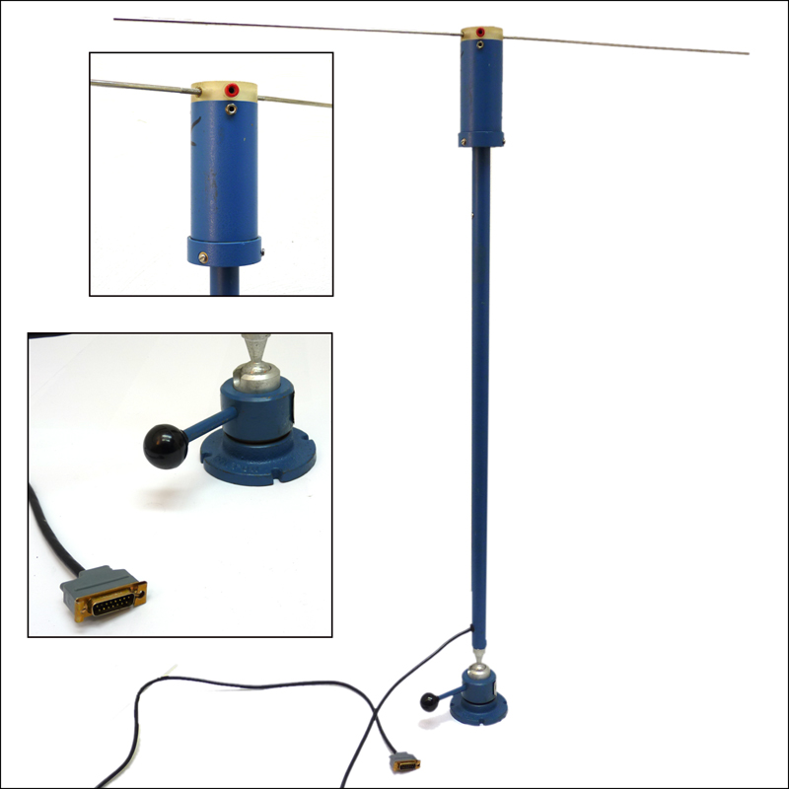
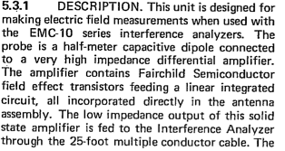
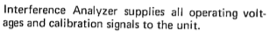
Near Field / Far Field
R ≥ 2D²/λ + λ/32
Short dipole: “D” << λ/2
For a very short dipole where “D” << λ/2, the D/λ value sets the limit on phase difference:
R ≥ D²/8αλ + αλ/2 ➔
R ≥ D²/8[D/λ]λ + [D/λ]λ/2 ➔
R ≥ D/8 + D/2 ➔
R ≥ 5D/8
Example:
Fairchild Electro-Metrics PEF-10
20 Hz to 50 kHz/1 MHz (-10A model)

Slide 8
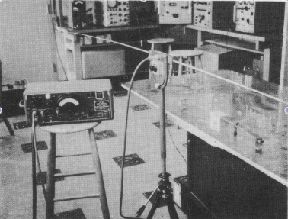
Near Field / Far Field
R ≥ 2D²/λ + λ/32
Tuned dipole: “D” = λ/2
R ≥ 2(λ/2)²/λ + λ/32
R ≥ λ/2 + λ/32 ≈ λ/2
30 MHz: 5 meters
100 MHz: 1.5 meters
400 MHz: 37.5 cm
1 GHz: 15 cm (6 inches)

Slide 9
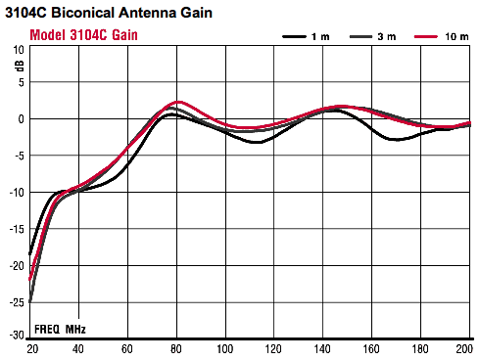
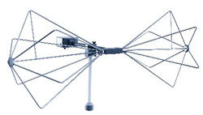
Near Field / Far Field
R ≥ 2D²/λ + λ/32
137 cm tip-to-tip biconical (MIL-STD-461, RTCA/DO-160, CISPR 25)
At 30 MHz, “D” = 0.137 λ, R = 0.6875 m
At 60 MHz, “D” = 0.274 λ, R = 0.9 m
At 90 MHz, “D” = 0.411 λ, R = 1.23 m 12
Above 90 MHz, the biconical can be considered to be a tuned half-wave dipole for the purpose of computing its far field.

Slide 10
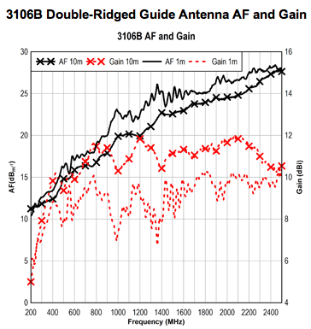
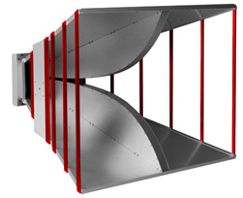
Near Field / Far Field
R ≥ 2D²/λ + λ/32
uhf DRG (MIL-STD-461E/F): “D” is the greater of 69 cm x 94.5 cm
At 200 MHz, “R” ≥ 1.2 meters
At 300 MHz, “R” ≥ 1.786 meters
At 500 MHz, “R” ≥ 2.977 meters
At 700 MHz, “R” ≥ 4.167 meters
At 1000 MHz, “R” ≥ 5.953 meters

Slide 11
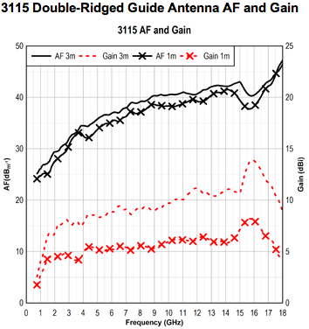
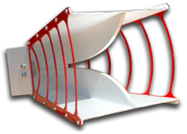
Near Field / Far Field
R ≥ 2D²/λ + λ/32
microwave DRG (MIL-STD-461E/F): “D” is the greater of 24.2 cm x 13.6 cm
At 1 GHz, “R” ≥ 0.391 meters
At 2 GHz, “R” ≥ 0.781 meters
At 4 GHz, “R” ≥ 1.562 meters
At 8 GHz, “R” ≥ 3.123 meters
At 16 GHz, “R” ≥ 6.247 meters

Slide 12
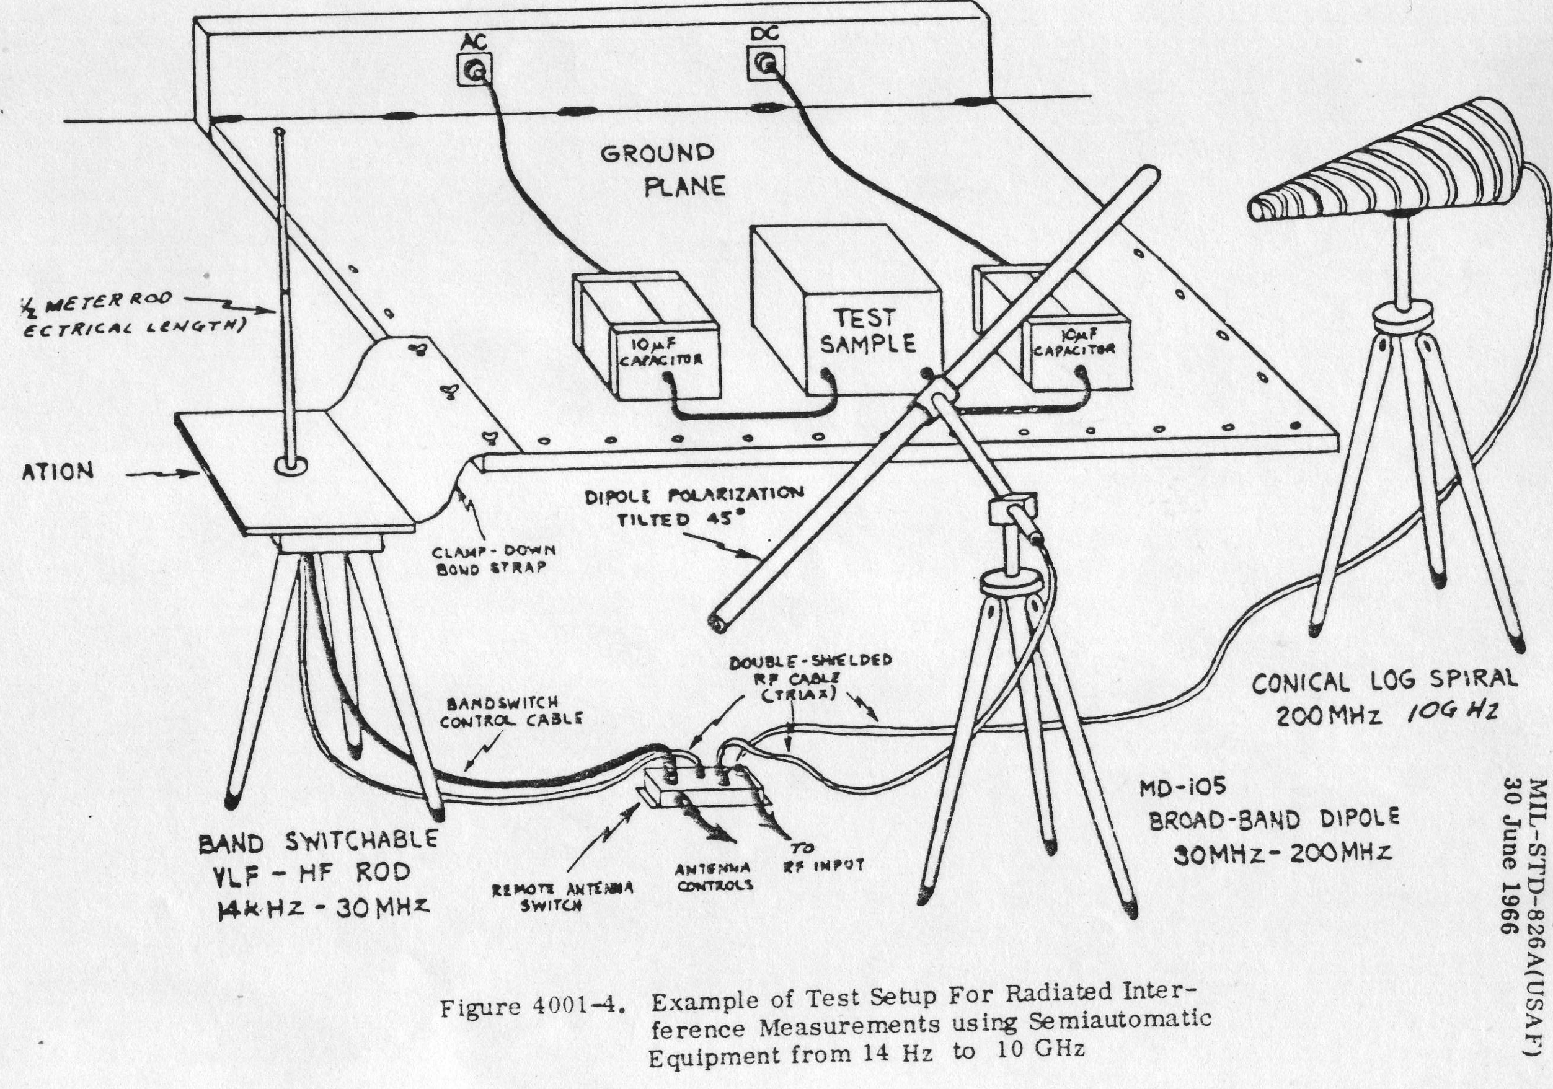



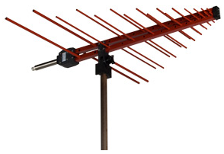

EMI Measurement Antenna Desiderata
Looks like actual victim antenna protected by RE requirement
Subject to above, is low gain and “sees” entire test set-up.

Slide 13
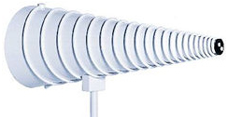
The Verboten Log-spiral
Required in MIL-STD-826 and MIL-STD-461/-462 basic/A and used through -461C
Forbidden in MIL-STD-462D (1993) through the present:
“Previous versions of this standard specified conical log spiral antennas. These antennas were
convenient since they did not need to be rotated to measure both polarizations of the radiated
field. The double ridged horn is considered to be better for standardization for several reasons.
At some frequencies, the antenna pattern of the conical log spiral is not centered on the antenna
axis. The double ridged horn does not have this problem. The circular polarization of the
conical log spiral creates confusion in its proper application. Electric fields from EUTs would
rarely be circularly polarized. Therefore, questions are raised concerning the need for 3 dB
correction factors to account for linearly polarized signals. The same issue is present when spiral
conical antennas are used for radiated susceptibility testing. If a second spiral conical is used to
calibrate the field correctly for a circularly polarized wave, the question arises whether a 3 dB
higher field should be used since the EUT will respond more readily to linearly polarized fields
of the same magnitude.
Other linearly polarized antennas such as log periodic antennas are not to be used. It is
recognized that these types of antennas have sometimes been used in the past; however, they will
not necessarily produce the same results as the double ridged horn because of field variations
across the antenna apertures and far field/near field issues. Uniform use of the double ridge horn
is required for standardization purposes to obtain consistent results among different test
facilities.”

Slide 14
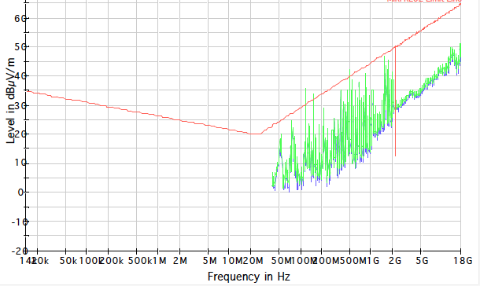
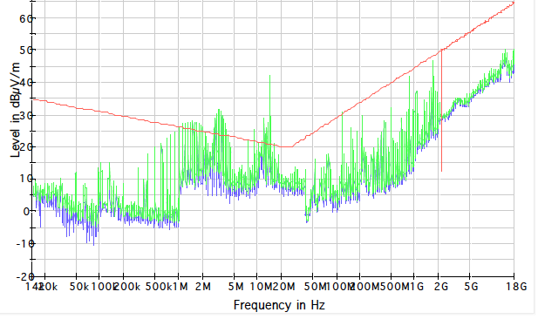
The Verboten Log-spiral (cont.)
“The double ridged horn is considered to be better for standardization for several reasons.
At some frequencies, the antenna pattern of the conical log spiral is not centered on the antenna
axis. The double ridged horn does not have this problem.”
But the gain is only 2 – 3 dBi to begin with; it is looking at everything in front of it, so what does it matter?
“The circular polarization of the conical log spiral creates confusion in its proper application. Electric fields from EUTs would rarely be circularly polarized. Therefore, questions are raised concerning the need for 3 dB correction factors to account for linearly polarized signals.”
If purely linearly polarized fields are being measured, then we could simply add 3 dB to the ARP-958 measured antenna factor. But it isn’t that simple.
horizontal
vertical

Slide 15
The Verboten Log-spiral (cont.)
Given the above typical signatures, it makes sense to ask the following question:
If the typical EMI source emits both horizontal and vertical field polarizations simultaneously, then isn’t it possible that a circularly polarized antenna would see the total fields and report them, and that might well offset the 3 dB desensitization to any single linear polarization?

Slide 16
The same issue is present when spiral conical antennas are used for radiated susceptibility testing. If a second spiral conical is used to calibrate the field correctly for a circularly polarized wave, the question arises whether a 3 dB higher field should be used since the EUT will respond more readily to linearly polarized fields of the same magnitude.
Other linearly polarized antennas such as log periodic antennas are not to be used. It is
recognized that these types of antennas have sometimes been used in the past; however, they will not necessarily produce the same results as the double ridged horn because of field variations across the antenna apertures and far field/near field issues. Uniform use of the double ridge horn is required for standardization purposes to obtain consistent results among different test facilities.”

Slide 17
Background

Slide 18

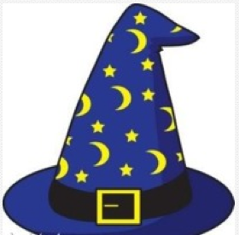

Dipole Antenna Basics
John McCloskey
NASA/GSFC Chief EMC Engineer & Mathemagician
Building 29, room 104
301-286-5498
John.C.McCloskey@nasa.gov

Slide 19
Near and Far Fields of Elemental Dipoles
Electric (Hertzian) Dipole
z
θ
r
Complex dependence on 1/r and 1/r² in near field
Complex dependence on 1/r, 1/r², & 1/r³ in near field
dl
y
x
Wavenumber:
Only 1/r dependence remains in far field
Only 1/r dependence remains in far field
z
Magnetic (Loop) Dipole
θ
r
Complex dependence on 1/r, 1/r², & 1/r³ in near field
I
Complex dependence on 1/r and 1/r² in near field
b
y
x
Only 1/r dependence remains in far field
Only 1/r dependence remains in far field
Magnetic dipole moment:

Slide 20
Wave Impedances of Elemental Dipoles
Electric (Hertzian) Dipole
z
θ
r
dl
y
x
z
Magnetic (Loop) Dipole
θ
r
I
y
b
x
Magnetic dipole moment:

Slide 21
Wave Impedance of Elemental Dipoles (cont.)

Slide 23
Linear Dipole
z
R’
θ
h
R
dz
I_{m}
h
= 0 with symmetrical integration limits
But:
CONTINUED…

Slide 24
Linear Dipole (cont.)
Pattern Function:

Slide 25
Linear Dipole (cont.)
Evaluated numerically
For half-wave dipole, 2h = λ/2, β₀h = π/2:

