Slide 1
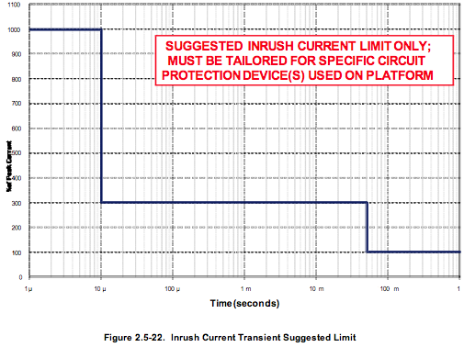
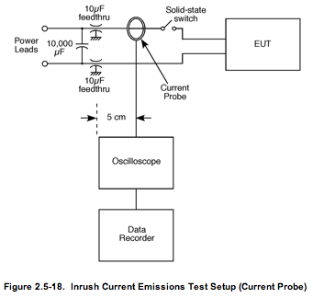
Selected Topic in Time Domain Measurements
Setting up for a single event transient
Inrush current turn-on transient: trigger type: edge detection, positive-going, level slightly above nominal pre-event current; time base per division typically 1 us/div to as much as 10 ms/div. May take several sweeps to capture all important data (fast sweep for initial high current phase, then slower sweeps to capture return to nominal).

Slide 2
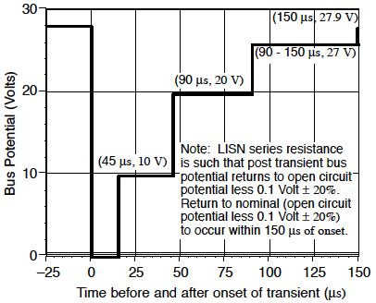
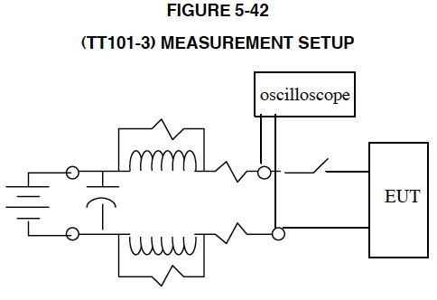
Selected Topic in Time Domain Measurements
Setting up for a single event transient
Transient voltage due to turn-on transient: trigger type: edge detection, negative-going, level below nominal pre-event current; time base per division typically 1 – 5 us/division.
SL-E-0002F

Slide 3
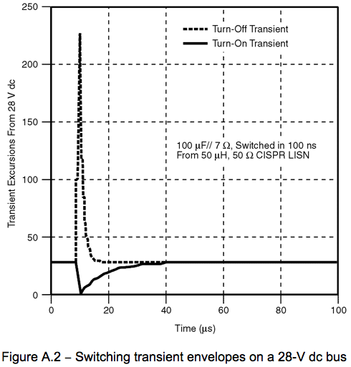
Selected Topic in Time Domain Measurements
Setting up for a single event transient
Transient voltage due to turn-off transient: trigger type: edge detection, positive-going, level above nominal pre-event current; time base per division based on LISN L/R time constant, typically 100 ns to 1 us/division.

Slide 4
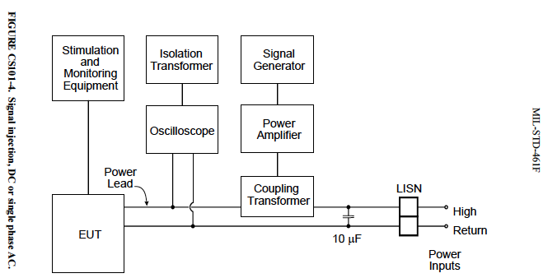
Issues in Audio Frequency Potential Measurements
• Monitoring the injected potential cannot compromise the ground scheme
• The injected signals must be monitored across the test sample.
• If the required level cannot be achieved across the test sample input, measure across the power source impedance and if the lost potential is there, take steps to reduce the drop (lower power source impedance). The new GEVS 10,000 uF cap should take care of this problem.

Slide 5
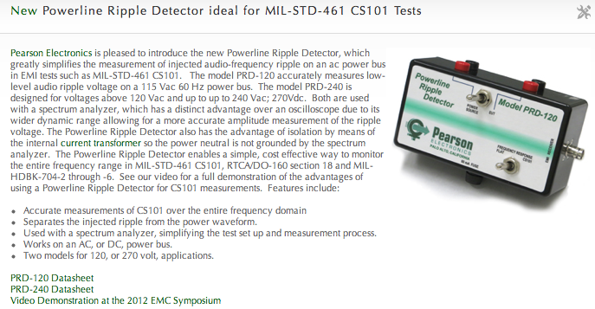
Issues in Audio Frequency Potential Measurements
Injecting and measuring audio ripple superimposed on an ac-powered test sample

Slide 6
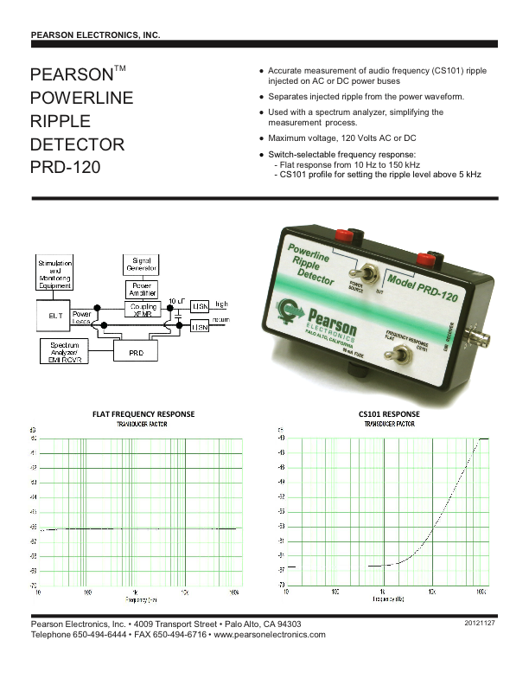
Issues in Audio Frequency Potential Measurements
Injecting and measuring audio ripple superimposed on an ac-powered test sample
https://www.youtube.com/watch?v=z2g9AKxmEW0

Slide 7
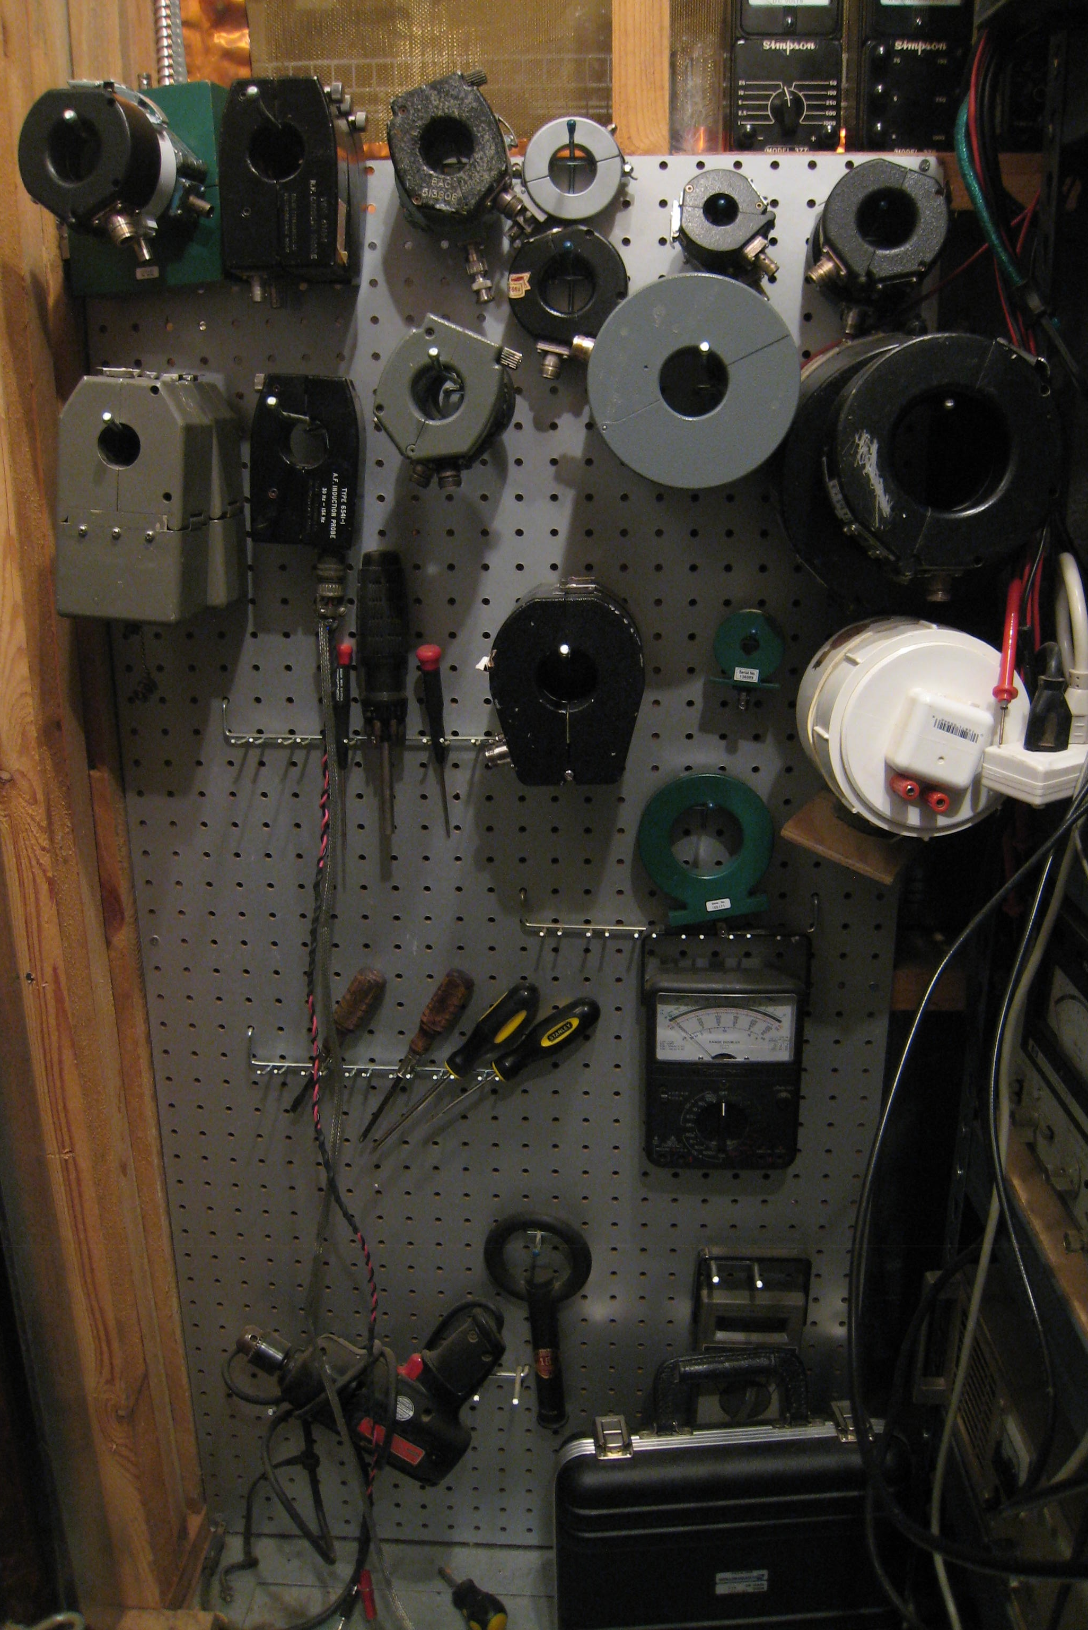
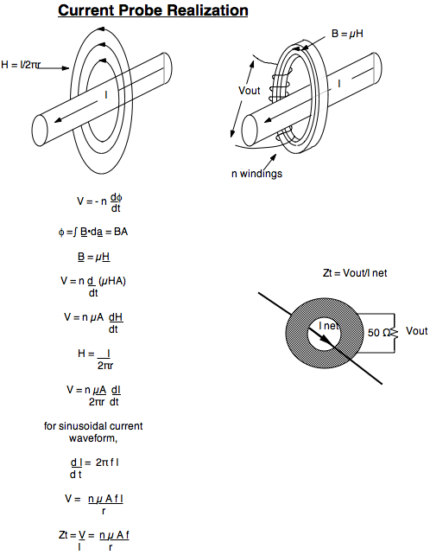
Current Measurement Current Probe

Slide 8
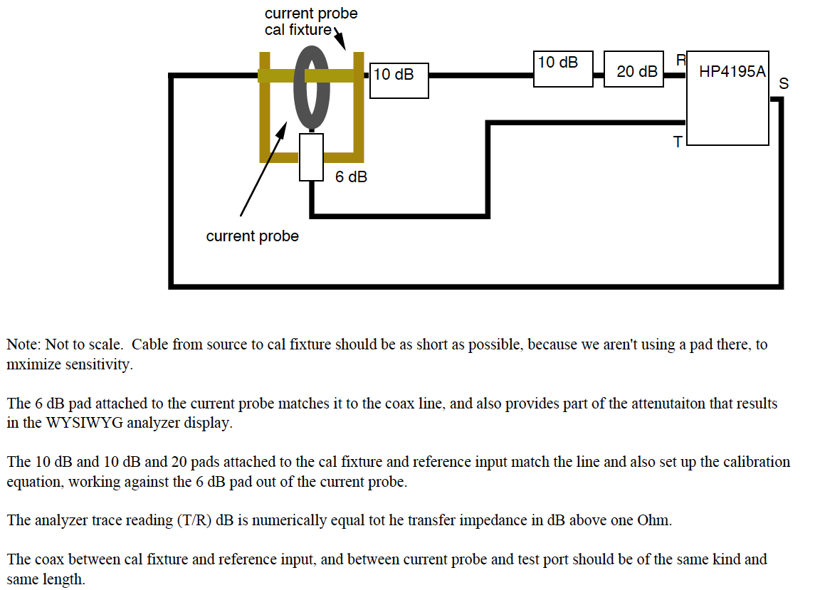
Current Measurement – Current Probe Calibration
may be useful at higher frequencies
10 dB

Slide 9
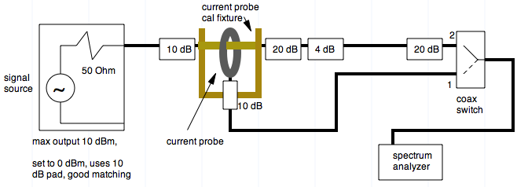
Using a spectrum analyzer and signal source
in lieu of a network analyzer
may be useful at higher frequencies
10 dB
6 dB

Slide 10
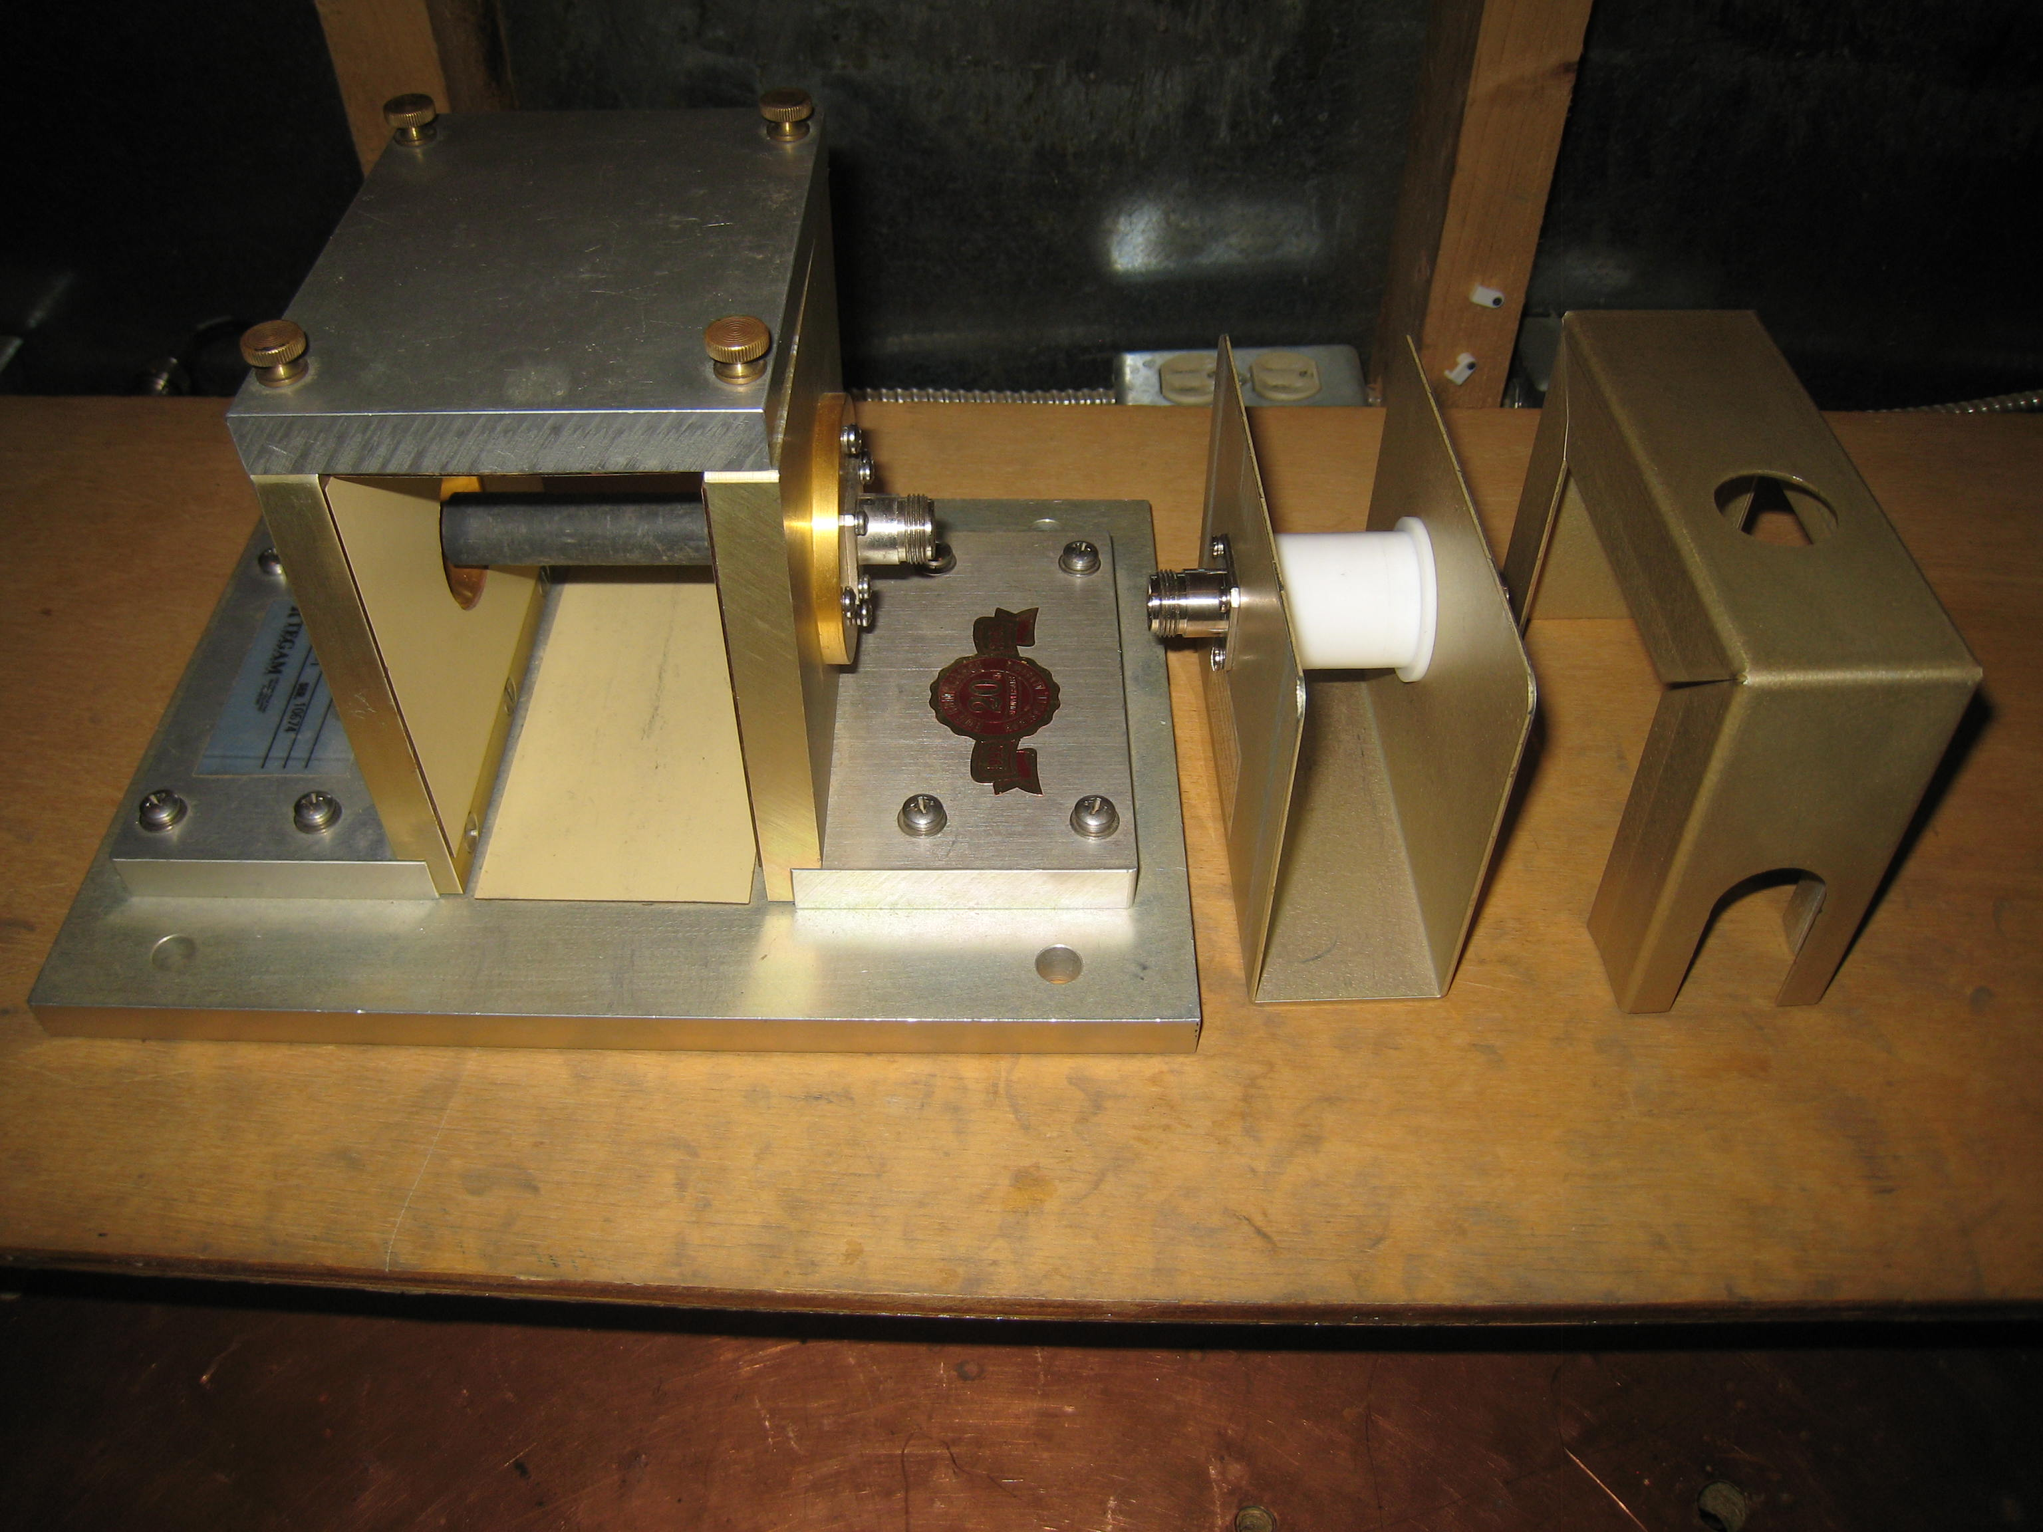
Current Probe Calibration Fixtures

Slide 11
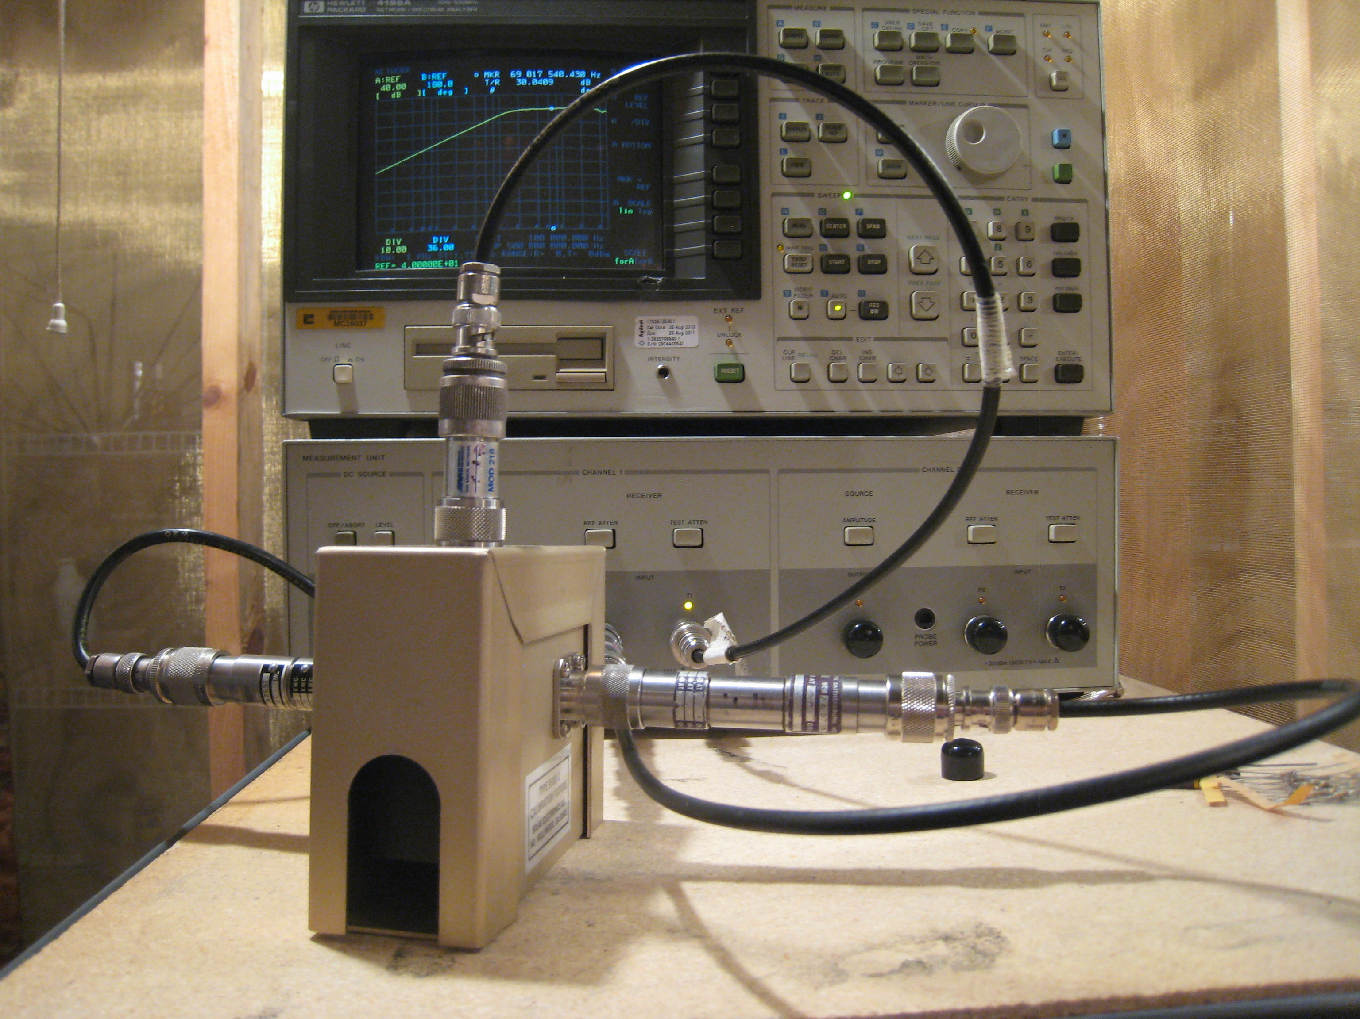
Current Probe Calibration

Slide 12
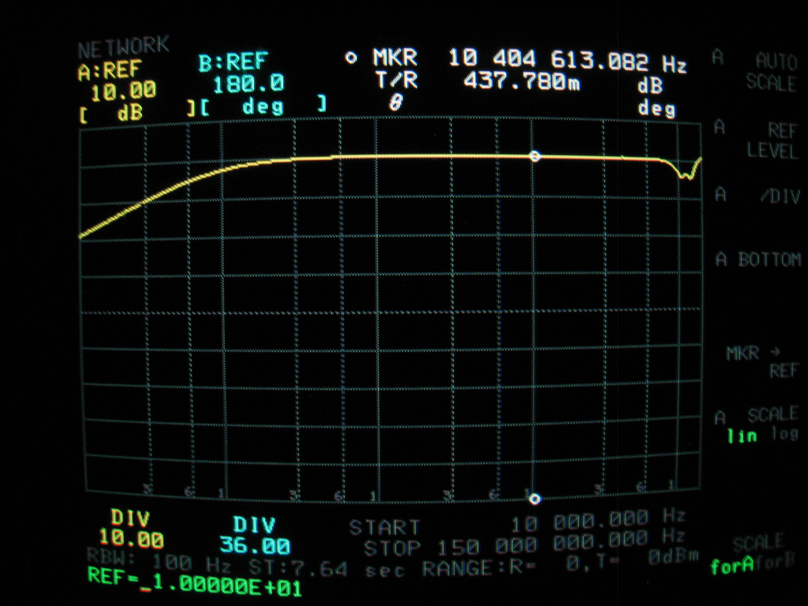
Sample transfer impedance for Empire Devices CP-105

