Slide 1
Pre-amp Calibration
Network analyzer
T
R
T/R
S
splitter
Pre-amp
At what level should source be set?

Slide 2
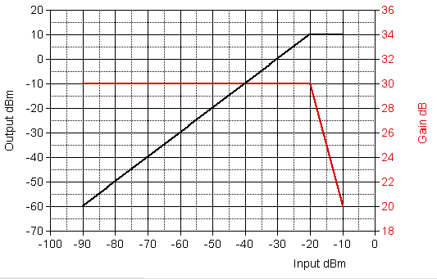
Amplifier Gain as a function of input level

Slide 3
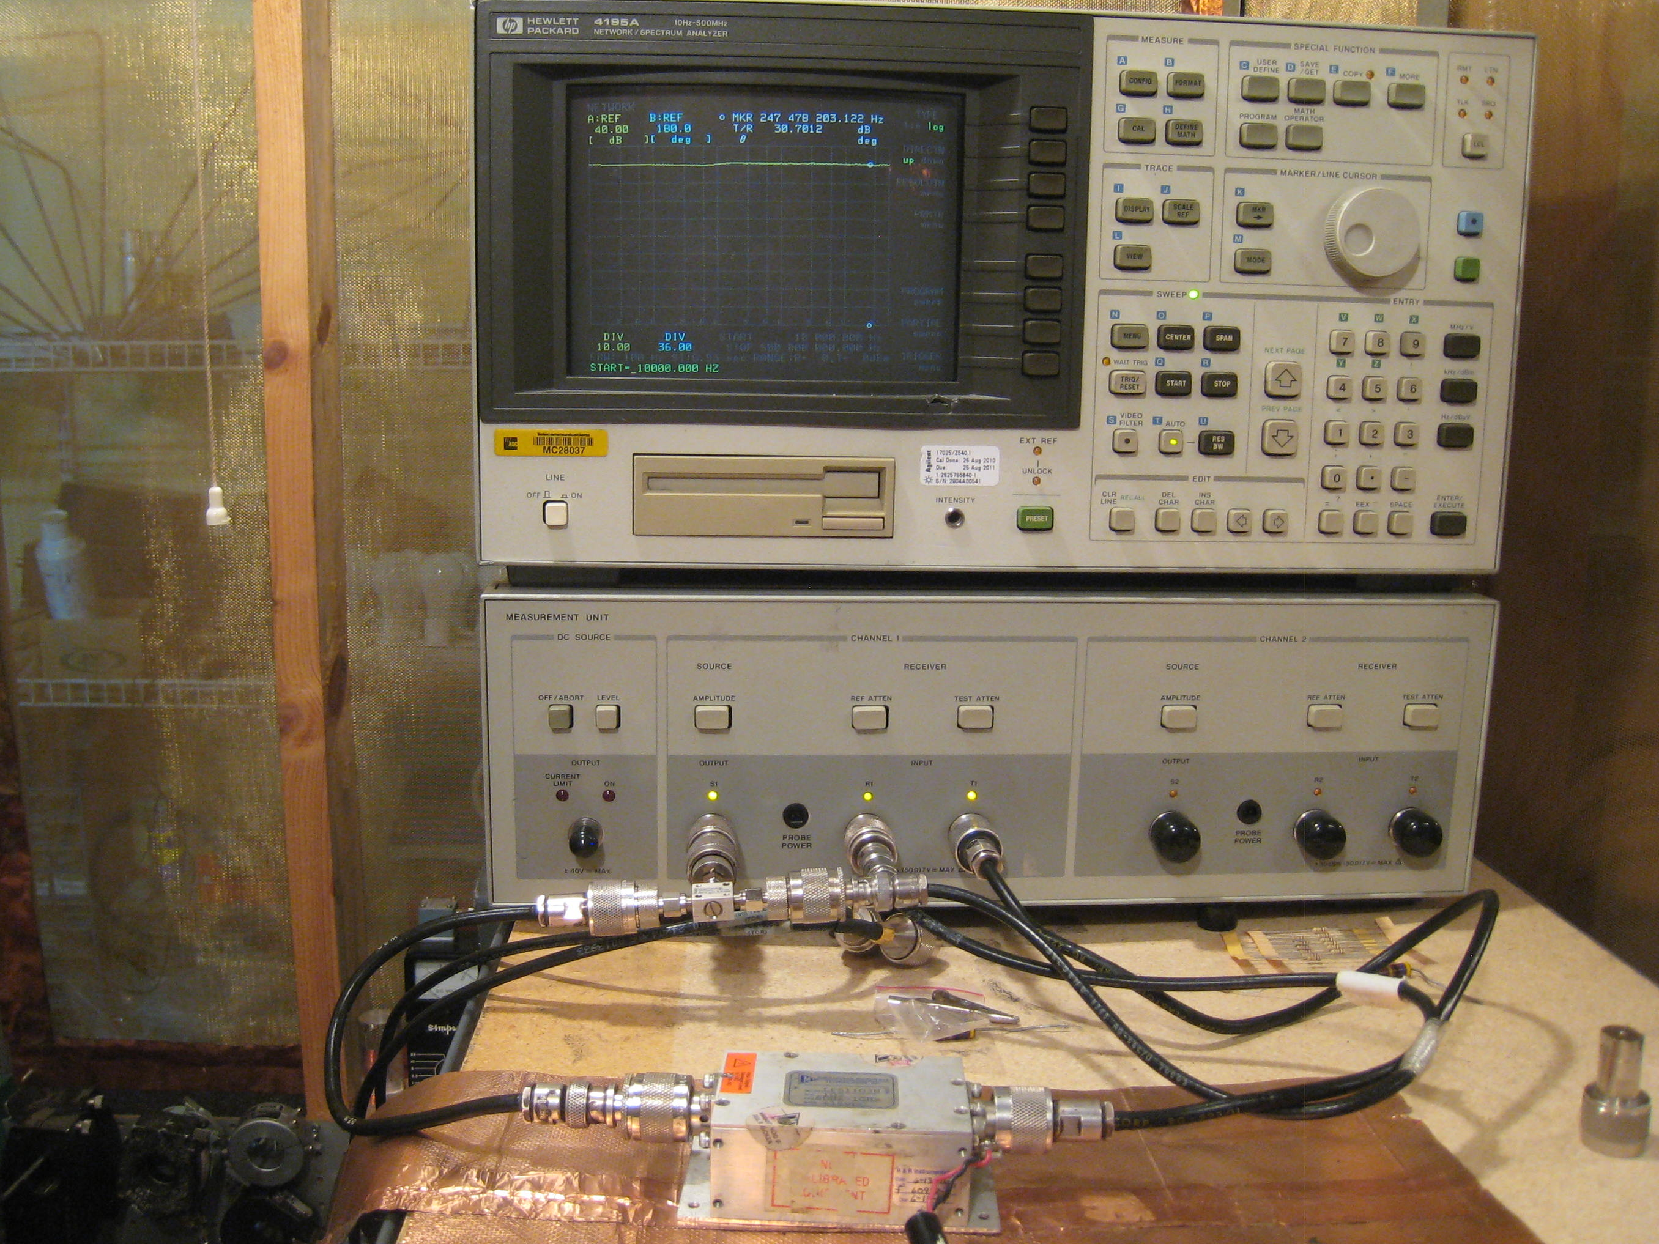
Amplifier Gain Measurement
Test Set-Up

Slide 4
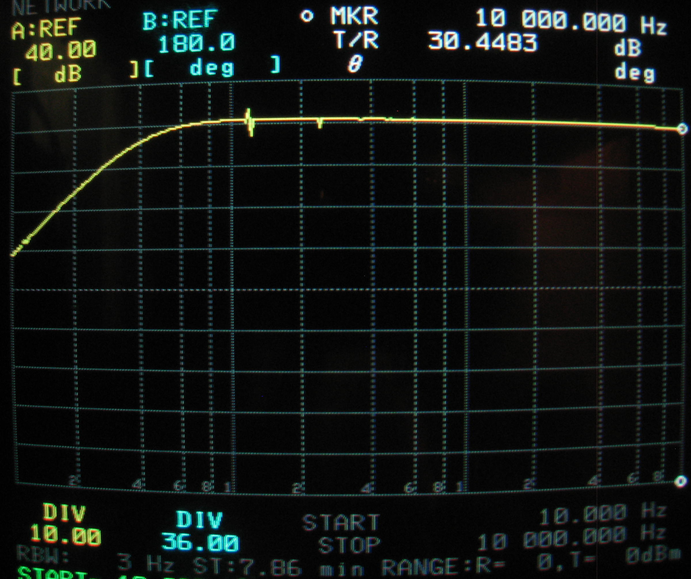
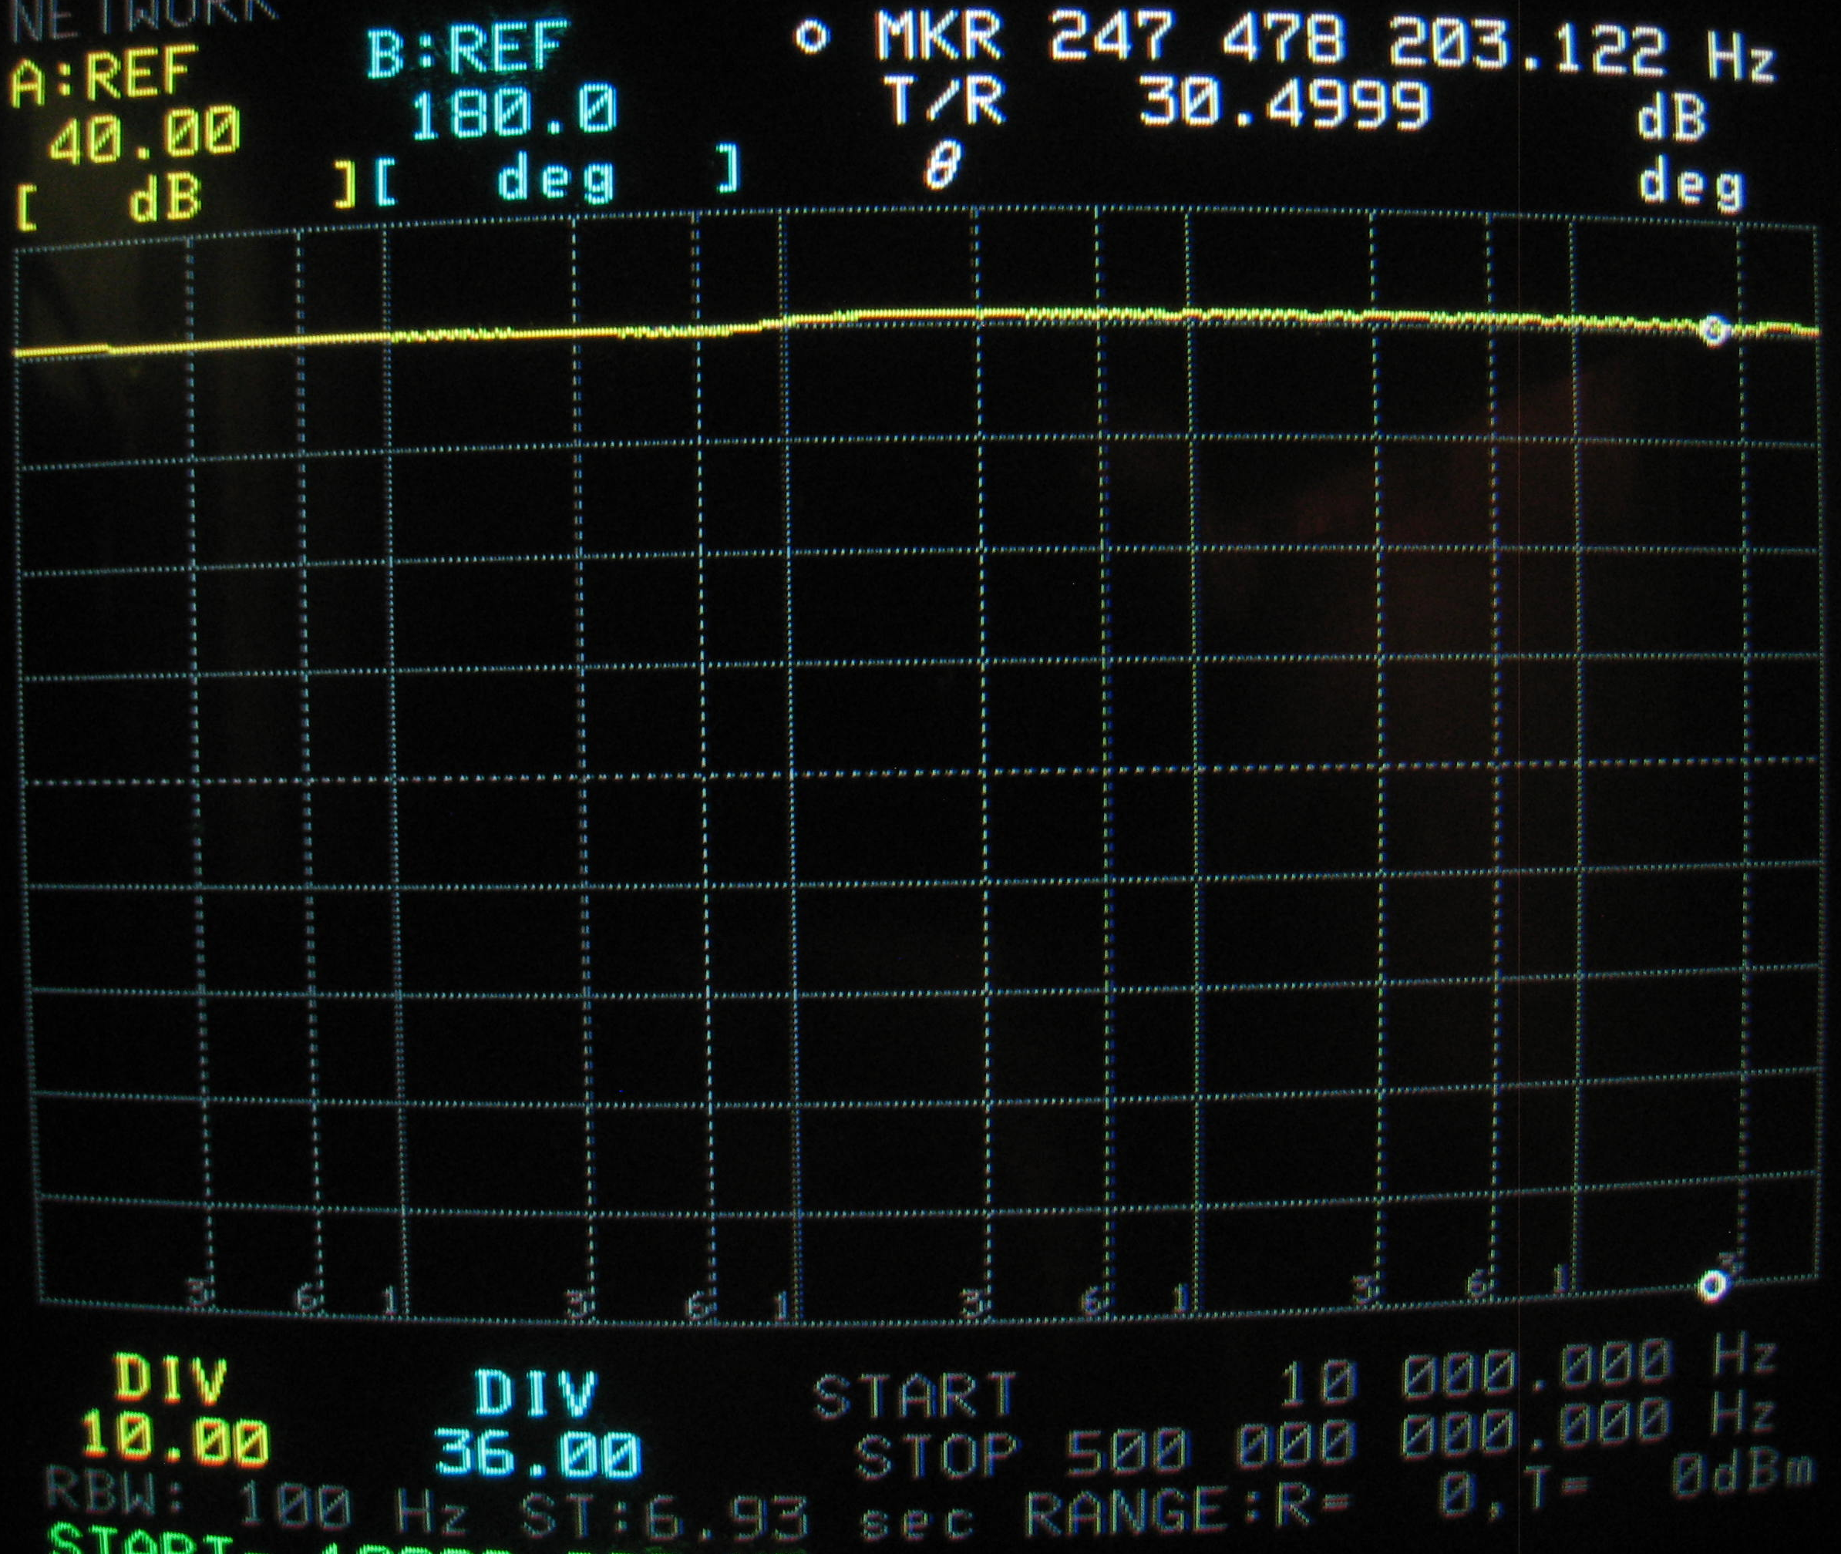
Amplifier Gain Measurement

Slide 5
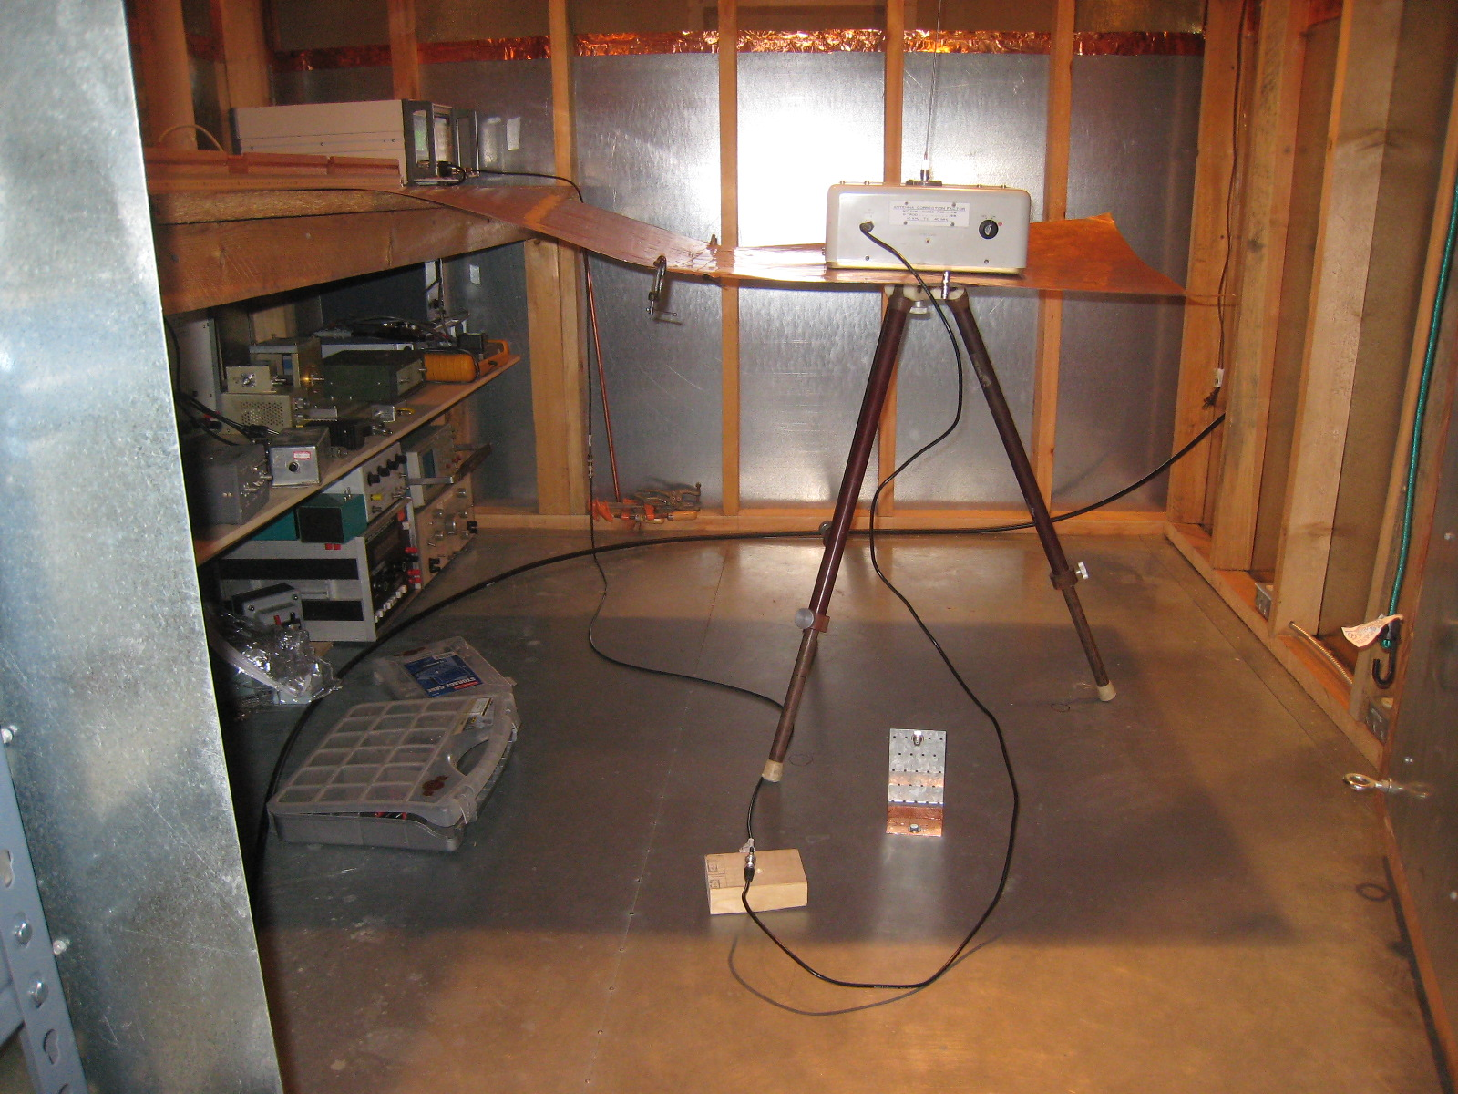
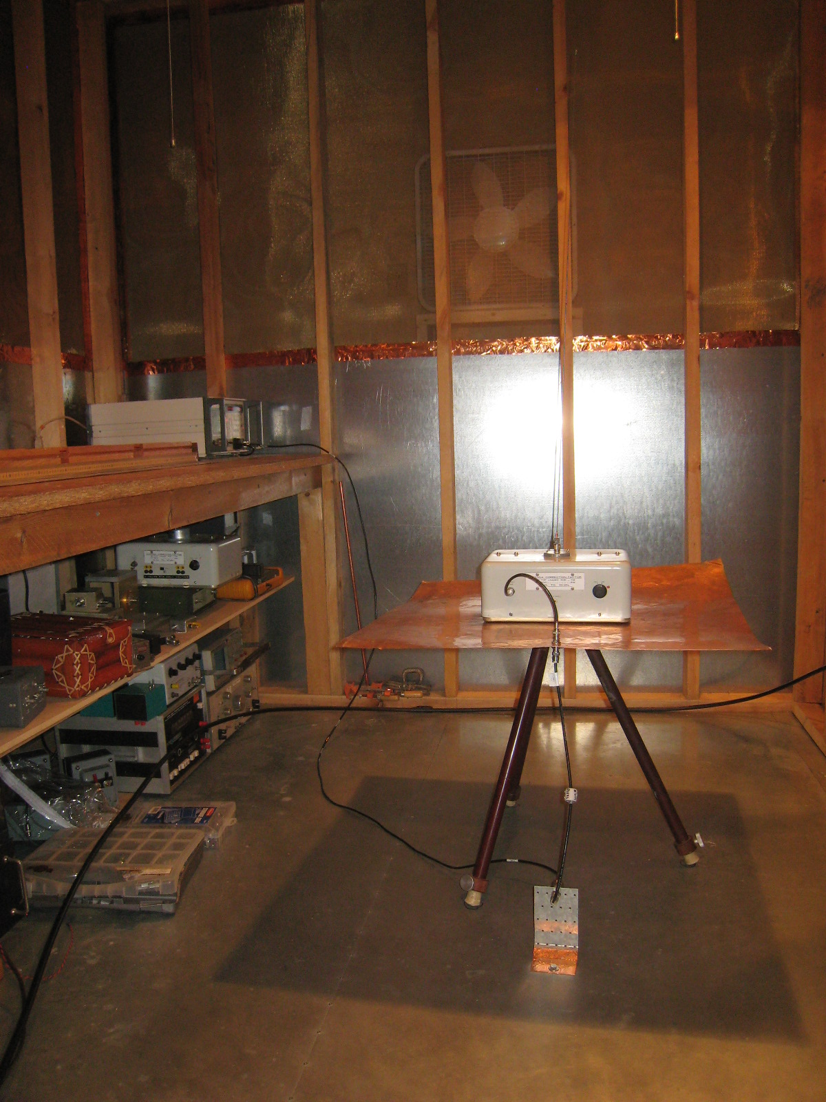
Electric Field Measurements Using an Electrically Short Whip
-462 Notice 2 through -461E
-461F

Slide 6
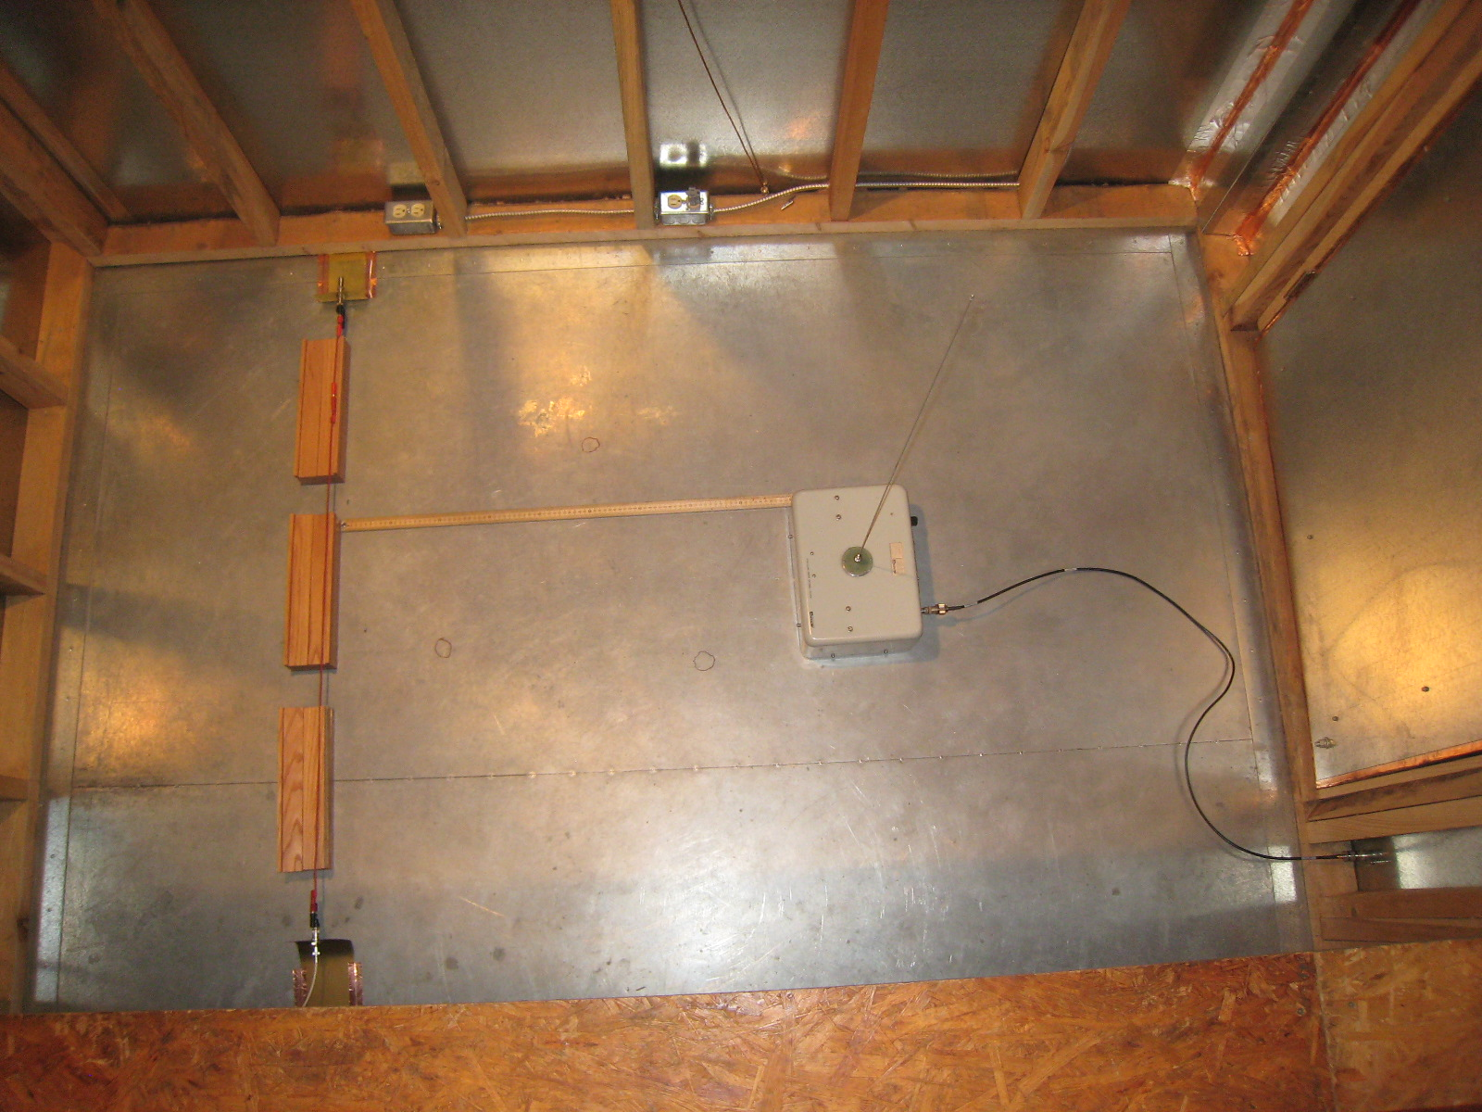
What We Want

Slide 7
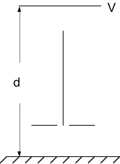
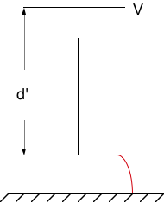
Effect of perfectly grounding the counterpoise
E = V/d
E’ = V/d’
0.4 m
0.4 m
1 V/m * 1.6 m = 1.6 V
1.4 V/m * 1 m = 1.4 V
1 V/m * 0.6 m = 0.6 V
0 V
0.6 m
0.6 m
ΔV_{rod} = 1.4 V – 0 V = 1.4 V
V_{base} = ½ (Δv_{rod}) = 0.7 V
ΔV_{rod} = 1.6 V – 0.6 V = 1 V
V_{base} = ½ (Δv_{rod}) = 0.5 V
V = 2 Volts
d’ = 1.4 meters
E’ = 2 V / 1.4 m = 1.4 V/m
V = 2 Volts
d = 2 meters
E = 2 V / 2 m = 1 V/m
40% error; 3 dB

Slide 8
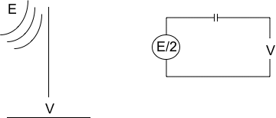
Electrically short probe physics necessary to understand calibration technique
For the 41” rod, the capacitive source impedance is the reactance of 10 pF.
In order to get useful output at low frequencies, the capacitance must be either tuned out or the load must be a near open-circuit.

Slide 9
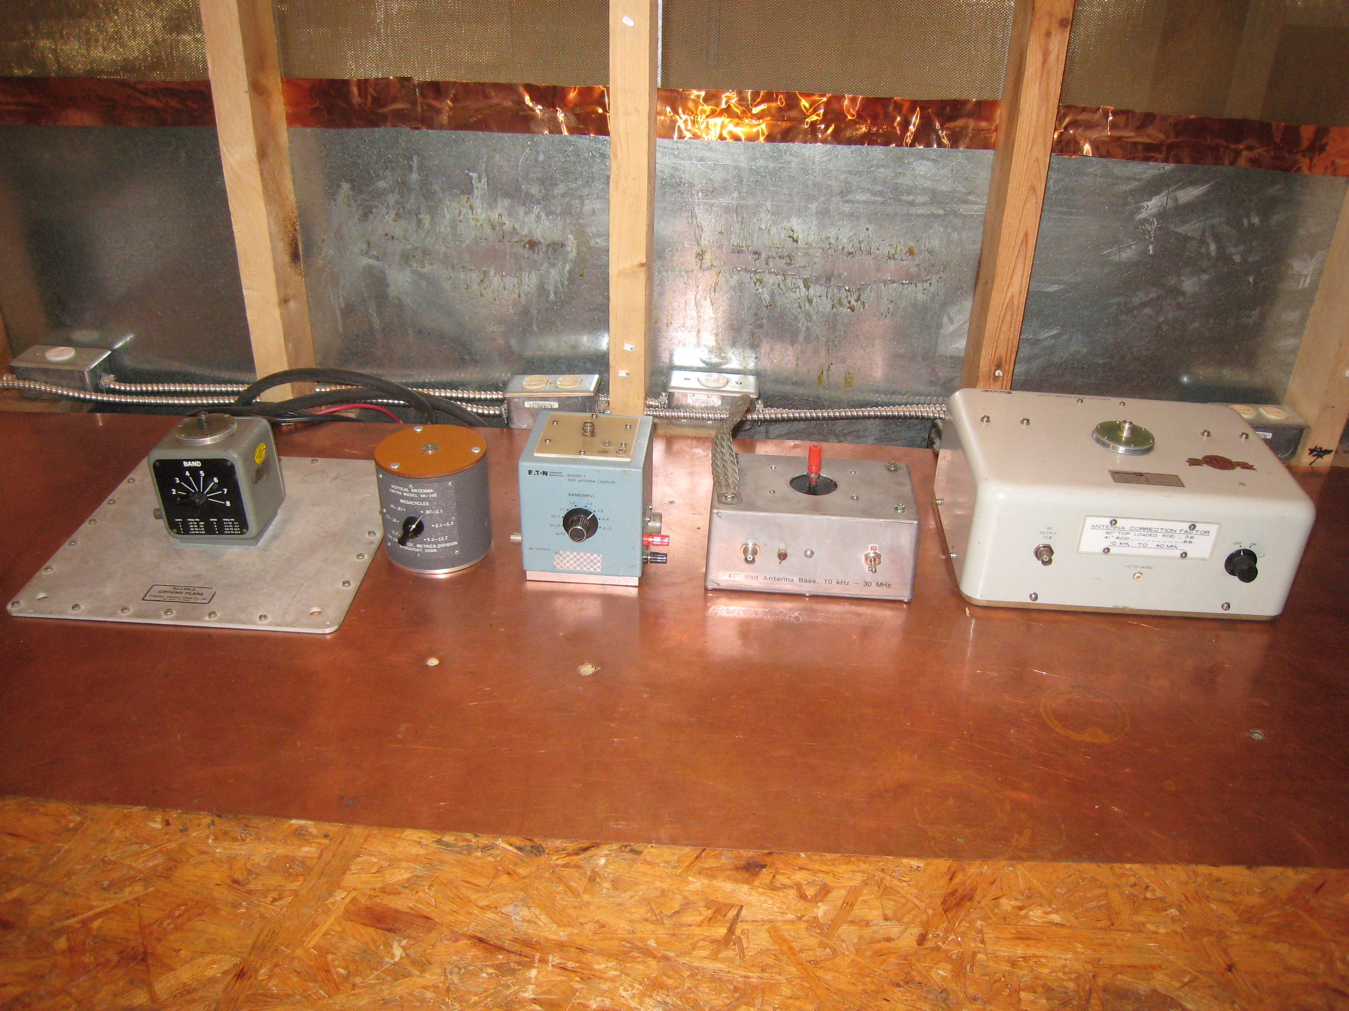
Electric Field Measurements Using an Electrically Short Whip
Two Kinds of Matching Networks – Active and Passive

Slide 10
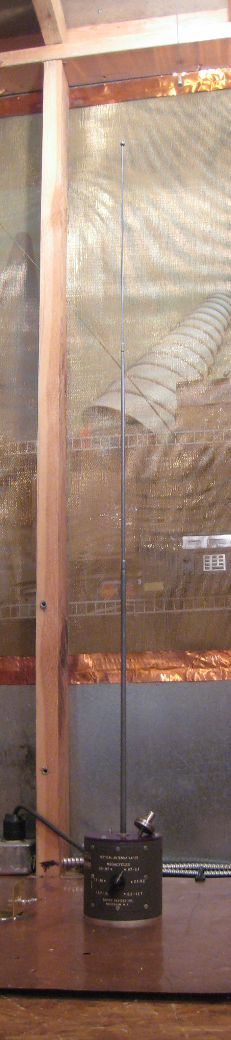
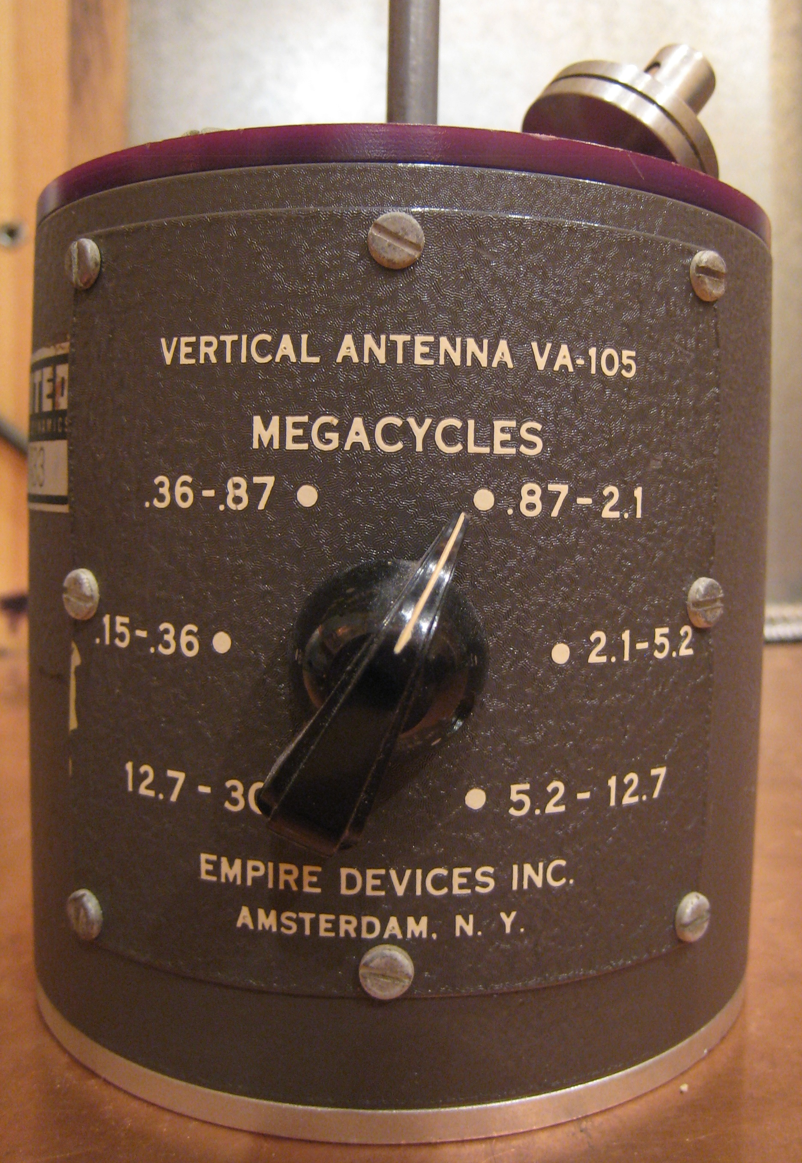
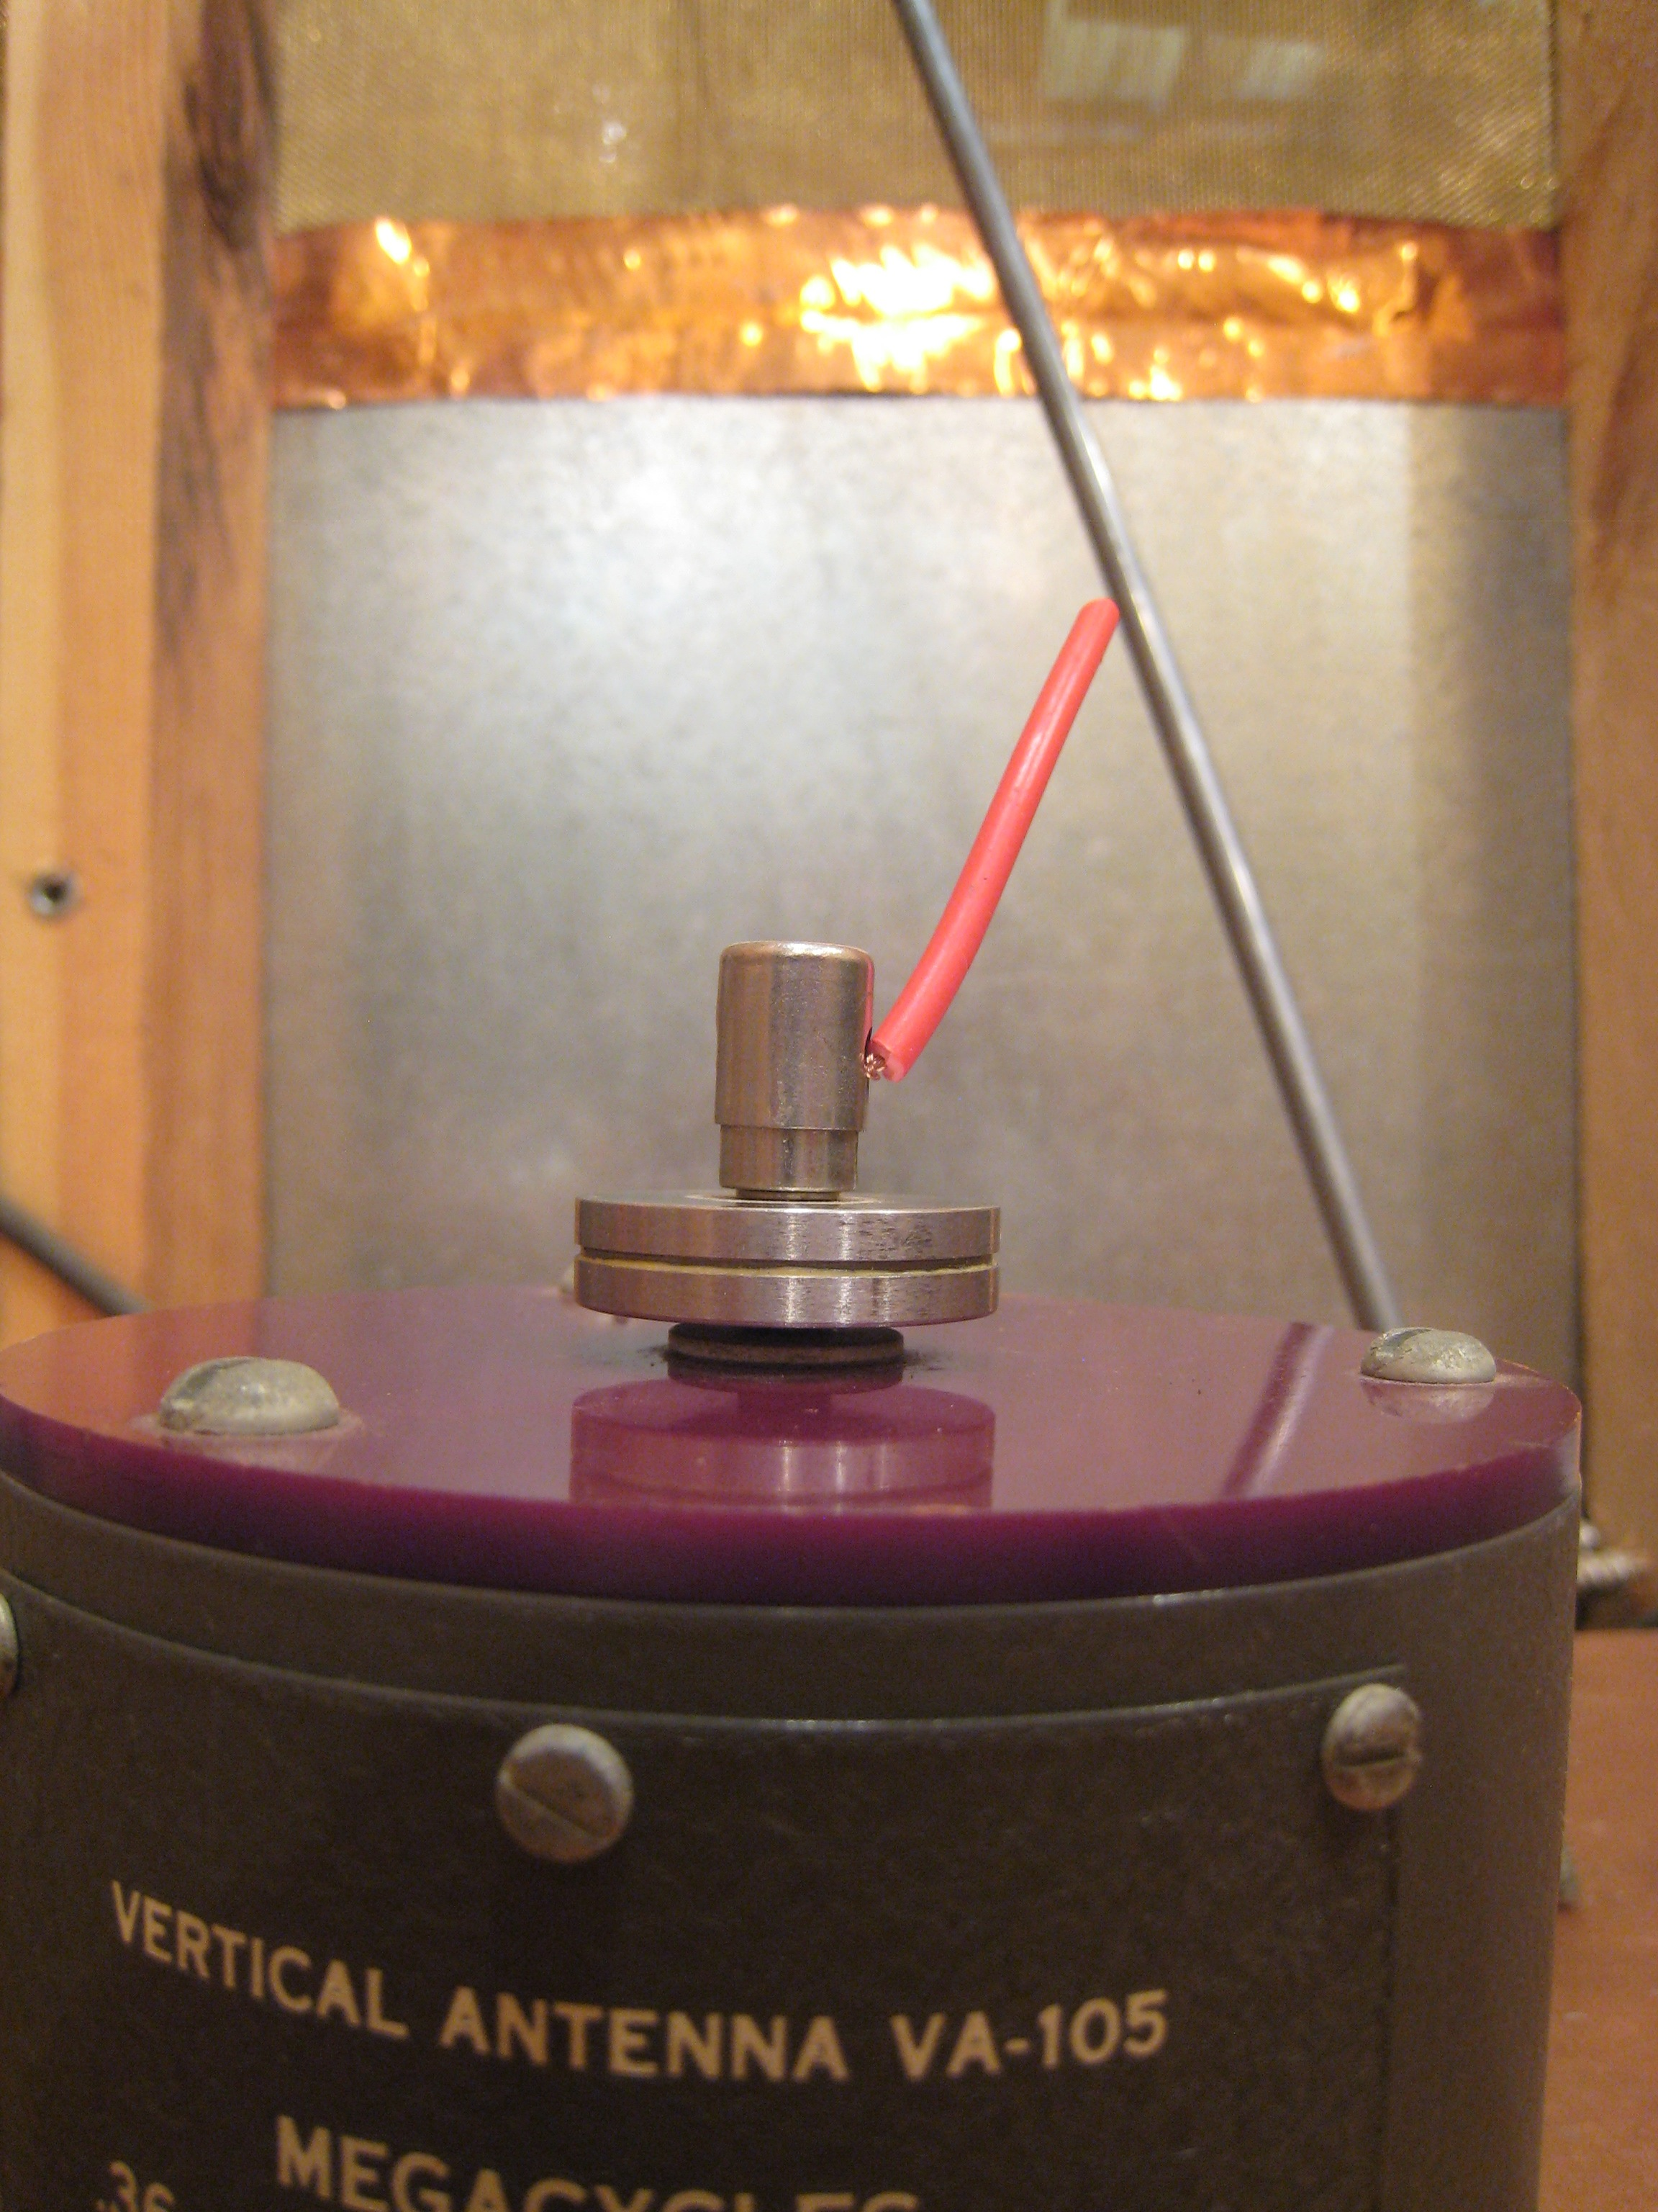
41” Rod and Calibration Thereof

Slide 11
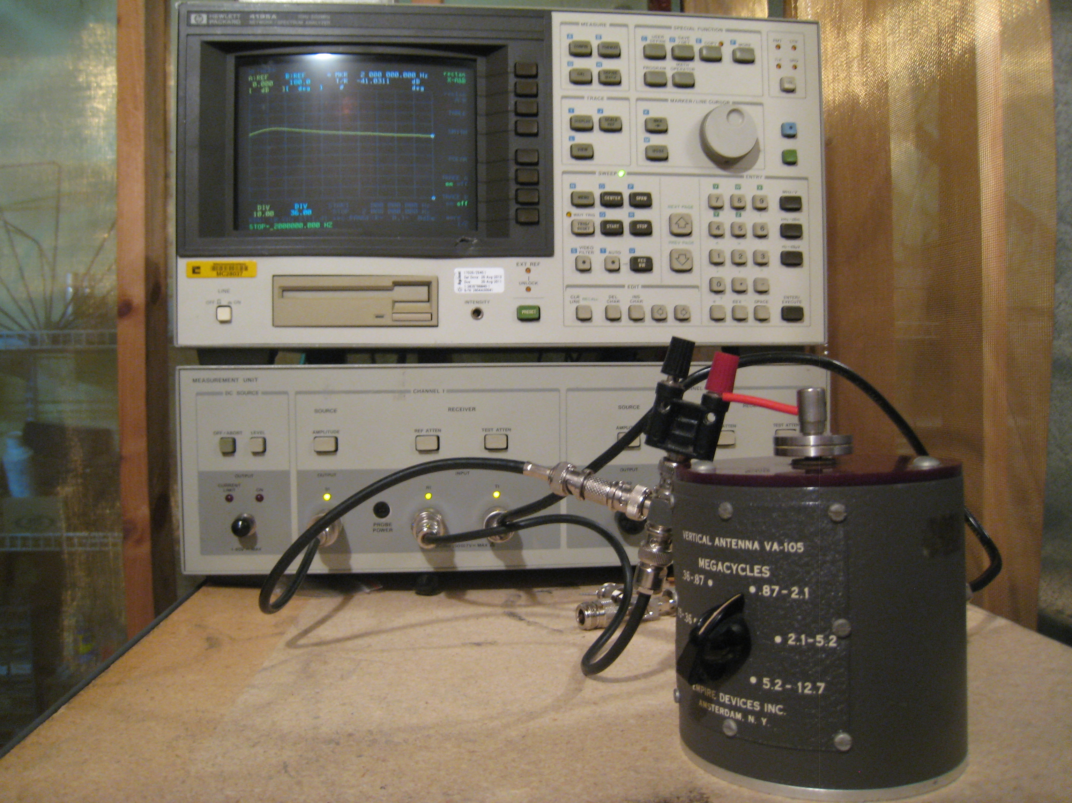
41” Rod and Calibration Thereof

