Slide 1
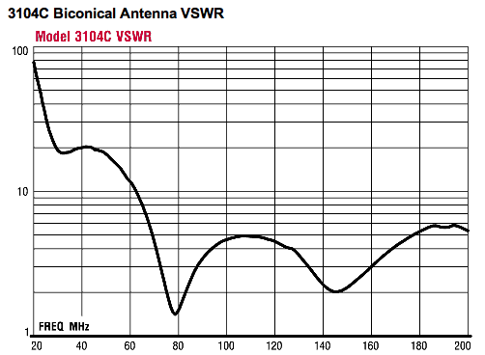
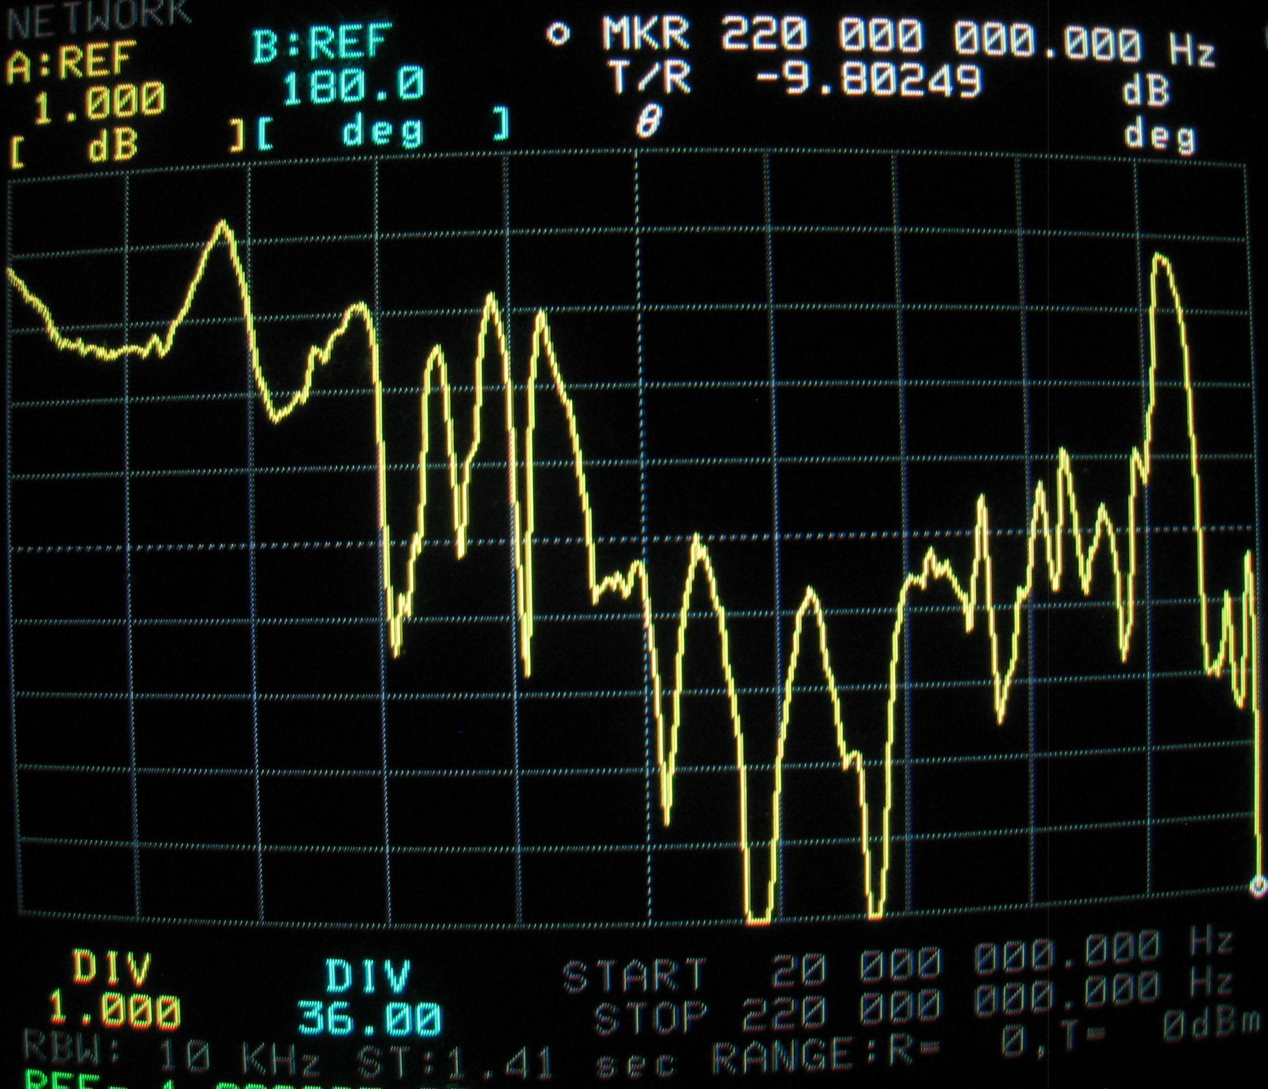
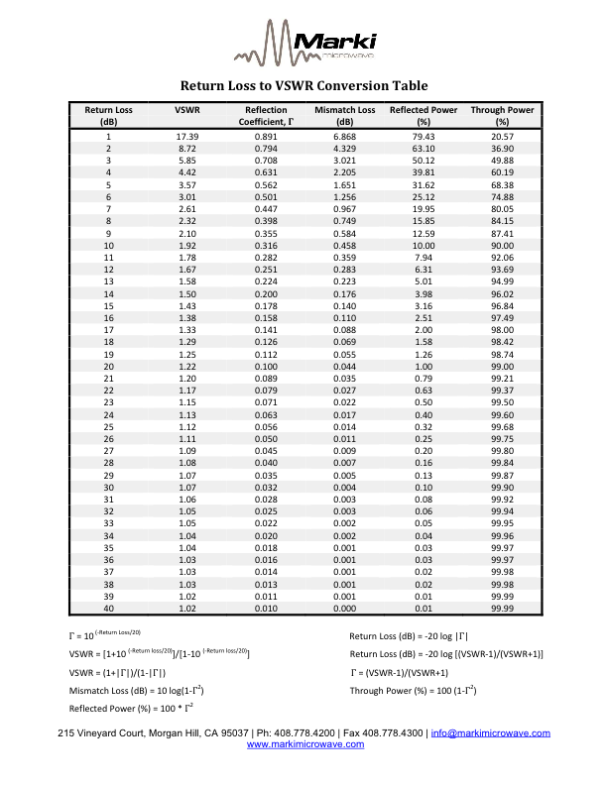
Measuring VSWR – checking an antenna balun

Slide 2
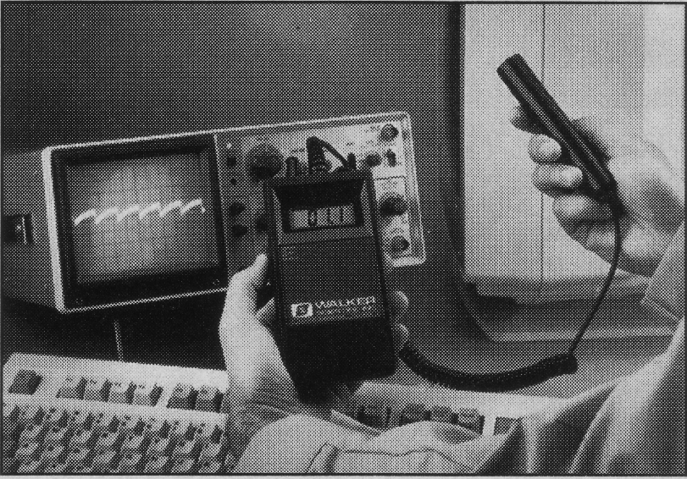
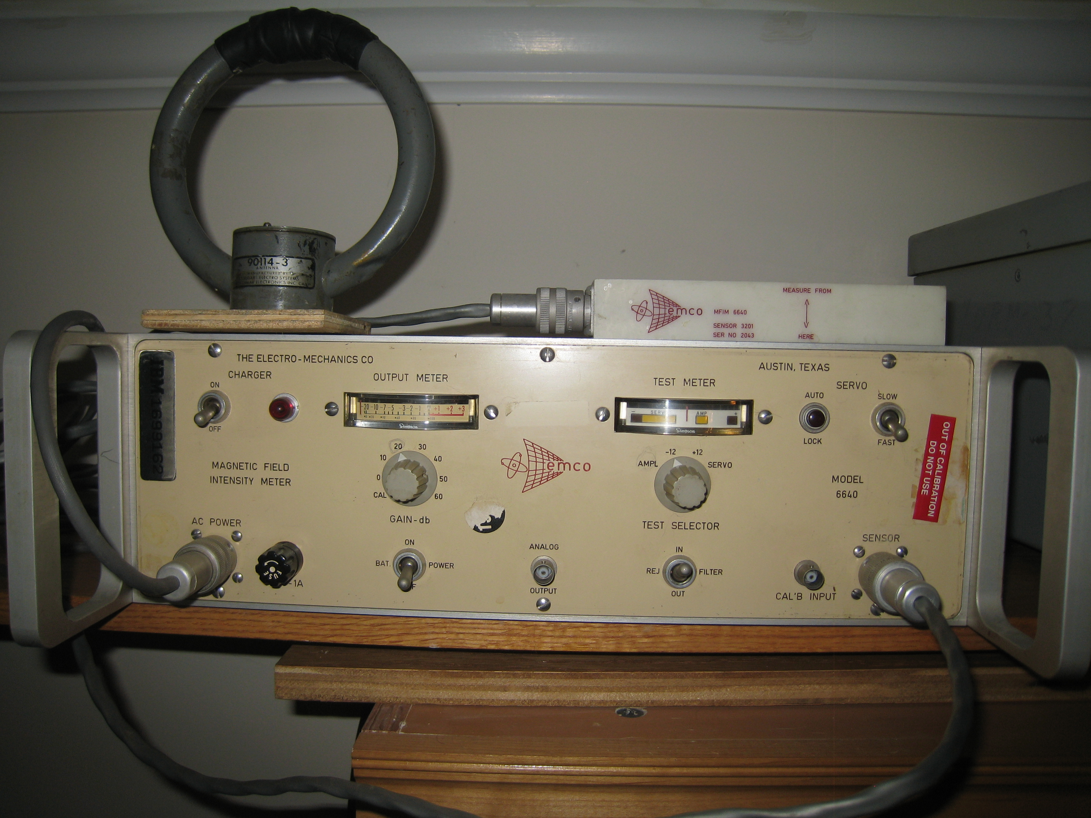
Walker Scientific VLF-80D
Magnetic Field Measurement
RE01
RE04

Slide 3
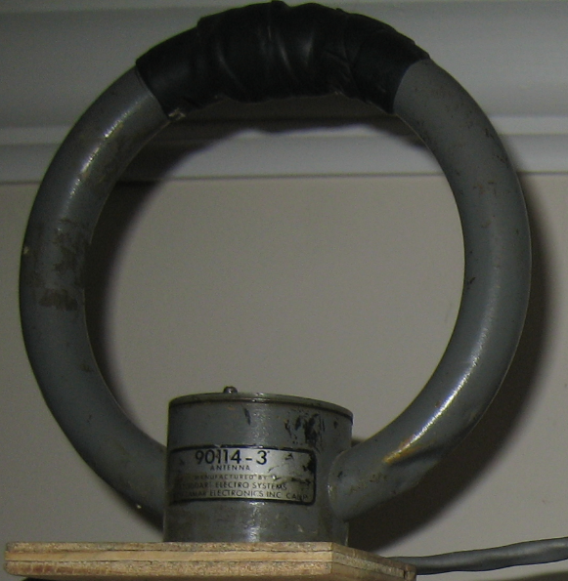
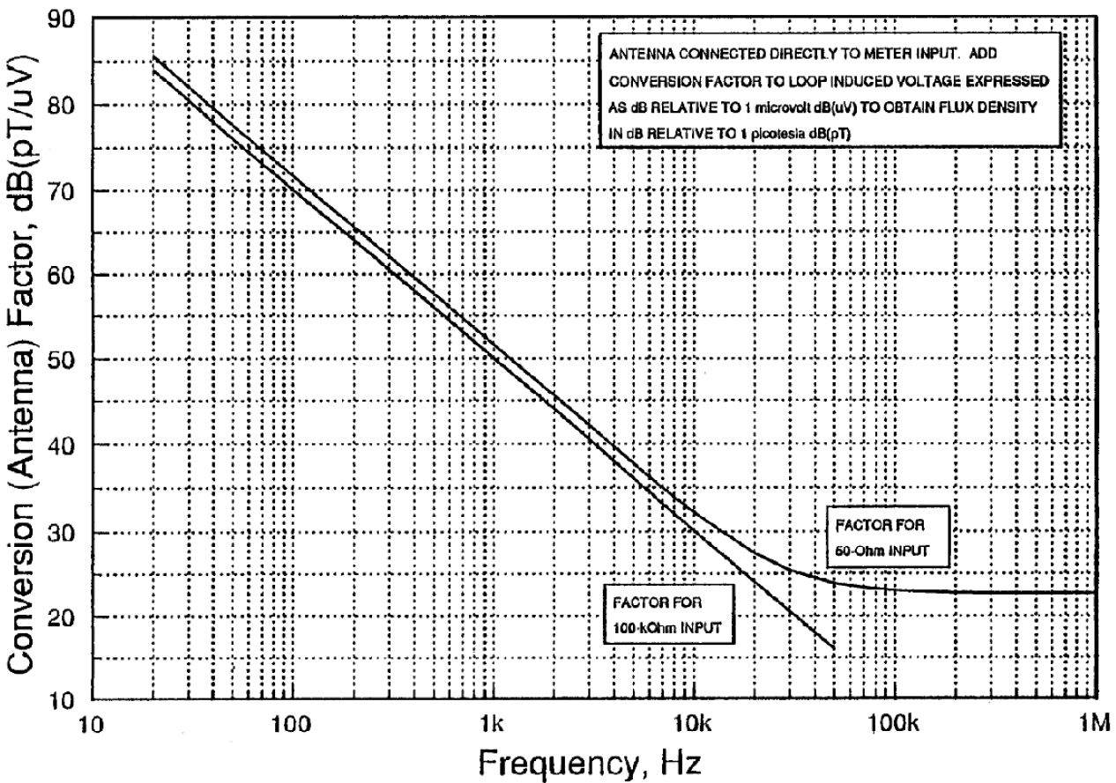
Walker Scientific VLF-80D
Magnetic Field Measurement
RE01
RE04
36 turns on 5.25” coil form
Simple Faraday Law coupling: V = -dΦ/dt

Slide 4
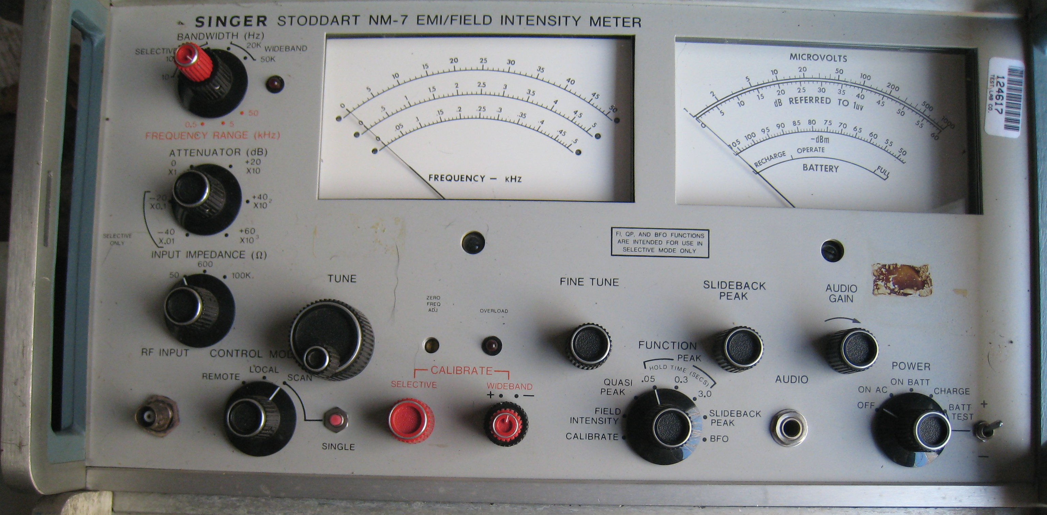
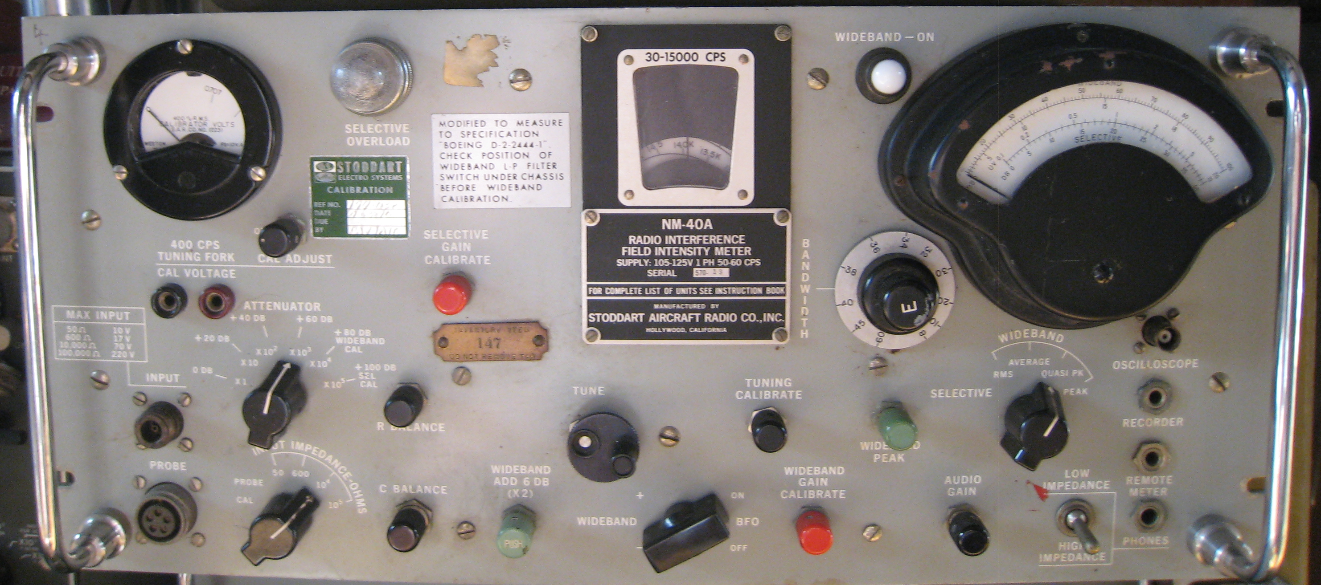
Walker Scientific VLF-80D
Magnetic Field Measurement
RE01
RE04

Slide 5
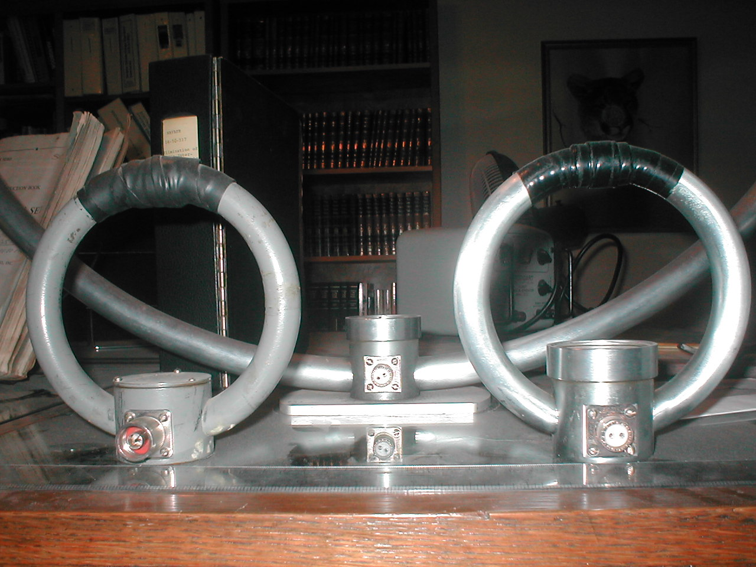
5.16 RE101, Audio Frequency Magnetic Emissions
WARNING! WARNING!

Slide 6
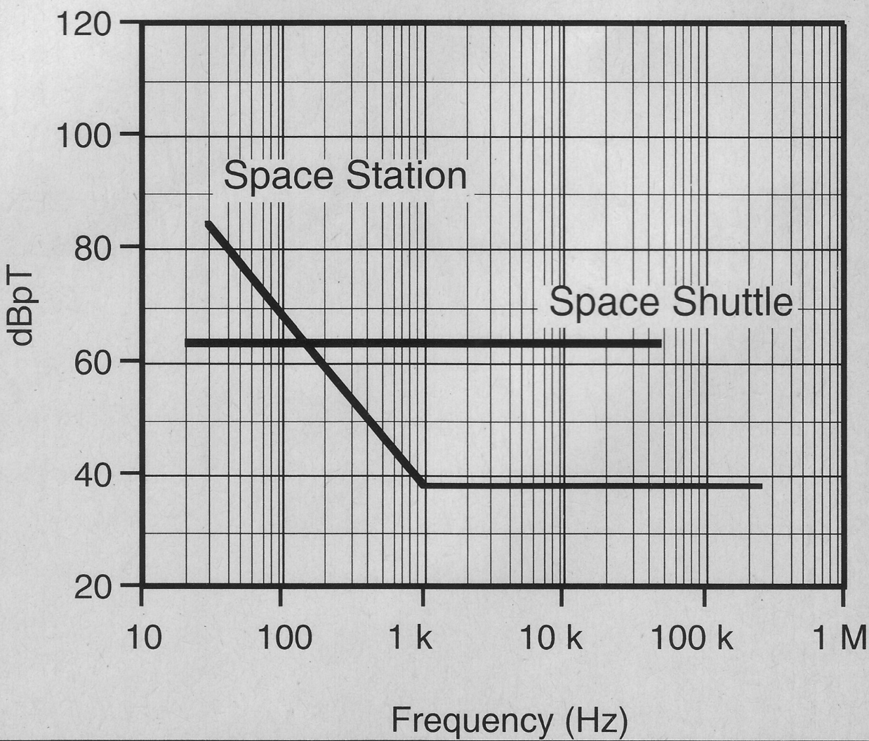
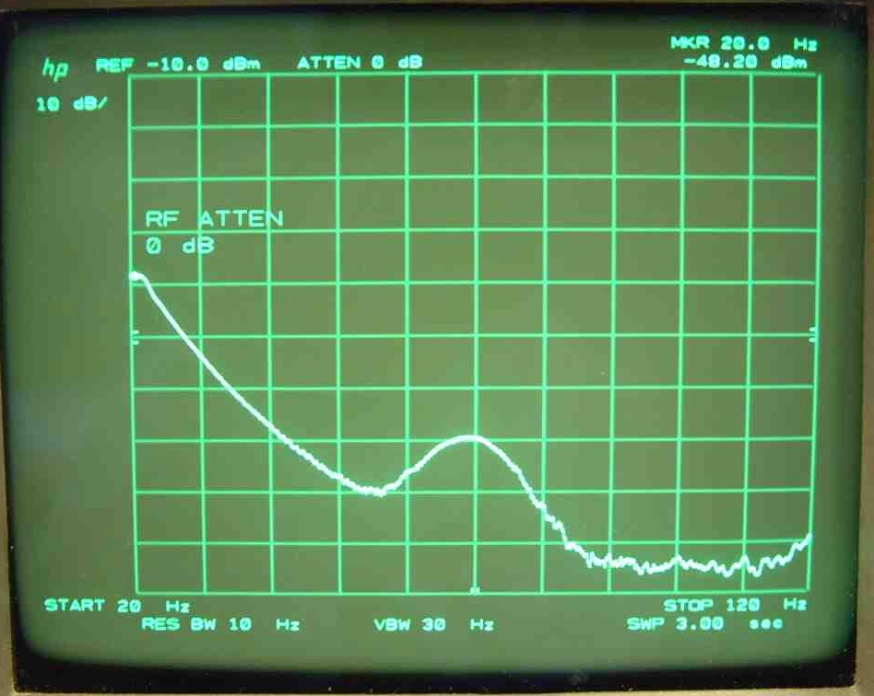
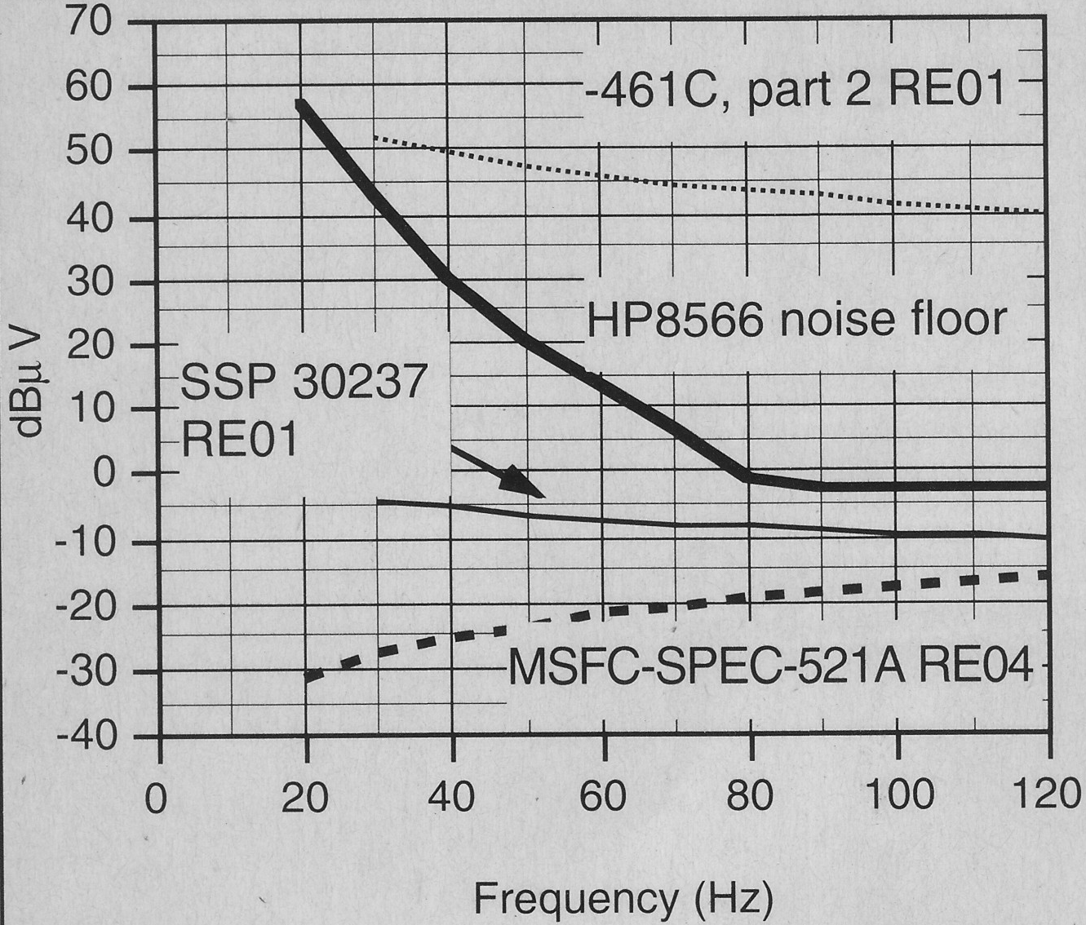
Loop instrumentation issue: sensitivity
–
=
R&S ESU noise floor
57
47
37
R&S ESU noise floor
27
17
07
-3

Slide 7
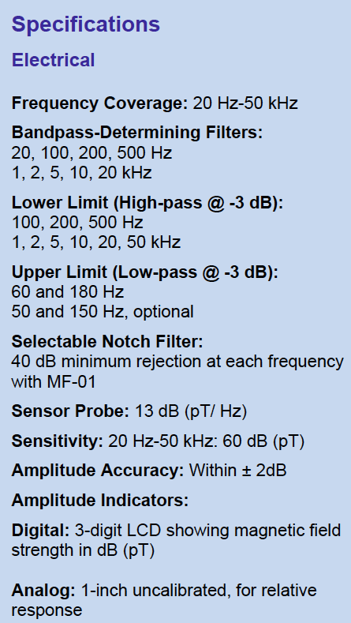
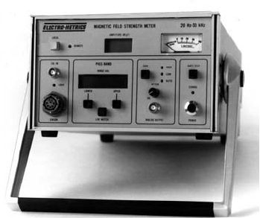
Loop Alternative (Best Performance): Variable-μ magnetometer
EMCO 6640, 1964
Electro-Metrics EM-7530, today

Slide 8
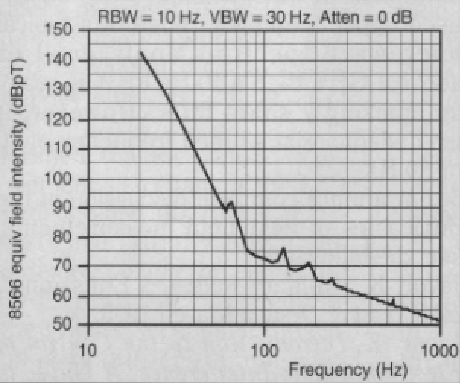
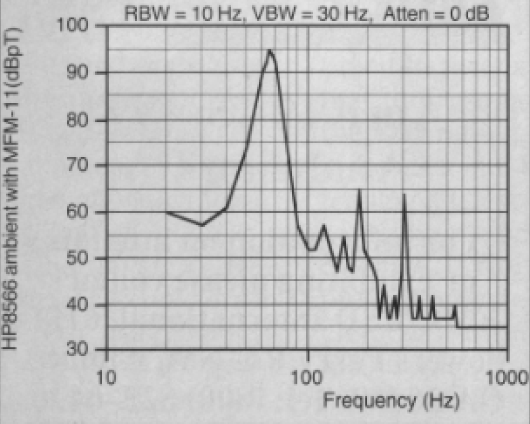
Loop Alternative (Best Performance): Variable-μ magnetometer
Room “ambient” using RE01 loop
Electro-Metrics EM-7530
Room “ambient” using EM-7530

Slide 9
Loop Alternative (Better Performance, lower cost): mag field meter
Walker Scientific VLF-80D (or equivalent)
With HP 8566, will do Space Station, but not (old, obsolete) Space Shuttle limit

