Slide 1
Micrometeoroid and Orbital Debris (MMOD) Risk Overview
Eric Christiansen
NASA Johnson Space Center
July 2014

Slide 2
Agenda
Background on micrometeoroid and orbital debris (MMOD) environment
MMOD shielding overview
ISS MMOD risk issues
  Radiators
  Solar arrays
  Solar array masts
  EVA Handrails
  Hardware behind bumpers or covers
  Return vehicle thermal protection systems (TPS)

Slide 3
MMOD Environment Models
Orbital Debris provided by JSC & is the predominate threat in low Earth orbit
  ORDEM 3.0 is latest model (released December 2013)
  Man-made objects in orbit about Earth impacting up to 16 km/s
    average 9-10 km/s for ISS orbit
  High-density debris (steel) is major issue
  http://orbitaldebris.jsc.nasa.gov/
Meteoroid model provided by MSFC
  MEM-R2 is latest release
  http://www.nasa.gov/offices/meo/home/index.html
  Natural particles in orbit about sun
    Mg-silicates, Ni-Fe, others
  Meteoroid environment (MEM): 11-72 km/s
    Average 22-23 km/s

Slide 4
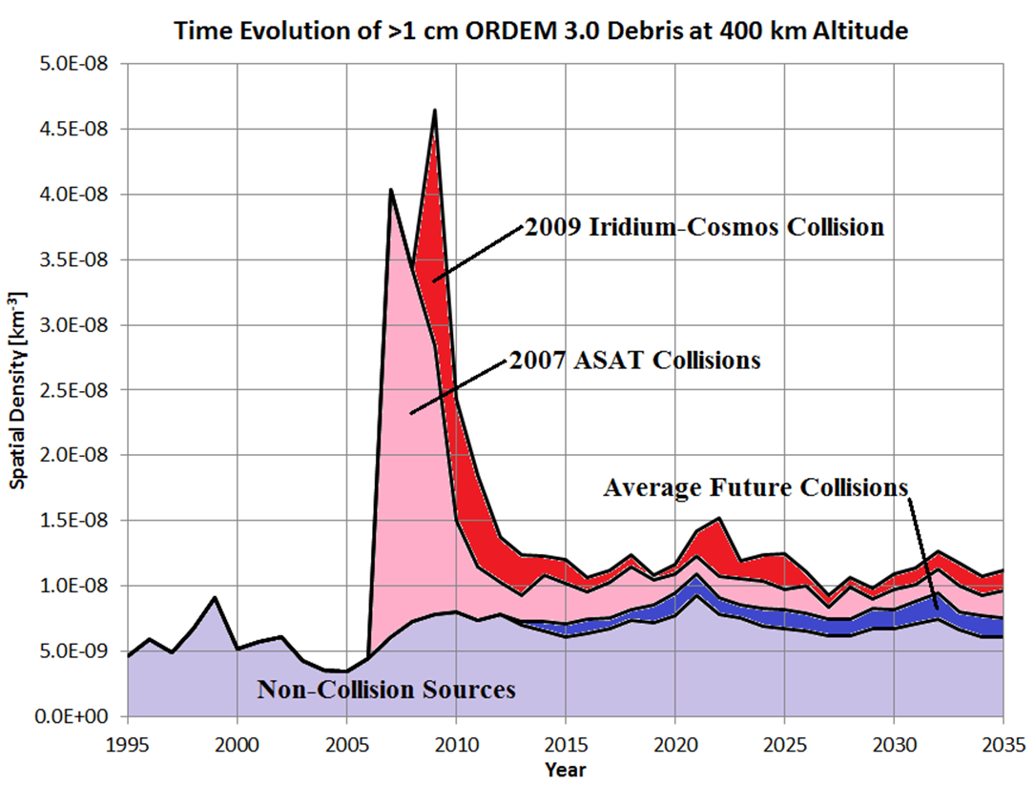
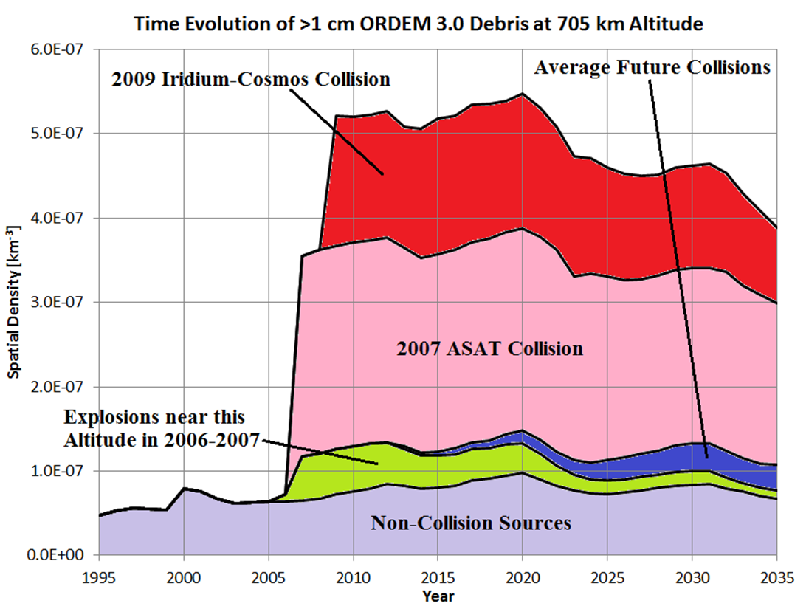
MMOD Environment Models
Meteoroids consist of background sporadic flux (static), and streams from meteor showers (variable)
  Occasionally, showers can turn into storms
Orbital Debris is dynamic, changing as function of the rate of on-orbit explosions & collisions, launch rate and atmospheric drag/solar activity
400km altitude
705km altitude
Note, Spatial Density is proportional to impact risk

Slide 5
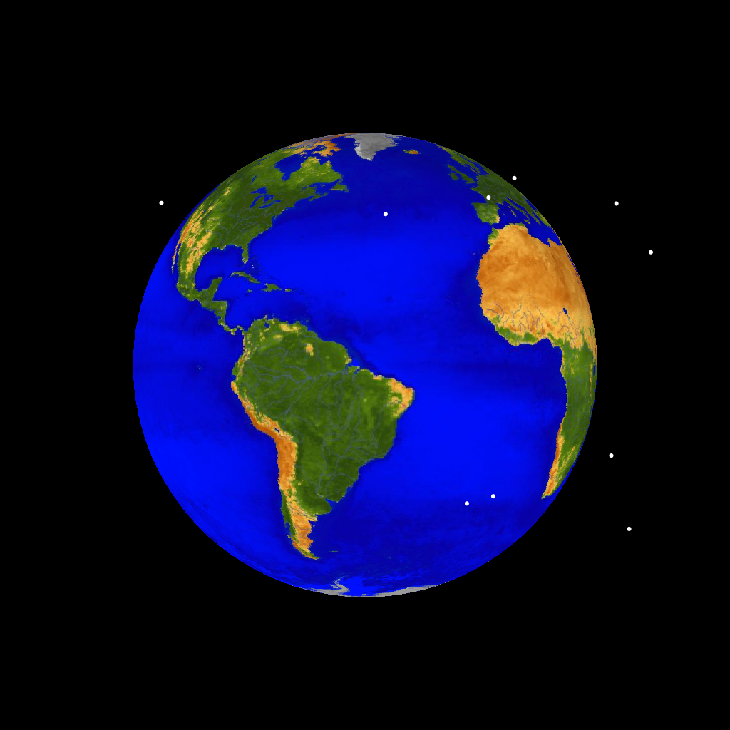
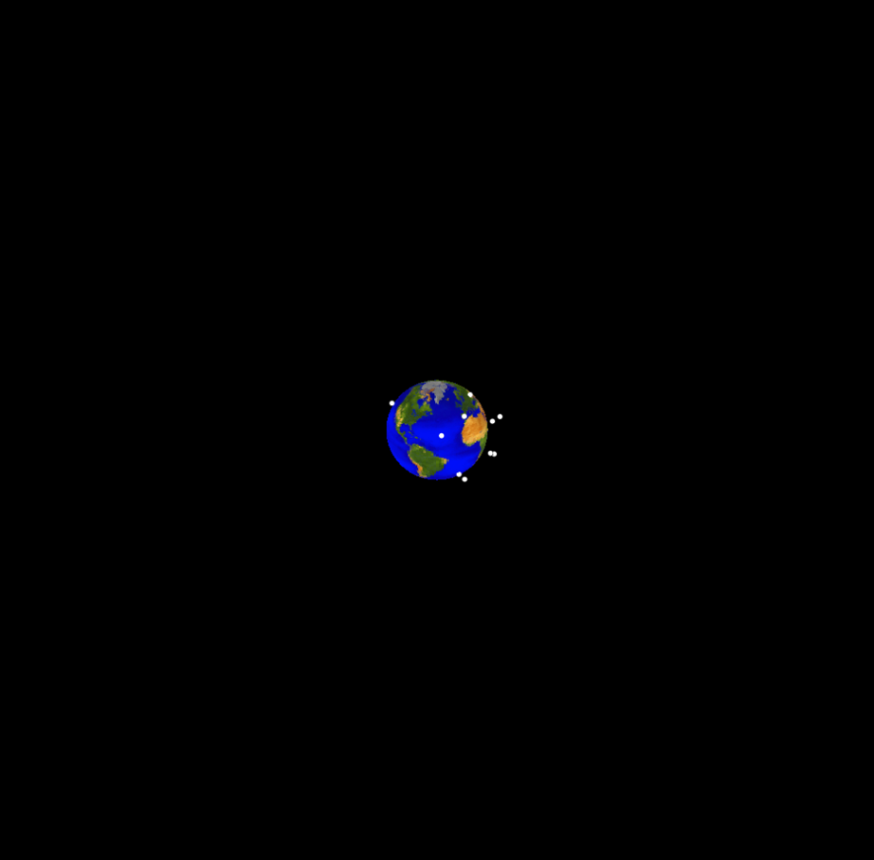
1960
Cataloged objects >10 cm diameter
5

Slide 6
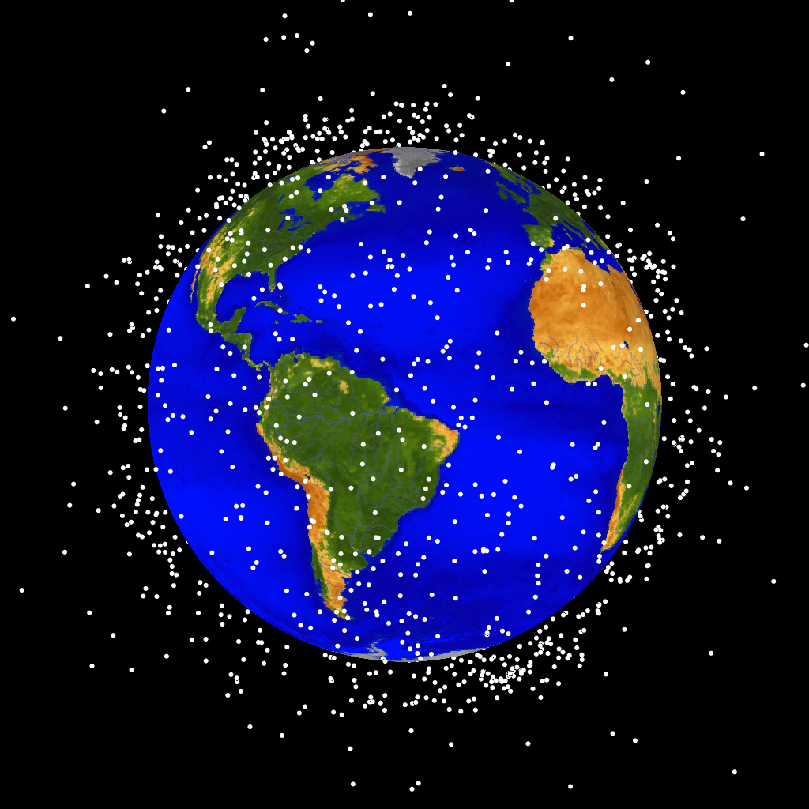
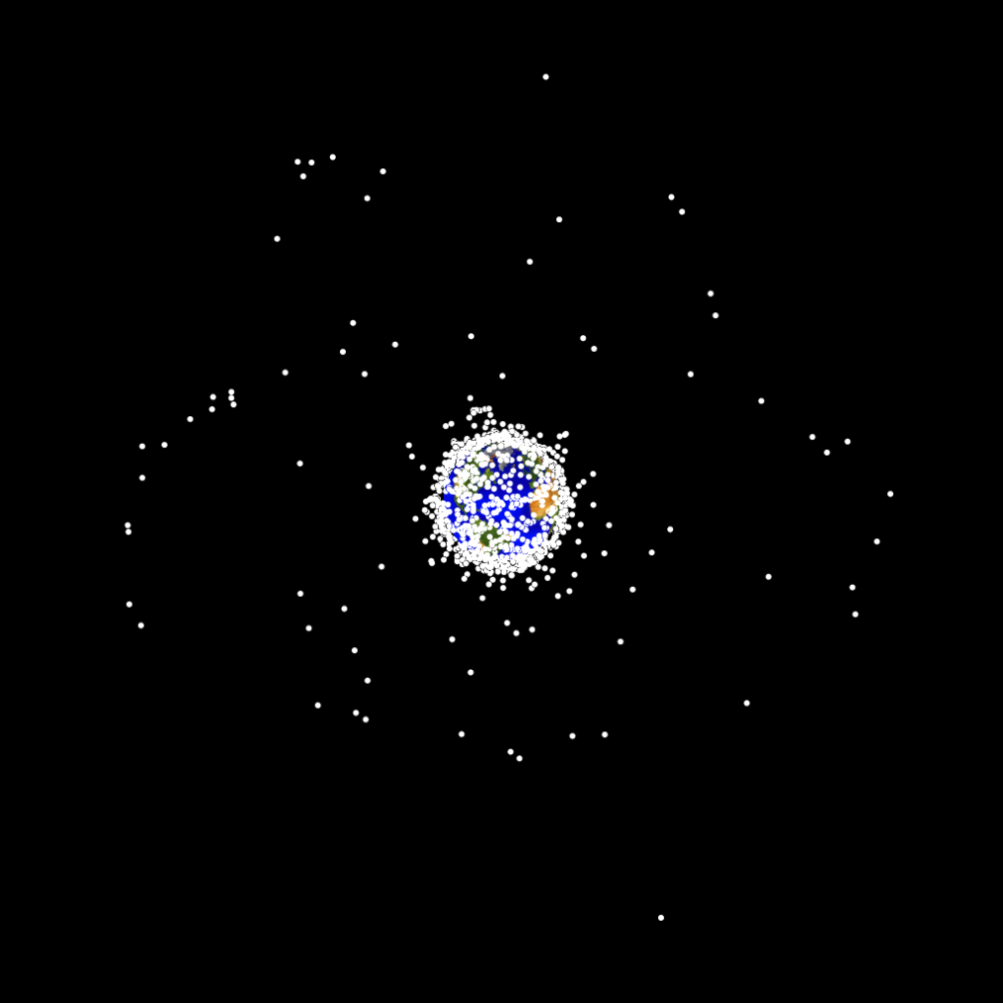
1970
Cataloged objects >10 cm diameter
6

Slide 7
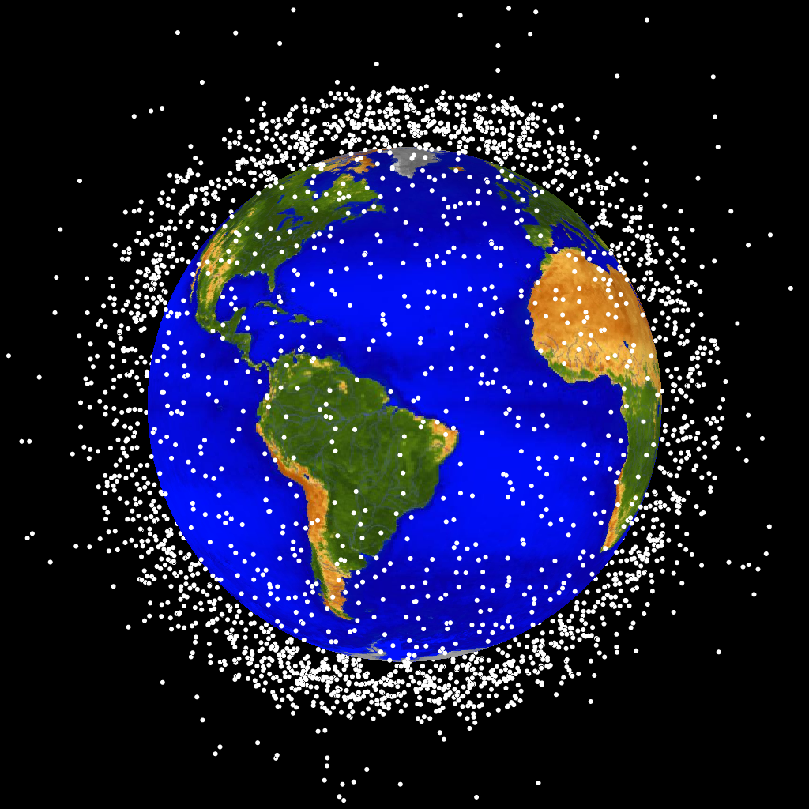
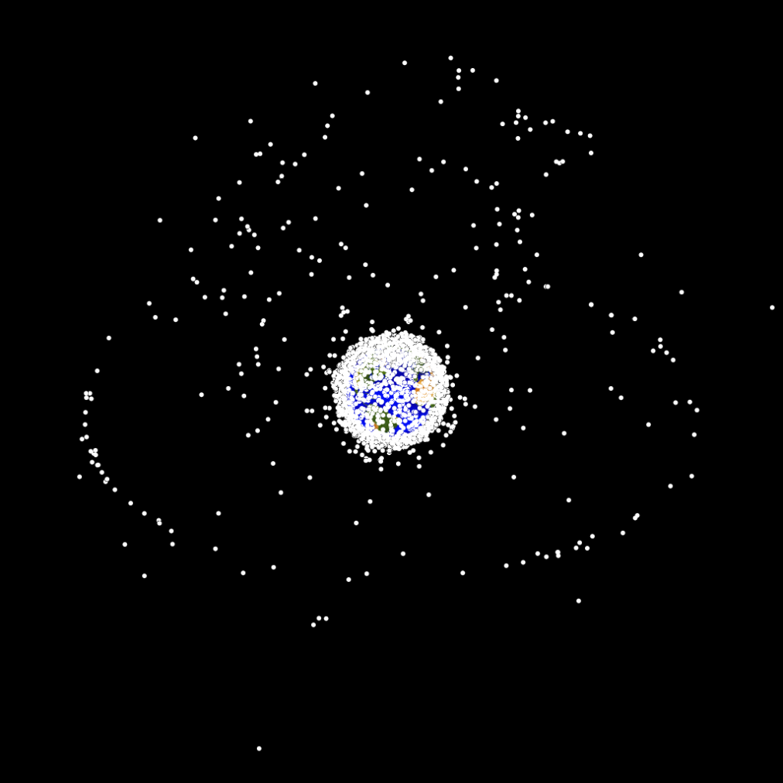
1980
Cataloged objects >10 cm diameter
7

Slide 8
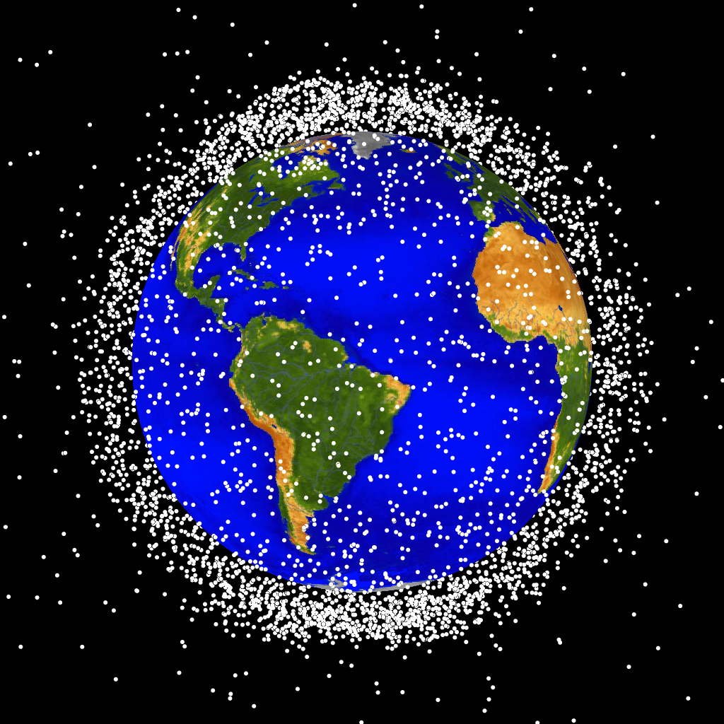
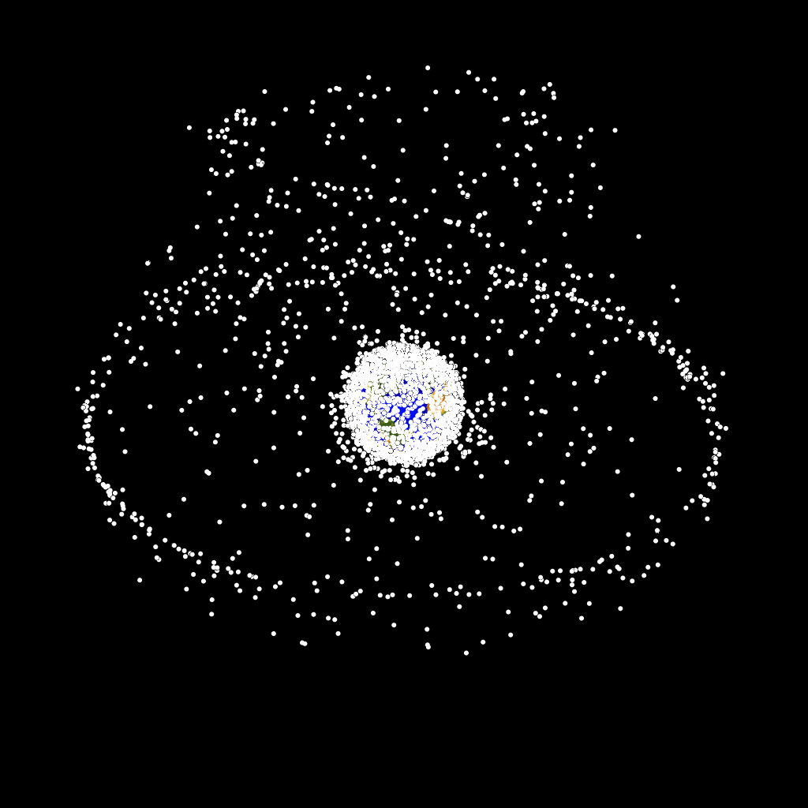
1990
Cataloged objects >10 cm diameter
8

Slide 9
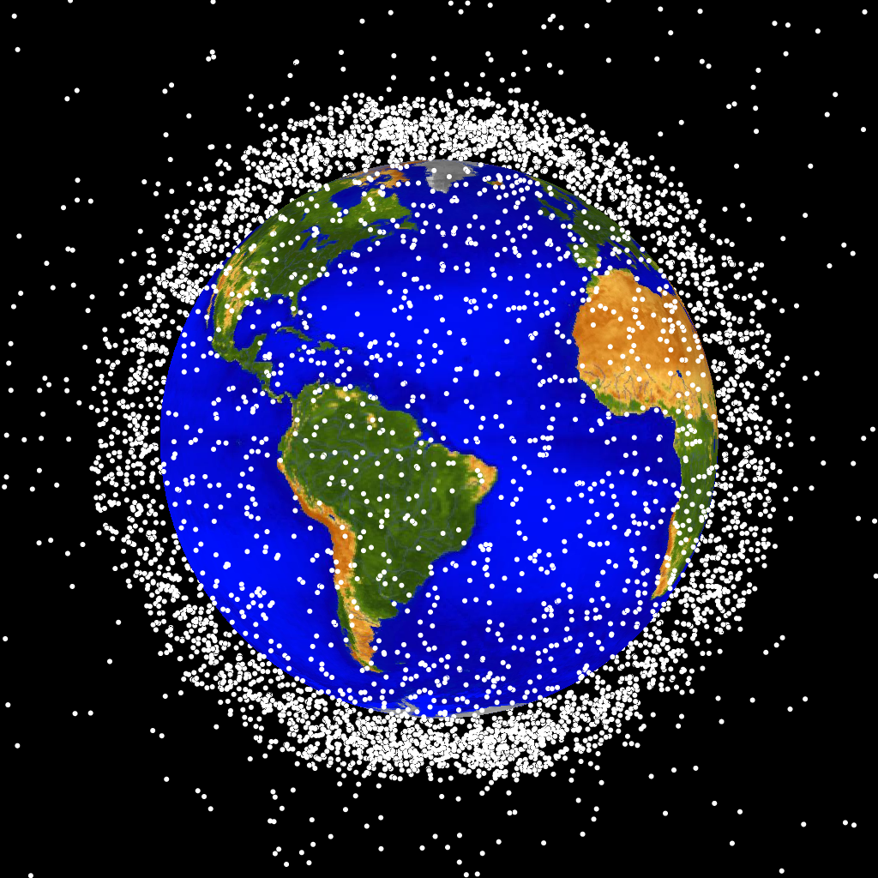
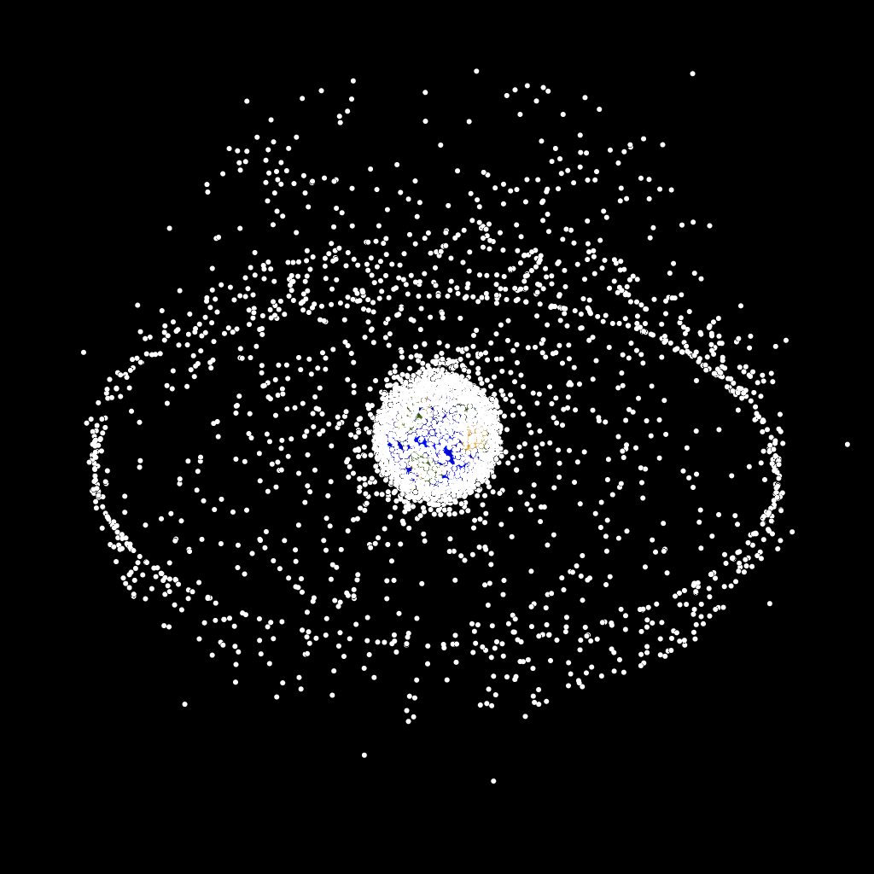
2000
Cataloged objects >10 cm diameter
9

Slide 10
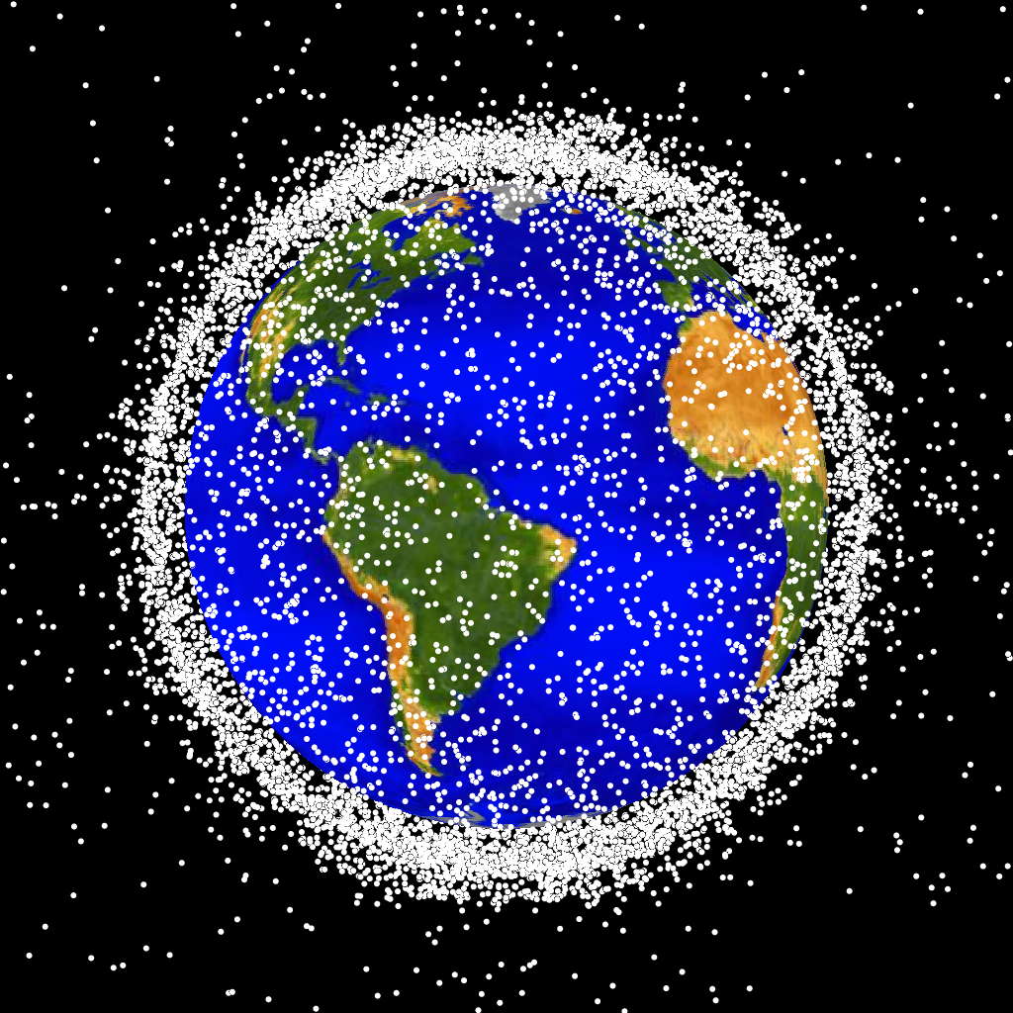
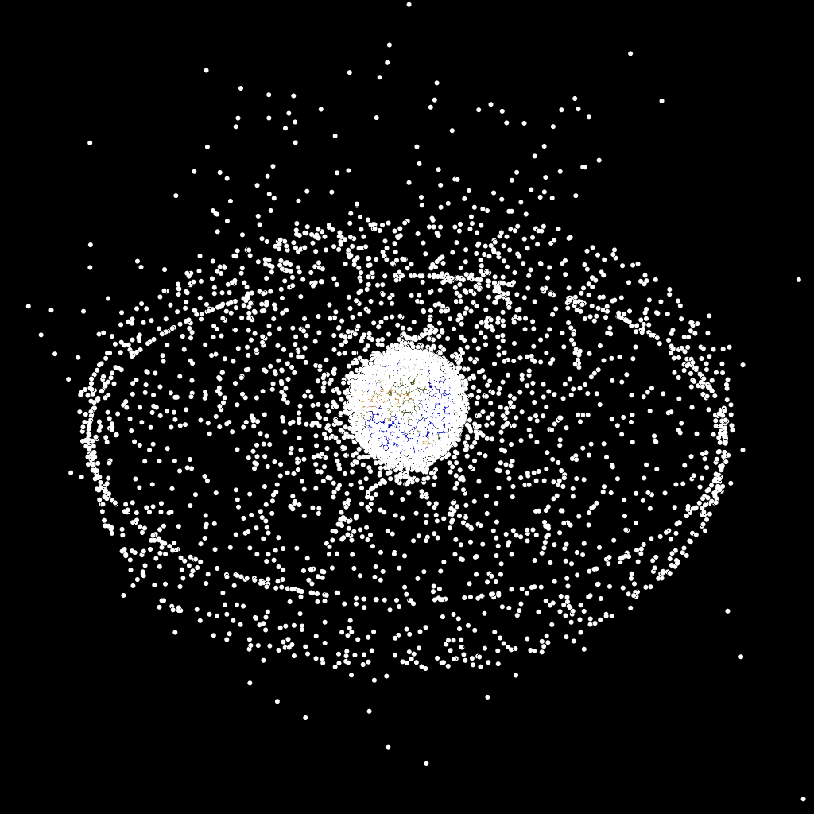
2010
Cataloged objects >10 cm diameter
10

Slide 11
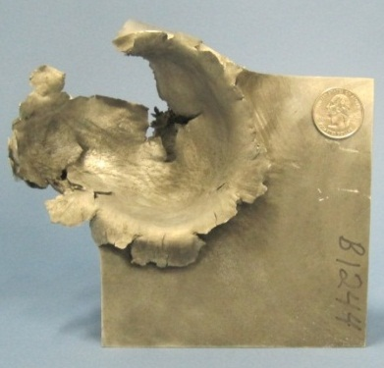
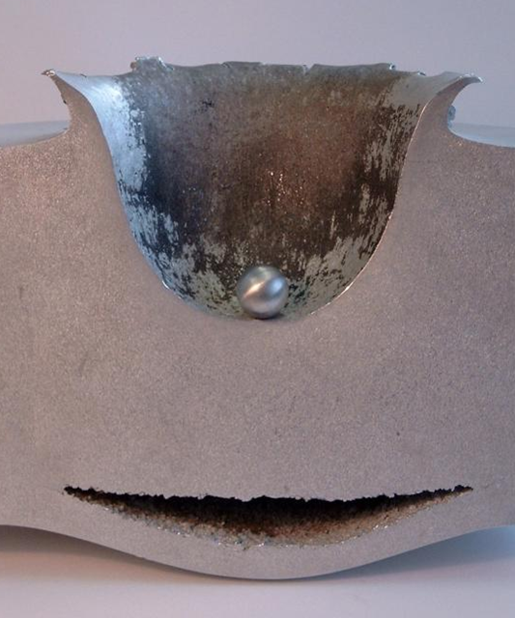
Effects of Micrometeoroid and
Orbital Debris (MMOD) Impacts
Even small MMOD impacts can cause a lot of damage
  Hypervelocity MMOD impacts represent a substantial threat to spacecraft
  Rule of thumb: at 7km/s, aluminum sphere can penetrate completely through an aluminum plate 4x the sphere’s diameter
Damage from a 1.3cm diameter sphere at 7km/s
Comparison of size of projectile to size of impact crater

Slide 12
Monolithic versus Stuffed Whipple Shield
Weight Comparison of Equal-Performance Shielding
Stuffed Whipple Shield
4.5 pounds per square foot
aluminum sphere
(debris simulant)
0.5” diameter
Aluminum “Monolith” Shield
29.1 pounds per square foot
Scale: 1” = 1”
Impact Velocity
(7 km/s)
aluminum sphere
(debris simulant)
0.5” diameter
(spacecraft exterior)
0.08” aluminum
Impact Velocity
(7 km/s)
(vacuum)
(spacecraft exterior)
2.00” aluminum
equal performance
thermal insulation
(vacuum)
6 layers Nextel® AF-62
2.00” (solid)
4.50”
84% weight reduction
6 layers Kevlar® Style 710
(or KM2-705)
(spacecraft interior)
(vacuum)
These shields can stop a 0.5” diameter aluminum debris projectile impacting at 7km/s, but the Stuffed Whipple shield weighs 84% less (94% if rear wall is excluded) and costs much less to launch to orbit
0.188” aluminum
(spacecraft interior)

Slide 13
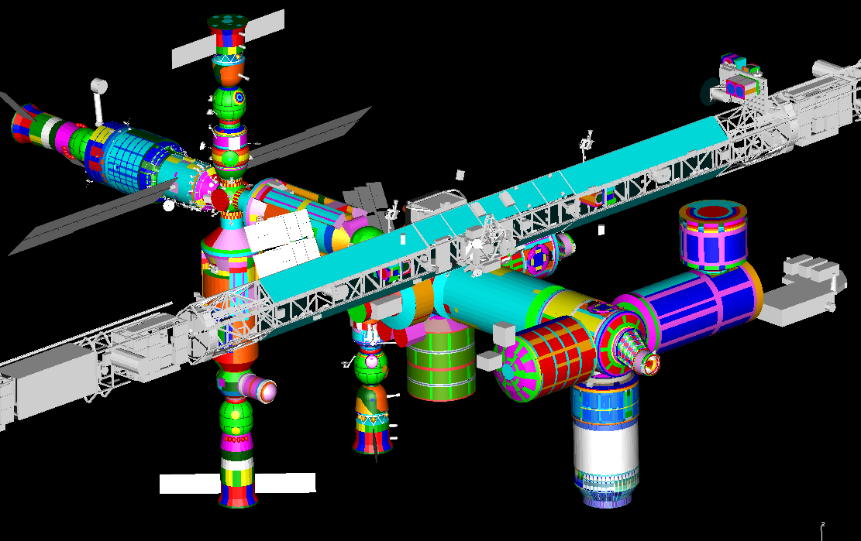
ISS shielding overview
Several hundred MMOD shields protect ISS, differing by materials, standoff distance, and capability
Heavier shields on front & sides (where we expect most MMOD impacts), less capable shielding on aft, nadir and visiting vehicles
Russian Segment
JAXA
NASA
velocity direction
ESA
JAXA
Earth
colors represent different MMOD shield configurations

Slide 14
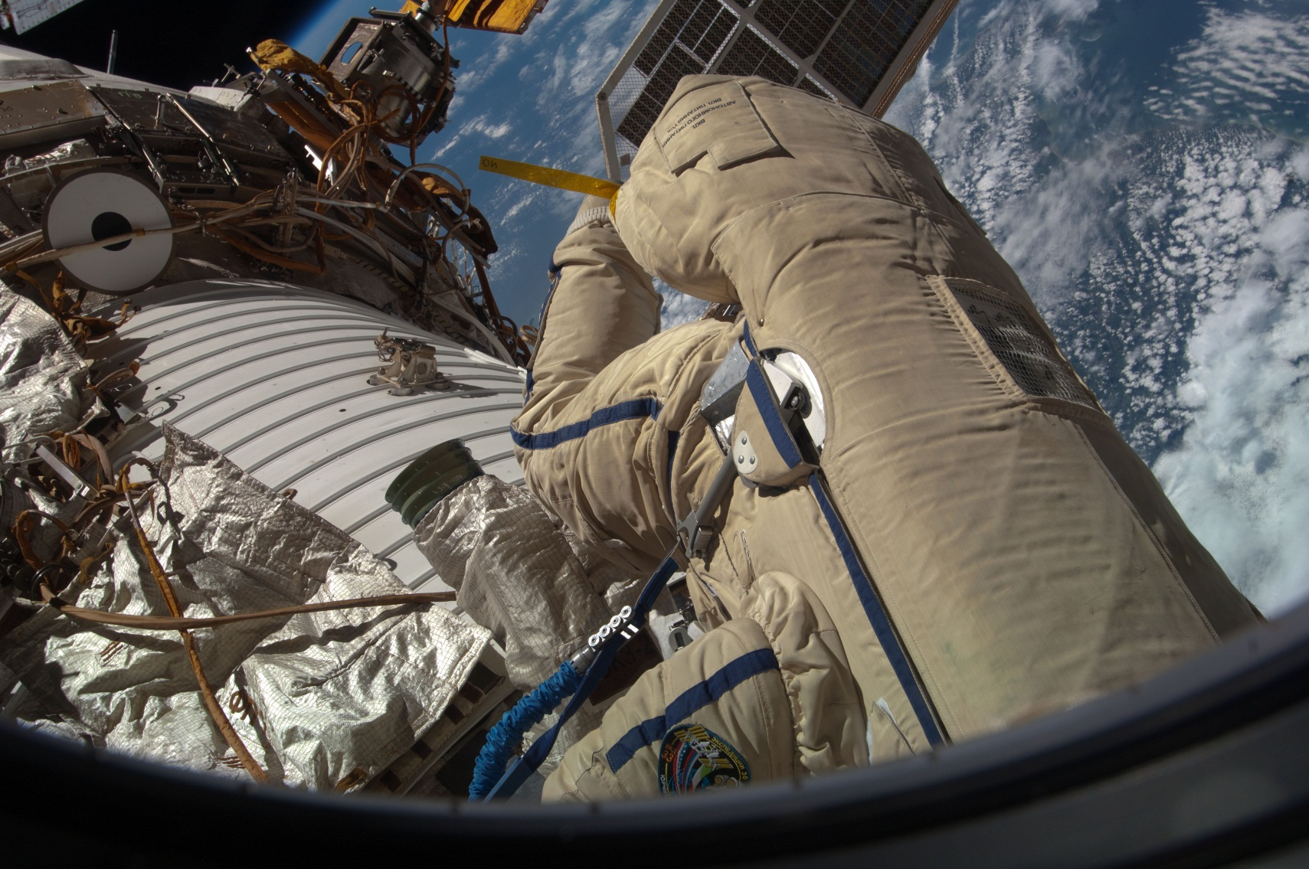
Issues: MMOD Damage to ISS Radiators
MMOD impact damages observed to ISS radiator panels during Russian EVA (June 2013)
ISS036e011356

Slide 15
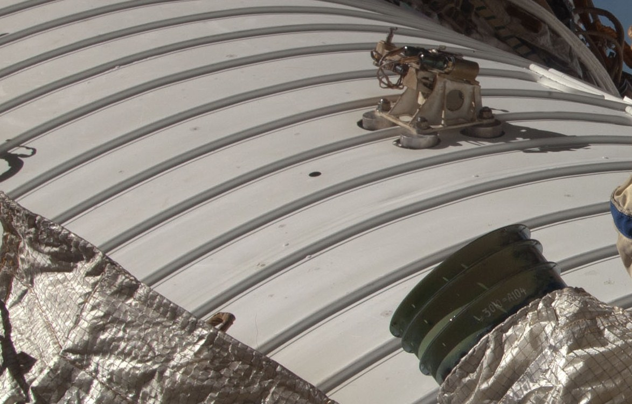
MMOD Damage to ISS Radiators
ISS036e011356

Slide 16
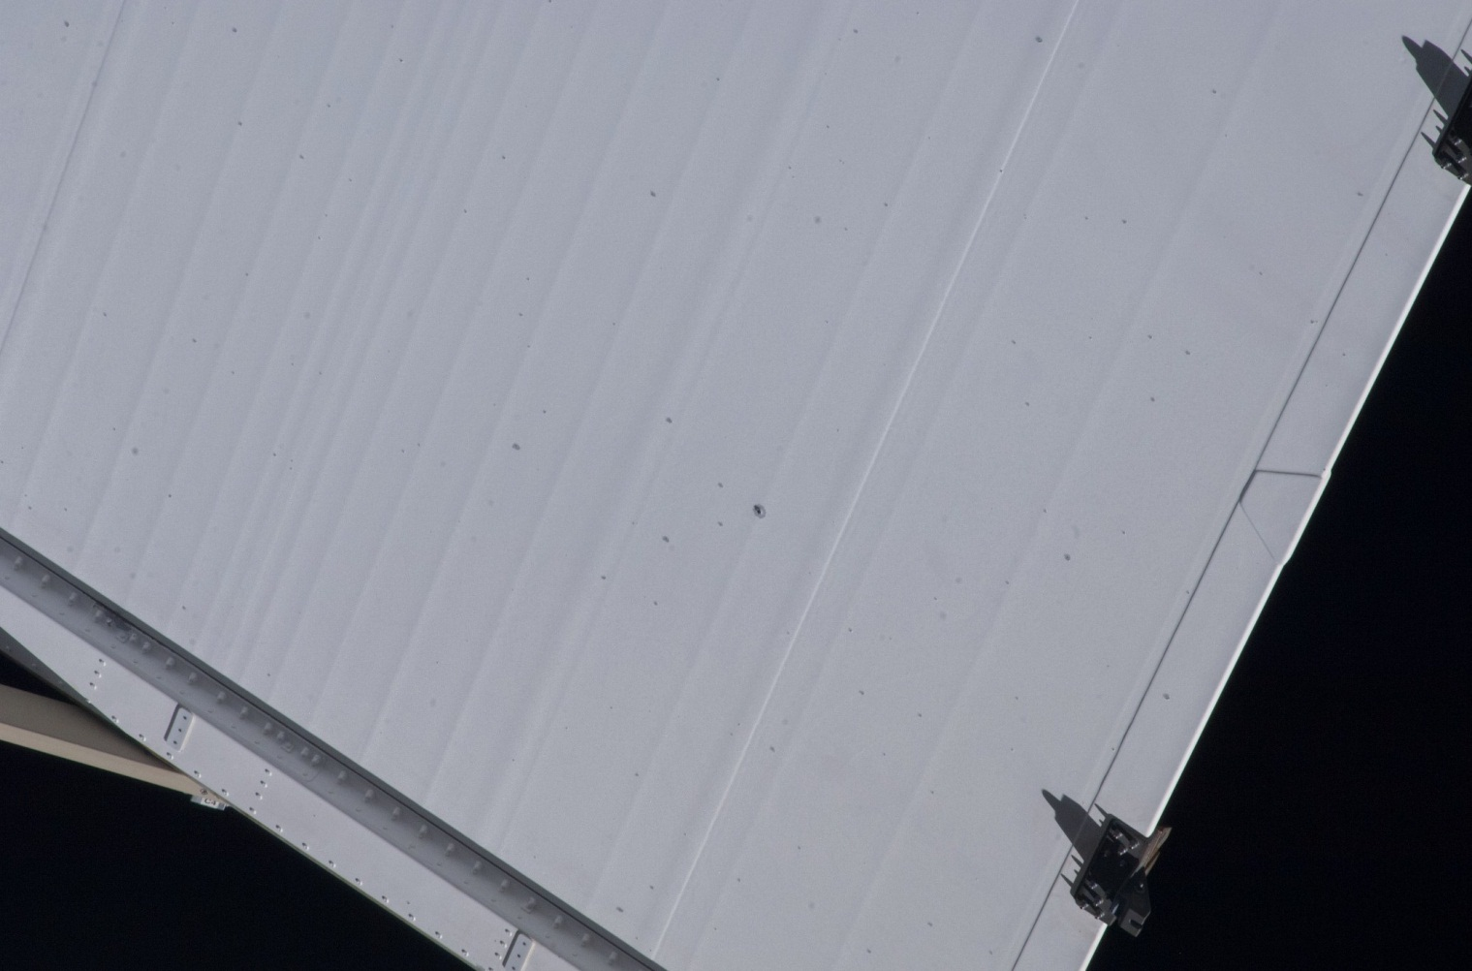
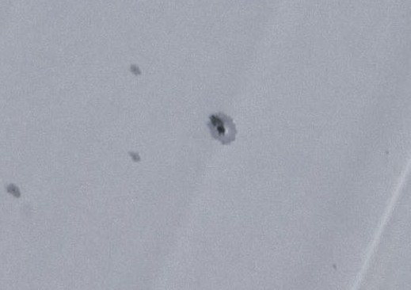
MMOD Damage to ISS Radiators (US)
MMOD impact damages observed to ISS radiator panels (Aug. 2013)
ISS036e037365

Slide 17
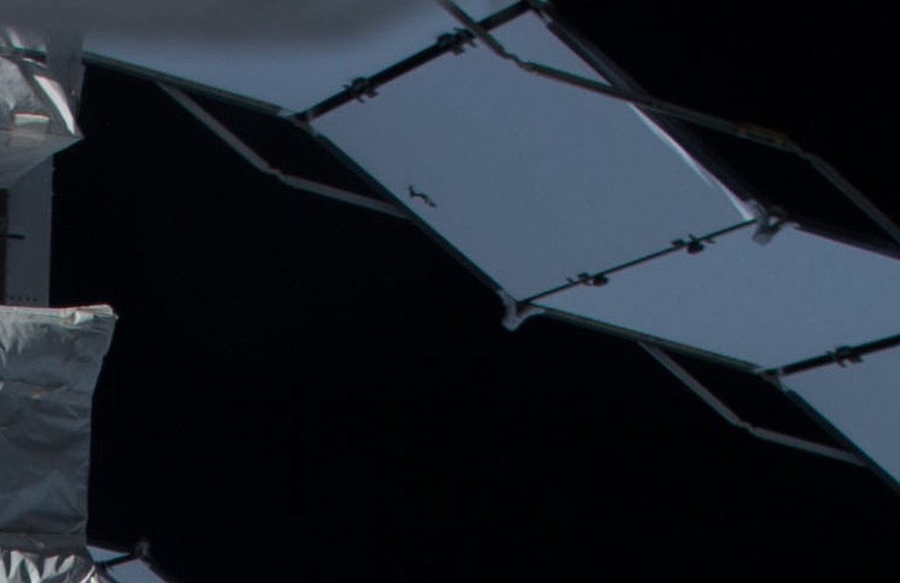
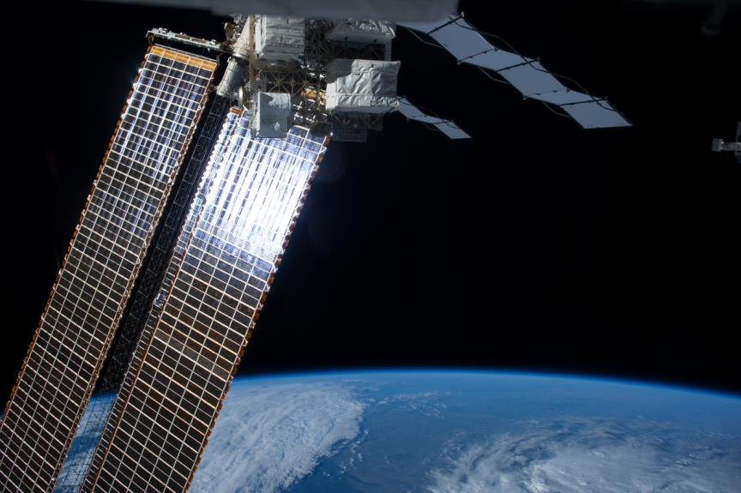
P4 photovoltaic radiator
Initial indication found on 6/30/2014

Slide 18
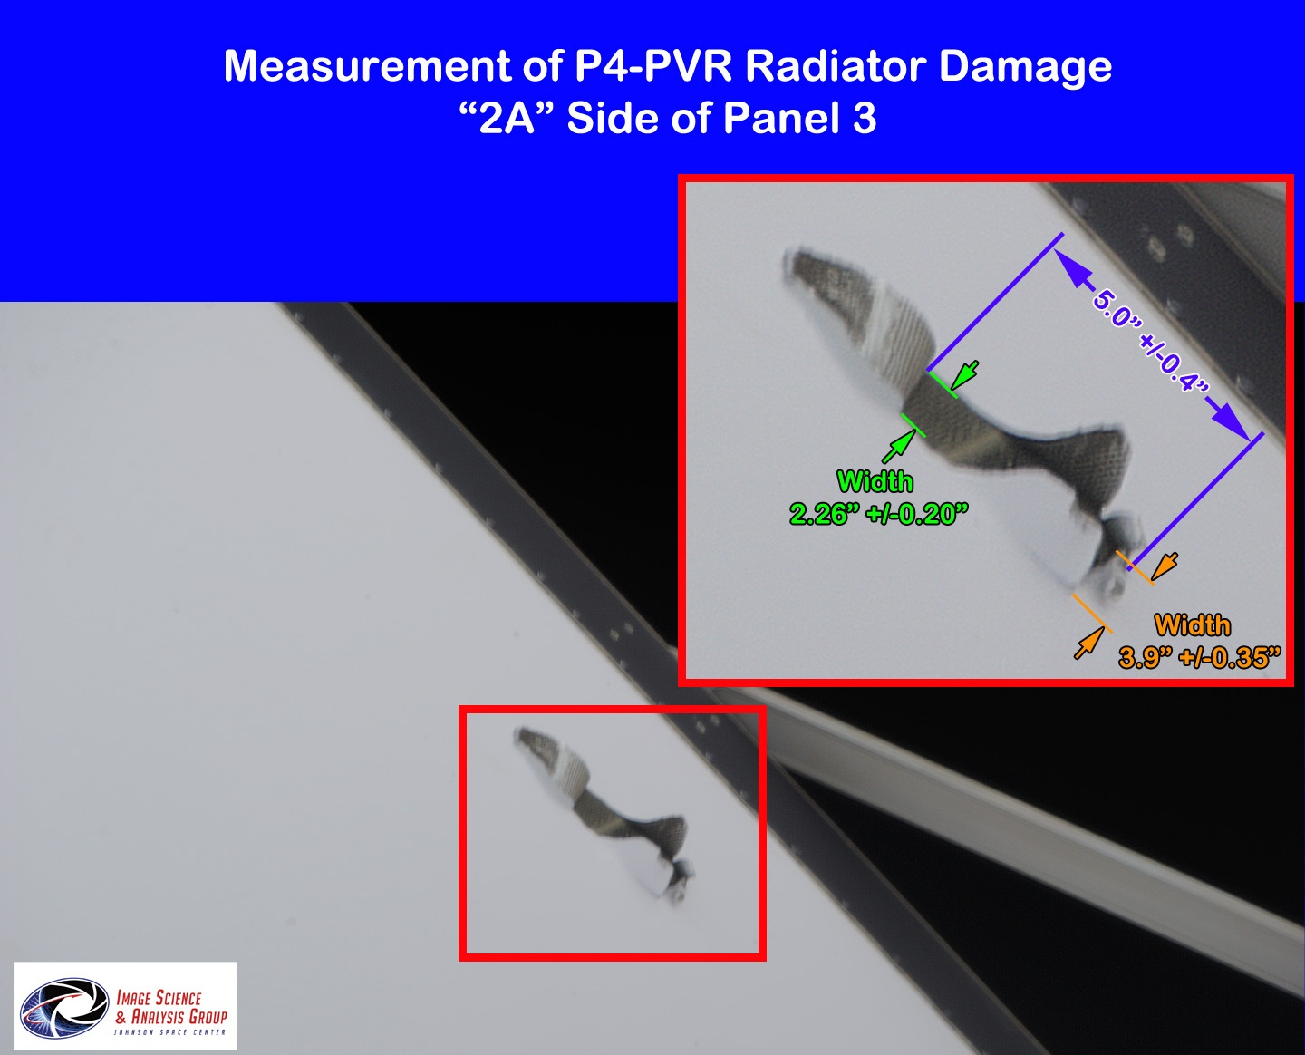

Slide 19
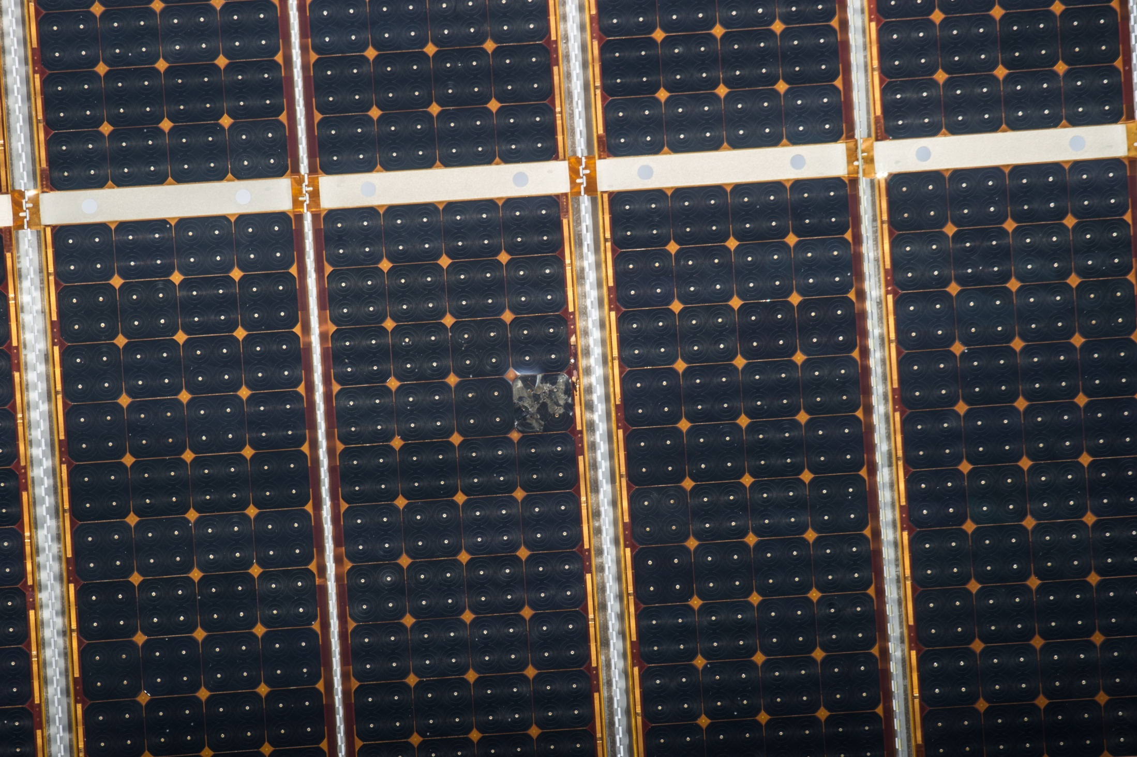
ISS Solar Array Damage
MMOD damage caused disconnected bypass diode, leading to cell overheat damage

Slide 20
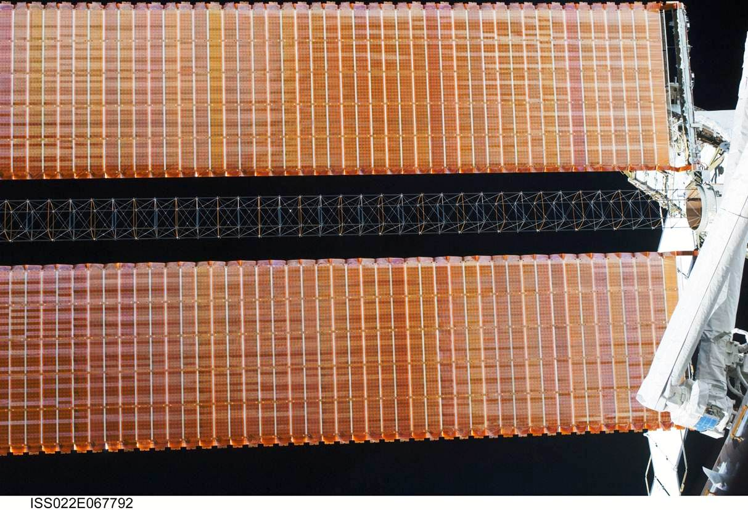
ISS Solar Array Mast
Deployable structural booms or masts used to support ISS solar arrays

Slide 21
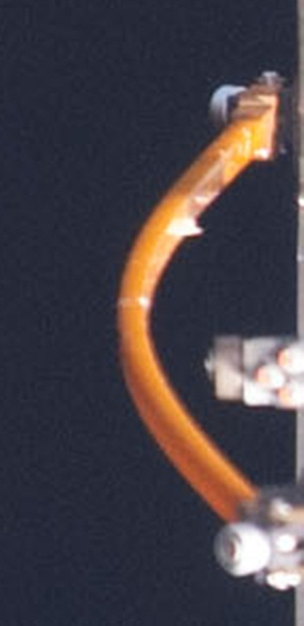
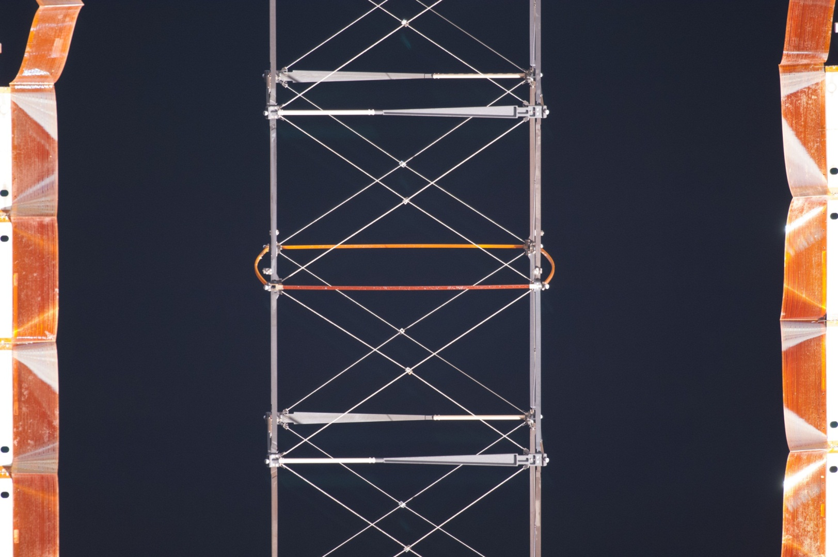
MMOD Damage to ISS Solar Array Masts
Elements of the solar array masts have been damaged from MMOD impacts
ISS038e006032, Nov. 2013

Slide 22
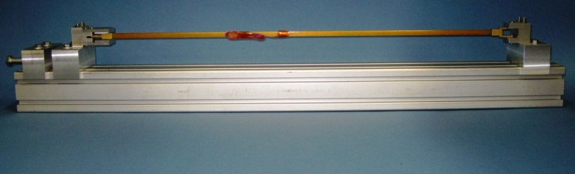
Hypervelocity impact tests
Mast elements have been hypervelocity impact tested and structurally tested to assess residual strength for ISS life extension

Slide 23
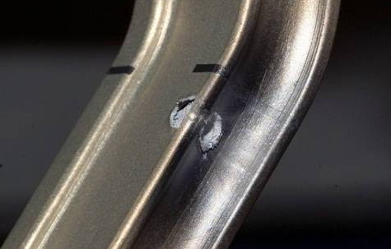
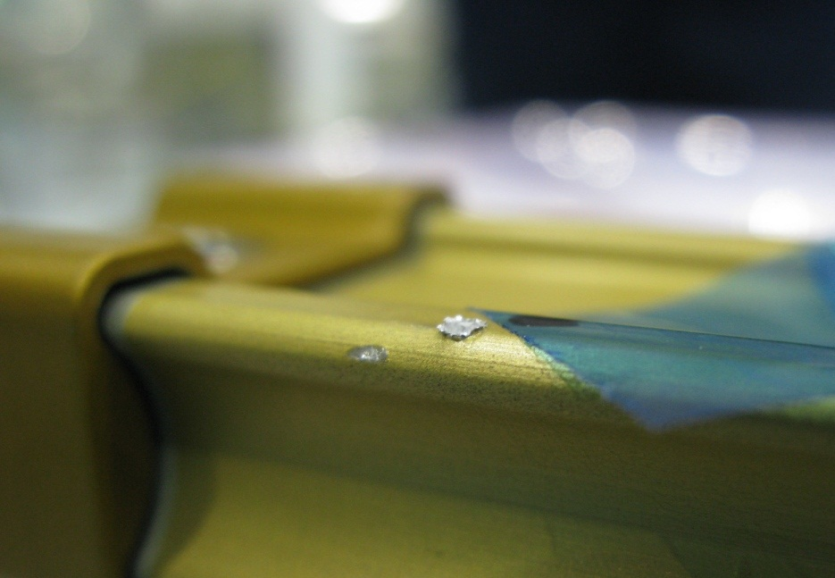
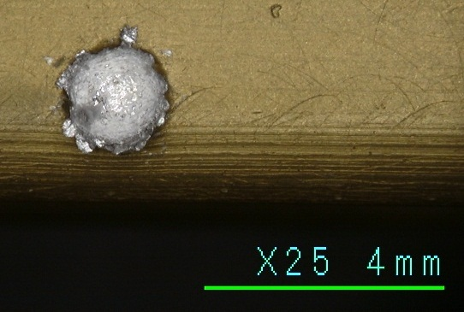
Handrail and EVA tool MMOD damage
Many craters noted to ISS handrails and EVA tools
Sharp crater lips have lead to cuts on EVA gloves
EVA terminated early on STS-118 due to glove cuts
Modifications to EVA suit and ISS EVA procedures necessary to reduce cut glove risk from MMOD damage
Crater on D-handle tool
5mm diameter
Repaired on-orbit during STS-123
Tear in EVA glove
(STS-118 EVA#3)
Crater on ISS pump module handrail
1.85mm diameter x 0.8mm deep
Returned STS-135

Slide 24
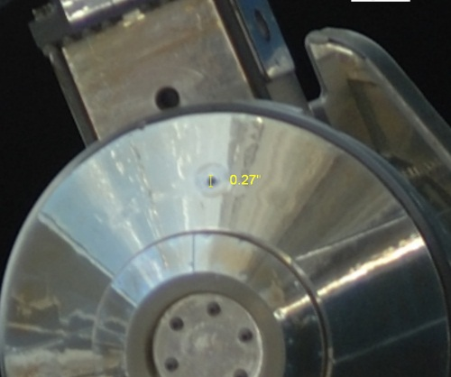
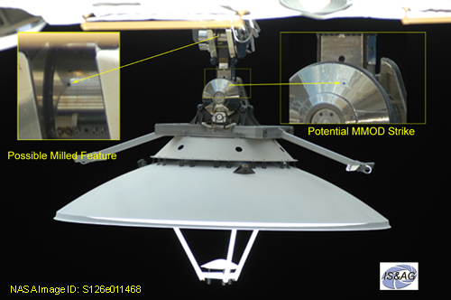
Ku-band antenna
An MMOD Strike was seen on the ISS Ku Antenna Gimbal Gear Cover. The image was captured during Mission ULF2 / STS-126.
Interior damage?

Slide 25
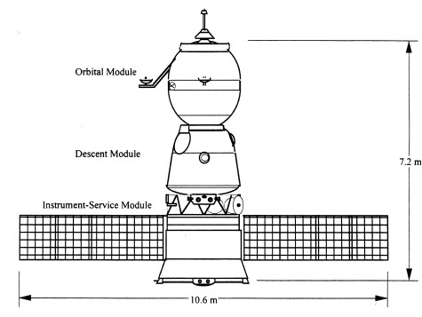
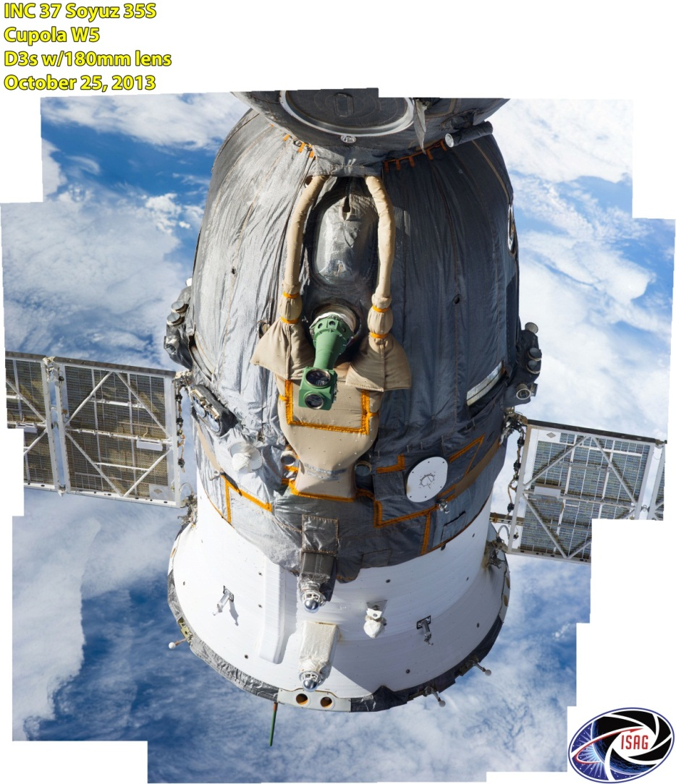
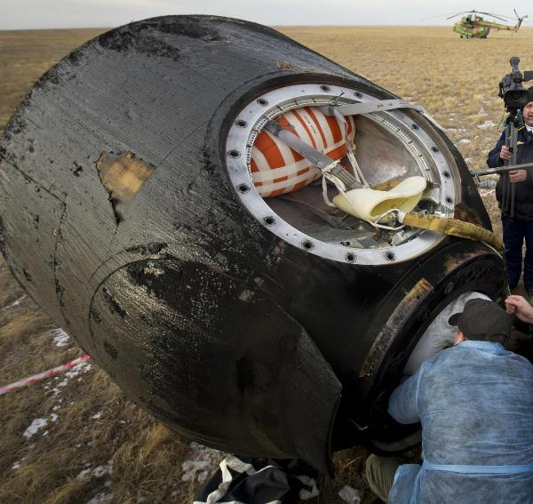
Thermal protection systems (TPS) for crew return vehicles
MMOD risk to thermal protection system (TPS) of ISS crew return vehicles (Soyuz, Commercial vehicles) is high
  Concern is TPS damage that can lead to loss-of-vehicle during reentry
  Issue can be mitigated by inspection and repair or safe-haven (not Program baseline)
Soyuz vehicle
Descent Module
backshell
heatshield

Slide 26
BackuP Charts

Slide 27
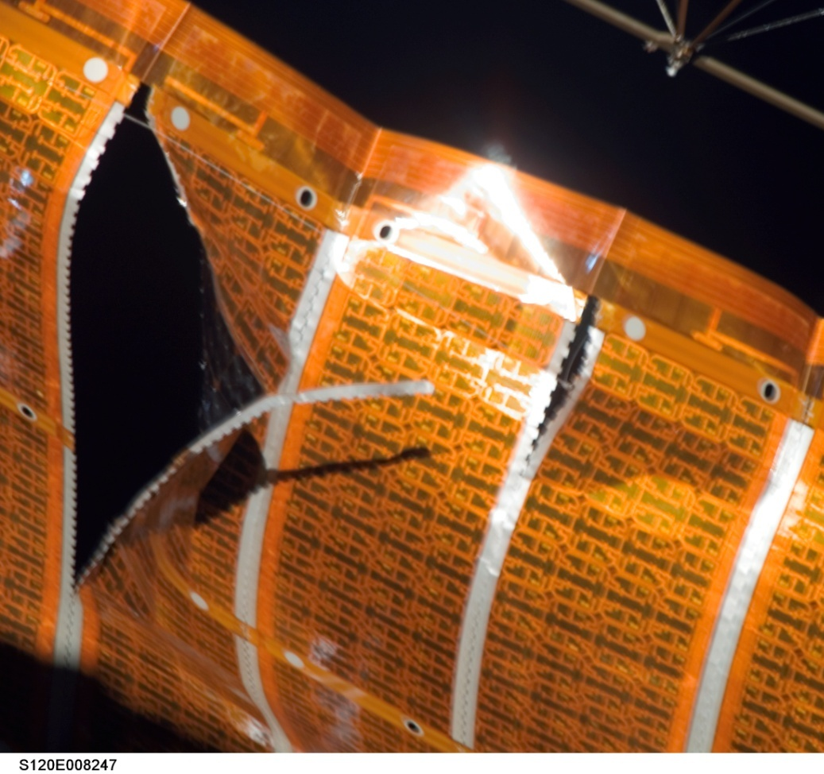
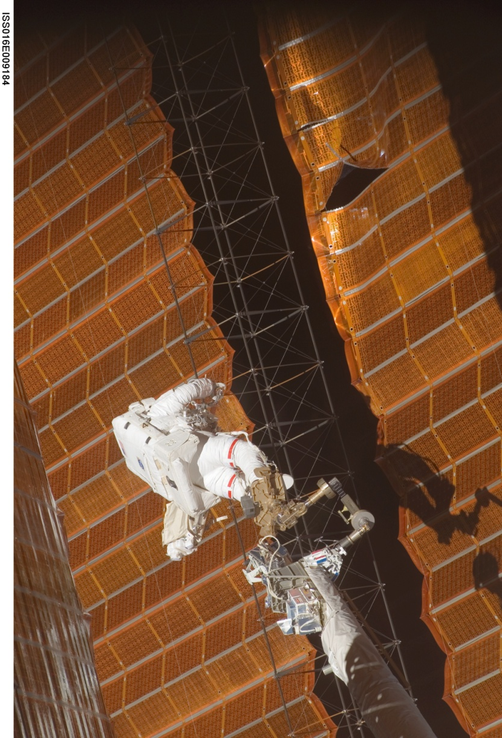
STS-120 Solar Array Wing (SAW) EVA repair was caused by MMOD impact damage
During STS-120 two solar array wings were removed from Z1 truss and relocated to P6 location. During re-deployment, the 4B solar array wing was torn in two places, due to a snagged guide wire. The guide wire was removed and “cuff-links” added to stabilize the array.

Slide 28
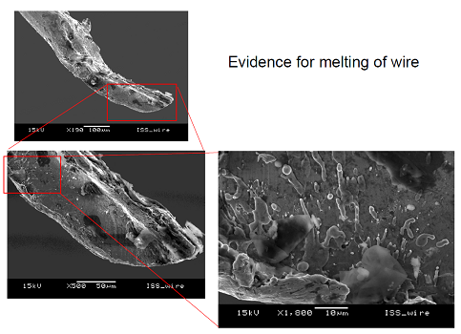
Scanning Electron Microscope EDXA Evaluation of retrieved guide wire
7 of 21 wires in the guide wire cable were broken, causing the guide wire to hang-up in a solar array grommet.
3 of the 7 cut wires exhibited evidence of extensive melt at broken ends, indicative of MMOD impact.

Slide 29
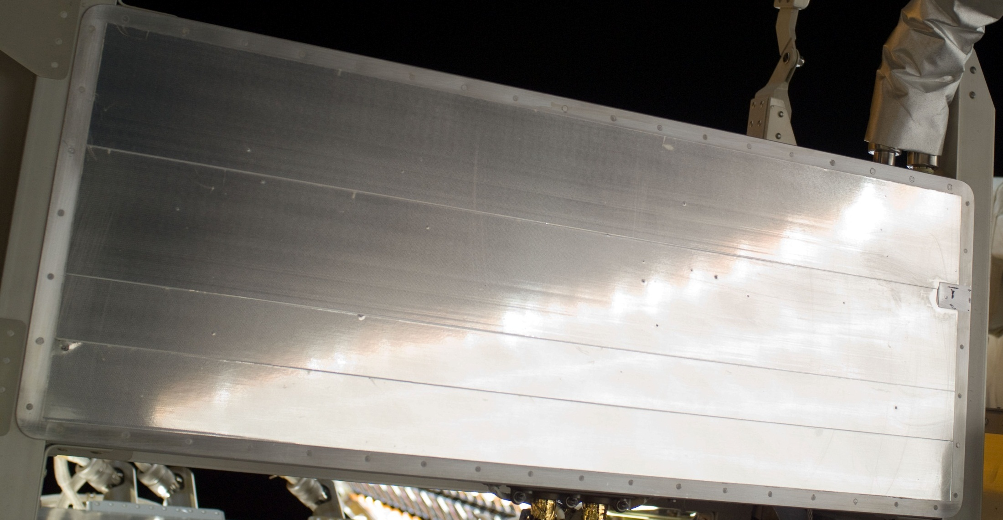
MMOD Damage to ISS
MMOD impact damages observed to radiator panel during EVA-20 (Nov. 2012)
P6 Photovoltaic Radiator Torque Panel (NOTE: numerous smaller impacts not indicated)
ISS033e017859

Slide 30
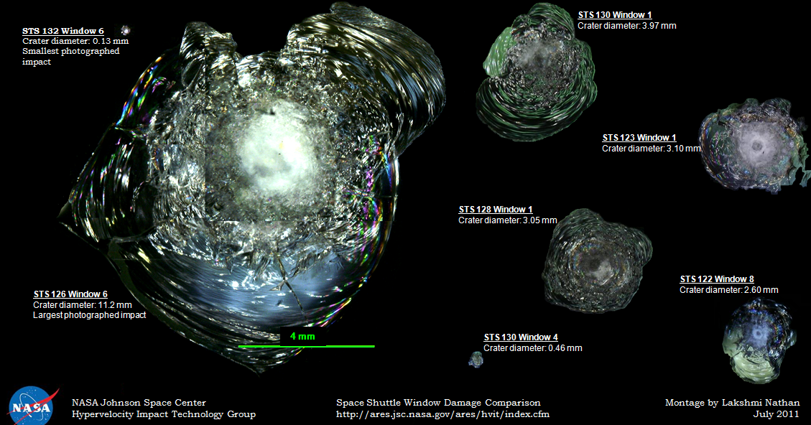
Observed Spacecraft MMOD Impacts
Shuttle Windows
Sampling of Shuttle Window MMOD Impact Craters
(all displayed on same dimensional scale)

Slide 31
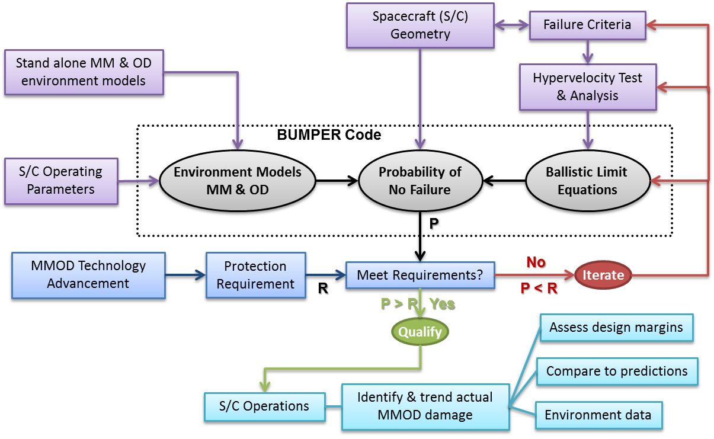
MMOD Risk Assessment Process
Process used to identify MMOD risk drivers, evaluate risk mitigation options & optimization, verify compliance with protection requirements

Slide 32
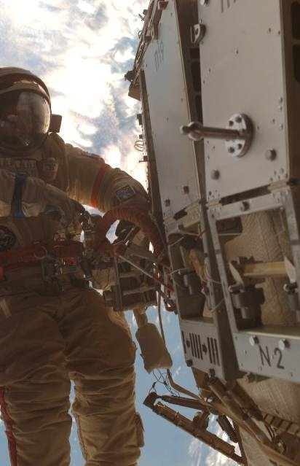
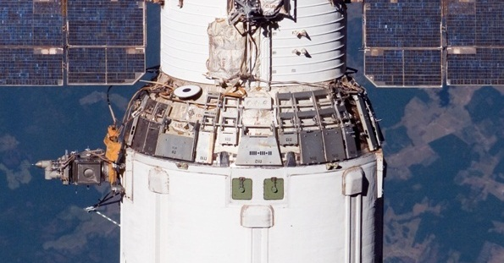
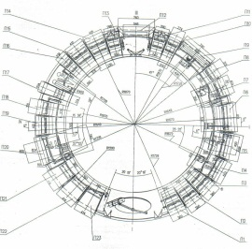
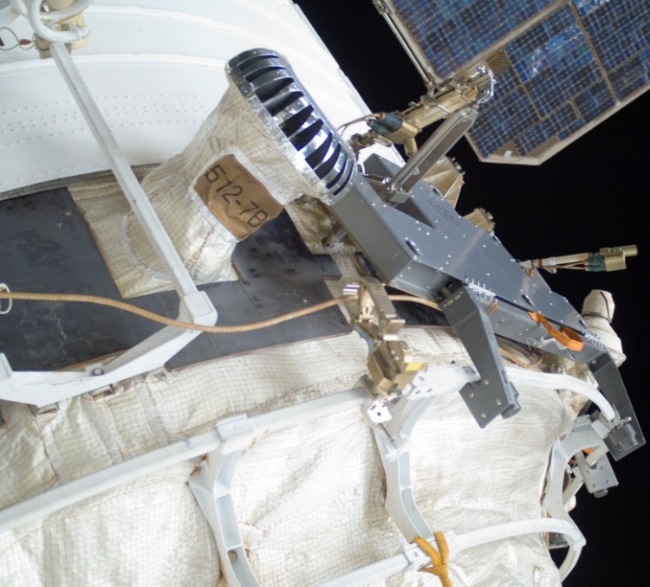
ISS Service Module Shielding
Service Module (SM) identified as high penetration risk using Bumper risk analysis
  large cone region
  forward sides of small diameter cylinder
Shields designed and tested, EVA installed
  23 augmentation shields for the cone region
  5 augmentation shields for the cylinder region
28 shields reduced SM MMOD risk by 30%
SM “conformal” augmentation shield
High-risk (red)
Low-risk (blue)
1mm Al
Corrugated 0.5mm Al
3mm Fiberglass panel
10 cm
Russian “Kevlar” fabric (6)
MLI Thermal Blanket
Original Zone 8
0.5/10/0.5mm graphite-epoxy honeycomb
2 cm
2mm Al pressure shell
EVA Installation
23 “conformal” panels on cone region
5 panels on small diameter cylinder

