Slide 1

Technical Objective #4:
Identify and formalize the software development requirements for eventual deployment to an environment requiring FAA certification
FAA Debrief – Executive Summary
February 1st, 2018
Rev -
Metis Technology Solutions, Inc.

Slide 2
Agenda
Code of Federal Regulations – Title 14
FAA Regulatory and Guidance Library (RGL)
Avionics Top-Level
Systems / Safety Design Assurance
Hardware / Environmental Qualification Design Assurance
Software Design Assurance – Airborne Software
Software Considerations In Airborne Systems and Equipment (RTCA/DO-178C) and Associated Supplements (DO-330, 331, 332)
Software Integrity Assurance Considerations for Communication, Navigation, Surveillance and Air Traffic Management (CNS/ATM) Systems (RTCA/DO-278A) – Ground-based systems S/W
Software Design Approval (Order 8110.49 Chg 2)
Notes:
FAA does not certify software only – rather certify systems which include systems/hardware/software.
Focus on design assurance – getting systems certified not post certification / continued airworthiness / manufacturing
Not a training class – only will touch on some of these bullets
Airborne vs ground based software design assurance

Slide 3
‘Some’ Key Definition of Terms
Applicant – A person or organization seeking approval from the certification authority
Appliance - Any instrument, mechanism, equipment, part, apparatus, appurtenance, or accessory, including communications equipment, that is used or intended to be used in operating or controlling an aircraft in flight, is installed in or attached to the aircraft, and is not part of an airframe, engine, or propeller.
Type Certificate (TC) - Issued to Applicant to signify the airworthiness of an aircraft manufacturing design. The certificate is issued by a regulating body, and once issued, the design cannot be changed. The certificate reflects a determination made by the regulating body that the aircraft is manufactured according to an approved design, and that the design ensures compliance with airworthiness requirements.

Slide 4
‘Some’ Key Definition of Terms
Type Design - For the purposes of this document (aka, DO-178C), the type design consists of the following: (1) The drawings and specifications, and a listing of those drawings and specifications, necessary to define the configuration and the design features of the certified product shown to comply with the requirements for that product; (2) Any other data necessary to allow, by comparison, the determination of the airworthiness of later products of the same type.
  Note: Use of the term “product” in this definition refers to any item for which type certificates are granted by the certification authorities, for example, aircraft, engines, propellers, and, by region, auxiliary power units
Technical Standard Order (TSO) - A minimum performance standard for specified articles such as materials, parts, processes, or appliances used on civil aircraft. (e.g., TSO-C106, AIR DATA COMPUTER)
Technical Standard Order Authorization (TSOA) - Approval to manufacture an article that may be installed on an aircraft only after showing that the article meets the specific airworthiness requirements (certification basis) of a particular aircraft model. In other words, receiving a TSO authorization means that an article meets a minimum performance requirement independent of the article's intended installation on an aircraft. A separate FAA approval is required to install the article on an aircraft
Notes:
Type Design for software really comes down to the life cycle data called in section 11.0 – 11.21 of DO-178C and amplified by additional data as called out in applicable supplements such as requiring model based standards with applying MBD.
TSO is not an aircraft level certification but rather a piece part certification for an appliance. When certifying avionics can be under the TC of the aircraft or separately as part of a TSOA. Again, TSOA is acceptance of design and manufacture (H/W) of appliance. TSOA marking is placed on the appliance listing the TSO it was manufactured for

Slide 5
‘Some’ Key Acronyms
AC – Advisory Circular
ARP - Aerospace Recommended Practice (such as SAE ARP-4754A)
CAST – Certification Authority Software Team
CFR – Code of Federal Regulations
PDS – Previously Developed Software
FAS - Forum on Aeronautical Software
IP – Issue Paper (FAA) / Information Paper (FAS)
PSAC – Plan for Software Aspects of Certification
RTCA - Radio Technical Commission for Aeronautics (such as DO-178C)
SAE - Society of Automotive Engineers (such as ARP-4754A)
SAS – Software Accomplishment Summary
SCI – Software Configuration Index
STC – Supplemental Type Certificate
TC – Type Certificate
TSO(A) – Technical Standard Order (Authorization)
Notes:
FAS is new - https://www.rtca.org/content/forum-aeronautical-software. Three IPs:
IP 1002 DO-331: "MBD Annex Table A-3 and A-4 Item Clarification"
IP 1000 DO-248: "Parameter Data Item Clarifications"
IP 1003 DO-330: "Tool Operational Requirements Validation“
Lots of acronyms – overloads occur such as FAR meaning, Acronym ‘soup’
Commentary
Since 1958, these rules have typically been referred to as "FARs", short for Federal Aviation Regulations. However, another set of regulations (Title 48) is titled "Federal Acquisitions Regulations", and this has led to confusion with the use of the acronym "FAR". Therefore, the FAA began to refer to specific regulations by the term "14 CFR part XX".

Slide 6
FAA Regulatory and Guidance Library (RGL) & Industry Standards
Notes:
PSAC requires per section 11.0 a certification basis and means of compliance to be provided along with the software level (DAL). The Misc guidance can also be listed as provided additional guidance (as applicable)

Slide 7
Code of Federal Regulations – Title 14 Aeronautics and Space (14 CFR)
The Code of Federal Regulations (CFR) annual edition is the codification of the general and permanent rules (sometimes called the administrative law) published in the Federal Register by the departments and agencies of the Federal Government produced by the Office of the Federal Register (OFR) and the Government Publishing Office.
Title 14 of the Code of Federal Regulations – Aeronautics and Space define the rules for Aeronautics and Space. Title 14 of the CFR contains 5 volumes, 6 chapters (I – VI) and 1399 Parts.
Notes:
Chaper 1 – subchapter C Aircraft, Parts 21.1 through 49.63
21 CERTIFICATION PROCEDURES FOR PRODUCTS AND ARTICLES
23 AIRWORTHINESS STANDARDS: NORMAL CATEGORY AIRPLANES
25 AIRWORTHINESS STANDARDS: TRANSPORT CATEGORY AIRPLANES
26 CONTINUED AIRWORTHINESS AND SAFETY IMPROVEMENTS FOR TRANSPORT CATEGORY AIRPLANES
27 AIRWORTHINESS STANDARDS: NORMAL CATEGORY ROTORCRAFT
29 AIRWORTHINESS STANDARDS: TRANSPORT CATEGORY ROTORCRAFT
31 AIRWORTHINESS STANDARDS: MANNED FREE BALLOONS
33 AIRWORTHINESS STANDARDS: AIRCRAFT ENGINES
34 FUEL VENTING AND EXHAUST EMISSION REQUIREMENTS FOR TURBINE ENGINE POWERED AIRPLANES
35 AIRWORTHINESS STANDARDS: PROPELLERS
36 NOISE STANDARDS: AIRCRAFT TYPE AND AIRWORTHINESS CERTIFICATION
39 AIRWORTHINESS DIRECTIVES
43 MAINTENANCE, PREVENTIVE MAINTENANCE, REBUILDING, AND ALTERATION
45 IDENTIFICATION AND REGISTRATION MARKING
47 AIRCRAFT REGISTRATION
48 REGISTRATION AND MARKING REQUIREMENTS FOR SMALL UNMANNED AIRCRAFT
49 RECORDING OF AIRCRAFT TITLES AND SECURITY DOCUMENTS
50-59 [RESERVED]

Slide 8
Code of Federal Regulations – Title 14 Aeronautics and Space (14 CFR)
Key CFR parts associated with aviation certification and airworthiness standards. (Software centric / Cert. Basis in PSAC)
Key CFR Parts | Title | Notes | IIPS App?
21 | Certification Procedures for Products and Parts
21.31 | Type Design | All the data specifying the product for meeting the regulations | Yes (SW: life cycle data per section 11, DO-178C)
23 | Airworthiness standards: normal, utility, acrobatic, and commuter category airplanes | Includes business jets – Gulfstream, Embraer, Dassault etc..
23.1301 | Function and Installation | {snip}…Function properly when installed..{snip} Note: The term ‘{snip}’ indicates only relevant text take from CFR. For complete text go to https://www.ecfr.gov | Yes (if normal) (if commuter)
23.1309 | Equipment, systems, and installations | {snip} (1)… perform their intended function under any foreseeable operating condition…{snip} | Yes (if normal) (if commuter)
25 | Airworthiness Standards: Transport Category Airplanes | Boeing / Airbus Large Transport
25.1301 | Function and Installation | {snip}…Function properly when installed..{snip} | Yes (if transport)
25.1309 | Equipment, systems, and installations | {snip} (a)… perform their intended function under any foreseeable operating condition…{snip} | Yes (if transport)
25.1322 | Flightcrew alerting | {snip} a) Flightcrew alerts must: (1) Provide the flightcrew with the information {snip} | Yes (if transport)
27 | Airworthiness standards: normal category rotorcraft | Normal Rotorcraft
29 | Airworthiness standards: transport category rotorcraft | Transport Rotorcraft
Notes:
Complete text for each of these listed sections can be found in ecfr.gov. Use of ‘snip’
‘Software centric’
25.1322 would be listed as cert basis in top level certification plan / PSCP. System development would derive h/w and s/w requirements and allocate them as appropriate
(a) Flightcrew alerts must:
(1) Provide the flightcrew with the information needed to:
(i) Identify non-normal operation or airplane system conditions, and
(ii) Determine the appropriate actions, if any.
(2) Be readily and easily detectable and intelligible by the flightcrew under all foreseeable operating conditions, including conditions where multiple alerts are provided.
(3) Be removed when the alerting condition no longer exists.
(b) Alerts must conform to the following prioritization hierarchy based on the urgency of flightcrew awareness and response.
(1) Warning: For conditions that require immediate flightcrew awareness and immediate flightcrew response.
(2) Caution: For conditions that require immediate flightcrew awareness and subsequent flightcrew response.
(3) Advisory: For conditions that require flightcrew awareness and may require subsequent flightcrew response.
(c) Warning and caution alerts must:
(1) Be prioritized within each category, when necessary.
(2) Provide timely attention-getting cues through at least two different senses by a combination of aural, visual, or tactile indications.
(3) Permit each occurrence of the attention-getting cues required by paragraph (c)(2) of this section to be acknowledged and suppressed, unless they are required to be continuous.
(d) The alert function must be designed to minimize the effects of false and nuisance alerts. In particular, it must be designed to:
(1) Prevent the presentation of an alert that is inappropriate or unnecessary.
(2) Provide a means to suppress an attention-getting component of an alert caused by a failure of the alerting function that interferes with the flightcrew's ability to safely operate the airplane. This means must not be readily available to the flightcrew so that it could be operated inadvertently or by habitual reflexive action. When an alert is suppressed, there must be a clear and unmistakable annunciation to the flightcrew that the alert has been suppressed.
(e) Visual alert indications must:
(1) Conform to the following color convention:
(i) Red for warning alert indications.
(ii) Amber or yellow for caution alert indications.
(iii) Any color except red or green for advisory alert indications.
(2) Use visual coding techniques, together with other alerting function elements on the flight deck, to distinguish between warning, caution, and advisory alert indications, if they are presented on monochromatic displays that are not capable of conforming to the color convention in paragraph (e)(1) of this section.
(f) Use of the colors red, amber, and yellow on the flight deck for functions other than flightcrew alerting must be limited and must not adversely affect flightcrew alerting.

Slide 9
Top Level - Avionics
Notes:
Expand picture – in Visio and talk to each discipline

Slide 10
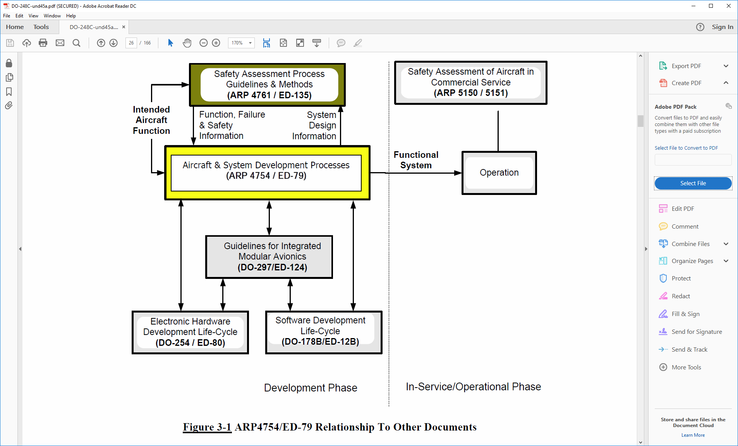
Avionics - Document Relationship
Relationship between ARP-4754A, ARP-4761, DO-178C and DO-254^{[1]}
Note: The figure above show ARP-4754 and DO-178B and current revisions are ARP-4754A and DO-178C but in context of the relationship between these standards the figure does not change.
[1]: RTCA/DO-248C Section 3.24 FAQ #24 Figure 3-1 ARP4754/ED-79 Relationship to Other Documents
Notes:
Back-up slides details all the data flow between systems and software – main ones are detailed on top level avionics previously discussed above. Refer to the Note [1] about where this figure comes from

Slide 11
Systems / Safety Design Assurance
FAA Advisory Circular AC 20-174 provides guidance on development of Civil Aircraft Systems and recognizes SAE ARP 4754A as an acceptable means for establishing a system development process.
Note: Both ARP 4754A and ARP 4761 are identified as acceptable means of establishing an assurance process in the Draft AC 25.1309 (ARSENAL; Date: 2002).
ARP Number | Title | Date | IIPS?
ARP 4754A | Certification Considerations for Highly-Integrated or Complex Aircraft Systems | Sept 2011 | Yes (System)
ARP 4761 | Guidelines and Methods for Conducting the Safety Assessment Process on Civil Airborne Systems and Equipment | Dec 1996 | Yes (Safety)

Slide 12
Hardware / Environmental Qualification Design Assurance
FAA Advisory Circular AC 20-152 provides guidance on development of Airborne Electronic Hardware and recognizes RTCA DO-254 as an acceptable means for establishing a hardware development process.
FAA Advisory Circular AC 21-16F provides guidance on qualification of Airborne Electronic Hardware and recognizes RTCA DO-160 as an acceptable means for establishing an environmental qualification process.
DO Number | Title | Date | IIPS?
DO-254 | Design Assurance Guidance for Airborne Electronic Hardware | 19 Apr 2000 | No (H/W)
DO-160 | Environmental Conditions and Test Procedures for Airborne Equipment | 8 Dec 2010 | No (H/W Qual)

Slide 13
Software Design Assurance
FAA Advisory Circular AC 20-115D provides guidance on development of software aspects of airborne systems and equipment and recognizes RTCA DO-178C and associated supplements as an acceptable means for establishing a software development process.
DO Number | Title | Date | IIPS?
DO-178C | Software Considerations in Airborne Systems and Equipment Certification | 5 Jan 2012 | Yes (S/W)
DO-248C | Supporting Information for DO-178C and DO-278A | 13 Dec 2011 | Yes (S/W)
DO-330 | Software Tool Qualification Considerations | 11 Dec 2011 | Yes (S/W)
DO-331 | Model-Based Development and Verification Supplement to DO-178C and DO-278A | 13 Dec 2011 | No (S/W)
DO-332 | Object-Oriented Technology and Related Techniques Supplement to DO-178C and DO-278A | 13 Dec 2011 | Yes (S/W, Java)
DO-333 | Formal Methods Supplement to DO-178C and DO-278A | 13 Dec 2011 | No (S/W)

Slide 14
DO-178C Graphical View
Notes:
Open up in visio to enlarge and discuss further.
Key points – A1 through A10 objectives; DO-178C does not require a specific software life cycle model, only how life cycle meets the objectives (i.e., Agile could be used, iterative waterfall is another);

Slide 15
RTCA/DO-178C Objectives Summary
RTCA/DO-178C provides objectives for the software life cycle processes that the software must comply with to achieve certification. A statement of compliance is issued by the certification authorities (or though one of the designees, (via FAA Form 8110-3)) at the conclusion of a certification program to indicate the software has complied with the objectives within DO-178C.
Annex A Table # | # of Objectives | Annex A Table Title
A-1 | 7 | Software Planning Process
A-2 | 7 | Software Development Process
A-3 | 7 | Verification of Outputs of Software Requirements Process
A-4 | 13 | Verification of Outputs of Software Design Process
A-5 | 9 | Verification of Outputs of Software Coding and Integration Process
A-6 | 5 | Testing of Outputs of Integration Process
A-7 | 9 | Verification of Verification Process Results
A-8 | 6 | Software Configuration Management Process
A-9 | 5 | Software Quality Assurance Process
A-10 | 3 | Certification Liaison Process
TOTAL | 71

Slide 16
DO-178C / Software Level / Failure Conditions Categories
DO-178C defines software levels for each software component based on its contribution to failure condition categories in the event the software exhibits ‘anomalous behavior’. The higher the software level resulting in a more severe failure condition increases the number of applicable objectives within DO-178C that must be met.

Slide 17
DO-178C / Software Level / Failure Conditions Categories (cont)
Software Level | # of Objectives | Software Level Definitions | Failure Condition Categories
A | 71 | Software whose anomalous behavior, as shown by the system safety assessment process, would cause or contribute to a failure of system function resulting in a Catastrophic failure condition for the aircraft. | Catastrophic – Failure Conditions, which would result in multiple fatalities, usually with the loss of the airplane
B | 69 | Software whose anomalous behavior… {snip} resulting in a Hazardous failure condition…{snip} | Hazardous – Failure Conditions, which would reduce the capability of the airplane or the ability of the flight crew to cope with adverse operating conditions to the extent that there would be: A large reduction in safety margins or functional capabilities; Physical distress or excessive workload such that the flight crew cannot be relied upon to perform their tasks accurately or completely, or Serious or fatal injury to a relatively small number of the occupants other than the flight crew
C | 62 | Software whose anomalous behavior… {snip} resulting in a Major failure condition…{snip} | Major – Failure Conditions which would reduce the capability of the airplane or the ability of the crew to cope with adverse operating conditions to the extent that there would be, for example, a significant reduction in safety margins or functional capabilities, a significant increase in crew workload or in conditions impairing crew efficiency, or discomfort to the flight crew, or physical distress to passengers or cabin crew, possibly including injuries
D | 26 | Software whose anomalous behavior… {snip} resulting in a Minor failure condition…{snip} | Minor – Failure Conditions which would not significantly reduce airplane safety, and which involve crew actions that are well within their capabilities. Minor Failure Conditions may include, for example, a slight reduction in safety margins or functional capabilities, a slight increase in crew workload, such as routine flight plan changes, or some physical discomfort to passengers or cabin crew.
E | 0 | Software whose anomalous behavior… {snip} with No Effect on aircraft operational capability…{snip} | No Effect – Failure Conditions that would have no effect on safety; for example, Failure Conditions that would not affect the operational capability of the airplane or increase crew workload.

Slide 18
Software Development
Software Requirements Process
Software Design Process
Software Coding Process
Software Integration Process
Commentary
The Software Requirement Process ‘Examples’ column in the following table (next slide) are not intended to be all inclusive of what should be defined for each phase of a process but representative of the types of entry/exit criteria and process activities that occur.
For time considerations, only software requirements process example is provided. Similar ones would exist for Design / Coding / Integration

Slide 19
Software Requirements Process
Phase | DO-178C Section | Description | Examples
Entry Criteria | 4.3.b | Entry criteria for software requirements process | Software Level (flowed down from System Safety Assessment) Plans are reviewed and released as defined in Software Planning SRS is released System Requirements are ready for decomposition (per ARP-475A)
Process Activities | 5.1.2 | Perform process activities for software requirements process | Create SRD (HLRs) from system requirements (decompose) using SRS Establish bi-directional trace from SRD (HLRs) to Sys. Req. Create derived requirements and provide to system/safety
Exit Criteria | Table A-2 #1, #2 5.1.1 5.5 | Outputs of software requirements to meet process objectives | Software Requirement Data (SRD) under version control in CM Trace (SRD ⬅➔ Sys Req.)

Slide 20
Software Integral Processes
Software Verification Process
Software Configuration Management Process
Software Quality Assurance Process
Certification Liaison Process

Slide 21
Software Verification Process
Reviews – Technical review (with independence as applicable per Annex A of DO-178C) of the HLR, LLR, Architecture, Source Code, Integration, Test Cases/Procedures and Test Results
Analyses – Two classes of analyses are required. One type of analyses relates to code and integration and consists of the following:
  Worst-Case Execution Time (WCET) Analysis (Ref: DO-178C 6.3.4 f.)
  Memory Margin Analysis (Ref: DO-178C 6.3.4 f.)
  Link and Memory Map Analysis (Ref: DO-178C 6.3.5)
  Errors and Warning Analysis (Ref: DO-178C 6.3.5)
  Partitioning Analysis (if applicable) (Ref: DO-178C 6.3.3 f.)
The other class of analyses relates to test coverage and consists of the following:
  Requirements Coverage Analysis (Ref: DO-178C 6.4.4 a., b.)
  Structural Coverage Analysis (Ref: DO-178C 6.4.4 c., d.)
Test – Test of the software execution (i.e., EOC) on the target computer, emulator and/or simulator. Tests are written against requirements (i.e., HLRs and LLRs). Ideally, EOC should be tested on the target computer. If an emulator and/or simulator are used it must be detailed within the approved plans along with limitations on its usage. However, some portion of selected tests must run on the integrated target computer environment since some errors are only detected in this environment (such as timing related tests).

Slide 22
Software Verification Process
The software verification process as defined within DO-178C consists of the following processes:
Software Planning Review Process
Software Requirements Review Process
Software Architecture Review (Design) Process
Software Low-Level Requirements Review (Design) Process
Software Coding Review Process
Software Integration Review Process
Software Testing Process
Software Testing Cases/Procedures Review Process
Software Testing Results Review Process
Software Test Coverage Analysis Process

Slide 23
Software Configuration Management Process
  Software Configuration Management (SCM) consists of configuration identification, change control, establishing of baselines, archiving the software product and all of its lifecycle data and configuration status accounting. SCM should meet the Annex A Table A-8 Software Configuration Management Process
  Excerpt from DO-178C Glossary
    Configuration management – (1) The process of (a) identifying and defining the configuration items of a system; (b) controlling the release and change of these items throughout the software life cycle; (c) recording and reporting the status of configuration items and Problem Reports; and (d) verifying the completeness and correctness of configuration items. (2) A discipline applying technical and administrative direction and surveillance to (a) identify and record the functional and physical characteristics of a configuration item; (b) control changes to those characteristics; and (c) record and report change control processing and implementation status.

Slide 24
Software Quality Assurance Process
  The software quality assurance process should meet the Annex A Table A-9 Software Quality Assurance Process
  Excerpt from DO-178C Section 8.0 – Software Quality Assurance Process
  The SQA process assesses the software life cycle processes and their outputs to obtain assurance that objectives are satisfied, deficiencies are detected, evaluated, tracked, and resolved, and software product and software life cycle data conform to certification requirements.

Slide 25
Certification Liaison Process
  The certification liaison process should meet the Annex A Table A-10 Certification Liaison Process
  Excerpt from DO-178C Glossary
  Certification Liaison Process – The process that establishes communication, understanding, and agreement between the applicant and the certification authority.

Slide 26
Other DO-178C Topics
Other DO-178C Topics
Use of Previously Developed Software (PDS) | Multiple-Version Dissimilar Software | Regression Analysis
Reusable Software Components | Commercial Off-the-Shelf Software (COTS) Software | Aeronautical Data (RTCA/DO-200A)
Software Tools and Identification | Use of Suppliers, Sub-Tier Suppliers and Off-Shore Facilities | Normal / Robustness Testing
Tool Qualification | Dead / Deactivated / Extraneous Code | Bi-Directional (Traceability
Alternative Means of Compliance | Object Oriented Technology | Partitioning / RTOS
Product Service History | Model-Based Development (MBD) | Structural Coverage Analysis / Resolution
Field Loadable Software (FLS) | Formal Methods (FM) | Independence
Option Selectable Software | Reverse Engineering | Conformity Review / Inspections
User Modifiable Software | Multiple-Version Dissimilar Software | Other Analyses (WCET, Memory, Linker, etc..)
Electronic Part Numbering | Field Loadable Software | Verification Environment (Target vs Simulator vs Emulator)

Slide 27
Software Integrity Assurance Considerations for Communication, Navigation, Surveillance and Air Traffic Management (CNS/ATM) Systems (RTCA/DO-278A)
DO-278A Software Integrity Assurance Considerations for Communication, Navigation, Surveillance and Air Traffic Management (CNS/ATM) Systems focuses on ground-based CNS/ATM software. Revision A of this standard was released on December 2011 and has many similarities with DO-178C.
It’s noted here that the associated DO-330, -331, -332, and -332 apply for both DO-178C and DO-278A. The main differences are detailed in table below

Slide 28
Software Design Approval
Software Approval Guidelines (Order 8110.49 Chg 2)
Order Chapter | IIPS Applicability | Commentary
1. Introduction | Yes | General Information on Order layout
2. Software Review Process | Yes | FAA or designee will perform software reviews of life cycle data to ensure compliance to DO-178C objectives. Per Appendix A, assessment is performed to determine how many software reviews would be performed. Due to limited use of RTCA/DO-178C compliance, level of involvement would be ‘MEDIUM’ or ‘HIGH’ based on software level. 4 reviews are most likely events: Software Planning Review Software Development Review Software Verification Review Software Completion Review
3. Reserved | No
4. Software Conformity Inspections | Yes | May apply in future event if ‘for credit’ testing is performed as part of flight test. Two types of conformity are required: 1) Software Part Conformity and 2) Software Installation Conformity
5. Approval of Field-Loadable Software (FLS) | No | FLS would be part of the platform requirements not specific to IIPS
6. Approval of FLS by Finding Identicality Through the PMA Process | No | FLS would be part of the platform requirements not specific to IIPS
7. Approval of Airborne Systems and Equipment Containing User-Modifiable Software (UMS) | No | No observation that UMS would apply for IIPS. Additional considerations section in PSAC would indicate – does not apply.
8. Previously Developed Software (PDS) – Applying RTCA/DO-178B Level D Criteria | No | No PDS for IIPS
9. Qualification of Software Tools Using RTCA/DO-178B | No | No Tool Qualification per DO-178B for IIPS. Commentary This section is specific to showing compliance DO-178B for Tool Qualification. IIPS would be using DO-178C/DO-330 which supersedes this guidance.
10. Approval of Software Changes in Legacy Systems Using RTCA/DO-178B | No | IIPS is new development. Changes to legacy systems and DO-178B does not apply.
11. Oversight of Software Change Impact Analyses Used to Classify Software Changes as Major or Minor | Yes | IIPS is new development. Change impact analyses only applies after a system has been certified and system changes are required.
12. Approving Reused Software Life Cycle Data | No | IIPS is new development. Reusing life cycle data is not applicable.
13. Properly Overseeing Suppliers | Unknown | May apply if software suppliers are used for development. Software suppliers require oversight to ensure compliance to objectives.
14 Software Problem Reporting | Yes | Problem reporting would apply for managing and tracking problems to IIPS
15 Assuring Airborne System Databases and Aeronautical Databases | No | No known system/aeronautical database development applies for IIPS. Commentary Design assurance for databases must comply with AC20-153A and RTCA/DO-200A.
16. Managing the Software Development or Verification Environment | Yes | Managing the software development/verification environment from the simulated/emulated environment in relation to actual production hardware would mostly likely apply for IIPS.

Slide 29
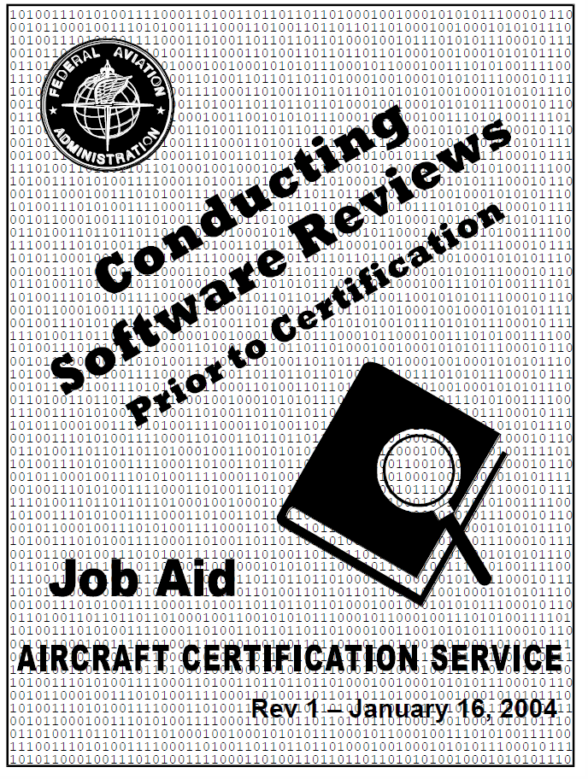
Software Design Approval
FAA Compliance Assessment (Order 8110.49 Chg 2, Chapter 2)
Stages of Involvement (SOI) | Phase / Activity
SOI #1 | Software Planning
SOI #2 | Software Development
SOI #3 | Software Verification
SOI #4 | Software Wrap-up
This software job aid has been discontinued and removed from the FAA guidance material with recent updates (4/2017) to Order 8110.49 Chapter 2 Software Review Process. The FAA Order still requires conducting software reviews however, it does not prescribe use of this Job Aid. However, this Job Aid is still in use by certification programs as it provides a detailed set of checklists that if followed would allow a successful review by the FAA.

Slide 30
Summary
Item 1: Brief the FAA and other regulatory documents that describe the requirements for software to be deployed in FAA-certified environments to the Metis development team and management.
Requirement | Title | Requirement | Title
14 CFR 21 (Regulatory) | Certification Procedures for Products and Parts | ARP 4754A (Systems) | Certification Considerations for Highly-Integrated or Complex Aircraft Systems
14 CFR 2x.1301 (Regulatory) | Function and Installation | ARP 4761 (Safety) | Guidelines and Methods for Conducting the Safety Assessment Process on Civil Airborne Systems and Equipment
14 CFR 2x.1309 (Regulatory) | Equipment, systems, and installations | DO-178C (Software, Airborne) | Software Considerations in Airborne Systems and Equipment Certification
14 CFR 25.1322 (Regulatory) | Flightcrew alerting | DO-248C (Software, Airborne) | Supporting Information for DO-178C and DO-278A
AC 00-69 (Guidance, Means of Compliance) | Best Practices for Airborne Software Development Assurance Using EUROCAE ED-12( ) and RTCA DO-178( ) | DO-278A (Software, Ground Systems) | Software Integrity Assurance Considerations for Communication, Navigation, Surveillance and Air Traffic Management (CNS/ATM) Systems
AC 20-115D (Guidance) | Airborne Software Assurance | DO-330 (Airborne/Ground Sys.) | Software Tool Qualification Considerations
AC 25.1322-1 (Guidance) | Flight Crew alerting | DO-332 (S/W, Airborne/Ground Sys.) | Object-Oriented Technology and Related Techniques Supplement to DO-178C and DO-278A
Order 8110.4C (FAA Order) | Type Certification | CAST-18 (Software, Airborne) | Reverse Engineering in Certification Projects
Order 8110.49 Change 2 (FAA Order) | Software Approval Guidelines | Misc. CAST/FAS IPs/ FAA Research (S/W) | Various Topics

Slide 31
Back-Up Slides

Slide 32
DO-178C Software Planning
The DO-178C planning process consists creation of project-specific plans and standards. The plans and standards should address how the plans meet the DO-178C objectives and should provide content as detailed within section 11 of DO-178C.
Plan / Standard | DO-178C section | IIPS applicability? | Commentary
Plan for Software Aspects of Certification (PSAC) | Annex A Table A-1 11.1 | Yes | Refer to section 11.1 for content. The PSAC is delivered to the certification authorities and becomes the contract between the applicant and the certification authority. Therefore, it should be delivered early in the life cycle to reduce risk of the certification authorities findings causing re-work late in the project development. DO-178C 11.g Additional Considerations is an important section of the PSAC as it details any special considerations or unique aspects associated with this certification. Refer to section 4.3.2.1.1 for details. A DO-178C compliance matrix detailing out all the applicable objectives within DO-178C Annex A and referencing the applicable sections within the PSAC for showing compliance should be contained as an Appendix to the PSAC. For OOT, a section should be added (proposed in additional considerations), for addressing vulnerabilities and related techniques identified in DO-332 Annex OO.D.1 and Annex OO.D.2 for general issues.
Software Development Plan (SDP) | Annex A Table A-1 11.2 | Yes | Refer to section 11.2 of DO-178C for content. It should detail use of OOT and if Reverse Engineering (R.E.) is part of the life cycle model.
Software Verification Plan (SVP) | Annex A Table A-1 11.3 | Yes | Refer to section 11.3 of DO-178C for content. In general verification consist of reviews, analysis and test. It should detail how the independence objectives are being met as detailed within the DO-178C Annex A objectives.

Slide 33
DO-178C Software Planning (cont)
Plan / Standard | DO-178C section | IIPS applicability? | Commentary
Software Configuration Management Plan (SCMP) | Annex A Table A-1 11.4 | Yes | Refer to section 11.4 of DO-178C for content. The SCMP when followed should allow for compliance to all objectives with Annex A Table A-8
Software Quality Assurance Plan (SQAP) | Annex A Table A-1 11.5 | Yes | Refer to section 11.5 of DO-178C for content. The SQAP when followed should allow for compliance to all objectives with Annex A Table A-9
Software Requirements Standards (SRS) | Annex A Table A-1 11.6 | Yes | Refer to section 11.6 of DO-178C for content.
Software Design Standards (SDS) | Annex A Table A-1 11.7 | Yes | Refer to section 11.7 of DO-178C for content. One key aspects on using OOT required in this standards is addressing any constraints on usage of OOT features addressing the vulnerabilities described in Annex OO.D.1, Inheritance Parametric Polymorphism Overloading Type Conversion Exception Management Dynamic Memory Management Virtualization (JVM concerns)
Software Code Standards (SCS) | Annex A Table A-1 11.8 | Yes | Refer to section 11.7 of DO-178C for content. Constraints on OOT vulnerabilities as discussed in SDS above.

Slide 34
DO-178C Additional Considerations
PSAC – Additional Considerations Section | IIPS Applicability? | Commentary
x.0 ADDITIONAL CONSIDERATIONS | Yes | Required per section 11.1 of DO-178C
x.1 Use of Previously Developed Software (PDS) | Yes | IIPS Phase 2 Baseline as PDS. Refer to the following section for PDS considerations
x.2 Reusable Software Components | No | AC20-148 is N/A for IIPS
x.3 Software Tools and Identification | Yes | List of tools and associated configuration (best practice)
x.4 Tool Qualification | Yes | Assume some TQ for IIPS
x.5 Alternative Means of Compliance | No | Indicate ‘None’ sought in PSAC
x.6 Product Service History | No | Indicate ‘None’ sought in PSAC
x.7 Field Loadable Software (FLS) | No | Part of existing FLS part of Flight Deck (if capability exists)
x.8 Option Selectable Software | Maybe | Determine when closer to certification
x.9 User Modifiable Software | Maybe | Determine when closer to certification
x.10 Multiple-Version Dissimilar Software | No | Indicate ‘None’ in PSAC
x.11 Commercial Off-the-Shelf Software (COTS) Software | Yes | If using Java and associated Runtime (JRE). For any JRE components, compliance to DO-178C is required so this could be a significant cost driver.
x.12 Use of Suppliers, Sub-Tier Suppliers and Off-Shore Facilities | Unknown | Will suppliers be used for IIPS?
x.13 Deactivated Code | Unknown | Determine when closer to certification
x.14 Object Oriented Technology | Yes | Use of Java, will need to address vulnerabilities and other DO-332 OOT Table A-7 objectives in plans
x.15 Model-Based Development (MBD) | No | No use of MBD
x.16 Formal Methods (FM) | No | No use of FM
x.17 Reverse Engineering | Yes | CAST Paper 18 (attached below)

Slide 35
DO-178C Previously Developed Software
Excerpt from DO-178C – Glossary
  Previously Developed Software – Software already developed for use. This encompasses a wide range of software, including COTS software through software developed to previous or current software guidance.
Commentary
It is proposed to use the IIPS Phase 2 baseline as PDS per section 12.1.4 Upgrading a Development Baseline.

Slide 36
DO-178C Previously Developed Software
Excerpt from DO-178C Section 12 – Additional Considerations
12.1.4 Upgrading a Development Baseline
Guidance follows for software whose software life cycle data from a previous application are determined to be inadequate or do not satisfy the objectives of this document, due to the requirements associated with a new application. This guidance is intended to aid in satisfying the objectives of this document when applied to:
 COTS software.
 Airborne software developed to other guidance.
 Airborne software developed prior to the existence of this document.
 Software previously developed to this document at a lower software level.
Activities for upgrading a development baseline include:
The objectives of this document should be satisfied while taking advantage of software life cycle data of the previous development that satisfy the objectives for the new application.
b. Software aspects of certification should be based on the failure conditions and software level(s) as determined by the system safety assessment process.
Comparison to failure conditions of the previous application will determine areas that may need to be upgraded.
c. Software life cycle data from a previous development should be evaluated to ensure that the software verification process objectives of the software level are satisfied for the new application to the necessary level of rigor and independence.
d. Reverse engineering may be used to regenerate software life cycle data that is inadequate or missing in satisfying the objectives of this document. In addition to producing the software product, additional activities may need to be performed to satisfy the software verification process objectives.
e. If use of product service history is planned to satisfy the objectives of this document in upgrading a development baseline, section 12.3.4 should be considered.
  f. The applicant should specify the strategy for accomplishing compliance with this document in the Plan for Software Aspects of Certification.

Slide 37
PDS Process Flow (Sec 12.1.4) / Reverse Engineering – IIPS Proposed

Slide 38
Software Design Process
Phase | DO-178C Section | Description | Examples
Entry Criteria | 4.3.b | Entry criteria for software design process | Plans are reviewed and released as defined in Software Planning SDS is released Software Requirements are ready for decomposition
Process Activities | 5.2.2 | Perform process activities for software design process | Create Low Level requirements (LLR) from software requirements (decompose) using SDS Create software architecture Establish bi-directional trace from SRD (HLRs) to LLRs. Create derived LLR requirements and provide to system/safety
Exit Criteria | Table A-2 #3, #4, #5 5.2.1 5.5 | Outputs of software design to meet process objectives | Software Design Data (SDD) under version control in CM Trace (SDD (LLRs) ⬅➔ SRD (HLRs))

Slide 39
Software Coding Process
Phase | DO-178C Section | Description | Examples
Entry Criteria | 4.3.b | Entry criteria for software code process | Plans are reviewed and released as defined in Software Planning SCS is released SRD (HLRs) and SDD (LLRs) are ready for decomposition into source code
Process Activities | 5.3.2 | Perform process activities for software code process | Create source code from SRD (HLRs) and SDD (LLRs) using SCS Establish bi-directional trace from LLRs to source code
Exit Criteria | Table A-2 #6 5.3.1 5.5 | Outputs of software code to meet process objectives | Source Code under version control in CM Trace (LLRs ⬅➔ Source Code)

Slide 40
Software Integration Process
Phase | DO-178C Section | Description | Examples
Entry Criteria | 4.3.b | Entry criteria for software integration process | Software Source Code is available and under version control in CM Preliminary form of Software Configuration Index (SCI) Preliminary form of Software Life Cycle Environment Index (SLECI) Compiler / Linker Options are defined and captured in SCI and/or SLECI
Process Activities | 5.4.2 | Perform process activities for software integration process | Develop build procedures (script, makefiles and the like) Build code executable using build procedures Develop load procedures Load executable into target for hardware/software integration
Exit Criteria | Table A-2 #7 5.4.1 5.5 | Outputs of software integration to meet process objectives | Updated SCI / SLECI containing build and load procedures Script files for build and load procedures under version control in CM.

Slide 41
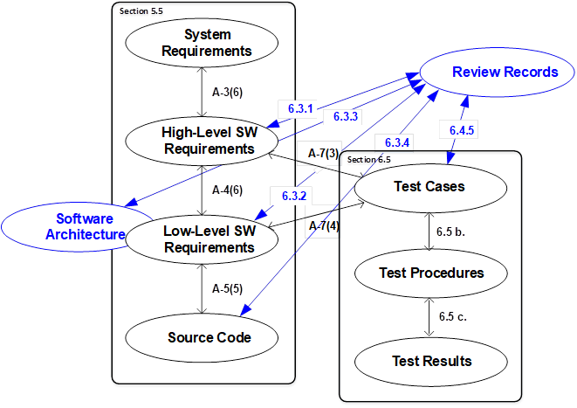
Traceability

Slide 42
Independence
Verification Independence – indicates a separate individual performs the verification activity (i.e., not the same individual that created the artifact that’s being verified). As an example, the individual that wrote the software component should not be the same individual who is writing the test procedure for that software component.
Organization Independence – As stated, software quality assurance (SQA) objectives (per Table A-9 in DO-178C) requires independence. In most organizations, a separate quality organization exists outside of the engineering organization performing the development. By this means, the quality organization though it’s ‘independent’ process monitoring objectives (such as ensuring compliance to plans through in process reviews for example) has the authority to ensure corrective actions are put into place in the event of findings of non-compliance against the engineering software development plans.

Slide 43
Partitioning
DO-178C defines partitioning in section 2.4.1 as a ‘technique for providing isolation between software components to contain and/or isolate faults and potentially reduce the effort of the software verification process. Partitioning between software components may be achieved by allocating unique hardware resources to each component (that is, only one software component is executed on each hardware platform in a system). Alternatively, partitioning provisions may be made to allow multiple software components to run on the same hardware platform. Regardless of the method, the following should be ensured for partitioned software components:
  A partitioned software component should not be allowed to contaminate another partitioned software component’s code, input/output (I/O), or data storage areas.
  A partitioned software component should be allowed to consume shared processor resources only during its scheduled period of execution.
  Failures of hardware unique to a partitioned software component should not cause adverse effects on other partitioned software components.
  Any software providing partitioning should have the same or higher software level as the highest level assigned to any of the partitioned software components.
  Any hardware providing partitioning should be assessed by the system safety assessment process to ensure that it does not adversely affect safety.’

Slide 44
Structural Coverage Analysis
Statement Coverage (DO-178C Annex A Table A-7 Objective 7)
Definition: ‘Every statement in the program has been invoked at least once.’
Decision Coverage (DO-178C Annex A Table A-7 Objective 6)
Definition: ‘Every point of entry and exit in the program has been invoked at least once and every decision in the program has taken on all possible outcomes at least once.’
Modified Decision/Condition Coverage (DO-178C Annex A Table A-7 Objective 5)
Definition: ‘Every point of entry and exit in the program has been invoked at least once, every condition in a decision in the program has taken all possible outcomes at least once, every decision in the program has taken all possible outcomes at least once, and each condition in a decision has been shown to independently affect that decision's outcome. A condition is shown to independently affect a decision's outcome by: (1) varying just that condition while holding fixed all other possible conditions, or (2) varying just that condition while holding fixed all other possible conditions that could affect the outcome.’
Data Coupling and Control Coupling (DO-178C Annex A Table A-7 Objective 8)
Definition:
Data coupling – ‘The dependence of a software component on data not exclusively under the control of that software component.’
Control coupling – ‘The manner or degree by which one software component influences the execution of another software component.’

Slide 45
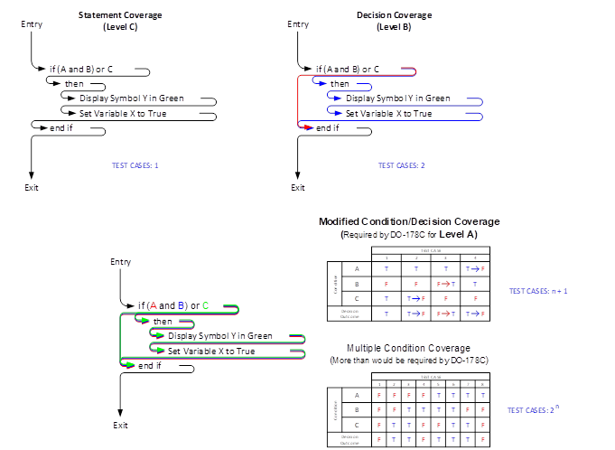
Structural Coverage Analysis

Slide 46
Structural Coverage Analysis
Commentary
It should be clearly understood, that SCA is an analysis that occurs after or in conjunction with (when using tools to capture code structure)
execution of the requirements based testing.
The concept of testing the software structure (or ‘structural testing’) is NOT a concept within DO-178C.
You performed requirements-based testing and then analysis is performed to determine the code structure that was executed as part of the testing.
Figure 8 details the SCA required to show compliance to the SCA objectives NOT necessarily the number of tests that should be performed as part of good requirements based testing.
In other words, requirements-based testing may require more test cases than what’s shown in the Figure 8 to meet the SCA objectives.

Slide 47
Supporting Information for DO-178C (RTCA/DO-248C)
RTCA/DO-248C provides clarification of guidance material in DO-178C in the form of Frequently Asked Questions (FAQs), Discussion Papers (DPs) and Rationale.
FAQ / DP | IIPS? | Commentary
{snip} Note: The term ‘{snip}’ indicates this table is only a small portion of what’s detailed in the completed milestone 1 document (Milestone_1.docx). | {snip} | {snip}
3.20 FAQ #20: What is the source of the glossary of terms in DO-178C, DO-278A, and the Supplements, and why do they appear to be different from other standard definitions? | Yes | General guidance would apply for any certification
3.21 FAQ #21: How is the second sentence of the definition of “patch” in DO-178C/DO-278A Annex B relevant to the definition itself? | Yes | General guidance would apply for any certification
3.22 FAQ #22: Can various industry process assessments such as the Software Engineering Institute (SEI) Capability Maturity Model Integration (CMMI), Software Process Improvement Capability Evaluation (SPICE), etc. be used for certification credit? | Maybe | Answer: The simple answer is that an applicant cannot claim certification “credit” for the use of the SEI CMMI, SPICE, etc. Although DO-178C/DO-278A and its predecessors advocate good process characteristics, process objectives are given primarily in terms of attributes of the process data and the associated product. Many of the DO-178C/DO-278A objectives specifically relate to completeness and rigor of development and verification processes in specific terms, whereas the generalized process models, such as the SEI CMMI and SPICE, are more focused on business process measurement and improvement. They stipulate and assess against many process attributes that are necessary, but not sufficient conditions, for high product integrity and safety. For example, the SEI CMMI has no process activities or capabilities or metrics associated with verification (review, analysis, or test) coverage, whereas this is a very significant aspect of DO-178C/DO-278A guidance, because verification is a key factor in system safety. Although there is some overlap, DO-178C/DO-278A remains the more comprehensive guidance for airborne and CNS/ATM systems. Applicants seeking process recognition for the use of the SEI CMMI, SPICE, etc. may readily reuse the same process compliance data to substantiate compliance with DO-178C/DO-278A objectives. Such data would still be required to meet the software life cycle data attributes of DO-178C/DO-278A section 11 and the objectives of DO-178C/DO-278A Annex A with respect to independence and configuration control.

Slide 48
Model-Based Development
(RTCA/DO-331)
Based on preliminary assessment, it doesn’t appear Model-Based Development would apply for IIPS.
Excerpt from DO-330 – MB1.0:
MB.1.0 INTRODUCTION
A model is an abstract representation of a set of software aspects of a system that is used to support the software development process or the software verification process. This supplement addresses model(s) that have the following characteristics:
a. The model is completely described using an explicitly identified modeling notation. The modeling notation may be graphical and/or textual.
b. The model contains software requirements and/or software architecture definition.
c. The model is of a form and type that is used for direct analysis or behavioral evaluation as supported by the software development process or the software verification process.
The following are not considered as models within this supplement:
Figures without syntax/semantics (these may be illustrative).
Equations related to natural language sentences.
The use of models may bring the benefits and capabilities of:
Providing unambiguous expression of requirements and architecture.
Supporting the use of automated code generation.
Supporting the use of automated test generation.
Supporting the use of analysis tools for verification of requirements and architecture.
Supporting the use of simulation for partial verification of requirements, architecture, and/or Executable Object Code.

Slide 49
Object Oriented Technology
(RTCA/DO-332)
Based on preliminary assessment, OOT guidance would apply for IIPS.
Excerpt from DO-332 – OO1.0:
OO.1.0 INTRODUCTION
Object-oriented technology (OOT) has been widely adopted in non-critical software development projects. The use of this technology for critical software applications in avionics has increased, but there are a number of issues that need to be considered to ensure the safety and integrity goals are met. These issues are both directly related to language features and to complications encountered with meeting well-established safety objectives. In fact, there are a number of related techniques that are used with OOT that need to be considered as well. Clarifying each of these issues will ease the application of object-oriented technology and related techniques (OOT&RT); therefore, this supplement addresses both object-oriented technology and related techniques.
OO.1.1 Purpose
The purpose of this supplement is to provide guidance for the production of software using OOT&RT for systems and equipment that performs its intended function with a level of confidence in safety that complies with airworthiness requirements. This supplement contains modifications and additions to DO-178C objectives, activities, explanatory text, and software life cycle data that should be addressed when OOT&RT are used as part of the software life cycle.
Compliance with the objectives of DO-178C, Software Considerations in Airborne Systems and Equipment Certification, is the primary means of obtaining approval of software used in civil aviation products. Object-oriented technology is a software development methodology that uses objects and the connections between those objects to express the software design. There are a number of related techniques commonly associated with, but not limited to, object-oriented technology that are considered in this supplement. These related techniques include parametric polymorphism, overloading, type conversion, exception management, dynamic memory management, and virtualization. Since OOT&RT differs from the traditional functional approach to software development, satisfying some of the DO-178C objectives when using OOT&RT may be unclear and/or complicated.
This supplement identifies the additions, modifications, and deletions to DO-178C objectives when object-oriented technology or related techniques are used as part of the software development life cycle and additional guidance is required. This supplement, in conjunction with DO-178C, is intended to provide a common framework for the evaluation and acceptance of OOT&RT based systems.

Slide 50
Formal Methods (RTCA/DO-333)
Based on preliminary assessment, it doesn’t appear Model-Based Development would apply for IIPS.
Excerpt from DO-333 – FM.1.0:
FM.1.0 INTRODUCTION
Formal methods are mathematically based techniques for the specification, development, and verification of software aspects of digital systems. The mathematical basis of formal methods consists of formal logic, discrete mathematics, and computer-readable languages. The use of formal methods is motivated by the expectation that, as in other engineering disciplines, performing appropriate mathematical analyses can contribute to establishing the correctness and robustness of a design. For example, formal methods, because of their mathematical basis, are capable of:
 Unambiguously describing requirements of software systems.
 Enabling precise communication between engineers.
 Providing verification evidence such as consistency and accuracy of a formally
specified representation of software.
 Providing verification evidence of the compliance of one formally specified
representation with another.
Formal methods are also capable of demonstrating properties of software systems such
as:
 Freedom from exceptions.
 Freedom from deadlock.
 Non-interference between different levels of criticality.
 Worst case execution time.
 Bounds on stack size during execution.
 Freedom from unintended function.
 Correct synchronous or asynchronous behavior.

Slide 51
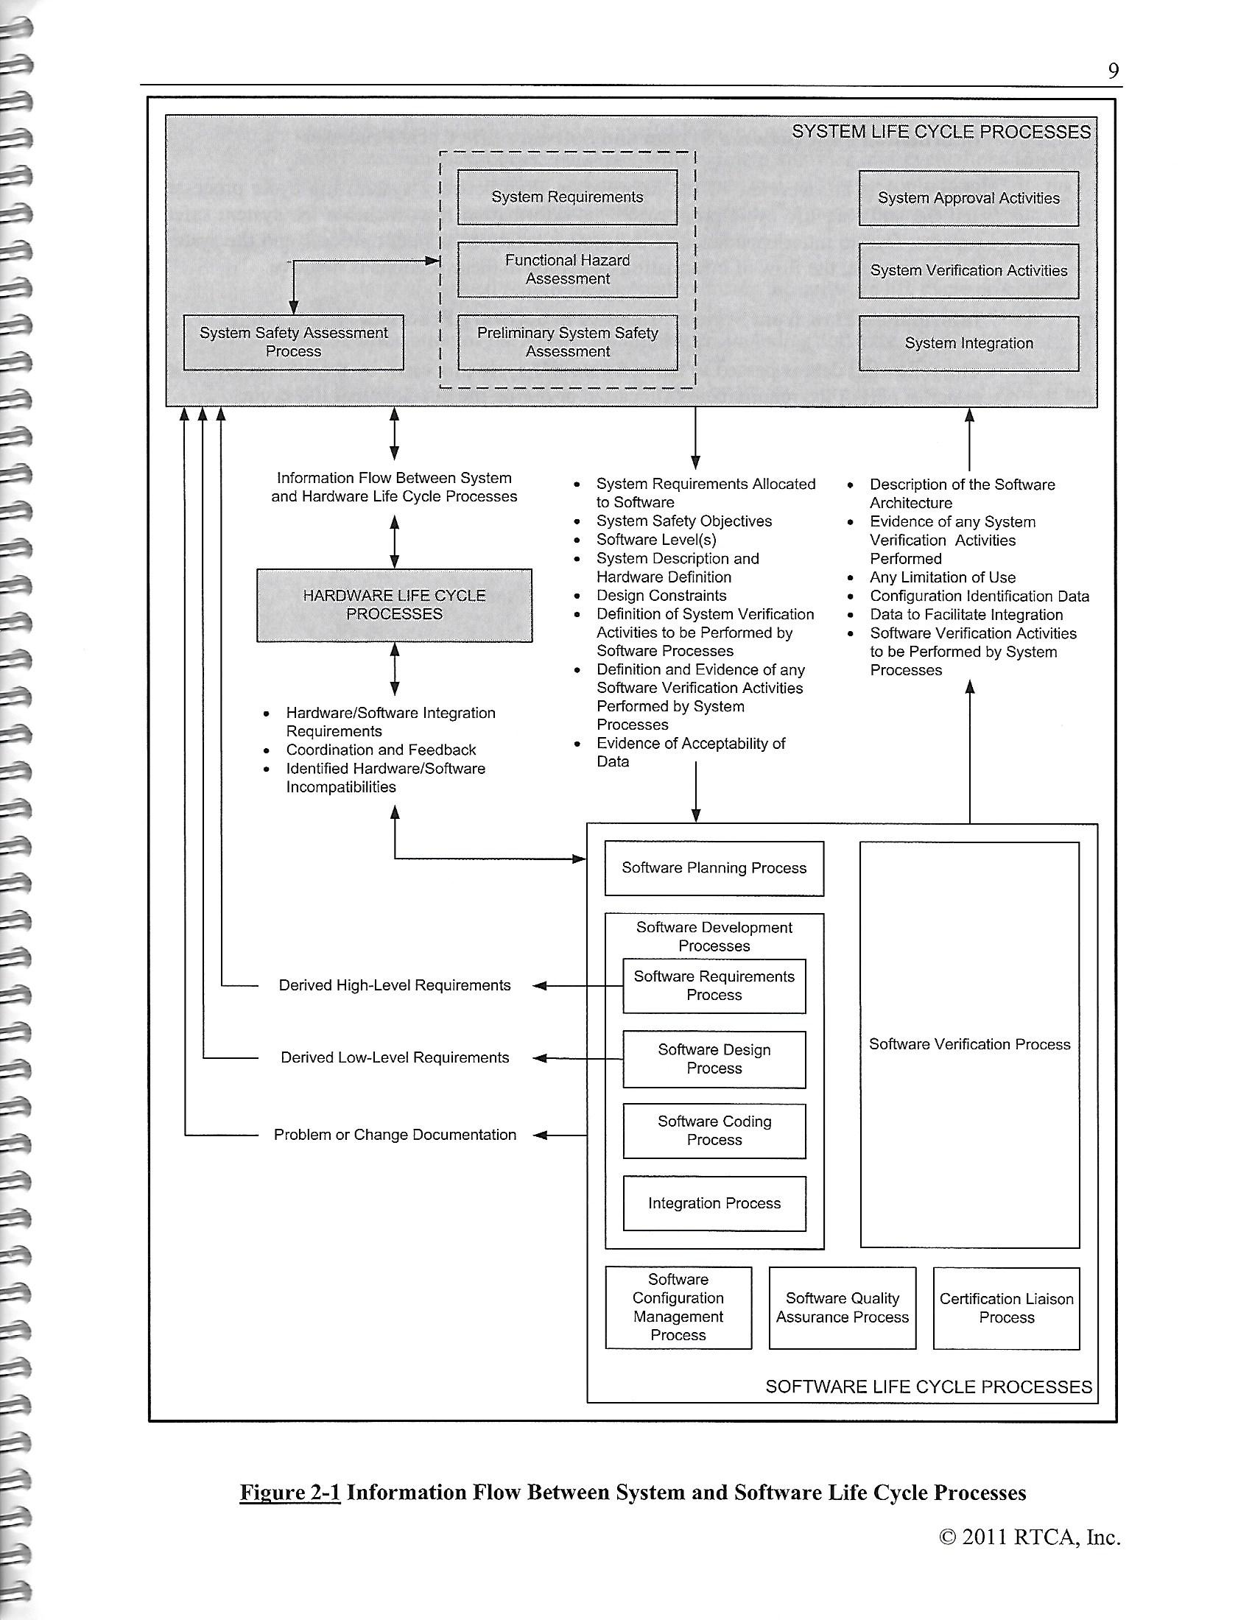
Information Flow: Systems & Software

Slide 52
Software Tool Qualification
(RTCA/DO-330)
DO-178C Section 12.2 Tool Qualification specify that qualification of a tool is needed when processes of DO-178C are eliminated, reduce, or automated by the use of a software tool without its outputs being verified as specified in section 6.
The three types of Tool Qualification Levels are:
  Criteria 1: A tool whose outputs is part of the airborne software and thus could insert an error
  Criteria 2: A tool that automates verification process(es) and thus could fail to detect an error, and whose output is used to justify the elimination or reduction of:
    Verification process(es) other than that automated by the tool, or
    Development process(es) that could have an impact on the airborne software.
  Criteria 3: A tool that, within the scope of its intended use, could fail to detect an error.
Commentary
Criteria 1 tool qualifications are rare due to the high level of design assurance that is required for the tool. It’s equivalent to the same level of design assurance required for the airborne software within DO-178C. The most common type of tool qualification is Criteria 3 which is equivalent to qualification of a verification type tool (structural coverage analyzer, auto generation of test procedures)

