Slide 1
Today’s Moderator: Neil Dennehy (NESC)
Today’s Speaker: John Burken (DFRC)
Welcome to THE NESC GN&C TDT WEBCAST Series
Fundamentals of
Aircraft Flight Control

Slide 2
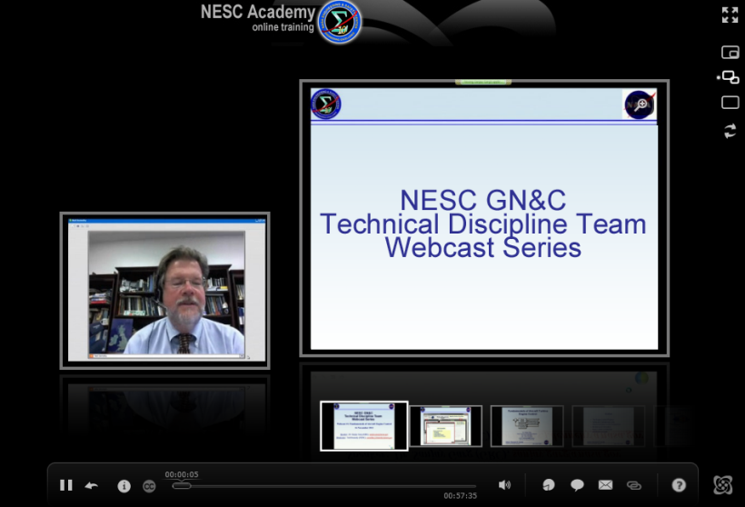
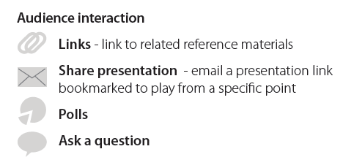


Slide 3
NASA Engineering and Safety Center (NESC) Webcast
Fundamentals of Aircraft Flight Control
NESC GN&C Webcast
October 17, 2012
John Burken NASA DFRC
NESC Technical Discipline Team Member

Slide 4
Outline
Objective of Talk
Why use control
  Some Under Graduate Background Information
  What’s not covered due to time constraints
Models
  X-29 example
Design Method Used
  Background on Robust Servomechanism LQR (LQI)
Robustness Issues
  Add actuators with surface and rate limits
  Sensors (real states or estimated states?)
Results / Time Histories
Conclusions
  Remarks
Appendix
  Call me for models and matlab files

Slide 5
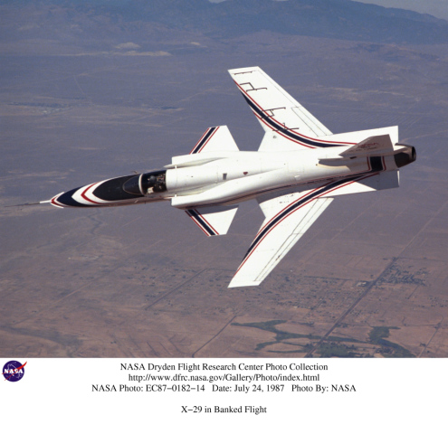
Flight Control Design – a snap shot
Objective of Talk:
This 50 minute “short course” will hopefully hit the major control design issues and what to beware of in the “design process”.
In a linear design world the actuator rates and limits are ignored, along with time delays, and this can bring down an otherwise “good design method”.
This class will hopefully show you ways to design a robust control design method with some of the “real world” issues involved.
The control method will be the Linear Quadratic Tracker design technique, applied to the X-29 vehicle with matlab scripts included upon request.
Scripts available for self-study purposes.
  Call or email john.burken@nasa.gov 661-276-3726
Why the X-29
Models are open literature (no ITAR or SBU issues)
Therefore we can show them, design with them & give them out.

Slide 6
Flight Control Design – Not covered
Not Covered in this Talk but are important: (maybe covered in later talks?)
  Software and hardware System redundancy {triplex etc…}
  Verification and validation testing {did you design it the way you wanted & does it make sense}
  System Failure Accommodation {one engine out etc…}
  Pilot / Aircraft Handling Qualities (one bad pilot rating can cause a full redesign cycle)
  AeroServoElasticity (ASE) → When flexible structures meets dynamic pressure
  Integrator Windup Protection
  Digital system design (some talk on anti-aliasing)

Slide 7
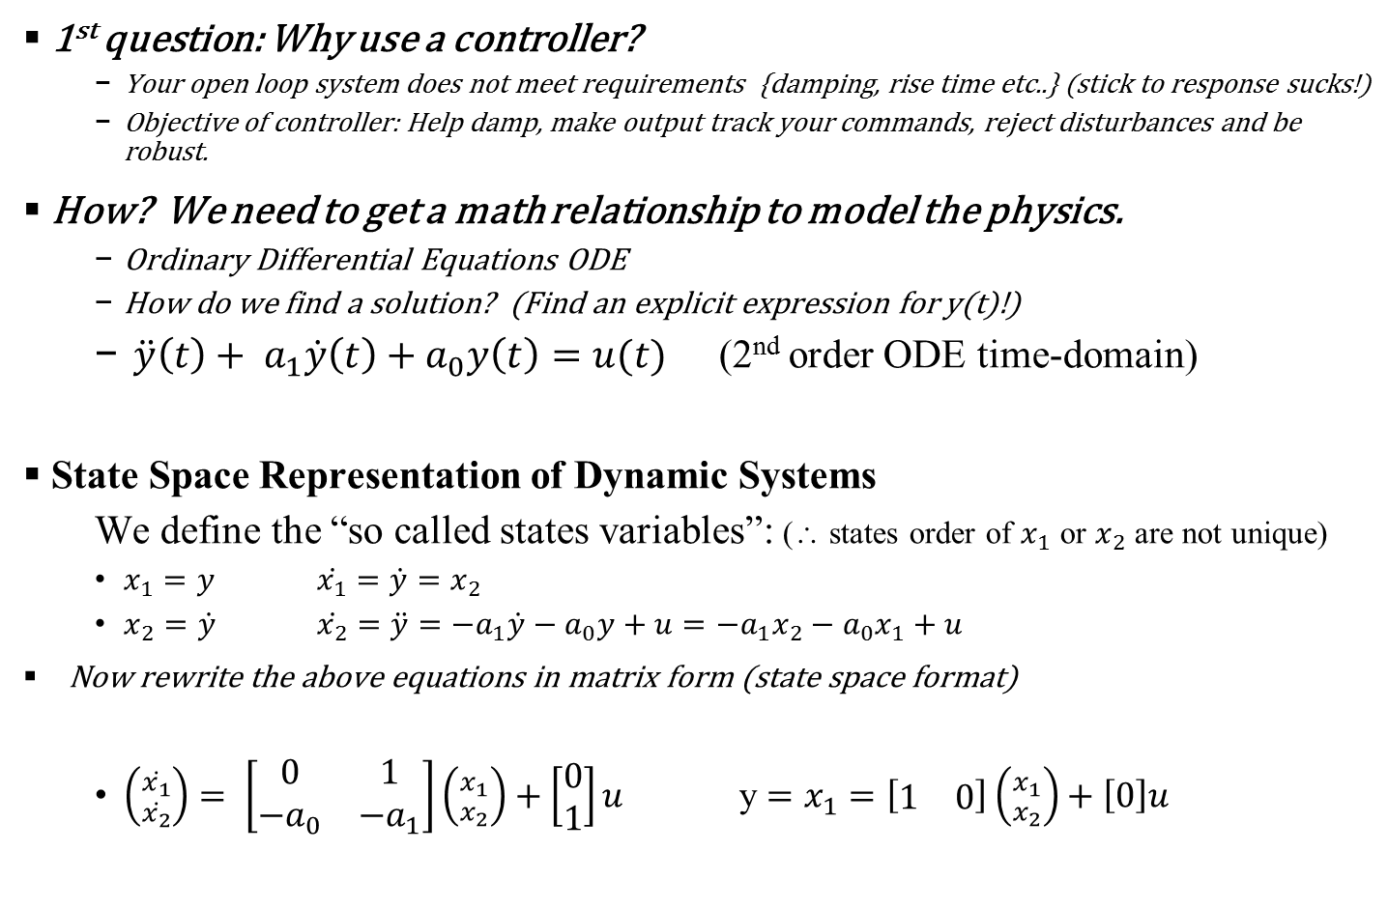
Basic review of concepts (Under Graduate stuff)
1st question: Why use a controller?
  Your open loop system does not meet requirements {damping, rise time etc..} (stick to response sucks!)
  Objective of controller: Help damp, make output track your commands, reject disturbances and be robust.
How? We need to get a math relationship to model the physics.
  Ordinary Differential Equations ODE
  How do we find a solution? (Find an explicit expression for y(t)!)
  $\ddot{y}\left(t\right)+ a_{1}\dot{y}\left(t\right)+a_{0}y\left(t\right)=u(t)$ (2nd order ODE time-domain)
State Space Representation of Dynamic Systems
  We define the “so called states variables”: (∴ states order of $x_{1}$ or $x_{2}$ are not unique)
  $x_{1}=y$ $\dot{x_{1}}=\dot{y}=x_{2}$
  $x_{2}=\dot{y}$ $\dot{x_{2}}=\ddot{y}=−a_{1}\dot{y}−a_{0}y+u=−a_{1}x_{2}−a_{0}x_{1}+u$
Now rewrite the above equations in matrix form (state space format)
  $\left({\dot{x_{1}} \atop \dot{x_{2}}}\right)= \left[\begin{matrix}0 & 1 \\ −a_{0} & −a_{1}\end{matrix}\right]\left({x_{1} \atop x_{2}}\right)+\left[\begin{matrix}0 \\ 1\end{matrix}\right]u$ y $=x_{1}=\left[\begin{matrix}1 & 0\end{matrix}\right]\left({x_{1} \atop x_{2}}\right)+\left[0\right]u$

Slide 8
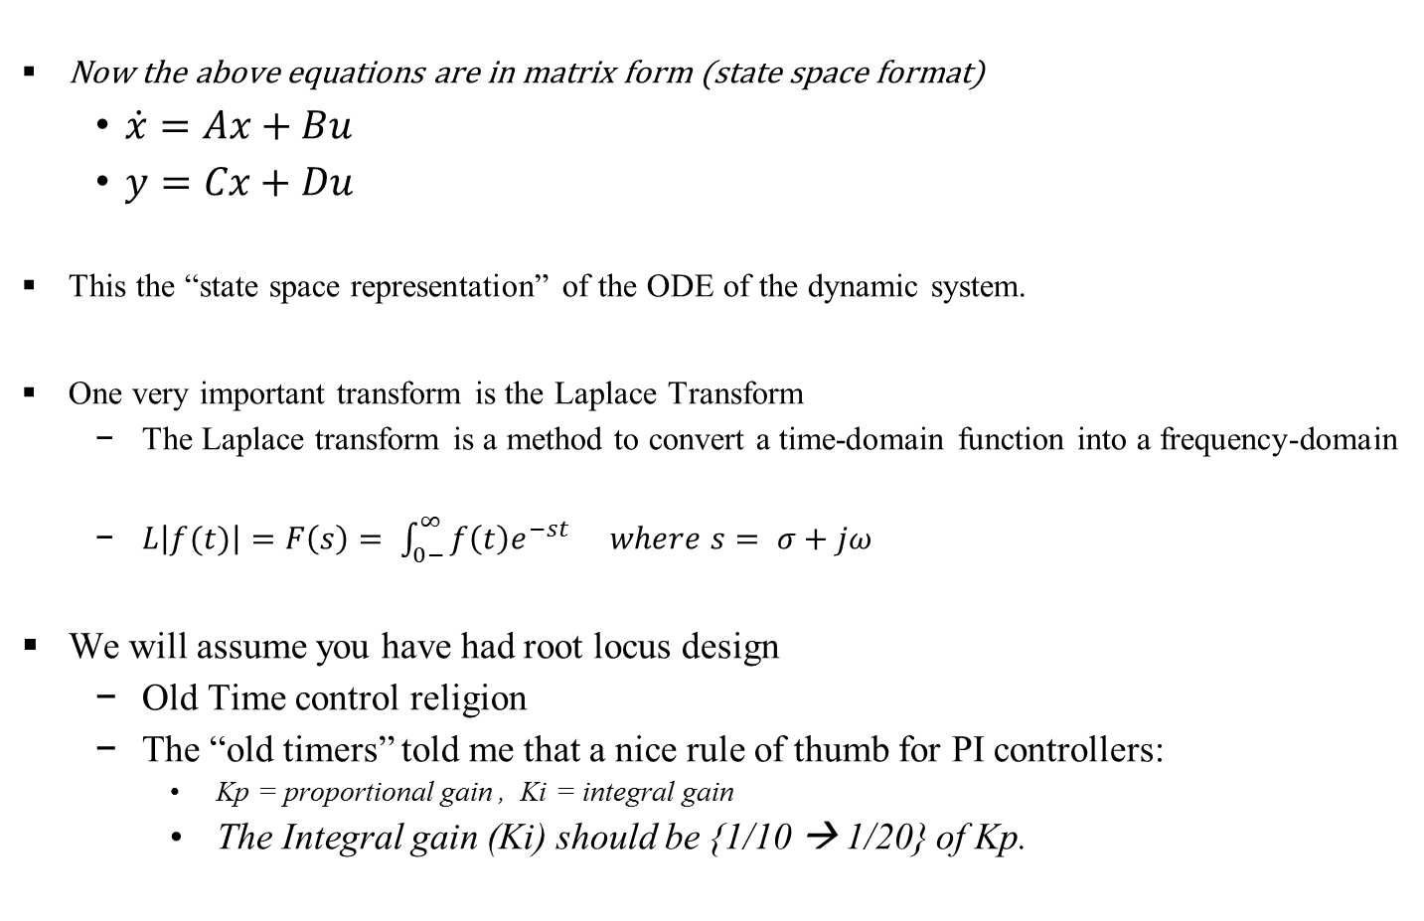
Basic review of concepts (continued)
Now the above equations are in matrix form (state space format)
  $\dot{x}=Ax+Bu$
  $y=Cx+Du$
This the “state space representation” of the ODE of the dynamic system.
One very important transform is the Laplace Transform
  The Laplace transform is a method to convert a time-domain function into a frequency-domain
  $L\left|f(t)\right|=F\left(s\right)= \int_{0−}^{∞}{f\left(t\right)e^{−st} }$ $where s= σ+jω$
We will assume you have had root locus design
  Old Time control religion
  The “old timers” told me that a nice rule of thumb for PI controllers:
    Kp = proportional gain , Ki = integral gain
    The Integral gain (Ki) should be {1/10 → 1/20} of Kp.

Slide 9
Flight Controllers
Typical Controller types:
  Stability Augmentation Systems (SAS)
    Purpose: Increase damping / very simple
    Pitch, Roll & Yaw Dampers
      Limited control authority
      Limited number of sensors required
  Command Augmentation Systems (CAS)
    Purpose: Track pilots commanded inputs
      α_cmd , Φ_cmd or p_cmd etc…
    Autopilots
      Help reduce pilot work load
      Altitude hold, Mach hold ; etc…
Actuator model
pilot stick
q (d/s)
A/C response
Pilot cmd
K(s)
G(s)
sensors

Slide 10
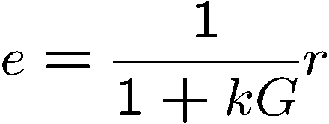
Feedback in a Nutshell
e = r-y
r
u
y
Objective is to make the error e small
  But don’t know G exactly.
  Use feedback and make k large to make e small
  Larger k can give better performance
  Large k is good for disturbance rejection
  Large k can give rate limiting etc…
  Large k is bad for noise rejection
k
G
10

Slide 11
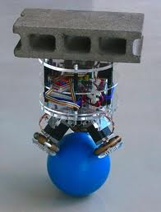
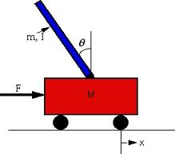

Assuming we have stability!
Too little feedback won’t stabilize an unstable G
Too much feedback can destabilize a stable G
Controller tuning by trial and error can be dangerous: cliffs are conceivably everywhere? Do you want to chance this??
11

Slide 12
  Continuous (s-plane) to discrete (z-plane)
A word of caution if you have a digital system (and who doesn’t these days?)
  Aliasing
    High frequency signals are “aliased” into lower frequencies.
    Just see a movie with a stagecoach wheel as it starts to turn faster!!!
  Sampling theorem : Critical frequency
    π/T → Nyquist frequency
  Don’t let the high frequencies look like low frequencies .
    The fix: Use a Continuous low pass filter, F(s) on all signals used in the digital controller
      Look up anti-aliasing filters
      Anti-aliasing filter: “Don’t leave home without one”

Slide 13
All models are wrong, but some are very useful
The model must suit the task
  Balance simplicity and accuracy
  Accommodate uncertainty
Most models are based on a combination of physics and data
  Physics: Newton, Maxwell, Hooke, Joule
  Data: Measurements and the estimates we derive from them
    Parameters, frequency response, empirical models
Moral of the story:
Don’t assume your model is right, you need to build in robustness
13

Slide 14
1st Fundamental Question of Control Tuning
What limits feedback performance?
Performance is the ability to
stabilize, follow commands, and reject disturbances
14

Slide 15
What Makes Feedback Control Challenging?
  Unstable and lightly damped dynamics (requires stabilization)
  Noise (sensor, actuator, disturbance)
  Non-minimum-phase zeros (limits achievable performance)
  Time delays
  Loop coupling (MIMO)
    (ex yaw into roll, use a little rudder and see what happens open loop)
  Nonlinearities
    Nonlinear dynamics (geometric, kinematic, chaotic,…)
    Hardware constraints (magnitude/rate saturation, deadzone)
  Constraints on states (hard bounds)
  Model uncertainty
    Exacerbates all of the above
15

Slide 16
2nd Fundamental Question of Feedback Control
  What do you need to model and how
  accurately do you need to model it?
Remember all models are wrong.
You need robustness to uncertainties
  For SISO systems use phase “and/or” gain margins
  For MIMO use μ analysis
16

Slide 17
Gain and Phase Margins
-GM
+GM
Im
Im
Re
-1
+GM
Re
-1
+PM
Close to (-1,j0). Small simultaneous gain and phase uncertainty will destabilize closed loop system.
Gain Margins:
+PM
Phase Margins:
Include These Models In Frequency Domain Analysis
Command Inputs
Plant Input
Zero Order
Actuator
Rigid Body
Controller
Time Delay
Hold
Dynamics
Dynamics
+
lin ...
timedelay
zoh
actuate
lon lat/dir
+
Linear Analysis Model
ASE
Dynamics
TBD
ASE
Plant Output
Sensor
C
Compensation
Time Delay
Dynamics
FB
asecomp
timedelay
sensor

Slide 18
Important Transfer Function Loops
SISO
Returned
Signal
Injected
Signal
+
K(s)
G(s)
-
Controller
Plant
Inject signal , examine returned signal
K(s),G(s) Transfer Functions
- The Return Difference Dynamics
Zeros of the return difference are the poles of the closed loop system
Sensitivity
Complementary Sensitivity

Slide 19
Recap
You need a controller (open loop response is not good)?
  Will SAS work or do you need full CAS
  Will a linear controller work?
Is the controller Single Input Single Output (SISO)?
  Classical gain or phase margins (anywhere in the loop: same margins)
Is the controller Multiple Input Multiple Output (MIMO)?
  Robustness
  Use mu (but we still use SISO margins on top of mu – Get pass the FRR).
    Why SISO Gm or Pm: Some axes are very decoupled and SISO is almost OK!
    Why MIMO Mu: It can be shown (Doyle) that infinite margins in SISO format is no guarantee
Don’t trust your models
  All models are wrong, but by how much?
I assumed you have had a root locus design course.
  We’ll start off with the cornerstone to modern control design (LQR)

Slide 20
Design Example
Design an LQR controller
  Why LQR?
    Guaranteed Stability Margins for LQRs
      Excellent Stability Guarantees { -6, ∞} Gain Margins and {±60 degree} Phase Marin
      Example of LQRs Boeing 777 lateral/directional axes
    Small problem with LQRs
      Regulators like zero commands
      Airplanes don’t fly at zero AOA
  You may need the LQR controller to track a constant command
    Robust servomechanism → RSLQR → LQR Tracker → LQR-PI → LQI
    To track a constant command you need a type 1 controller
      Append the integrator states to Open Loop dynamics
      Examples of LQR trackers
        X-31 (The Germans non-zero set point LQR)
        JDAM (Boeing)

Slide 21
Servomechanism Design Methodology
Optimize the following cost function.
Optimal linear-quadratic-regulator (LQR) problem.
The algebraic Riccati equation
And the optimal control is given by:

Slide 22
Servomechanism Design Methodology (cont.)
Note :
LQR Servo = LQR PI = LQI (matlab)
Approach is simple to implement.
If this statement is true: there
exist a closed-loop system that is stable.

Slide 23
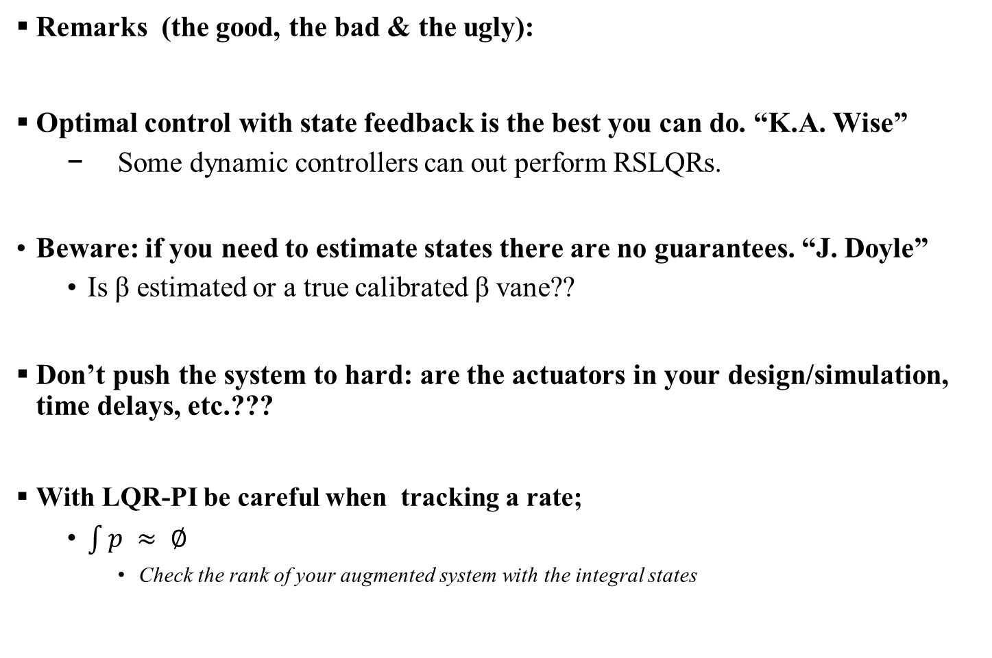
Servomechanism Design Methodology (cont.)
Remarks (the good, the bad & the ugly):
Optimal control with state feedback is the best you can do. “K.A. Wise”
  Some dynamic controllers can out perform RSLQRs.
Beware: if you need to estimate states there are no guarantees. “J. Doyle”
  Is β estimated or a true calibrated β vane??
Don’t push the system to hard: are the actuators in your design/simulation, time delays, etc.???
With LQR-PI be careful when tracking a rate;
  $\int{p ≈ ∅}$
    Check the rank of your augmented system with the integral states

Slide 24
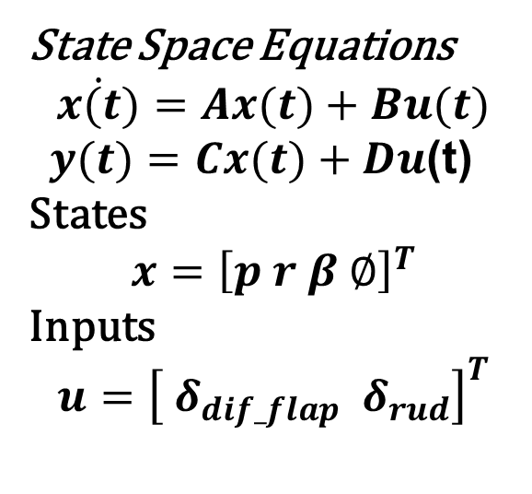

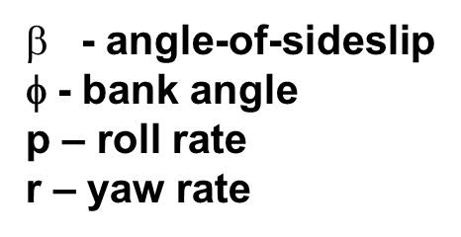
X-29 Lat/Dir Linear Model
Design the controller to track p & β commands
Flt condition: Mach .7 / H = 20k ft

Slide 25
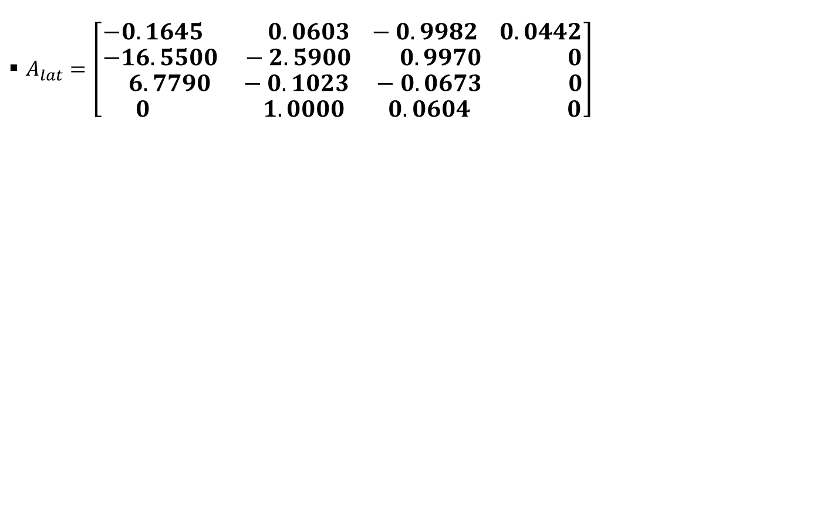
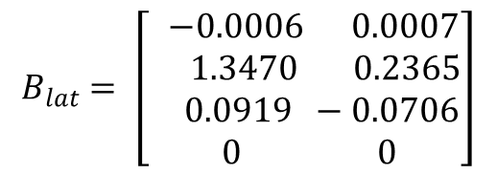
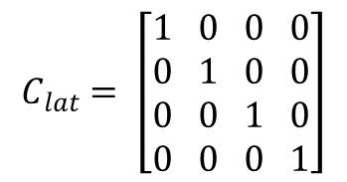
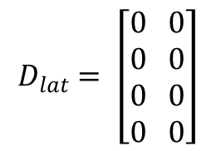
X-29 Lateral Directional State Space Models
$A_{lat}=\left[\begin{aligned}−0.1645 0.0603 −0.9982 0.0442 \\ −16.5500 −2.5900 0.9970 0 \\ 6.7790 −0.1023 −0.0673 0 \\ 0 1.0000 0.0604 0\end{aligned}\right]$
$$B_{lat}= \left[\begin{aligned} −0.0006 0.0007 \\ 1.3470 0.2365 \\ 0.0919 −0.0706 \\ 0 0\end{aligned}\right]$$
Flt condition: Mach .7 / H = 20k ft
$$C_{lat}= \left[\begin{aligned}1 0 0 0 \\ 0 1 0 0 \\ 0 0 1 0 \\ 0 0 0 1\end{aligned}\right]$$
Outputs = x’s = [β p r phi] radians
Inputs = u’s = [Ailerons Rudder] degrees
$$D_{lat}= \left[\begin{aligned}0 0 \\ 0 0 \\ 0 0 \\ 0 0\end{aligned}\right]$$

Slide 26
Block Diagram

Slide 27
3 test cases for Mach .7 // H= 20k ft
Test case 1:
  Design without actuators (not thinking to much about reality)
  Does it meet requirements
Test case 2:
  Test the first case with real actuators
Test case 3:
  Redesign with actuators in mind
  Reduce gains to reduce command demand

Slide 28
X-29 Lat/Dir LQI Design
Test Case 1: First design without actuators:
  Why : If it does meet your requirements here, how can it with real actuators??
Controller gains
Klqi = [-22.0455 5.0649 8.6107 35.5815 -29.5533
96.9614 7.5731 -47.7479 -295.5326 -35.5815]

Slide 29
X-29 Lat/Dir LQI Design
Test Case 2: Test with actuators {same gains} Has states and real limits {rate limits / position limits}
Performance??
Rate limiting??
Controller gains
Klqi = [-22.0455 5.0649 8.6107 35.5815 -29.5533
96.9614 7.5731 -47.7479 -295.5326 -35.5815]
Gains are too BIG!!

Slide 30
X-29 Lat/Dir LQI Design
Test Case 3: Change the Q & R weightings to penalize the surface activity (Reduce demand on commands)
Controller gains
Klqi = [ -12.4120 5.5202 3.7623 7.4219 -30.7395
3.2892 2.3039 -11.2919 -43.4722 -10.4962]
Gains are lower!!

Slide 31
Final Remarks
  Always design with a reality check in final test (put in real actuators etc..).
  In your simulation: add realistic time delays and non-linear elements.
    Go from simple to more complex (3 dof → 6 dof)
      Why not just start in nonlinear high fidelity 6 dof simulation?
        You lose insight to simple dynamics.
  Have the pilot involved early in the 6-dof simulation.

Slide 32
Appreciations / Thanks
Dennis S. Bernstein
  Department of Aerospace Engineering, University of Michigan
Kevin A. Wise
  Boeing

Slide 33
Appendix
If you want the matlab scripts or have questions please call or email me.
If you improve on the example please share with us (NESC).
  John Burken
      phone 661-276-3726
      john.burken@nasa.gov

Slide 34
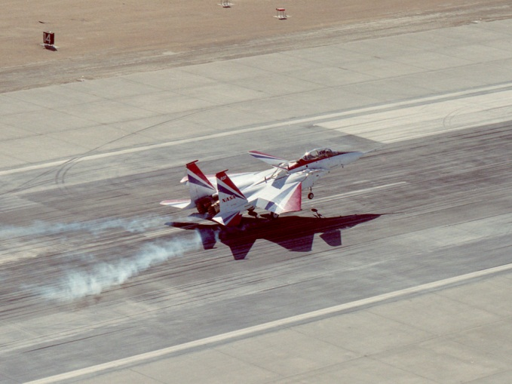
Thank you for
Attending TODAy’s WeBCAST
ANY QUESTIONS?

Slide 35
Upcoming NESC GN&C TDT
Webcasts (as of October 2012)
    “Fundamentals of Adaptive Control”, Irene Gregory (LaRC), 28th November 2012, 2pm Eastern Time (4th Wednesday of Nov only)
    “Fundamentals of Spacecraft Attitude Determination”, John Crassidis (Univ. of Buffalo), on 16 January 2013
    “Fundamentals of Kalman Filtering and Estimation”, Chris Dsouza (JSC), on 20 March 2013
20 June 2012 Update

