Slide 1
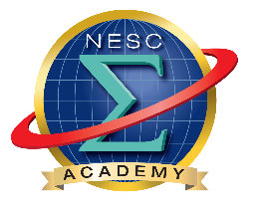


NESC Academy Webcast
Fundamentals of
Libration Point Mission Design –
Applications
David Folta
NASA Goddard Space Flight Center
January 18th, 2017
Moderated by Neil Dennehy
NASA Technical Fellow for Guidance, Navigation, & Control
NASA Engineering & Safety Center (NESC)

Slide 2
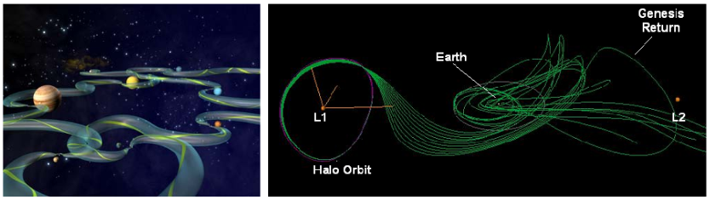
Fundamentals of Libration Point Mission Design –
Applications
David Folta
Goddard Space Flight Center

Slide 3
Libration Point Mission Design
Origins based on the three body problem, and applications of Dynamical System Theory (DST) and Chaos Theory
Theoretical development over three hundred years
Applied to astrodynamics in the last several decades, ref: from the ISEE-3, the first mission to a Sun-Earth libration point and now JWST
Incorporates the idea of a multi-body gravitational environment for orbits and transfers between or within individual systems
Applications to many GSFC missions in Cis-lunar and Sun-Earth regions
The DST concept provides
  A trajectory or orbit design that is not necessarily intuitive
  A transport mechanism that can reduce fuel or DV cost – at the possible expense of longer duration flight times
  A method for understanding the orbit stability and structure
  Data for use in high fidelity operational tools
Notes:
Examples include the mathematical models that describe the swinging of a clock pendulum, the flow of water in a pipe, and the number of fish each spring in a lake.
The system's evolving state over time traces a path (a phase space trajectory for the system) through the high-dimensional space. The phase space trajectory represents the set of states compatible with starting from one particular initial condition, located in the full phase space that represents the set of states compatible with starting from any initial condition.
Chaos theory describes the behavior of certain dynamical systems – that is, systems whose state evolves with time – that may exhibit dynamics that are highly sensitive to initial conditions (popularly referred to as the butterfly effect).
In mathematics and physics, a phase space of a dynamical system is a space in which all possible states of a system are represented, with each possible state of the system corresponding to one unique point in the phase space. For mechanical systems, the phase space usually consists of all possible values of position and momentum variables. The concept of phase space was developed in the late 19th century by Ludwig Boltzmann, Henri Poincaré, and Willard Gibbs.^{[1]}

Slide 4
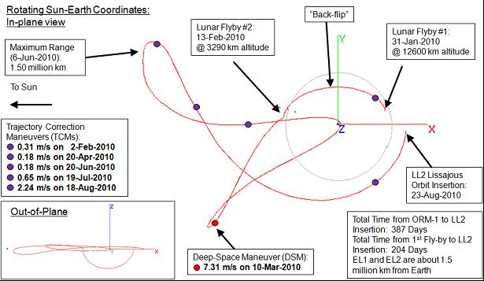
Why Dynamical Systems Theory Approach
Dynamical Systems Theory Application
  Automatic Generation Of Trajectories
  Maps Out Phase Space Structures
  Can Provide Optimum Trajectory Designs
  Provides A Global Perspective
Traditional Design Approach
  Requires First Hand Numerical Knowledge Of Phase Space
  Trajectory Computation Can Be Intensive
  Extensive Parametric Study Or Monte Carlo Simulation Required
  Optimization Can Be Difficult to Structure
Dynamical Design of a Transfer
Numerical Design of a Transfer

Slide 5
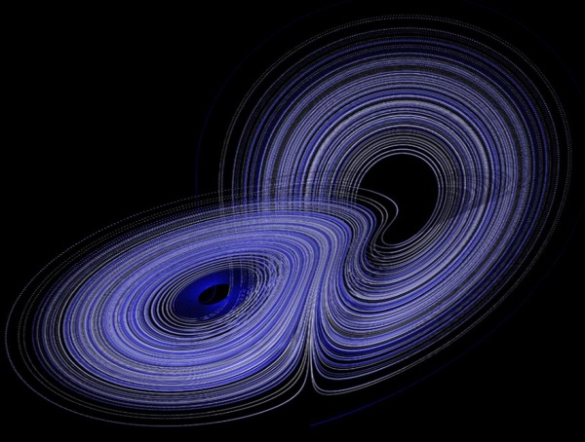
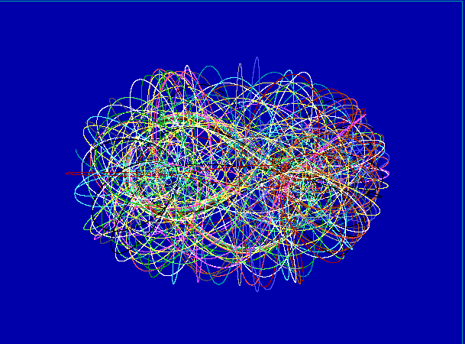
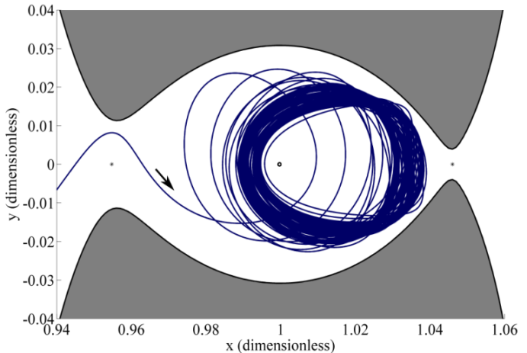
Dynamical Systems Theory
Describes long-term qualitative behavior of complex dynamical systems - describe how quantities (like the states of a particle) follow some rule and evolve over time
Employs differential equations (continuous) & difference equations (discrete) to model system behavior [ ]
Nonlinear leads to complexity but not necessarily a loss of predictability
Focus not on precise solutions, but on general exploration of space (periodic orbits, quasi-periodic motion, chaos, …)
EML₁
EML₂
Moon
Lorenz Attractor – a non linear system sensitivity
Complex nature of evolving system
Periapsis Poincaré map
Images from Howell, Craig Davis, and Haapala, Journal of Mathematical Problems in Engineering, Special Issue: Mathematical Methods Applied to the Celestial Mechanics of Artificial Satellites, 2012 and from Wikipedia search on Lorenz attractors
Notes:
Dynamical system is a concept in mathematics to describe how quantities (like the states of a particle) follow some rule and evolve over time.
Dynamical systems → the evolution of quantities over time. Evolution can occur smoothly over time of in discrete time steps.
If model as a discrete dynamical system, essentially take snapshots of system at sequence of times once a year or every millisecond (does not have to be even steps even). Must specify a ‘rule’ that determines, given an initial state, what future snapshots must be.
It is notable for having chaotic solutions for certain parameter values and initial conditions. In particular, the Lorenz attractor is a set of chaotic solutions of the Lorenz system which, when plotted, resemble a butterfly or figure eight.
Describing the quality of something in size, appearance, value, etc. Such adjectives can be submodified by words such as very and have comparative and superlative forms.

Slide 6
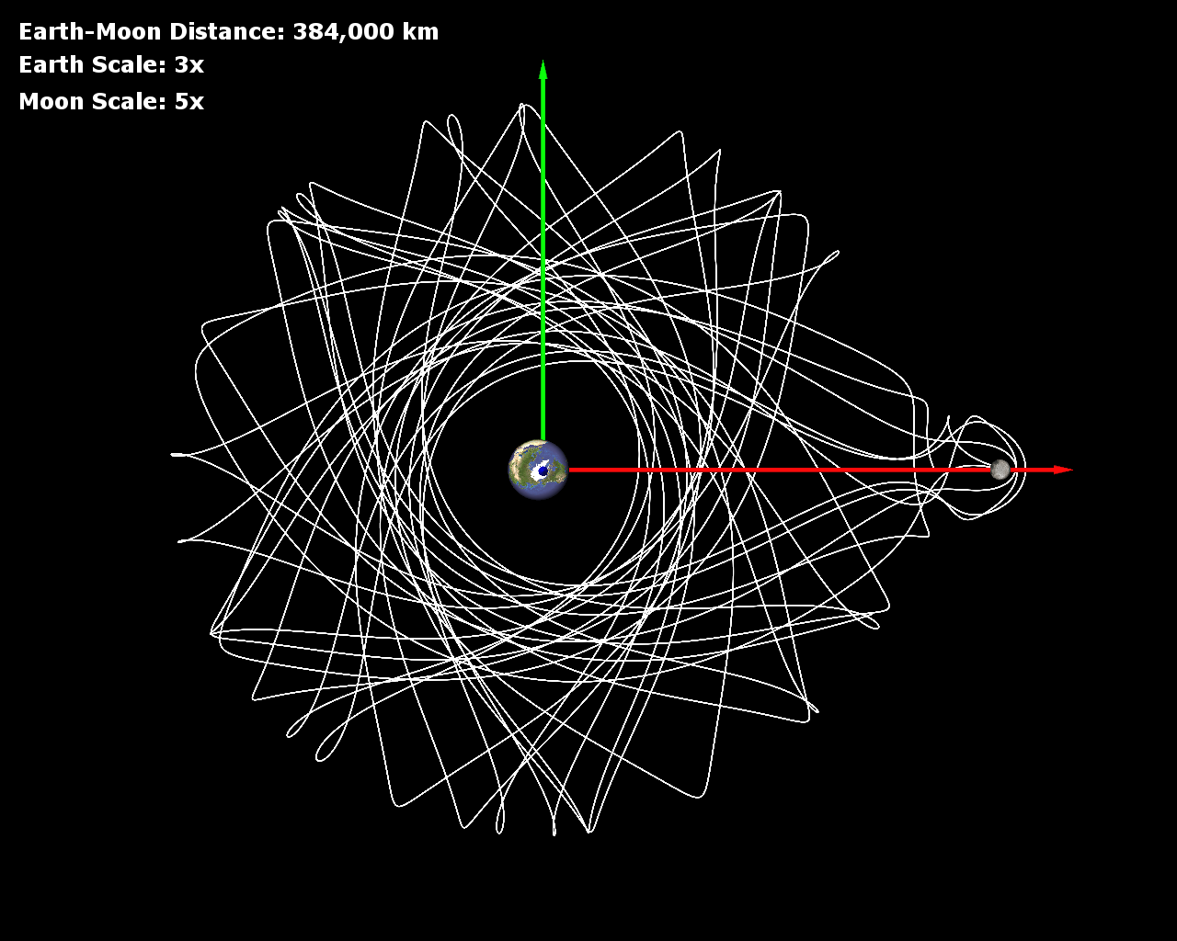
Astrodynamics Design Opportunity
Focus of DST applied to Mission Design is NOT necessarily the determination of precise solutions to differential equations but, instead, the answers to the following questions:
Will the system settle down to a steady state in the long term?
Does long-term behavior depend on Initial Condition?
How can I use this information for a mission design problem?
Ref: Howell, Purdue

Slide 7
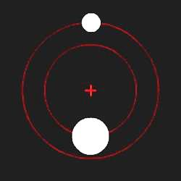
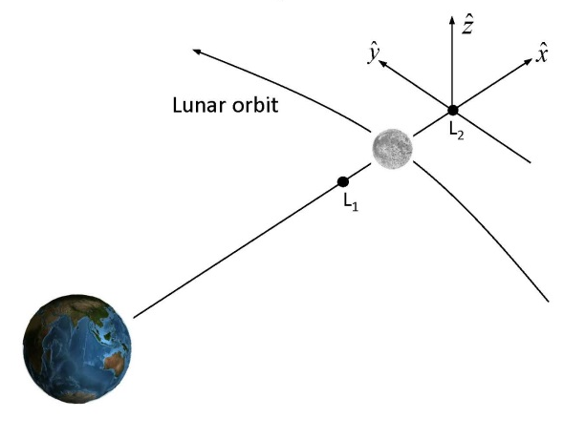
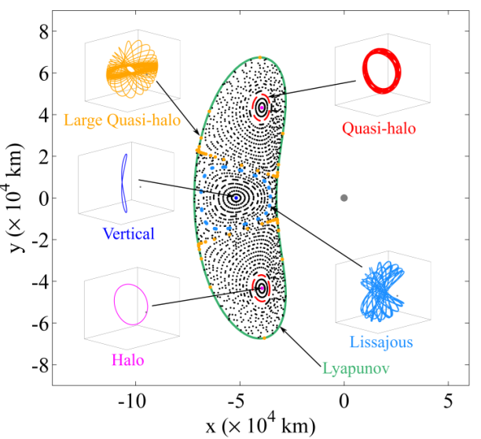
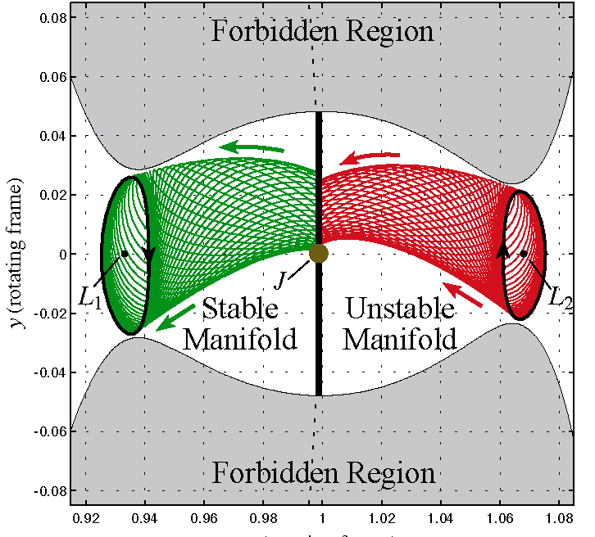
Building Blocks
Employ A Variety of Mathematical Constructs and Applications
Three Body or Multi-body Motion
Two Body Motion
Manifolds
Incorporation into Operational tools
Poincaré Maps
Escape Flow

Slide 8

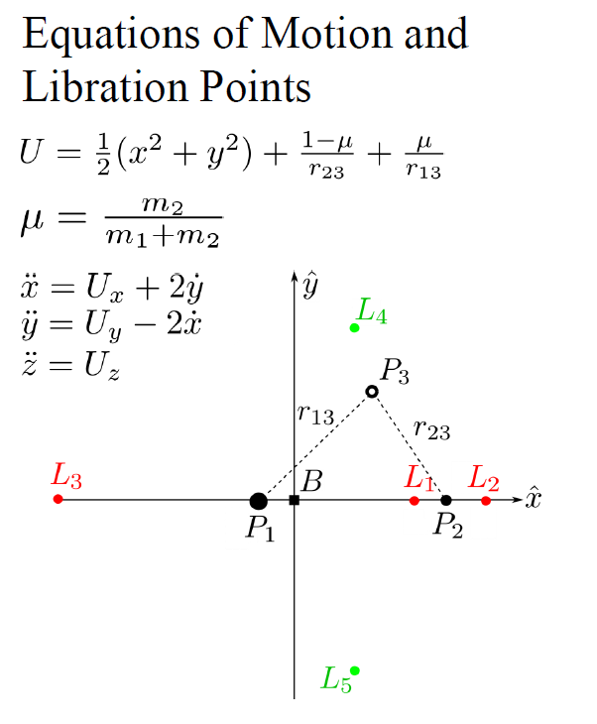
Planar Circular Restricted Three Body Problem
Three-body problem: an analytical solution does not exist
A ‘rule’ for the evolution in terms of a set of nonlinear differential equations
  Deterministic for one particular initial state only one set of future states evolves
Know particular equilibrium solutions (libration points) and we have successfully determined – and learned to compute -- some periodic solutions of which there is an infinite number
We can approximate the solution numerically
Spacecraft
Sun
Earth
Notes:
The circular restricted three-body problem is a valid approximation of elliptical orbits found in the Solar System, and this can be visualized as a combination of the potentials due to the gravity of the two primary bodies along with the centrifugal effect from their rotation (Coriolis effects are dynamic and not shown). The Lagrange points can then be seen as the five places where the gradient on the resultant surface is zero (shown as blue lines) indicating that the forces are in balance there.
Three-body problem: an analytical solution does not exist. So we have a ‘rule’ for the evolution in terms of a set of nonlinear differential equations. But the rule is deterministic, that is, for one particular initial state only one set of future states evolves. We do not have a complete solution; we cannot solve those equations so we do not know the states for all initial conditions and for times past, present and future. We know some particular equilibrium solutions (libration points) and we have successfully determined – and learned to compute -- some periodic solutions of which there is an infinite number.
We can choose the units of mass, distance and time so that the gravitational constant is 1, and the period of the circular orbits is 2π. . We can study the dynamics relative to a co-rotating system of coordinates for which the positions of the primaries relative to this system are … The motion of the infinitesimal particle relative to the co-rotating frame is described by the second order differential equations:
The Jacobi Constant; named after Carl Gustav Jacob Jacobi) is the only known conserved quantity for the circular restricted three-body problem.^{[1]} Unlike in the two-body problem, the energy and momentum of the system are not conserved separately and a general analytical solution is not possible. The integral has been used to derive numerous solutions in special cases.
Note that the Jacobi integral is minus twice the total energy per unit mass in the rotating frame of reference: the first term relates to centrifugal potential energy, the second represents gravitational potential and the third is the kinetic energy. In this system of reference, the forces that act on the particle are the two gravitational attractions, the centrifugal force and the Coriolis force. Since the first three can be derived from potentials and the last one is perpendicular to the trajectory, they are all conservative, so the energy measured in this system of reference (and hence, the Jacobi integral) is a constant of motion.

Slide 9

Dynamical Systems Theory: Model
A Conceptual Model (CRTBP) is key for understanding:
Much simpler than complex reality
Useful model clarifies tendencies or relationships, not necessarily ‘laws’, that would otherwise be obscure
Mathematical models must be robust in important features –
  Topological and dynamical structure of the space of solutions (phase
  portrait) is unchanged by sufficiently small perturbations
Successful conceptual mathematical model:
accurate method of prediction
new insights
CR3BP
Ref: Howell, Purdue

Slide 10
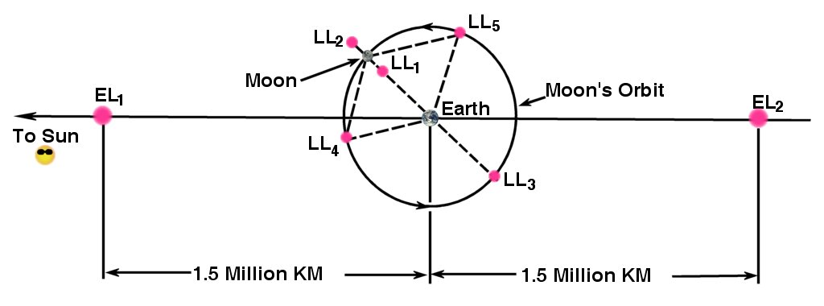
Libration Points
Equilibrium or libration points represent singularities in the equations of motion where velocity and acceleration components are zero and the forces are balanced
Viewed in the rotating frame: centrifugal (Coriolis-Type) force balances with gravitational forces of the two primaries
Libration points are in plane with no Z component. Orbits are mapped to a rotating frame where there are no time dependent forces
Sun-Earth L₁ and L₂ distance of ~1.5 million km: Collinear Points, unstable
Sun-Earth L₄ and L₅ distance of ~150 million km: Triangular Points, stable
Notes:
Need to convey the idea from the CRTPB to Libration Points. Solution of quantic equations to solve the precise location of the point. These give rise to the CRTPB for orbits about these locations.

Slide 11
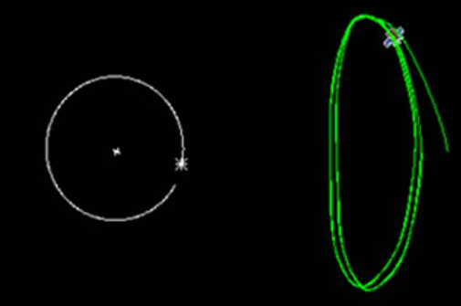
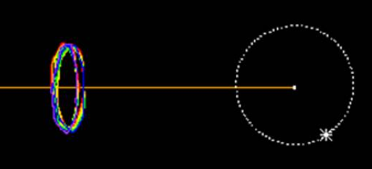
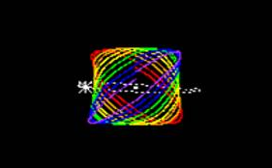
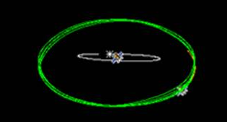
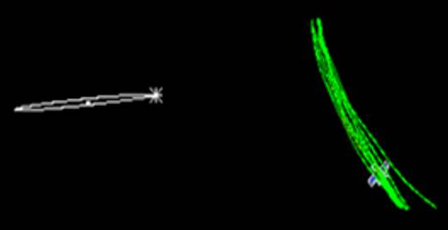
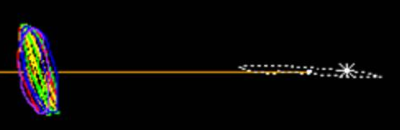
Some ‘Standard’ Libration orbits
JWST (Sun-Earth L2 orbiter)
DSCOVR (Sun-Earth L1 Orbiter)
Y-amplitude ~832k km, 32 deg SEV angle
Y-amplitude ~292k km, 4 deg x 15 deg angle
Top view (Rotating Frame)
Top view (Rotating Frame)
DSCOVR Orbit
Y
X
Y
-X
Lunar Orbit
Lunar Orbit
JWST Orbit
View along x-axis
DSCOVR Orbit
Large Quasi-Halo Orbit
View along x-axis
Lunar Orbit
Lissajous Orbit
JWST Orbit
Lunar Orbit
Z
Y
Z
Y
View along y-axis
View along y-axis
JWST Orbit
Lunar Orbit
Lunar Orbit
DSCOVR Orbit
Z
-X
Z
X
Notes:
Talk to the CRTBP concept (eqn) and a full ephemeris modeling

Slide 12



Some ‘Standard’ Libration orbits
Ref: M. Mesarch, GSFC
Notes:
Talk to the CRTBP concept (eqn) and a full ephemeris modeling

Slide 13
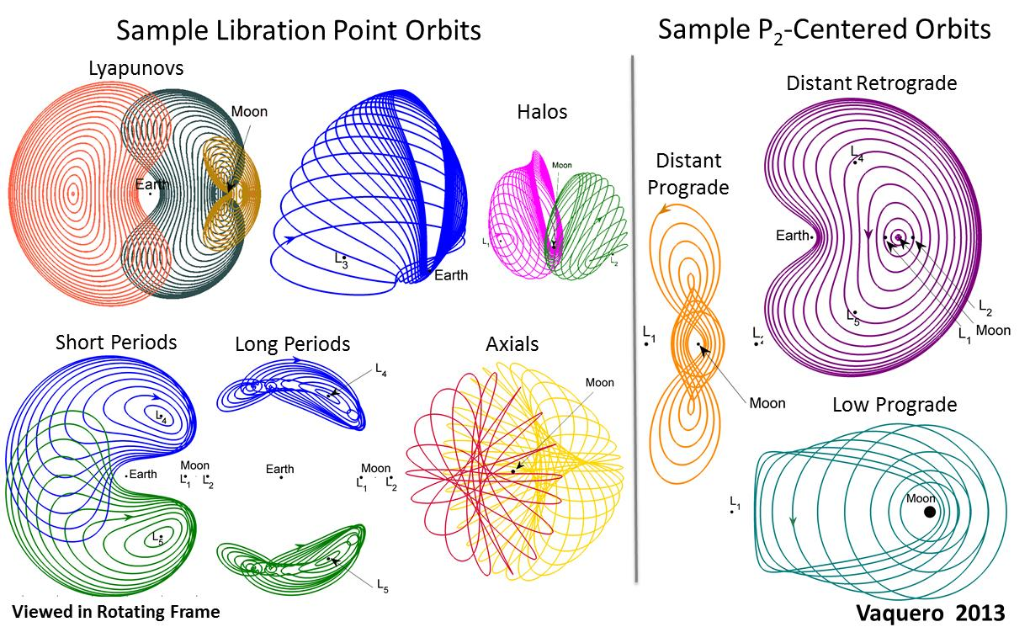
Orbit Architecture in the CR3BP

Slide 14
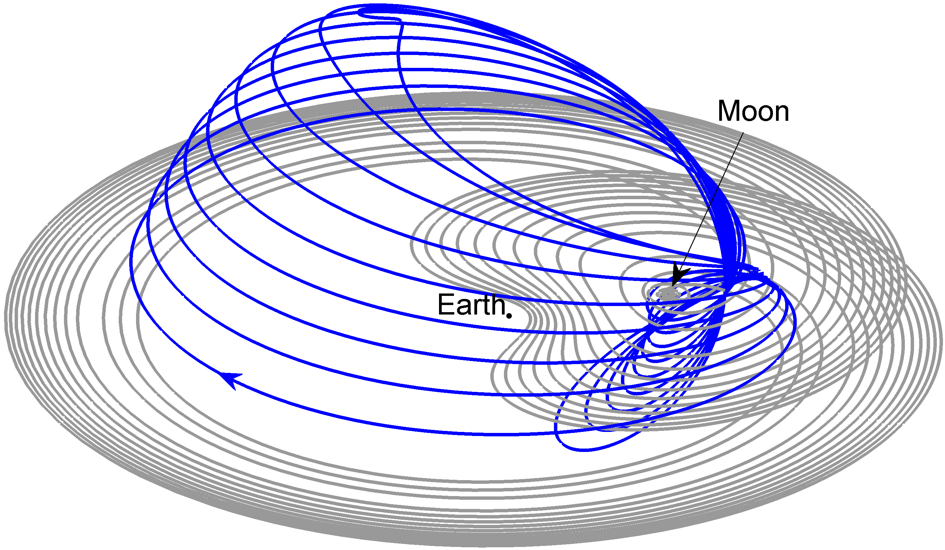
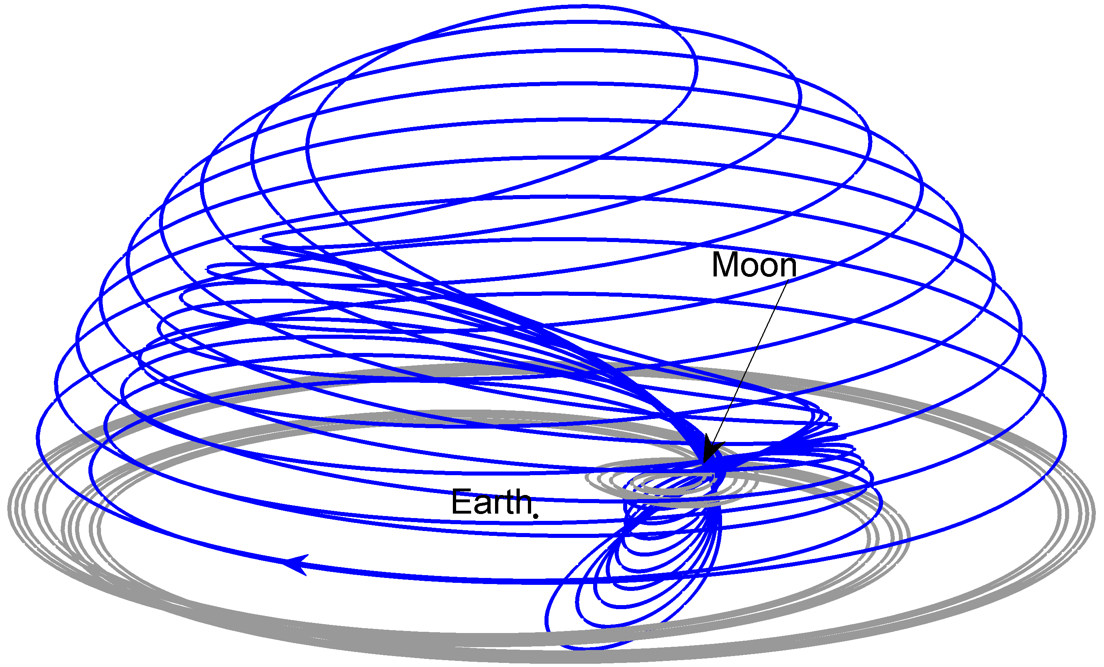
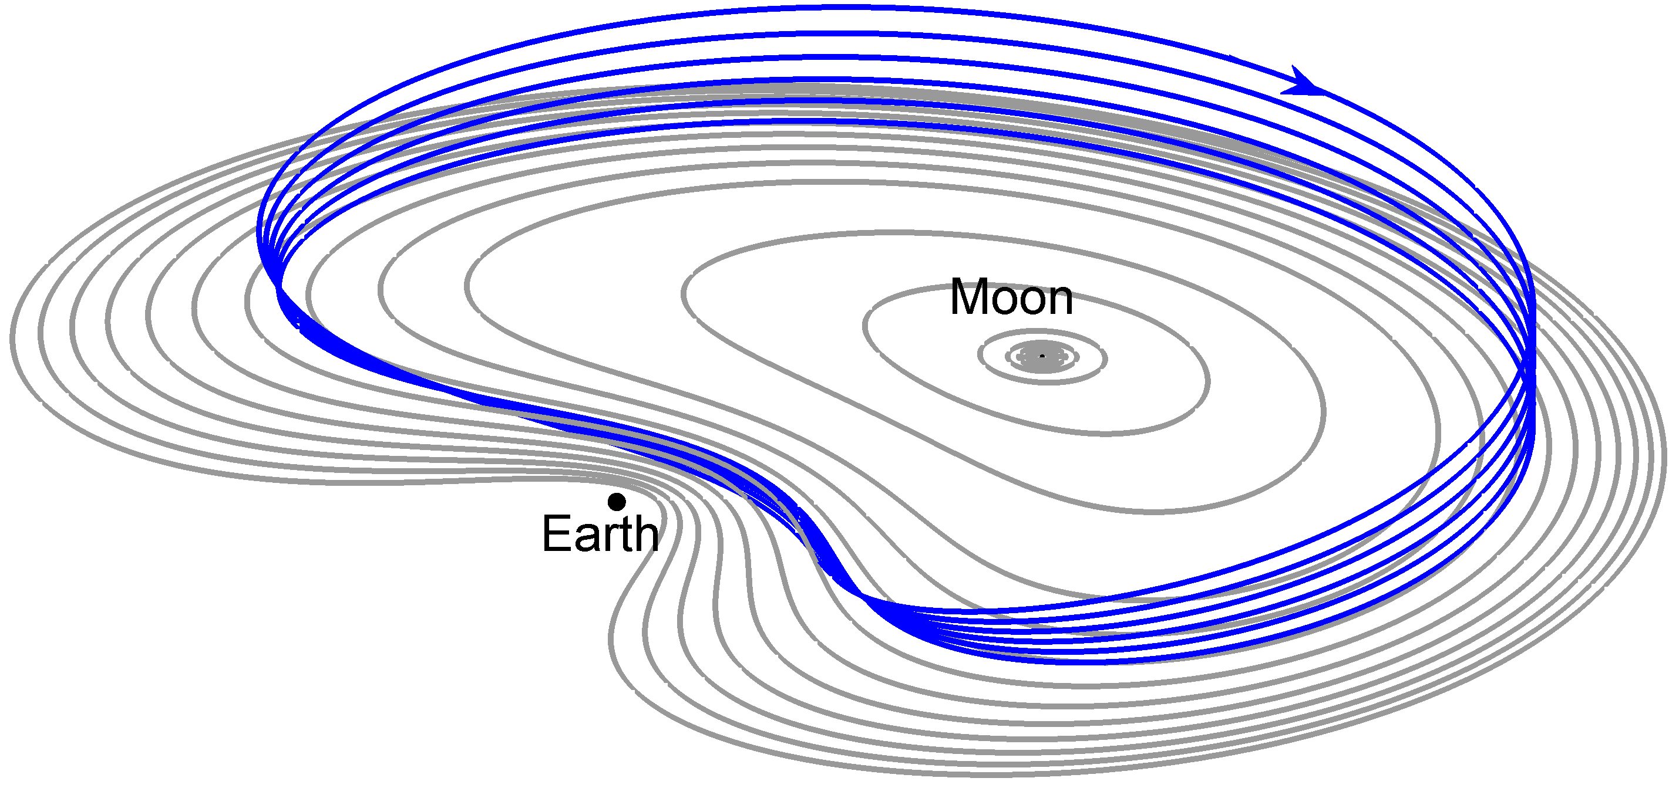
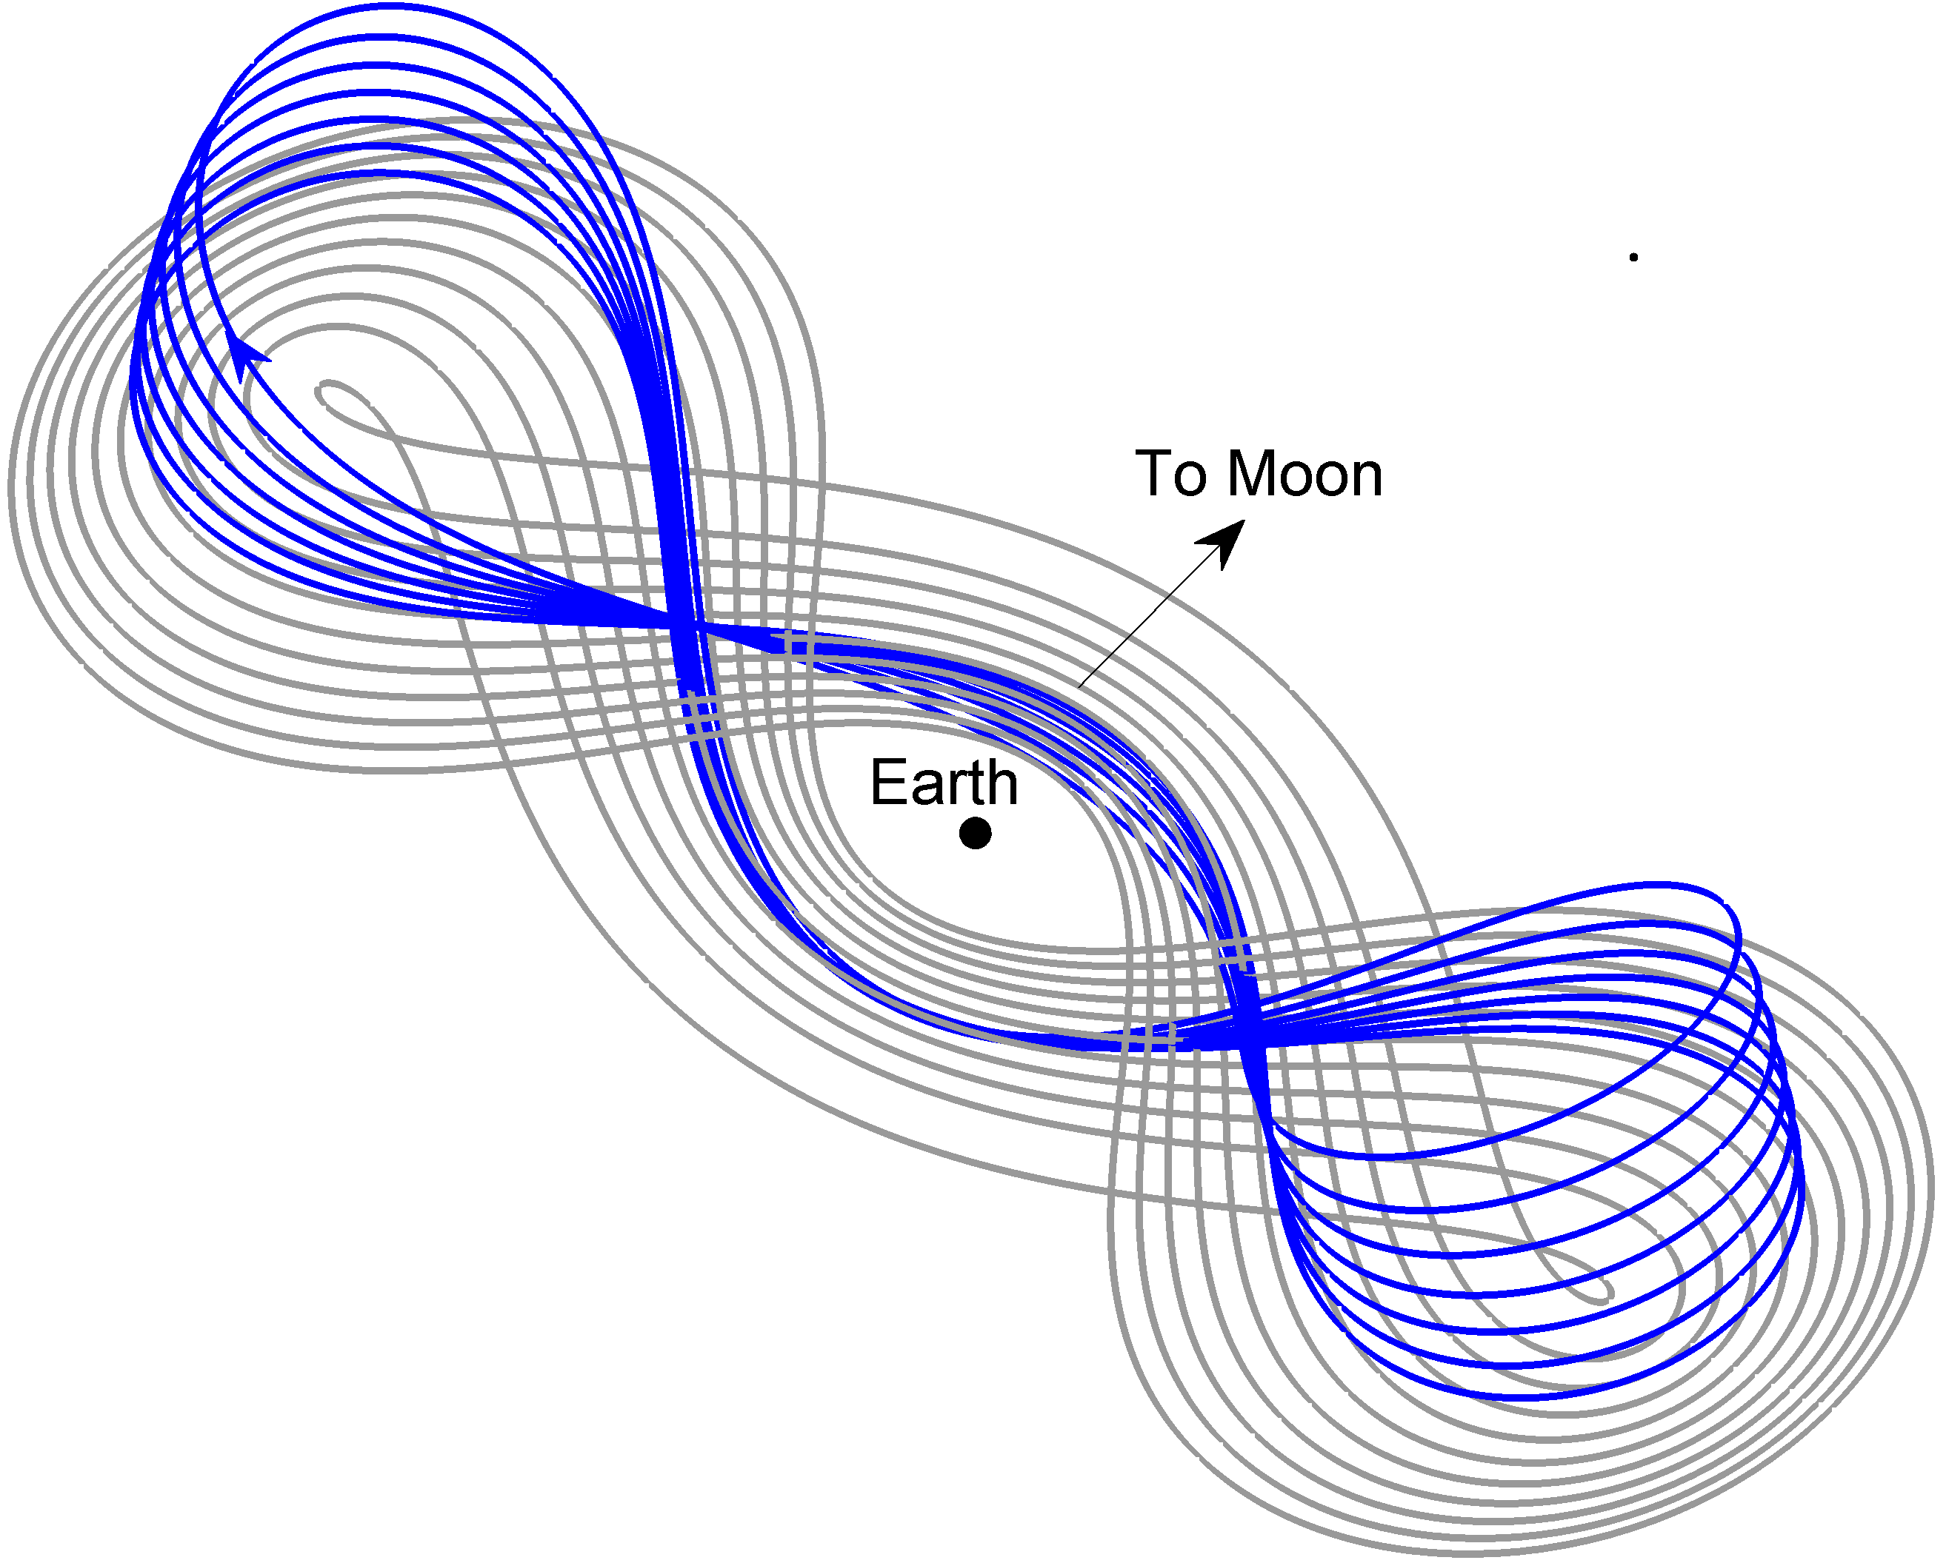
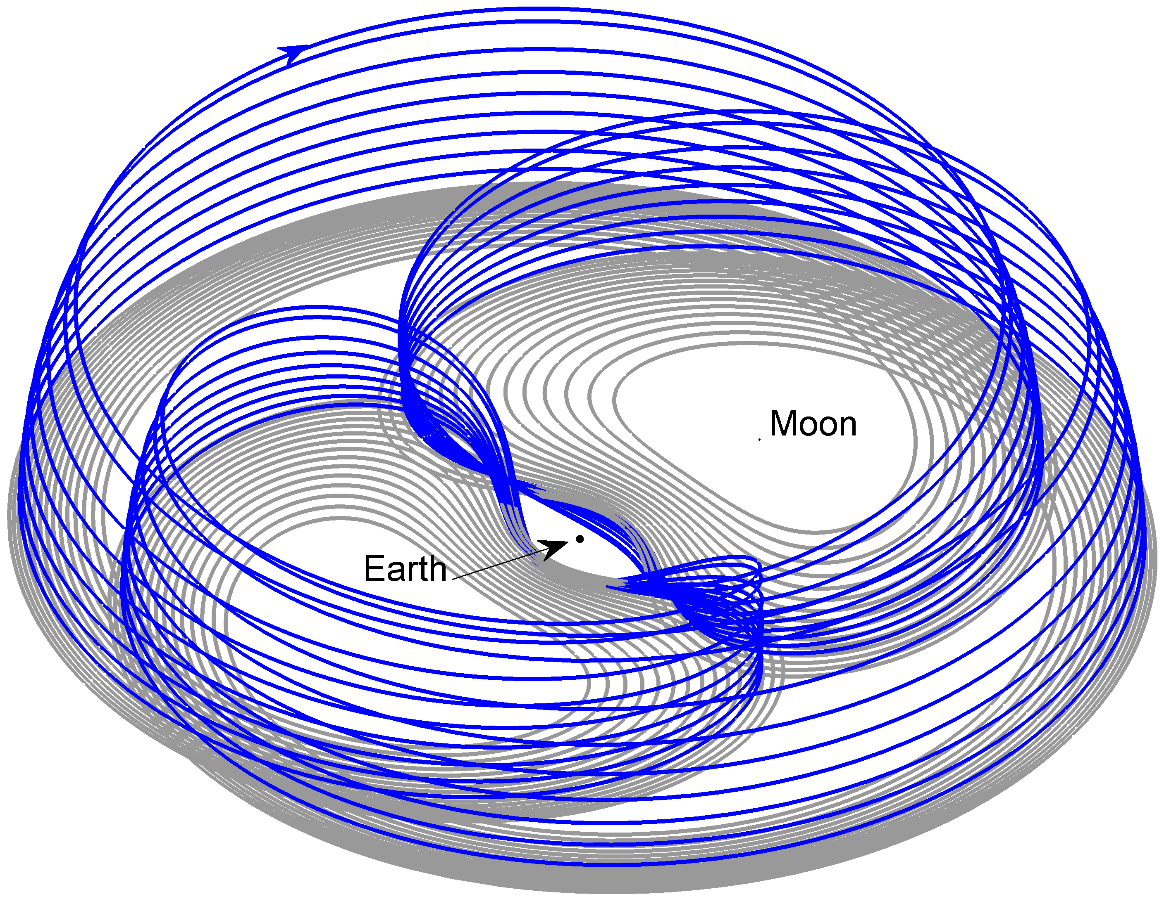
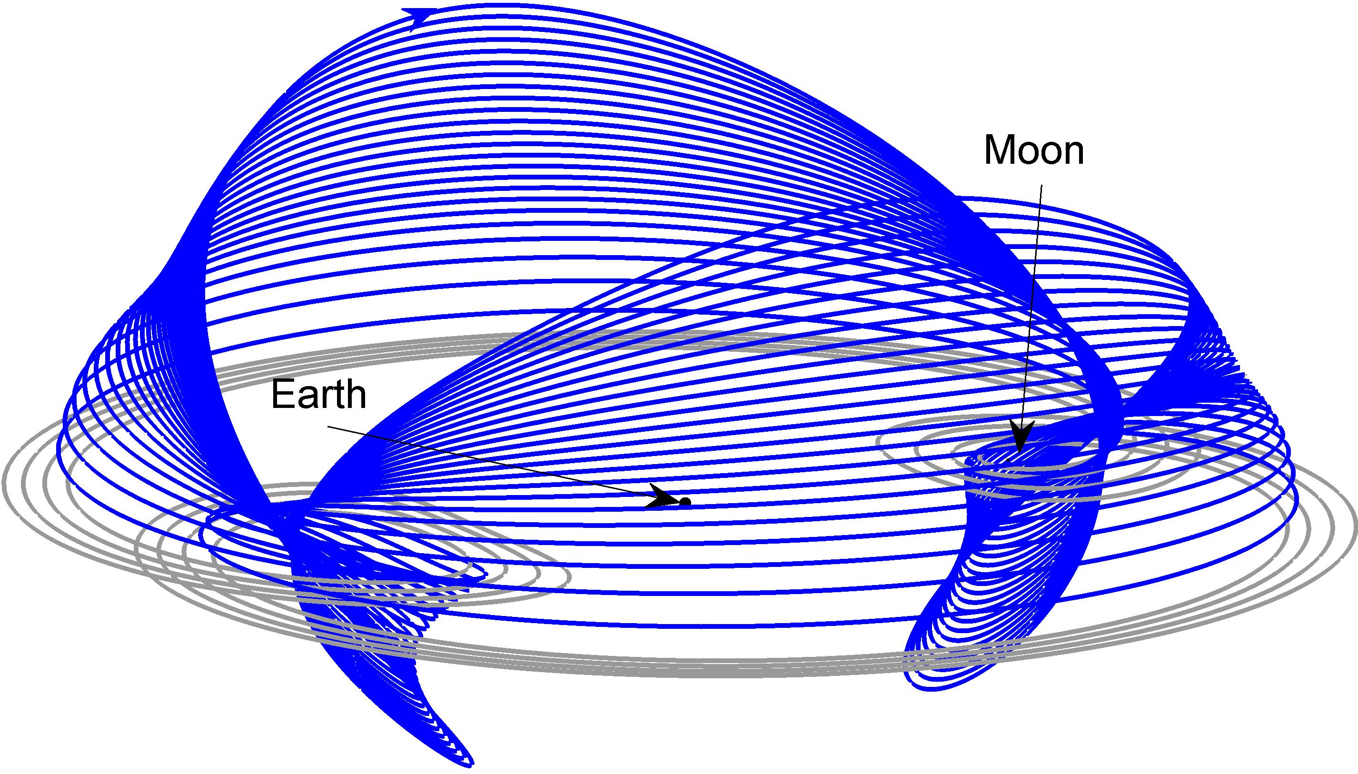
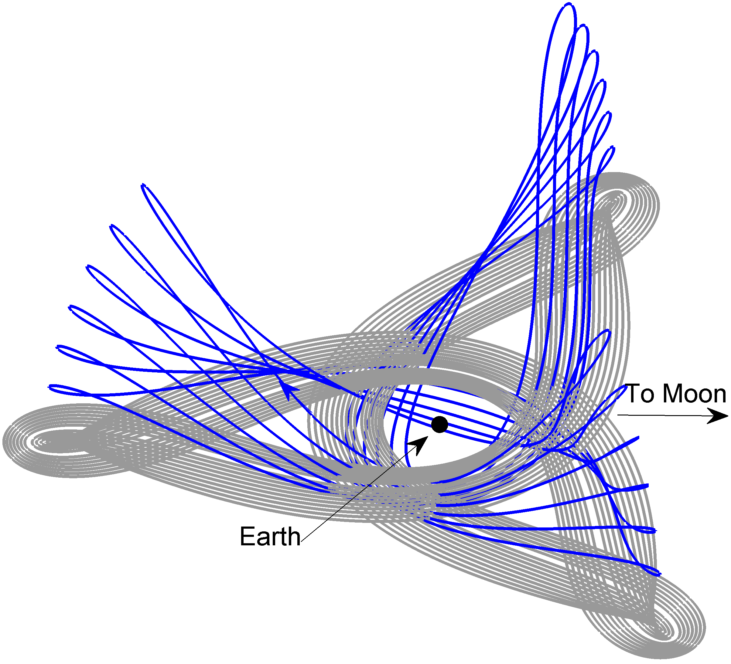
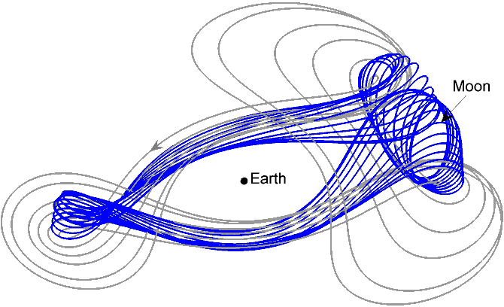
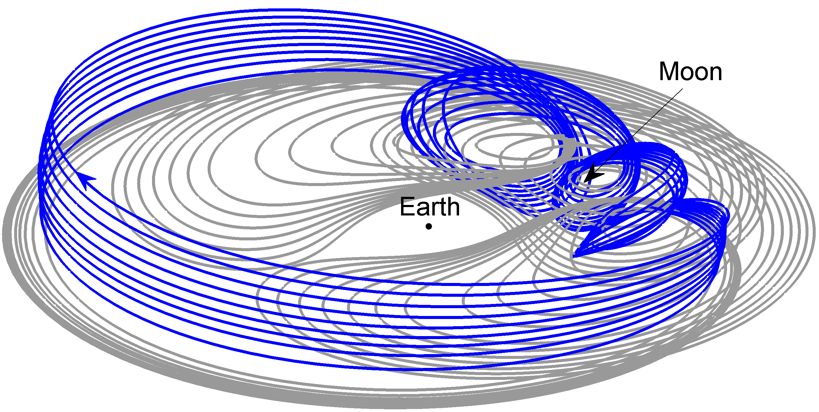
Orbit Architecture in the CR3BP
Resonant Orbits in the Earth-Moon System
1:1
1:2
1:3
2:1
2:3
2:3
3:1
3:2
3:4
Notes:
Lastly, we show three families of 3:1, 3:2, and 3:4 resonant orbits. Notice again the formation of three loops, which indicate that the spacecraft completes 3 revolutions around the Earth in approximately the time the Moon completes 1, 2 and 4.
The three-dimensional 3:1 resonant orbits have already proven to be useful in a mission scenario. IBEX is currently located in this long term stable Earth orbit in resonance with the Moon. The selection of this particular orbit was primarily based on the stability factor.

Slide 15
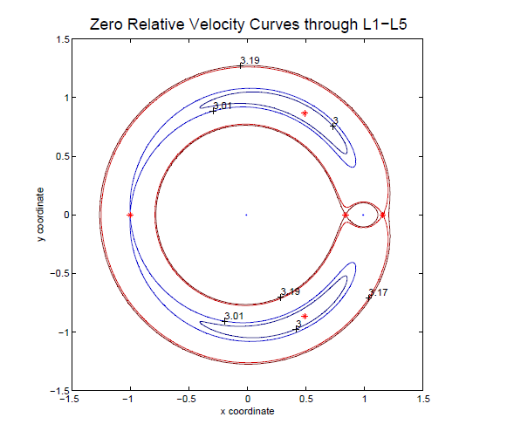
Jacobi Energy Constant
Jacobi constant can be used to visualize the possible paths of transfers and motion about the more stable locations
Define energy levels
Hill’s regions in CRTBP
V² = x²+y² + [2(1-μ)/r₁]+ [2μ/r₂]-C
Earth
Moon
Sun
Earth
Notes:
The energy manifold is 3-dimensional, and its projection onto the configuration space is called a Hill’s region. Its boundary is a zero
velocity surface. The topology of Hill’s regions depends on the energy level. Each trajectory is confined to the Hill’s region for the corresponding energy level.
Zero velocity curves are introd
The Jacobi Constant; named after Carl Gustav Jacob Jacobi) is the only known conserved quantity for the circular restricted three-body problem.^{[1]} Unlike in the two-body problem, the energy and momentum of the system are not conserved separately and a general analytical solution is not possible. The integral has been used to derive numerous solutions in special cases.uced as a qualitative method of gaining information about the motion without actually solving the differential equations.

Slide 16
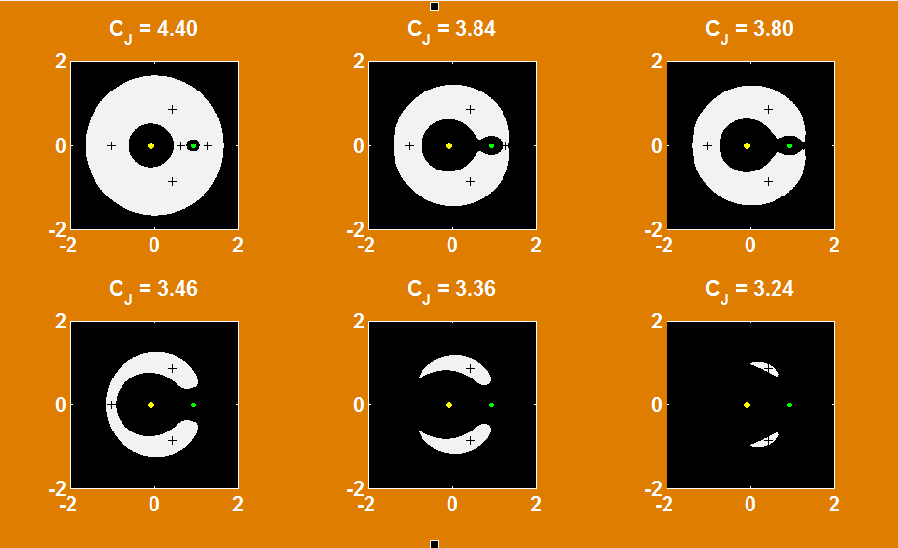
Jacobi Energy Constant
Jacobi constant can be used to visualize the possible ‘natural’ paths of transfers and motion about the more stable locations
Define energy levels
Ref: Wikipedia

Slide 17
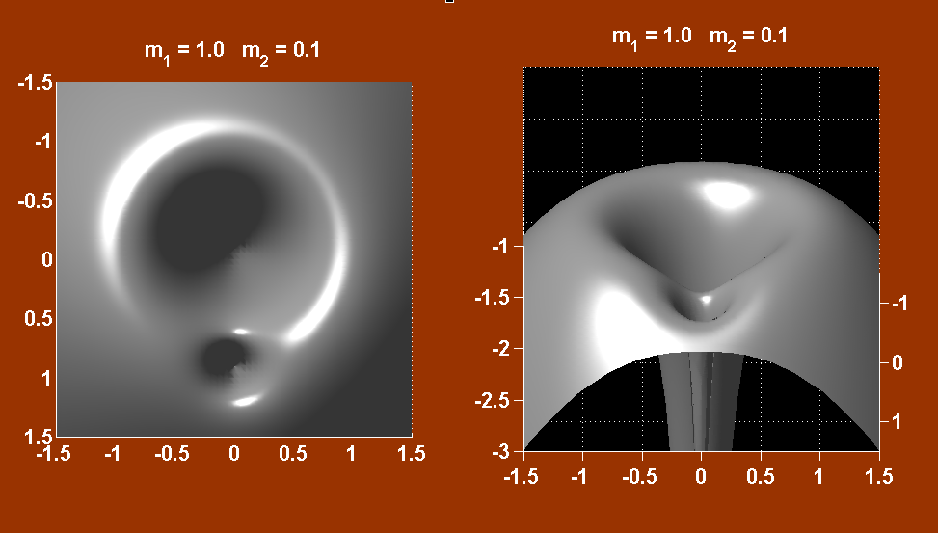
Jacobi Energy Constant
Jacobi constant can be used to visualize the possible paths of transfers and motion about the more stable locations
Ref: Wikipedia

Slide 18
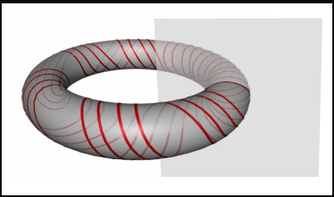



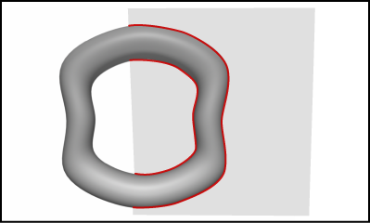

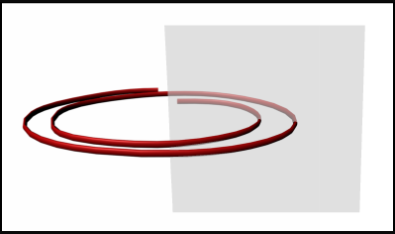
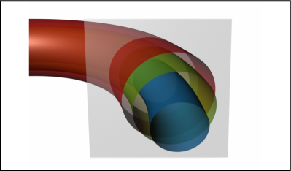
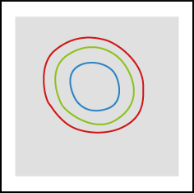
Mapping the Orbit Space Using Poincare Sections
Surface of Section (Σ )
.
.
.
.
Orbits
Poincaré Map
.

Slide 19

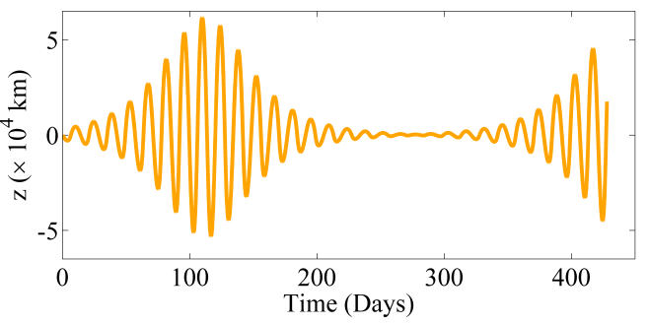
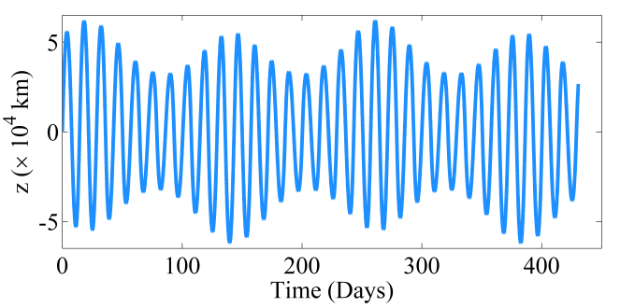
Mapping the Orbit Space Using Poincare Sections
Poincaré Map Depicting Lunar L1 Periodic and Quasi-Periodic LPO Structures
Use the Earth – moon plane as the surface-of-section
Apply an Earth-Moon system energy level, e.g. C = 3.080
Moon

Slide 20
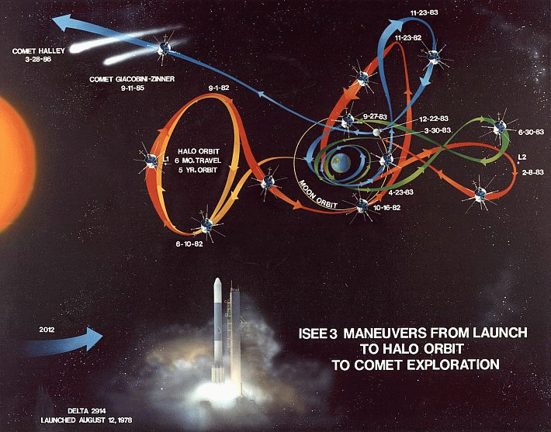
Transportation Using Our Newly Found Dynamics
The next logical step is to determine if the natural flow in the system has some structure
If the system does not originate (initial conditions) on one of the known particular solutions, is the evolution at all predictable?
Does the evolution of the states follow some pattern?
Since the co-linear orbits are unstable, there is flow toward and away from these structures (manifolds) and it is the natural place to start to seek understanding of the natural flow of the system.
We have examined how the flows evolve and continue to learn how they are connected / linked and how we can exploit that natural flow for space vehicles.
Sample Flow towards Libration Orbit
Libration
Orbit
Application of Dynamical Flow, the ISEE-3 Mission
Notes:
Manifolds: We do not know the complete evolution of the states but, given the particular solutions we have (points, periodic solutions, etc.) The next logical step is to determine if the natural flow in the system has some structure. If the system does not originate (initial conditions) on one of the known particular solutions, is the evolution at all predictable? Does the evolution of the states follow some pattern? Can it be predicted? Since the points/orbits are saddles, there is flow toward and away from these structures (manifolds) and it is the natural place to start to seek understanding of the natural flow of the system. We have examined how the flows evolve and continue to learn how they are connected/linked and how we can exploit that natural flow for space vehicles.

Slide 21
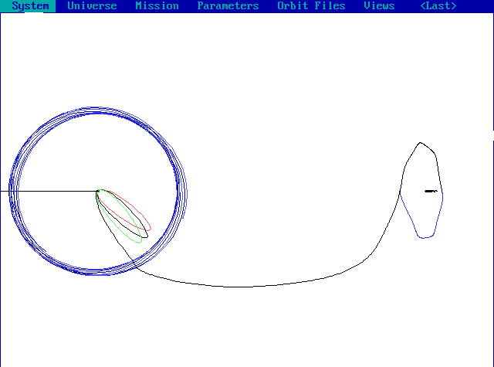
Sun-Earth L2 Orbiter with Lunar Gravity Assist
A forward design process
A forward targeting process using
Differential Correction
Achieve injection asymptote with a
launch energy (C3) and direction
Target the Moon at the appropriate
encounter epoch
Target the lunar B-Plane condition to
achieve a gravity assist and a Sun-Earth
libration x-z plane crossing
Target x-z plane crossing velocity
which yields a second x-z plane crossing,
target to a one period revolution at L2
Re-target lunar B-plane conditions to achieve the correct orientation of the
Lissajous pattern with respect to the ecliptic plane.
Vary the launch injection Launch C3 and parking orbital parameters:
ω, Ω, i, and parking orbit coast
Constrained Lissajous Orbit with Three Phasing Loops
Solar Rotating - Ecliptic Plane Projection
SUN
Lunar Orbit
Maneuvers at Periapsis and Apoapsis
X-z plane crossing
Lunar Gravity Assist
Sun Earth L₂

Slide 22
General Design Process and Application
Generate libration orbits in CRTBP
  Calculation of libration points for system, L2, L3, Sun-Earth, Earth-moon
  Use of Jacobi constant and Poincare Mapping to identify and select orbit
Generate related manifolds (stable and unstable flows) to design transfers to/from libration orbits
Blending of manifold transfers with conics
Increase of fidelity modeling from CRTB to full ephemeris
Incorporate basic design into operational s/w, e.g. GSFC’s General Mission Analysis Tool (GMAT)
Application to example missions; WFIRST, ARTEMIS, Lunar IceCube, and other unique designs, e.g. formations…
Can I design a Libration Orbiter mission w/o a DST process?
  Yes, but you will follow a similar design process based on the dynamical properties of the system – “Astrodynamics is Astrodynamics”
  Need selection of ‘time, position, and velocity targets’ to represent orbits and transfers
  Use of Differential Correctors, optimizers, and other targeting methods, e.g colocation

Slide 23
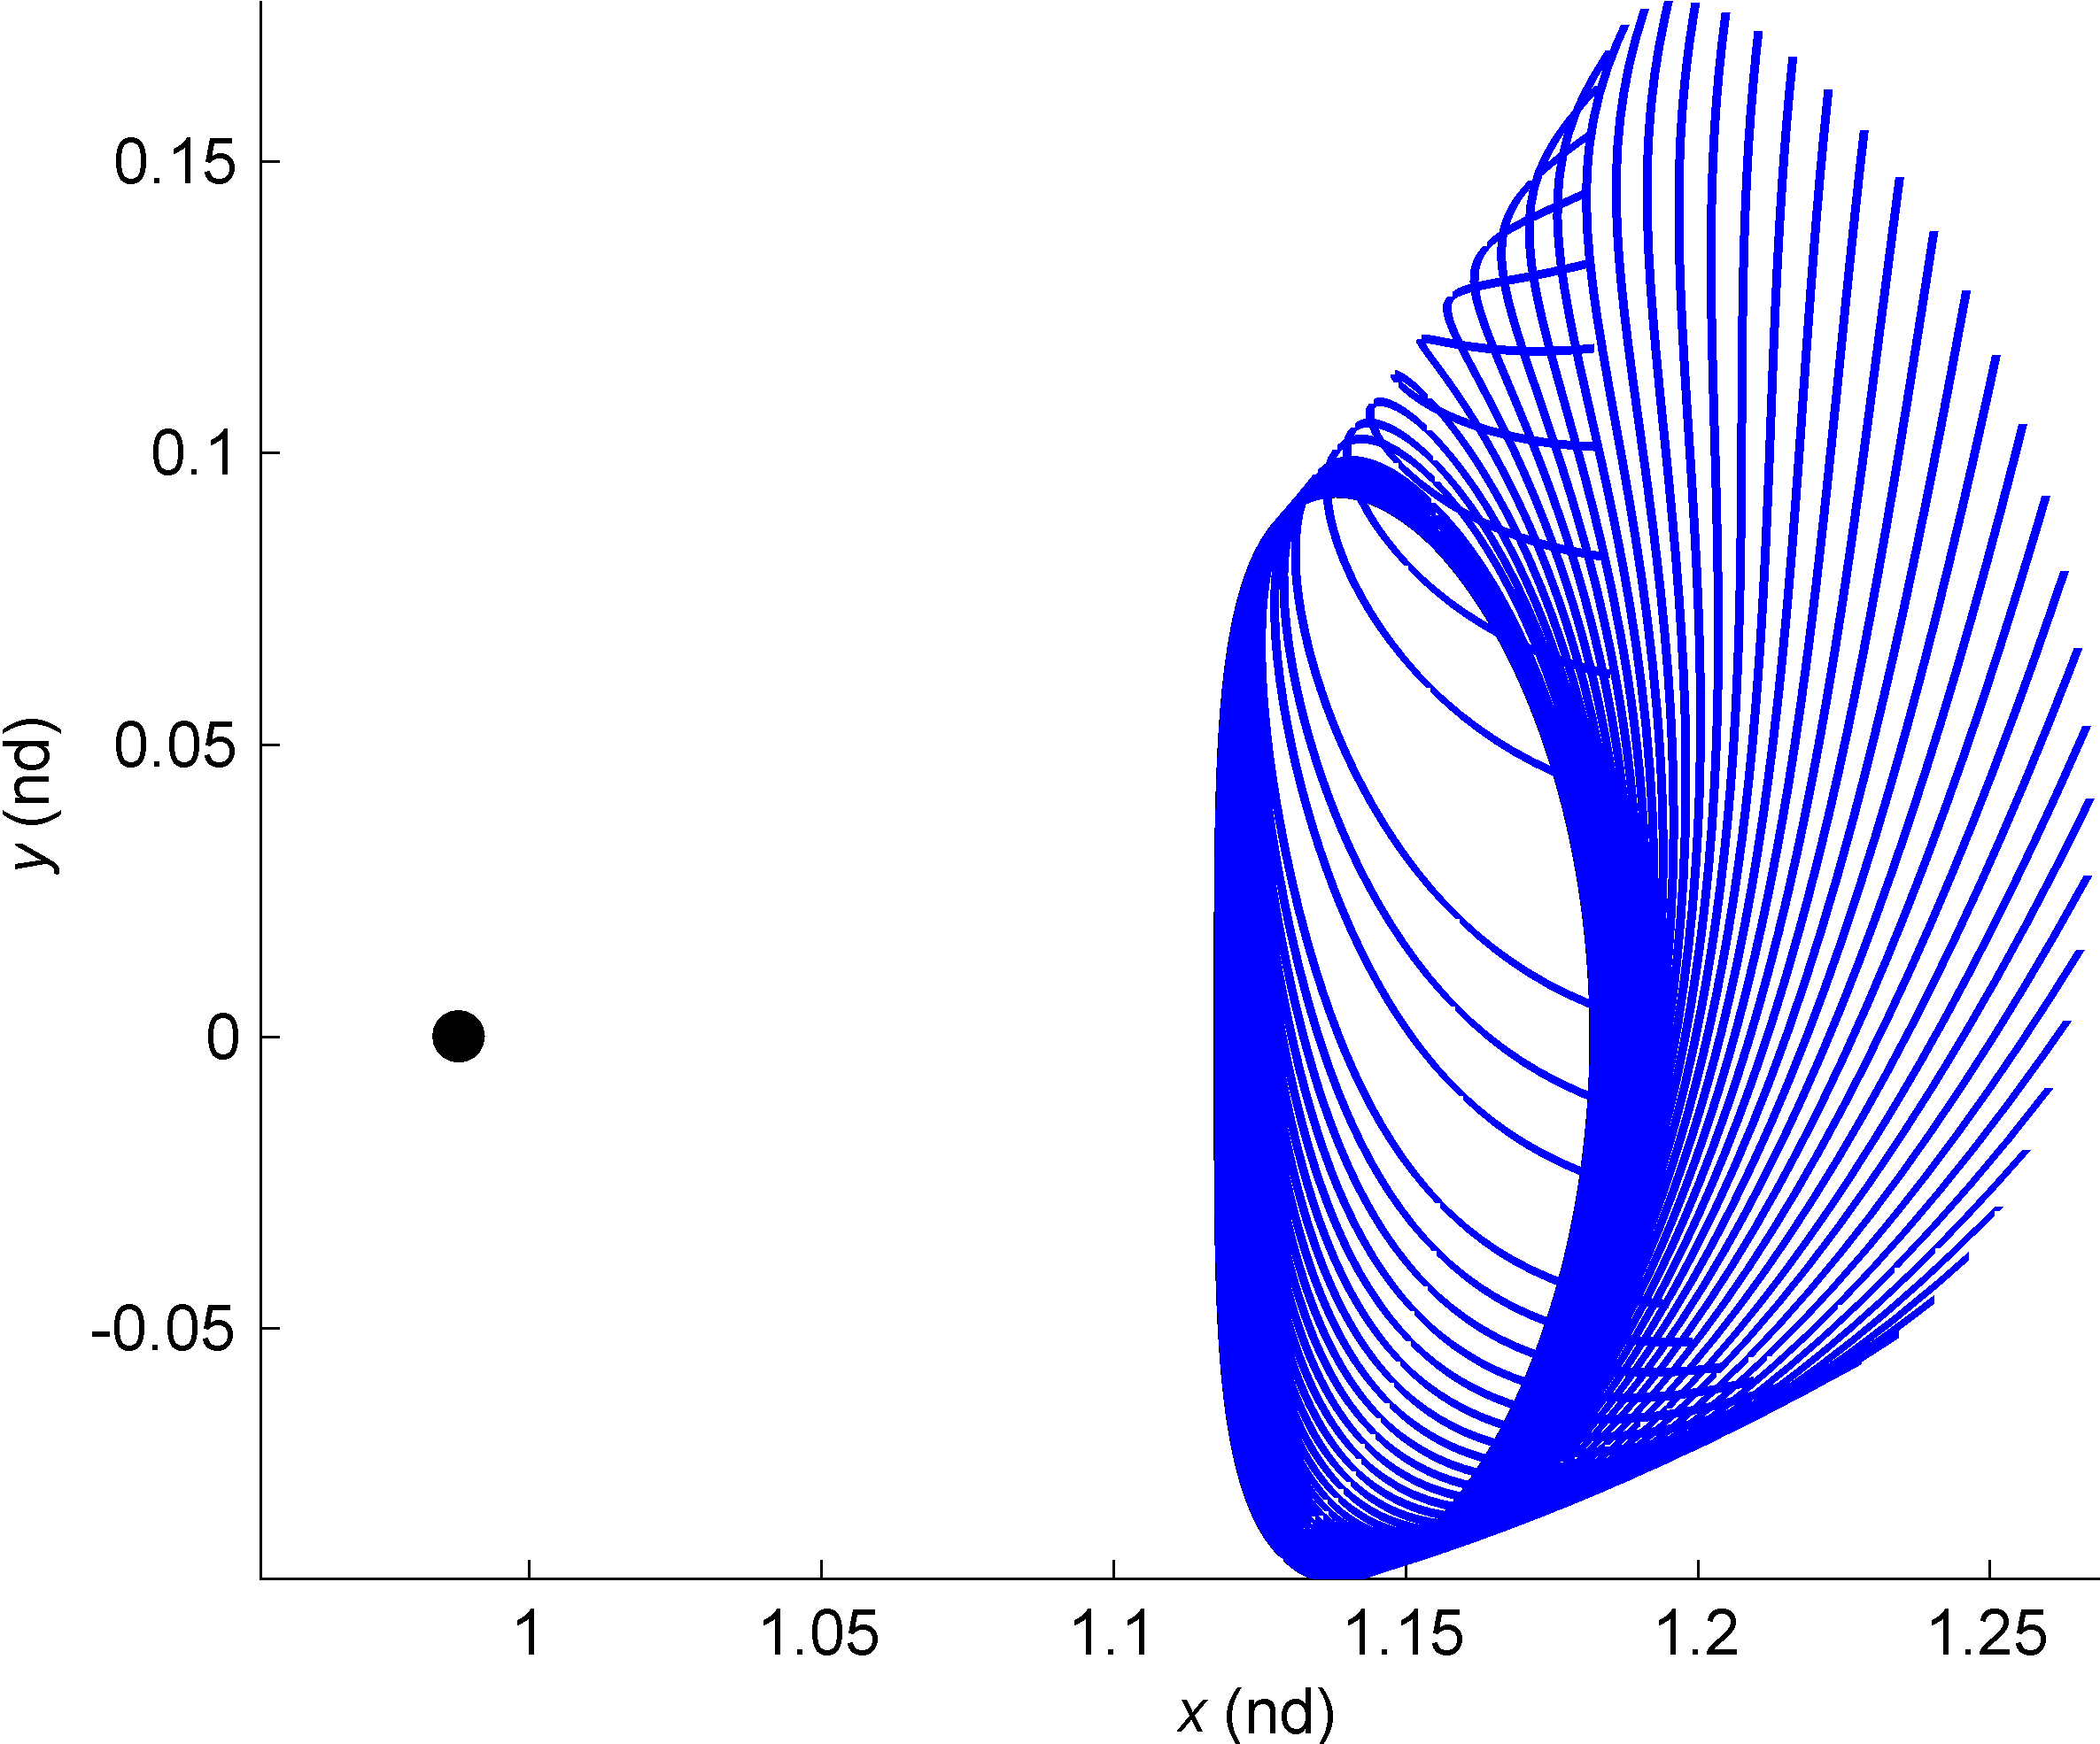
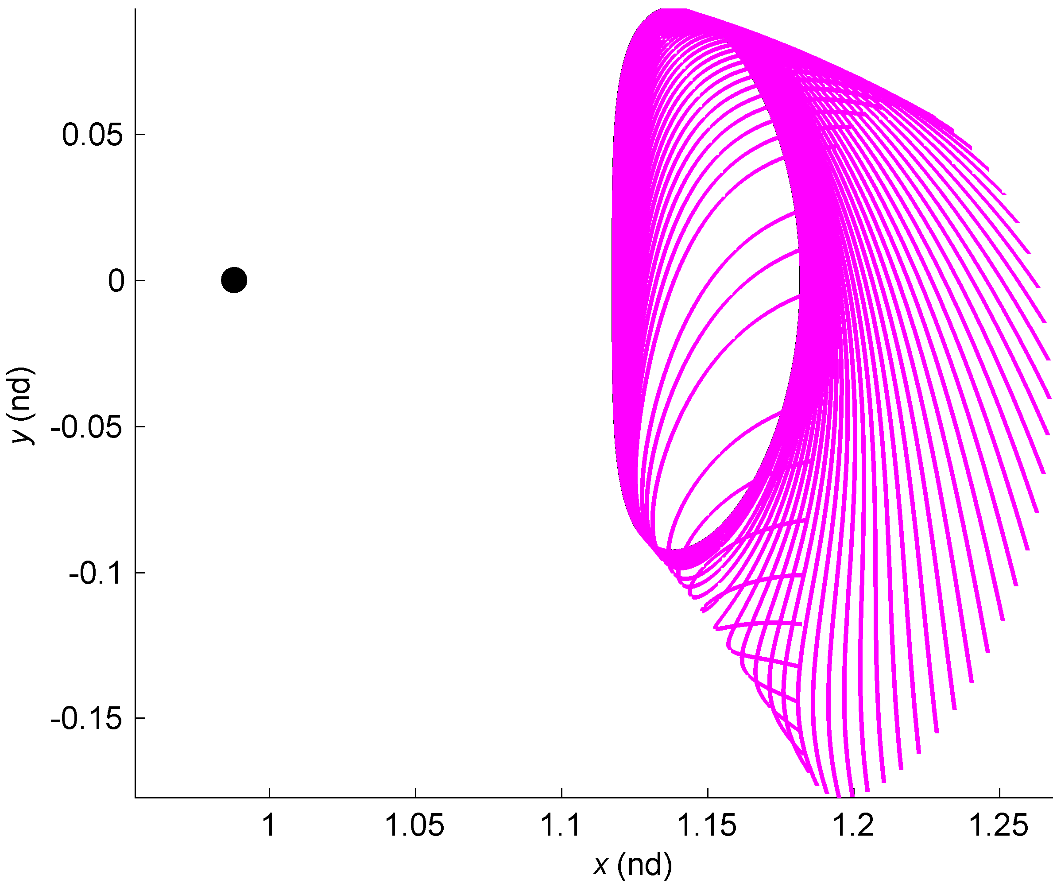
Manifold Trajectories
Having established a libration orbit, construct transfers
Stable Manifold: consists of trajectories that asymptotically approach the orbit as
Unstable Manifold: consists of trajectories that asymptotically depart the orbit as
Moon
L₂
Moon
L₂
15 days
Representation of stable and unstable manifolds associated with a periodic orbit
Vaquero 2013

Slide 24
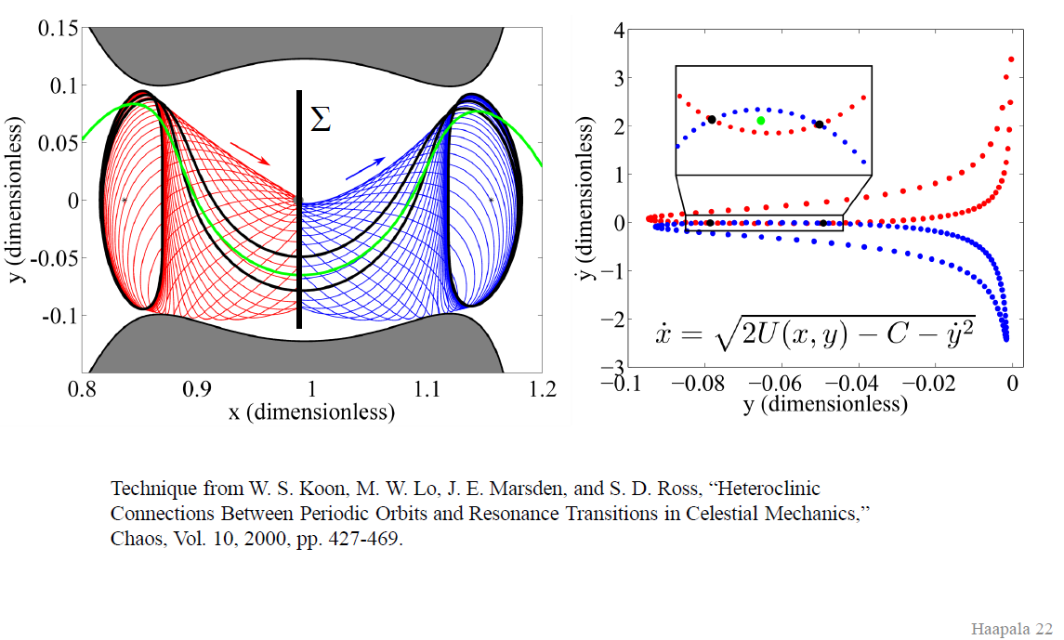
Manifold Trajectories
Combining Manifolds for Transfer between and within Libration Point Orbits
Forbidden Region based on Jacobi Constant
Forbidden Region based on Jacobi Constant

Slide 25
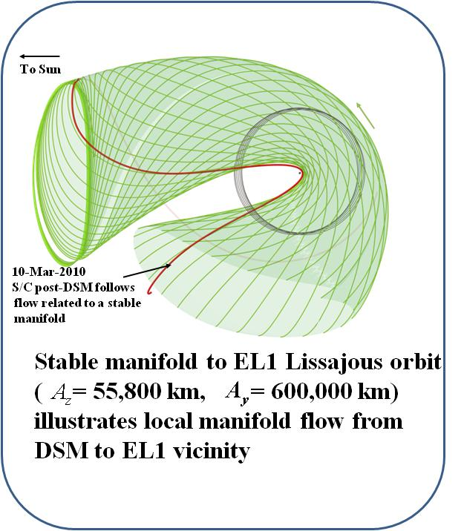
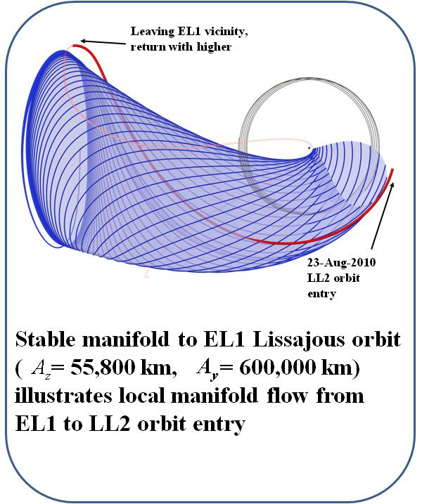
Libration Orbits, Manifolds, and Conics
Manifold Definition: is a representation of local trajectories that can be numerically integrated in a full ephemeris model
Manifolds can be constructed used the initial states of navigation solutions, meaning they represent a higher-fidelity model of all local (nearby) trajectories.
Stable
Unstable
Lunar Orbit
Lunar Orbit

Slide 26
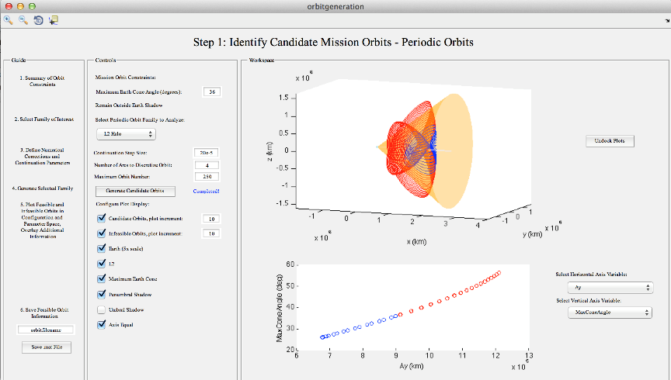
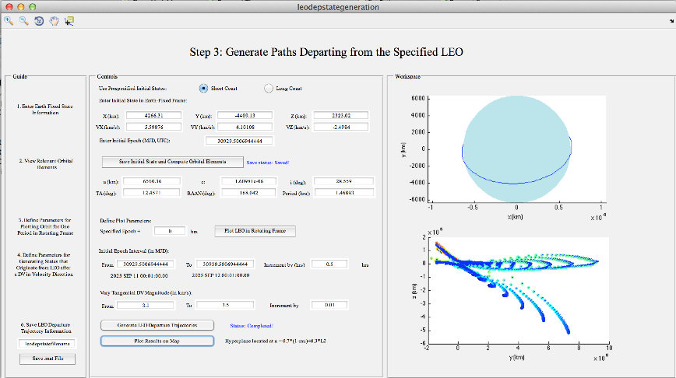
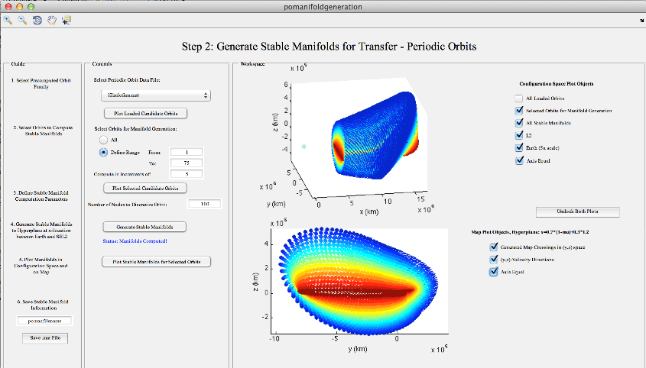
WFIRST Trajectory Design
Adaptive Trajectory Design (ATD) Module
1: Identify Candidate Mission Orbits in CR3BP
3: Generate LEO Departure Paths
2: Generate Periodic Orbit Manifolds in CR3BP
Leverage generated data to
construct initial guess

Slide 27
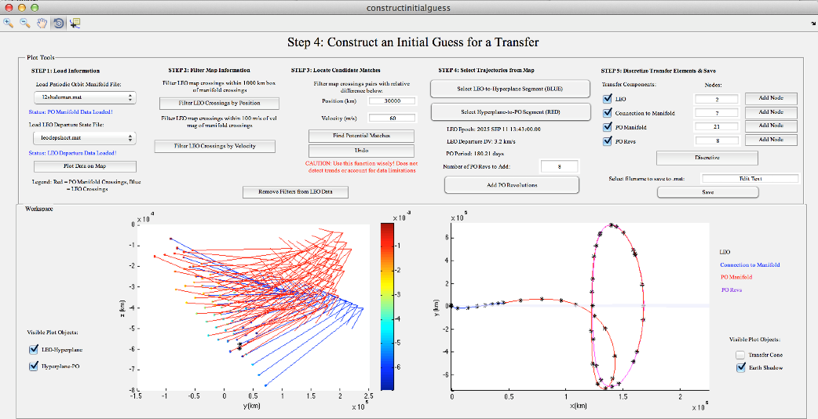


WFIRST Trajectory Design
Adaptive Trajectory Design (ATD) Module
4: Construct an Initial Guess via Mapping
5: Correct in CR3BP
Analyze data via Poincaré mapping, construct an initial guess and correct to find an end-to-end trajectory
6: Correct in Ephemeris

Slide 28


Earth-Moon Application
ARTEMIS P1 and P2 Trajectories
Transfer Two Spacecraft from Earth elliptical orbits to lunar orbits via Multi-Body dynamics
Orbit Raising Maneuvers (ORMs) performed near periapsis to methodically raise apoapsis to lunar distance
Lunar Gravity Assist to align trajectory for libration insertion and to raise periapsis
Lunar Targeting Maneuvers (LTMs) and Trajectory Correction Maneuvers (TCMs) corrected for maneuver execution errors
Sun-Earth Rotating Frame
P1 Design
P2 Design

Slide 29
ARTEMIS Stable Manifolds
Consider only the outbound arc and final correction maneuver (TCM5).
From the Deep Space Maneuver, P1 follows the original outbound path to the location of TCM5
TCM5 shifted the spacecraft onto a different path, one that can be envisioned in terms of a different (orange) manifold
Subsequent to the DSM, and along the outbound trajectory two outbound manifold arcs emerge from the TCM5 location
These two manifolds represent the potential outcomes from (1) flow along the optimal path and (2) the alternative that incorporates a possible TCM5 maneuver
P1 Planned Stable Sun-Earth P1 Pre and Post TCM5 Stable Sun-Earth Manifold

Slide 30

ARTEMIS Unstable Manifolds
Unstable manifold and the effect of TCM5 on the return orbit
Original planned and the corrected post TCM5 trajectory shown
For the actual maneuver, the difference is slight in terms overall design but the shift in the general direction of the flow is consistent with a new manifold
The post TCM5 path with a small shift in direction guaranteed that P1 would reach its Cartesian goal at the proper epoch

Slide 31
Manifold Applications to ARTEMIS
Use of Multi-body Environment to raise periapsis to lunar orbit
Two lunar gravity assist separated by 13 days for flip of apoapsis direction
Deterministic Deep Space Maneuver (DSM1) was performed 33 days later
Unstable Lissajous manifold towards the Earth-Moon system
L₂ Lissajous insertion orbit maneuver of 2.56 m/s vs. ~ 300 m/s direct

Slide 32

Construction of Heteroclinic Orbits
Manifold Intersections Computed Via Poincaré Sections
Intersections Provide Transit Orbits from L₂ to L₁
Ref: M. Lo JPL

Slide 33


Use of Heteroclinic Orbits
ARTEMIS P1 Spacecraft Trajectory Transfer between E-M L2 and L1
Earth-moon Libration Orbit
P1 captures into EML₂
Orbit
Transfers to L₁ Orbit
Transfers to Lunar Orbit
While in E-M L2 orbit, planned and executed a maneuver to hop onto a transfer, from an Unstable L2 manifold to Stable L1 manifold to converge to a E-M L1 orbit

Slide 34


Construction of Capture Orbits
Manifold Intersections Computed Via Poincaré Sections
Moon
Ref: M. Lo, JPL

Slide 35



Construction of Capture Orbits in S-E & E-M Region
Estimated DVs in few m/s range
Transfer durations ~ 90 days
Solar Rotating Frame
Stationkeeping ΔVs ~ 1m/s
EML2 Target (timing) ΔV2 ~ 5m/s
EML2 Departure
Point (ΔV ~ 1m/s)
Return Trajectory
Direction of Sun
SEL2
Earth
Lunar
Orbit
Departure Trajectory
EML2 Return
Insertion Point
(ΔV ~ 5 m/s)
Side view Along Ecliptic Plane
View from Sun

Slide 36


Transfers in SE & EM Region
Lunar IceCube Deployment
Lunar Orbit
Solar Rotating Frame
No Maneuvers included; this is just a propagation of the state
ICPS Trajectory
ICPS Trajectory
Flyby is at radius of 2309 km (572 km altitude)
Trajectory looks similar to the lunar impact case
Using perturbation model from ICPS study cases
Note: Apoapsis out beyond lunar orbit radius before moon’s arrival for flyby
ICPS Trajectory

Slide 37


Lunar IceCube Designs
Nominal deployment in Fall of 2018, latest launch date is October 2018
Deployed from EM-1 (along with 13 others) ~ 13 minutes after ICPS blowdown
Employ low thrust propulsion to return to Moon from high energy transfer
Dynamical system (Manifolds and energy mapping)
  Deployment DV of 1.2 m/s at 13 min after deployment
  Low Thrust maneuvers at pre-lunar trajectory and lunar capture
  Idle period of 12-hrs for attitude de-tumble, navigation solutions, and command uplinks
  ~ 4 day thrust for lunar targeting at <1 mN, lunar capture thrust at 0.8 mN for ~3 months
Transfer Duration of ~2 months
Total DV 740 m/s (0.8 kg)
Thrust Level ~0.9 mN
Transfer Duration of ~6 months
Total DV 600 m/s ( 0.6 kg)
Thrust Level ~ 0.5 mN

Slide 38

Feasible Transfer Regions using CRTB
Apoapsis CR3BP map with Jacobi Constant of 3.00088 for prograde initial conditions.
Blue, red and green regions: initial apoapses of feasible trajectories that remain within the Earth vicinity for two revolutions
Color indicates different transfer geometries

Slide 39
Libration Orbit Stationkeeping
Few stationkeeping strategies have considered trajectories in Earth-Moon libration points (Farquhar, Hoffman, Scheeres, Folta, Howell)
Previous research of several strategies with the intent to select a method for ARTEMIS
From this research, two strategies emerged that best met requirements
  Optimal Continuation Scheme (OCS)
  Global search method
  Both embrace Floquet mode indirectly
OCS incorporates optimization with the targeting method
  OCS targets an X-axis velocity at the next X-axis crossing (wraps orbit onto itself)
  Up to four crossings were used as the improvement in the DV after the third crossing was usually below 0.01 cm/s and therefore unachievable by the spacecraft propulsion system.
  EM L₂ and EM L₁ targets differed slightly
    Far side (away from the Moon) used an velocity of -20 m/s +/- 0.1 cm/s
    Close side (nearer to the Moon) used velocity of +10 m/s +/- 0.1 cm/s
    Once in orbit about the EM L₁ targets are +/- 10 cm/s at each crossing

Slide 40


Stationkeeping Operational Results for ARTEMIS E-M L2 and L1 orbits
Total DV P1 = 3.99 m/s (September 8th 2010 – June 6th 2011: 271 days, DV / 7.5 days)
Total DV P2 = 3.24 m/s (October 20th 2010 – June 10th 2011: 233 days, DV / 7.4 days)
Projected yearly stationkeeping cost
    P1 DV = 7.39 m/s per year for L₂ and 5.28 m/s per year for L₁
    P2 DV = 5.09 m/s per year
P1 STK DVs
P2 STK DVs
C_{r} inconsistent
Y-max DVs
Att error

Slide 41



Post Maneuver Mode Research
Alternate stationkeeping methods of the libration orbit to compute information regarding the orbit stability
Mode Analysis investigates the use of eigenstructure (eigenvectors and eigenvalues)
Proper modeling of the orbit using various methods indicate that a DV along the stable or unstable mode direction could be used for stationkeeping
ARTEMIS permits us to validate that research and show how the OCS places maneuvers along the stable mode direction
P1 EML₂
P1 EML₁
P2 EML₁

Slide 42
Post Maneuver Mode Research
Using the ARTEMIS orbit determination solutions we computed an approximate monodromy matrix by generating and propagating the State Transition Matrix (STM) from an initial state
To calculate the STM, we propagate an initial state that is perturbed in each of its components (4e-4 km and 1e-4 cm/s for each position and velocity)
In Matlab, a finite‑difference STM using initial and final state information from GMAT yields an approximation of the monodromy matrix
From this information, we then compute the 6 eigenvalues, λ_{i}, of the STM which yields
        | λ_{i} | < 1 → stable eigenvalue(s)
        | λ_{i} | > 1 → unstable eigenvalue(s)
Once the mode information is generated we compare actual maneuver direction with stable/unstable eigenvector information
Additional methods are being studied for computing eigenvalues/eigenvectors in less periodic portions of the orbits (i.e., the P1 L₂ Lissajous trajectory).

Slide 43




ARTEMIS Mode Results
Sample Stable (blue) and Unstable (red) directions for EML₁ and EML₂
P1
Angle Between P1 DV and Stable Mode
Angle Between P2 DV and Stable Mode
P2

Slide 44

Use of Heteroclinic – Homoclinic Chains
Libration Orbit Invariant manifolds in position space
Stable Manifolds (green), Unstable (red)
Poincaré sections (U1, U2, U3) are also shown
Ref: Gomez (Barcelona) et al

Slide 45

Sample Earth Departure on Zero Velocity Curve
Representation of a heliocentric orbit for a given energy value, ‘C’
A cross – zero velocity curve contours are needed for Mars and Earth
Additional DV is required for short durations (<1 yr)
Sun
Earth

Slide 46


Transfer Earth-Moon L2 Halo to Mars
Ref: Kakoi , Howell, Folta, Acta Astronautica

Slide 47

Use of Heteroclinic – Homoclinic Chains
Heteroclinic-Homoclinic Chain in Jupiter’s InterPlanetary Transport Network
2:3 to 3:2 Resonance Transport, No Energy Transfer Needed
Source of Chaotic Motion in the Solar System
Example is Hilda 3:2 resonance orbits
2:3 Resonance
Ref: M. Lo JPL

Slide 48
Theorem to Temporary Capture by Design
The Existence of Homoclinic and Heteroclinic Cycles Implies We Can Choose An Infinite Sequence of Integers, Doubly Indexed,
  N(i ,j) , i = Sun, L1, Jupiter, L2, Xsun; j = 1, 2, 3, …
  N(i ,j) = Number of Revolutions Around Body(I), Called an ITINERARY
THEOREM: There Exist an Orbit Which Realizes N(i ,j).
Based on Conley-Moser’s Theorem on Symbolic Dynamics
TEMPORARY CAPTURE BY DESIGN
Xsun
N5
Sun
N1
L1
N2
Jupiter
N3
L2
N4
Ref: M. Lo JPL

Slide 49

Transport in the Solar System
Poincaré Section of the InterPlanetary Transport Network
Legend
■ L₁ ITN Orbits
■ L₂ ITN Orbits
○ Comets
■ Asteroids
○ Kuiper Belt
Object
Ref: M. Lo JPL

Slide 50
Applications of Libration Orbit Fundamentals
Summary
Defined by Dynamical Systems Theory and Chaos Theory
  Incorporates two-body and three-body motion
  Provides a means to qualitatively address trajectory characteristics
  Based on interactions gravitational perturbations
Transport mechanism is derived from use of manifolds and Poincaré mapping to identify pathways
Combined with optimization / targeting and improved numerical techniques permits feasible mission designs and a powerful methodology
Numerous applications: Cis-lunar trajectories, Sun-Earth Orbits, Distant Retrograde Orbits, Any planetary libration point orbits, Planetary transfers, Asteroid designs

Slide 51
Libration (CRTBP and Manifold) Mission Use
Mission | Center | Usage
ISEE-3 | GSFC | L1, Multiple LGA, Stable/unStable Manifolds
Wind | GSFC | L1, L2, Other, MLGA, Stable/unStable Manifolds
SOHO | GSFC | L1, Stable Manifold
ACE | GSFC | L1, Stable Manifold
MAP | GSFC | L1, LGA, Stable Manifold
Genesis | JPL | L1, Stable / unStable Manifold
Herschel / Plank | ESA | L1, Stable Manifold
Gaia | ESA | L2, Stable Manifold
DSCOVR | GSFC | L1, Stable Manifold
JWST | GSFC | L2, Stable Manifold
ARTEMIS | GSFC | Lunar L1 & L2 & Lunar Orbit, LGA, Stable /UnStable Manifolds (SE and EM)
Grail | JPL | Lunar Orbit, Stable / unStable Manifold
SMART-1 | ESA | Low Thrust, Stable Manifold - spiral
Lunar IceCube | GSFC | Low Thrust, Stable/Unstable Manifolds (SE and EM)
WFIRST | GSFC | L2, Stable Manifold,
Missions Using DST / ITN / Manifolds / Multi-body

Slide 52


Libration Orbit Application Tools
Simplified model, autonomous system
Provides useful information about fundamental solutions (libration point orbits, stable/unstable invariant manifolds, retrograde orbits, …)
Solutions from CR3BP transitioned to ephemeris model, generally, maintain orbit characteristics
Earth-Moon CR3BP (ATD©)
Sun-Earth-Moon (GMAT)
Ref: Images from Haapala, Vaquero, Pavlak, Howell, and Folta

Slide 53


Libration Orbit Application Tools
  Poincaré maps useful for a variety of applications
    Provide visual picture of solution space
    Evaluate stability
    Locate solutions with prescribed characteristics
  Including maps in trajectory design software is essential to facilitate design in the spatial problem
Snapshots of Adaptive Trajectory Design (ATD) tools, Purdue/Goddard collaboration

Slide 54
Applications of Libration Orbit Fundamentals
Special Thanks to:
  Dr. Kathleen Howell, Purdue University
  Dr. Martin Lo, JPL

Slide 55
Applications of Libration Orbit Fundamentals
Thank You

Slide 56
Some References
Folta, Howell, “The Lunar IceCube Mission Design: Construction Of Feasible Transfer Trajectories With A Constrained Departure”
Folta, Webster, Howell, “Trajectory Design Tools for Libration and Cis-Lunar Environments ... on Astrodynamics Tools and Techniques”, (ICATT); 6th; 14-17 Mar. 2016 .
Barden, Howell, “Formation Flying in the Vicinity of Libration Point Orbits”, AAS 98-169, Monterey, CA, 2/98
Barden, Howell, “Dynamical Issues Associated with Relative Configurations of Multiple Spacecraft Near the Sun-Earth/Moon L1 Point”, AAS 99-450, Girdwood, Alaska, 8/99
Gomez, Masdemon, Simo, “Lissajous Orbits Around Halo Orbits”, AAS 97-106, Huntsville, Alabama, 2/97
Howell, Barden, Lo, “Applications of Dynamical Systems Theory to Trajectory Design for a Libration Point Mission”, JAS 45(2), April 1997, 161-178
Howell, Marchand, Lo, “The Temporary Capture of Short-Period Jupiter Family Comets from the Perspective of Dynamical Systems”, AAS 00-155, Clearwater, FL, 1/2000
Koon, Lo, Marsden, Ross, “Heteroclinic Connections between Lyapunov Orbits and Resonance Transitions in Celestial Mechanics”, Chaos
Koon, Lo, Marsden, Ross, “The Genesis Trajectory and Heteroclinic Connections”, AAS99-451, Girdwood, Alaska, August, 1999
Koon, Lo, Marsden, Ross, “Shoot the Moon”, AAS00-166, Clearwater, Florida, January, 2000
Lo, “The InterPlanetary Superhighway and the Origins Program”, IEEE Aerospace2002 Conference, Big Sky, MT, February, 2002
Serban, Koon, Lo, Marsden, Petzold, Ross, Wilson, “Halo Orbit Correction Maneuvers Using Optimal Control”, Automatica, April, 2000
Scheeres, Vinh, “Dynamics and Control of Relative Motion in an Unstable Orbit”, AIAA Paper 2000-4135, August, 2000

Slide 57
NESC Academy Webcast
Questions?
Upcoming GNC Webcast:
March 15, 2017
Spacecraft Control–Structures Interaction
Dr. Davin Swanson
nescacademy.nasa.gov

