Slide 1
Part 1

Slide 2
Introduction
With today's analysis tools, large, complex thermal radiation problems are easily solved;
But, as with any analytical tool, lack of an understanding of the fundamental equations and technique limitations may leave you with the wrong answer;
Whether you are a new engineer or a seasoned veteran, an understanding of the techniques employed by these powerful analysis tools is crucial.

Slide 3
Overview
This lesson explores thermal radiation analysis techniques for form factors, grey body factors and Radks.

Slide 4
Scope of this Lesson
The Radk and its role in thermal analysis;
Form factor calculation techniques;
Grey body factor calculation techniques;
Radiation Conductance (Radk).

Slide 5
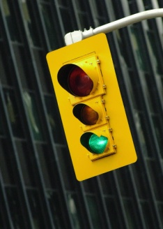
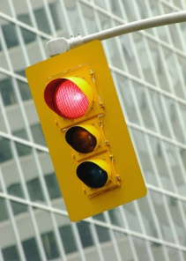
Lesson Roadmap
Exact Solutions
Fundamentals
What is a Radk?
Form Factors
Double Area Summation
Nusselt Sphere
The "World's Worst Dart Player"
Approximating F
Crossed-String Method
Form Factors Using Monte Carlo Ray Tracing
Form Factor Reciprocity and Combinations
Grey Body Factors
Gebhart's Method
Statistical Error
Imperfect Form Factor Sums
Calculating Grey Body Factors Using Monte Carlo Ray Tracing
Turning the Grey Body Factor into a Radk
The Fence Problem
Application in Analysis

Slide 6
Part 1 -- Lesson Roadmap
Exact Solutions
Fundamentals
What is a Radk?
Form Factors
Double Area Summation
Nusselt Sphere
The "World's Worst Dart Player"
Approximating F
Crossed-String Method
Form Factors Using Monte Carlo Ray Tracing
Form Factor Reciprocity and Combinations
Grey Body Factors
Gebhart's Method
Statistical Error
Imperfect Form Factor Sums
Calculating Grey Body Factors Using Monte Carlo Ray Tracing
Turning the Grey Body Factor into a Radk
The Fence Problem
Application in Analysis

Slide 7
Fundamentals

Slide 8

The Blackbody
A blackbody is the perfect absorber and emitter of radiant energy;
The Stefan-Boltzmann law shows that energy radiated from a blackbody is a function only of its absolute temperature, T:
where σ = 5.67 × 10⁻⁸ W/m² K⁴.

Slide 9

The Grey Body
Most objects are not perfect blackbody absorbers or emitters -- they are said to be "grey";
To account for imperfect absorption and emission, the Stefan-Boltzmann equation is scaled by an proportionality term, ε;
where ε is a value between 0 and unity.

Slide 10
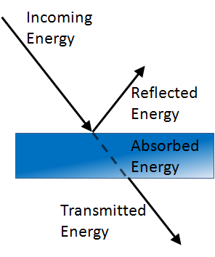
Conservation of Energy
Conservation of energy tells us that the fraction of energy absorbed by a surface, α_{λ}, plus the energy reflected, ρ_{λ}, plus the energy transmitted, τ_{λ}, must equal the energy incident on that unity:
For an opaque surface, τ_{λ} = 0 and the equation simplifies to:

Slide 11

Conservation of Energy
If we limit our discussion of absorption and emission to the same portion of the spectrum (or, more precisely, to a given wavelength, λ), we can say:
For the purpose of our discussion, we're going to use ε for, both, absorption and emission in the infrared spectrum.

Slide 12
Kirchhoff's Law
This says, for a given wavelength, λ, an object's ability to absorb radiant energy is equal to its ability to radiate energy;
Consider an object with surface area, A, and emittance, ε, at temperature, T₁, introduced into an oven at T₂.
T₂
A, ε
T₁

Slide 13

Kirchhoff's Law
At steady state, there is no net heat transfer so the object warms until is reaches T₂;
When the object reaches T₂, the amount of energy per unit time being absorbed is equal to that being radiated.
T₂
A, ε
T₂

Slide 14

Kirchhoff's Law
The only way for this to be true is for:
T₂
A, ε
T₂

Slide 15
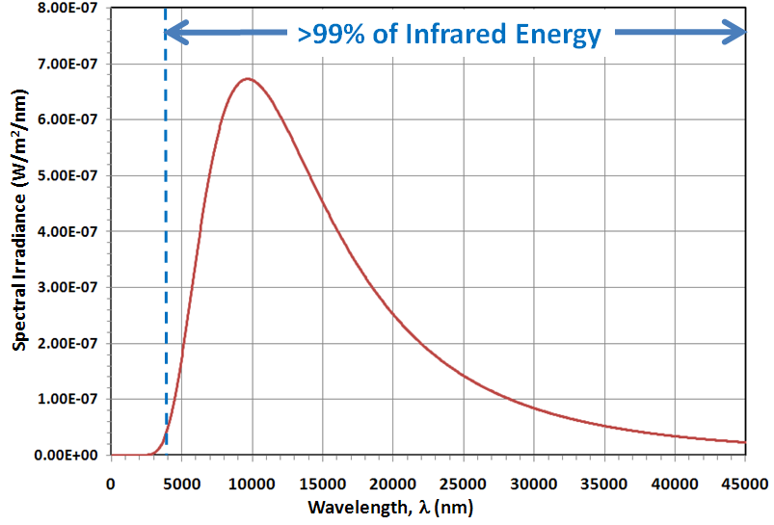
Emittance
For thermal radiation, we generally consider the range of λ > 4000 nm to be in the infrared range (Ref. 1);
We use ε to describe absorption and emission of radiation in this wavelength range.
Planck Blackbody Curve for 300 K

Slide 16
Diffuse and Specular Reflection
We saw previously that when energy strikes a surface, it may be absorbed, transmitted, or reflected;
For our discussion, we're going to consider only opaque surfaces;
In this case, transmitted radiation is zero.
Incoming
Energy
Reflected
Energy
Absorbed
Energy
Transmitted
Energy

Slide 17
Diffuse and Specular Reflection
Reflection may occur in a number of ways:
Diffuse -- energy striking a surface is scattered in all directions;
Specular -- the energy angle of incidence is equal to the angle of reflection in the pure case;
Mixed -- a combination of both, diffuse and specular modes.

Slide 18
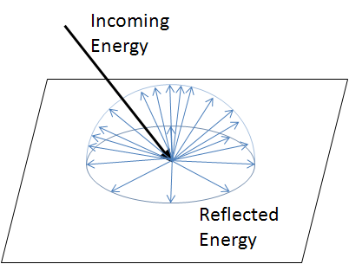
Diffuse and Specular Reflection
Diffuse -- energy striking a surface is scattered in all directions.

Slide 19
Diffuse and Specular Reflection
Specular -- In a pure specular reflection, the angle of incidence (θ_{i}) is equal to the angle of reflection (θ_{r}).
Incoming
Energy
Reflected
Energy
θ_{i}
θ_{r}

Slide 20
Diffuse and Specular Reflection
Mixed-- A combination of, both, diffuse and specular reflections;
In this case, we consider a specular fraction -- the fraction of the total reflected energy that is reflected specularly.
Reflected
Energy (Specular)
Incoming
Energy
Reflected
Energy (Diffuse)

Slide 21
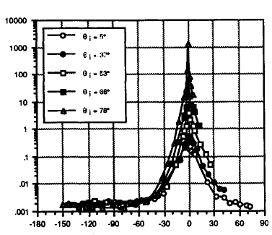
Real Surfaces
Reflection from real surfaces is often more complex than the pure diffuse or specular case;
Bidirectional reflectance distribution function (BRDF) (Adapted from Ref. 2).
S13-GLO Painted Aluminum
θ_{i} = 5°
θ_{i} = 37°
θ_{i} = 53°
θ_{i} = 66°
θ_{i} = 78°
BRDF, 1/sr
Angle from Specular In Incidence Plane, deg
Wavelength = 10.63 μm

Slide 22
What is a Radk and What is its Role in Heat Transfer?

Slide 23
Conduction, Convection and Radiation
Heat is transferred by three distinct modes:
Conduction;
Convection;
Radiation.

Slide 24
The Thermal Network
The goal of thermal analysis is to represent, accurately, the physics of heat transfer phenomena;
Nodes represent objects with mass (diffusion), objects that can reasonably be modeled as massless (arithmetic), and substantial heat sinks (boundary);
Conductors represent heat flow paths.

Slide 25
The Thermal Network
Conductors come in the following varieties:
Conduction Conductor -- a heat transfer path between two solid objects;
Convection Conductor -- a heat transfer path between a solid object and a convecting liquid or gas;
Radiation Conductor -- a heat transfer path, via electromagnetic radiation, between two objects.

Slide 26



The Thermal Network
Heat transfer via conduction and convection is proportional to ΔT:
But, heat transfer via radiation takes this form:

Slide 27
The Thermal Network
Differential equation solvers for thermal analysis solve linear differential equations;
The introduction of radiation into thermal networks adds non-linearity to the problem;
But, the radiation portion of the thermal network can be linearized to make solution as part of the overall network possible.

Slide 28



The Thermal Network (Ref. 3)
We seek to express the radiation heat transfer between the two nodes of interest in terms of ΔT.
Linearized Radiation Conductor

Slide 29
The Thermal Network
But what about the G_{rad} term?
This is the radiation conductor, or, Radk for short;
Developing the Radk, via form factors and grey body factors, will be the focus of the remainder of this lesson.

Slide 30
The Thermal Network
Consider the following geometry:
4 (Space)
3
1
2

Slide 31
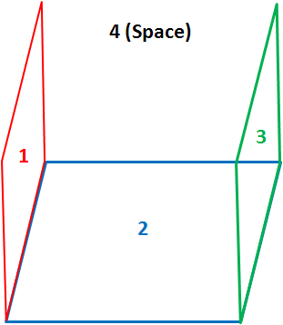
The Thermal Network
Considering only conduction between the objects:
1 and 2 can exchange energy;
2 and 3 can exchange energy.
When we add radiation:
1 and 2 can exchange energy;
1 and 3 can exchange energy;
1 and 4 can exchange energy;
2 and 3 can exchange energy;
2 and 4 can exchange energy;
3 and 4 can exchange energy.

Slide 32
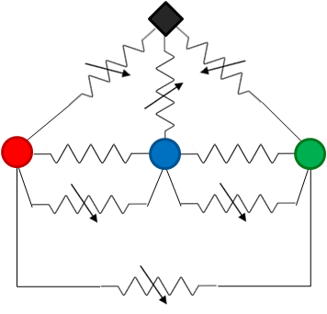
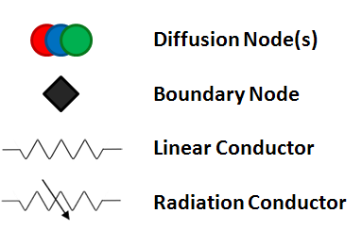
The Thermal Network
The thermal network looks like this:

Slide 33
Wrap-Up of Part 1
In Part 1, we established a foundation for thermal radiation heat transfer;
We discussed the radiation conductance and its role in thermal network calculations.

Slide 34
Part 2

Slide 35
Part 2 -- Lesson Roadmap
Exact Solutions
Fundamentals
What is a Radk?
Form Factors
Double Area Summation
Nusselt Sphere
The "World's Worst Dart Player"
Approximating F
Crossed-String Method
Form Factors Using Monte Carlo Ray Tracing
Form Factor Reciprocity and Combinations
Grey Body Factors
Gebhart's Method
Statistical Error
Imperfect Form Factor Sums
Calculating Grey Body Factors Using Monte Carlo Ray Tracing
Turning the Grey Body Factor into a Radk
The Fence Problem
Application in Analysis

Slide 36
Form Factors

Slide 37
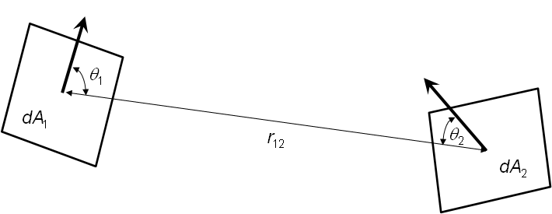
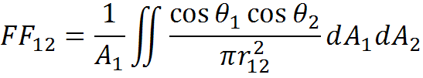
The Form Factor
A form factor (a.k.a. shape factor, configuration factor, view factor) describes how well one object can "see" another object;
The form factor may take on a value from zero to unity.

Slide 38
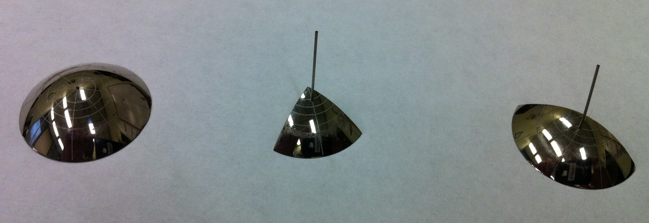
The Form Factor
A form "factometer" was used in conjunction with a physical model to determine key form factors for radiation analysis; the technique used a partial spherical mirror and the projection of the reflected image of a target surface on the unit circle;
With modern computers, however, calculating form factors is now an analytical pursuit.

Slide 39
Exact Solutions
Throughout this lesson, we'll be exploring techniques for approximating the form factor between two surfaces;
There are a limited number of geometries for which exact solutions exist;
Having an exact solution available for comparison will help us show the benefit of the approximate methods.

Slide 40

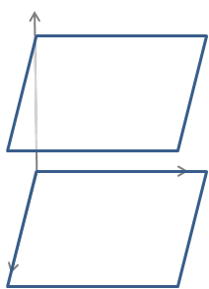


Exact Solutions
We'll be using the geometry of parallel unit plates with unit separation throughout this lesson;
Let's take a look at the exact solution for this geometry.
For convenience, we define: X = a/c and Y = b/c
A₂
A₁

Slide 41
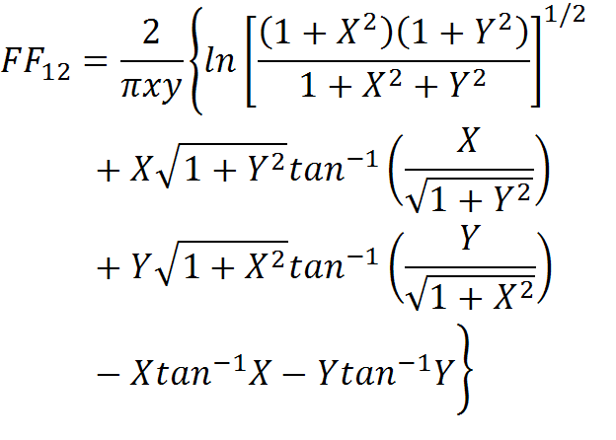
Exact Solutions (Ref. 4)
An exact solution is possible through a technique called contour integration:
A₂
A₁

Slide 42
Exact Solutions
For unit plates with unit separation:
X = Y = 1
and the exact solution for FF₁₂ becomes:
FF₁₂ = 0.2
A₂
A₁

Slide 43
The Form Factor
Form factors may be calculated using a variety of techniques including:
Double area summation;
Nusselt Sphere technique;
Crossed-String method;
Monte Carlo ray tracing;
Contour integration;
Hemi-cube;
Quadrature;
Newton Cotes integrals
We'll examine the highlighted techniques in detail.

Slide 44
The Double Area Summation Method

Slide 45

Double Area Summation
Consider, again, the integral defining the form factor:
We see that finite area approximations may be made and summations may be substituted for the integrals:

Slide 46
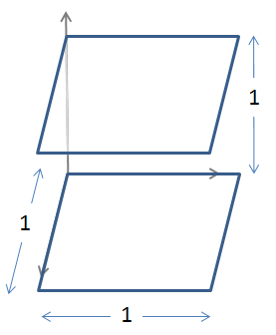
Double Area Summation Example
Consider two parallel unit plates separated by one unit;
We seek the form factor between surfaces a and b.
We'll examine a number of solutions.
b
a

Slide 47
Double Area Summation Example
First, consider the case where each surface consists of one element (n = 1, m = 1);
The angles (θ_{a} and θ_{b}) between the line connecting the element centers and the surface normal is 0°;
The distance (r_{ab}) between element center is 1.
b
θ_{b}
r_{ab}
θ_{a}
a

Slide 48


Double Area Summation Example
Applying the formula:
Our estimate is:
Recall, the exact solution is 0.2 -- we can do better.
b
θ_{j}
r_{ij}
θ_{i}
a

Slide 49
Double Area Summation Example
Let's subdivide each element into 4 subelements (n = 4, m = 4);
The same calculation is performed for each subelement on the other surface;
A total of 16 calculations is required.
b
a

Slide 50
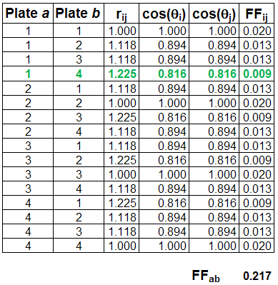
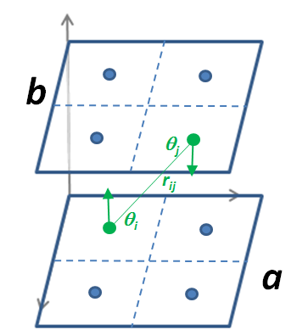
Double Area Summation Example
The subelement to subelement calculations are :

Slide 51
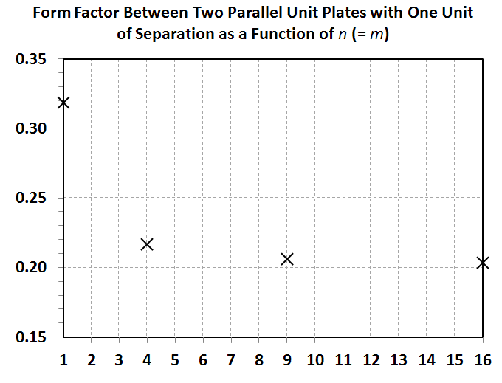
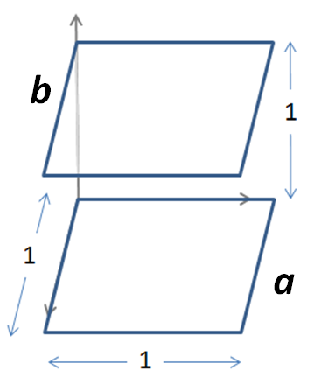
Double Area Summation Example
FF_{ab}
Exact Solution
n

Slide 52
The Nusselt Sphere Method

Slide 53
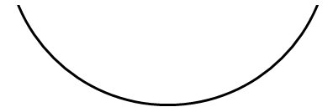
Nusselt Sphere
The Nusselt Sphere technique is one of many ways to calculate form factors;
The form factor from dA₁ to Surface 2 is calculated as the projected area, A_{P}, divided by the area of the hemisphere's circular base.
Surface 2
dA₁
A_{P}

Slide 54
Nusselt Sphere
Let's use the Nusselt Sphere technique for calculating the form factor to the planet from an orbiting plate, at altitude h above the planet, whose surface normal faces the nadir direction.
r_{e}
Planet
r_{e}
h
dA₁
A_{P}

Slide 55

Nusselt Sphere
We see that we can construct a right triangle (in green) with a short side measuring r_{e} and a hypotenuse measuring r_{e}+h;
We define the angle φ by noting:
r_{e}
Planet
r_{e}
r_{e}
h
φ
dA1
A_{P}

Slide 56

Nusselt Sphere
Similarly, we can construct a right triangle (in red) with a hypotenuse measuring unity and the angle φ, already defined;
We define the distance x by noting:
r_{e}
Planet
r_{e}
r_{e}
h
x
φ
r = 1
dA1
A_{P}

Slide 57
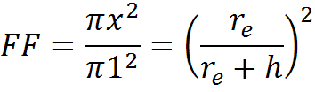
Nusselt Sphere
Projecting x down to the base, we see that the ratio of the projected circular area to the total area of the base is:
r_{e}
Planet
r_{e}
r_{e}
h
x
φ
r = 1
dA1
A_{P}

Slide 58
The Crossed-String Method

Slide 59
Crossed-String Method (Ref. 5)
The Crossed-String method may be used on two dimensional geometries of infinite extent;
The general formula for calculating a form factor between two surfaces is:

Slide 60
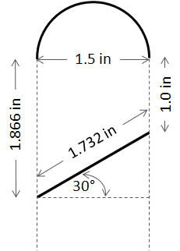
Crossed-String Method
Consider the following two-dimensional geometry of infinite extent;
We seek the form factor between surface 1 and surface 2.
Surface 2
Surface 1

Slide 61
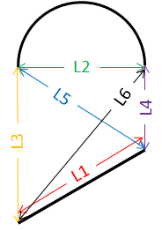
Crossed-String Method
Let's define our string lengths:
L₁ = 1.732 in
L₂ = 1.5 in
L₃ = 1.866 in
L₄ = 1.0 in
L₅ = 1.803 in
L₆ = 2.394 in
Surface 2
Surface 1

Slide 62



Crossed-String Method
Solving...
Surface 2
Surface 1

Slide 63
The Monte Carlo Ray Tracing Method

Slide 64
Monte Carlo Methods
A Monte Carlo method uses random numbers to perform an integration;
How can a random number can be used to accomplish such a feat?
Furthermore, how can we get usable answers from anything involving random numbers?
Let's start with an example.

Slide 65
Example -- The "World's Worst Dart Player"
To see how random numbers can be applied in integration, let's consider the challenge of approximating π ;
We'll establish a thought experiment, establish some equations to help us conduct this experiment, and then use random numbers to help us achieve our goal.

Slide 66
Example -- The "World's Worst Dart Player"
Suppose you encounter the World's Worst Dart Player...

Slide 67
Example -- The "World's Worst Dart Player"
He's so bad that no matter how he throws, he can do no better than a random scattering of the darts.

Slide 68
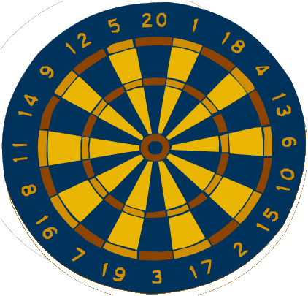
Example -- The "World's Worst Dart Player"
So, to make the game fair, you decide to build a very large, circular dart board -- one that just fits onto a square wall;
Our dart player may be the world's worst but he can certainly hit somewhere on the square wall!

Slide 69
Example -- The "World's Worst Dart Player"
Let's put some dimensions on our wall and dartboard -- represented here by a square and circle, respectively.
s
s/2
s

Slide 70
Example -- The "World's Worst Dart Player"
The area of the square is given by:
And the area of the circle is, simply:
A_{s} = s²
s
s/2
A_{c} = πs²/4
s

Slide 71
Example -- The "World's Worst Dart Player"
If all of our dart thrower's darts must land somewhere inside the square, the chances that a dart will land inside the circle will depend on the relative areas of the circle and the square.
s
s/2
s

Slide 72

Example -- The "World's Worst Dart Player"
In other words, for a large total number of darts, n_{t} , we have:
where n_{c} is the number of darts that land inside the circle.

Slide 73
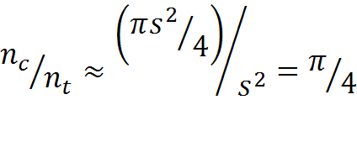

Example -- The "World's Worst Dart Player"
But, we have expressions for areas A_{c} and A_{s}:
or...
This gives us a framework for our numerical experiment.

Slide 74
Example -- The "World's Worst Dart Player"
Let's throw our first dart;
If it lands inside the circle, our estimate of π for n_{t} = 1 is:
Not bad for one dart.
π ≅ 4 (1/1) = 4

Slide 75
Example -- The "World's Worst Dart Player"
But since it's a random dart, it could have just as easily landed outside the dartboard;
Our estimate becomes:
Not so good.
π ≅ 4 (0/1) = 0

Slide 76
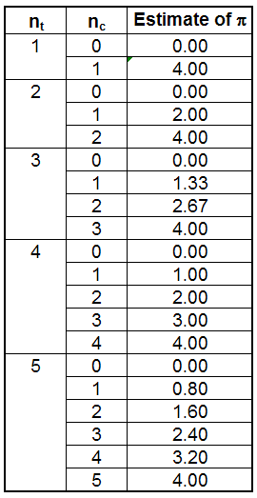
Example -- The "World's Worst Dart Player"
Depending on where the darts fall for each n_{t}, a number of different outcomes are possible;
As n_{t} increases, more and more n_{c}/n_{t} combinations are possible.

Slide 77
Example -- The "World's Worst Dart Player"
This suggests that our ability to approximate π accurately increases with the total number of darts thrown;
Also, as n_{t} increases, the addition of a single dart has less of an effect on the approximation of π;
So, instead of simply throwing only a few darts, let's see what happens when we throw thousands of darts.

Slide 78
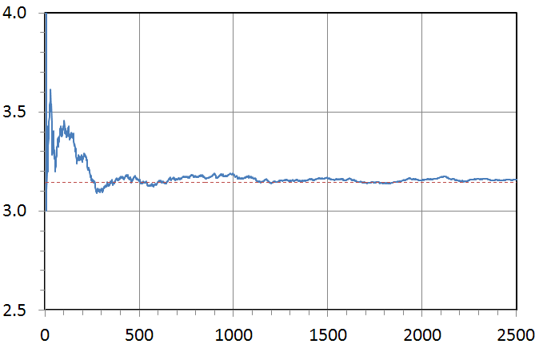
Example -- The "World's Worst Dart Player"
Predicted by Monte Carlo
Estimate of π
π
Total Number of Darts Thrown, n_{t}

Slide 79
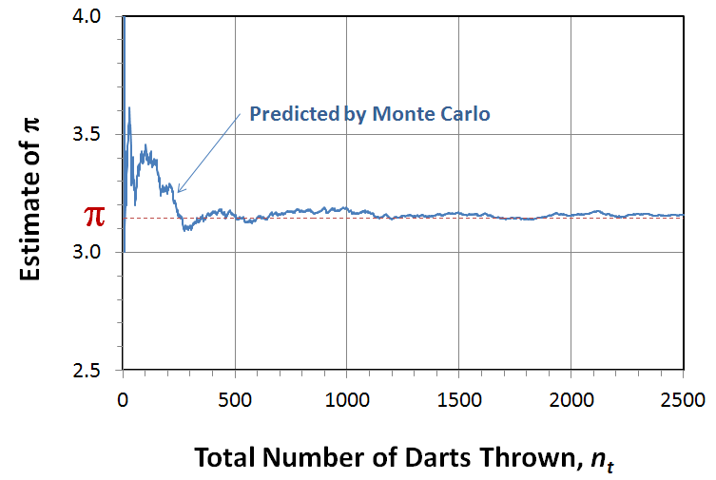
Example -- The "World's Worst Dart Player"
For this example our estimate of π can vary dramatically for only a small number of darts;
But, eventually, with enough darts, we get an excellent approximation of π.

Slide 80
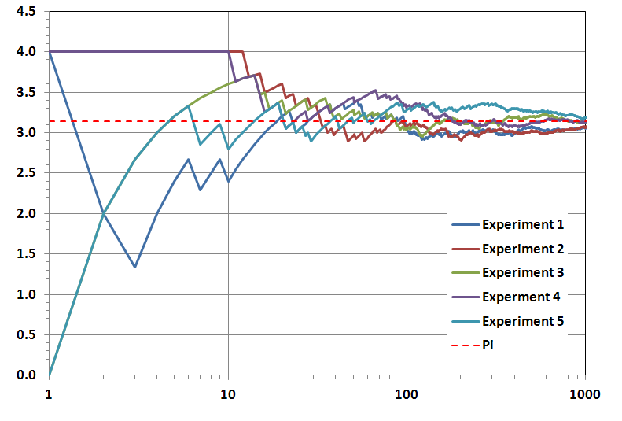
Example -- The "World's Worst Dart Player"
π
Estimate of π
Number of Darts Thrown, n_{t}

Slide 81
Calculating Form Factors Using the Monte Carlo Method
To calculate a form factor, we'd like our Monte Carlo simulation to represent the view from one surface over the region that surface can "see";
For example, a flat plate surface can "see" an entire hemisphere.

Slide 82
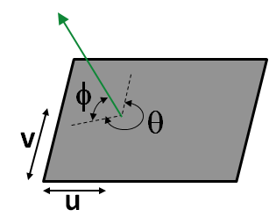
Calculating Form Factors Using the Monte Carlo Method
Our integration scheme will need to sample from the entire plate area (u, v), and all angles (θ, φ);
In this case, four random numbers are needed for each ray.

Slide 83
Calculating Form Factors Using the Monte Carlo Method
Consider the following geometry -- all surfaces are opaque.
3
4
2
1

Slide 84
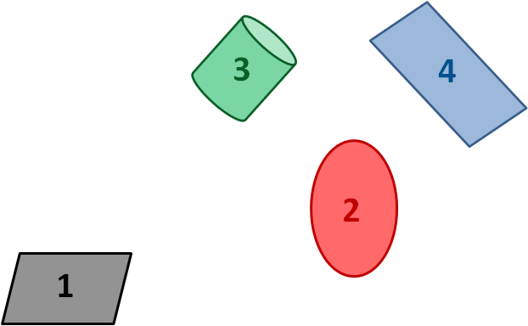
Calculating Form Factors Using the Monte Carlo Method
Let's shoot 1000 rays from Surface 1;
200 rays hit Surface 2;
150 rays hit Surface 3;
80 rays hit Surface 4;
The rest escape to Space.

Slide 85
Calculating Form Factors Using the Monte Carlo Method
The form factor between Surface 1 and the others is:
FF₁₂ = 200/1000 = 0.200
FF₁₃ = 150/1000=0.150
FF₁₄ = 80/1000 = 0.080
FF_{1SPACE} = 570/1000 = 0.570

Slide 86
Calculating Form Factors Using the Monte Carlo Method
We also see that:
FF₁₂ + FF₁₃ + FF₁₄ + FF_{1SPACE} =
0.200 + 0.150 + 0.080 + 0.580 = 1.000
In all cases, form factors must sum to unity.

Slide 87
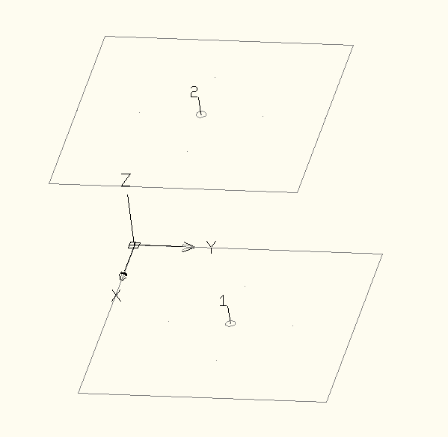
Sample Problem
Consider two parallel unit plates separated by one unit;
We'll apply the Monte Carlo method to calculate the form factor between these two surfaces.
1 m
1 m
1 m
Screen shot from RadCad® by Cullimore and Ring Technologies, Inc

Slide 88
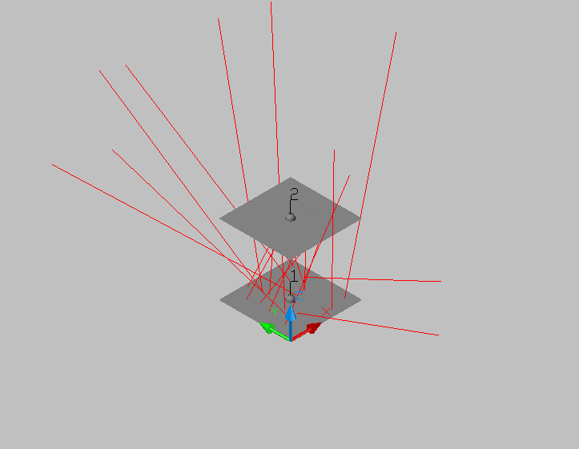
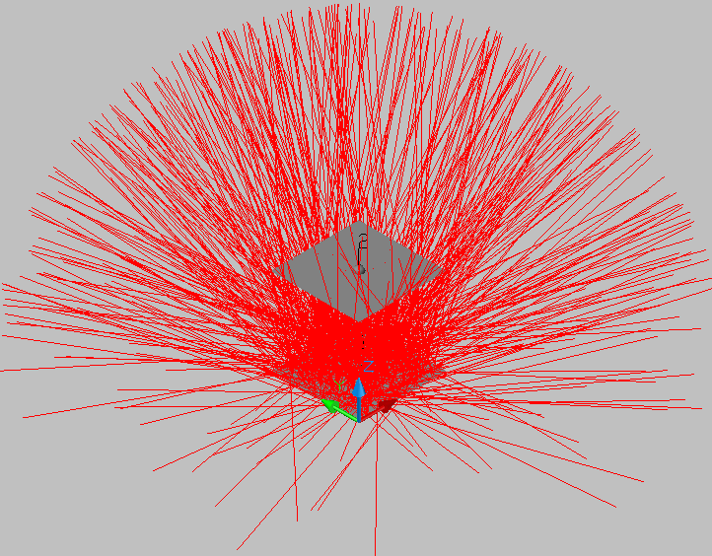
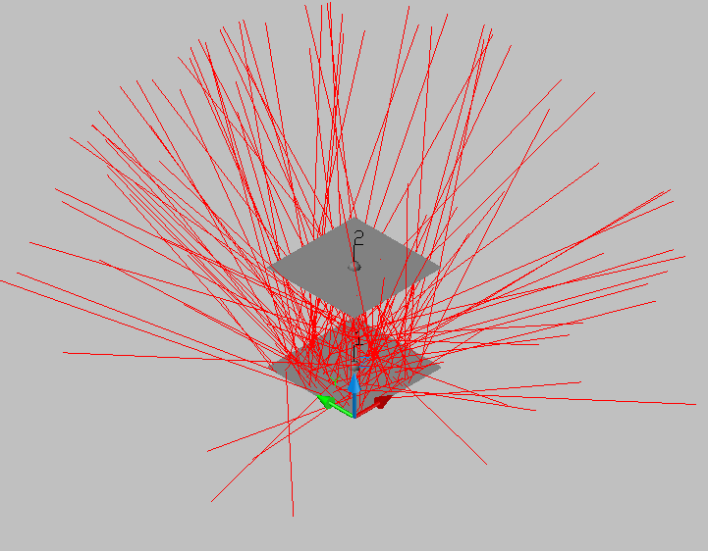

Sample Problem
20 rays
220 rays
420 rays
720 rays
Screen shot from RadCad® by Cullimore and Ring Technologies, Inc

Slide 89
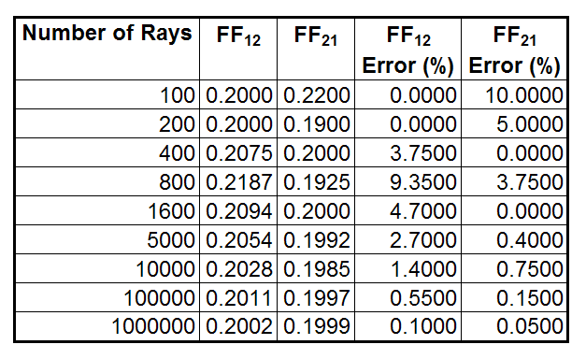
Sample Problem
The solution improves as the number of rays shot increases:
Screen shot from RadCad® by Cullimore and Ring Technologies, Inc

Slide 90
Statistical Error (Ref. 6)
If we are estimating a value generated by sampling a random distribution, we cannot be 100% certain of a bounding value unless we say that its value lies somewhere between -∞ and + ∞;
So if we're to generate meaningful answers using random variables, we'll need to be more realistic about the bounds;
We can do this by specifying a confidence interval.

Slide 91
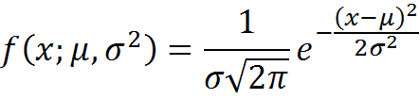
Statistical Error (Ref. 7)
The Normal or Gaussian Distribution is given by:
where...
μ is the mean value, and;
σ is the standard deviation.

Slide 92

Statistical Error (Ref. 7)
We will also consider the Cumulative Density Function (CDF):
The CDF tells us the probability of a random variable falling in the interval (-∞, x);

Slide 93

Statistical Error (Ref. 7)
We want to know the probability of a random variable falling in the interval (μ-Nσ, μ+Nσ):
where N is the number of standard deviations (σ) from the mean value (μ).

Slide 94

Statistical Error
For example, for one standard deviation, N = 1, the probability of a random variable falling in the interval (μ-σ, μ+σ) is:
In other words, we can say that a random variable has a 68.3% chance of being within one standard deviation of the mean -- or, to put it another way, we're 68.3% confident that the value lies somewhere within one standard deviation of the mean.

Slide 95

Statistical Error
If we want to establish an answer with 90% confidence, we would need to find N for the following:
This occurs for N = 1.645.

Slide 96
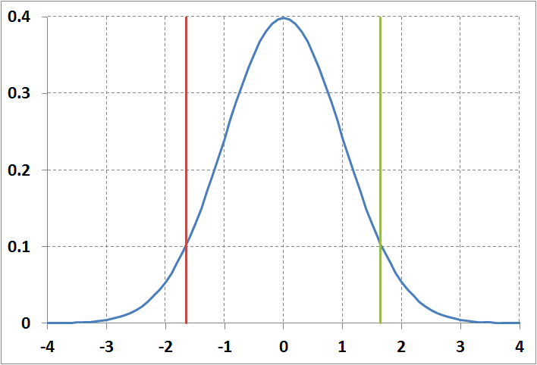
Statistical Error
σ=1
μ-1.645σ
μ+1.645σ
P(x)
90%
Confidence
Interval
μ

Slide 97
Statistical Error (Ref. 5)
Rays shot for form factor calculations can take on one of two states:
If the ray hits a given surface, it adds 1 to the tally;
If the ray misses a given surface, it adds nothing to the tally and takes on a value of 0;
For a form factor calculation, the value of the form factor is simply the probability, p, that a random ray shot from one surface will strike the other.

Slide 98
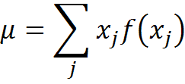
Statistical Error (Ref. 6)
With only two possible states, we see this is a discrete distribution;
To calculate the mean, μ of a discrete distribution, we use:
where...
x_{j} is the value of an event, and;
f(x_{j}) is the probability of the event happening.

Slide 99
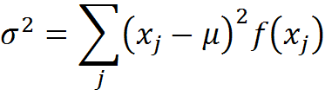
Statistical Error (Ref. 6)
For a discrete distribution, the variance, σ², is:
Note that j = 2 since x can take on a value of 0 or 1;
But variance can be applied to, both, of a sample, s², or of the mean, σ².

Slide 100


Statistical Error (Ref. 6)
Form factor error estimation strategy we assume:
The variance of a sample, s², is approximately equal to the variance of the distribution:
The variance of the distribution of means, σ_{m}², calculated from n samples, is estimated by using the variance of the sample population:

Slide 101
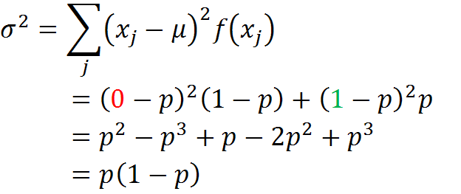
Statistical Error (Ref. 6)
If the mean value, μ is simply the probability, p, of the ray striking the other surface, then the probability of missing the surface is (1-p) and the variance becomes:

Slide 102

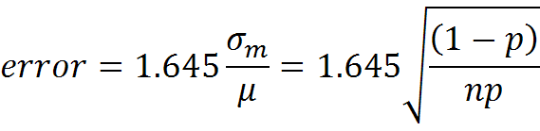
Statistical Error (Ref. 6)
What we really seek is a variance of the means, σ_{m}²:
For a 90% confidence interval, our estimate of our error:

Slide 103
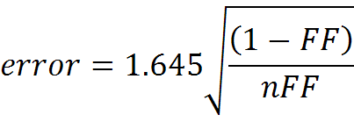
Statistical Error (Ref. 6)
When FF is high, (1-FF)/FF is low and n doesn't have to be large to achieve low error;
When FF is low, (1-FF)/FF is high and n must be large, relatively speaking, to lower the error.

Slide 104
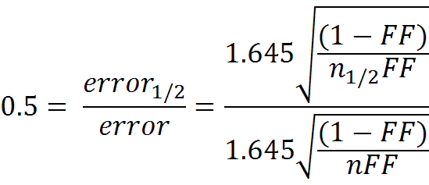
Statistical Error
How does that change the number of rays (n_{1/2}) we have to shoot if we wish to halve the error?
The number of rays required quadruples: n_{1/2} = 4n

Slide 105
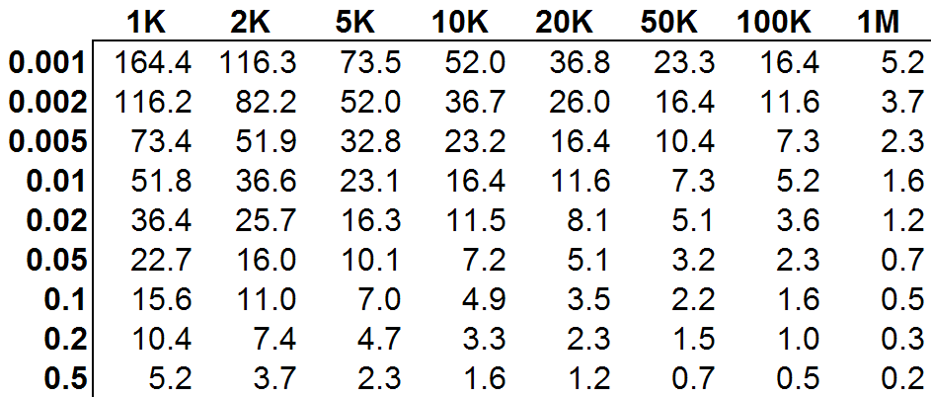
Statistical Error (Ref. 8)
For 90% confidence, the relationship between form factor magnitude, number of rays shot and the associated statistical error is:
Number of Rays
Form Factor Magnitude
% Error

Slide 106
Form Factor Reciprocity and Combinations

Slide 107

Reciprocity
For two nodes i and j, we observe the following relationship:
This is called reciprocity;
We can use this to solve for unknown form factors in our geometry.

Slide 108
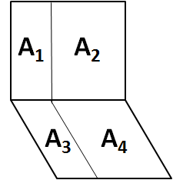


Form Factor Combinations (Ref. 3)
Reciprocity, in combination with form factor algebra, can be used to identify the following relationships:

Slide 109
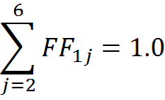


Form Factor Combinations
Let's look at the form factor relationships for a cube:
1 m
1
1 m
3
6
4
5
2
1 m

Slide 110
Form Factor Combinations
We see that:
But we see symmetry in this cube geometry so we conclude that:
We'll use this result in an example problem later.

Slide 111
Wrap-Up of Part 2
In this part, we defined the thermal radiation form factor;
We explored a variety of techniques for calculating the form factor;
Establishing an error estimate for Monte Carlo-generated form factors was discussed.

Slide 112
Part 3

Slide 113
Part 3 -- Lesson Roadmap
Exact Solutions
Fundamentals
What is a Radk?
Form Factors
Double Area Summation
Nusselt Sphere
The "World's Worst Dart Player"
Approximating F
Crossed-String Method
Form Factors Using Monte Carlo Ray Tracing
Form Factor Reciprocity and Combinations
Grey Body Factors
Gebhart's Method
Statistical Error
Imperfect Form Factor Sums
Calculating Grey Body Factors Using Monte Carlo Ray Tracing
Turning the Grey Body Factor into a Radk
The Fence Problem
Application in Analysis

Slide 114
Grey Body Factors

Slide 115
Difference Between a Form Factor and Grey Body Factor
A form factor describes how well one object "sees" another object via direct view;
In other words, a form factor quantifies the fraction of energy emitted from one surface that arrives at another surface directly;
A grey body factor quantifies the fraction of energy leaving one surface that is absorbed another surface through all possible paths.

Slide 116
The Mirror Maze Analogy
Consider two friends, A and B situated at opposite ends of a maze comprised of mirrors;
We ask, can the two friends see one another?
A
B

Slide 117
The Mirror Maze Analogy
A cannot see B directly;
We say that the form factor between A and B is zero;
A
X
B

Slide 118
The Mirror Maze Analogy
But if the walls are mirrors, A can see B via reflection;
In this case, the grey body factor between A and B is greater than zero.
A
B

Slide 119
The Mirror Maze Analogy
Actually, there are many possible reflections that will allow A to see B;
The grey body factor is the amount of energy that leaves A and is absorbed at B via all possible paths.
A
B

Slide 120
Gebhart's Method

Slide 121
Turning Form Factors Into Grey Body Factors
Form factors are an intermediate product and, by themselves, have limited use;
We really seek a means of determining how radiant energy is distributed in a thermal network;
Form factors and surface emittances are inputs to Gebhart's method to calculate grey body factors which can readily be turned into Radks.
This method works for diffuse interchange only.

Slide 122

Gebhart's Method (from Ref. 9)
Define the Gebhart factor as:
where i is one surface and j is another and A_{i} and A_{j} are surface areas of i and j, respectively.

Slide 123
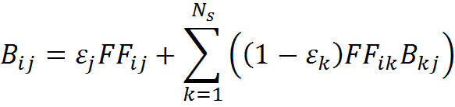
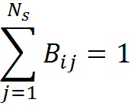
Gebhart's Method (from Ref. 9)
For N_{s} objects, the general formula is:
We also note for an object, i:

Slide 124
Gebhart's Method
For three objects that see only one another, we can establish the B_{ij} values, holding i constant:
By remembering that B₁₁ + B₁₂ + B₁₃ = 1 and noting that reflectance, ρ = (1-ε), we can interpret each of these terms.

Slide 125
Gebhart's Method (Ref. 10)
Fraction leaving object 1...
directly absorbed at j=1, 2, 3;
reflecting off of 1 and is absorbed j=1, 2, 3;
reflecting off of 2 and is absorbed at j=1, 2, 3;
reflecting off of 3 and is absorbed at j=1, 2, 3;
The B_{1j} for j = 1, 2, 3 must sum to unity.

Slide 126



Gebhart's Method
Consider two infinite parallel plates with the specified properties;
Given the infinite extent, we can say:
2
1
ε₂
ε₁

Slide 127
Gebhart's Method
Our expression for the B_{ij} values becomes:

Slide 128
Gebhart's Method
Rearranging, yields the following:
Grouping similar terms together:

Slide 129


Gebhart's Method
In matrix form, the system of equations becomes:
Recall, for infinite parallel plates:

Slide 130

Gebhart's Method
Our system of equations becomes:

Slide 131

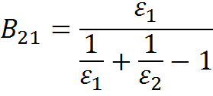
Gebhart's Method
From the first equation, we see that:
Substituting into the second equation yields:
Finally, solving for B₂₁:

Slide 132


Gebhart's Method
You may be more familiar with the infinite parallel plate solution that looks like this:
is the ratio of the energy incident at surface 1 originating at surface 2 divided by the total radiation emitted at 2.

Slide 133

Gebhart's Method
But, remember, the B₂₁ is the ratio of the energy absorbed at surface 1 originating as emission at surface 2 divided by the total radiation emitted at 2;
The relationship between the two is:

Slide 134

Approximating F₂₁(Ref. 11)
We can establish an approximate value of F₂₁ using a simpler expression when the surface emittance values are relatively high.
To do this, we can modify our expression for F₂₁ by multiplying the numerator and denominator by ε₁ε₂:

Slide 135

Approximating F₂₁(Ref. 11)
This simplifies to:
As ε₁ and ε₂ approach unity, the expression approaches ε₁ × ε₂.

Slide 136

Approximating F₂₁(Ref. 11)

Slide 137
Gebhart's Method Example
Consider an infinitely long enclosure with an equilateral triangular cross section;
We wish to calculate the radiation interchange for the internal surfaces given:
ε₁ = ε₂ = ε₃ = 0.05
ε₁
1
2
ε₂
3
ε₃

Slide 138
Gebhart's Method Example
Due to infinite extent and problem symmetry:
FF₁₁ = FF₂₂ = FF₃₃ = 0
FF₁₂ = FF₁₃ = 0.5
FF₂₁ = FF₂₃ = 0.5
FF₃₁ = FF₃₂ = 0.5
The FF sum for each node must equal unity. All FF to Space equal zero.
ε₁
1
2
ε₂
3
ε₃

Slide 139
Gebhart's Method Example
We apply our equation for B_{ij} where N_{s} = 3:
Our system of equations is:

Slide 140

Gebhart's Method Example
Rearranging yields:
In matrix form, the system of equations becomes:

Slide 141


Gebhart's Method Example
Substituting values into the matrices:
Solving for B₁₁, B₂₁ and B₃₁:

Slide 142

Imperfect Form Factor Sums
We can use this example to explore the effect of imperfect form factor sums on energy conservation;
Consider the same geometry but assume, this time, that whichever form factor approximation methodology we used left us with imperfect form factor sums:
with other FFs inferred through symmetry.

Slide 143

Imperfect Form Factor Sums
In this instance, our form factors do not sum to unity:
How does this affect energy conservation in the radiation network?

Slide 144


Imperfect Form Factor Sums
If we substitute the imperfect form factors into our system of equations, we get:
Solving once again for B₁₁, B₂₁ and B₃₁:

Slide 145
Imperfect Form Factor Sums
A check of energy conservation yields an imperfect summation:
In this example, only about 83% of the thermal radiation interchange is represented by the network;
This result cautions the analyst to ensure form factors sum to unity for each node.

Slide 146
Calculating Grey Body Factors Using the Monte Carlo Ray Tracing Method

Slide 147
Calculating Grey Body Factors Using the Monte Carlo Method
We saw that Monte Carlo ray tracing can be used to calculate form factors;
By extension, we can also use them to calculate grey body factors;
Let's see how this works.

Slide 148
Calculating Grey Body Factors Using the Monte Carlo Method
Consider the following geometry -- all surfaces are opaque.
ε₃=0.6
3
4
ε₄=0.8
2
ε₂=0.4
1
ε₁=0.3

Slide 149

Calculating Grey Body Factors Using the Monte Carlo Method
A ray with unit energy is fired from a random location on Surface 1 and in a random direction;
The rays hits Surface 2;
What is the energy transfer?
E=1

Slide 150
Calculating Grey Body Factors Using the Monte Carlo Method
Since the ray leaves Surface 1 with unit energy and hits a surface with an emittance of 0.4, we conclude that 40% of the energy is absorbed by Surface 2 and 60% is reflected.
E=1

Slide 151
Calculating Grey Body Factors Using the Monte Carlo Method
Now suppose another ray is shot from Surface 1 but, through reflections, strikes other surfaces in the model.
E=1

Slide 152


Calculating Grey Body Factors Using the Monte Carlo Method
We can tally the energy deposited as the ray moves from reflection to reflection:

Slide 153
Calculating Grey Body Factors Using the Monte Carlo Method
If many such rays are shot and a tally of energy deposition is maintained, we have an estimate of the fraction of energy leaving Surface 1 and arriving at Surface 2 via all possible paths.

Slide 154
Calculating Grey Body Factors Using the Monte Carlo Method
A ray is traced until it leaves the geometry or the ray energy drops below a specified threshold;
In the latter case, once this occurs, a test is performed at the next ray-to-surface intersection to determine whether the ray is completely absorbed or completely reflected -- depending on the surface properties;
This allows for energy conservation.

Slide 155

Calculating Grey Body Factors Using the Monte Carlo Method
In an enclosure, rays may undergo many bounces before the ray energy drops below the threshold to terminate the ray.
Single Ray Traced in Enclosure with ε = 0.05
Screen shot from RadCad® by Cullimore and Ring Technologies, Inc

Slide 156
Grey Body Statistical Error (Refs. 6 and 8)
A conservative error estimate is formed using discrete distribution assumptions also applies to grey body factors -- 90% confidence interval shown:
Number of Rays
Grey Body Factor Magnitude
% Error

Slide 157
The Fence Problem

Slide 158
The Fence Problem
The Fence Problem arises when the Gebhart technique is used without giving proper consideration to nodal boundaries;
Let's examine how the Gebhart and Monte Carlo techniques handle this type of situation.

Slide 159

The Fence Problem
Consider the following geometry in which a fence is established at the midpoint of the long base rectangle.
All surface emittances, ε = 0.5.
2
1
Fence
100
Node 100 is a single node
spanning the entire base rectangle
Screen shot from RadCad® by Cullimore and Ring Technologies, Inc

Slide 160
The Fence Problem
Under normal circumstances, Nodes 1 and 2 should have no radiation coupling to one another.
2
1
Fence
100
Node 100 is a single node
spanning the entire base rectangle
Screen shot from RadCad® by Cullimore and Ring Technologies, Inc

Slide 161

The Fence Problem
With Gebhart's method, energy incident onto the base rectangle is distributed and re-reflected from the entire area.
1
2
Single Base Rectangle Node

Slide 162

The Fence Problem
With a Monte Carlo (MC) approach, energy incident onto the base rectangle is re-reflected locally.
1
2
Single Base Rectangle Node (100)

Slide 163
The Fence Problem
Now consider the same geometry but with the base rectangle divided into two nodes:
2
1
101
Fence
100
Screen shot from RadCad® by Cullimore and Ring Technologies, Inc

Slide 164

The Fence Problem
Using Gebhart's method with a properly nodalized geometry, leakage of energy to the other side of the fence is prevented.
1
2
100
101
Two Base Rectangle Nodes

Slide 165



The Fence Problem
Single Base Rectangle
Base Rectangle Divided
Screen shot from RadCad® by Cullimore and Ring Technologies, Inc

Slide 166
The Fence Problem
Diffuse reflection using Gebhart's method across the entire base rectangle results in a grey body factor between Nodes 1 and 2;
When properly divided, the grey body factor between Nodes 1 and 2 is zero;
Monte Carlo-generated grey body factors rely on reflection from the ray-surface intersection point and does not show the same nodalization sensitivity as does the Gebhart approach.

Slide 167
Wrap-Up of Part 3
We introduced the Grey Body factor and applied Gebhart’s Method to calculate grey body factors from form factors;
We also showed how grey body factors may be calculated using Monte Carlo methods.
Finally, we explored some pitfalls using the fence problem example.

Slide 168
Part 4

Slide 169
Part 4 -- Lesson Roadmap
Exact Solutions
Fundamentals
What is a Radk?
Form Factors
Double Area Summation
Nusselt Sphere
The "World's Worst Dart Player"
Approximating F
Crossed-String Method
Form Factors Using Monte Carlo Ray Tracing
Form Factor Reciprocity and Combinations
Grey Body Factors
Gebhart's Method
Statistical Error
Imperfect Form Factor Sums
Calculating Grey Body Factors Using Monte Carlo Ray Tracing
Turning the Grey Body Factor into a Radk
The Fence Problem
Application in Analysis

Slide 170
Turning the Grey Body Factor into a Radk

Slide 171
Turning a Grey Body Factor into a Radk
We've seen how to generate grey body factors using, either, form factors plus Gebhart's method or by direct generation of grey bodies using Monte Carlo methods;
Now let's see how we can take the final step to turn the grey bodies into usable radiation conductances, or Radks.

Slide 172


Turning a Grey Body Factor into a Radk
The Radk (G_{rad})_{ij} between two nodes i and j is given by:
where ε_{i} is the emittance of node i, A_{i} is the area of node i and B_{ij} is the grey body factor from i to j.
We also note:

Slide 173
Radk Screening
For configurations with a large quantity of nodes and/or highly reflective surfaces with view factors to one another, it is possible to generate an undesirably large quantity of Radks;
Engineers must judge which couplings are significant;
Radk dumps with different screening criteria may be used in thermal network models to determine the point of diminishing returns.

Slide 174
Application in Analysis

Slide 175
Example: Radiation in a Box
Consider the interior surfaces of a six-sided box with dimensions: 1m × 1m × 1m, and
interior surface ε: 0.8
Side 1 is maintained at 100 C;
Sides 2 - 6 are maintained
at 20 C;
Considering only radiation,
what is the heat transfer between Side 1 and the other box sides?
1 m
1
1 m
3
6
4
5
2
1 m

Slide 176
Example: Radiation in a Box
The form factor solution for opposing parallel plates (Sides 1 and 2) yields an exact answer of 0.2;
For the form factors to sum to unity, the form factor sum from Side 1 to the remaining Sides (3, 4, 5, 6) must be 0.8 (i.e., 1 - 0.2). By symmetry arguments:

Slide 177
Example: Radiation in a Box
If we wish to solve this using Gebhart's method, the system of equations for Side 1 will be:

Slide 178


Example: Radiation in a Box
Rearrange the equations into the form:
Substituting known values, we have this system:
=

Slide 179
Example: Radiation in a Box
Our B_{ij} values are:
B₁₁ = 0.038462
B₁₂ = 0.192308
B₁₃ = 0.192308
B₁₄ = 0.192308
B₁₅ = 0.192308
B₁₆ = 0.192308
To obtain our Radks, we multiply by the area and the emittance of Side 1.

Slide 180
Example: Radiation in a Box
We can also use Gebhart's method using Monte Carlo-generated form factors -- we'll present this solution, as well, using 1,000,000 rays per node (and we'll assume reciprocity to find F_{ji} given F_{ij});
Finally, we'll form our Radks directly using Monte Carlo-generated grey bodies, again using 1,000,000 rays per node.

Slide 181

Example: Radiation in a Box
Comparing solutions...

Slide 182
Example: Radiation in a Box
The heat flow is...
By similarity arguments, the heat transfer between Side 1 and all other sides is the same.

Slide 183
Concluding Remarks
A discussion of form factors, grey body factors and radiation conductors has been presented;
Analytical formulations were shown for a variety of methodologies;
Sample problems were provided to aid in understanding.

Slide 184
Acknowledgements
The author acknowledges the NESC Passive Thermal Technical Discipline Team for their valuable review and comments during the development of this lesson.
Matt Garrison and Carol Mosier of GSFC are also acknowledged for their review of the draft lesson and their valuable comments.

Slide 185
References/Credits
1) Ungar, E. K., Slat Heater Boxes for Control of Thermal Environments in Thermal/Vacuum Testing, SAE 1999-01-2135, 1999.
2) Drolen, B., used with permission.
3) McMurchy, R., Thermal Network Modeling Handbook, 14690-H003-R0-00, NASA Contract 9-10435, January 1972.
4) http://www.me.utexas.edu/~Howell/sectionc/C-11.html
5) http://www.mhtl.uwaterloo.ca/courses/ece309/
lectures/pdffiles/summary_ch12.pdf.

Slide 186
References/Credits
6) TSS Theory Manual, Version 9.01, October 1999.
7) http://en.wikipedia.org/wiki/Normal_distribution
8) Thermal Radiation Analysis -- The Basics, Methodologies, and Use of Analysis Tools, Rickman, S.L. and Welch, M.
9) Gebhart Factor, http://en.wikipedia.org/wiki/Gebhart_factor

Slide 187
References/Credits
10) http://www.siggraph.org/education/materials/
HyperGraph/radiosity/overview_1.htm
11) Drolen, B., used with permission.
Monte Carlo ray trace analyses and screen shots from RadCad® by Cullimore and Ring Technologies, Inc.
Microsoft® clip art was used throughout this lesson.

Slide 188
For Additional Information
Closed-Form Form Factor Solutions -
Schröder, P., Hanrahan, P., On the Form Factor Between Two Polygons, http://www.multires.caltech.edu/pubs/ffpaper.pdf
Howell, J. R., A Catalog of Radiation Heat Transfer Configuration Factors, 3rd Edition, http://www.engr.uky.edu/rtl/Catalog/
Thermal Radiation Heat Transfer
Siegel, R., Howell, J. R., Thermal Radiation Heat Transfer (Volumes I-III), NASA SP-164, 1968.

