Slide 1
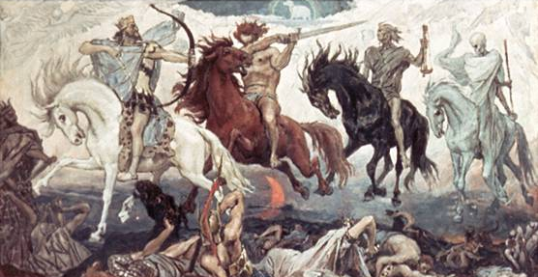

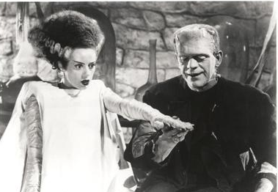

Fundamentals of EMC – Cast of Characters

Slide 2
Fundamentals of
Electromagnetic Compatibility
(EMC)
Introduction
Oct. 30, 2012
John McCloskey
NASA/GSFC Chief EMC Engineer
Code 565
Building 23, room E203
301-286-5498
John.C.McCloskey@nasa.gov

Slide 3
GSFC EMC Working Group Commercial
Weekly meeting/telecon: Wednesdays at 10:00 AM Eastern
  Dial-up: 877-337-6964, passcode 313963
  Webex (https://nasa.webex.com)
    Meeting number: 991 230 600
    Meeting password: gsfc_emcwg1
XSPACES page: https://xspaces.gsfc.nasa.gov/display/EMCWG/Home
  Presentation charts for this and previous courses
  EMC-related documentation (GEVS, MIL standards, papers, etc.)
  Links to NESC Academy training videos
  Links to other EMC-related websites
  Events (courses, seminars, etc.)
  On-line discussion topics
E-mail list: gsfc-emc@lists.nasa.gov
Contact information
  E-mail: John.C.McCloskey@nasa.gov
  Phone: 301-286-5498

Slide 4
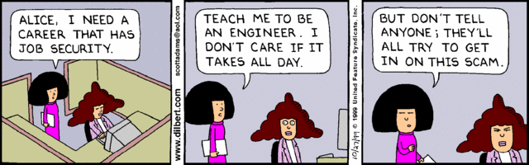
I don’t care if it takes all day…

Slide 5
References
Ott, Henry: Electromagnetic Compatibility Engineering
Paul, Clayton: Introduction to Electromagnetic Compatibility
Cheng, David: Field and Wave Electromagnetics
XSPACES site

Slide 6
If You Remember Nothing Else From Today…
DO YOU KNOW WHERE YOUR CURRENTS ARE FLOWING?

Slide 7
Agenda
8:30 – 9:00 AM: Introduction
9:00 – 10:00 AM: Building Blocks
10:00 – 10:15 AM: Break
10:15 – 10:45: Building Blocks (cont.)
10:45 – 11:15 AM: Time Domain vs. Frequency Domain
11:15 – 11:45 AM: Transmission Lines
11:45 AM – 1:15 PM: Lunch
1:15 – 1:45 PM: Dipole Antenna Basics
1:45 – 2:45 PM: Grounding
2:45 – 3:00 PM: Break
3:00 – 4:00 PM: Mitigation Strategies
4:00 – 4:30 PM: Discussion and Wrap-Up
4:30 PM Adjourn and room cleanup

Slide 8
Your Instructor
25 years at GSFC as Electronics/Electrical Systems Engineer
GSFC Chief EMC Engineer since Sept. 20, 2010
Certified iNARTE MIL-STD specialist
  iNARTE = International Association for Radio, Telecommunications and Electromagnetics
Electrical Systems Branch (565) for 12 years
  JWST/ISIM Electrical Systems & EMC Lead (2002-present)
  JWST Observatory EMC Lead Engineer (Oct. 2010 – present)
  Electrical Systems Lead for EOS-Aqua (1998-2002)
Detector Systems Branch (553) for first 10 years
  Board level design engineer (digital and analog)
  MODIS-T, CIRS, IRAC, etc.
  Early experience with board-level noise and crosstalk

Slide 9

EMI: Divine Intervention or Physics?
Nay, Plato, the laws of physics cause these phenomena, as will be expressed in an elegant set of equations by a brilliant dude named Maxwell in a couple of millenia, and as will be summarized in a somewhat dumbed-down manner by this dude in the next few viewgraphs…
Aristotle, I present thee with another test:
Is Electromagnetic Interference caused by the gods to whom I doth presently point with my right hand, indeed the same gods that cause Microsoft Windows to crash on a regular basis?
Dude, what the ηελλ are “viewgraphs”?

Slide 10

Goals for this Course
Debunk “EMC is black magic” myth
  "The great enemy of the truth is very often not the lie - deliberate, contrived, and dishonest - but the myth - persistent, persuasive, and unrealistic."
  - John F. Kennedy
Increase awareness and appreciation of EMC principles at all project levels
  Managers & systems engineers
    Importance of EMC issues for ensuring mission success
    Consequences of ignoring them
    Provide basis for making informed decisions
  Design engineers
    Provide overview of fundamental electromagnetic principles
    Provide design techniques that can be incorporated at lowest levels
    Most effective and most cost-effective
Have you screaming for more EMC training
Inspire potential future EMC engineers
  Deal with natural phenomena
  Always new things to learn
  Always in demand

Slide 11
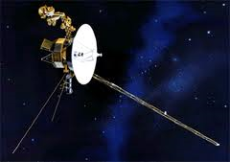
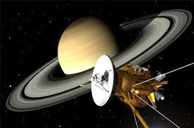
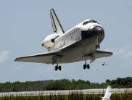

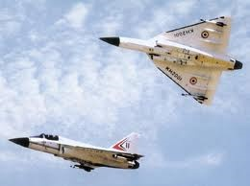
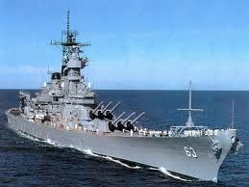
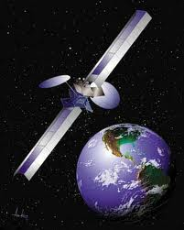
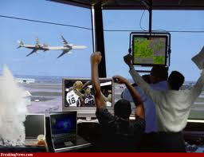
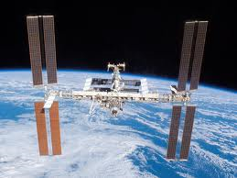
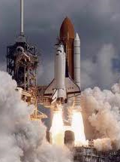

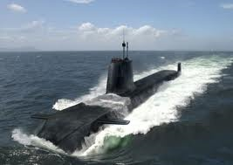
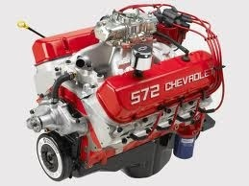
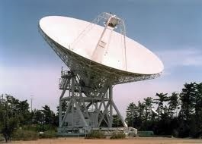
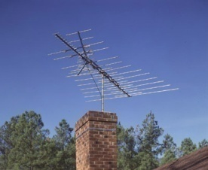

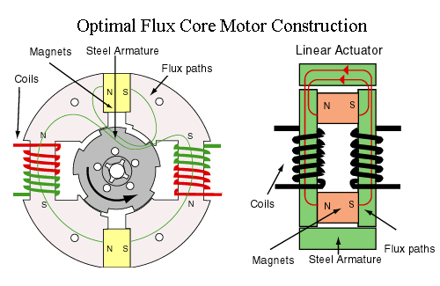
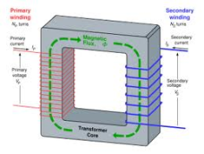


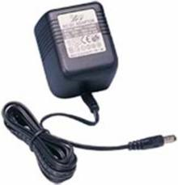
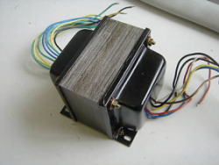

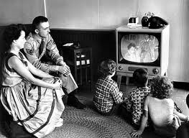
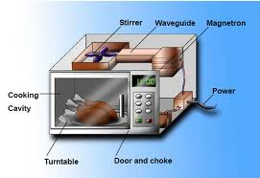
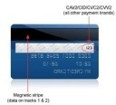
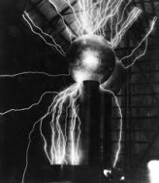
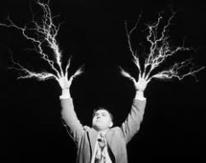
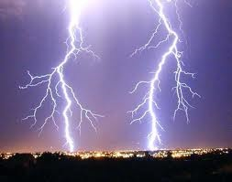
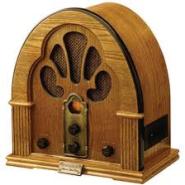
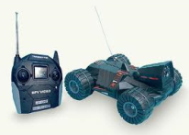
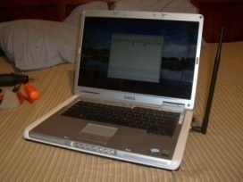
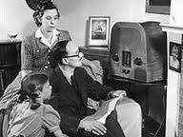
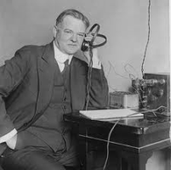
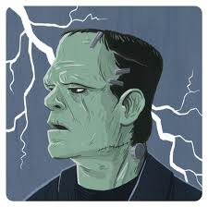
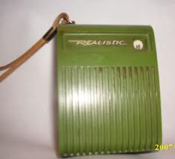


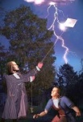
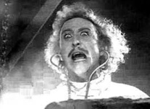
Electromagnetic Energy Is Everywhere

Slide 12
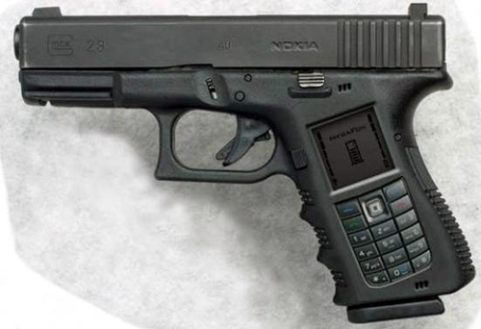
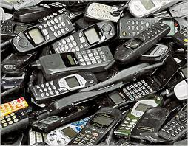

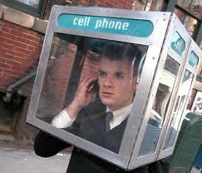
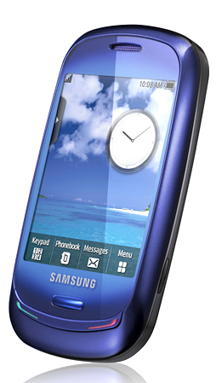
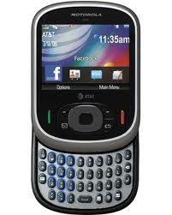
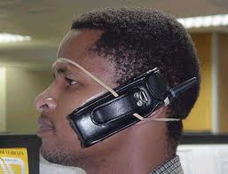
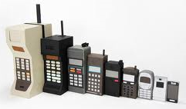
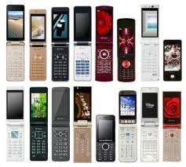
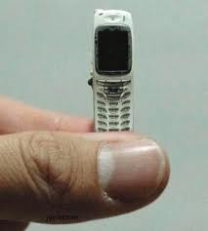

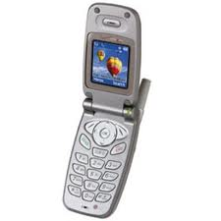

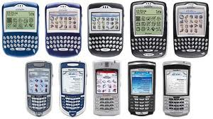

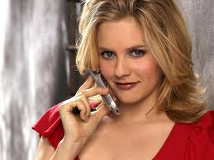

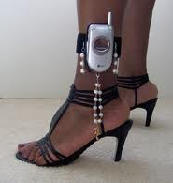
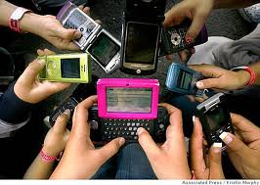
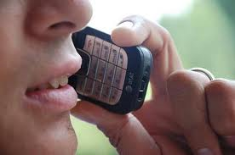
Yes, Cell Phones Too

Slide 13
Basic Goals of EMC
The goals of EMC are common to ANY application:
  Commercial
  Military
  Aerospace
From General Environmental Verification Standard (GEVS) for GSFC Flight Programs and Projects, GSFC-STD-7000
  Available at http://standards.gsfc.nasa.gov/gsfc-stds.html
  2.5 ELECTROMAGNETIC COMPATIBILITY (EMC) REQUIREMENTS
    The general requirements for electromagnetic compatibility are as follows:
      The payload (spacecraft) and its elements shall not generate electromagnetic interference that could adversely affect its own subsystems and components, other payloads, or the safety and operation of the launch vehicle (STS or ELV) and launch site.
      The payload (spacecraft) and its subsystems and components shall not be susceptible to emissions that could adversely affect their safety and performance. This applies whether the emissions are self-generated or emanate from other sources, or whether they are intentional or unintentional.

Slide 14


Terminology
Electromagnetic Interference (EMI): the phenomenon in which one component/subsystem interferes with the proper operation of another subsystem due to the propagation of electromagnetic energy
Electromagnetic Compatibility (EMC): the discipline of ensuring that electronic components/subsystems function together in the resulting electromagnetic environment
EMI/EMC relationship: We control EMI in order to achieve EMC.
Culprit: a component/subsystem that is an emitter of electromagnetic energy
Victim: a component/subsystem that is susceptible to EMI
Coupling Mechanism: the process by which electromagnetic energy emitted by a culprit causes interference in a victim
COUPLING
MECHANISM
CULPRIT
VICTIM

Slide 15







Typical Culprits, Victims, and Coupling Mechanisms on Spacecraft
Culprits
  Radio transmitters
  Switching power converters
  Motors
  Cryocoolers
  High speed digital electronics
Victims
  Radio receivers
  Detectors
  Sensors
  Low level analog electronics
Coupling Mechanisms
  Conducted
  Radiated
  Crosstalk

Slide 16

Typical Project EMC Flow
Define requirements
YES
Passed EMI Tests?
NO
YES
Consult EMC Engineer?
NO
Except for all of the non-compliances
YES
Fix hardware, retest, meet all requirements with flying colors and ensure no further EMI problems for the rest of the mission?
NO
Just kidding
Design hardware
Build hardware
Submit waiver(s)
You may say that I’m a dreamer
But I’m not the only one…
Test hardware
Blame EMC Engineer for holding up waiver request(s)

Slide 17
How We Got Here
University level electromagnetics courses tend to emphasize theoretical over practical
  Theory is wonderful and indispensible, but not enough
  Need practical side for intuitive understanding
Engineers can ride the wave of luck until we get bitten
  Digital is only 1’s and 0’s, right?
Less intuitively comprehensible than other environmental effects (vibration, shock, thermal, acoustics, etc.)
  You can’t see it, smell it, touch it
  But you count on it every time you:
    Use your cell phone
    Complain about no wireless internet access in your hotel room
    Use your microwave (protecting the magnetron, of course…)
    Use your ATM card
    Etc. etc. etc.
Requirements that are not always the best fit for our needs
Etc., etc., etc…..
WE CAN DO BETTER THAN THIS

Slide 18
War Stories
Cassini/CIRS
Spitzer/IRAC
Swift/BAT
Wake Shield Experiment

Slide 19
War Story #1: Cassini/CIRS
My first direct experience with EMI
Analog signal processing board for Composite Infrared Spectrometer (CIRS)
  Multiple op-amp stage filter (detector compensation)
  Low frequency (DC – 30 Hz), high gain (~10,000)
Output signal showed spikes
  Synchronous with intended signal
  Independent of frequency
Root cause: Trace connecting final output stage signal to test connector routed adjacent to input signal to first stage
  Capacitive coupling (“hidden schematic”) caused feedback with large gain
  Spikes went away when signal trace to test connector was broken
INPUT CONNECTOR
INPUT SIGNAL
PARASITIC CAPACITANCE BETWEEN SIGNAL TRACES (“HIDDEN SCHEMATIC”)
TEST CONNECTOR
OUTPUT SIGNAL
SAMPLE AND HOLD
BACKPLANE CONNECTOR

Slide 20


War Story #2: Spitzer/IRAC
IRAC passed Radiated Susceptibility tests at instrument level
Interference observed at observatory level
Root causes:
  Magnetic coupling from solar array cable near FPA cables
  Signal returns from detectors routed on separate cables from clocks and biases (large loop area)
~ 1 month delay, < 6 months before launch
Problem improved, but not eliminated, by installing METGLAS shielding
Launched “as is” with compromised science performance
Fortunately, problem has not appeared on orbit
VICTIM
CULPRIT

Slide 21

War Story #3: Swift/BAT
Failures in TVAC attributed to improper decoupling of RTSX Actel FPGAs and incorrect termination of the IO drivers
RTSX parts had higher slew outputs (dV/dt, dI/dt) than previous generation of Actels
Caused glitch on an interrupt line when the PCI bus was switching
Proper fix would have been to respin board
  Not feasible due to late phase of project
Workaround solution was to respin FPGA to implement digital filter to “ignore” noise
  Band aid; did not truly “fix” problem
Designing, installing and testing a new FPGA in such a late phase still posed schedule hit and $$$$ (including many man-hours of troubleshooting)
Purple - 3.3 V
0.5 V/div
Note more noise as AD driven “High”
Valid “Start” Cycle Pulse (Red)
When Data Bits drive low (Yellow), ground bounces causing a phantom positive glitch on “Start” locking up the system
Green - D Gnd
0.5 V/div
Note more noise as AD driven “Low”
Yellow - AD 12
2 V/div
Red – Start signal
0.5 V/div
Note signal is nominally driven “low”, glitches represent internal chip ground

Slide 22
War Story #4: Wake Shield Experiment
Shuttle experiment
  Towed behind STS-60, launched Feb. 3, 1994
  Purpose: to create better vacuum for experiments than available in orbiter
Inductive crosstalk between unshielded attitude control sensor cable and spacecraft power bus
  Prevented experiment from being successfully deployed
  Experiment failed
Control system’s cable was eventually redesigned and shielding added
  Flew successfully on STS-69
  Damage done on STS-60; time and $$$$ gone

Slide 23


Impacts of EMC Problems
Technical impacts of EMC problems range from:
  Occasional “glitches” (annoyance)
  Compromised mission performance
  Mission failure
All EMC problems:
  Cost projects valuable time and $$$$ to diagnose
  Force undesirable decision:
    Spend additional time and $$$$ to fix the problem properly, or
    Spend minimal additional time and $ to apply “band aid” fix, or
    Submit waiver and live with compromised performance and risk of continued problems over mission life
“An ounce (28.35 grams) of prevention is worth a pound (0.4536 kilogram) of cure”

