Slide 1
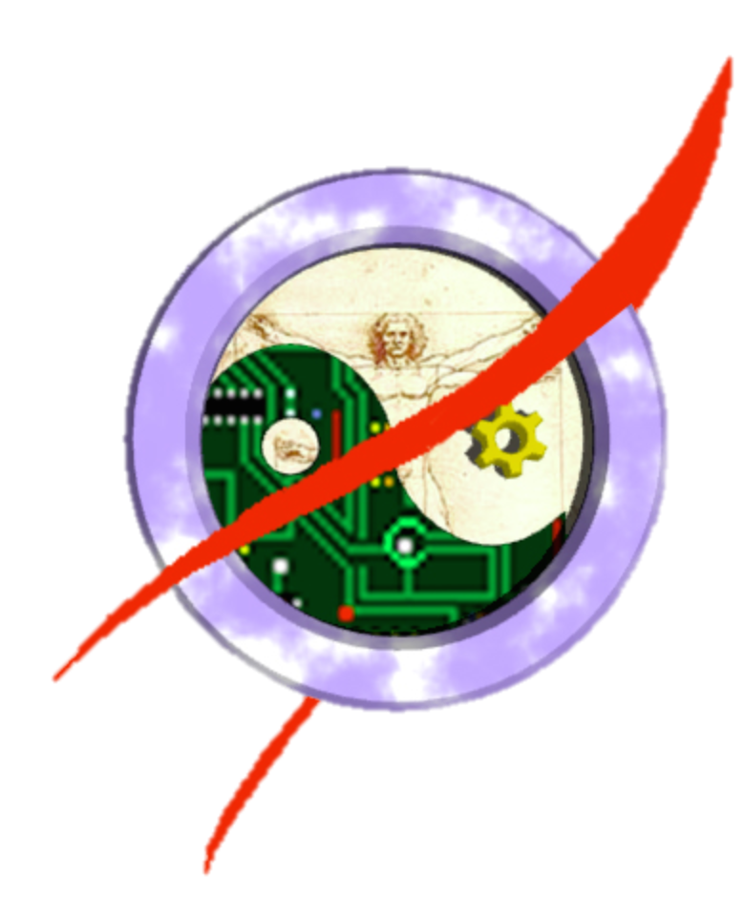
How to Make the Most of Your Human
HCI International 2015
August 5, 2015
Crew Systems & Aviation Operations Branch
NASA Langley Research Center
Hampton, VA 23681-2199
Paul Schutte paul.c.schutte@nasa.gov

Slide 2
Flight Crew Error

Slide 3



Humans throughout the system
Designer
Manufacturer
Software
Operator
Maintenance
Pilot
Arrows are errors made by humans – thickness represents ‘amount’

Slide 4
One reason flight crew error prominent
Pilot

Slide 5
Is Automation the hero?
One reason why computers are so reliable at what they are programmed to do is because they give up at the first sign of trouble.
When the autopilot reaches its maximum authority, it throws up its hands and tosses control back to the human, whether the human is ready for it or not.
Pilots routinely must intervene whether it’s simply resetting a circuit breaker or turning off the automation.
The main reason why humans are still on the flight deck is to manage risk by dealing with or avoiding the unexpected, unanticipated, or complex situations
  Computers can do virtually everything else better

Slide 6
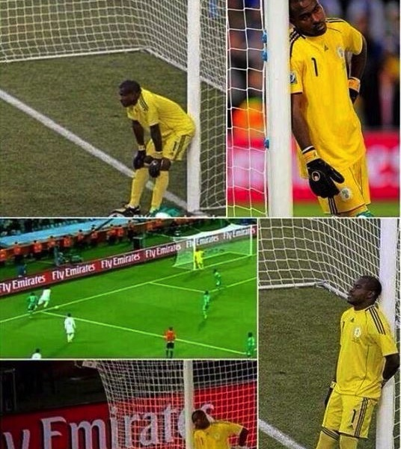
The Bored Goalie
The automation does everything reliably nearly all of the time
Humans are there to deal with things that the automation cannot deal with
Very rare
Goalie is bored and disengaged
  The worst condition for a human to be in to catch errors!

Slide 7
Humans at their worst
But by putting the human in the role of monitoring the automation (and little more) they are more likely to be unable to perform these tasks when the time comes to act in this role
  Humans are poor monitors
  Automation complacency
  Startle effect
  Brittle, uncommunicative automation
  Skill loss
The things that automation cannot do are usually hard for humans as well
  They are tasked with all the hard stuff
It should not be surprising that humans make errors

Slide 8
Example: Air France 447
Problems with icing on pitot tubes were known and pilots were given advisories
  Just one among many (design error)
  Pilots compensated for this problem (error catch)
When the airspeed indicators failed the autopilot just gave up
  Sounded the Caution alarm (startle)
  Returned control immediately to pilots (unprepared)
  The automation would definitely have crashed the aircraft if left on its own
Pilots had significantly more experience flying the automation than flying manually (skill loss)
  Especially in Alternate Law (no envelop protection)
Multiple, simultaneous alerts and messages (confusion)
Pilots affected by uniquely human characteristics when suddenly confronted with this situation
  Confusion – Fear
  Knee jerk reaction – Fatigue
  Cultural power distance
Imagine a copilot acting as automation did in this case

Slide 9

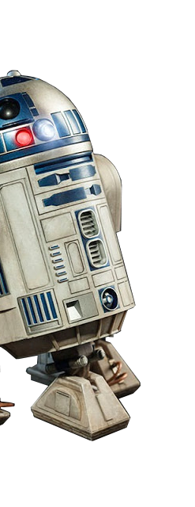
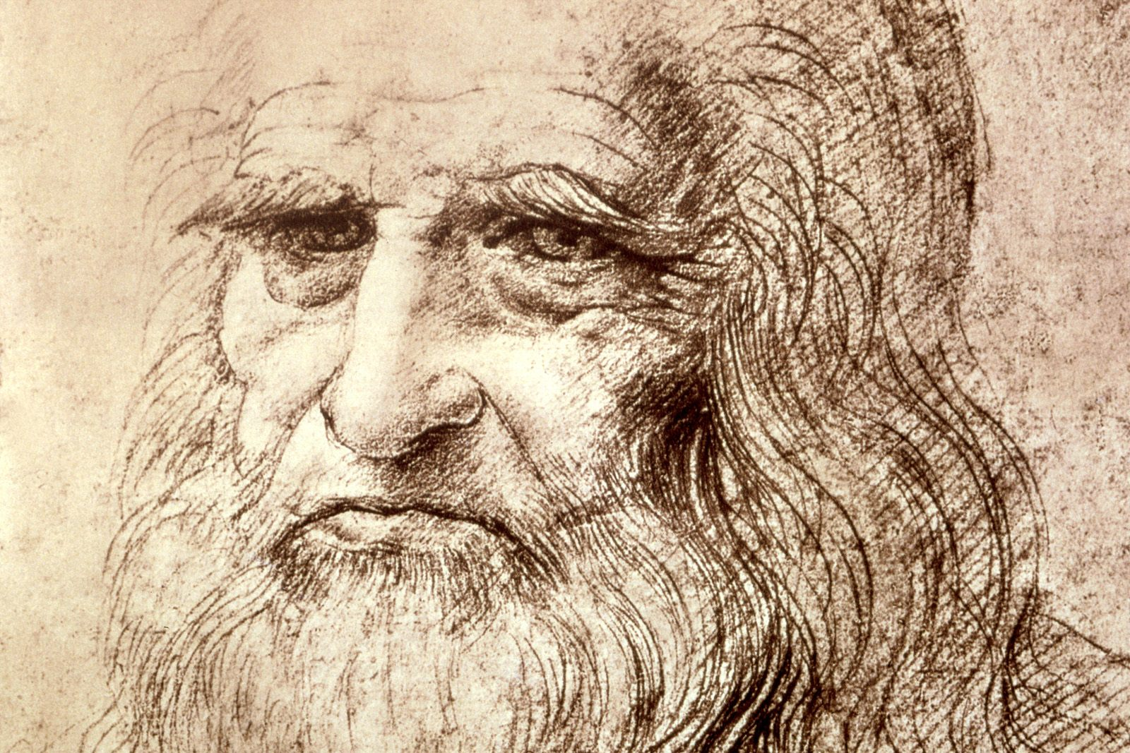


Traditional Allocation
I can handle that …
Who does it better?
?
TASKS
AVIATE
NAVIGATE
COMMUNICATE
MANAGE TASKS
MANAGE SYSTEMS

Slide 10
Traditional Allocation
Say … who handles the gaps?
Who does it better?
?
TASKS
AVIATE
NAVIGATE
COMMUNICATE
MANAGE TASKS
MANAGE SYSTEMS

Slide 11

Making the most of your human
Human Limitations
Memory
  Declarative
  Retrospective
  Prospective
  Procedural
Computation
Vigilance
Endurance
Distractible
Standardization
Personality
Culture/Language
Moods
Complacency
Skill-Rule-Knowledge Errors
Human Strengths
Creative
Adaptive
Goal Driven
Multipurpose
Multimodal
Teachable
Efficient
Empathetic
Intuition
Will-to-Live
Automaticity
Requires no new technology
Human Needs
Meaning
Engagement
Social
Goals
Trust
Rest/Recreation

Slide 12
Complemation
Targeted Automation Support
Micro-task
Assign tasks specifically to human’s role
Assign automation to remaining tasks
Individually target task assignments for human
    Strengths & Limitations
Apply Fluid Automation

Slide 13
FLUID AUTOMATION
Default automation
  Best it can do
  Safety net
Human Complemation added
  Human starts in ‘normal’ position
  Synergy (Whole > Human + Automation)
  Automation and human performance improved
When unexpected events happen
Human moves to cover
Automation backfills (flows in)
  Minimal level of safety and performance
  Predictable and reliable behavior

Slide 14
Summary
Stop assuming humans can be trained to be immune to problems with:
  Memory – Complacency
  Vigilance – Standardization
  Computation –Attention
Understand exactly what you want the human there to do
  Don’t forget “Handle Exceptions” unless they will not be called on to do so
Use automation to ‘surgically’ target human weaknesses
Use automation to ‘surgically’ enhance human capabilities
Consider ‘soft’ criteria when designing and allocating
  Meaning – Engagement
  Social needs – Trust
Use fluid automation to allow the human to be adaptable

