Slide 1

Introduction to Digital Signal Processing (DSP)
Part 1 of 4 (“Mathematical Concepts”)
James R. (Jim) Beaty, PhD - NASA Langley Research Center
Vehicle Analysis Branch, Systems Analysis & Concepts Directorate
Bldg 1209, Room 128B, M/S 451
1 North Dryden Street
Hampton, VA 23681
757-864-1322
James.R.Beaty@nasa.gov

Slide 2
Overview
Part 1, “Mathematical Concepts”
  Definitions, mathematical pre-requisites, and application techniques
    Fourier transforms and convolution
    Discrete Fourier transforms (DFT) and Fast Fourier transforms (FFT)
    Shannon Sampling Theorem and data aliasing
Part 2, “Power Spectral Density Basics”
      Power Spectral Density (PSD) to estimate spectral characteristics of waveforms
      PSD Demonstration
Part 3 “Implementing Discrete Filters”
  Converting from continuous Laplace domain filters to discrete Z-domain filters (Tustin’s rule, or bilinear transformation)
  Recursive filter implementations for discrete filters
Part 4 “Typical GN&C Applications”
  Normalized frequency
  Methods to verify transfer function magnitude/phase of discrete filters using DFT (or FFT)
  Example use of discrete filter to implement a notch filter

Slide 3
Definition of Fourier Transform
For continuous functions of time, f(t), the Fourier transform, F(ω) (and its inverse, or the synthesis equation) are usually defined as:
Note that some use the following alternate definition of the continuous Fourier transform with the √2π applied only to the synthesis equation:
These are equivalent, but care should be exercised when using Fourier transforms so it is clear which form is used
Pay particular attention to the second form: the “synthesis” equation on the right (converts frequency domain back to time domain) contains a scaling of 2π, which will affect the discrete Fourier transform to follow later (it will have similar scaling factors applied to the synthesis equation)

Slide 4
Fourier Transform Example
For example, if f(t) = cos(at), the Fourier transform of f(t) is
where δ is the dirac delta function, defined such that δ(x) is zero for all x, except x = 0, and has a value at x = 0 sufficiently large such that its integral from -∞ to +∞ has a value of 1
This Fourier transform, F(ω) produces a waveform that looks like:
Therefore, the Fourier transform of f(t) = cos(at) produces single spikes at ω = ±a, which is useful for identifying and extracting frequency content of signals
F(ω)
ω = -a
ω = +a
ω

Slide 5
Linearity Property of Fourier Transform
Now, if f(t) is composed of many sinusoids, the linearity property of the Fourier transform requires that the Fourier transform of f(t) will have discrete non-zero spikes at each distinct frequency of those sinusoids.
This is the essential property of Fourier analysis that is key to signal processing. For example, if ʄ { } represents the Fourier transform shown earlier, then
  Linearity property of Fourier transforms:
  ʄ { a · f(t) + b · g(t) } ⬄ a · F(ω) + b · G(ω)
  Convolution property of Fourier transforms (* denotes convolution, • denotes ordinary multiplication):
  ʄ { f(t) * g(t) } ⬄ √2π · [ F(w) · G(w) ]
  Multiplication property of Fourier transforms:
  ʄ { f(t) · g(t) } ⬄ 1/(√2π) · [ F(w) * G(w) ]
  That is, multiplication in the time domain is convolution in the frequency domain, and vice-versa

Slide 6
Convolution - Definition
Convolution is a mathematical operator, acting on two functions, which computes the integral of the product of the two functions where one is reversed and shifted in its independent variable
  Note that the asterisk (*) is typically used to denote convolution
  The range of integration, τ = a to b, depends on the domain over which the functions f and g are defined
Discrete convolution of sequences of “N” samples of functions f and g is computed by:

Slide 7
Convolution - Uses
Typically, in signal processing applications, one of the functions in a convolution is a filter’s impulse response, (also known as the filter kernel), and the other function is some signal to be processed, or conditioned, by that filter
Convolution can also be used to multiply two polynomials
  For example, if p(x) and q(x) are polynomials in x
  p(x) = p₀ + p₁ x + p₂ x² + ... + p_{n} x^{n}
  q(x) = q₀ + q₁ x + q₂ x² + ... + q_{m} x^{m}
  If one wishes to compute r(x) = p(x) · q(x), where “·” denotes simple multiplication, then
  r(x) = p * q = r₀ + r₁ x + r₂ x² + ... + r_{m+n} x^{m+n}
  The coefficients of x^{n} in the r(x) polynomial can be computed with the Matlab convolution function, “conv” :
  p = [ p₀ p₁ p₂ ... p_{n} ];
  q = [ q₀ q₁ q₂ ... p_{m} ];
  r = conv( p , q ); → r = [ r₀ r₁ ... r_{m+n} ] , length of r is 1+m+n

Slide 8
Convolution - Properties
Properties of convolution:
  Commutative
    f (t) * g(t) = g(t) * f(t)
  Associative
    f (t) * ( g(t) * h(t) ) = ( f(t) * g(t) ) * h(t)
  Distributive
    f (t) * ( g(t) + h(t) ) = ( f(t) * g(t) ) + ( f(t) * h(t) )
  Linearity
    k ( f(t) * g(t) ) = ( k f(t) ) * g(t) = f(t) * ( k g(t) )
  Convolution theorem
    ʄ { f(t) * g(t) } = ʄ { f(t) } · ʄ { g(t) } , where ʄ{} is the Fourier transform operator
The convolution theorem is key to digital signal processing. It states that the inverse Fourier transform ( ʄ ⁻¹) of the product of the Fourier transforms of f and g is proportional to the convolution of f and g:
    f (t) * g(t) = k ʄ ⁻¹ { ʄ { f(t) } · ʄ { g(t) } } , where k is some constant
That is, the convolution operation can be replaced with two Fourier transforms, a multiplication of these, and an inverse Fourier transform

Slide 9
Convolution – Computing It
Methods of computing convolution:
  “Brute force” involves performing the summation shown a few slides ago
    Many signal processing applications may require large sequences of numbers to be processed (N=1024, 2048, 4096, etc)
    This straight forward method may take a long time to compute
  More numerically efficient algorithms have been developed, such as the Fast Fourier Transform (FFT)
    Can increase the time required to perform the convolution to the order of N log(N), where N is the number of samples in the sequence
    But, the key point is that an FFT is another algorithm, or technique for performing convolution, NOT a different mathematical concept
  Can also compute as inverse DFT of product of DFTs of f(t) and g(t)

Slide 10
Real Discrete Fourier Transform
A discrete sample of values from the real periodic† function, F(t), sampled at regular intervals produces a sequence of time samples, f(n), n = 1, 2, 3, ..., N
The real discrete Fourier transform (DFT) produces N/2+1 coefficients, X_{k}, (k=0,...,N/2) of the sequence of N samples, x_{n}, (n = 0,...,N-1) of f(t). The real DFT (X_{k}) and is inverse (x_{n}) are defined as:
The DFT of a discrete sequence of samples from a periodic function is the discrete domain equivalent of the continuous Fourier transform of continuous signals
Note the factor of 1/N on the synthesis equation to the right…it is equivalent to the 1/(2π) factor in the synthesis equation of the second form of the continuous Fourier transform presented earlier
† Note: the function F(t) must be periodic with period “N” samples, and N must be power of 2
(e.g. – F(t) = F(t ± kN) for all integer k)

Slide 11
DFT: Real & Imaginary Form
Because of Euler’s identity, e^{-jθ} = cosθ –j sinθ, the coefficients of the DFT, X_{k}, can be (and usually are!) separated into their real and complex parts, Re{ X_{k} } and Im{ X_{k} } (or alternately, in polar form, the magnitude and phase):
The “scaled” DFT coefficients in the synthesis equation apply the 1/N scaling seen on the previous page (equivalent to 1/(2π) factor in continuous Fourier transform)

Slide 12
DFT: Mag / Phase Form
The real and complex parts of a DFT, Re{ X_{k} } and Im{ X_{k} }, can be converted to their polar forms, the magnitude, M{ X_{k} }, and phase, φ { X_{k} }, and vice-versa
Recall that at the ends of the sequence of 0 … N/2 samples (k=0 & k=N/2), the imaginary parts are always 0, so that
  M{0} = Re{0} , M{N/2} = Re{N/2} and
  φ{0} = φ{N/2} = 0

Slide 13
Interpretation of Re / Im part of DFT
A few comments about the real DFT presented on the previous slide:
  The Re{ X_{k} } and Im{ X_{k} } are the amplitudes of cosine and sine basis functions, cos( 2π k/N ) and sin( 2π k/N ), respectively, that complete “k” cycles in N samples, where k = 0,1,...,N/2
  That is, the real DFT decomposes ( or correlates ) the input signal into a series of N/2+1 sine and cosine functions
  Recall that the input signal, x(t), is assumed to be periodic in N samples
  As a result of this, the real DFT produces sinusoids with frequencies up to the “Nyquist frequency”, which is half the sample frequency
  A note about the values of Re{X_{k}} and Im{X_{k}} at the sequence endpoints (k = 0 & k = N/2)
    at k = 0, Re{X_{k}} is amplitude of a cosine function that makes 0 cycles in N samples; that is, it contains the mean value of the input signal
    at k = 0 and k = N/2, Im{X_{k}} is ALWAYS = 0, and does not contribute to the synthesis of the time domain signal, when the inverse DFT is used

Slide 14
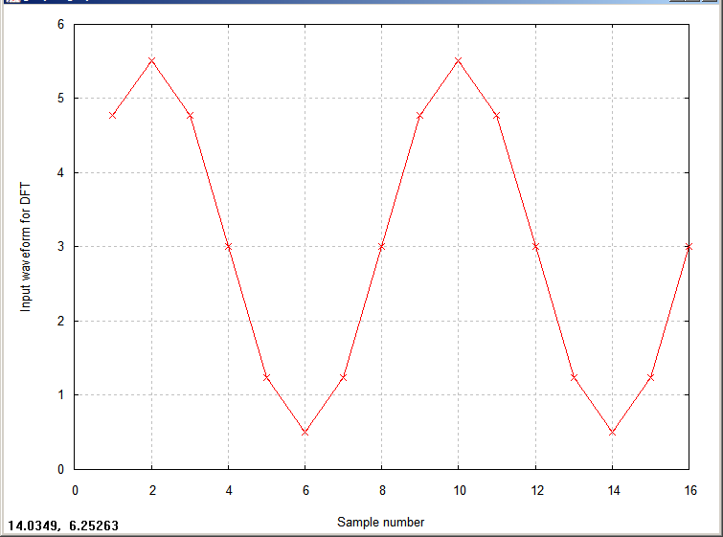
Example of Real DFT
Consider a 16 sample waveform, composed of a 2.5 unit amplitude sine function completing two cycles in its 16 samples, with a constant bias of 3 units:
  amp = 2.5 (units) , bias = 3.0 (units) ,
  f = 2 cycles in N = 16 samples ( 8 samples/cycle )
  x_{i} = bias + amp * sin( 2π * f * i / N ) , i = 1, 2, ... , N
Compute the 16-point real DFT of x in rectangular { Re , Im } form:
  [ Re , Im , freq ] = dft_fft( x , 16 , 0 );
Compute the 16-point real DFT of x in polar { mag , phase } form:
  [ mag , phase , freq ] = dft_fft( x , 16 , 1 );
8 samples per cycle
const bias = 3

Slide 15
Example of Real DFT
This simple waveform has only 2 places where x_{k} is non-zero:
  k=0 (the constant bias, which occurs at d.c. or zero frequency), and
  k = 2 (the constant cosine component with amplitude of 2.5 at normalized basis frequency of 1/8 = 2cycles / 16samples )
The magnitude of the DFT coefficients at k=0 and 2 are (Note the scaling factors N and N/2):
  M{0} = N * x(0) = 16 * 3 = 48
  M{2} = (N/2) * x(2) = 8 * 2.5 = 20
The imaginary part of the DFT coefficient at k = 0 ( Im { x₀ } ) is always zero, so the Re{ x₀ } = M{ x₀ } = 48
The real and imaginary parts of the DFT coefficients at k = 2 are equal, but opposite, so that the phase is 45°, and sin45° = cos45° = √2 / 2
  Re{ x₂ } = -Im{ x₂ } = M{ x₂ } * √2 / 2 = 14.1421
8 samples per cycle
const bias = 3

Slide 16
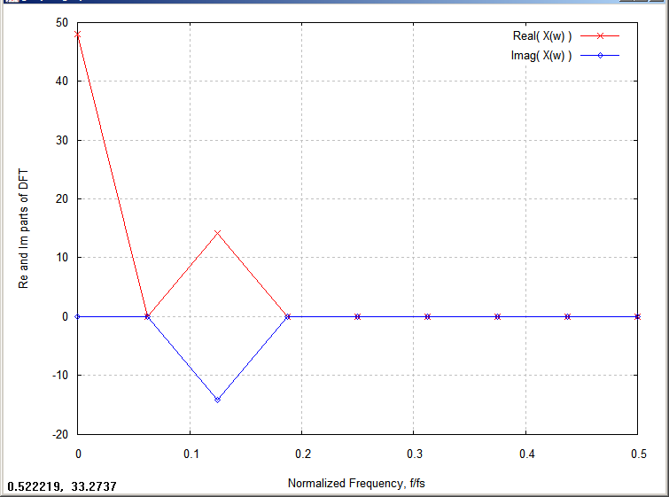
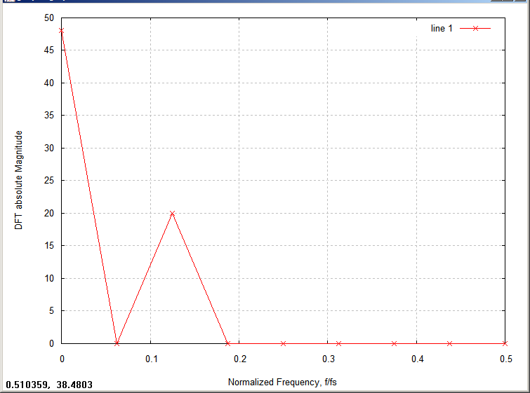
Plot of DFT Re/Im and Mag
The only non-zero values of the samples are at:
  k = 0 (const bias value )
  k = 1/8 (2 cycles for 16 samples, or 1 cycle per 8 samples )
Magnitude part of DFT ( polar form) converted from dB to absolute magnitude
Real & Imaginary parts of DFT ( rectangular form)
Re{ x₀ } = 48
Im{ x₀ } = 0
M{ x₀ } = 48
Mag
f_{n} = 0.125
f_{n} = 0.125
M{ x₂ } = 20
Re{ x₂ } = 20 * cos45°
Im{ x₂ } = -20 * sin45°

Slide 17
Complex Discrete Fourier Transform
A few comments about the real DFT just presented:
  Note that there is a complex Discrete Fourier Transform, which is a generalization of the real DFT
  The complex discrete Fourier transform (DFT) produces N coefficients, X_{k}, (k=0,...,N-1) of the sequence of N samples, x_{n}, (n = 0,...,N-1) of f(t), whereas the real DFT produces N/2+1 coefficients
  The complex DFT and its inverse are defined as:
  The complex DFT forms the mathematical basis for “Laplace transforms” and “Z-transforms”
  For most of our signal processing tasks, the real DFT is adequate

Slide 18
DFT – Requires Periodicity of input sequence
As a consequence of the requirement that the input sequence for a DFT must be samples from a periodic function, F(t), sampled at regular intervals, DFT does have limitations. Namely:
  The DFT can only be represented for periodic signals, or finite duration signals
  The inverse DFT cannot reproduce the entire time domain signal for non-periodic functions
But, fortunately, many of the waveforms that we are interested in are indeed periodic, or we are only interested in a finite length sequence of samples, so DFTs are an important signal processing tool

Slide 19
Fast Fourier Transform Algorithm
As mentioned earlier, the Fast Fourier Transform, or FFT, is a numerically efficient algorithm for computing the discrete Fourier transform, or DFT
  FFT is NOT another mathematical concept, but a specific implementation method to compute DFTs efficiently
  FFT can increase the speed of computing DFTs by order N log(N), where N is the number of samples of the signal being transformed
  Many analysis packages, such as Matlab or Octave, include built in FFT functions
In Part 2 of this presentation “Power Spectral Density Basics”, we will discuss the Power Spectral Density techniques for analyzing spectral content of data, and will contrast it with the processing technique called the FFT which is used for more efficient calculations of DFTs needed for PSD analysis

Slide 20
Shannon Sampling Theorem & Data Aliasing
Shannon sampling theorem (paraphrased)
  If a continuous signal is sampled at a frequency at least twice the frequency of the signal’s highest frequency content, the digitized samples can be used to completely reconstruct the original continuous signal
    That is, if the signal being sampled contains no frequencies above the Nyquist frequency (half the sample frequency), its frequency content is preserved so that inverse DFT can be used to re-construct the original continuous signal
    If the signal being sampled DOES contain frequencies above the Nyquist frequency, the frequency content of the signal above the Nyquist frequency will be “aliased”, or wrapped down into the lower frequency range (0 to 0.5 normalized frequency, f/fs) as if a lower frequency content was present (and its power at that fictitious frequency will combine with any “real” signal content at that frequency)
  Usually sampled data systems use “anti-aliasing” low pass filters to attenuate any signal above the Nyquist frequency so that anti-aliasing cannot occur

Slide 21
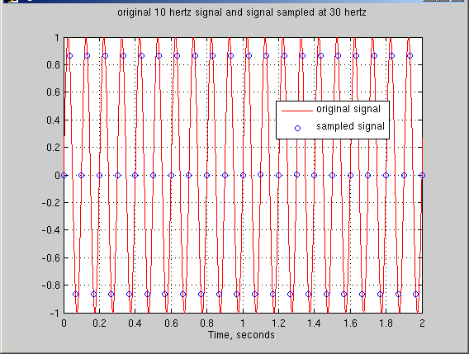
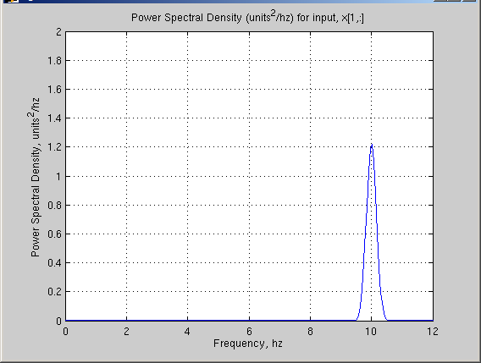
Example of Sampling & Data Aliasing
Consider a sinusoidal waveform with 10 hz frequency content
  To avoid aliasing, the signal must be sampled at sample frequency of at least 20 hz
  Sample the signal at 30, 22, 18, and 12 hz and see what happens:
    at fs = 30hz, (f/fs) = 0.33, which is less than 0.5, so sampling is correct
    area under the PSD curve is ½ * 1.2 units²/hz * (10.42 – 9.58) hz ≈ 0.50 → RMS = 1/sqrt(2)
10 hz analog signal and 30 hz samples:
PSD of 30 hz samples:
PSD shows single frequency
content at 10hz

Slide 22
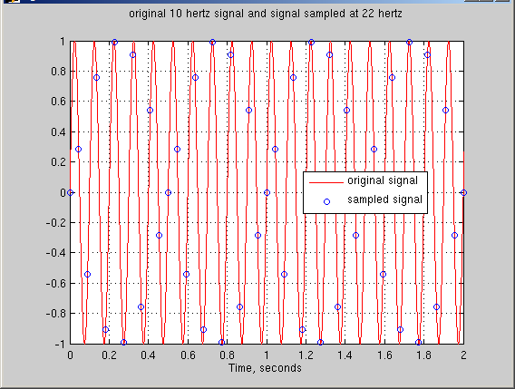
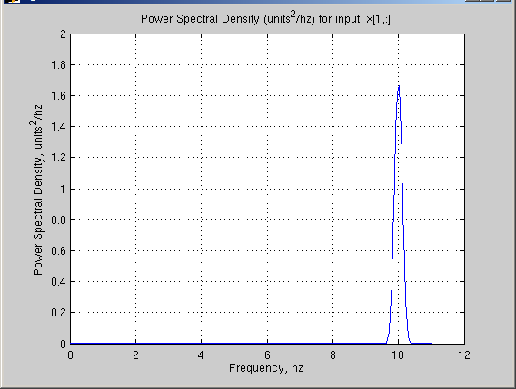
Example of Sampling & Data Aliasing
Consider a sinusoidal waveform with 10 hz frequency content
  Now, sample the signal at 22 hz and see what happens:
    at fs = 22 hz, (f/fs) = 0.45 which is less than 0.5, so sampling is correct
    area under the PSD curve is ½ * 1.65 units²/hz * (10.35 – 9.68) hz ≈ 0.50 → RMS = 1/sqrt(2)
10 hz analog signal and 22 hz samples:
PSD of 22 hz samples:
PSD shows single frequency
content at 10hz

Slide 23
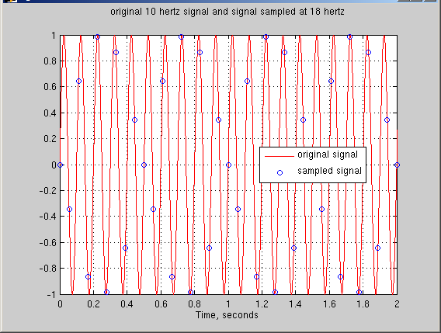
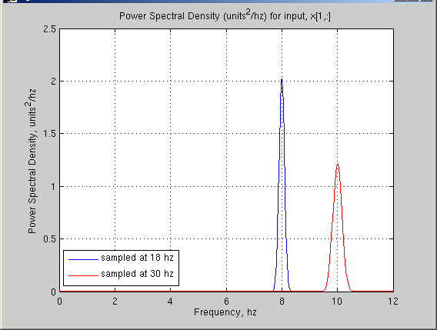
Example of Sampling & Data Aliasing
Consider a sinusoidal waveform with 10 hz frequency content
  Now, sample the signal at 18 hz and see what happens:
    at 18 hz, the frequency ratio (f/fs) = 0.555 → wraps around to (f/fs) = 1 – 0.555, f = 8 hz
    area under the PSD curve is ½ * 1.65 units²/hz * (10.40 – 9.55) hz ≈ 0.50 → RMS = 1/sqrt(2)
10 hz analog signal and 18 hz samples:
PSD of 18 hz samples:
PSD shows single frequency
content at 8hz
2hz shift
incorrect
18 hz sampling
correct

Slide 24
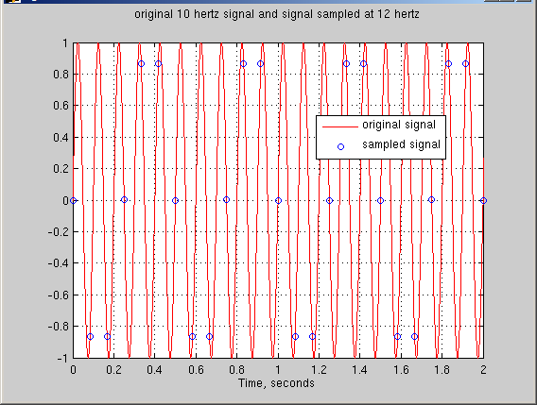
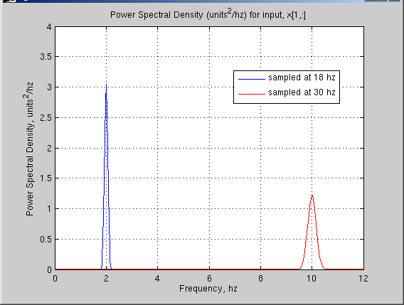
Example of Sampling & Data Aliasing
Consider a sinusoidal waveform with 10 hz frequency content
  Now, sample the signal at 12 hz and see what happens:
    at 12 hz, the frequency ratio (f/fs) = 0.833 → wraps around to (f/fs) = 1 - 0.833 f = 2 hz
    area under the PSD curve is ½ * 3.0 units²/hz * (2.15 – 1.83) hz ≈ 0.50 → RMS = 1/sqrt(2)
10 hz analog signal and 12 hz samples:
PSD of 12 hz samples:
incorrect
12 hz sampling
8hz shift
correct

Slide 25
Introduction to DSP, Part 1 of 4
Summary
In Part 1, “Mathematical Concepts” we have covered the following:
  Definitions, mathematical pre-requisites, and application techniques
    Fourier transforms and convolution
    Discrete Fourier transforms (DFT) and Fast Fourier transforms (FFT)
    Shannon Sampling Theorem and data aliasing
In Part 2, “Power Spectral Density Basics”, we will cover the following:
      Power Spectral Density (PSD) to estimate spectral characteristics of waveforms
      PSD Demonstration
In Part 3 “Implementing Discrete Filters” we will cover the following:
  Converting from continuous Laplace domain filters to discrete Z-domain filters (Tustin’s rule, or bilinear transformation)
  Recursive filter implementations for discrete filters
In Part 4 “Typical GN&C Applications” we will cover the following:
  Normalized frequency
  Methods to verify transfer function magnitude/phase of discrete filters using DFT (or FFT)
  Example use of discrete filter to implement a notch filter

