Slide 1

Introduction to Digital Signal Processing (DSP)
Part 2 of 4 (“Power Spectral Density Basics”)
James R. (Jim) Beaty, PhD - NASA Langley Research Center
Vehicle Analysis Branch, Systems Analysis & Concepts Directorate
Bldg 1209, Room 128B, M/S 451
1 North Dryden Street
Hampton, VA 23681
757-864-1322
James.R.Beaty@nasa.gov

Slide 2
Overview
Part 1, “Mathematical Concepts”
  Definitions, mathematical pre-requisites, and application techniques
    Fourier transforms and convolution
    Discrete Fourier transforms (DFT) and Fast Fourier transforms (FFT)
    Shannon Sampling Theorem and data aliasing
Part 2, “Power Spectral Density Basics”
      Power Spectral Density (PSD) to estimate spectral characteristics of waveforms
      PSD Demonstration
Part 3 “Implementing Discrete Filters”
  Converting from continuous Laplace domain filters to discrete Z-domain filters (Tustin’s rule, or bilinear transformation)
  Recursive filter implementations for discrete filters
Part 4 “Typical GN&C Applications”
  Normalized frequency
  Methods to verify transfer function magnitude/phase of discrete filters using DFT (or FFT)
  Example use of discrete filter to implement a notch filter

Slide 3
Power Spectral Density (PSD)
Power spectral density, or PSD, is a technique for estimating the spectral (i.e. – frequency) content of signal waveforms
PSDs use FFTs to compute the discrete Fourier transforms (DFTs) of the input signal to extract its frequency content
PSD is useful for evaluating periodic content of signals from some device (e.g. – sensors) to characterize for modeling or requirements compliance
PSD represents the density of the signal squared magnitude at a particular frequency, e.g. – units^2 per hertz
  The integral of a signal’s PSD provides the signal’s mean square value
  Nonzero mean signals are usually “detrended” (e.g. – remove the mean value) before computing the PSD

Slide 4
DFT size and sampling
Before continuing with the PSD discussion, provide a few comments about characteristics of DFT size, sampling, and windowing on the calculation of the DFT used in PSD analysis
The DFT size used in computing PSDs affects the resolution of the calculation of the spectral content of the data
  Larger DFT sizes increase the resolution of the calculations
  Higher resolution can introduce some unexpected results (more to follow on this)
The placement of spectral content in the sampled data with respect to the DFT “basis frequencies” can affect the output DFT calculation (more to follow on this)
The use of “windows” in the calculation of the DFT can eliminate some of these issues that will be discussed

Slide 5
DFT “basis frequencies”
“Basis frequencies” of a DFT refer to the specific sinusoids used to in the calculation of the DFT that extract the spectral content of the sequence being analyzed
Basis frequencies (ƭ = (f/f_{s}) ) are normalized to the sample frequency of the sequence, f_{s},
Basis frequencies of N-sample DFT occur at integer multiples of 1/N, since the sine functions used in the DFT use 2πk/N frequencies, k = 0, … , N/2
  For example, 256 point DFT basis frequencies are multiples of 1/256 = 0.003906 normalized frequency
  If sampled sequence x[n] contains frequencies at frequencies not aligned with a basis frequency, the spectral energy at that frequency is spread among adjacent basis frequencies

Slide 6
FFT Size Example
Consider 256 point sample of the sequence from a single sinusoid:
x[n] = sin( 2π*f*[0:255])
  where f = 0.19922 ( specific frequency selected to match a basis frequency, = 51/256 )
  With this single basis frequency in the spectrum of the sequence x[n], DFT should produce single spike at f = 0.19922 normalized frequency
First, compute 256 point DFT of x[n] to demonstrate the alignment with the basis frequency at 0.19922
Then, compute DFTs of x[n] with sizes of 512 and 4096 and compare magnitude versus frequency with 256 point DFT

Slide 7
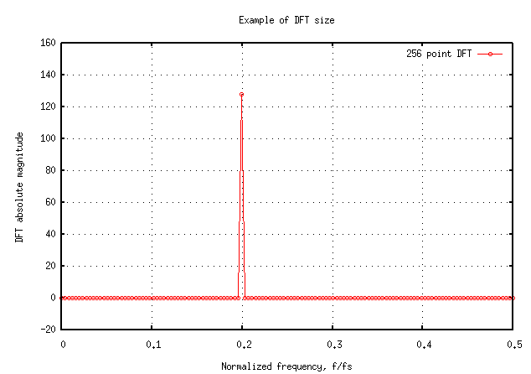
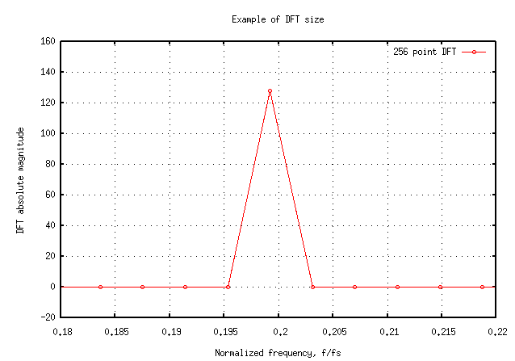
Plot of DFT Magnitude for DFT size of 256
DFT magnitude versus normalized frequency (full range 0 to 0.5)
Expand around single non-zero magnitude (normalized frequency = 0.19922)
0.19922
Note single non-zero point
in the DFT at 0.19922
normalized frequency, and
its amplitude is 128 ( = N/2 )

Slide 8
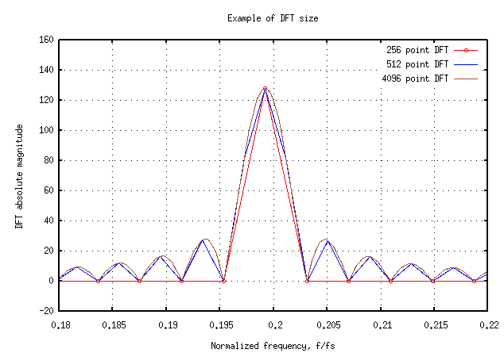
Plot of DFT Magnitude for DFT sizes of 256, 512, 4096
What causes the “side lobes” in the larger size DFTs?
  x[n] is 256 point sample of an infinitely long sinusoid sequence
  Sampling of x[n] is equivalent to the convolution of input sinusoid x(t) with rectangular waveform y[k] with value of 1 for k=0 to 255 and zero for k > 255
  DFT of rectangular pulse is sinc function ( sin(x) / x )
    Rectangular pulse in time domain transforms to sinc function in frequency domain
    Sinc function in time domain transforms to rectangular function in frequency domain
  DFT of sampled x[n] is product of sinc function and DFT of sinusoid sequence
  Results in sinc function centered about the input frequency of the sinusoid sequence, x[n], at 0.19922 frequency

Slide 9
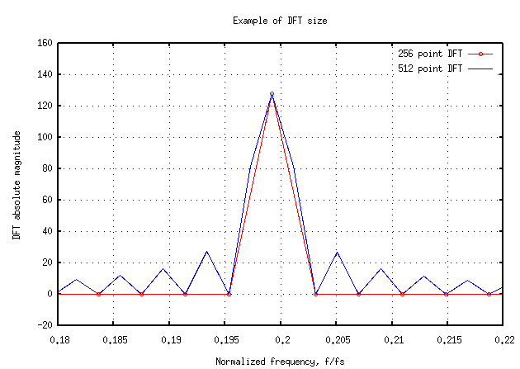
Plot of DFT Magnitude for DFT sizes of 256 and 512
Why aren’t the “side lobes” seen in the 256 point DFT?
  256 point DFT lacks the resolution necessary to display them
    It only has data at the basis frequencies of the DFT, where the calculation is zero except at the peak of the sinc function
    It only samples the parts of the sinc function that cross through zero in addition to the single peak at center of the sinc function (Note the plot symbols on the red line in the plot on right)
  Comparison of 512 point DFT with the 256 point DFT is shown at right
    Note that the extra resolution of the 512 point DFT captures some additional non-zero parts of the sinc function

Slide 10
DFT and “basis frequencies”
In the example just presented, the 0.19922 normalized frequency of the input sinusoid sequence, x[n], was carefully chosen to align exactly with one of the basis frequencies of the DFT which occur at integer multiples of 1/256 for a 256 point DFT
What happens if the input sequence is not so carefully contrived?
For this second example, change the normalized frequency of the input sequence from 0.19922 to 0.2, again using 256 point samples and a 256 point DFT
That is: x[n] = sin( 2π*0.2 * [0:255] ) , n = 0 , … , 255

Slide 11
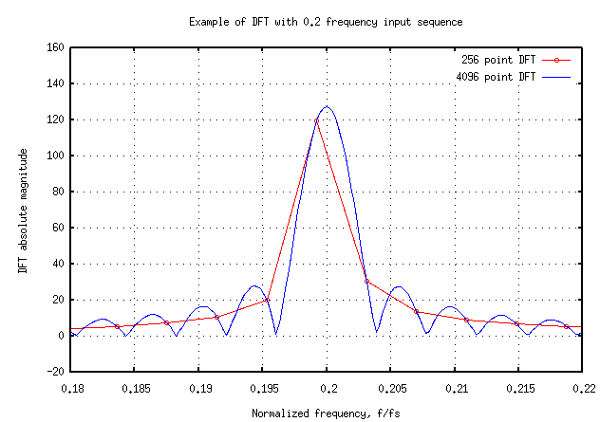
Spectral Leakage of DFT
Now, notice the 256 point DFT is not a single non-zero peak at the input sequence frequency of 0.2, but has extended “tails” around it
What is the cause of these “tails”?
These tails are caused by what is called spectral leakage, caused by the signal strength of the sinusoid of the original signal leaking into adjacent sinusoids in the calculation of the DFT
These “tails” and the “side lobes” of the previous example, can be eliminated by using “windows” in the calculation of the DFT

Slide 12
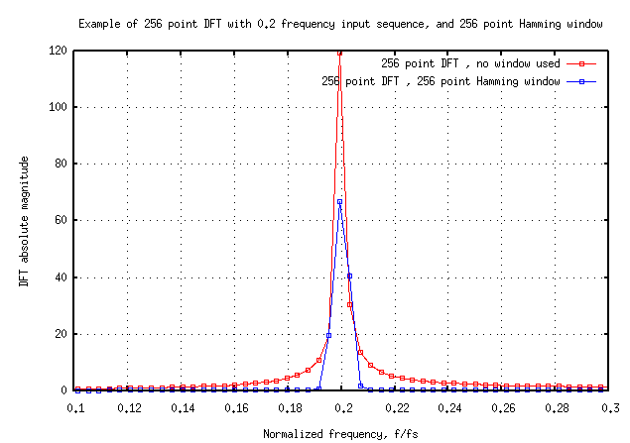
DFT Windows
For example, a Hamming window of length “m” is defined as:
w[k] = 0.54 – 0.46 cos(2π*k/(m-1) )
where k = 0 to m-1
For this example, define a 256 point Hamming window:
w = 0.54–0.46*cos(2π/255*[0:255]);
Compute 256 point DFT of the “term by term” multiplication of x[n] and w[n] (NOT convolution!)
Shown at right is 256 point DFT for x[n] alone, and windowed by the 256 point Hamming window
Note the “tails” around 0.2 frequency are removed, but amplitude is reduced

Slide 13
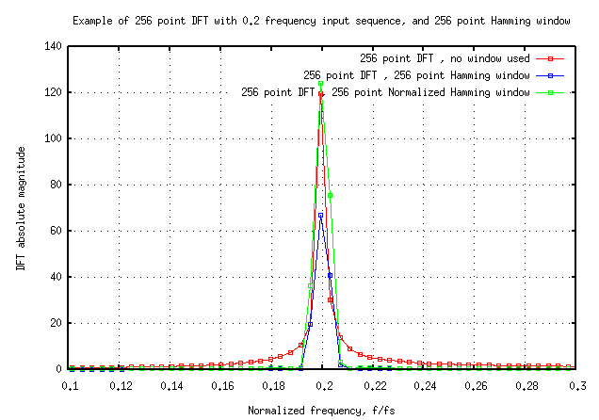
DFT Windows with Normalization
In the previous example, the use of the Hamming window removed the “tails” in the DFT, but reduced the peak amplitude at 0.2 normalized frequency
This phenomenon can be corrected by normalizing the window before using it:
  divide each of the window samples by the sum of all samples divided by the number of samples
  e.g. – w(i) = w(i)/norm, where norm = sum(w)/length(w)
  In the plot on the right, the green line is the DFT using the normalized Hamming window

Slide 14
PSD Usage
Many analysis packages, such as Matlab and Octave provide built in PSD functions, however, their use requires knowledge of somewhat “unfamiliar” mathematics concepts:
  windowing methods (covered briefly in the preceding slides)
    Hamming, Hanning, Blackman, rectangular, others
  normalized frequencies
    Nyquist frequency, sampling frequency
  overlapping, detrending, etc.
  Periodiograms
  How to “scale” the outputs to something meaningful for the particular signal being analyzed
For help with Matlab or Octave PSD function, type “help psd” at the command prompt

Slide 15
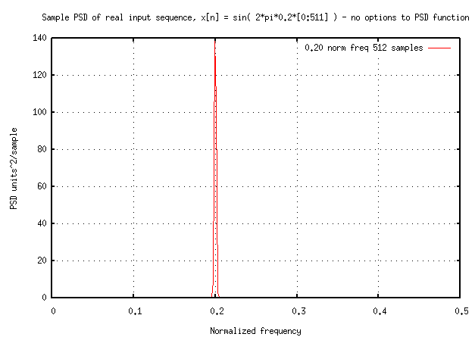
PSD Demonstration
create a real 512-point 0.2 normalized frequency sinusoid sequence, x[n]
x = sin(2*pi*0.2*[0:511]);
call the psd function for real, x[n]
and all default inputs and no outputs
psd(x);
  Note that if no outputs are specified, a plot of the PSD of x[n] is presented
  Can also save output PSD and frequency arrays as:
  [pxx, freq]=psd(x);
Note frequency 0 to 0.5 for real x[n]
  normalized frequency of 0.5 is Nyquist frequency ( ½ the sample frequency)

Slide 16
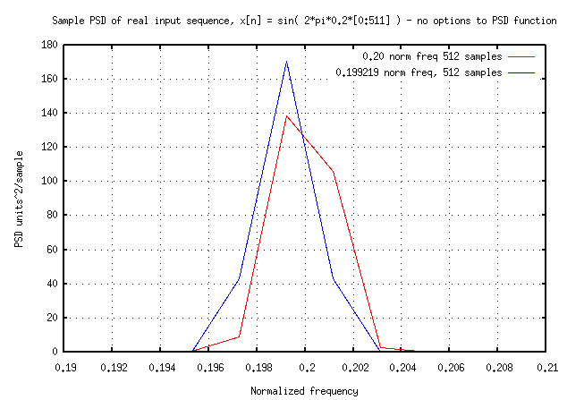
“Basis Frequencies” of DFT
Re-scale PSD around normalized frequency of 0.2 (red line)
Note asymmetry, because 0.2 is not a “basis frequency” for 512 point DFT of sequence, x[n]
  Basis frequencies proportional to 1/512
  Repeat, with frequency 0.2 changed to 0.19922
  ( → 0.19922 is 102/512 )
  All “energy” of 0.19922 normalized frequency sinusoid occurs at single DFT frequency
  Now, note that PSD is symmetric about 0.19922 normalized frequency (blue line)
sqrt(Area under PSD curve) = RMS value of x[n]:
  Actual for sin( 2π f_{n} * [0:511]) is 1/√2 = .707
  sqrt(sum(pxx)*freq(end)/(length(pxx)-1) ) = 0.707106781186889

Slide 17
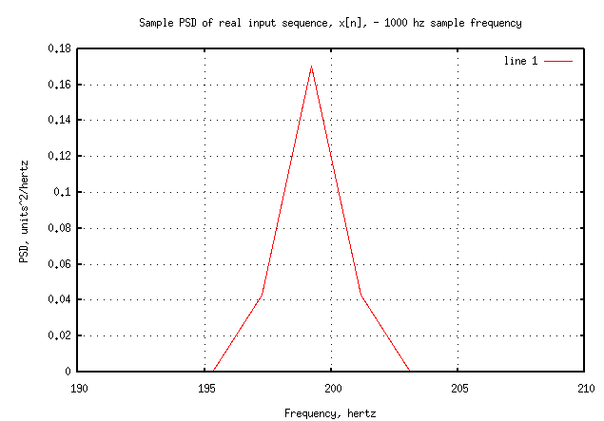
Normalized frequency vs. sample frequency
If sample frequency is not provided to the psd function, the frequency array output is normalized frequency ( actual frequency divided by Nyquist frequency, or ½ the sample frequency , where psd assumes sample frequency of 1, if not provided)
  Frequency range of PSD for a real x[n] is 0 to 0.5
  Frequency range of PSD for complex x[n] is 0 to 1.0 ( 0.5 to 1.0 represents negative frequencies: two sided PSD )
If sample frequency is provided to psd function, the frequency array output is units of hertz
Shown to right is same PSD as on previous slide, with sample frequency of 1000 hz provided
  [ pxx , freq ] = psd( x , [] , 1000 );
  Note horizontal axis now in hertz
  Note amplitude of PSD 1/1000 of before &
  units^2/hz, not units^2/sample

Slide 18
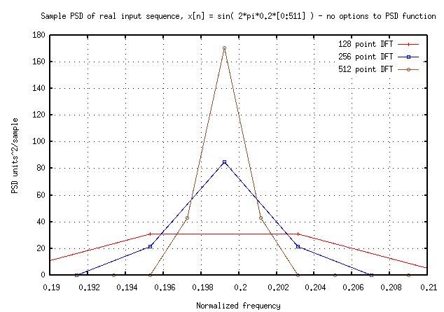
Magnitude of PSD peak
Peak magnitude of the PSD is dependent on the size of the DFT
  If not specified, psd function uses DFT size equal to the number of samples of x[n]
  Smaller DFT sizes result in smaller PSD peak
  Larger DFT sizes result in larger PSD peak
  All will give the same integrated area under the PSD, since the RMS of the input sequence, x[n], is the same
  Shown at right are PSD’s for 128, 256, 512 point DFTs computed as:
    [ pxx1 , freq1 ] = psd( x , 128 )
    [ pxx2 , freq2 ] = psd( x , 256 )
    [ pxx3 , freq3 ] = psd( x , 512 )
The size of DFT affects the PSD peak (and the
resolution of the PSD), but not the frequency
content or computed power of the input
sequence (area under PSD curve)

Slide 19
Units of PSD
Recall that PSD stands for “power spectral density” e.g. – the density of the power spectrum of the input signal, x[n]
  Thus, the PSD contains the power (units^2) of the sequence x[n] per unit frequency
The units of the PSD is normally “units^2 per hertz”, if the sample frequency of the input sequence, x[n], is provided to the psd function
If sample frequency is not provided to PSD function, units of PSD are “units^2 / sample” as the frequency output is normalized to the Nyquist frequency

Slide 20
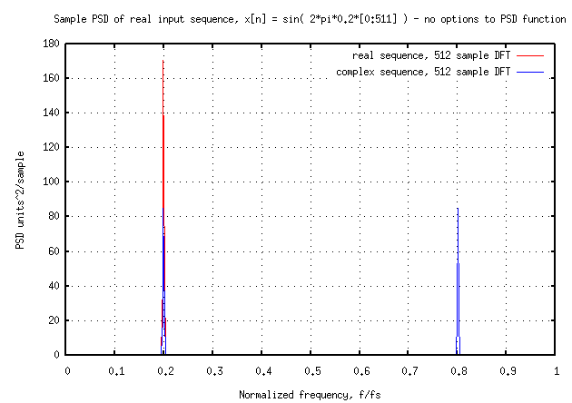
Complex sequence
(two sided PSD)
Create a complex sequence, xc[n], by adding 0.00001*i to one of the elements of the previous real sequence x[n]:
xc = x;
xc(1) = xc(1) + 0.00001*i;
call the psd function all default inputs and outputs, pxx and freq:
[pxx, freq] = psd(xc);
Plot the PSD of the complex sequence, xc[n] in blue along with the PSD of the real sequence, x[n] in red
Note that the frequency range is now 0.0 to 1.0.
  The negative frequencies are 0.5 to 1.0
    0.8 normalized frequency is same as -0.2
  Also note that the amplitude of the PSD is half that of the PSD of the real sequence, x[n] (e.g. – two-sided PSD compared with one-sided PSD)
0 to +0.5
+0.5
&
-0.5
0 to -0.5

Slide 21
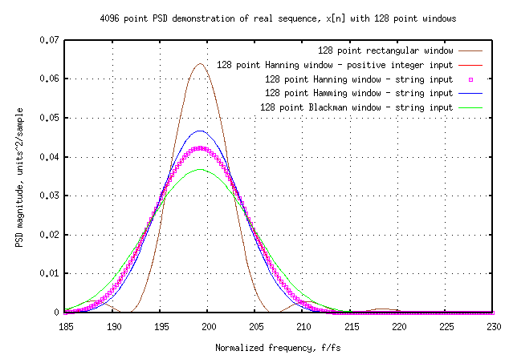
PSD Window Options
Compute 4096 point PSD of real sequence, x[n] with frequency of 199.22hz and illustrate different window options available:
  negative window size ,n = n-point rectangular window (average the n-point PSDs)
  [pxx1,freq1] = psd( x, 4096,1000,-128)
  128 point Hanning window (average 128 point PSDs) – note positive integer window input, defaults to hanning window of that length
  [pxx2,freq2] = psd( x, 4096,1000,128);
  128 point Hanning window (average 128 point PSDs) – note string window input
  [pxx3,freq3] = psd( x, 4096,1000,’hanning(128)’);
  128 point Hamming window (average 128 point PSDs) – note string window input
  [pxx4,freq4] = psd( x, 4096,1000,’hamming(128)’);
  128 point Blackman window string input – average the 128 point PSDs
  [pxx5,freq5] = psd( x, 4096,1000, 'blackman(128)' );
Frequency, hz

Slide 22
PSD as “Averaged Periodograms”
When windows are used that are smaller size than the length of the sequence, x[n] being analyzed, the PSDs are formed by averaging the individual PSDs computed from the smaller, windowed samples of the sequence
These averaged PSDs are called “averaged periodograms”

Slide 23
PSD “Detrending” & “Overlap”
“Detrending” in the calculation of a PSD refers to removing trends from the sampled data, x[n]
  Trends include:
    Non-zero mean value, or constant bias
    Linear bias
  The Matlab and Octave psd function includes a string input, “dflag” that specifies the type of detrending desired:
    ‘none’ – to perform no de-trending (this is the default action)
    ‘constant’ – to remove a constant bias , or mean value
    ‘linear’ – to remove a linear bias
“Overlap” is similar to averaging used in windows, except that a specified number of adjacent, or overlapped, values of the input sequence, x[n] are included in the individual PSDs that are computed, then averaged

Slide 24
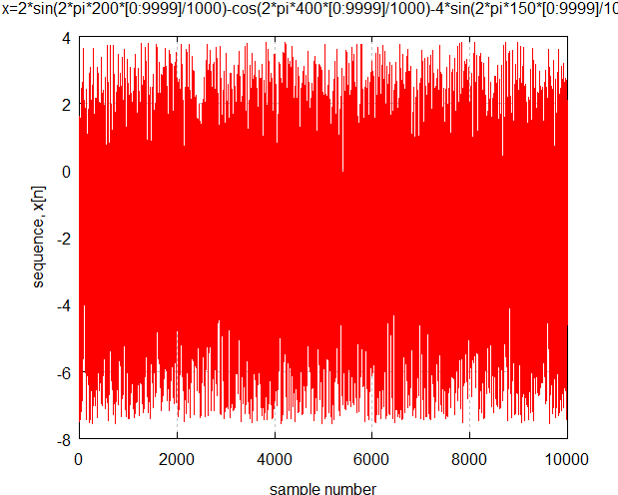
PSD Example with sequence containing multiple sinusoids, bias, and random signal
Create a 10,000 sample real sequence of several sinusoids and uniform random variable, x[n]
x = 2*sin(2π*200 * [0:9999]/1000)
-cos(2π*400 * [0:9999]/1000)
-4*sin(2π*150 * [0:9999]/1000).^2
+5*(rand(1,10000,1)-0.5);
Note that x[n] contains one term proportional to sine-squared of 150 hertz and uniformly distributed random variable between ±2.5

Slide 25
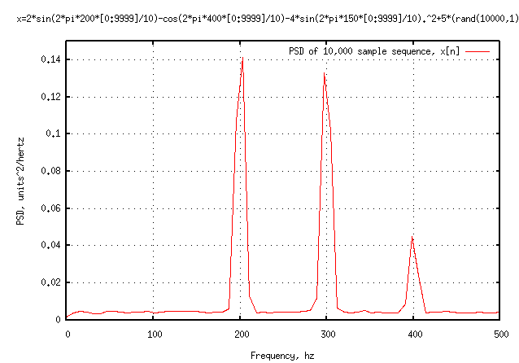
PSD Example with sequence containing multiple sinusoids, bias, and random signal
call the psd function, with the new, 10,000 point real sequence, x[n], and provide non-default values for:
FFT size = 128,
Sample Frequency = 1000,
window parameter = 128 (e.g. 128-point
Hanning window, and divides x[n] into
128-point seqments and average the
FFTs)
no overlap
'constant' detrend (removes the mean of
x[n] before computing FFTs)
[pxx,freq]=psd(x,128,1000,128,[],'constant');

Slide 26
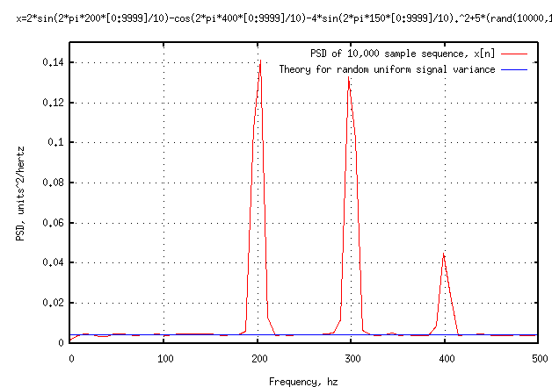
PSD Example with sequence containing multiple sinusoids, bias, and random signal
Note that the squared 150-hertz signal appears at 300 hertz, since sin²(x) = ½ (1-cos(2x))
note that the peaks at 200 and 300 hertz are the same magnitudes and about 4 times those of the peak at 400 hertz
  Is consistent with amplitudes of the input sinusoids of x[n]
the constant theoretical line for the random uniform component of x[n] is computed from the amplitude squared of the uniform random signal (5²), divided by Fs (1000), and multiplied by two (for one-sided PSD) times the theoretical 1/12 variance of a uniform signal from -0.5 to +0.5 (value = 0.00417)

Slide 27
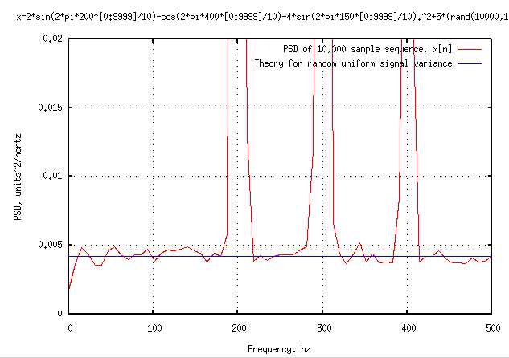
PSD Example with sequence containing multiple sinusoids, bias, and random signal
Rescale the plot to show the area around the constant theoretical line for random component of x[n]
Note that the mean value of the 10,000 point waveform, x[n], is -1.9919, its standard deviation is 2.5768 its RMS value is 3.2568
Compute the RMS value of the signal, x[n], by integrating its PSD e.g.
rms = sqrt( sum(pxx) * ( freq(end)/length(freq) )
rms = 2.5669
Note that this RMS value computed from the PSD does not include the mean value of the input signal since the mean was removed by the 'detrend' PSD argument, so this “RMS” calculation should match the standard deviation of x

Slide 28
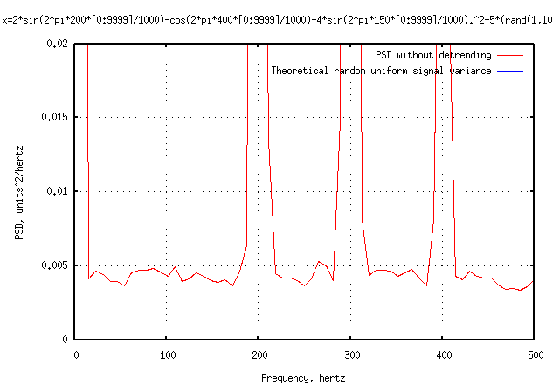
PSD Example with sequence containing multiple sinusoids, bias, and random signal
What happens if we do not supply the “detrend” input to the PSD?
Without it, the mean value of the sequence, x[n] is included in the PSD
Note that now, the PSD shows a component near zero frequency, which results from the constant bias of -2 in the sequence, x[n]
The area under the PSD at the low frequency part equals the mean value squared
Typically, a dc component of a PSD indicates that the signal being evaluated contains a non-zero mean value

Slide 29
Introduction to DSP, Part 2 of 4
Summary
In Part 1, “Mathematical Concepts” we covered the following:
  Definitions, mathematical pre-requisites, and application techniques
    Fourier transforms and convolution
    Discrete Fourier transforms (DFT) and Fast Fourier transforms (FFT)
    Shannon Sampling Theorem and data aliasing
In Part 2, “Power Spectral Density Basics”, we have covered the following:
      Power Spectral Density (PSD) to estimate spectral characteristics of waveforms
      PSD Demonstration
In Part 3 “Implementing Discrete Filters” we will cover the following:
  Converting from continuous Laplace domain filters to discrete Z-domain filters (Tustin’s rule, or bilinear transformation)
  Recursive filter implementations for discrete filters
In Part 4 “Typical GN&C Applications” we will cover the following:
  Normalized frequency
  Methods to verify transfer function magnitude/phase of discrete filters using DFT (or FFT)
  Example use of discrete filter to implement a notch filter

