Slide 1

Introduction to Digital Signal Processing (DSP)
Part 3 of 4 (“Implementing Discrete Filters”)
James R. (Jim) Beaty, PhD - NASA Langley Research Center
Vehicle Analysis Branch, Systems Analysis & Concepts Directorate
Bldg 1209, Room 128B, M/S 451
1 North Dryden Street
Hampton, VA 23681
757-864-1322
James.R.Beaty@nasa.gov

Slide 2
Overview
Part 1, “Mathematical Concepts”
  Definitions, mathematical pre-requisites, and application techniques
    Fourier transforms and convolution
    Discrete Fourier transforms (DFT) and Fast Fourier transforms (FFT)
    Shannon Sampling Theorem and data aliasing
Part 2, “Power Spectral Density Basics”
      Power Spectral Density (PSD) to estimate spectral characteristics of waveforms
      PSD Demonstration
Part 3 “Implementing Discrete Filters”
  Converting from continuous Laplace domain filters to discrete Z-domain filters (Tustin’s rule, or bilinear transformation)
  Recursive filter implementations for discrete filters
Part 4 “Typical GN&C Applications”
  Normalized frequency
  Methods to verify transfer function magnitude/phase of discrete filters using DFT (or FFT)
  Example use of discrete filter to implement a notch filter

Slide 3
Implementing Continuous or Discrete Filters
Filters are used to condition signals, either to remove unwanted content at certain frequencies or to change the stability characteristics of a control loop
Filters can be implemented as continuous filters (using Laplace transforms) or discrete filters (using Z Transforms and recursive equations)
Most modern control systems utilize digital controllers, so discrete filters are more commonly used in the GN&C applications
  But, more often the specifications of filters or stability analyses of a control loop will be performed in the continuous, or Laplace domain
  Thus, there is a need to convert between the two forms

Slide 4
Laplace Transform to Z Transform – Tustin’s rule
Tustin’s rule (or bilinear transformation) can be used for converting from continuous Laplace domain filters to discrete Z domain filters
Laplace transform and its inverse are defined as:
Z transform and its inverse are defined as:
where C denotes a counterclockwise closed path encircling the origin and entirely in the function’s region of convergence, and containing all the poles of X(z)
Z transform is a generalization of the discrete-time Fourier transform

Slide 5
Derivation of Tustin’s Rule
From the definitions of the Laplace transform and the Z transform, it can be shown that the Laplace operator, s, is related to the Z transform operator, z, by
  z = e ^{sT} or s = 1/T log_{e}(z)
  where T is the sample time of the discrete system, and log_{e} is natural logarithm
Now, since | z | < 1 (the domain of z is entirely within the unit circle around the origin), the natural log of z can be approximated by
This results in the bilinear transformation, or Tustin’s rule, for substituting s for z⁻¹ in a transfer function, G(s)
Note also that z ⁻¹ = e ^{-sT} represents a delay of one sample of a discrete sequence at T seconds per sample

Slide 6
Implementation of Continuous Filters
Consider a Laplace domain transfer function, G(s), which defines a filter with a lead frequency, ω_{l}, and a lag frequency, ω_{n}:
To implement this filter in a time-domain simulation, first break the transfer function into two parts, with the lag part first, introduce a temporary state, w, re-arrange terms, substitute the time derivative for the Laplace operator, s, and solve for the highest derivative of the output, y: E.G. –

Slide 7
First Order Continuous Domain Filter Implementation
To implement this transfer function, define a state, w, to be integrated, and compute its derivative from eq (1), and then the filter output at any time is the value of, y, from eq (2):

Slide 8
Second Order Continuous Domain Filter Implementation
Now, consider a 2nd order transfer function
To implement this transfer function, define two states, y and w, to be integrated, and compute their derivatives from eqs (1) & (2), and the filter output at any time is the integrated value of the state, y

Slide 9
Tustin’s Rule Implementation
Now, to implement the previous first order lead/lag example filter as a discrete filter, with an update rate of T seconds, substitute the Laplace operator, s, with the z-transform operator, z , using Tustin’s rule:
This is the recursive equation for implementing
this discrete filter

Slide 10
Implementation of Discrete Filter With Recursive Equation
Now that we have defined the transfer function, G(z), to implement the discrete form of the original Laplace filter, how do we implement it?
Since z ⁻¹ = e ^{-sT}, it is a delay of one sample, T, and the equation above can be re-written in terms of current and previous samples of the input signal x[n], and the output y[n]:
Note that implementation of the discrete filter does not require integration of any states, just algebraic equations, which are easier to implement in digital controllers

Slide 11
Another Form for G(z)

Slide 12
Recursive Equation for Implementing Discrete Filters
One general form† of recursive filter implementation is:
The recursion coefficients a₀, a₁, ... and b₁, b₂, ... can be computed as described on the previous slides using Tustin’s rule to convert a Laplace domain transfer function, G(s), to its discrete Z-transform form, G(z)
In these recursive filter implementations, the filter update time interval is defined as T in the bilinear transformation used to define the coefficients; z⁻¹ represents the previous value of the parameters x or y, z⁻² represents the previous value of the previous value (e.g. – second oldest), etc.
† Care should be exercised when someone gives you recursive filter coefficients, as some people define the polarity of the denominator coefficients, b_{i}, as positive rather than negative as shown above, and sometimes the leading factor of 1 in the denominator is instead another constant, b₀

Slide 13
Continuous Filters vs. Discrete Filters
Advantages of recursive filters versus continuous filters:
  can be implemented as “stand-alone” algebraic functions which do not require numerical integration and its interface with the controlling process
The most common causes of problems with discrete filters are:
  Denominator polynomial coefficient polarities are not as expected (see note on previous page)
  Discrete filter is not defined in the “standard form” shown in the example:
    the filter coefficients are not defined so that the denominator leading coefficient is 1
    the polarities of the denominator coefficients are positive instead of negative
  Recursive filter is called, or updated, at a rate inconsistent with the time interval “T” used to define the recursion coefficients with Tustin’s rule
    This results in a frequency shift of the filter characteristics, so that the actual natural frequency of the discrete filter is different than intended
  Past states for input (x_{n}, x_{n-1}, ...) and output (y_{n}, y_{n-1}, ...) are not properly initialized or saved from update to update of the recursive filter
  Confusion over converting from “real” frequency to normalized frequency

Slide 14
Numerical Example of Discrete Lead/Lag Filter
Consider the lead/lag filter example previously shown to illustrate Tustin’s rule
Now, assign some values to the lead, ω_{l}, and lag, ω_{n}, frequencies and the discrete sample interval, T:
  Lead frequency, ω_{l} = 2π * 10 hertz = 62.8318 rad/sec
  Lag frequency, ω_{n} = 2π * 1 hertz = 6.28318 rad/sec
  Discrete filter sample interval, T = 0.01 seconds (100 hertz)
  →

Slide 15
Matlab / Octave Commands For Example
% define lag frequency of 1 hz, lead frequency of 10 hz, sample frequency of 100 hz
fn = 1; , wn = 2*pi*fn;
fl = 10.; , wl = 2*pi*fl;
fs=100; , T=1/fs;
% compute the continuous frequency response of the specified lead/lag filter
[magc,phasec,freqc]=mybode( tf2sys( [1/wl 1] , [1/wn 1] ) , logspace(-3,2,1000) );
% compute the recursive filter coefficients
b1 = exp(-wn*T);
a0 = ( 1 - b1 ) / ( 1 - exp(-wl*T) );
a1 = -a0 * exp(-wl*T);
a = [a0 a1];
% define 4096 point impulse response function ( 1 for first sample; 0 for all others )
impulse = zeros(size([1:4096])); , impulse(1) = 1;
% define the 4096 point impulse response of the lead-lag filter
x=recursive_filter(impulse,a,b1);
% compute the frequency response of the impulse response of the filter with discrete Fourier transform (with FFT implementation)
[mag,phase,freq]=dft_fft(x,4096);

Slide 16
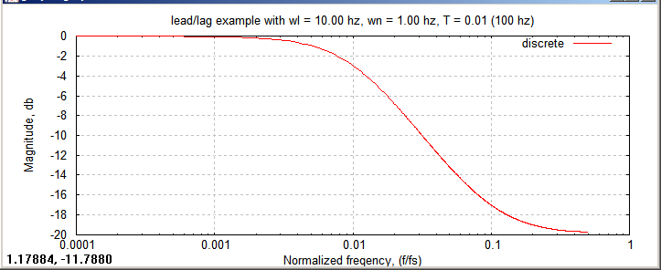
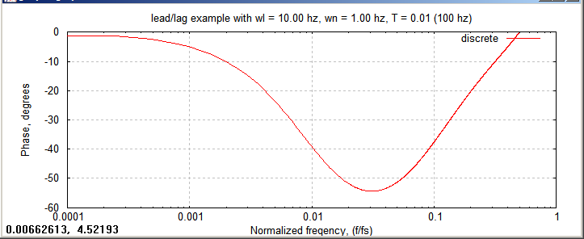
Frequency Response of Example Lead/Lag Discrete Filter
Note frequency
range from DFT
is “zero” to 1
(frequency is normalized
to the sample frequency)
Note last frequency
computed is 0.5

Slide 17
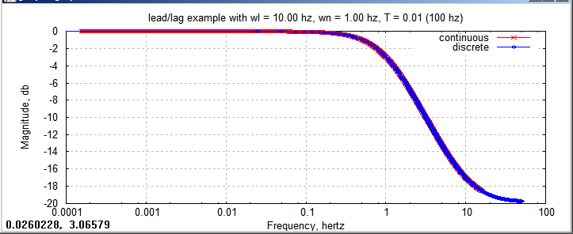
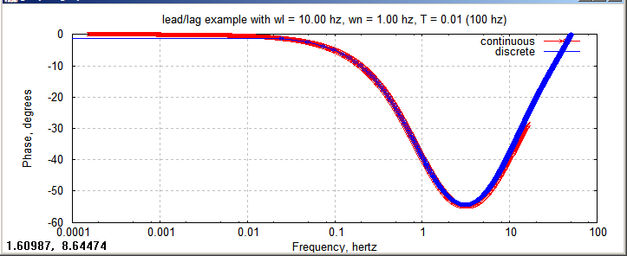
Compare Frequency Response of
Digital & Continuous Lead/Lag Filter
semilogx(freqc/2/pi,magc,'-rx;continuous;')
hold on
semilogx(freq*fs,mag,'-bo;discrete;')
semilogx(freqc/2/pi,phasec,'-rx;continuous;')
hold on
semilogx(freq*fs,phase,'-bo;discrete;')

Slide 18
Introduction to DSP, Part 3 of 4
Summary
In Part 1, “Mathematical Concepts” we covered the following:
  Definitions, mathematical pre-requisites, and application techniques
    Fourier transforms and convolution
    Discrete Fourier transforms (DFT) and Fast Fourier transforms (FFT)
    Shannon Sampling Theorem and data aliasing
In Part 2, “Power Spectral Density Basics”, we covered the following:
      Power Spectral Density (PSD) to estimate spectral characteristics of waveforms
      PSD Demonstration
In Part 3 “Implementing Discrete Filters” we have covered the following:
  Converting from continuous Laplace domain filters to discrete Z-domain filters (Tustin’s rule, or bilinear transformation)
  Recursive filter implementations for discrete filters
In Part 4 “Typical GN&C Applications” we will cover the following:
  Normalized frequency
  Methods to verify transfer function magnitude/phase of discrete filters using DFT (or FFT)
  Example use of discrete filter to implement a notch filter

