Slide 1

Introduction to Digital Signal Processing (DSP)
Part 4 of 4 (“Typical GN&C Applications”)
James R. (Jim) Beaty, PhD - NASA Langley Research Center
Vehicle Analysis Branch, Systems Analysis & Concepts Directorate
Bldg 1209, Room 128B, M/S 451
1 North Dryden Street
Hampton, VA 23681
757-864-1322
James.R.Beaty@nasa.gov

Slide 2
Overview
Part 1, “Mathematical Concepts”
  Definitions, mathematical pre-requisites, and application techniques
    Fourier transforms and convolution
    Discrete Fourier transforms (DFT) and Fast Fourier transforms (FFT)
    Shannon Sampling Theorem and data aliasing
Part 2, “Power Spectral Density Basics”
      Power Spectral Density (PSD) to estimate spectral characteristics of waveforms
      PSD Demonstration
Part 3 “Implementing Discrete Filters”
  Converting from continuous Laplace domain filters to discrete Z-domain filters (Tustin’s rule, or bilinear transformation)
  Recursive filter implementations for discrete filters
Part 4 “Typical GN&C Applications”
  Normalized frequency
  Methods to verify transfer function magnitude/phase of discrete filters using DFT (or FFT)
  Example use of discrete filter to implement a notch filter

Slide 3
Normalized Frequency
One of the most confusing concepts of digital signal processing in general, and DFTs / FFTs in particular, is the concept of normalized frequency
A Laplace domain filter specifies the filter response in terms of a natural frequency (also known as “corner” frequency)
  usually in units of radians/second, if ω, or ω_{n} is used to denote the filter frequency
  sometimes in hertz (cycles/second), if f or f_{n} is used to denote the filter frequency
When Laplace domain filters are converted to discrete filters, the calculations for the discrete filter coefficients contain terms like “ωT/2”
The discrete filter is entirely described by the normalized frequency, which is the ratio of the “natural frequency” of the filter (in hertz) divided by the update frequency (in hertz), of the discrete filter:
  f_{S} (the sample frequency in hertz) = 1 / ( T, seconds per sample )
  Now, since T = 1 / f_{S}, then ωT/2 = 2πf /f_{S} /2, = π (f/ f_{S}), and ( f / f_{S} ) = the normalized frequency
So, “ωT/2” shown in the equations which define the filter coefficients can be replaced with normalized frequency multiplied by π

Slide 4
Normalized Frequency - Continued
When a DFT (or FFT) is computed for an input sequence, the output frequency is normalized to the sample frequency, (f / f_{S})
  For entirely real sequences, the range of normalized frequencies is 0 to 0.5
  For complex sequences, the range of normalized frequencies is ±0.5
  A normalized frequency of 0.5 represents the Nyquist frequency, or half the sample frequency
  A discrete filter cannot implement frequencies above the Nyquist frequency
To convert the normalized frequency computed by the DFT (or FFT) of a signal into “real” frequency (e.g. – hertz, or radians/second), the output normalized frequency must be multiplied by the sample frequency, f_{S} = 1/T, (for output in hertz), or 2π times the sample frequency (for output in radians per second)

Slide 5
Frequency Warping
As just described, discrete filter implementations are limited to frequencies less than the “Nyquist frequency”, which is half of the sample frequency for the discrete filter
For filter frequencies that approach this upper limit, the approximation used for Tustin’s rule may cause the discrete filter’s frequency response to differ from its continuous filter counterpart, which is caused by “frequency warping”
Frequency warping can be counteracted by a technique known as “pre-warping” the filter corner frequencies
In this technique, the corner frequencies of the continuous filter, ω_{n}, can be pre-warped to the discrete frequency, ω_{d}, using the equation:

Slide 6
Frequency Warping
- Continued
Using the pre-warping equation on the previous slide, the discrete frequency, ω_{d}, can be computed, and used instead of the continuous frequency, ω_{n}
This “pre-warping” of the frequency will cause the discrete filter to have the exact gain and phase as the continuous filter at the desired corner frequency
  However, the gain / phase at other points may still be different than the continuous filter
  The “match” of the gain / phase overall may be worse than the digital filter without pre-warping (except at the specified frequency)
  The need to match the frequency response at a specific frequency can be very important for filters such as notch filters, in which a slight mismatch of the frequency response at other frequencies may not be as important as the need to match the gain/phase at the desired notch frequency
For example, consider a first-order lag transfer function with corner frequency, f_{n} = 15 hz with a discrete sample time of 50 hz

Slide 7
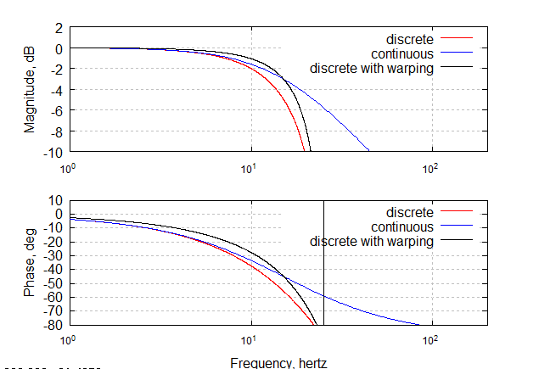
Frequency Warping
1st order low pass example
f_{n} = 15 hz
ω_{n} = 2πf_{n} = 94.248 rad/sec
ω_{d} = 2/T tan( πf_{c}) = 137.638 rad/sec
Note Exact match
of gain / phase at
15 hz for pre-warped
discrete filter

Slide 8
Techniques to Verify Transfer Function of a Discrete Filter
DFT (or FFT) can be used to verify the transfer function frequency response (magnitude/phase versus frequency) of discrete filters
  Compute the impulse response (also called the “filter kernel”) of the discrete filter by passing a N sample impulse response (=1 for sample 1, =0 samples 2-N) through the filter
    Via recursion: x = recursive_filter( Impulse , a , b );
    where a and b are the digital filter’s numerator and denominator polynomial coefficients (described in Part 3 of 4 of this topic)
    Make sure that you know how denominator polynomial coefficients, b, are defined!
  Use discrete Fourier transform (DFT) to compute the frequency response of the filter’s impulse response, x, or filter kernel:
    Via “brute force” summation method (VERY SLOW !!!) :
      [mag,phase,freq] = dft( x , N );
    Via DFT using FFT (VERY FAST !!!) :
      [mag,phase,freq] = dft_fft( x , N );
      Much faster than brute force DFT method (faster by order of N log_{e}(N) )

Slide 9
Example for Verification of Transfer Function
Example: notch filter with lowpass:
  % low pass filter discrete coefficients:
  al = 1.0e-02 * [ 2.54234646 5.08469292 2.54234646 0 0 ];
  bl = [ 1.501043369 -0.602737225 0 0 ];
  % notch filter discrete coefficients:
  an = [ 0.9024681335 -3.5026519614 5.2034846577 -3.5026519614 0.9024681336 ];
  bn = [ 3.68352427976 -5.19672754635 3.32581338106 -0.815728911280 ];
  % define the update frequency (50 hertz) and sample time, T
  fs=50; , T=1/fs;
  % define 4096 point impulse response function (zero everywhere except first point)
  impulse = zeros(size([1:4096])); , impulse(1) = 1;
  % define the 4096 point impulse response of the notch filter and the lowpass filter
  xn = recursive_filter(impulse , an , bn );
  xl = recursive_filter(impulse , al , bl );
  % compute the frequency response of the notch filter and the lowpass filter
  [magn,phasen,freqn]=dft_fft(xn,4096);
  [magl,phasel,freql]=dft_fft(xl,4096);
  % combine the magnitude and phase of each of the filters for the overall filter transfer function:
  mag = magn + magl;
  phase = phasen + phasel;

Slide 10
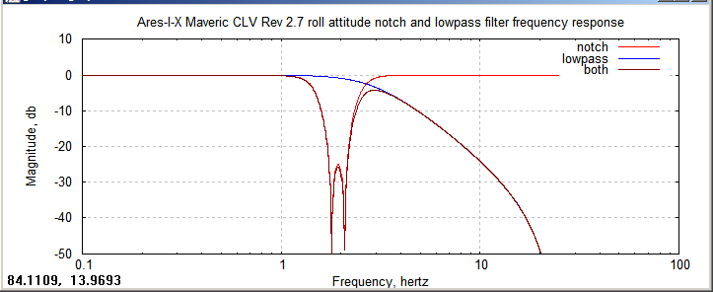
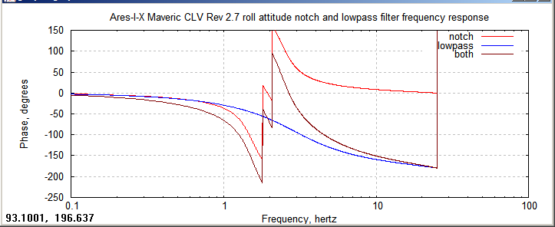
Calculated Frequency Response of Notch/Lowpass Discrete Filter
Center of notch at 2hertz
Minimum attenuation in notch = -26dB @ 1.95 hz
Phase @ 1 hz = -65.7°
(more on this later!)

Slide 11
Example of Using Discrete
Notch Filter
Now, from the previous example, we will demonstrate how to use such a notch / lowpass filter to remove some frequency content at the location of the notch and above the low pass frequency rolloff
From our computed frequency response of the digital filter, we showed that the notch is centered at 2hz with at least 26 dB of attenuation, and that the lowpass attenuation is also at least 26 dB for frequencies at 10 hz and above
Create 2048 point input test waveform with three sinusoid components:
  Amplitude of 2 at 1 hz (normalized frequency of 0.02 for filter operating at 50 hz) ( below the
  lowpass filter cutoff frequency)
  Amplitude of 4 at 2hz (normalized frequency of 0.04) ( at the center of the notch filter
  frequency)
  Amplitude of 1 at 10hz (normalized frequency of 0.2) ( above the lowpass filter cutoff
  frequency)
  x = 2*sin( 2*pi * 0.02 * [0:2047] ) + 4*sin( 2*pi * 0.04 * [0:2047]) + 1*sin( 2*pi * 0.2 * [0:2047])

Slide 12
Example of Using Discrete
Notch Filter
Once filtered with the discrete filter, we should see the following characteristics:
  the high frequency component (10 hz, or 0.2 normalized frequency) should be attenuated by approximately -26 dB ( 0.05 amplitude )
  the component within the notch filter (2 hz, or 0.04 normalized frequency) should also be attenuated by approximately -26dB
  the low frequency component (1 hz, or 0.02 normalized frequency) should pass through with little or no attenuation, but with some phase lag (-65.7° shown earlier)
  Compute 2048-point impulse response of the discrete filter, by convolving the input signal with the total filter’s impulse response (e.g. – the “filter kernel” )
  Filter the input waveform with the discrete filter, using the fft form of the convolution operation (see Matlab function “convolv_fft.m”)
  filter_notch = recursive_filter( impulse , an , bn );
  filter_notch_lowpass = recursive_filter( filter_notch , al , bl );
  x_filtered = convolv_fft( x , filter_notch_lowpass );
Note successive calls
to recursive filter, which
cascades the notch and lowpass
filters together

Slide 13
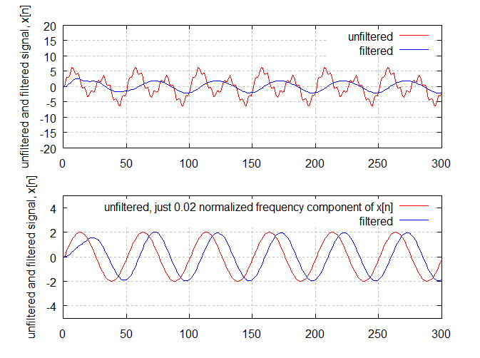
Output of Notch / Lowpass Discrete Filter
Top right plot shows original signal, x[n] in red, and output of notch / lowpass discrete filter in blue
Bottom right plot shows only the 0.02 normalized frequency component of x[n] and its filtering with the notch/lowpass discrete filter
  The lower plot shows essentially no attenuation of the 1 hz (0.02 normalized frequency) signal, as expected
  The lower plot shows a 9 sample lag between the 0.02 normalized filter sinusoid and its filtered value, as expected (see below)
  The predicted phase lag of the filter at 1 hz (0.02 normalized filter for filter running at 50 hertz) is 65.7°
  ( 65.7° phase lag / 360°/cycle ) * ( 50 samples /cycle ) = 9 samples lag
9 sample lag

Slide 14
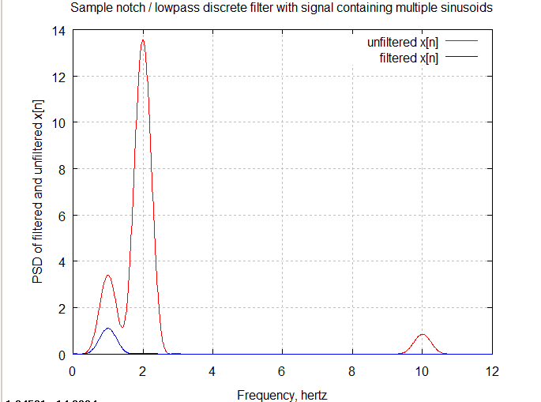
Output of Notch / Lowpass Discrete Filter
Compute PSD of the unfiltered signal, x[n], and compare with PSD of x[n] filtered by the notch / lowpass filter
Note that the original signal, x[n] exhibits peaks at 1, 2, and 10 hertz (0.020, 0.040, 0.20 normalized frequency for sample frequency of 50 hz), as expected
Note that the filtered signal (blue line) shows no content except for the low frequency 20 hertz signal, which is expected, since the lowpass does not attenuate that frequency, but the notch and low pass attenuate the other frequencies

Slide 15
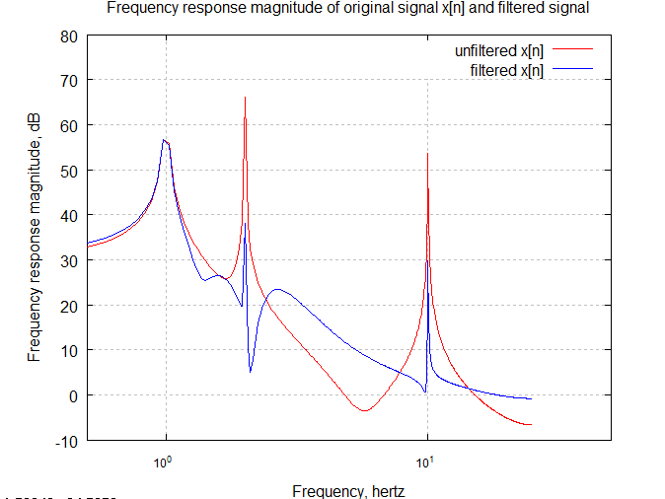
Frequency Response of original signal, x[n] and filtered signal
Compute 1024 point DFT of the unfiltered signal, x[n], and compare magnitude with that of x[n] filtered by the notch / lowpass filter
Note very little attenuation in magnitude at low frequency (1 hz), as expected
Note that the sharp attenuation at the 2 hz notch location of >26 dB, as expected
Note the wider region of attenuation for the higher frequencies above 2 hz, with >26dB at 10 hertz, as expected

Slide 16
Comments on Previous Example
  The previous example implemented the filter as the convolution of the input signal x[n] with the impulse response of the filter (e.g. – the “filter kernel”)
  It also used an FFT form of convolution (“convolv_fft.m”)
  Recall from an earlier slide that convolution can be implemented as the inverse DFT of the product of the DFT of each input signal:
    The convolution theorem is key to digital signal processing. It states that the inverse Fourier transform of the product of the Fourier transforms of f and g is proportional to the convolution of f and g (e.g. - f * g ):
        F { f * g } = k { F ( f ) · F ( g ) } → f * g = k F ⁻¹ { F ( f ) · F ( g ) }
    That is, the convolution operation can be replaced with two Fourier transforms, a multiplication of these, and an inverse Fourier transform
    Why go to the trouble for these extra steps instead of direct summation convolution?
  Term-by-term summation (e.g. – “brute force”) method of convolution is very slow for large sequences of numbers, it is often much faster to implement via FFT and inverse FFT as described
  Can also implement the discrete filter directly as a recursive filter (which is usually done in digital flight control software)

Slide 17
Implement with Recursive Filter
  For a multiple stage discrete filter (recall that our previous example used a notch and a low pass filter cascaded together) one can implement the filter as a recursive filter in two different ways:
    two-stage discrete filters implemented in series (first, the lowpass, then the notch) :
      x_low = recursive_filter( x , al , bl );
      x_filtered = recursive_filter( x_low , an , bn );
    Or, a single discrete filter constructed from the two discrete filters (compute convolution of each filter’s numerator and denominator polynomials):
      a = conv( al , an );
      b = conv( [ 1 , -b1 ] , [ 1 , -bn ] );
      b = -b( 2:length(b) );
      x_filtered = recursive_filter ( x , a , b );
    Why were these steps necessary?
      the recursive filter automatically assumes that the denominator polynomial has a leading coefficient of 1, that is not normally included and that the coefficients have implied negative signs
      [1 , -bl ] and [ 1 , -bn ] above are the actual denominator polynomial of the low pass and notch discrete filters, and after their convolution, the second calculation, “b = ...” removed the leading coefficient of 1 after convolution of the two denominators and negated the coefficients after removing the leading 1

Slide 18
Introduction to DSP, Part 4 of 4
Summary
In Part 1, “Mathematical Concepts” we covered the following:
  Definitions, mathematical pre-requisites, and application techniques
    Fourier transforms and convolution
    Discrete Fourier transforms (DFT) and Fast Fourier transforms (FFT)
    Shannon Sampling Theorem and data aliasing
In Part 2, “Power Spectral Density Basics”, we covered the following:
      Power Spectral Density (PSD) to estimate spectral characteristics of waveforms
      PSD Demonstration
In Part 3 “Implementing Discrete Filters” we covered the following:
  Converting from continuous Laplace domain filters to discrete Z-domain filters (Tustin’s rule, or bilinear transformation)
  Recursive filter implementations for discrete filters
In Part 4 “Typical GN&C Applications” we have covered the following:
  Normalized frequency
  Methods to verify transfer function magnitude/phase of discrete filters using DFT (or FFT)
  Example use of discrete filter to implement a notch filter

