Slide 1
Introduction
What is thermal control?
What is the difference between active thermal control, passive thermal control and thermal protection?
Why is thermal control required?
Brief overview of passive thermal control and thermal protection hardware.

Slide 2
Active Thermal Control, Passive Thermal Control and Thermal Protection
Thermal Control -
Active - pumps, fluid loops, heat exchangers, radiators, heaters, etc.;
Passive - insulations, isolators, heat pipes, louvers, passive radiators and coolers, thermo-optical coatings, geometry, orientation, natural and induced environments, phase change materials, some use of heaters;
Thermal Protection - reusable insulations, ablatives, seals, barriers, high temperature blankets, hot structures.

Slide 3
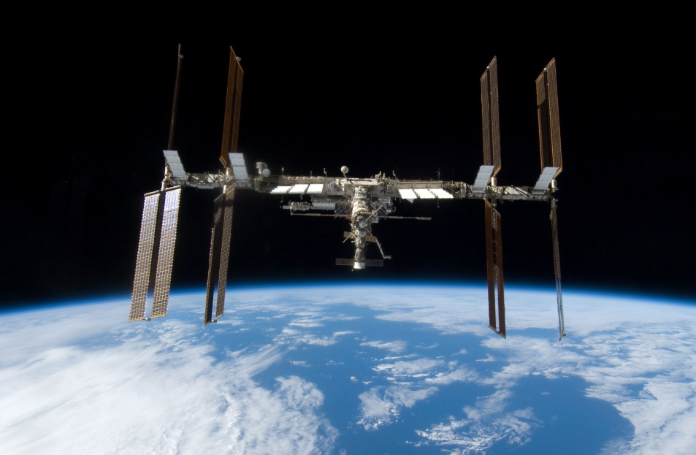
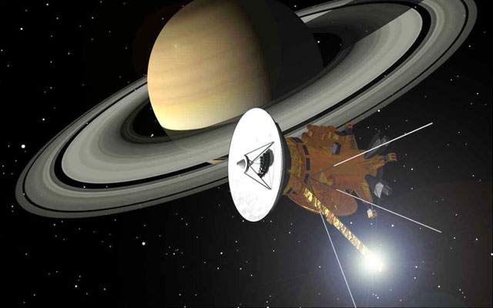
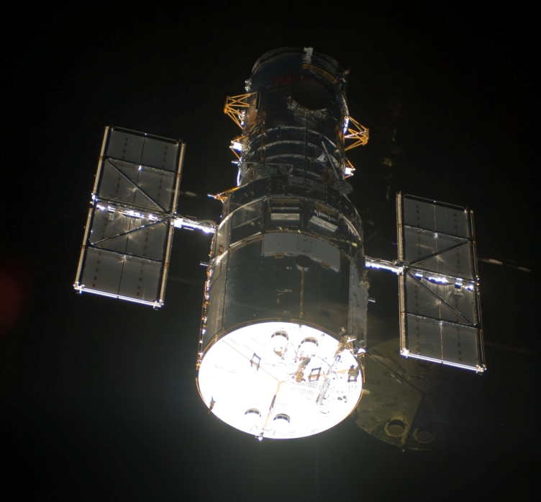
Why Thermal Control and Thermal Protection Are Required
Cassini
International Space Station
Hubble Space Telescope

Slide 4
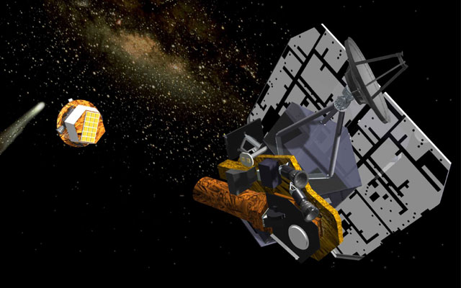
The Thermal Environment
Space Sink Temperature (~3 K)
Deep Impact/Epoxi Spacecraft

Slide 5
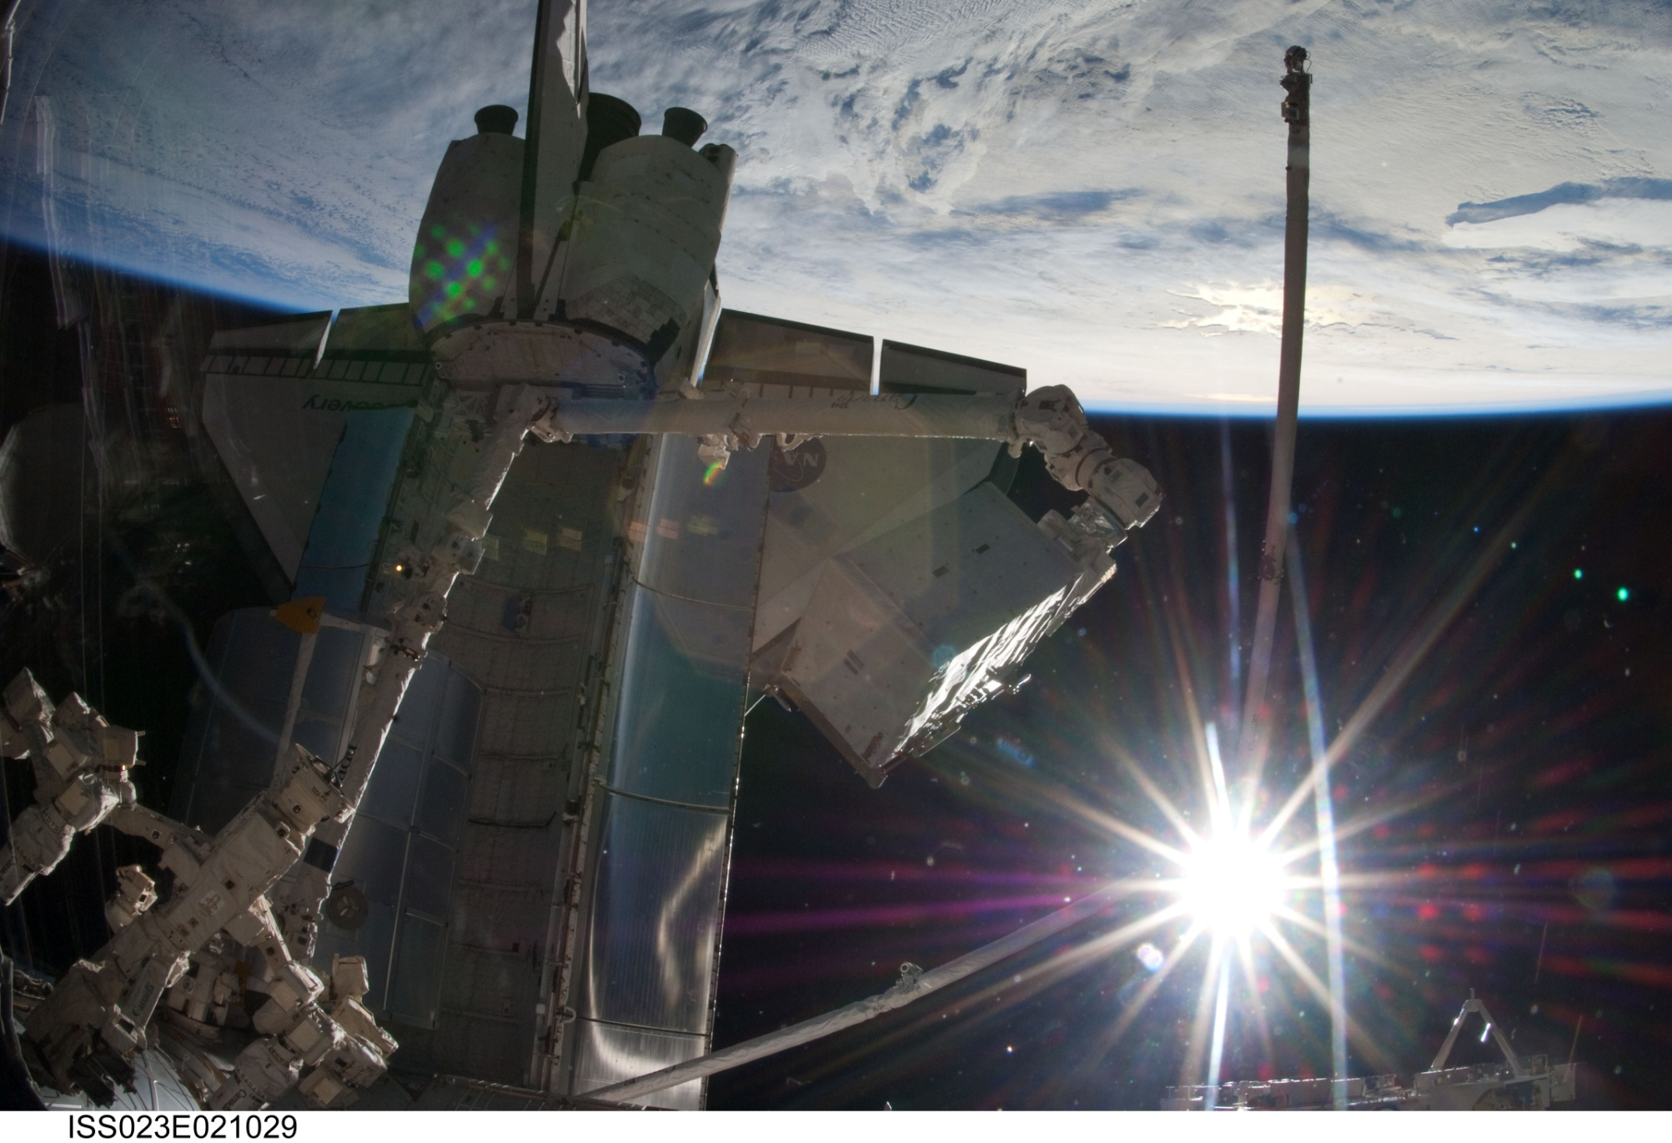
The Thermal Environment
Solar
Albedo
Planetary OLR

Slide 6
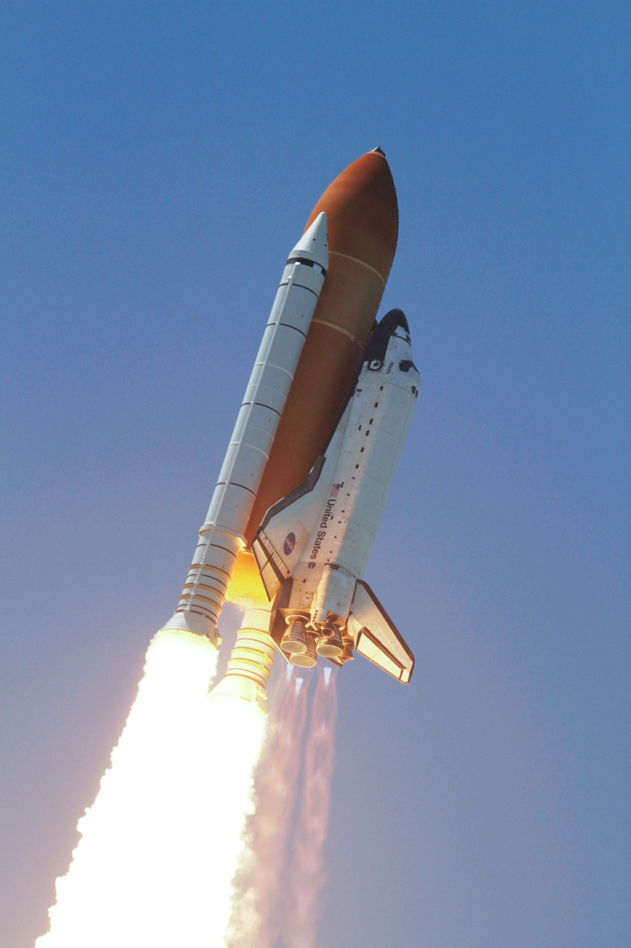
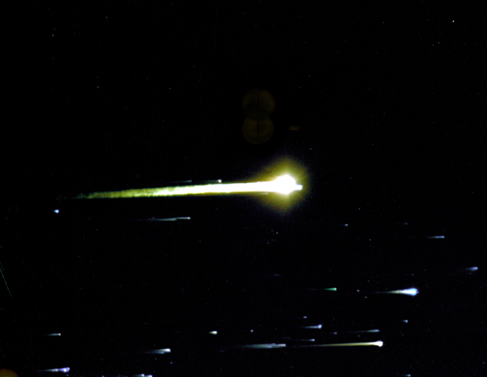
The Thermal Environment
Ascent Heating
Aerothermal Heating
Plume Heating
and Radiation
Apollo 8 Reentry
Space Shuttle Ascent

Slide 7

Basic Heat Transfer

Slide 8
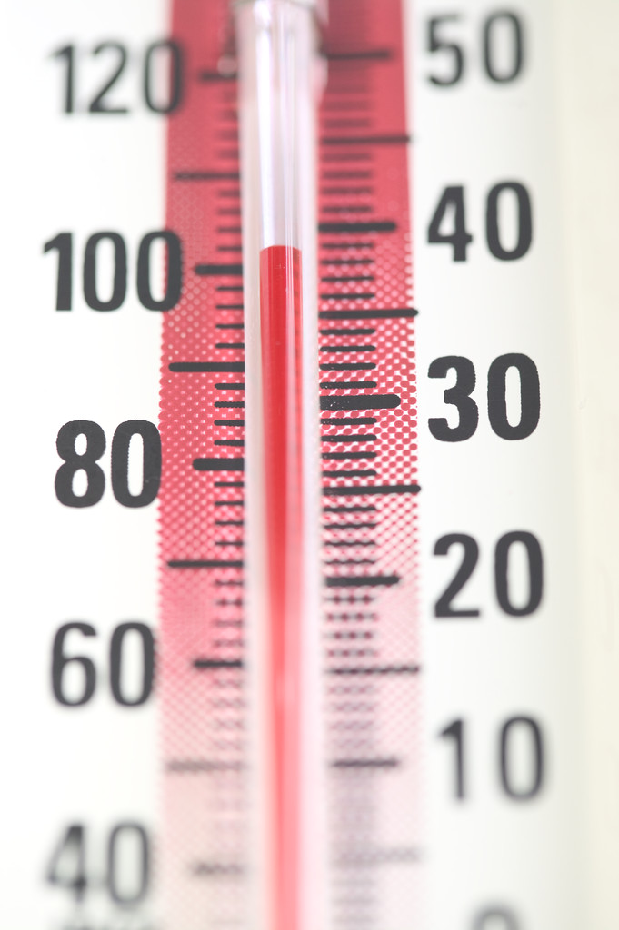
Temperature
Temperature is a measure of the average kinetic energy of molecules in a system.

Slide 9
Temperature
It is convenient to think of temperatures on an absolute scale;
Absolute zero is the lowest possible temperature, at which point the atoms of a substance transmit no thermal energy.
SI System:
0 K = -273.15 °C
English System:
0 R = -459.67 °F

Slide 10
Conduction
Conduction is moving heat through a solid;
Heat flow is directly proportional to the temperature difference.
Hot Soup

Slide 11
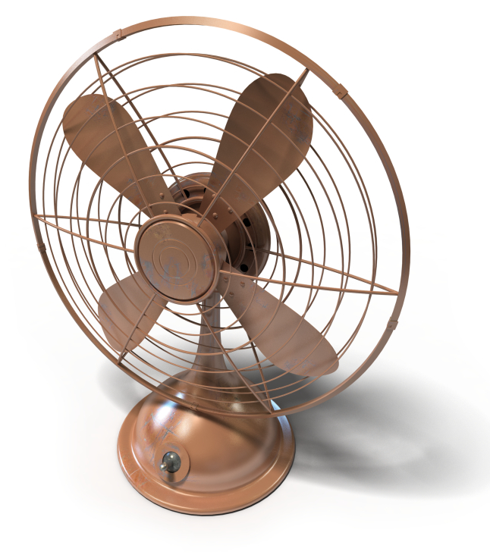
Convection
Convection is moving heat through a liquid or gas;
Heat flow is directly proportional to the temperature difference.

Slide 12
Convection

Slide 13
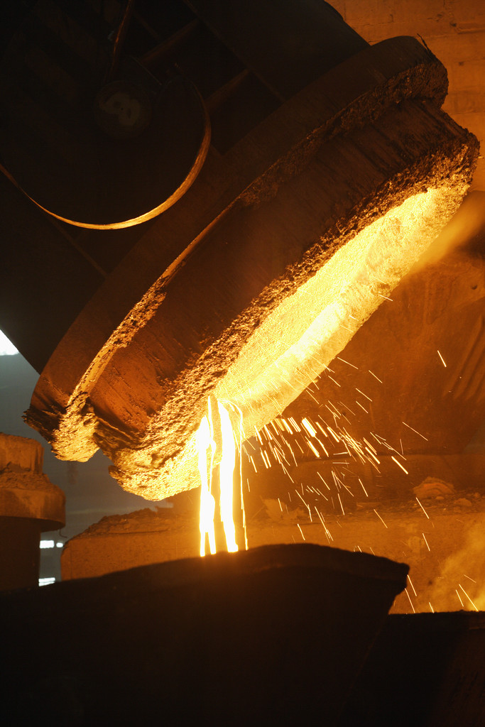
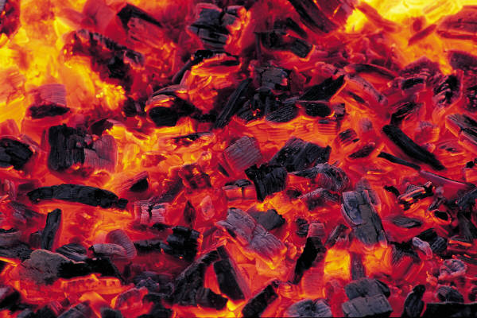
Radiation
Radiation is energy emitted from an object as a consequence of its temperature -- via electromagnetic radiation;
Heat flow is directly proportional to fourth power of the temperature difference.

Slide 14
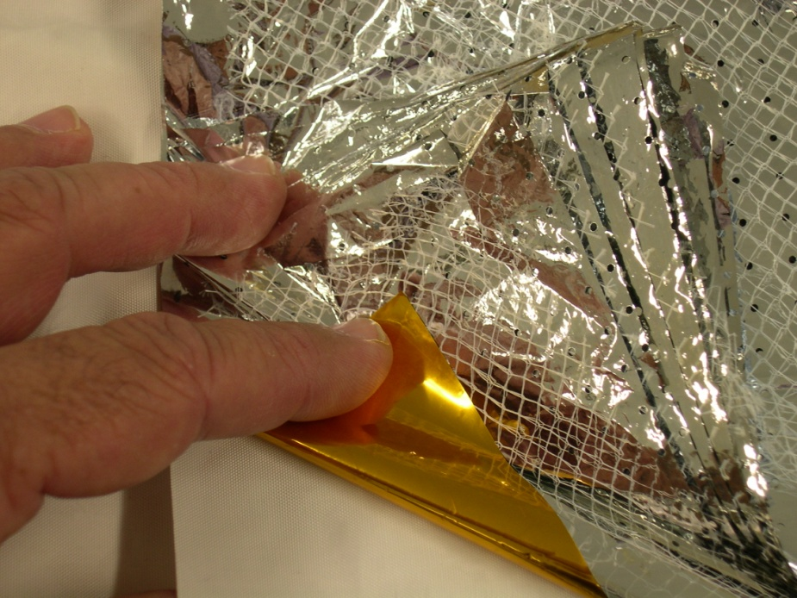
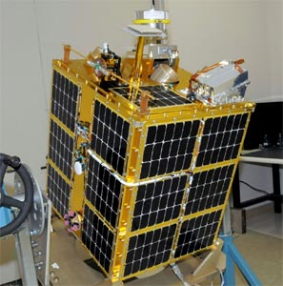
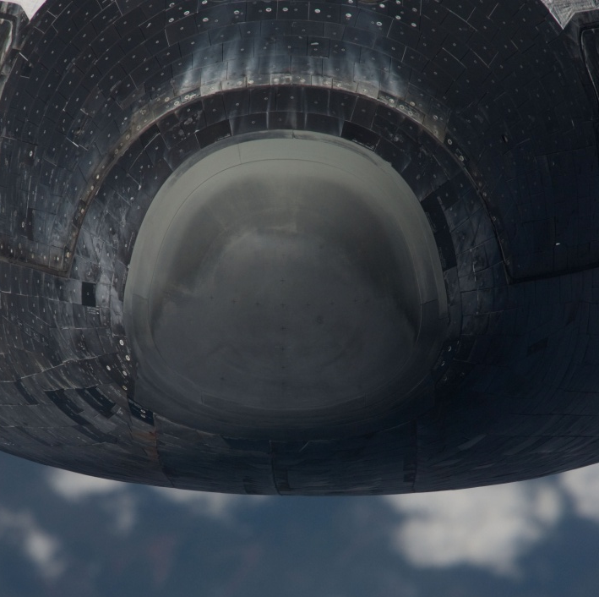
Thermal Control and Protection Hardware

Slide 15
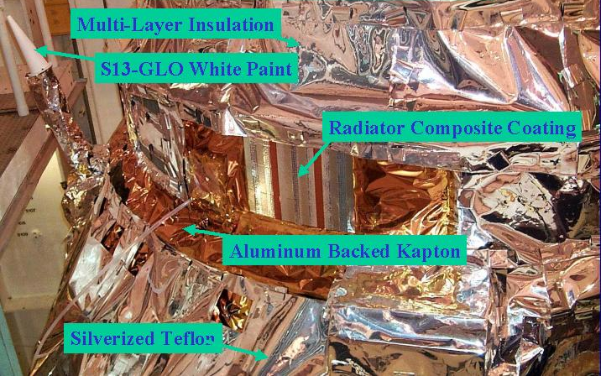
Thermo-Optical Coatings
Multi-Layer Insulation
S13-GLO White Paint
Radiator Composite Coating
Aluminum Backed Kapton
Silver Teflon
Chandra X-Ray Observatory

Slide 16
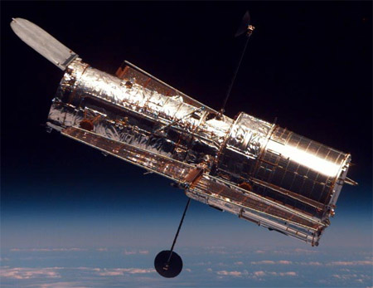
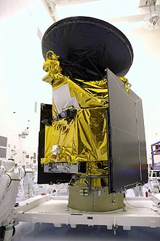
Multi-Layer Insulation (MLI)
MLI
MLI
Hubble Space Telescope
Mars Reconnaissance Orbiter

Slide 17
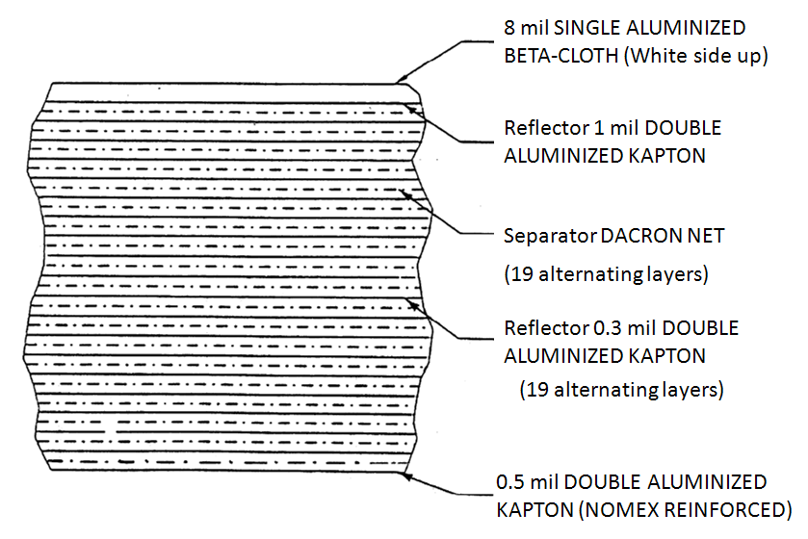
Multi-Layer Insulation (MLI)
MLI - One on Many Possible Lay-Ups

Slide 18
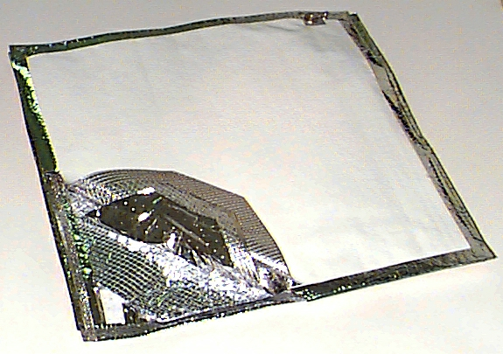
Multi-Layer Insulation (MLI)
Polyester Separator Mesh
Aluminized Kapton

Slide 19
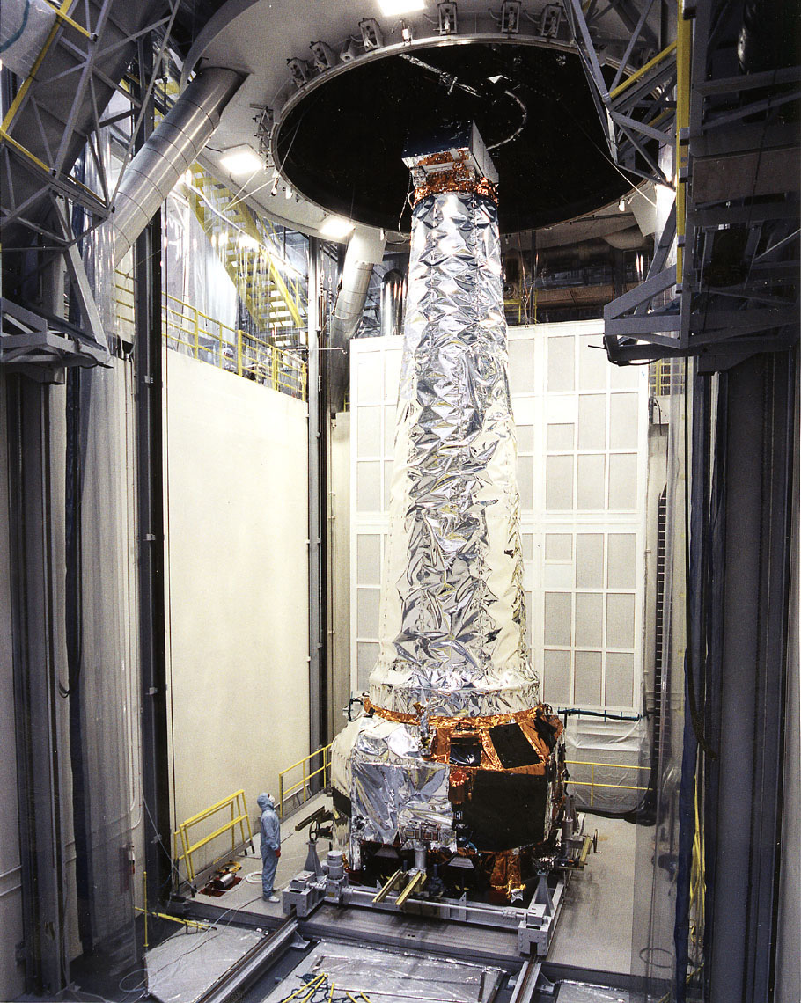
Multi-Layer Insulation (MLI)
Chandra X-Ray Observatory

Slide 20
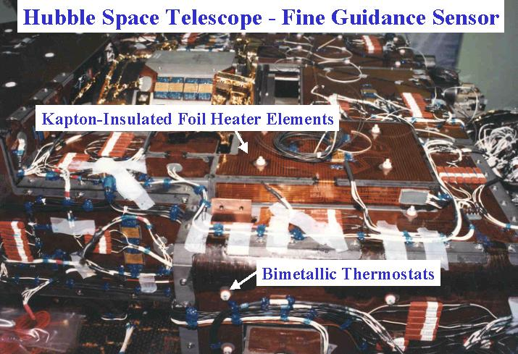
Heaters
Kapton-Insulated Foil Heater Elements
Bimetallic Thermostats
Hubble Space Telescope Fine Guidance Sensor

Slide 21
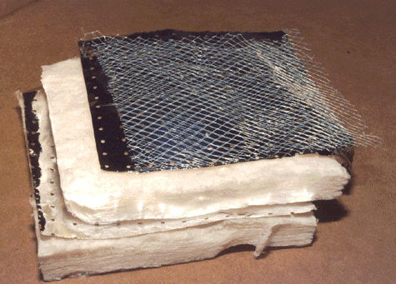
Bulk Insulation

Slide 22
Phase Change Materials (PCMs)
Heat Transfer to Environment
Radiator Surface
PCM
Ice
Ice
Air flow
Air Flow
Air
Flow

Slide 23
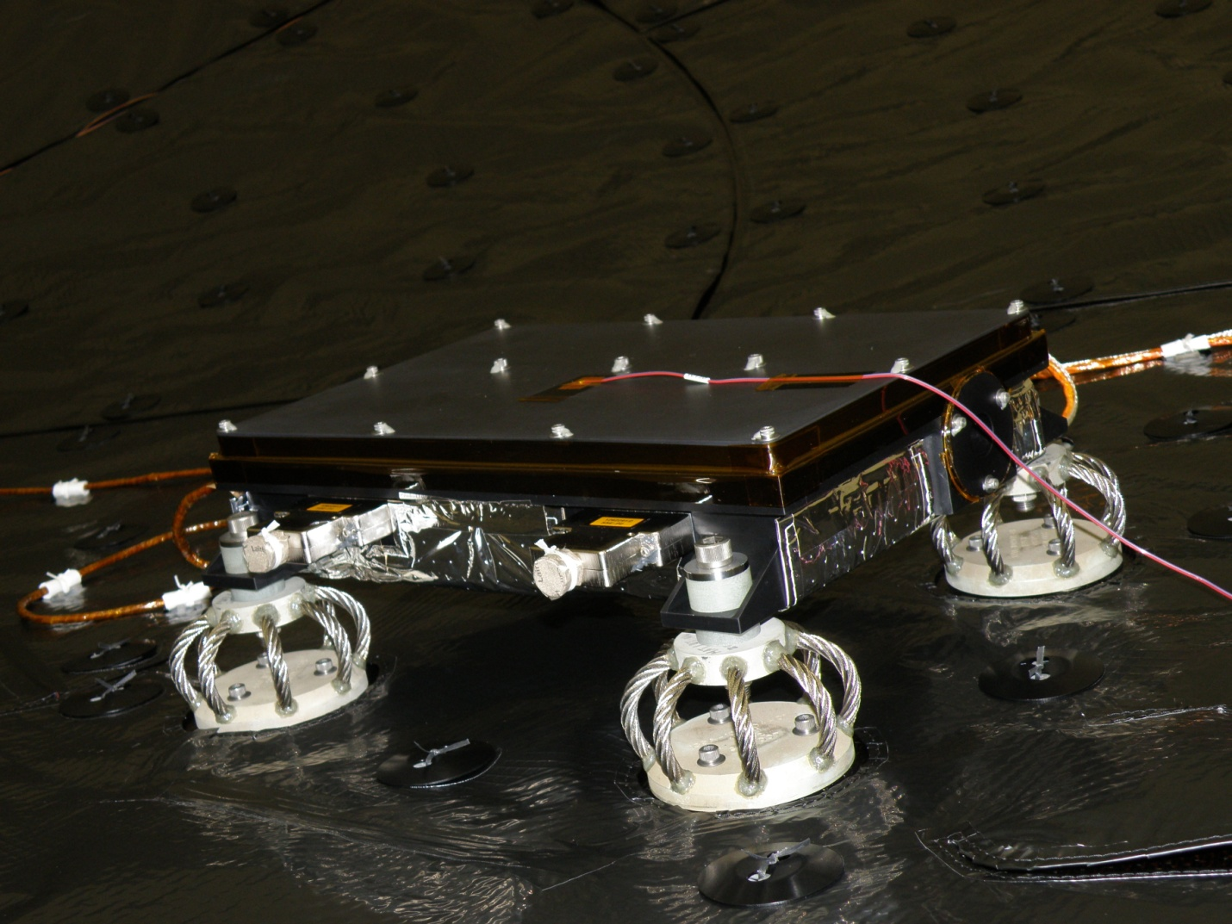
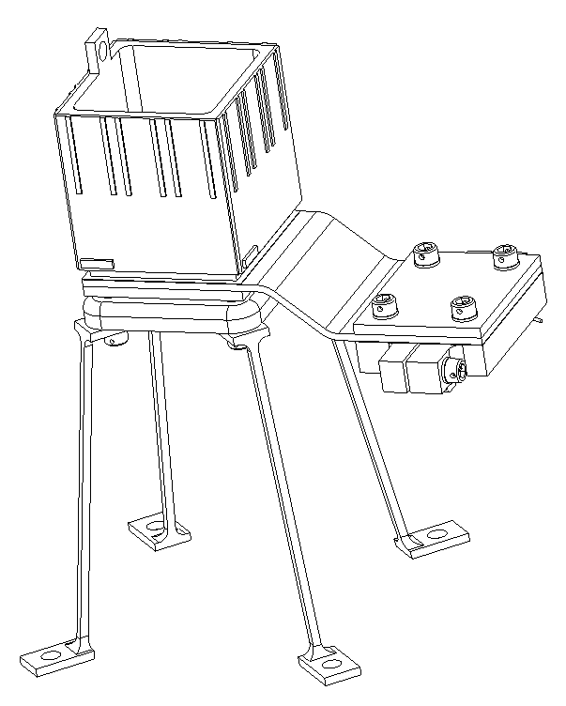
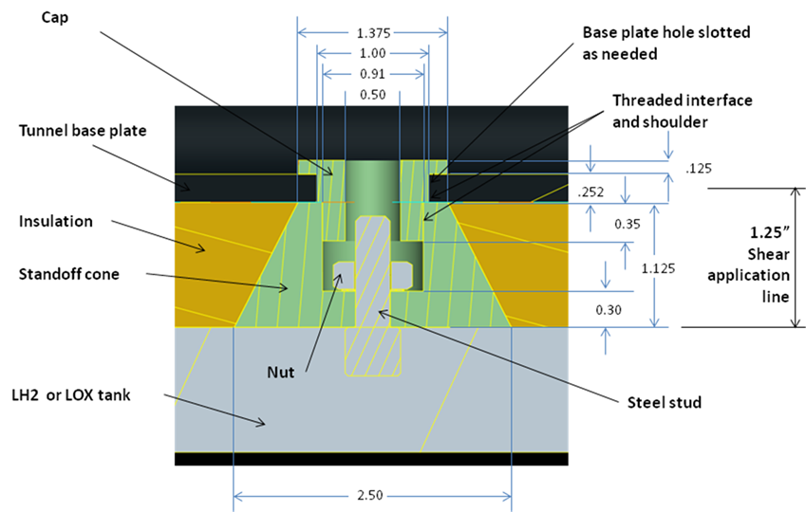
Thermal Isolators

Slide 24
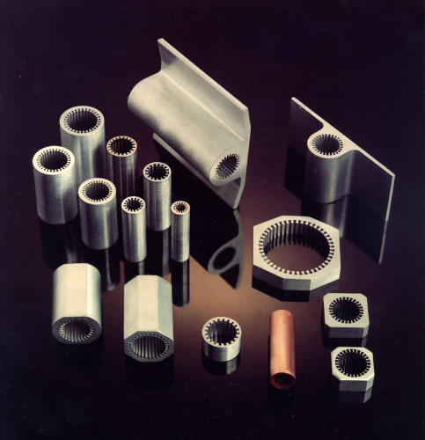
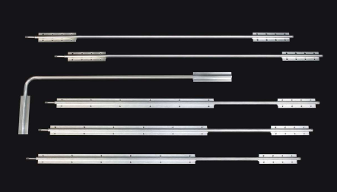
Heat Pipes
Typical Heat Pipe
Heat Pipe Cross-Sections

Slide 25
Heat Pipes
Wick
Wick
Heat Output
Heat Input
Heat Output
Heat Input
Vapor Flow
Vapor Flow
Liquid Return
Liquid Return
Evaporator
Evaporator
Condenser
Condenser

Slide 26
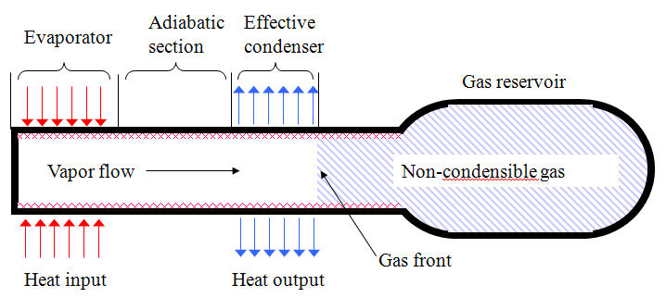
Heat Pipes
Adiabatic Section
Effective Condenser
Evaporator
Gas Reservoir
Non-condensable gas
Vapor Flow
Non-Condensable Gas
Gas Front
Heat Input
Heat Output
Variable Conductance Heat Pipe

Slide 27
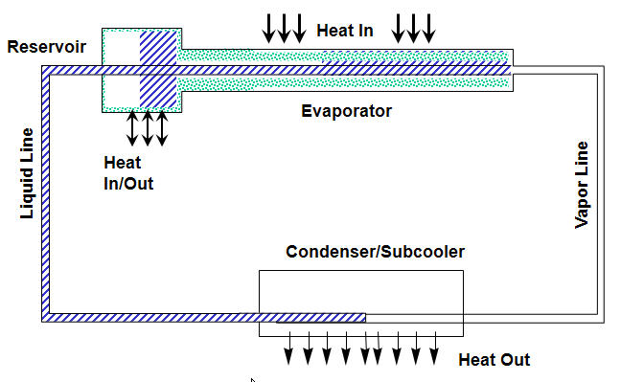
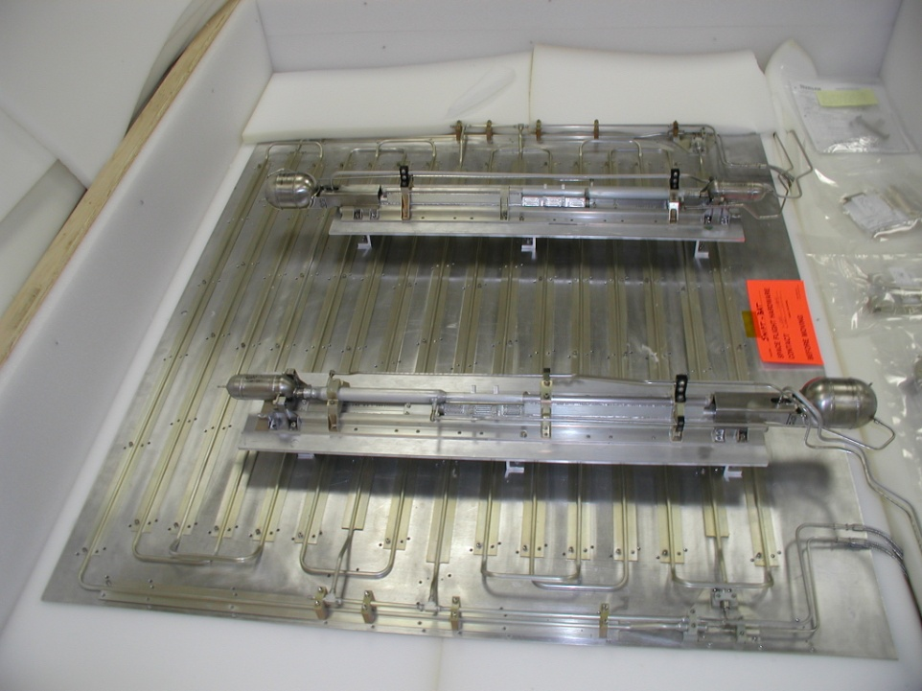
Heat Pipes
Heat In
Reservoir
Evaporator
Heat In/Out
Vapor Line
Liquid Line
Condenser/Subcooler
Heat Out
Loop Heat Pipe Schematic
Loop Heat Pipes for SWIFT Spacecraft

Slide 28
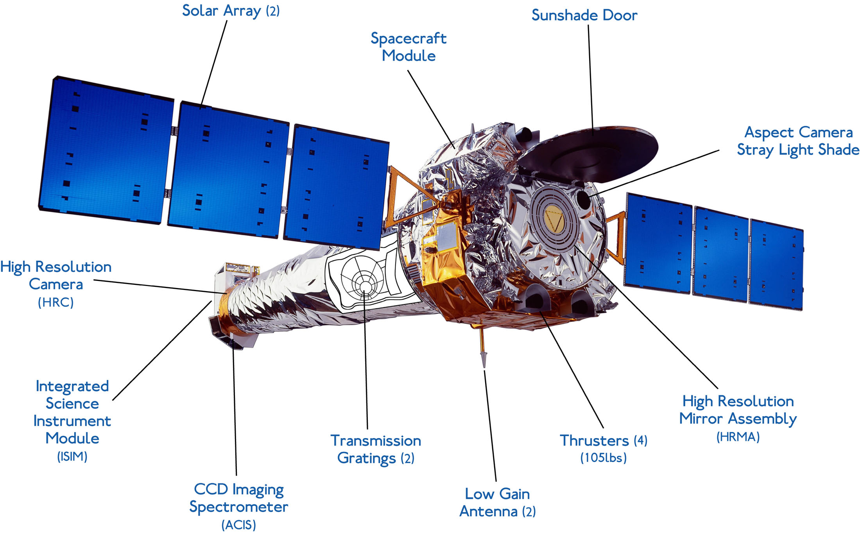
Sun Shades
Chandra X-Ray Telescope

Slide 29
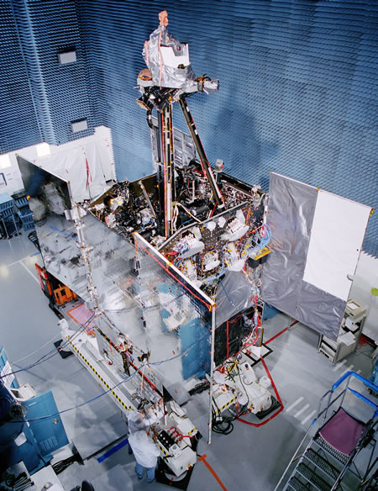
Passive Radiators
Passive Radiators

Slide 30
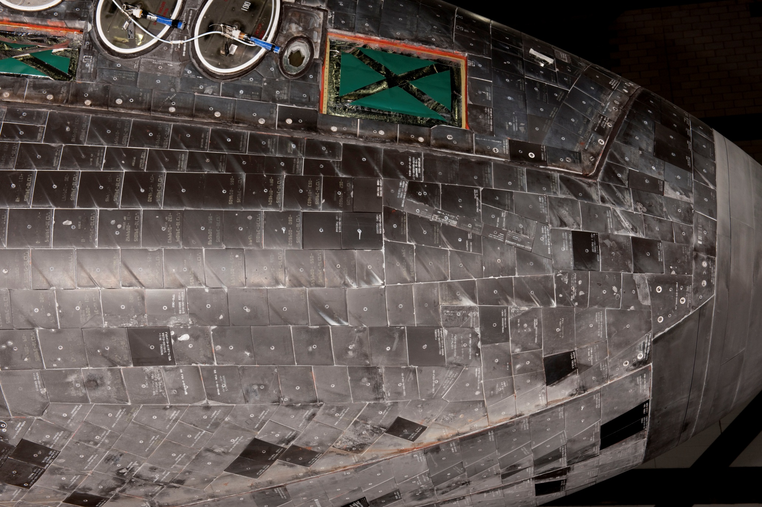
Reusable Thermal Protection System
Silica Tiles on the Space Shuttle Orbiter

Slide 31
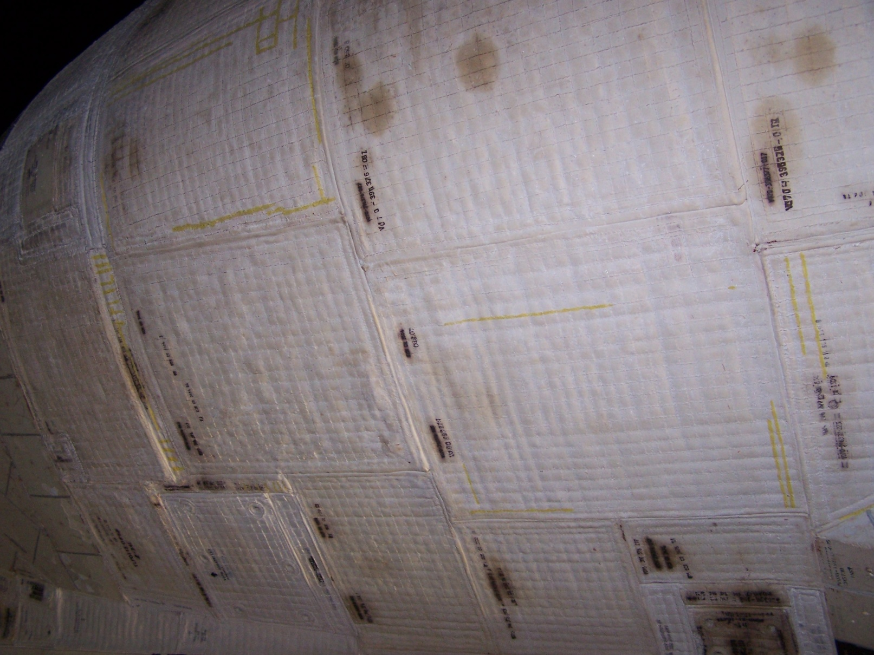
Thermal Protection System Blankets
AFRSI Blankets on the Space Shuttle Orbiter OMS Pod

Slide 32
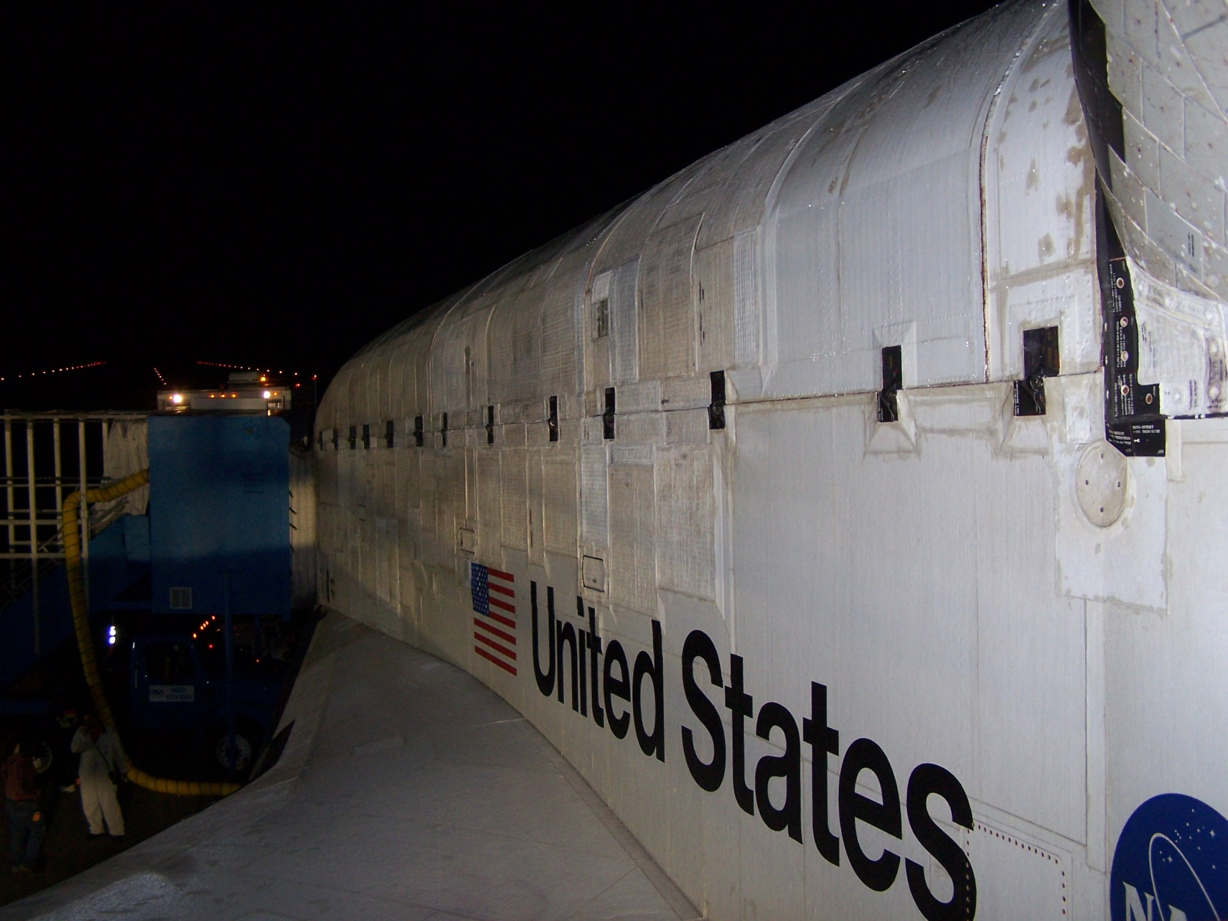
Thermal Protection System Blankets
AFRSI
FRSI
Space Shuttle Orbiter Side Fuselage and Wing

Slide 33
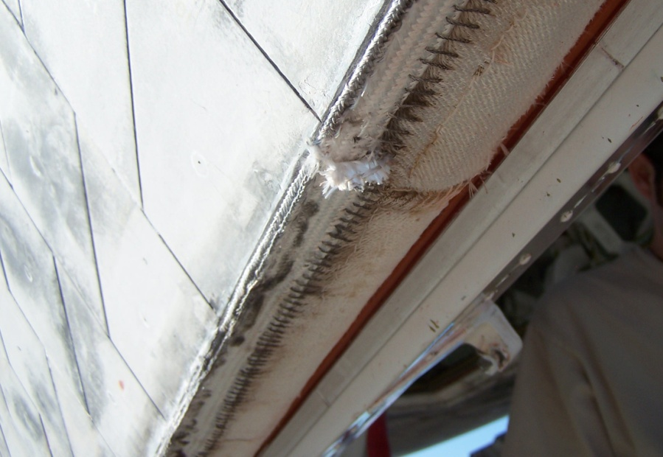
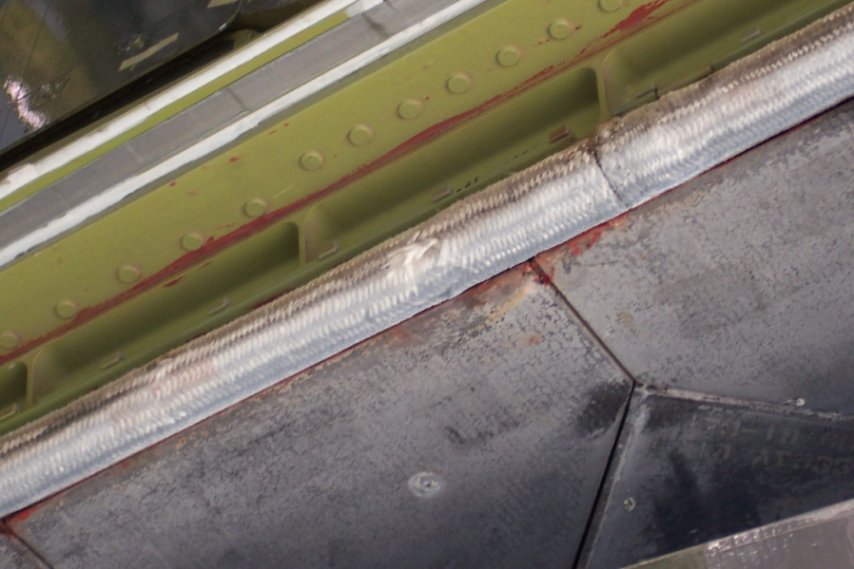
Seals and Barriers
Seal
Barrier

Slide 34
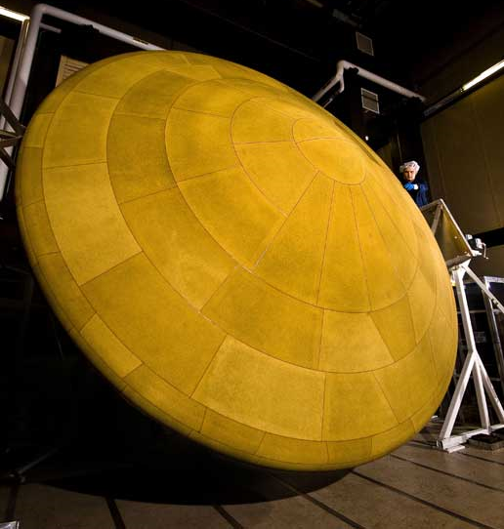
Ablatives
Mars Science Lander Ablative Heat Shield

Slide 35
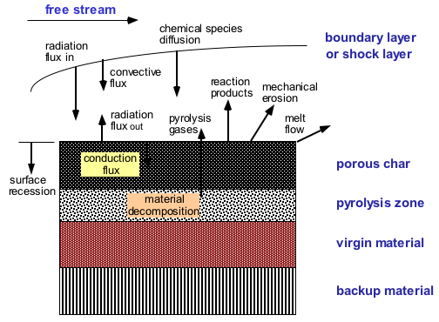
Ablatives

Slide 36
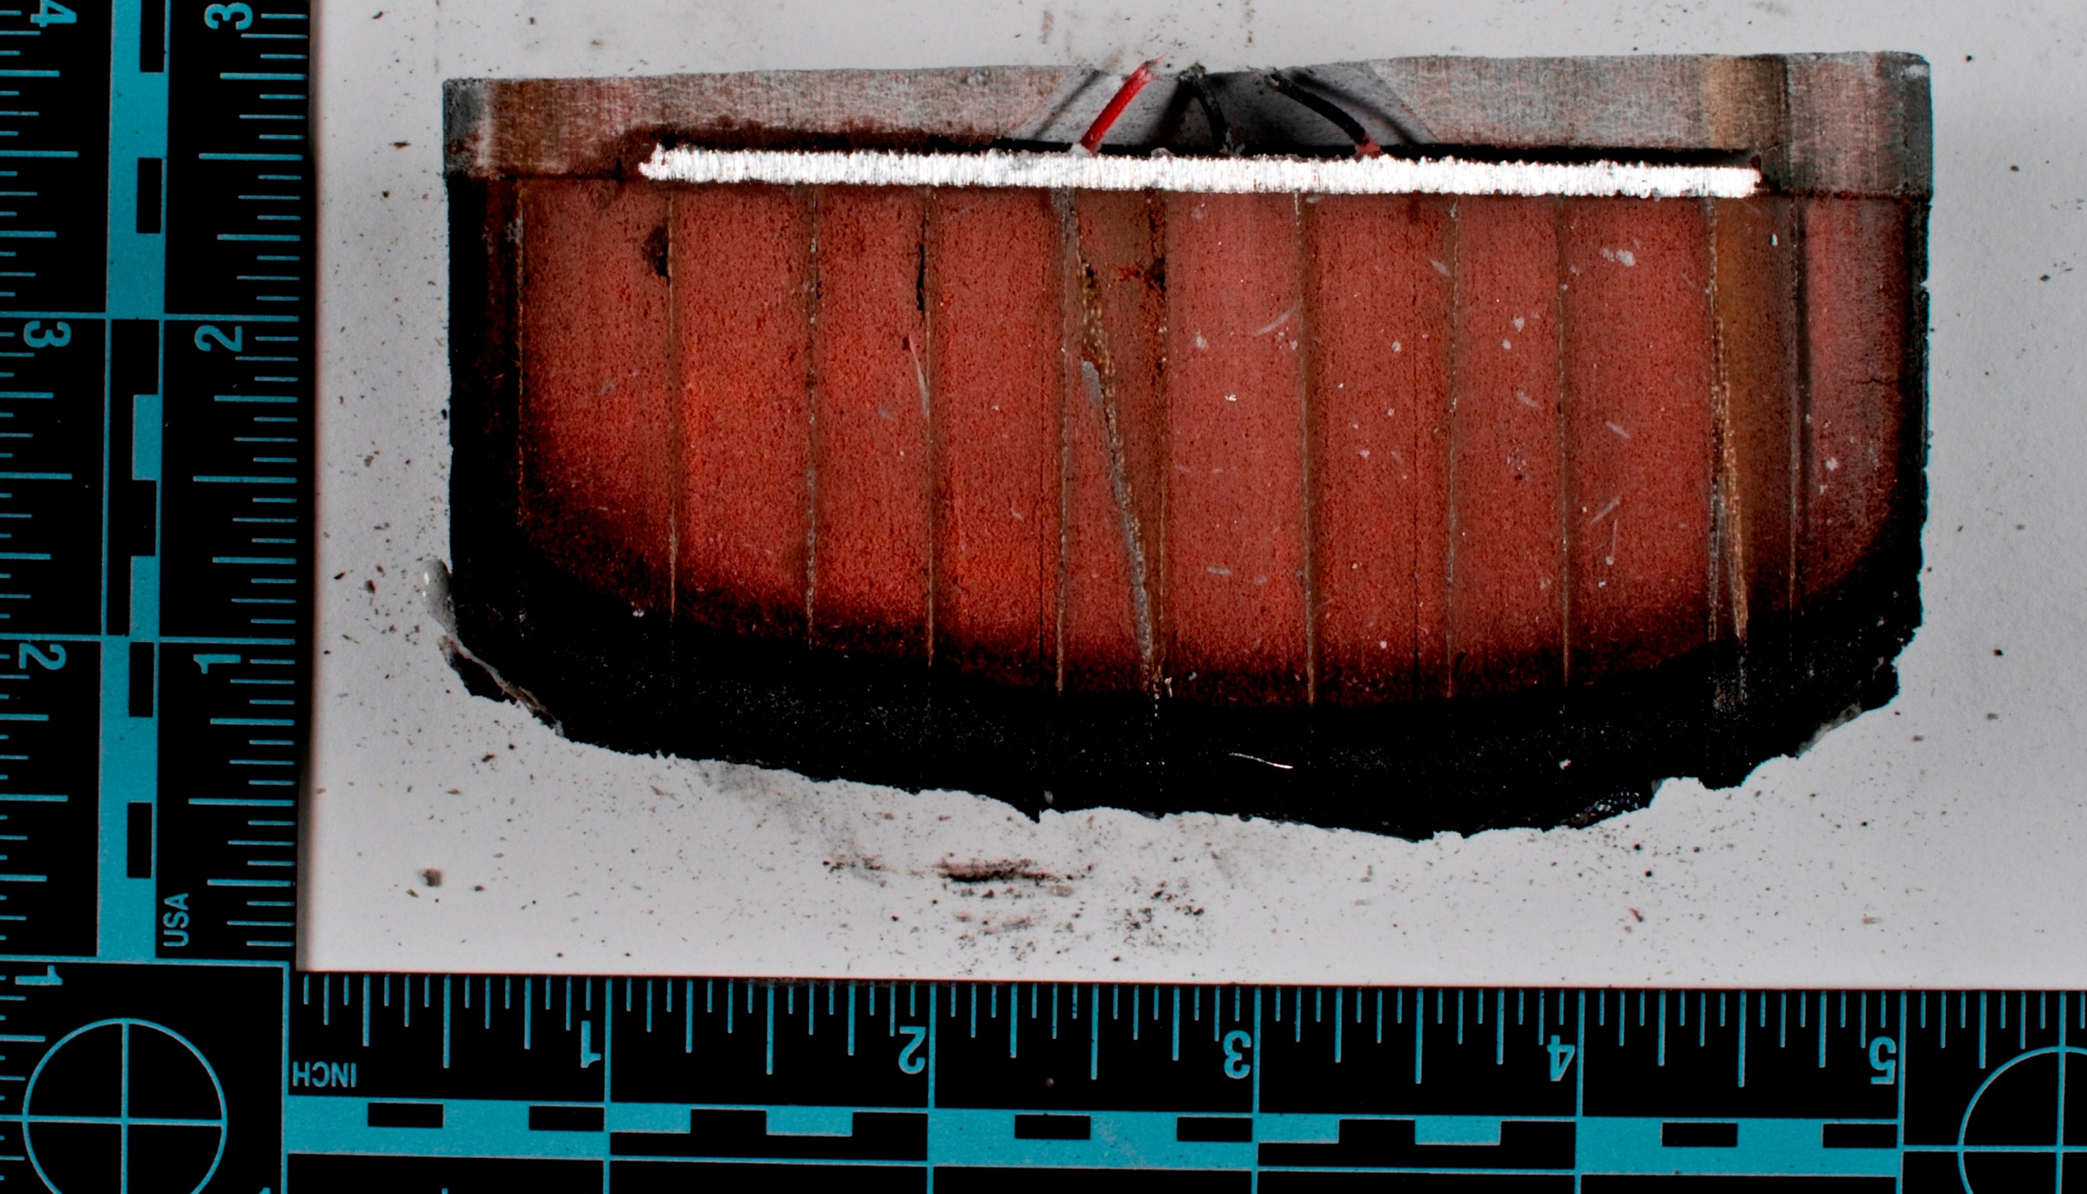
Ablatives
Char Layer
Pyrolysis Zone
Virgin Material
Cross-Section of Ablator Arc Jet Test Article

Slide 37
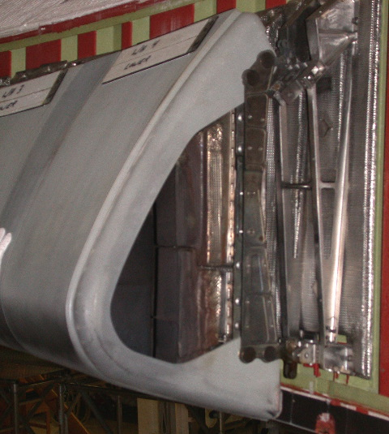
Hot Structure
Space Shuttle Orbiter Wing Leading Edge Panel

Slide 38
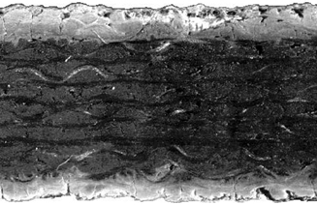
Hot Structure
Silicon Carbide Coating
Carbon Substrate
Silicon Carbide Coating
Reinforced Carbon-Carbon
Cross Section

Slide 39
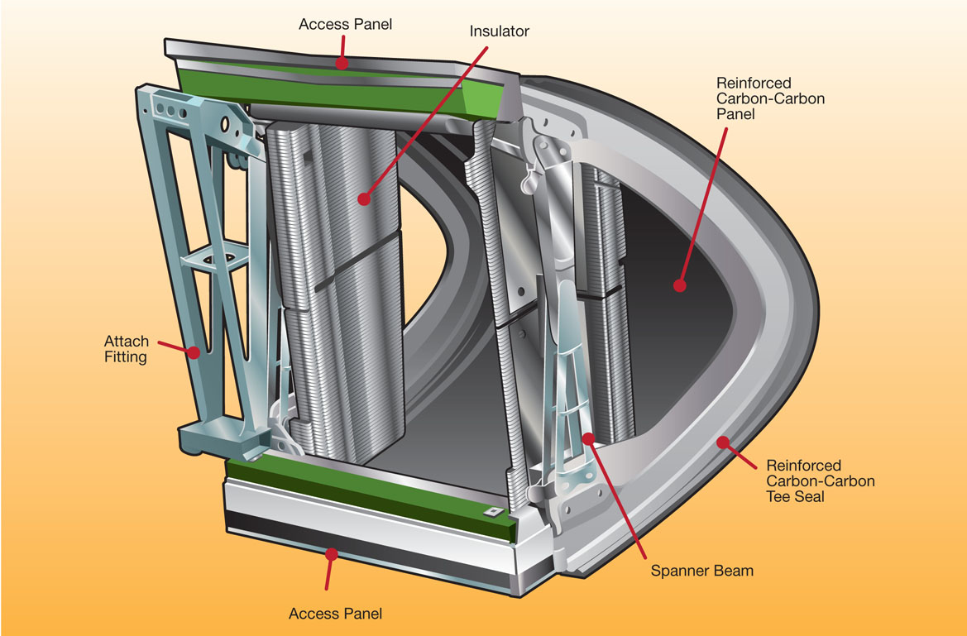
Hot Structure
Space Shuttle Wing Panel Assembly

Slide 40
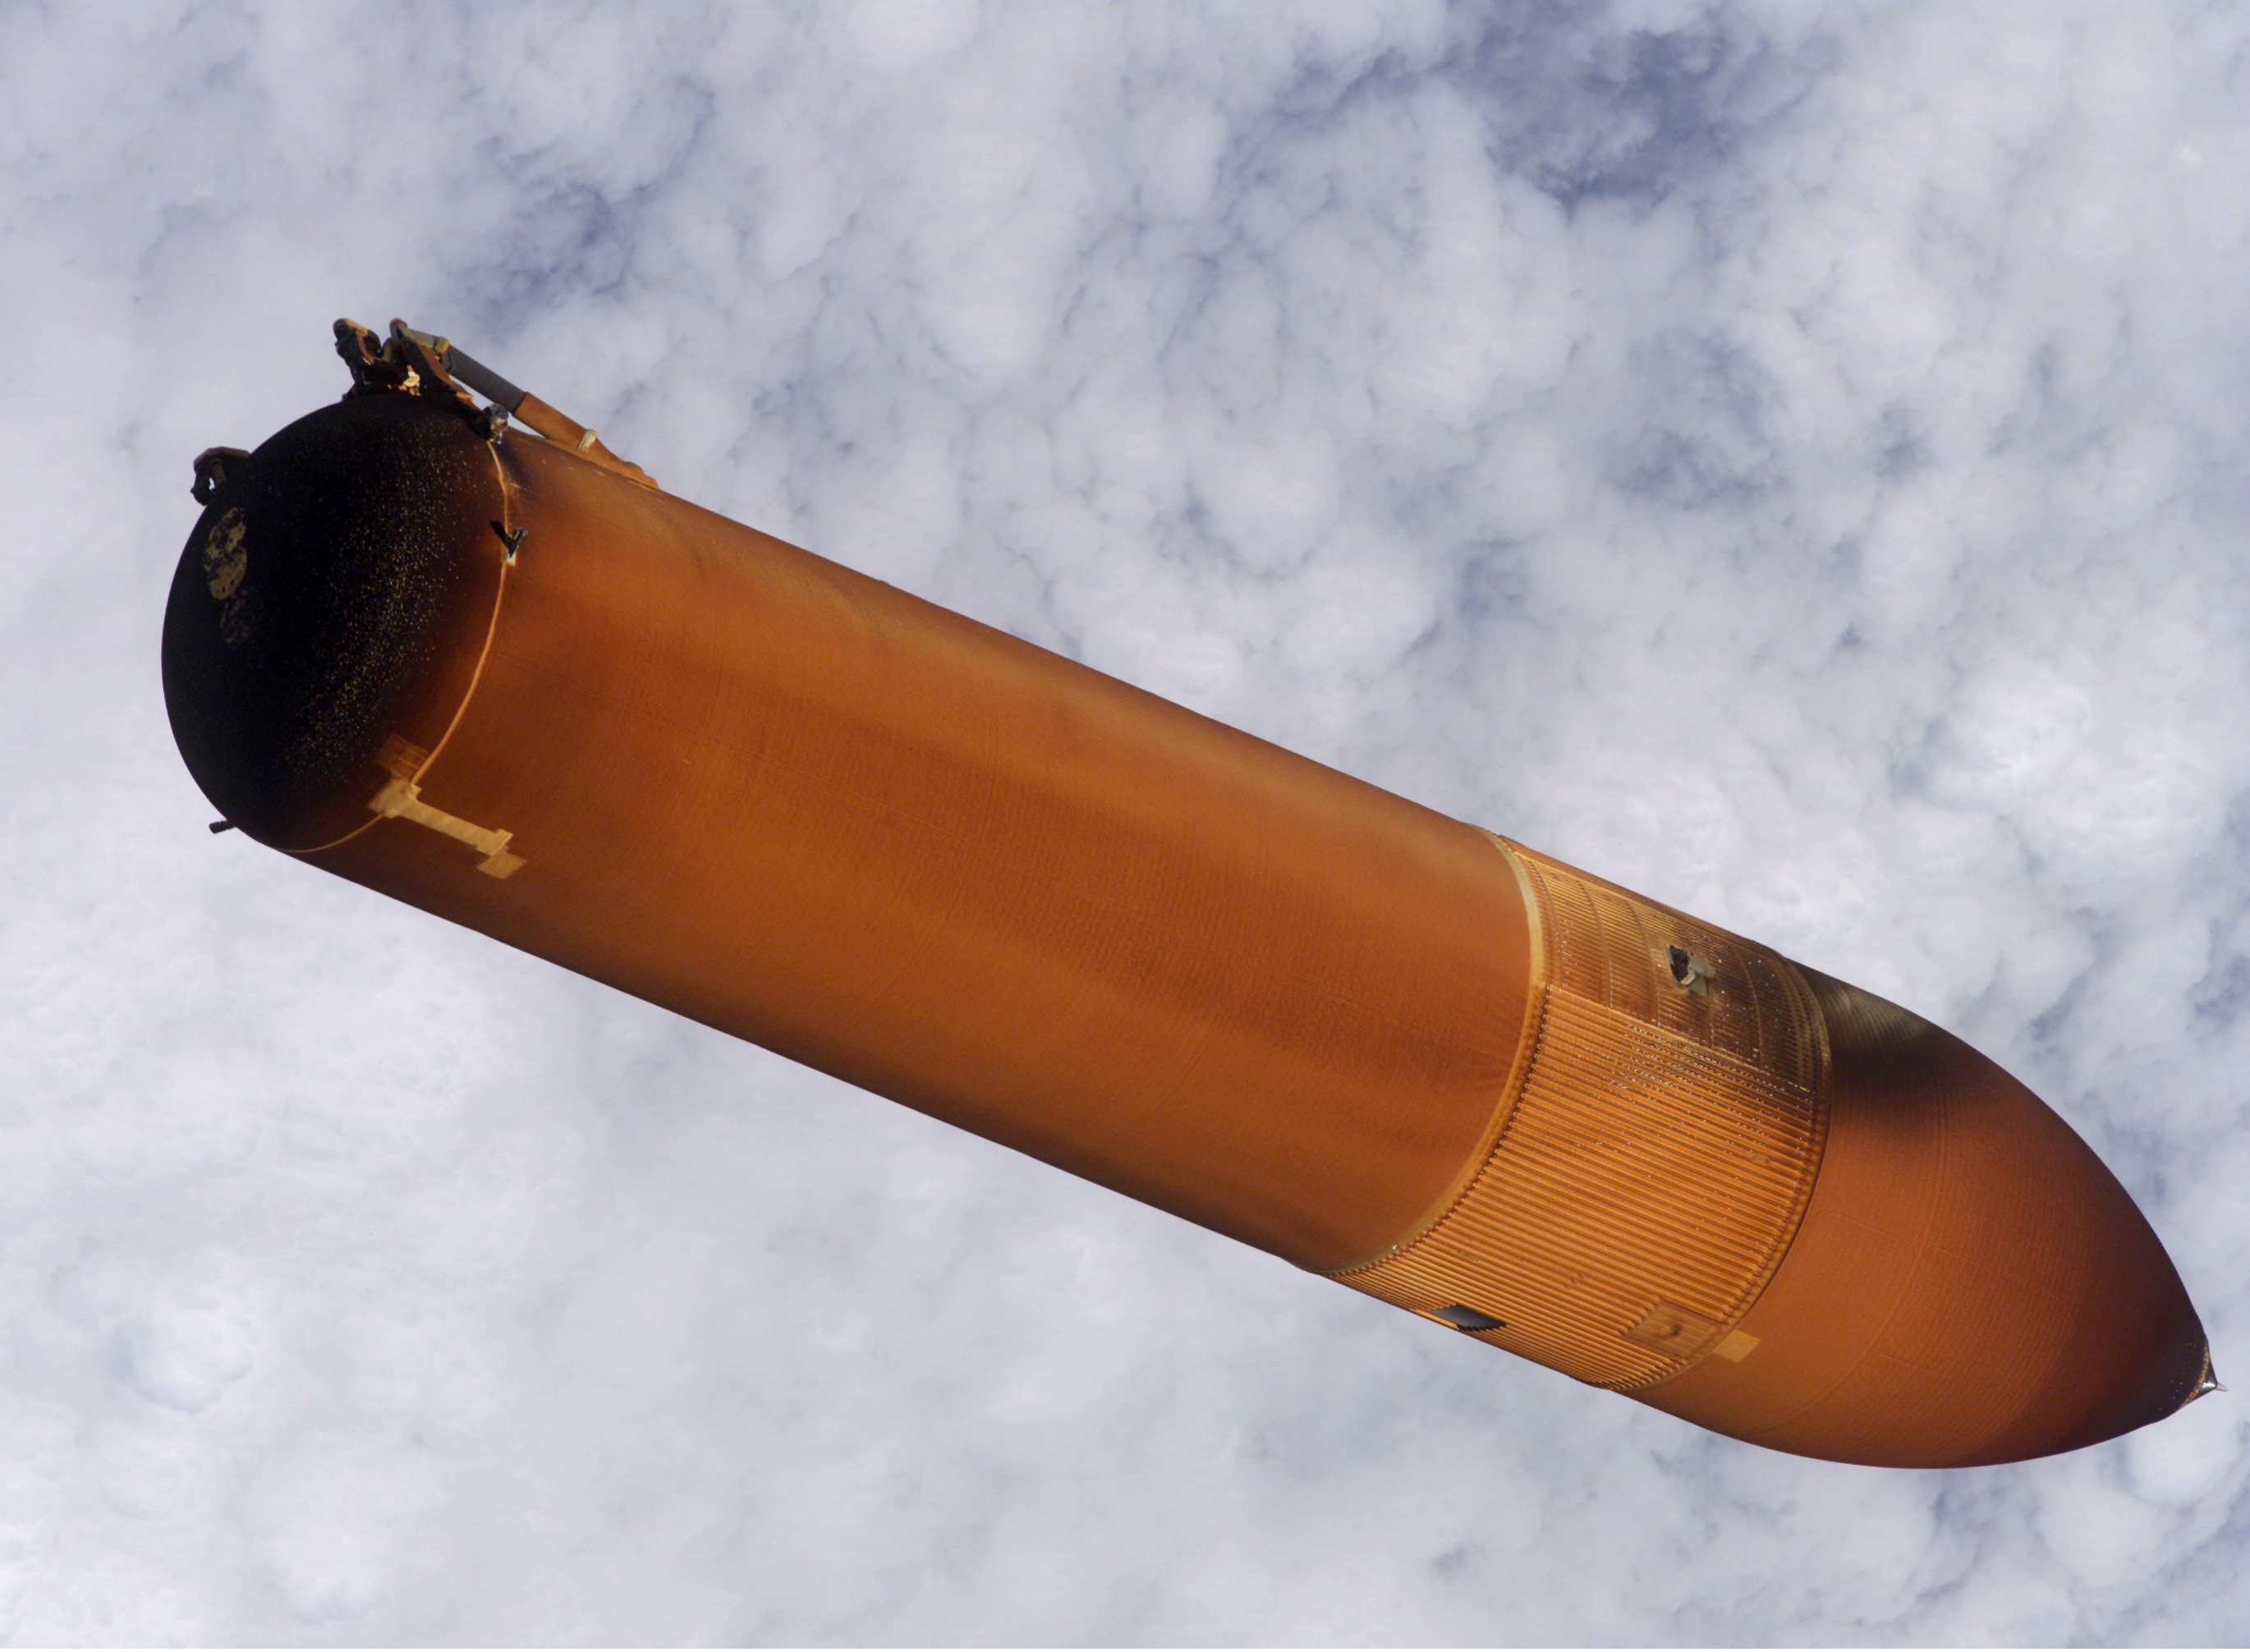
Cryogenic Insulations
Space Shuttle External Tank After Separation

Slide 41
Conclusion
Thermal control versus thermal protection;
Necessity of thermal control and protection;
Introduction to the space and entry thermal environments;
Conduction, convection and radiation;
Hardware overview.

Slide 42
Acknowledgements
This overview was developed by the NESC Passive Thermal Technical Discipline Team;
The team thanks the following personnel for contributing material to this presentation:
Robin Beck
Bruce Drolen
Jim Yuko
David Gilmore
Arturo Avila
Ruth Amundsen
Steve Scotti
Richard Wear
John Sharp
Ángel Álvarez-Hernández
Charles "Dan" Butler
Steve Rickman
Cooper Snapp
Lisa Huddleston
Mark Flahaut
Brian Remark
Alvaro Rodriguez
Jentung Ku
Carlos Lopez
Felix Gomez
Callie McKelvey
Ken Kittredge
Brian Hamill

Slide 43
Photos/References
Chandra Graphic: http://chandra.harvard.edu/graphics/resources/illustrations/spacecraft_labeled.jpg
Cassini Photo: http://www.jpl.nasa.gov/missions/missiondetails.cfm?mission=Cassini
Deep Impact/Epoxi Photo: http://www.jpl.nasa.gov/missions/missiondetails.cfm?mission=Epoxi
Microsoft Clip Art (various)
Absolute Zero Definition:
http://physics.about.com/od/glossary/g/absolutezero.htm

