Slide 1
The Representations and Practices of the Discipline of Systems Engineering
Dr. Stephen B. Johnson
Dependable System Technologies, LLC
University of Colorado, Colorado Springs

Slide 2
Part 2 of 2 Papers
This paper is part two of two papers on the Theory, Representations and Practices of DSE
This paper covers an addition to the theoretical bases and principles, and the strategies, representations, and practices.
Part 1: Stephen B. Johnson, “Theoretical Foundations of the Discipline of Systems Engineering”, AIAA SciTech/Infotech Conference, San Diego, California, 4 January 2016
  Covers Motivation, Approach, Bases, and Principles

Slide 3
Summary of Paper #1: “Theory of DSE”
Motivation & Approach
The Problems with Traditional SE
  Too often, programs fail, slip schedules, overrun budgets
  Complaints that it costs too much, compared to benefits
New approach: model the new “Discipline of SE” on how “Classical Engineering Disciplines” work
  CEDs: theory to model of product, run analyses and compare results to needs, requirements, expectations, in spiral development with product
  Reasons; state-based models and rigor:
    Significantly reduces communication mistakes
    Increases the probability of finding individual mistakes
    This reduces chances of failure and hence reduces cost overruns & schedule slips

Slide 4
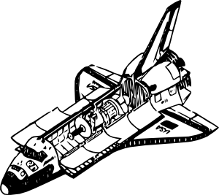

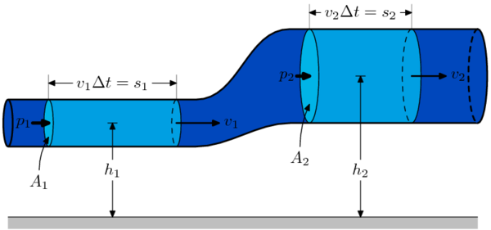
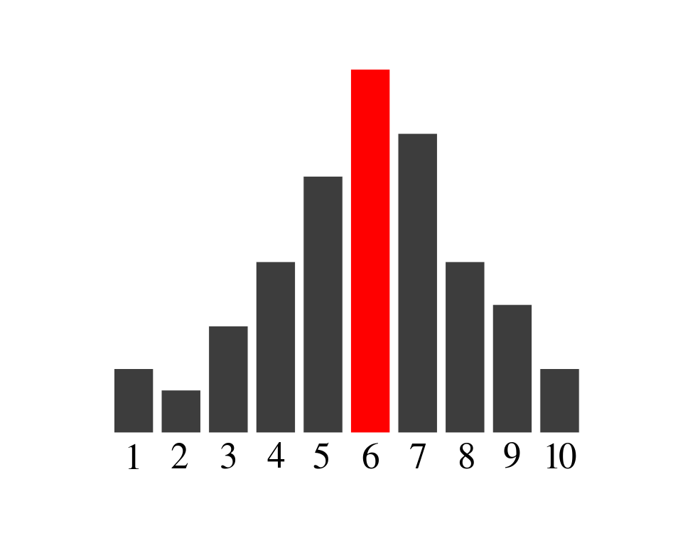
How Do Classical Engineering Disciplines Work?
Physical laws, logical relationships, theory
Theory applied via models to the application/system
System development progressively, iteratively refines the system model and the system design
Discussion, analysis, mainly/significantly through the model to project understanding and expectations of the system
Theory
Compare to
design
Applied via model
Generate analysis
results

Slide 5
The Bases of DSE (paper 1 summary)
System Basis
  Systems theory applies, particularly concepts of hierarchy and recursion
Value Basis
  Von Neumann-Morgenstern value-utility theory should be used as much as practicable
Model Basis
  Use models instead of natural language documents
State Basis and Functions
  Functions defined as mapping from input state vectors x(t) to output state vector y(t): y(t) = f(x(t))
Goal Basis
  Goals (requirements) are state variables within constraints: g = lower limit < y(t) < upper limit
Control Basis
  Control of state variables is the basis of the system and all of its functions
Knowledge Basis
  Probability theory to model uncertainties in knowledge about the system, environment, internal & external context
Predictive Basis
  Probability theory to model uncertainties in prediction (cost, schedule, performance)

Slide 6
Strategies of SE (1)
System theory strategies
  DSE shall divide its space of representation into the system, the system’s environment, and the system’s internal and external contexts.
  In hierarchical representations, DSE concepts will typically be applied recursively to each level of the hierarchy.
Value theory strategies
  DSE prefers to construct von Neumann-Morgenstern (vN-M) utility functions whenever possible.
  When it is not possible to construct vN-M utility, other goals, constraints, or uses of the system shall be used to define system goals and preferences.
  Specification of requirements should be delayed as long as practicable during system design and development, in favor of negotiable preferences.
  Note: SBJ skepticism about full applicability of value theory
Model strategies
  DSE shall maximize the use of models to represent, maintain, and generate knowledge.
  DSE system-level representations shall at a minimum include those for value, optimization, intention, design, performance, behavior, and agency.
  DSE shall provide abstract, system-level-compatible representations of discipline models.

Slide 7
System, Environment, Internal & External Context
 | Controllable by project | Not Controllable by project but influences and can be influenced by system
Operational | System (includes system and orgs/people that operate it) | Environment (immediate operational environment the system interacts with)
Non-Operational | Internal Context (org that designs & builds system) | External Context (orgs, politics, culture, economics)
SE directly develops the system, through the organizations of its “internal context”.
SE must account for the environment.
SE coordinates preferences from the external context to system goals through the value model.

Slide 8
Strategies of SE (2)
State strategies
  DSE shall maximize, to the extent practicable, the use of state variables in its representations.
  DSE shall define functions as mappings of input states of state variables to output states of state variables, y = f(x).
Goal strategies
  To the maximum extent practicable, DSE shall define goals as constraints on the ranges of output state variables of a function over a specified period of time. Goal = r_{l} < y < r_{h} , where y = f(x) between times t₀ and t₁.
  DSE shall represent system goals both in terms of operational description and of hierarchy.
Control strategies
  DSE shall deploy passive and active means to control state variables within appropriate constraints so as to achieve the corresponding goal.
  DSE shall use and extend classical control theory concepts of state estimation and state control to assess the system’s ability to achieve goals.
  DSE shall simultaneously with nominal system design also address design of the system to mitigate the failure to achieve goals

Slide 9
Strategies of SE (3)
Knowledge strategies
  DSE shall use existing sources of knowledge about the system.
  DSE shall accept the variability of human interpretation of acceptable and expected system behaviors.
  DSE shall maximize to the extent that is cost-effective the provision of automated means to cross-check the validity and consistency of information across all representations using different, overlapping knowledge sources.
  DSE shall estimate uncertainties of knowledge about the system, environment, internal context and external context.
Predictive strategies
  DSE shall use predictive models of performance, dependability, cost, and schedule.
  DSE predictive models shall include assessments of uncertainty.

Slide 10
Loop-Spiral of DSE Representations
Models of Preference
Rounded boxes
are functions,
not models.
Concept of
Operations
Model
Value-Decision
Model
Models of Intention
Goal-Function
Tree
Anomaly Investigation
Design
Optimization
Pattern Recognition and Anomaly Detection
Performance Models
Models of Failure
Fault Tree
Physical Simulation Models
Failure Propagation Model
Tests
State Machine Model
Models of Behavior
Design Model
Models of Design
Cost & Schedule Models
Physical Containment Model
Models of Agency
Organization Hierarchy Model

Slide 11
Traditional SE Process
Configuration Management Process Controls ALL Products
Concept of Operations
(ConOps) Document
Validate
System
Design
System Requirements
Document
Verify
System
Design
Verification
Traceability to
System
Requirements
Traceability
Interface
Requirements
Documents
Integrate
Subsystems
To System
Design
Functions
Subsystem
Requirements
Documents
Verify
Subsystems
Verification
Traceability to
Subsystem
Requirements
Traceability to Design
Design
Integrate
Boxes to
Subsystems
Functions
Interface
Control
Documents
Requirements
Traceability to V&V Plan
Verification
Traceability to
Boxes
Verify
Boxes
Design
V&V Plan
Integrate
Components
To Boxes
Requirements
Traceability to V&V
Procedures
Verification
Traceability to
Components
Disciplines &
Organizations
Disciplines &
Organizations
V&V
Procedures
Verify Components
Build Components

Slide 12
Using DSE Models
GFT to Fault Trees
  Logical complement of GFT, then add new failure branches
  Fault trees have more branches than success trees, because failures create new “off-nominal paths” in the system
  More generally, failure space models are the “more complete” system models than success space models
GFT-Functions & Requirements to Organizations and Organization Interfaces
  State variables key
  GFT ➔ Design Model ➔ Physical Containment Model (Configuration Items) ➔ Organization Model
Nominal and Failure Scenarios for Requirement Verification
  Paths from bottom to top of GFTs and Fault Trees, when implemented with state variables
  Test procedures and observables extracted from trees

Slide 13
Traceability from Functions to Organizations; GFT to Fault Trees
G(y)
Fault Tree
Ḡ(y)
Failures sometimes create new paths
GFT
Fcn 1
Fail 1
Logical Complement
G1(y1)
G2(y2)
G3(y3)
Ḡ1(y1)
Ḡ2(y2)
Ḡ3(y3)
Ḡ4(y4)
Fcn 2a
Fcn 2b
Fcn 2c
Fail 2a
Fail 2b
Fail 2c
Fail 2d
State variables exist in design & GFT
State variables mostly same for failure as for success
TEAMS Model mostly same as design model, except for new paths
Diagnostic Model
Design
Design 3b
x3
Design 2b
y2
Design 3b
x3
Design 2b
y2
Design 2a
y1
Design 1
y
Design 2a
y1
Design 1
y
Design 2c
y3
Design 2c
y3
Design includes component interfaces
Interfaces include failure behaviors
Design 2d
y4
Physical
Containment
G(y)
G(y)
Organization
Hierarchy
System
Physical interfaces usually match organizational interfaces
Prime
Physical interface goals (requirements) extracted to documentation
System, Element, and Interface Requirements
Documents
G1(y1)
G2(y2)
G3(y3)
G1(y1)
G2(y2)
G3(y3)
Ele 2a
Ele 2b
Ele 2c
SubC 2a
SubC 2b
SubC 2c

Slide 14
Experience with DSE Methods
On NASA SLS, some DSE models developed & used
Goal-Function Tree
  Used for fault management design (coverage of failure detections to protect system goals like crew safety and mission trajectory)
Failure Propagation Model
  Used for analysis of failure effects, criticality, launch commit criteria, fault isolation/diagnostics analysis, latent failure analysis
State Machine models
  Used for debugging / testing algorithms, flight sequences
  Pre-running and assist generation of test scripts
No integration between models so far, but we’re thinking about it!

