Slide 1


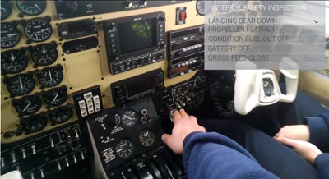
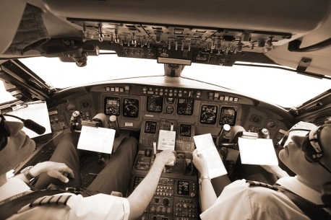

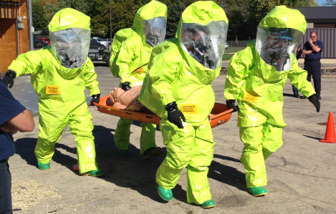

Method for Evaluation &
Simulation of Procedure Performance
NESC Academy Webcast
Lance Sherry (Ph.D.)
Houda Kourdali (B.Sc., CFII)
lsherry@gmu.edu
October 24, 2017
Moderated by Jon Holbrook (Ph.D.)

Slide 2
Acknowledgements
Immanuel Barshi (NASA-ARC)
Michael Feary (NASA-ARC)
Robert Mauro (Decision Research Inc)
Julia Trippe (Univ Oregon)
Sasha Snisarevska (GMU/CATSR)
John Shortle (GMU/CATSR)
Anonymous airlines (2)

Slide 3
Overview
Procedures are critical component of Command-and-Control System (e.g. flightdeck of airliner)
  define the sequence of flight control commands top execute mission
  handle all mission situations that can emerge
Procedures must be completed within an Allowable Operational Time Window (AOTW) to avoid a hazardous outcome
  AOTW is a distribution
  varies with interactions between environment, plant, and operator actions
Need to evaluate procedures to account for variability in AOTW/ToP
Describes a method to evaluate the time distributions for SOPs
  Calculate the Probability of Failure to Complete on Time

Slide 4
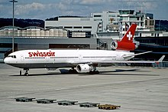
Motivation
MD-11/SwissAir Flight 111
  Crew not recognize fire started
    not warned by instruments
  Uncertainty → difficulty diagnosis
  Average 15 minutes = max time to identify and distinguish fire
  MD-11 Procedures designed to take 35 mins
Spoiler Arm Problem (Degani) – MD-80
  Spoiler cannot be armed until Gear Down
  Gear down takes an average of 22 seconds
  Flap extension must be completed simultaneously
  Pilots can fail to Arm Spoilers while performing simultaneous task(s)
Time is Critical Design Parameter for Procedure Evaluation

Slide 5
Table of Contents
Role
Definition
Analysis
Sim
Notes
Role of Procedures
Definition of Procedures
Time-based Analysis of Procedures
Time-based Simulation of Procedures
Notes

Slide 6
Role of Procedures
Role
Definition
Analysis
Sim
Notes

Slide 7
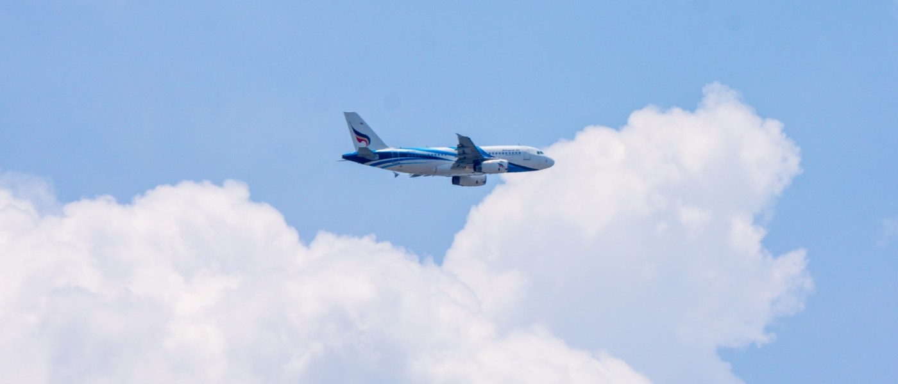
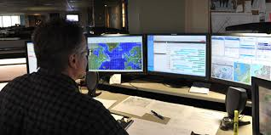
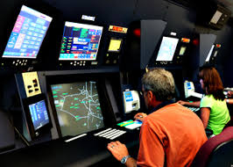
Airliner is an Autonomous “System”
Role
Definition
Analysis
Sim
Notes
Autonomous Airliner “System”
Cognizant
Taskable
Reflective
Airline Ops
Fuel
Aircraft System Emergency Support
Separation
Weather
Traffic System Emergency Support
Remote Operators
Airline Dispatch
Air Traffic Control
Traffic Flow Management
Notes:
So what awe are saying is that with reagrds the rest of the airspace transportation system, each flight can be considered an autonomous vehicle with chacateristics of cognizant, taskable and reflective.
For all intents and purposes the Airliner System is autonomous. The human-machine system in the flightdeck is Cognizant, Taskable, Reflective.
So what can learn about the characteristics of the behavior and the architecture of this autonomous system.

Slide 8
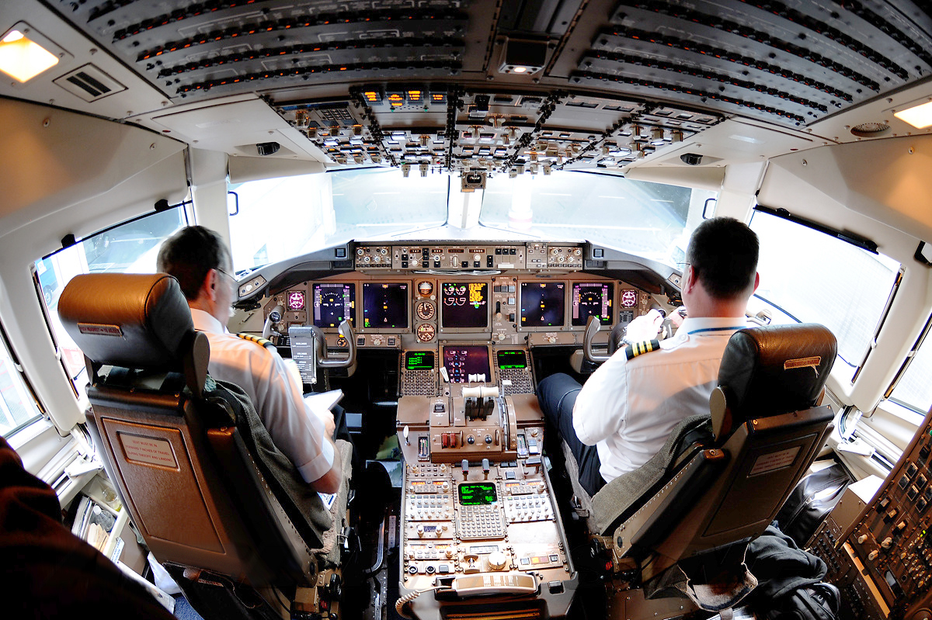
“Autonomous Airliner System” Decision-making (Flightdeck)
Role
Definition
Analysis
Sim
Notes
Filed flightplan (i.e. desired 4-D trajectory)
Procedures for expected, planned mission
Completed 4-D Trajectory for filed flightplan
Control Surface & Propulsion Commands
Environment (traffic, weather, …)
Wind, storms, ceiling & visibility, traffic (ATC), airspace restrictions (ATC), …
Notes:
Lets start with what it does
The decision-making autonomous system takes as inputs the combination of the desired filed flightplan and the existing conditions and performs decisions that result in commands to the control surface and propulsion system such that the vehcile follows the desired trajectory. Due to the nature of the complex ever changing environment, decision-making must constantly adjust to a large number of events that occur in the real world. These events are both expected events that are planned for in the flightplan as well as expected events that are not planned for on this flight
The system is composed of two (redundant) human-operators and a suite of automation. The Captain and First-Officer take turns serving as the Pilot Flying (PF) and Pilot Not Flying (PNF) and confirm and verify (i.e. double check) all actions on the flightdeck. The flightcrew are supported by the automation that performs rapid complex computations to instantaneously identify aircraft state (position, veloicty etc.) and control the trajectory by adjusting the flight control surfaces and engine thrust. The automation also performs complex decision-making to select speed, altitude, course targets to follow the desired flightplan. In addition, the automation performs complex computations to determine the correct route using a navigation data base and optimizes the flighplan (e.g. optimum cruise flightlevels, economy speeds, optimum step climb points, …).
Like the flightcrew, the automation also has built in redundancy. (next slide)

Slide 9
Definition – Mission Event
Role
Definition
Analysis
Sim
Notes
Airliner mission event
  situations that can occur in the conduct of the mission
    Cleared from gate
    Cleared for taxi (with taxi instructions)
    Cleared to runway
    Cleared for takeoff (using SID)
    ….
    Cleared to climb maintain altitude
    …
    Cleared Direct To
    Cleared Lateral Path Offset
    Instructed to Hold
    Instructed to Level Off
    Instructed to Expedite Descent
    …
    Engine-out
    Traffic avoidance
    Hold for traffic
    Weather avoidance
    Turbulence avoidance
    …
Notes:
So lets introduce the concept of a mission event. These are all the circumstances, stepping stones that must occur to complete the mission. Examples …

Slide 10
Categories of Mission Events
Role
Definition
Analysis
Sim
Notes
  Expected events, planned response
    all filed “flight plan” events
    takeoff, SID, STAR, step-climb, …
  Unexpected events, but planned response
    Non-flight plan events, but expected
    hold for traffic, lateral path offset, Direct To, …. engine-out, equipment malfunctions, ….
  Unexpected events (not planned)
    Surprises leading to hazardous events
      controlled flight into stall, controlled flight into terrain, traffic collision, …
    Hidden causes that cannot be recognized
Notes:
Thse mission events can be categorized as expected That is part of the plan or unexpected not part of the plan. Within the combination of unexpected events there are events that are known to occur but are not planned. When these events do occur it is not a surpise. They are handled according to a planned and trained response
Another set of unexpected events are surprises for which there are no planned or trained responses

Slide 11
Flightdeck Architecture
Role
Definition
Analysis
Sim
Notes
Navigation Procedures
Standard Operating Procedures (SOPs)
Captain + Automation + First Officer
Completed 4-D Trajectory for filed flightplan
Manage expected, unplanned mission surprises
Manage unexpected mission surprises (i.e. operational hazards)
Filed flightplan (i.e. desired 4-D trajectory)
Procedures for expected/unplanned mission surprises
Procedures for unexpected
Commands
Environment (traffic, weather, …)
Wind, storms, ceiling & visibility, traffic (ATC), airspace restrictions (ATC), …
Notes:
The system is composed of two (redundant) human-operators and a suite of automation. The Captain and First-Officer take turns serving as the Pilot Flying (PF) and Pilot Not Flying (PNF) and confirm and verify (i.e. double check) all actions on the flightdeck. The flightcrew are supported by the automation that performs rapid complex computations to instantaneously identify aircraft state (position, velocity etc.) and control the trajectory by adjusting the flight control surfaces and engine thrust. The automation also performs complex decision-making to select speed, altitude, course targets to follow the desired flightplan. In addition, the automation performs complex computations to determine the correct route using a navigation data base and optimizes the flighplan (e.g. optimum cruise flightlevels, economy speeds, optimum step climb points, …).
Like the flightcrew, the automation also has built in redundancy.
Everything is governed by the SOPs.
Navigation

Slide 12
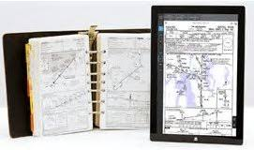
Airliner is an Autonomous “System”
Role
Definition
Analysis
Sim
Notes
Autonomous Airliner “System”
Cognizant
Taskable
Reflective
Airline Ops
Fuel
Aircraft System Emergency Support
Separation
Weather
Traffic System Emergency Support
Remote Operators
Airline Dispatch
Air Traffic Control
Traffic Flow Management
Notes:
So what awe are saying is that with reagrds the rest of the airspace transportation system, each flight can be considered an autonomous vehicle with chacateristics of cognizant, taskable and reflective.
For all intents and purposes the Airliner System is autonomous. The human-machine system in the flightdeck is Cognizant, Taskable, Reflective.
So what can learn about the characteristics of the behavior and the architecture of this autonomous system.

Slide 13
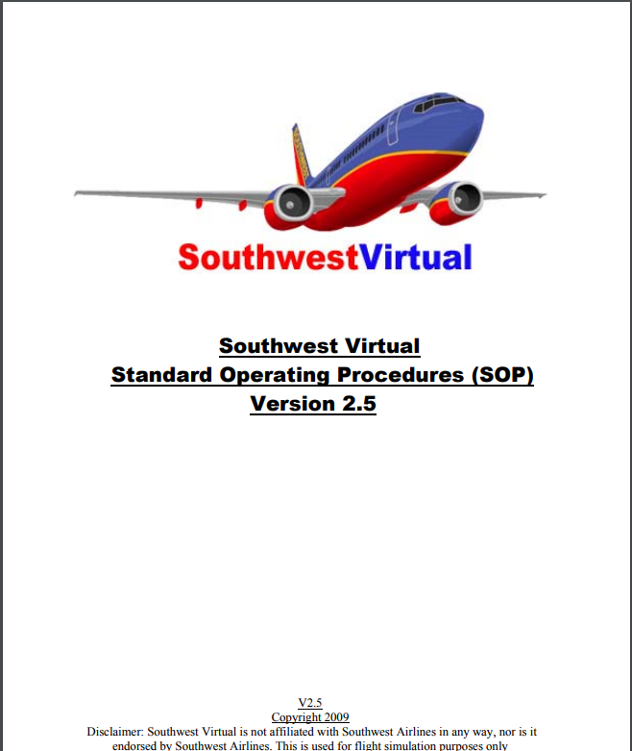
Standard Operating Procedures
Role
Definition
Analysis
Sim
Notes
What must be accomplished/Tasks
  Each Operator Action that must be executed in a sequence
When (under what conditions)
Who is responsible for each step
How each step is performed/Functions
How to confirm
Procedures define:
  Human-Machine Interaction
  Human Automation Interaction
  Human-Human Interaction
  Human-External Actors Interaction
Types of Operartor Actions:
Info gathering
Info processing
Conditional branching
Decision-making
Waiting/Timing
Action
Verification
Validation

Slide 14
Procedure Design & Evaluation
Role
Definition
Analysis
Sim
Notes
Commercial aviation standards for design
  Guidance for testing
Procedures developed by experts
Procedure evaluation
  Review by experts
  Testing in fixed-based/motion-based sim
    Cost and time prohibitive
  Human-in-the-loop testing with subjects (e.g. 20 crews)
    Cost and time prohibitive
    Do not cover all plausible situations/scenarios
Need for comprehensive testing of procedures for all plausible scenarios

Slide 15
Summary – Role of Procedures
Role
Definition
Analysis
Sim
Notes
Procedures are (over-looked) critical component of any C^{x}I system
Procedures define methods and techniques to complete mission
  respond all plausible mission events
    Normal (expected/planned)
    Non-normal /Emergency (expected/not planned)
    Other (not expected)
Procedures define:
  Human-Machine Interaction
  Human Automation Interaction
  Human-Human Interaction
  Human-External Actors Interaction
Design and evaluation can be enhanced with more rigorous testing
Need for comprehensive testing of procedures for all plausible scenarios

Slide 16
Definition of Procedures
Role
Definition
Analysis
Sim
Notes

Slide 17
Standard Operating Procedures (SOPs)
Role
Definition
Analysis
Sim
Notes
Airline flight deck operations are governed by airline Standard Operating Procedures (SOPs)
SOPs identify the flight crew sequence of actions in response to all plausible situations that might emerge in the execution of a revenue-service airline flight
  Continuously growing list

Slide 18
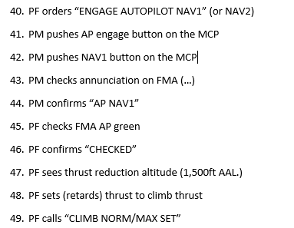
Standard Operating Procedures (SOPs)
Role
Definition
Analysis
Sim
Notes
Standard Operating Procedures (SOPs) specify
  what task to perform
  when to perform the task (timing and sequence)
  what actions are required to perform the task
  who conducts the task (i.e. pilot-flying (PF) or pilot-monitoring (PM)), and
  what feedback to provide (i.e., call-outs)
Extract Takeoff SOP
Barshi, I., R. Mauro, A. Degani, L. Loukopoulou (2016) Designing Flightdeck Procedures. NASA/TM—2016–219421
Notes:
Put in the references

Slide 19
Standard Operating Procedures (SOPs)
Role
Definition
Analysis
Sim
Notes
By standardizing procedures, the airline can:
  (1) ensure safe and efficient operations that are in adherence to its overall operational philosophy and policies
  (2) enable crew members to be paired with other crew members with whom they may have never flown before, and
  (3) provide the basis for objective flight crew proficiency evaluation

Slide 20
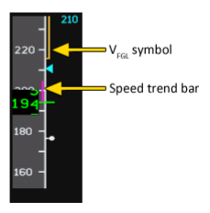
Airline Takeoff Procedure (Summary)
Role
Definition
Analysis
Sim
Notes
Engage AP NAV 1
Not to Exceed Limit
Current Speed and Trend Vector
Altitude
Flaps Zero
Climb Nor/Max Set
ATC
Flaps 18
V_{flapRetract}
Engage AP NAV 1
1,500’ AGL
V_{flapRetract}
XXXX 123 Runway 16, cleared for Takeoff
V -ONE
Gear Up
80 Knots
ROTATE
350’ AGL
Gear Up
Runway
80 Knots
V₁
V_{R}
Obstacle
Roll
Rotate
Climb-out
Flaps 24 to 18
Not Drawn to Scale
Hazard Events

Slide 21
Video
Role
Definition
Analysis
Sim
Notes
Takeoff
https://www.youtube.com/watch?v=gStkrQGK5wQ
Engine out Procedure
https://www.youtube.com/watch?v=rEf35NtlBLg

Slide 22
Takeoff Procedure (Events/Op Actions)
Role
Definition
Analysis
Sim
Notes
ATC gives clearance to Takeoff: “XXX123, RNW16, cleared for takeoff”
PF reads back clearance “Cleared for takeoff, XXX123”
PM announces “TAKE-OFF”
PM announces “YOUR CONTROLS” simultaneously holds ailerons into wind
PF puts right hand on the nose wheel steering control and simultaneously keeps left hand on lap, and simultaneously confirms “MY CONTROLS”
PM advances throttle levers
PM checks that all 4 engines accelerate symmetrically beyond 50% N1
PM activates auto throttles by means of TOGA buttons
PM checks FMA auto-throttle engagement: A/T green arc and FADEC trim arrow extinguished (if applicable)
PF simultaneously checks FMA auto-throttle engagement: A/T green arc and FADEC trim arrow extinguished (if applicable)
PM: before reaching 80 kts. Checks that take-off thrust is set
Needs time/aircraft dynamics awareness
PM: reports “TAKE-OFF THRUST SET”
PF verifies that takeoff thrust is set
PF confirms “CHECKED”
PM checks engine parameters throughout the take-off toll to be within limits
Procedure is composed of
Events
Operator Actions
79 Events/ Operator Actions for Normal Airline Takeoff Procedure

Slide 23
Takeoff Procedure 2/4
Role
Definition
Analysis
Sim
Notes
Aircraft Reaches 80 kts
PM sees 80 kts (or past)
PM calls “80 KTS”
PF compares speed indication on his/her side of the PFD
PF releases NWS
PF takes over control column with both hands
PF simultaneously confirms “MY COLUMN”
PM simultaneously keeps his right hand on the thrust levers throughout the take-off roll until V1
Segment = grouping of Operator Actions between a triggering Event and Hazardous Event

Slide 24
Takeoff Procedure 3/4
Role
Definition
Analysis
Sim
Notes
AC reaches V1=115kts (average) speed
PM sees V1 (e.g. 115 kts) on the PFD
PF calls “V1”
PM takes his/her hand away from the thrust lever after passing V1 = 115kts.
AC reaches VR
PM sees VR
PM calls “ROTATE”
PF starts a smooth rotation with about 3 ⁰/sec. to simultaneously follow the FD pitch command. If FD is not usable, pilot needs to know climb with max V2+10 (initially 12⁰-15⁰ ANU)
PF sees clear of ground
PF sees positive rate of climb (simultaneously since previous step is in the field of vision)
PF orders “GEAR UP”
PM silently checks positive rate of climb
PM selects gear up
PM monitors gear retraction
PF checks above 350 ft. RA (Do not engage the autopilot in the TO mode below 350 ft AGL. Do not deselect the TO mode until obstacle clearance is assured.)
PF orders “ENGAGE AUTOPILOT NAV1” (or NAV2)
PM pushes AP engage button on the MCP
PM pushes NAV1 button on the MCP
PM checks annunciation on FMA (…)
PM confirms “AP NAV1”
PF checks FMA AP green
PF confirms “CHECKED”
PF sees thrust reduction altitude (1,500ft AAL.)
PF sets (retards) thrust to climb thrust
PF calls “CLIMB NORM/MAX SET”
PM checks thrust on PFD
PM reports “CHECKED”
PF after thrust reduction and passing acceleration altitude accelerates (Acceleration altitude 1500 ft. AAL of 3000 ft. AAL if not otherwise stated in OM-C)
PF sees acceleration altitude 1,500 ft. AAL (check previous step) sets speed (VF18+20. E.g. 146kts)
PF calls “SPEED 146 SET”
PM sees 146 kts on the MCP
PM reports “CHECKED”
Segment = time period in which Operator Actions must be completed

Slide 25
Takeoff Procedure 4/4
Role
Definition
Analysis
Sim
Notes
Allowable Operational Time Window (AOTW) = time in which Operator Actions must be performed before Critical/Hazardous Event
Time-on-Procedure (ToP) = time taken to perform sequence of Operator Actions
Procedure Buffer Time (PBT) = AOTW – ToP
SPEED ACHIEVES VF18 (e.g. 126 knots)
PF sees VF18 (e.g. 126kts) on PFD
PF orders “FLAPS 18”
PM silently checks VF18 (e.g. 126 kts) on the PFD
PM selects flaps lever to 18⁰
PM monitors flaps transition on flaps position indicator
PM confirms “FLAPS 18”
PF checks flaps position 18⁰ on flaps position indicator
PF confirms “CHECKED”
PF checks altitude on the PFD
PF sets appropriate speed VFT0+20 (e.g. 155kts)
PF states “SPEED 155”
PM sees 155 kts on the MCP
PM report “CHECKED”
SPEED ACHIEVES VF0 (e.g. 135 knots)
PF sees VF0 (e.g. 135 kts) on the PFD ~ flap retraction from 18 to 0
PF orders “FLAPS 0”
PM silently checks VF0 on the PFD
PM selects flaps lever t 0⁰
PM monitors flap retraction on flap position indicator ~ end
PM confirms after clean-up “FLAPS AT 0”
PF checks flaps position 0⁰
PF confirms “CHECKED”
79 Events/ Operator Actions for Normal Airline Takeoff Procedure

Slide 26
Summary - Definition
Role
Definition
Analysis
Sim
Notes
Procedure is composed of Operator Actions, Events
Events:
  trigger Operator Actions
  Define Critical/Hazardous Outcomes
Critical (Hazardous) Events define Segments
Procedures must be completed before Critical Events
  Allowable Operational Time Window (AOTW)
  Time-on-Procedure (ToP)
  Procedure Buffer Time (PBT) = AOTW - ToP

Slide 27
Time-based Analysis of Procedures
Role
Definition
Analysis
Sim
Notes

Slide 28
Measuring Procedure Performance
Role
Definition
Analysis
Sim
Notes
Time widely accepted means for evaluation of procedures used in management and control of complex, dynamic systems (e.g. airliners)
  correlated with
    errors
    operational efficiency
    task loading
  common unit of measurement performance
    both naturalistic (i.e. ops) and experimental conditions

Slide 29
Allowable Operational Time Window (AOTW)
Role
Definition
Analysis
Sim
Notes
Time from Triggering Event to Critical Event
  Time aircraft achieves Flap 18 speed to time aircraft achieves Flaps Zero speed
AOTW is not constant
  Distribution based on external/environmental conditions
Distribution of AOTW
Triggering Event
Time (secs)

Slide 30
Time-on-Procedure
Role
Definition
Analysis
Sim
Notes
Time from Triggering Event to completion of Operator Actions
ToP is not constant (based on system design and human performance)
ToP is sum of Operator Actions
Notional
Distribution of ToP
Triggering Event
+
+
+
+
Triggering Event
Time (secs)
Time (secs)

Slide 31
Procedure Buffer Time (PBT)
Role
Definition
Analysis
Sim
Notes
Time between AOTW and ToP
  PBT(i) = AOTW(i) – ToP(i) for flight i
PBT > 0 : AOTW > ToP (completed on time)
PBT < 0 : ToP > AOTW (not completed on time)
PBT is a distribution
Distribution of PBT
0 Time (secs)

Slide 32
Probability of Failure to Complete on Time (PFtCoT)
Role
Definition
Analysis
Sim
Notes
% PBT < 0 = Probability of Failure to Complete on Time (PFtCoT)
  Procedure satisfactory PFtCoT < 0.01
Probability of Failure to Complete on Time (= area in this region)
Distribution of PBT
0 Time (secs)

Slide 33
AOTW vs ToP Chart
Role
Definition
Analysis
Sim
Notes
Time on Procedure (ToP)
Procedure Completed in AOTW
Procedure Buffer Time (PBT) >o
Allowable Operational Time Window (AOTW)
Time on Procedure (ToP)
Allowable Operational Time Window (AOTW)

Slide 34
AOTW vs ToP Chart
Role
Definition
Analysis
Sim
Notes
Time on Procedure (ToP)
Procedure not Completed in AOTW
Procedure Buffer Time (PBT) < 0
Time on Procedure (ToP)
Allowable Operational Time Window (AOTW)
Allowable Operational Time Window (AOTW)

Slide 35
AOTW vs ToP Chart
Role
Definition
Analysis
Sim
Notes
Distribution of PBT
Time on Procedure (ToP)
Probability of Failure to Complete on Time
0 Time (secs)
Procedure Buffer Time (PBT)
Distribution of ToP
Procedure not Completed in AOTW
Time (secs)
Time on Procedure (ToP)
AOTW is a Random Variable (depends on weather, weight, traffic, … etc)
ToP is Random Variable (depends on human performance)
Procedure Buffer Time (PBT) → Probability of Faulure to Complete on Time
Allowable Operational Time Window (AOTW)
Distribution of AOTW
Time (secs)

Slide 36
Example TOP for Takeoff Segments
Role
Definition
Analysis
Sim
Notes
(a)
(b)
One mode, but long tail
Multiple Modes (lots of variability)
(c)
(d)

Slide 37
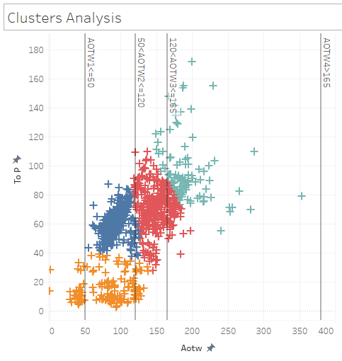
Role
Definition
Analysis
Sim
Notes
ToP > AOTW
If AOTW longer, then ToP longer
Longer ToP for medium and long ATOW
Quick ToP for quick and medium ATOW

Slide 38
Time-based Simulation of Procedures
Role
Definition
Analysis
Sim
Notes

Slide 39
Monte Carlo Simulation
Role
Definition
Analysis
Sim
Notes
Procedure
Operator Actions
Monte Carlo Simulation of Procedure Time
Triggering Events
PBT Distribution
Probability of Failure to Complete on Time
Critical/ Hazardous Events
AOTW Distribution
Data-base of Distributions for Operator Actions

Slide 40
Spreadsheet MC Sim (Inputs)
Role
Definition
Analysis
Sim
Notes
1
Trigger Event
2
Operator Actions
3
Time Distributions for Operator Actions
4
AOTW (μ, σ)

Slide 41
Spreadsheet MC Sim (Calculations)
Role
Definition
Analysis
Sim
Notes
Trial #1
5
Operator Action Time
= MAX (NORMINV (RND(), μ, σ), 0.1)
6
ToP = Σ OA Times
8
7
AOTW =
(NORMINV(RND, μ, σ)
PBT = AOTW -ToP

Slide 42
Spreadsheet MC Sim (Outputs)
Role
Definition
Analysis
Sim
Notes
9
11
10
% Flights PBT < 0
% Flights PBT > 0
12
Probability of Failure to Complete on Time

Slide 43
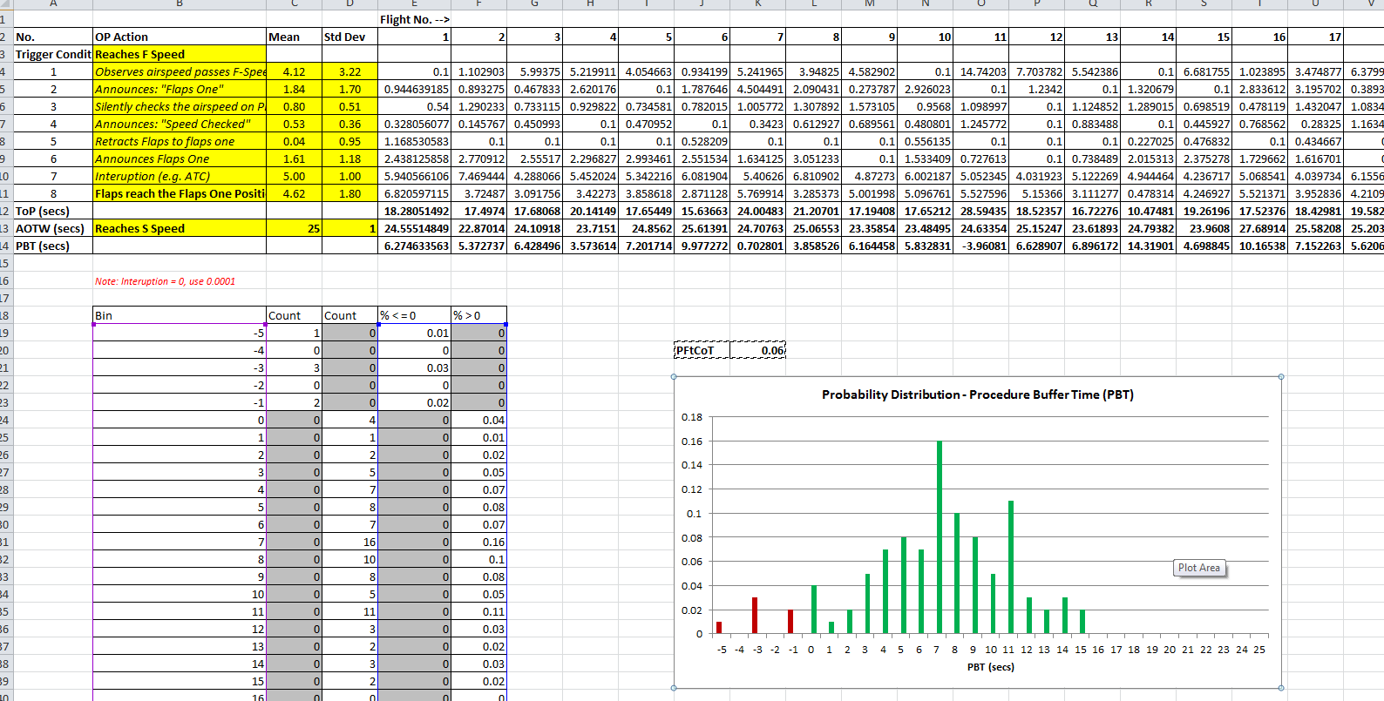
Excel MC Sim
Role
Definition
Analysis
Sim
Notes

Slide 44
Sim Instructions
Role
Definition
Analysis
Sim
Notes
Enter Trigger Event
Enter Operator Actions & Events
Assign Operator Actions & Events Time Distributions (μ,σ)
Enter Critical/Hazardous Event
  Assign AOTW Distribution (μ,σ)
Enter Interruptions
    Assign Interruption Distribution (μ,σ)
Run Simulation & Evaluate PFtCoT

Slide 45
Notes - Sim
Role
Definition
Analysis
Sim
Notes
Source of OA Distributions
  Standard from lit
  Empirical data from experiments
  OA Data-base
MC Sim OA computation
  Distributions: Norm, Log-normal, Weibull
  Multi-modal
  Parametric from empirical data
AOTW distribution
  Empirical data
  Data-base (NASA)
Sim model allows OA out of sequence
Interruptions
Enhanced Sim model handles “Missed Oas”
  Two stage model
    #1 Probability OA occurred
    #2 Time distribution of OAs

Slide 46
Notes – Safety Auditing
Role
Definition
Analysis
Sim
Notes
Safety and Performance Auditing
  Tracking AOTW
    Distributions = multi-modal
    Cluster Analysis
  Learn more about environment in which operations take place (than Command-and-Control)

Slide 47
Summary
Role
Definition
Analysis
Sim
Notes
Method for evaluating procedures (based on time)
  AOTW
  ToP
  PBT
  PFtCoT
Simulation for procedure performance (based on time)
Spreadsheet, data-base – lsherry@gmu.edu
Collaboration opportunities:
  Data collection for Operator Actions needed for data-base
    Provide data to derive OAs, ToPs, AOTWs
    Submit/use distributions for OAs, ToPs, AOTWs

Slide 48
NESC Academy Webcast
Questions?
nescacademy.nasa.gov

