Slide 1



NESC Academy Webcast
Orbiter Water Dump Nozzle Redesign Lessons Learned
Hank Rotter
NASA Technical Fellow
Environmental Control/Life Support
NASA Engineering & Safety Center
April 14th, 2017
Moderated by Cinda Chullen
U.S. Spacesuit Knowledge Capture Program

Slide 2
Orbiter Water Dump Nozzle Redesign
During STS-41B and STS-41D Space Shuttle missions, an icicle formed over the supply and wastewater dump nozzles. This could have caused hazardous impacts on the side and aft end of the Orbiter during entry.
The two occurrences of this problem had two different causes:
  STS-41B – problem caused by a water pressure drop to the nozzles that widened the spray patterns.
  STS-41D – problem caused by the new thermal protection blankets installation around the nozzles.
The concern was that during the entry, the air flow path was aligned from the Orbiter side nozzles’ location to the Orbital Maneuvering System (OMS) pod location, and any ice on the nozzles could strike the OMS pod when released.
As the Water & Waste Management (WWM) Subsystem Manager (SSM) it was my task was to redesign the nozzle configuration to prevent icicle formation.

Slide 3
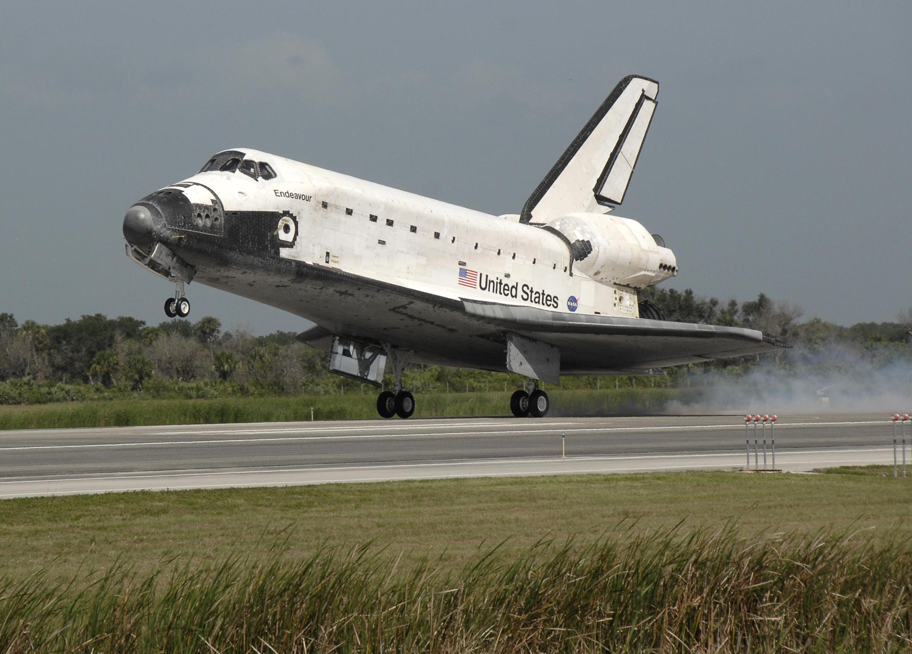
Dump
Nozzles
OMS Pod

Slide 4
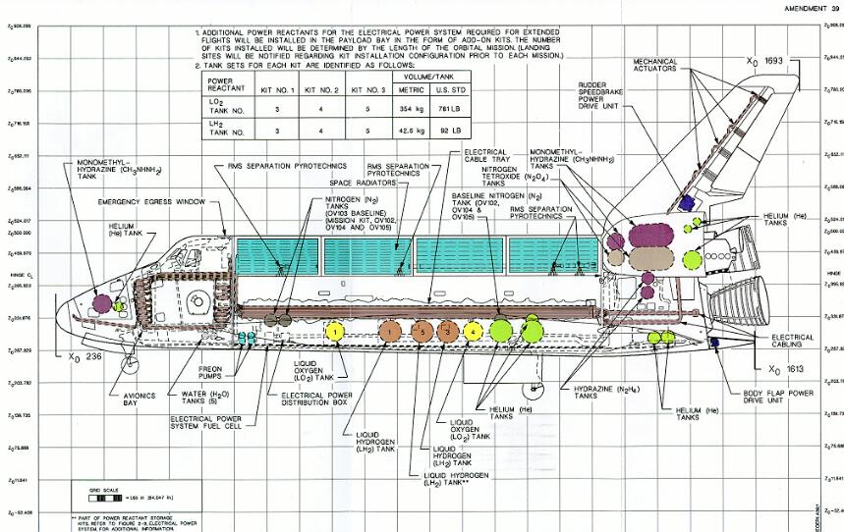

Slide 5
Orbiter Water Dump Nozzle Redesign
The STS-41B icicle that formed in a vacuum at about 80% density of solid ice was about 200 lbs of fuel cell water and wastewater (humidity water and urine ice pellets):
  The base of the icicle was about 2+ ft diameter over both nozzles, and estimated to be about 5+ ft long:
    The base size was based on the entry burn stain from the urine solids on the Orbiter Thermal Protection System (TPS) tile.
    The length was based on vacuum chamber testing.
Post-landing inspection found several tiles damaged in line to the OMS pod, and several hits on top of the left wing.
The big concern – the OMS fuel tank’s pod structural cover, which had about 2 sq ft damage on pod tile with the non-metallic structure, crumbled behind the tile, with only the wire mesh holding the tile together.
Note that no tile was missing during the decent.

Slide 6
First Lesson Learned
Mission Operations desired to do a dual potable and wastewater dump:
  Engineering did not do a full analysis of the pressure control system for a dual dump of potable water and wastewater systems.
  There were two pressure control regulators and two relief valves, but only one system was active as designed for one active dump system.
  The pressure regulator had a max flow rate of 1.2 lb/hr.
  Post event, the WWM SSM did the analysis of the reg flow rate vs. the potable and wastewater systems’ dual dump nozzle water flow rates that verified that the single regulator could not maintain the pressure on the water tanks.

Slide 7
Orbiter Water Dump Nozzle Redesign
STS-41D was the first flight with TPS blankets on the side of the Orbiter that formed an ideal trap for ice collection around the nozzles:
  The nozzle was recessed in a blanket circular valley.
  This time, the flight directors listened and the Orbiter arm was moved to view the icicle.
  A procedure was developed to bump the icicle off with the arm after testing the strength of the ice attachment to the side blankets in a vacuum chamber.
  The icicle removal was successful.

Slide 8
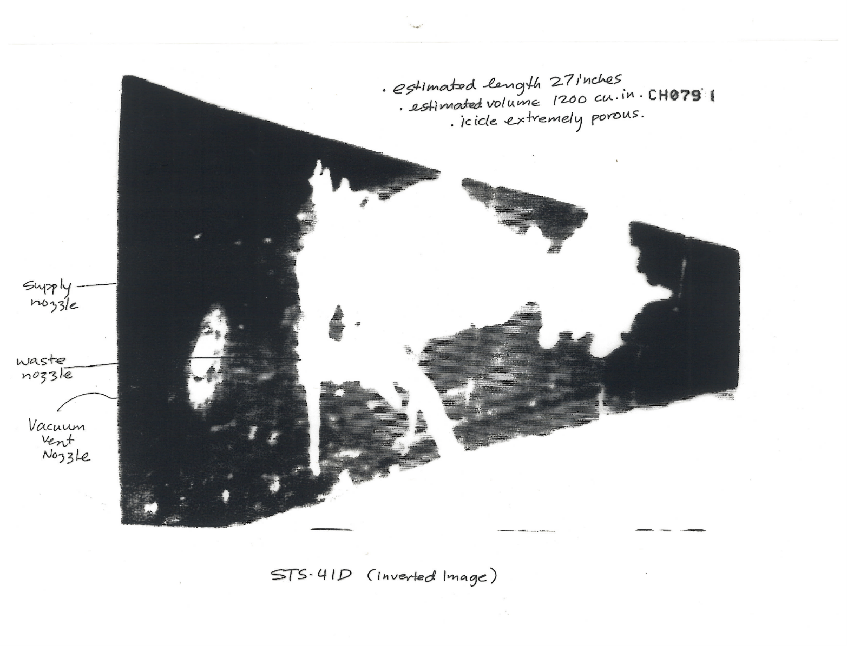

Slide 9
Orbiter Water Dump Nozzle Redesign
After testing several nozzle designs, a sharp edge orifice was selected that had a near zero spray pattern:
  At 20 ft, it had less than 2 ft diameter spray pattern vs. the old nozzle of about 6+ ft diameter at normal water pressure.
  At 50% pressure, the sharp edge nozzle spray pattern had almost no change.
The WWM SSM directed Rockwell and the nozzle vendor to drill out the current straight-edge nozzle to a sharp-edge nozzle and assumed that Rockwell and the vendor would do the drawing dimensional tolerance analysis. This led to the following problems:
  Because this was a simple drill out of the flow path with ¼ bit, no one did the analysis.
  Two spare dump nozzles were drilled out and installed for the next flight.
Rockwell was directed to install black tile around the two nozzles with the nozzle 0.1 inch above the tile on vehicles with the TPS blankets.

Slide 10
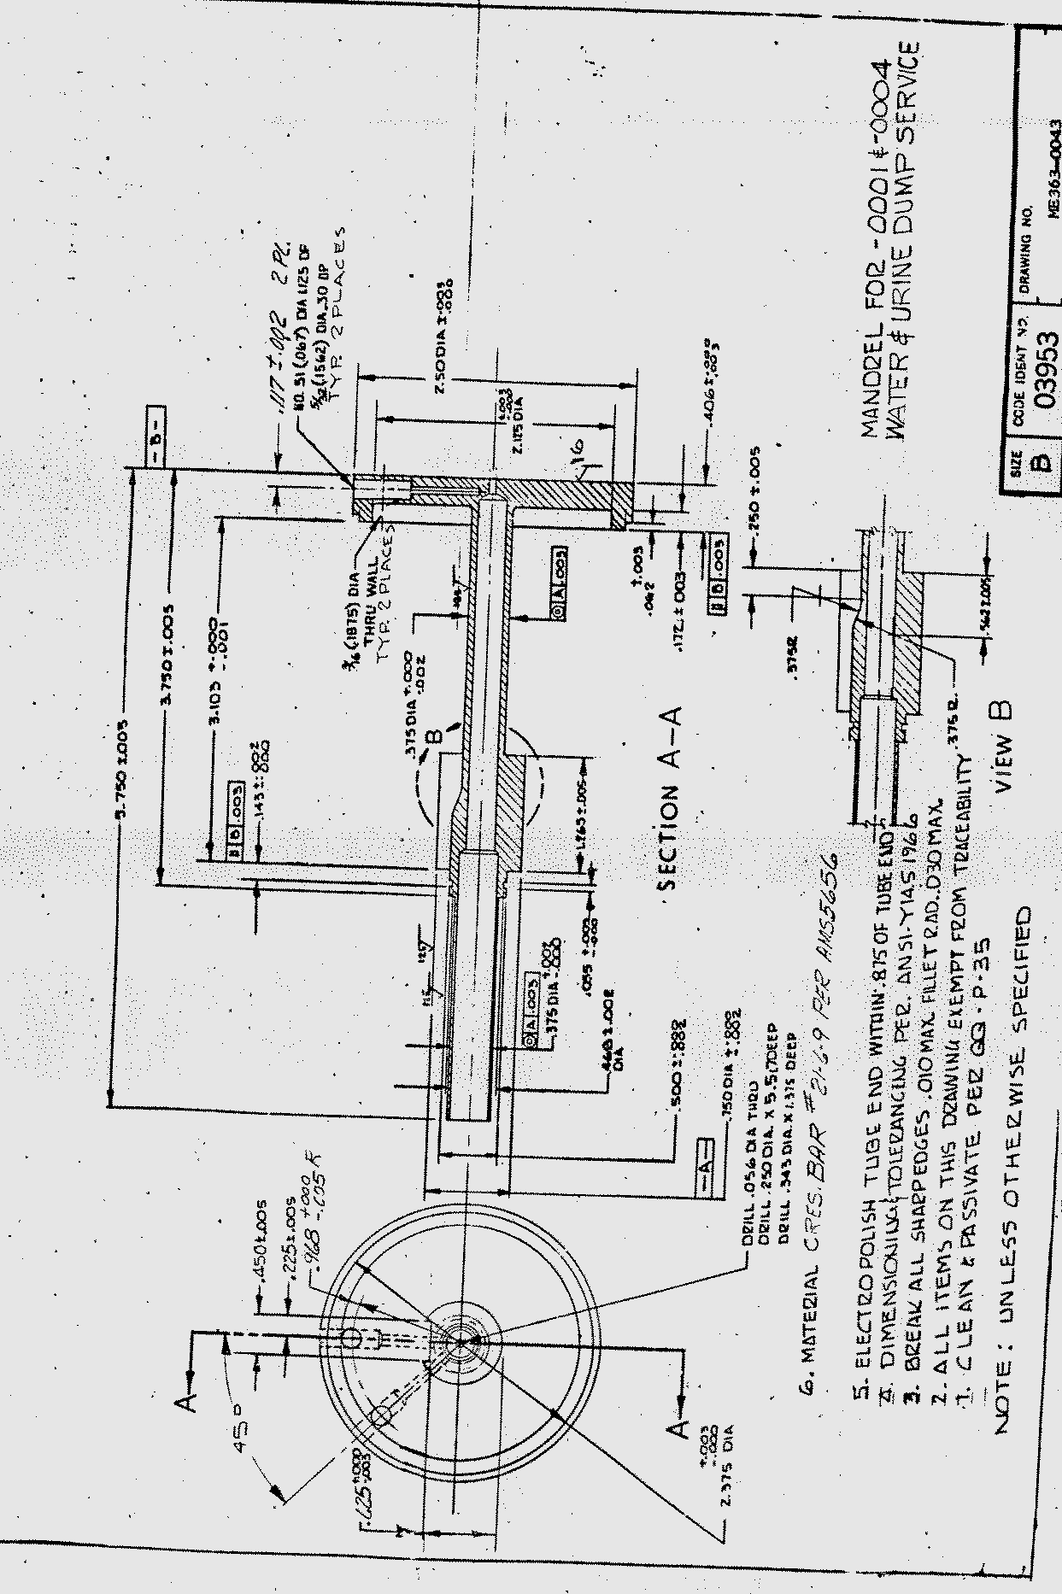
Old Nozzle Design
22.5 W heater coils

Slide 11
Orbiter Water Dump Nozzle Redesign

Slide 12
Orbiter Water Dump Nozzle Redesign
  One of the four sensor wells had a small water leak path through it with unusual temperature drops during the supply water dumps – the first error.
  Rockwell or their vendor suggested putting a braze plug in the bottom of the sensor well about 0.1 to 0.2 inch thick.
  The WWM SSM assumed that they had a solder expert to review this, but no one did it.
  The next flight had two new nozzles installed with a braze plug, and we had the same problem with a water leak into a sensor well.
  To braze two surfaces together requires no more than a 0.0005-inch thick layer of braze compound.
  Then a metal plug was brazed into the bottom of old nozzle sensor wells and changed the drawing to include a new nozzle that did not require the plug by shorten the sensor well depth.

Slide 13
Orbiter Water Dump Nozzle Redesign

Slide 14
Orbiter Water Dump Nozzle Redesign
New design
Old design

Slide 15
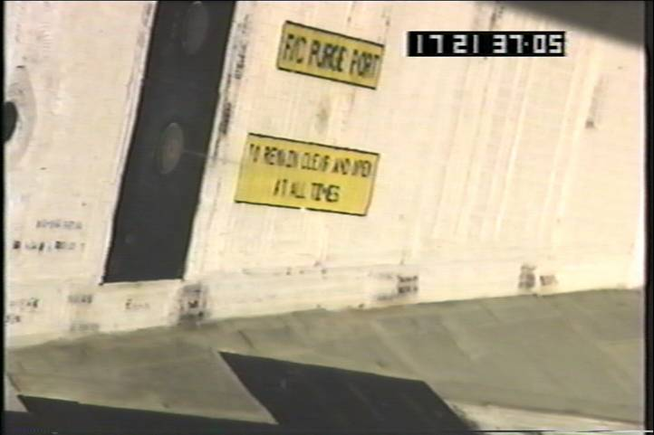

Slide 17
Orbiter Water Dump Nozzle Redesign
Lessons learned:
  No change is simple; all changes must be integrated with other systems that can be impacted.
  Must fully analyze, test, and/or assess any new off-normal operations.
  Engineers are not experts in all technical areas. An expert is needed to check any technique used in design change.

Slide 18
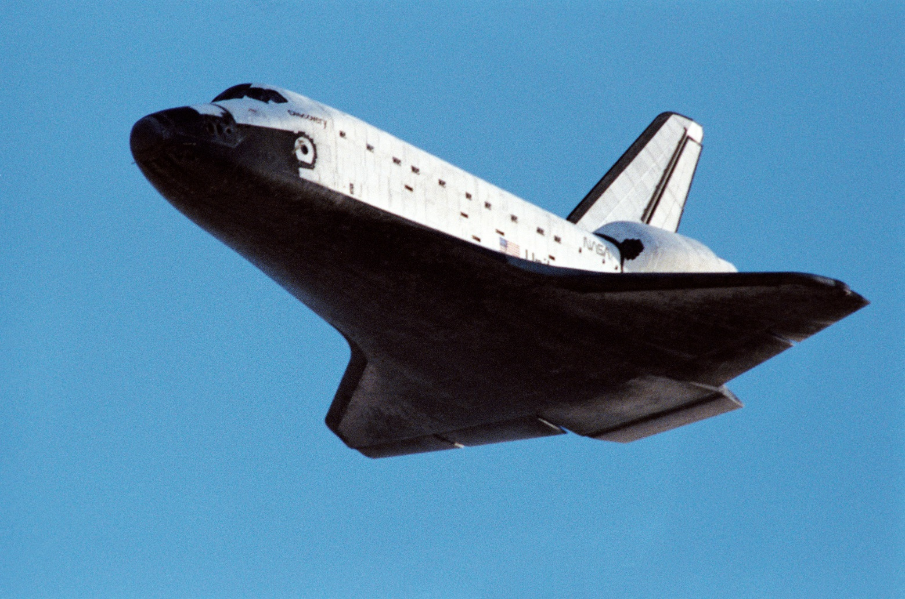
Questions?
nescacademy.nasa.gov

