Slide 1
Metal Fatigue Part 1
Raymond Patin, JSC
Welcome…
Ivatury Raju
ivatury.s.raju@nasa.gov

Slide 2




SLaMS Webcast
Series

Slide 3
Metal Fatigue a cursory overview
by
Raymond Patin
NASA/JSC

Slide 4
Subject Outline
Introduction – Definition & Historical Overview
The S-N Curve
The S-N Endurance Limit
S-N Fatigue Scatter
Torsion Fatigue
Mechanics of Fatigue Damage Accumulation
Fatigue Failure Fracture Surface Features
Strain-Life
Linear Elastic Fracture Mechanics
Fatigue Life Example Problem

Slide 5
Introduction

Slide 6
Structural integrity is a multi-disciplinary endeavor with the objective of preventing catastrophic failures within the operational life of the hardware. Structural integrity is assured via the imposed static strength and service life (fracture control) requirements.
Static Strength
The static strength requirement assures the load carrying capacity of the structure for a single load cycle up to a prescribed maximum load magnitude (limit-load x factor of safety). Static strength verification testing can be performed at various stages (component level, subassembly level, and/or fully integrated assembly) with the inherent assumption that nominal material and build tolerances are captured within the test article. The assumption of a ‘nominal material’ applies not only to the static strength properties, but also the initial quality regarding preexisting defects that can alter the failure load capacity of the structure. Thus the static strength test article does not verify or define the load carrying capacity of the structure with initial damage and/or structural damage that will accumulate with usage.
Service Life (Fracture Control)
The service life (fracture control) requirements address the time based or usage induced damage mechanisms that degrade the structural load capacity and functionality of the structure. Environmental interactions such as corrosion, mechanical load fluctuations, and/or thermal exposure variations interact to degrade and damage the structure and its load carrying capacity as function of service time. The service life discipline must not only define the rate of damage accumulation, it must also define the load carrying capacity of the structure with damage present (residual strength). Service life verification testing is typically performed on an accelerated time scale which may exclude the time based influences and interactions to some degree. The loss of testing based realism in terms of the time scale, environmental exposures, usage deviations, and boundary condition variations is why usage monitoring and periodic inspections are required to verify service life predictions. The objective of the service life requirements is to define a safe interval of operation with multiple intervention opportunities to mitigate a catastrophic failure in service.

Slide 7
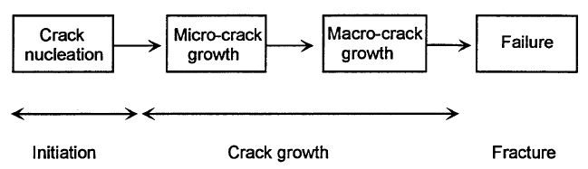
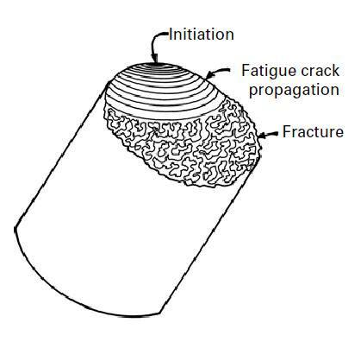
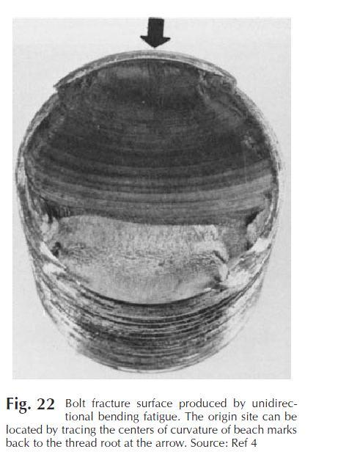
What is metal fatigue?
The definition of "fatigue" according to ASTM* Standard E 1150 reads as follows: “The process of progressive localized permanent structural damage occurring in a material subjected to conditions that produce fluctuating stresses and strains at some point or points and that may culminate in cracks or complete fracture after a sufficient number of fluctuations.”
*ASTM – American Society for Testing and Materials
Flow chart description of the metal fatigue process

Slide 8
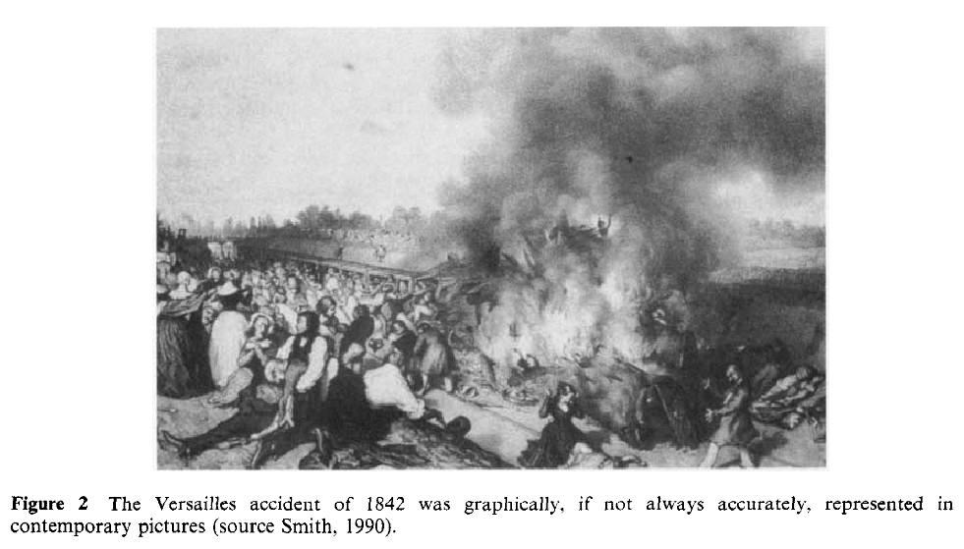
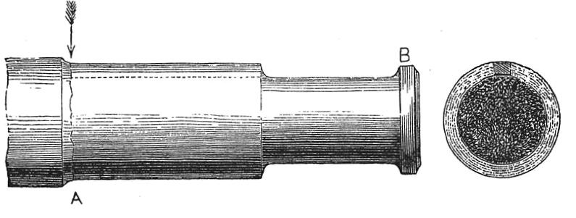
May 8, 1842 – Versailles train crash
An axle of the leading locomotive of a double-headed train suddenly failed (departing King Louis Philippe's birthday celebration), causing it to derail resulting in the second locomotive crashing into the first and the wooden carriages piled into the wreckage where they were set alight by the burning locomotives. More than 75 persons died in the accident. During the subsequent debates regarding the accident the term “fatigue” was coined to describe the sudden fracture of a component from repeated stresses which appeared to be performing well up to that point.
Axle failure location
Rotating beam/bending fatigue crack initiation & propagation
Fast fracture region
Ref.: R. A. Smith, “Railways: Structure Integrity, Past, Present, and Future”, Chapter 1.03, Volume 1, Examples and Case Studies, R. O. Ritchie and Y. Murakami, volume editors, part of the 10-volume set, Comprehensive Structural Integrity, B. Karihaloo, R. O. Ritchie, and I. Milne, overall editors, Elsevier Science Ltd. Oxford, England, 2003.

Slide 9
The S-N (stress versus life) Curve

Slide 10
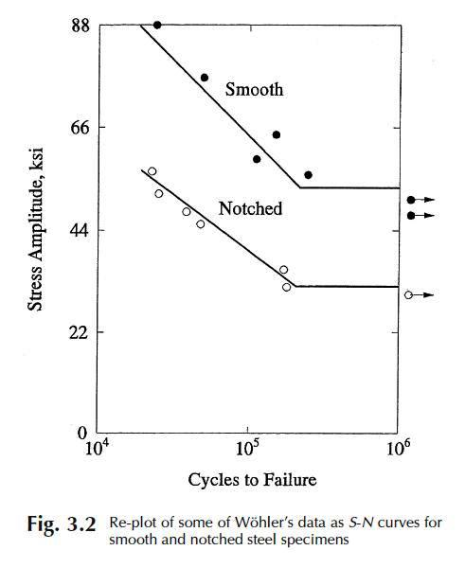
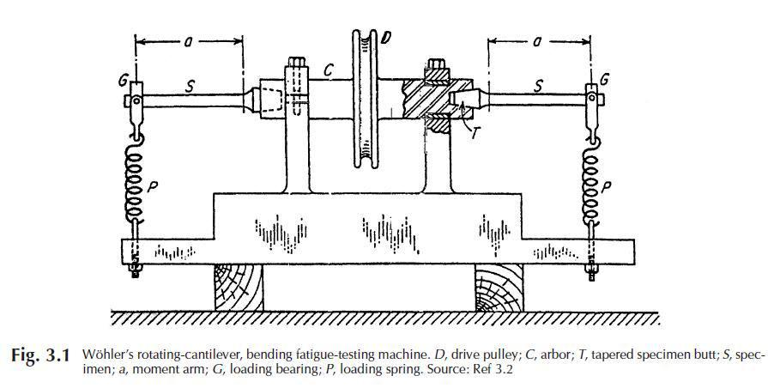
The S-N curve : August Wöhler – Rotating Beam Fatigue Testing
In the 1850s and 1860s August Wöhler performed the first systematic laboratory experiments that demonstrate why repeated stresses in railroad axles were so damaging. The rotating beam fixture imposed fully reversed bending stresses over the entire periphery of the specimens. Wöhler was seeking to define the stress level below which an “indefinite” number of reversals could be sustained without failure – defined today as the “endurance limit”. Wöhler also demonstrated that applied stress range was more important than stress magnitude.
Applied torque to rotate specimens (2)
moment arm
increasing stress concentration
Applied Load
peak bending stress
fully reversed
Ref.: S.S. Manson, G.R. Halford, Fatigue and Durability of Structural Materials, ASM International, March 2006, pp. 45-46.

Slide 11
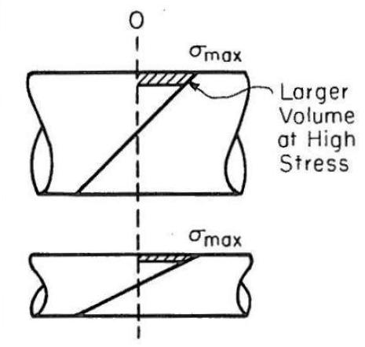
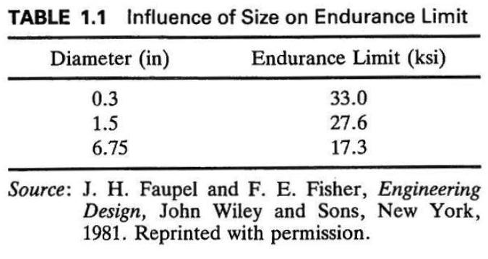
The S-N curve : Rotating Beam Fatigue Testing
The linear elastic stress gradient associated with bending results in larger volumes of material being affected as the diameter of the cross section is increased. Larger material volumes at higher cyclic stresses increases the likelihood of microstructural defects being present which adversely impacts fatigue strength. Thus bending fatigue data demonstrates a size effect ; primarily at long lives – less evident in tension fatigue data.
Diameter ↑ → Endurance Limit ↓
Ref.: Bannantine, J., Comer, J., Handrock, J., Fundamentals of Metal Fatigue, Prentice-Hall, 1990, pg. 12.

Slide 12
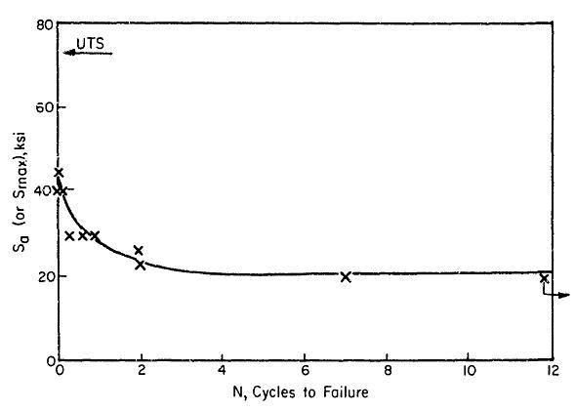
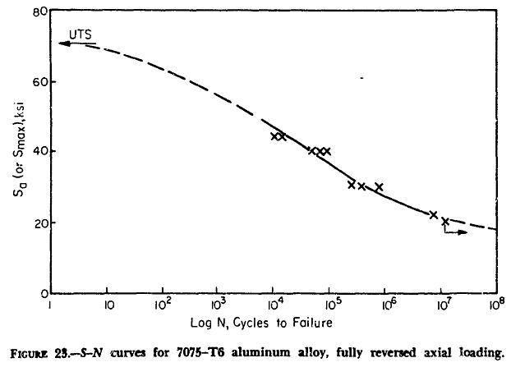
The S-N curve : Linear versus Logarithmic
The same S-N data results are plotted below on a linear and logarithmic scale for the test defined cycles to failure. The logarithmic scale linearizes the results over a range of applied stress amplitudes.
The Basquin power law relation (1910) defines the finite fatigue life in the linear region ; S_{a} = A(N_{f})^{b}
S-N data linear region on log scale
S-N data linear plot
S-N data logarithm plot
Ref.: Horace J. Grover, Fatigue of Aircraft Structures, NAVAIR 01-1A-13, 1960, pg. 36.

Slide 13
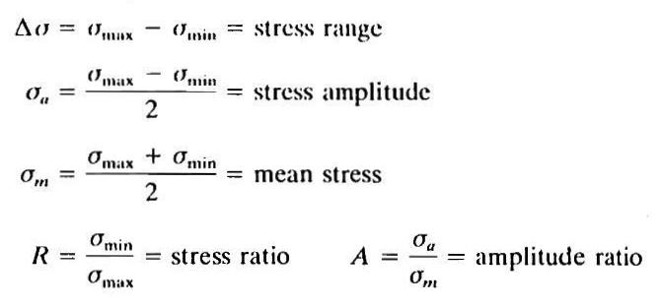
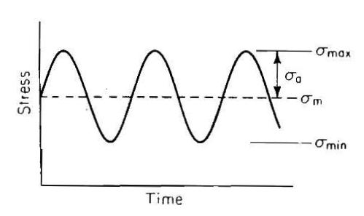
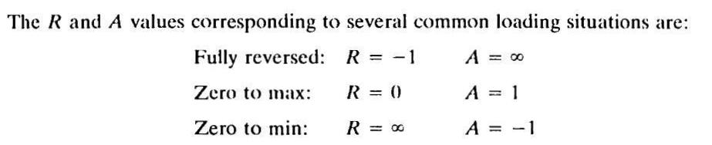
Constant Amplitude Cyclic Loading Definition
Constant amplitude cyclic loading is typically utilized for the characterization of materials in fatigue testing. The load-time waveform is typically sinusoidal and varies from a fixed minimum to maximum load magnitude at a defined frequency (cycles/second). It is noted that most engineering fatigue applications deviate from this simplified loading scheme since the max/min loads vary throughout (variable amplitude loading).
1 cycle
Δσ
Ref.: Bannantine, J., Comer, J., Handrock, J., Fundamentals of Metal Fatigue, Prentice-Hall, 1990, pp. 5-6.

Slide 14
Stress Ratio Loading Demonstrations
Constant amplitude cyclic loading waveforms for various stress ratio levels are provided below relative to a fixed maximum load/stress ; (R = σ_{min}/σ_{max}) .
Load/Stress
0 < R < 1
High tensile mean load/stress
R = 1
Constant load
σ_{m} >> 0
σ_{m} > 0
σ_{m} > 0
σ_{m} = 0
R = 0
Tensile mean load/stress = 0
Full range tension loading
Time
σ_{m} < 0
σ_{m} < 0
-1< R < 0
Low tensile mean load/stress
σ_{m} << 0
R = -1
Mean load/stress = 0
Fully reversed loading
R = ∞
Zero to minimum
R > 1
Cyclic compression loading
R < -1
Compressive mean load/stress

Slide 15
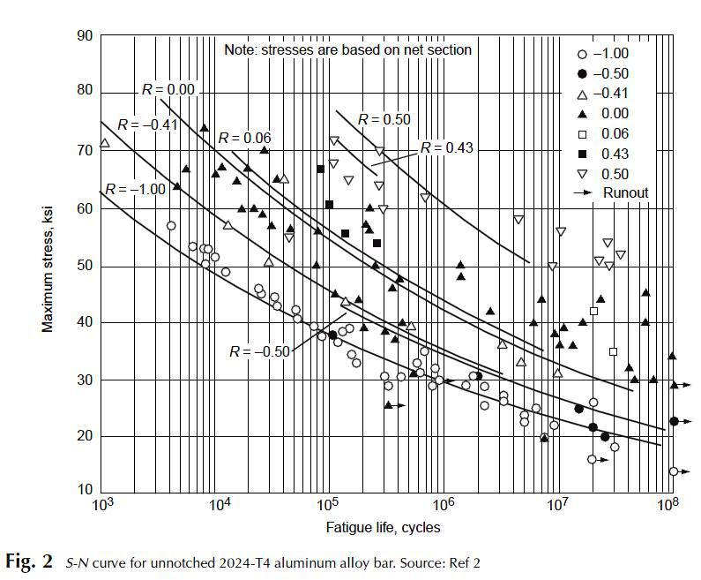
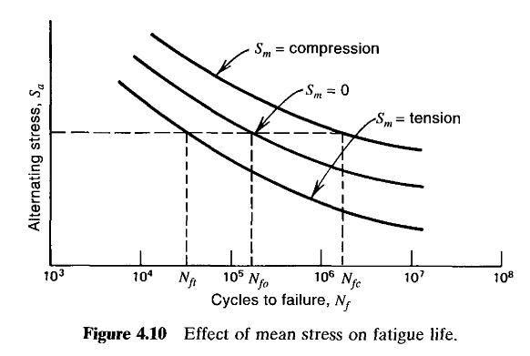
Mean Stress Influence on Constant Amplitude Fatigue Life
The fatigue life is minimized for increasing applied stress ranges (Δσ) at a fixed maximum stress level.
For a fixed alternating stress (σ_{a}) level the resulting fatigue life will generally decrease within increasing mean stress (σ_{m}) – applied maximum stress is increasing with increasing mean.
R < -1
R = -1
R > -1
Ref.: Stephens, R.I., Fatemi, A., Stephens, R.R., & Fuchs, H.O., Metal Fatigue in Engineering, 2nd ed., .John Wiley & Sons, 2001, pg 75.
Ref.: ASM Handbook, Vol. 11 Failure Analysis & Prevention, Becker, W.T., and Shipley, R.J., editors, Fatigue-Life Assessment, Kaplan, M.P., & Wolff, T.A., pg. 277, ASM International, 2002.

Slide 16
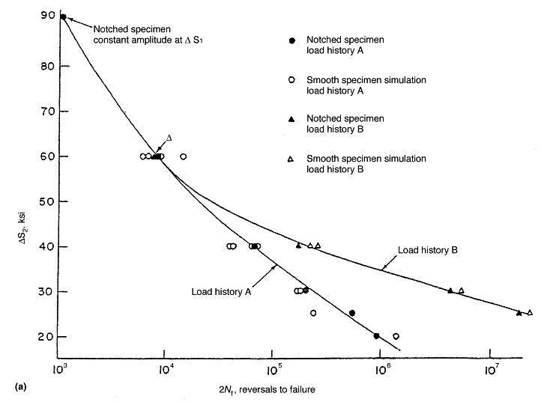
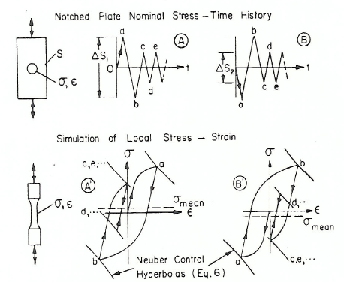
Example of Mean/Residual Stress Influence Limitations
A tensile overload will reverse yield into compression and conversely a compressive underload will reverse yield into tension (for localized yielding enveloped by a large elastic volume). The remaining fatigue life is greater for the compressive residual/mean stress at lower load levels, but the mean stress influence is neutralized at higher load levels by cyclic plastic straining.
Cyclic plastic straining on a per cycle basis removes mean stress influence
tensile mean stress
compressive mean stress
Ref.: Morrow, JoDean, Wetzel, R.M., and Topper, T.H., “Laboratory Simulation of Structural Fatigue Behavior,” Effects of Environment and Complex Load History on Fatigue Life, ASTM STP 462, 1970, pp. 74-91.

Slide 17
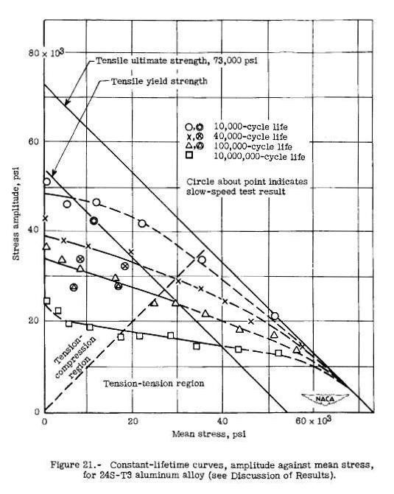
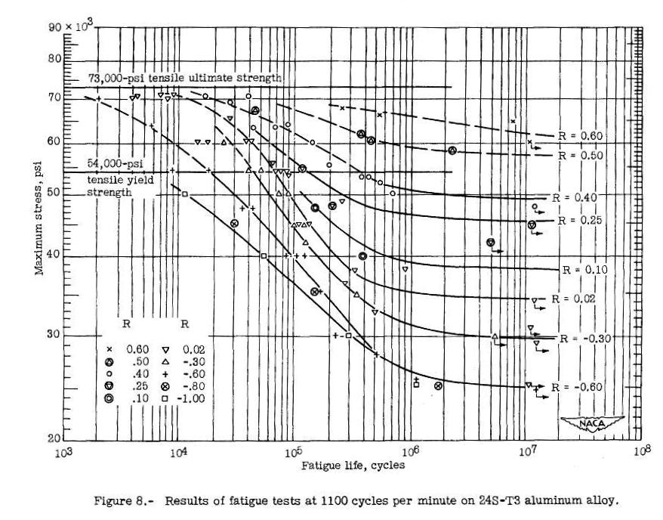
Constant Life (Haigh ; 1917) Diagrams
The S-N fatigue data can be transformed into a constant life diagram as a function of the applied alternating and mean stresses via the test data points at specified cycles to failure. The resulting plot is known as a Haigh diagram (1917) which is used to characterize constant amplitude fatigue data mean stress influences.
R = -1
(max stress)
R = 0
(N ; cycles to failure)
R = 1
Ref.: Grover, H.J., Bishop, S.M., and Jackson, L.R., NACA TN 2324, March 1951, pp. 51,64.

Slide 18
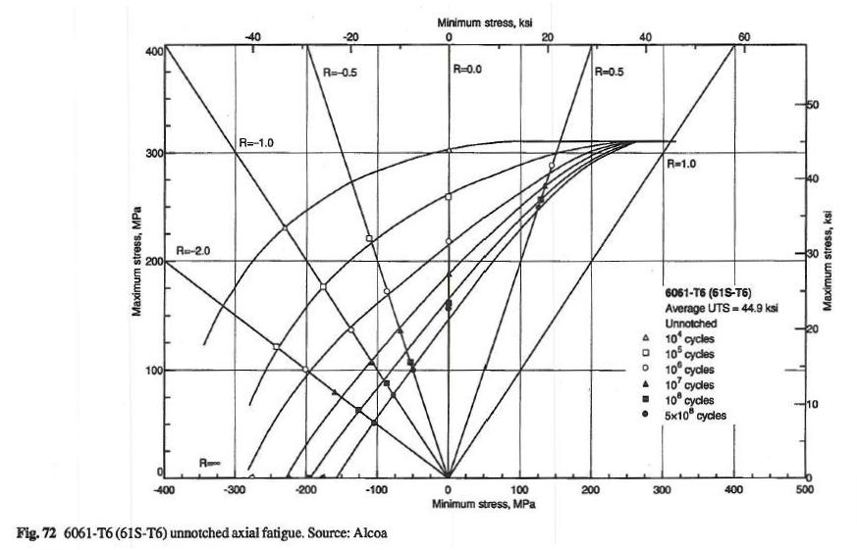
Master Diagrams
The addition of an extra set of axes (maximum & minimum stress) to the constant life (Haigh) diagram results in a master diagram.
Alternating
stress
Mean stress
Ref.: Fatigue Data Book : Light Structural Alloys, ASM International, 1995, pg 72.

Slide 19
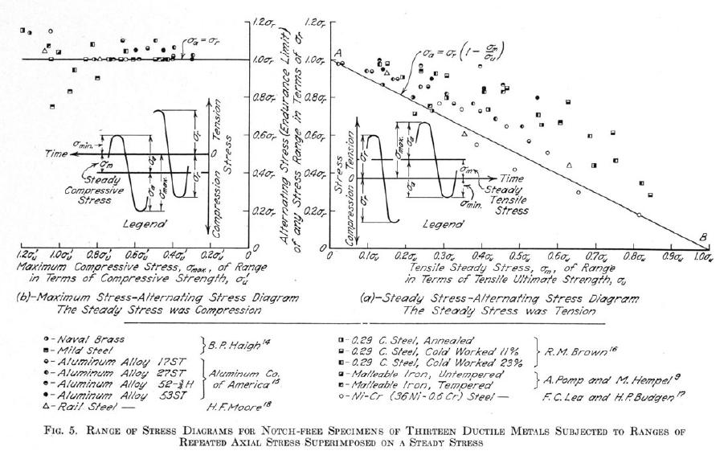
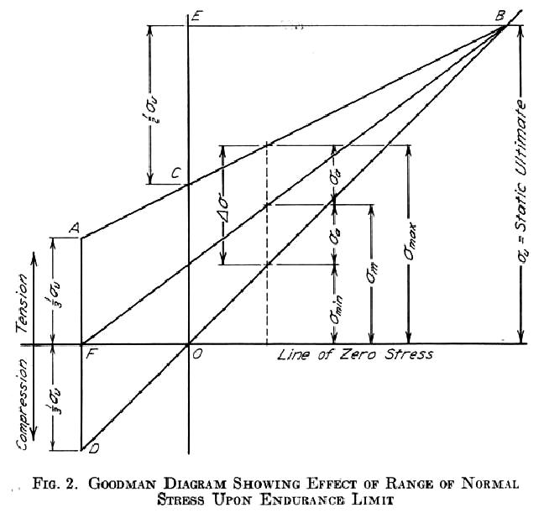

Goodman Diagram (1899)
The original Goodman diagram (1899) defined the influence of mean and alternated stresses on the resulting cycles to failure with Wohler’s data with linear projections as a function of material ultimate strength and applied mean and alternating stresses. A subsequent correction (inclusion of endurance limit) to improve agreement with data results in the modified Goodman equation/diagram.
modified Goodman
Goodman diagram
Ref.: James O. Smith, Univ. of Illinois Bulletin -The Effect of Range of Stress on the Fatigue Strength of Metals, Vol. XXXIX, Feb. 17, 1942, No. 26, pg. 14, 20.

Slide 20

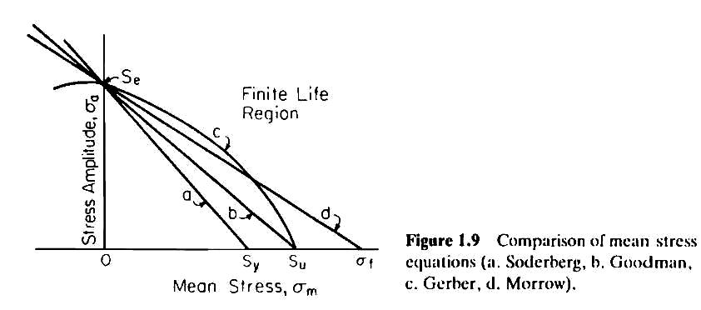
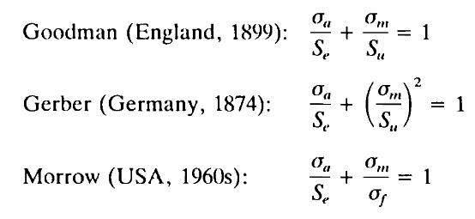
Mean Stress Empirical Relationships
The generation of S-N master diagrams is very expensive and time consuming. Empirical relationships that define the infinite life boundary afford a reasonable preliminary design option.
These methods result in various curves that connect the alternating stress (σ_{a}) and mean stresses (σ_{m}) to the endurance limit (S_{e}) and either the material yield (S_{y}), ultimate (S_{u}), or true fracture stress (σ_{f}).
Ref.: Bannantine, J., Comer, J., Handrock, J., Fundamentals of Metal Fatigue, Prentice-Hall, 1990, pp. 6-7.

Slide 21
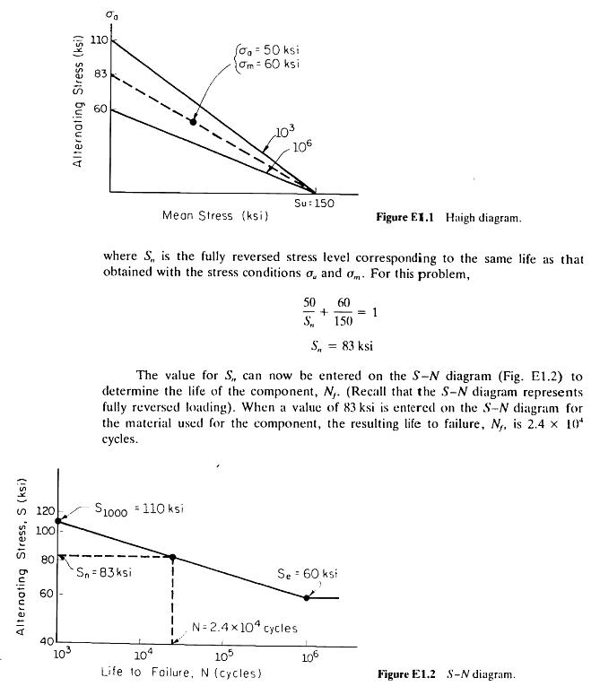
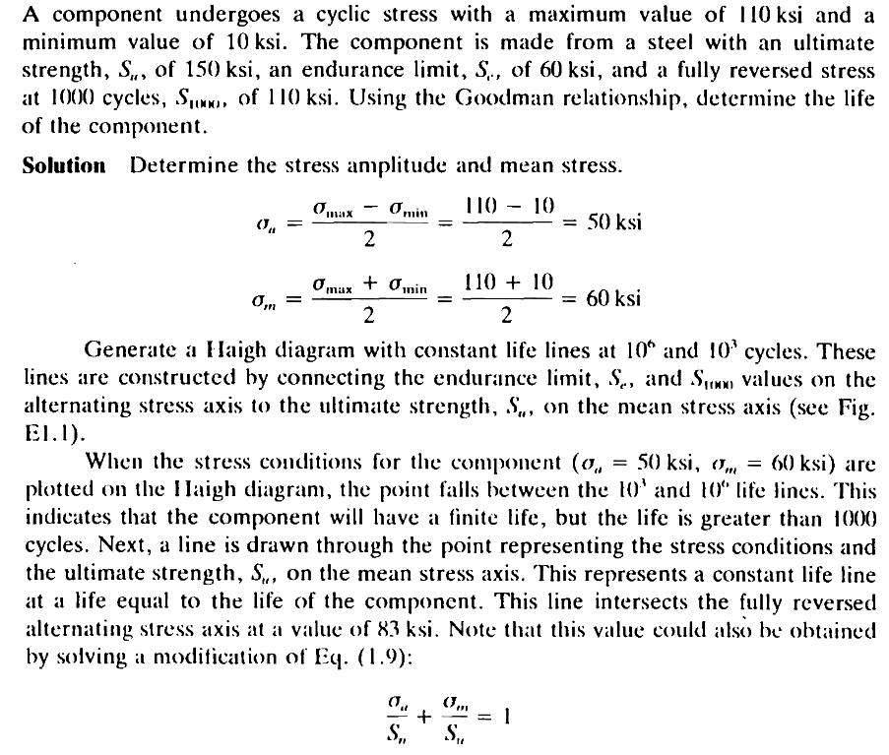
Mean Stress Constant Amplitude Service Life Example
Note: analytical result is dependent upon potential endurance limit variations/reductions & material data scatter (scatter factor).
load, size, Kt, surface finish
scatter factor?
Ref.: Bannantine, J., Comer, J., Handrock, J., Fundamentals of Metal Fatigue, Prentice-Hall, 1990, pp. 8-9.

Slide 22


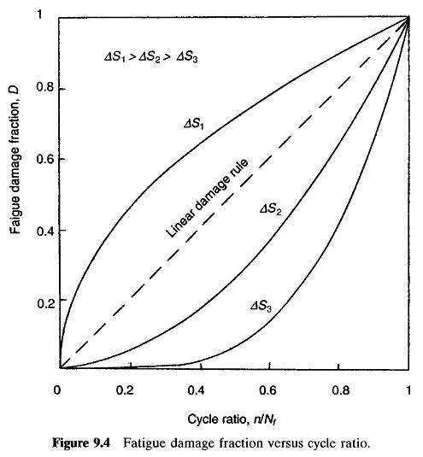
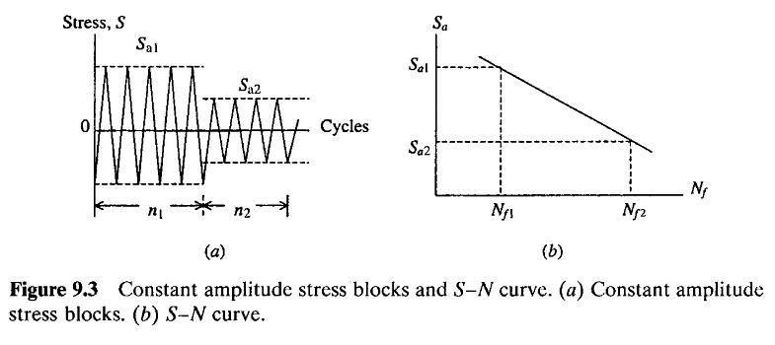
Palmgren-Miner Linear Damage Rule
In 1924 Palmgren uses linear damage accumulation to define the cycle life of bearings.
In 1945 Miner applies the Palmgren linear damage model to aircraft fatigue.
The shortcomings of assuming linear damage accumulation are well known (low-to-high or high-to-low loading sequences Σn_{i}/N_{fi} ≠ 1) but is still commonly incorporated due to ease of use and overall accuracy with respect to other models.
Ref.: R. I. Stephens, A. Fatemi, R. R. Stephens, H. Fuchs, “Metal Fatigue in Engineering, 2nd ed.,” John Wiley & Sons, 2000, pp. 275-276.

Slide 23
S-N Fatigue Endurance Limit

Slide 24
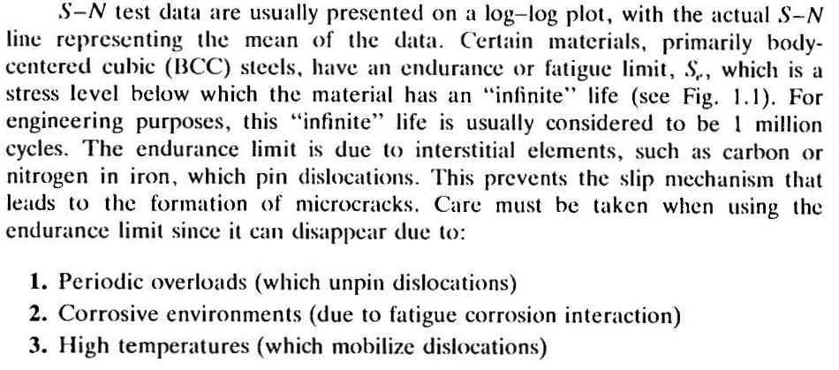
S-N Endurance Limit
Alloys that demonstrate a fatigue endurance limit (cyclic stress levels below which fatigue damage is assumed to not occur) and the mechanisms that can remove or eliminate the endurance limit are provided below.
Complex assemblies with relative movement that results in localized wear which degrades the initial surface condition relative to that which defined the endurance limit; e.g., bolted joints.
Ref.: Bannantine, J., Comer, J., Handrock, J., Fundamentals of Metal Fatigue, Prentice-Hall, 1990, pp. 2.

Slide 25
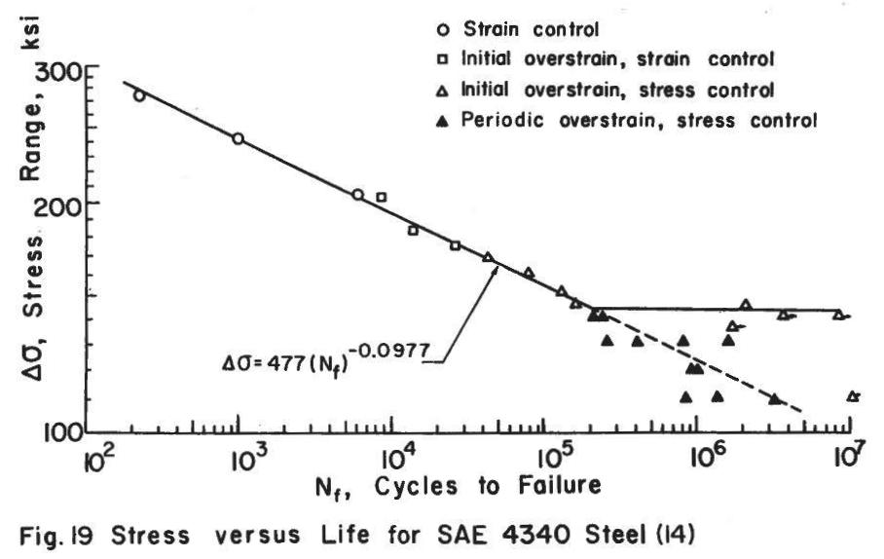
S-N Endurance Limit ; (cont)
A demonstration of periodic overloads removing the S-N fatigue endurance limit is provided below.
Most structural applications deviate from the laboratory defined constant amplitude loading.
Removes constant amplitude defined endurance limit.
Ref.: JoDean Morrow, J.F. Martin, N.E. Dowling, Local Stress-Strain Approach to Cumulative Fatigue Damage Analysis, UILU-ENG 74 6001, T.&A.M. Report No. 379, 1974, pg 51.

Slide 26
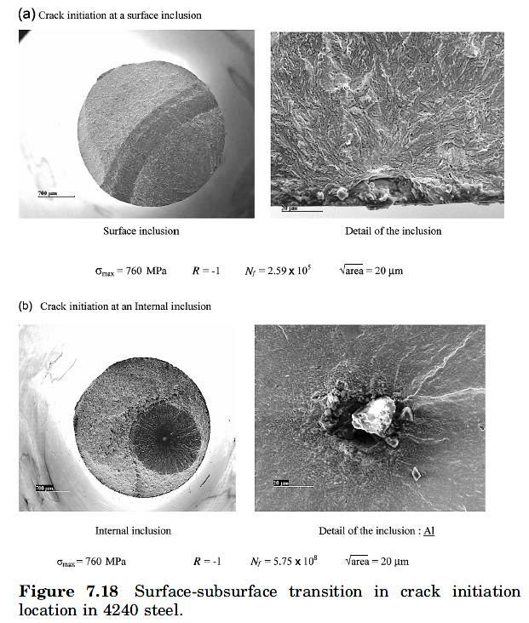
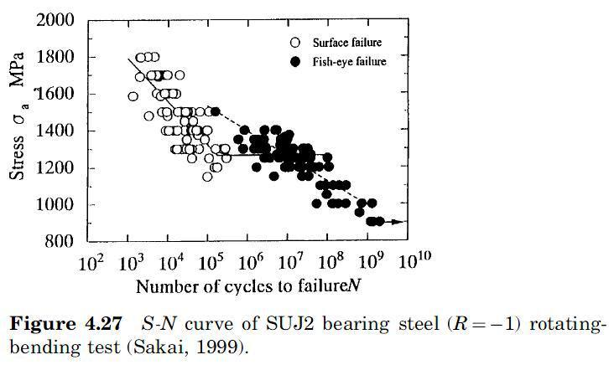
S-N Endurance Limit – Gigacycle Fatigue ; (cont)
Constant amplitude fatigue testing at ultra high cycles (gigacycles ; 10⁹) demonstrates finite life at cycle counts beyond 10⁶. The fatigue damage accumulation also shifts from surface to interior initiations.
Ref.: C. Bathias, P.C. Paris, Gigacycle Fatigue in Mechanical Practice, Marcel Dekker, 2205.

Slide 27
S-N Fatigue Scatter

Slide 28
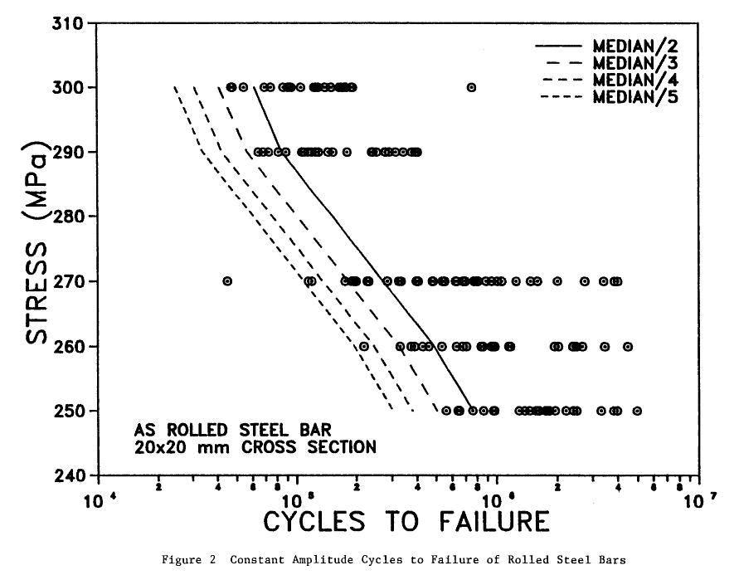
S-N Material Data Scatter
S-N data sets typical include only a few data points at various stress levels. The fatigue crack nucleation and initiation process constitutes the majority of the fatigue life and is highly dependent upon surface finish quality and microstructure. From a deterministic perspective a knockdown factor of 4 applied to the median of the S-N data set is assumed to define the lower bound for a complete S-N data set.
Ref.: A.P. Berens, Fatigue Life Scatter Factors in Aircraft Applications, UDR-TR-92-138, 1992.

Slide 29
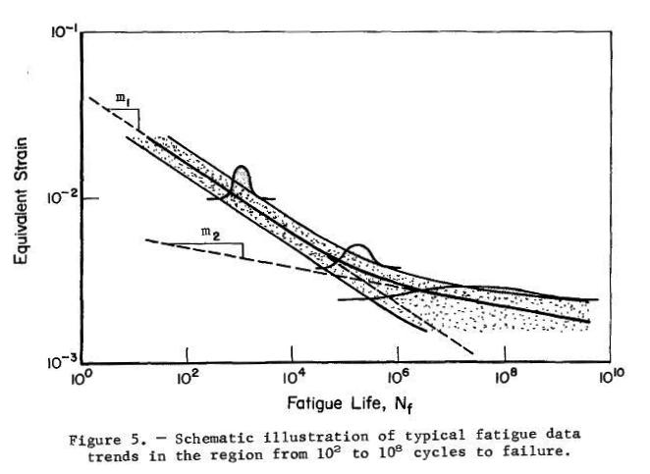
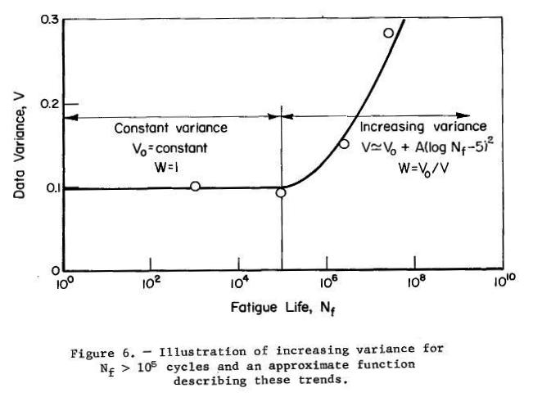
S-N Material Data Scatter ; (cont)
The scatter factor of 4 is only applicable to the linear region of the S-N curve – it not applicable within the asymptotic regions of the data curve (endurance limit and material allowable). This result is confirmed in the results below wherein the variance of the S-N data set is no longer constant and increasing beyond 10⁵ cycles.
Linear damage accumulation region where the deterministic scatter factor is applicable.
Ref.: R.C. Rice, K.B. Daview, C.E. Jaske, and C.E. Feddersen, Consolidation of Fatigue and Fatigue Crack Propagation Data for Design Use, NASA-CR-2586, 1975, pp. 24-25.

Slide 30
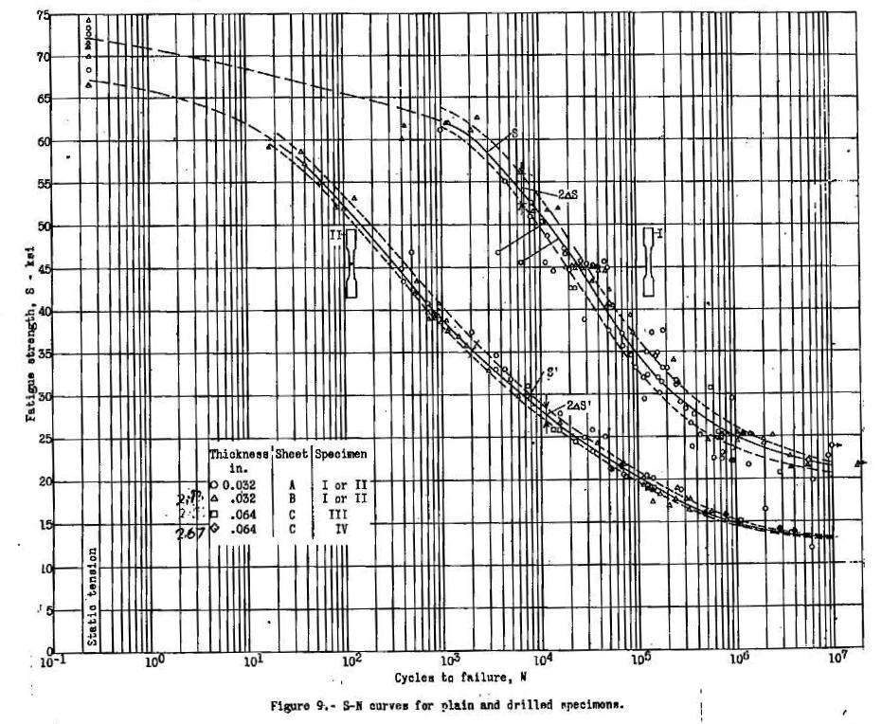
S-N Material Data Scatter ; (cont)
The S-N fatigue asymptotic regions wherein the traditional scatter factor on life does not assure the desired level of structural integrity assurance is illustrated below.
S-N material data curves asymptotic regimes where the traditional scatter factor on life loses its applicability.
Ref.:W.C. Brueggeman, M. Mayer, Jr., and W.H. Smith, Axial Fatigue Tests at Zero Mean Stress of 24S-T Aluminum-Alloy Sheet With and Without a Circular Hole, NACA TN 995 1944.

Slide 31
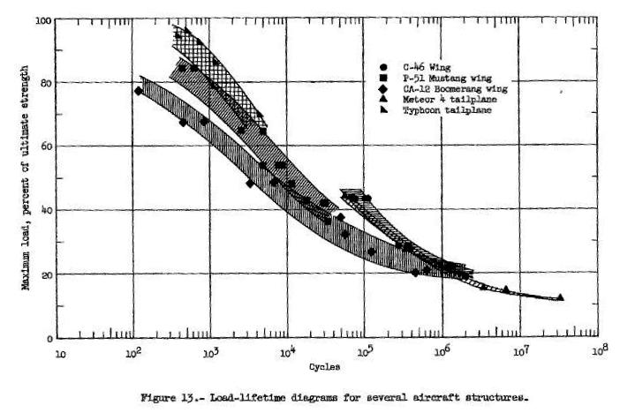
S-N Scatter (cont.) - Full Scale Test Results
“It can be seen from this figure that all of the full-scale data presented lie within a comparatively narrow scatter band, considering the fact that the data includes different types of airplanes and components with many types of stress raisers. Full-scale fatigue data from other airplanes have been found to fall within the scatter of the data that are presented.”
Ref.: J.J. McGuigan, Jr. D.F. Bryan, and R.E. Whaley, Fatigue Investigation of Full-Scale Transport Airplane Wings, NACA TN 3190, 1954, pg. 10, 41.

Slide 32
Torsion Fatigue

Slide 33
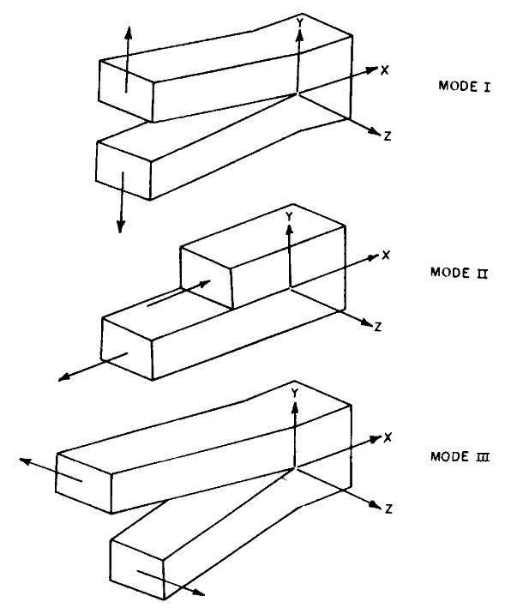
Modes of Crack Surface Displacements
The 3 basics modes of loading and displacements associated with cracked elastic bodies is presented below. The superposition of these 3 displacement modes is typically sufficient to describe most crack tip deformation/stress fields.
Mode I – tensile opening mode ; the crack surfaces are displaced away from each other (symmetric with respect to the x-y and x-z planes.
Mode II – in-plane (edge) sliding of the crack faces relative to each other ; symmetric with respect to the x-y plane and skew symmetric with respect to the x-z plane.
Mode III – lateral displacement of the crack faces (tearing) ; skew symmetric with respect to the x-y and x-z planes.
Ref.: H. Tada, P. Paris, & G. Irwin, The Stress Analysis of Cracks, 2nd ed., Del Research Inc, 1985, pg. 1.2.

Slide 34
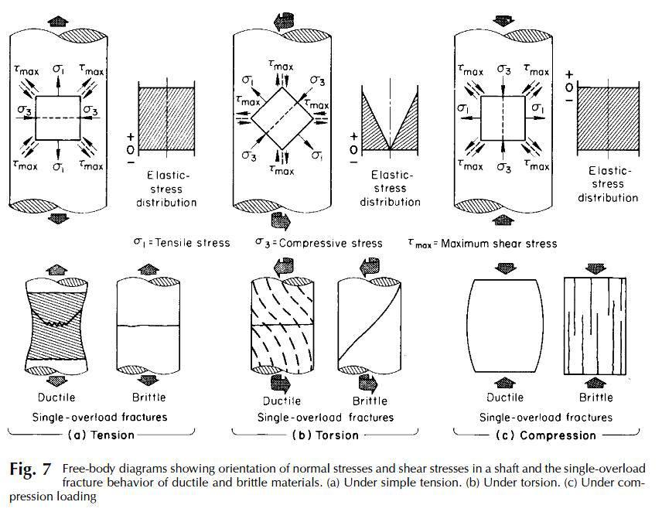
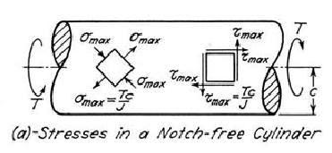
Torsion Induced Stress Fields
Torsion loading (round cross section) will result in maximum shear stresses on the longitudinal and transverse planes with axial stresses on 45° planes.
Ref.: ASM Handbook, Vol. 11 Failure Analysis Prevention, J.D. Landes, W.T. Becker, R.S. Shipley, J. Raphael, Stress Analysis and Fracture Mechanics, ASM International, 2002, pg. 467.

Slide 35
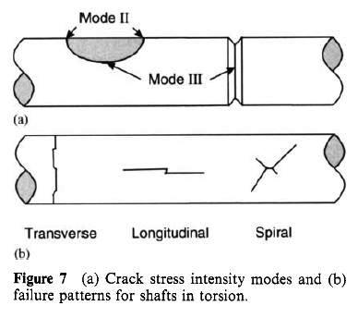
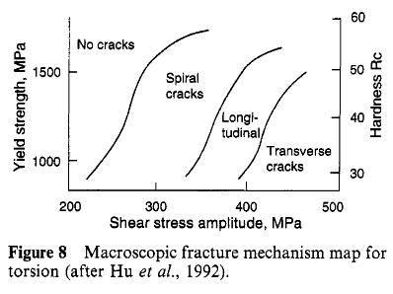
Torsion Induced Fatigue Cracking Pattern/Modes
Torsion loading (round cross section) fatigue cracking pattern is a function of the applied shear stress magnitude.
Ref.: G.B. Marquis, D.F. Socie, “Multiaxial Fatigue”, Chapter 4.09, Volume 1, Examples and Case Studies, R. O. Ritchie and Y. Murakami, volume editors, part of the 10-volume set, Comprehensive Structural Integrity, B. Karihaloo, R. O. Ritchie, and I. Milne, overall editors, Elsevier Science Ltd. Oxford, England, 2003.

Slide 36
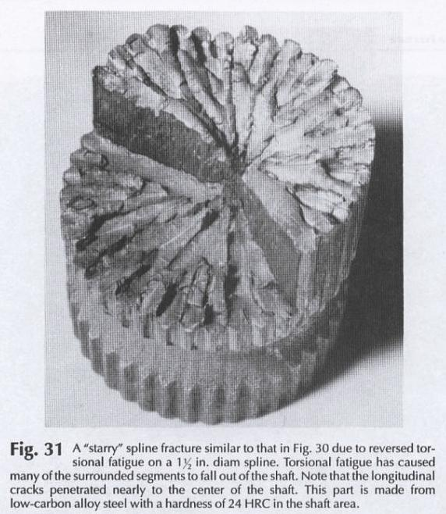
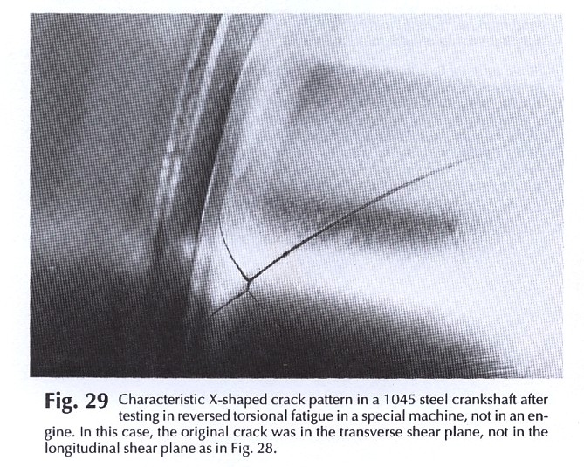
Torsion Fatigue Failure Cracking Pattern Examples
Transverse reversed torsion fatigue crack
Spiral reversed torsion fatigue crack
Ref.: Donald J. Wulpi, Understanding How Components Fail, 2nd edition, ASM International 1999, pp. 158,160.

Slide 37
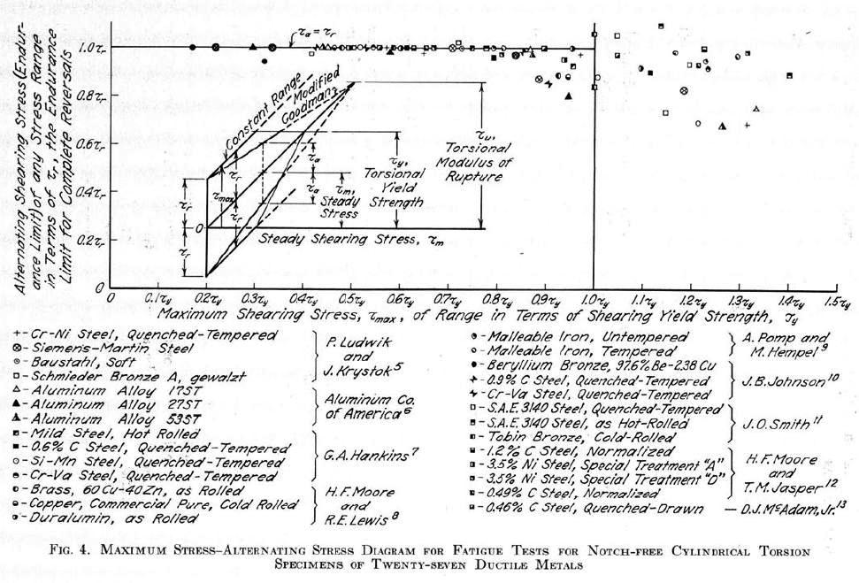
Torsion Fatigue Data
Smooth bar torsion fatigue data for various materials with constant cyclic stress amplitude does not demonstrate the same Goodman trend established for tensile (Mode I) fatigue data.
Torsion mean stress does not open/displace the crack flanks in sliding modes.
Ref.: James O. Smith, Univ. of Illinois Bulletin -The Effect of Range of Stress on the Fatigue Strength of Metals, Vol. XXXIX, Feb. 17, 1942, No. 26, pg. 18.

Slide 38
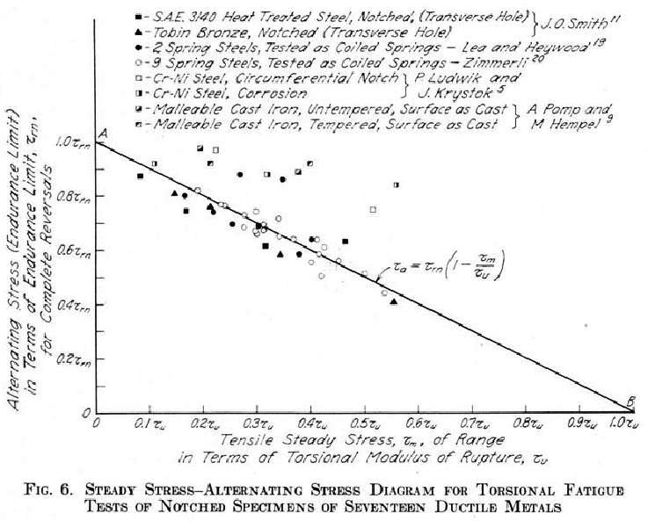
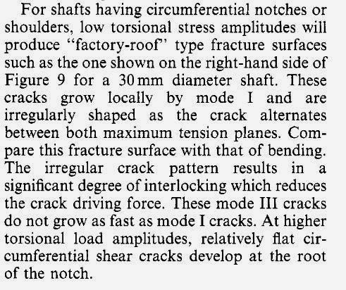
Torsion Fatigue Data ; (cont.)
Notched bar torsion fatigue data for various materials with constant cyclic stress amplitude does demonstrate a similar Goodman trend established for tensile (Mode I) fatigue data.
Ref.: G.B. Marquis, D.F. Socie, “Multiaxial Fatigue”, Chapter 4.09, Volume 1, Examples and Case Studies, R. O. Ritchie and Y. Murakami, volume editors, part of the 10-volume set, Comprehensive Structural Integrity, B. Karihaloo, R. O. Ritchie, and I. Milne, overall editors, Elsevier Science Ltd. Oxford, England, 2003.
Ref.: James O. Smith, Univ. of Illinois Bulletin -The Effect of Range of Stress on the Fatigue Strength of Metals, Vol. XXXIX, Feb. 17, 1942, No. 26, pg. 22.

Slide 39
Mechanics of Fatigue Damage Accumulation

Slide 40
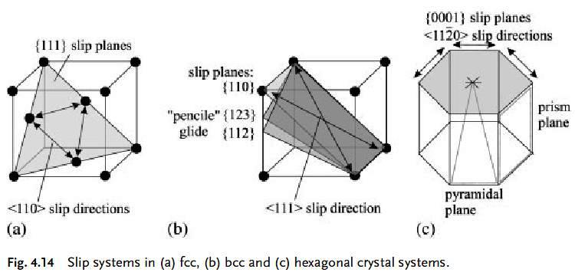
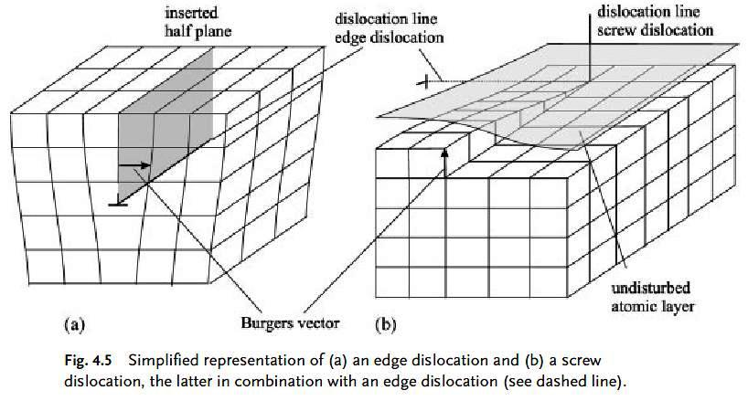

Plastic Deformation in Metals
The elastic limit of a material defines the stress level below which the strains are reversible (on a global level – measurable on a macroscopic scale).
Plastic (irreversible) deformation occurs primarily by slip along crystallographic planes – the slip mechanism is dictated by local shear stresses and crystal defect orientations.
Defects and imperfections within the crystalline lattice create slip systems along specific planes and in specific directions along a plane. Dislocations (edge & screw) are line defects that exist in nearly all crystals.
Ref.: U. Krupp, Fatigue Crack Propagation in Metals and Alloys, Wiley, 2007.
Ref.: A.C. Reardon, Metallurgy for the Non-Metallurgist - 2nd Ed., ASM International, 2011.

Slide 41



Plastic Deformation in Metals – Monotonic & Cyclic Loading
When the resolved shear stress exceeds the critical shear stress on the crystal slip plane local yielding will begin.
The slip direction will remain unchanged unless barriers/constraints (e.g., adjacent grains, test grips) are encountered.
Cyclic slip is not reversible (due to defect creation/annihilation) and this results is surface extrusions/intrusions along persistent slip bands on the surface.
cyclic plastic strain
montonic plastic strain
Ref.: V. Levitin, S. Loskutove, Strained Metallic Surfaces, Wiley-VCH, 2009, pg 187.
Ref.: R. Hertzberg, Deformation and Fracture Mechanics of Engineering Materials, 3rd Ed., John-Wiley, 1989, pg 496.

Slide 42




Fatigue Crack Nucleation (Surface)
The preferential nucleation of fatigue cracks at the surface is due to ease of plastic deformation at the free surface (as opposed to the interior where there is additional constraint). Fatigue cracks can also nucleate at singularities or discontinuities (e.g., inclusions, second phase particles, grain boundaries, etc.) on the surface or in the interior.
axial load reversal
dislocations
Ref.: M.A. Meyers, K.K. Chawla, “Mechanical Behavior of Materials,” Cambridge University Press, 2009, pp. 725-729.

Slide 43


Micro Crack Initiation/Propagation (Surface)
Cyclic loading induced fatigue crack nucleation will result in multiple crack initiation sites within the stress concentration region of the component. The local microstructure and surface conditions strongly influence the resulting localized slip responses and subsequent coalescence into micro cracks..
10 μm = 0.000394 inches
MSFC – microstructurally small fatigue crack

Slide 44




Micro Crack Initiation/Propagation (Surface) – (cont.)
Another example of micro crack initiation and propagation is provided below.
10,500 cycles
15,000 cycles
10 μm = 0.000394 inches
17,000 cycles
Ref.: Ulrich Krupp, “Fatigue Crack Propagation in Metals and Alloys,” Wiley-VCH, 2007, pp. 151.

Slide 45



Crack Propagation Transition : Mode II (short crack) to Mode I (long crack)
The resolved shear stress (mode II) mechanism that dictates the surface crack initiation within slip bands is primarily responsible for the subsequent small crack initiation/propagation. As the micro crack growth extends over several grains the single slip mechanism transitions into a multiple slip response that results in mode I crack propagation response.
Ref.: Ulrich Krupp, “Fatigue Crack Propagation in Metals and Alloys,” Wiley-VCH, 2007, pp. 172, 239.

Slide 46


Long Crack Propagation (Mode I) - Striations
The Mode I fatigue crack propagation occurs via dislocation movements along multiple slip planes in the vicinity of the crack tip. The irreversible nature of the slip response can result in the formation of microscopically visible steps on the fracture surface known as striations. Detectable striations are not always formed - dependent upon material, environment, and rate of crack propagation.
Ref.: Pippan, Zelger, Gach, Bichler, Weinhandl, On the mechanism of fatigue crack propagation in ductile metallic materials, Fatigue & Fracture of Engineering Materials & Structures, 34, 2010, pp. 1-16.
Ref.: V. Kerlins, ASM Handbook Vol. 12 : Fractography, 1987, pg 21.

Slide 47


Long Crack Propagation (Mode I) – Striations (cont.)
Within a failure analysis investigation striations can be used to physically quantify aspects of the fatigue crack propagation which in turn can be used to calculate the corresponding structural response states (loading type, loading magnitude, number of cycles, etc.).
Ref.: P.H. DeVries, K.T. Ruth, D.P. Dennies, Counting on Fatigue : Striations and Their Measure, “J Failure Analysis and Prevention,” vol. 10, 2000, pp. 123, 130.

Slide 48

Fatigue Damage Accumulation Process
A schematic representation of the fatigue crack nucleation, initiation, and propagation phases is provided below.
Fatigue crack nucleation/initiation at the surface via persistent slip bands.
Small crack propagation via Mode II mechanism.
Long crack propagation via Mode I mechanism.
Ref.: R. I. Stephens, A. Fatemi, R. R. Stephens, H. Fuchs, “Metal Fatigue in Engineering, 2nd ed.,” John Wiley & Sons, 2000, pp. 51.

Slide 49

S-N curve ; Fatigue Damage Accumulation
The cyclic time required to nucleate and initiate a fatigue crack consumes the majority of the overall fatigue life.
Crack nucleation initiation cycles
crack propagation cycles
S-N curve
Ref. :W.G. Barrois, Manual of Fatigue of Structures ; Fundamental and Physical Aspects, AGARD-MAN-8-70, June 1970, pg 227.

Slide 50

S-N curve ; Fatigue Damage Accumulation (cont.)
The fatigue damage accumulation trend in terms of physical crack measurements with specialized equipment for various alloys is provided below.
~ durability EIFS
~ NDE detection
NDE – non-destructive evaluation.
EIFS – equivalent initial flaw size
Ref. : S.J. Klima, D.J. Lesco, and J.C. Freche, Ultrasonic Technique for Detection and Measurement of Fatigue Cracks, NASA TN D-3007, 1965, pg 13.

Slide 51


S-N curve ; Fatigue Damage Accumulation (cont.)
The fatigue test results from full scale structure testing demonstrates the same trend observed at the coupon level.
average crack initiation
average crack propagation
Ref.: R.E. Whaley, Fatigue Investigation of Full-Scale Transport Airplane Wings, NACA TN 4132, 1957, pg 42.

Slide 52
Fatigue Failure Fracture Surface Features

Slide 53


Fatigue Failure Induced Surface Features
The information associated with a fracture surface (macroscopic and microscopic) typically affords useful details regarding the fundamental cause of the failure.
Ref.: ASM Handbook, Vol. 11 Failure Analysis Prevention, R.A. Lund, Fatigue Fracture Appearances, ASM International, 2002, pg. 627.

Slide 54

Fatigue Failure Induced Surface Features (cont.)
Macroscopic view of T-section fatigue failure.
Ref.: P.H. DeVries, K.T. Ruth, D.P. Dennies, Counting on Fatigue : Striations and Their Measure, “J Failure Analysis and Prevention,” vol. 10, 2000, pg. 131.

Slide 55


Fatigue Failure Induced Surface Features (cont.)
Torsion fatigue in root of grooved bar. Fatigue crack initiation occurs on the surface via Mode III and Mode I propagation occurs in the circumferential direction (downhill) not radially.
Mode III initiation
Mode I propagation
Ref.: K. Tanaka, Small Crack Propagation in Multiaxial Notch Fatigue, pg 40, www.gruppofrattura.it/pdf/cp/CP2012005.pdf.

Slide 56

Fatigue Failure Fracture Surface Features (cont.)
Ref.: ASM Handbook, Vol. 11 Failure Analysis Prevention, R.A. Lund, Fatigue Fracture Appearances, ASM International, 2002, pg. 632.
neutral
axis
neutral
axis

Slide 57

Fatigue Failure Fracture Surface Features (cont.)
Ref.: ASM Handbook, Vol. 12 Fractography, G.F. Vander Voort, Visual Examination and Light Microscopy, ASM International, 1987, pg. 119.
neutral
axis
neutral
axis
neutral
axis
neutral
axis

Slide 58
Questions???
To Be Continued….

Slide 59
Thank you for
attending…
Metal Fatigue Part 2
June 7, 1PM ET
Raymond Patin

