Slide 1
Fundamentals of EMC
Mitigation Strategies
John McCloskey
NASA/GSFC Chief EMC Engineer
Code 565
Building 23, room E203
301-286-5498
John.C.McCloskey@nasa.gov

Slide 2
Topics
Twisted Pairs
Shielding
Method of Images
Balanced Differential Interfaces
Filter Connectors
Radiated Coupling Strategies
Cost/Benefit Analysis

Slide 3
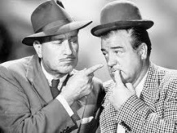
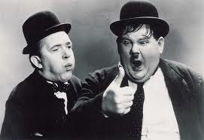
Twisted Pairs
Emissions
  Provides return current path to cancel culprit current
  Reduced net current reduces net magnetic field
Susceptibility
  Reduced loop area
  Voltages induced on adjacent half-twist loops cancel
  Worst case induced voltage is that induced on loop area of single half twist
Total enclosed I →0
Net B → 0
I_{C}
CULPRIT CIRCUIT
V_{C}
R_{L}
I_{C}
I
V_{HT1}
V_{HT2}
V_{HT3}
V_{HT4}
V_{HT5}
H
P
VICTIM CIRCUIT
+
-
+
-
+
-
+
-
+
-
R_{NE}
R_{FE}
B
E
Poynting Vector
Right Hand Rule

Slide 4

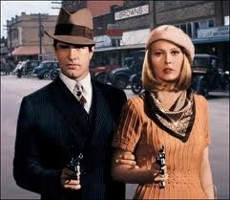
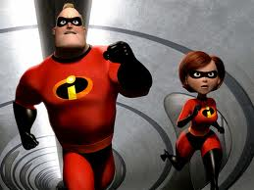



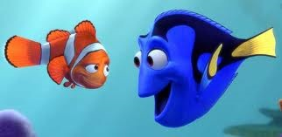
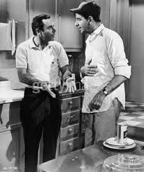
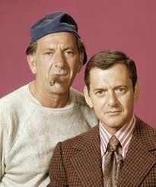


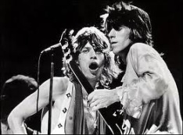

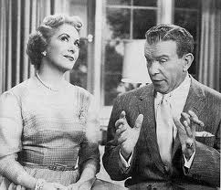
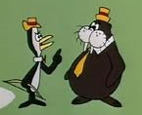

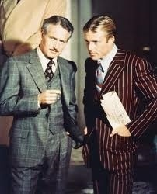
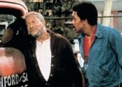
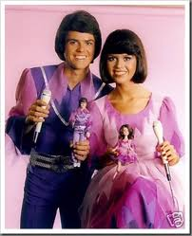

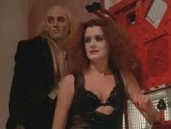
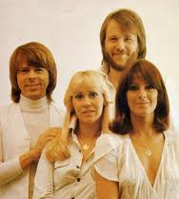

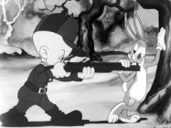
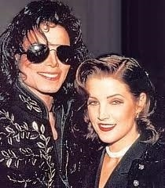


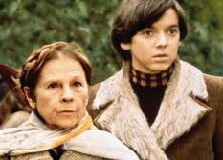
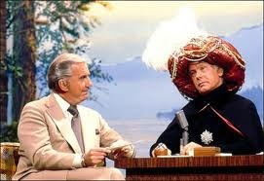
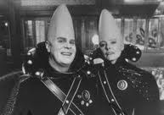


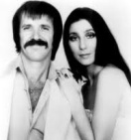
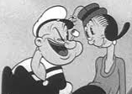
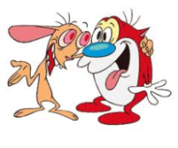

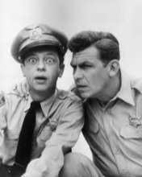
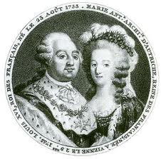

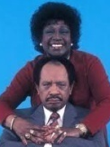
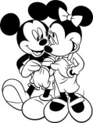
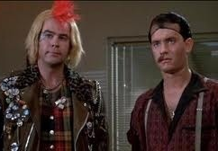
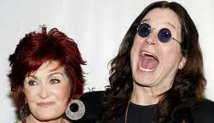
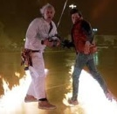

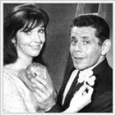
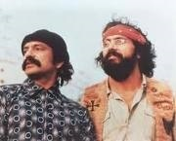
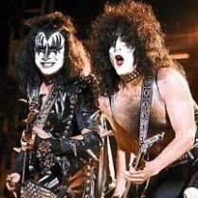
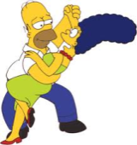
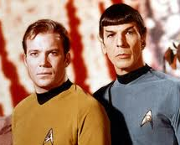
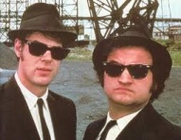
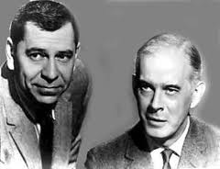
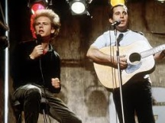
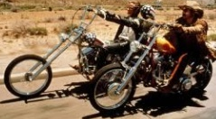
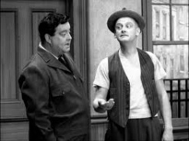
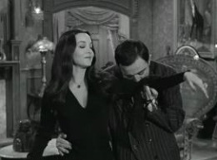
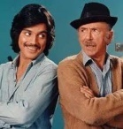
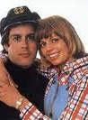
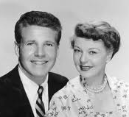
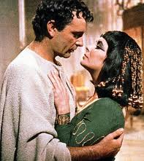
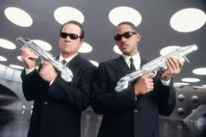

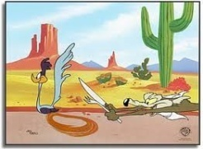

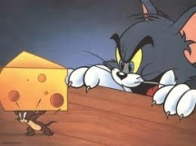
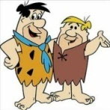

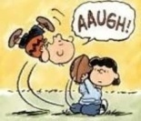






















More Twisted Pairs

Slide 5
Shielding
Purpose of shielding:
  Contain emissions from noisy circuits
  Protect signal carrying conductors from interference
Remember Kirchoff’s Current Law:
  All currents return to their sources following path of least impedance
Shield’s raison d’être:
  Provide return path to the source over the lowest impedance (most desirable) path possible
  Direct current back to source and away from sensitive circuitry

Slide 6
Cable Shielding - Capacitive Coupling
Emissions
  Culprit current couples to its own shield and returns to its source
Susceptibility
  Any remaining current that makes its way to victim couples to victim’s shield and gets shunted back to source (via ground), protecting victim signal wire
Shields must provide low impedance path back to source
  Includes shield terminations, connector to chassis connections, reference plane to chassis connections, etc.
CULPRIT CIRCUIT
V_{C}
I_{C}
R_{L}
C_{CV}
I_{CV}
VICTIM CIRCUIT
R_{NE}
R_{FE}

Slide 7
Cable Shielding - Inductive Coupling
Emissions
  Provides return current path to cancel culprit current
  Reduced net current reduces net magnetic field
Susceptibility
  Reduced loop area
  Any remaining B field induces V and I in shield to counter incident field
  Shield must be terminated at both ends to allow current to flow
Total enclosed I →0
Net B → 0
R_{L}
I_{C}
I_{C}
R_{FE}
CULPRIT CIRCUIT
V_{C}
-
+
V_{VS}
I_{S}
VICTIM CIRCUIT
R_{NE}
Induced shield voltage/current and resulting B field to counter incident field

Slide 8
Skin Depth
x
SKIN DEPTH
ABSORPTION LOSS (ATTENUATION)
100 mils (2.54 mm) of aluminum provides > 80 dB attenuation above 100 kHz

Slide 9
Enclosure Shielding - Seams and Penetrations
Metal chassis provides darned good shielding (previous slide)
Weak point always comes at seams and penetration points
  Poor connections allow ΔV between conductors (antenna)
  ΔV induces common mode current (I_{CM}) across connection impedance
  I_{CM} induces radiated fields
I_{CM}
I_{CM}
ΔV
SHIELD
SIGNAL CONDUCTOR
ΔV

Slide 10
Enclosure Shielding - Seams and Penetrations (cont.)
Good metal-to-metal contact is essential
  RF gaskets on all seams and penetrations
  360º termination of shield to backshell (NO PIGTAILS!!!)
  Good metal-to-metal contact between backshell and chassis
  Class R bonds
360º shield termination
RF gaskets
SHIELD
SIGNAL CONDUCTOR
Good backshell to chassis connection

Slide 11
Enclosure Shielding - Seams and Penetrations (cont.)
Reference planes should be bonded to chassis at I/O connector(s)
  Provide low impedance path for currents to return to source
  Minimize ΔV between reference plane and chassis
  Reduce radiated emissions
SHIELD
SIGNAL CONDUCTOR
REF
I_{CM}
ΔV → 0

Slide 12
Enclosure Shielding - Seams and Penetrations (cont.)
“Pigtail” termination has significant inductance
Allows ΔV between conductors (antenna)
ΔV induces common mode current (I_{CM}) across connection impedance
  I_{CM} induces radiated fields
“PIGTAIL” termination
ΔV
SHIELD
I_{CM}
SIGNAL CONDUCTOR

Slide 13

Enclosure Shielding - Seams and Penetrations (cont.)
Alternative for panel to panel seams
  Minimum of 2 right angle turns (“labyrinth”)
  Electromagnetic energy has to “work” harder to get through seam

Slide 14

Demo 8: Twisted Pairs and Shielding

Slide 15


Demo 8: Twisted Pairs and Shielding (cont.)
TWISTED PAIRS
SHIELDING

Slide 16
Demo 8: Twisted Pairs and Shielding (cont.)
Equipment
  R&S FSH4 spectrum/network analyzer
  Test fixture
  2 Large coax cables to connect analyzer to fixture
  Single wire fixture with banana-BNC adaptors at each each
  Twisted pair fixture with banana-BNC adaptors at each end
  RG-58 coax with BNC-banana adaptors at each end, plugging into banana-BNC adaptors at each end
  Velcro straps

Slide 17
Demo 8: Twisted Pairs and Shielding (cont.)

Slide 18
Demo 8: Twisted Pairs and Shielding (cont.)

Slide 19
Compiled Data – Pigtails of Varying Lengths

Slide 20
Pigtail Observations
Quantifiable frequency range: ~ 1 MHz to ~ 20 MHz
  Below 1 MHz, measurements are limited by noise floor of analyzer
  Above ~20 MHz, standing wave effects appear
  l = ~70 cm = λ/4 @ ~110 MHz
Pigtails are reasonably effective at low frequencies, but become less effective as frequency increases
Pigtail of any length (presence of BNC-to-banana adaptors in this case) significantly degrades shield effectiveness above 1 MHz
Curves for longer pigtails rise above noise floor at lower frequency (lower “knee” frequency for longer pigtails)
Shielding effectiveness degrades at 40 dB/decade
  Compared to 20 dB/decade for unshielded wire
  Secondary coupling from shield to center conductor

Slide 21


Method of Images
Routing cables/traces over ground plane implements the “method of images”
  When a charge is placed over a ground plane, the fields line up to effectively create an image charge of opposite polarity (or cable with opposite potential and current)
  Physically, return current flows back to source on ground plane immediately beneath cable/trace
  Fully enclosed “Faraday cage” not necessary for ground plane to provide benefit
NO GROUND PLANE
WITH GROUND PLANE
B
+V
+V
I
I
E
B
E
-I
-V
Fields radiate
Localized return path for CM current
Fields better contained; partially cancelled by “image”
Reduced loop area reduces susceptibility
THE GROUND PLANE IS OUR FRIEND!

Slide 22
Method of Images - Crosstalk Data
2 WIRES SEPARATED BY 2 cm
VARYING HEIGHTS ABOVE GROUND PLANE

Slide 23
Balanced Differential Interfaces
Emissions
  Equal and opposite potentials on (+) and (-) conductors
  Emitted electric fields cancel
Susceptibility
  Incident field couples common current to (+) and (-) conductors
  Common impedance to ground results in common voltage on (+) and (-) conductors
  Differential interface subtracts out common mode voltage
V_{C+}
CULPRIT CIRCUIT
R_{L}
V_{C-}
C_{CV}
I_{CV}
+
VICTIM CIRCUIT
R_{NE}
R_{FE}
I_{CV}
C_{CV}
-

Slide 24



Differential Interface Examples
RS-422
MIL-STD-1553B
Low Voltage Differential Signal
(LVDS)

Slide 25

Filter Connectors
Connectors provide capacitor to connector shell
Attenuate high frequencies
Designer must make sure desired frequencies pass
Frequency content
τ_{r}
τ_{f}
0 dB/decade
-20 dB/decade
τ
Amplitude
-40 dB/decade
T = 1/f
f
PULSE WIDTH
RISE/FALL TIME

Slide 26
Radiated Coupling – Mitigation Strategies
Shielding, yes, but also:
  Terminate all shields entering or exiting a box to chassis with full 360 degree coverage
  Use EMI gaskets on all chassis seams (connectors, lids, etc.)
  Control common mode currents (Yin/Yang relationship between conducted and radiated coupling)
    Minimize loop areas
    Provide low impedance path for currents back to source
    Route cables/traces over ground plane (“method of images” - next slide)
    On PCB boards, avoid routing traces over split ground planes
In general, same techniques help with both emissions and susceptibility
CONTROLLED COMMON MODE CURRENTS
REDUCED RADIATED EMISSIONS
SHIELD TERMINATED TO CHASSIS
I_{cm}
I_{cm}

Slide 27
Cost/Benefit Analysis
Cost of implementing recommendations in this presentation:
  Trivial if integrated into design process and implemented early
Cost of EMI problems late in project flow
  Engineer’s salary: ~$1000/day ($125/hr)
  Team of 10 engineers: ~$10,000/day
  10 working days in I&T: ~$100,000
This is very much a “low ball” estimate
  Much direct experience
  Summer 2013: Out of house instrument, larger team, 3 week delay in EMI test campaign
  ~$500 k cost to project
“An ounce (or a few $) of prevention is worth a few $100 k of cure”

Slide 28
If You Remember Nothing Else From Today…
DO YOU KNOW WHERE YOUR CURRENTS ARE FLOWING?

