Slide 1
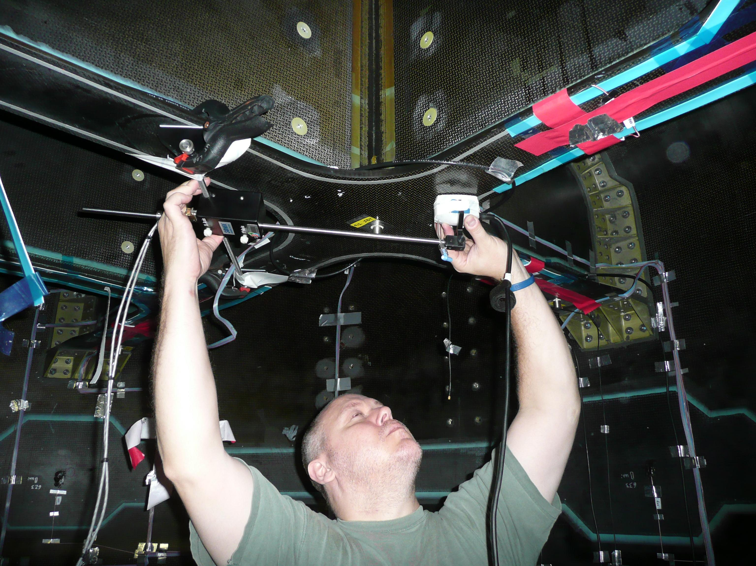
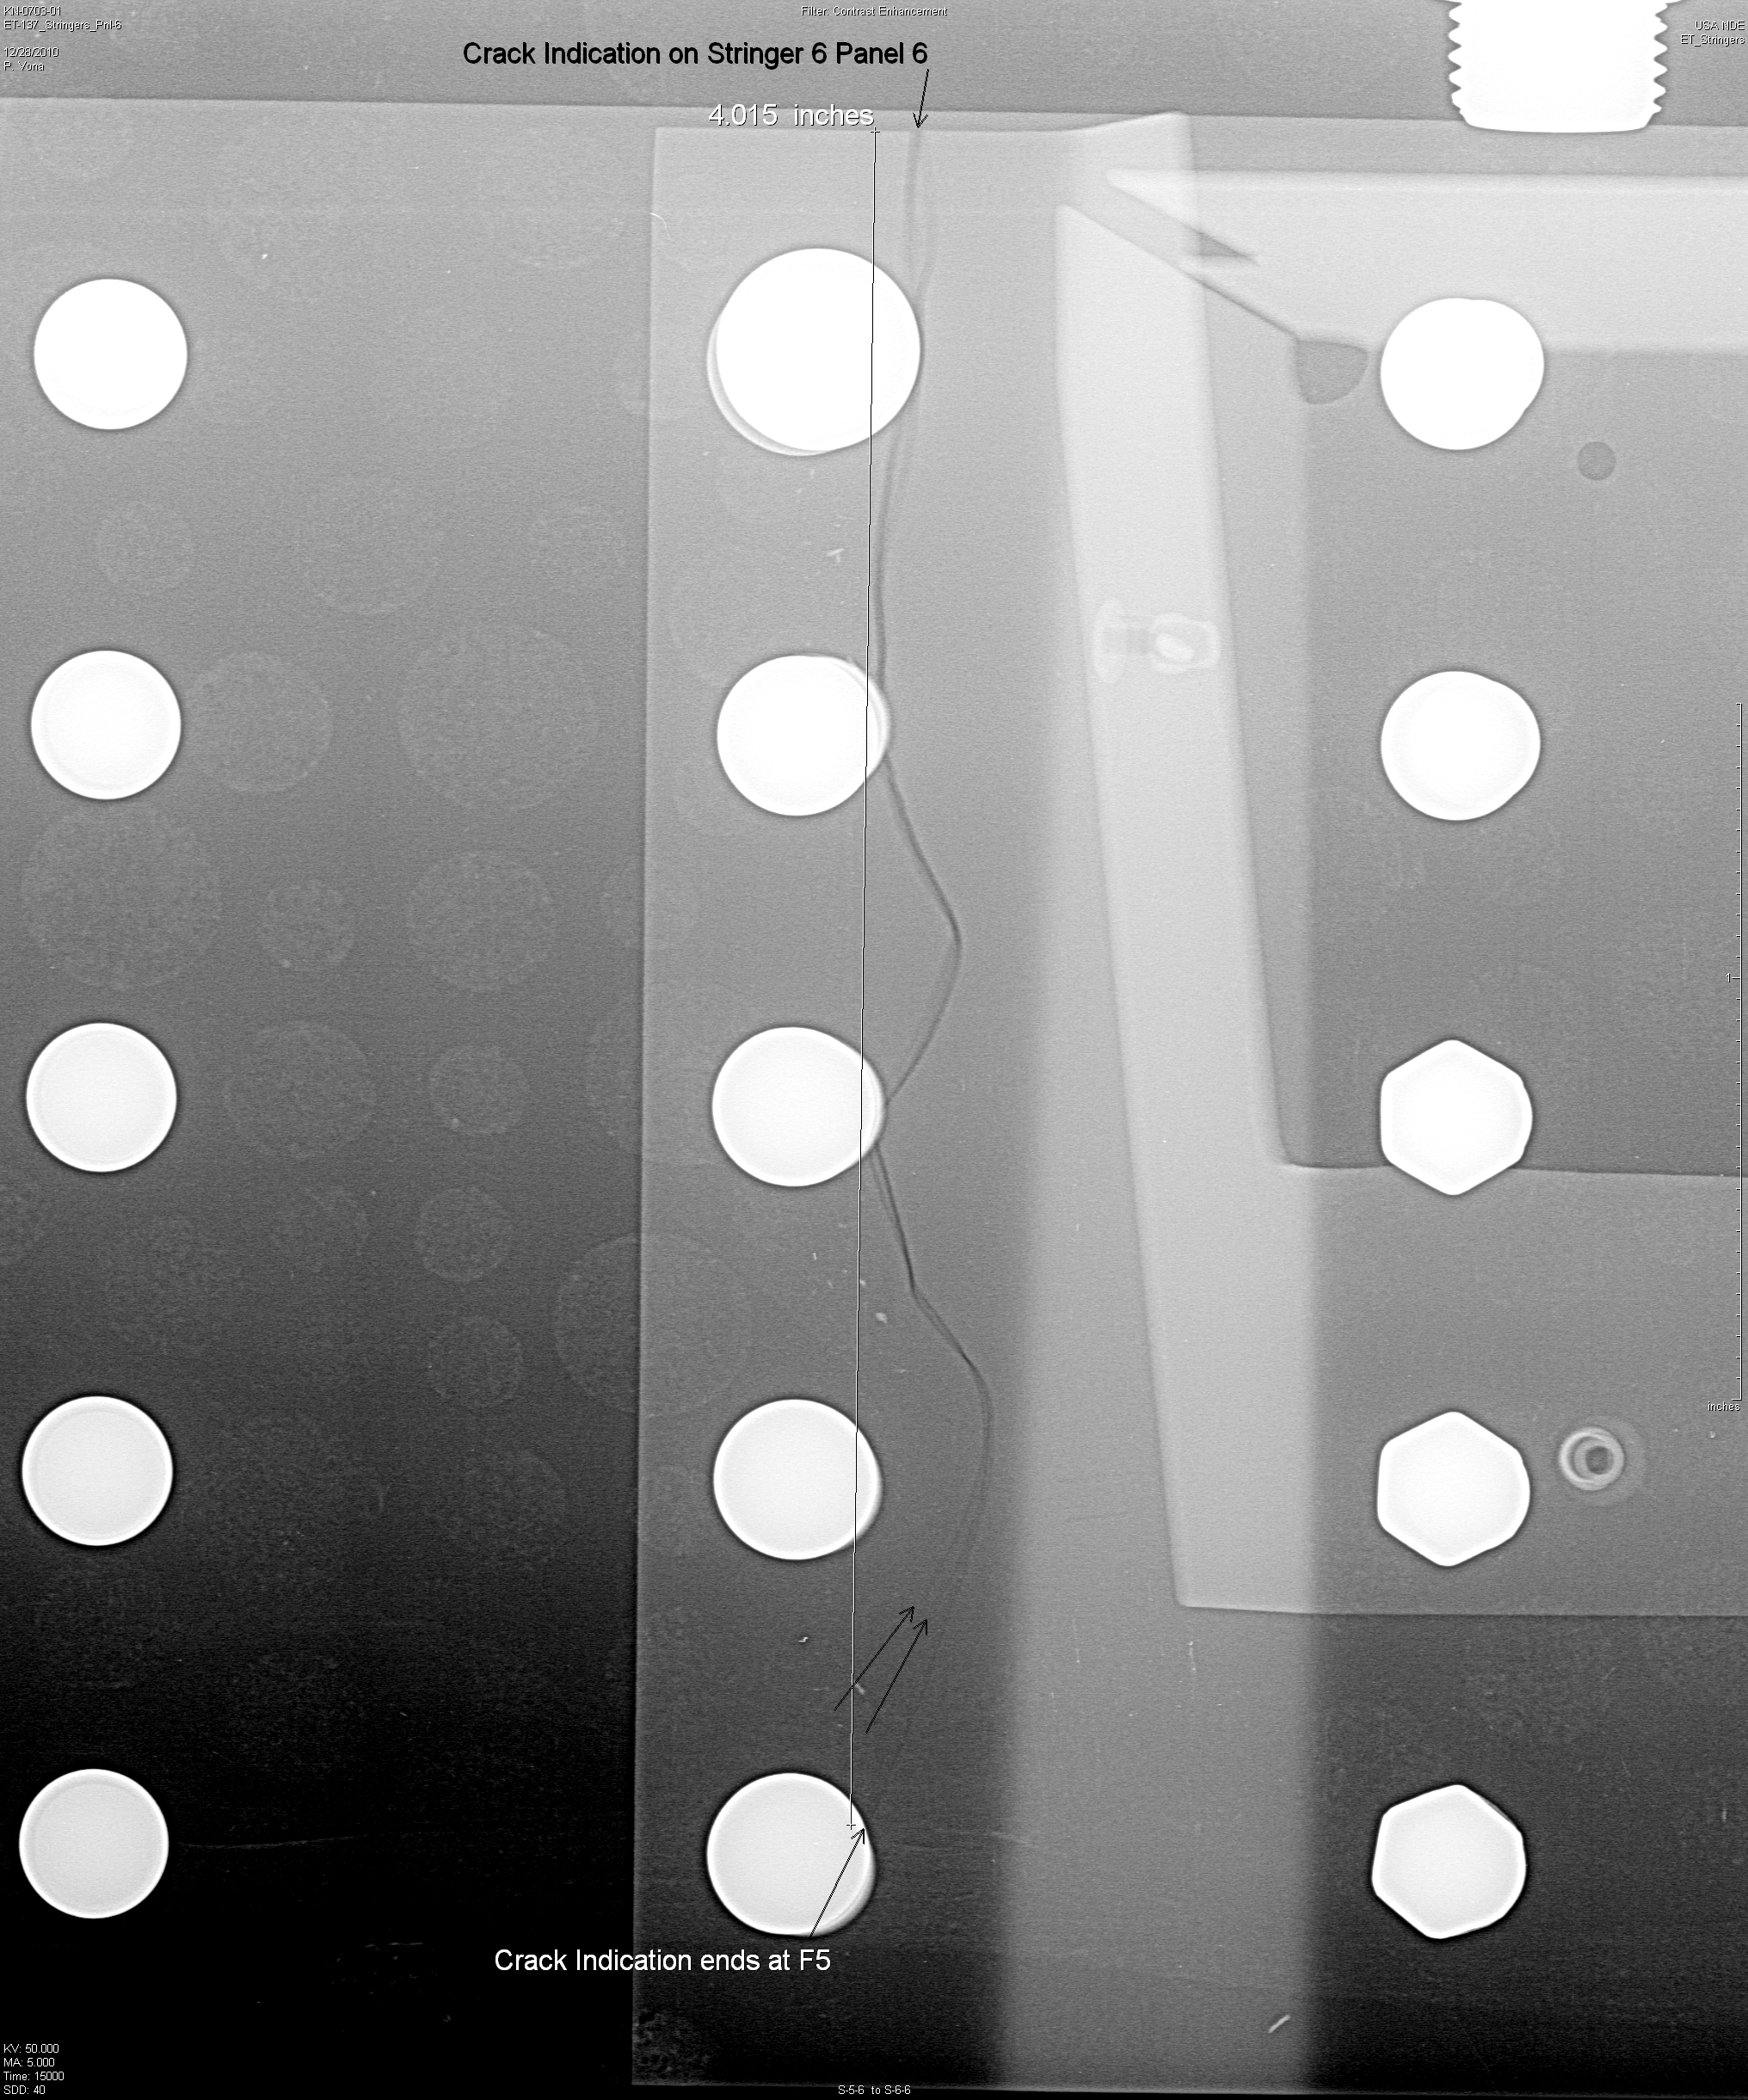
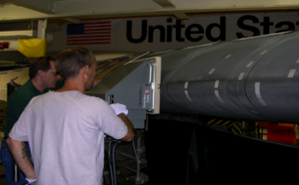
Introduction to Probability of Detection (POD) for Nondestructive Evaluation (NDE)
Ultrasonic Inspection of
Composite Crew Module
Radiograph of Cracked Space
Shuttle External Tank Stringer
Thermographic Inspection of Space
Shuttle Wing Leading Edge

Slide 2
Outline
What is POD and why is it important?
How is POD used?
How do you estimate POD for NDE?
When is POD required?
What is not covered
  POD detailed statistical methodologies
  Actual POD curves, or detectable flaw size limits based on POD for specific NDE techniques or applications

Slide 3
NDE Capability
“What is smallest flaw that an NDE technique can detect?”
One of the most commonly asked questions about NDE … Also, the wrong question to be asking!
More important question is “what are the largest flaws that might be missed by an NDE technique?” It is these flaws that can lead to failure.
Also of importance is an understanding of the false call rate
These questions relate to the “capability” of NDE, which is characterized by “Probability of Detection” or POD

Slide 4
What is POD?
POD is the probability that a flaw of a specific type will be detected by a given technique given the flaw exists in the material. It is usually unknown and therefore statistically estimated.
False call rate is the percentage of times a technique will indicate a flaw when no flaw is present in the material

Slide 5
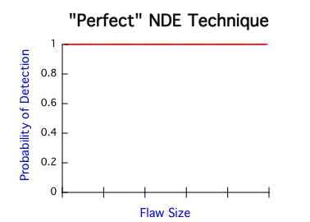
“Perfect” NDE Technique
Detects all flaws regardless of size
Also would have no “false calls”
  All real measurement techniques have some minimum size below which detection is not possible
“Perfect” NDE technique does not exist!

Slide 6
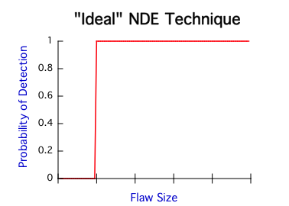
“Ideal” NDE Technique
Detects all flaws above a certain flaw size
Any flaw size that can be detected at least once will always be detected
“What is smallest flaw NDE technique can detect” would be the important question
“Ideal” NDE also does not exist!
Smallest Flaw Detected

Slide 7
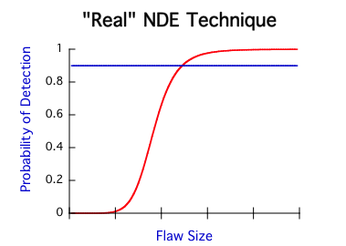
Real NDE Techniques
POD is a function of size
  Zero for very small flaws
  Near perfect for large flaws
  Transition region in between
POD for smallest detectable flaw is very low – much more likely not to be detected!
When POD required by NASA (more later), must have 90% probability of detection (with 95% confidence level – also more later)
90% POD
Smallest Flaw Detected

Slide 8
How is POD Used?
All real materials and structures have flaws
For fracture critical components, materials/structural engineers must calculate an “critical flaw size”
  Function of material properties, structural geometry, operating environment (loads, temperature, etc.), planned lifetime, etc.
  Conservative assumptions (e.g. multiple estimated lifetimes)
NDE used to ensure that no flaws are present that are of this critical size or larger
  Flaw size detection capability established by POD
  Must be equal to or less than critical flaw size
Results in low probability that flaws exist in material or structure that will grow to failure -> SAFETY

Slide 9
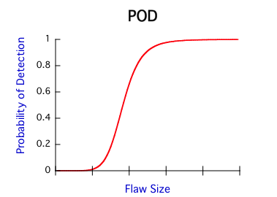
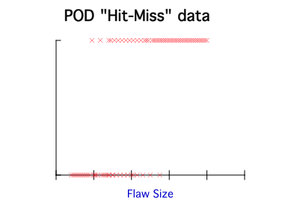
How is POD Estimated?
Statistical in nature – never can determine “actual” POD
POD “estimated” from results of NDE tests using a statistical sampling of specimens with representative flaws of known sizes
Flaws Detected
Flaws Missed

Slide 10
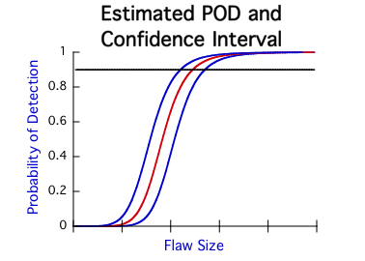
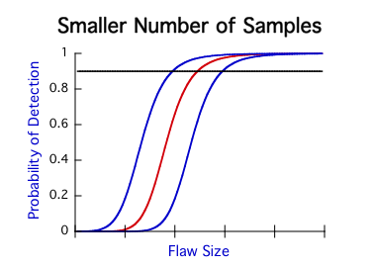
Confidence Intervals
How good is our POD estimate?
Confidence interval is a function of number of samples
NASA requirement is to demonstrate at least 90% POD at a given flaw size with 95% confidence

Slide 11
Two Methods
Full POD (MIL-HDBK-1823A 2009 Nondestructive Evaluation System Reliability Assessment)
  Larger number of test flaws whose flaw sizes are distributed over range from not detectable to readily detectable
  Perform testing and generate estimate of POD curve
  Determine estimated flaw size for 90% POD with 95% confidence
  Provides minimum flaw size with required capability
Point Estimate (Materials Evaluation, Vol. 40, No. 9, pp 922-932, 1982)
  Demonstrate capability is at least 90% POD at a given flaw size with 95% confidence
  Smaller number of specimens with nominally same size flaws (and a few larger and smaller flaw sizes to verify detection assumptions)
  Binomial statistics provides number of successful detections required for 90/95 demonstration (e.g. 29/29, 45/46 …)
  Specified flaw size set in demonstration. Required capability may exist at even smaller flaw sizes

Slide 12
Factors Affecting Capability
Flaw
  Nature, Length, width, depth, location, surface characteristics, etc.
Material
  Surface finish, microstructure, product form, physical properties, etc.
Structure
  Dimensional variations, geometry, inspection access, etc.
NDE Technique
  Probe sensitivity variations, instrument settings, electronic noise, etc.
Operator (Human Factors)
  Skills, training, attention to detail, etc.

Slide 13
When is POD Required?
Primary Agency Guidance – NASA STD-5009 – Nondestructive Evaluation Requirements for Fracture-Critical Metallic Components
Also called out in other Program specific requirements and procurement standards
  SD73-SH-0082A Space Shuttle Orbiter Fracture Control Plan
  SSP-30558 Fracture Control Requirements for Space Station
  ANSI/AIAA S-080 – Metallic Pressure Vessels
  ANSI/AIAA S-081 - COPV Metallic Pressure Vessel Liners
  NASA-STD-5019 Fracture Control Requirements for Spaceflight Hardware
Check with NDE technical authority for specific program or project

Slide 14
NASA STD-5009
Defines requirements for nondestructive evaluation in support of NASA-STD-5019, Fracture Control Requirements for Spaceflight Hardware
Fracture-Critical Hardware, Component, or Part: Classification that assumes that cracks in the hardware, component, or part could lead to a catastrophic failure, an event that results in loss of life, serious personal injury, loss of the manned flight system, or national asset.
Nondestructive inspections of fracture-critical hardware shall detect the initial crack sizes used in the damage tolerance fracture analyses with a capability of 90/95 (90 percent probability of detection at a 95 percent confidence level).
Not all components are fracture critical!

Slide 15
NASA STD-5009
Two NASA NDE Classifications
  Standard
    Limited to the following NDE techniques: eddy current, fluorescent penetrant, magnetic particle, radiography, and ultrasonics
    Established minimum detectable crack sizes
    Formal POD demonstration not required, only a calibration on simulated or real crack-like flaws
  Special
    Flaw sizes smaller than standard established minimum detectable sizes
    Includes techniques other than those listed above
    Formal 90/95 POD demonstration required by specific inspector(s) that will perform inspection
    Can use either point estimate or full POD method

Slide 16
Summary
POD used to estimate capability of NDE techniques
Many factors affect POD
Two methods for estimating POD: Point estimate and full POD method
When POD required by NASA, must demonstrate 90 percent POD with 95 percent confidence
NASA STD-5009 provides general guidance for when POD required, but also included in other program or procurement specific documents
NASA STD-5009 designates two levels of NDE
  Standard – certain methods and established minimum detectable flaw sizes – no formal POD demonstration required
  Special – smaller flaw sizes or nonstandard methods – formal POD demonstration required by specific inspector(s)

