Slide 1

Dynamic Fracture I
Failure under impact load
Dr. Don Shockey
Director, Center for Fracture Physics
SRI International Menlo Park, CA donald.shockey@sri.com

Slide 2
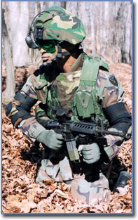
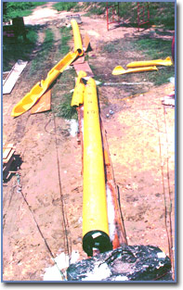
1. Dynamic load applied to structure
(projectile striking target)
Load is dynamic & crack is static
2. Rapidly propagating crack
(crack in pressurized pipe)
Crack is dynamic & load is static
2 Major Classes of Dynamic Fracture Problems
Notes:
I will present a case history of each.

Slide 3
Objectives
  Show how structures can be designed to resist dynamic fracture
  Show that environment can influence high-rate fracture
  Show that durability issues must be addressed when using materials in different application

Slide 4

Sioux City, 1989
Engine burst
Hydraulic lines severed by fragments
Crash-landed
Notes:
After this incident, Congress acted quickly to mandate the FAA to take steps to mitigate the effects of a turbine burst. I wrote a proposal to develop light weight armor that could be placed in the fuselage walls and stop ingress of turbine fragments. The idea is illustrated in this schematic.

Slide 5
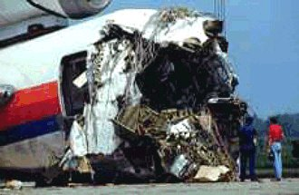
United Flight 232, Sioux City, 1989
Notes:
Don Shockey research scientist at SRI International in the SF Bay Area Metallurgist by training degrees from CMU post-doc at EMI in Germany specialized in fracture physics emphasis on high-strain-rate fracture explosive loads, ballistic impact, intense radiation
So I’ve had the misfortune of not being a NASA employee, but had the fortune of working of working for a NFP institute, got to work for many companies and government agencies on a wide variety of fracture problems. Today I’m going to tell you about some lessons I learned
I’ll present 2 case histories
In one a material successfully developed for one application was used in a different application without considering durability—with unfortunate results
In the other small scale testing showed an unforeseen damage mode before the mode could cause a catastrophic service failure.
But first let me define the 2 types of dynamic fracture

Slide 6
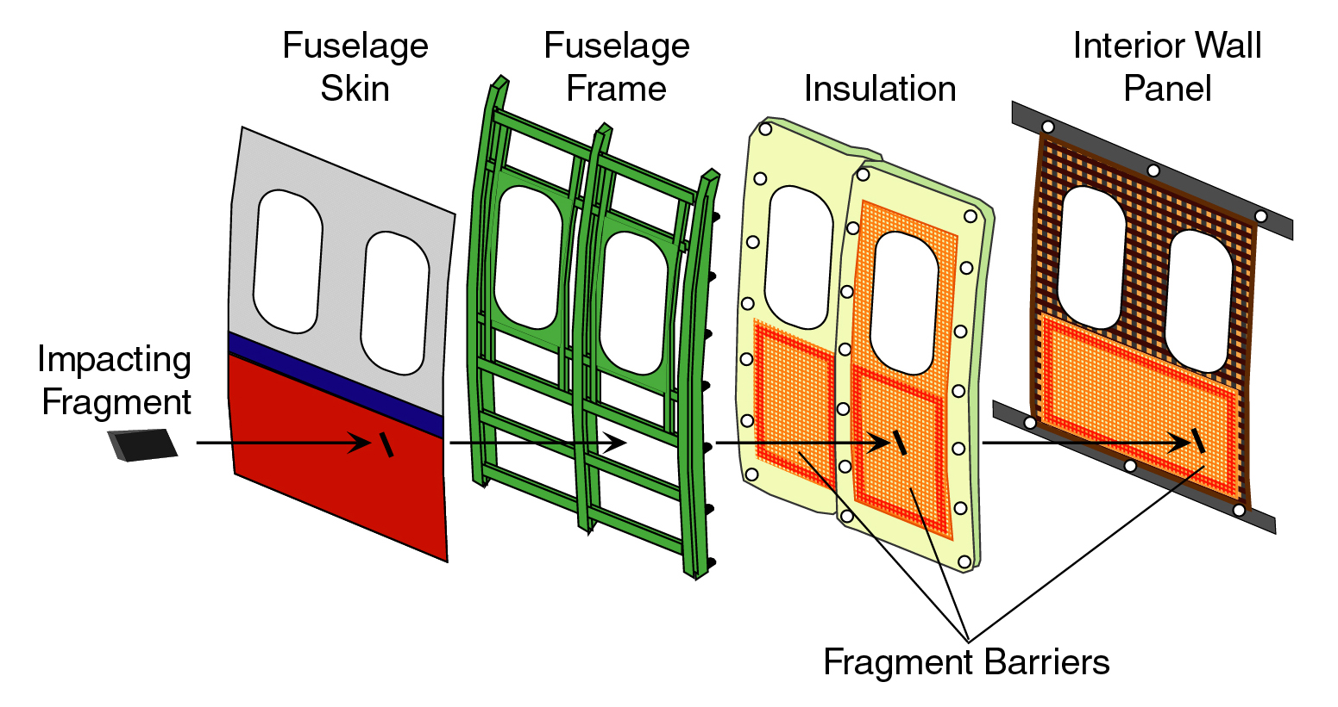
Fragment Barriers in Fuselage Wall
Notes:
This is an exploded view of a typical fuselage wall. The aircraft skin is typically 0.04 to 0.080-inch-thick of 2024 Al. It is attached to an Al frame, which in turn is attached to the IWP, made of something lightweight like 200 mil thick composite (hit elbow). In between is the insulation blanket—fiberglass in a moisture-proof bag (show it). These four layers are all that separate you from the great outdoors when you fly back to Langley or wherever.
Typically 5 ½ inches of space between skin and IWP. Our idea was to put a ballistic panel in this space. We looked at all the typical armor materials—metals, ceramics, composites, an fabric. We tested their ability to stop a flying fragment. Did gas gun experiments where we accelerated simulated fragments against the candidate materials. Found that on a weight basis, fabrics outperformed metals, ceramics, and composites.
Next slide shows hi-speed photos of two tests

Slide 7

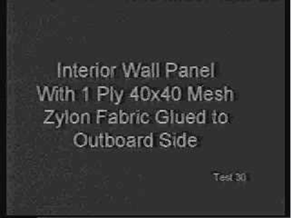
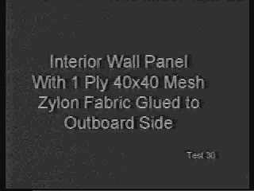


Evaluating Barrier Materials
Interior wall panel
Interior wall panel plus a layer of ballistic fabric
Notes:
You will see a IWP in cross section and a projectile approaching from the left. The projectile passed right through with little change in velocity. IWP offers little protection against an engine fragment.
Now I’ll show you a similar experiment—same projectile, same velocity, but one layer of ballistic fabric is place in front of the IWP. The projectile is prevented from penetrating and is thrown back. A successful test of the fragment barrier concept.
But what fabric to choose? We did tests on 3 fabrics—Kevlar, Spectra (HMWPE), and a relatively new fabric called Zylon

Slide 8
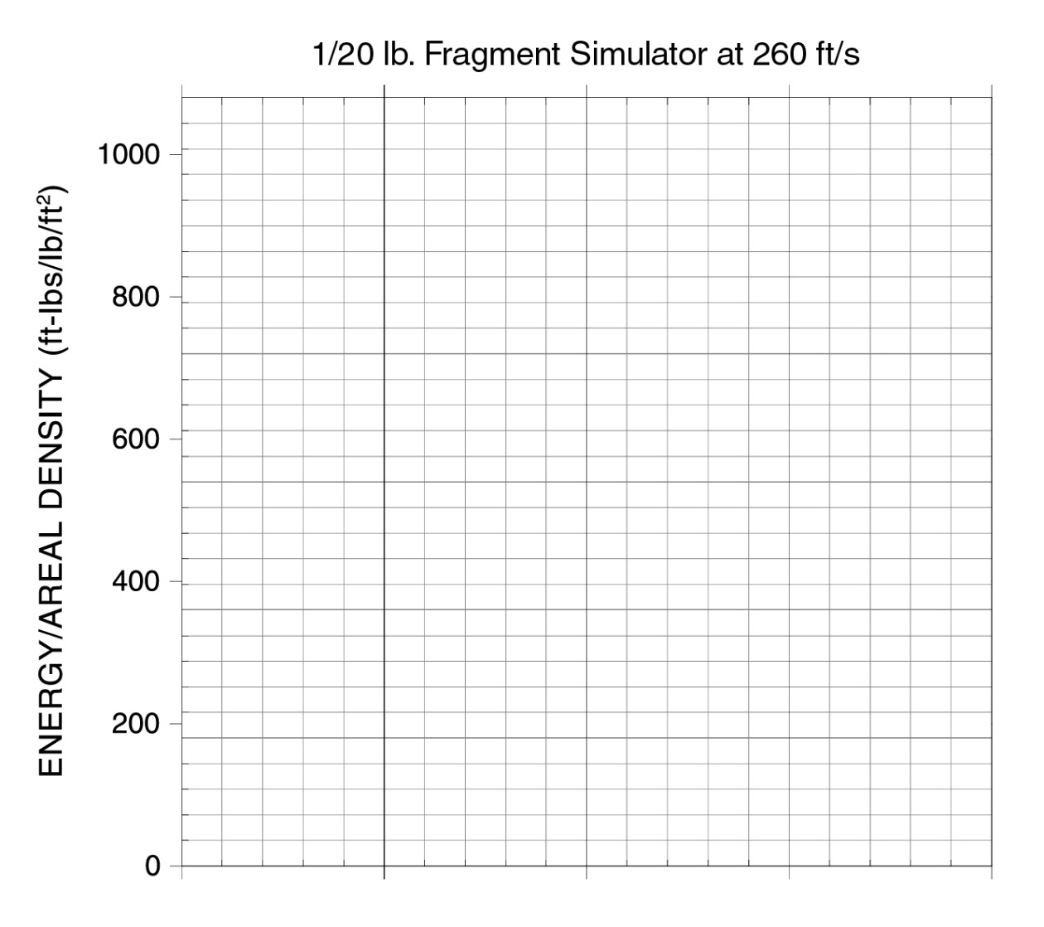
Fragment Energy Absorbed
Aluminum not very good
Kevlar & Spectra 6–7x
Zylon best
Zylon
Spectra
Kevlar
Al Fuselage Skin
Notes:
So we felt we had found our material. Zylon (show it) is a flexible, lightweight fabric not unlike the shirt you are wearing.
The next step was to design barriers. How many layers were optimum? How should they be attached to the aircraft? What about off-center hits—were they more or less dangerous than center hits? What about oblique impacts? Etc

Slide 9
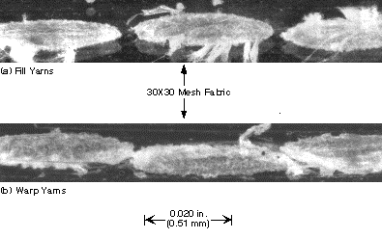
Computational modeling
Measured geometry from micrographs
Got yarn cross-section dimensions
Measured offsets for fill and warp yarns

Slide 10
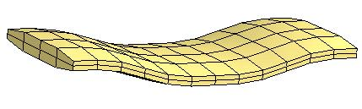
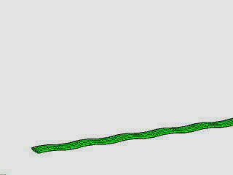
Computational Model of Yarn and Fabric
Notes:
The yarn model is depicted here. There are 8 finite lelements on the cross section, and finite elements along the yarn length that model the curvature. When we do the simulation, the stresses and strains in each element is computed.
And now we use the yarn model to build up the fabric.
So now we have a accurate model of fabric geometry. The next step is to measure the mechanical properties of the yarn.

Slide 11
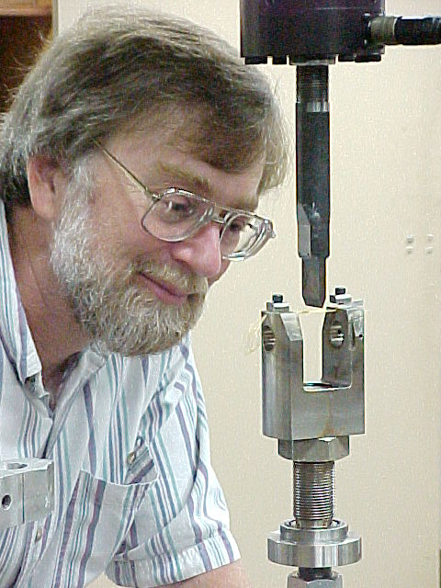
Mechanical Property Tests
Tensile Strength
Failure Strain
Friction Coefficient

Slide 12
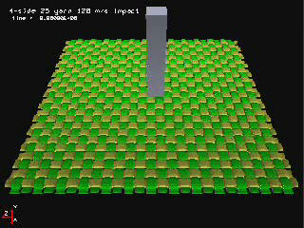

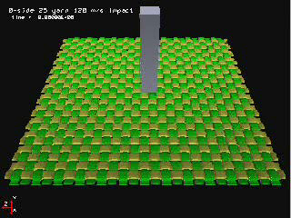
“Virtual” Experiments
(with the Computer)
Held on 4 sides
Held on 2 sides
Not held
Notes:
So here is the computer model of the fabric. And here is a fragment that will impact the fabric.
In this first simulation we hold the fabric tightly on all 4 sides. The fragment impacts from the top and we’ll see how the fabric reacts. You see the fabric deflects a bit before the fragment breaks through. We calculate how much energy the fabric absorbed.
In this second simulation we hold the fabric on only 2 sides and don’t hold it on the other two sides. In this case the fabric deflects a bit more before being penetrated by the fragments. Turns out this absorbs a bit more energy.
Now we looked at a third case in which the fabric wasn’t held on any side—just sitting free. This absorbed the least energy, but there is an interesting result—the fabric was not penetrated,--the fragment just carried the fabric with it. This was interesting to us, because if we could just cloak the fragment with the fabric, the fragment would have to drag it along and in the process absorb energy and slow it down.
So by doing additional virtual experiments, we designed an attachment scheme that got the most energy absorption out of the fabric. That is, we held the fabric tightly at first, to exert the most resistance on the fragment, then just before the fragment penetrated, the fabric tears away from its attachment and rides along with the fragment as it continues.
So we could finalize the design of the engine fragment barrier system.

Slide 13
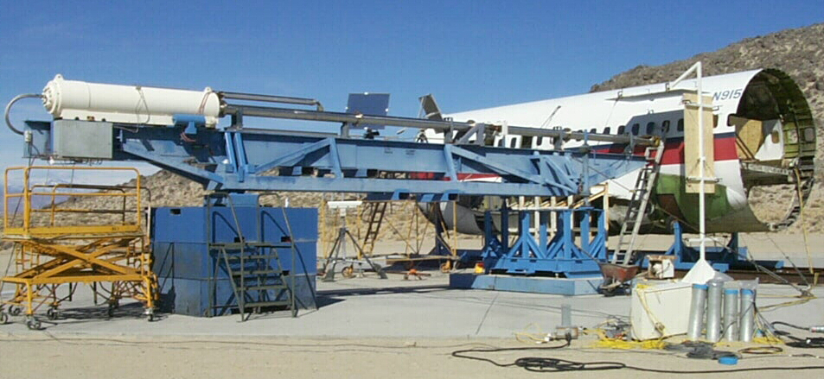
Full-Scale Impact Tests
NSWC, China Lake, CA
Notes:
This is a full-scale fuselage section of a Boeing 727. 3 layers of Zylon is included in the insulation blanket and attached to the frame in the fuselage wall. A real turbine blade fragment (show it) is accelerated down the barrel of this gas gun against the fuselage skin. The result is shown here.

Slide 14
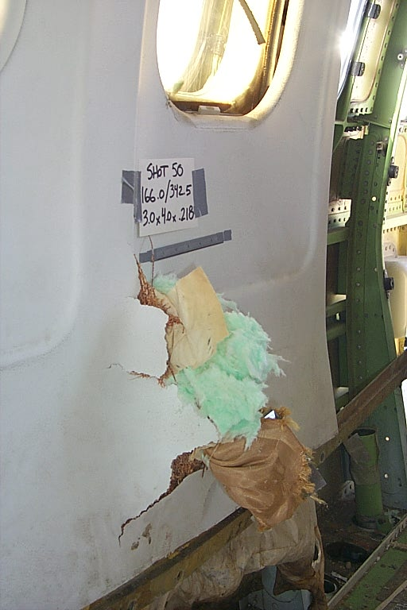
Arrested Engine Fragment
Fan blade fragment
3″ x 4″, 0.37 lbs
Sharp-ended
622 ft/s
3 layers of Zylon
Weighs 0.1 lbs/ft²
Notes:
So the program to develop lightweight barriers that could protect passengers and flight-critical systems from engine debris was successful.

Slide 15
Fragment Shield Summary
Lightweight, low-cost barriers to engine fragments
  Advanced polymer with superior properties
  Computational tool for barrier design
  Full-scale demonstration of barrier effectiveness
Technology ready for transfer to industry
Notes:
BUT! Another company decided to use it in another application and they didn’t do their homework.

Slide 16
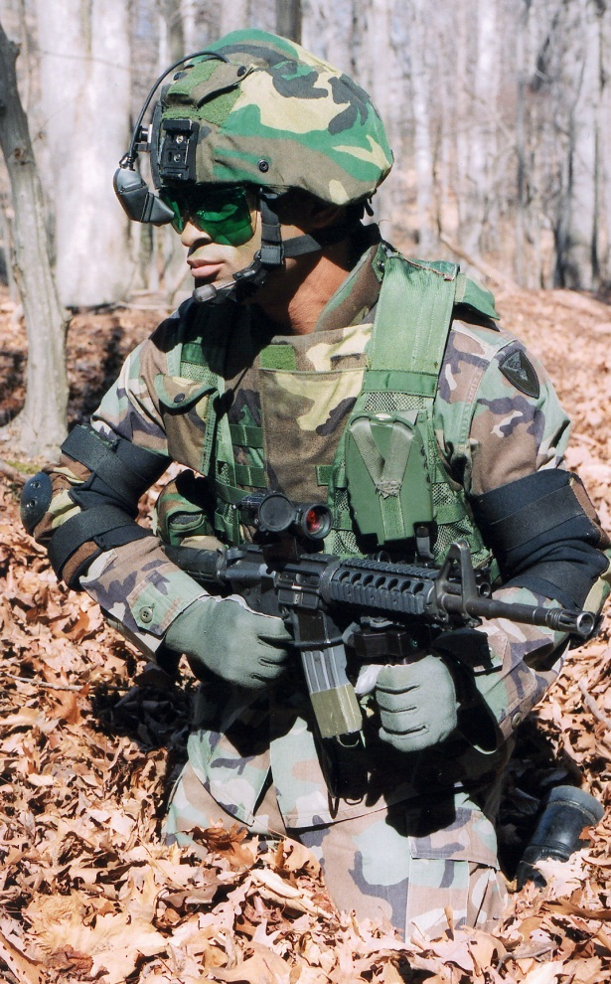
Use of Zylon for Body Armor
Lightweight, low-cost, ballistically effective
Company made police vests
But fatality occurred!
Zylon degrades over time
  Moisture
  Temperature
  Sunlight

Slide 17
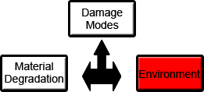
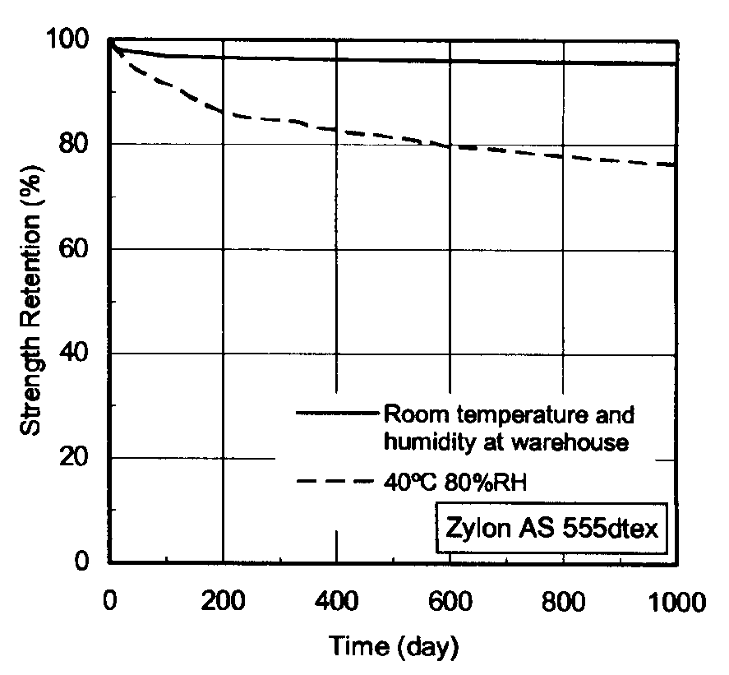
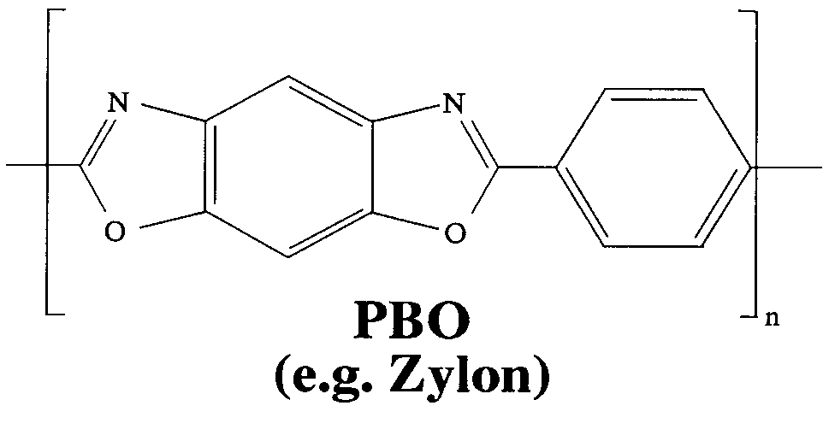
The Durability Issue—
Performance Degradation with Time
Environment
  Moisture
  Temperature
  Sunlight
Bond scission
Property degradation

Slide 18
Lessons Learned
Changes in a material’s application warrant new evaluation
Always consider long-term aging effects on material properties and behavior
Design and evaluate most efficiently with iterative computational simulations & experiments

Slide 20
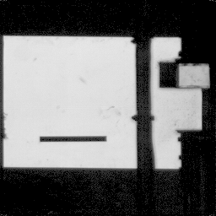
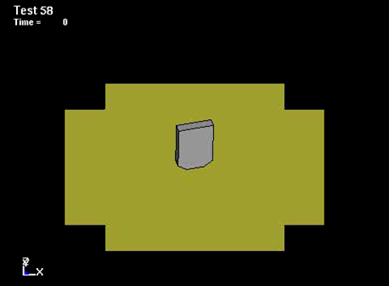

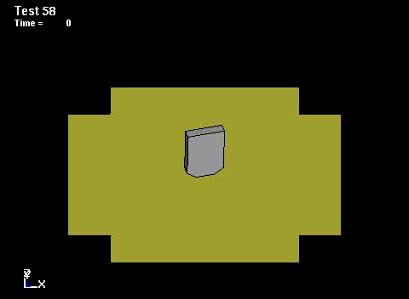
Fragment impacting fabric
Experiment
1 layer of fabric
1/4-lb fragment
Impact velocity: 192 m/s
Simulation
LSDYNA3D FE code
SRI fabric model
Analyze/design barriers
Boeing/UCB/SRI/FAA
Notes:
To answer these questions in an efficient way, we developed a computer model and did computational simulations, varying the barrier and projectile parameters. Then we performed experiments to check the calculations, modify the model.
Then did second generation calculations, did additional experiments to check them. In this iterative computation/experiment approach, we arrived at acceptable designs quickly and at low cost. We do all of our research projects this way.
Once we had a design we believed in, we did full scale tests to verify it.
Left video should be linked to TEST58.AVI
Right video should be linked to t58.avi

Slide 21
2 Major Classes of Dynamic Fracture Problems
1. Dynamic load applied to structure
(projectile striking target)
Load is dynamic & crack is static
2. Rapidly propagating crack
(crack in pressurized pipe)
Crack is dynamic & load is static
Notes:
I will present a case history of each.

Slide 22
Dynamic Fracture II
Fast-running cracks
Dr. Don Shockey
Director, Center for Fracture Physics
SRI International Menlo Park, CA donald.shockey@sri.com

Slide 23
1. Dynamic load applied to structure
(projectile striking target)
Load is dynamic & crack is static
2. Rapidly propagating crack
(crack in pressurized pipe)
Crack is dynamic & load is static
2 Major Classes of Dynamic Fracture Problems
Notes:
I will present a case history of each.

Slide 24
Objectives
  Show that scale-model testing can identify unforeseen damage modes
  Show that a failure mode can transition from controllable (leak) to catastrophic (RCP)
  Show how structures can be designed to resist rapid crack propagation
  Encourage thinking ahead and proactively precluding damage modes

Slide 25

Dynamic Fracture of a Pipeline
Notes:
Animation links to gas_pipe.exe

Slide 26
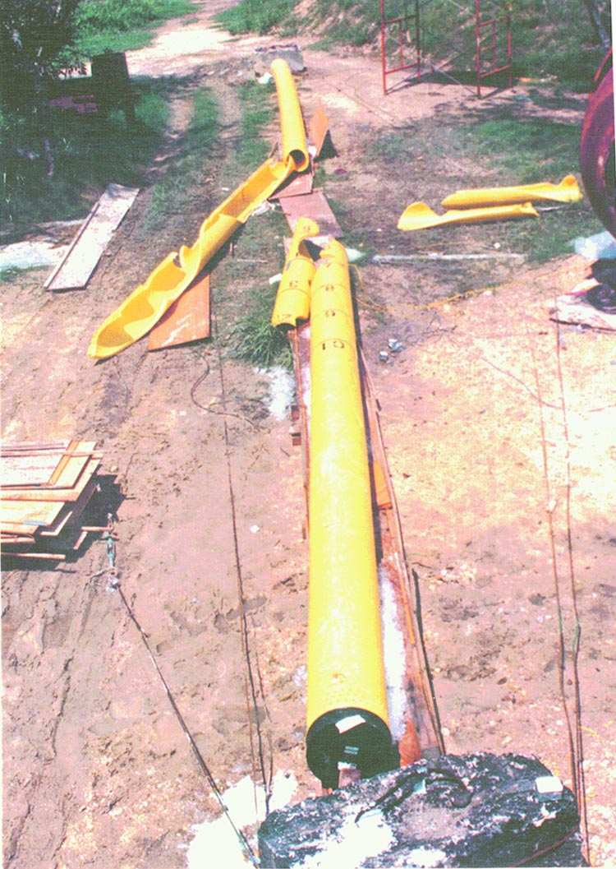
Ruptured Test Pipe
Never an RCP event in USA
But RCP occurs reproducibly in tests
Thus, RCP a potential damage mode
The good news: we can anticipate & design against RCP
Kanninen, et. al., SwRI

Slide 27
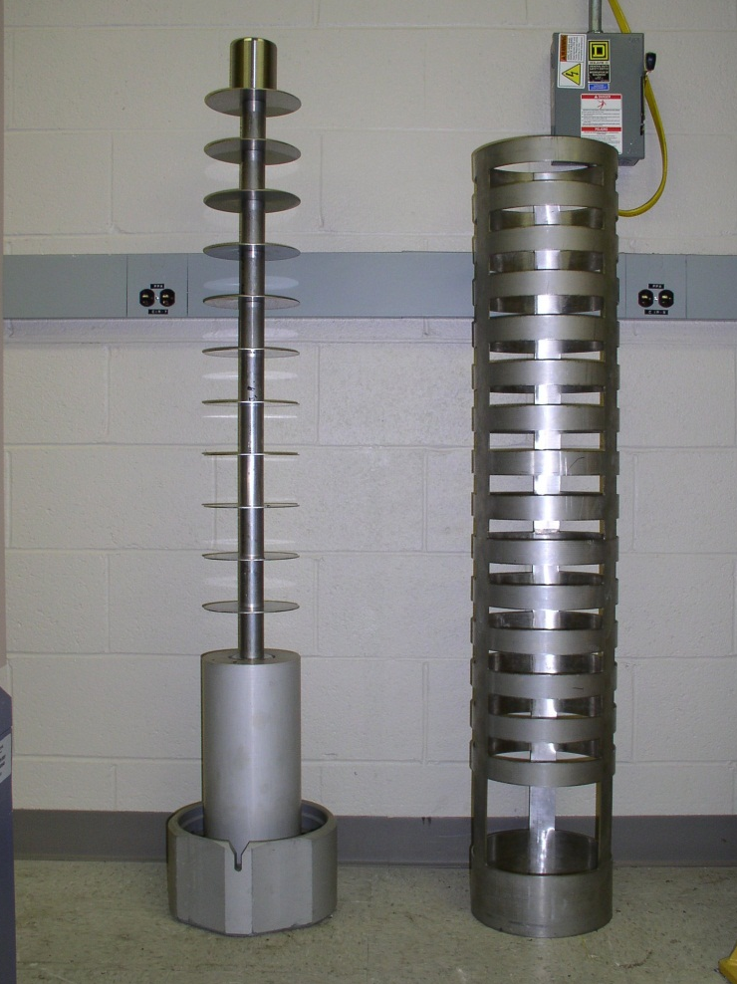
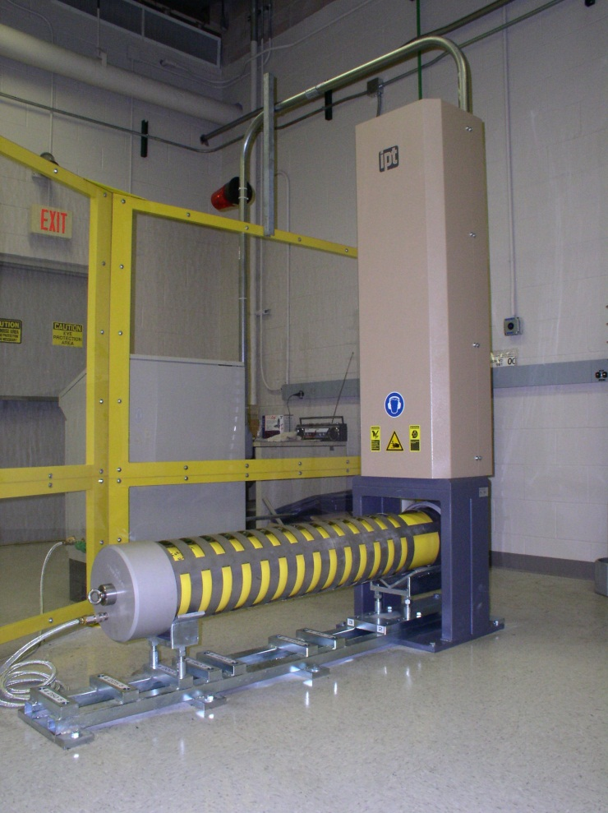
Small-Scale Pipe Test (ISO S4 Test)

Slide 28
Test Under Controlled Conditions
Vary pressure, temp.
Vary environments
Show damage mode
Measure crack speed, depressurization kinetics
Quantify response

Slide 29
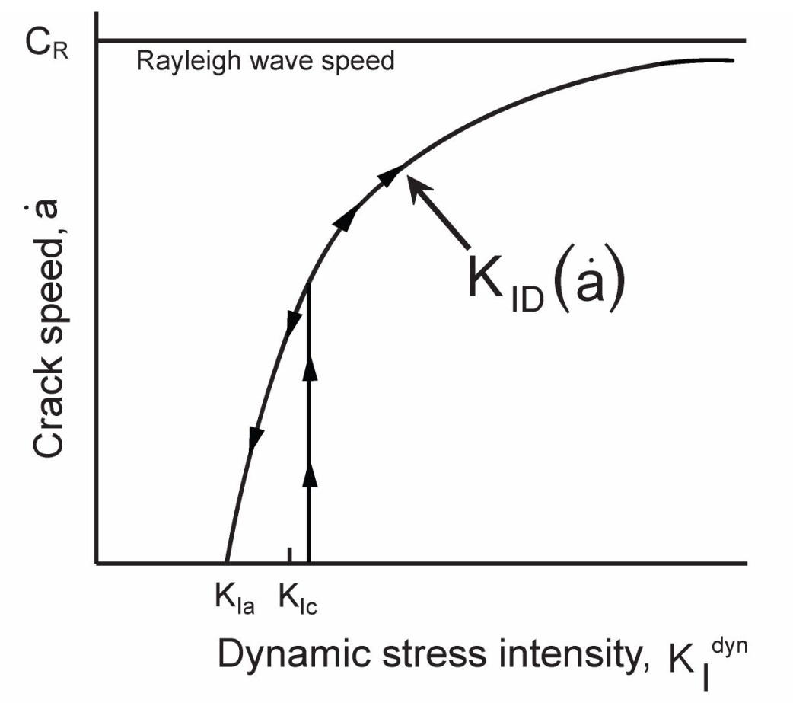
Crack Velocity vs. Stress Intensity
Material property controlling leak vs. burst response
T. Kobayashi and J. W. Dally,
Fracture and Crack Arrest, ASTM STP 627, 1977
PM 9-9

Slide 30
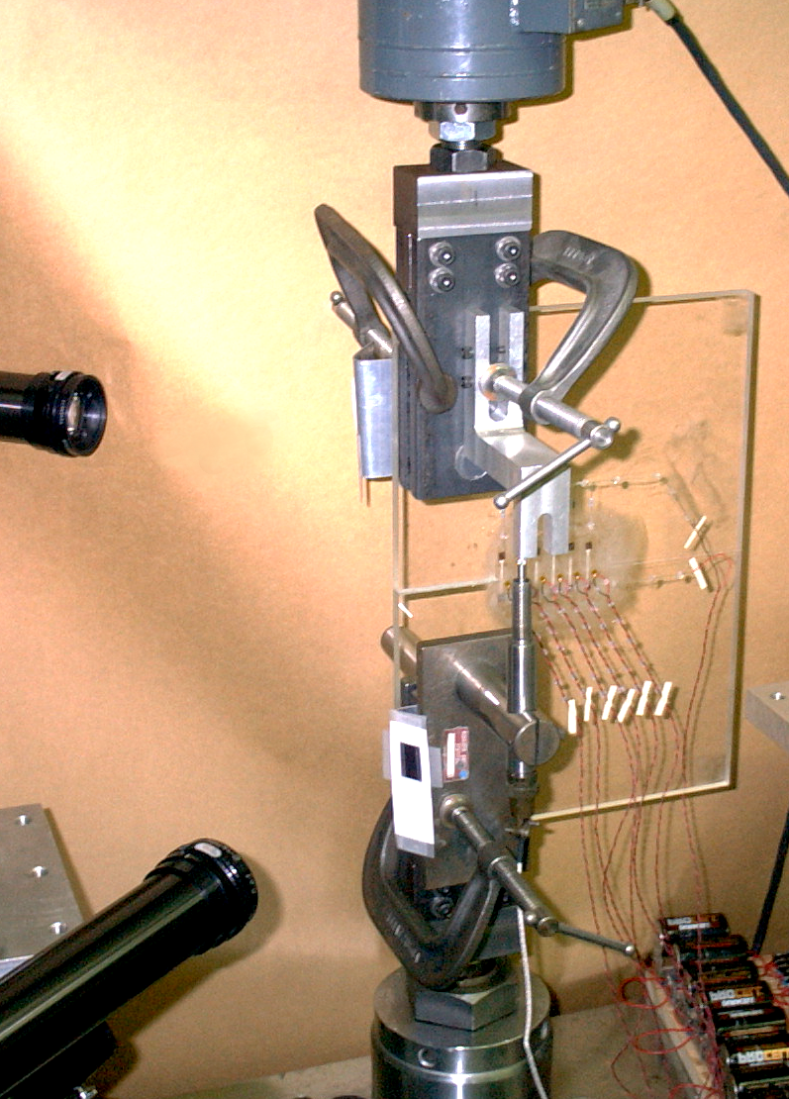
Laboratory Test to Measure K_{ID}(a)
Strain gages placed to obtain stress intensity
α
φ
Crack propagation

Slide 31
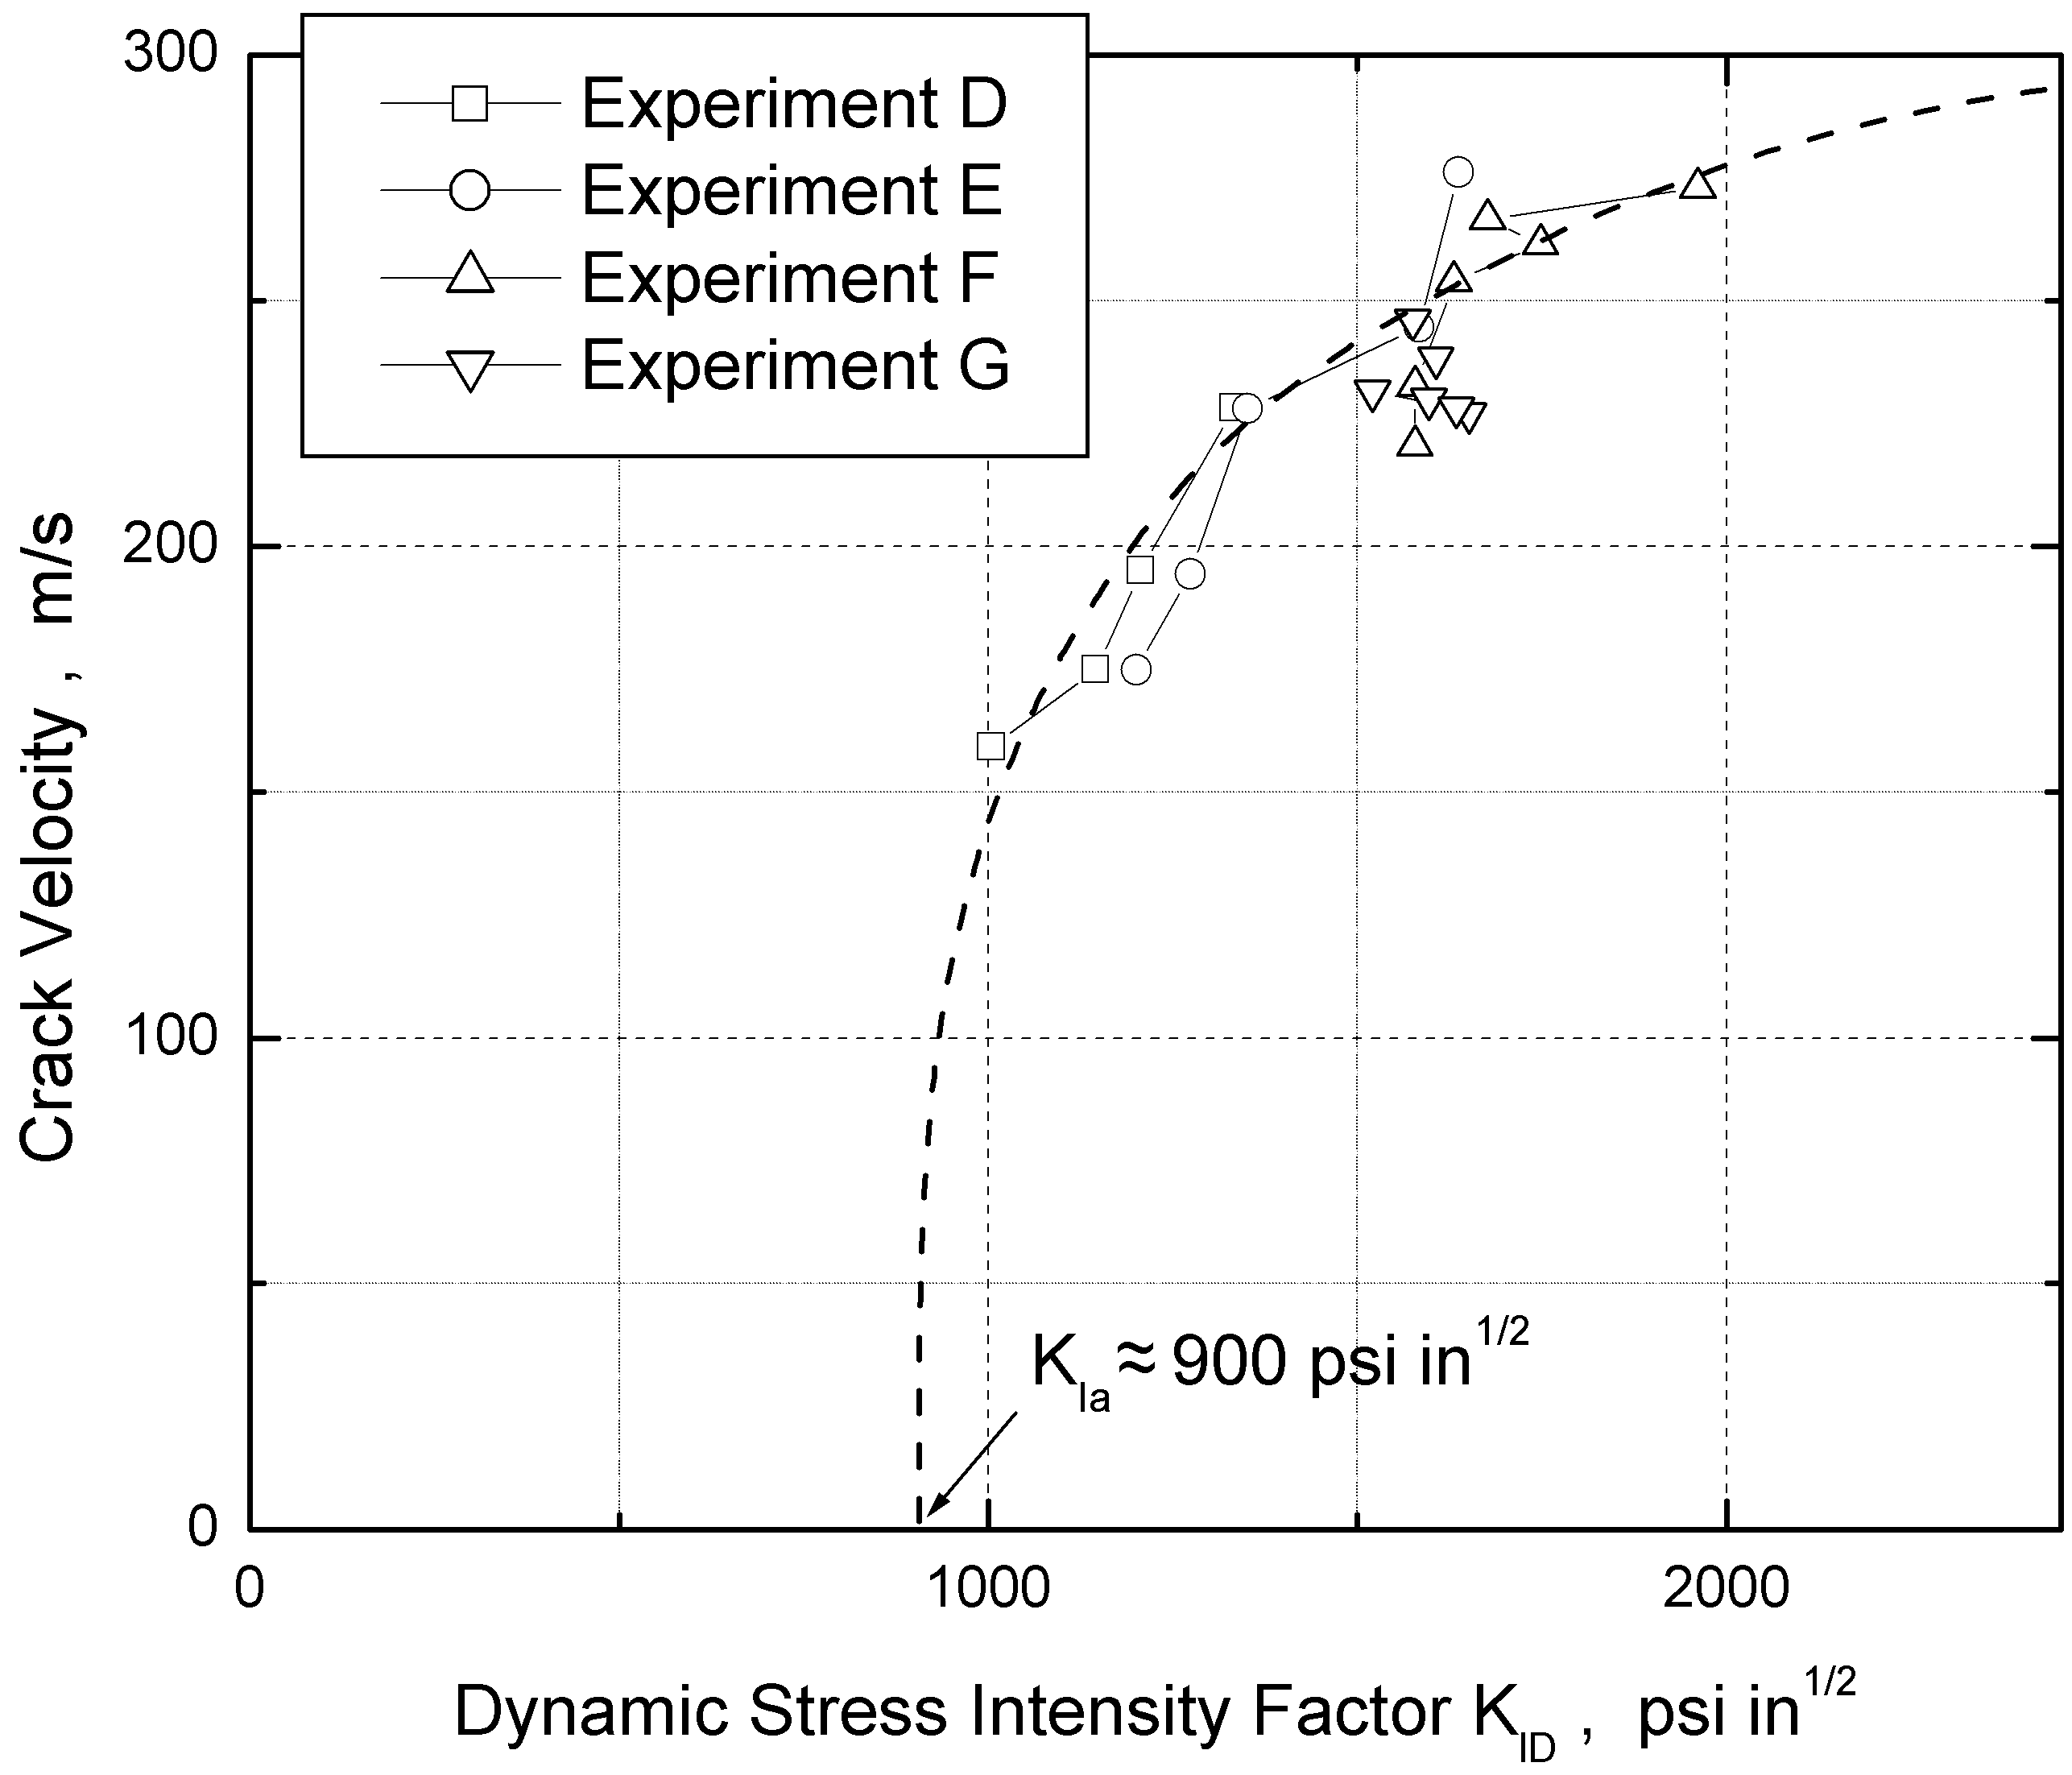
Measured Crack Velocity vs. K

Slide 32
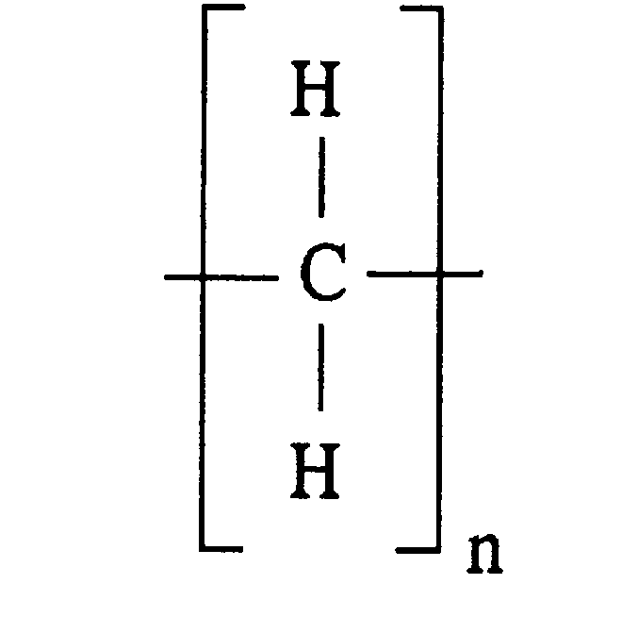
Environment Effects on Microstructure
Breaks bonds
Increases crystallinity
Redistributes carbon black
Degrades mechanical properties (fracture toughness)
Polyethylene

Slide 33
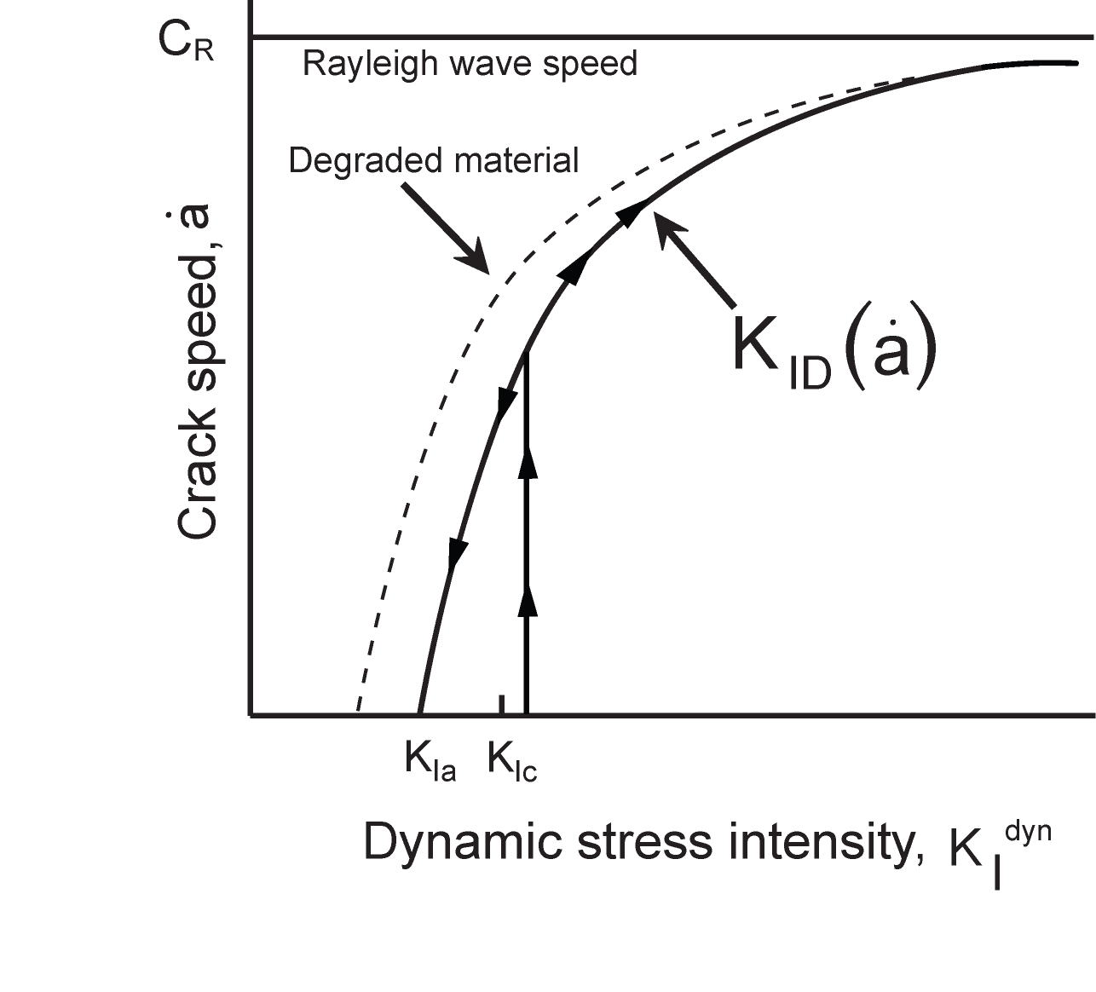
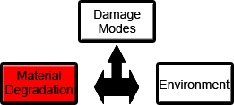
Crack Velocity vs. Stress Intensity
Material property controlling
leak vs. burst response

Slide 34
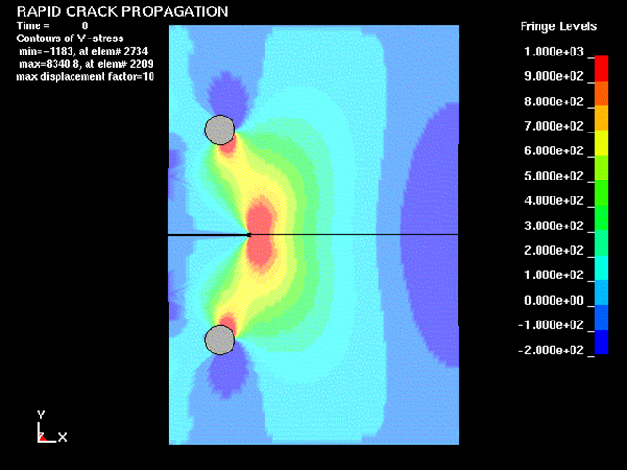
Computed stress history during RCP
Notes:
This movie should go to rcp_stress.avi in the DonShockey folder

Slide 35
Lessons Learned
Tests can reveal an unforeseen failure mode
RCP in pipelines could cause major damage
Environment exposure could cause a failure mode transition from leak to RCP
Tests can provide a chance to be proactive!
  For example, avoid disaster in new hydrogen economy by accounting for environment effects

Slide 36
Summary
When designing against fracture:
  Be aware of a damage mode transition when using materials in a low-factor-of-safety design
  Perform service-simulating tests to discover unforeseen failure behavior
  Design for failure by the least disastrous failure mode
  Envision what damage modes might operate—then
  Be PROACTIVE!

