Slide 1
Determination of Thermal Model Error When Correlating to Test or Flight Data

Slide 2
Introduction
Thermal models are most useful when they can be shown to represent physical reality correctly.
The best way to accomplish this is to correlate the thermal model against data obtained from the actual hardware, either test or flight data.
A measure of the model correlation quality is necessary, to show how well correlated the model is, or how well it corresponds to what was modeled.

Slide 3
Model Types
Thermal models are used for a wide variety of situations.
A model's purpose is key to determining how to best correlate the model.

Slide 4
Model Types (continued)
A thermal model's purpose may be to:
best represent the entire thermal timeline or lifetime of a device.
determine the maximum temperature a component experiences over its life.
determine the maximum temperature a component experiences at a certain time.
determine the temperature change (delta) over a period of time.
determine the temperature gradient across a distance.

Slide 5
Error Types
Each of the foregoing model types may require a different description of the model quality.
A model that is just concerned with a component peak temperature may only focus on how well the peak temperature is predicted.
A model that is meant to describe the behavior of a part on orbit may focus on the entire thermal timeline prediction.

Slide 6
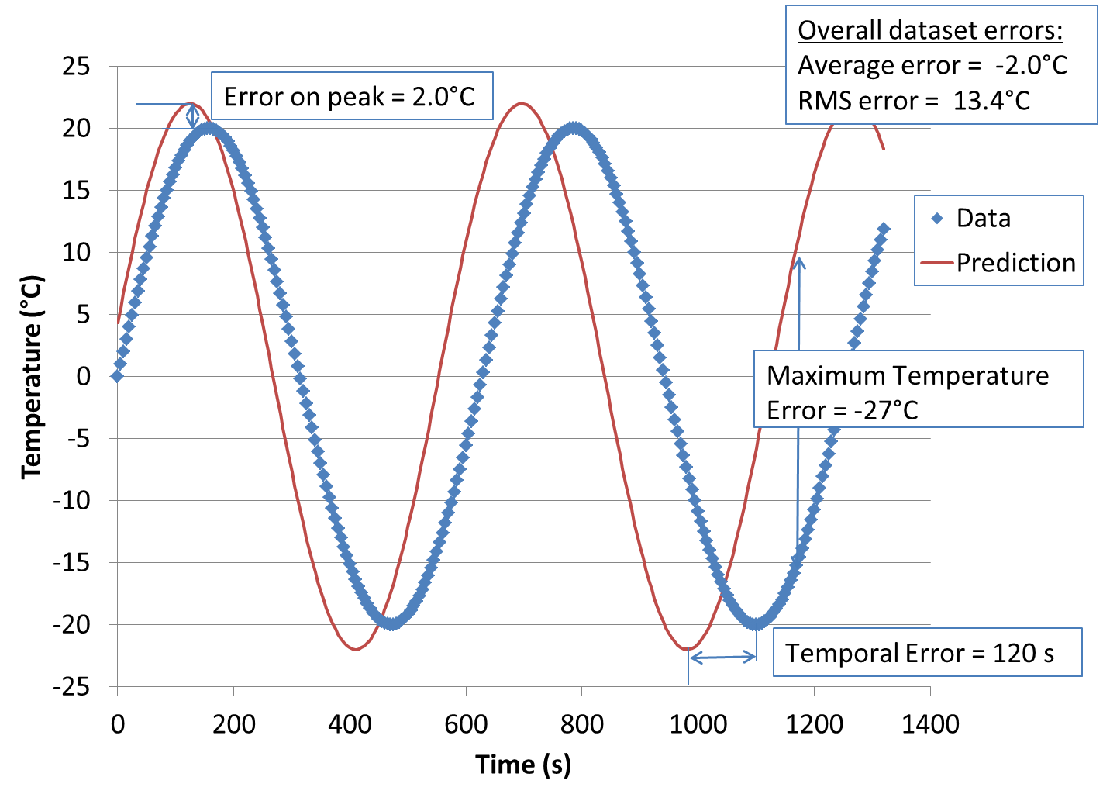
Sample Comparison of Data and Prediction

Slide 7
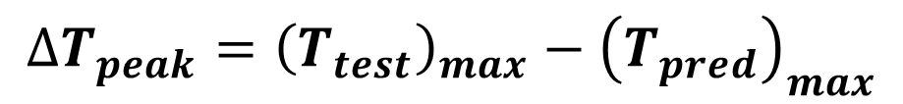
Error on Peak
Error on Peak: difference between the maximum temperature observed in test (or flight) and the maximum temperature predicted by the model.
Used in a case where only the maximum temperature is of interest due to a maximum use limit on a component or material.
$$∆T_{peak}={\left(T_{test}\right)}_{max}−{\left(T_{pred}\right)}_{max}$$

Slide 8
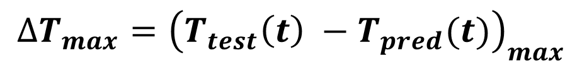
Maximum Temperature Error
Maximum temperature error: maximum difference between the data and the model prediction at any point in time.
Used when the ultimate deviation of the model from data is of the most importance.
$$∆T_{max}={\left(T_{test}\left(t\right) −T_{pred}(t)\right)}_{max}$$

Slide 9
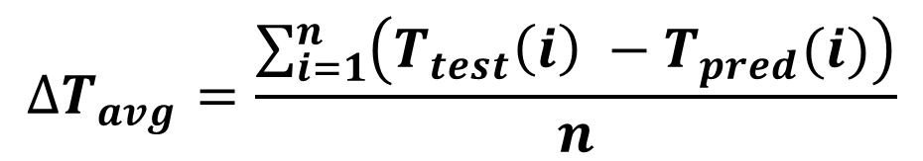
Average Error
Average error: the difference between the flight/test data and model prediction, taken at each time point, and averaged.
Can result in unrealistically low values since positive and negative errors will cancel out.
$$∆T_{avg}=\frac{\sum_{i=1}^{n}{\left(T_{test}\left(i\right) −T_{pred}(i)\right)}}{n}$$

Slide 10
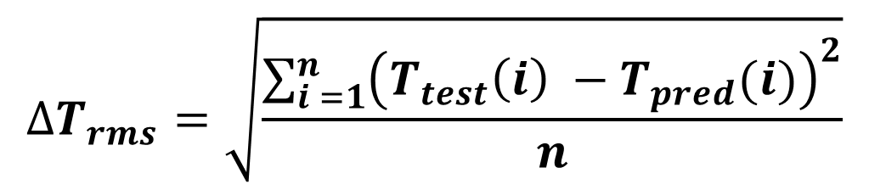
Root Mean Square (RMS) Error
RMS error: the difference between the flight/test data and model prediction, taken at each time point, and averaged using a root-mean-square method.
Gives the best overall single measure of the realism of the model over a timeline; the average variation of the prediction from reality.
$$∆T_{rms}=\sqrt{\frac{\sum_{i =1}^{n}{{\left(T_{test}\left(i\right) −T_{pred}(i)\right)}^{2}}}{n}}$$

Slide 11
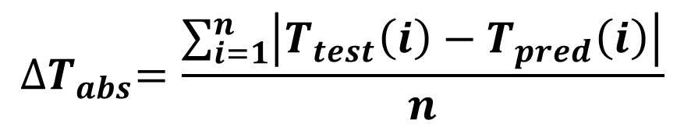
Average Absolute Error
Average absolute error: the difference between the flight/test data and model prediction, taken at each time point as an absolute value, and averaged.
Similar to RMS error in that positive and negative errors do not offset one another, so this error is a good physical representation of the model realism.
$${∆T}_{abs}=\frac{\sum_{i=1}^{n}{\left|T_{test}\left(i\right)−T_{pred}\left(i\right)\right|}}{n}$$

Slide 12
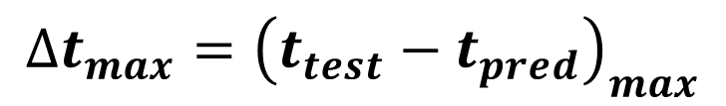
Temporal Error
Temporal error: the error of the model in time, in other words, how far off it is in the time scale in predicting the response time of the system or component.
$$∆t_{max}={\left(t_{test}−t_{pred}\right)}_{max}$$

Slide 13
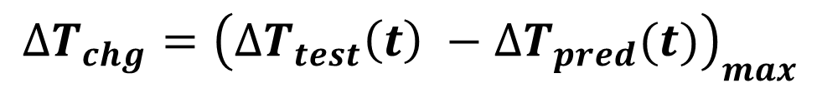
Error in Temperature Change
Error in temperature change or temperature delta: the difference between the change in data over a certain event and the change in temperature predicted by the model for that event.
Useful where the absolute temperature is not considered of high importance, only the response of the model temperatures to an event.
$$∆T_{chg}={\left(∆T_{test}\left(t\right) −{∆T}_{pred}(t)\right)}_{max}$$

Slide 14
Error in Temperature Difference
Error in temperature difference: the difference between the predicted difference or thermal gradient between two components and the actual difference between those components seen in the data.
Useful where the central model criteria is a thermal difference between two components.
$$∆T_{gradient}={\left\{\left[T_{test}\left(x_{1}\right)−T_{test}(x_{2})\right]\text{ − }\left[T_{pred}\left(x_{1}\right)−T_{pred}(x_{2})\right]\right\}}_{max}$$

Slide 15
RMS Error Calculation
Normally, data and prediction will not be taken at the same time points.
Excel® function VLOOKUP (or, MATCH and INDEX, or TREND) can be used to find the interpolated prediction at each time point where data is available.

Slide 16
Excel® Interpolation Functions
Two methods to find model prediction at data time points:
  For model predictions with time steps finer than data, use VLOOKUP to find closest model time point to data;
  For model predictions with time steps coarser than available data, use MATCH, INDEX and TREND to interpolate model predictions appropriately.

Slide 17
Excel® Example – Closest Model Time
 | A | B | C | D | E | F | G | H
 | Data Time Points (sec) | Data (°C) |  | Model Time (sec) | Model Prediction (°C) |  | Data Time Points (sec) | Model prediction at data time points (°C)
3 | 0 | 0.0 |  | 0 | 4.4 |  | 0 | 4.4
4 | 5 | 1.0 |  | 1 | 5.5 |  | 5 | 10.1
5 | 10 | 2.0 |  | 2 | 6.7 |  | 10 | 15.0
6 | 15 | 3.0 |  | 3 | 7.9 |  | 15 | 18.8
7 | 20 | 4.0 |  | 4 | 9.0 |  | 20 | 21.2
8 | 25 | 4.9 |  | 5 | 10.1 |  | 25 | 22.0
9 | 30 | 5.9 |  | 6 | 11.1 |  | 30 | 21.1
Model prediction at data time points =VLOOKUP(G3,$D$3:$E$9,2,TRUE)

Slide 18
Excel ® TREND Function
TREND(known_y's, known_x's, new_x's, [const])
Using known line of x and y values, does least-squares fit to produce a new interpolated y value for a given x.
Here the model times are known x’s, the model predictions are known y’s, the desired data time point is the new x, and the new y is the interpolated model prediction.

Slide 19
Excel® Example – Coarse Model Times
Model_xs
 | A | B | C | D | E | F | G | H
 | Data Time Points (sec) | Data (°C) |  | Model Time (sec) | Model Prediction (°C) |  | Data Time Points (sec) | Model prediction at data time points (°C)
3 | 0 | 0.0 |  | 0 | 4.4 |  | 0 | 4.4
4 | 5 | 1.0 |  | 10 | 5.5 |  | 5 | 5.0
5 | 10 | 2.0 |  | 20 | 6.7 |  | 10 | 5.5
6 | 15 | 3.0 |  | 30 | 7.9 |  | 15 | 6.1
7 | 20 | 4.0 |  | 40 | 9.0 |  | 20 | 6.7
8 | 25 | 4.9 |  | 50 | 10.1 |  | 25 | 7.3
9 | 30 | 5.9 |  | 60 | 11.1 |  | 30 | 7.9
Model_ys
Model prediction at data time points =
TREND(INDEX(model_ys,MATCH(G4,model_xs)):INDEX(model_ys,MATCH(G4,model_xs)+1),
INDEX(model_xs,MATCH(G4,model_xs)):INDEX(model_xs,MATCH(G4,model_xs)+1),G4)

Slide 20
TREND Function Explanation
TREND(INDEX(model_ys,MATCH(G4,model_xs)):INDEX(model_ys,MATCH(G4,model_xs)+1),
INDEX(model_xs,MATCH(G4,model_xs)):INDEX(model_xs,MATCH(G4,model_xs)+1),G4)
Known model y’s (temperatures)
Known model x’s (time points)
Data time point
Note: model_xs is defined name for D3:D9, and model_ys is defined name for E3:E9 as in previous slide

Slide 21
TREND Function Y Argument
INDEX(model_ys,MATCH(G4,model_xs)):INDEX(model_ys,MATCH(G4,model_xs)+1)
Find position of data time point in model time point array
Y (temperature) value from model at model time closest to first data time point
Y (temperature) value from model at next model time point

Slide 22
TREND Function X Argument
INDEX(model_xs,MATCH(G4,model_xs)):INDEX(model_xs,MATCH(G4,model_xs)+1)
Find position of data time point in model time point array
Closest X (time) value from model lower than data time point
Next higher X (time) value from model

Slide 23
Multiple Data Sets
Several data sets may be used to correlate a model: multiple thermal sensors or multiple case runs.
Normally, the measure of model correlation used, such as RMS error, can be averaged across all the data sets to yield one single value that represents the model quality in that version.

Slide 24
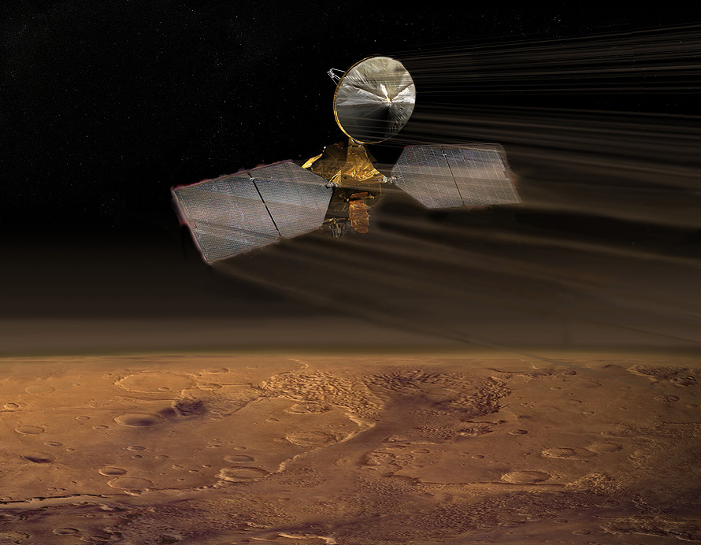
Example: Mars Reconnaissance Orbiter (MRO) Aerobraking

Slide 25
MRO Solar Panel Thermal Sensors
T-309 back side,
T-310 cell side
Outboard panel
Inboard panel
T-110
T-109
Thickness not to scale

Slide 26
Sample Correlation from MRO
 |  |  |  |  |  | Average error
 | h (contact conductance, W/m²-K) |  | Overall RMS error (°C) | Core delta error (°C) |  | T-109 (°C) | T-110 (°C) | T-309 (°C) | T-310 (°C) |  | Overall correlation quality (RMS) (°C)
TCM1
 | 4.35E-05 |  | 4.4 | 9.5 |  | -0.9 | -6.2 | -4.7 | 4.7 |  | 19.4
 | 6.00E-05 |  | 2.9 | 5.5 |  | 1.4 | -3.8 | -2.3 | 3.1 |  | 12.8
 | 8.00E-05 |  | 2.4 | 2.7 |  | 3.1 | -2.1 | -0.7 | 2.0 |  | 10.6
 | 1.00E-04 |  | 2.2 | 1.2 |  | 4.1 | -1.0 | 0.3 | 1.2 |  | 12.1
Thruster cal 1
 | 4.35E-05 |  | 3.3 | 7 |  | 0.8 | -4.7 | -2.4 | 4.3
 | 6.00E-05 |  | 2.5 | 3.6 |  | 2.8 | -2.6 | -0.4 | 2.9
 | 8.00E-05 |  | 2.4 | 1.6 |  | 4.2 | -1.2 | 1.0 | 1.9
 | 1.00E-04 |  | 2.4 | 1.2 |  | 5.0 | -0.3 | 1.8 | 1.3
Thruster cal 2
 |  | 4.35E-05 | 5 | 5.6 |  | -0.1 | -0.8 | -1.0 | 4.4
 |  | 6.00E-05 | 4.9 | 3.6 |  | 1.3 | 0.7 | 0.4 | 3.4
 |  | 8.00E-05 | 5 | 2.8 |  | 2.2 | 1.7 | 1.3 | 2.7
 |  | 1.00E-04 | 5.1 | 5.9 |  | 2.8 | 2.3 | 1.9 | 2.3

Slide 27
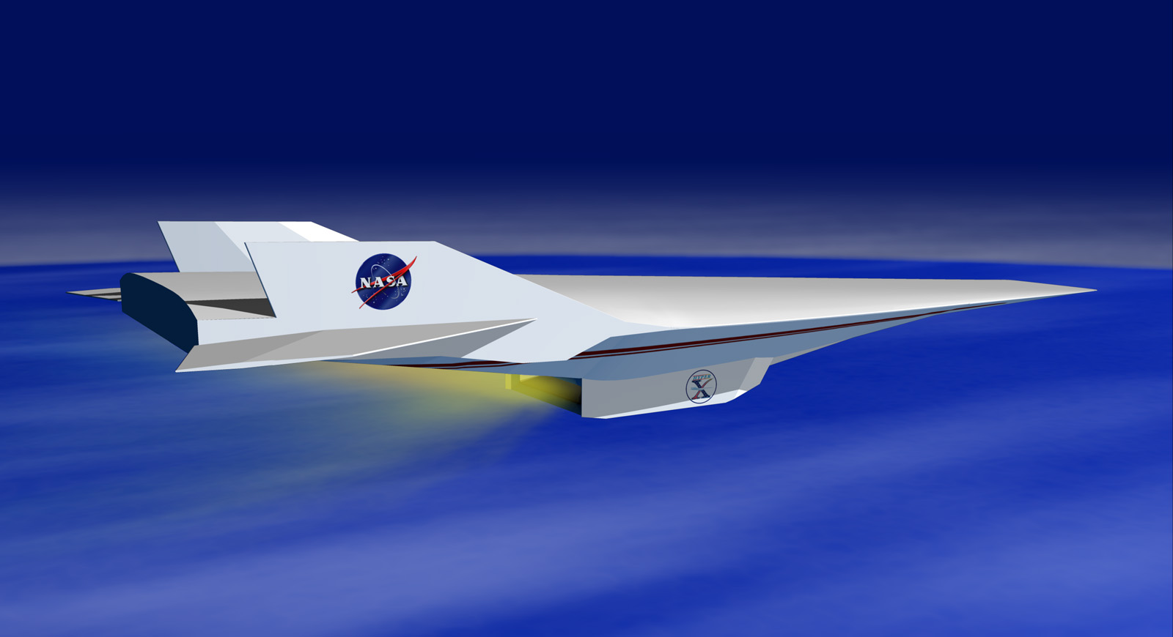
Example: Hyper-X (X-43A) Vehicle
Validate airframe-integrated air-breathing scramjet performance in flight
Mach 7 and Mach 10 vehicles

Slide 28
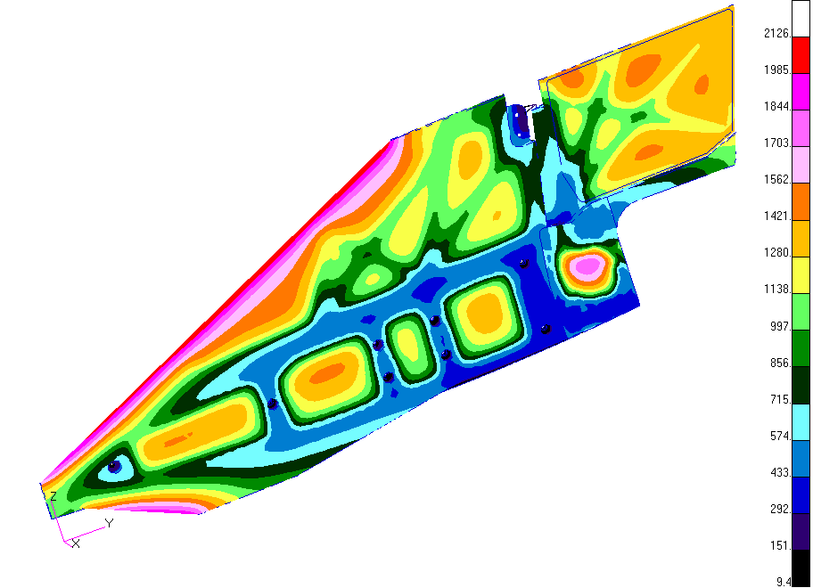
Hyper-X Mach7 Vertical Tail Thermal Prediction (°F)

Slide 29
Sample Correlation from Hyper-X
Run | Average RMS error (°F) |  | Average end error (°F) |  | RMS of end error (°F)
Corr0 | 162.7 |  | 216.3 |  | 272.6
Corr1 | 157.9 |  | 209.7 |  | 267.8
Corr2 | 157.3 |  | 209.6 |  | 267.8
Corr3 | 146.1 |  | 201.5 |  | 261.1
Corr4 | 146.5 |  | 201.9 |  | 261.3
Corr5 | 87.7 |  | 59.4 |  | 159.4
Corr6 | 104.0 |  | 132.3 |  | 192.7
Corr7 | 78.1 |  | 33.4 |  | 137.0

Slide 30
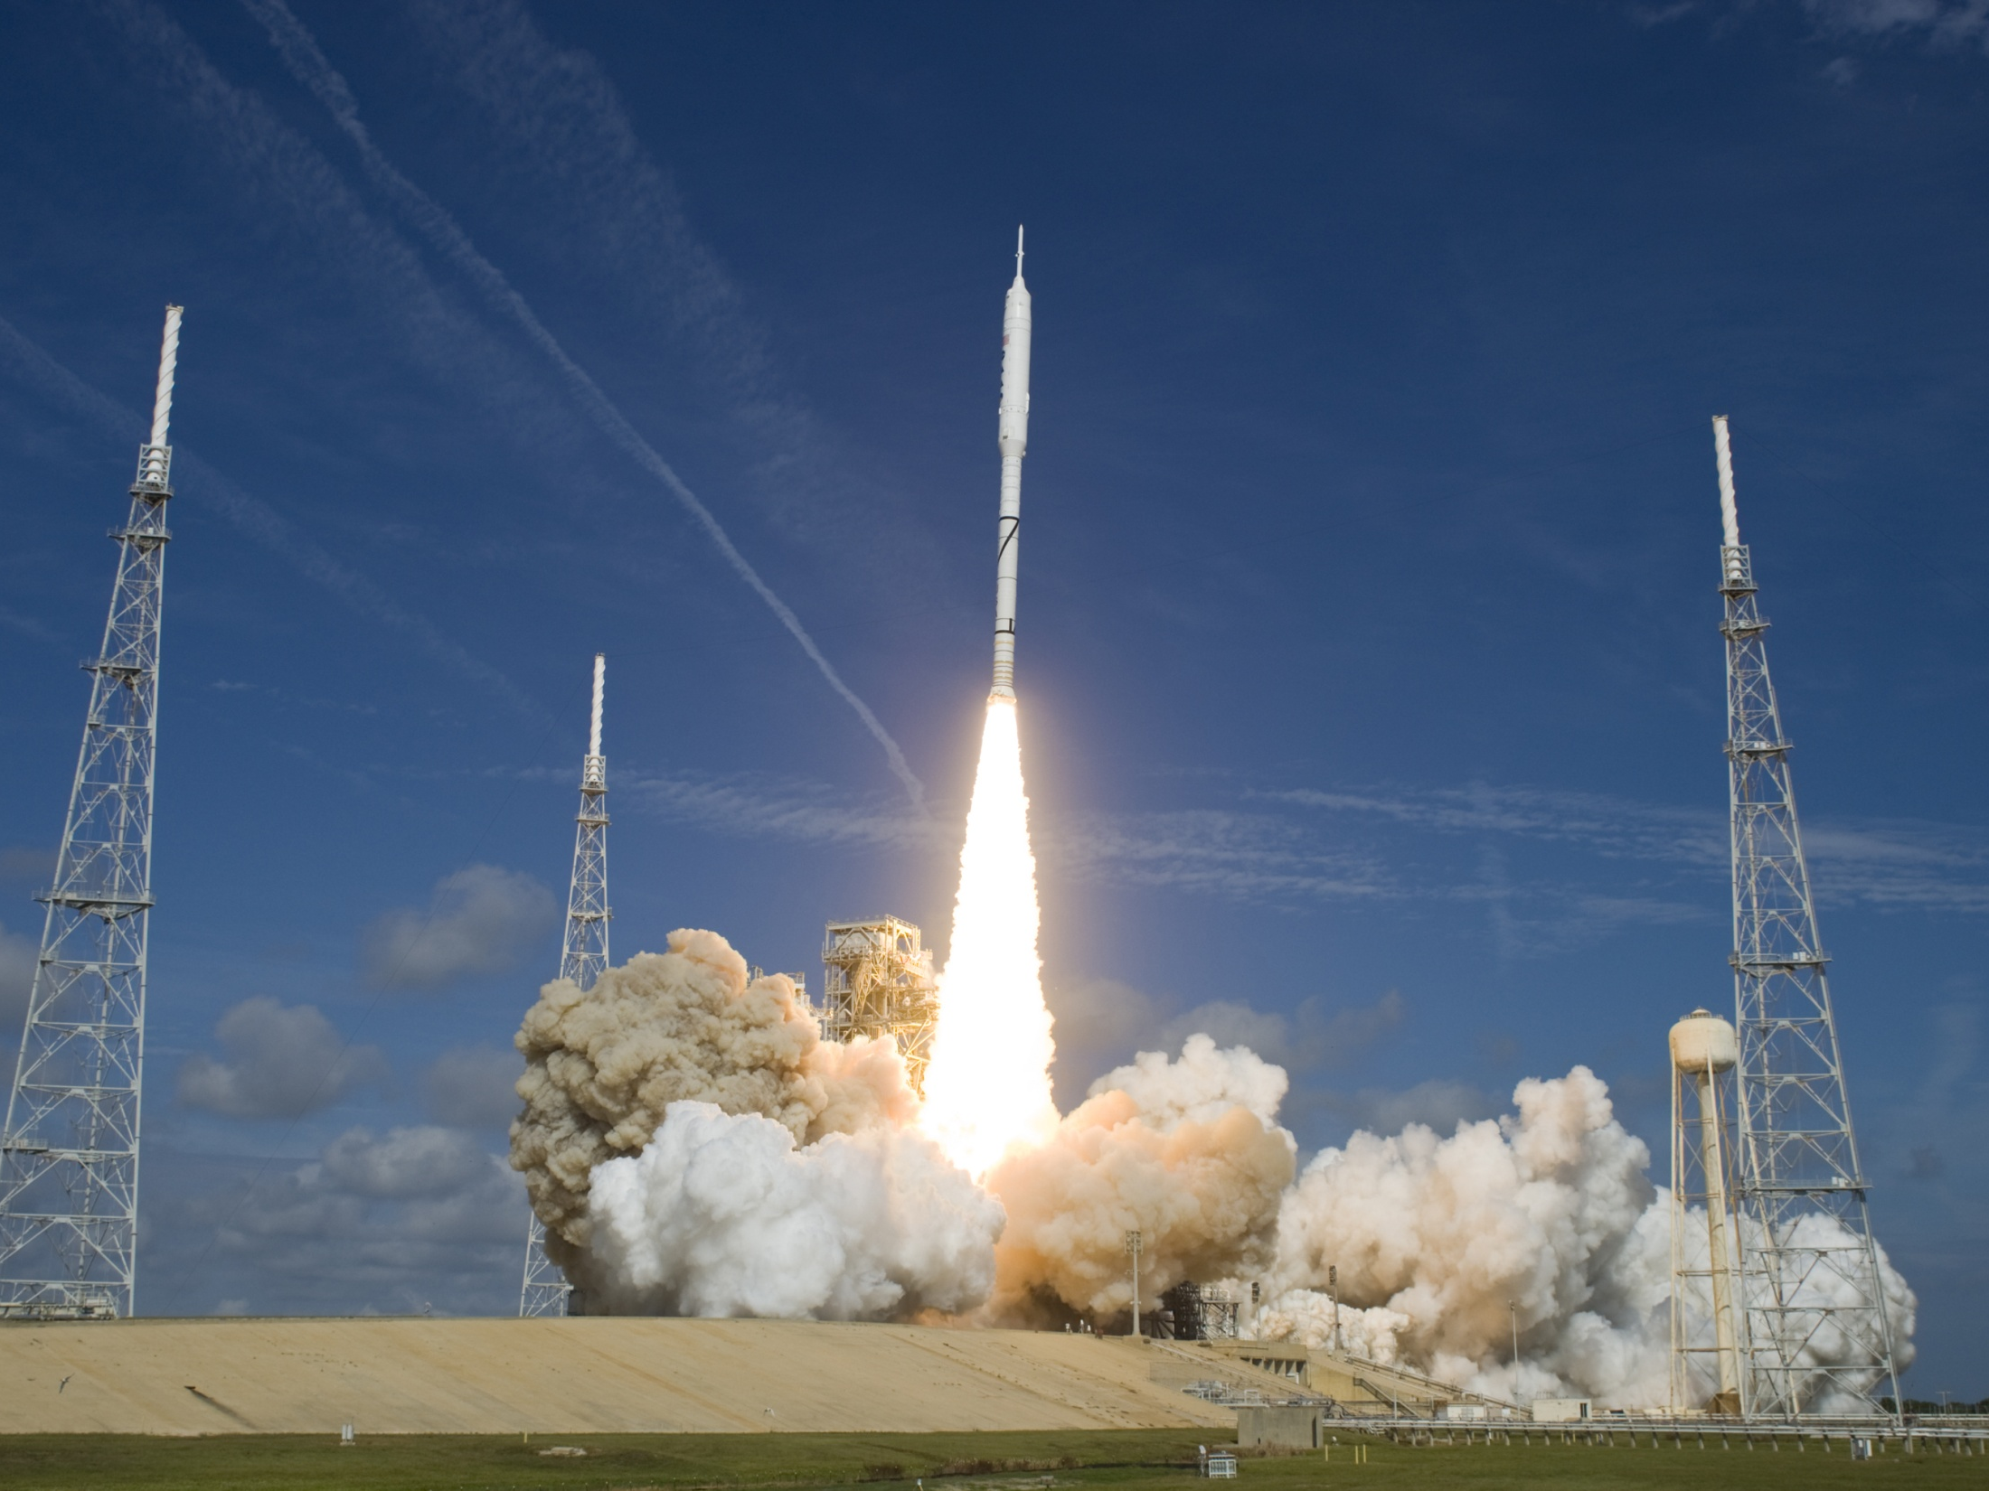
Example: Ares I-X
  Ares I-X
  Flew in 2009
  350-ft, 2-million-lb vehicle
  Ground structures and planet interaction
  11,000 thermal nodes, 100 fluid lumps
  144 flight thermal sensors in model

Slide 31
Sample Correlation from Ares I-X
Case | RMS avg error (°F)
Run 1 | 5.6
Run 2 | 5.9
Run 3 | 5.3
Run 4 | 5.9
Run 5 | 6.5
Run 6 | 6.4
Run 7 | 4.6
Run 8 | 4.0
Run 9 | 3.9
Run 10 | 3.9
Run 11 | 3.8
Run 12 | 3.8
Run 13 | 9.9
Run 14 | 8.0
Run 15 | 3.9
Run 16 | 4.3
Run 17 | 5.0
Run 18 | 5.5
Run 19 | 6.7
Run 20 | 6.6
Run 21 | 6.9
Run 22 | 6.4
Run 23 | 4.8
Run 24 | 4.7
Run 25 | 4.7
Run 26 | 4.2
Run 27 | 4.4
Run 28 | 3.4
Run 29 | 3.4
Run 30 | 3.2
The Ares I-X vehicle and model included 144 thermal sensors;
31 of the most critical were used to define the quality of model correlation, combining their RMS errors over the timeline of the mission;
The progression of correlation over 30 versions of the model is shown.

Slide 32
Cautionary Note
Model uncertainties and data uncertainties such as exact location of thermal sensors will always exist.
The model should not be distorted away from physical reality in a single-minded pursuit of a perfect model correlation quality value.
Goal for RMS error for the correlation should be modified if the initial goal is unachievable.

Slide 33
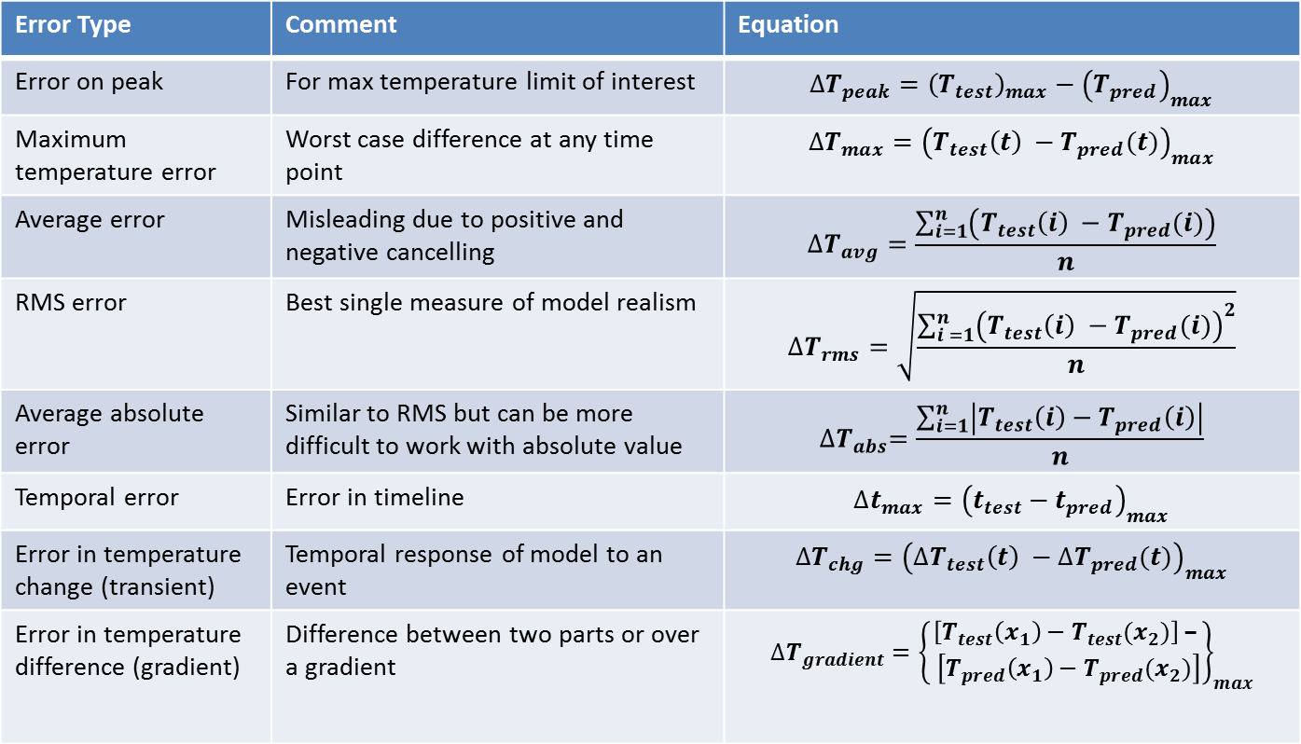
Error Type Summary
Error Type | Comment | Equation
Error on peak | For max temperature limit of interest | $$∆T_{peak}={\left(T_{test}\right)}_{max}−{\left(T_{pred}\right)}_{max}$$
Maximum temperature error | Worst case difference at any time point | $$∆T_{max}={\left(T_{test}\left(t\right) −T_{pred}(t)\right)}_{max}$$
Average error | Misleading due to positive and negative cancelling | $$∆T_{avg}=\frac{\sum_{i=1}^{n}{\left(T_{test}\left(i\right) −T_{pred}(i)\right)}}{n}$$
RMS error | Best single measure of model realism | $$∆T_{rms}=\sqrt{\frac{\sum_{i =1}^{n}{{\left(T_{test}\left(i\right) −T_{pred}(i)\right)}^{2}}}{n}}$$
Average absolute error | Similar to RMS but can be more difficult to work with absolute value | $${∆T}_{abs}=\frac{\sum_{i=1}^{n}{\left|T_{test}\left(i\right)−T_{pred}\left(i\right)\right|}}{n}$$
Temporal error | Error in timeline | $$∆t_{max}={\left(t_{test}−t_{pred}\right)}_{max}$$
Error in temperature change (transient) | Temporal response of model to an event | $$∆T_{chg}={\left(∆T_{test}\left(t\right) −{∆T}_{pred}(t)\right)}_{max}$$
Error in temperature difference (gradient) | Difference between two parts or over a gradient | $$∆T_{gradient}={\left\{\begin{aligned}\left[T_{test}\left(x_{1}\right)−T_{test}(x_{2})\right]\text{ −} \\ \left[T_{pred}\left(x_{1}\right)−T_{pred}(x_{2})\right]\end{aligned}\right\}}_{max}$$

Slide 34
Conclusion
Thermal models are most useful when a measure of their quality can be determined.
Many metrics for model quality, based on model type.
RMS error often most robust measure.
Single model quality variable can differentiate among differing versions of model correlation.

Slide 35
Acknowledgements
This author is grateful to the NESC Passive Thermal Technical Discipline Team (TDT) for their contributions and technical review of this lesson.
The author would also like to thank Dr. James Womack of the Aerospace Corporation for the remarks on RMS error versus absolute error.

Slide 36
Photo/Image Credits
MRO artist’s representation:
http://mars.jpl.nasa.gov/mro/mission/timeline/mtaerobraking/
MRO thermal model solar panel image:
http://tfaws.grc.nasa.gov/TFAWS10/Proceedings/Aerothermal/Ruth%20Amundsen.pdf
Hyper-X vehicle artist conception:
http://www.nasa.gov/centers/dryden/multimedia/imagegallery/X-43A/index.html#lowerAccordion-set3-slide25
Hyper-X Mach 7 tail thermal prediction:
http://tfaws.nasa.gov/TFAWS04/Website/program/paper/TFAWS04_RAmundsen_Aero_CFD.pdf
Ares I-X image:
http://tfaws.nasa.gov/TFAWS10/Proceedings/Passive%20Thermal/Ruth%20Amundsen.pdf

