Slide 1
Force Limited Vibration Testing:
A Review of Existing and New Methods
Dr. Ali Kolaini, JPL
ali.r.kolaini@jpl.nasa.gov
Welcome…
Dr. Curt Larsen
curtis.e.larsen@nasa.gov

Slide 2
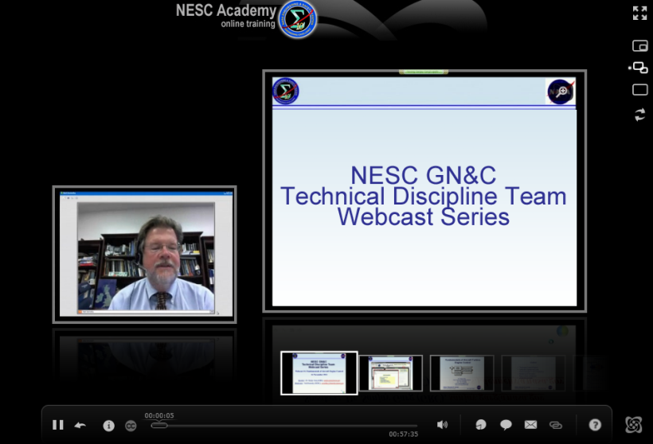


SLaMS Webcast
Series

Slide 3
Acknowledgment:
  Walter Tsuha
  Dennis Kern
  Ben Doty
  Curtis Larsen
  JPL Office Chief Engineering
  JPL Environmental Testing Laboratories
  Arya Majed
  Darlene Lee

Slide 4


Slide 5
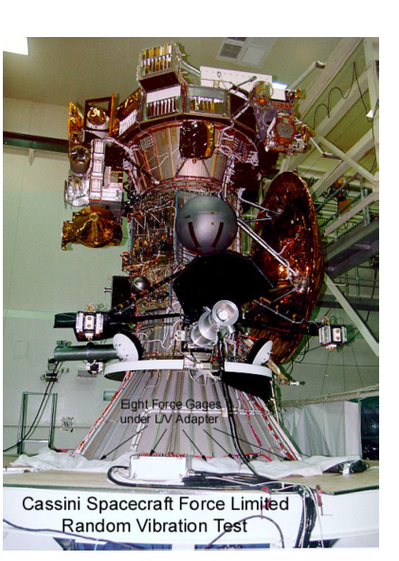
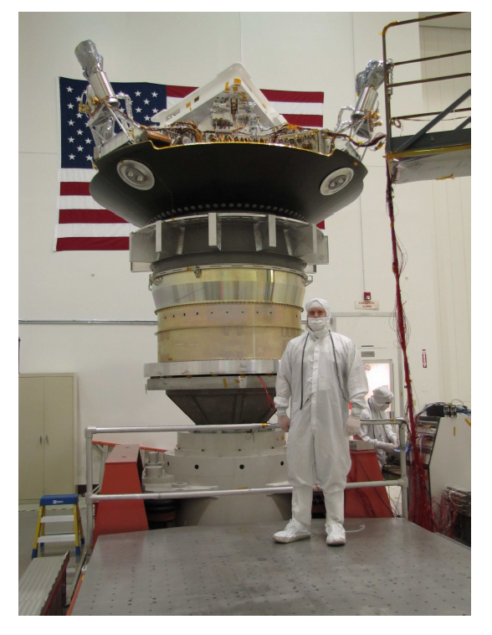
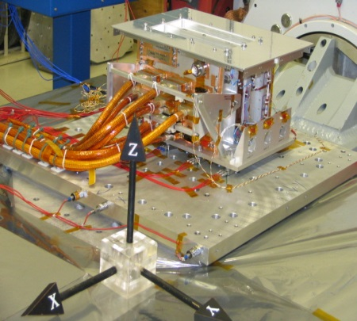
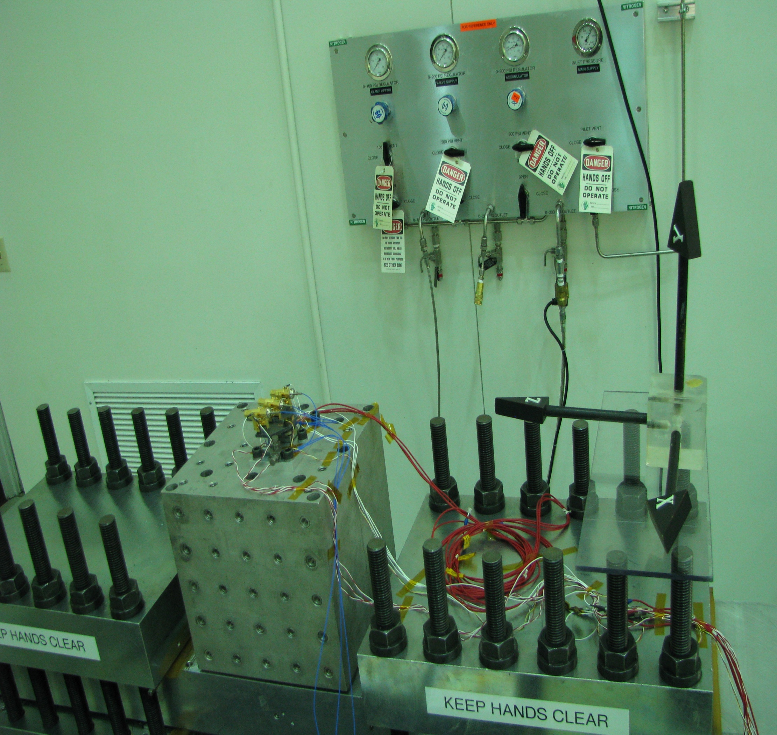
Electronic Box
Small Optical System < 1 kg
Cassini Spacecraft
MSL

Slide 6
Force Limiting Tests: Existing Approaches
To qualify flight hardware for random vibration environments the following methods that are used to limit the loads in the aerospace industry will be reviewed:
  Response limiting and notching
  Simple TDOF model
  Semi-empirical force limits
  Apparent mass, etc.
In all these methods attempts are made to remove conservatism due to the mismatch in impedances between the test and the flight configurations of the hardware that are being qualified
  Assumption is the hardware interfaces have correlated responses
A new method that takes into account of the un-correlated hardware interface responses is also reviewed in this presentation.

Slide 7
Force Limited RV Tests: Response Limiting and Notching (1/5)
In force limited vibration testing, base acceleration is considered an input and base force is a response
Both acceleration and force specifications are needed
  Force limits are proportional to the acceleration specification,
  Forces limits typically cover only first few modes
In force limiting, input is reduced (notched) at frequencies where force limits would be exceeded
  Notch depth depends on the force limit, and the damping of the resonance being limited in the test,
  Notching is not nearly as effective in reducing rms response as reducing the input at all frequencies.

Slide 8
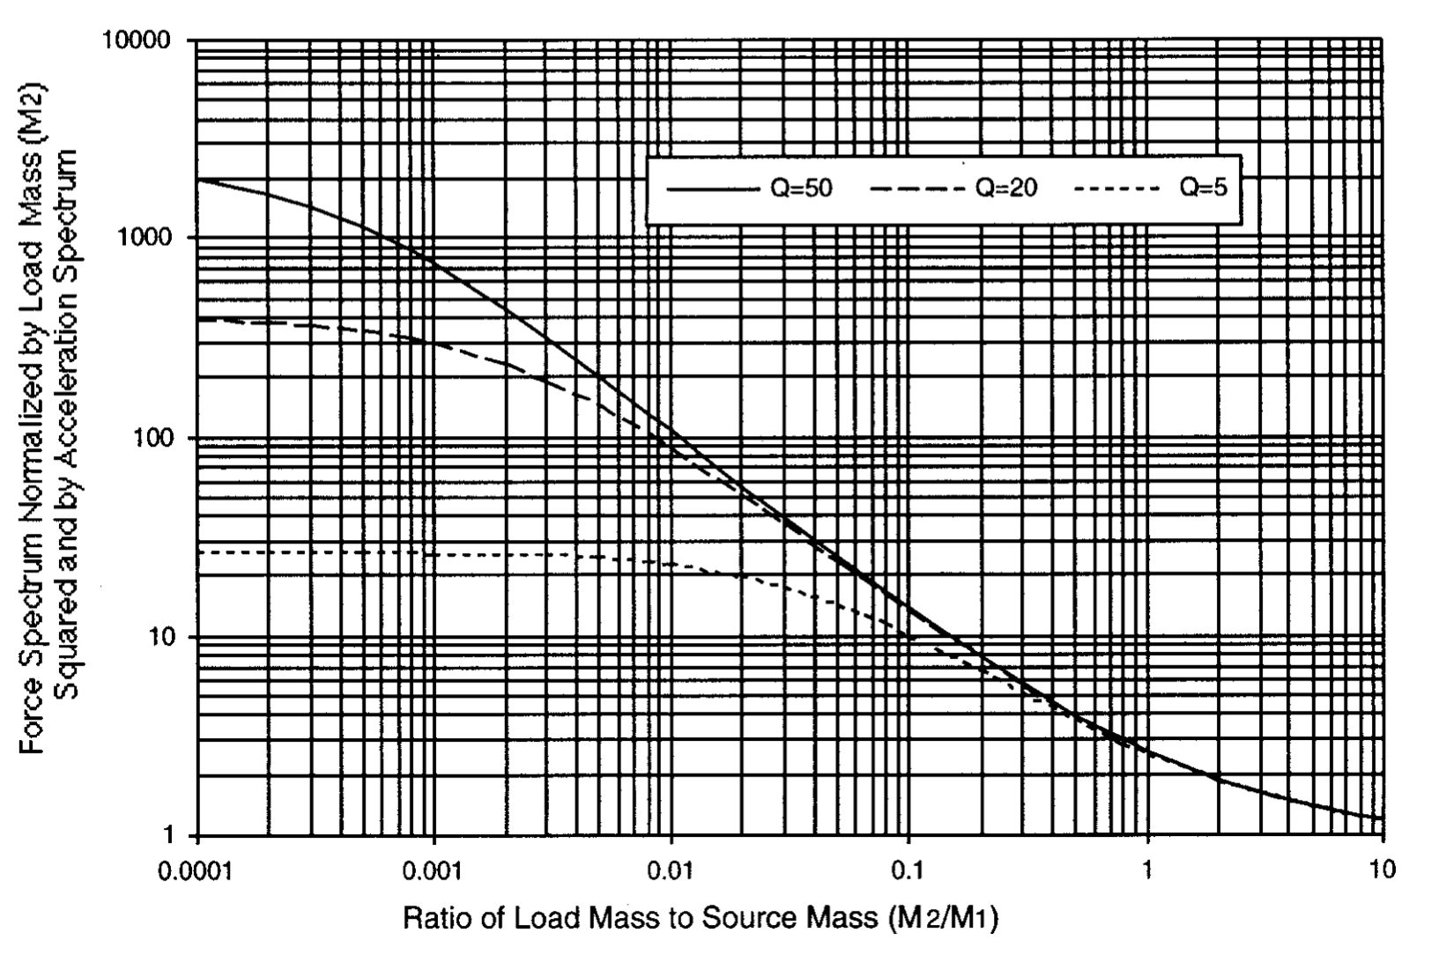
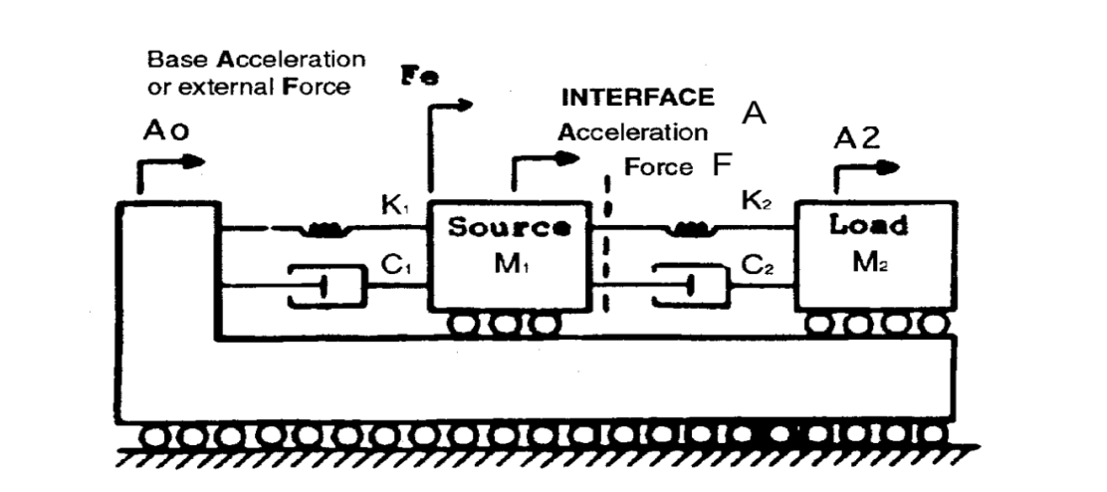
Force Limits Review: Simple TDOF Model (2/5)
Q= 50
Q= 20
Q= 5
From Terry Scharton

Slide 9
Force Limits Review: Semi-empirical Force Limits (3/5)
Semi-empirical force limit S_{ff} (f) for random vibration test with input acceleration spectral density of S_{aa}:
  S_{ff} (f) = C² M_{o}²S_{aa}(f), f < f_{b}
  S_{ff} (f) = C² M_{o}² (f_{b}/f)^{2n} S_{aa} (f), f ≥ f_{b}
  where C is dimensionless constant that depends on the flight
  mounting configuration, M_{o} is the total mass of the test item,
  f_{b} is a break frequency (often f_{o}), and n is a positive constant
  (often 2),
Constant C, analogous to Q, determined from:
  Simple TDOF model,
  Impedance analyses,
  Finite element analysis of flight configuration, and
  Flight or ground test data on similar configurations.

Slide 10
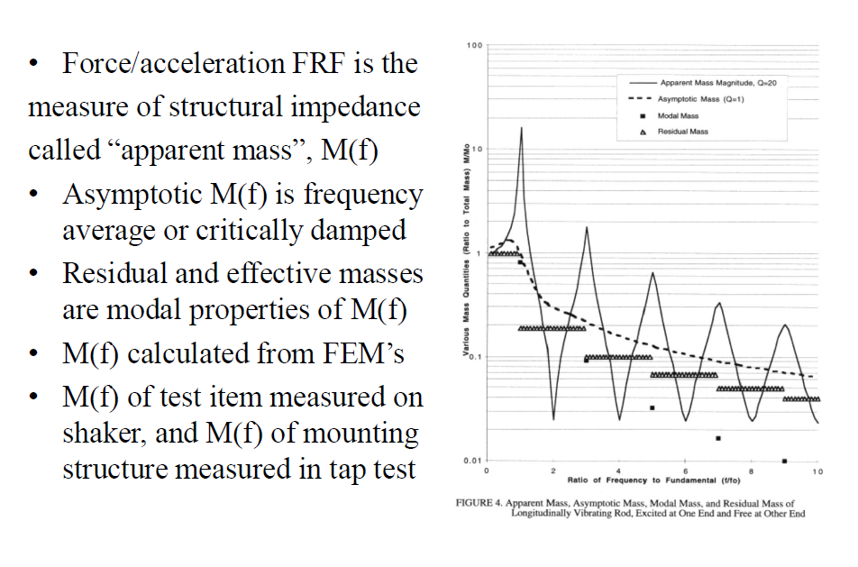
Apparent, Residual, and effective Masses (4/5)
Force/acceleration FRF is the measure of structural impedance called “apparent mass”, M(f)
Asymptotic M(f) is frequency average or critically damped
Residual and effective masses are modal prosperities of M(f)
M(f) calculated from FEM’s
M(f) of test item measured on shaker, and M(f) of mounting structures measured in tap test

Slide 11
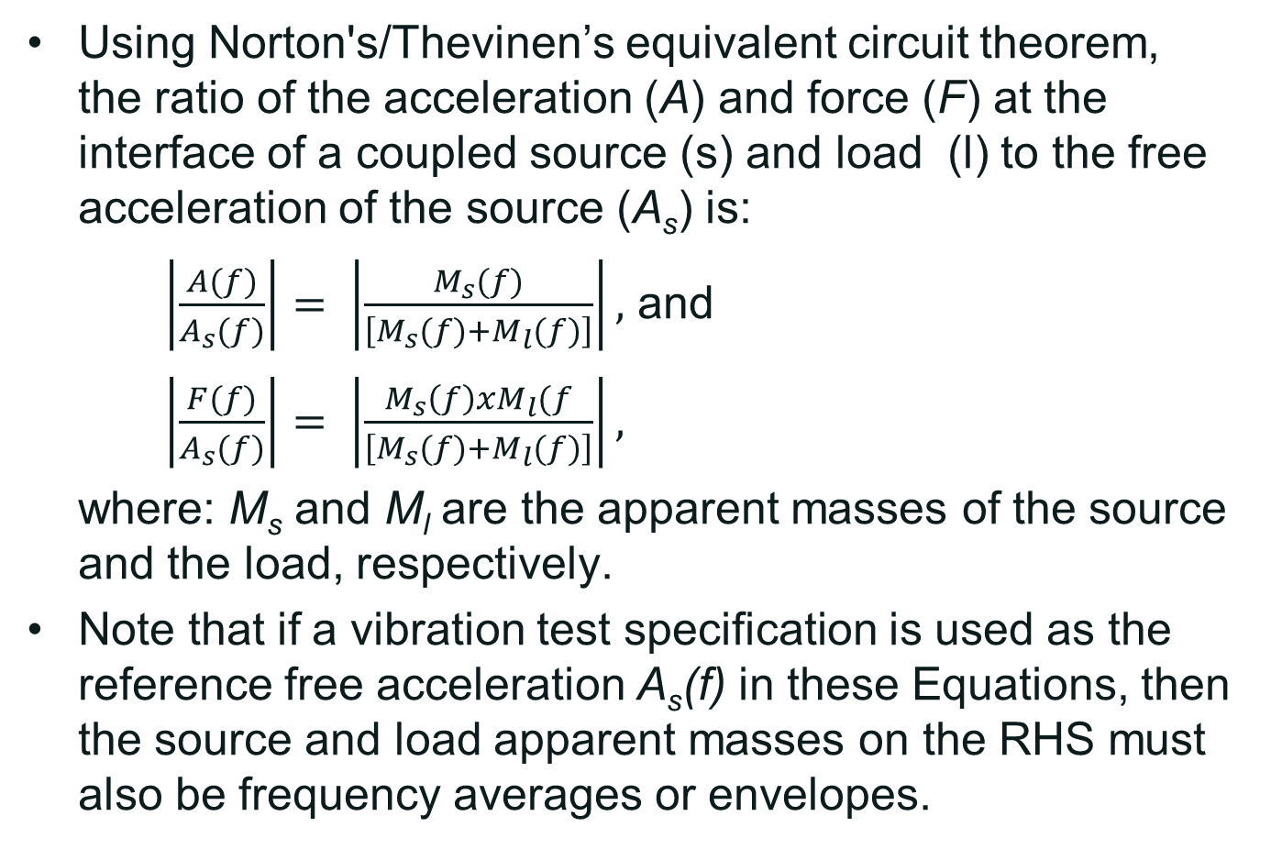
Force Limits Review: Impedance Method (5/5)
Using Norton's/Thevinen’s equivalent circuit theorem, the ratio of the acceleration (A) and force (F) at the interface of a coupled source (s) and load (l) to the free acceleration of the source (A_{s}) is:
$\left|\frac{A(f)}{A_{s}(f)}\right|= \left|\frac{M_{s}(f)}{\left[M_{s}(f)+M_{l}(f)\right]}\right|,$ and
$\left|\frac{F(f)}{A_{s}(f)}\right|= \left|\frac{M_{s}\left(f\right)xM_{l}(f}{\left[M_{s}(f)+M_{l}(f)\right]}\right|,$
where: M_{s} and M_{l} are the apparent masses of the source and the load, respectively.
Note that if a vibration test specification is used as the reference free acceleration A_{s}(f) in these Equations, then the source and load apparent masses on the RHS must also be frequency averages or envelopes.

Slide 12
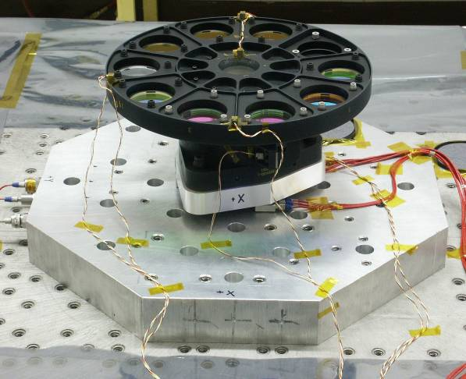
Force Limited Vibration Test: Example 1
The first predominant lateral X mode was measured to be 260 Hz.
C² of 5 was used to derive the force limiting specification
Notches at frequencies near 260 Hz (~ 4 dB) and 488 Hz (~20 dB) were achieved as a result of applying the force limiting method
The deeper notch at 488 Hz was expected since this hardware had very low damping!

Slide 13

Force Limited Vibration Test: Example 2
A highly nonlinear and highly damped system. C² of 4 was used to derive the force limiting specification

Slide 14
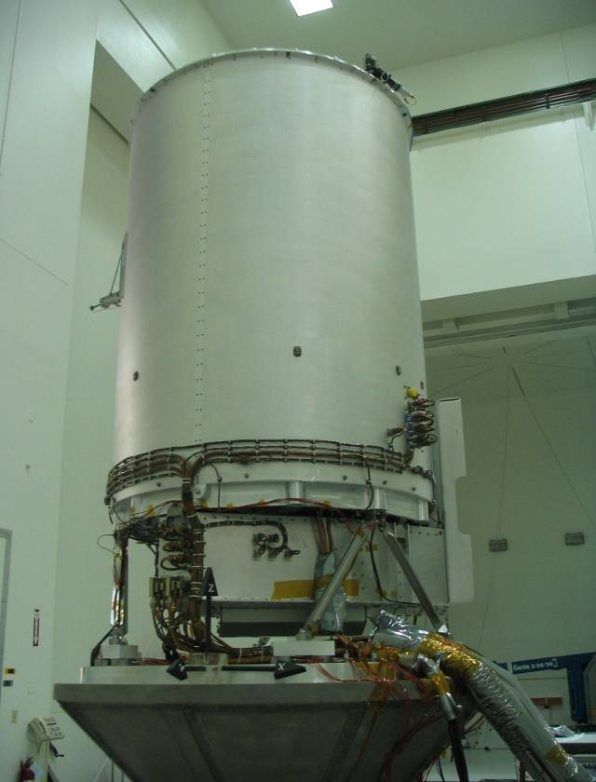
Force Limited Vibration Test: Example 3
The force specification was developed based on C² of 2

Slide 15
LIMITATIONS OF EXISTING FORCE LIMITING METHODS
Existing force limiting methods, which are based on one-dimensional translation source and load apparent mass considerations, do not, taken alone, guarantee realistic vibration tests.
One must remember that the payload natural frequencies and response mode shapes will seldom be the same on the shaker as in the field.
About all one can do with traditional force limiting methods is to try and achieve the same maximum vibratory force on the shaker as that predicted in flight, but the frequencies and mode shapes will not be correct
For lightweight payloads mounted on panels uncorrelated motion of the mounting points is indeed an important consideration
The effect of correlated, but out-of-phase motion of the supports, i.e., rotations also need to be considered

Slide 16
CONSIDERING “ROCK AND ROLL” MOTION
Results from a recent R&D Mass Loading Study are used to take a new look at force limiting approaches
  Acoustic tests performed using two boxes attached to panels are considered as flight-like data
    Acceleration responses at boxes interfaces are measured and enveloped to obtain input acceleration for each box
    Boxes base shaked to inputs obtained from acoustic tests
    Forces at boxes interfaces measured
  Semi-empirical approach was used to force limit the shaker testing of the boxes
  The base shake test results are compared with the interface force responses measured from acoustic tests

Slide 17
Acoustic Test: Al Panel and Boxes A&B
AL panel with boxes underwent reverberant acoustic tests to OASPL of 140 dB.

Slide 18
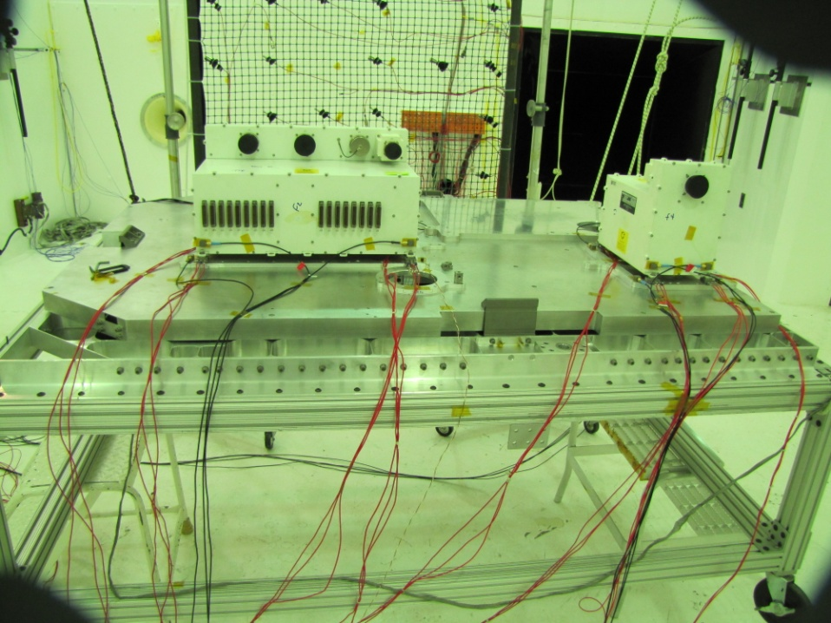
Acoustic Test: Rover Deck and Boxes A&B
Rover Deck with boxes underwent reverberant acoustic tests to OASPL of 140 dB.

Slide 19
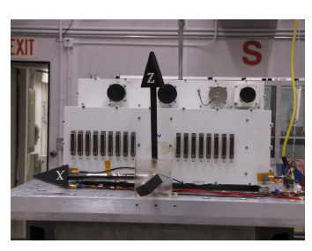
Box A and B Base Shake Test Setup
Box A
Box B
Electronic Boxes underwent force limited RV tests to input environments derived from acoustic test.

Slide 20
Input Acceleration Specification for Box A Shaker Test
Average Acceleration Responses (Acoustic test)
Shaker Input Acceleration
The average Box A acceleration responses from acoustic test (Al Panel+Box A) is used to derive the base shake input.

Slide 21
Box A Shaker Test Force Limit: Semi-Empirical Method
Force Limit using semi-empirical method with C² of 6: Accounts for mismatch in impedances of Box’s correlated interface responses

Slide 22
Semi-Empirical Force Limit vs. Acoustic Test (Box A and AL Panel
Force limit using semi-empirical method with C² of 6
Acoustic Test
Shaker Test
Force Limit using acoustic data: Accounts for mismatch in impedances of Box’s un-correlated interface responses

Slide 23
Semi-Empirical Force Limit vs. Acoustic Test Box B and AL Panel
Acoustic Test
Shaker Test
Force Limits: Acoustic Test vs. semi-empirical method with C² of 2.
@ f₀ more than 50 dB over test!

Slide 24
Semi-Empirical Force Limit vs. Acoustic Test Box A and Rover Deck (Fixed-fixed BC)
Comparison of the summed forces measured at Box A interfaces: random vibe test and acoustic test of Box A mounted on Rover Deck
Force limit using semi-empirical method with C² of 6
Acoustic Test
Shaker Test

Slide 25
Semi-Empirical Force Limit vs. Acoustic Test Box B and Rover Deck (Fixed-fixed BC)
Comparison of the summed forces measured at Box B interfaces: random vibe test vs acoustic test of Box B mounted on Rover Deck
Acoustic Test
Shaker Test

Slide 26

C² Estimate Using Apparent Mass (Box A) Source Structure: Al Panel
M₂/M₁ ~ 17.5/10 ~1.75 w/ C² of ~2
The apparent mass estimated by tapping Al panel w/o boxes @ four Box A interfaces
Box A Mass (M₂) ~17.5 lbs
The Source Mass (M₁) estimated to be ~ 10 lbs (asymptote)

Slide 27

C² Estimate Using Measured Apparent Mass (Box B); Source Structure: AL Panel
M₂/M₁ ~ 45/8 ~5 w/ C² of ~1.5
The apparent mass estimated by tapping Al panel w/o boxes @ four Box B interfaces
Box B Mass (M₂) ~45 lbs
The Source Mass (M₁) estimated to be ~ 8 lbs

Slide 28

C² Estimate Using FEM Predicted Apparent Mass (Box A); Source Structure: Al Panel
M₂/M₁ ~ 17.5/10 ~2 w/ C² of ~2
The apparent mass estimated using FEM of Al panel w/o boxes by applying white-noise force @ four Box A interfaces
Box Mass (M₂) ~17.5 lbs
The Source Mass (M₁ ) estimated to be ~ 10 lbs

Slide 29
Force Limiting Specification Using FE Models

Slide 30
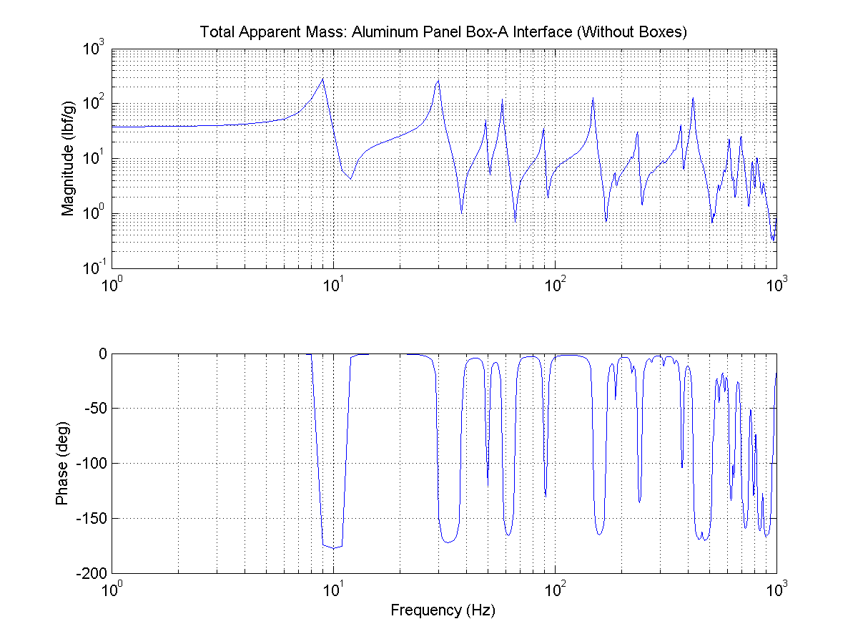
FE Apparent Mass Prediction: AL Panel
Panel Total Weight = 37.7 lbf
Apparent mass of the source (Al panel) at box A interfaces is computed by inverting the complex accelerance matrix. All terms in the matrix are used to obtain the apparent mass shown in this Figure. The plateau apparent mass curve is predicted to be close to 37.7 lbf, which is the weight of the box.

Slide 31
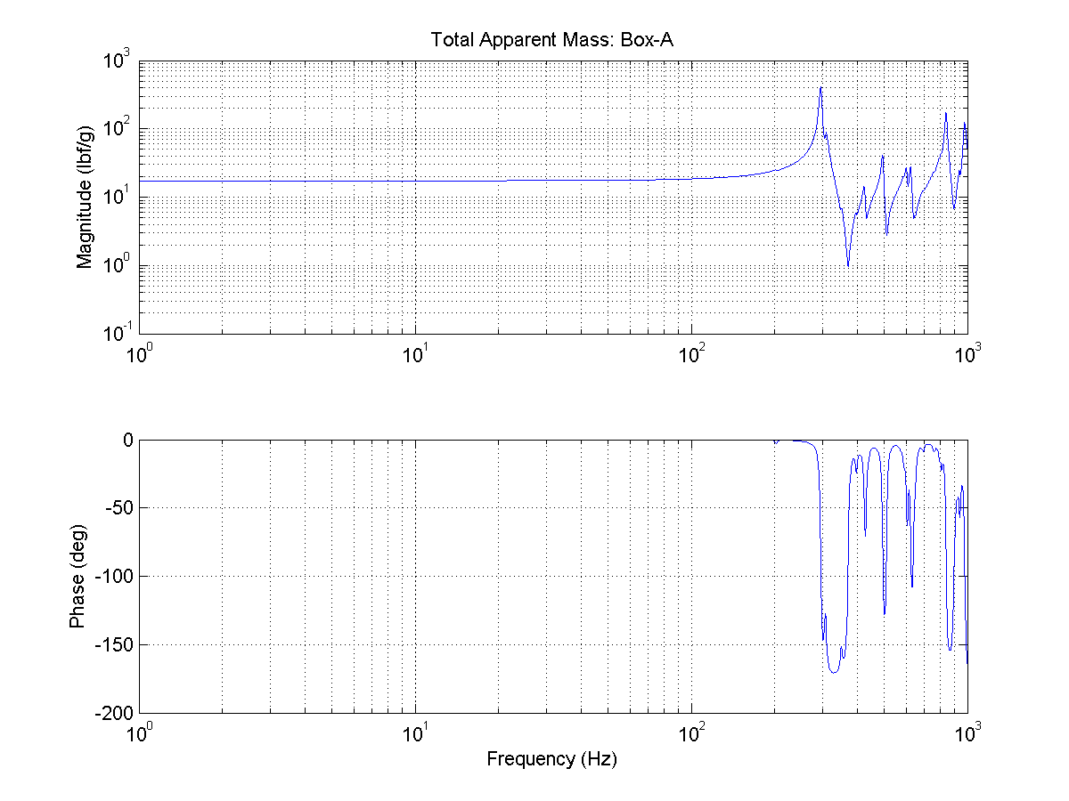
FE Apparent Mass Prediction: Box A
Box-A Total Weight = 17.4 lbf
Accelerance with all terms in the matrix are used to obtain the apparent mass shown here. The plateau apparent mass curve is predicted to be close to 17.4 lbf, which is the weight of the box

Slide 32
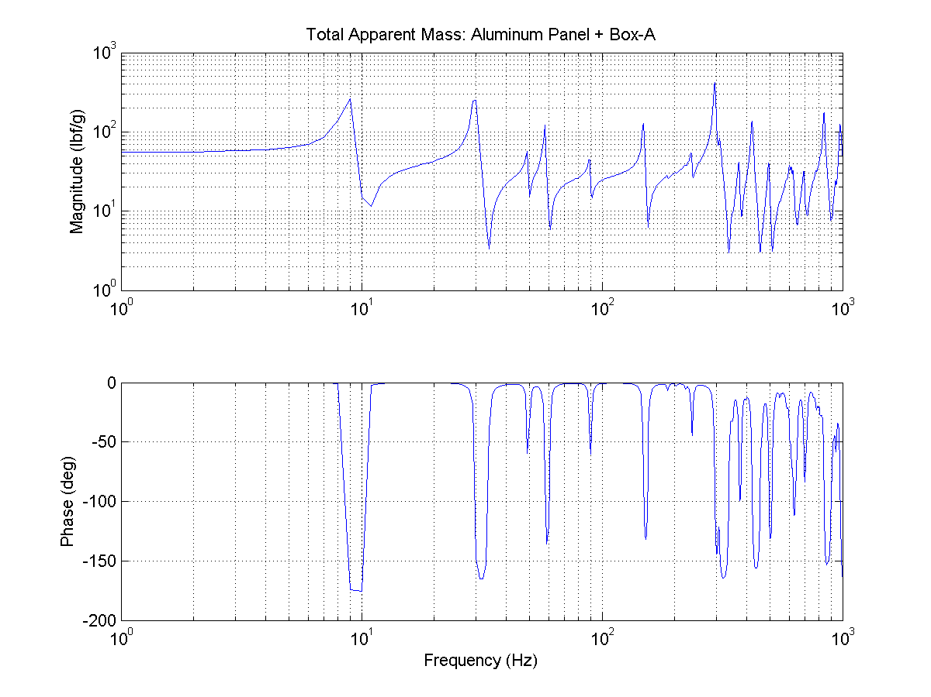
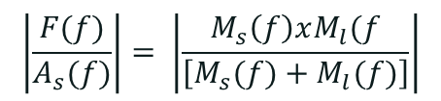
FE Apparent Mass Prediction: Panel + Box A
Panel + Box-A Total Weight = 55.1 lbf
Apparent mass of the source (Al panel) and the load (box A) at box A interfaces is computed by inverting the complex accelerance matrix. All terms in the matrix are summed to obtain the apparent mass shown in this Figure. The plateau apparent mass curve is predicted to be close to 55.1 lbf, which is the weight of the box.

Slide 33
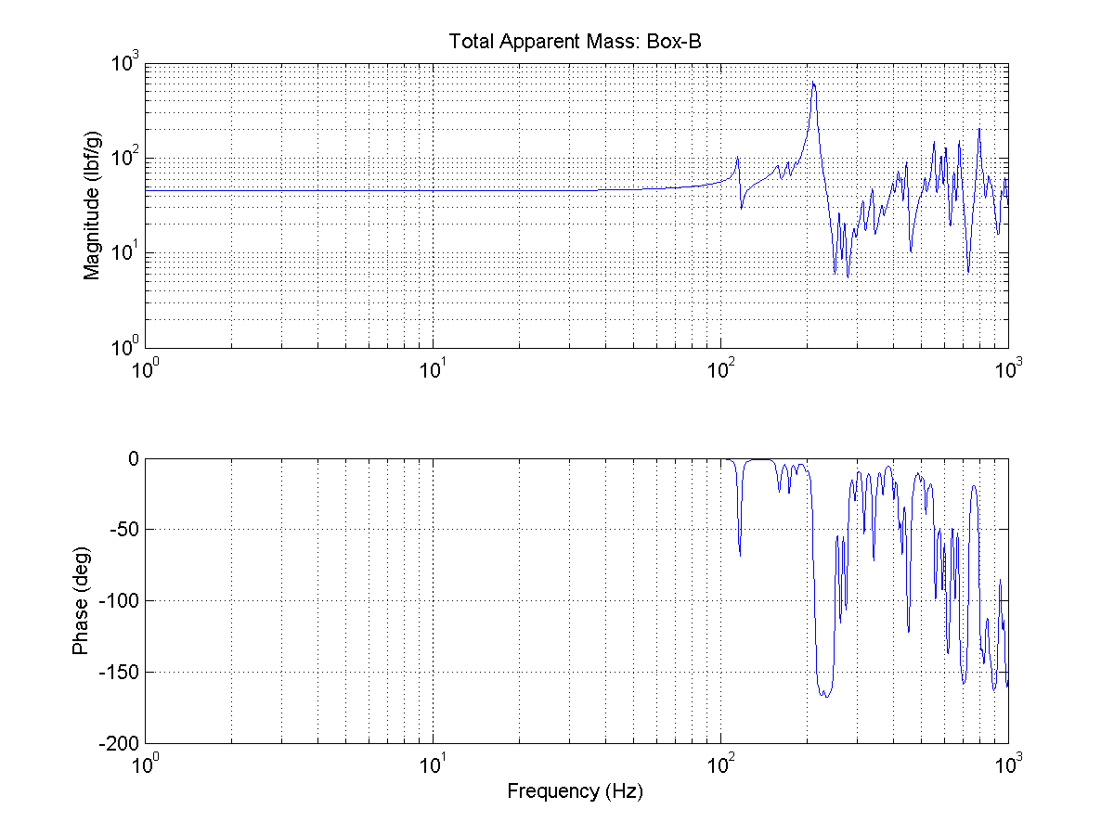
Predicted Apparent Mass of the Load (Box B)
Apparent mass of the load (Box B) is computed by inverting the complex accelerance matrix. All terms in the matrix are used to obtain the apparent mass shown in this Fig. The plateau apparent mass curve is predicted to be close to 44.9 lbf, which is the weight of the box

Slide 34
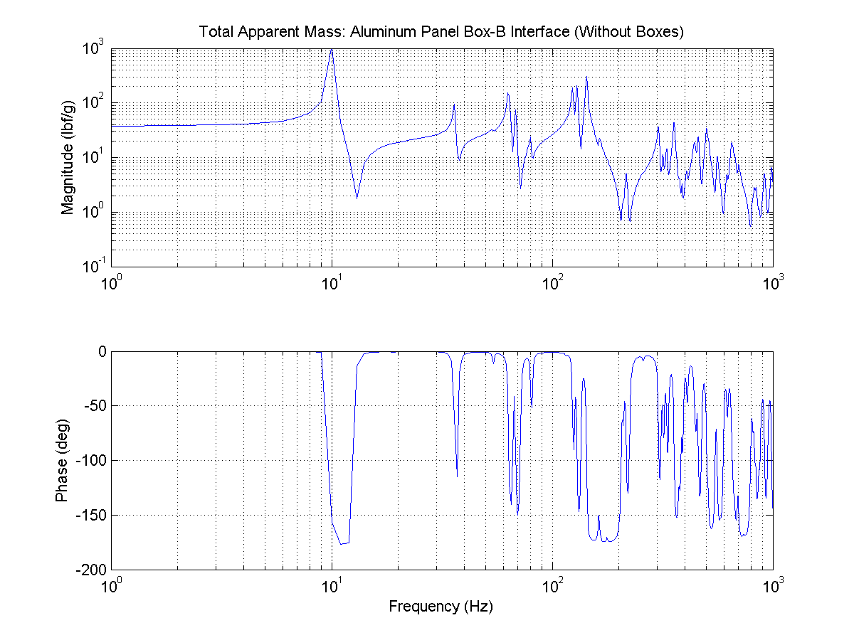
Predicted Apparent Mass of the AL
Apparent mass of the source (Al panel) at box B interfaces is computed by inverting the complex accelerance matrix. All terms in the matrix are used to obtain the apparent mass shown in this Figure. The plateau apparent mass curve is predicted to be close to 37.7 lbf, which is the weight of the box

Slide 35
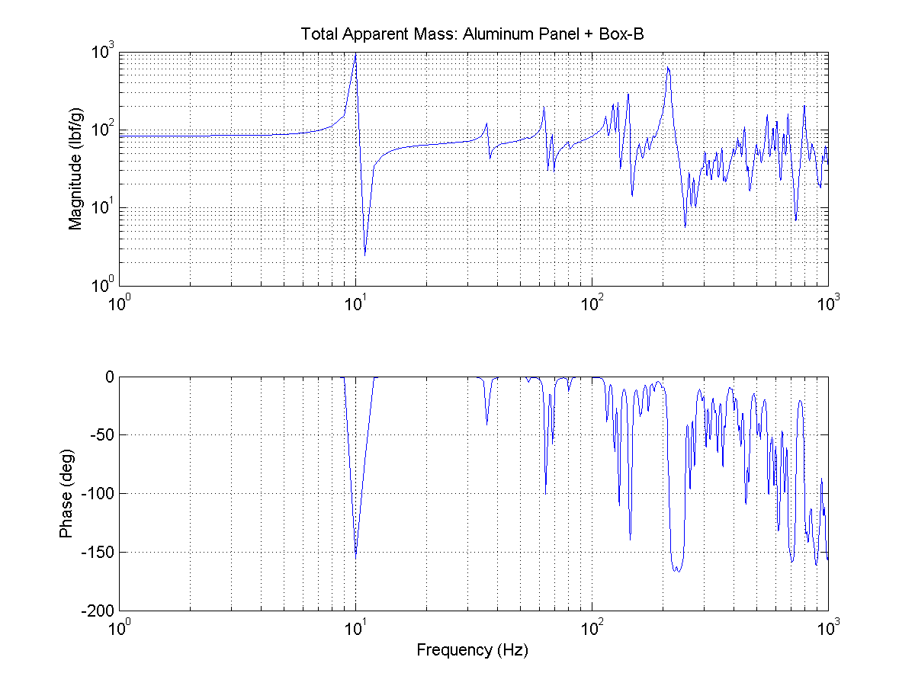
Predicted Apparent Mass of AL+Box B
Apparent mass of the source (Al panel) and the load (box B) at box B interfaces is computed by inverting the complex accelerance matrix. All terms in the matrix are summed to obtain the apparent mass shown in this Figure. The plateau apparent mass curve is predicted to be close to 82.6 lbf, which is the weight of the box

Slide 36
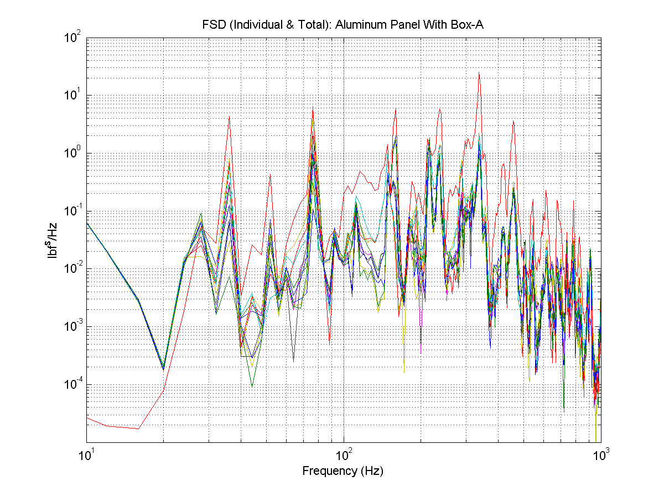
FEM Predicted Interface Forces
Interface forces predicted at box A interfaces mounted on Al panel. The envelop of the predicted forces (green line) are compared with the semi-empirical derived force limiting specification (red line).

Slide 37
Force Limiting Specification Using Boundary Element Method (BEM)

Slide 38
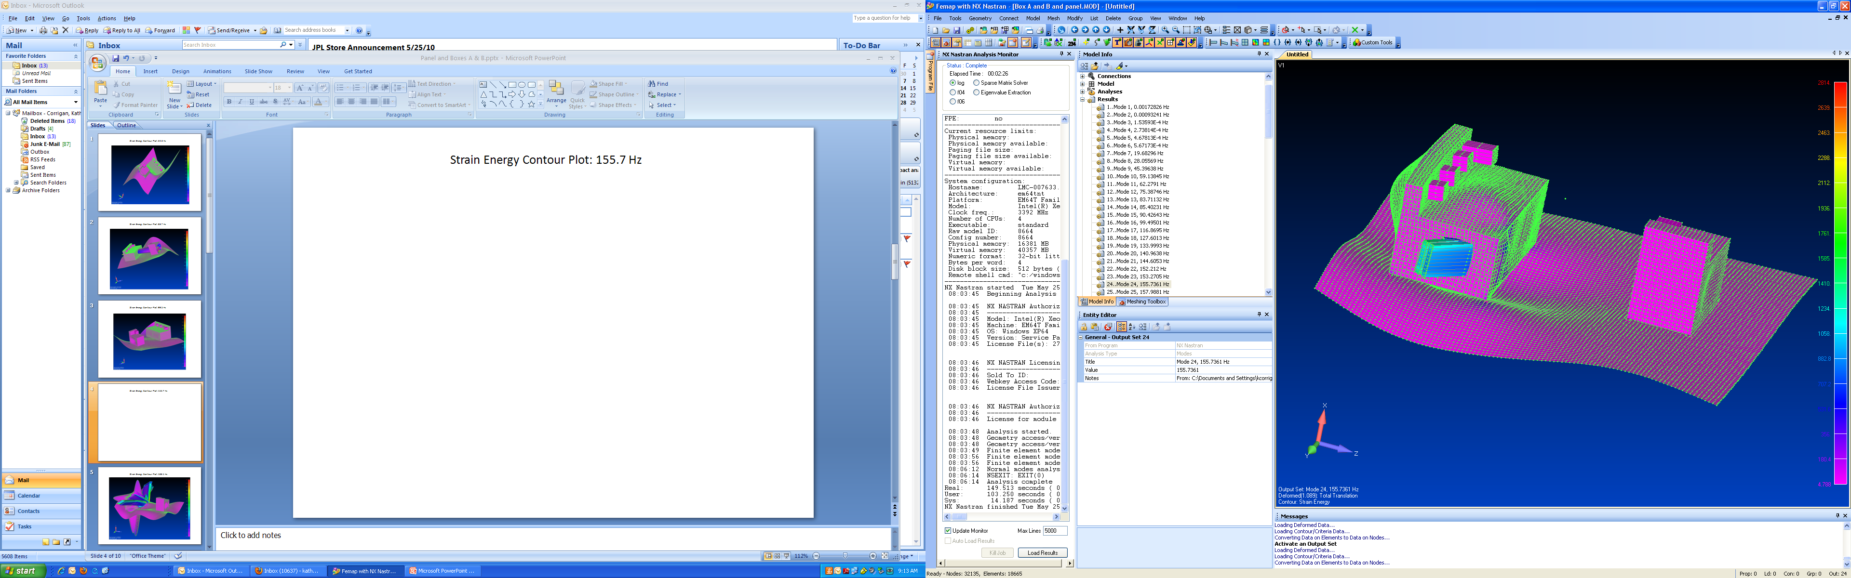
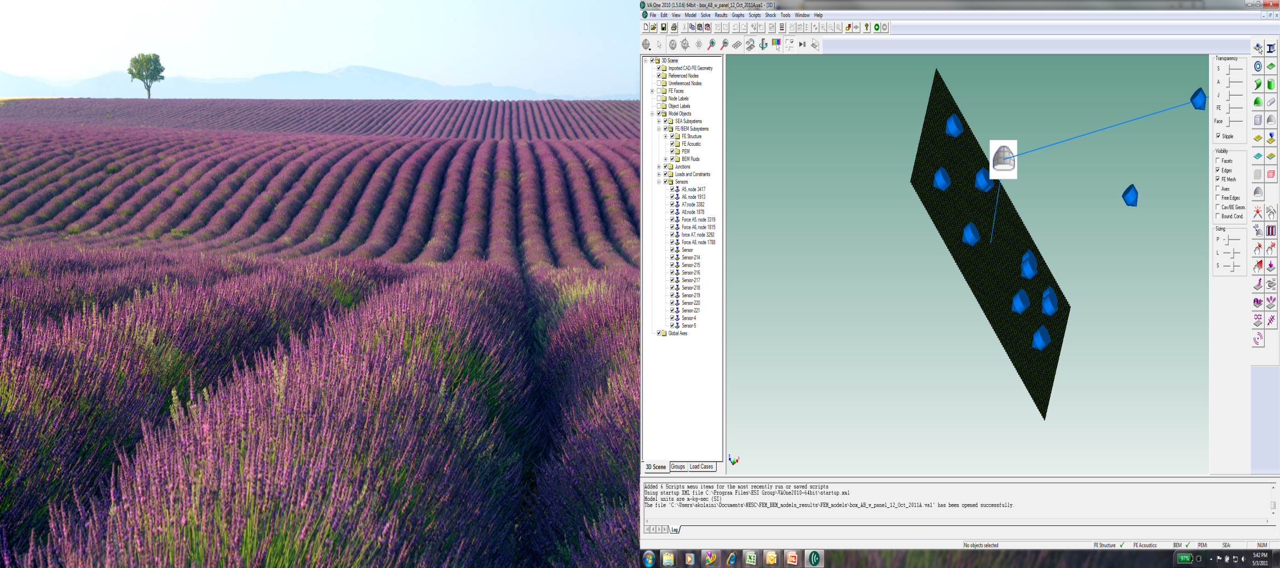
FEM/BEM: AL +Boxes A&B
FEM Mesh
BEM Mesh
The FEM model of the Al panel loaded with boxes A and B was used to compute the Eigen frequencies and to generate a BEM mesh (fluid mesh) as shown. The vibro-acoustic analysis was performed over the entire structural response frequency range, i.e. up to 2000 Hz. The force responses in three orthogonal axes of the panel at box interfaces were obtained and are used to derive the force limiting specification.

Slide 39
BEM vs. Semi-Empirical Force Limit
Al Panel + Box A
Semi-empirical
BEM
Semi-empirical: ~122 lb²/Hz vs BEM ~15 lb²/Hz

Slide 40
Generalized Mass Attenuation (GMA)
Arya Majed

Slide 41
GMA References
Majed, A., Kolaini, A, and Henkel, E., “Improved Force Limit Predictions via GMA”, Submitted to the NESC as a part of the follow-on VARR Task, Jan. 17, 2012.
Majed, A., and Kolaini, A., “An Improved Method of Structural-Borne Random Vibration Mass Attenuation”, 162nd Meeting of the Acoustical Society of America, Nov. 1, 2011.
Majed, A., Kolaini, A., Henkel, E., “Improved Force-Limit Predictions via GMA”, ASD-TB-11-022-R3, Submitted to the NESC as a part of the follow-on VARR Task, August 2011.
Majed, A., Henkel, E., Kolaini, A., “Special Topics in Random Vibrations”, Presented at the /JPL and Launch Vehicle Workshop, 2011.
Majed, A., Henkel, E., Kolaini, A., “An Improved Method of Random Vibration Mass Attenuation”, ASD-TB-11-015-R5, Presented at the NESC F2F Meeting, May 2011.

Slide 42
GMA Method
The GMA method of force limiting is another improved approach developed by Dr. Majed et al. for deriving force environments. The improved accuracy results from the force equation's inclusion of multi-axis, multi-drive point unloaded acceleration environments coupled with their respective cross correlations and drive point and transfer apparent masses.
  A robust approach in computing acceleration and force environments for complex structural systems.
The GMA force equation constitute a significant improvement over the current state of the art and can provide the vibroacoustic community with a powerful force limiting tool.

Slide 43
Summary (1/2)
Existing force limiting methods outlined in NASA-HDBK-7004 are used to notch the input acceleration of the test hardware
  Accounts for mismatch in impedances between testing and flight configurations,
  Assumes the hardware interface responses are correlated
Recent detailed acoustic tests conducted using two electronics boxes and panels, performed under NESC vibro-acoustic risk reduction program, used to re-assess the existing force limiting approaches
  The data from these tests treated as flight-like,
  The acceleration responses at boxes’ interfaces measured in the acoustic tests used to derive the box input specifications
  Boxes base shaked using the input from acoustic tests
  Boxes interface force responses measured during the base shake and acoustic tests provide a clear evidence of over testing of the components

Slide 44
Summary (2/2)
Current force limiting techniques account for correlated interface responses
  Most commonly used method is the semi-empirical method with C² in general obtained based on experience and engineering judgments (often FEM or TDOF system are used to obtain C²)
The knowledge of the component un-correlated interface responses provide more accurate force spectrum that can be used to limit the input accelerations
  These can be obtained using
    Flight Data
    FE models to recover uncorrelated interface force responses,
    Generalized Mass Attenuation method
    BEM to recover forces at the interfaces

Slide 45
Proposed Revision to NASA Handbook 7004C (1/2)
Use finite element models of the source and components in flight configuration to predict loaded interface using the auto- and cross-correlation acceleration and force responses with all DOFs. The predicted forces are obtained either by knowing the source acceleration responses at components’ interfaces or computing the load and source impedances by applying unit force at each interface (i.e. white noise)
  Envelop the predicted summed forces obtained using all elements in the apparent mass matrix
    Enveloped force specification removes some of the potential inaccuracy in predicting the coupled system’s modes,
  Add 3 dB to the enveloped spectrum to account for uncertainties in modeling and additional margin as needed to account for future configuration changes,
  Update the predicted force specifications as the FEMs are matured.

Slide 46
Proposed Revision to NASA Handbook 7004C (2/2)
Use GMA by including multi-axis, multi-drive point unloaded acceleration environment in the force questions coupled with their respective cross-correlations.
Use Boundary Element Method analysis to predict the interface forces of the component mounted on source structures
  Envelop the summed forces over all interface keeping real and imaginary,
  Add 3 dB to the enveloped spectrum to account for uncertainties in modeling and additional margin as needed to account for future configuration changes,
  Update the predicted force specifications as the FEMs are matured.
Peer review of these methods is needed

Slide 47
Questions???

Slide 48
Thank you for
attending…
Upcoming SLaMS Webcast:
Composite Overwrapped Pressure Vessels by Dr. Lorie Grimes-Ledesma
TBD

