Slide 1
Introduction to On-Orbit Thermal Environments
Part 1

Slide 2
Introduction
This lesson provides an introduction to On-Orbit Thermal Environments for those unfamiliar with this subject and will also serve as a refresher for practitioners of thermal analysis.

Slide 3
Overview of Natural Thermal Environments
Main focus will be on naturally occurring heating sources driven by solar heating, reflected solar heating and infrared sources;
Some focus will be given to free molecular heating;
Charged particle heating will be briefly discussed.

Slide 4
Lesson Breakdown
Part 1 -- Thermal Radiation, Orbits, Solar Flux;
Part 2 -- Albedo Flux, Planetary Flux, Combined Albedo and Planetary;
Part 3 -- Beta Angle and Its Consequences;
Part 4 -- Putting It All Together, Free Molecular Heating, Charged Particle Heating, References, For Additional Information.

Slide 5


Lesson Roadmap
Solar Zenith Angle
Thermal Radiation Basics
Orbits
Solar Flux
Albedo Flux
Form Factor
Planetary Infrared Flux
Albedo and Planetary Flux Combinations
Beta Angle
Projected Area
Time Constant
The Celestial Inertial Coordinate System
Consequences of Beta Angle Variation
Putting It All Together
Other Heating Environments

Slide 6
Part 1 Roadmap
Solar Zenith Angle
Thermal Radiation Basics
Orbits
Solar Flux
Albedo Flux
Form Factor
Planetary Infrared Flux
Albedo and Planetary Flux Combinations
Beta Angle
Projected Area
Time Constant
The Celestial Inertial Coordinate System
Consequences of Beta Angle Variation
Putting It All Together
Other Heating Environments

Slide 7
Thermal Radiation Basics

Slide 8


Thermal Radiation Basics
Unlike conduction and convection, thermal radiation is a highly non-linear phenomenon and is proportional to the fourth power of an object's absolute temperature.
Conduction and Convection
Radiation

Slide 9

The Rayleigh-Jeans Law and the Ultraviolet Catastrophe (Ref. 1)
Classical theory used the Rayleigh-Jeans law to predict spectral distribution:
where u(λ) is the spectral radiance, λ is the wavelength, k is the Boltzmann constant, and T is temperature.
For large λ, there was good agreement with experiment but as λ approached zero, u(λ) approached infinity -- the "ultraviolet catastrophe."

Slide 10
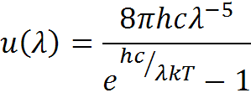
Blackbody Radiation and Planck's Law (Ref. 1)
By assuming that electromagnetic radiation is quantized, Max Planck showed that for a blackbody at a temperature, T:
where u(λ) is the spectral radiance, λ is the wavelength, h is Planck's constant, c is the speed of light, and k is the Boltzmann constant.
This is known as Planck's Law.

Slide 11
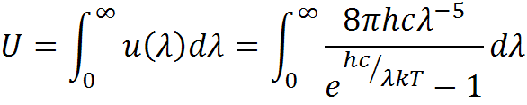

Blackbody Radiation and Planck's Law (Ref. 1)
The total energy density is given by:
Let x = hc/λkT. The integral becomes:

Slide 12
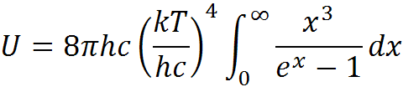
Blackbody Radiation and Planck's Law (Ref. 1)
We see that:
and observe the quantity in the integral is dimensionless;
We conclude that the spectral radiance is proportional to T⁴ - the Stefan-Boltzmann Law.

Slide 13
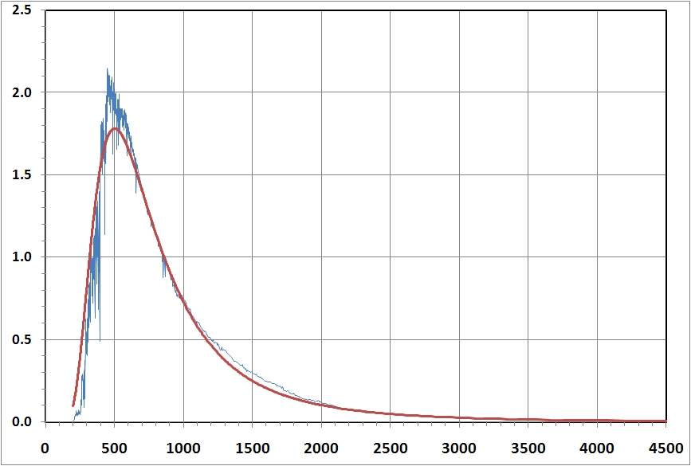
The Solar Spectrum
Wehrli 85 Data (Ref. 2)
Planck Blackbody (5777 K)
Spectral Irradiance (W/m²/nm)
Wavelength, λ (nm)

Slide 14
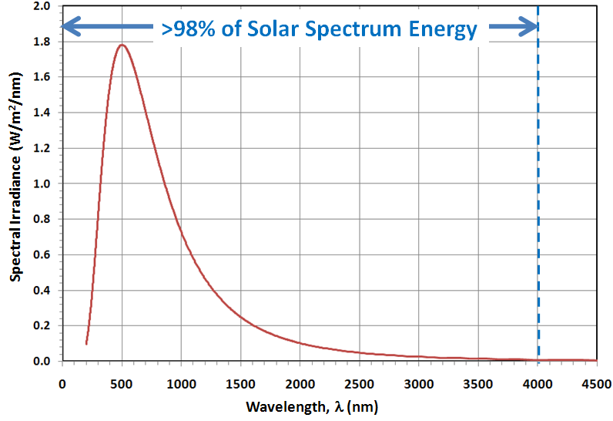
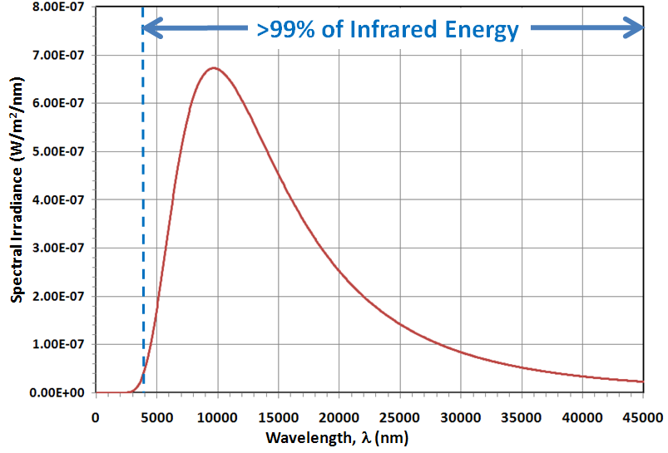
The Solar and Infrared Spectra (Ref. 3)
>98% of the solar spectrum energy lies below 4000 nm;
For a blackbody at 300 K, >99% of its energy lies above 4000 nm;
Think of these two regions as the solar and infrared spectra, respectively.

Slide 15


The Blackbody
A blackbody is the perfect absorber and emitter of radiant energy;
The Stefan-Boltzmann law shows that energy radiated from a blackbody is a function only of its absolute temperature, T:
where σ = 5.67 × 10⁻⁸ W/m² K⁴.

Slide 16

The Grey Body
Most objects are not perfect blackbody absorbers or emitters -- they are said to be "grey";
To account for imperfect absorption and emission, the Stefan-Boltzmann equation is scaled by an emissivity term, ε;
ε is a value between 0 and unity.

Slide 17
Solar Absorptance and Infrared Emittance
In the spacecraft thermal lexicon, we differentiate between how well a surface absorbs solar spectrum energy and how well it absorbs and emits infrared energy:
α refers to solar absorptance;
ε refers to infrared emittance;
But for a given wavelength, λ, the absorptance is equivalent to the emittance:

Slide 18
Conservation of Energy
Conservation of energy tells us that the energy absorbed by a surface, α_{λ} plus the energy reflected, ρ_{λ} plus the energy transmitted, τ_{λ} must equal the energy incident on that surface:
For an opaque surface, τ_{λ} = 0 and the equation simplifies to:
This will be important when we calculate albedo flux.

Slide 19
Solar Absorptance and Infrared Emittance
When we differentiate between the solar and infrared spectra, we drop the λ subscript and it is understood that:
α applies to the 0-4000 nm range;
ρ applies, roughly, to the 0-4000 nm range;
ε applies to the 4000 nm and above range.

Slide 20
Orbits

Slide 21




Anatomy of an Orbit
Periapsis -- the location of minimum orbit altitude
Argument of Periapsis -- the angle, measured in the orbit plane, from the ascending node to the periapsis
Semimajor Axis-- half the distance from apoapsis to periapsis
Equator
True Anomaly -- angle from the periapsis location to the spacecraft location
+
Inclination -- the tilt of the orbit plane with respect to the equator
Focus
Ascending Node -- the location where the orbit crosses the equator headed south to north
+
Focus
Apoapsis -- the location of maximum orbit altitude
Right Ascension of the Ascending Node will be discussed in a subsequent section.

Slide 22

Orbit Eccentricity
The eccentricity, e, of an ellipse is defined as:
where a is the length of the semimajor axis and f is the distance from the center to one of the foci.
For a circle, e = 0.
a
+
+
+
f
f=0
+
a

Slide 23
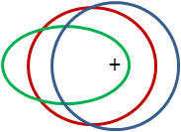
Orbit Eccentricity
Three orbits with the same semimajor axis are shown here;
The only difference is the orbit eccentricity:
e = 0.0 (circular)
e = 0.4
e = 0.8

Slide 24
Circular Orbits
Circular orbits are easier to describe because they are a degenerate case of the ellipse;
For a circular orbit, the semimajor and semiminor axes are equal in length and, because of this, the argument of periapsis is undefined;
Hence, the shape and orientation of a circular orbit may be described by its radius, inclination and right ascension of the ascending node, only.

Slide 25
Solar Flux

Slide 26
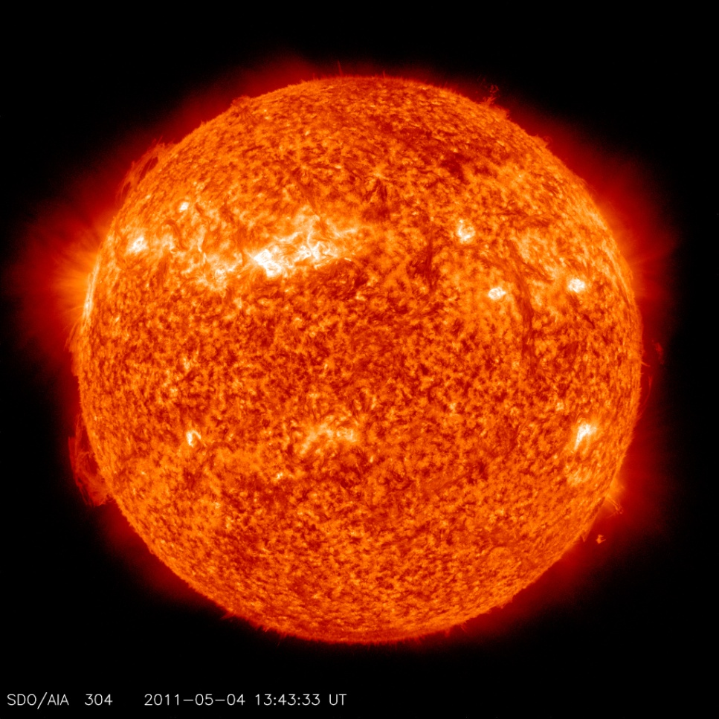
Solar Flux
At a distance of 1 a.u., the intensity of the incoming solar flux is 1367 W/m² (Ref. 4);
We seek an expression that allows us to calculate the intensity of the solar flux at any distance.
The Sun as seen by the Solar Dynamics Observatory on 04 May 2011
NASA Photo

Slide 27


Solar System Geometry
Earth's orbit around the sun is slightly elliptical (e = 0.0167);
Earth closer to the sun during part of the year;
Earth's average distance from the sun, a, is one half of the ellipse's major axis.
ν
r_{A}
r_{P}
2a

Slide 28
Solar System Geometry
Earth's closest approach to the sun is called perihelion (r_{P});
Earth's most distant point from the sun is called aphelion (r_{A});
Earth's angular position from perihelion is called true anomaly (ν).
ν
r_{A}
r_{P}
2a

Slide 29
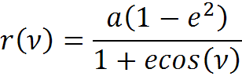
Solar System Geometry
Earth's distance from the sun may be determined for any value of true anomaly, ν by using the formula:
ν
r_{A}
r_{P}
2a

Slide 30
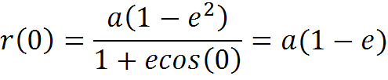
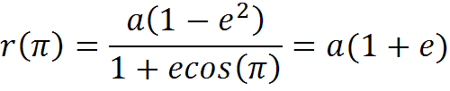
Solar System Geometry
Perihelion, then, is determined as:
And, similarly, aphelion is:
For Earth, a = 1 a.u.
ν
r_{A}
r_{P}
2a

Slide 31


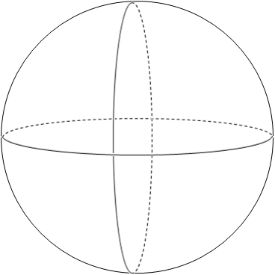


Calculating Solar Flux
The sun broadcasts its energy in all directions;
If we construct imaginary spherical surfaces about the sun, we know that the total energy crossing each surface must be the same.
r_{A}
r_{P}

Slide 32
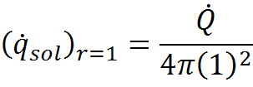
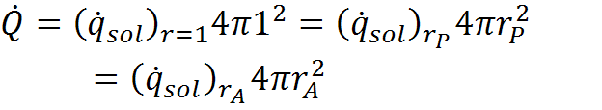
Calculating Solar Flux
We can set up an energy balance as follows:
But since the same amount of energy must cross each sphere:
r_{A}
r_{P}

Slide 33
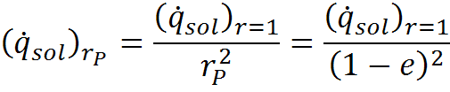
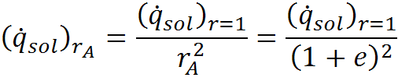
Calculating Solar Flux
The flux at Earth perihelion and aphelion is, respectively:
r_{A}
r_{P}

Slide 34


Calculating Solar Flux
For a = 1 a.u., e = 0.0167 and a solar flux of 1367 W/m² at 1 a.u., the following values are obtained:
These typically have a ±5 W/m² accuracy.
Note: A value of 1423 W/m² is a typical hot case solar flux design parameter and depends on the mean value of solar constant assumed.
W/m²
W/m²

Slide 35


Calculating Solar Flux
Using this same formulation, we can calculate the solar flux at any distance, r, from the sun:
For the remainder of this lesson, solar flux will be referred to as, simply .
r
r=1 a.u.

Slide 36
Conclusion of Part 1

