Slide 1
Introduction to On-Orbit Thermal Environments
Part 2

Slide 2
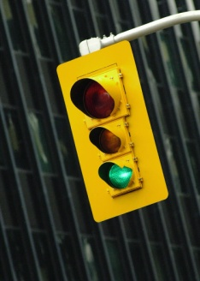
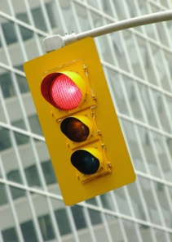
Part 2 Roadmap
Solar Zenith Angle
Thermal Radiation Basics
Orbits
Solar Flux
Albedo Flux
Form Factor
Planetary Infrared Flux
Albedo and Planetary Flux Combinations
Beta Angle
Projected Area
Time Constant
The Celestial Inertial Coordinate System
Consequences of Beta Angle Variation
Putting It All Together
Other Heating Environments

Slide 3
Albedo Flux

Slide 4
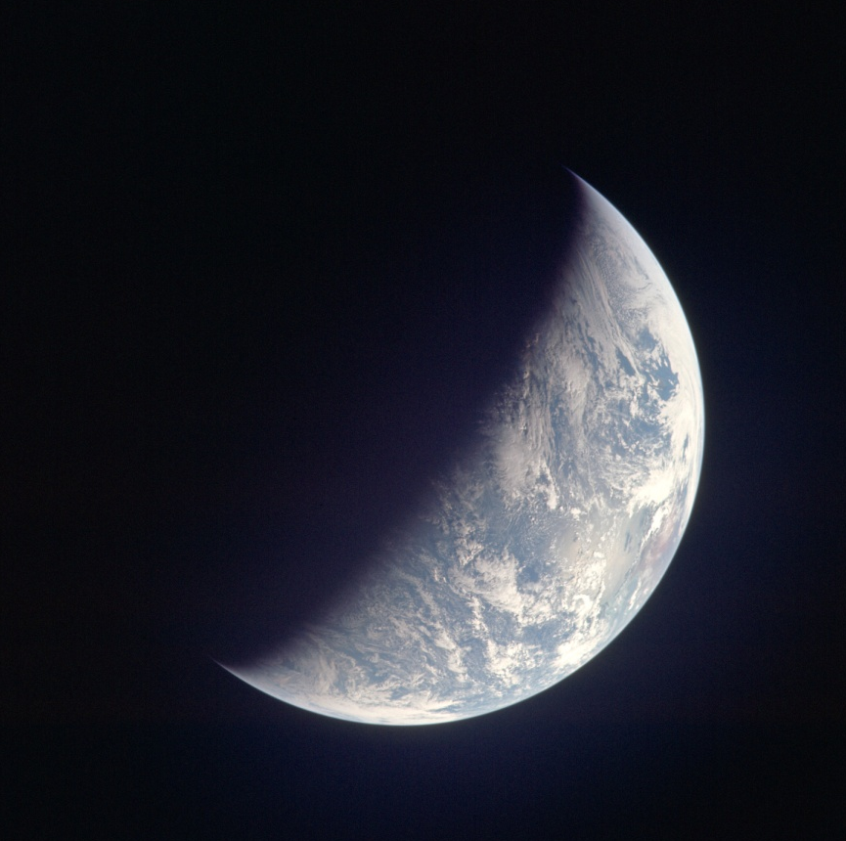
Albedo Heating
Albedo heating is solar energy reflected from the planet and its atmosphere;
It is not a point source -- it subtends a solid angle and has non-uniform area intensity.
Partially Illuminated Earth as Seen from Apollo 12
(NASA Photo)

Slide 5
A Simplified Albedo Model
Analysis of albedo is complicated by its non-uniform area intensity;
We can, however, gain an understanding of the contribution of albedo heating by making some simplifying assumptions;
Corrections to this will be discussed.

Slide 6


Assumptions for the Simplified Albedo Model
Simplifying assumptions:
Low altitude, circular orbit -- restricts planet viewing to local regions with similar illumination conditions;
Constant albedo factor planet-wide -- uniform albedo factor, with diffuse reflection, is the easiest to model.

Slide 7
Simplified Albedo Flux Calculation
The expression for the simplified albedo flux is formed by considering the following:
intensity of the sunlight striking the planet, q_{sol};
fraction of sunlight reflected, ρ (i.e., the albedo factor is just 1 - α);
scaling of intensity from orbit noon (i.e., solar zenith angle, ξ);
local form factor to the planet, FF.
.

Slide 8



Aside: Solar Zenith Angle, ξ
The solar zenith angle, ξ, is a measure of angular distance from orbit noon;
If orbit angle, θ is measured from orbit noon and β is measured from a plane containing the sun, an increase in either parameter results in an increase in ξ.
θ
β
ξ

Slide 9



Aside: Solar Zenith Angle, ξ
Mathematically, ξ is expressed as:
We'll explore β in detail in Part 3.
θ
β
for:
ξ

Slide 10
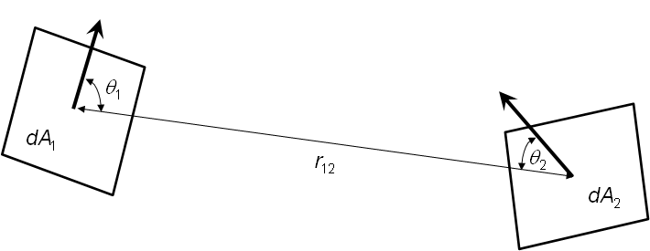
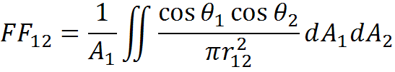
Aside: The Form Factor
A form factor describes how well one object can "see" another object;
The form factor may take on a value from zero to unity.

Slide 11

Aside: Form Factor
The Nusselt Sphere technique is one of many ways to calculate form factors;
The form factor from dA₁ to Surface 2 is calculated as the projected area, A_{P}, divided by the area of the hemisphere's circular base.
Surface 2
dA₁
A_{P}

Slide 12
Aside: Form Factor
Let's use the Nusselt Sphere technique for calculating the form factor to the planet from an orbiting plate, at altitude h above the planet, whose surface normal faces the nadir direction.
r_{e}
Planet
r_{e}
h
dA₁
A_{P}

Slide 13

Aside: Form Factor
We see that we can construct a right triangle (in green) with a short side measuring r_{e} and a hypotenuse measuring r_{e}+h;
We define the angle φ by noting:
r_{e}
Planet
r_{e}
r_{e}
h
φ
dA1
A_{P}

Slide 14

Aside: Form Factor
Similarly, we can construct a right triangle (in red) with a hypotenuse measuring unity and the angle φ, already defined;
We define the distance x by noting:
r_{e}
Planet
r_{e}
r_{e}
h
x
φ
r = 1
dA1
A_{P}

Slide 15
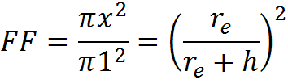
Aside: Form Factor
Projecting x down to the base, we see that the ratio of the projected circular area to the total area of the base is:
We'll come back to this result in our heating calculations.
r_{e}
Planet
r_{e}
r_{e}
h
x
φ
r = 1
dA1
A_{P}

Slide 16
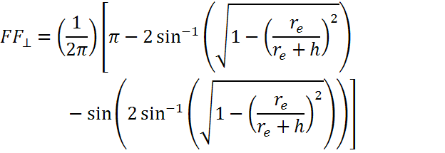
Aside: Form Factor
The forward (east)-, aft (west)-, north- and south-facing surfaces have a different view to the planet due to their orientation.
For these "perpendicular" surfaces, the form factor is presented in Ref. 5 and shown here, without derivation.

Slide 17
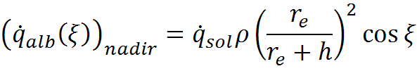

Simplified Albedo Flux Calculation
The equation for a nadir-facing plate is:
Intensity of sunlight striking the planet
Scaling of intensity from orbit noon
Fraction of the sunlight reflected
Local Form Factor to the planet
ρ
ξ
r_{e}
h
For:

Slide 18




Solar Zenith Angle Corrections
to Albedo (Ref. 6)
Our simplified model isn't perfect but there's a way to correct for albedo by applying this formula:
Note that this correction was derived from data restricted to latitudes of +30° to -30°.

Slide 19
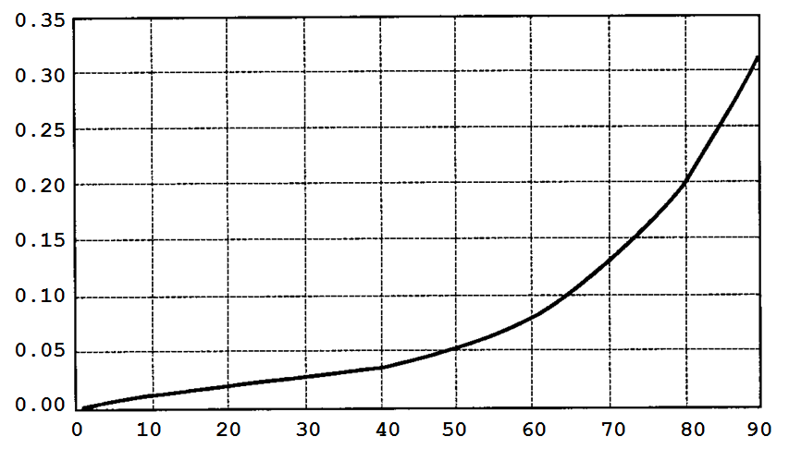
Solar Zenith Angle Corrections
to Albedo (Ref. 6)
Albedo Correction Term, ρ(ξ)
Solar Zenith Angle, ξ (°)

Slide 20
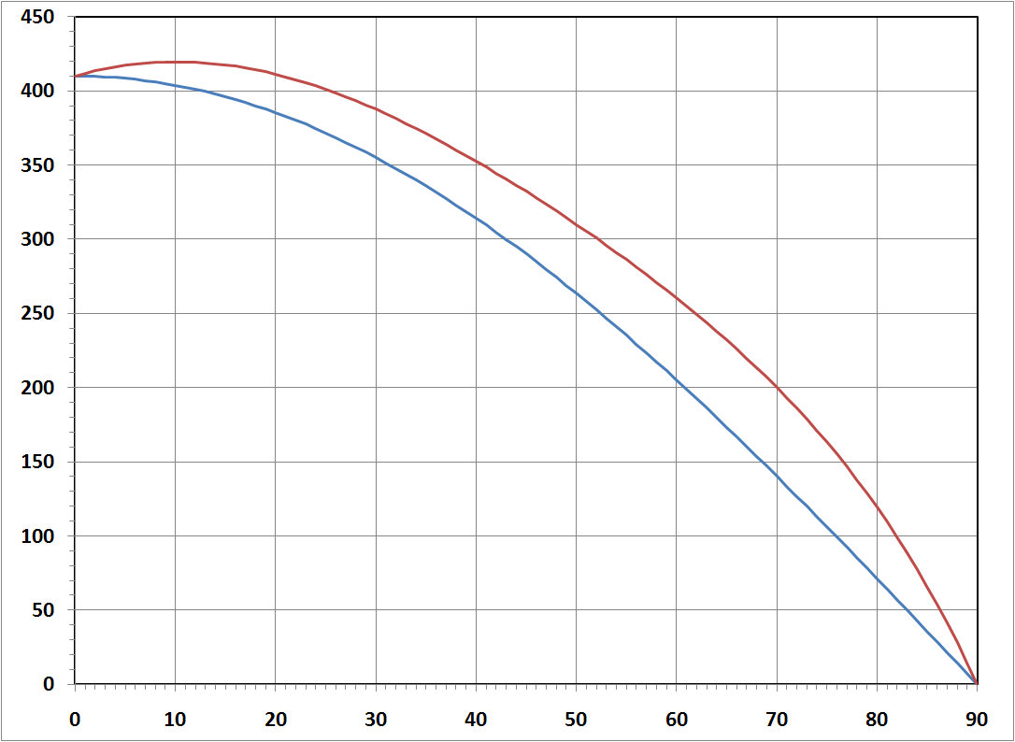
Solar Zenith Angle Corrections to Albedo
Corrected Model
Simplified Model
Albedo Flux (W/m²)
Assumptions:
ρ = 0.3
q_{sol} = 1367 W/m²
.
Note: Raw flux value with no form factor correction.
Solar Zenith Angle, ξ (°)

Slide 21
Planetary Infrared Flux

Slide 22
Planetary Infrared Heating
Thus far, we've discussed natural heating components using illumination in the solar spectrum;
But there is another heating source incident on a spacecraft when in proximity to a planet/moon;
And the heating is concentrated in the infrared portion of the spectrum -- it's called planetary infrared or outgoing long-wave radiation (OLR);

Slide 23
Simplifying Assumptions for Earth Infrared
We can learn much by examining a simplified representation of Earth's heat balance;
For this analysis, we'll assume that Earth's atmosphere and relatively rapid rotation with respect to the sun results in uniform temperatures over the entire globe; Earth is at thermal radiation equilibrium; and, Earth's albedo is constant over the entire surface.

Slide 24

The Overall Planetary Heat Balance
The overall planetary heat balance assumes steady state heat transfer -- the amount of heat absorbed by the planet must equal the amount radiated:
Let's take a closer look at each of these terms.

Slide 25

The Overall Planetary Heat Balance
The heat absorbed is the amount of incoming solar flux times the area that intercepts the flux times the fraction absorbed:
But what is meant by the projected area (A_{proj})?

Slide 26
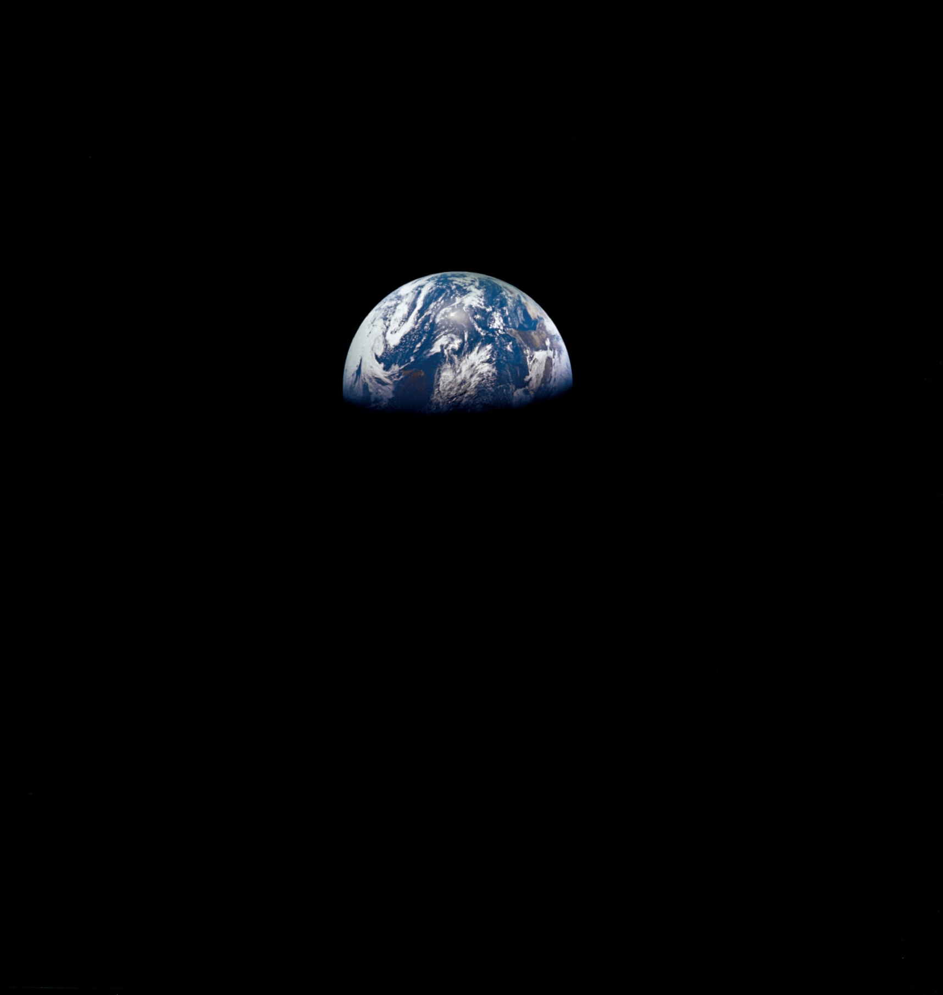
Aside: Projected Area
The entire planetary sphere is not illuminated;
Only half is illuminated at any given instant and even that illumination is not uniform;
But it's easy to visualize how much sunlight is intercepted by the planet, even with this non-uniform illumination.
Earth as Seen from Apollo 8
(NASA Photo)

Slide 27



Aside: Projected Area
Imagine that you could lower a white screen behind an illuminated planet and observe from afar;
How much sunlight would be missing?
Incoming Solar Heating
(Assumed Parallel)
r_{e}

Slide 28

Aside: Projected Area
Looking at the screen head-on, we see that a circle of sunlight is missing;
The projected area of a sphere is simply that of a circle.
r_{e}

Slide 29


The Overall Planetary Heat Balance
The heat emitted is assumed uniform over the entire planet;
We can express the heat rejected using the familiar Stefan-Boltzmann law:
where is recognized as the surface area of the planetary sphere.

Slide 30

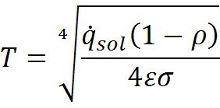
The Overall Planetary Heat Balance
Next, we equate the outgoing and incoming energy, and substituting for the projected area:
Solving for the planetary temperature, T yields:

Slide 31



The Overall Planetary Heat Balance
We can also find the flux emitted by the planet at temperature, T:
For a mean solar flux of 1367 W/m², albedo of 0.3 and an assumed Earth emittance of 1.0:
255 K
239 W/m²

Slide 32
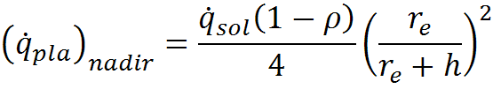
The Overall Planetary Heat Balance
The flux incident on the spacecraft is scaled by the local form factor to the planet for a nadir-facing plate:
ρ
r_{e}
h

Slide 33
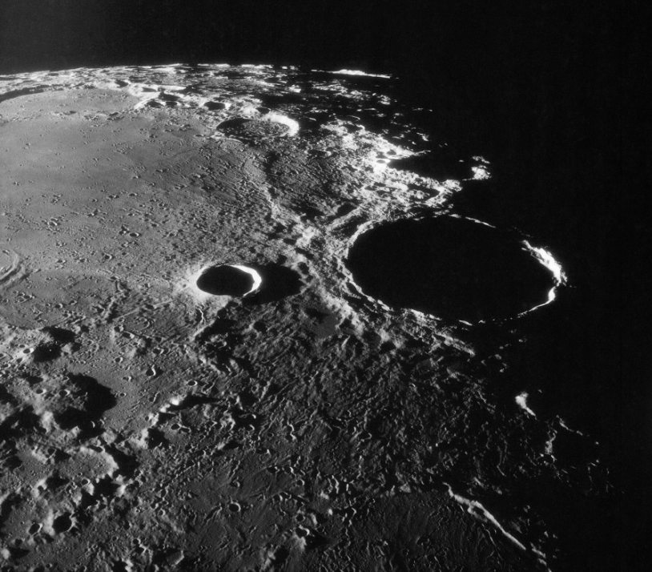
Why Won't This Calculation Work for the Moon?
Recall our simplifying assumptions:
Earth has an atmosphere to transport heat over the globe -- the Moon does not;
Earth rotates rapidly with respect to the sun when compared to the Moon.
Cold
Hot
Moon as Seen from Apollo 11
(NASA Photo)

Slide 34
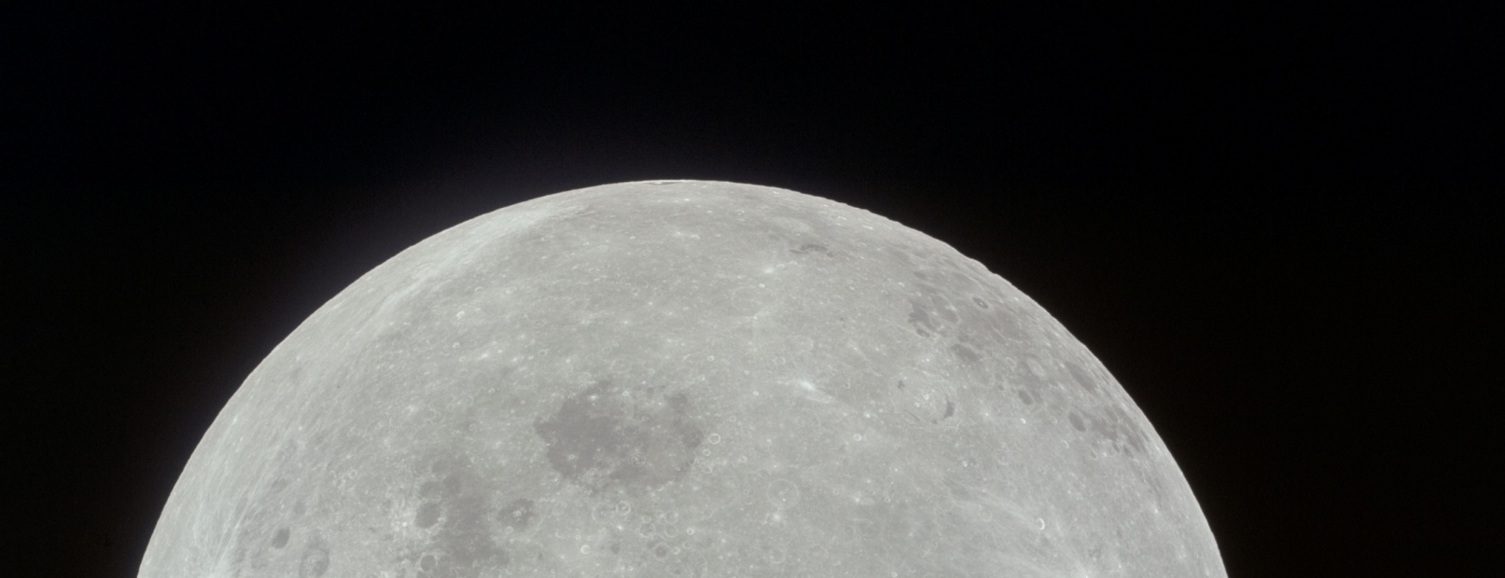
Why Won't This Calculation Work for the Moon?
Because of this, assuming the Moon is isothermal is not a good assumption.
Moon as Seen from Apollo 11 as it was Homeward Bound
(NASA Photo)

Slide 35
Albedo and Planetary Flux Combinations

Slide 36
Combination of Natural Environmental Parameters
The previous developments were used to show how reasonable estimates of natural environmental parameters could be obtained using some simplifying assumptions;
Now, it's time to explore "reality".

Slide 37
Local Variation vs. the Planet-Wide Heat Balance
Our earlier derivation for planetary OLR assumed a planet-wide heat balance;
This isn't necessarily true for local conditions;
Seasonal variation in vegetation, snow cover, cloud cover, etc., can all affect local albedo and OLR components.
So how do engineers account for this?

Slide 38
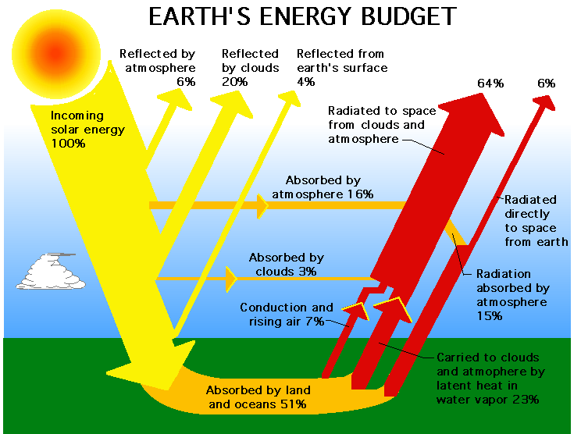
Local Variation vs. the Planet-Wide Heat Balance (Ref. 7)

Slide 39
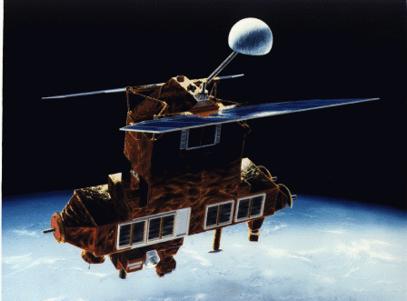
Earth Radiation Budget Experiment (ERBE)
The Earth Radiation Budget Experiment (ERBE) used a new generation of instrumentation to make accurate regional and global measurements of the components of the radiation budget. (Ref. 8)
Earth Radiation Budget Satellite (ERBS)

Slide 40
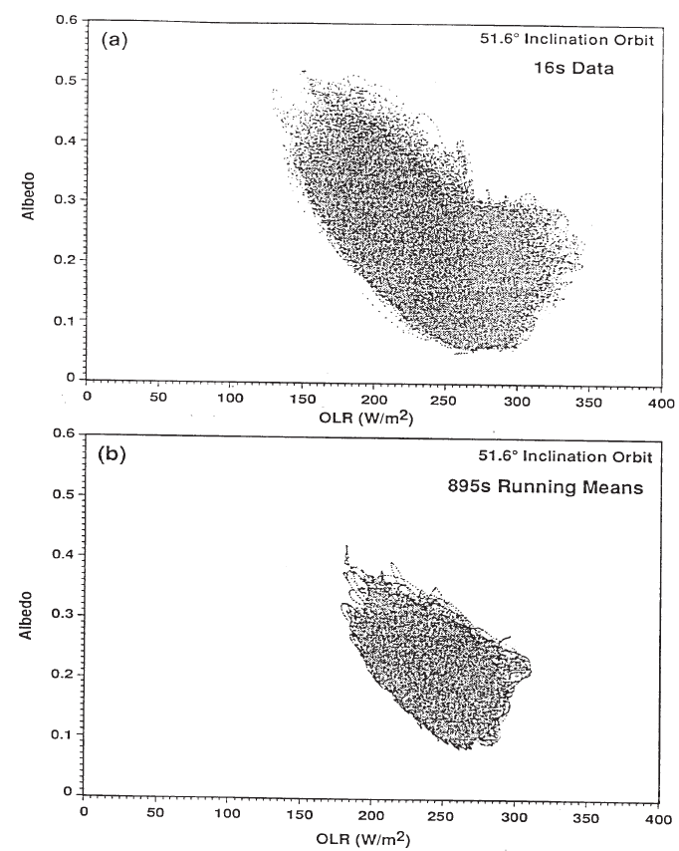
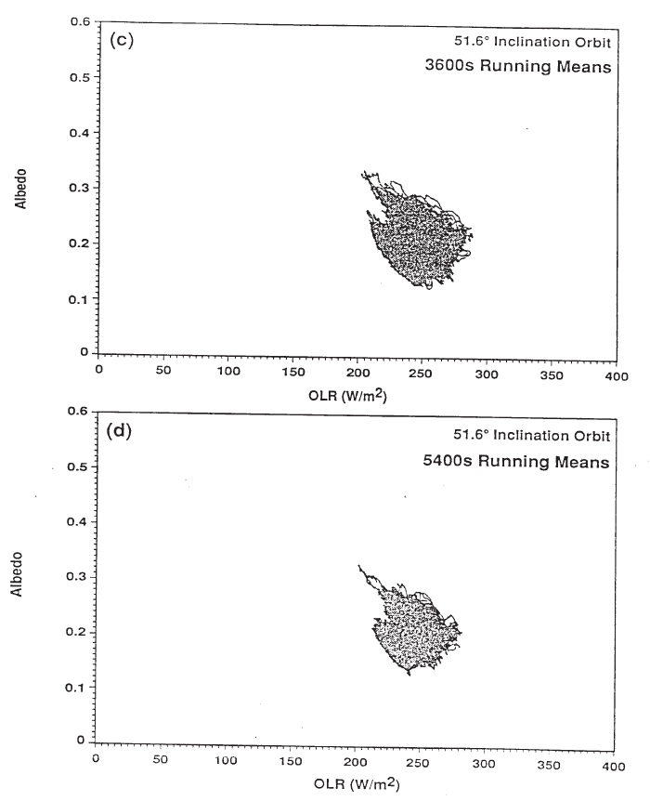
Albedo and Planetary OLR Data (Ref. 9)
51.6° Inclination
16 s Data
51.6° Inclination
3600 s Running Means
Albedo
Albedo
51.6° Inclination
895 s Running Means
51.6° Inclination
5400 s Running Means
Albedo
Albedo

Slide 41
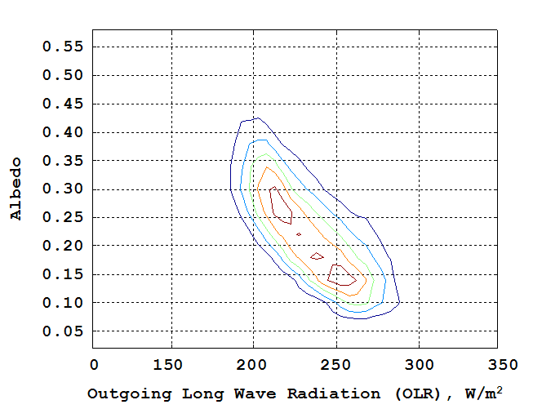
Albedo vs.Planetary OLR (Ref. 9)
High Inclination Orbits, 128 Second Averaged Data

Slide 42
Aside: Time Constant
As the thermal environment changes, so does an object's temperature;
Objects with low thermal inertia react faster than objects with a higher thermal inertia;
Objects with high heat transfer to or from the environment will react more rapidly than those with lower heat transfer.

Slide 43

Aside: Time Constant
The effect of thermal inertia and heat transfer into and out of an object may be understood through investigation of the time constant, τ.
Mathematically, for a mass, m, the time constant, τ is given by:
where C_{p} is the specific heat and G is conductance or a linearized conductance.

Slide 44
Aside: Time Constant
Real-life problems require more than a single set of environmental parameters:
Objects with short time constants react to short-term changes in the thermal environment -- examples: components such as radiators and insulation surfaces;
Objects with longer time constants react more slowly to changes -- examples: massive components with small area and insulated structure.

Slide 45
Albedo vs. OLR (Ref. 9)
Engineering Extreme Cases for High Inclination Orbits

Slide 46
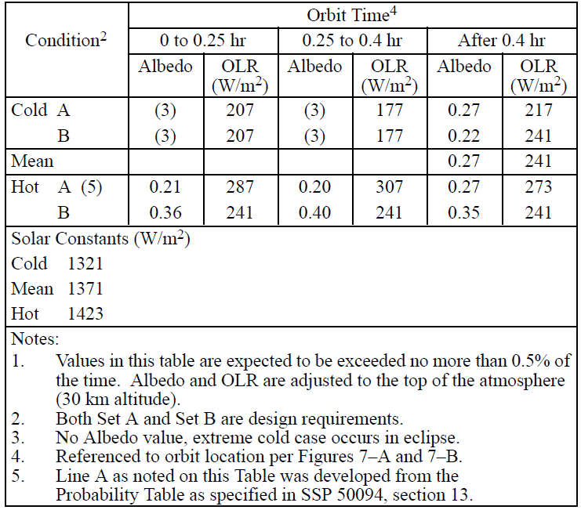
Albedo and OLR Combinations (Ref. 10)

Slide 47
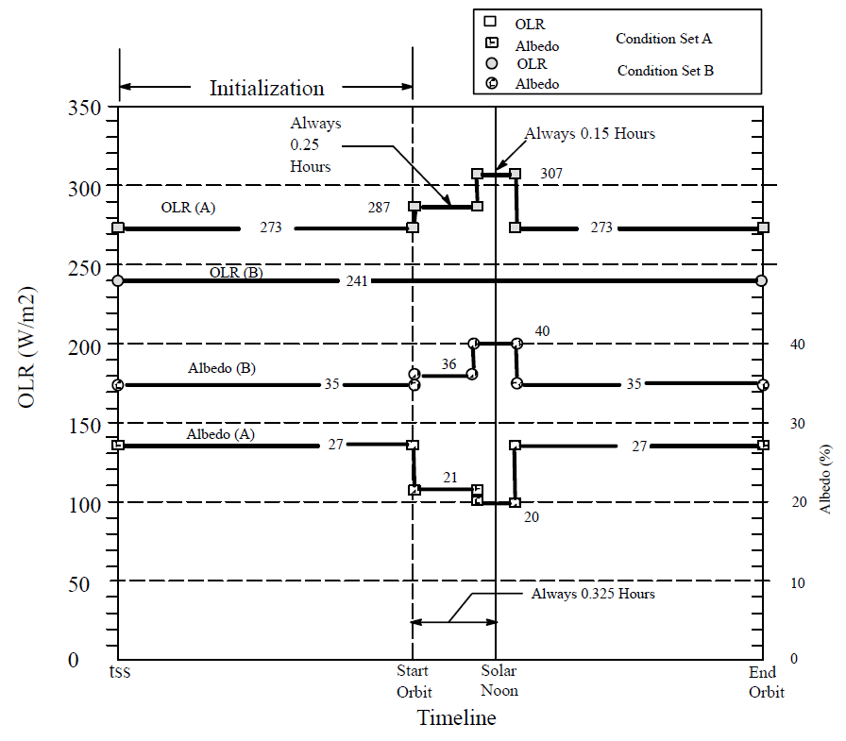
Albedo and OLR Combinations (Ref. 10)
Design Hot Case Thermal Environment Profile

Slide 48
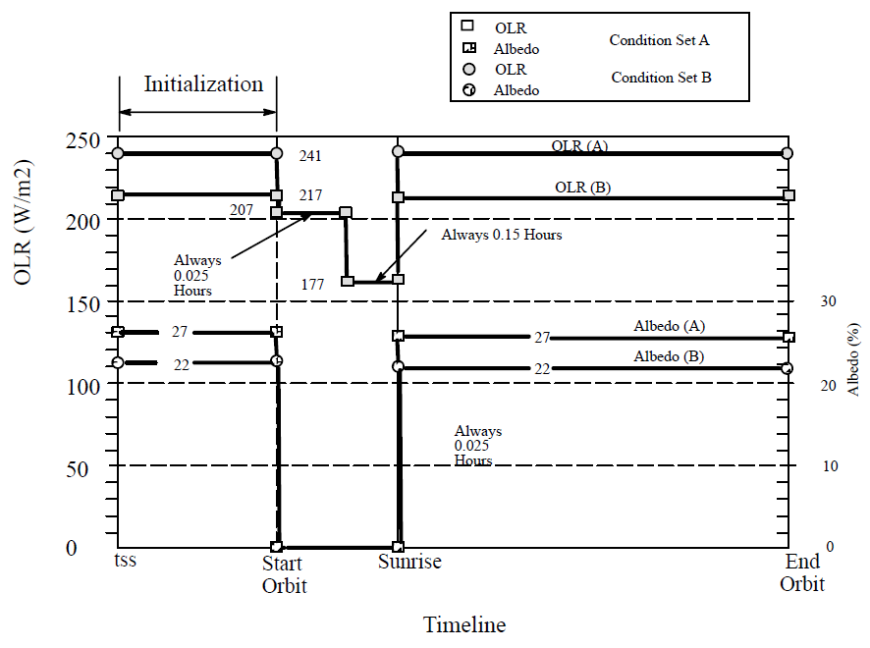
Albedo and OLR Combinations (Ref. 10)
Design Cold Case Thermal Environment Profile

Slide 49
Conclusion of Part 2

