Slide 1
Introduction to On-Orbit Thermal Environments
Part 3

Slide 2
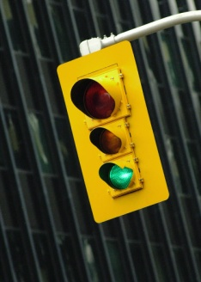
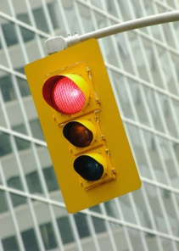
Part 3 Roadmap
Solar Zenith Angle
Thermal Radiation Basics
Orbits
Solar Flux
Albedo Flux
Form Factor
Planetary Infrared Flux
Albedo and Planetary Flux Combinations
Beta Angle
Projected Area
Time Constant
The Celestial Inertial Coordinate System
Consequences of Beta Angle Variation
Putting It All Together
Other Heating Environments

Slide 3
Beta Angle

Slide 4



The Beta Angle
The beta angle, β is the angle between the solar vector, s, and its projection onto the orbit plane;
We're going to calculate the beta angle but before we do, we need to explain some concepts.
β
s

Slide 5

Aside: The Celestial Inertial Coordinate System
A simplified representation of Earth's orbit about the sun is shown below:
Vernal
Equinox
Perihelion
(~January 4)
Summer
Solstice
Sun
Winter
Solstice
Aphelion
(~July 4)
Ecliptic Plane
Autumnal
Equinox

Slide 6



Aside: The Celestial Inertial Coordinate System
The celestial inertial coordinate system is convenient for performing on-orbit thermal environment calculations.
North
z
Celestial Equator
y
Ecliptic Plane
ε = 23.45 °
Equator
x
γ
(Vernal Equinox)

Slide 7
The Solar Vector
We define the solar vector, s, as a unit vector in the celestial inertial coordinate system that points toward the sun.
North
z
s
y
Ecliptic Plane
ε = 23.45 °
x
γ
(Vernal Equinox)

Slide 8
The Solar Vector
The apparent motion of the sun is constrained to the Ecliptic Plane and is governed by two parameters: Γ and ε.
North
z
s
y
Ecliptic Plane
Γ
ε = 23.45 °
x
γ
(Vernal Equinox)

Slide 9
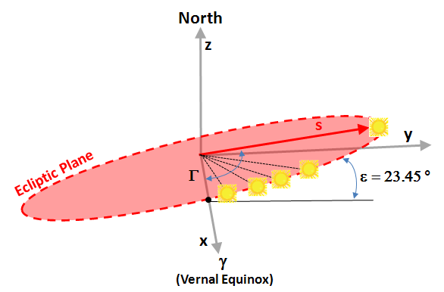
The Solar Vector
ε is the Obliquity of the Ecliptic and, for Earth, is presently 23.45°;
Γ is the Ecliptic True Solar Longitude and changes with date -- Γ is 0° when the sun it at the Vernal Equinox.

Slide 10
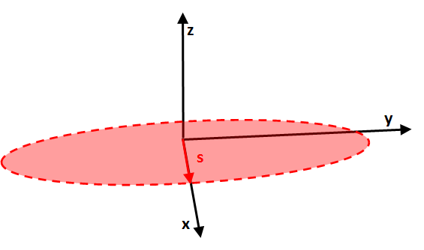
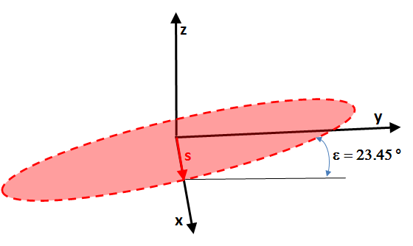
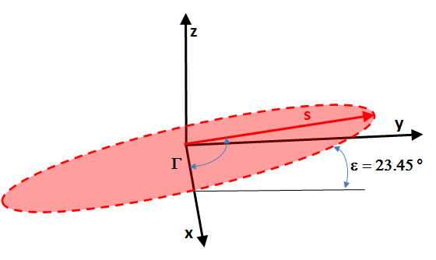
The Solar Vector
We can form the solar vector via two Euler angle transformations: first a rotation of the unit vector of ε about the x-axis and then a rotation of Γ about the new z-axis.
z
Unit Vector,
No Rotation
First Rotation,
ε about x-axis
Second Rotation,
Γ about new z-axis

Slide 11


The Solar Vector
Mathematically, the transformation is expressed as:

Slide 12
The Orbit Normal Vector
In the same celestial inertial coordinate system, we define the vector, o, as a unit vector pointing normal to the orbit plane.
North
Orbit
Plane
o
z
Celestial Equator
y
Equator
x
γ
(Vernal Equinox)

Slide 13
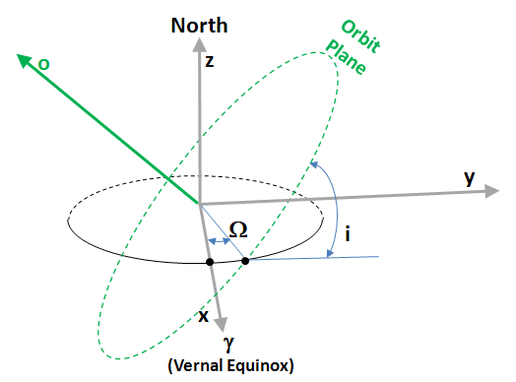
The Orbit Normal Vector
i is the Orbit Inclination -- a measure of angular tilt from the equatorial plane;
Ω is the Right Ascension of the Ascending Node -- a measure of angle between the x-axis at the point where the orbit cross the equatorial plane going from south to north.

Slide 14
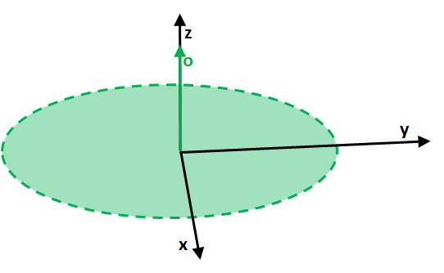
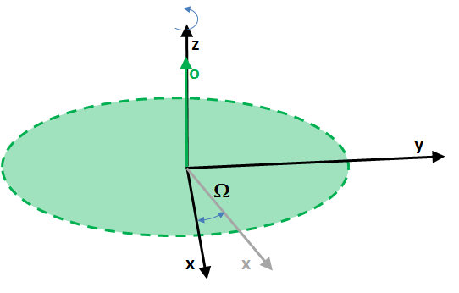
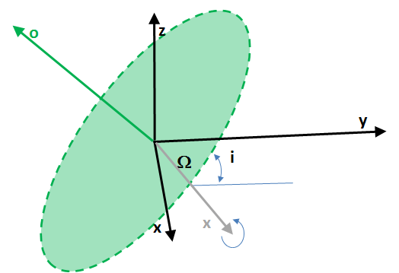
The Orbit Normal Vector
We can form the orbit normal vector via two Euler angle transformations: first a rotation of the unit vector of Ω about the z-axis and then a rotation of i about the new x-axis.
Unit Vector,
No Rotation
First Rotation,
Ω about z-axis
Second Rotation,
i about new x-axis

Slide 15

The Orbit Normal Vector
Mathematically, the transformation is expressed as:

Slide 16
Calculating the Beta Angle
To most easily calculate the angle between a vector and a plane, it is necessary to determine the angle between the vector and a vector normal to the plane, denoted here by φ;
We note that β = φ - (π/2) radians.
φ
β
s

Slide 17
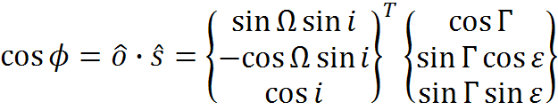


Calculating the Beta Angle
The beta angle, then, is given by:
But, since β = φ - (π/2) radians:

Slide 18

Calculating the Beta Angle
We see that β is limited by:
Beta angles where the sun is north of the orbit plane are considered positive -- beta angles where the sun is south of the orbit are considered negative.

Slide 19
Consequences of Beta Angle Variation

Slide 20
Variation of the Beta Angle
Our expression for β, repeated here for convenience is:
The beta angle is not static and varies constantly;
Two factors that affect β variation the most:
1. The change of seasons (variation in Γ);
2. Perturbation of the orbit due to the oblateness of the planet (variation in Ω).

Slide 21
Variation Due to the Change of Seasons
It takes the sun just over one year to make one circuit around the celestial sphere;
We measure the sun's progress by Γ;
Strictly speaking, the rate that the sun makes this circuit is not constant.

Slide 22

Variation Due to the Change of Seasons
Since Earth's orbit about the sun is nearly circular, an approximation of the variation of Γ with time is sufficient.

Slide 23
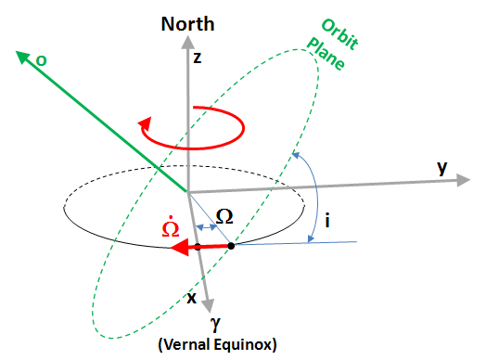
Variation Due to Precession of the Orbit
Earth is not a perfect sphere;
Equatorial bulge produces a torque on the orbit;
Effect is a precession of the orbit ascending node;
Precession is a function of orbit altitude and inclination.

Slide 24
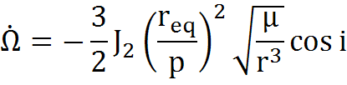
Variation Due to Precession of the Orbit
This variation is called the Ascending Node Angular Rate, Ω, and is given by:
where J₂ is the oblateness perturbation, r_{eq} is the planet equatorial radius, p is the parameter, μ is the planet mass × G, r is the orbit radius and i is inclination.
.

Slide 25
Variation Due to Precession of the Orbit
For Earth, typical values for these parameters are (Ref. 4):
J₂ = 1082.62 × 10⁻⁶
r_{eq} = 6378.1 km
μ = 0.3986 × 10⁶ km³/s²
For a typical ISS orbit...
r = 6378.1 km + 408 km
Circular (e = 0, a = r)
i = 51.6°

Slide 26

Variation Due to Precession of the Orbit
The "parameter" is calculated as:
The resulting precession is:
Ω = -1.00634×10⁻⁶ rad/s
Ω = -4.98 °/day
.
.

Slide 27
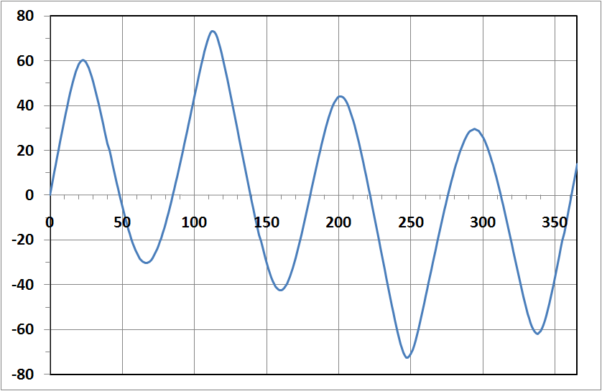
Variation of the Beta Angle Due to Seasonal Variation and Orbit Precession
Representative Profile:
Altitude = 408 km, Circular
Inclination = 51.6 °
Beta Angle (°)
Note: This is one of many possible profiles
Number of Days Since Vernal Equinox

Slide 28
Consequences of Beta Angle Variation
As β changes, there are two consequences of interest to thermal engineers:
1) The time spent in eclipse (i.e., planet shadow) varies;
2) The intensity and direction of heating incident on spacecraft surfaces changes;
Let's explore each of these effects.

Slide 29
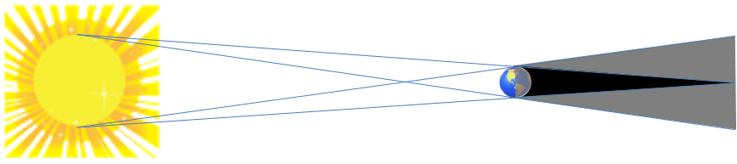
Eclipse: Umbra and Penumbra
Umbral region - sunlight is completely obscured;
Penumbral region - sunlight is partially obscured.
Line-of-Sight (Typical)
Penumbra
Umbra
Planet
Sun
Not to Scale

Slide 30
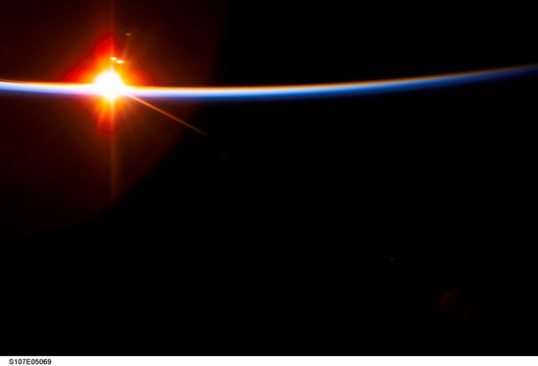
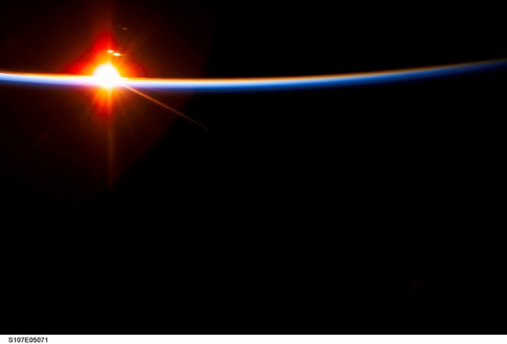
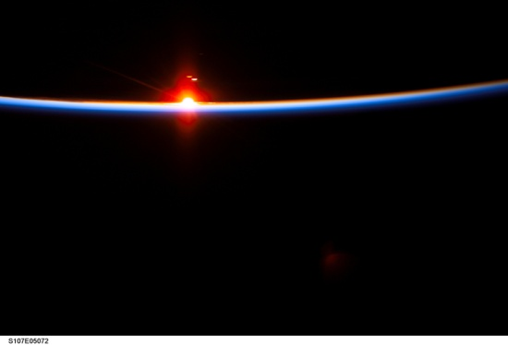
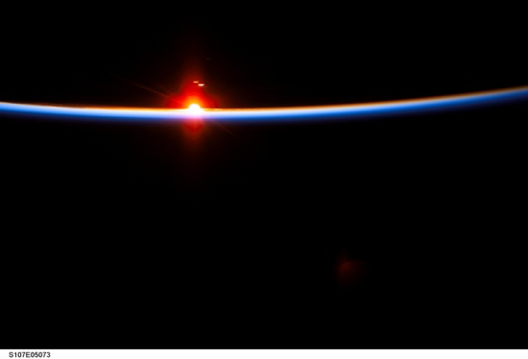
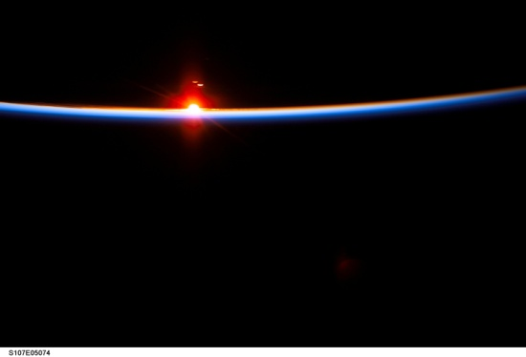
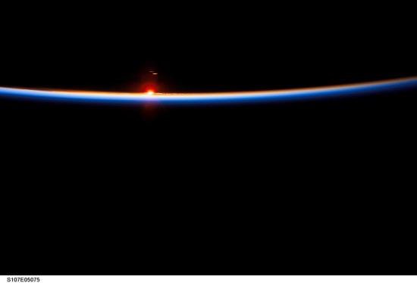
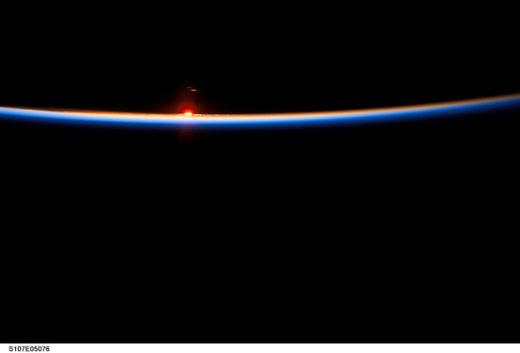

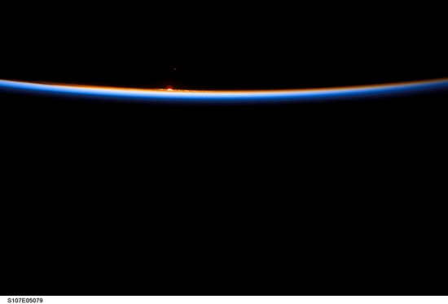
Orbital Sunset: From Penumbra to Umbra
Earth
Earth
Earth
Earth
Earth
Earth
Earth
Earth
Earth
NASA Photos

Slide 31

Eclipse: Umbra and Penumbra
If time in penumbra is minimal, analysis may be simplified using a cylindrical shadow assumption.
Cylindrical Shadow Approximation
Umbral Shadow Cone
(Exaggerated ~4X)

Slide 32
Geometry for Eclipse Calculation
(Low, Circular Orbit Only)
We create a new coordinate system where the sun is always in the xy-plane and the orbit is inclined β;
z_{β}
β
x_{β}
r_{e}
y_{β} is in to the page

Slide 33

Geometry for Eclipse Calculation
(Low, Circular Orbit Only)
Looking down onto the orbit plane gives us this geometry (when β = 0°).
y_{β}
θ
r'
r
x_{β}
r_{e}
h
z_{β} is out of the page

Slide 34
Geometry for Eclipse Calculation
(Low, Circular Orbit Only)
We seek an expression for r' which is a projection of r onto the y_{β}z_{β}-plane.
y_{β}
θ
r'
r
x_{β}
r_{e}
h
z_{β} is out of the page

Slide 35
Geometry for Eclipse Calculation
(Low, Circular Orbit Only)
When |r'| < r_{e}, the spacecraft is in the umbral shadow.
y_{β}
θ
r'
r
x_{β}
r_{e}
h
z_{β} is out of the page

Slide 36

Calculating Umbral Eclipse Entry
(Low, Circular Orbit Only)
Spacecraft position vector, r, can be expressed as a function of altitude above planet, h, planet radius, r_{e}, angle from orbit noon, θ, and beta angle, β:
The magnitude of this vector is:
This reduces to:

Slide 37


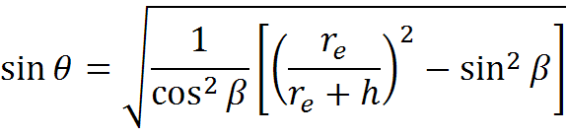
Calculating Umbral Eclipse Entry
(Low, Circular Orbit Only)
The projection of this vector onto the y_{β}z_{β}-plane is given by:
And the magnitude is given by:
The onset of shadowing occurs when |r'| < r_{e}:

Slide 38
Calculating Umbral Eclipse Entry/Exit
(Low, Circular Orbit Only)
Now that the θ of eclipse onset is known, it is a simple matter to determine the entire eclipse period by noting that the total angle shadowed is 2(π-θ):
θ
2(π-θ)
θ

Slide 39
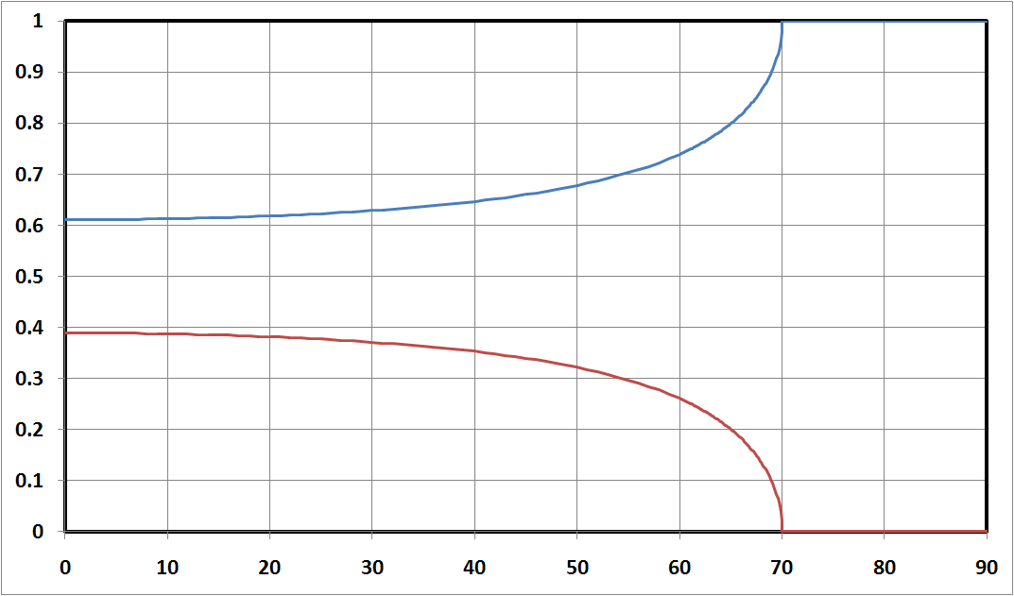
Fraction of Orbit Spent in Sunlight/Eclipse
The fraction of orbit spent in sunlight and eclipse for a circular orbit is clearly related to β:
408 km (220 nm) Circular Orbit
Fraction Spent
in Sunlight
Fraction of Orbit
Fraction Spent
in Eclipse
β Angle (°)

Slide 40
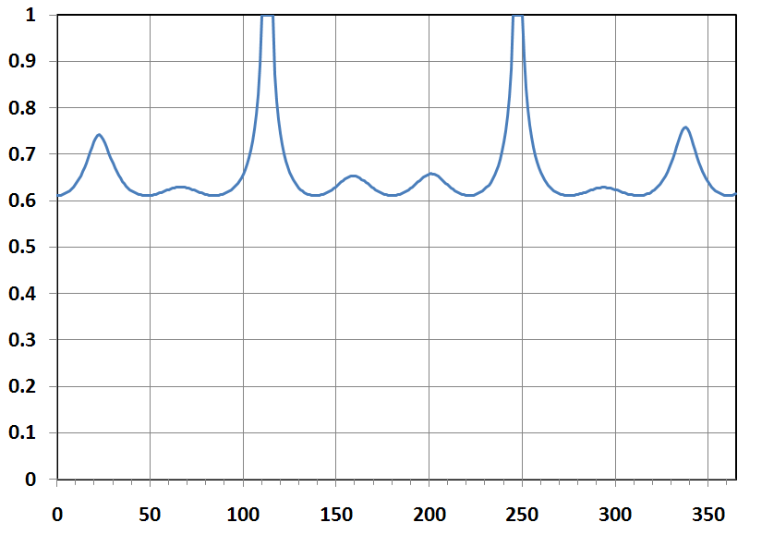
Variation of the Orbit Eclipse Period as a Function of Beta Angle
Fraction of Orbit In Sunlight
Representative Profile:
Altitude = 408 km, Circular
Inclination = 51.6 °
Note: This is one of many possible profiles
Number of Days Since Vernal Equinox

Slide 41
Variation of the Heating to Surfaces as Function of Beta Angle
To study this, we will consider an orbiting plate and look at the effect of β angle on heating to a planet-facing (N = nadir) surface.
ρ
N
β

Slide 42




Variation of the Solar Heating to a Nadir-Facing Surface as a Function of Beta Angle
At orbit noon (θ = 0°), the nadir-facing surface has no view to the incoming solar flux;
As θ varies past 90°, the heating scales with -cos θ.
As β increases, the projected area scales with cos β;
ρ
for:

Slide 43


Variation of the Albedo Heating to a Nadir-Facing Surface as a Function of Beta Angle
For a given β, at orbit noon (θ = 0°), the nadir-facing surface has a maximum view to the sun lit planet;
As β increases and θ increases from orbit noon, the solar zenith angle, ξ, increases.
Overall, the heating scales with cos ξ.
ρ
for:

Slide 44


Variation of the Planetary Heating to a Nadir-Facing Surface as a Function of Beta Angle
From our assumption of a constant planetary flux, the planetary infrared heating to the plate is easily calculated as the product of the planetary flux, scaled by the form factor to the planet.
ρ
for:

Slide 45
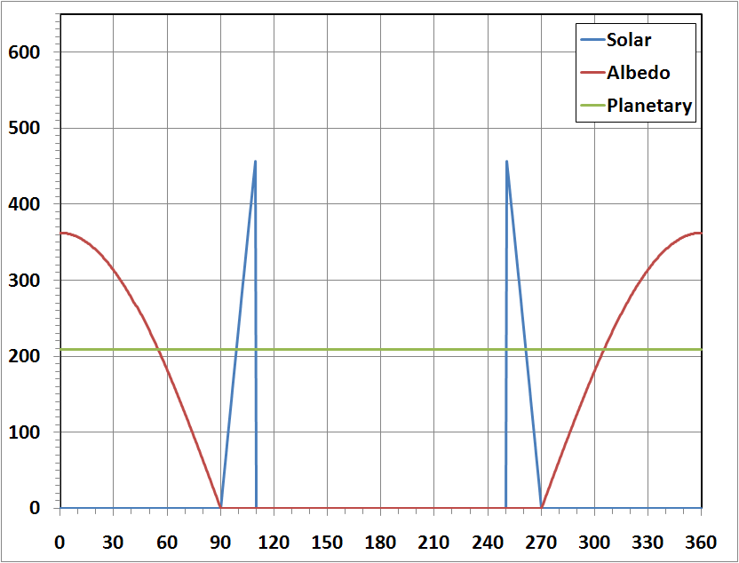
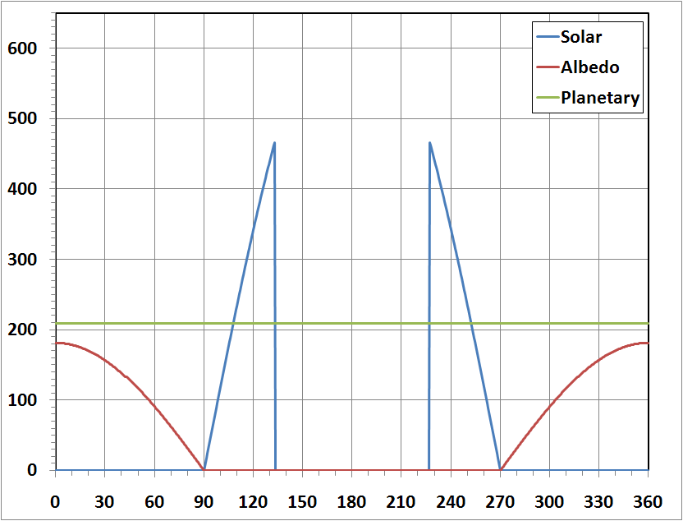
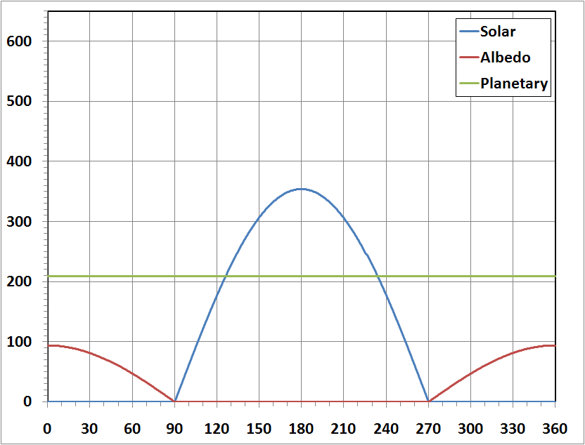
Variation of the Heating to a Nadir-Facing Surface as a Function of Beta Angle
β = 0°
β = 60°
Incident Heating Flux (W/m²)
Incident Heating Flux (W/m²)
Orbit Angle, θ (°)
Orbit Angle, θ (°)
β = 75°
h = 408 km (Circular)
q_{sol} = 1367 W/m²
a = 0.3
q_{pla} = 236 W/m²
r_{e} = 6378.14 km
.
Incident Heating Flux (W/m²)
.
Orbit Angle, θ (°)

Slide 46
Conclusion of Part 3

