Slide 1
Introduction to On-Orbit Thermal Environments
Part 4

Slide 2


Part 4 Roadmap
Solar Zenith Angle
Thermal Radiation Basics
Orbits
Solar Flux
Albedo Flux
Form Factor
Planetary Infrared Flux
Albedo and Planetary Flux Combinations
Beta Angle
Projected Area
Time Constant
The Celestial Inertial Coordinate System
Consequences of Beta Angle Variation
Putting It All Together
Other Heating Environments

Slide 3
Putting It All Together

Slide 4
Putting It All Together
We've looked separately at:
The solar, albedo and planetary infrared heating components;
Beta angle and its effect on heating flux and on-orbit eclipse.
Let's pull it all together with an example problem.

Slide 5

Example: The Orbiting Box
Consider a box-like spacecraft orbiting Earth:
h = 408 km (Circular)
q_{sol} = 1367 W/m²
ρ = 0.3
q_{pla} = 236 W/m²
r_{e} = 6378.14 km
.
.
β
θ is in orbit plane (green dashed line)

Slide 6

Example: The Orbiting Box
Side 1 - faces away from the planet (zenith-facing)
Side 2 - faces the planet (nadir-facing)
Side 3 - faces forward (velocity vector-facing)
Side 4 - faces aft (anti-velocity vector-facing)
Side 5 - faces north
Side 6 - faces south
5
2
4
1
6
β
Note: Side 3 not
shown

Slide 7
Example: The Orbiting Box
3
1
2
5
4
View Looking "Down" from Normal to the Orbit Plane
θ
Note: Side 6 not
shown
5
2
4
1
View Looking Edge On to the Orbit Plane
6
β
Note: Side 3 not
shown

Slide 8
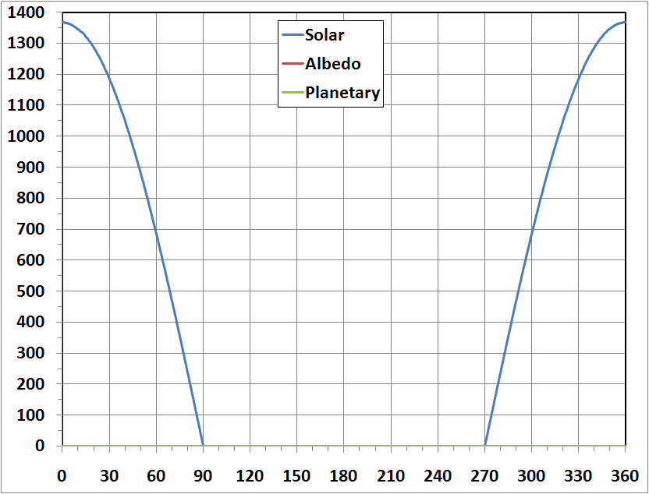
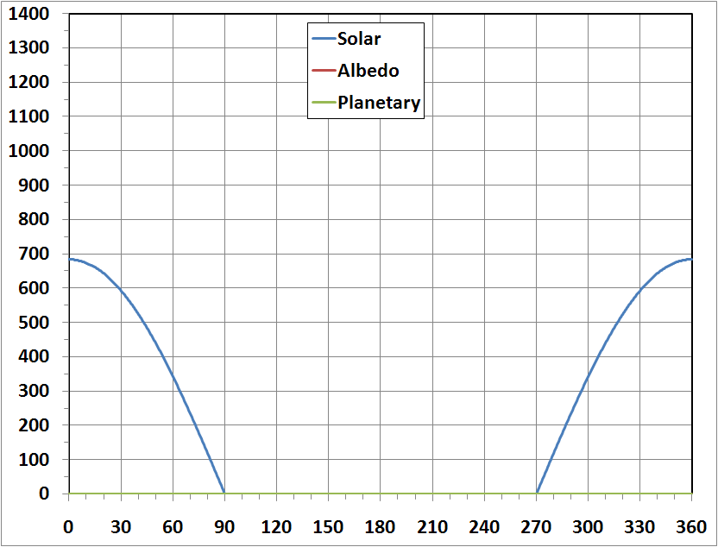
Example: Side 1 - Zenith-Facing Surface
The zenith-facing plate "sees" only sunlight.
β = 0°
β = +60°
Incident Heating Flux (W/m²)
Incident Heating Flux (W/m²)
Orbit Angle from Solar Noon, θ (°)
Orbit Angle from Solar Noon, θ (°)

Slide 9
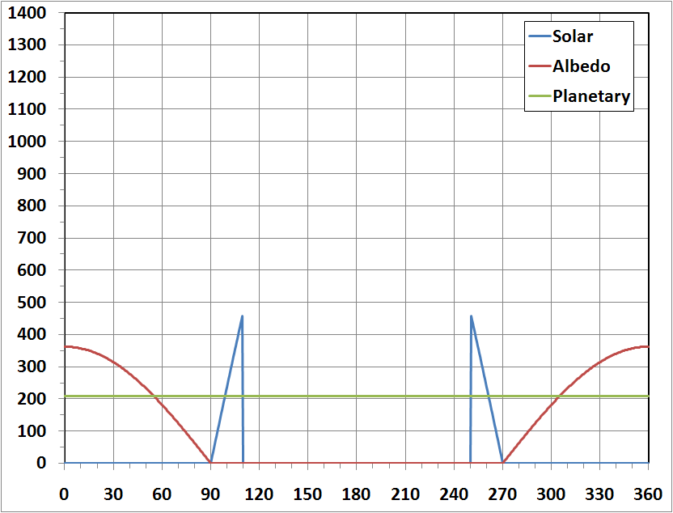
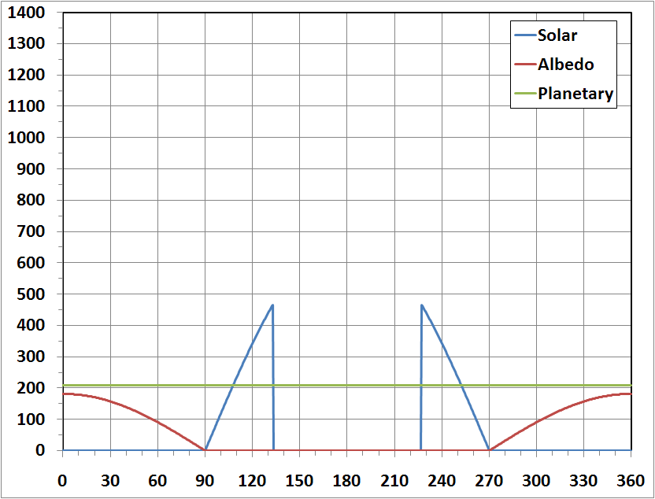
Example: Side 2 - Nadir-Facing Surface
The nadir-facing plate experiences solar, albedo and planetary heating.
β = 0°
β = +60°
Incident Heating Flux (W/m²)
Incident Heating Flux (W/m²)
Orbit Angle from Solar Noon, θ (°)
Orbit Angle from Solar Noon, θ (°)

Slide 10
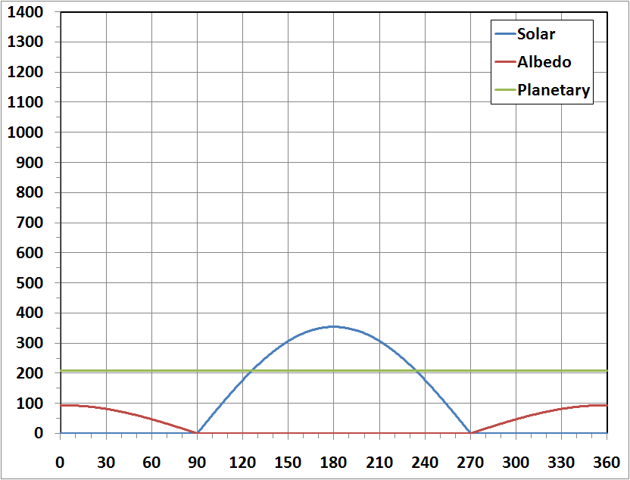
Example: Side 2 - Nadir-Facing Surface
For this orbit, above |β| = ~71°, no eclipse is experienced.
β = +75°
Incident Heating Flux (W/m²)
Orbit Angle from Solar Noon, θ (°)

Slide 11
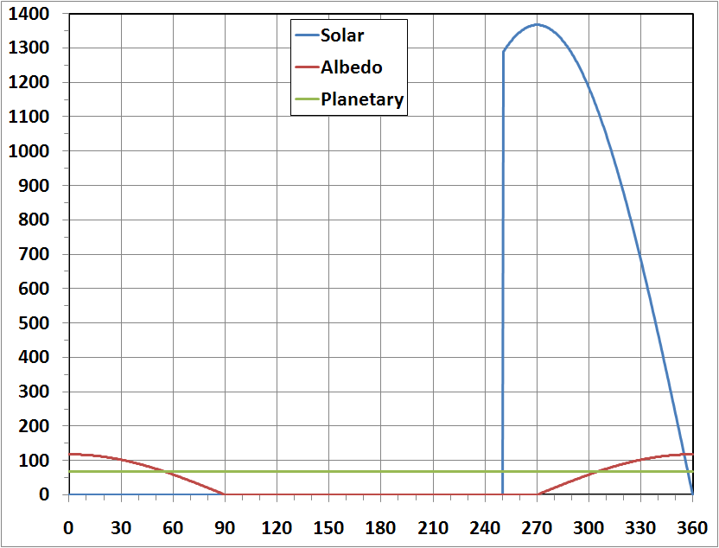
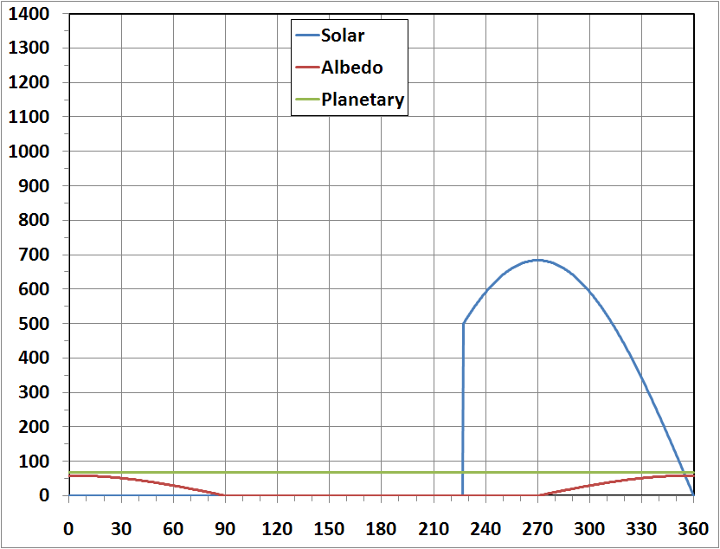
Example: Side 3 - Forward-Facing Surface
Solar flux phase is shifted due to orientation of surface;
β = 0°
β = +60°
Incident Heating Flux (W/m²)
Incident Heating Flux (W/m²)
Orbit Angle from Solar Noon, θ (°)
Orbit Angle from Solar Noon, θ (°)

Slide 12
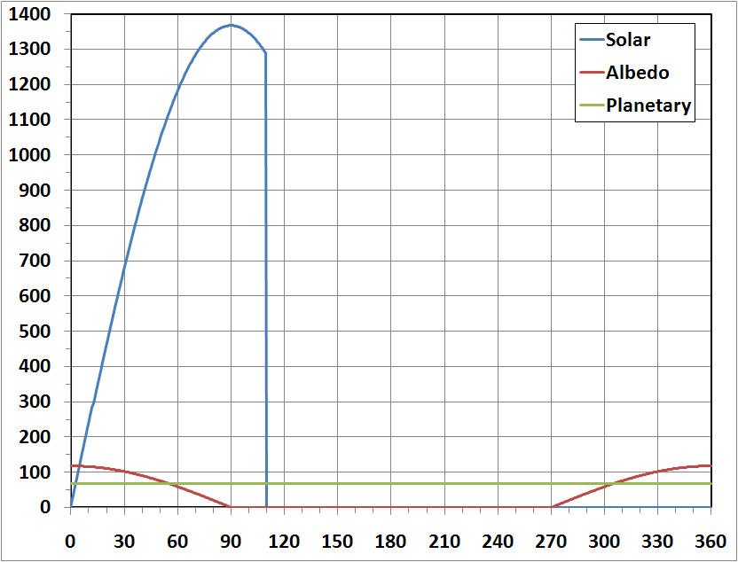
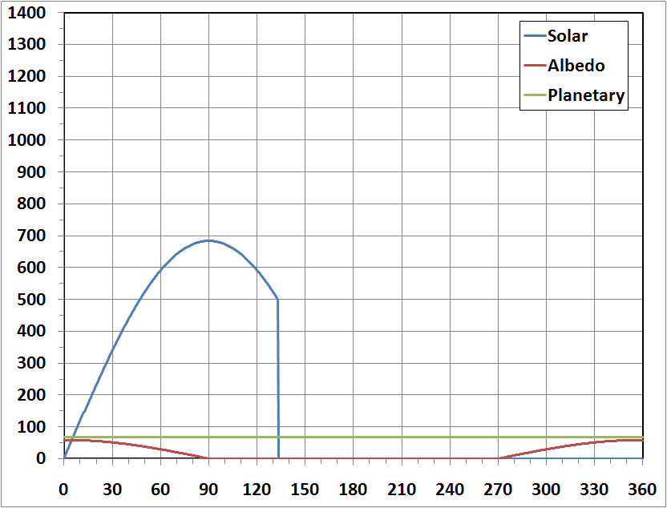
Example: Side 4 - Aft-Facing Surface
Solar flux phase is shifted again due to orientation of surface -- mirror image of Forward-Facing surface;
β = 0°
β = +60°
Incident Heating Flux (W/m²)
Incident Heating Flux (W/m²)
Orbit Angle from Solar Noon, θ (°)
Orbit Angle from Solar Noon, θ (°)

Slide 13
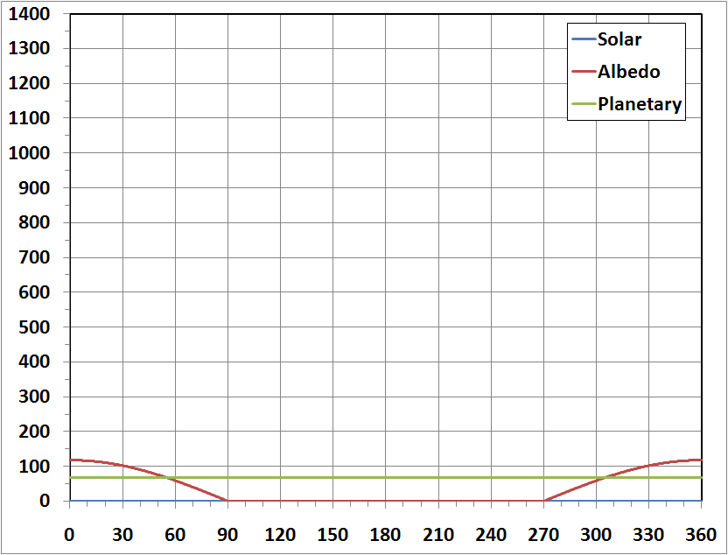
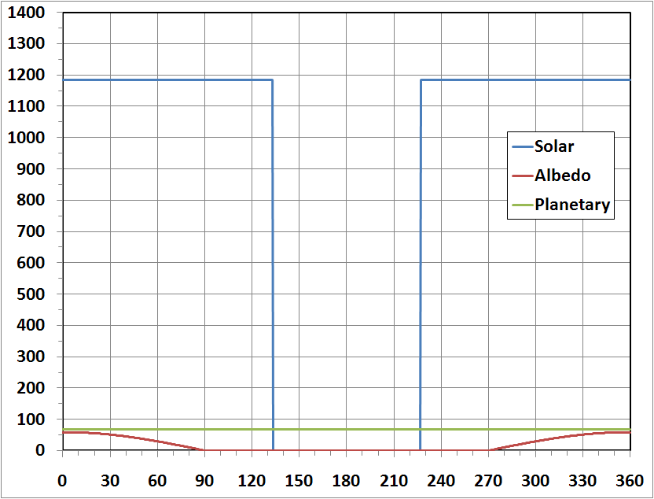
Example: Side 5 - North-Facing Surface
At β = 0°, surface is edge on to sun and solar flux is zero -- for negative β, solar flux is zero;
β = 0°
β = +60°
Incident Heating Flux (W/m²)
Incident Heating Flux (W/m²)
Orbit Angle from Solar Noon, θ (°)
Orbit Angle from Solar Noon, θ (°)

Slide 14
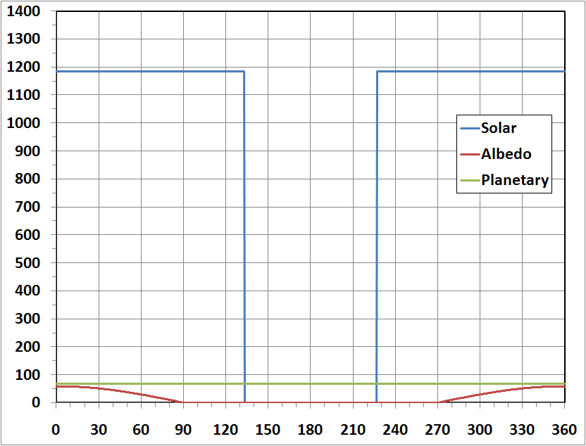
Example: Side 6 - South-Facing Surface
At β = 0°, the surface is edge on to sun and solar flux is zero -- for positive β, solar flux is zero;
β = 0°
β = -60°
Incident Heating Flux (W/m²)
Incident Heating Flux (W/m²)
Orbit Angle from Solar Noon, θ (°)
Orbit Angle from Solar Noon, θ (°)

Slide 15
Other Heating Environments

Slide 16
Other Heating Environments
We’ve focused our attention on solar, albedo and planetary heating and the consequences of beta angle.
We're going to turn briefly to other heating environments a spacecraft may experience:
free molecular heating;
charged particle heating.

Slide 17

Free Molecular Heating (Refs. 11 and 12)
We define the Stanton number, St to be:
where q_{w} is the convective heat flux, ρ_{e} is the flow density at the edge of the boundary layer, u_{e} is the flow velocity at the edge of the boundary layer, h_{aw} is the enthalpy at the wall assuming an adiabatic wall temperature and h_{w} is the enthalpy at the wall assuming the actual wall temperature.
.

Slide 18

Free Molecular Heating (Ref. 11)
St can be thought of is the efficiency of heat transfer from the flow field to a surface;
The numerator is the actual heating applied while the denominator is the total available convective energy;
From this definition, we see that:

Slide 19


Free Molecular Heating (Ref. 11)
We can rearrange our equation for St to solve for the surface convective heating flux:
We assume that:
This is true for a calorically perfect gas (i.e., C_{p} and C_{v} are functions of T only) and may be true for a thermally perfect gas (C_{p} and C_{v} are constant) assuming C_{p} is a function of T only.

Slide 20



Free Molecular Heating (Ref. 11)
From this, we can say that:
For a high energy flow field, it is reasonable to assume that:
and this implies:

Slide 21



Free Molecular Heating (Ref. 11)
With this information, we can further simplify our expression for the convective heating flux at the wall:
But, this equation can be simplified even further because if viscous effects are ignored:

Slide 22



Free Molecular Heating (Ref. 11)
Our expression becomes:
Also,
so...

Slide 23



Free Molecular Heating (Ref. 11)
By definition,
But for high velocity flows,
because

Slide 24


Free Molecular Heating (Ref. 11)
T∞ is typically low. The expression becomes:
For maximum heating, St = 1.0 and the expression becomes:
which is our desired result.

Slide 25


Free Molecular Heating and Density Dispersions
Ref. 12 describes a methodology to calculate free molecular heating using dispersed density, ρ_{disp}:
The dispersed density may be calculated from:
where K is a density dispersion factor, affected by numerous factors but most notably solar activity, and ρ₇₆ is the U.S. Standard 1976 density.

Slide 26
Free Molecular Heating and Density Dispersions
K factors were developed to disperse nominal densities for different altitudes and times in the solar cycle;
The strategy is to calculate a 3-sigma dispersed density. (Ref. 13)

Slide 27
Charged Particle Heating (Ref. 14)
Charged particle heating must be considered in the design of a system operating at cryogenic temperatures;
Focus is to calculate the energy dissipation of charged particles as they pass through an absorbing medium;
The volumetric heating created as a result through interaction with absorbing medium must be factored into the overall heat transfer calculation.

Slide 28
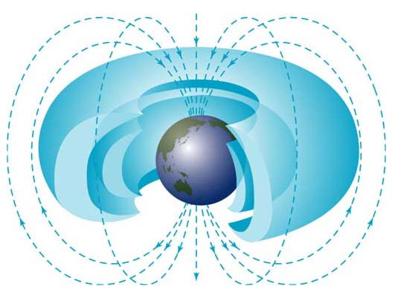
Charged Particle Heating (Ref. 15)
Van Allen Radiation Belts
(NASA Image)

Slide 29
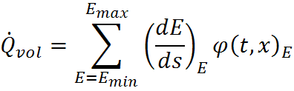


Charged Particle Heating (Ref. 13)
Volumetric heating may be calculated as follows:
Where...
is the "stopping power"
is the particle energy
is the penetration depth
is the particle flux.

Slide 30
Concluding Remarks
Overview of radiation heat transfer, the solar and infrared spectra;
Derived expressions for solar, albedo and planetary heating fluxes;
Derived an expression for the beta angle and investigated the effect beta has on orbit environment heating;
Explored free molecular heating and charged particle heating phenomena.

Slide 31
Acknowledgements
Special acknowledgement is given to JSC/Mr. Brian Anderson for his development and derivation of the free molecular heating lesson content.
This author is grateful to the NESC Passive Thermal Technical Discipline Team (TDT) for their contributions and technical review of this lesson.

Slide 32
References/Credits
1) Tipler, P. A., Modern Physics, New York, Worth Publishers, Inc., 1978.
2) National Renewable Energy Center, Renewable Resource Data Center, http://rredc.nrel.gov/solar/spectra/am0/wehrli1985.html.
3) Ungar, E. K., Slat Heater Boxes for Control of Thermal Environments in Thermal/Vacuum Testing, SAE 1999-01-2135, 1999.
4) National Space Science Data Center (NSSDC)
http://nssdc.gsfc.nasa.gov/planetary/factsheet/earthfact.html.
5) Ballinger, J. C., Elizalde, J. C., Garcia-Varela, R. M., and Christiansen, E. H.,
Environmental Control of Space Vehicles, Part II, Thermal Environment of Space, Convair, ERR-AN-016, 1960.
6) Anderson, B. J., Justus, C. G., Batts, G. W., Guidelines for the Selection of Near-Earth Thermal Environment Parameters for Spacecraft Design, NASA/TM-2001-211221, 2001.

Slide 33
References/Credits
7) The Earth Radiation Budget Experiment, http://asd-www.larc.nasa.gov/erbe/components2.gif.
8) The Earth Radiation Budget Experiment, http://asd-www.larc.nasa.gov/erbe/erbssat.gif.
9) Space Station Program Natural Environment Definition for Design, SSP 30425 Revision B, February 8, 1994.
10) Russian Segment Specification, International Space Station Program, SSP 41163G, October 9, 1999.
11) Anderson, B. P., fmh-derivation.pdf, March 31, 2011.
12) Heiser, W., Pratt, D., Hypersonic Airbreathing Propulsion, American Institute of Aeronautics and Astronautics, Washington, D.C., 1994.

Slide 34
References/Credits
13) Charles, T. L., Nitschke, M. D., Prediction of Three Sigma Maximum Dispersed Density for Aerospace Applications, Fifth Annual Thermal and Fluids Analysis Workshop, NASA Conference Publication 10122, August 16-20, 1993.
14) Jimenez, R., "Effects of Natural Environment Charged Particle Heating on the Design and Performance of Spacecraft Cryogenic Components", AIAA 89-1760, AIAA 24thThermophysics Conference, Buffalo, June 12-14, 1989.
15) Van Allen Belts, http://image.gsfc.nasa.gov/poetry/venus/a11789.html
Microsoft® Clip Art was used throughout the presentation.

Slide 35
For Additional Information
Natural and Induced Thermal Environments
Musgrave, G.E., Larsen, A., Sgobba, T., Safety Design for Space Systems, Butterworth-Heinemann, 2009. [Section 2.6, Natural and Induced Thermal Environments by Rickman, S.L.]
Orbit Mechanics
Bate, R.R., Mueller, D.D., White, J.E., Fundamentals of Astrodynamics, 1st Edition, New York, Dover, 1971.
Thermal Environments
Gilmore, D. G., Spacecraft Thermal Control Handbook, Volume I: Fundamental Technologies, American Institute of Aeronautics and Astronautics, 2nd Edition, 2002.
Eclipse Entry and Exit Angles for Elliptical Orbits
Mullins, L.D., “Calculating Satellite Umbra/Penumbra Entry and Exit Positions and
Times,” The Journal of Astronautical Sciences, 39 [4], 411-422, 1991.
Orbital Average Thermal Environments
Rickman, S.L., "A Simplified, Closed-Form Method for Screening Orbital Heating Variations", Thermal and Fluids Analysis Workshop (TFAWS) 2002, August 16-20, 2002.

