Slide 1
Neil Dennehy
NASA Technical Fellow for Guidance Navigation & Control cornelius.j.dennehy@nasa.gov
Welcome…
X-15 Flight 3-65-97 Accident Analysis:
A Fresh Look at the Role of the MH-96
“Self-Adaptive” Flight Control System
Presented by: Dr. Jeb Orr
The Charles Stark Draper Laboratory, Inc.

Slide 2
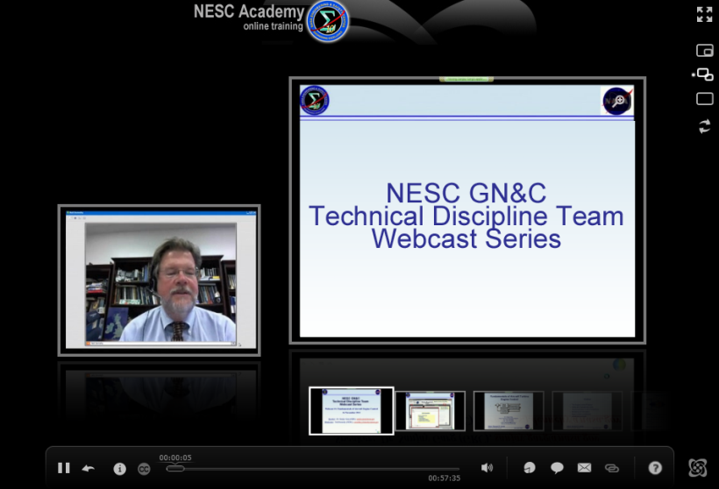



Slide 3
X-15 Flight 3-65-97 Accident Analysis:
A Fresh Look At The Role of the MH-96 “Self-Adaptive” Flight Control System
Jeb S. Orr, Ph.D.
The Charles Stark Draper Laboratory, Inc.
jeb.orr@nasa.gov

Slide 4
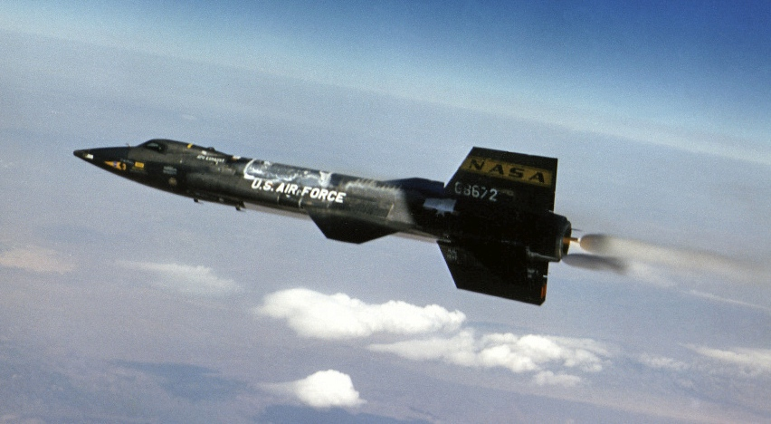
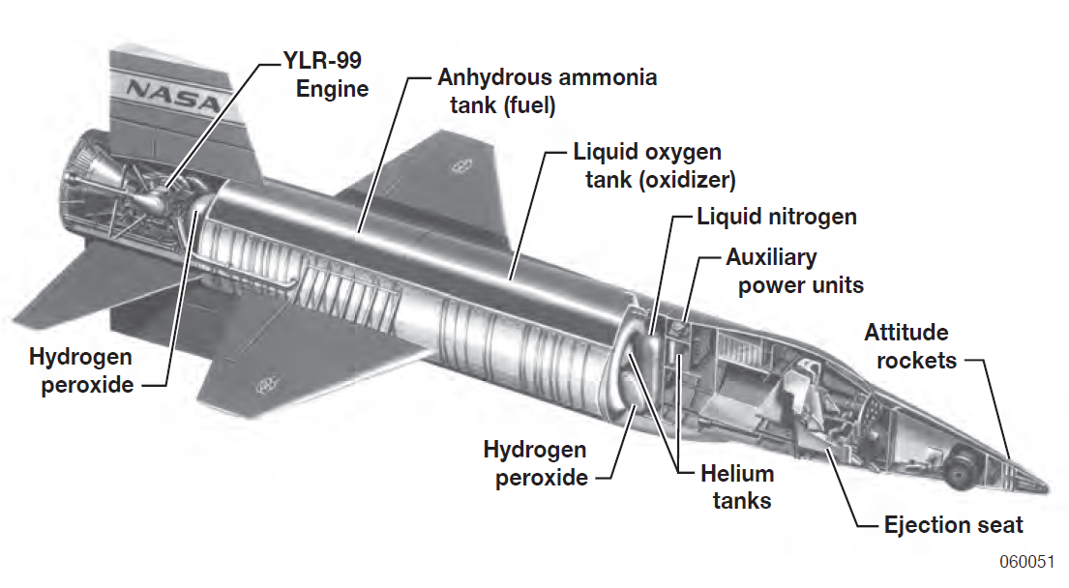
The X-15 Research Aircraft
The X-15 research airplane was a manned hypersonic vehicle developed by NASA/USAF/USN and operated by NASA from 1959-1968
  Designed as a platform for high-speed, high-altitude research
  Suborbital, ballistic flight to 350,000 ft, Mach 6.7; the first reusable space plane
  Supported development of numerous new technologies, including propulsion, instrumentation, structures, TPS, and flight controls
X-15 program conducted 199 research flights over 10 years
  Four major accidents, 1 fatal
X-15 56-6672 in flight
X-15 internal layout

Slide 5

1967 Accident
X-15-3 (56-6672) suffered a fatal accident on November 15, 1967
  Maj. Michael J. Adams, USAF
  Loss of control caused in-flight breakup of airframe
  Partly due to failure (LCO) in MH-96 “self-adaptive” control system
  A joint NASA/USAF IB documented the accident in early 1968; however, IB report has some shortcomings
  Causes of the accident not well-understood in the community and not accurately reported in the open literature
NASA engaged in a research effort to thoroughly understand the causes of the accident, especially as they relate to the flight control system
The support of Mr. Neil Dennehy (NESC), Dr. Immanuel Barshi (NASA ARC), Dr. Irv Statler (NASA ARC), Eamonn Moyer (MSFC Summer Intern) and Lauren Massey (MSFC Summer Intern) is gratefully acknowledged
Maj. Michael J. Adams, USAF

Slide 6
Flight 3-65-97 Accident Summary (I)
“Routine” altitude flight, 65th flight of X-15-3 and 191st flight of program
Planned 250kft altitude and 5100 fps
Pilot’s 7th X-15 flight and 3rd flight in #3 airframe (relatively new X-15 pilot)
Required tracking task using Precision Attitude Indicator (PAI) near peak altitude (high gain task)
Launch 10:30:07 PST, power-on sideslip during boost to β=5 deg (TV misalignment)
Poor radio communications (typical)
Electrical disturbance from on-board shock geometry experiment begins 10:31:28
  Causes malfunction of IFDS (inertial computer), MH-96 gain changer electronics
  Pilot notes IFDS malfunction and attempts reset; unable to reset; acknowledged by ground controllers
  Ground notes control anomaly, does not advise pilot or terminate science
  Instrumentation, flight control servos, and RCS electronics malfunction

Slide 7
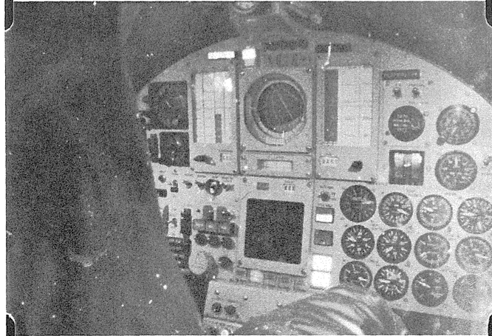
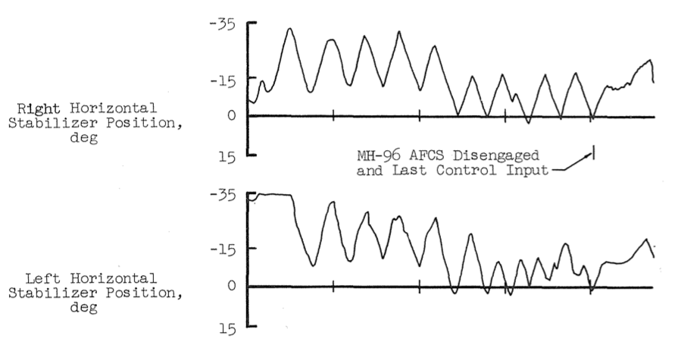
Flight 3-65-97 Accident Summary (II)
Pilot attempts to execute planned wing-rock maneuver and aircraft exhibits poor control response
Aircraft starts slow yaw drift to right; pilot exhibits apparent mode confusion (roll vs. yaw instrument)
Aircraft rates increasing; pilot attempts control using manual RCS override (left-hand stick) at 10:33:05
Aircraft enters hypersonic spin at ~10:33:32; pilot reports, “I’m in a spin” at 10:34:02
Spin recovery by 10:34:38 into inverted dive; FCS resets at least twice (gyro rate reset & electrical faults)
FCS begins large-amplitude pitch LCO, M=4.5, q=140 psf
LCO prevents pitch recovery; ±15g Nz, qβ exceeded, breakup at 62kft, q=1300 psf, MET +00:04:47
Last Full Cockpit Frame
Master caution illuminated
Limit Cycle Oscillation (LCO) Before Breakup
ADI depicts inverted dive
ADI in PAI mode
MH-96 still engaged
RCS set to AUTO

Slide 8
What happened?
At >90,000 feet altitude (prior to engine shutdown), traverse probe experiment in starboard wing pod exhibited low-pressure gas dielectric breakdown and introduced +300V spikes in at least one aircraft AC power bus
  Behavior was reproduced after the accident using reconstructed hardware
  Experiment builders used an off-the-shelf motor not knowing it contained a step-up transformer yielding potentials of 630V peak @ 400 Hz over a 0.25” gap
  Minimum (Paschen) breakdown voltage at X-15 altitudes is only 230V @ 400 Hz
  Traverse probe had been flown twice before on airframes #1 and #2, but on lower-altitude flights and was assumed “qualified”
  Altitude testing was not performed
Power irregularity caused numerous system anomalies:
  TM noise & communications system interference
  ALERT (boost guidance) computer failure
  Servo transients (known problem!)
  Servo rate monitor disconnects (tripped MH-96 hardover monitors)
  Gain changer electronics malfunction (gain-down behavior and reduction in gain-up rate)
  IFDS computer resets and gross error in inertial estimates of altitude, altitude rate, velocity, angle of attack, and sideslip
    IFDS computer was known to have a susceptibility to EMI

Slide 9
What happened?
RCS rate damping and access to the RCS from the RH controller became intermittent
  A combination of servo transients and noise caused the MH-96 gain changer to falsely detect a high dynamic pressure condition, and gains were repeatedly reset to their minimum values
  When FCS disengages (damper resets) occurred, the system was also designed to set gains to minimum to mitigate transients (false positives on failure detect circuits)
  Each time the gain was reset, the RCS was disengaged with no indication given to the pilot
Ground control recognized but did not inform the pilot the subsystem anomalies and furthermore advised the pilot that he was “on heading” meaning on track (no heading information was available to the controller)
Ground control advised the pilot to switch to a known erroneous source of sideslip information
The pilot was coming “over the top” in a high stress/workload situation, possibly spatially disoriented
The pilot recognized a control problem with the auto RCS and switched to manual control using the left stick
  The pilot did not disable the automatic system, as per procedure
The pilot experienced apparent mode confusion and attention tunneling caused by a poor ADI design
  Having switched the vertical ADI needle from yaw to roll mode, the pilot made control inputs consistent with having interpreted the roll needle as yaw
  These inputs exacerbated the sideslip deviation
  Two other instruments in the vicinity of the ADI were correctly displaying off-scale aircraft nose right

Slide 10
What happened?
Upon recognition that the aircraft rates were increasing, the pilot attempted to arrest the rates but the aircraft entered a hypersonic spin
The pilot and/or aerodynamic stability of the aircraft recovered the spin into an inverted dive at 100kft
The electrical disturbance ceased, probably due to severing of 2A line fuses supplying the traverse probe motor
The combination of high gain, large inputs, and violent dynamics introduced a rate-limit instability (large amplitude LCO) into the pitch SAS-servo-power actuator inner loop
  The rate-saturated control surface oscillations prevented recovery of the aircraft attitude in pitch or roll
Aircraft structural limits were exceeded as dynamic pressure increased on entry
Pilot did not successfully eject

Slide 11
X-15-3 Flight Control
Vertical stabilizer with all-moving rudder; all-moving horizontal tail; wing flaps; speedbrakes
Ventral fin used for engine TV misalignment mitigation but removed in 1963 (also eliminated unstable entry lateral-directional mode)
Hydraulically actuated surfaces with mechanically interlinked pilot power-assist
Differential stabilators for roll control
2 sets of 110 lbf RCS (“BCS”) monopropellant jets

Slide 12
X-15-3 Adaptive Flight Control System
Airframe #1 and #2 used a conventional fixed-gain (pilot-selectable) 3-axis SAS
Airframe #3 used an experimental adaptive FCS, the Honeywell-developed MH-96
MH-96 design goals:
  Provide automatic blending of RCS and aerosurfaces during exit and entry
  Provide invariant response at all flight conditions without air data or gain scheduling
  Overcome limitations of predicting aerodynamic parameters
The MH-96 was a relatively advanced form of forward gain adaptive control
  Modulate the loop gain of the otherwise fixed-structure SAS inner loop to maximize performance while maintaining stability
  Maintain a limit cycle of a prescribed amplitude in the loop at the maximum forward gain

Slide 13
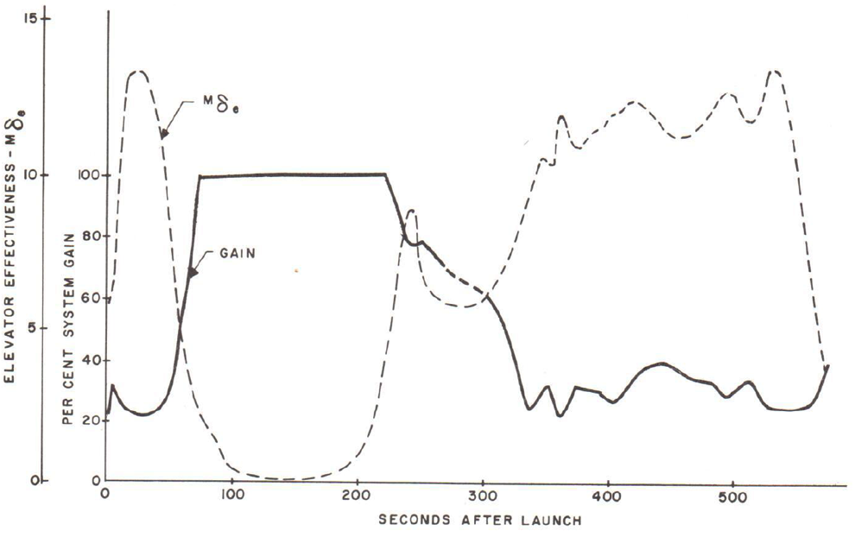
MH-96 Design
Small amplitude servoactuator LCO was recognized to be nearly invariant with respect to flight condition (typ. 2-4 Hz)
  Loop shape could be maintained with filters for nearly constant phase margin
  Adaptive law modulates the inner loop gain to maintain an LCO set point amplitude
  Adaptive gain provides invariant response as the effective loop gain varies with Mach number, dynamic pressure, etc.
  “Model” is a 1st-order LPF
  Other than filters, inner loop of SAS is identical to fixed-gain system

Slide 14
X-15 RCS and the MH-96
Dual-string monopropellant 3-axis RCS system (110 lbf jets)
#1 and #2 airframes had an auto RCS system (reaction augmentation system or RAS)
  Rate damping mode only (single-string jets)
  Engaged/disengaged manually by the pilot during the ballistic phase
  Controlled by LH stick (dual-string jets) – pilot could override auto system
The MH-96 added two major features
  Hold modes (based on IMU attitude reference and/or alpha/beta reference)
  Automatic engage/disengage of the RCS (“R/C AUTO”) based on adaptive gain level with control through the RH stick
The “R/C AUTO” mode was well-liked; it increased attitude control accuracy, reduced propellant expenditure, and decreased pilot workload
X-15-3 was used primarily for altitude flights due to increased reliability and decreased pilot workload associated with the MH-96

Slide 15
MH-96 Design Issues (Human Factors)
Pilot display of MH-96 behavior was substantially absent from the design
  No indication of “R/C AUTO” engage/disengage provided to the pilot
  Initial location of MH-96 status panel could not be seen by the pilot with head restraint
  Mechanical interlink with the pilot was problematic
Multiple features developed and tested for forward legacy to future missions (e.g. X-20) that were unused by X-15 pilots but remained in the design (multiple hold modes, display modes)
Markedly complex human interface to the flight control system
  Partly driven by putting the MH-96 “on top of” an existing manual-hydraulic SAS/FCS
Design was such that a malfunction could prevent access to a critical control function without the pilot’s knowledge

Slide 16
MH-96 Design Issues (Flight Control)
Actual hysteresis effects exceeded those provided to Honeywell for design
  Lowered LCO frequency and allowed brief periods of supercritical operation
Coupling from RCS firings and pilot inputs reduced the gain, causing RCS disengages
  This led to the inclusion of the wide hysteresis band on the engage logic
Unexplained servo transient anomalies appeared in flight, probably due to EMI
  This was never resolved as it was considered a benign behavior
  Caused channel tripouts due to false positive detection in failure monitor circuits
  In both cases, system was designed to delay “up” adaptation to suppress transients
The MH-96 inner loop had a latent design error resulting in an unstable large-amplitude LCO
  This LCO destroyed the aircraft on flight 3-65
  The causes have apparently never been fully understood

Slide 17
MH-96 Large Amplitude LCO (I)
In May 1960 a severe high-frequency SAS LCO was discovered on airframe #2
  12-13 Hz oscillation involving servoelastic coupling of the stabilators (TWD effect)
  NASA FRC maintained the SAS for the fixed-gain airframes
  FRC redesigned the fixed-gain SAS filters to mitigate the LCO and successfully installed and verified the filter change using the HWIL sim and flight tests
  No further problems with the 13 Hz LCO were seen on airframe #1 and #2
MH-96 still in development at this time
  FRC sent a basic model of the structural dynamics to Honeywell for evaluation
  Honeywell concluded that a redesign of their inner loop would also be required and created their own notch filter to mitigate the issue
  The first flight of the MH-96 was scheduled for December 1961 and the FCS was in the final hardware qualification stages
  A filter modification was rushed for inclusion in the MH-96 design (hardware filters)
FRC used a nonlinear model of the actuator, Honeywell did not
  Honeywell did not evaluate the nonlinear effects or fully regression test the modification

Slide 18
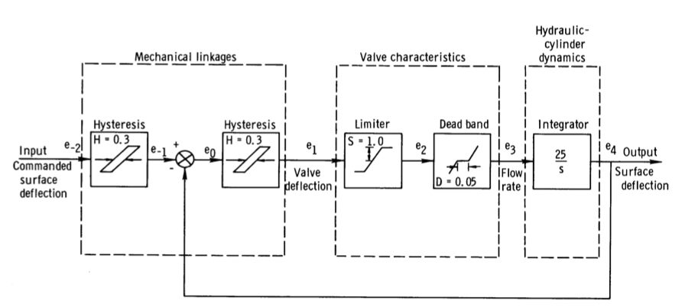
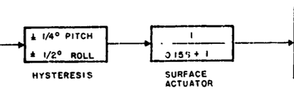
MH-96 Large Amplitude LCO (II)
NASA FRC Model of Power Actuator (excluding servo)
Linear Versus NL Model (rate saturated, 15 deg input)
Honeywell Model
Rate and servo saturation causes a substantial change in the ideal frequency response characteristics of an actuator

Slide 19
MH-96 Large Amplitude LCO (III)
Result: the SAS inner loop of the MH-96 was unstable under saturation at certain flight conditions
  Resulted from coupling of the airframe short period pitch mode (~0.5 Hz) with the actuator dynamics when the actuators were rate saturated (a classic case in PIO)
  Although FRC had demonstrated the analysis process for predicting this type of LCO on the other aircraft, they did not analyze the MH-96 inner loop because it was not “owned” by FRC
  FRC was aware of this problem, having discovered it in simulation as early as 1962 and in-flight in 1965, but seldom saw it in actual mission simulation
    HWIL simulator was not usually run at full flight hydraulic pressures
Unlike previously thought, the inner-loop unstable design is not directly related to the adaptation mechanism
  Adaptation exacerbated the onset of the problem by amplifying the forward gain, tending to allow large pilot inputs to saturate the actuator in rate
  The same LCO would have resulted on the fixed-gain airplane had the same filter been used, or if adaptation was disabled (verified through analysis and simulation)
  The AIB deemed that no further analysis was necessary since the MH-96 had been destroyed

Slide 20
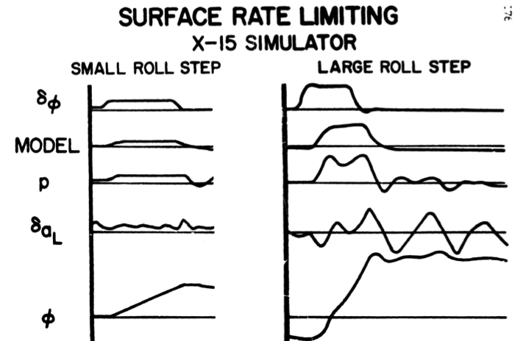
Flight and Historical Simulation Data
Based upon available technical reports, the MH-96 large-amplitude LCO phenomenon was known by the end of 1962 and occurred in flight in 1965 (flight 3-39)
  “When a large … command is made, rate limiting occurs and causes [a] greatly deteriorated response… nonlinearities in system components cannot be ignored in high-gain control systems.”
  Honeywell was consulted after 3-39 and recommended avoiding the problematic flight conditions and to “brief pilots on the potential consequences of abrupt control motions…” [AIB]
L. Taylor report/conference paper (1962)
1967 Accident

Slide 21
MH-96 Simulation
Nonlinear time-domain simulation of airframe + actuator + MH-96 confirms prediction of LCO
  LCO initiated by large stick input (cause rate saturation) at critical flight condition
Articles in the open literature (IEEE Control Sys. Magazine) erroneously report that the adaptation is the cause of the failure
  Discussions with authors reveal that these simulations did not use a rate-limited actuator or a servo model
Adaptive ON, increasing qbar
Adaptive OFF, fixed qbar

Slide 22
MH-96 Large Amplitude LCO (IV)
A well-known modern extension to DF analysis, called Exact Sinusoidal Inverse Describing Function (SIDF) analysis, can be used to predict instability due to rate limited actuators
  Numerical computation of Fourier coefficients associated with DF
  Multi-variable problem
Possible two-stage instability
  Initial power actuator LCO ~1.8 Hz
  Pitch limit cycle ~0.58 Hz
Coincidentally, the benchmark case for SIDF analysis is the X-15-1 landing PIO
  Same actuator, similar problem
  See Klyde et. al, JGCD

Slide 23
Preliminary Summary Recommendations (I)
Actuator nonlinearity.
  Explicitly account for saturation, rate limiting, and other nonlinear behavior in design.
  Exercise regions outside of the expected flight envelope to include cases that induce these behaviors.
Modifications to fielded systems.
  Modifications should be reconciled with the original design methodology.
  Deficient or poorly flight-correlated results should be resolved and documented.
Arc discharge.
  Arc discharge may be more relevant for ballistic spaceplanes than other systems.
  Scrutinize any systems with component voltages above ~60 V, and assess risk.
  Testing is mandatory in flight-like pressure, thermal, and radiation environments.
  Departures from the ideal theory, including frequency, wave shape, gas composition and temperature, external radiation, electrode composition, and electrode geometry, should be considered in the evaluation of the design.
  Applicable standards and handbooks should be utilized (e.g. NASA-HDBK-4002A).

Slide 24
Preliminary Summary Recommendations (II)
Flight anomalies.
  Seemingly benign anomalies may point to major design flaws.
  Low-level engineers must be engaged and have a medium to report concerns.
  Flight operations should not continue based on rationale that “it didn’t break last time.”
Availability of safety-critical information to ground control.
  For flights involving any experimental systems, all information affecting safety-critical systems and flight dynamics parameters should be available to ground control.
Mission operations procedures.
  Prevent the formation of an “operational” and “routine” culture.
  Flight controllers must be trained that there are no negative consequences to discontinuing a mission if a threat to safety of flight is suspected.
Design of pilot-aircraft interface, training procedures, simulations
  Instrument modes and FCS automation must be communicated to the pilot.
  Train what you fly, fly what you trained.
  Design the interface for average humans, even if it will be operated by astronauts.

Slide 25
Selected References
D. Jenkins, X-15: Extending the Frontiers of Flight. No. SP-2007-9-001-HQ, NASA, 2007.
M. Thompson and J. Welsh, “Flight Test Experience With Adaptive Control Systems,” tech. rep., NASA Flight Research Center, 1970.
“Investigation of the Crash of The X-15-3 Aircraft on November 15, 1967,” NASA/USAF Accident Investigation Board Final Report, January 1968.
L. Taylor and J. Smith,“An Analysis of the Limit-Cycle and Structural-Resonance Characteristics of the X-15 Stability Augmentation System,”Tech. Rep. TN D-4287, NASA Flight Research Center, December 1967.
D. Klyde, D. McRuer, and T. Myers, “Pilot-Induced Oscillation Analysis and Prediction with Actuator Rate Limiting,” Journal of Guidance, Control, and Dynamics, vol. 20, no. 1, pp. 81-89, 1996.

Slide 26
Questions ???

Slide 27
Upcoming NESC GN&C Webcast
Implementation Challenges for Multivariable Control: What You Did Not Learn in School
Dr. Sanjay Garg
Wednesday, June 18th
2PM EDT

Slide 28
BACKUP

Slide 29
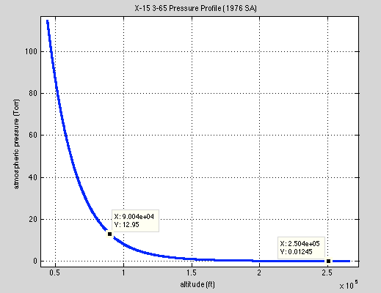
Dielectric Breakdown Phenomena
Low pressure dialectric breakdown can readily occur in suborbital flight conditions
The X-15 traverse probe motor voltage exceeded the predicted breakdown voltage by ~2X
Approximate motor voltage
X-15 Coast Flight Regime
90kft altitude
1cm gap
Breakdown voltage (~230 V)
90 kft
250 kft
*Data is for 300K, not ambient temp at altitude
*Data is for parallel plates; high, non-uniform field intensities (pointed electrodes) will yield lower breakdown voltages

Slide 30
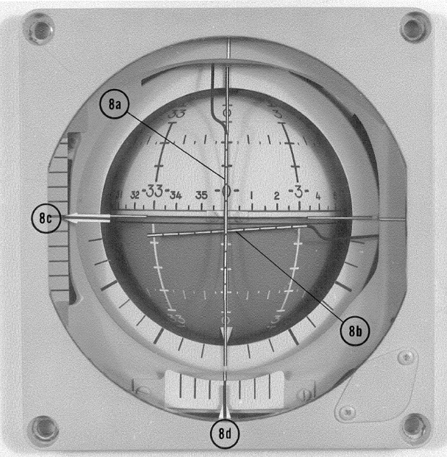
Pilot Performance (I)
Pilot performance during the flight was consistent with Maj. Adams’s experience as a research pilot and his exceptional qualifications (1st in class USAF ETPS, 1963)
The pilot exhibited signs of negative transfer, attentional tunneling, and reversion to basic training in the high stress, task saturated environment
  The pilot was presented with multiple failed instruments, none of which he had any reason to believe
  The ground exacerbated the situation
The pilot mistakenly flew the roll needle as yaw, despite having three working instruments in the same field of view (ADI ball, beta indicator*, heading indicator)
  Lack of mode indication on the ADI instrument
Maj. Adams did not disengage the AFCS as per procedure when transitioning to the LH stick
  Verification of MH-96 disconnect was part of the in-flight analyzer check
    May have been skipped; no mention on transcript
PAI needle
ADI ball
Heading indicator

Slide 31
Pilot Performance (II)
The AIB (and subsequent analyses) have speculated that the pilot experienced spatial disorientation (then called “pilot vertigo”) based upon the pilot’s history of “labyrinth sensitivity”
  Somatogravic/oculoagravic illusions during 3.5g boost
  Maj. Adams had previously commented on persistent Type II SD
  There is no conclusive evidence supporting the hypothesis that Maj. Adams was disoriented at least until he came over the top
  His performance is consistent with belief that aircraft was OK and generally at the correct attitude
AIB suggested that the pilot could recognize the adverse yaw rate visually
  During critical period, aircraft was pitch up; only black sky visible
  Pilot unlikely to detect ~1 dps yaw rate at 250,000 feet by visual reference to the horizon*
The pilot was task saturated and dealing with a severely malfunctioning and unresponsive aircraft
The pilot was aware that only 60-90 seconds were available to resolve the problem

Slide 32
Pilot Training and Other Hypotheses
A review of Maj. Adams training records revealed that less than 20% of his logged simulator time was spent in the #3 aircraft configuration
  The potential for negative transfer exists given the substantial differences in the #3 aircraft versus the #1 / #2 aircraft (no MH-96, different panel and instrumentation)
There is some speculation that an O2 regulator or supply failure may have caused hypoxia and degraded the pilot’s performance
  O2 system was mostly destroyed on impact
  AIB flight surgeon deemed the analysis inconclusive
Aircraft | Hours of Training | Percentage
X – 15 – 1 | 165.2 | ~ 69%
X – 15 – 2 / X – 15A – 2 | 25.5 | ~ 11%
X – 15 – 3 | 47.5 | ~ 20%

Slide 33
Backup: MH-96 Architecture
Architecture designed to provide fail-safety & redundancy for critical entry phase
  Independent dual-string architecture: two sets gain changer electronics, gyros, stick force transducers, accelerometers, etc.
  Total gain was sum of both channels at the servo
  System could down-mode to fixed-gain operation on pilot request
  At time of design, airframe was unstable during entry and drove 99%+ reliability
  Design complied with applicable MIL-STDs for airborne electronics (in 1960)
Monitor circuits included to detect and isolate failures
  Servo outputs compared to analog model and disconnected if spurious motion detected (difference in sign of surface rate)
  Gyro monitor disconnected rate gyro channel if rate exceeded 30 deg/sec
Mechanical override
  MH-96 was not fly-by-wire (this would come later with the F-8 DFBW)
  MH-96 servos were in parallel to the mechanical links to the power actuators
  Pilot brute force could override servo motion and trim actuator motion

Slide 34
Aircraft Configuration
Three airframes in service (56-6670 – 56-6672), 56-6672 (#3) involved in 1967 accident
Aircraft varied substantially over course of program
  Changes in instrumentation, display panels, avionics, experiments, etc.
X-15-3 (56-6672)
  High-altitude (ballistic) workhorse (others used for high-speed flights)
  MH-96 “Self-Adaptive” flight control system (AFCS) provided automatic RCS blending and invariant aircraft response
  Successfully executed 60+ high-altitude flights prior to the 1967 accident
  Configuration at time of accident flight will be discussed

Slide 35
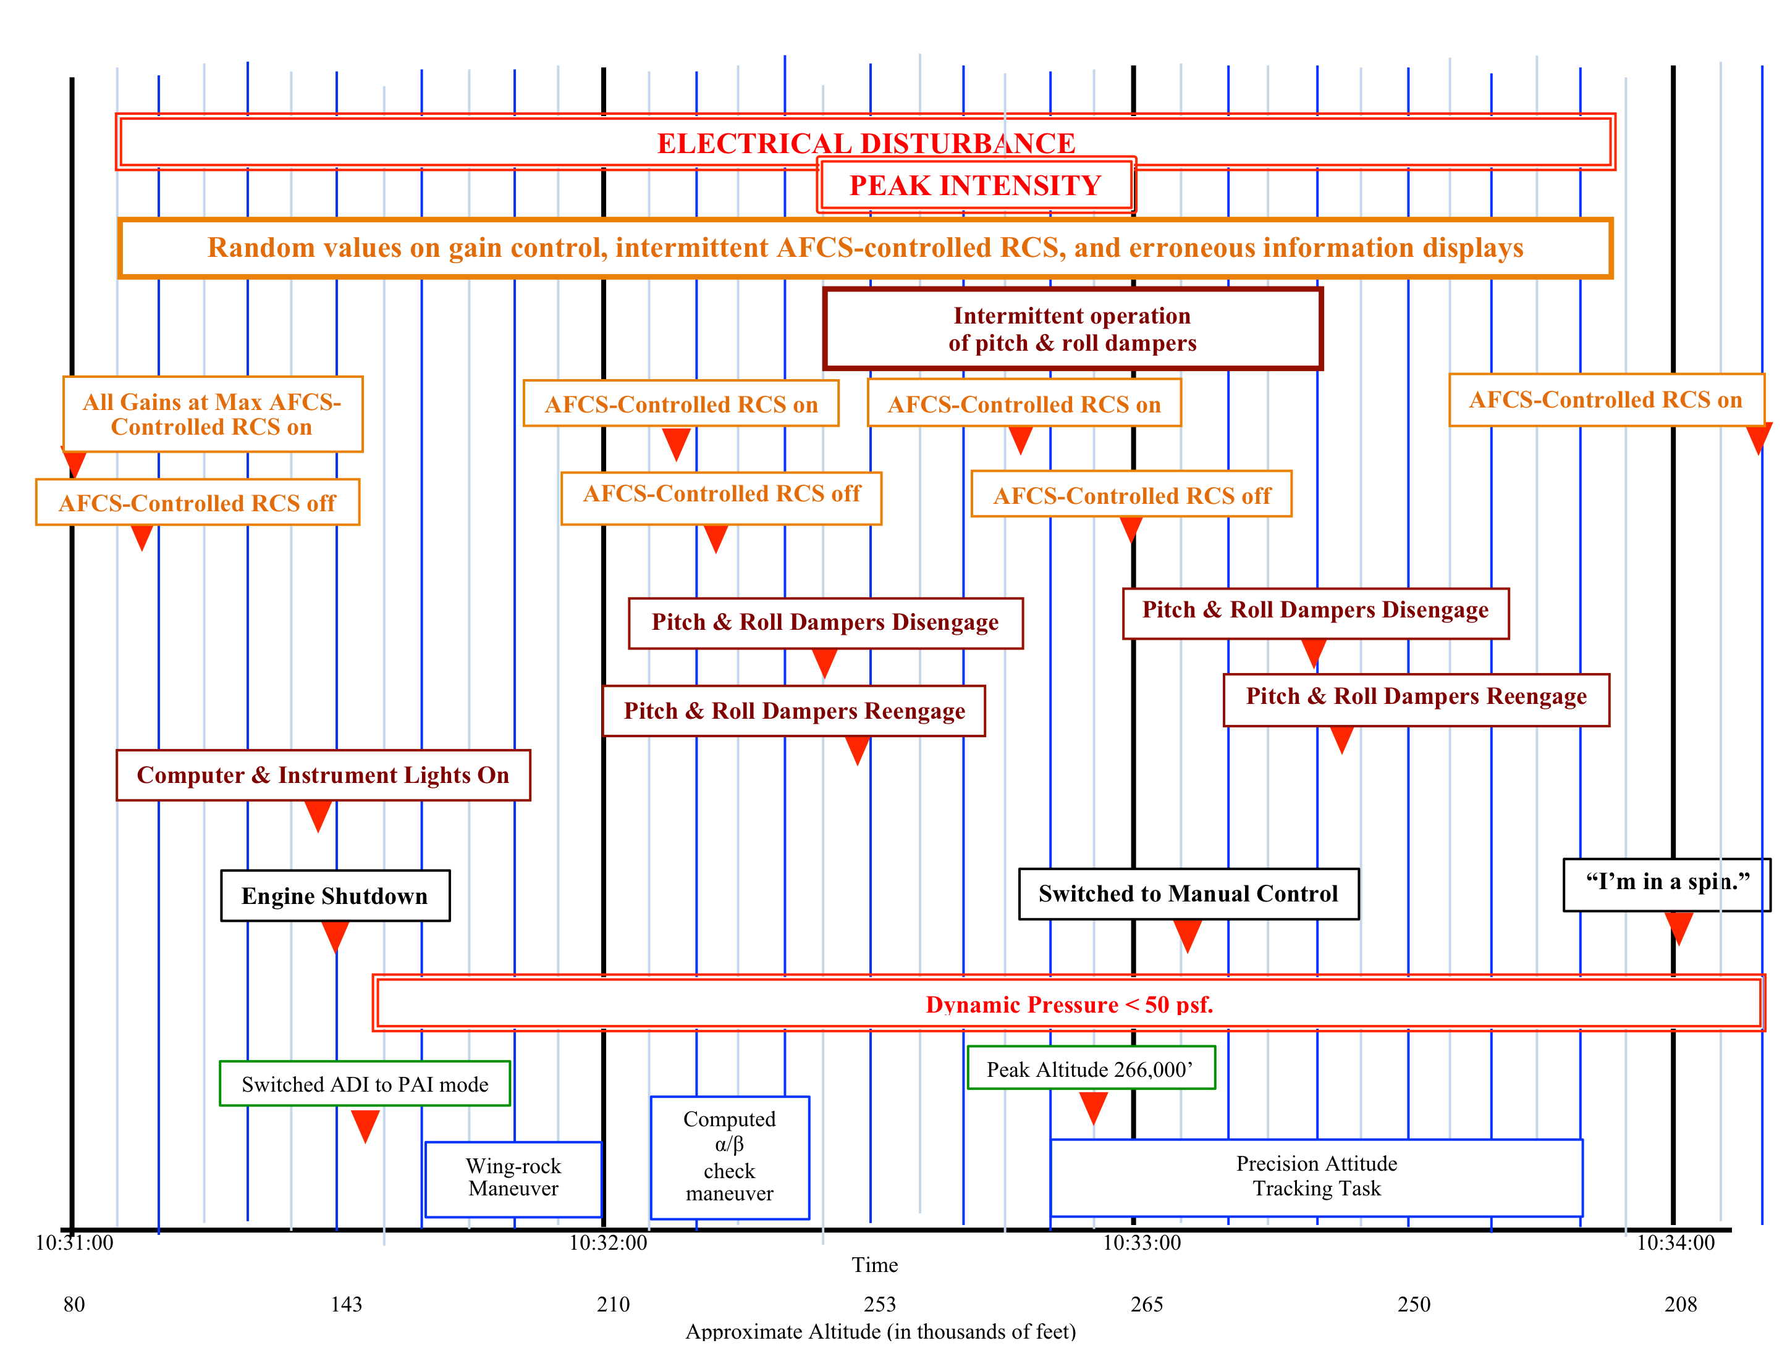
Flight 3-65-97 Event Timeline
Approximately 3 minutes

Slide 36
Backup: Flight Instrumentation on X-15-3
(excluding research instrumentation)
3-axis IMU and Inertial Flight Data System (IFDS)
  Used to provide pilot estimates of altitude, altitude rate, velocity
  IFDS computed inertial solution; IMU drove ADI ball directly
  IFDS computer had documented susceptibility to EMI
Flight control rate gyros
  Two independent, redundant rate gyro assemblies (unique to X-15-3)
  Strapdown (body rate), used for stability augmentation only
  Failure monitor circuit zeroed gyro if rates exceeded 30 deg/sec; no pilot indication
Hypersonic flow direction sensor (ball nose)
  Null-seeking spherical flow sensor
  Provided reliable α, β, q to ~50 psf; still usable below 50 psf but with jet interaction effects
Flight control accelerometers
  Strapdown package for Nz, Ny feedback
  Nz feedback used for entry g-limiting

Slide 37
Spatial Disorentiation
TYPES OF SPATIAL DISORIENTATION
  TYPE I (UNRECOGNIZED)
    9-3. In type I SD, an aviator does not perceive any indication of SD or think anything is wrong. What the aviator sees—or thinks he or she sees—is corroborated by other senses. The pilot might see the instruments functioning properly and have no suspicion of instrument malfunction. Likewise, the aircraft might be performing normally with no indication of aircraft control malfunction. Unaware of a problem, the pilot fails to recognize or correct the SD, a mistake that usually results in a fatal aircraft mishap. Type I SD is the most dangerous type of disorientation. An example is the height/depth perception illusion, where a pilot descends into the ground or some obstacle above the ground due to a lack of situational awareness.
  TYPE II (RECOGNIZED)
    9-4. In type II SD, the pilot perceives a problem resulting from SD but might not recognize it as SD. The pilot might feel a control is malfunctioning or perceive an instrument failure as in the graveyard spiral, a classic example of type II SD. The pilot will not correct aircraft roll as indicated by the attitude indicator because his or her vestibular indications of straight-and-level flight are so strong.
  TYPE III (INCAPACITATING)
    9-5. In type III SD, the pilot experiences such an overwhelming sensation of movement that he or she cannot orient using visual cues or the aircraft instruments. Type III SD is not fatal if the copilot can gain control of the aircraft.
    US Army Training Circular No. 3-04.93 (FM 3-04.301) “Aeromedical Training for Flight Personnel”

Slide 38
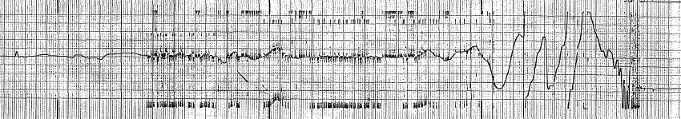
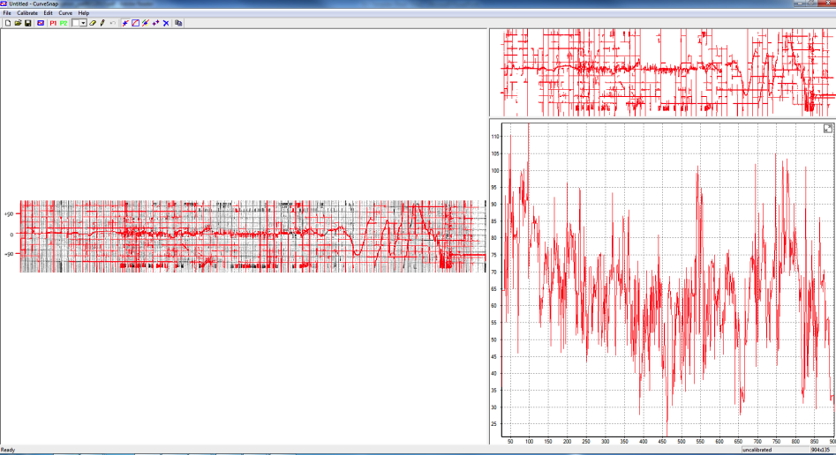
Backup: Flight Data (Reconstructed)
Flight data reconstructed from original strip chart recordings
Some parameters (Mach, qbar) were not extracted with sufficient fidelity and are reproduced from trajectory data and the 1976 standard atmosphere
Most raw data digitization completed by L. Massey (2013 Fall Intern, MSFC)
Additional estimation and time-correlation by E. Moyer (2013 Fall Graduate Intern, MSFC)
Data interpolated and uniformly sampled at 10 Hz
Noise filtering 2th order LPF (fc = 1 Hz), forward-backward filtered
*MET referenced to ignition

Slide 39
Backup: Reconstructed Flight Data
Reconstructed data from TM’d stripchart recording of IMU resolver angles
AIB post-correlated IMU data to recovered video footage of sun angle from onboard cameras
MET referenced to ignition
Spin entry at ~10:33:22 based on cockpit sun angle
360 deg wrapping of yaw data is attenuated due to filtering effects
Pilot recognition of failure until aircraft demise: ~45 sec
LCO stops
Wing rock
Inverted attitude
LCO starts
Ignition
LoV
Spin recovery
Spin begins
Heading deviation

Slide 40
Backup: Flight Data

Slide 41
Backup: Flight Data

Slide 42
Backup: Flight Data

Slide 43
Backup: Flight Data

Slide 44
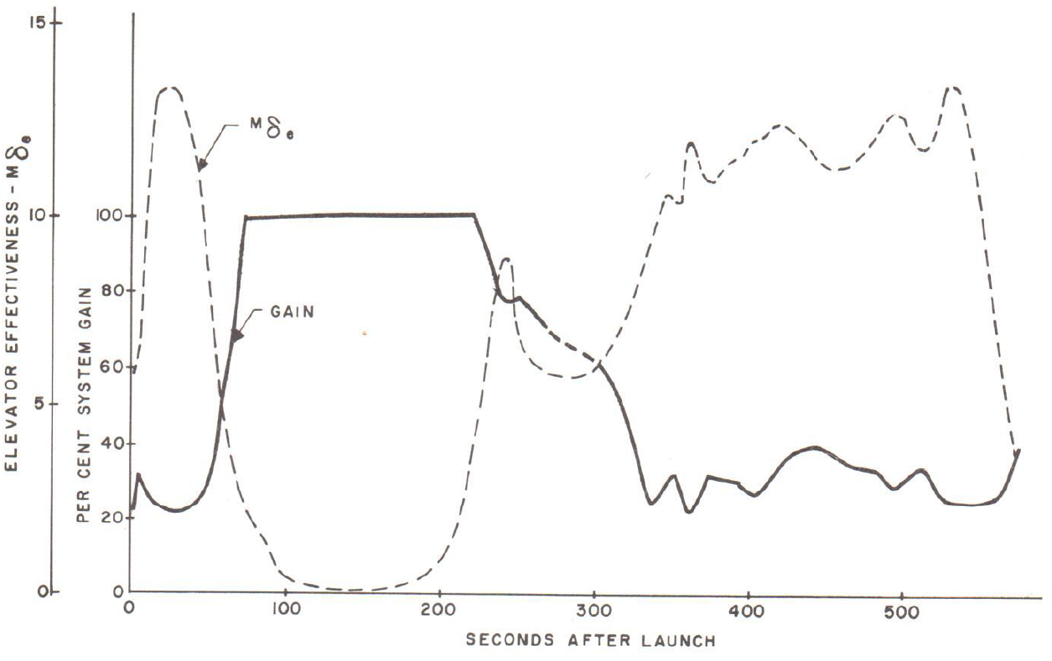
Backup: MH-96 Simulation
MH-96 model reproduces flight adaptation behavior for nominal and off-nominal qbar profiles
Typical entry (flight data)
Normal adaptation response

Slide 45

Backup: X-15 Simulation Facility

Slide 46
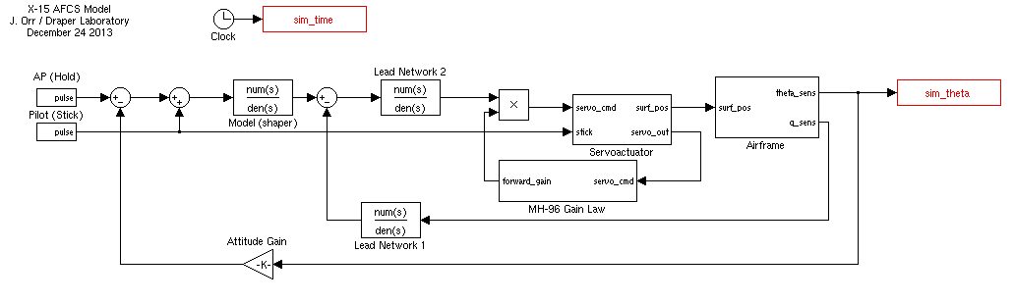
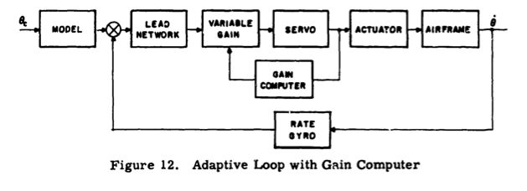
Backup: X-15 AFCS Simulink Model (Base)

Slide 47
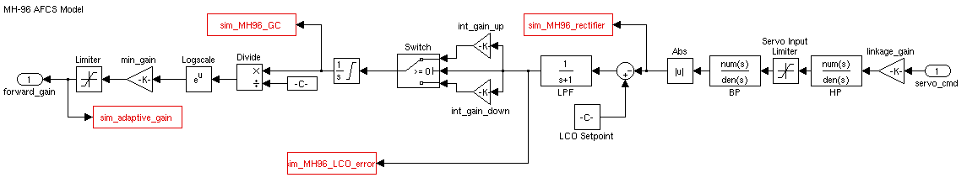
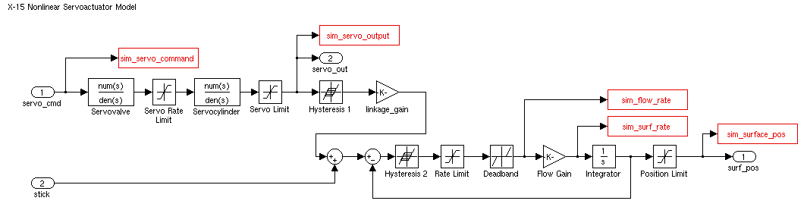
Backup: X-15 AFCS Simulink Model (MH-96/Servo)

Slide 48
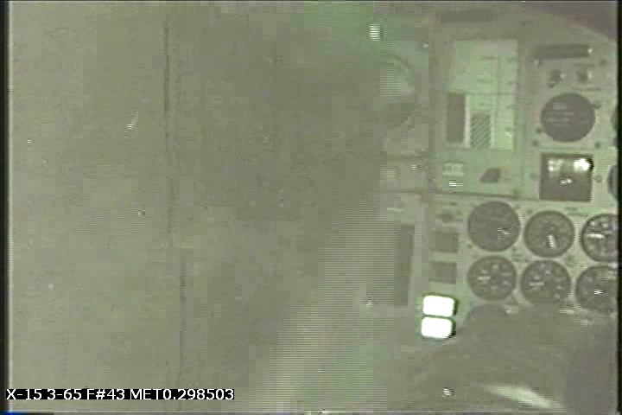
Cockpit Video (Retimed)
Ignition
chamber pressure

Slide 49
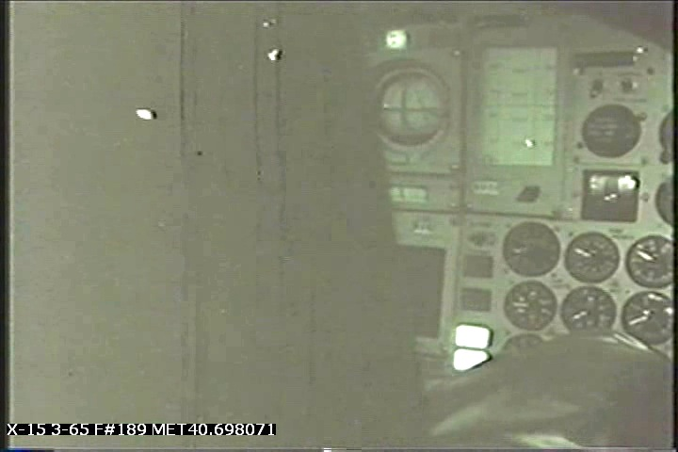
Cockpit Video (Retimed)
Climb (ADI needles centered)
Boost guidance mode active
Precision needles centered
VV tape hdot>0

Slide 50
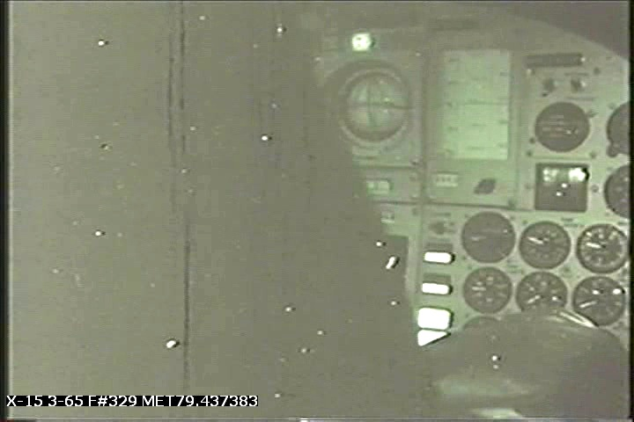
Cockpit Video (Retimed)
Computer and instrument malfunction lights on
PAI selector switch
IFDS computer light
IFDS instrument light (flashing)

Slide 51
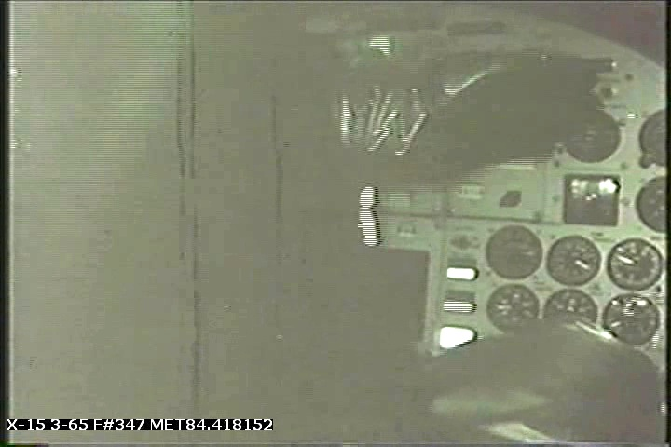
Cockpit Video (Retimed)
Pilot switches ADI to PAI (5 sec after prior frame)
PAI mode on

Slide 52
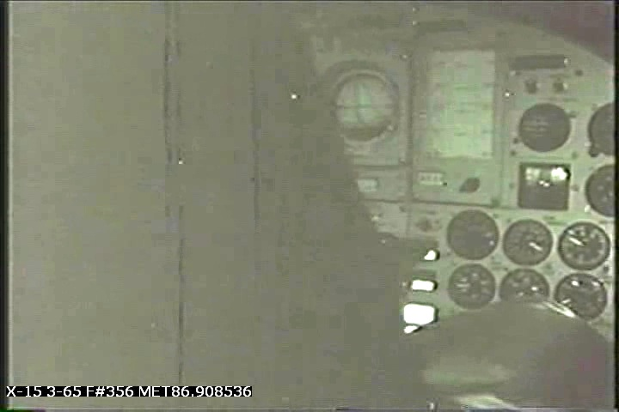
Cockpit Video (Retimed)
Pilot attempts IFDS computer reset
IFDS reset depressed

Slide 53
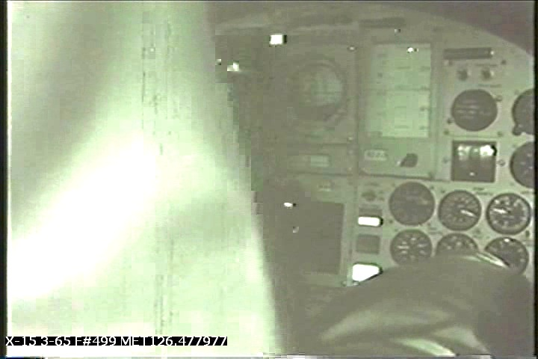
Cockpit Video (Retimed)
Pilot selects computed (IFDS) alpha/beta (light blinks at 50 psf, pilot pauses at light for ~7 sec)
Computed alpha/beta mode light

Slide 54
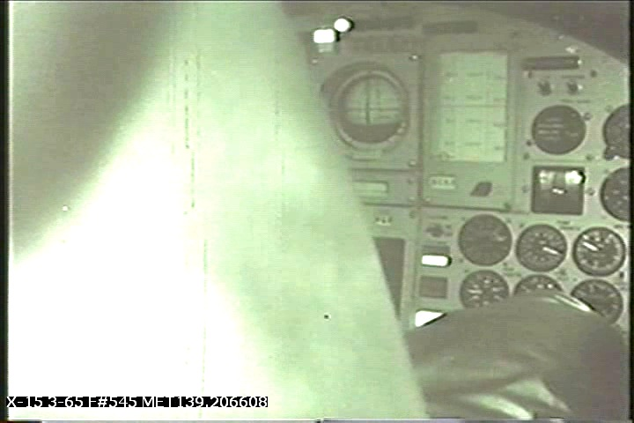
Cockpit Video (Retimed)
MH-96 damper disengage
MH-96 reset warning light

Slide 55
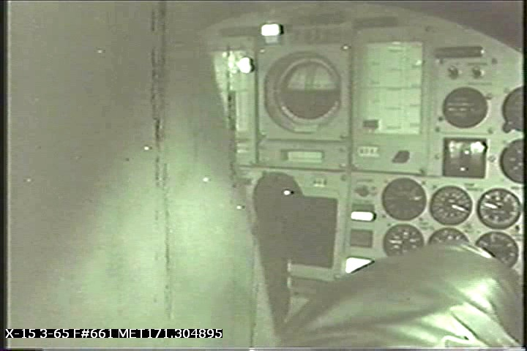
Cockpit Video (Retimed)
Near peak altitude
Vertical needle near center
ADI in PAI mode
VV tape is now in error
Beta off-scale left
IFDS light still on

Slide 56
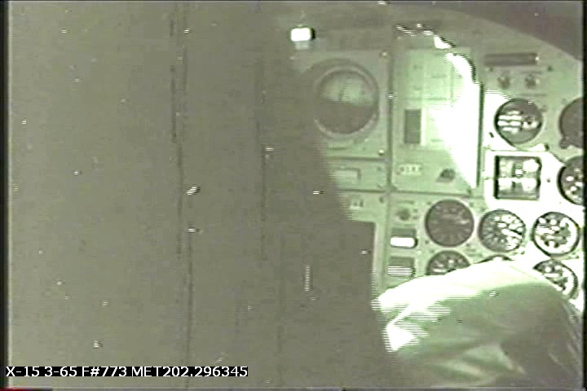
Cockpit Video (Retimed)
Spin entry
ADI in PAI mode
Sun angle indicates yaw rate
IFDS lights still on

