Slide 1


    PSPICE Circuit Simulation
    Overview: Part 2
    Using the Schematic Entry Tool- Capture
    Dr. Chris Iannello
    Deputy, Power Technical Fellow
    NASA Kennedy Space Center
    321-861-3276 chris.iannello@nasa.gov

Slide 2
Discussion Topics
PSPICE Overview
  Part 2: Schematic Entry in Capture
    Guided Tour of Starting a Project and the Interface
      Getting Started
        New Project Wizard
        Drawing a schematic and placing a ground
        Overview of Simulation Types
        Library Configuration (Symbol, Model, Include)
      Common pitfalls

Slide 3
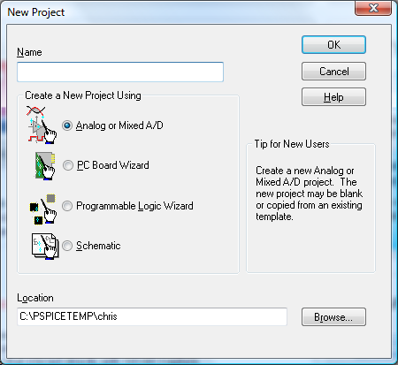
New Project Wizard
Most common initial pitfall
Need to select Analog or Mixed AD to get simulation option

Slide 4
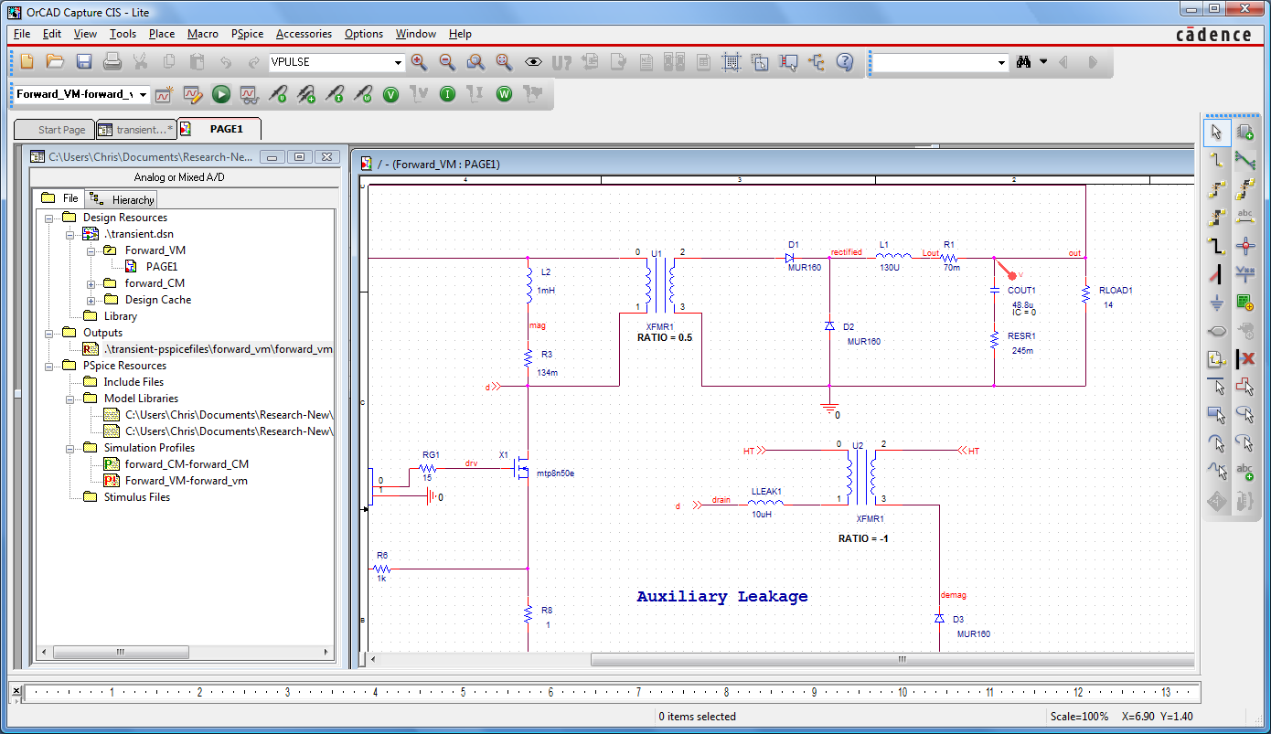
Drawing Schematic
Project browser
Simulations and drawing templates

Slide 5
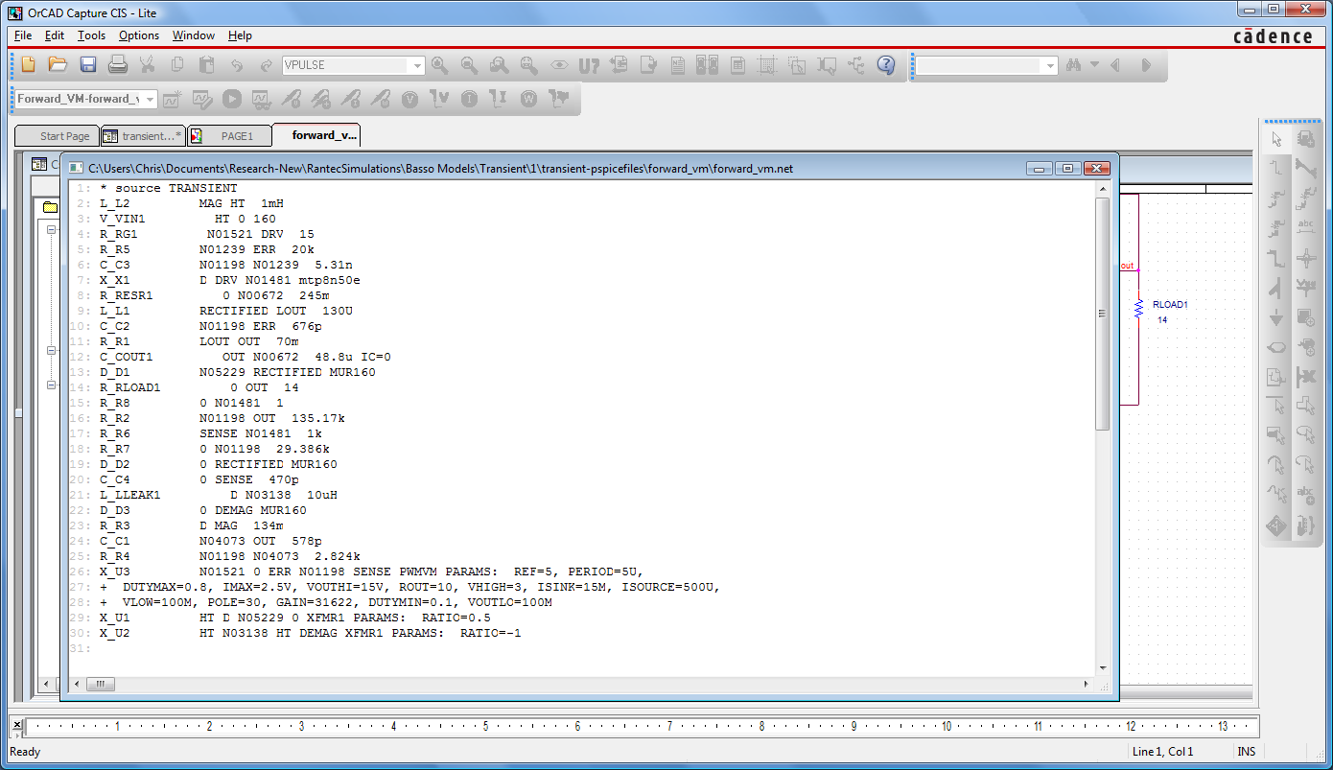
*.net
Netlist that describes interconnection to the simulator

Slide 6
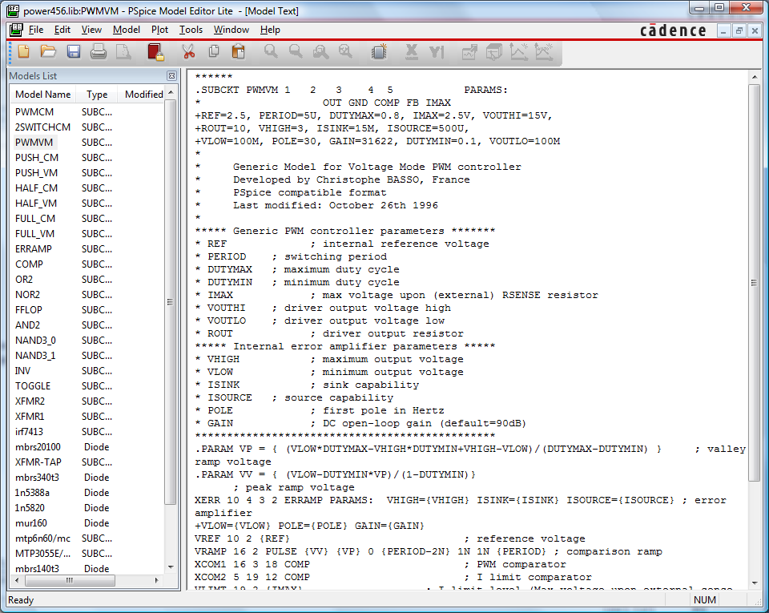
*.lib
Text files holding libraries.
Every simulatable part must have a reference in a *.lib file

Slide 7
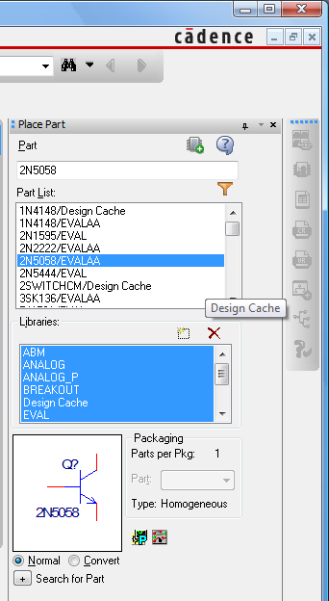
Part browser
Search only active for libraries highlighted in libraries window
Lower icons denote part templates available.
The PSPICE icon must be present here in order to simulate
Browse the libraries

Slide 8
Buck Converter CCM Open Loop
Transient Simulation
30A
24.47V
24.46V
20A
24.45V
10A
24.44V
V(L1:2)
2.0V
0A
-10A
1.0V
60V
I(L1)
0V
V(V2:+)
40V
4.0A
3.0A
20V
2.0A
SEL>>
SEL>>
1.0A
0V
9.9772ms
9.9800ms
9.9840ms
9.9880ms
9.9920ms
9.9960ms
10.0000ms
0s
V(L1:2)
2ms
4ms
6ms
8ms
10ms
I(L1)
Time
Time

