Slide 1

Digitizing Plots

Slide 2


NASA Engineering & Safety Center (NESC) Academy
Dynamic Concepts, Inc.
Huntsville, Alabama

Slide 3
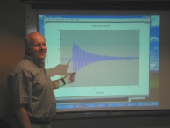
Tom Irvine
Email: tirvine@dynamic-concepts.com
Phone: (256) 922-9888

Slide 4
Digitizing Introduction
Engineers encounter PSD and SRS plots from test reports and other documents.
Typically, the data for these curves is only available in plotted form.
But engineers made need the corresponding ASCII text data for further analysis or re-plotting with other curves.
A common task is thus to digitize SRS and PSD functions from plots.
The old-fashion method is to digitize the plots using a ruler and pencil.
This can be done more accurately via Matlab scripts, especially if one or more of the axes is logarithmic.

Slide 5
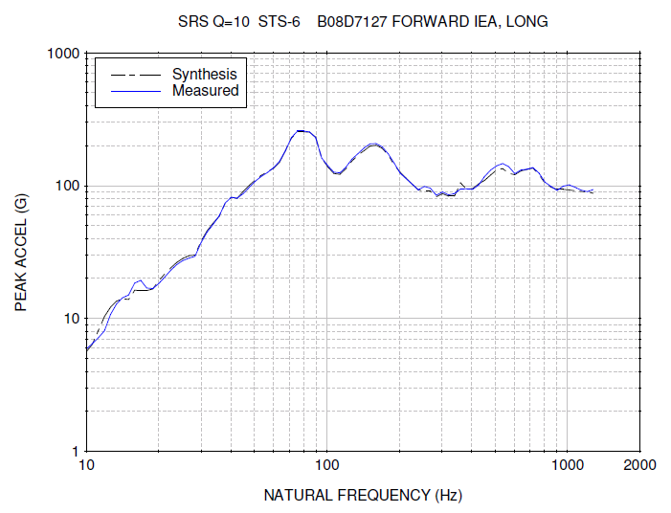
Typical SRS Curve
Water impact shock of a Shuttle SRB
Filename:
srs_plot.jpg

Slide 6
loglog_digitize.m, SRS
>> loglog_digitize
loglog_digitize.m ver 1.5 January 10, 2011
By Tom Irvine Email: tomirvine@aol.com
Select file input method
1=external image file
2=image preloaded into Matlab
1
srs_plot.jpg
Select graph type
1=SRS 2=PSD 3=other
1

Slide 7
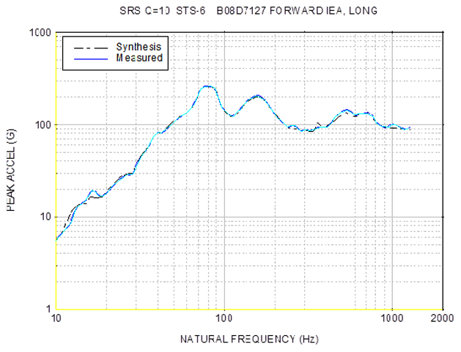
loglog_digitize.m, SRS (cont.)
Screenshot from Matlab.
Yellow lines are the axes.
The turquoise line is the selected points for the Measured data.

Slide 8
loglog_digitize.m, SRS (cont.)
Output ASCII text file?
1=yes 2=no 1
Enter output filename
srs.txt
The output filename is: srs_out
Clear figure?
1=yes 2=no
1

Slide 9
signal_stats.m, SRS
>> signal_stats
signal_stats.m
ver 3.2 January 10, 2011
by Tom Irvine Email: tomirvine@aol.com
This program gives statistics and plots for
PSD, SRS and time history functions.
Select function:
1=PSD
2=SRS
3=VRS
4=SPL
5=time history
2

Slide 10
signal_stats.m, SRS (cont.)
Select data input method
1=data preloaded in matlab
2=keyboard entry
3=external ASCII file
4=Excel file
1
Enter the input filename: srs_out
Plot the data?
1=yes 2=no 1
Enter Q 10

Slide 11
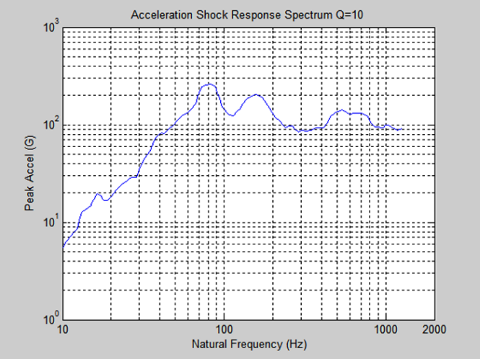
signal_stats.m, SRS Plot

Slide 12
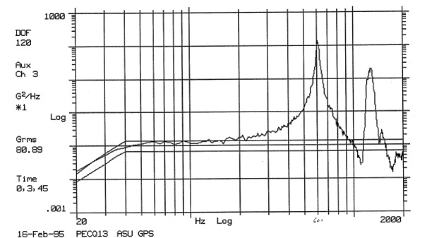
Typical PSD Plot
Image of a photocopy of a test plot from a circuit board response. Slightly skewed. Filename: psd_plot.jpg

Slide 13
loglog_digitize.m, PSD
>> loglog_digitize
loglog_digitize.m ver 1.4 December 10, 2007
By Tom Irvine Email: tomirvine@aol.com
Select file input method
1=external image file
2=image preloaded into Matlab
1
psd_plot.jpg

Slide 14
loglog_digitize.m, PSD (cont.)
Select graph type
1=SRS 2=PSD 3=other
2
Output ASCII text file?
1=yes 2=no 1
Enter output filename
psd_plot.txt

Slide 15
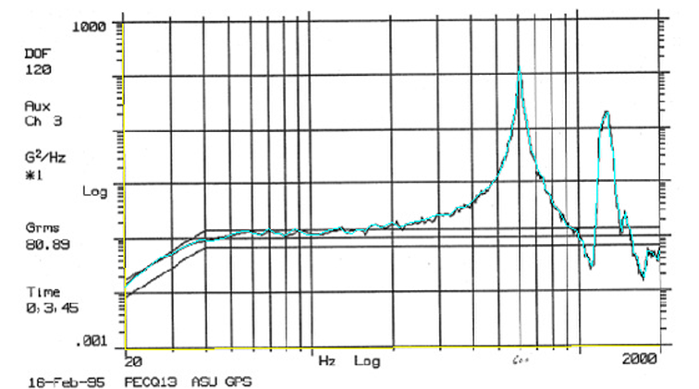
loglog_digitize.m, PSD (cont.)
Screenshot from Matlab. Yellow lines are the axes.
The turquoise line is the selected points for the measured data.

Slide 16
loglog_digitize.m, PSD (cont.)
The output filename is: psd_out
Clear figure?
1=yes 2=no
1

Slide 17
psd_out, inspection
>> psd_out
psd_out =
1.0e+003 *
1.8662 0.0001
1.9267 0.0000
2.0000 0.0001
2.0100 0.0001
>> size(psd_out)
ans =
111 2
>> psd_out(111,:)=[]
(Only showing the last four lines)

Slide 18
signal_stats.m, PSD
>> signal_stats
signal_stats.m
ver 3.2 January 10, 2011
by Tom Irvine Email: tomirvine@aol.com
This program gives statistics and plots for
PSD, SRS and time history functions.
Select function:
1=PSD
2=SRS
3=VRS
4=SPL
5=time history
1

Slide 19
signal_stats.m, PSD (cont.)
Select data input method
1=data preloaded in matlab
2=keyboard entry
3=external ASCII file
4=Excel file
1
Enter the input filename: psd_out
Power Spectral Density 79.63 GRMS overall
Plot the data?
1=yes 2=no 1
Write data to ASCII text file?
1=yes 2=no 2

Slide 20
signal_stats.m, PSD (cont.)
Additional Options
1=add dB margin
2=convert to octave format
3=scale to GRMS
4=exit
3
Input GRMS 80.89
Matlab output array = psd_new

Slide 21
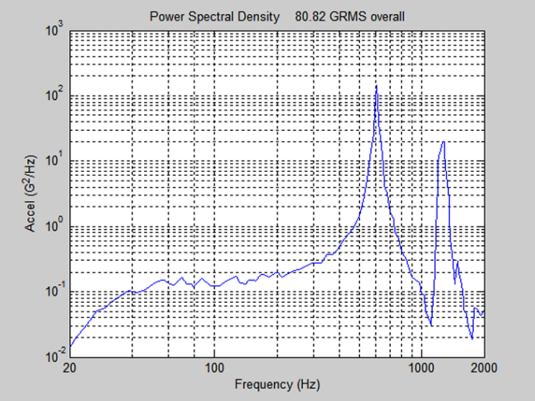
signal_stats.m, PSD plot
Power Spectral Density 80.89 GRMS Overall

Slide 22
Program Summary
Matlab Scripts
loglog_digitize.m
signal_stats.m
digitize_spl.m
Convert Image to jpg
Snagit – third party software
Or PrtSc + Paint
Data
srs_plot.jpg
psd_plot.jpg

